Slide 1
Academy Fountain Park Lewis Place Vandeventer
December 2023
Monthly Crime Report
Washington University Medical Center

Slide 2
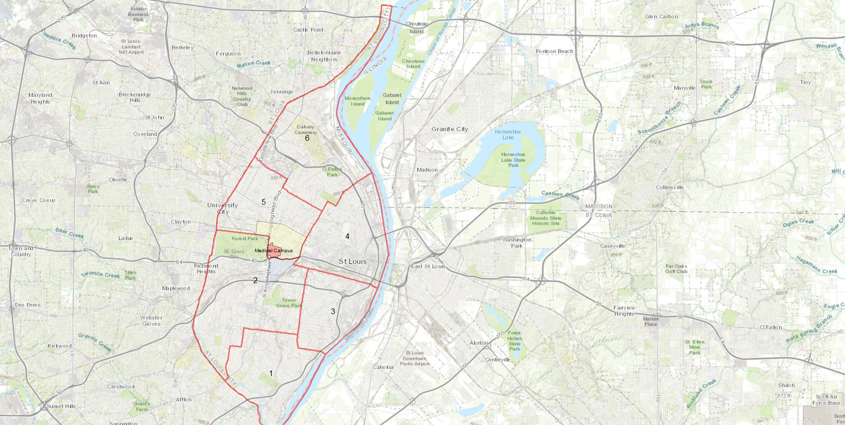
City of St Louis Police Districts
6
Academy, Fountain Park, Lewis Place, and Vandeventer are all located within District 5.
5
WUMC
4
2
3
1

Slide 3
District 5 Summary Notes
There are 15 neighborhoods in District 5.
Academy
Central West End
DeBaliviere Place
Fountain Park
Hamilton Heights
Kingsway East
Kingsway West
Lewis Place
Skinker-DeBaliviere
The Greater Ville
The Ville
Vandeventer
Visitation Park
Wells-Goodfellow
West End
The lowest number of crimes in one neighborhood was 10 in both Lewis Place and Fountain Park
The highest number of crimes in one neighborhood was 194 in the Central West End
The average number of crimes per neighborhood was 45.9
The lowest crime rate per 100,000 in one neighborhood was 735.8 in Lewis Place
The highest crime rate per 100,000 in one neighborhood was 2026.8 in DeBaliviere Place
The overall crime rate in District 5 was 1218.2
Source: SLMPD

Slide 4
Neighborhoods vs City Crime rate over time

Slide 5
Academy Neighborhood Detail

Slide 6
Academy Summary Notes
29 total crimes in November 2023
Down 59% compared to November 2022 (70 crimes)
6 crimes against persons in November 2023
Down 76% compared to November 2022 (25 crimes)
380 total crimes so far in 2023
Down 30% compared to this time in 2022 (546 crimes)
69 crimes against persons so far in 2023
Down 47% compared to this time in 2022 (130 crimes)
Source: SLMPD

Slide 7
Academy Year to Year Comparison
2022 | 2020 | 2020 | 2020 | 2020 | 2020 | 2020 | 2020 | 2020 |  |  |  |  | 2020
Crimes | Jan | Feb | Mar | Apr | May | Jun | Jul | Aug | Sep | Oct | Nov | Dec | Total
Aggravated Assault | 4 | 0 | 5 | 9 | 3 | 6 | 5 | 9 | 4 | 2 | 10 | 2 | 60
Arson | 1 | 0 | 0 | 0 | 0 | 1 | 2 | 0 | 0 | 0 | 0 | 0 | 4
Burglary | 2 | 2 | 3 | 1 | 0 | 3 | 4 | 2 | 6 | 3 | 2 | 3 | 32
Homicide | 0 | 0 | 0 | 0 | 1 | 0 | 1 | 2 | 0 | 0 | 1 | 0 | 5
Larceny | 4 | 3 | 6 | 5 | 6 | 9 | 7 | 6 | 4 | 0 | 4 | 4 | 58
Motor Vehicle Theft | 2 | 2 | 2 | 5 | 4 | 6 | 13 | 8 | 4 | 3 | 3 | 2 | 55
Robbery | 2 | 2 | 0 | 1 | 0 | 1 | 0 | 2 | 0 | 0 | 0 | 2 | 10
Total | 15 | 9 | 16 | 21 | 14 | 26 | 32 | 29 | 21 | 8 | 20 | 13 | 224
2023 | 2020 | 2020 | 2020 | 2020 |  |  |  |  |  |  |  | 2020
Crimes | Jan | Feb | Mar | Apr | May | Jun | Jul | Aug | Sep | Oct | Nov | Total
Aggravated Assault | 2 | 2 | 4 | 5 | 8 | 2 | 3 | 2 | 4 | 2 | 2 | 36
Arson | 0 | 0 | 0 | 0 | 0 | 0 | 0 | 0 | 0 | 0 | 0 | 0
Burglary | 3 | 2 | 4 | 7 | 2 | 1 | 4 | 3 | 1 | 0 | 2 | 29
Homicide | 0 | 0 | 0 | 0 | 1 | 0 | 0 | 0 | 0 | 0 | 0 | 1
Larceny | 4 | 5 | 2 | 4 | 2 | 4 | 5 | 3 | 6 | 4 | 3 | 42
Motor Vehicle Theft | 6 | 6 | 6 | 0 | 3 | 2 | 3 | 2 | 4 | 4 | 2 | 38
Robbery | 2 | 1 | 0 | 2 | 1 | 0 | 0 | 1 | 0 | 0 | 0 | 7
Total | 17 | 16 | 16 | 18 | 17 | 9 | 15 | 11 | 15 | 10 | 9 | 153
Source: SLMPD

Slide 8
Fountain Park Neighborhood Detail

Slide 9
Fountain Park Summary Notes
10 total crimes in November 2023
Down 66% compared to November 2022 (29 crimes)
3 crimes against persons in November 2023
Down 40% compared to November 2022 (5 crimes)
299 total crimes so far in 2023
Down 20% compared to this time in 2022 (372 crimes)
51 crimes against persons so far in 2023
Down 32% compared to this time in 2022 (75 crimes)
Source: SLMPD

Slide 10
Fountain Park Year to Year Comparison
2022 | 2020 | 2020 | 2020 | 2020 | 2020 | 2020 | 2020 | 2020 |  |  |  |  | 2020
Crimes | Jan | Feb | Mar | Apr | May | Jun | Jul | Aug | Sep | Oct | Nov | Dec | Total
Aggravated Assault | 8 | 5 | 0 | 5 | 4 | 12 | 2 | 3 | 3 | 2 | 0 | 4 | 48
Arson | 0 | 0 | 0 | 0 | 0 | 0 | 0 | 1 | 0 | 0 | 0 | 1 | 2
Burglary | 1 | 2 | 2 | 0 | 1 | 2 | 0 | 0 | 1 | 0 | 3 | 3 | 15
Homicide | 0 | 0 | 1 | 1 | 0 | 2 | 0 | 0 | 0 | 1 | 1 | 0 | 6
Larceny | 3 | 3 | 8 | 6 | 5 | 8 | 8 | 1 | 3 | 1 | 2 | 5 | 57
Motor Vehicle Theft | 0 | 2 | 2 | 1 | 2 | 0 | 2 | 3 | 5 | 5 | 4 | 0 | 26
Robbery | 1 | 0 | 0 | 0 | 1 | 0 | 0 | 1 | 0 | 1 | 0 | 0 | 4
Total | 13 | 12 | 13 | 13 | 13 | 24 | 12 | 9 | 12 | 10 | 10 | 13 | 154
2023 | 2020 | 2020 | 2020 | 2020 |  |  |  |  |  |  |  | 2020
Crimes | Jan | Feb | Mar | Apr | May | Jun | Jul | Aug | Sep | Oct | Nov | Total
Aggravated Assault | 5 | 0 | 1 | 0 | 6 | 2 | 4 | 2 | 1 | 3 | 2 | 26
Arson | 0 | 0 | 0 | 0 | 0 | 0 | 2 | 0 | 0 | 0 | 0 | 2
Burglary | 3 | 0 | 2 | 3 | 0 | 0 | 0 | 2 | 0 | 0 | 0 | 10
Homicide | 0 | 0 | 1 | 0 | 0 | 1 | 0 | 0 | 1 | 0 | 0 | 3
Larceny | 5 | 1 | 2 | 4 | 6 | 3 | 2 | 2 | 5 | 2 | 1 | 33
Motor Vehicle Theft | 4 | 2 | 4 | 1 | 2 | 4 | 1 | 0 | 7 | 5 | 3 | 33
Robbery | 0 | 0 | 0 | 0 | 0 | 1 | 0 | 0 | 0 | 2 | 0 | 3
Total | 17 | 3 | 10 | 8 | 14 | 11 | 9 | 6 | 14 | 12 | 6 | 110
Source: SLMPD

Slide 11
Lewis Place Neighborhood Detail

Slide 12
Lewis Place Summary Notes
10 total crimes in November 2023
Down 23% compared to November 2022 (13 crimes)
1 crime against persons in November 2023
Down 50% compared to November 2022 (2 crimes)
205 total crimes so far in 2023
Up 3% compared to this time in 2022 (199 crimes)
43 crimes against persons so far in 2023
Up 2% compared to this time in 2022 (42 crimes)
Source: SLMPD

Slide 13
Lewis Place Year to Year Comparison
2022 | 2020 | 2020 | 2020 | 2020 | 2020 | 2020 | 2020 | 2020 |  |  |  |  | 2020
Crimes | Jan | Feb | Mar | Apr | May | Jun | Jul | Aug | Sep | Oct | Nov | Dec | Total
Aggravated Assault | 1 | 1 | 2 | 3 | 0 | 4 | 0 | 1 | 0 | 1 | 2 | 9 | 24
Arson | 0 | 0 | 0 | 0 | 0 | 0 | 0 | 0 | 0 | 0 | 0 | 0 | 0
Burglary | 0 | 0 | 3 | 1 | 2 | 1 | 2 | 1 | 0 | 1 | 1 | 0 | 12
Homicide | 0 | 0 | 1 | 0 | 0 | 0 | 0 | 0 | 0 | 1 | 0 | 0 | 2
Larceny | 6 | 2 | 3 | 3 | 3 | 3 | 4 | 3 | 2 | 0 | 1 | 2 | 32
Motor Vehicle Theft | 3 | 0 | 1 | 1 | 4 | 3 | 1 | 5 | 2 | 3 | 1 | 2 | 26
Robbery | 1 | 1 | 0 | 1 | 2 | 1 | 1 | 0 | 2 | 0 | 1 | 0 | 10
Total | 11 | 4 | 10 | 9 | 11 | 12 | 8 | 10 | 6 | 6 | 6 | 13 | 106
2023 | 2020 | 2020 | 2020 | 2020 |  |  |  |  |  |  |  | 2020
Crimes | Jan | Feb | Mar | Apr | May | Jun | Jul | Aug | Sep | Oct | Nov | Total
Aggravated Assault | 0 | 0 | 2 | 2 | 6 | 0 | 1 | 2 | 2 | 5 | 0 | 20
Arson | 0 | 0 | 0 | 0 | 0 | 0 | 0 | 0 | 0 | 0 | 0 | 0
Burglary | 1 | 1 | 0 | 0 | 1 | 0 | 0 | 2 | 2 | 1 | 0 | 8
Homicide | 0 | 0 | 0 | 3 | 0 | 0 | 0 | 0 | 0 | 0 | 0 | 3
Larceny | 2 | 2 | 1 | 1 | 2 | 3 | 3 | 2 | 5 | 5 | 1 | 26
Motor Vehicle Theft | 0 | 4 | 3 | 2 | 2 | 1 | 3 | 4 | 4 | 0 | 1 | 23
Robbery | 0 | 0 | 1 | 2 | 0 | 0 | 0 | 1 | 0 | 0 | 0 | 4
Total | 3 | 7 | 7 | 10 | 11 | 4 | 7 | 11 | 13 | 11 | 2 | 84
Source: SLMPD

Slide 14
Vandeventer Neighborhood Detail

Slide 15
Vandeventer Summary Notes
27 total crimes in November 2023
Down 13% compared to November 2022 (31 crimes)
4 crimes against persons in November 2023
Down 43% compared to November 2022 (7 crimes)
355 total crimes so far in 2023
Down 1% compared to this time in 2022 (360 crimes)
67 crimes against persons so far in 2023
Up 24% compared to this time in 2022 (54 crimes)
Source: SLMPD

Slide 16
Vandeventer Year to Year Comparison
2022 | 2020 | 2020 | 2020 | 2020 | 2020 | 2020 | 2020 | 2020 |  |  |  |  | 2020
Crimes | Jan | Feb | Mar | Apr | May | Jun | Jul | Aug | Sep | Oct | Nov | Dec | Total
Aggravated Assault | 0 | 0 | 3 | 2 | 2 | 3 | 1 | 0 | 3 | 4 | 5 | 1 | 24
Arson | 0 | 0 | 0 | 1 | 0 | 0 | 0 | 0 | 0 | 0 | 1 | 0 | 2
Burglary | 2 | 0 | 1 | 2 | 1 | 1 | 1 | 2 | 0 | 1 | 0 | 4 | 15
Homicide | 0 | 0 | 0 | 0 | 0 | 0 | 2 | 0 | 0 | 1 | 0 | 0 | 3
Larceny | 6 | 2 | 3 | 7 | 13 | 11 | 7 | 1 | 10 | 8 | 3 | 2 | 73
Motor Vehicle Theft | 3 | 2 | 1 | 2 | 2 | 3 | 6 | 12 | 9 | 12 | 4 | 2 | 58
Robbery | 1 | 2 | 2 | 1 | 2 | 1 | 1 | 0 | 0 | 0 | 0 | 0 | 10
Total | 12 | 6 | 10 | 15 | 20 | 19 | 18 | 15 | 22 | 26 | 13 | 9 | 184
2023 | 2020 | 2020 | 2020 | 2020 |  |  |  |  |  |  |  | 2020
Crimes | Jan | Feb | Mar | Apr | May | Jun | Jul | Aug | Sep | Oct | Nov | Total
Aggravated Assault | 4 | 1 | 4 | 0 | 1 | 2 | 4 | 1 | 2 | 0 | 0 | 19
Arson | 0 | 0 | 0 | 0 | 0 | 0 | 0 | 0 | 0 | 0 | 0 | 0
Burglary | 0 | 1 | 2 | 1 | 0 | 2 | 0 | 3 | 1 | 1 | 3 | 14
Homicide | 1 | 0 | 0 | 0 | 1 | 0 | 0 | 0 | 0 | 0 | 0 | 2
Larceny | 1 | 4 | 5 | 3 | 10 | 6 | 5 | 7 | 3 | 3 | 4 | 51
Motor Vehicle Theft | 6 | 2 | 1 | 4 | 4 | 2 | 2 | 8 | 4 | 5 | 2 | 40
Robbery | 0 | 0 | 0 | 1 | 1 | 2 | 0 | 0 | 3 | 2 | 0 | 9
Total | 12 | 8 | 12 | 9 | 17 | 14 | 11 | 19 | 13 | 11 | 9 | 135
Source: SLMPD

