Slide 1
Academy Fountain Park Lewis Place Vandeventer
December 2023
Monthly Crime Report
Washington University Medical Center

Slide 2
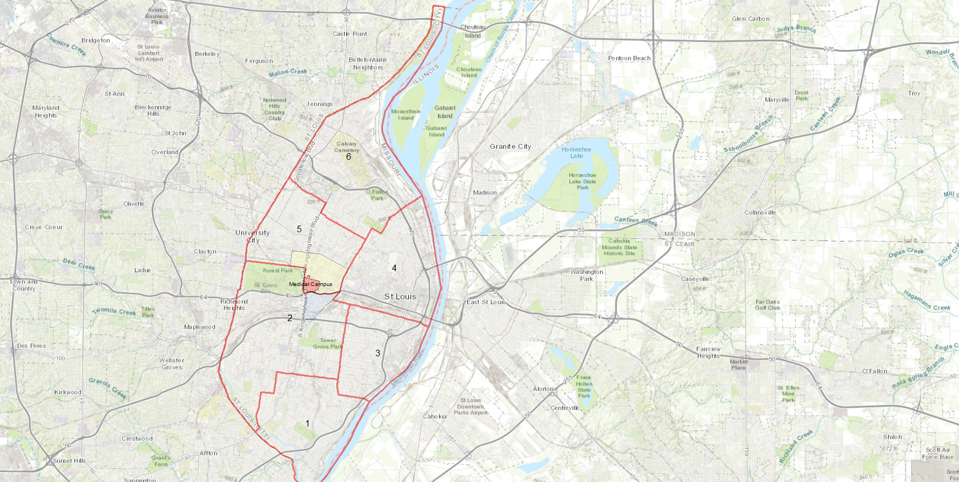
City of St Louis Police Districts
6
Academy, Fountain Park, Lewis Place, and Vandeventer are all located within District 5.
5
WUMC
4
2
3
1

Slide 3
District 5 Summary Notes
There are 15 neighborhoods in District 5.
Academy
Central West End
DeBaliviere Place
Fountain Park
Hamilton Heights
Kingsway East
Kingsway West
Lewis Place
Skinker-DeBaliviere
The Greater Ville
The Ville
Vandeventer
Visitation Park
Wells-Goodfellow
West End
The lowest number of crimes in one neighborhood was 6 in Visitation Park
The highest number of crimes in one neighborhood was 237 in the Central West End
The average number of crimes per neighborhood was 53.7
The lowest crime rate per 100,000 in one neighborhood was 649.4 in Visitation Park
The highest crime rate per 100,000 in one neighborhood was 2790.7 in Fountain Park
The overall crime rate in District 5 was 1423.3
Source: SLMPD

Slide 4
Neighborhoods vs City Crime rate over time

Slide 5
Academy Neighborhood Detail

Slide 6
Academy Summary Notes
29 total crimes in December 2023
Down 9% compared to December 2022 (32 crimes)
5 crimes against persons in December 2023
No change compared to December 2022
409 total crimes in 2023
Down 31% compared to 2022 (592 crimes)
74 crimes against persons in 2023
Down 46% compared to 2022 (137 crimes)
Source: SLMPD

Slide 7
Academy Year to Year Comparison
2022 | 2020 | 2020 | 2020 | 2020 | 2020 | 2020 | 2020 | 2020 |  |  |  |  | 2020
Crimes | Jan | Feb | Mar | Apr | May | Jun | Jul | Aug | Sep | Oct | Nov | Dec | Total
Aggravated Assault | 4 | 0 | 5 | 9 | 3 | 6 | 5 | 9 | 4 | 2 | 10 | 2 | 60
Arson | 1 | 0 | 0 | 0 | 0 | 1 | 2 | 0 | 0 | 0 | 0 | 0 | 4
Burglary | 2 | 2 | 3 | 1 | 0 | 3 | 4 | 2 | 6 | 3 | 2 | 3 | 32
Homicide | 0 | 0 | 0 | 0 | 1 | 0 | 1 | 2 | 0 | 0 | 1 | 0 | 5
Larceny | 4 | 3 | 6 | 5 | 6 | 9 | 7 | 6 | 4 | 0 | 4 | 4 | 58
Motor Vehicle Theft | 2 | 2 | 2 | 5 | 4 | 6 | 13 | 8 | 4 | 3 | 3 | 2 | 55
Robbery | 2 | 2 | 0 | 1 | 0 | 1 | 0 | 2 | 0 | 0 | 0 | 2 | 10
Total | 15 | 9 | 16 | 21 | 14 | 26 | 32 | 29 | 21 | 8 | 20 | 13 | 224
2023 | 2020 | 2020 | 2020 | 2020 |  |  |  |  |  |  |  |  | 2020
Crimes | Jan | Feb | Mar | Apr | May | Jun | Jul | Aug | Sep | Oct | Nov | Dec | Total
Aggravated Assault | 2 | 2 | 4 | 5 | 8 | 2 | 3 | 2 | 4 | 2 | 2 | 3 | 39
Arson | 0 | 0 | 0 | 0 | 0 | 0 | 0 | 0 | 0 | 0 | 0 | 0 | 0
Burglary | 3 | 2 | 4 | 7 | 2 | 1 | 4 | 3 | 1 | 0 | 2 | 2 | 31
Homicide | 0 | 0 | 0 | 0 | 1 | 0 | 0 | 0 | 0 | 0 | 0 | 0 | 1
Larceny | 4 | 5 | 2 | 4 | 2 | 4 | 5 | 3 | 6 | 4 | 3 | 3 | 45
Motor Vehicle Theft | 6 | 6 | 6 | 0 | 3 | 2 | 3 | 2 | 4 | 4 | 2 | 4 | 42
Robbery | 2 | 1 | 0 | 2 | 1 | 0 | 0 | 1 | 0 | 0 | 0 | 4 | 11
Total | 17 | 16 | 16 | 18 | 17 | 9 | 15 | 11 | 15 | 10 | 9 | 16 | 169
Source: SLMPD

Slide 8
Fountain Park Neighborhood Detail

Slide 9
Fountain Park Summary Notes
30 total crimes in December 2023
Up 3% compared to December 2022 (29 crimes)
6 crimes against persons in December 2023
Up 100% compared to December 2022 (3 crimes)
333 total crimes in 2023
Down 20% compared to 2022 (414 crimes)
57 crimes against persons in 2023
Down 34% compared to 2022 (87 crimes)
Source: SLMPD

Slide 10
Fountain Park Year to Year Comparison
2022 | 2020 | 2020 | 2020 | 2020 | 2020 | 2020 | 2020 | 2020 |  |  |  |  | 2020
Crimes | Jan | Feb | Mar | Apr | May | Jun | Jul | Aug | Sep | Oct | Nov | Dec | Total
Aggravated Assault | 8 | 5 | 0 | 5 | 4 | 12 | 2 | 3 | 3 | 2 | 0 | 4 | 48
Arson | 0 | 0 | 0 | 0 | 0 | 0 | 0 | 1 | 0 | 0 | 0 | 1 | 2
Burglary | 1 | 2 | 2 | 0 | 1 | 2 | 0 | 0 | 1 | 0 | 3 | 3 | 15
Homicide | 0 | 0 | 1 | 1 | 0 | 2 | 0 | 0 | 0 | 1 | 1 | 0 | 6
Larceny | 3 | 3 | 8 | 6 | 5 | 8 | 8 | 1 | 3 | 1 | 2 | 5 | 57
Motor Vehicle Theft | 0 | 2 | 2 | 1 | 2 | 0 | 2 | 3 | 5 | 5 | 4 | 0 | 26
Robbery | 1 | 0 | 0 | 0 | 1 | 0 | 0 | 1 | 0 | 1 | 0 | 0 | 4
Total | 13 | 12 | 13 | 13 | 13 | 24 | 12 | 9 | 12 | 10 | 10 | 13 | 154
2023 | 2020 | 2020 | 2020 | 2020 |  |  |  |  |  |  |  |  | 2020
Crimes | Jan | Feb | Mar | Apr | May | Jun | Jul | Aug | Sep | Oct | Nov | Dec | Total
Aggravated Assault | 5 | 0 | 1 | 0 | 6 | 2 | 4 | 2 | 1 | 3 | 2 | 1 | 27
Arson | 0 | 0 | 0 | 0 | 0 | 0 | 2 | 0 | 0 | 0 | 0 | 0 | 2
Burglary | 3 | 0 | 2 | 3 | 0 | 0 | 0 | 2 | 0 | 0 | 0 | 2 | 12
Homicide | 0 | 0 | 1 | 0 | 0 | 1 | 0 | 0 | 1 | 0 | 0 | 1 | 4
Larceny | 5 | 1 | 2 | 4 | 6 | 3 | 2 | 2 | 5 | 2 | 1 | 3 | 36
Motor Vehicle Theft | 4 | 2 | 4 | 1 | 2 | 4 | 1 | 0 | 7 | 5 | 3 | 2 | 35
Robbery | 0 | 0 | 0 | 0 | 0 | 1 | 0 | 0 | 0 | 2 | 0 | 1 | 4
Total | 17 | 3 | 10 | 8 | 14 | 11 | 9 | 6 | 14 | 12 | 6 | 10 | 120
Source: SLMPD

Slide 11
Lewis Place Neighborhood Detail

Slide 12
Lewis Place Summary Notes
13 total crimes in December 2023
Down 38% compared to December 2022 (21 crimes)
3 crimes against persons in December 2023
Down 70% compared to December 2022 (10 crimes)
221 total crimes in 2023
No change compared to 2022
46 crimes against persons in 2023
Down 13% compared to 2022 (53 crimes)
Source: SLMPD

Slide 13
Lewis Place Year to Year Comparison
2022 | 2020 | 2020 | 2020 | 2020 | 2020 | 2020 | 2020 | 2020 |  |  |  |  | 2020
Crimes | Jan | Feb | Mar | Apr | May | Jun | Jul | Aug | Sep | Oct | Nov | Dec | Total
Aggravated Assault | 1 | 1 | 2 | 3 | 0 | 4 | 0 | 1 | 0 | 1 | 2 | 8 | 23
Arson | 0 | 0 | 0 | 0 | 0 | 0 | 0 | 0 | 0 | 0 | 0 | 0 | 0
Burglary | 0 | 0 | 3 | 1 | 2 | 1 | 2 | 1 | 0 | 1 | 1 | 0 | 12
Homicide | 0 | 0 | 1 | 0 | 0 | 0 | 0 | 0 | 0 | 1 | 0 | 0 | 2
Larceny | 6 | 2 | 3 | 3 | 3 | 3 | 4 | 3 | 2 | 0 | 1 | 3 | 33
Motor Vehicle Theft | 3 | 0 | 1 | 1 | 4 | 3 | 1 | 5 | 2 | 3 | 1 | 2 | 26
Robbery | 1 | 1 | 0 | 1 | 2 | 1 | 1 | 0 | 2 | 0 | 1 | 0 | 10
Total | 11 | 4 | 10 | 9 | 11 | 12 | 8 | 10 | 6 | 6 | 6 | 13 | 106
2023 | 2020 | 2020 | 2020 | 2020 |  |  |  |  |  |  |  |  | 2020
Crimes | Jan | Feb | Mar | Apr | May | Jun | Jul | Aug | Sep | Oct | Nov | Dec | Total
Aggravated Assault | 0 | 0 | 2 | 2 | 6 | 0 | 1 | 2 | 2 | 5 | 0 | 0 | 20
Arson | 0 | 0 | 0 | 0 | 0 | 0 | 0 | 0 | 0 | 0 | 0 | 0 | 0
Burglary | 1 | 1 | 0 | 0 | 1 | 0 | 0 | 2 | 2 | 1 | 0 | 0 | 8
Homicide | 0 | 0 | 0 | 3 | 0 | 0 | 0 | 0 | 0 | 0 | 0 | 0 | 3
Larceny | 2 | 2 | 1 | 1 | 2 | 3 | 3 | 2 | 5 | 5 | 1 | 2 | 28
Motor Vehicle Theft | 0 | 4 | 3 | 2 | 2 | 1 | 3 | 4 | 4 | 0 | 1 | 3 | 26
Robbery | 0 | 0 | 1 | 2 | 0 | 0 | 0 | 1 | 0 | 0 | 0 | 0 | 4
Total | 3 | 7 | 7 | 10 | 11 | 4 | 7 | 11 | 13 | 11 | 2 | 5 | 89
Source: SLMPD

Slide 14
Vandeventer Neighborhood Detail

Slide 15
Vandeventer Summary Notes
41 total crimes in December 2023
Up 41% compared to December 2022 (29 crimes)
14 crimes against persons in December 2023
Up 600% compared to December 2022 (2 crimes)
402 total crimes in 2023
Up 2% compared to 2022 (394 crimes)
81 crimes against persons in 2023
Up 37% compared to 2022 (59 crimes)
Source: SLMPD

Slide 16
Vandeventer Year to Year Comparison
2022 | 2020 | 2020 | 2020 | 2020 | 2020 | 2020 | 2020 | 2020 |  |  |  |  | 2020
Crimes | Jan | Feb | Mar | Apr | May | Jun | Jul | Aug | Sep | Oct | Nov | Dec | Total
Aggravated Assault | 0 | 0 | 3 | 2 | 2 | 3 | 1 | 0 | 3 | 4 | 5 | 1 | 24
Arson | 0 | 0 | 0 | 1 | 0 | 0 | 0 | 0 | 0 | 0 | 1 | 0 | 2
Burglary | 2 | 0 | 1 | 2 | 1 | 1 | 1 | 2 | 0 | 1 | 0 | 5 | 16
Homicide | 0 | 0 | 0 | 0 | 0 | 0 | 2 | 0 | 0 | 1 | 0 | 0 | 3
Larceny | 6 | 2 | 3 | 7 | 13 | 11 | 7 | 1 | 10 | 8 | 3 | 4 | 75
Motor Vehicle Theft | 3 | 2 | 1 | 2 | 2 | 3 | 6 | 12 | 9 | 12 | 4 | 2 | 58
Robbery | 1 | 2 | 2 | 1 | 2 | 1 | 1 | 0 | 0 | 0 | 0 | 0 | 10
Total | 12 | 6 | 10 | 15 | 20 | 19 | 18 | 15 | 22 | 26 | 13 | 12 | 187
2023 | 2020 | 2020 | 2020 | 2020 |  |  |  |  |  |  |  |  | 2020
Crimes | Jan | Feb | Mar | Apr | May | Jun | Jul | Aug | Sep | Oct | Nov | Dec | Total
Aggravated Assault | 4 | 1 | 4 | 0 | 1 | 2 | 4 | 1 | 2 | 0 | 0 | 11 | 30
Arson | 0 | 0 | 0 | 0 | 0 | 0 | 0 | 0 | 0 | 0 | 0 | 0 | 0
Burglary | 0 | 1 | 2 | 1 | 0 | 2 | 0 | 3 | 1 | 1 | 3 | 1 | 15
Homicide | 1 | 0 | 0 | 0 | 1 | 0 | 0 | 0 | 0 | 0 | 0 | 0 | 2
Larceny | 1 | 4 | 5 | 3 | 10 | 6 | 5 | 7 | 3 | 3 | 4 | 4 | 55
Motor Vehicle Theft | 6 | 2 | 1 | 4 | 4 | 2 | 2 | 8 | 4 | 5 | 2 | 4 | 44
Robbery | 0 | 0 | 0 | 1 | 1 | 2 | 0 | 0 | 3 | 2 | 0 | 1 | 10
Total | 12 | 8 | 12 | 9 | 17 | 14 | 11 | 19 | 13 | 11 | 9 | 21 | 156
Source: SLMPD

