Slide 1
Forest Park Southeast Central West End
December 2023
Monthly Crime Report
Washington University Medical Center

Slide 2
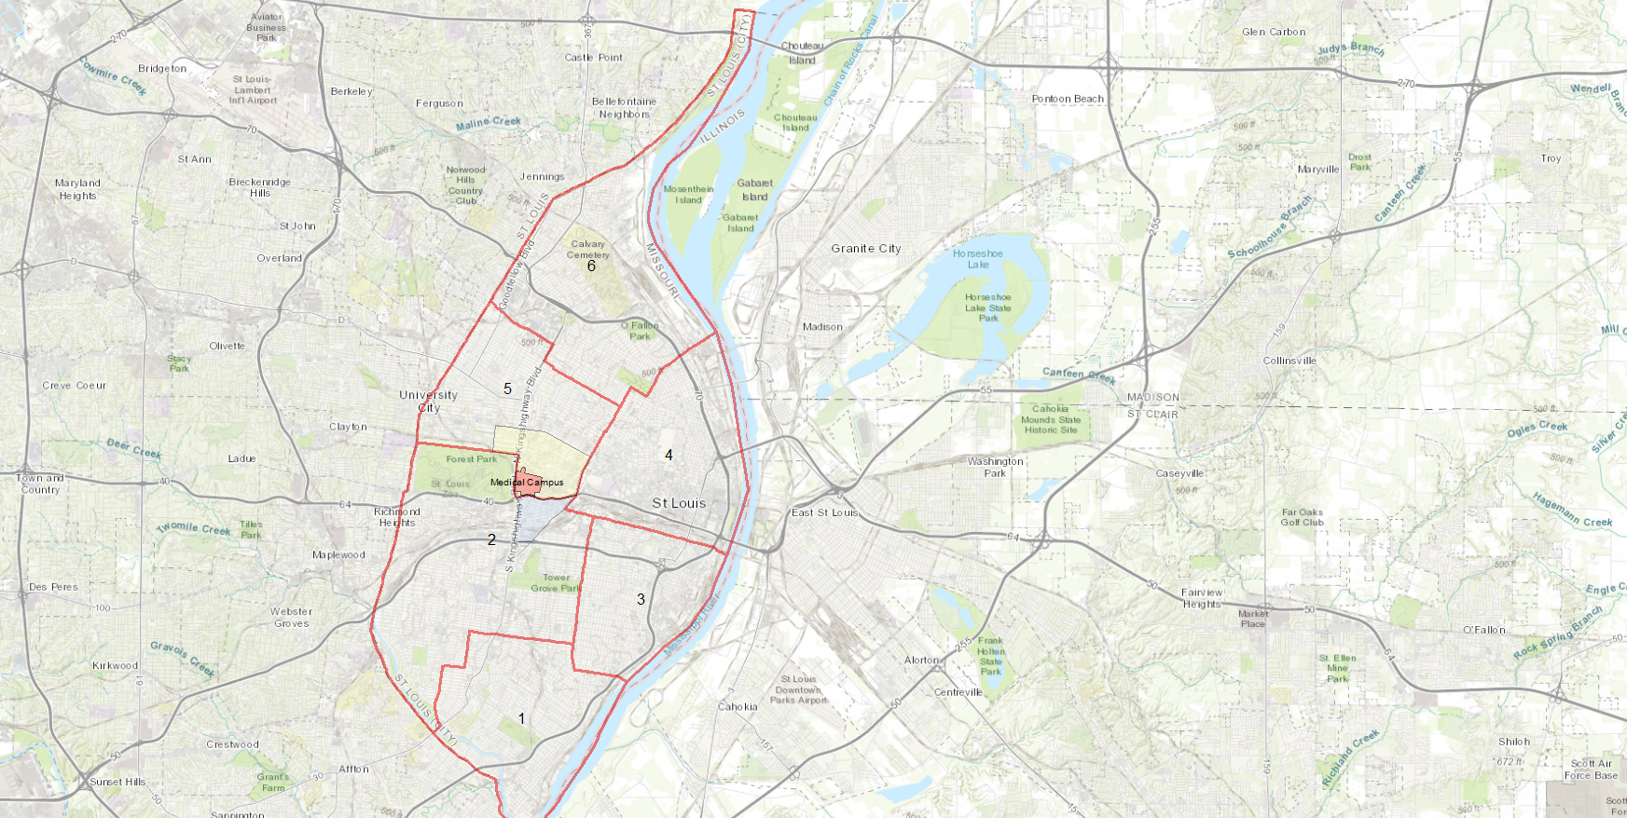
City of St Louis Police Districts
6
Central West End Neighborhood
5
WUMC
4
Forest Park Southeast Neighborhood
2
3
1

Slide 3
District 5 Summary Notes
There are 15 neighborhoods in District 5.
Academy
Central West End
DeBaliviere Place
Fountain Park
Hamilton Heights
Kingsway East
Kingsway West
Lewis Place
Skinker-DeBaliviere
The Greater Ville
The Ville
Vandeventer
Visitation Park
Wells-Goodfellow
West End
The lowest number of crimes in one neighborhood was 10 in both Lewis Place and Fountain Park
The highest number of crimes in one neighborhood was 194 in the Central West End
The average number of crimes per neighborhood was 45.9
The lowest crime rate per 100,000 in one neighborhood was 735.8 in Lewis Place
The highest crime rate per 100,000 in one neighborhood was 2026.8 in DeBaliviere Place
The overall crime rate in District 5 was 1218.2
Source: SLMPD

Slide 4
District 2 Summary Notes
There are 19 neighborhoods in District 2.
Botanical Heights
Cheltenham
Clayton-Tamm
Clifton Heights
Ellendale
Forest Park Southeast
Franz Park
Hi-Pointe
Kings Oak
Lindenwood Park
Northampton
Shaw
Southampton
Southwest Garden
St. Louis Hills
The Hill
Tiffany
Tower Grove South
Wydown-Skinker
*Southampton is split between District 2 and District 1.
The lowest number of crimes in one neighborhood was 2 in Wydown-Skinker
The highest number of crimes in one neighborhood was 110 in Tower Grove South
The average number of crimes per neighborhood was 35.4
The lowest crime rate per 100,000 in one neighborhood was 178.4 in Wydown-Skinker
The highest crime rate per 100,000 in one neighborhood was 2994 in Kings Oak
The overall crime rate in District 2 was 867
Source: SLMPD

Slide 5
Neighborhoods vs City Crime rate over time

Slide 6
Forest Park Southeast Neighborhood Detail

Slide 7
Forest Park Southeast Summary
79 total crimes in November 2023
Up 22% compared to November 2022 (65 crimes)
14 crimes against persons in November 2023
Up 100% compared to November 2022 (7 crimes)
862 total crimes so far in 2023
Down 4% compared to this time in 2022 (898 crimes)
72 crimes against persons so far in 2023
Up 9% compared to this time in 2022 (66 crimes)
Source: SLMPD

Slide 8
Forest Park Southeast Year to Year Comparison
2022 | 2020 | 2020 | 2020 | 2020 | 2020 | 2020 | 2020 | 2020 |  |  |  |  | 2020
Crimes | Jan | Feb | Mar | Apr | May | Jun | Jul | Aug | Sep | Oct | Nov | Dec | Total
Aggravated Assault | 0 | 1 | 3 | 8 | 1 | 6 | 1 | 3 | 2 | 1 | 4 | 2 | 32
Arson | 0 | 0 | 0 | 0 | 0 | 0 | 0 | 0 | 0 | 0 | 0 | 0 | 0
Burglary | 0 | 1 | 1 | 3 | 2 | 0 | 4 | 4 | 2 | 9 | 4 | 2 | 32
Homicide | 0 | 0 | 0 | 1 | 0 | 0 | 0 | 0 | 1 | 0 | 0 | 0 | 2
Larceny | 14 | 19 | 20 | 44 | 16 | 24 | 35 | 34 | 29 | 23 | 16 | 36 | 310
Motor Vehicle Theft | 4 | 3 | 1 | 0 | 3 | 2 | 12 | 24 | 12 | 7 | 9 | 16 | 93
Robbery | 0 | 0 | 0 | 0 | 0 | 2 | 0 | 2 | 0 | 1 | 0 | 1 | 6
Total | 18 | 24 | 25 | 56 | 22 | 34 | 52 | 67 | 46 | 41 | 33 | 57 | 475
2023 | 2020 | 2020 | 2020 | 2020 |  |  |  |  |  |  |  | 2020
Crimes | Jan | Feb | Mar | Apr | May | Jun | Jul | Aug | Sep | Oct | Nov | Total
Aggravated Assault | 0 | 4 | 1 | 1 | 4 | 4 | 2 | 0 | 2 | 2 | 5 | 25
Arson | 0 | 0 | 0 | 0 | 0 | 0 | 0 | 0 | 0 | 0 | 0 | 0
Burglary | 4 | 1 | 0 | 2 | 8 | 1 | 1 | 3 | 3 | 2 | 3 | 28
Homicide | 0 | 0 | 0 | 0 | 0 | 1 | 0 | 0 | 0 | 0 | 0 | 1
Larceny | 43 | 26 | 15 | 18 | 13 | 12 | 14 | 14 | 19 | 27 | 18 | 219
Motor Vehicle Theft | 14 | 10 | 14 | 7 | 7 | 6 | 6 | 5 | 4 | 8 | 8 | 89
Robbery | 0 | 0 | 1 | 0 | 0 | 0 | 1 | 0 | 0 | 3 | 2 | 7
Total | 61 | 41 | 31 | 28 | 32 | 24 | 24 | 22 | 28 | 42 | 36 | 369
Source: SLMPD

Slide 9
Central West End Neighborhood Detail

Slide 10
Central West End Summary Notes
194 total crimes in November 2023
Down 10% compared to November 2022 (216 crimes)
15 crimes against persons in November 2023
Down 21% compared to November 2022 (19 crimes)
2663 total crimes so far in 2023
Up 3% compared to this time in 2022 (2582 crimes)
256 crimes against persons so far in 2023
Down 10% compared to this time in 2022 (285 crimes)
Source: SLMPD

Slide 11
Central West End Year to Year Comparison
2022 | 2020 | 2020 | 2020 | 2020 | 2020 | 2020 | 2020 | 2020 |  |  |  |  | 2020
Crimes | Jan | Feb | Mar | Apr | May | Jun | Jul | Aug | Sep | Oct | Nov | Dec | Total
Aggravated Assault | 3 | 6 | 9 | 6 | 9 | 10 | 23 | 8 | 4 | 6 | 7 | 6 | 97
Arson | 0 | 0 | 0 | 0 | 0 | 1 | 0 | 1 | 0 | 1 | 0 | 0 | 3
Burglary | 9 | 4 | 9 | 5 | 7 | 10 | 18 | 9 | 9 | 14 | 17 | 9 | 120
Homicide | 0 | 0 | 2 | 1 | 5 | 0 | 1 | 0 | 1 | 0 | 0 | 0 | 10
Larceny | 59 | 64 | 57 | 70 | 64 | 89 | 102 | 70 | 72 | 64 | 63 | 74 | 847
Motor Vehicle Theft | 10 | 15 | 10 | 10 | 17 | 38 | 86 | 62 | 64 | 46 | 38 | 5 | 401
Robbery | 3 | 1 | 3 | 3 | 3 | 2 | 6 | 3 | 2 | 2 | 2 | 1 | 31
Total | 84 | 90 | 90 | 95 | 105 | 150 | 236 | 153 | 174 | 133 | 126 | 95 | 1509
2023 | 2020 | 2020 | 2020 | 2020 |  |  |  |  |  |  |  | 2020
Crimes | Jan | Feb | Mar | Apr | May | Jun | Jul | Aug | Sep | Oct | Nov | Total
Aggravated Assault | 7 | 11 | 6 | 5 | 8 | 12 | 4 | 8 | 7 | 5 | 2 | 75
Arson | 0 | 0 | 1 | 0 | 0 | 2 | 0 | 0 | 0 | 0 | 0 | 3
Burglary | 6 | 7 | 8 | 9 | 7 | 6 | 23 | 12 | 8 | 4 | 4 | 94
Homicide | 0 | 0 | 0 | 0 | 2 | 0 | 0 | 0 | 1 | 0 | 0 | 3
Larceny | 90 | 55 | 50 | 44 | 70 | 59 | 73 | 65 | 83 | 48 | 56 | 693
Motor Vehicle Theft | 37 | 29 | 19 | 21 | 29 | 37 | 52 | 39 | 29 | 26 | 20 | 338
Robbery | 1 | 3 | 2 | 1 | 3 | 0 | 1 | 4 | 3 | 5 | 3 | 26
Total | 141 | 105 | 86 | 80 | 119 | 116 | 153 | 128 | 131 | 88 | 85 | 1232
Source: SLMPD

