Slide 1
Forest Park Southeast Central West End
December 2023
Monthly Crime Report
Washington University Medical Center

Slide 2
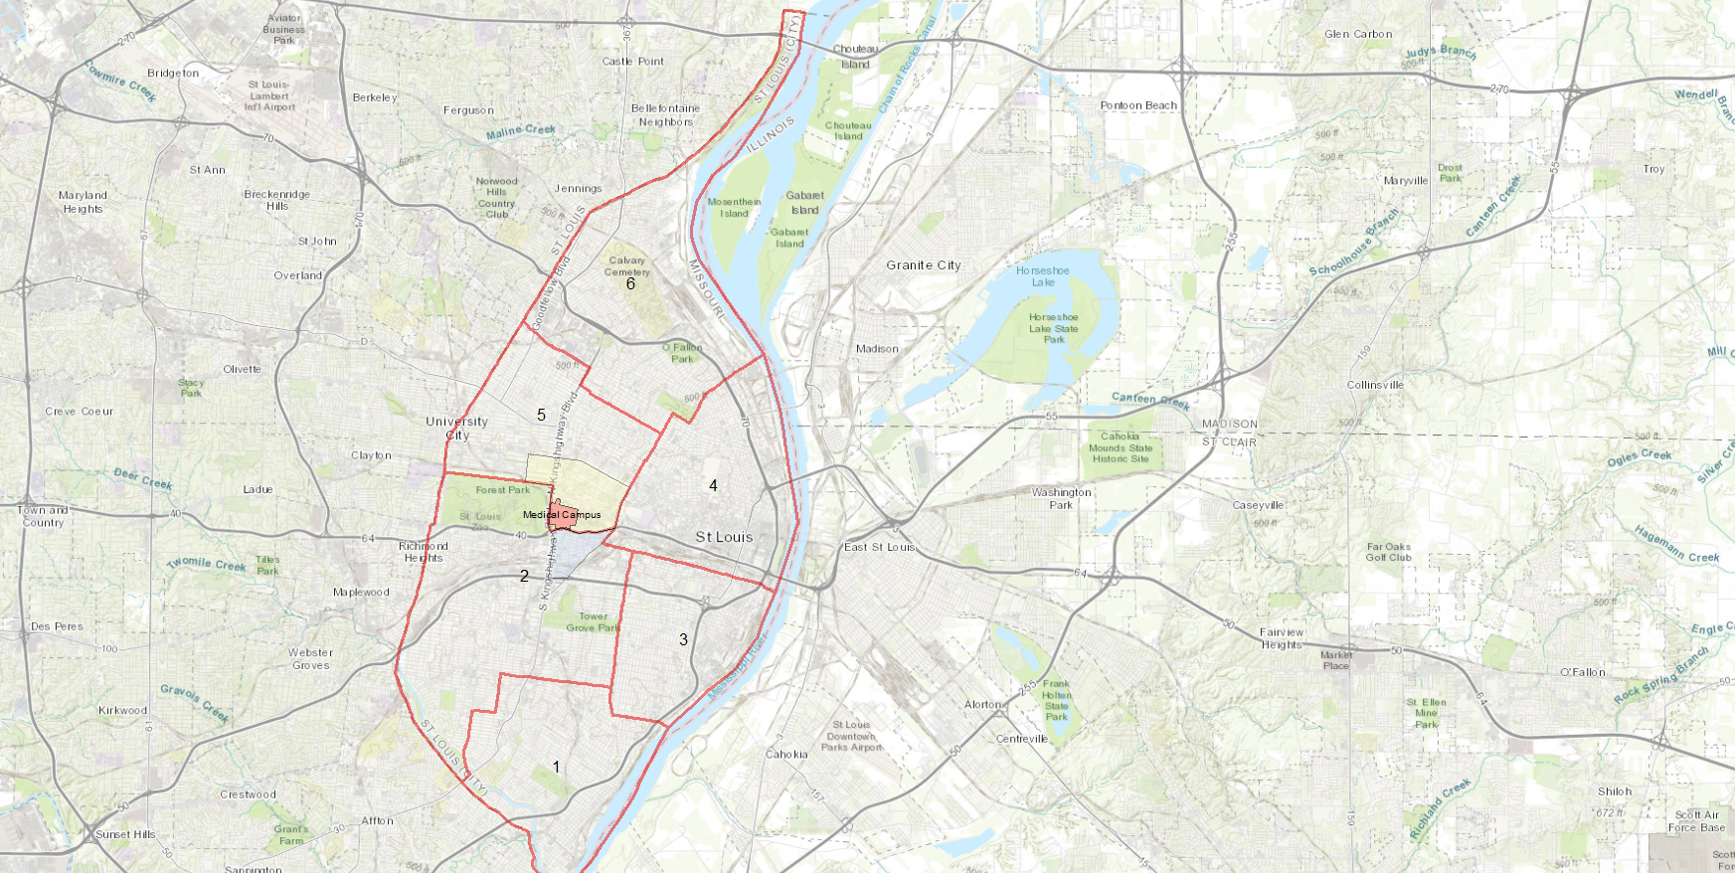
City of St Louis Police Districts
6
Central West End Neighborhood
5
WUMC
4
Forest Park Southeast Neighborhood
2
3
1

Slide 3
District 5 Summary Notes
There are 15 neighborhoods in District 5.
Academy
Central West End
DeBaliviere Place
Fountain Park
Hamilton Heights
Kingsway East
Kingsway West
Lewis Place
Skinker-DeBaliviere
The Greater Ville
The Ville
Vandeventer
Visitation Park
Wells-Goodfellow
West End
The lowest number of crimes in one neighborhood was 6 in Visitation Park
The highest number of crimes in one neighborhood was 237 in the Central West End
The average number of crimes per neighborhood was 53.7
The lowest crime rate per 100,000 in one neighborhood was 649.4 in Visitation Park
The highest crime rate per 100,000 in one neighborhood was 2790.7 in Fountain Park
The overall crime rate in District 5 was 1423.3
Source: SLMPD

Slide 4
District 2 Summary Notes
There are 19 neighborhoods in District 2.
Botanical Heights
Cheltenham
Clayton-Tamm
Clifton Heights
Ellendale
Forest Park Southeast
Franz Park
Hi-Pointe
Kings Oak
Lindenwood Park
Northampton
Shaw
Southampton
Southwest Garden
St. Louis Hills
The Hill
Tiffany
Tower Grove South
Wydown-Skinker
*Southampton is split between District 2 and District 1.
The lowest number of crimes in one neighborhood was 4 in Wydown-Skinker
The highest number of crimes in one neighborhood was 137 in Tower Grove South
The average number of crimes per neighborhood was 38.9
The lowest crime rate per 100,000 in one neighborhood was 356.8 in Wydown-Skinker
The highest crime rate per 100,000 in one neighborhood was 4790.4 in Kings Oak
The overall crime rate in District 2 was 954.7
Source: SLMPD

Slide 5
District Crime rate 2022-2023
District 2 (Forest Park Southeast and Southwest City) has had a crime rate about 33% below city average.
District 5 (Central West End and Northwest City) has generally had a crime rate comparable to the city average.

Slide 6
Neighborhoods vs City Crime rate over time

Slide 7
Forest Park Southeast Neighborhood Detail

Slide 8
Forest Park Southeast Summary
77 total crimes in December 2023
Down 33% compared to December 2022 (115 crimes)
7 crimes against persons in December 2023
Up 17% compared to December 2022 (6 crimes)
943 total crimes in 2023
Down 8% compared to 2022 (1020 crimes)
78 crimes against persons in 2023
Up 3% compared to 2022 (76 crimes)
Source: SLMPD

Slide 9
Forest Park Southeast Year to Year Comparison
2022 | 2020 | 2020 | 2020 | 2020 | 2020 | 2020 | 2020 | 2020 |  |  |  |  | 2020
Crimes | Jan | Feb | Mar | Apr | May | Jun | Jul | Aug | Sep | Oct | Nov | Dec | Total
Aggravated Assault | 0 | 1 | 3 | 8 | 1 | 6 | 1 | 3 | 2 | 1 | 4 | 2 | 32
Arson | 0 | 0 | 0 | 0 | 0 | 0 | 0 | 0 | 0 | 0 | 0 | 0 | 0
Burglary | 0 | 1 | 1 | 3 | 2 | 0 | 4 | 4 | 2 | 9 | 4 | 2 | 32
Homicide | 0 | 0 | 0 | 1 | 0 | 0 | 0 | 0 | 1 | 0 | 0 | 0 | 2
Larceny | 14 | 19 | 20 | 44 | 16 | 24 | 35 | 34 | 29 | 23 | 16 | 37 | 311
Motor Vehicle Theft | 4 | 3 | 1 | 0 | 3 | 2 | 12 | 24 | 12 | 7 | 9 | 20 | 97
Robbery | 0 | 0 | 0 | 0 | 0 | 2 | 0 | 2 | 0 | 1 | 0 | 1 | 6
Total | 18 | 24 | 25 | 56 | 22 | 34 | 52 | 67 | 46 | 41 | 33 | 62 | 480
2023 | 2020 | 2020 | 2020 | 2020 |  |  |  |  |  |  |  |  | 2020
Crimes | Jan | Feb | Mar | Apr | May | Jun | Jul | Aug | Sep | Oct | Nov | Dec | Total
Aggravated Assault | 0 | 4 | 1 | 1 | 4 | 4 | 2 | 0 | 2 | 2 | 5 | 3 | 28
Arson | 0 | 0 | 0 | 0 | 0 | 0 | 0 | 0 | 0 | 0 | 0 | 0 | 0
Burglary | 4 | 1 | 0 | 2 | 8 | 1 | 1 | 3 | 3 | 2 | 3 | 3 | 31
Homicide | 0 | 0 | 0 | 0 | 0 | 1 | 0 | 0 | 0 | 0 | 0 | 1 | 2
Larceny | 43 | 26 | 15 | 18 | 13 | 12 | 14 | 14 | 19 | 27 | 18 | 23 | 242
Motor Vehicle Theft | 14 | 10 | 14 | 7 | 7 | 6 | 6 | 5 | 4 | 8 | 8 | 9 | 98
Robbery | 0 | 0 | 1 | 0 | 0 | 0 | 1 | 0 | 0 | 3 | 2 | 0 | 7
Total | 61 | 41 | 31 | 28 | 32 | 24 | 24 | 22 | 28 | 42 | 36 | 39 | 408
Source: SLMPD

Slide 10
Central West End Neighborhood Detail

Slide 11
Central West End Summary Notes
237 total crimes in December 2023
Up 9% compared to December 2022 (218 crimes)
31 crimes against persons in December 2023
Up 106% compared to December 2022 (15 crimes)
2920 total crimes in 2023
Up 3% compared to 2022 (2829 crimes)
290 crimes against persons in 2023
Down 4% compared to 2022 (302 crimes)
Source: SLMPD

Slide 12
Central West End Year to Year Comparison
2022 | 2020 | 2020 | 2020 | 2020 | 2020 | 2020 | 2020 | 2020 |  |  |  |  | 2020
Crimes | Jan | Feb | Mar | Apr | May | Jun | Jul | Aug | Sep | Oct | Nov | Dec | Total
Aggravated Assault | 3 | 6 | 9 | 6 | 9 | 10 | 23 | 8 | 4 | 6 | 7 | 4 | 95
Arson | 0 | 0 | 0 | 0 | 0 | 1 | 0 | 1 | 0 | 1 | 0 | 0 | 3
Burglary | 9 | 4 | 9 | 5 | 7 | 10 | 18 | 9 | 9 | 14 | 17 | 7 | 118
Homicide | 0 | 0 | 2 | 1 | 5 | 0 | 1 | 0 | 1 | 0 | 0 | 0 | 10
Larceny | 59 | 64 | 57 | 70 | 64 | 89 | 102 | 70 | 72 | 64 | 63 | 66 | 839
Motor Vehicle Theft | 10 | 15 | 10 | 10 | 17 | 38 | 86 | 62 | 64 | 46 | 38 | 33 | 429
Robbery | 3 | 1 | 3 | 3 | 3 | 2 | 6 | 3 | 2 | 2 | 2 | 3 | 33
Total | 84 | 90 | 90 | 95 | 105 | 150 | 236 | 153 | 174 | 133 | 126 | 113 | 1527
2023 | 2020 | 2020 | 2020 | 2020 |  |  |  |  |  |  |  |  | 2020
Crimes | Jan | Feb | Mar | Apr | May | Jun | Jul | Aug | Sep | Oct | Nov | Dec | Total
Aggravated Assault | 7 | 11 | 6 | 5 | 8 | 12 | 4 | 8 | 7 | 5 | 2 | 7 | 82
Arson | 0 | 0 | 1 | 0 | 0 | 2 | 0 | 0 | 0 | 0 | 0 | 0 | 3
Burglary | 6 | 7 | 8 | 9 | 7 | 6 | 23 | 12 | 8 | 4 | 4 | 5 | 99
Homicide | 0 | 0 | 0 | 0 | 2 | 0 | 0 | 0 | 1 | 0 | 0 | 0 | 3
Larceny | 90 | 55 | 50 | 44 | 70 | 59 | 73 | 65 | 83 | 48 | 56 | 57 | 750
Motor Vehicle Theft | 37 | 29 | 19 | 21 | 29 | 37 | 52 | 39 | 29 | 26 | 20 | 27 | 365
Robbery | 1 | 3 | 2 | 1 | 3 | 0 | 1 | 4 | 3 | 5 | 3 | 3 | 29
Total | 141 | 105 | 86 | 80 | 119 | 116 | 153 | 128 | 131 | 88 | 85 | 99 | 1331
Source: SLMPD

