Slide 1
DeBaliviere Place Skinker-Debaliviere West End Visitation Park
December 2023
Monthly Crime Report
Washington University Medical Center

Slide 2
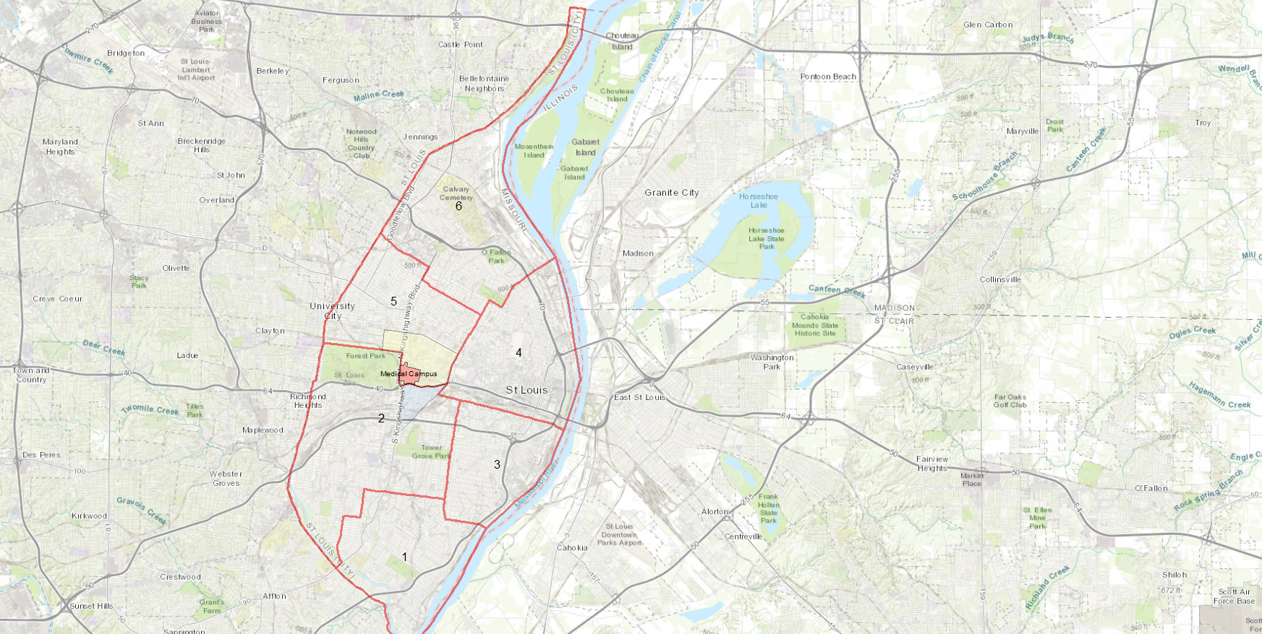
City of St Louis Police Districts
6
DeBaliviere Place, Skinker-DeBaliviere, West End, and Visitation Park are all located within District 5.
5
WUMC
4
2
3
1

Slide 3
District 5 Summary Notes
There are 15 neighborhoods in District 5.
Academy
Central West End
DeBaliviere Place
Fountain Park
Hamilton Heights
Kingsway East
Kingsway West
Lewis Place
Skinker-DeBaliviere
The Greater Ville
The Ville
Vandeventer
Visitation Park
Wells-Goodfellow
West End
The lowest number of crimes in one neighborhood was 10 in both Lewis Place and Fountain Park
The highest number of crimes in one neighborhood was 194 in the Central West End
The average number of crimes per neighborhood was 45.9
The lowest crime rate per 100,000 in one neighborhood was 735.8 in Lewis Place
The highest crime rate per 100,000 in one neighborhood was 2026.8 in DeBaliviere Place
The overall crime rate in District 5 was 1218.2
Source: SLMPD

Slide 4
Neighborhoods vs City Crime rate over time

Slide 5
DeBaliviere Place Neighborhood Detail

Slide 6
DeBaliviere Place Summary Notes
74 total crimes in November 2023
Up 106% compared to November 2022 (36 crimes)
2 crimes against persons in November 2023
Up 100% compared to November 2022 (0 crimes)
560 total crimes so far in 2023
Up 27% compared to this time in 2022 (442 crimes)
27 crimes against persons so far in 2023
Down 4% compared to this time in 2022 (28 crimes)
Source: SLMPD

Slide 7
DeBaliviere Place Year to Year Comparison
2022 | 2020 | 2020 | 2020 | 2020 | 2020 | 2020 | 2020 | 2020 |  |  |  |  | 2020
Crimes | Jan | Feb | Mar | Apr | May | Jun | Jul | Aug | Sep | Oct | Nov | Dec | Total
Aggravated Assault | 1 | 2 | 0 | 0 | 2 | 0 | 1 | 0 | 0 | 2 | 0 | 1 | 9
Arson | 0 | 0 | 0 | 0 | 0 | 0 | 0 | 0 | 0 | 0 | 0 | 0 | 0
Burglary | 0 | 2 | 3 | 3 | 1 | 3 | 5 | 3 | 1 | 1 | 3 | 1 | 126
Homicide | 0 | 0 | 0 | 1 | 0 | 0 | 0 | 1 | 0 | 0 | 0 | 0 | 2
Larceny | 13 | 10 | 22 | 12 | 11 | 16 | 8 | 16 | 10 | 13 | 11 | 11 | 153
Motor Vehicle Theft | 3 | 0 | 3 | 1 | 2 | 20 | 9 | 20 | 24 | 4 | 12 | 4 | 102
Robbery | 0 | 0 | 1 | 0 | 0 | 1 | 1 | 0 | 1 | 0 | 0 | 1 | 5
Total | 17 | 14 | 29 | 17 | 16 | 40 | 24 | 40 | 36 | 20 | 26 | 18 | 297
2023 | 2020 | 2020 | 2020 | 2020 |  |  |  |  |  |  |  | 2020
Crimes | Jan | Feb | Mar | Apr | May | Jun | Jul | Aug | Sep | Oct | Nov | Total
Aggravated Assault | 2 | 0 | 0 | 1 | 1 | 3 | 1 | 0 | 2 | 0 | 1 | 11
Arson | 0 | 0 | 0 | 0 | 0 | 0 | 0 | 0 | 0 | 0 | 0 | 0
Burglary | 1 | 1 | 0 | 4 | 0 | 2 | 2 | 2 | 3 | 2 | 2 | 19
Homicide | 0 | 0 | 0 | 0 | 0 | 0 | 0 | 0 | 0 | 0 | 0 | 0
Larceny | 26 | 12 | 9 | 17 | 9 | 5 | 9 | 12 | 20 | 16 | 22 | 157
Motor Vehicle Theft | 17 | 7 | 2 | 4 | 5 | 4 | 14 | 4 | 13 | 19 | 7 | 96
Robbery | 1 | 2 | 0 | 0 | 0 | 0 | 4 | 0 | 0 | 3 | 2 | 12
Total | 47 | 22 | 11 | 26 | 15 | 14 | 30 | 18 | 38 | 40 | 34 | 295
Source: SLMPD

Slide 8
Skinker-DeBaliviere Neighborhood Detail

Slide 9
Skinker-DeBaliviere Summary Notes
39 total crimes in November 2023
No change compared to November 2022
3 crimes against persons in November 2023
Up 100% compared to November 2022 (0 crimes)
474 total crimes so far in 2023
Up 10% compared to this time in 2022 (430 crimes)
30 crimes against persons so far in 2023
Up 76% compared to this time in 2022 (17 crimes)
Source: SLMPD

Slide 10
Skinker-DeBaliviere Year to Year Comparison
2022 | 2020 | 2020 | 2020 | 2020 | 2020 | 2020 | 2020 | 2020 |  |  |  |  | 2020
Crimes | Jan | Feb | Mar | Apr | May | Jun | Jul | Aug | Sep | Oct | Nov | Dec | Total
Aggravated Assault | 0 | 0 | 1 | 2 | 1 | 0 | 2 | 0 | 1 | 0 | 0 | 1 | 8
Arson | 0 | 0 | 0 | 0 | 0 | 0 | 0 | 0 | 0 | 0 | 0 | 0 | 0
Burglary | 1 | 0 | 6 | 4 | 1 | 1 | 3 | 2 | 3 | 8 | 1 | 1 | 31
Homicide | 0 | 0 | 0 | 0 | 0 | 0 | 0 | 0 | 0 | 0 | 0 | 0 | 0
Larceny | 7 | 8 | 12 | 7 | 6 | 15 | 17 | 11 | 8 | 13 | 12 | 9 | 125
Motor Vehicle Theft | 2 | 2 | 3 | 3 | 0 | 7 | 14 | 18 | 12 | 12 | 3 | 7 | 83
Robbery | 0 | 0 | 1 | 0 | 0 | 2 | 0 | 1 | 0 | 0 | 0 | 2 | 6
Total | 10 | 10 | 23 | 16 | 8 | 25 | 36 | 32 | 24 | 33 | 16 | 20 | 253
2023 | 2020 | 2020 | 2020 | 2020 |  |  |  |  |  |  |  | 2020
Crimes | Jan | Feb | Mar | Apr | May | Jun | Jul | Aug | Sep | Oct | Nov | Total
Aggravated Assault | 0 | 1 | 0 | 0 | 2 | 1 | 1 | 0 | 0 | 1 | 2 | 8
Arson | 0 | 0 | 0 | 0 | 0 | 0 | 0 | 0 | 1 | 0 | 0 | 1
Burglary | 2 | 2 | 0 | 1 | 0 | 1 | 0 | 3 | 2 | 1 | 1 | 13
Homicide | 1 | 0 | 0 | 0 | 0 | 0 | 0 | 1 | 0 | 0 | 0 | 2
Larceny | 16 | 7 | 7 | 6 | 8 | 9 | 9 | 15 | 15 | 21 | 10 | 123
Motor Vehicle Theft | 10 | 2 | 3 | 0 | 6 | 4 | 9 | 2 | 4 | 9 | 4 | 53
Robbery | 0 | 1 | 0 | 0 | 0 | 0 | 0 | 1 | 0 | 0 | 0 | 2
Total | 29 | 13 | 10 | 7 | 16 | 15 | 19 | 22 | 22 | 32 | 17 | 202
Source: SLMPD

Slide 11
West End Neighborhood Detail

Slide 12
West End Summary Notes
73 total crimes in November 2023
Down 11% compared to November 2022 (82 crimes)
14 crimes against persons in November 2023
Up 56% compared to November 2022 (9 crimes)
893 total crimes so far in 2023
Down <1% compared to this time in 2022 (898 crimes)
162 crimes against persons so far in 2023
Up 15% compared to this time in 2022 (141 crimes)
Source: SLMPD

Slide 13
West End Year to Year Comparison
2022 | 2020 | 2020 | 2020 | 2020 | 2020 | 2020 | 2020 | 2020 |  |  |  |  | 2020
Crimes | Jan | Feb | Mar | Apr | May | Jun | Jul | Aug | Sep | Oct | Nov | Dec | Total
Aggravated Assault | 2 | 1 | 8 | 12 | 4 | 2 | 2 | 10 | 4 | 5 | 4 | 10 | 64
Arson | 0 | 0 | 0 | 0 | 1 | 0 | 0 | 0 | 0 | 0 | 1 | 0 | 2
Burglary | 8 | 6 | 4 | 3 | 12 | 11 | 9 | 3 | 4 | 6 | 2 | 3 | 71
Homicide | 0 | 0 | 1 | 0 | 0 | 2 | 0 | 0 | 1 | 0 | 0 | 0 | 4
Larceny | 14 | 11 | 19 | 16 | 19 | 17 | 16 | 19 | 11 | 17 | 13 | 11 | 183
Motor Vehicle Theft | 6 | 1 | 5 | 4 | 7 | 17 | 20 | 15 | 6 | 8 | 10 | 9 | 108
Robbery | 2 | 0 | 0 | 1 | 2 | 2 | 1 | 1 | 0 | 2 | 4 | 1 | 16
Total | 32 | 19 | 37 | 36 | 45 | 51 | 48 | 48 | 26 | 38 | 34 | 34 | 448
2023 | 2020 | 2020 | 2020 | 2020 |  |  |  |  |  |  |  | 2020
Crimes | Jan | Feb | Mar | Apr | May | Jun | Jul | Aug | Sep | Oct | Nov | Total
Aggravated Assault | 0 | 6 | 2 | 7 | 9 | 8 | 6 | 6 | 2 | 11 | 7 | 64
Arson | 0 | 0 | 0 | 0 | 0 | 0 | 1 | 0 | 0 | 1 | 0 | 2
Burglary | 3 | 6 | 3 | 7 | 3 | 5 | 1 | 4 | 3 | 3 | 3 | 41
Homicide | 0 | 0 | 0 | 0 | 0 | 1 | 0 | 0 | 0 | 0 | 0 | 1
Larceny | 12 | 31 | 14 | 20 | 12 | 6 | 7 | 16 | 20 | 17 | 9 | 164
Motor Vehicle Theft | 11 | 15 | 11 | 6 | 7 | 10 | 7 | 9 | 9 | 6 | 14 | 105
Robbery | 0 | 1 | 0 | 0 | 3 | 3 | 0 | 3 | 0 | 1 | 1 | 12
Total | 26 | 59 | 30 | 40 | 34 | 33 | 22 | 38 | 34 | 39 | 34 | 389
Source: SLMPD

Slide 14
Visitation Park Neighborhood Detail

Slide 15
Visitation Park Summary Notes
11 total crimes in November 2023
Down 48% compared to November 2022 (21 crimes)
5 crimes against persons in November 2023
Down 17% compared to November 2022 (6 crimes)
116 total crimes so far in 2023
Up <1% compared to this time in 2022 (115 crimes)
29 crimes against persons so far in 2023
Up 61% compared to this time in 2022 (18 crimes)
Source: SLMPD

Slide 16
Visitation Park Year to Year Comparison
2022 | 2020 | 2020 | 2020 | 2020 | 2020 | 2020 | 2020 | 2020 |  |  |  |  | 2020
Crimes | Jan | Feb | Mar | Apr | May | Jun | Jul | Aug | Sep | Oct | Nov | Dec | Total
Aggravated Assault | 1 | 0 | 0 | 1 | 1 | 2 | 2 | 0 | 0 | 1 | 1 | 0 | 9
Arson | 0 | 0 | 0 | 0 | 0 | 0 | 0 | 0 | 0 | 0 | 0 | 0 | 0
Burglary | 0 | 0 | 0 | 1 | 0 | 0 | 0 | 1 | 0 | 0 | 1 | 0 | 3
Homicide | 0 | 0 | 0 | 0 | 0 | 0 | 0 | 0 | 0 | 0 | 0 | 0 | 0
Larceny | 2 | 4 | 2 | 0 | 3 | 0 | 7 | 3 | 0 | 0 | 2 | 1 | 24
Motor Vehicle Theft | 2 | 0 | 1 | 1 | 0 | 4 | 1 | 3 | 1 | 1 | 0 | 1 | 15
Robbery | 0 | 1 | 0 | 0 | 0 | 0 | 0 | 0 | 0 | 0 | 0 | 1 | 2
Total | 5 | 5 | 3 | 3 | 4 | 6 | 10 | 7 | 1 | 2 | 4 | 3 | 53
2023 | 2020 | 2020 | 2020 | 2020 |  |  |  |  |  |  |  | 2020
Crimes | Jan | Feb | Mar | Apr | May | Jun | Jul | Aug | Sep | Oct | Nov | Total
Aggravated Assault | 1 | 1 | 0 | 1 | 1 | 4 | 0 | 1 | 0 | 2 | 0 | 11
Arson | 0 | 0 | 0 | 0 | 0 | 0 | 0 | 0 | 0 | 0 | 0 | 0
Burglary | 1 | 0 | 0 | 0 | 0 | 0 | 1 | 0 | 0 | 0 | 0 | 2
Homicide | 0 | 0 | 0 | 0 | 0 | 0 | 0 | 0 | 0 | 0 | 0 | 0
Larceny | 2 | 1 | 4 | 3 | 2 | 0 | 2 | 0 | 2 | 3 | 0 | 19
Motor Vehicle Theft | 1 | 0 | 4 | 1 | 2 | 0 | 0 | 0 | 0 | 0 | 1 | 9
Robbery | 0 | 0 | 0 | 0 | 0 | 0 | 0 | 0 | 0 | 0 | 0 | 0
Total | 5 | 2 | 8 | 5 | 5 | 4 | 3 | 1 | 2 | 5 | 1 | 41
Source: SLMPD

