Slide 1
DeBaliviere Place Skinker-Debaliviere West End Visitation Park
December 2023
Monthly Crime Report
Washington University Medical Center

Slide 2
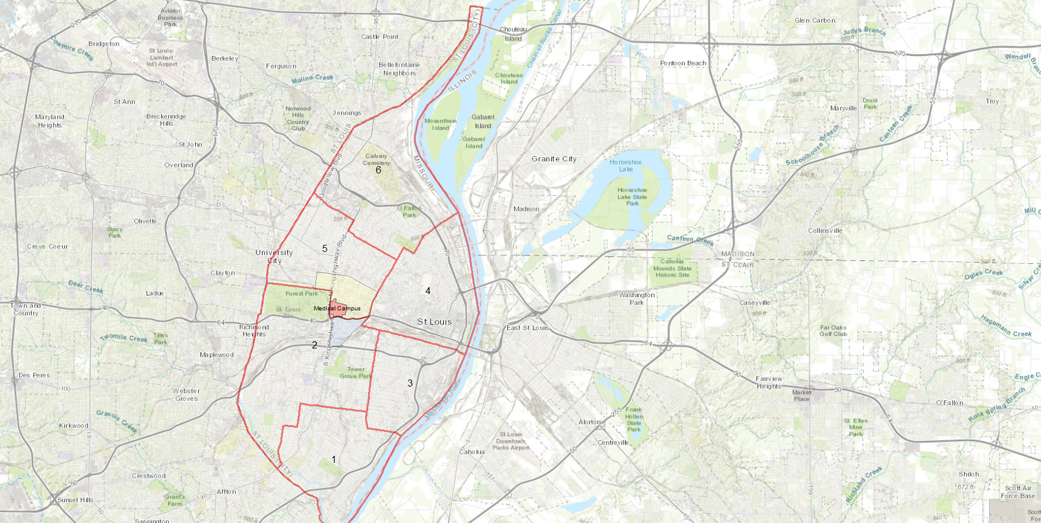
City of St Louis Police Districts
6
DeBaliviere Place, Skinker-DeBaliviere, West End, and Visitation Park are all located within District 5.
5
WUMC
4
2
3
1

Slide 3
District 5 Summary Notes
There are 15 neighborhoods in District 5.
Academy
Central West End
DeBaliviere Place
Fountain Park
Hamilton Heights
Kingsway East
Kingsway West
Lewis Place
Skinker-DeBaliviere
The Greater Ville
The Ville
Vandeventer
Visitation Park
Wells-Goodfellow
West End
The lowest number of crimes in one neighborhood was 6 in Visitation Park
The highest number of crimes in one neighborhood was 237 in the Central West End
The average number of crimes per neighborhood was 53.7
The lowest crime rate per 100,000 in one neighborhood was 649.4 in Visitation Park
The highest crime rate per 100,000 in one neighborhood was 2790.7 in Fountain Park
The overall crime rate in District 5 was 1423.3
Source: SLMPD

Slide 4
Neighborhoods vs City Crime rate IN 2023

Slide 5
DeBaliviere Place Neighborhood Detail

Slide 6
DeBaliviere Place Summary Notes
47 total crimes in December 2023
Up 38% compared to December 2022 (34 crimes)
4 crimes against persons in December 2023
Up 300% compared to December 2022 (1 crime)
610 total crimes in 2023
Up 28% compared to 2022 (478 crimes)
32 crimes against persons in 2023
Up 10% compared to 2022 (29 crimes)
Source: SLMPD

Slide 7
DeBaliviere Place Year to Year Comparison
2022 | 2020 | 2020 | 2020 | 2020 | 2020 | 2020 | 2020 | 2020 |  |  |  |  | 2020
Crimes | Jan | Feb | Mar | Apr | May | Jun | Jul | Aug | Sep | Oct | Nov | Dec | Total
Aggravated Assault | 1 | 2 | 0 | 0 | 2 | 0 | 1 | 0 | 0 | 2 | 0 | 1 | 9
Arson | 0 | 0 | 0 | 0 | 0 | 0 | 0 | 0 | 0 | 0 | 0 | 0 | 0
Burglary | 0 | 2 | 3 | 3 | 1 | 3 | 5 | 3 | 1 | 1 | 3 | 1 | 126
Homicide | 0 | 0 | 0 | 1 | 0 | 0 | 0 | 1 | 0 | 0 | 0 | 0 | 2
Larceny | 13 | 10 | 22 | 12 | 11 | 16 | 8 | 16 | 10 | 13 | 11 | 14 | 156
Motor Vehicle Theft | 3 | 0 | 3 | 1 | 2 | 20 | 9 | 20 | 24 | 4 | 12 | 4 | 102
Robbery | 0 | 0 | 1 | 0 | 0 | 1 | 1 | 0 | 1 | 0 | 0 | 1 | 5
Total | 17 | 14 | 29 | 17 | 16 | 40 | 24 | 40 | 36 | 20 | 26 | 21 | 300
2023 | 2020 | 2020 | 2020 | 2020 |  |  |  |  |  |  |  |  | 2020
Crimes | Jan | Feb | Mar | Apr | May | Jun | Jul | Aug | Sep | Oct | Nov | Dec | Total
Aggravated Assault | 2 | 0 | 0 | 1 | 1 | 3 | 1 | 0 | 2 | 0 | 1 | 0 | 11
Arson | 0 | 0 | 0 | 0 | 0 | 0 | 0 | 0 | 0 | 0 | 0 | 0 | 0
Burglary | 1 | 1 | 0 | 4 | 0 | 2 | 2 | 2 | 3 | 2 | 2 | 0 | 19
Homicide | 0 | 0 | 0 | 0 | 0 | 0 | 0 | 0 | 0 | 0 | 0 | 0 | 0
Larceny | 26 | 12 | 9 | 17 | 9 | 5 | 9 | 12 | 20 | 16 | 22 | 12 | 169
Motor Vehicle Theft | 17 | 7 | 2 | 4 | 5 | 4 | 14 | 4 | 13 | 19 | 7 | 8 | 104
Robbery | 1 | 2 | 0 | 0 | 0 | 0 | 4 | 0 | 0 | 3 | 2 | 2 | 14
Total | 47 | 22 | 11 | 26 | 15 | 14 | 30 | 18 | 38 | 40 | 34 | 22 | 317
Source: SLMPD

Slide 8
Skinker-DeBaliviere Neighborhood Detail

Slide 9
Skinker-DeBaliviere Summary Notes
30 total crimes in December 2023
Down 19% compared to December 2022 (37 crimes)
2 crimes against persons in December 2023
No change compared to December 2022
506 total crimes in 2023
Up 8% compared to 2022 (468 crimes)
31 crimes against persons in 2023
Up 63% compared to 2022 (19 crimes)
Source: SLMPD

Slide 10
Skinker-DeBaliviere Year to Year Comparison
2022 | 2020 | 2020 | 2020 | 2020 | 2020 | 2020 | 2020 | 2020 |  |  |  |  | 2020
Crimes | Jan | Feb | Mar | Apr | May | Jun | Jul | Aug | Sep | Oct | Nov | Dec | Total
Aggravated Assault | 0 | 0 | 1 | 2 | 1 | 0 | 2 | 0 | 1 | 0 | 0 | 1 | 8
Arson | 0 | 0 | 0 | 0 | 0 | 0 | 0 | 0 | 0 | 0 | 0 | 0 | 0
Burglary | 1 | 0 | 6 | 4 | 1 | 1 | 3 | 2 | 3 | 8 | 1 | 1 | 31
Homicide | 0 | 0 | 0 | 0 | 0 | 0 | 0 | 0 | 0 | 0 | 0 | 0 | 0
Larceny | 7 | 8 | 12 | 7 | 6 | 15 | 17 | 11 | 8 | 13 | 12 | 10 | 126
Motor Vehicle Theft | 2 | 2 | 3 | 3 | 0 | 7 | 14 | 18 | 12 | 12 | 3 | 7 | 83
Robbery | 0 | 0 | 1 | 0 | 0 | 2 | 0 | 1 | 0 | 0 | 0 | 2 | 6
Total | 10 | 10 | 23 | 16 | 8 | 25 | 36 | 32 | 24 | 33 | 16 | 21 | 254
2023 | 2020 | 2020 | 2020 | 2020 |  |  |  |  |  |  |  |  | 2020
Crimes | Jan | Feb | Mar | Apr | May | Jun | Jul | Aug | Sep | Oct | Nov | Dec | Total
Aggravated Assault | 0 | 1 | 0 | 0 | 2 | 1 | 1 | 0 | 0 | 1 | 2 | 0 | 8
Arson | 0 | 0 | 0 | 0 | 0 | 0 | 0 | 0 | 1 | 0 | 0 | 0 | 1
Burglary | 2 | 2 | 0 | 1 | 0 | 1 | 0 | 3 | 2 | 1 | 1 | 2 | 15
Homicide | 1 | 0 | 0 | 0 | 0 | 0 | 0 | 1 | 0 | 0 | 0 | 0 | 2
Larceny | 16 | 7 | 7 | 6 | 8 | 9 | 9 | 15 | 15 | 21 | 10 | 9 | 132
Motor Vehicle Theft | 10 | 2 | 3 | 0 | 6 | 4 | 9 | 2 | 4 | 9 | 4 | 2 | 55
Robbery | 0 | 1 | 0 | 0 | 0 | 0 | 0 | 1 | 0 | 0 | 0 | 0 | 2
Total | 29 | 13 | 10 | 7 | 16 | 15 | 19 | 22 | 22 | 32 | 17 | 13 | 215
Source: SLMPD

Slide 11
West End Neighborhood Detail

Slide 12
West End Summary Notes
81 total crimes in December 2023
Up 9% compared to December 2022 (74 crimes)
13 crimes against persons in December 2023
Down 32% compared to December 2022 (19 crimes)
984 total crimes in 2023
Down <1% compared to 2022 (990 crimes)
177 crimes against persons in 2023
Up 8% compared to 2022 (164 crimes)
Source: SLMPD

Slide 13
West End Year to Year Comparison
2022 | 2020 | 2020 | 2020 | 2020 | 2020 | 2020 | 2020 | 2020 |  |  |  |  | 2020
Crimes | Jan | Feb | Mar | Apr | May | Jun | Jul | Aug | Sep | Oct | Nov | Dec | Total
Aggravated Assault | 2 | 1 | 8 | 12 | 4 | 2 | 2 | 10 | 4 | 5 | 4 | 11 | 65
Arson | 0 | 0 | 0 | 0 | 1 | 0 | 0 | 0 | 0 | 0 | 1 | 0 | 2
Burglary | 8 | 6 | 4 | 3 | 12 | 11 | 9 | 3 | 4 | 6 | 2 | 4 | 72
Homicide | 0 | 0 | 1 | 0 | 0 | 2 | 0 | 0 | 1 | 0 | 0 | 0 | 4
Larceny | 14 | 11 | 19 | 16 | 19 | 17 | 16 | 19 | 11 | 17 | 13 | 11 | 183
Motor Vehicle Theft | 6 | 1 | 5 | 4 | 7 | 17 | 20 | 15 | 6 | 8 | 10 | 10 | 109
Robbery | 2 | 0 | 0 | 1 | 2 | 2 | 1 | 1 | 0 | 2 | 4 | 1 | 16
Total | 32 | 19 | 37 | 36 | 45 | 51 | 48 | 48 | 26 | 38 | 34 | 37 | 451
2023 | 2020 | 2020 | 2020 | 2020 |  |  |  |  |  |  |  |  | 2020
Crimes | Jan | Feb | Mar | Apr | May | Jun | Jul | Aug | Sep | Oct | Nov | Dec | Total
Aggravated Assault | 0 | 6 | 2 | 7 | 9 | 8 | 6 | 6 | 2 | 11 | 7 | 3 | 67
Arson | 0 | 0 | 0 | 0 | 0 | 0 | 1 | 0 | 0 | 1 | 0 | 0 | 2
Burglary | 3 | 6 | 3 | 7 | 3 | 5 | 1 | 4 | 3 | 3 | 3 | 4 | 45
Homicide | 0 | 0 | 0 | 0 | 0 | 1 | 0 | 0 | 0 | 0 | 0 | 0 | 1
Larceny | 12 | 31 | 14 | 20 | 12 | 6 | 7 | 16 | 20 | 17 | 9 | 14 | 178
Motor Vehicle Theft | 11 | 15 | 11 | 6 | 7 | 10 | 7 | 9 | 9 | 6 | 14 | 12 | 117
Robbery | 0 | 1 | 0 | 0 | 3 | 3 | 0 | 3 | 0 | 1 | 1 | 3 | 15
Total | 26 | 59 | 30 | 40 | 34 | 33 | 22 | 38 | 34 | 39 | 34 | 36 | 325
Source: SLMPD

Slide 14
Visitation Park Neighborhood Detail

Slide 15
Visitation Park Summary Notes
6 total crimes in December 2023
Down 68% compared to December 2022 (19 crimes)
2 crimes against persons in December 2023
Down 50% compared to December 2022 (4 crimes)
122 total crimes in 2023
Down 10% compared to 2022 (135 crimes)
31 crimes against persons in 2023
Up 35% compared to 2022 (23 crimes)
Source: SLMPD

Slide 16
Visitation Park Year to Year Comparison
2022 | 2020 | 2020 | 2020 | 2020 | 2020 | 2020 | 2020 | 2020 |  |  |  |  | 2020
Crimes | Jan | Feb | Mar | Apr | May | Jun | Jul | Aug | Sep | Oct | Nov | Dec | Total
Aggravated Assault | 1 | 0 | 0 | 1 | 1 | 2 | 2 | 0 | 0 | 1 | 1 | 0 | 9
Arson | 0 | 0 | 0 | 0 | 0 | 0 | 0 | 0 | 0 | 0 | 0 | 0 | 0
Burglary | 0 | 0 | 0 | 1 | 0 | 0 | 0 | 1 | 0 | 0 | 1 | 0 | 3
Homicide | 0 | 0 | 0 | 0 | 0 | 0 | 0 | 0 | 0 | 0 | 0 | 0 | 0
Larceny | 2 | 4 | 2 | 0 | 3 | 0 | 7 | 3 | 0 | 0 | 2 | 1 | 24
Motor Vehicle Theft | 2 | 0 | 1 | 1 | 0 | 4 | 1 | 3 | 1 | 1 | 0 | 1 | 15
Robbery | 0 | 1 | 0 | 0 | 0 | 0 | 0 | 0 | 0 | 0 | 0 | 1 | 2
Total | 5 | 5 | 3 | 3 | 4 | 6 | 10 | 7 | 1 | 2 | 4 | 3 | 53
2023 | 2020 | 2020 | 2020 | 2020 |  |  |  |  |  |  |  |  | 2020
Crimes | Jan | Feb | Mar | Apr | May | Jun | Jul | Aug | Sep | Oct | Nov | Dec | Total
Aggravated Assault | 1 | 1 | 0 | 1 | 1 | 4 | 0 | 1 | 0 | 2 | 0 | 0 | 11
Arson | 0 | 0 | 0 | 0 | 0 | 0 | 0 | 0 | 0 | 0 | 0 | 0 | 0
Burglary | 1 | 0 | 0 | 0 | 0 | 0 | 1 | 0 | 0 | 0 | 0 | 0 | 2
Homicide | 0 | 0 | 0 | 0 | 0 | 0 | 0 | 0 | 0 | 0 | 0 | 0 | 0
Larceny | 2 | 1 | 4 | 3 | 2 | 0 | 2 | 0 | 2 | 3 | 0 | 1 | 20
Motor Vehicle Theft | 1 | 0 | 4 | 1 | 2 | 0 | 0 | 0 | 0 | 0 | 1 | 1 | 10
Robbery | 0 | 0 | 0 | 0 | 0 | 0 | 0 | 0 | 0 | 0 | 0 | 1 | 1
Total | 5 | 2 | 8 | 5 | 5 | 4 | 3 | 1 | 2 | 5 | 1 | 3 | 44
Source: SLMPD

