Slide 1
St. Louis Central Corridor West Building Permits
Monthly Report: April 2024

Slide 2
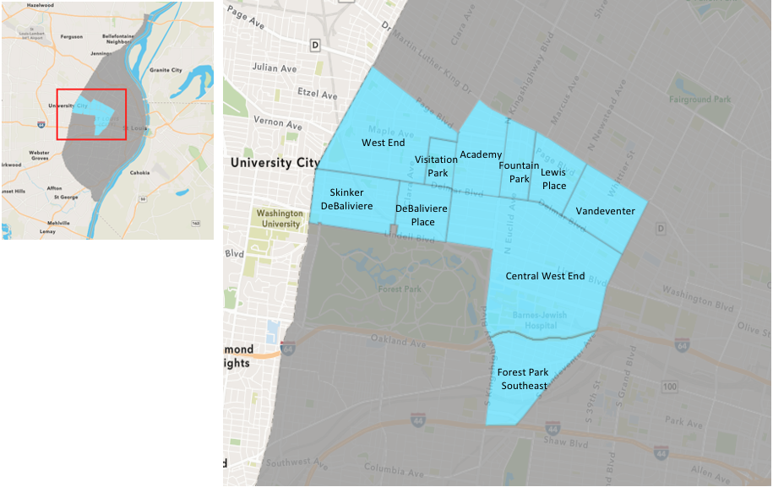
St. Louis Neighborhood Spatial Reference

Slide 3
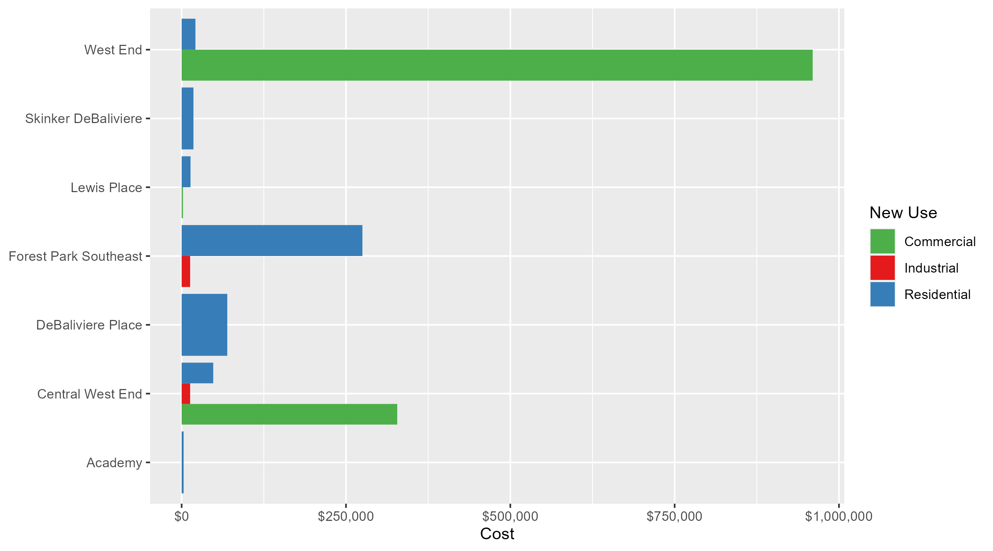
Neighborhood Summary: Average Building Permit Cost

Slide 4
Neighborhood Summary
April 2024 | April 2024 | April 2024 | April 2024
Neighborhood | Average Cost | # of Permits | Total Value of Permits
Academy | $3,000.0 | 1 | $3,000
Central West End | $159,127.9 | 40 | $6,365,114
DeBaliviere Place | $69,400.0 | 5 | $347,000
Forest Park Southeast | $143,950.0 | 2 | $287,900
Fountain Park | $0.0 | 0 | $0
Lewis Place | $7,746.0 | 2 | $15,492
Skinker DeBaliviere | $17,939.0 | 6 | $107,634
Vandeventer | $0.0 | 0 | $0
Visitation Park | $0.0 | 0 | $0
West End | $177,463.8 | 6 | $1,064,783
Last 6 Months | Last 6 Months | Last 6 Months | Last 6 Months
Neighborhood | Average Cost | # of Permits | Total Value of Permits
Academy | $37,079.65 | 17 | $630,354
Central West End | $477,977.11 | 197 | $94,161,490
DeBaliviere Place | $118,127.09 | 23 | $2,716,923
Forest Park Southeast | $97,132.30 | 46 | $4,468,086
Fountain Park | $36,218.18 | 11 | $398,400
Lewis Place | $37,722.90 | 10 | $377,229
Skinker DeBaliviere | $124,830.60 | 35 | $4,369,071
Vandeventer | $47,599.40 | 5 | $237,997
Visitation Park | $36,500.00 | 1 | $36,500
West End | $134,989.07 | 46 | $6,209,497

Slide 5
Core Neighborhoods

Slide 6
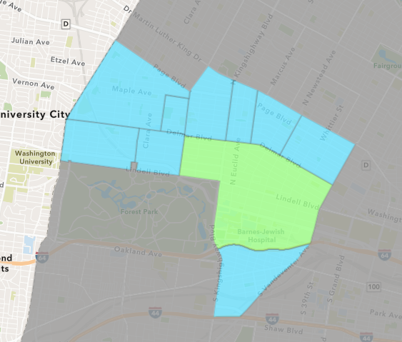
Central West End
April 2024 Neighborhood Cost Breakdown
  Mean: $159,128
  Median: $32,500
  Range: $1,850 - $1,500,000

Slide 7
Central West End: Summary Notes
40 building permits in April 2024
  60.00% change compared to April 2023 (25 total building permits)
  $159,128: Average building permit cost in April 2024
    -36.03% change compared to April 2023 ($248,760)
113 total building permits in 2024
  -12.40% change YTD compared to this time in 2023 (129 total building permits)
  $621,468: YTD average building permit cost in 2024
    59.78% change YTD compared to this time in 2023 ($388,957)

Slide 8
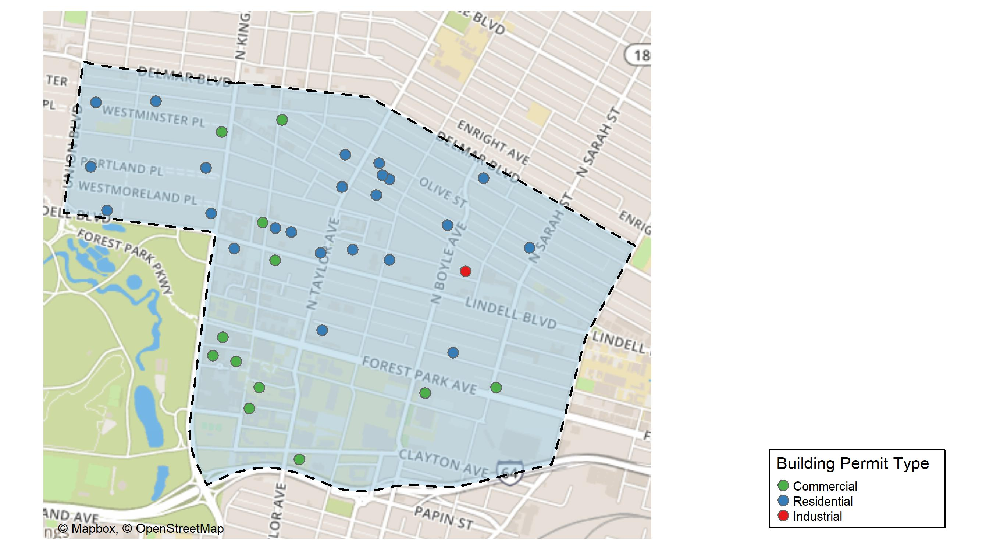
Central West End

Slide 9
Neighborhood Summary
April 2024 | April 2024 | April 2024 | April 2024
Permit Use | Average Cost | # of Permits | Total Value of Permits
Commercial | $327,968.31 | 16 | $5,247,493
Industrial | $12,900.00 | 1 | $12,900
Residential | $48,031.35 | 23 | $1,104,721
Last 6 Months | Last 6 Months | Last 6 Months | Last 6 Months
Permit Use | Average Cost | # of Permits | Total Value of Permits
Commercial | $951,053.47 | 94 | $89,399,026
Industrial | $16,950.00 | 5 | $84,750
Residential | $47,731.78 | 98 | $4,677,714

Slide 10
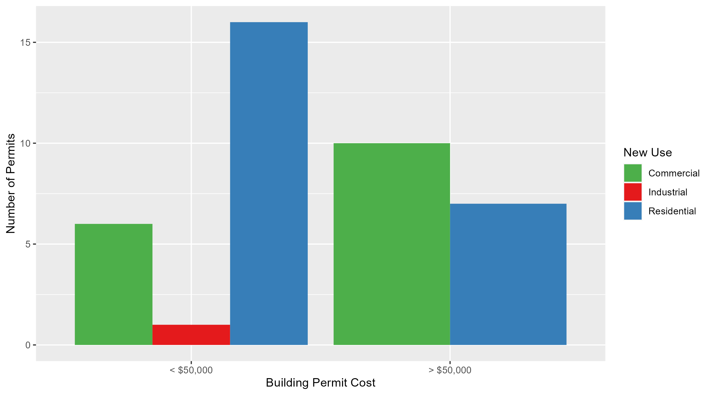
Central West End Permit Cost Breakdown

Slide 11
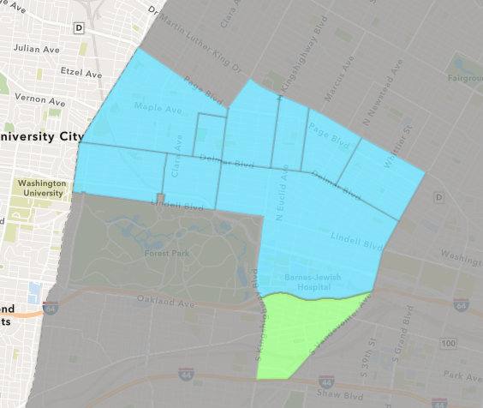
Forest Park Southeast
April 2024 Neighborhood Cost Breakdown
  Mean: $143,950
  Median: $143,950
  Range: $12,900 - $275,000

Slide 12
Forest Park Southeast: Summary Notes
2 building permits in April 2024
  -71.43% change compared to April 2023 (7 total building permits)
  $143,950: Average building permit cost in April 2024
    11.87% change compared to April 2023 ($128,671)
26 total building permits in 2024
  30.00% change YTD compared to this time in 2023 (20 total building permits)
  $91,176: YTD average building permit cost in 2024
    13.30% change YTD compared to this time in 2023 ($80,475)

Slide 13
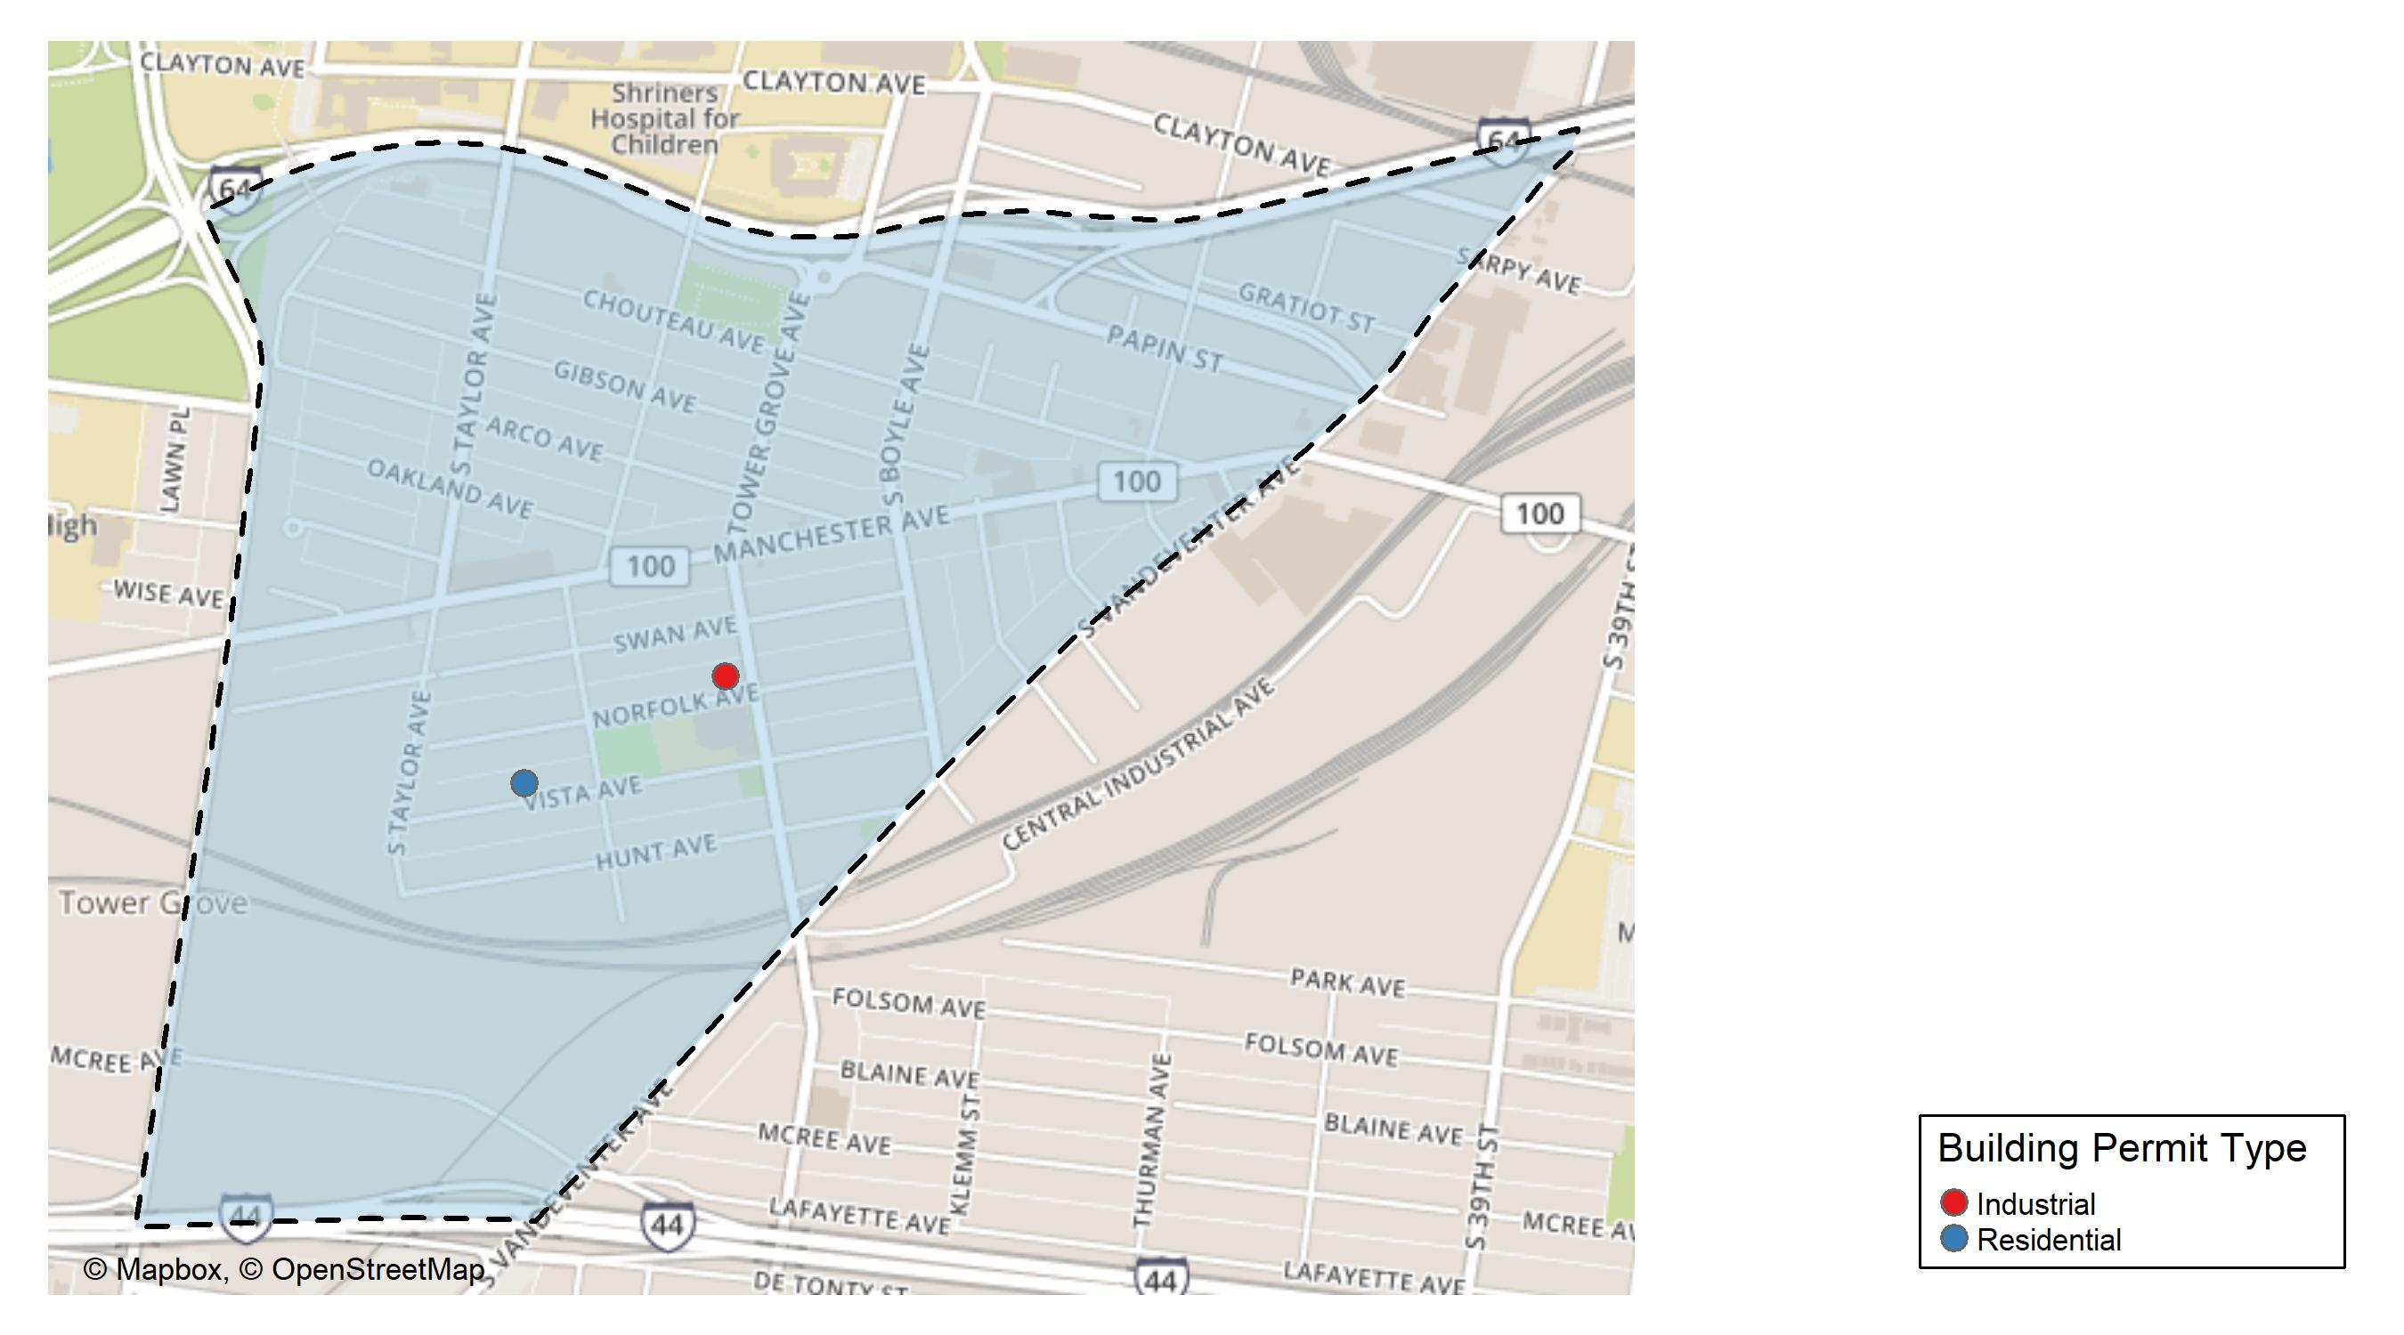
Forest Park Southeast

Slide 14
Neighborhood Summary
April 2024 | April 2024 | April 2024 | April 2024
Permit Use | Average Cost | # of Permits | Total Value of Permits
Commercial | $0 | 0 | $0
Industrial | $12,900 | 1 | $12,900
Residential | $275,000 | 1 | $275,000
Last 6 Months | Last 6 Months | Last 6 Months | Last 6 Months
Permit Use | Average Cost | # of Permits | Total Value of Permits
Commercial | $28,826.67 | 6 | $172,960
Industrial | $13,325.00 | 4 | $53,300
Residential | $117,828.50 | 36 | $4,241,826

Slide 15
Forest Park Southeast Individual Permit Breakdown
Neighborhood | Owner | New Use | Cost | address
Forest Park Southeast | UNIFY GROVE DEVELOPMENT PHASE II LLC | Residential | $275,000 | 4431 VISTA AV
Forest Park Southeast | BECKMAN, JULIE | Industrial | $12,900 | 4309 NORFOLK AV

Slide 16
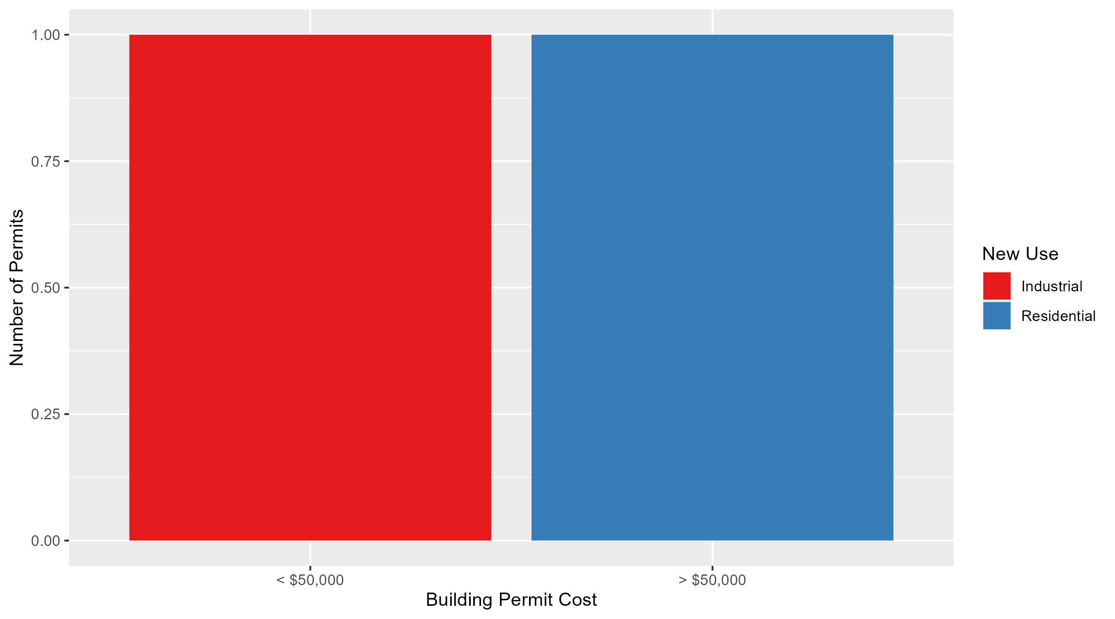
Forest Park Southeast Permit Cost Breakdown

Slide 17
Expanded Service Area

Slide 18
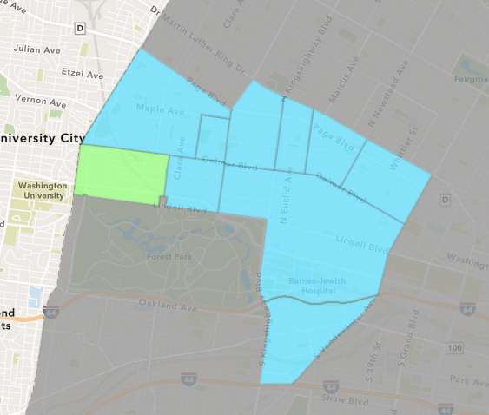
Skinker DeBaliviere
April 2024 Neighborhood Cost Breakdown
  Mean: $17,939
  Median: $9,685
  Range: $2,500 - $50,000

Slide 19
Skinker DeBaliviere: Summary Notes
6 building permits in April 2024
  -62.50% change compared to April 2023 (16 total building permits)
  $17,939: Average building permit cost in April 2024
    -76.27% change compared to April 2023 ($75,594)
17 total building permits in 2024
  -54.05% change YTD compared to this time in 2023 (37 total building permits)
  $74,630: YTD average building permit cost in 2024
    -7.14% change YTD compared to this time in 2023 ($80,370)

Slide 20
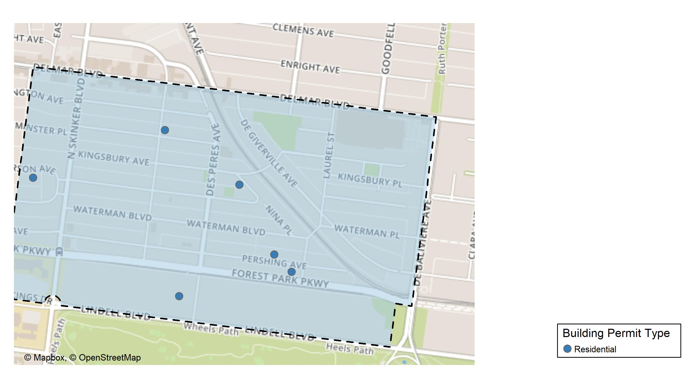
Skinker DeBaliviere

Slide 21
Neighborhood Summary
April 2024 | April 2024 | April 2024 | April 2024
Permit Use | Average Cost | # of Permits | Total Value of Permits
Commercial | $0 | 0 | $0
Industrial | $0 | 0 | $0
Residential | $17,939 | 6 | $107,634
Last 6 Months | Last 6 Months | Last 6 Months | Last 6 Months
Permit Use | Average Cost | # of Permits | Total Value of Permits
Commercial | $3,250.0 | 2 | $6,500
Industrial | $0.0 | 0 | $0
Residential | $132,199.1 | 33 | $4,362,571

Slide 22
Skinker DeBaliviere Individual Permit Breakdown
Neighborhood | Owner | New Use | Cost | address
Skinker DeBaliviere | BERGERON, ADAM | Residential | $7,370 | 5920 NINA PL
Skinker DeBaliviere | HASLER, ANTONY & JOAN N HART-HASLER | Residential | $30,564 | 6063 WESTMINSTER PL
Skinker DeBaliviere | LAZAROFF, DAVID & GAYLE | Residential | $12,000 | 6240 MCPHERSON AV
Skinker DeBaliviere | DAVIDSON, JACK & MICHELLE | Residential | $5,200 | 5835 PERSHING AV
Skinker DeBaliviere | ONE WORLD USA LLC | Residential | $50,000 | 5810 PERSHING AV
Skinker DeBaliviere | CABRAL, SAMUEL & CASSANDRA | Residential | $2,500 | 6025 LINDELL BLVD

Slide 23
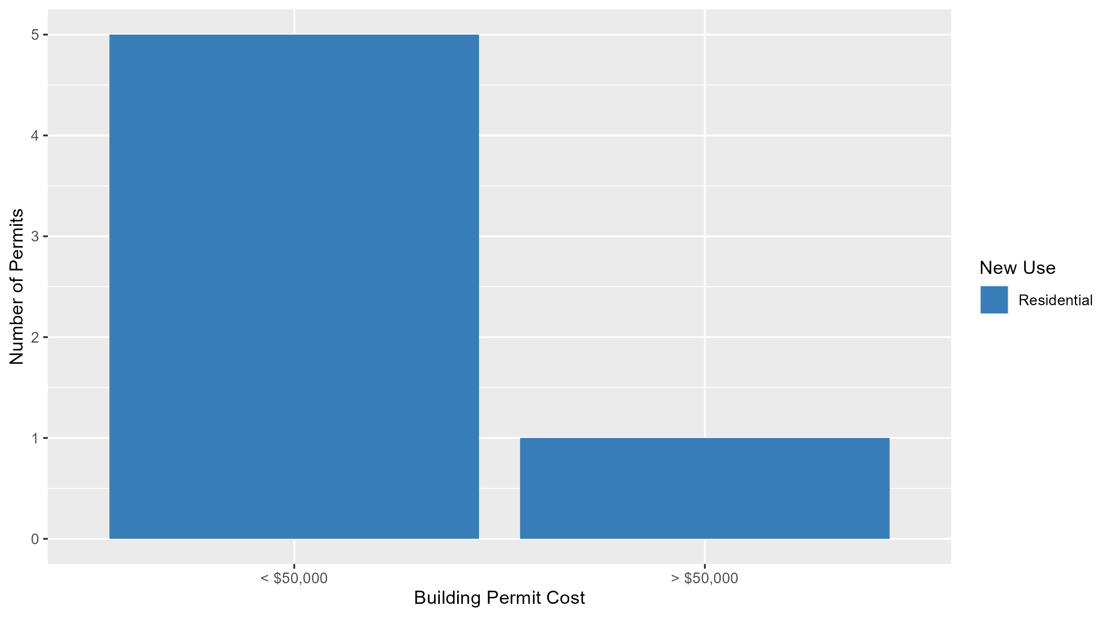
Skinker DeBaliviere Permit Cost Breakdown

Slide 24
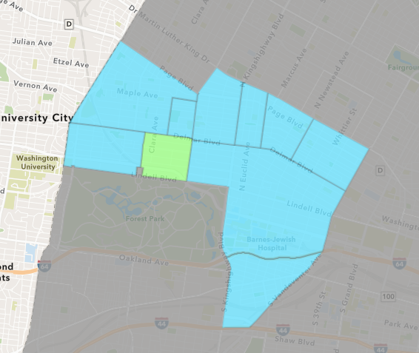
DeBaliviere Place
April 2024 Neighborhood Cost Breakdown
  Mean: $69,400
  Median: $10,000
  Range: $2,000 - $180,000

Slide 25
DeBaliviere Place: Summary Notes
5 building permits in April 2024
  25.00% change compared to April 2023 (4 total building permits)
  $69,400: Average building permit cost in April 2024
    -64.01% change compared to April 2023 ($192,853)
14 total building permits in 2024
  27.27% change YTD compared to this time in 2023 (11 total building permits)
  $56,434: YTD average building permit cost in 2024
    -57.51% change YTD compared to this time in 2023 ($132,822)

Slide 26
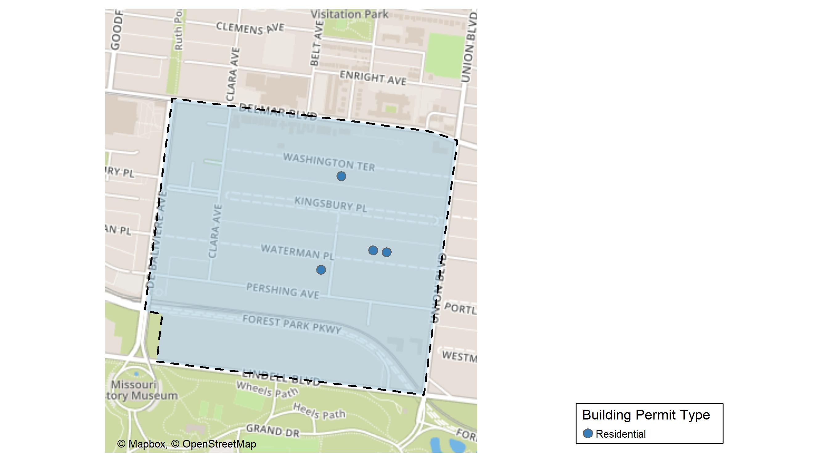
DeBaliviere Place

Slide 27
Neighborhood Summary
April 2024 | April 2024 | April 2024 | April 2024
Permit Use | Average Cost | # of Permits | Total Value of Permits
Commercial | $0 | 0 | $0
Industrial | $0 | 0 | $0
Residential | $69,400 | 5 | $347,000
Last 6 Months | Last 6 Months | Last 6 Months | Last 6 Months
Permit Use | Average Cost | # of Permits | Total Value of Permits
Commercial | $763,077.00 | 2 | $1,526,154
Industrial | $0.00 | 0 | $0
Residential | $56,703.29 | 21 | $1,190,769

Slide 28
DeBaliviere Place Individual Permit Breakdown
Neighborhood | Owner | New Use | Cost | address
DeBaliviere Place | ANTHONY J DICKSON & | Residential | $180,000 | 26 WASHINGTON TER
DeBaliviere Place | BUTSCH, DAVID T & | Residential | $150,000 | 71 WATERMAN PL
DeBaliviere Place | RANDOLPH CONDOMINIUMS | Residential | $5,000 | 5510 WATERMAN BLVD
DeBaliviere Place | CORMIER, TOM | Residential | $2,000 | 319 BELT AV
DeBaliviere Place | NASH, ALISON C & CLARENCE E DULA | Residential | $10,000 | 57 WATERMAN PL

Slide 29
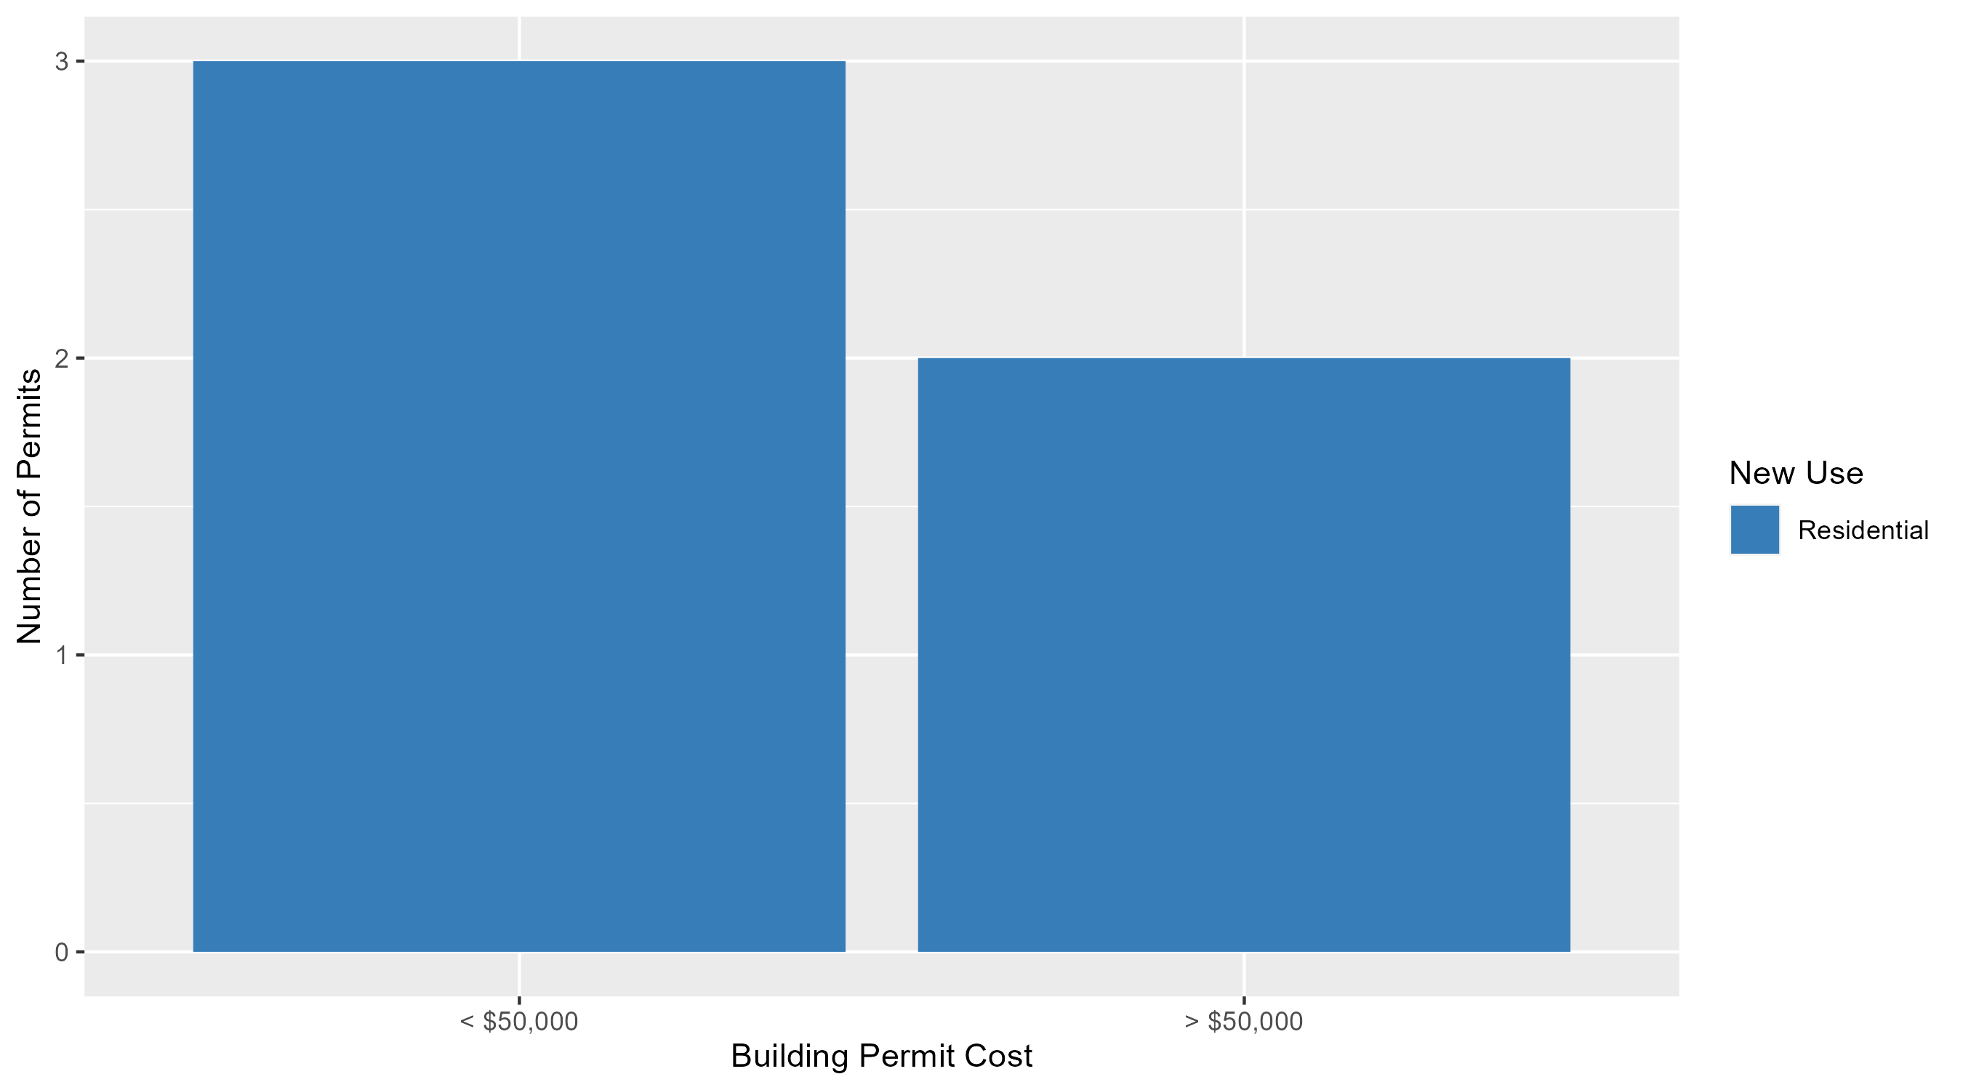
DeBaliviere Place Permit Cost Breakdown

Slide 30
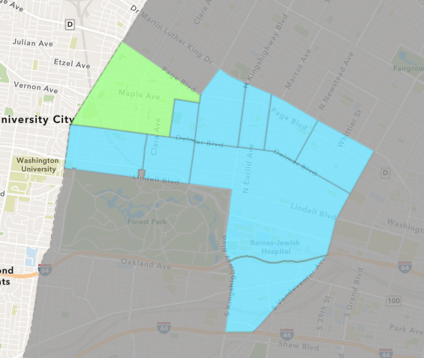
West End
April 2024 Neighborhood Cost Breakdown
  Mean: $177,464
  Median: $10,642
  Range: $1,000 - $960,000

Slide 31
West End: Summary Notes
6 building permits in April 2024
  -45.45% change compared to April 2023 (11 total building permits)
  $177,464: Average building permit cost in April 2024
    736.96% change compared to April 2023 ($21,203)
29 total building permits in 2024
  -6.45% change YTD compared to this time in 2023 (31 total building permits)
  $139,893: YTD average building permit cost in 2024
    305.34% change YTD compared to this time in 2023 ($34,513)

Slide 32
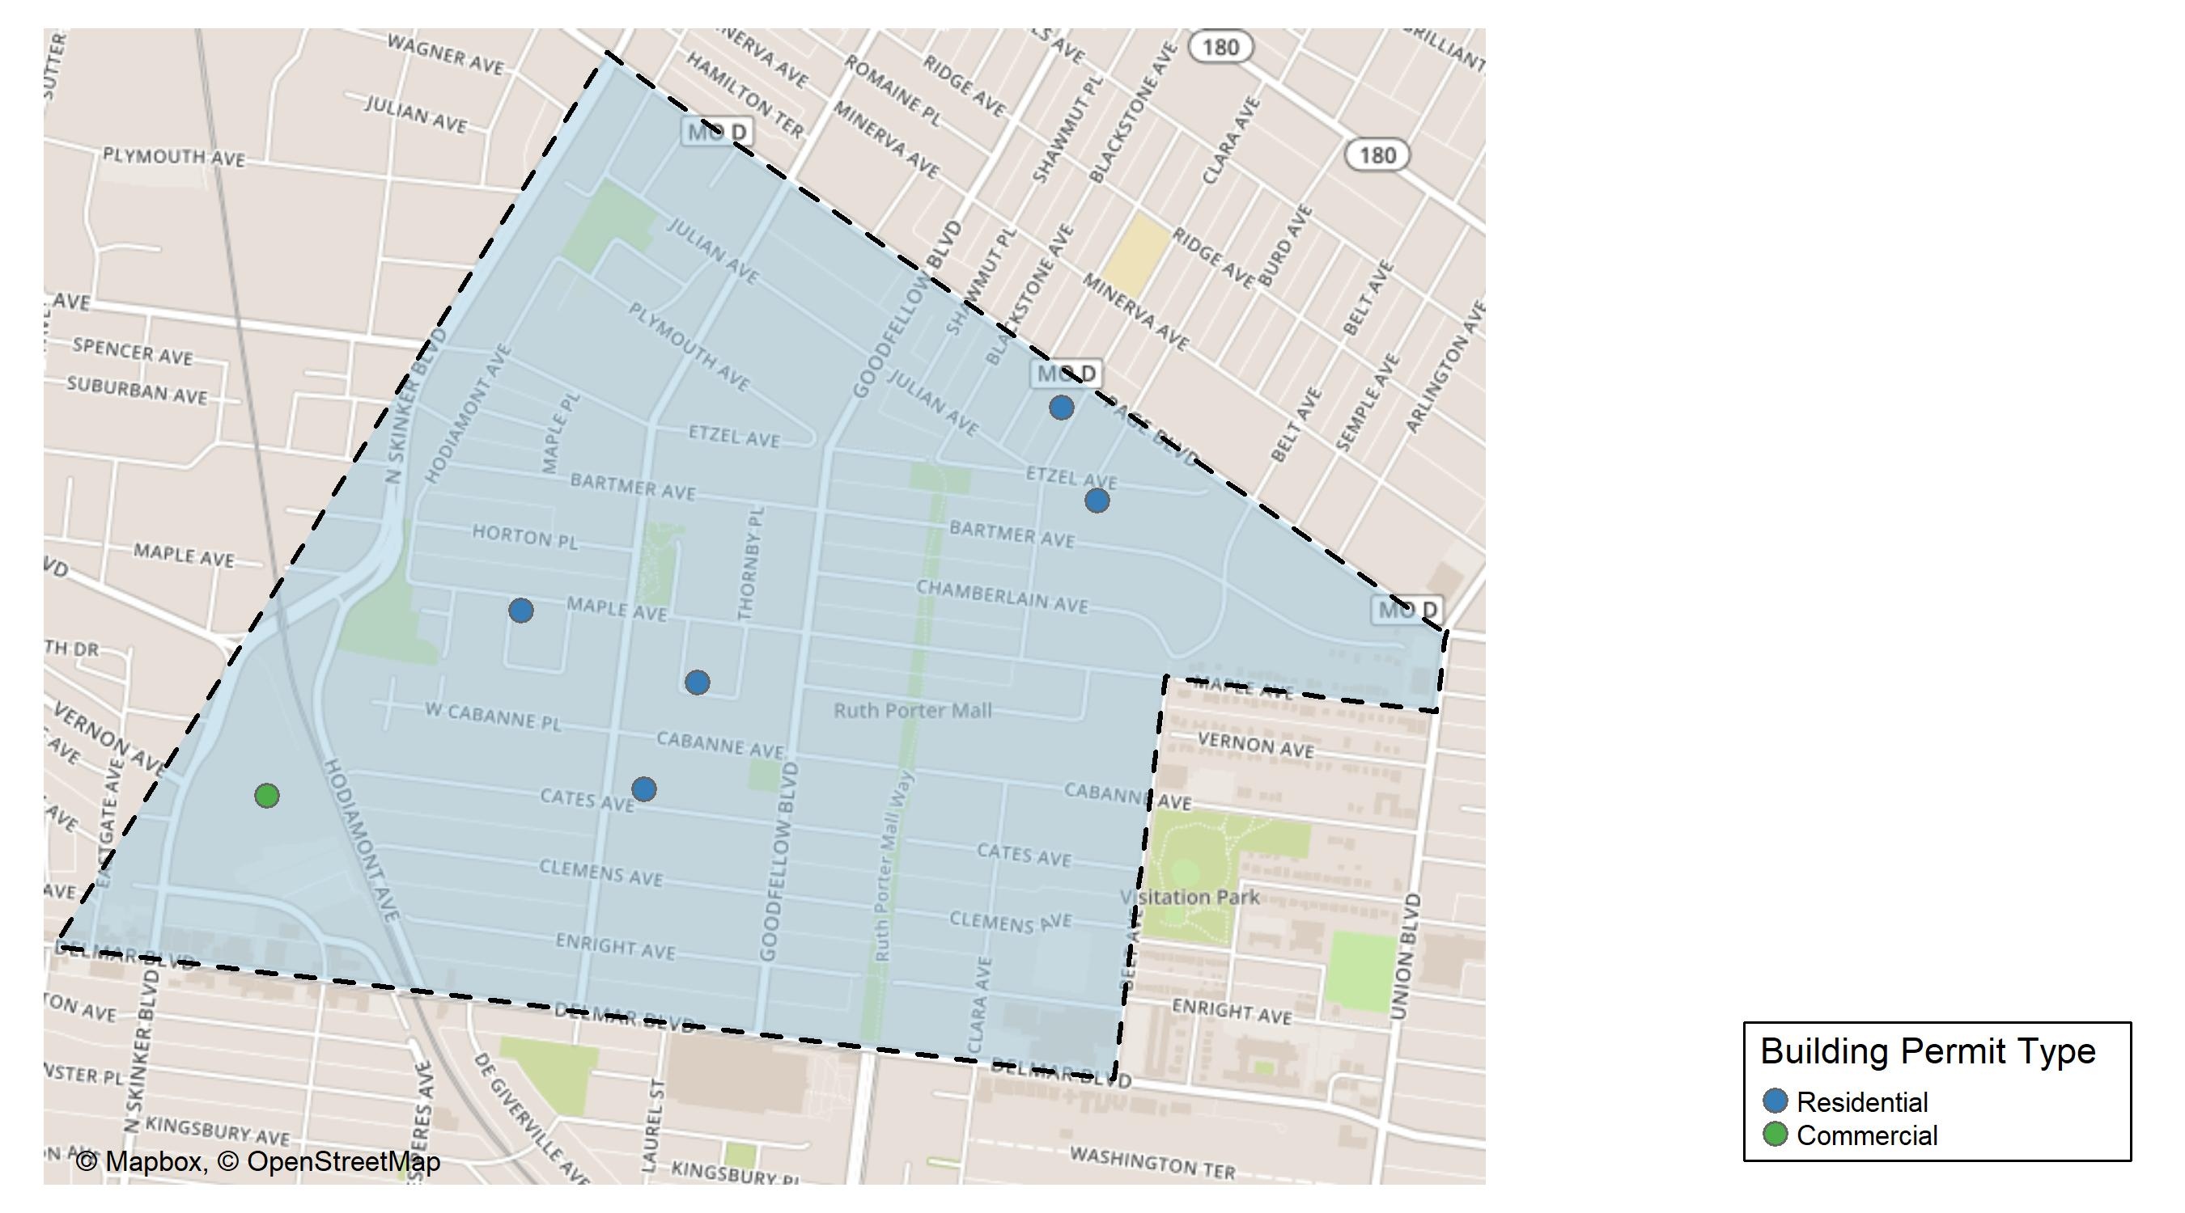
West End

Slide 33
Neighborhood Summary
April 2024 | April 2024 | April 2024 | April 2024
Permit Use | Average Cost | # of Permits | Total Value of Permits
Commercial | $960,000.0 | 1 | $960,000
Industrial | $0.0 | 0 | $0
Residential | $20,956.6 | 5 | $104,783
Last 6 Months | Last 6 Months | Last 6 Months | Last 6 Months
Permit Use | Average Cost | # of Permits | Total Value of Permits
Commercial | $405,052.25 | 8 | $3,240,418
Industrial | $14,400.00 | 2 | $28,800
Residential | $81,674.42 | 36 | $2,940,279

Slide 34
West End Individual Permit Breakdown
Neighborhood | Owner | New Use | Cost | address
West End | WASHINGTON UNIVERSITY ART BUILDING | Commercial | $960,000 | 840 ROSEDALE AV
West End | WILLIAMS, CANDACE E | Residential | $11,283 | 932 MARYVILLE AV
West End | NEWSOMEWORLD ENTERPRISES LLC C/O H | Residential | $75,000 | 1239 CLARA AV
West End | CAMPOVERDE-CISNEROS, ANA DEL | Residential | $1,000 | 5962 MAPLE AV
West End | LABRIADO, ANDRE | Residential | $7,500 | 5885 CATES AV
West End | FITZPATRICK, RENATO | Residential | $10,000 | 5582 ETZEL AV

Slide 35
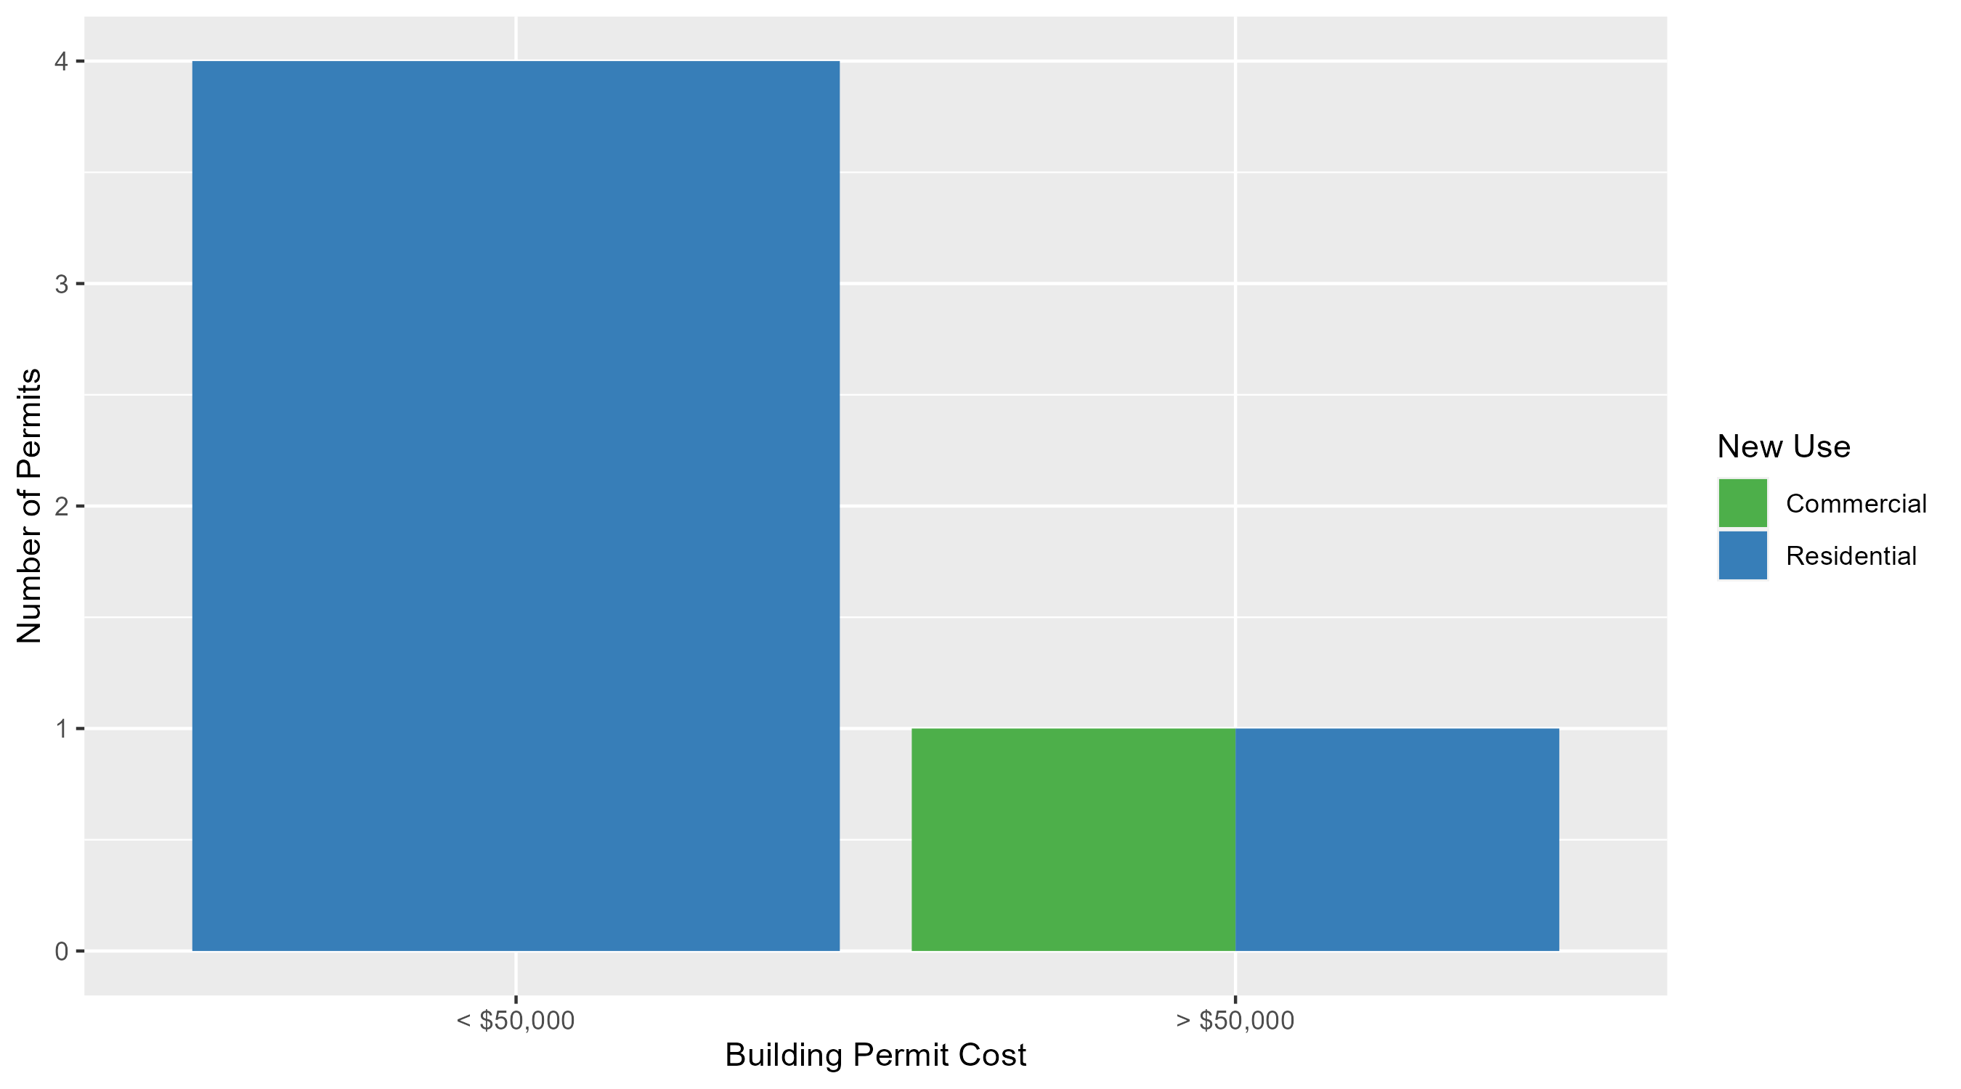
West End Permit Cost Breakdown

Slide 36
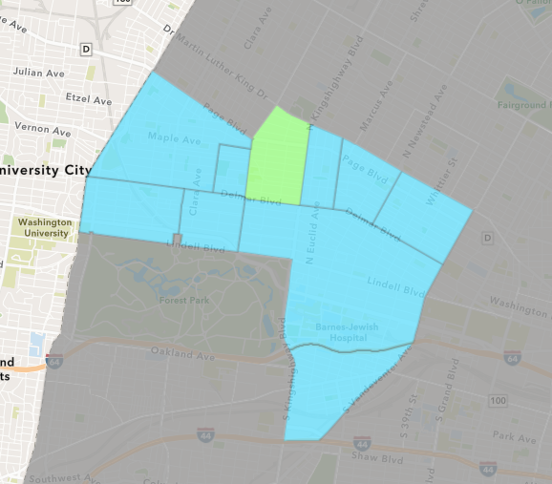
Academy
April 2024 Neighborhood Cost Breakdown
  Mean: $3,000
  Median: $3,000
  Range: $3,000 - $3,000

Slide 37
Academy: Summary Notes
1 building permits in April 2024
  0.00% change compared to April 2023 (1 total building permits)
  $3,000: Average building permit cost in April 2024
    200.00% change compared to April 2023 ($1,000)
7 total building permits in 2024
  -12.50% change YTD compared to this time in 2023 (8 total building permits)
  $19,886: YTD average building permit cost in 2024
    -15.94% change YTD compared to this time in 2023 ($23,656)

Slide 38
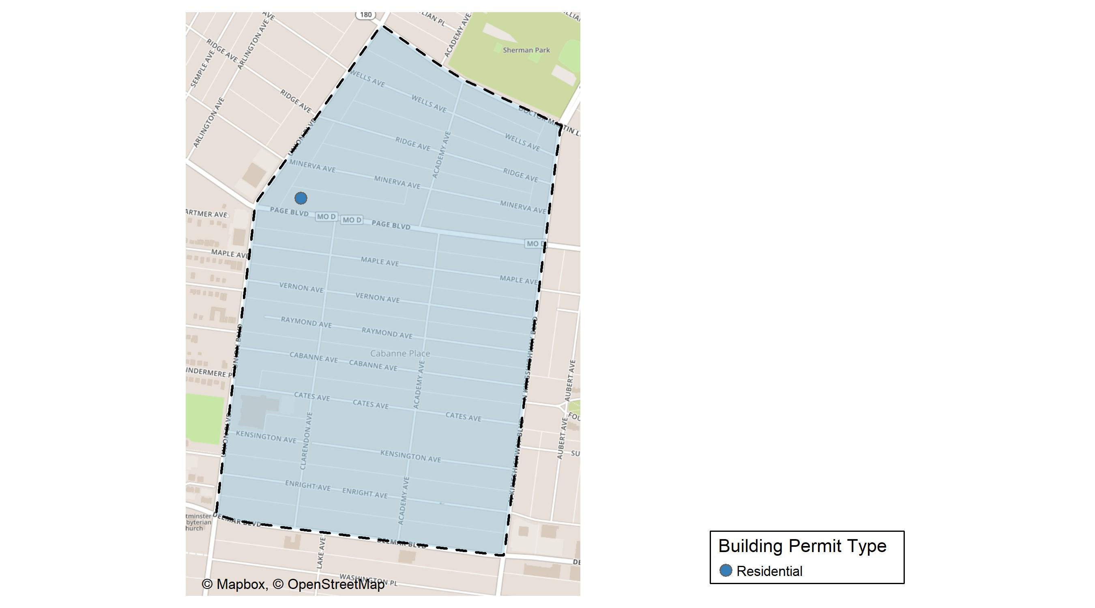
Academy

Slide 39
Neighborhood Summary
April 2024 | April 2024 | April 2024 | April 2024
Permit Use | Average Cost | # of Permits | Total Value of Permits
Commercial | $0 | 0 | $0
Industrial | $0 | 0 | $0
Residential | $3,000 | 1 | $3,000
Last 6 Months | Last 6 Months | Last 6 Months | Last 6 Months
Permit Use | Average Cost | # of Permits | Total Value of Permits
Commercial | $40,964.00 | 2 | $81,928
Industrial | $42,000.00 | 1 | $42,000
Residential | $36,173.29 | 14 | $506,426

Slide 40
Academy Individual Permit Breakdown
Neighborhood | Owner | New Use | Cost | address
Academy | WILLIAMS, JEROME & DORIS | Residential | $3,000 | 5257 PAGE BLVD

Slide 41
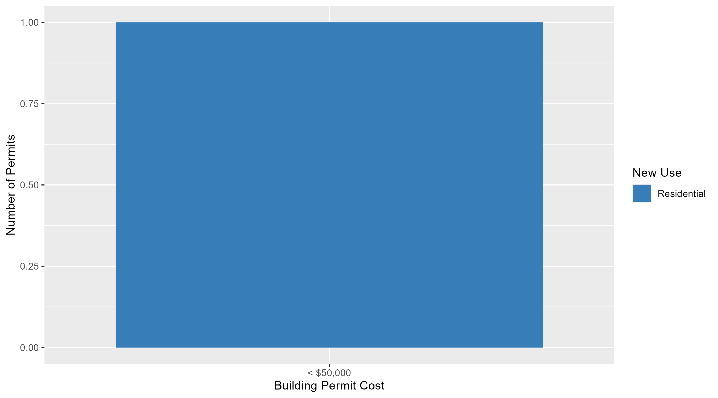
Academy Permit Cost Breakdown

Slide 42
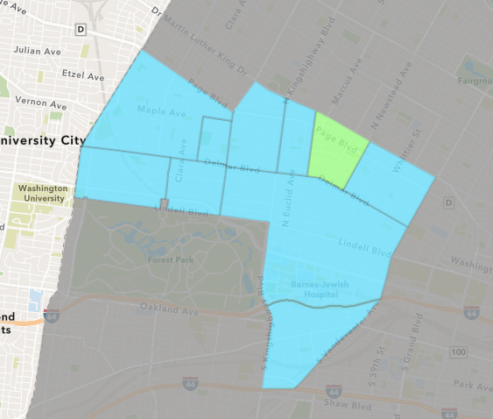
Lewis Place
April 2024 Neighborhood Cost Breakdown
  Mean: $7,746
  Median: $7,746
  Range: $1,992 - $13,500

Slide 43
Lewis Place: Summary Notes
2 building permits in April 2024
  -33.33% change compared to April 2023 (3 total building permits)
  $7,746: Average building permit cost in April 2024
    44.34% change compared to April 2023 ($5,367)
5 total building permits in 2024
  -16.67% change YTD compared to this time in 2023 (6 total building permits)
  $4,898: YTD average building permit cost in 2024
    -72.56% change YTD compared to this time in 2023 ($17,850)

Slide 44
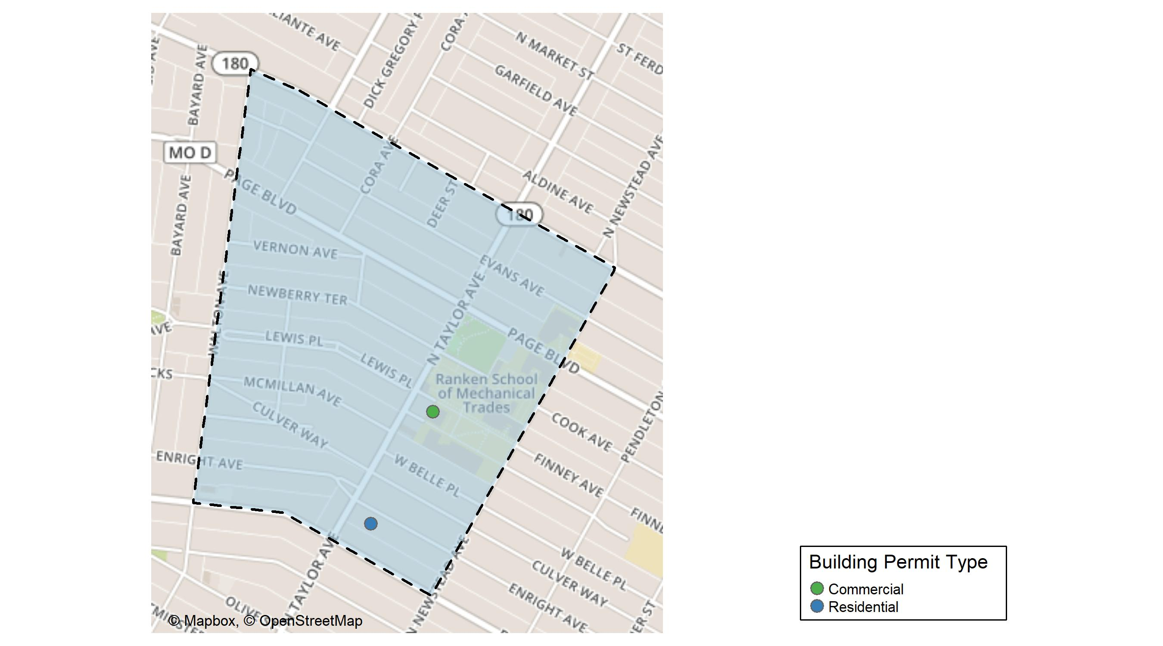
Lewis Place

Slide 45
Neighborhood Summary
April 2024 | April 2024 | April 2024 | April 2024
Permit Use | Average Cost | # of Permits | Total Value of Permits
Commercial | $1,992 | 1 | $1,992
Industrial | $0 | 0 | $0
Residential | $13,500 | 1 | $13,500
Last 6 Months | Last 6 Months | Last 6 Months | Last 6 Months
Permit Use | Average Cost | # of Permits | Total Value of Permits
Commercial | $113,763.5 | 2 | $227,527
Industrial | $7,000.0 | 1 | $7,000
Residential | $20,386.0 | 7 | $142,702

Slide 46
Lewis Place Individual Permit Breakdown
Neighborhood | Owner | New Use | Cost | address
Lewis Place | HOLLIE, GEORGE E | Residential | $13,500 | 4470-72 ENRIGHT AV
Lewis Place | DAVID RANKEN JR TECHNICAL COLLEGE | Commercial | $1,992 | 4468 FINNEY AV

Slide 47
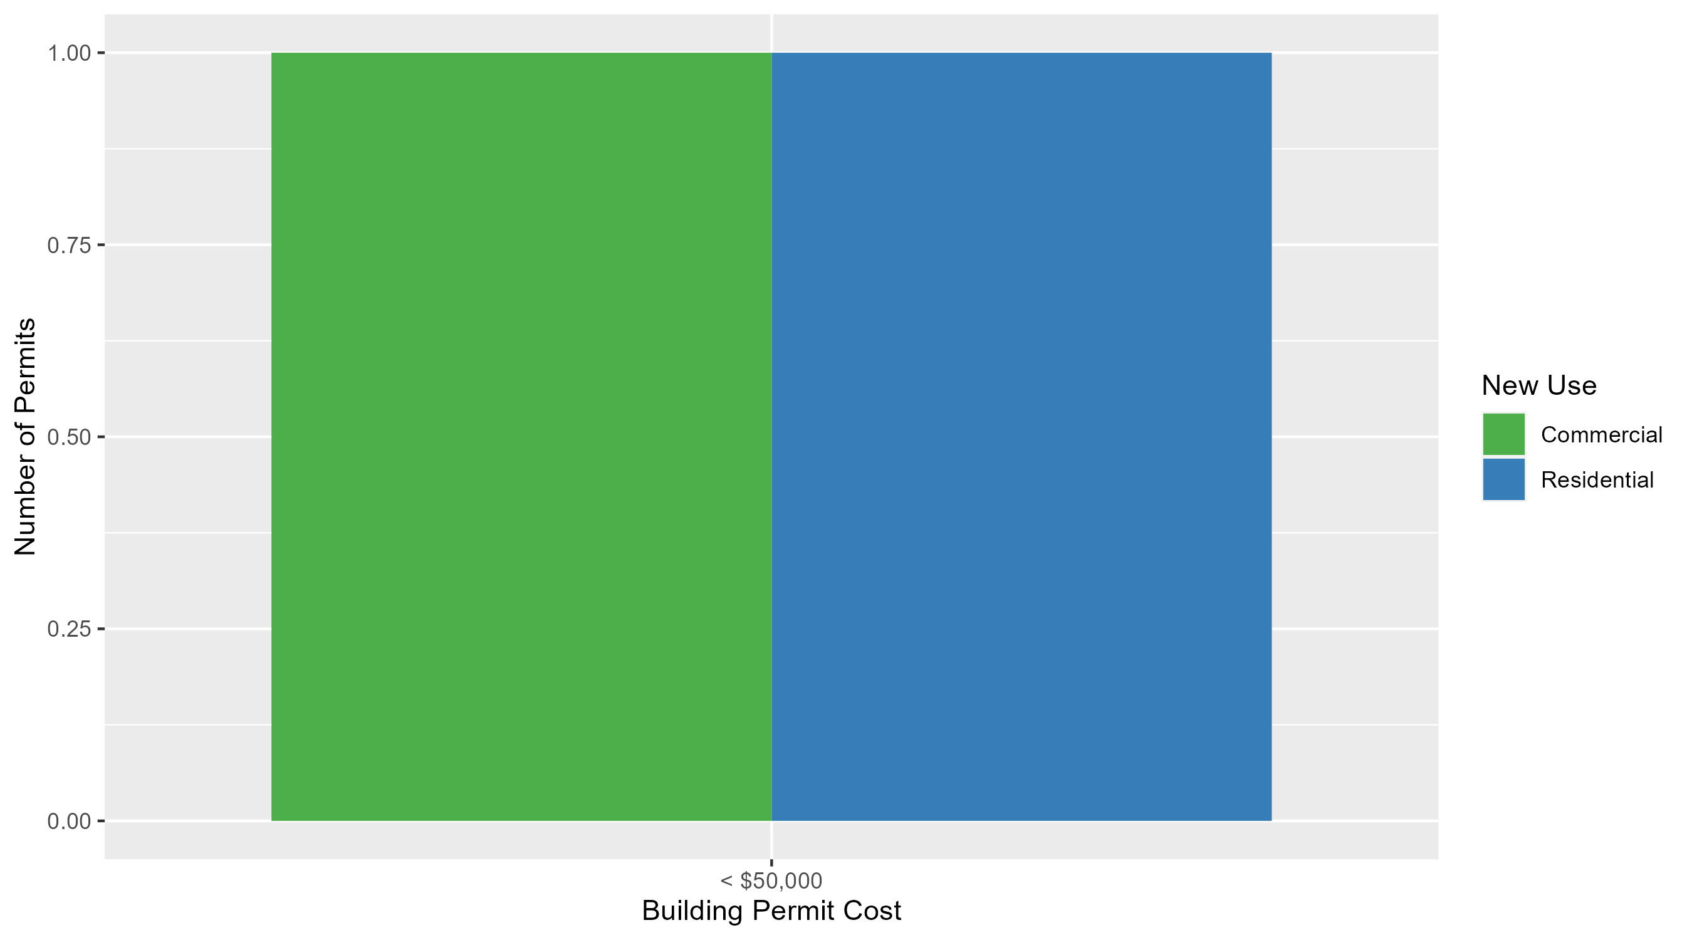
Lewis Place Permit Cost Breakdown

Slide 48
Additional Notes
Data retreived from https://www.stlouis-mo.gov/data/
Building permits with a cost of $0 were dropped
Building permits that were cancelled were dropped
Infinite change indicates 0 permits in the current or previous time period/comparison month so there was a overall increase or decrease

