Slide 1
St. Louis Central Corridor West Building Permits
Monthly Report: April 2025

Slide 2
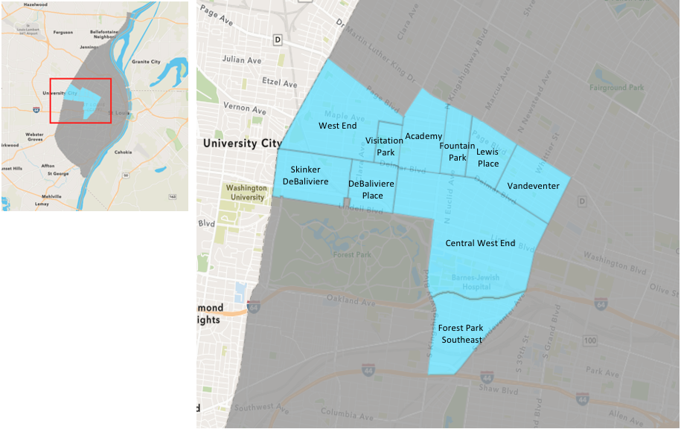
St. Louis Neighborhood Spatial Reference

Slide 3
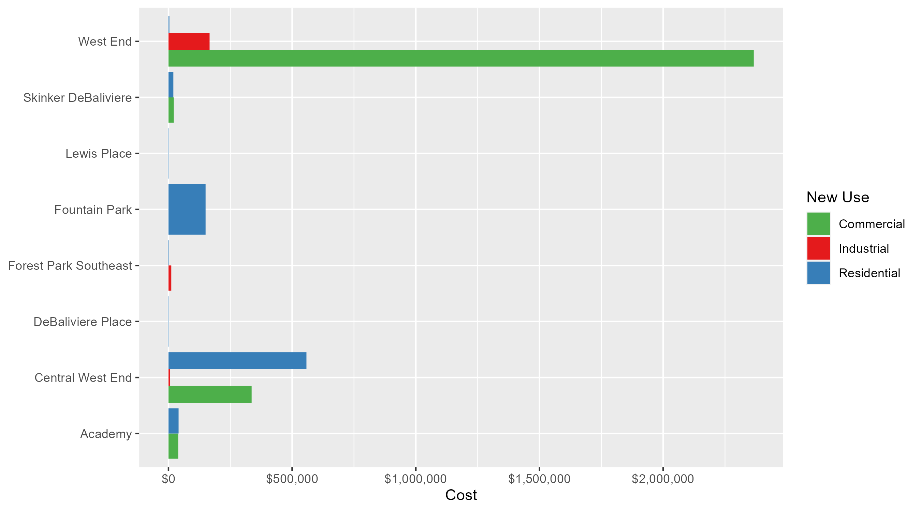
Neighborhood Summary: Average Building Permit Cost

Slide 4
Neighborhood Summary
April 2025 | April 2025 | April 2025 | April 2025
Neighborhood | Average Cost | # of Permits | Total Value of Permits
Academy | $40,333.33 | 3 | $121,000
Central West End | $451,395.35 | 26 | $11,736,279
DeBaliviere Place | $1,000.00 | 1 | $1,000
Forest Park Southeast | $8,300.00 | 3 | $24,900
Fountain Park | $150,000.00 | 1 | $150,000
Lewis Place | $1,000.00 | 2 | $2,000
Skinker DeBaliviere | $20,078.20 | 10 | $200,782
Vandeventer | $0.00 | 0 | $0
Visitation Park | $0.00 | 0 | $0
West End | $964,980.37 | 10 | $9,649,804
Last 6 Months | Last 6 Months | Last 6 Months | Last 6 Months
Neighborhood | Average Cost | # of Permits | Total Value of Permits
Academy | $26,764.71 | 17 | $455,000
Central West End | $219,299.71 | 196 | $42,982,743
DeBaliviere Place | $56,007.75 | 24 | $1,344,186
Forest Park Southeast | $153,940.17 | 36 | $5,541,846
Fountain Park | $60,225.00 | 8 | $481,800
Lewis Place | $17,714.29 | 7 | $124,000
Skinker DeBaliviere | $80,569.77 | 60 | $4,834,186
Vandeventer | $32,500.00 | 7 | $227,500
Visitation Park | $48,070.50 | 4 | $192,282
West End | $394,458.29 | 33 | $13,017,124

Slide 5
Core Neighborhoods

Slide 6
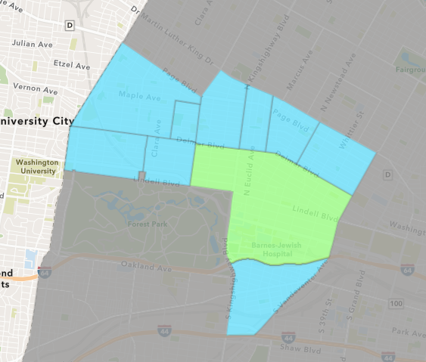
Central West End
April 2025 Neighborhood Cost Breakdown
  Mean: $451,395
  Median: $10,000
  Range: $1,000 - $8,200,000

Slide 7
Central West End: Summary Notes
26 building permits in April 2025
  -35.00% change compared to April 2024 (40 total building permits)
  $451,395: Average building permit cost in April 2025
    183.67% change compared to April 2024 ($159,128)
91 total building permits in 2025
  -19.47% change YTD compared to this time in 2024 (113 total building permits)
  $226,840: YTD average building permit cost in 2025
    -63.50% change YTD compared to this time in 2024 ($621,468)

Slide 8
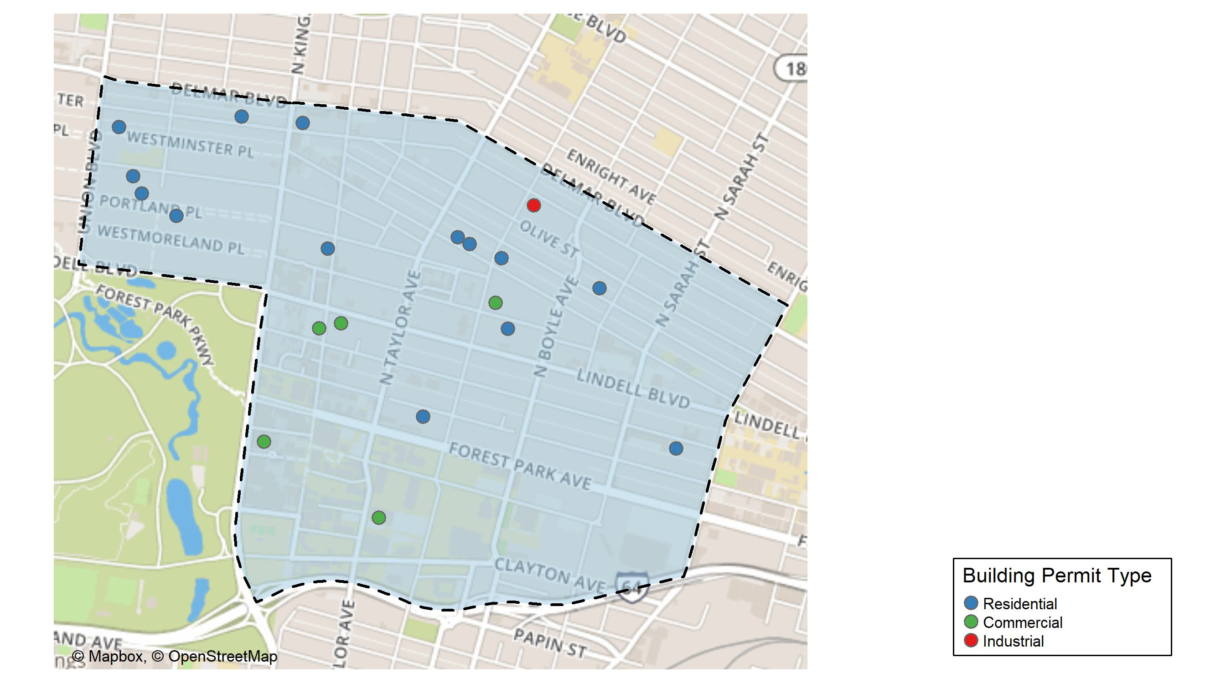
Central West End

Slide 9
Neighborhood Summary
April 2025 | April 2025 | April 2025 | April 2025
Permit Use | Average Cost | # of Permits | Total Value of Permits
Commercial | $336,138.2 | 10 | $3,361,382
Industrial | $7,000.0 | 1 | $7,000
Residential | $557,859.8 | 15 | $8,367,897
Last 6 Months | Last 6 Months | Last 6 Months | Last 6 Months
Permit Use | Average Cost | # of Permits | Total Value of Permits
Commercial | $378,938.0 | 68 | $25,767,783
Industrial | $632,187.0 | 5 | $3,160,935
Residential | $114,260.4 | 123 | $14,054,025

Slide 10
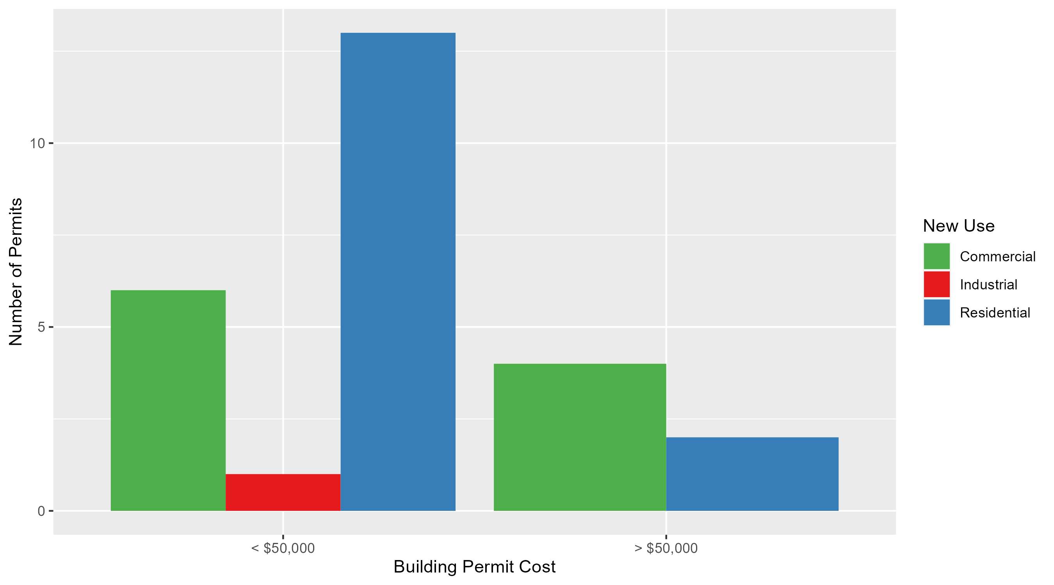
Central West End Permit Cost Breakdown

Slide 11
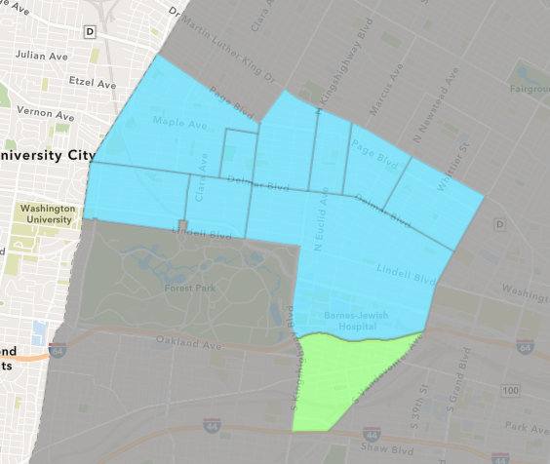
Forest Park Southeast
April 2025 Neighborhood Cost Breakdown
  Mean: $8,300
  Median: $10,000
  Range: $2,000 - $12,900

Slide 12
Forest Park Southeast: Summary Notes
3 building permits in April 2025
  50.00% change compared to April 2024 (2 total building permits)
  $8,300: Average building permit cost in April 2025
    -94.23% change compared to April 2024 ($143,950)
15 total building permits in 2025
  -42.31% change YTD compared to this time in 2024 (26 total building permits)
  $52,138: YTD average building permit cost in 2025
    -42.82% change YTD compared to this time in 2024 ($91,176)

Slide 13
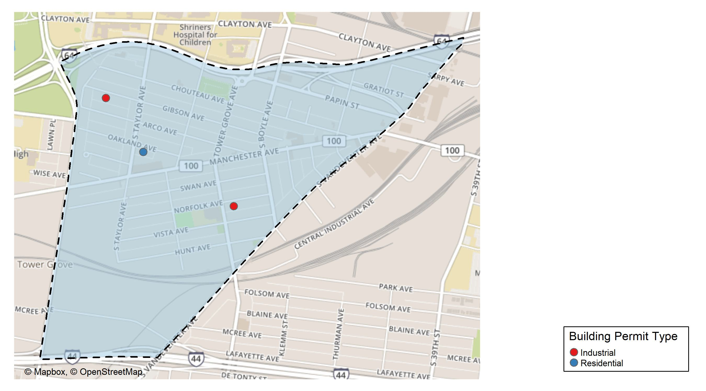
Forest Park Southeast

Slide 14
Neighborhood Summary
April 2025 | April 2025 | April 2025 | April 2025
Permit Use | Average Cost | # of Permits | Total Value of Permits
Commercial | $0 | 0 | $0
Industrial | $11,450 | 2 | $22,900
Residential | $2,000 | 1 | $2,000
Last 6 Months | Last 6 Months | Last 6 Months | Last 6 Months
Permit Use | Average Cost | # of Permits | Total Value of Permits
Commercial | $69,736.4 | 5 | $348,682
Industrial | $23,160.0 | 5 | $115,800
Residential | $195,283.2 | 26 | $5,077,364

Slide 15
Forest Park Southeast Individual Permit Breakdown
Neighborhood | Owner | New Use | Cost | address
Forest Park Southeast | RENARD PROPERTIES LLC | Residential | $2,000 | 4454 OAKLAND AV
Forest Park Southeast | BLUESTAR HOLDINGS LLC | Industrial | $12,900 | 4550 GIBSON AV
Forest Park Southeast | NEILSON, NATHAN A & JOSHUA D NORDMAN | Industrial | $10,000 | 4256 NORFOLK AV

Slide 16
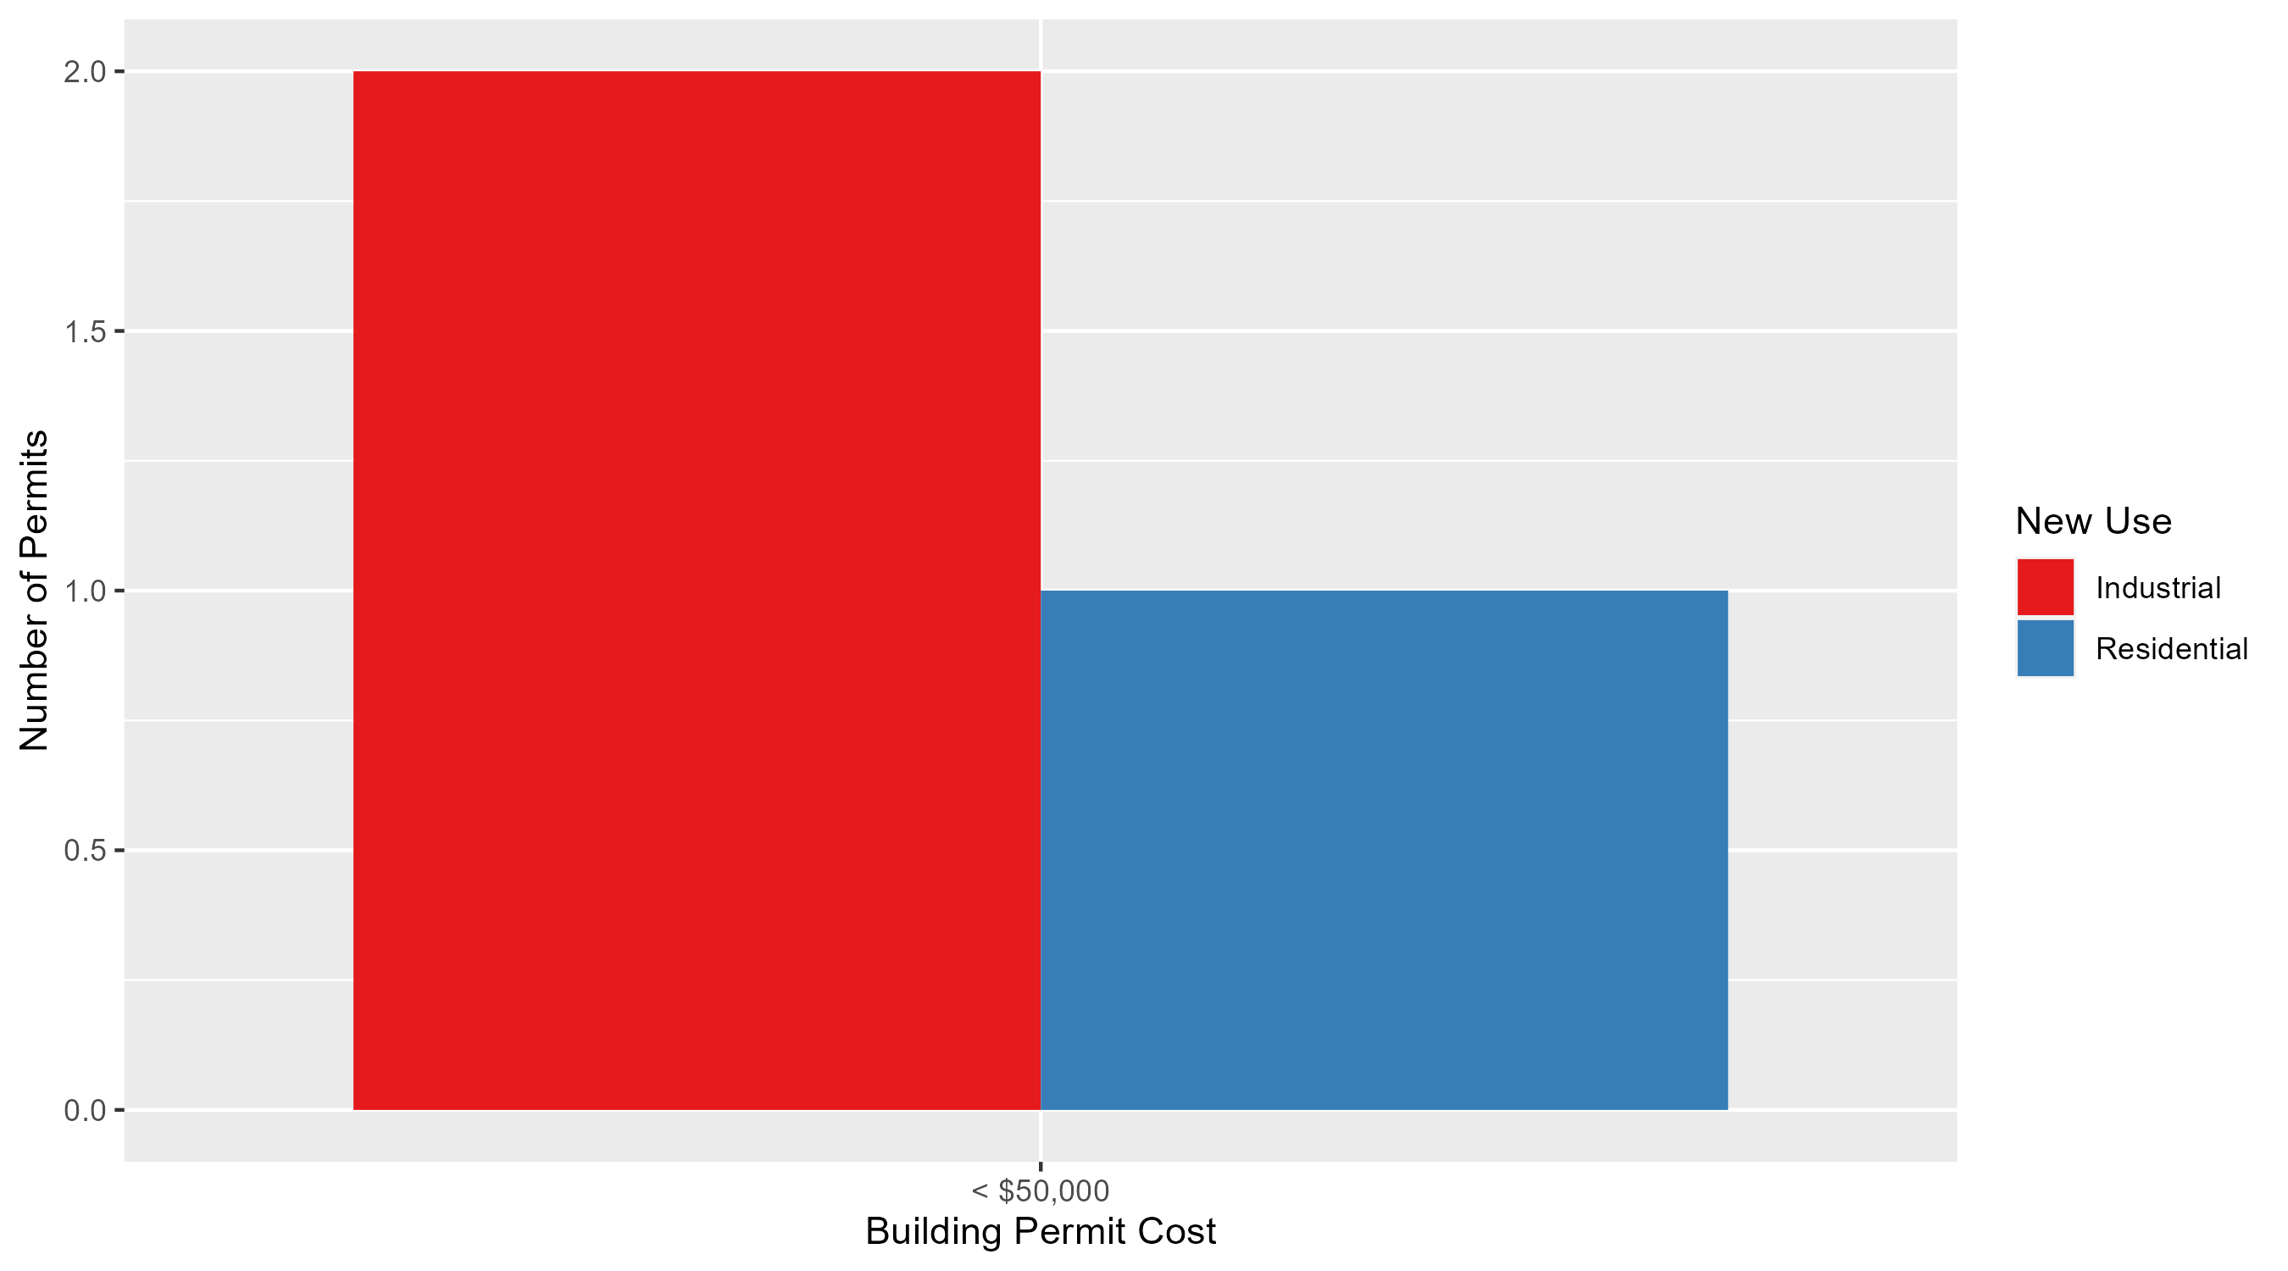
Forest Park Southeast Permit Cost Breakdown

Slide 17
Expanded Service Area

Slide 18
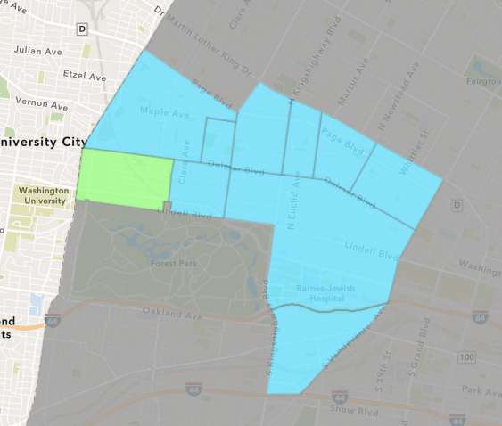
Skinker DeBaliviere
April 2025 Neighborhood Cost Breakdown
  Mean: $20,078
  Median: $13,347
  Range: $750 - $75,000

Slide 19
Skinker DeBaliviere: Summary Notes
10 building permits in April 2025
  11.11% change compared to April 2024 (9 total building permits)
  $20,078: Average building permit cost in April 2025
    -89.30% change compared to April 2024 ($187,694)
32 total building permits in 2025
  60.00% change YTD compared to this time in 2024 (20 total building permits)
  $48,460: YTD average building permit cost in 2025
    -66.00% change YTD compared to this time in 2024 ($142,516)

Slide 20
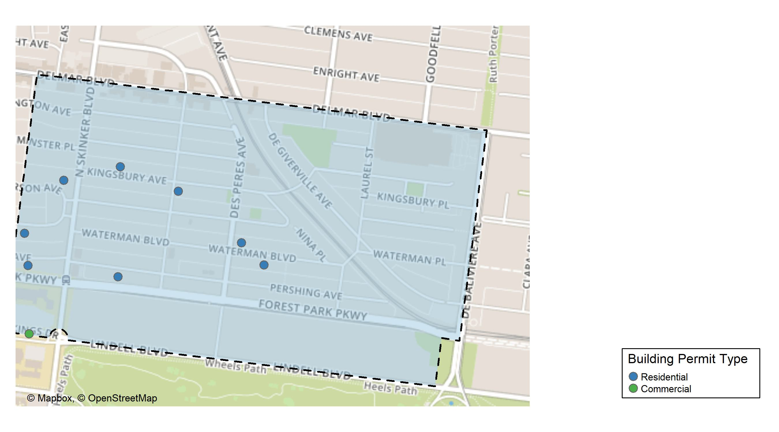
Skinker DeBaliviere

Slide 21
Neighborhood Summary
April 2025 | April 2025 | April 2025 | April 2025
Permit Use | Average Cost | # of Permits | Total Value of Permits
Commercial | $21,169.50 | 2 | $42,339
Industrial | $0.00 | 0 | $0
Residential | $19,805.38 | 8 | $158,443
Last 6 Months | Last 6 Months | Last 6 Months | Last 6 Months
Permit Use | Average Cost | # of Permits | Total Value of Permits
Commercial | $161,394.5 | 11 | $1,775,339
Industrial | $12,125.0 | 4 | $48,500
Residential | $66,896.6 | 45 | $3,010,347

Slide 22
Skinker DeBaliviere Individual Permit Breakdown
Neighborhood | Owner | New Use | Cost | address
Skinker DeBaliviere | WASHINGTON UNIVERSITY ART BUILDING | Commercial | $32,680 | 1 BROOKINGS DR
Skinker DeBaliviere | WASHINGTON UNIVERSITY ART BUILDING | Commercial | $9,659 | 1 BROOKINGS DR
Skinker DeBaliviere | BRIDGES, BERTHA A | Residential | $12,703 | 5924 WATERMAN BLVD
Skinker DeBaliviere | DODSON, WILLIAM E & KAREN L | Residential | $26,999 | 6248 WATERMAN BLVD
Skinker DeBaliviere | LIPPI, CORA JEANNE TRS | Residential | $75,000 | 6238 PERSHING AV
Skinker DeBaliviere | SHIELDS, JIMMIE L & SINDIA L | Residential | $4,000 | 6062 KINGSBURY AV
Skinker DeBaliviere | SCHENCK, SANFORD & KATHLEEN | Residential | $13,991 | 6211 MCPHERSON AV
Skinker DeBaliviere | ATWT PERSHING LLC | Residential | $750 | 5955 WATERMAN BLVD
Skinker DeBaliviere | GAVIN, RYAN J & DEANNE N HARRIS | Residential | $18,000 | 6161 KINGSBURY AV
Skinker DeBaliviere | GILBERT, TERRI L | Residential | $7,000 | 6144 PERSHING AV

Slide 23
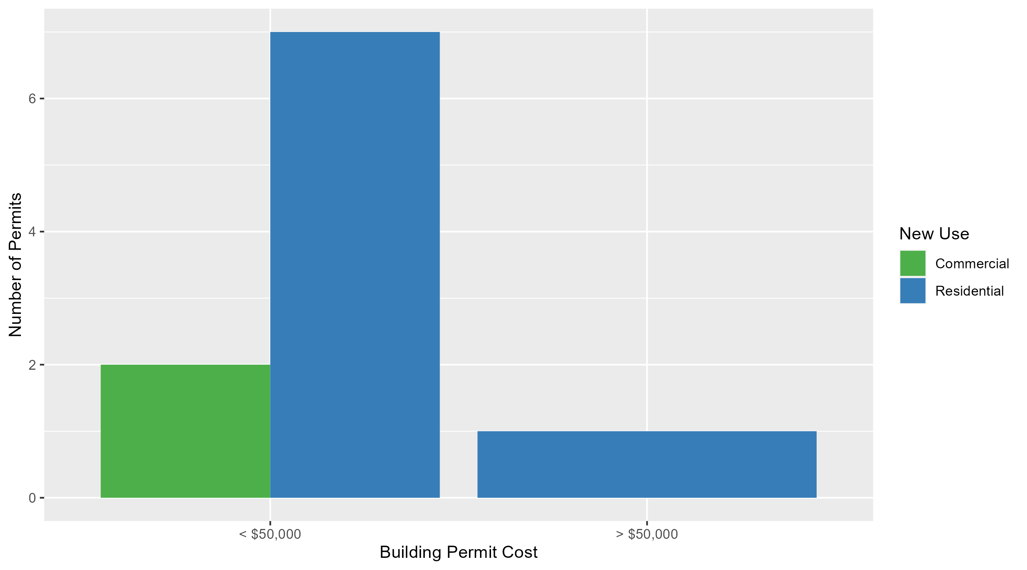
Skinker DeBaliviere Permit Cost Breakdown

Slide 24
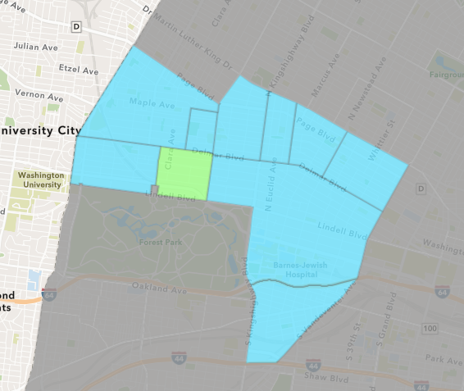
DeBaliviere Place
April 2025 Neighborhood Cost Breakdown
  Mean: $1,000
  Median: $1,000
  Range: $1,000 - $1,000

Slide 25
DeBaliviere Place: Summary Notes
1 building permits in April 2025
  -80.00% change compared to April 2024 (5 total building permits)
  $1,000: Average building permit cost in April 2025
    -98.56% change compared to April 2024 ($69,400)
13 total building permits in 2025
  -7.14% change YTD compared to this time in 2024 (14 total building permits)
  $60,187: YTD average building permit cost in 2025
    6.65% change YTD compared to this time in 2024 ($56,434)

Slide 26
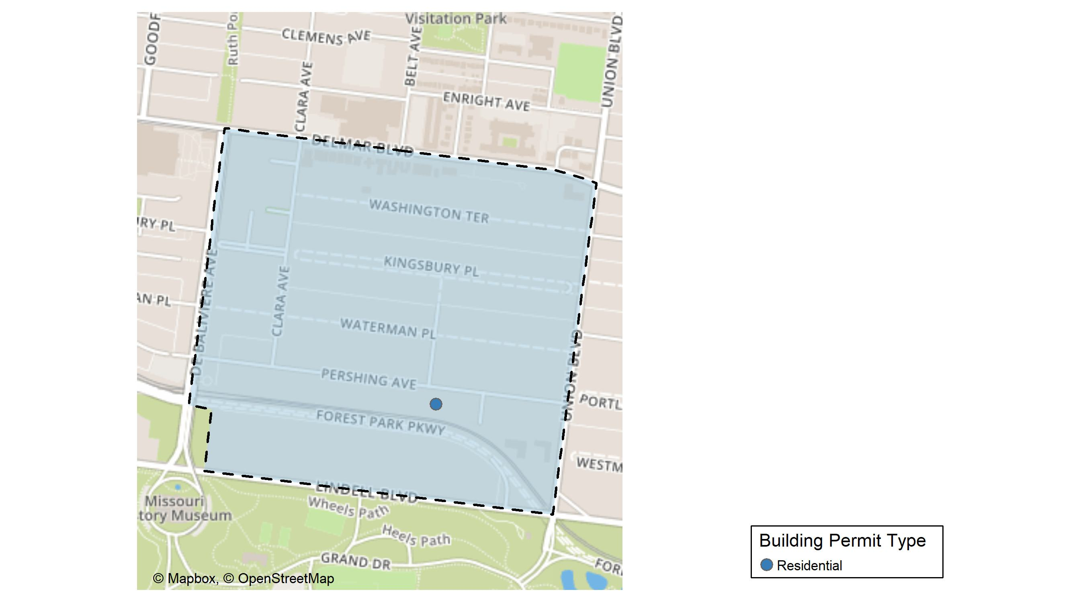
DeBaliviere Place

Slide 27
Neighborhood Summary
April 2025 | April 2025 | April 2025 | April 2025
Permit Use | Average Cost | # of Permits | Total Value of Permits
Commercial | $0 | 0 | $0
Industrial | $0 | 0 | $0
Residential | $1,000 | 1 | $1,000
Last 6 Months | Last 6 Months | Last 6 Months | Last 6 Months
Permit Use | Average Cost | # of Permits | Total Value of Permits
Commercial | $2,100.00 | 2 | $4,200
Industrial | $0.00 | 0 | $0
Residential | $60,908.45 | 22 | $1,339,986

Slide 28
DeBaliviere Place Individual Permit Breakdown
Neighborhood | Owner | New Use | Cost | address
DeBaliviere Place | BRENTWOOD PARTNERS LLC | Residential | $1,000 | 5394 PERSHING AV

Slide 29
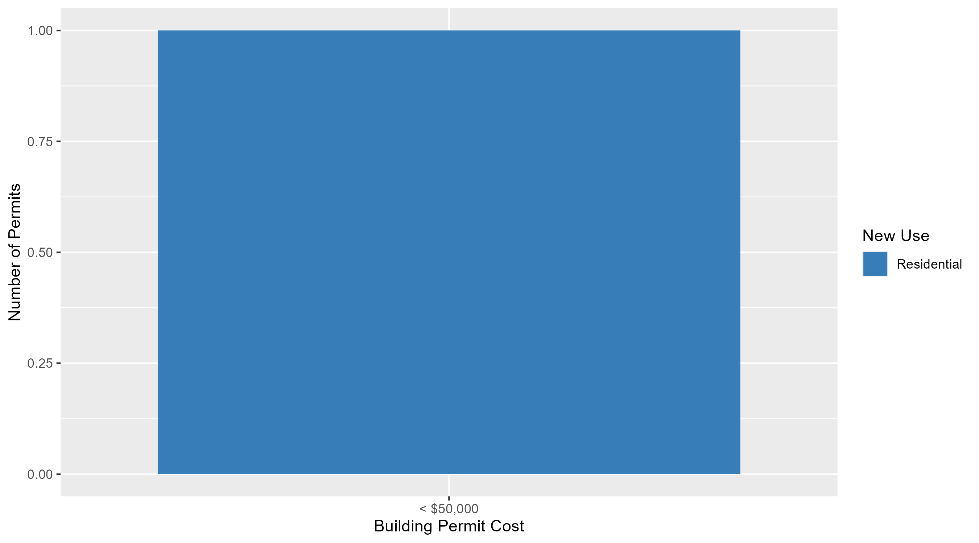
DeBaliviere Place Permit Cost Breakdown

Slide 30
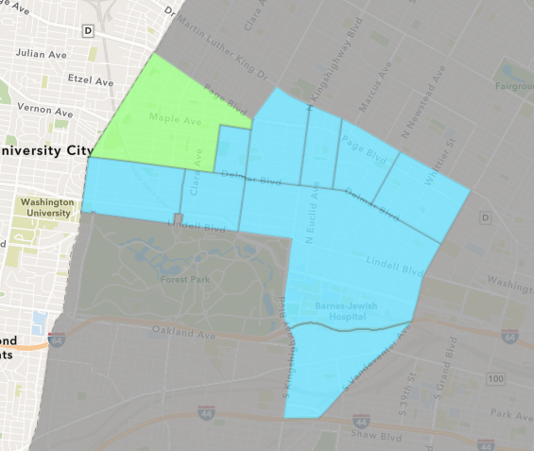
West End
April 2025 Neighborhood Cost Breakdown
  Mean: $964,980
  Median: $5,581
  Range: $1,500 - $9,000,000

Slide 31
West End: Summary Notes
10 building permits in April 2025
  66.67% change compared to April 2024 (6 total building permits)
  $964,980: Average building permit cost in April 2025
    443.76% change compared to April 2024 ($177,464)
21 total building permits in 2025
  -27.59% change YTD compared to this time in 2024 (29 total building permits)
  $533,204: YTD average building permit cost in 2025
    281.15% change YTD compared to this time in 2024 ($139,893)

Slide 32
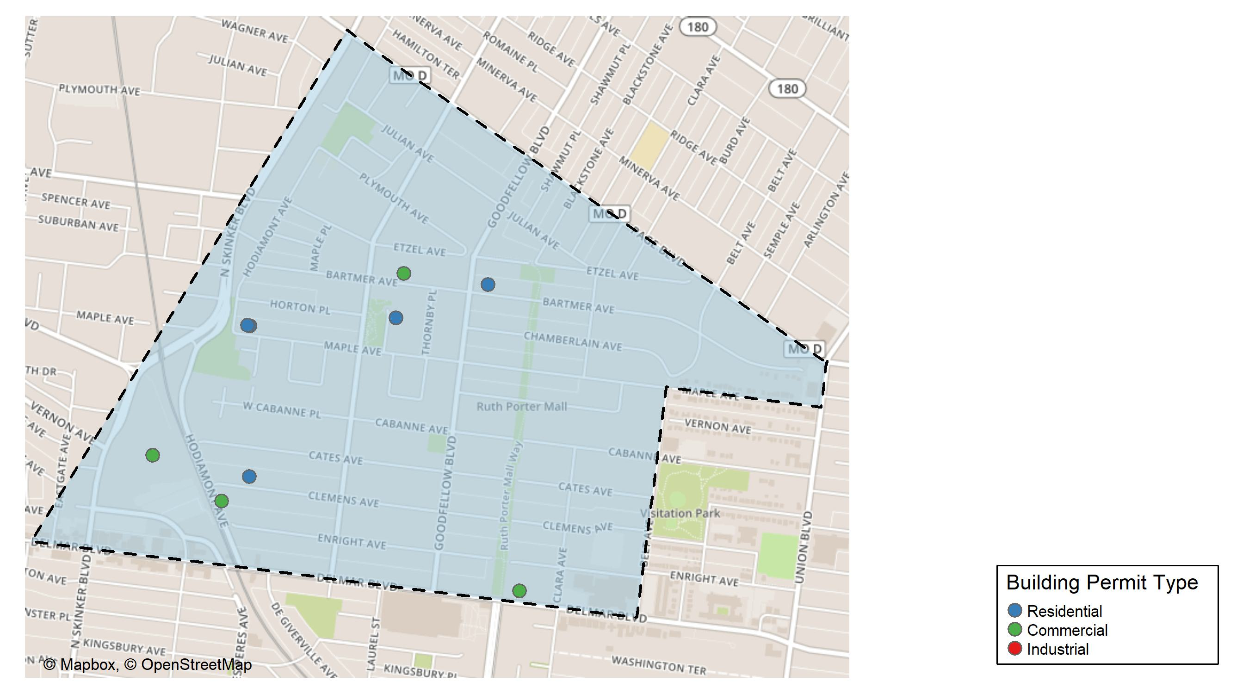
West End

Slide 33
Neighborhood Summary
April 2025 | April 2025 | April 2025 | April 2025
Permit Use | Average Cost | # of Permits | Total Value of Permits
Commercial | $2,366,250.000 | 4 | $9,465,000.00
Industrial | $166,141.000 | 1 | $166,141.00
Residential | $3,732.536 | 5 | $18,662.68
Last 6 Months | Last 6 Months | Last 6 Months | Last 6 Months
Permit Use | Average Cost | # of Permits | Total Value of Permits
Commercial | $1,512,362.57 | 7 | $10,586,538.0
Industrial | $384,464.60 | 5 | $1,922,323.0
Residential | $24,202.98 | 21 | $508,262.7

Slide 34
West End Individual Permit Breakdown
Neighborhood | Owner | New Use | Cost | address
West End | BETTY JEAN KERR PEOPLES HEALTH CNTRS | Commercial | $9,000,000 | 5635 DELMAR BLVD
West End | WASHINGTON UNIVERSITY | Industrial | $166,141 | 700 ROSEDALE AV
West End | HOPE HEALING WORSHIP CENTER | Commercial | $13,000 | 5869 BARTMER AV
West End | WASHINGTON UNIVERSITY | Commercial | $450,000 | 700 ROSEDALE AV
West End | JACOBSON, SANDRA L | Residential | $3,000 | 6049 MAPLE AV
West End | JACOBSON, SANDRA L | Residential | $3,000 | 6051 MAPLE AV
West End | BRICE,F MEDELEINE E & DALE L | Residential | $5,163 | 6023 CLEMENS AV
West End | PITALE, ANTHONY & VERONICA ERB | Commercial | $2,000 | 774 HODIAMONT AV
West End | THOMAS, HAVYARIMANA & AGNES THOMAS | Residential | $6,000 | 5747 BARTMER AV
West End | FEDERAL NATIONAL MORTGAGE ASSOCIATIO | Residential | $1,500 | 14 PARKLAND PL

Slide 35
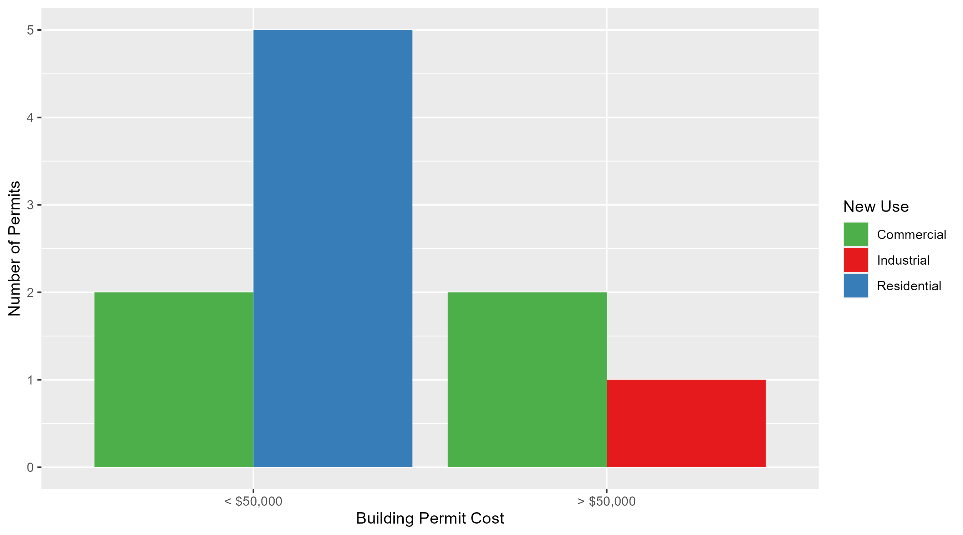
West End Permit Cost Breakdown

Slide 36
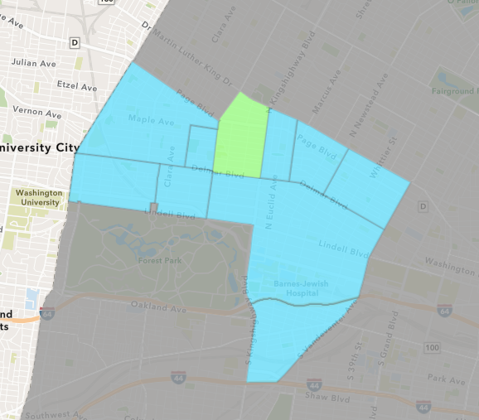
Academy
April 2025 Neighborhood Cost Breakdown
  Mean: $40,333
  Median: $39,400
  Range: $1,600 - $80,000

Slide 37
Academy: Summary Notes
3 building permits in April 2025
  200.00% change compared to April 2024 (1 total building permits)
  $40,333: Average building permit cost in April 2025
    1244.44% change compared to April 2024 ($3,000)
12 total building permits in 2025
  71.43% change YTD compared to this time in 2024 (7 total building permits)
  $33,000: YTD average building permit cost in 2025
    65.95% change YTD compared to this time in 2024 ($19,886)

Slide 38
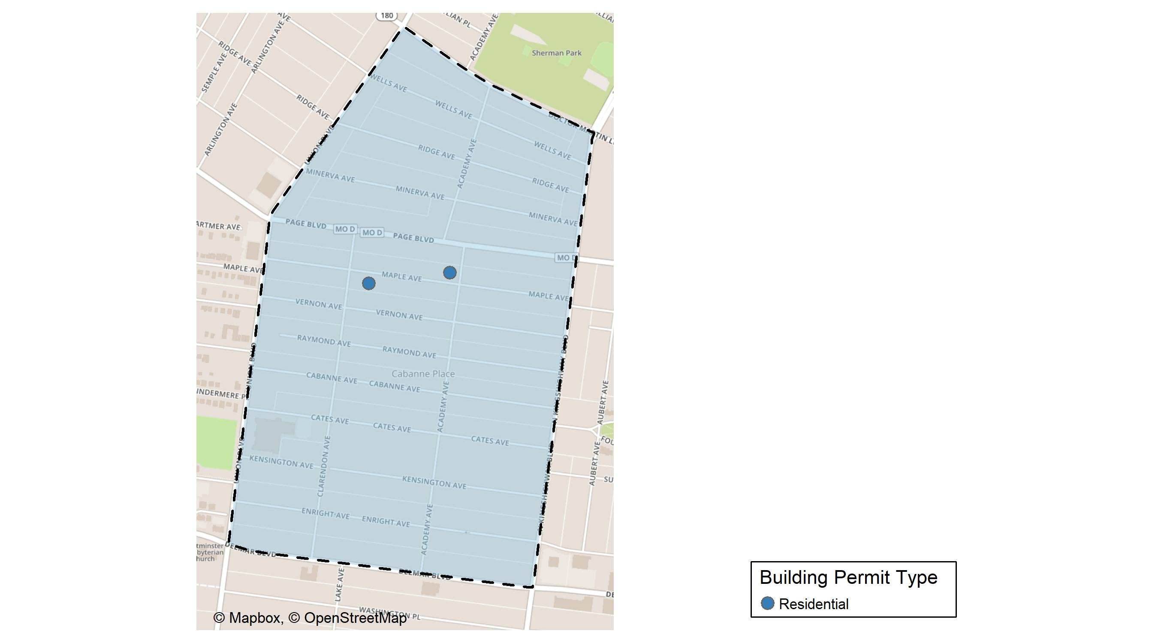
Academy

Slide 39
Neighborhood Summary
April 2025 | April 2025 | April 2025 | April 2025
Permit Use | Average Cost | # of Permits | Total Value of Permits
Commercial | $39,400 | 1 | $39,400
Industrial | $0 | 0 | $0
Residential | $40,800 | 2 | $81,600
Last 6 Months | Last 6 Months | Last 6 Months | Last 6 Months
Permit Use | Average Cost | # of Permits | Total Value of Permits
Commercial | $22,700.00 | 2 | $45,400
Industrial | $0.00 | 0 | $0
Residential | $27,306.67 | 15 | $409,600

Slide 40
Academy Individual Permit Breakdown
Neighborhood | Owner | New Use | Cost | address
Academy | BEATTY, SHARON | Residential | $80,000 | 5109 MAPLE AV
Academy | GOOD JOURNEY DEVELOPMENT FOUNDATION | Commercial | $39,400 | 5059 VERNON AV
Academy | JOHNSON, WILLIAM & GENEVA | Residential | $1,600 | 5180 MAPLE AV

Slide 41
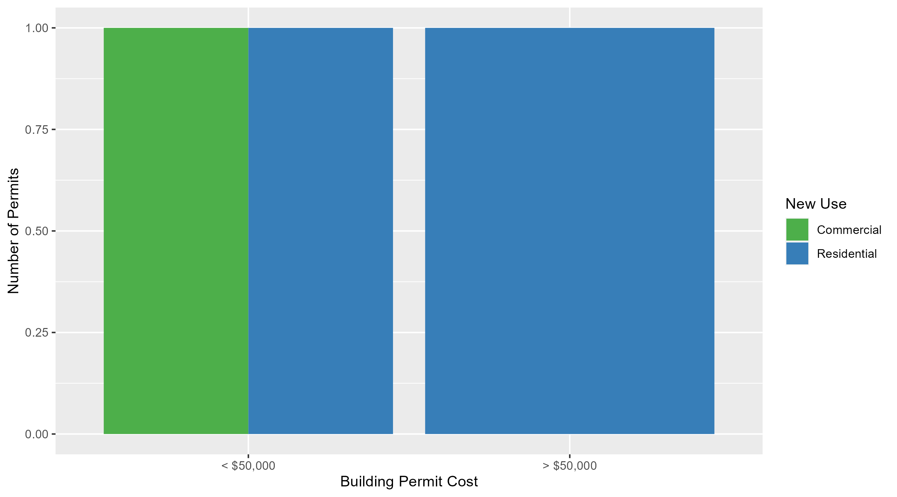
Academy Permit Cost Breakdown

Slide 42
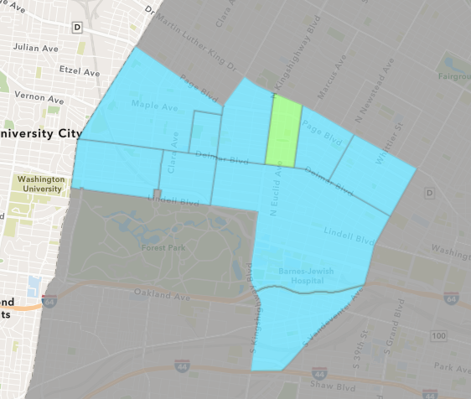
Fountain Park
April 2025 Neighborhood Cost Breakdown
  Mean: $150,000
  Median: $150,000
  Range: $150,000 - $150,000

Slide 43
Fountain Park: Summary Notes
1 building permits in April 2025
  Infinite change compared to April 2024 (0 total building permits)
  $150,000: Average building permit cost in April 2025
    Infinite change compared to April 2024 ($0)
3 total building permits in 2025
  -25.00% change YTD compared to this time in 2024 (4 total building permits)
  $62,267: YTD average building permit cost in 2025
    361.23% change YTD compared to this time in 2024 ($13,500)

Slide 44
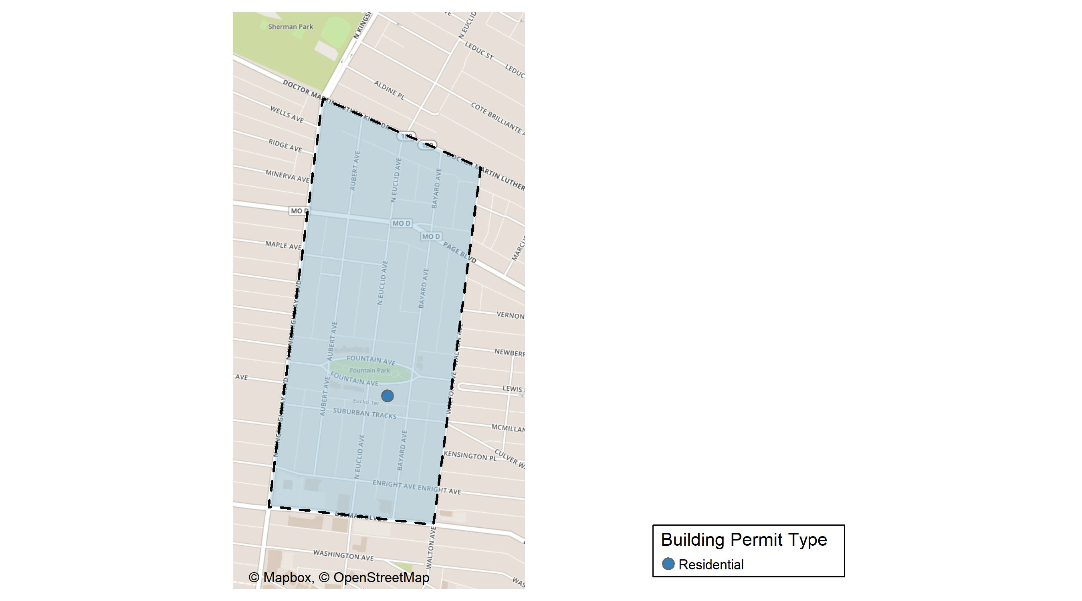
Fountain Park

Slide 45
Neighborhood Summary
April 2025 | April 2025 | April 2025 | April 2025
Permit Use | Average Cost | # of Permits | Total Value of Permits
Commercial | $0 | 0 | $0
Industrial | $0 | 0 | $0
Residential | $150,000 | 1 | $150,000
Last 6 Months | Last 6 Months | Last 6 Months | Last 6 Months
Permit Use | Average Cost | # of Permits | Total Value of Permits
Commercial | $57,000 | 3 | $171,000
Industrial | $0 | 0 | $0
Residential | $62,160 | 5 | $310,800

Slide 46
Fountain Park Individual Permit Breakdown
Neighborhood | Owner | New Use | Cost | address
Fountain Park | KINGSWAY DEVELOPMENT LLC | Residential | $150,000 | 4860 FOUNTAIN AV

Slide 47

Fountain Park Permit Cost Breakdown

Slide 48
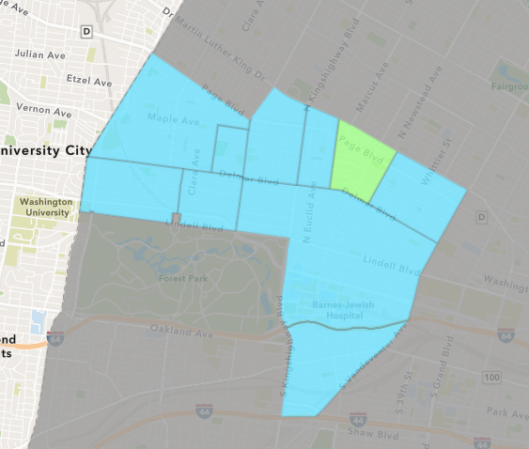
Lewis Place
April 2025 Neighborhood Cost Breakdown
  Mean: $1,000
  Median: $1,000
  Range: $1,000 - $1,000

Slide 49
Lewis Place: Summary Notes
2 building permits in April 2025
  0.00% change compared to April 2024 (2 total building permits)
  $1,000: Average building permit cost in April 2025
    -87.09% change compared to April 2024 ($7,746)
4 total building permits in 2025
  -20.00% change YTD compared to this time in 2024 (5 total building permits)
  $29,250: YTD average building permit cost in 2025
    497.13% change YTD compared to this time in 2024 ($4,898)

Slide 50
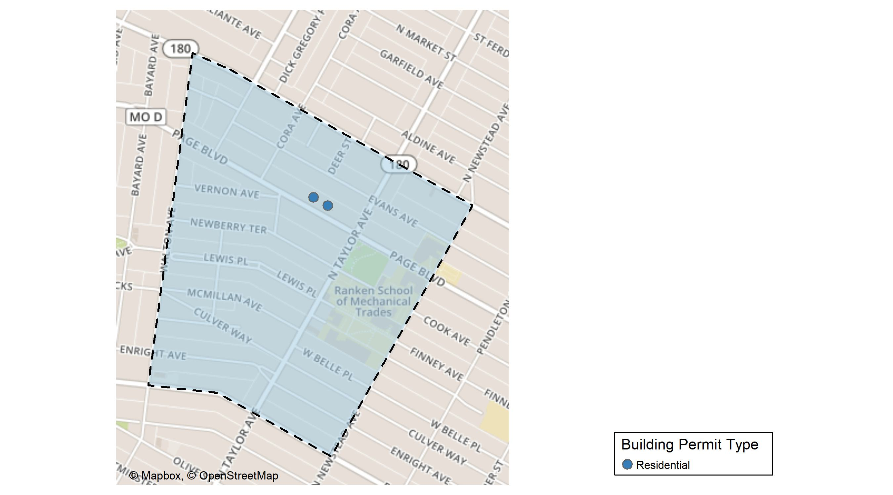
Lewis Place

Slide 51
Neighborhood Summary
April 2025 | April 2025 | April 2025 | April 2025
Permit Use | Average Cost | # of Permits | Total Value of Permits
Commercial | $0 | 0 | $0
Industrial | $0 | 0 | $0
Residential | $1,000 | 2 | $2,000
Last 6 Months | Last 6 Months | Last 6 Months | Last 6 Months
Permit Use | Average Cost | # of Permits | Total Value of Permits
Commercial | $4,500 | 1 | $4,500
Industrial | $1,500 | 1 | $1,500
Residential | $23,600 | 5 | $118,000

Slide 52
Lewis Place Individual Permit Breakdown
Neighborhood | Owner | New Use | Cost | address
Lewis Place | HOLMES, JANIE S | Residential | $1,000 | 4555-57 PAGE BLVD
Lewis Place | ETHRIDGE, LAUREN MICHELLE & | Residential | $1,000 | 4539 PAGE BLVD

Slide 53

Lewis Place Permit Cost Breakdown

Slide 54
Additional Notes
Data retreived from https://www.stlouis-mo.gov/data/
Building permits with a cost of $0 were dropped
Building permits that were cancelled were dropped
Infinite change indicates 0 permits in the current or previous time period/comparison month so there was a overall increase or decrease

