Slide 1
St. Louis Central Corridor West Building Permits
Monthly Report: December 2023

Slide 2
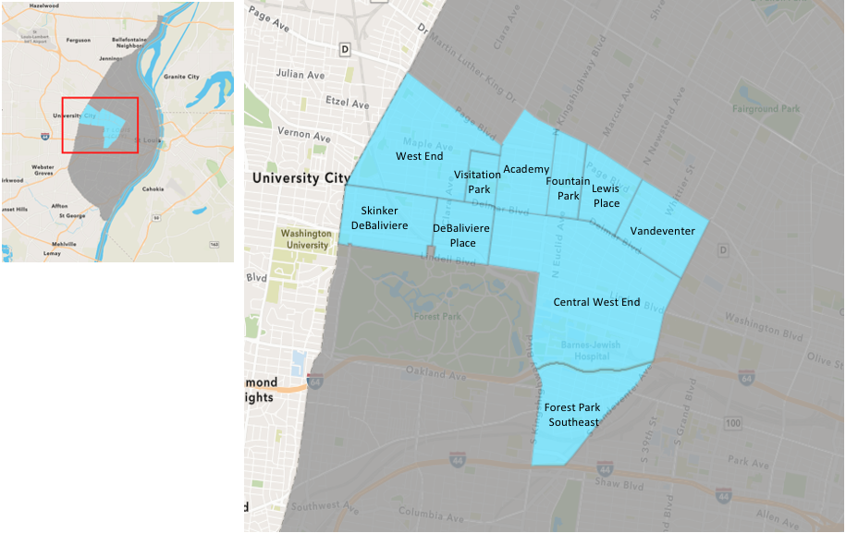
St. Louis Neighborhood Spatial Reference

Slide 3
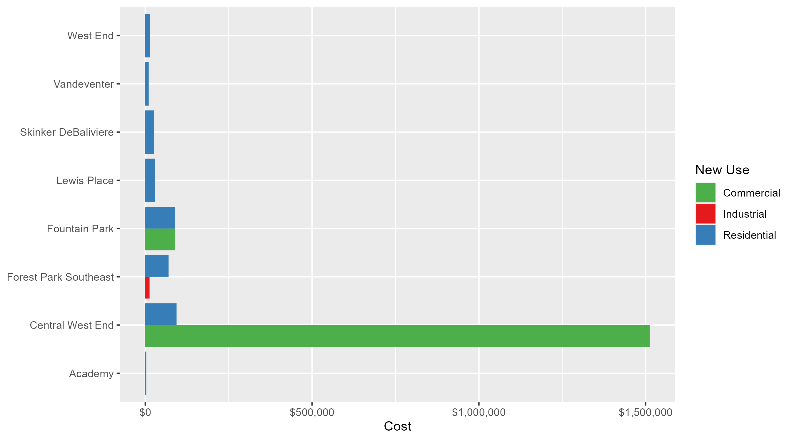
Neighborhood Summary: Average Building Permit Cost

Slide 4
Neighborhood Summary
December 2023 | December 2023 | December 2023 | December 2023
Neighborhood | Average Cost | # of Permits | Total Value of Permits
Academy | $3,000.0 | 2 | $6,000
Central West End | $619,199.3 | 27 | $16,718,382
DeBaliviere Place | $0.0 | 0 | $0
Forest Park Southeast | $62,800.0 | 8 | $502,400
Fountain Park | $90,000.0 | 2 | $180,000
Lewis Place | $29,101.0 | 2 | $58,202
Skinker DeBaliviere | $26,035.0 | 5 | $130,175
Vandeventer | $10,347.0 | 1 | $10,347
Visitation Park | $0.0 | 0 | $0
West End | $14,000.0 | 3 | $42,000
Last 6 Months | Last 6 Months | Last 6 Months | Last 6 Months
Neighborhood | Average Cost | # of Permits | Total Value of Permits
Academy | $27,990.63 | 19 | $531,822
Central West End | $156,830.40 | 215 | $33,718,535
DeBaliviere Place | $110,463.36 | 28 | $3,092,974
Forest Park Southeast | $81,931.28 | 47 | $3,850,770
Fountain Park | $192,340.00 | 11 | $2,115,740
Lewis Place | $62,956.17 | 6 | $377,737
Skinker DeBaliviere | $90,012.07 | 61 | $5,490,737
Vandeventer | $261,638.56 | 9 | $2,354,747
Visitation Park | $56,075.00 | 4 | $224,300
West End | $98,787.27 | 48 | $4,741,789

Slide 5
Core Neighborhoods

Slide 6
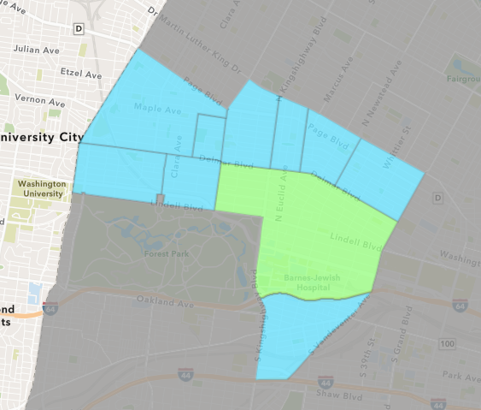
Central West End
December 2023 Neighborhood Cost Breakdown
  Mean: $619,199
  Median: $31,454
  Range: $3,000 - $7,683,000

Slide 7
Central West End: Summary Notes
27 building permits in December 2023
  -10.00% change compared to December 2022 (30 total building permits)
  $619,199: Average building permit cost in December 2023
    222.53% change compared to December 2022 ($191,982)
375 total building permits in 2023
  -0.53% change YTD compared to this time in 2022 (377 total building permits)
  $251,905: YTD average building permit cost in 2023
    -81.62% change YTD compared to this time in 2022 ($1,370,454)

Slide 8
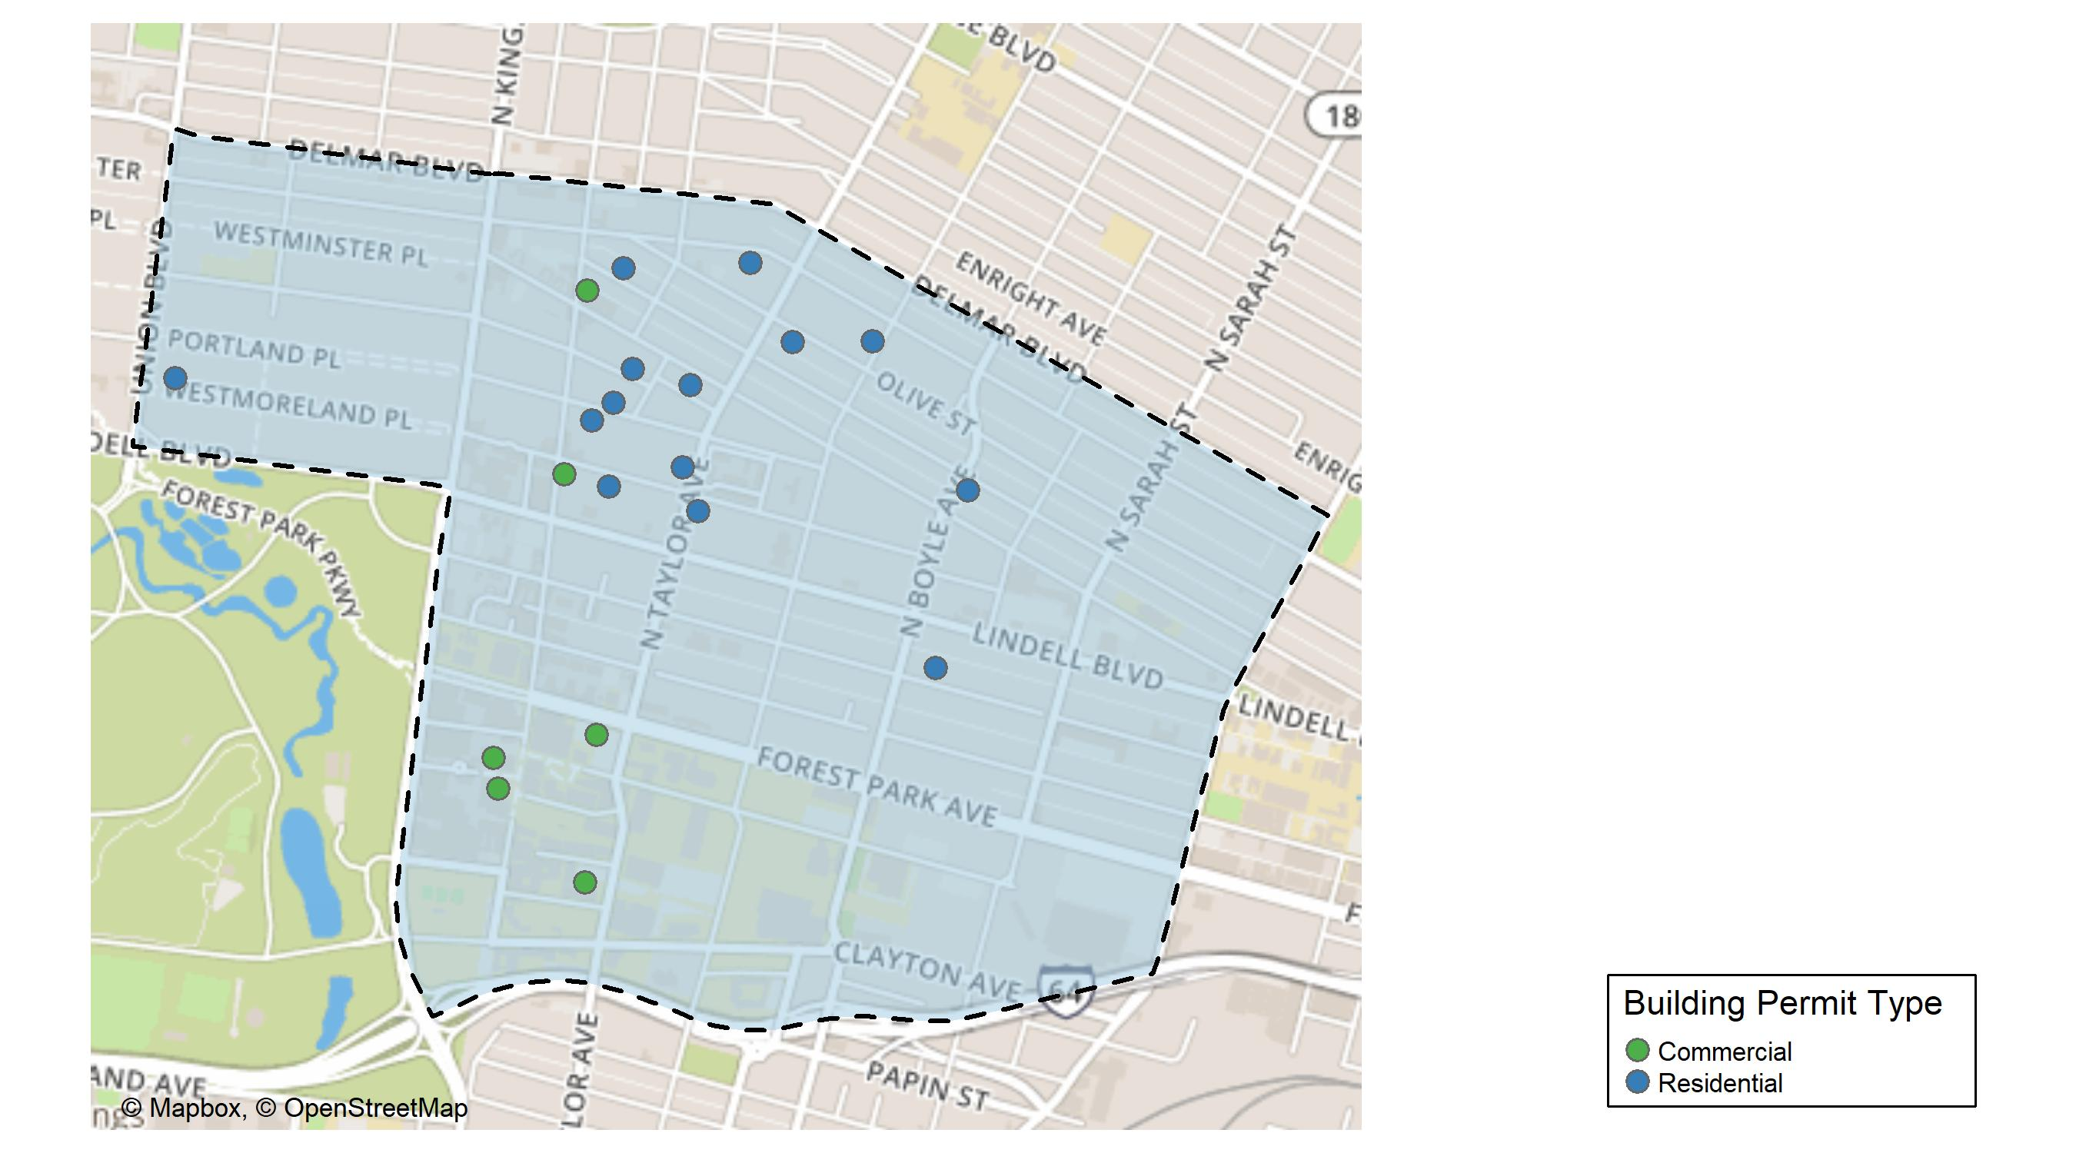
Central West End

Slide 9
Neighborhood Summary
December 2023 | December 2023 | December 2023 | December 2023
Permit Use | Average Cost | # of Permits | Total Value of Permits
Commercial | $1,512,235.20 | 10 | $15,122,352
Industrial | $0.00 | 0 | $0
Residential | $93,884.12 | 17 | $1,596,030
Last 6 Months | Last 6 Months | Last 6 Months | Last 6 Months
Permit Use | Average Cost | # of Permits | Total Value of Permits
Commercial | $346,667.11 | 80 | $27,733,369
Industrial | $19,950.00 | 4 | $79,800
Residential | $45,079.13 | 131 | $5,905,366

Slide 10
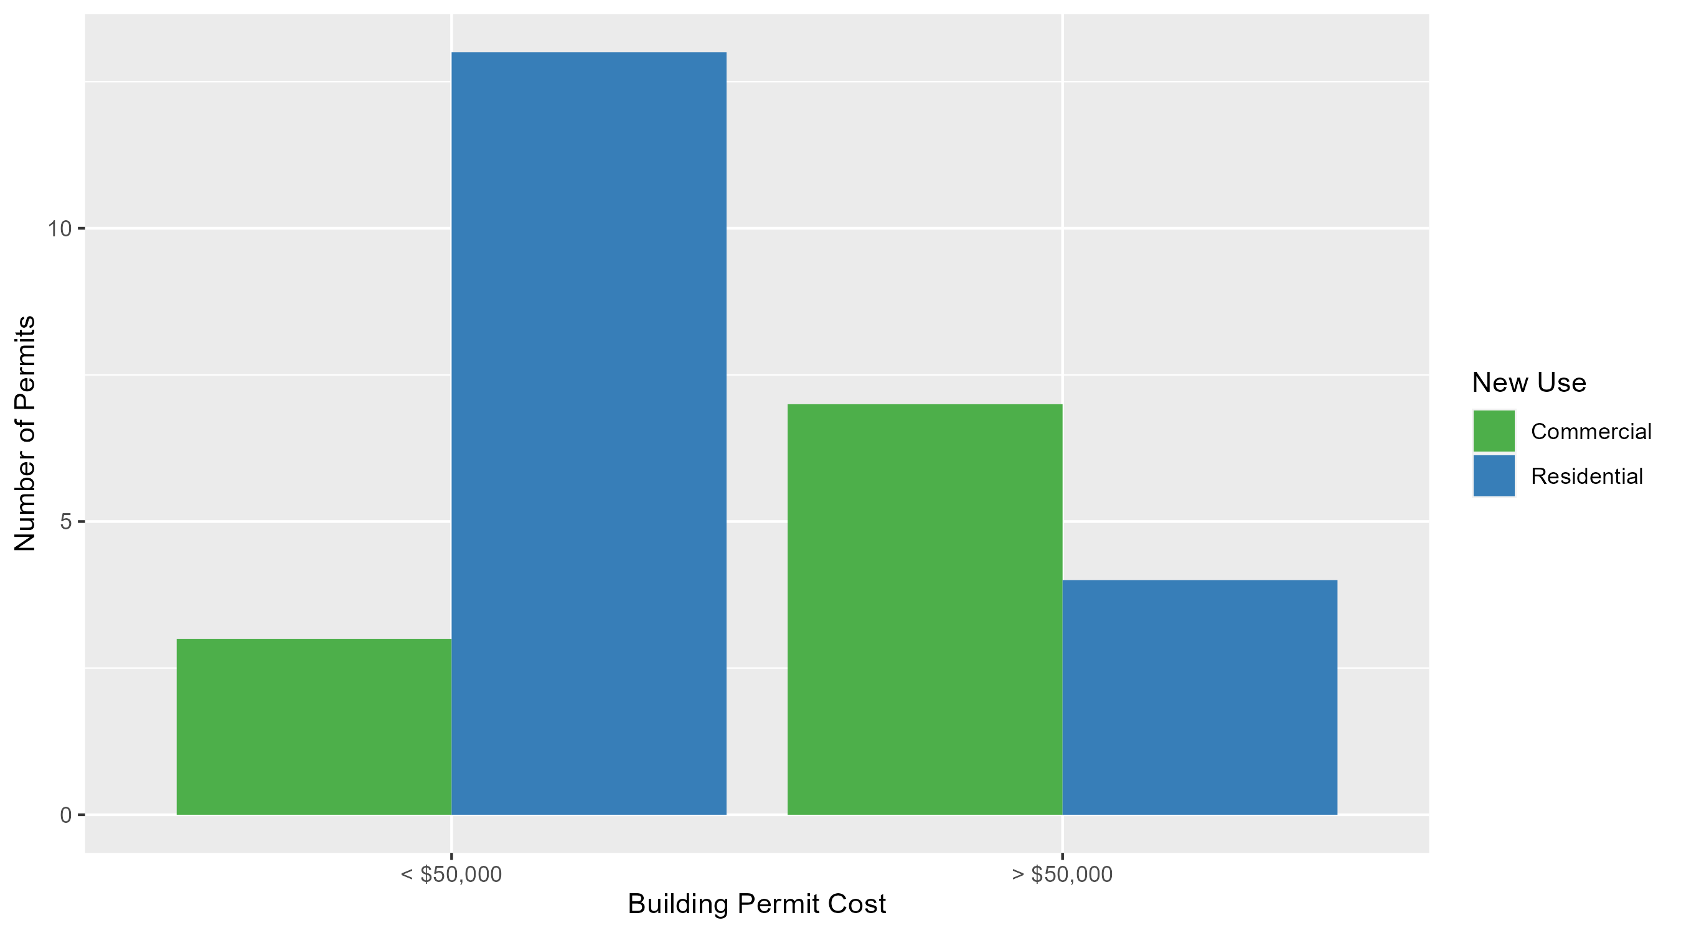
Central West End Permit Cost Breakdown

Slide 11
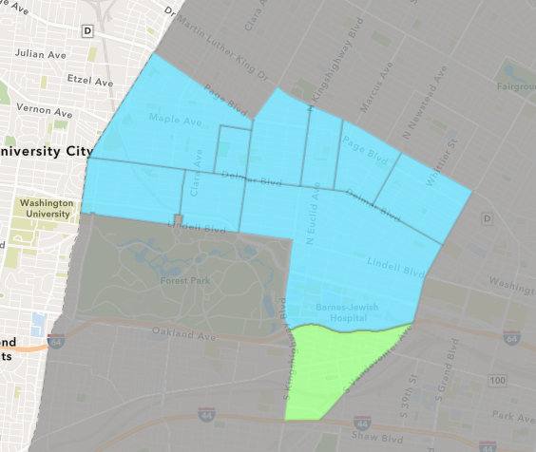
Forest Park Southeast
December 2023 Neighborhood Cost Breakdown
  Mean: $62,800
  Median: $9,950
  Range: $500 - $200,000

Slide 12
Forest Park Southeast: Summary Notes
8 building permits in December 2023
  -27.27% change compared to December 2022 (11 total building permits)
  $62,800: Average building permit cost in December 2023
    10.32% change compared to December 2022 ($56,925)
73 total building permits in 2023
  -51.33% change YTD compared to this time in 2022 (150 total building permits)
  $78,783: YTD average building permit cost in 2023
    -86.19% change YTD compared to this time in 2022 ($570,270)

Slide 13
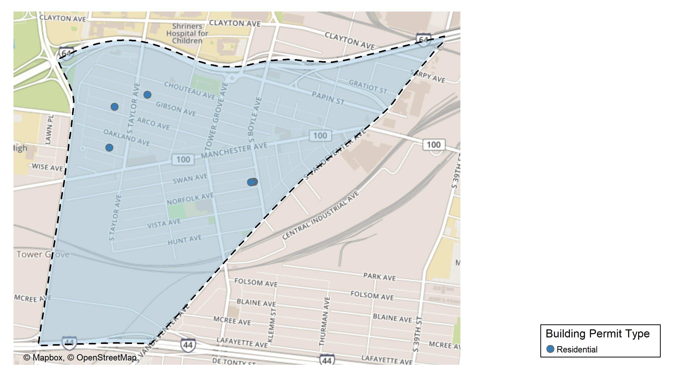
Forest Park Southeast

Slide 14
Neighborhood Summary
December 2023 | December 2023 | December 2023 | December 2023
Permit Use | Average Cost | # of Permits | Total Value of Permits
Commercial | $0.00 | 0 | $0
Industrial | $12,900.00 | 1 | $12,900
Residential | $69,928.57 | 7 | $489,500
Last 6 Months | Last 6 Months | Last 6 Months | Last 6 Months
Permit Use | Average Cost | # of Permits | Total Value of Permits
Commercial | $150,241.67 | 6 | $901,450
Industrial | $12,340.00 | 5 | $61,700
Residential | $80,211.67 | 36 | $2,887,620

Slide 15
Forest Park Southeast Individual Permit Breakdown
Neighborhood | Owner | New Use | Cost | address
Forest Park Southeast | JOLEN INVESTMENTS LLC | Residential | $200,000 | 4209 NORFOLK AV
Forest Park Southeast | PARK SOUTH PROPERTIES LLC | Residential | $7,000 | 4459 GIBSON AV
Forest Park Southeast | JOLEN INVESTMENTS LLC | Residential | $140,000 | 4207 NORFOLK AV
Forest Park Southeast | JOLEN INVESTMENTS LLC | Residential | $140,000 | 4205 NORFOLK AV
Forest Park Southeast | EYERWORKS GREENS LLC | Industrial | $12,900 | 4176 MANCHESTER AV
Forest Park Southeast | FRAILEY, SCOTT M & GANNA SHEYKO | Residential | $1,000 | 4529 ARCO AV
Forest Park Southeast | FRAILEY, SCOTT M & GANNA SHEYKO | Residential | $500 | 4529 ARCO AV
Forest Park Southeast | NEAL, DELORES C | Residential | $1,000 | 4527 WICHITA AV

Slide 16
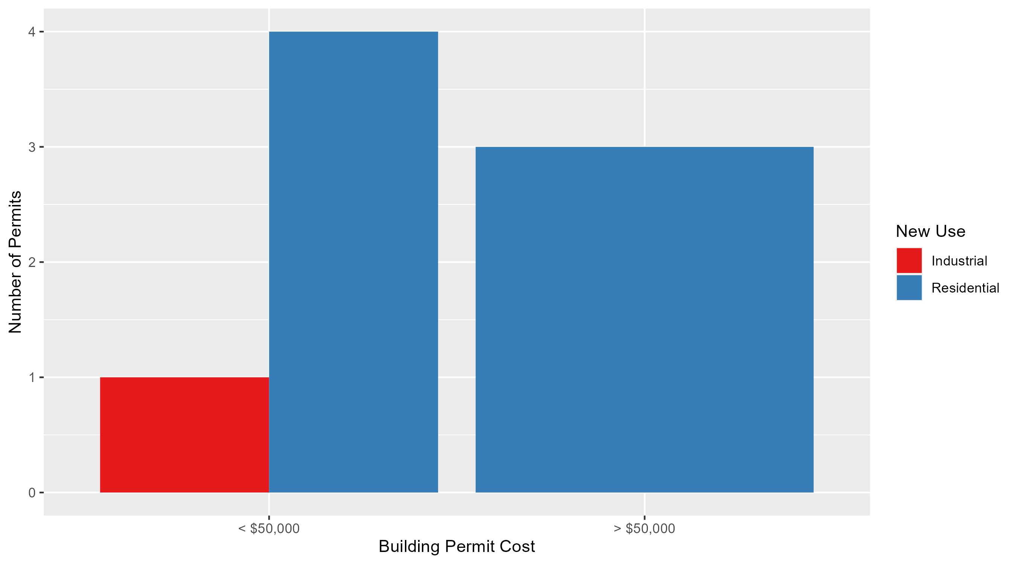
Forest Park Southeast Permit Cost Breakdown

Slide 17
Expanded Service Area

Slide 18
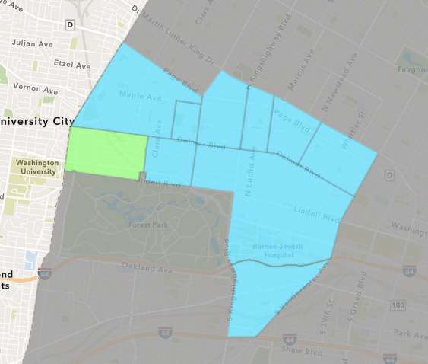
Skinker DeBaliviere
December 2023 Neighborhood Cost Breakdown
  Mean: $26,035
  Median: $20,000
  Range: $1,000 - $50,000

Slide 19
Skinker DeBaliviere: Summary Notes
5 building permits in December 2023
  25.00% change compared to December 2022 (4 total building permits)
  $26,035: Average building permit cost in December 2023
    -62.78% change compared to December 2022 ($69,953)
105 total building permits in 2023
  29.63% change YTD compared to this time in 2022 (81 total building permits)
  $81,136: YTD average building permit cost in 2023
    -29.13% change YTD compared to this time in 2022 ($114,482)

Slide 20
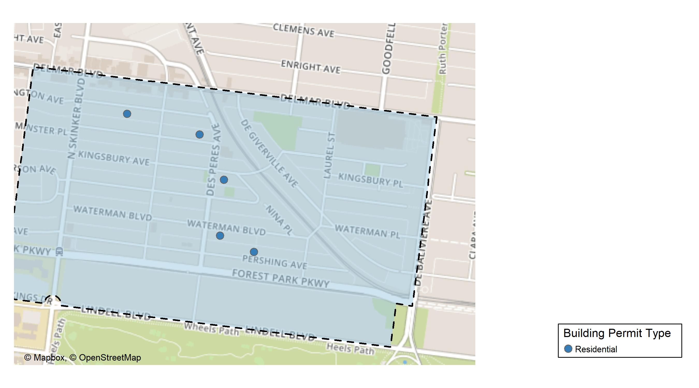
Skinker DeBaliviere

Slide 21
Neighborhood Summary
December 2023 | December 2023 | December 2023 | December 2023
Permit Use | Average Cost | # of Permits | Total Value of Permits
Commercial | $0 | 0 | $0
Industrial | $0 | 0 | $0
Residential | $26,035 | 5 | $130,175
Last 6 Months | Last 6 Months | Last 6 Months | Last 6 Months
Permit Use | Average Cost | # of Permits | Total Value of Permits
Commercial | $82,075.00 | 8 | $656,600
Industrial | $57,633.33 | 3 | $172,900
Residential | $93,224.73 | 50 | $4,661,237

Slide 22
Skinker DeBaliviere Individual Permit Breakdown
Neighborhood | Owner | New Use | Cost | address
Skinker DeBaliviere | STITH, KHIMONNA | Residential | $20,000 | 5946 WATERMAN BLVD
Skinker DeBaliviere | VON ROHN, ENRIQUE & MELISSA P | Residential | $9,175 | 5950 KINGSBURY AV
Skinker DeBaliviere | MA PROP LLC | Residential | $50,000 | 5901 PERSHING AV
Skinker DeBaliviere | TAYLOR, JOHN DAVID & TAMARA ELLEN | Residential | $50,000 | 6140 WASHINGTON AV
Skinker DeBaliviere | EVANS, MICHAEL G M | Residential | $1,000 | 6021-3 WESTMINSTER PL

Slide 23
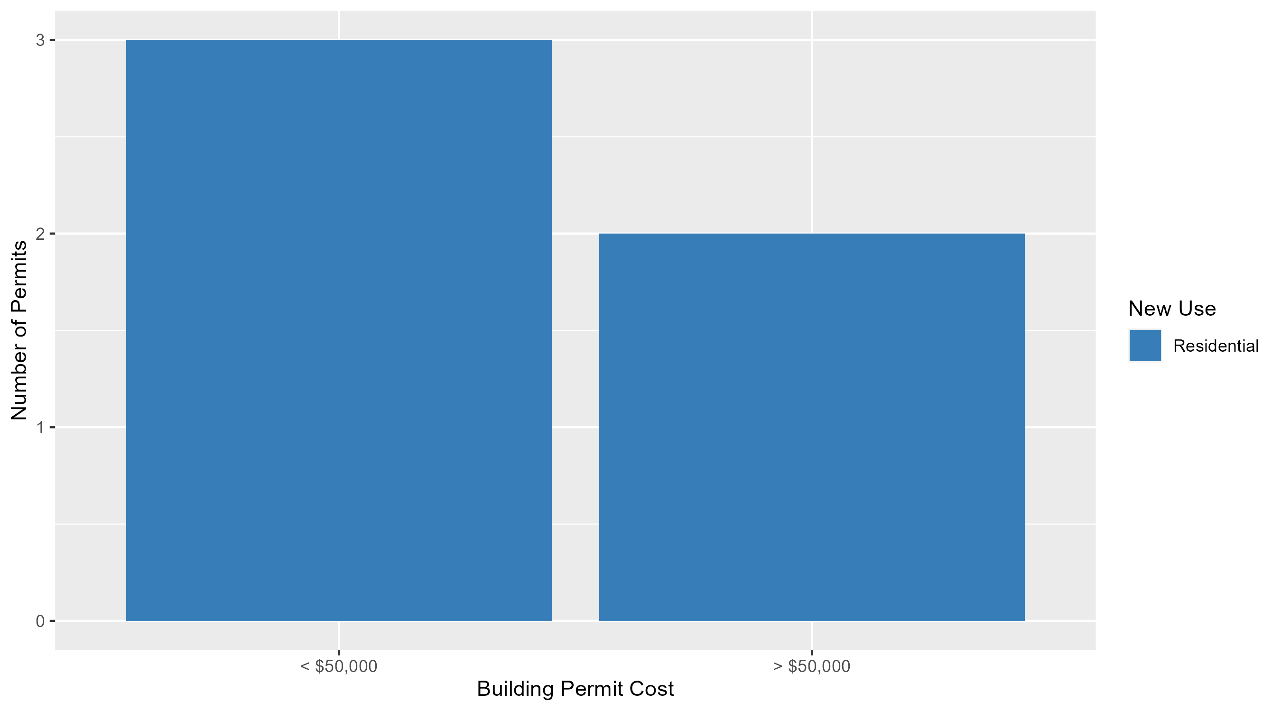
Skinker DeBaliviere Permit Cost Breakdown

Slide 24
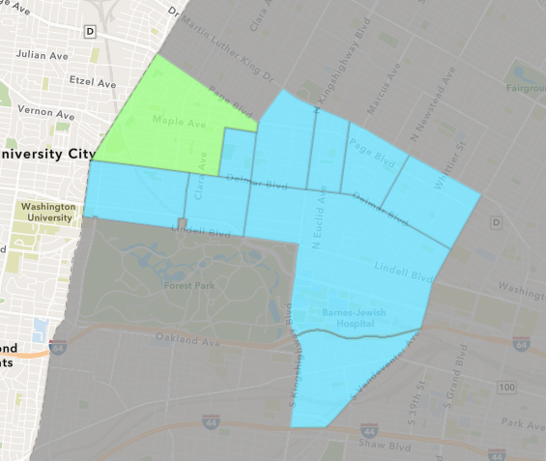
West End
December 2023 Neighborhood Cost Breakdown
  Mean: $14,000
  Median: $1,000
  Range: $1,000 - $40,000

Slide 25
West End: Summary Notes
3 building permits in December 2023
  -50.00% change compared to December 2022 (6 total building permits)
  $14,000: Average building permit cost in December 2023
    -29.30% change compared to December 2022 ($19,802)
87 total building permits in 2023
  -20.18% change YTD compared to this time in 2022 (109 total building permits)
  $69,737: YTD average building permit cost in 2023
    -38.74% change YTD compared to this time in 2022 ($113,831)

Slide 26
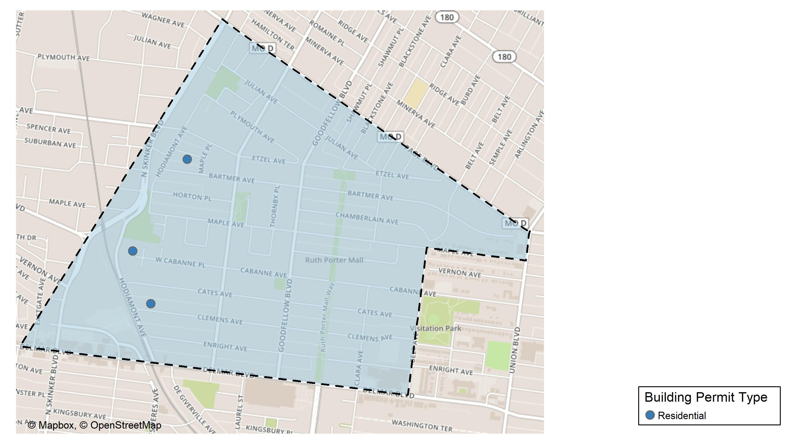
West End

Slide 27
Neighborhood Summary
December 2023 | December 2023 | December 2023 | December 2023
Permit Use | Average Cost | # of Permits | Total Value of Permits
Commercial | $0 | 0 | $0
Industrial | $0 | 0 | $0
Residential | $14,000 | 3 | $42,000
Last 6 Months | Last 6 Months | Last 6 Months | Last 6 Months
Permit Use | Average Cost | # of Permits | Total Value of Permits
Commercial | $232,042.00 | 6 | $1,392,252
Industrial | $0.00 | 0 | $0
Residential | $79,750.88 | 42 | $3,349,537

Slide 28
West End Individual Permit Breakdown
Neighborhood | Owner | New Use | Cost | address
West End | PETERSON, NATHAN & ANNE | Residential | $40,000 | 6035 CLEMENS AV
West End | MCKINNIS, BERTHA | Residential | $1,000 | 6085 WEST CABANNE PL
West End | HOPKINS, LILLIE F | Residential | $1,000 | 6020 SUBURBAN AV

Slide 29
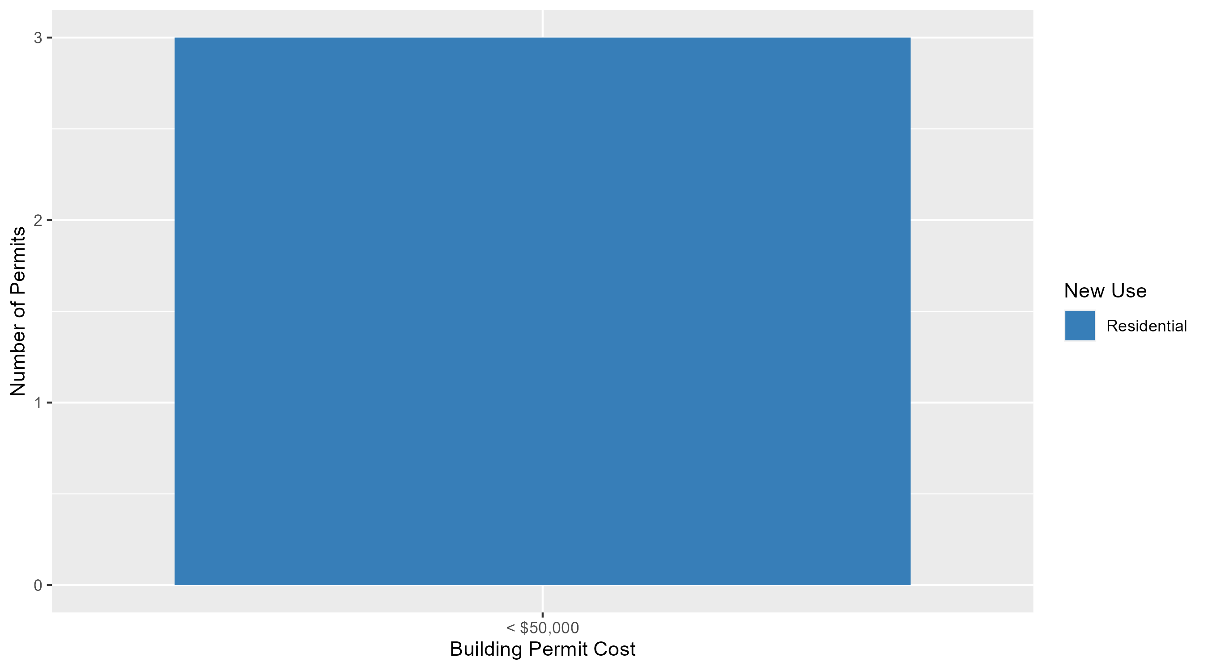
West End Permit Cost Breakdown

Slide 30
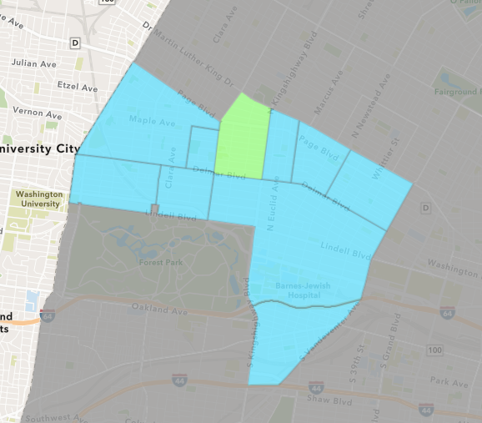
Academy
December 2023 Neighborhood Cost Breakdown
  Mean: $3,000
  Median: $3,000
  Range: $1,000 - $5,000

Slide 31
Academy: Summary Notes
2 building permits in December 2023
  Infinite change compared to December 2022 (0 total building permits)
  $3,000: Average building permit cost in December 2023
    Infinite change compared to December 2022 ($0)
31 total building permits in 2023
  3.33% change YTD compared to this time in 2022 (30 total building permits)
  $24,123: YTD average building permit cost in 2023
    -61.80% change YTD compared to this time in 2022 ($63,140)

Slide 32
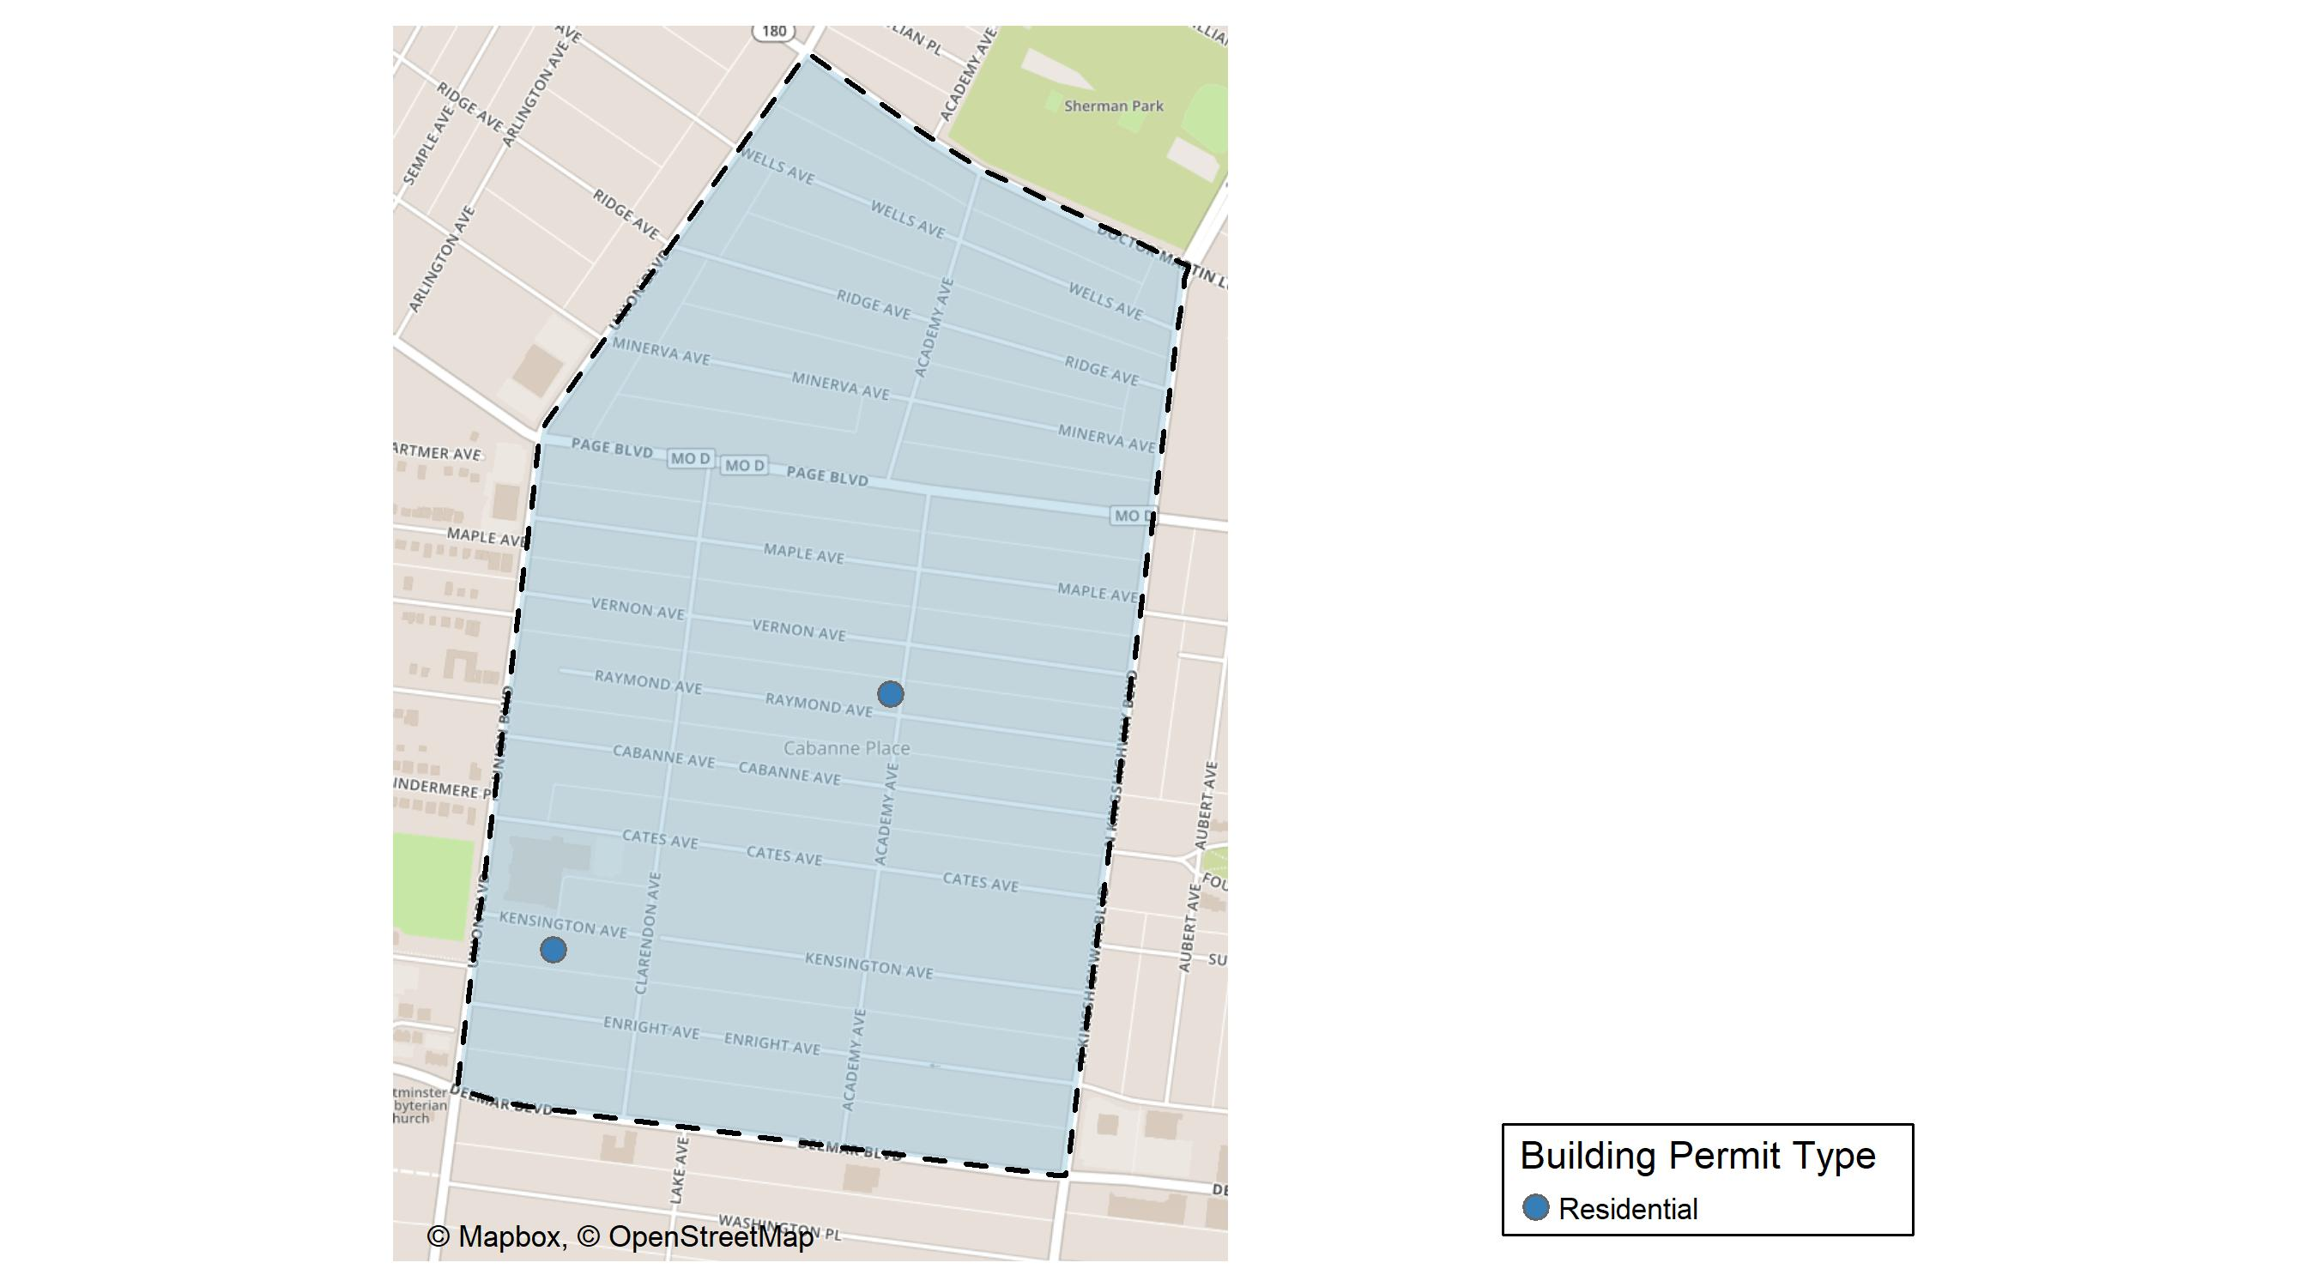
Academy

Slide 33
Neighborhood Summary
December 2023 | December 2023 | December 2023 | December 2023
Permit Use | Average Cost | # of Permits | Total Value of Permits
Commercial | $0 | 0 | $0
Industrial | $0 | 0 | $0
Residential | $3,000 | 2 | $6,000
Last 6 Months | Last 6 Months | Last 6 Months | Last 6 Months
Permit Use | Average Cost | # of Permits | Total Value of Permits
Commercial | $1,928.00 | 1 | $1,928
Industrial | $1,400.00 | 1 | $1,400
Residential | $31,087.88 | 17 | $528,494

Slide 34
Academy Individual Permit Breakdown
Neighborhood | Owner | New Use | Cost | address
Academy | MOORE, JANICE L | Residential | $5,000 | 5101 RAYMOND AV
Academy | PATTERSON, SANDRA ANN | Residential | $1,000 | 5238 KENSINGTON AV

Slide 35
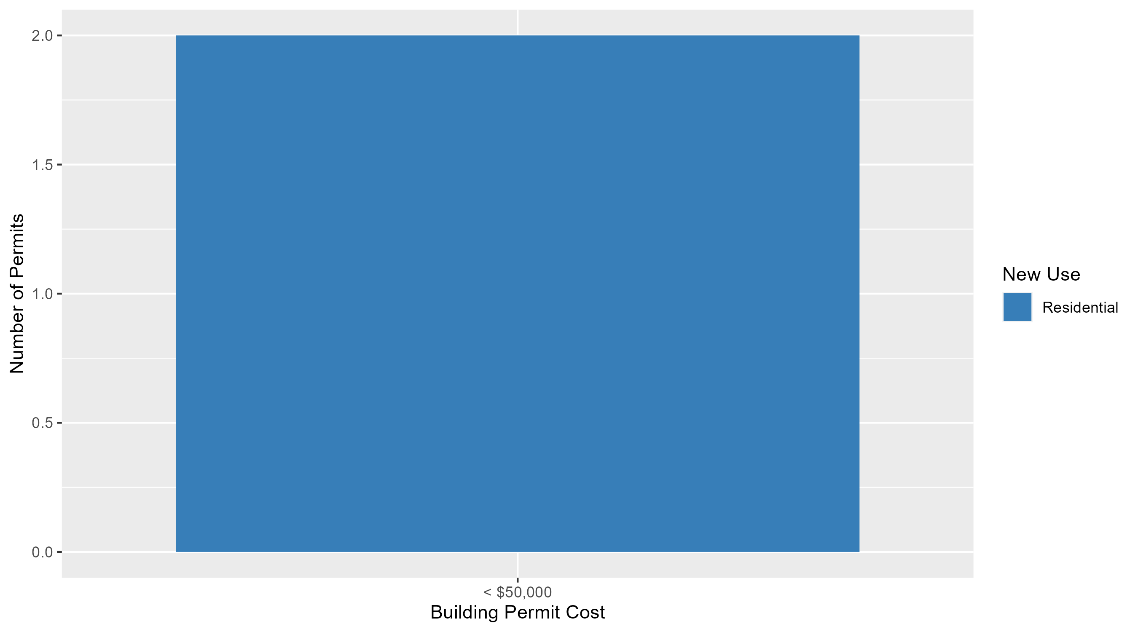
Academy Permit Cost Breakdown

Slide 36
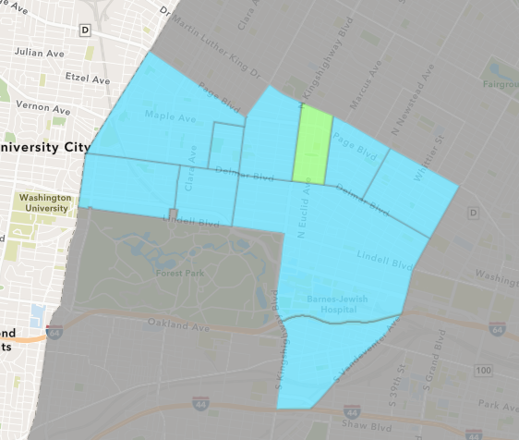
Fountain Park
December 2023 Neighborhood Cost Breakdown
  Mean: $90,000
  Median: $90,000
  Range: $90,000 - $90,000

Slide 37
Fountain Park: Summary Notes
2 building permits in December 2023
  Infinite change compared to December 2022 (0 total building permits)
  $90,000: Average building permit cost in December 2023
    Infinite change compared to December 2022 ($0)
16 total building permits in 2023
  -11.11% change YTD compared to this time in 2022 (18 total building permits)
  $135,921: YTD average building permit cost in 2023
    -41.78% change YTD compared to this time in 2022 ($233,475)

Slide 38
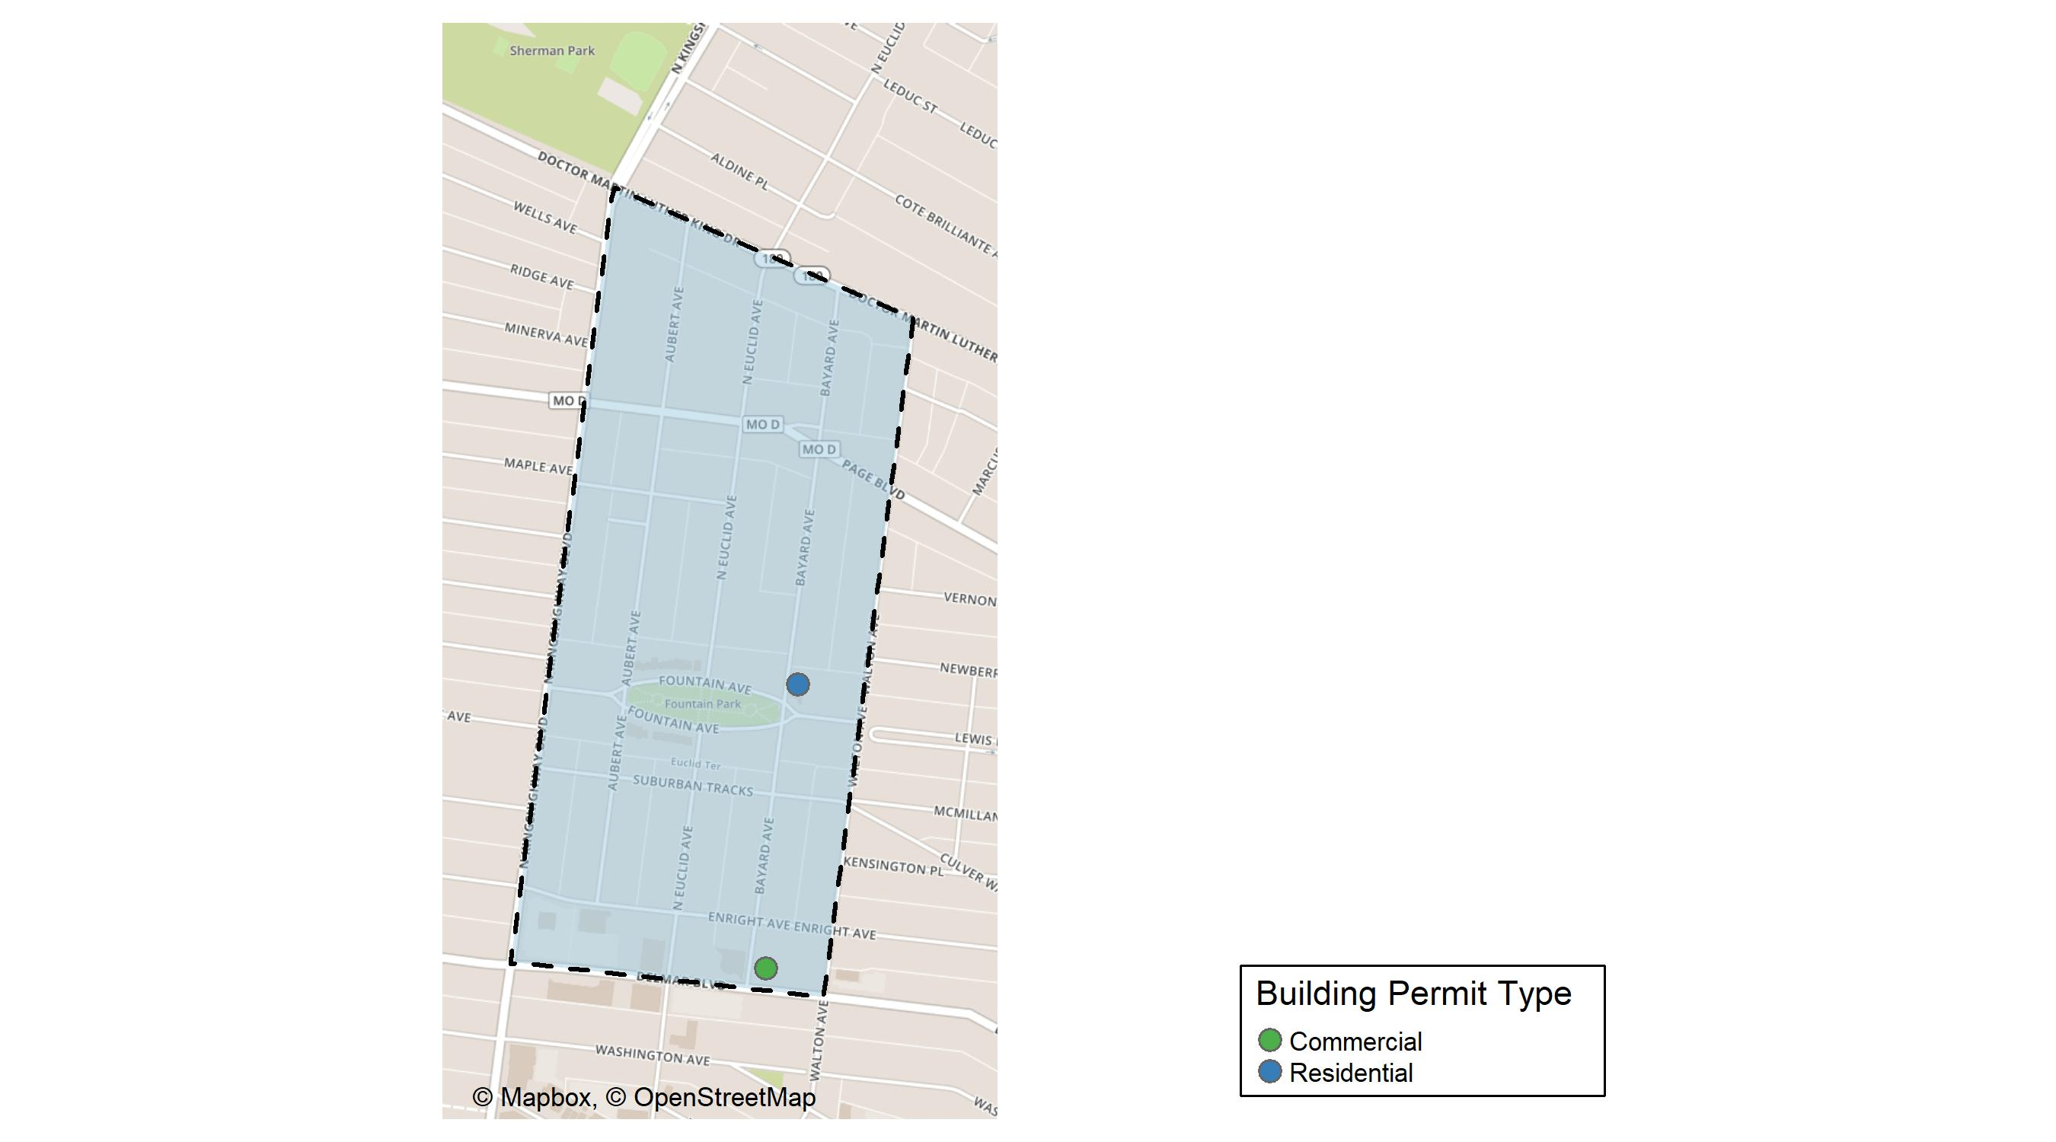
Fountain Park

Slide 39
Neighborhood Summary
December 2023 | December 2023 | December 2023 | December 2023
Permit Use | Average Cost | # of Permits | Total Value of Permits
Commercial | $90,000 | 1 | $90,000
Industrial | $0 | 0 | $0
Residential | $90,000 | 1 | $90,000
Last 6 Months | Last 6 Months | Last 6 Months | Last 6 Months
Permit Use | Average Cost | # of Permits | Total Value of Permits
Commercial | $39,775 | 4 | $159,100
Industrial | $1,750,000 | 1 | $1,750,000
Residential | $34,440 | 6 | $206,640

Slide 40
Fountain Park Individual Permit Breakdown
Neighborhood | Owner | New Use | Cost | address
Fountain Park | ELEVATION QALICB LLC | Commercial | $90,000 | 4731 DELMAR BLVD
Fountain Park | TITSWORTH PROPERTIES LLC | Residential | $90,000 | 4831-37 FOUNTAIN AV

Slide 41
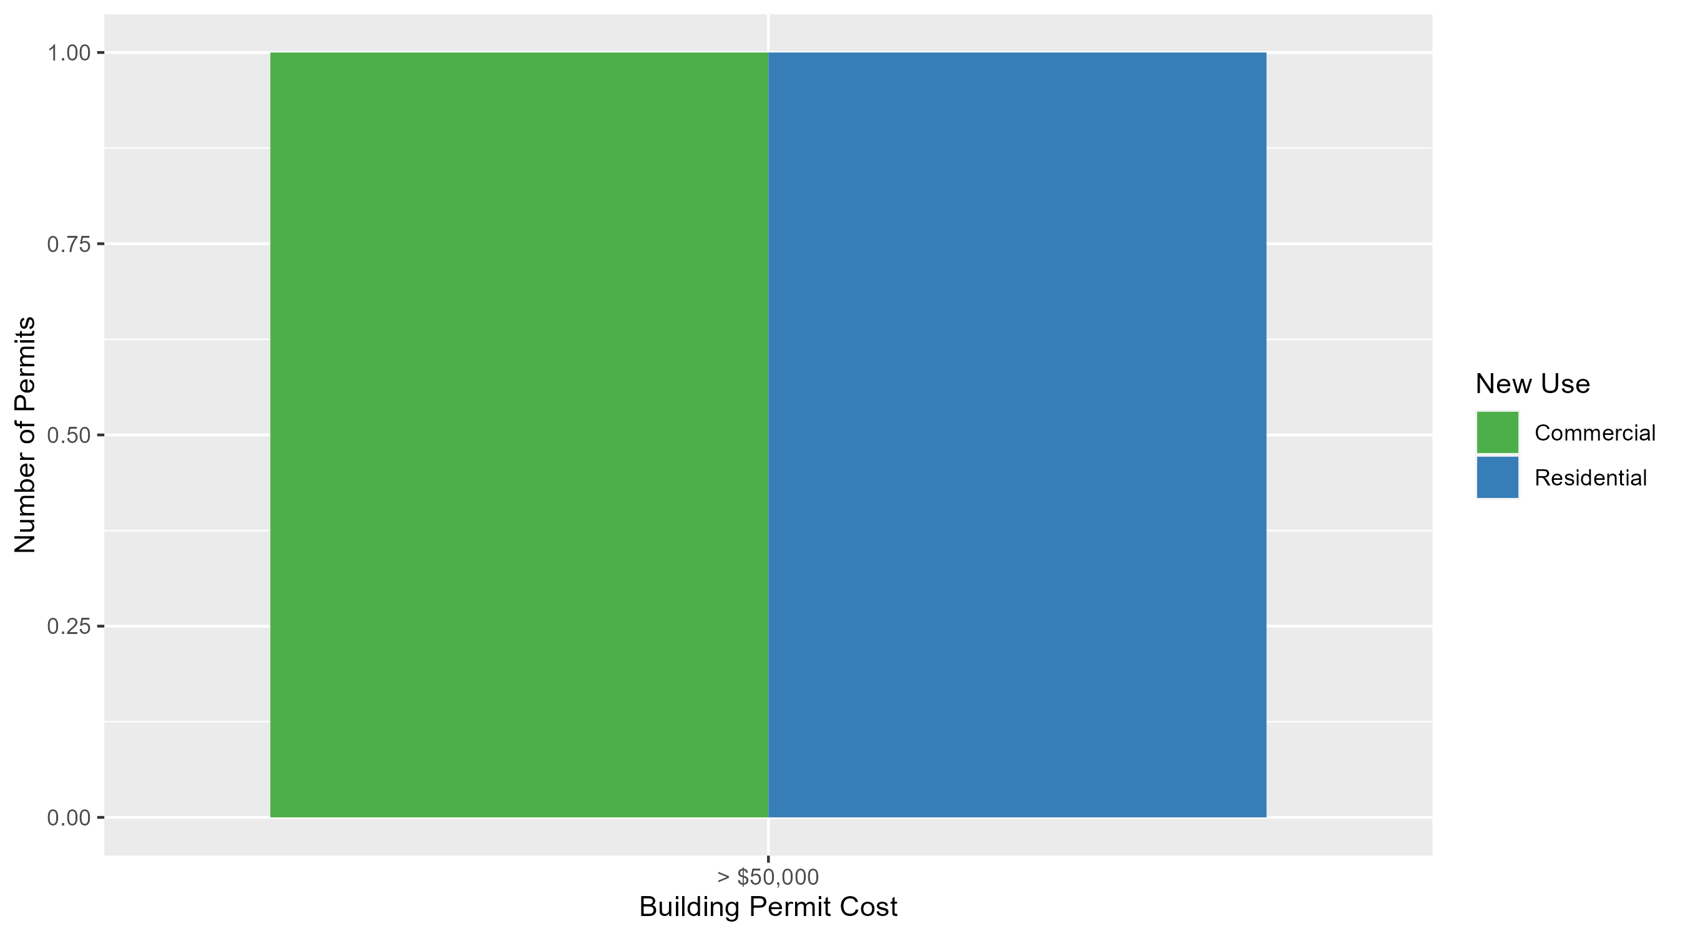
Fountain Park Permit Cost Breakdown

Slide 42
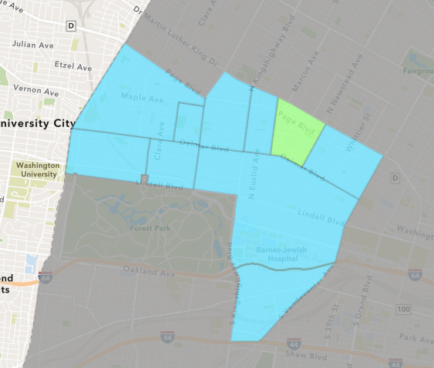
Lewis Place
December 2023 Neighborhood Cost Breakdown
  Mean: $29,101
  Median: $29,101
  Range: $8,202 - $50,000

Slide 43
Lewis Place: Summary Notes
2 building permits in December 2023
  0.00% change compared to December 2022 (2 total building permits)
  $29,101: Average building permit cost in December 2023
    -35.63% change compared to December 2022 ($45,210)
14 total building permits in 2023
  -22.22% change YTD compared to this time in 2022 (18 total building permits)
  $58,646: YTD average building permit cost in 2023
    79.04% change YTD compared to this time in 2022 ($32,756)

Slide 44
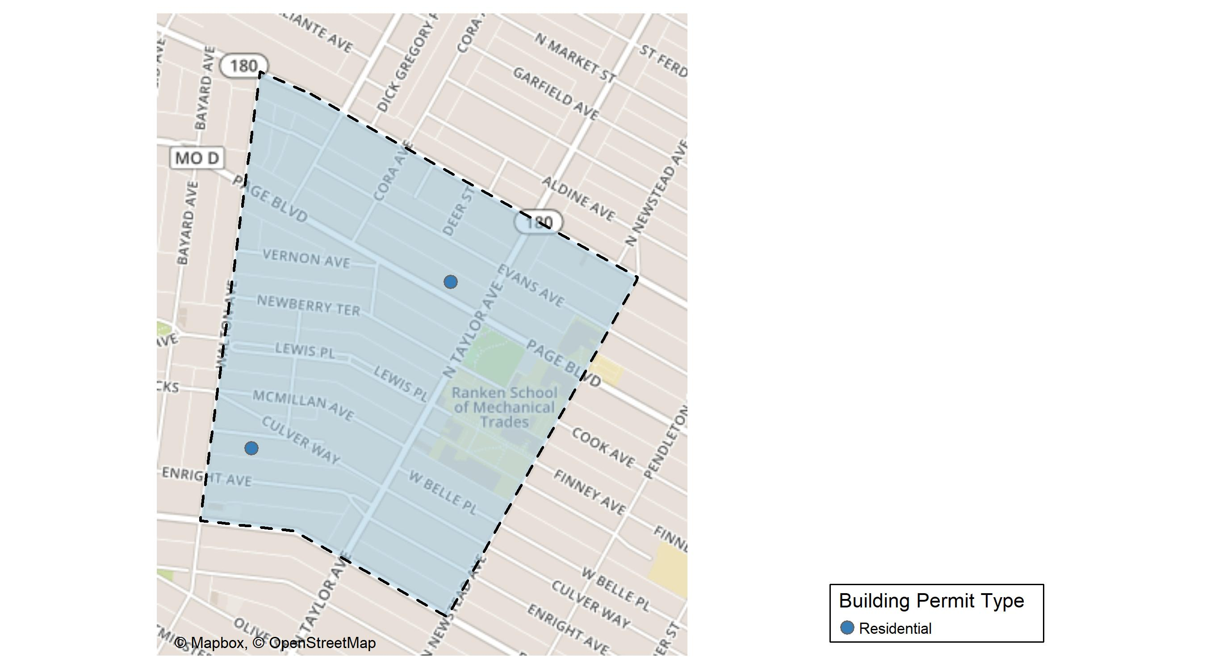
Lewis Place

Slide 45
Neighborhood Summary
December 2023 | December 2023 | December 2023 | December 2023
Permit Use | Average Cost | # of Permits | Total Value of Permits
Commercial | $0 | 0 | $0
Industrial | $0 | 0 | $0
Residential | $29,101 | 2 | $58,202
Last 6 Months | Last 6 Months | Last 6 Months | Last 6 Months
Permit Use | Average Cost | # of Permits | Total Value of Permits
Commercial | $225,535.0 | 1 | $225,535
Industrial | $25,000.0 | 1 | $25,000
Residential | $31,800.5 | 4 | $127,202

Slide 46
Lewis Place Individual Permit Breakdown
Neighborhood | Owner | New Use | Cost | address
Lewis Place | CARTER, JOYCE & JARDEE | Residential | $8,202 | 4531 PAGE BLVD
Lewis Place | PENNY & AVI LLC | Residential | $50,000 | 4726-28 KENSINGTON AV

Slide 47
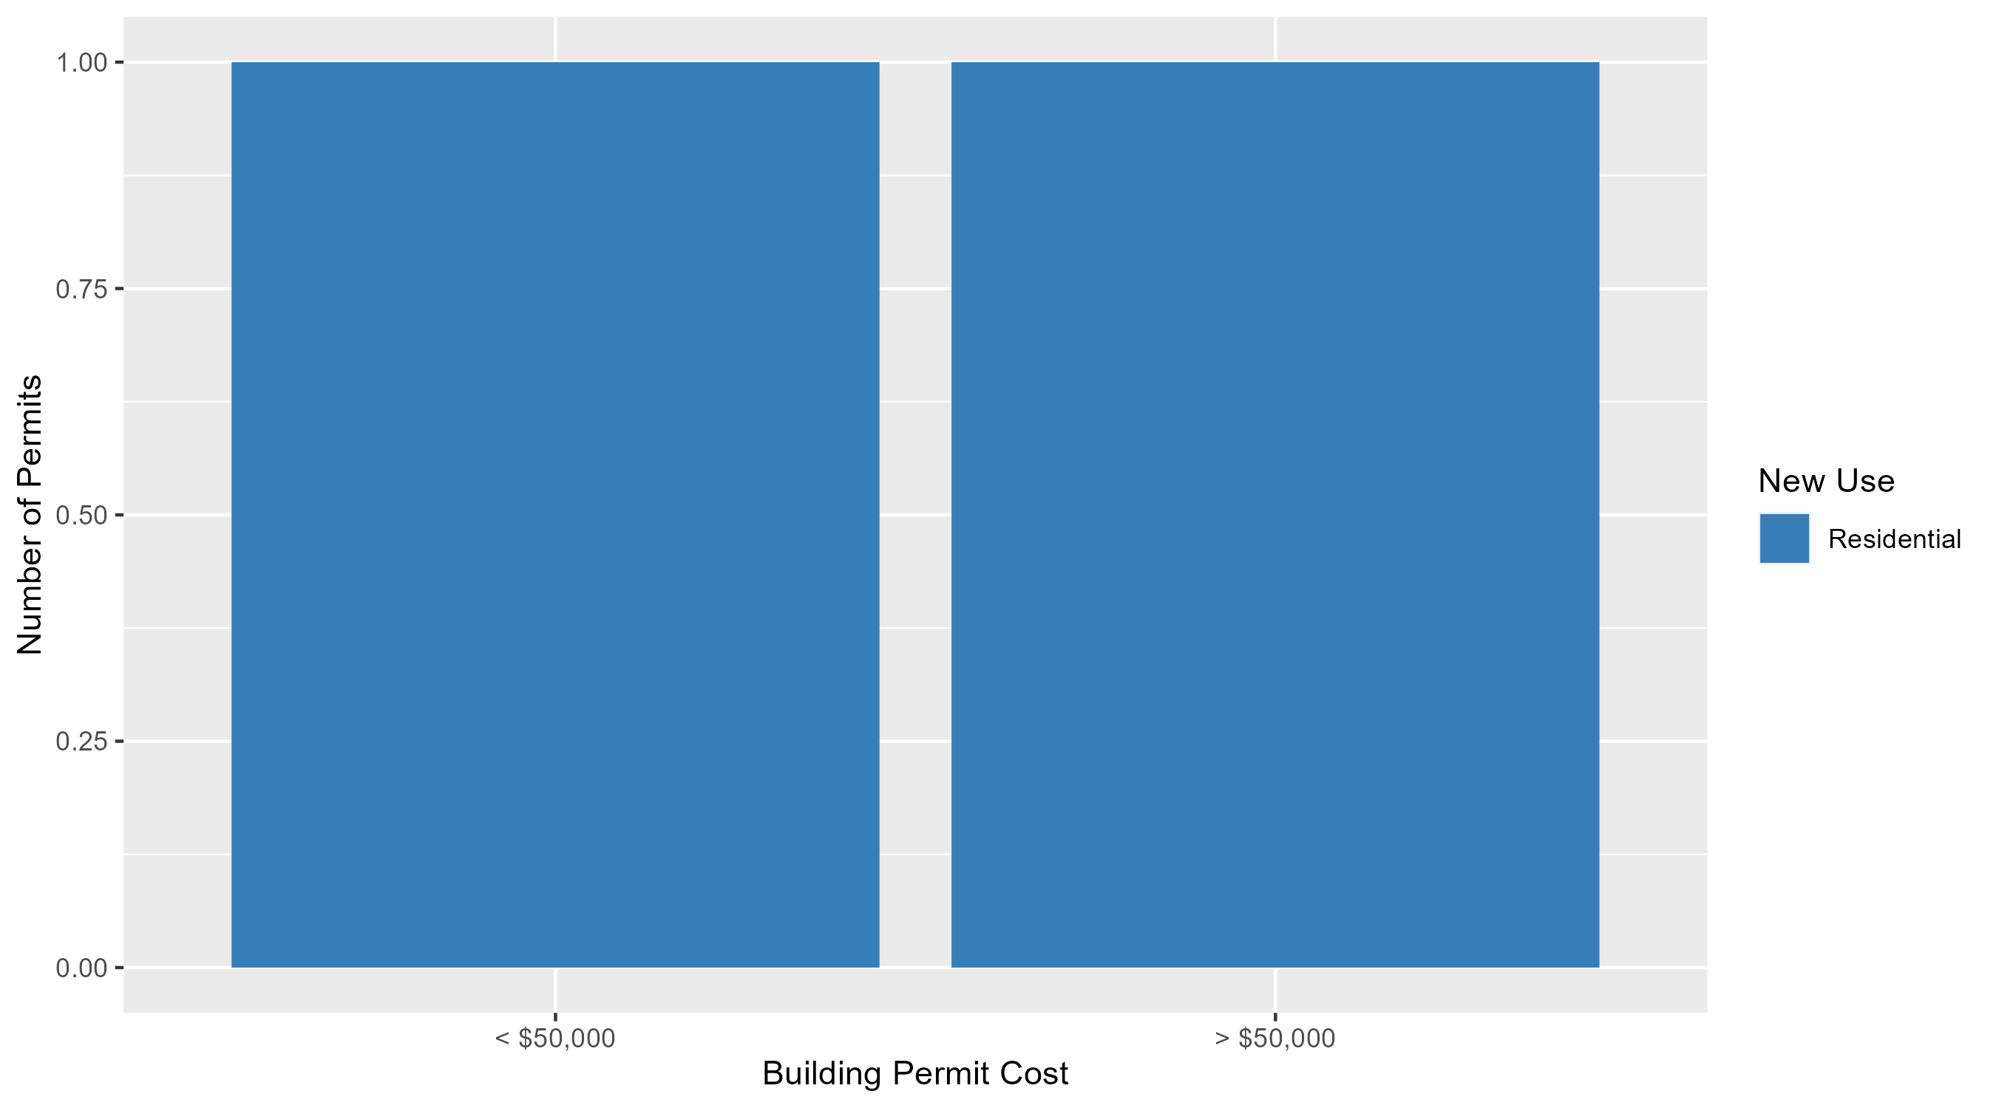
Lewis Place Permit Cost Breakdown

Slide 48
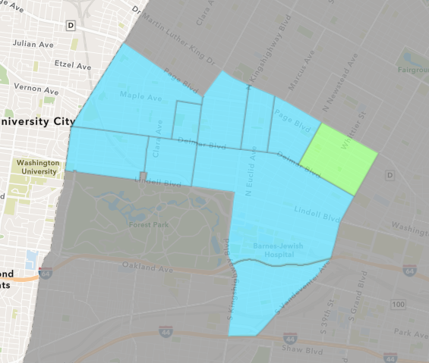
Vandeventer
December 2023 Neighborhood Cost Breakdown
  Mean: $10,347
  Median: $10,347
  Range: $10,347 - $10,347

Slide 49
Vandeventer: Summary Notes
1 building permits in December 2023
  -75.00% change compared to December 2022 (4 total building permits)
  $10,347: Average building permit cost in December 2023
    -80.05% change compared to December 2022 ($51,874)
17 total building permits in 2023
  -45.16% change YTD compared to this time in 2022 (31 total building permits)
  $141,734: YTD average building permit cost in 2023
    -50.72% change YTD compared to this time in 2022 ($287,638)

Slide 50
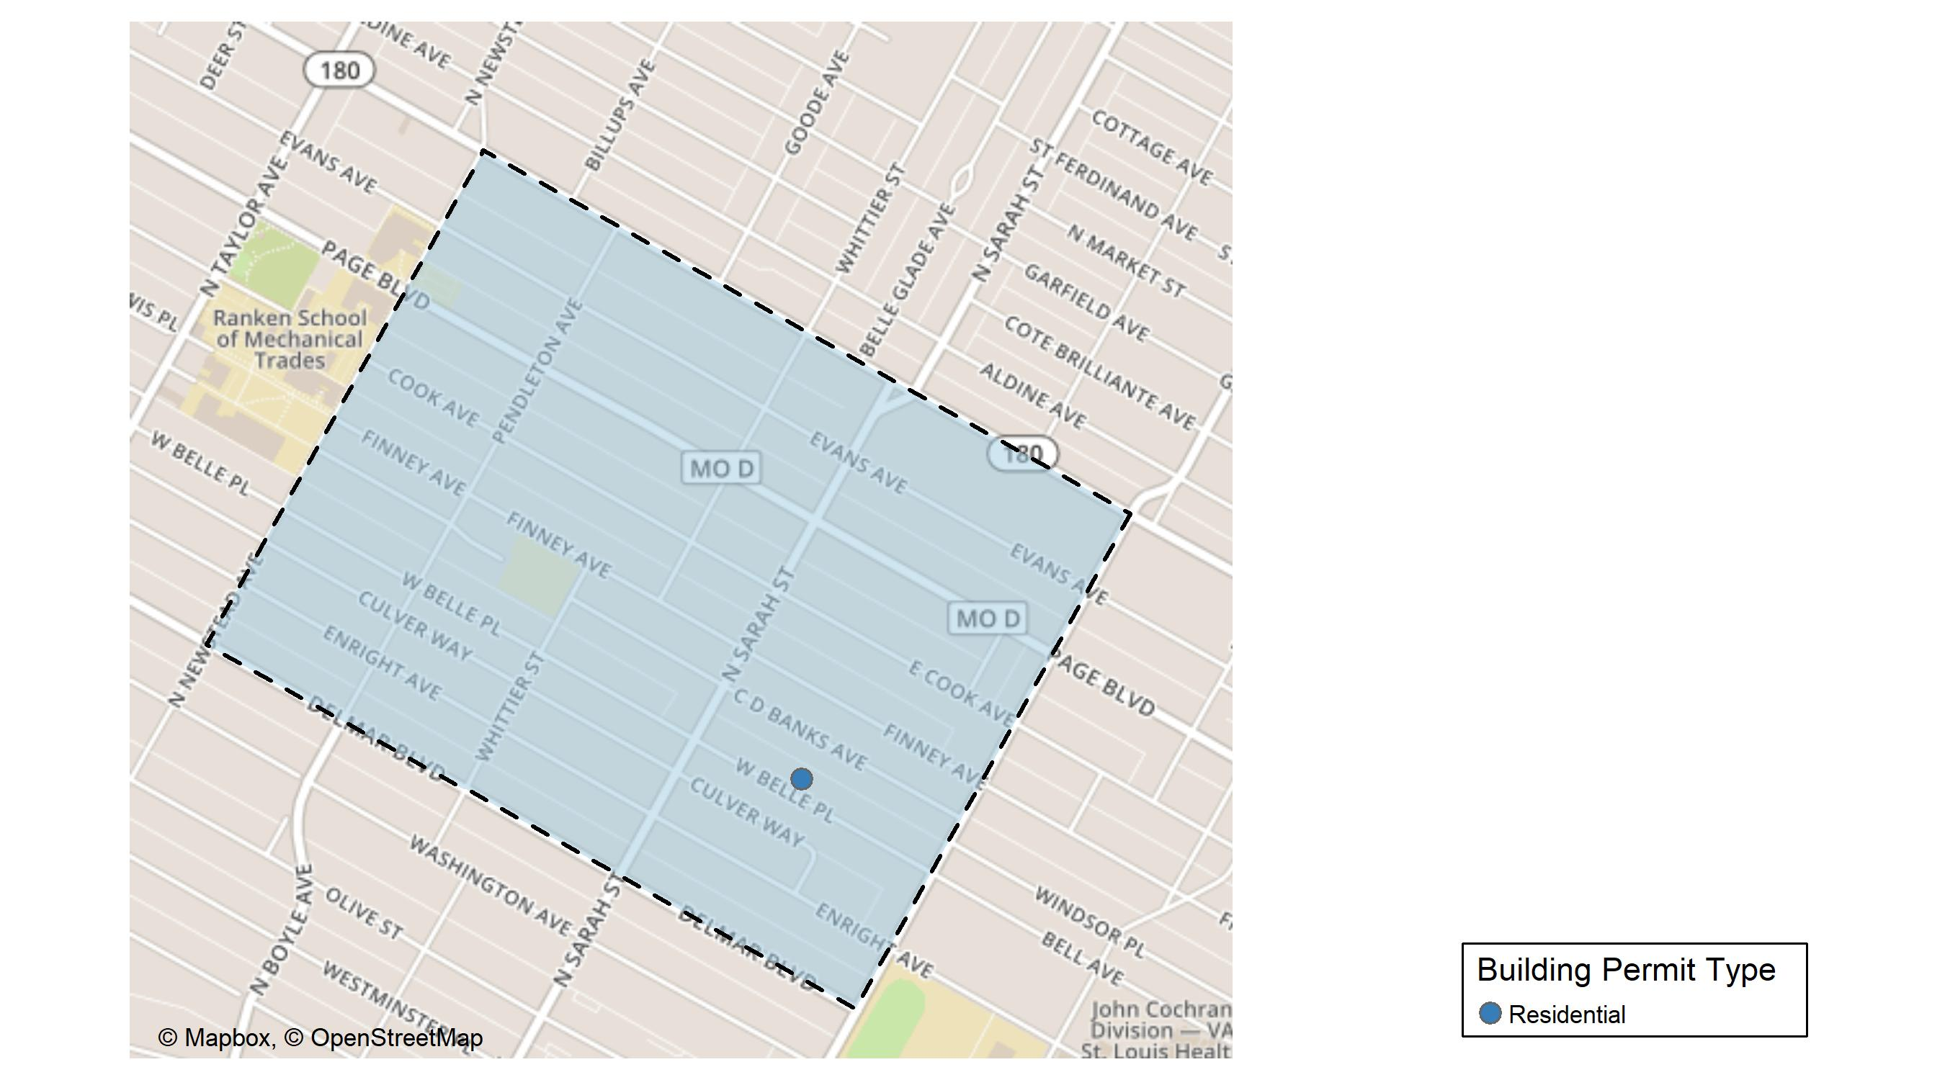
Vandeventer

Slide 51
Neighborhood Summary
December 2023 | December 2023 | December 2023 | December 2023
Permit Use | Average Cost | # of Permits | Total Value of Permits
Commercial | $0 | 0 | $0
Industrial | $0 | 0 | $0
Residential | $10,347 | 1 | $10,347
Last 6 Months | Last 6 Months | Last 6 Months | Last 6 Months
Permit Use | Average Cost | # of Permits | Total Value of Permits
Commercial | $2,000,000 | 1 | $2,000,000
Industrial | $10,900 | 1 | $10,900
Residential | $49,121 | 7 | $343,847

Slide 52
Vandeventer Individual Permit Breakdown
Neighborhood | Owner | New Use | Cost | address
Vandeventer | BROWN, MEDINA D | Residential | $10,347 | 4009 WEST BELLE PL

Slide 53

Vandeventer Permit Cost Breakdown

Slide 54
Additional Notes
Data retreived from https://www.stlouis-mo.gov/data/
Building permits with a cost of $0 were dropped
Building permits that were cancelled were dropped
Infinite change indicates 0 permits in the current or previous time period/comparison month so there was a overall increase or decrease

