Slide 1
St. Louis Central Corridor West Building Permits
Monthly Report: December 2024

Slide 2
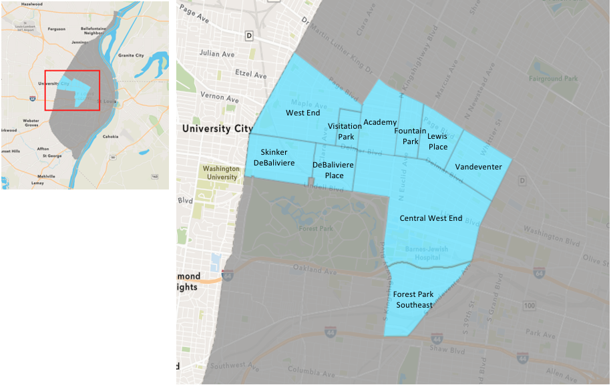
St. Louis Neighborhood Spatial Reference

Slide 3
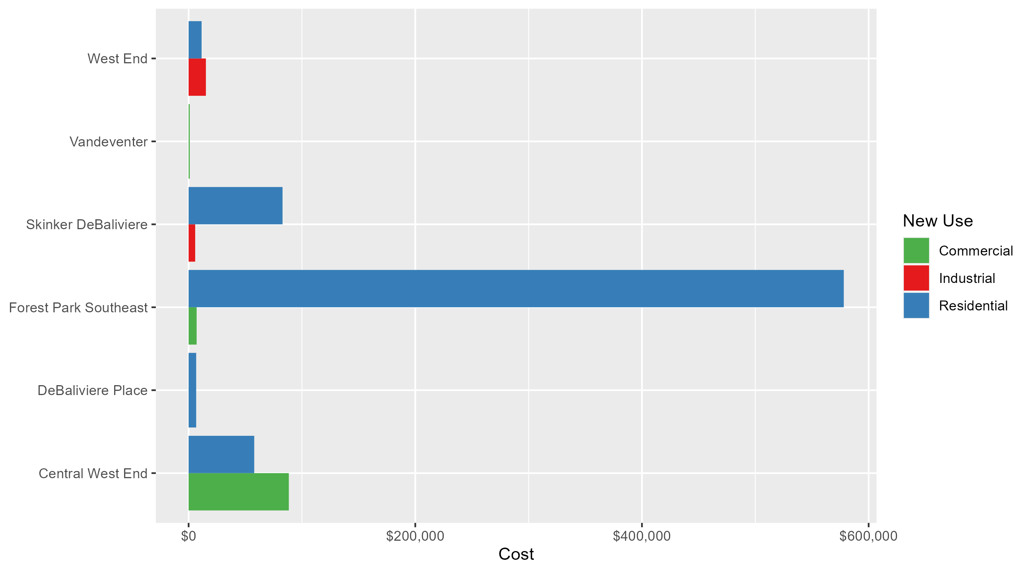
Neighborhood Summary: Average Building Permit Cost

Slide 4
Neighborhood Summary
December 2024 | December 2024 | December 2024 | December 2024
Neighborhood | Average Cost | # of Permits | Total Value of Permits
Academy | $0.00 | 0 | $0
Central West End | $69,448.57 | 37 | $2,569,597
DeBaliviere Place | $6,682.00 | 2 | $13,364
Forest Park Southeast | $506,697.75 | 8 | $4,053,582
Fountain Park | $0.00 | 0 | $0
Lewis Place | $0.00 | 0 | $0
Skinker DeBaliviere | $60,856.14 | 7 | $425,993
Vandeventer | $1,000.00 | 1 | $1,000
Visitation Park | $0.00 | 0 | $0
West End | $13,990.00 | 3 | $41,970
Last 6 Months | Last 6 Months | Last 6 Months | Last 6 Months
Neighborhood | Average Cost | # of Permits | Total Value of Permits
Academy | $23,841.64 | 14 | $333,783
Central West End | $224,512.30 | 221 | $49,617,218
DeBaliviere Place | $85,339.93 | 28 | $2,389,518
Forest Park Southeast | $127,656.43 | 42 | $5,361,570
Fountain Park | $52,800.00 | 10 | $528,000
Lewis Place | $31,967.11 | 9 | $287,704
Skinker DeBaliviere | $91,336.65 | 57 | $5,206,189
Vandeventer | $29,578.75 | 8 | $236,630
Visitation Park | $20,520.50 | 4 | $82,082
West End | $73,627.70 | 30 | $2,208,831

Slide 5
Core Neighborhoods

Slide 6
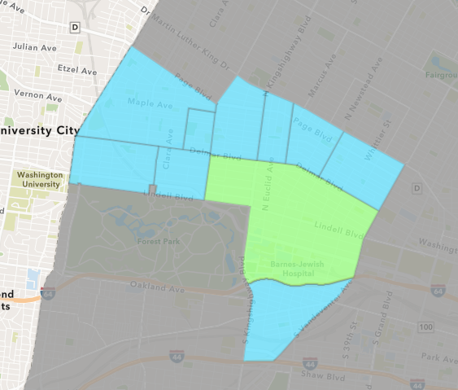
Central West End
December 2024 Neighborhood Cost Breakdown
  Mean: $69,449
  Median: $22,000
  Range: $1,855 - $380,447

Slide 7
Central West End: Summary Notes
37 building permits in December 2024
  42.31% change compared to December 2023 (26 total building permits)
  $69,449: Average building permit cost in December 2024
    -89.19% change compared to December 2023 ($642,261)
361 total building permits in 2024
  -3.22% change YTD compared to this time in 2023 (373 total building permits)
  $341,249: YTD average building permit cost in 2024
    34.83% change YTD compared to this time in 2023 ($253,105)

Slide 8
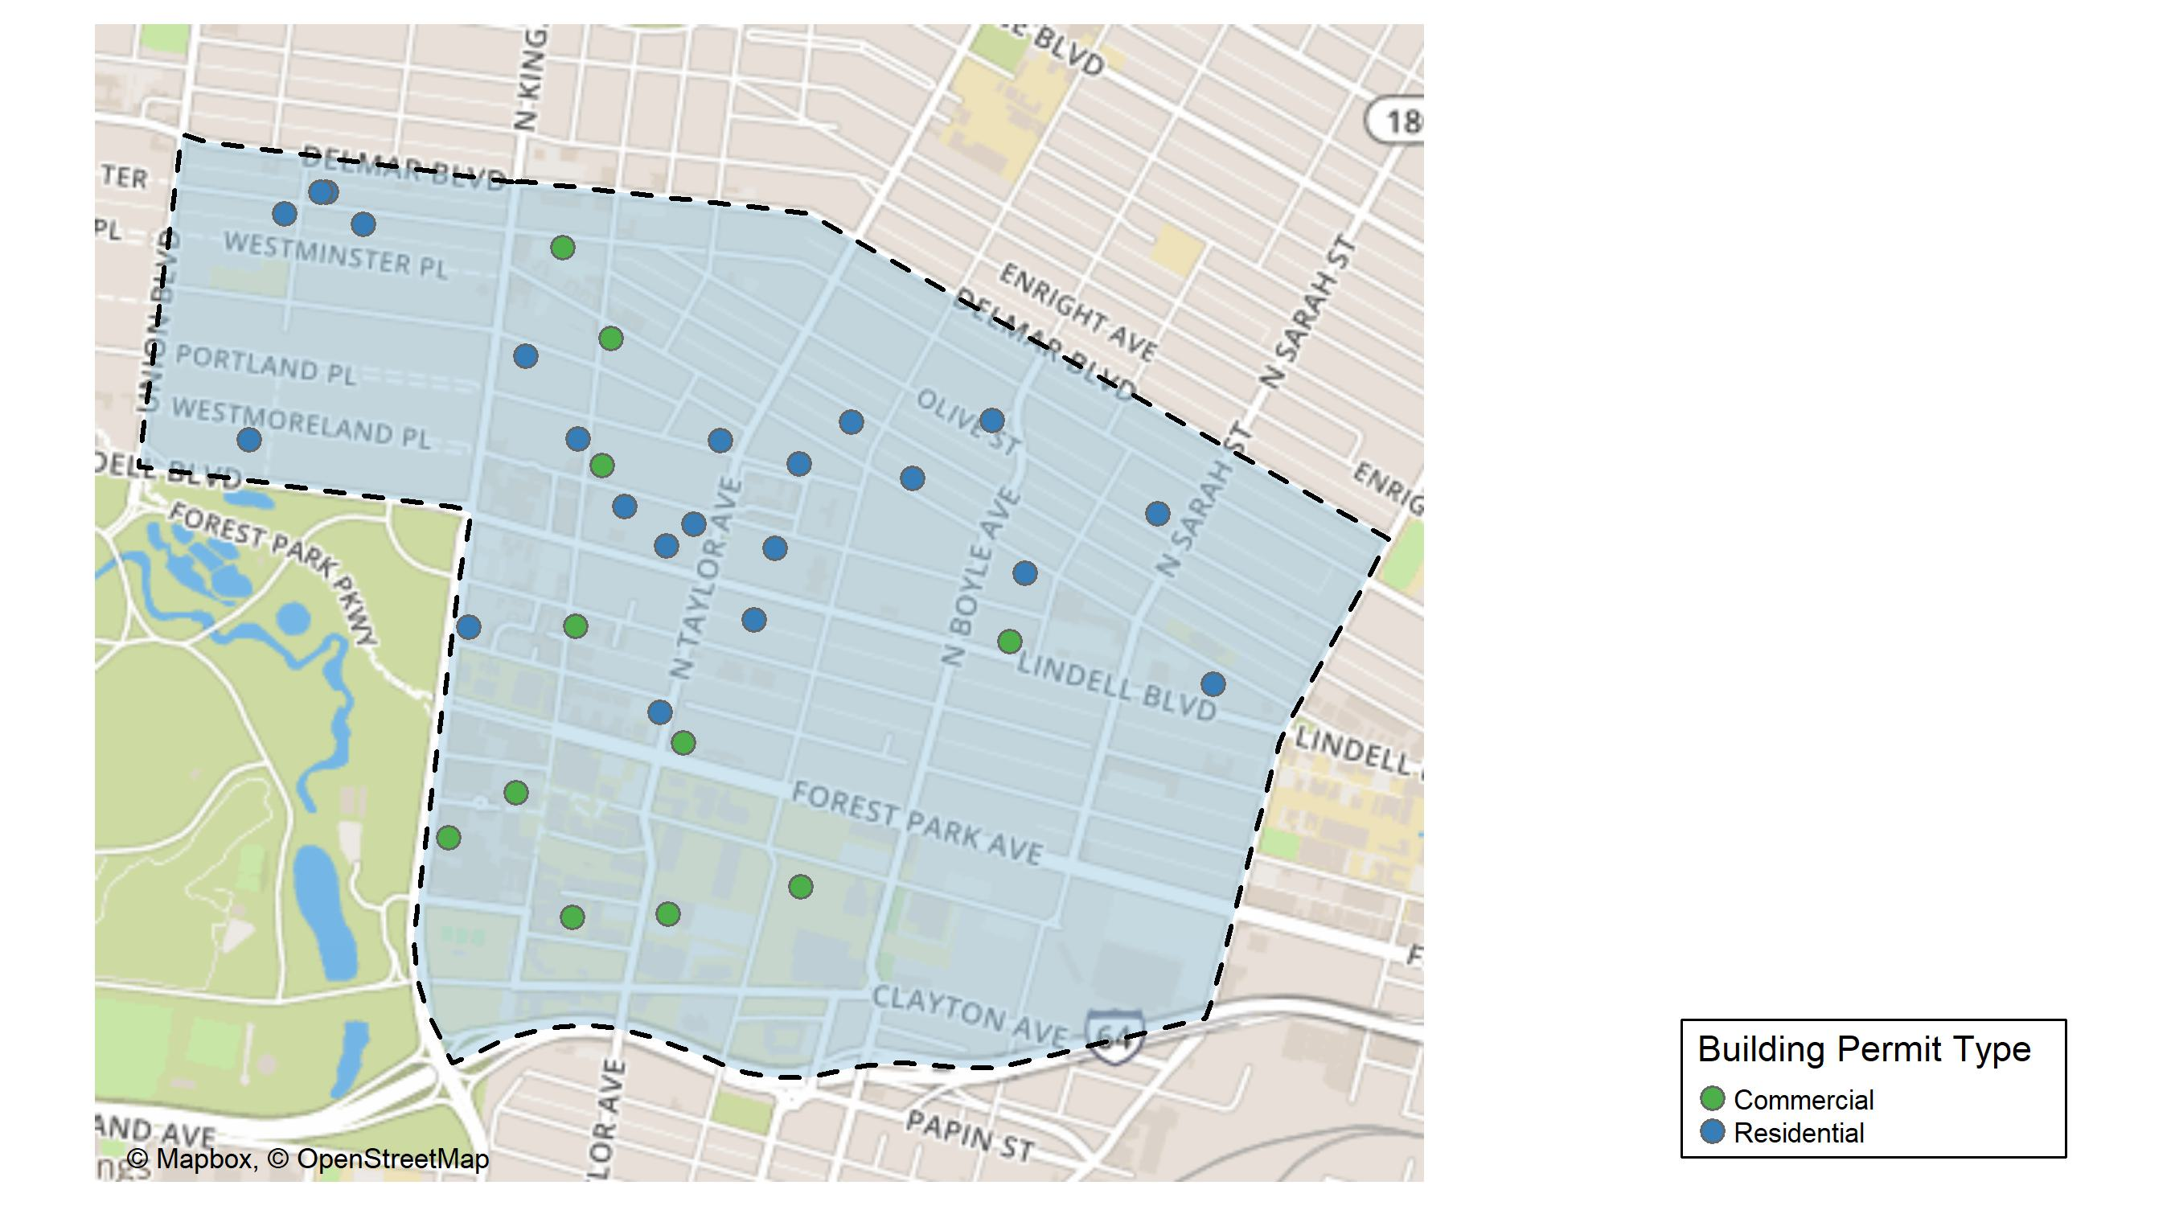
Central West End

Slide 9
Neighborhood Summary
December 2024 | December 2024 | December 2024 | December 2024
Permit Use | Average Cost | # of Permits | Total Value of Permits
Commercial | $88,424.57 | 14 | $1,237,944
Industrial | $0.00 | 0 | $0
Residential | $57,897.96 | 23 | $1,331,653
Last 6 Months | Last 6 Months | Last 6 Months | Last 6 Months
Permit Use | Average Cost | # of Permits | Total Value of Permits
Commercial | $370,787.33 | 92 | $34,112,434
Industrial | $44,071.33 | 3 | $132,214
Residential | $122,004.52 | 126 | $15,372,570

Slide 10
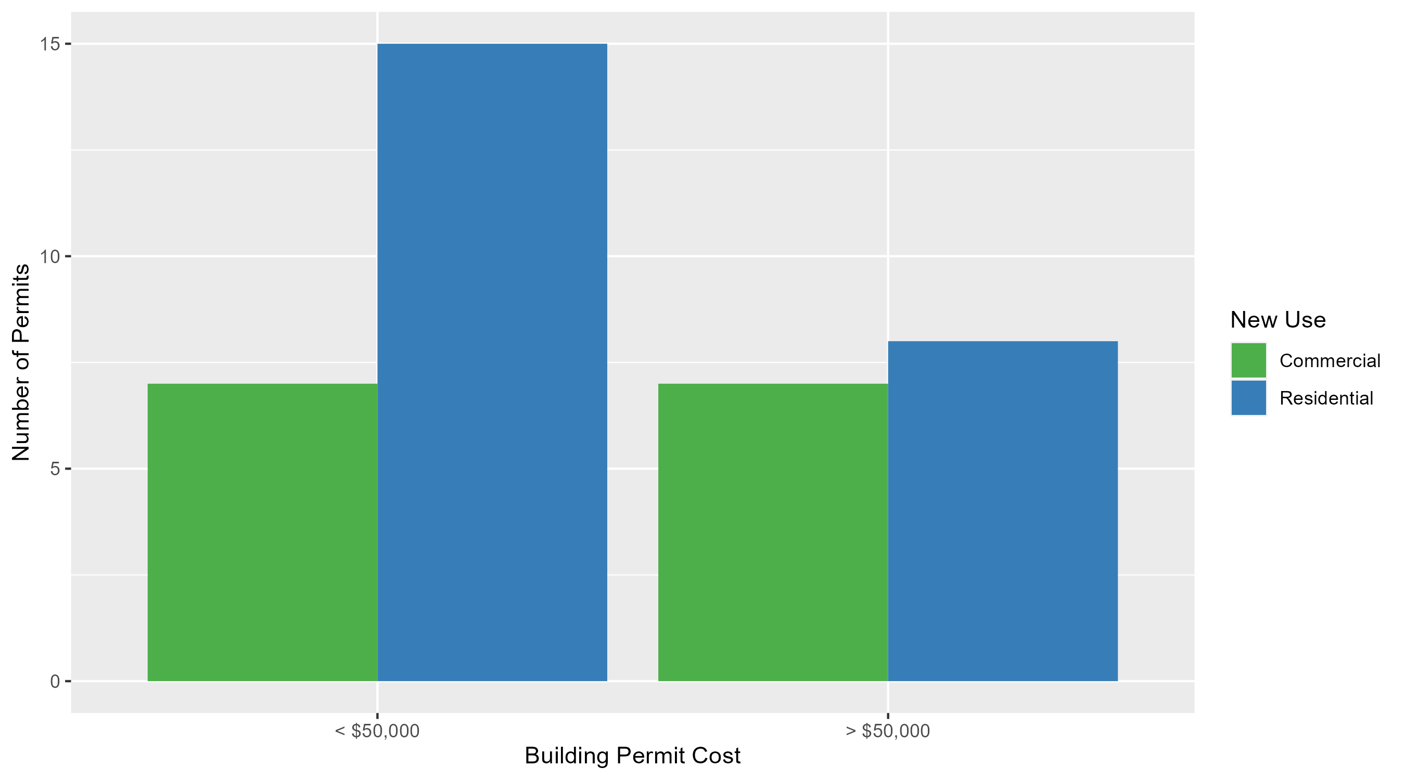
Central West End Permit Cost Breakdown

Slide 11
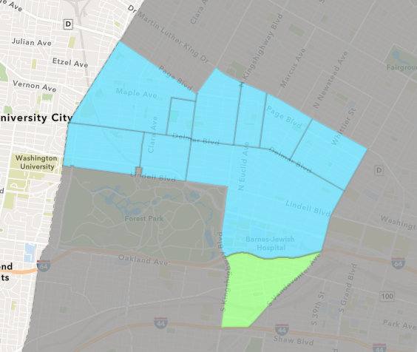
Forest Park Southeast
December 2024 Neighborhood Cost Breakdown
  Mean: $506,698
  Median: $46,500
  Range: $1,000 - $3,500,000

Slide 12
Forest Park Southeast: Summary Notes
8 building permits in December 2024
  0.00% change compared to December 2023 (8 total building permits)
  $506,698: Average building permit cost in December 2024
    706.84% change compared to December 2023 ($62,800)
74 total building permits in 2024
  2.78% change YTD compared to this time in 2023 (72 total building permits)
  $106,971: YTD average building permit cost in 2024
    34.21% change YTD compared to this time in 2023 ($79,703)

Slide 13
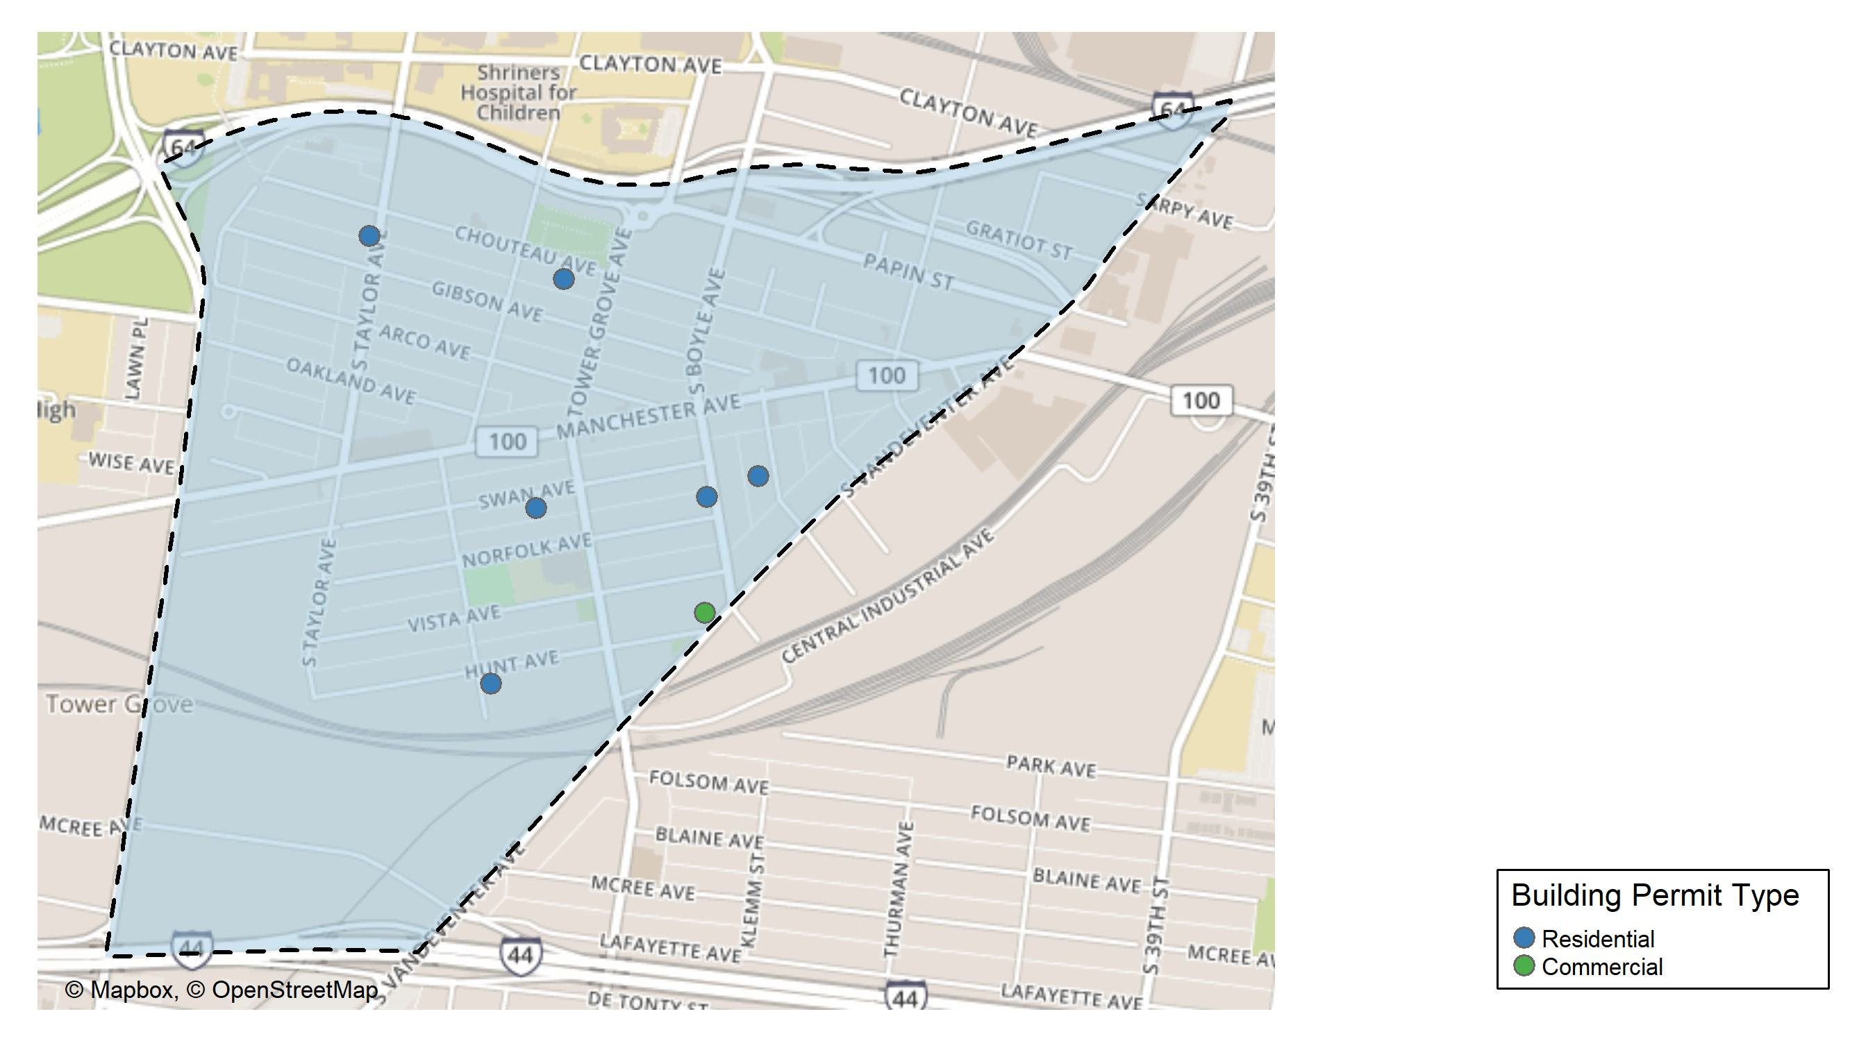
Forest Park Southeast

Slide 14
Neighborhood Summary
December 2024 | December 2024 | December 2024 | December 2024
Permit Use | Average Cost | # of Permits | Total Value of Permits
Commercial | $7,082.0 | 1 | $7,082
Industrial | $0.0 | 0 | $0
Residential | $578,071.4 | 7 | $4,046,500
Last 6 Months | Last 6 Months | Last 6 Months | Last 6 Months
Permit Use | Average Cost | # of Permits | Total Value of Permits
Commercial | $19,117.62 | 8 | $152,941
Industrial | $31,933.33 | 3 | $95,800
Residential | $164,929.97 | 31 | $5,112,829

Slide 15
Forest Park Southeast Individual Permit Breakdown
Neighborhood | Owner | New Use | Cost | address
Forest Park Southeast | ANZAC DEVELOPMENTS LLC | Residential | $300,000 | 4368 HUNT AV
Forest Park Southeast | MR 1301 | Residential | $147,500 | 1301 KENTUCKY AV
Forest Park Southeast | TOWER VISTA TOWNHOMES LLC | Residential | $3,500,000 | 4300 VISTA AV
Forest Park Southeast | DOCUMENT IMAGING SYSTEMS OF ST LOUIS | Commercial | $7,082 | 1463 S VANDEVENTER AV
Forest Park Southeast | GREEN DOT PROPERTIES LLC | Residential | $5,000 | 1219 S BOYLE AV
Forest Park Southeast | PARK SOUTH PROPERTIES LLC | Residential | $1,000 | 4322-24 SWAN AV
Forest Park Southeast | CITYRISE DEVELOPMENT LLC | Residential | $58,000 | 1015 S TAYLOR AV
Forest Park Southeast | LGJ REAL ESTATE LLC | Residential | $35,000 | 4382 CHOUTEAU AV

Slide 16
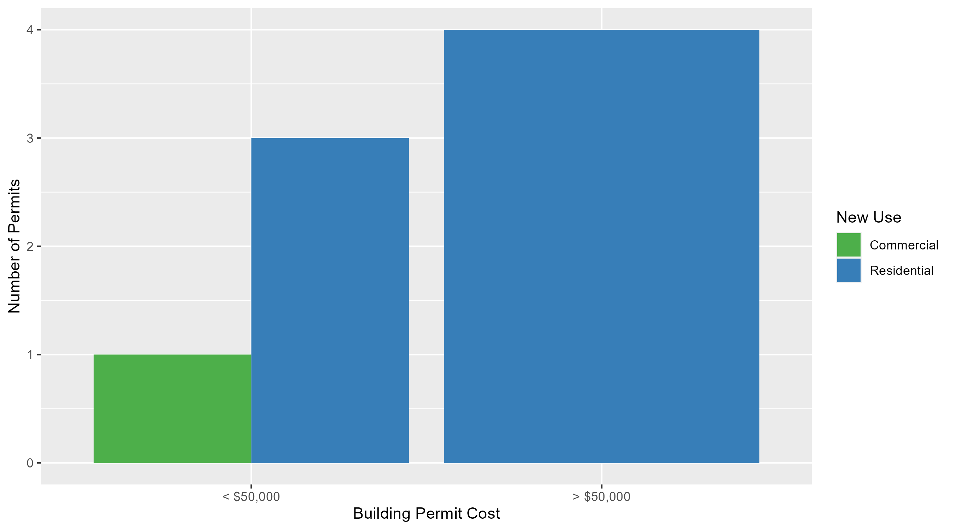
Forest Park Southeast Permit Cost Breakdown

Slide 17
Expanded Service Area

Slide 18
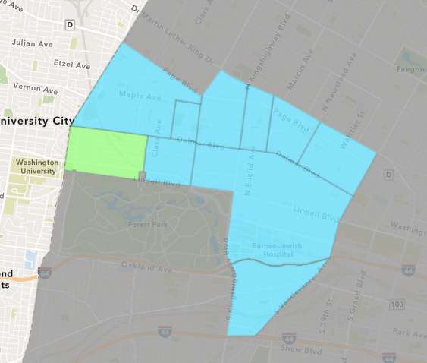
Skinker DeBaliviere
December 2024 Neighborhood Cost Breakdown
  Mean: $60,856
  Median: $11,000
  Range: $600 - $300,000

Slide 19
Skinker DeBaliviere: Summary Notes
7 building permits in December 2024
  40.00% change compared to December 2023 (5 total building permits)
  $60,856: Average building permit cost in December 2024
    -24.72% change compared to December 2023 ($80,835)
83 total building permits in 2024
  -22.43% change YTD compared to this time in 2023 (107 total building permits)
  $103,605: YTD average building permit cost in 2024
    15.40% change YTD compared to this time in 2023 ($89,777)

Slide 20
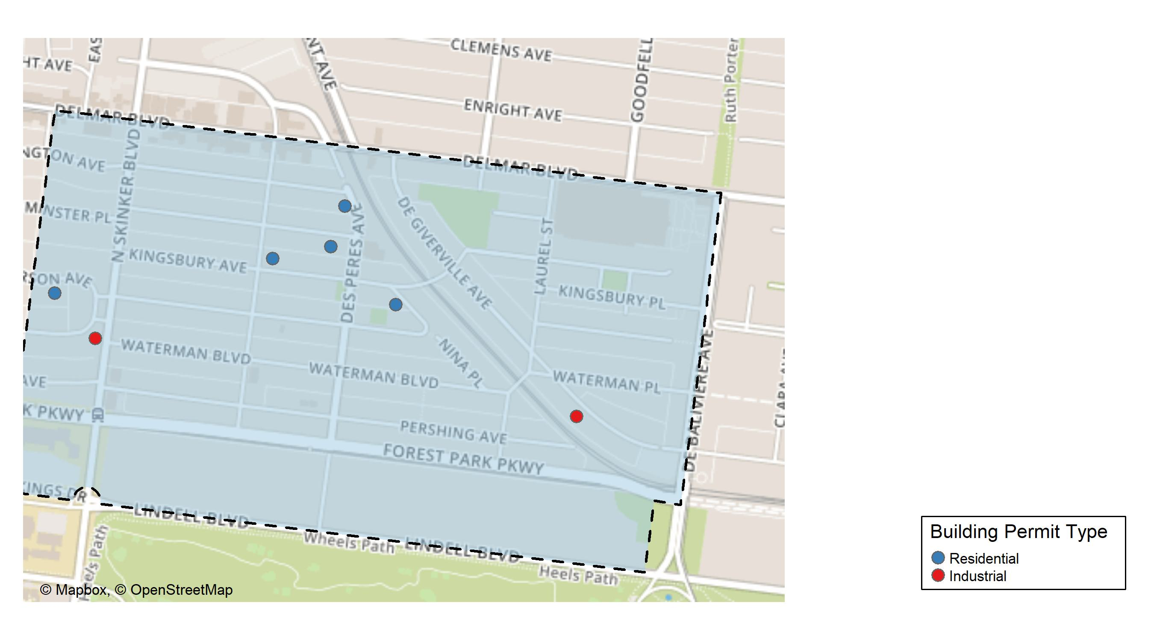
Skinker DeBaliviere

Slide 21
Neighborhood Summary
December 2024 | December 2024 | December 2024 | December 2024
Permit Use | Average Cost | # of Permits | Total Value of Permits
Commercial | $0.0 | 0 | $0
Industrial | $5,800.0 | 2 | $11,600
Residential | $82,878.6 | 5 | $414,393
Last 6 Months | Last 6 Months | Last 6 Months | Last 6 Months
Permit Use | Average Cost | # of Permits | Total Value of Permits
Commercial | $185,709.88 | 8 | $1,485,679
Industrial | $117,700.00 | 5 | $588,500
Residential | $71,182.05 | 44 | $3,132,010

Slide 22
Skinker DeBaliviere Individual Permit Breakdown
Neighborhood | Owner | New Use | Cost | address
Skinker DeBaliviere | WILLIAMS, NANA | Industrial | $11,000 | 5768 DEGIVERVILLE AV
Skinker DeBaliviere | LAZAROFF, DAVID & GAYLE | Residential | $300,000 | 6240 MCPHERSON AV
Skinker DeBaliviere | STL SENIOR HOUSING LLC | Residential | $7,451 | 521 DES PERES AV
Skinker DeBaliviere | BERGERON, ADAM | Residential | $68,120 | 5920 NINA PL
Skinker DeBaliviere | MORITZ, CHRISTOPHER R | Residential | $10,822 | 6059 KINGSBURY AV
Skinker DeBaliviere | THREE DOORS PROPERTIES LLC | Residential | $28,000 | 6014 WESTMINSTER PL
Skinker DeBaliviere | MACHAFFIE, SAMUEL & ALIX WEITMAN & T | Industrial | $600 | 6204 WATERMAN BLVD

Slide 23
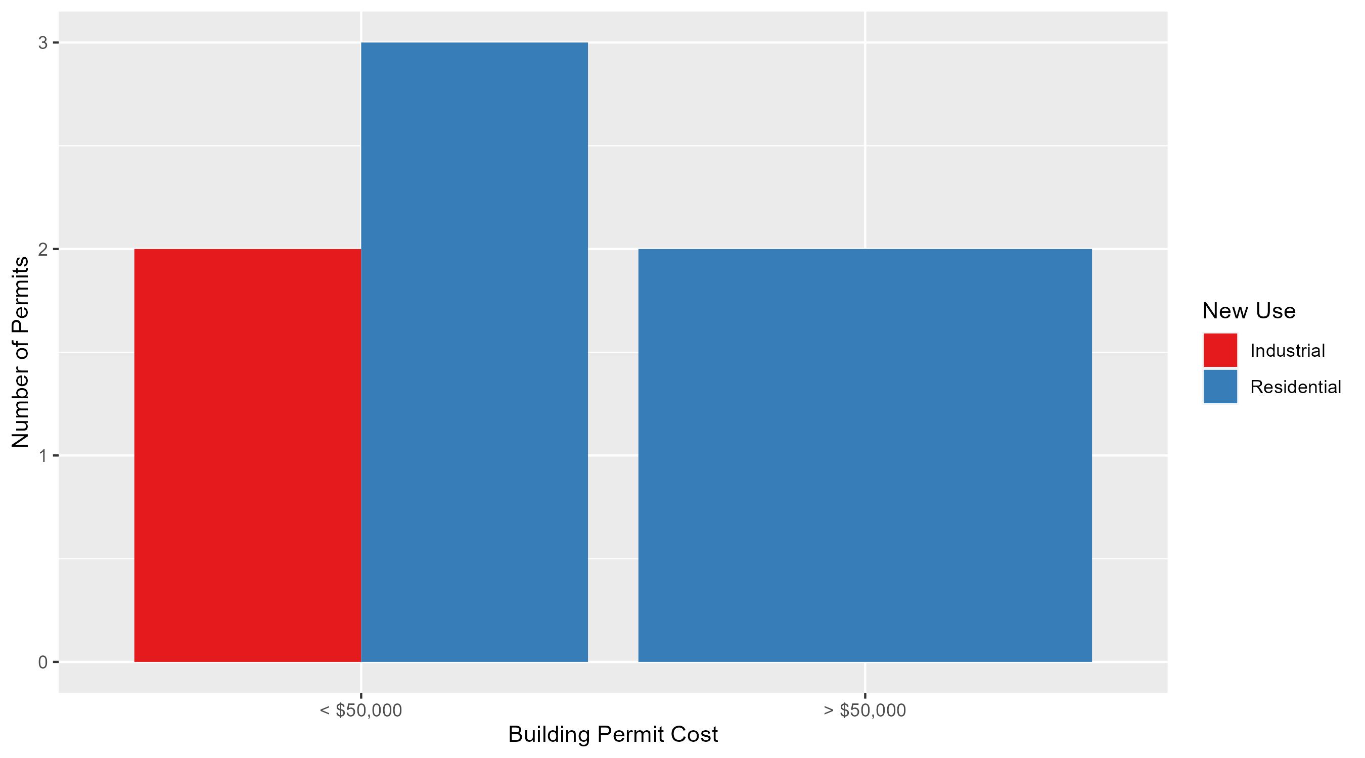
Skinker DeBaliviere Permit Cost Breakdown

Slide 24
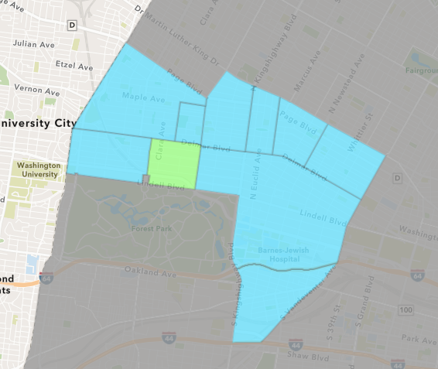
DeBaliviere Place
December 2024 Neighborhood Cost Breakdown
  Mean: $6,682
  Median: $6,682
  Range: $6,541 - $6,823

Slide 25
DeBaliviere Place: Summary Notes
2 building permits in December 2024
  Infinite change compared to December 2023 (0 total building permits)
  $6,682: Average building permit cost in December 2024
    Infinite change compared to December 2023 ($0)
46 total building permits in 2024
  6.98% change YTD compared to this time in 2023 (43 total building permits)
  $110,270: YTD average building permit cost in 2024
    -31.92% change YTD compared to this time in 2023 ($161,961)

Slide 26
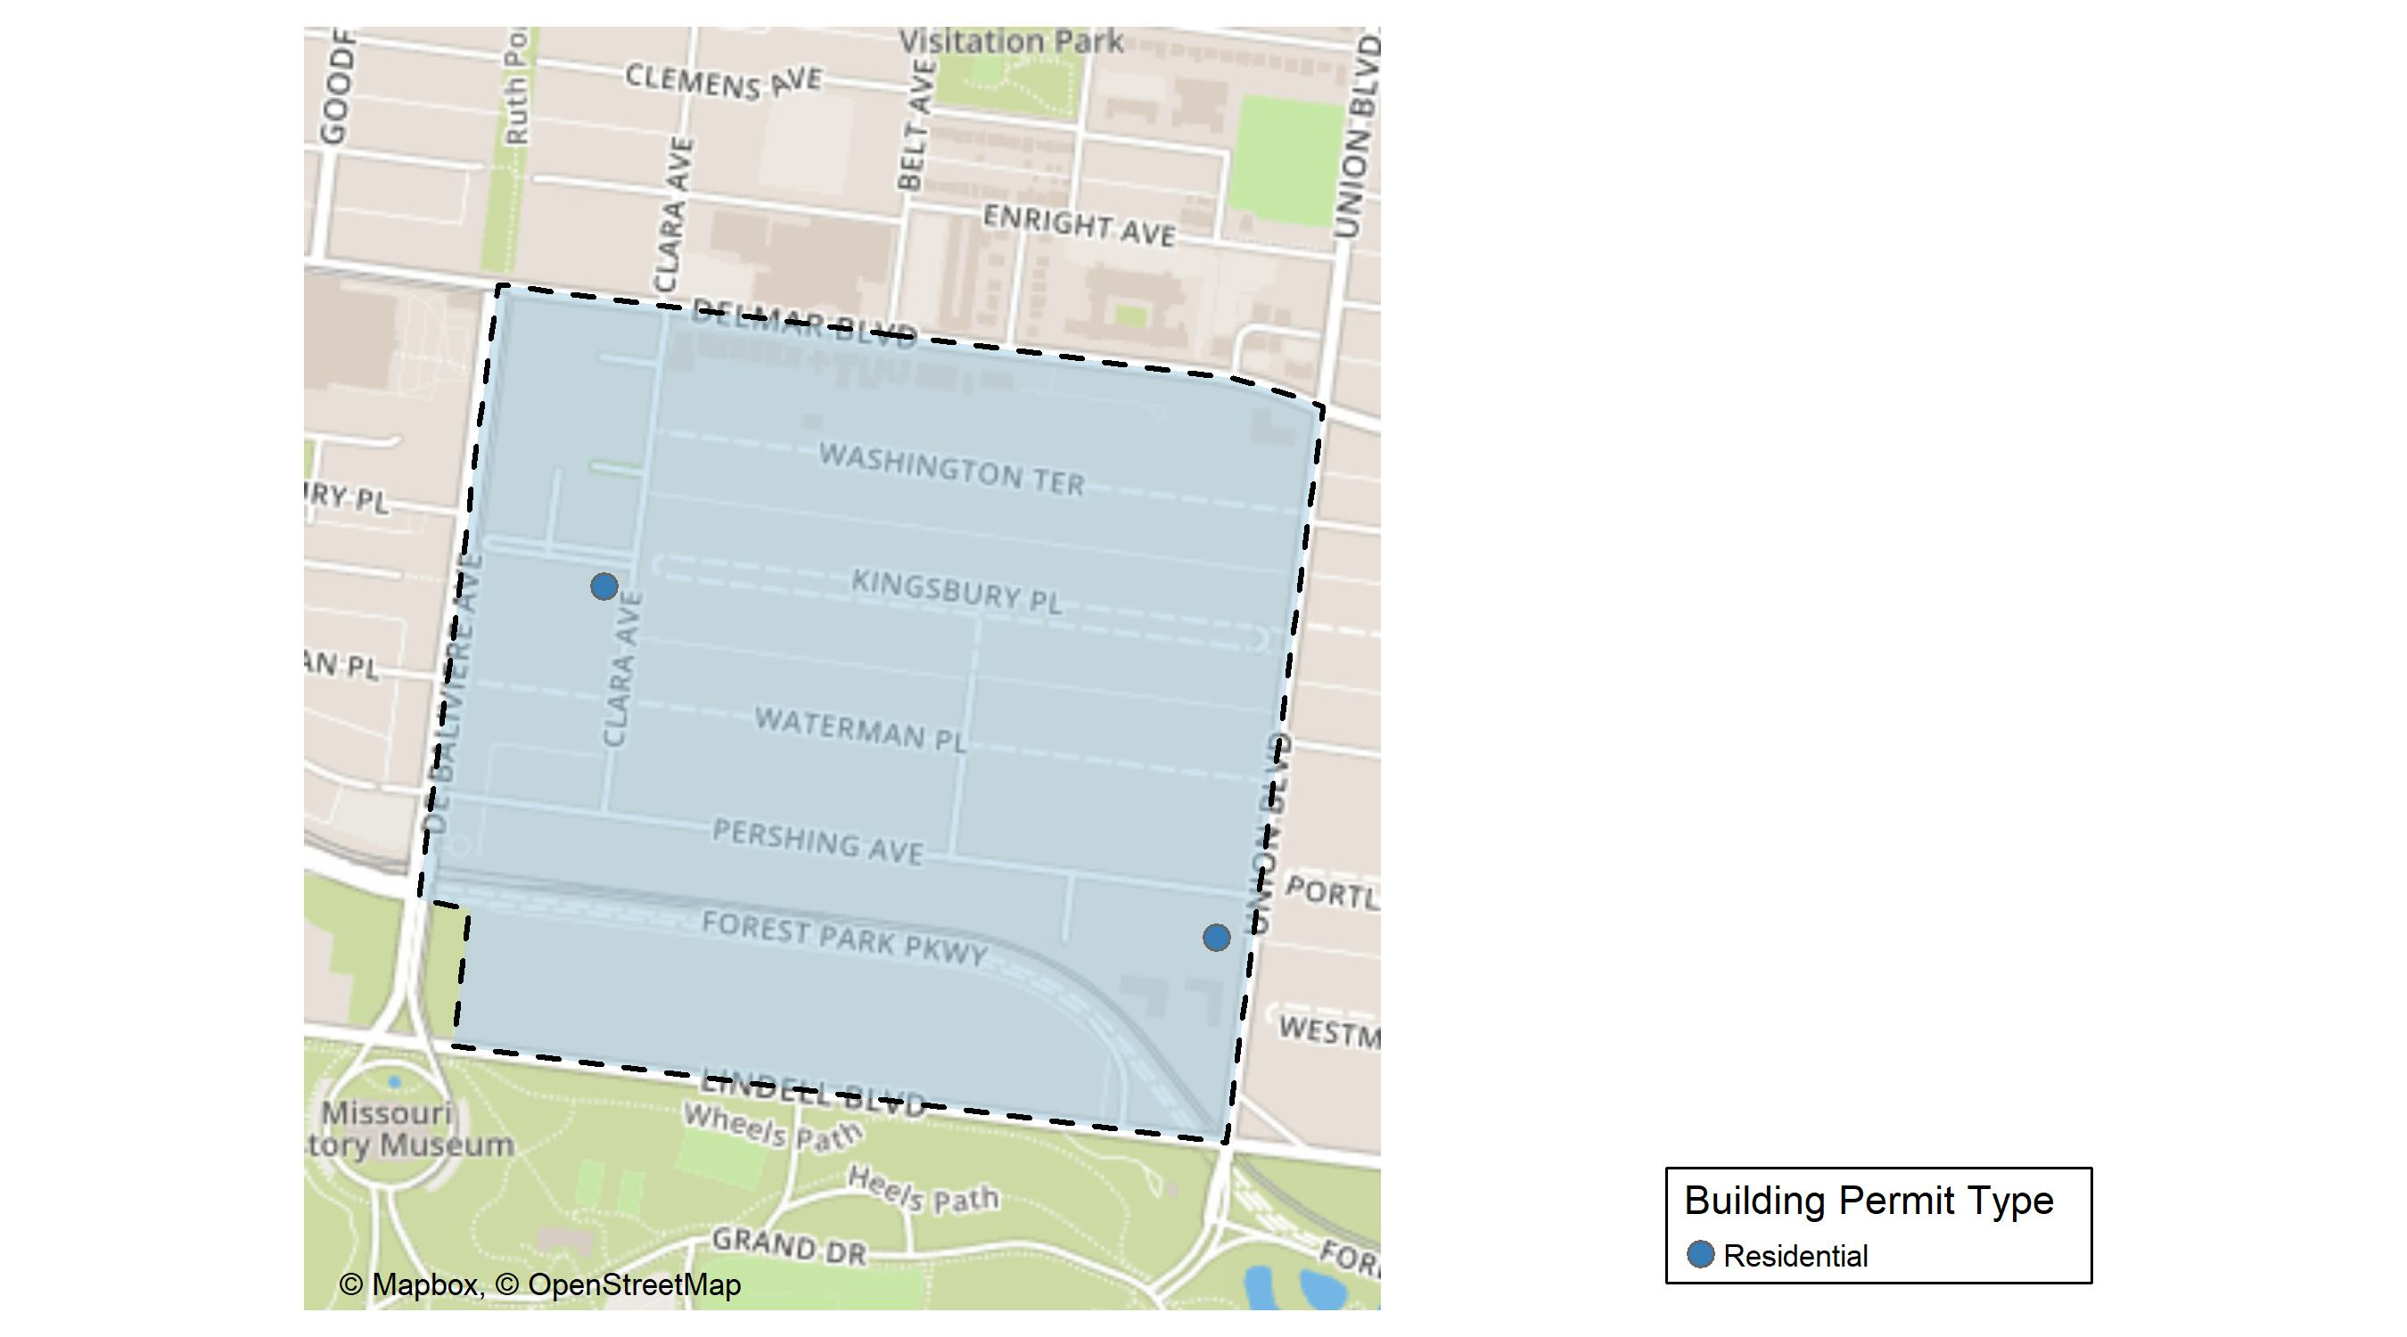
DeBaliviere Place

Slide 27
Neighborhood Summary
December 2024 | December 2024 | December 2024 | December 2024
Permit Use | Average Cost | # of Permits | Total Value of Permits
Commercial | $0 | 0 | $0
Industrial | $0 | 0 | $0
Residential | $6,682 | 2 | $13,364
Last 6 Months | Last 6 Months | Last 6 Months | Last 6 Months
Permit Use | Average Cost | # of Permits | Total Value of Permits
Commercial | $32,796.67 | 3 | $98,390
Industrial | $0.00 | 0 | $0
Residential | $91,645.12 | 25 | $2,291,128

Slide 28
DeBaliviere Place Individual Permit Breakdown
Neighborhood | Owner | New Use | Cost | address
DeBaliviere Place | ORO 275 PARKSIDE LLC & | Residential | $6,823 | 275 UNION BLVD
DeBaliviere Place | AMORNSAWADWATTANA | Residential | $6,541 | 437 CLARA AV

Slide 29
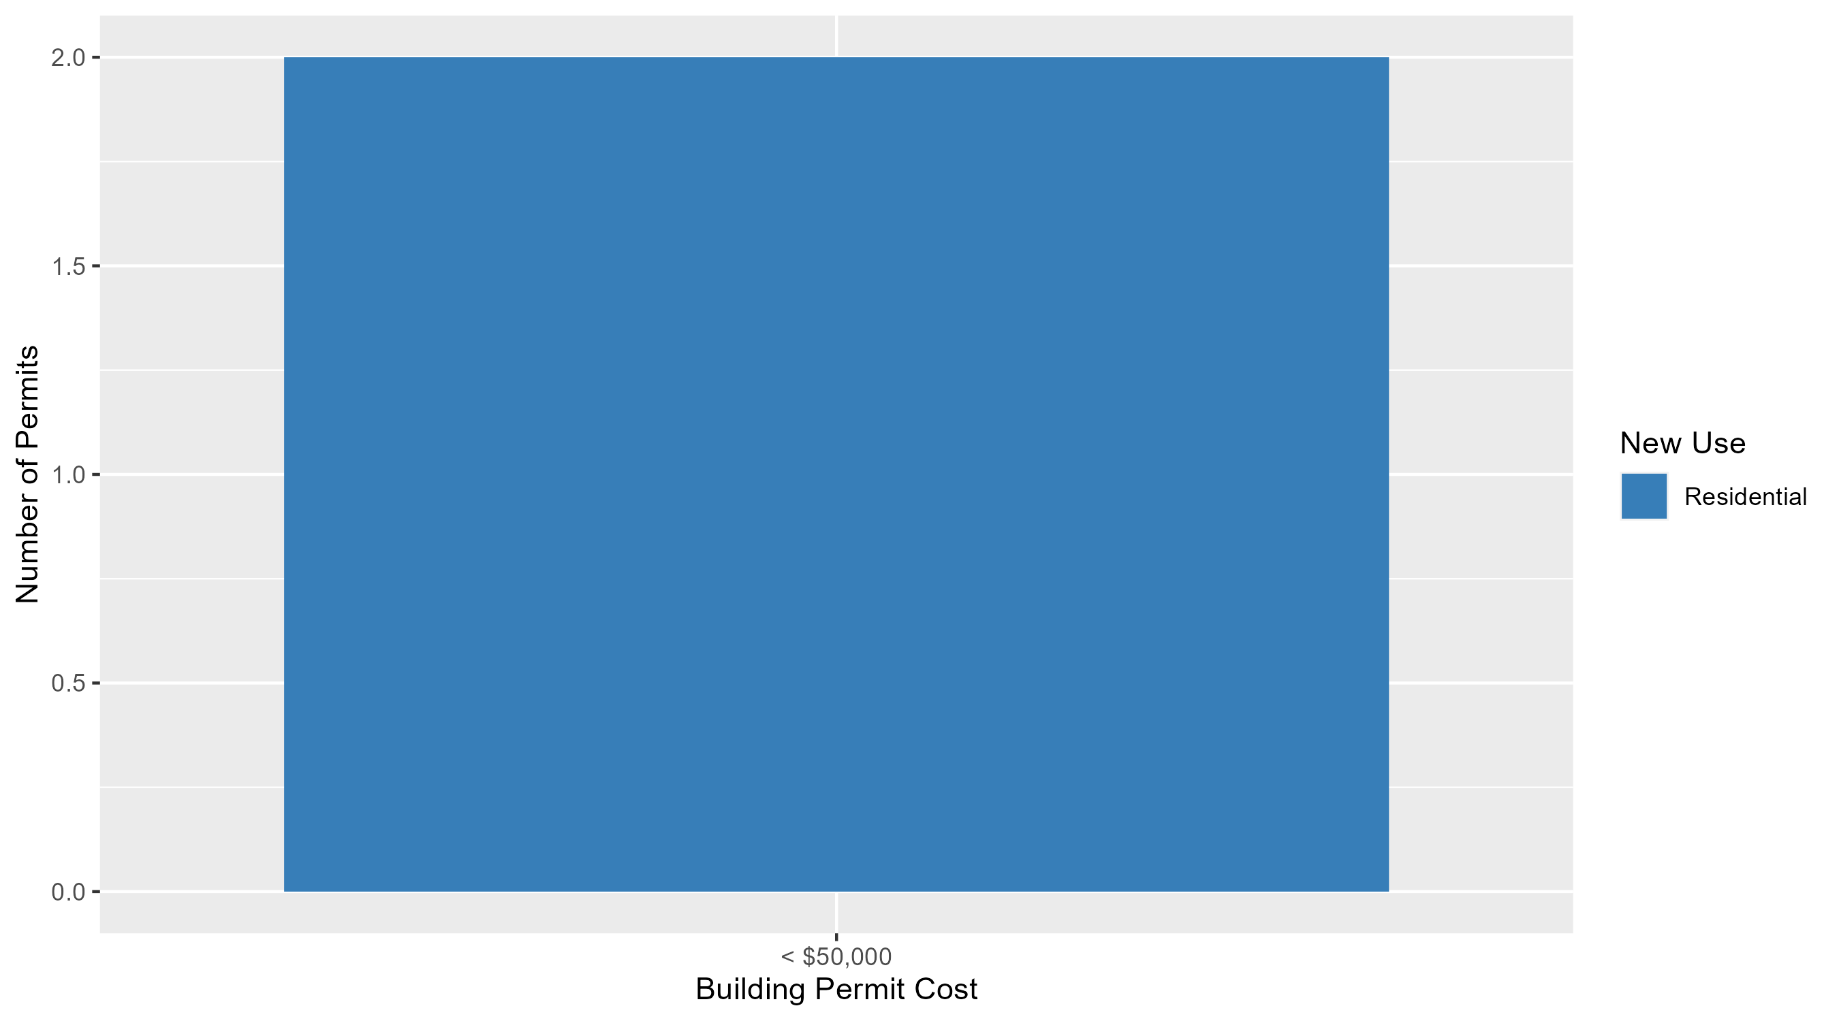
DeBaliviere Place Permit Cost Breakdown

Slide 30
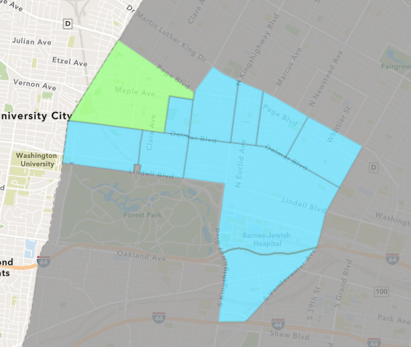
West End
December 2024 Neighborhood Cost Breakdown
  Mean: $13,990
  Median: $11,470
  Range: $500 - $30,000

Slide 31
West End: Summary Notes
3 building permits in December 2024
  0.00% change compared to December 2023 (3 total building permits)
  $13,990: Average building permit cost in December 2024
    -0.07% change compared to December 2023 ($14,000)
69 total building permits in 2024
  -20.69% change YTD compared to this time in 2023 (87 total building permits)
  $93,028: YTD average building permit cost in 2024
    33.40% change YTD compared to this time in 2023 ($69,737)

Slide 32
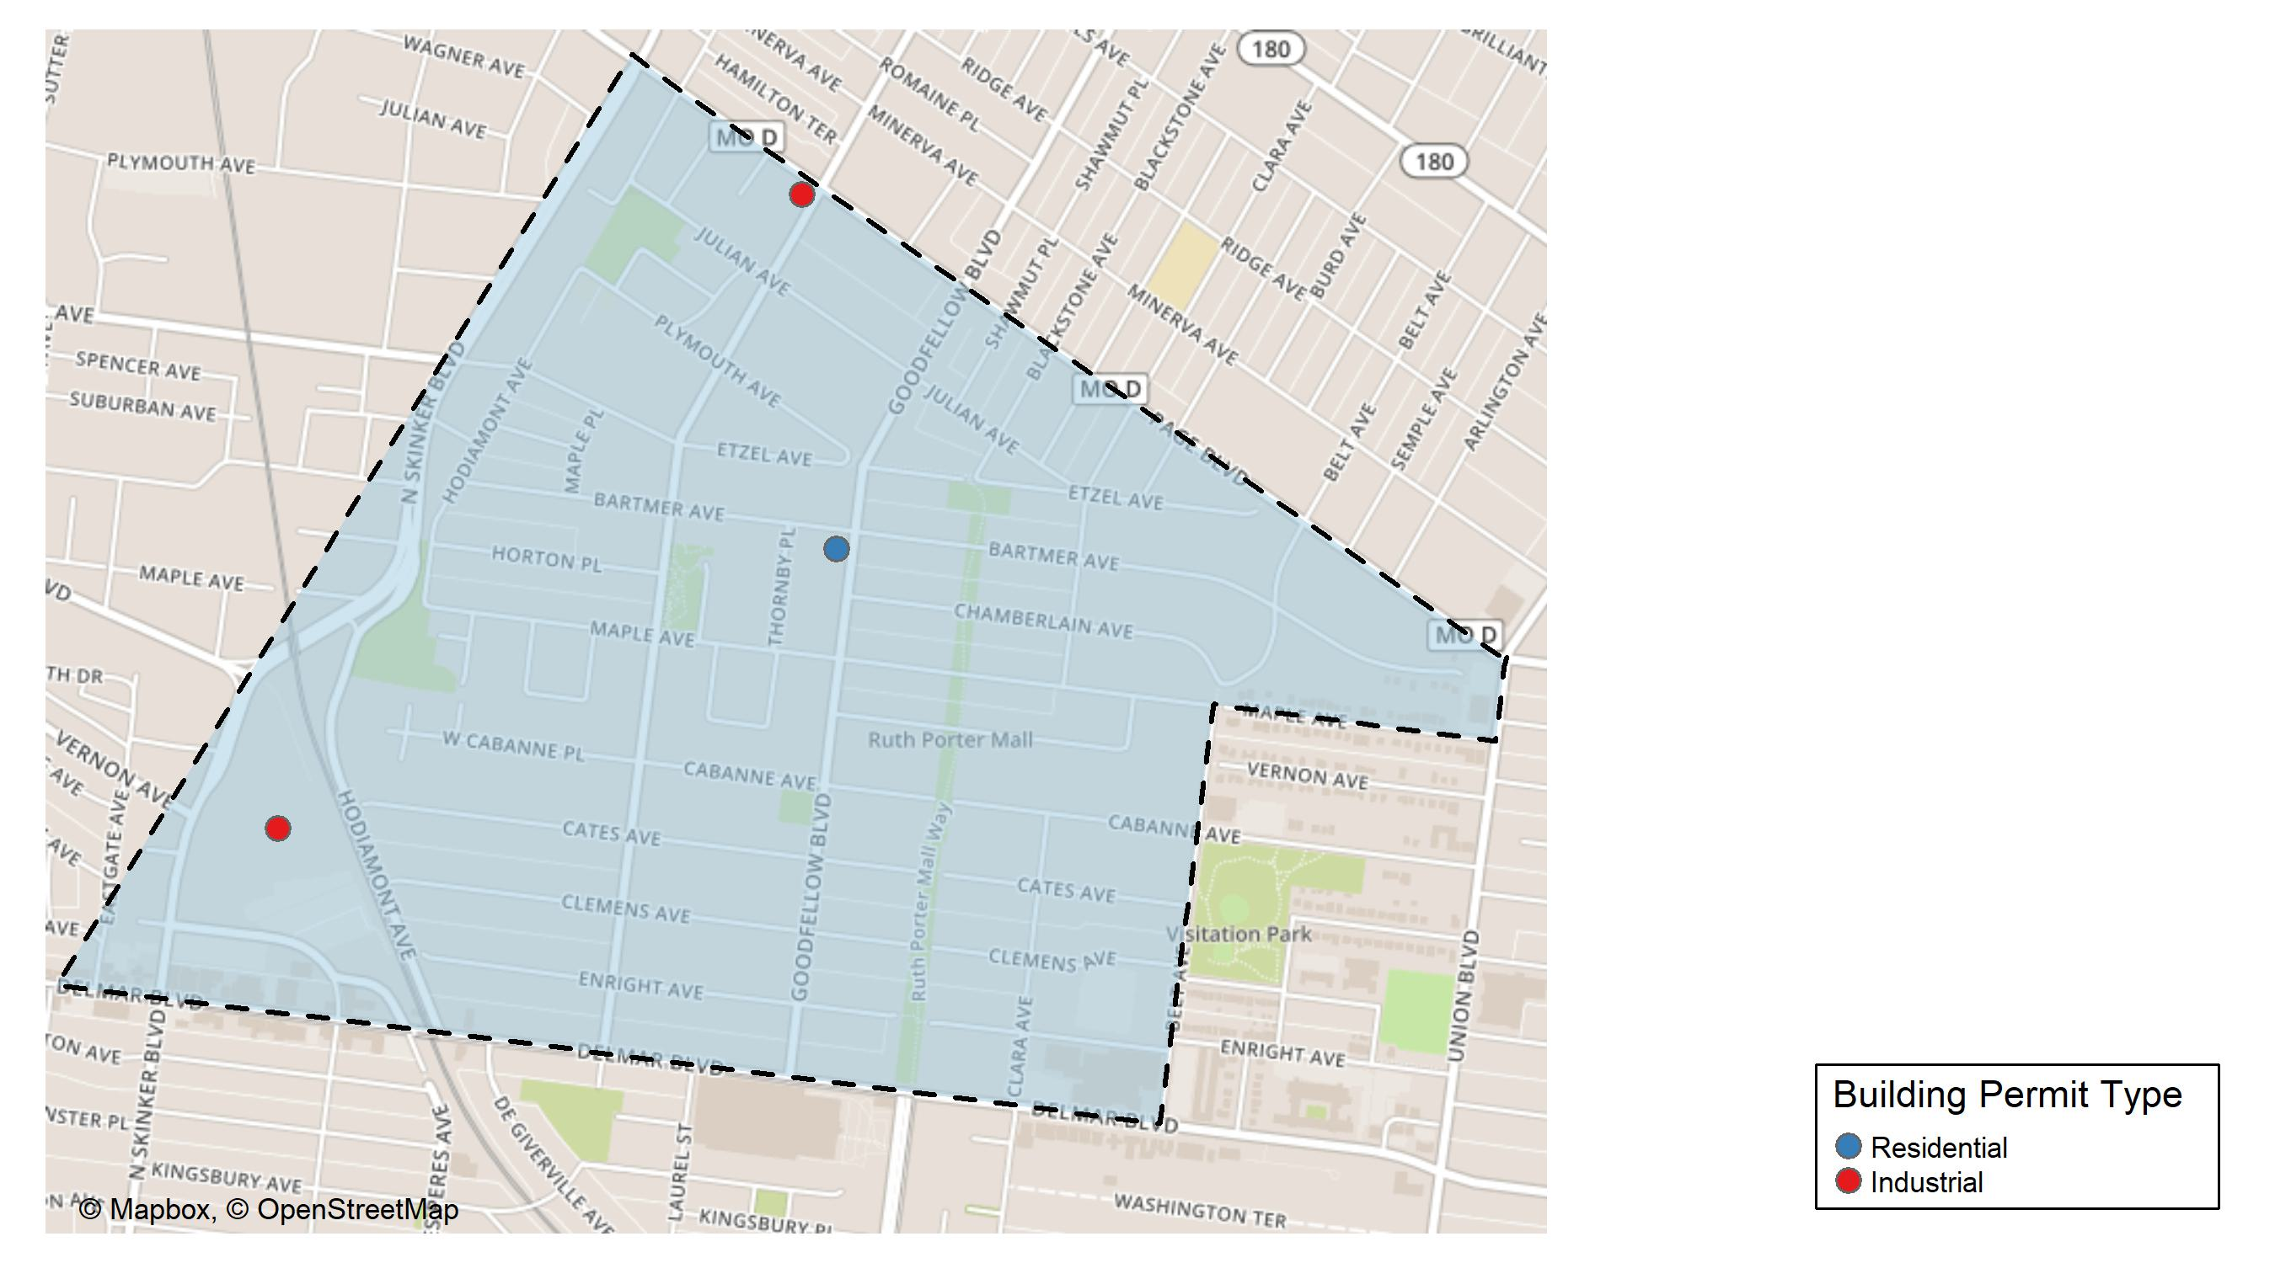
West End

Slide 33
Neighborhood Summary
December 2024 | December 2024 | December 2024 | December 2024
Permit Use | Average Cost | # of Permits | Total Value of Permits
Commercial | $0 | 0 | $0
Industrial | $15,250 | 2 | $30,500
Residential | $11,470 | 1 | $11,470
Last 6 Months | Last 6 Months | Last 6 Months | Last 6 Months
Permit Use | Average Cost | # of Permits | Total Value of Permits
Commercial | $22,842.00 | 5 | $114,210
Industrial | $439,045.50 | 4 | $1,756,182
Residential | $16,116.14 | 21 | $338,439

Slide 34
West End Individual Permit Breakdown
Neighborhood | Owner | New Use | Cost | address
West End | CARLSON, GORDON D | Industrial | $500 | 1295-97 HAMILTON AV
West End | WASHINGTON UNIVERSITY | Industrial | $30,000 | 700 ROSEDALE AV
West End | RANSOM, DONNA CHRISTINE | Residential | $11,470 | 5806 BARTMER AV

Slide 35
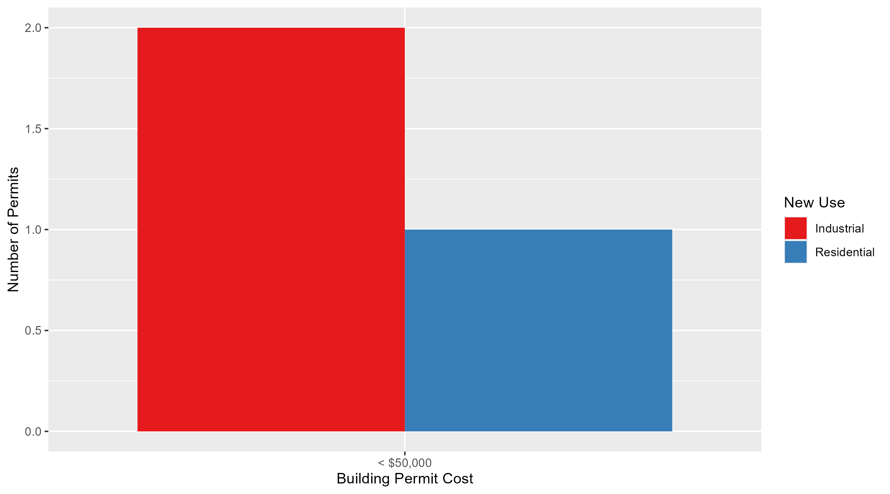
West End Permit Cost Breakdown

Slide 36
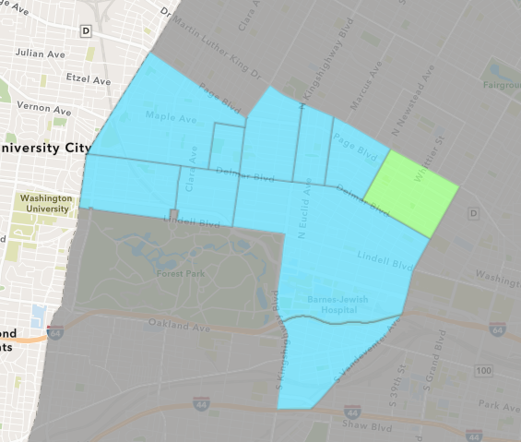
Vandeventer
December 2024 Neighborhood Cost Breakdown
  Mean: $1,000
  Median: $1,000
  Range: $1,000 - $1,000

Slide 37
Vandeventer: Summary Notes
1 building permits in December 2024
  0.00% change compared to December 2023 (1 total building permits)
  $1,000: Average building permit cost in December 2024
    -90.34% change compared to December 2023 ($10,347)
13 total building permits in 2024
  -13.33% change YTD compared to this time in 2023 (15 total building permits)
  $44,945: YTD average building permit cost in 2024
    -71.95% change YTD compared to this time in 2023 ($160,231)

Slide 38
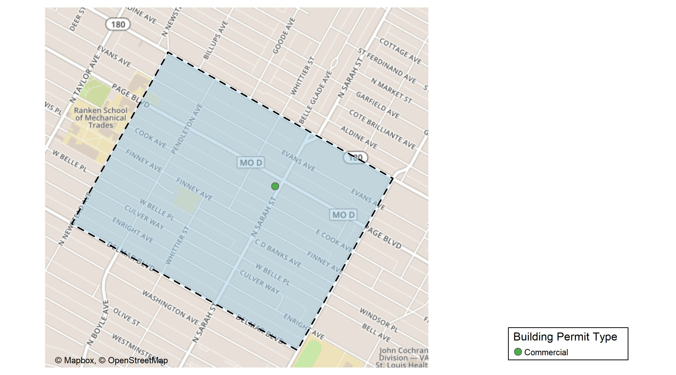
Vandeventer

Slide 39
Neighborhood Summary
December 2024 | December 2024 | December 2024 | December 2024
Permit Use | Average Cost | # of Permits | Total Value of Permits
Commercial | $1,000 | 1 | $1,000
Industrial | $0 | 0 | $0
Residential | $0 | 0 | $0
Last 6 Months | Last 6 Months | Last 6 Months | Last 6 Months
Permit Use | Average Cost | # of Permits | Total Value of Permits
Commercial | $6,815 | 2 | $13,630
Industrial | $3,000 | 1 | $3,000
Residential | $44,000 | 5 | $220,000

Slide 40
Vandeventer Individual Permit Breakdown
Neighborhood | Owner | New Use | Cost | address
Vandeventer | BURRUSS, RICHARD TRS | Commercial | $1,000 | 4100 PAGE BLVD

Slide 41
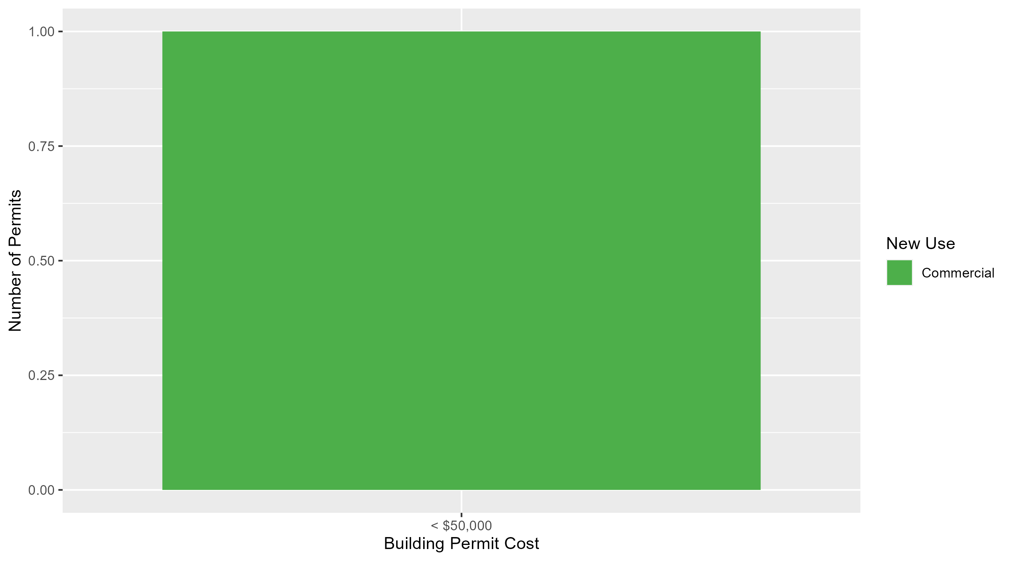
Vandeventer Permit Cost Breakdown

Slide 42
Additional Notes
Data retreived from https://www.stlouis-mo.gov/data/
Building permits with a cost of $0 were dropped
Building permits that were cancelled were dropped
Infinite change indicates 0 permits in the current or previous time period/comparison month so there was a overall increase or decrease

