Slide 1
St. Louis Central Corridor West Building Permits
Monthly Report: February 2024

Slide 2
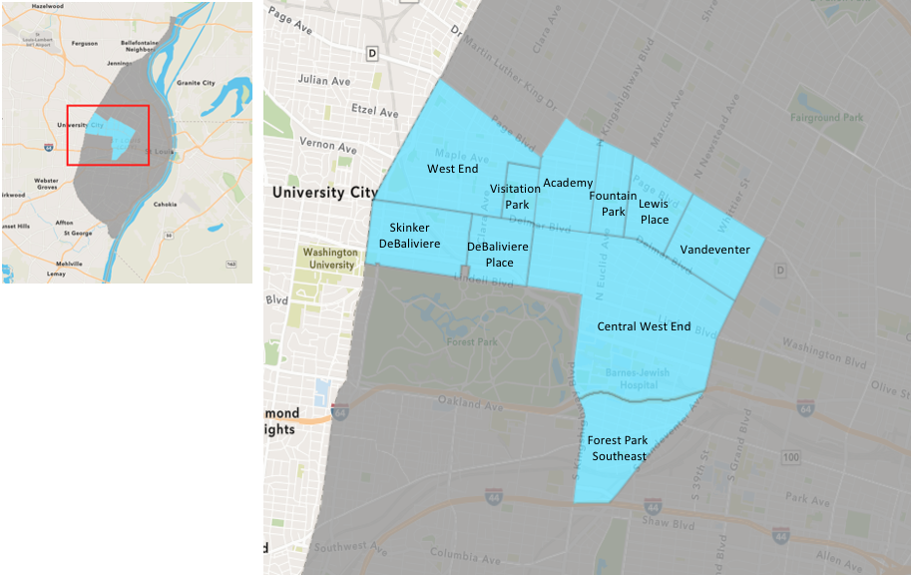
St. Louis Neighborhood Spatial Reference

Slide 3
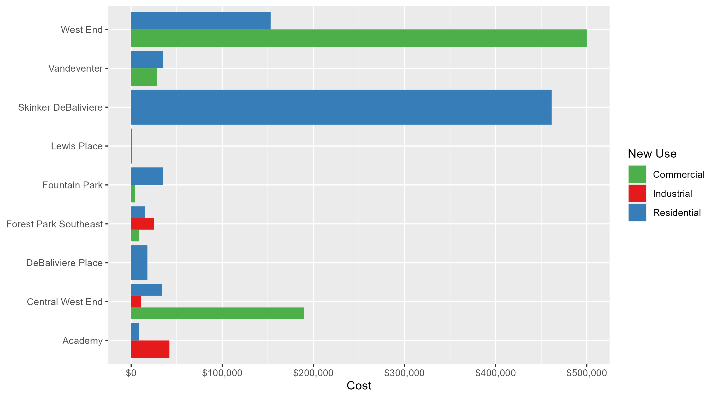
Neighborhood Summary: Average Building Permit Cost

Slide 4
Neighborhood Summary
February 2024 | February 2024 | February 2024 | February 2024
Neighborhood | Average Cost | # of Permits | Total Value of Permits
Academy | $25,350.5 | 2 | $50,701
Central West End | $110,907.5 | 22 | $2,439,966
DeBaliviere Place | $17,875.0 | 3 | $53,625
Forest Park Southeast | $16,020.0 | 5 | $80,100
Fountain Park | $19,500.0 | 2 | $39,000
Lewis Place | $1,000.0 | 1 | $1,000
Skinker DeBaliviere | $461,455.0 | 2 | $922,910
Vandeventer | $31,650.0 | 2 | $63,300
Visitation Park | $0.0 | 0 | $0
West End | $252,142.9 | 7 | $1,765,000
Last 6 Months | Last 6 Months | Last 6 Months | Last 6 Months
Neighborhood | Average Cost | # of Permits | Total Value of Permits
Academy | $30,597.44 | 18 | $550,754
Central West End | $299,052.09 | 206 | $61,604,730
DeBaliviere Place | $114,188.59 | 27 | $3,083,092
Forest Park Southeast | $61,975.86 | 42 | $2,602,986
Fountain Park | $29,981.43 | 14 | $419,740
Lewis Place | $50,676.71 | 7 | $354,737
Skinker DeBaliviere | $104,551.29 | 51 | $5,332,116
Vandeventer | $233,308.82 | 11 | $2,566,397
Visitation Park | $108,150.00 | 2 | $216,300
West End | $112,445.52 | 52 | $5,847,167

Slide 5
Core Neighborhoods

Slide 6
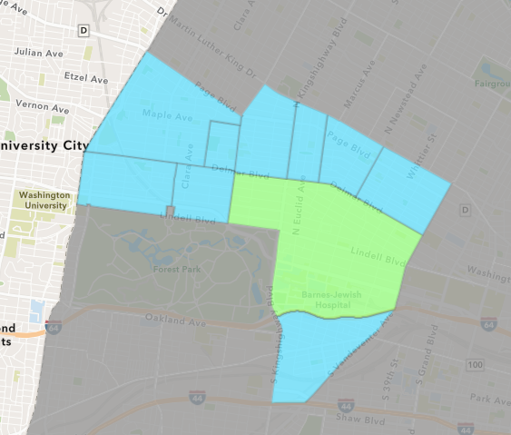
Central West End
February 2024 Neighborhood Cost Breakdown
  Mean: $110,908
  Median: $23,500
  Range: $2,014 - $1,500,000

Slide 7
Central West End: Summary Notes
22 building permits in February 2024
  -37.14% change compared to February 2023 (35 total building permits)
  $110,908: Average building permit cost in February 2024
    -80.39% change compared to February 2023 ($565,580)
49 total building permits in 2024
  -25.76% change YTD compared to this time in 2023 (66 total building permits)
  $617,587: YTD average building permit cost in 2024
    76.60% change YTD compared to this time in 2023 ($349,708)

Slide 8
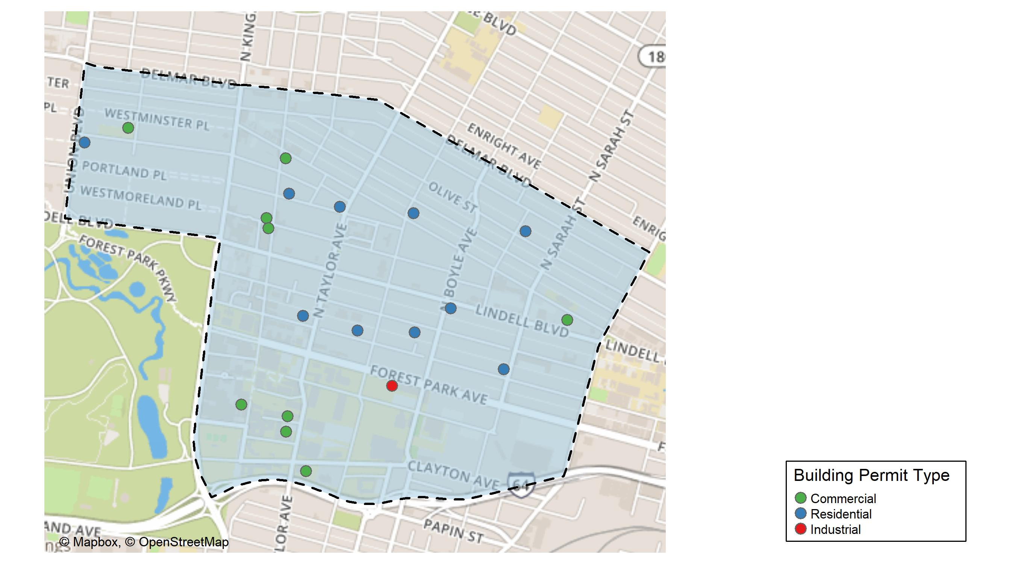
Central West End

Slide 9
Neighborhood Summary
February 2024 | February 2024 | February 2024 | February 2024
Permit Use | Average Cost | # of Permits | Total Value of Permits
Commercial | $189,799.6 | 11 | $2,087,796
Industrial | $11,050.0 | 1 | $11,050
Residential | $34,112.0 | 10 | $341,120
Last 6 Months | Last 6 Months | Last 6 Months | Last 6 Months
Permit Use | Average Cost | # of Permits | Total Value of Permits
Commercial | $611,448.04 | 93 | $56,864,668
Industrial | $14,330.00 | 5 | $71,650
Residential | $43,226.04 | 108 | $4,668,412

Slide 10
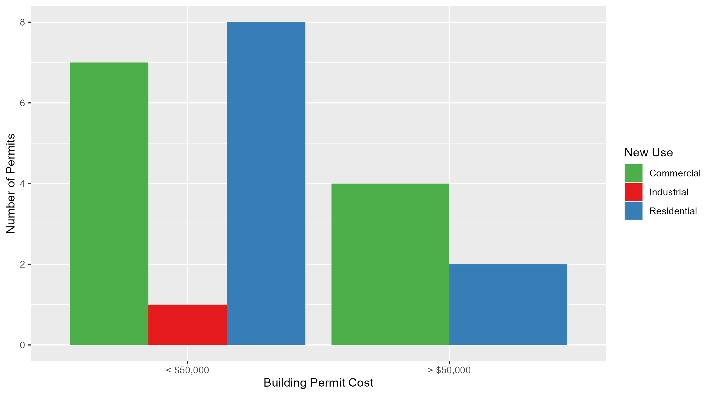
Central West End Permit Cost Breakdown

Slide 11
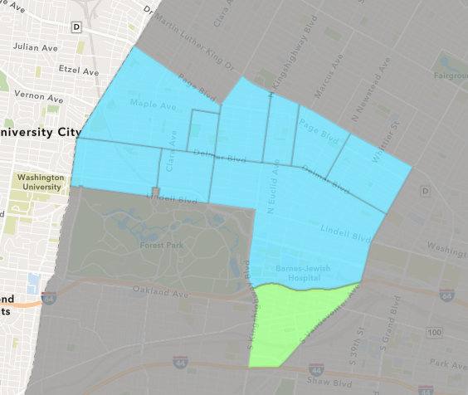
Forest Park Southeast
February 2024 Neighborhood Cost Breakdown
  Mean: $16,020
  Median: $10,250
  Range: $8,850 - $26,000

Slide 12
Forest Park Southeast: Summary Notes
5 building permits in February 2024
  0.00% change compared to February 2023 (5 total building permits)
  $16,020: Average building permit cost in February 2024
    -83.88% change compared to February 2023 ($99,379)
12 total building permits in 2024
  0.00% change YTD compared to this time in 2023 (12 total building permits)
  $24,279: YTD average building permit cost in 2024
    -58.49% change YTD compared to this time in 2023 ($58,484)

Slide 13
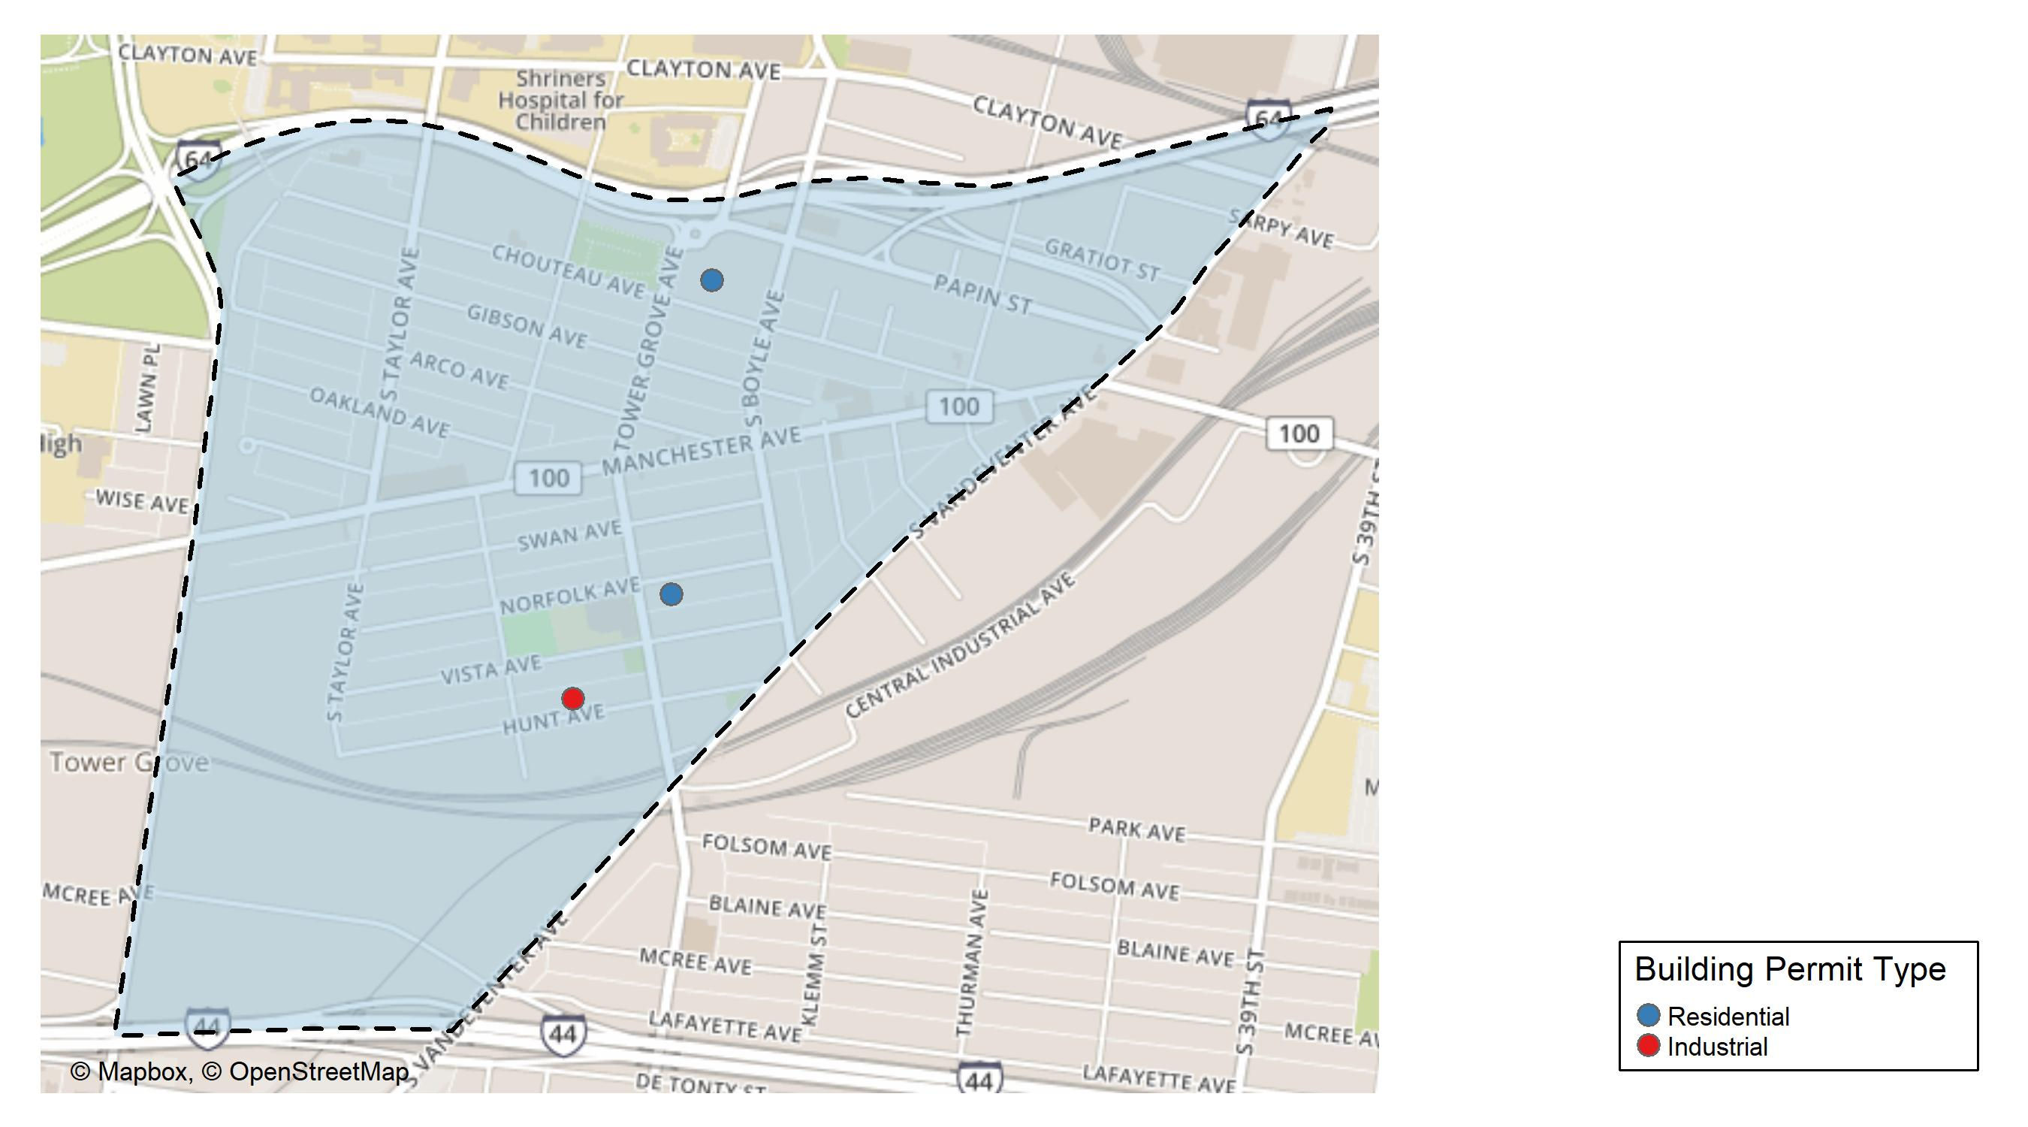
Forest Park Southeast

Slide 14
Neighborhood Summary
February 2024 | February 2024 | February 2024 | February 2024
Permit Use | Average Cost | # of Permits | Total Value of Permits
Commercial | $8,850.00 | 1 | $8,850
Industrial | $25,000.00 | 1 | $25,000
Residential | $15,416.67 | 3 | $46,250
Last 6 Months | Last 6 Months | Last 6 Months | Last 6 Months
Permit Use | Average Cost | # of Permits | Total Value of Permits
Commercial | $27,062.50 | 4 | $108,250
Industrial | $10,340.00 | 5 | $51,700
Residential | $74,031.39 | 33 | $2,443,036

Slide 15
Forest Park Southeast Individual Permit Breakdown
Neighborhood | Owner | New Use | Cost | address
Forest Park Southeast | CHOUTEAU HOUSE QALICB INC | Residential | $26,000 | 4321 CHOUTEAU AV
Forest Park Southeast | EYERWORKS GREENS LLC | Commercial | $8,850 | 4176 MANCHESTER AV
Forest Park Southeast | NEILSON, NATHAN A & JOSHUA D NORDMAN | Residential | $10,250 | 4256 NORFOLK AV
Forest Park Southeast | ANZAC DEVELOPMENTS LLC | Residential | $10,000 | 4343 HUNT AV
Forest Park Southeast | ANZAC DEVELOPMENTS LLC | Industrial | $25,000 | 4343 HUNT AV

Slide 16
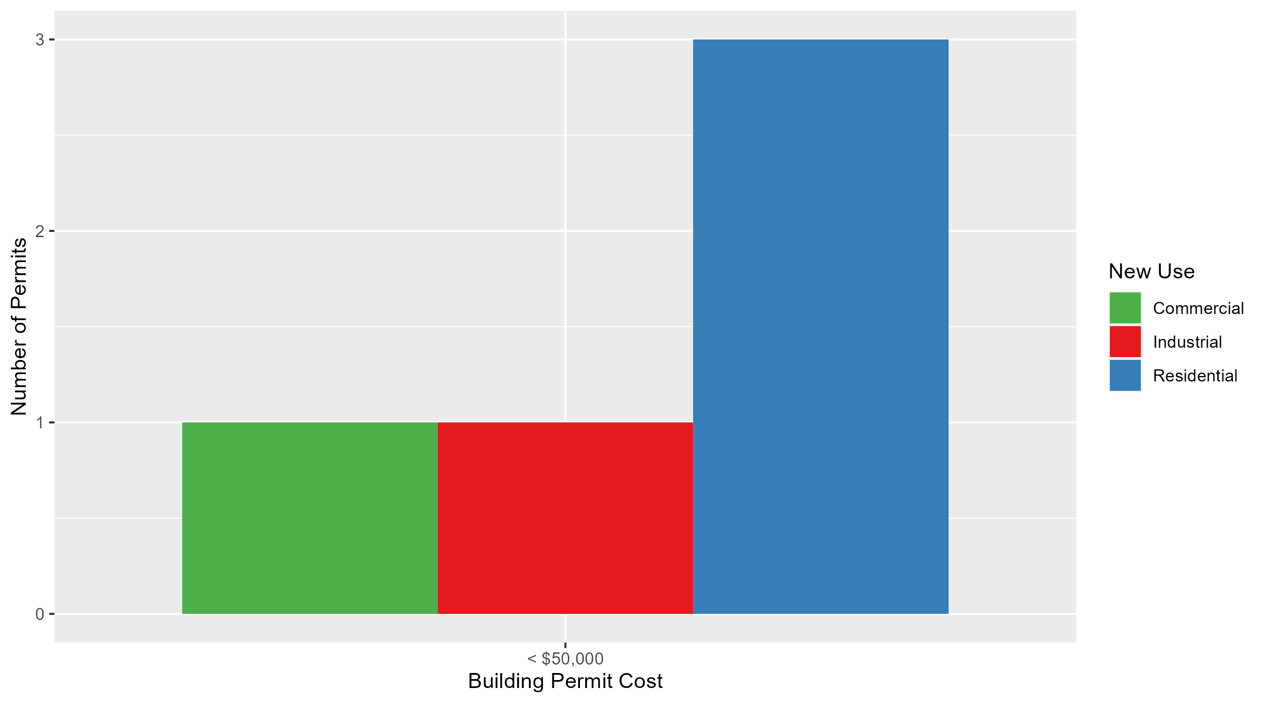
Forest Park Southeast Permit Cost Breakdown

Slide 17
Expanded Service Area

Slide 18
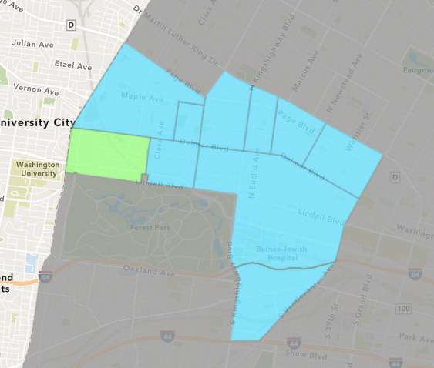
Skinker DeBaliviere
February 2024 Neighborhood Cost Breakdown
  Mean: $461,455
  Median: $461,455
  Range: $30,910 - $892,000

Slide 19
Skinker DeBaliviere: Summary Notes
2 building permits in February 2024
  0.00% change compared to February 2023 (2 total building permits)
  $461,455: Average building permit cost in February 2024
    778.96% change compared to February 2023 ($52,500)
8 total building permits in 2024
  -33.33% change YTD compared to this time in 2023 (12 total building permits)
  $136,270: YTD average building permit cost in 2024
    64.68% change YTD compared to this time in 2023 ($82,748)

Slide 20
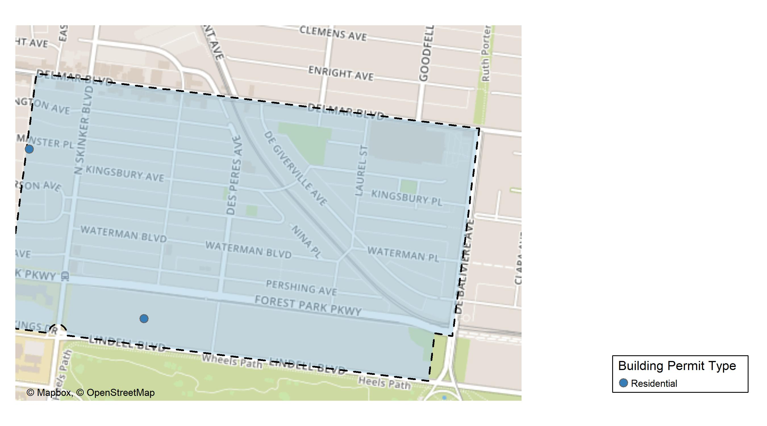
Skinker DeBaliviere

Slide 21
Neighborhood Summary
February 2024 | February 2024 | February 2024 | February 2024
Permit Use | Average Cost | # of Permits | Total Value of Permits
Commercial | $0 | 0 | $0
Industrial | $0 | 0 | $0
Residential | $461,455 | 2 | $922,910
Last 6 Months | Last 6 Months | Last 6 Months | Last 6 Months
Permit Use | Average Cost | # of Permits | Total Value of Permits
Commercial | $7,275.0 | 4 | $29,100
Industrial | $16,450.0 | 2 | $32,900
Residential | $117,113.7 | 45 | $5,270,116

Slide 22
Skinker DeBaliviere Individual Permit Breakdown
Neighborhood | Owner | New Use | Cost | address
Skinker DeBaliviere | KHABELE, DINEO & JAMES W HUNTER | Residential | $892,000 | 6115 LINDELL BLVD
Skinker DeBaliviere | ROBISON, LEON R III & ANN R | Residential | $30,910 | 6252 WESTMINSTER PL

Slide 23
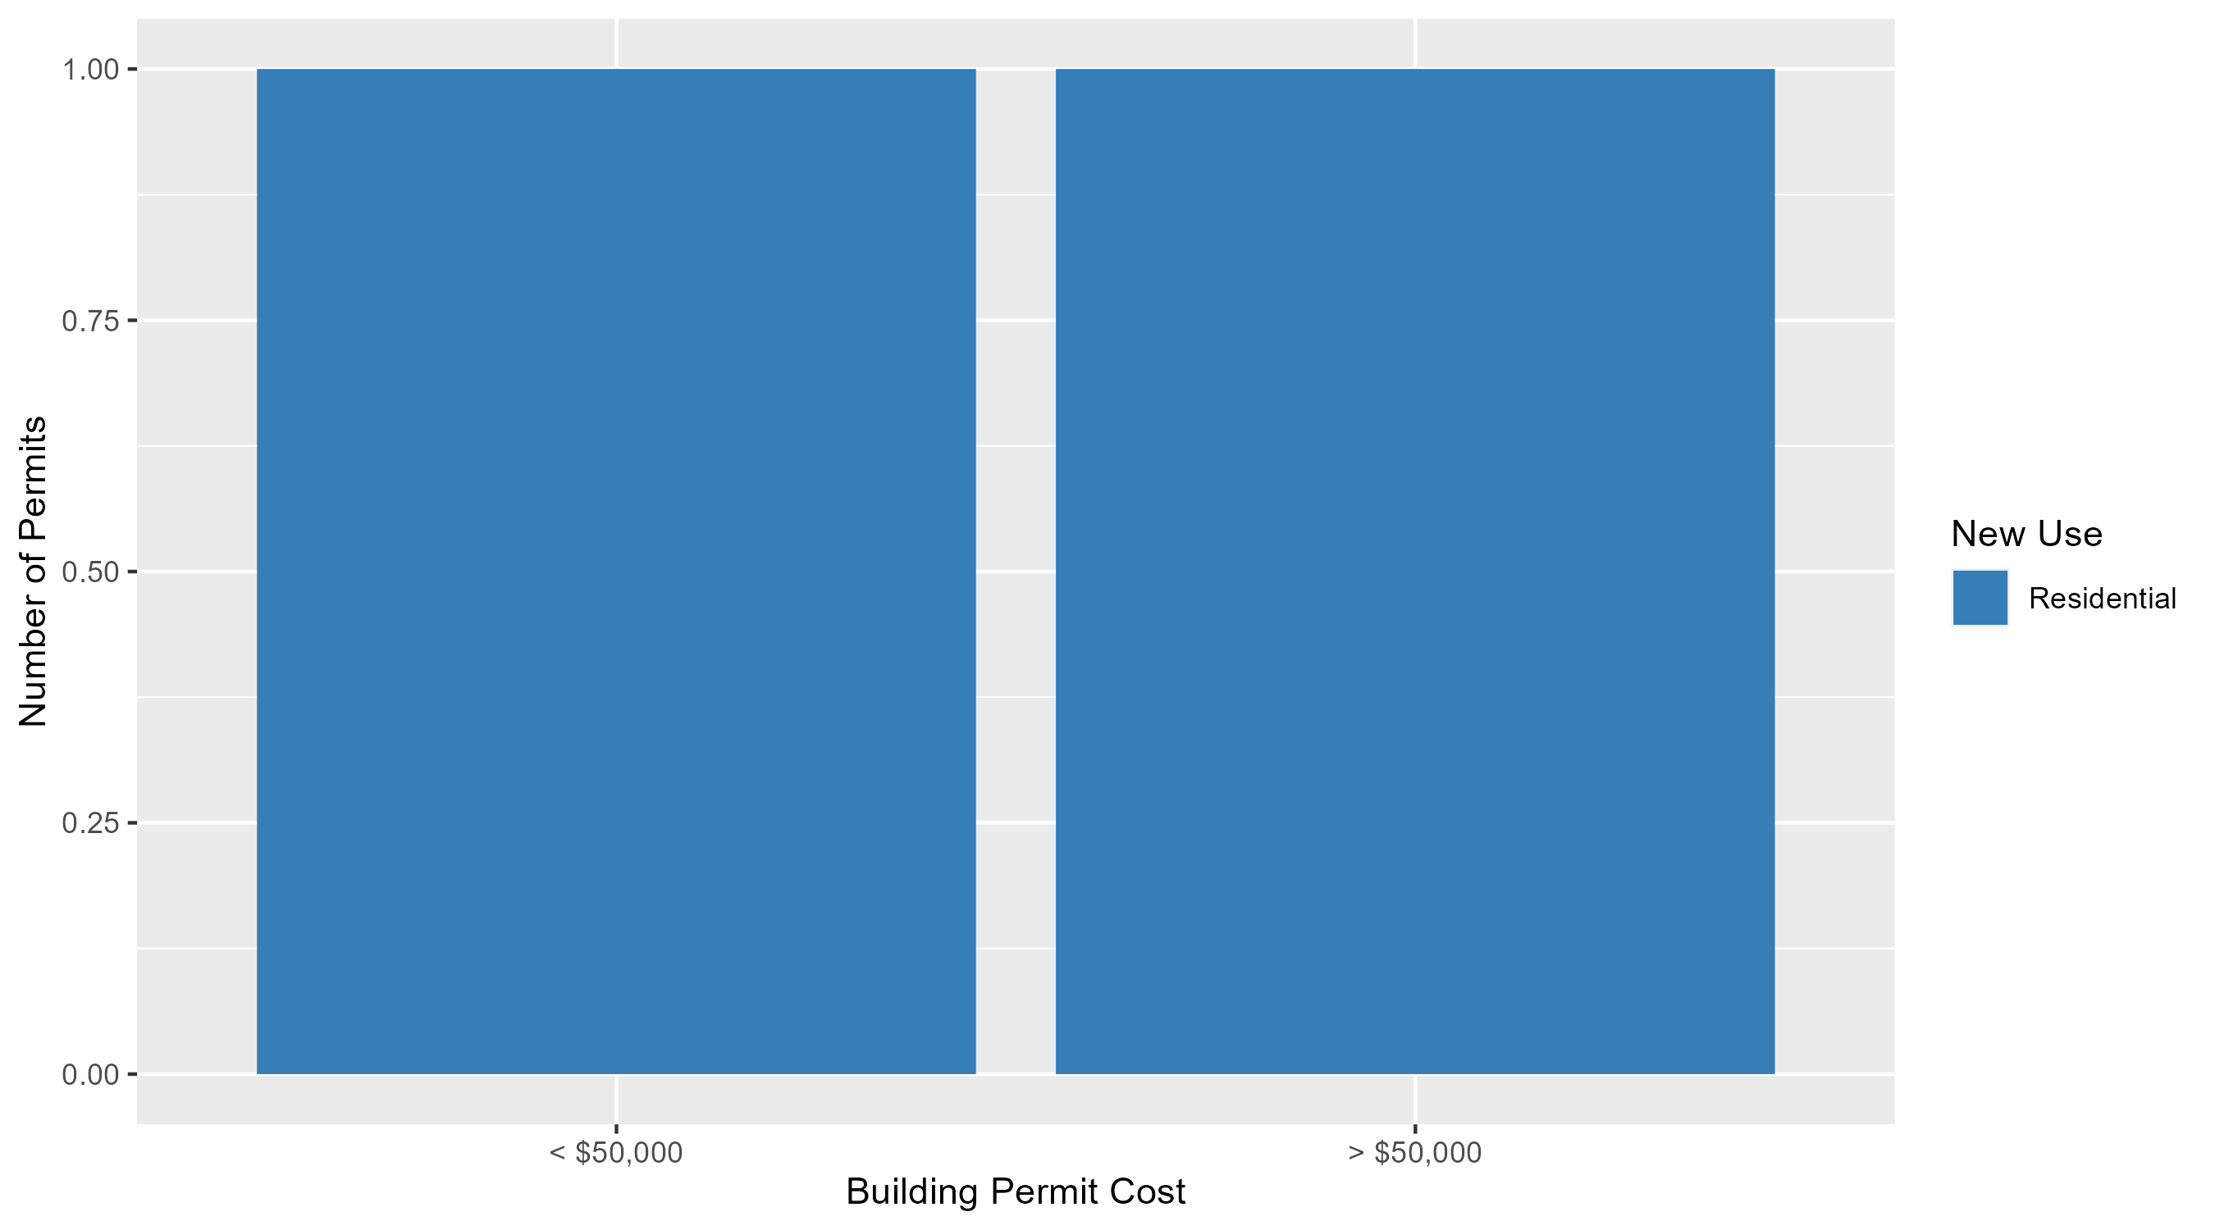
Skinker DeBaliviere Permit Cost Breakdown

Slide 24
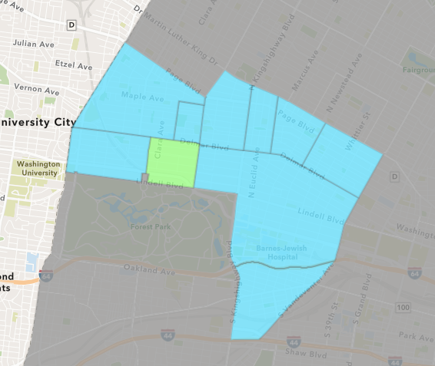
DeBaliviere Place
February 2024 Neighborhood Cost Breakdown
  Mean: $17,875
  Median: $10,000
  Range: $3,625 - $40,000

Slide 25
DeBaliviere Place: Summary Notes
3 building permits in February 2024
  200.00% change compared to February 2023 (1 total building permits)
  $17,875: Average building permit cost in February 2024
    -28.45% change compared to February 2023 ($24,983)
7 total building permits in 2024
  16.67% change YTD compared to this time in 2023 (6 total building permits)
  $55,518: YTD average building permit cost in 2024
    -47.09% change YTD compared to this time in 2023 ($104,939)

Slide 26
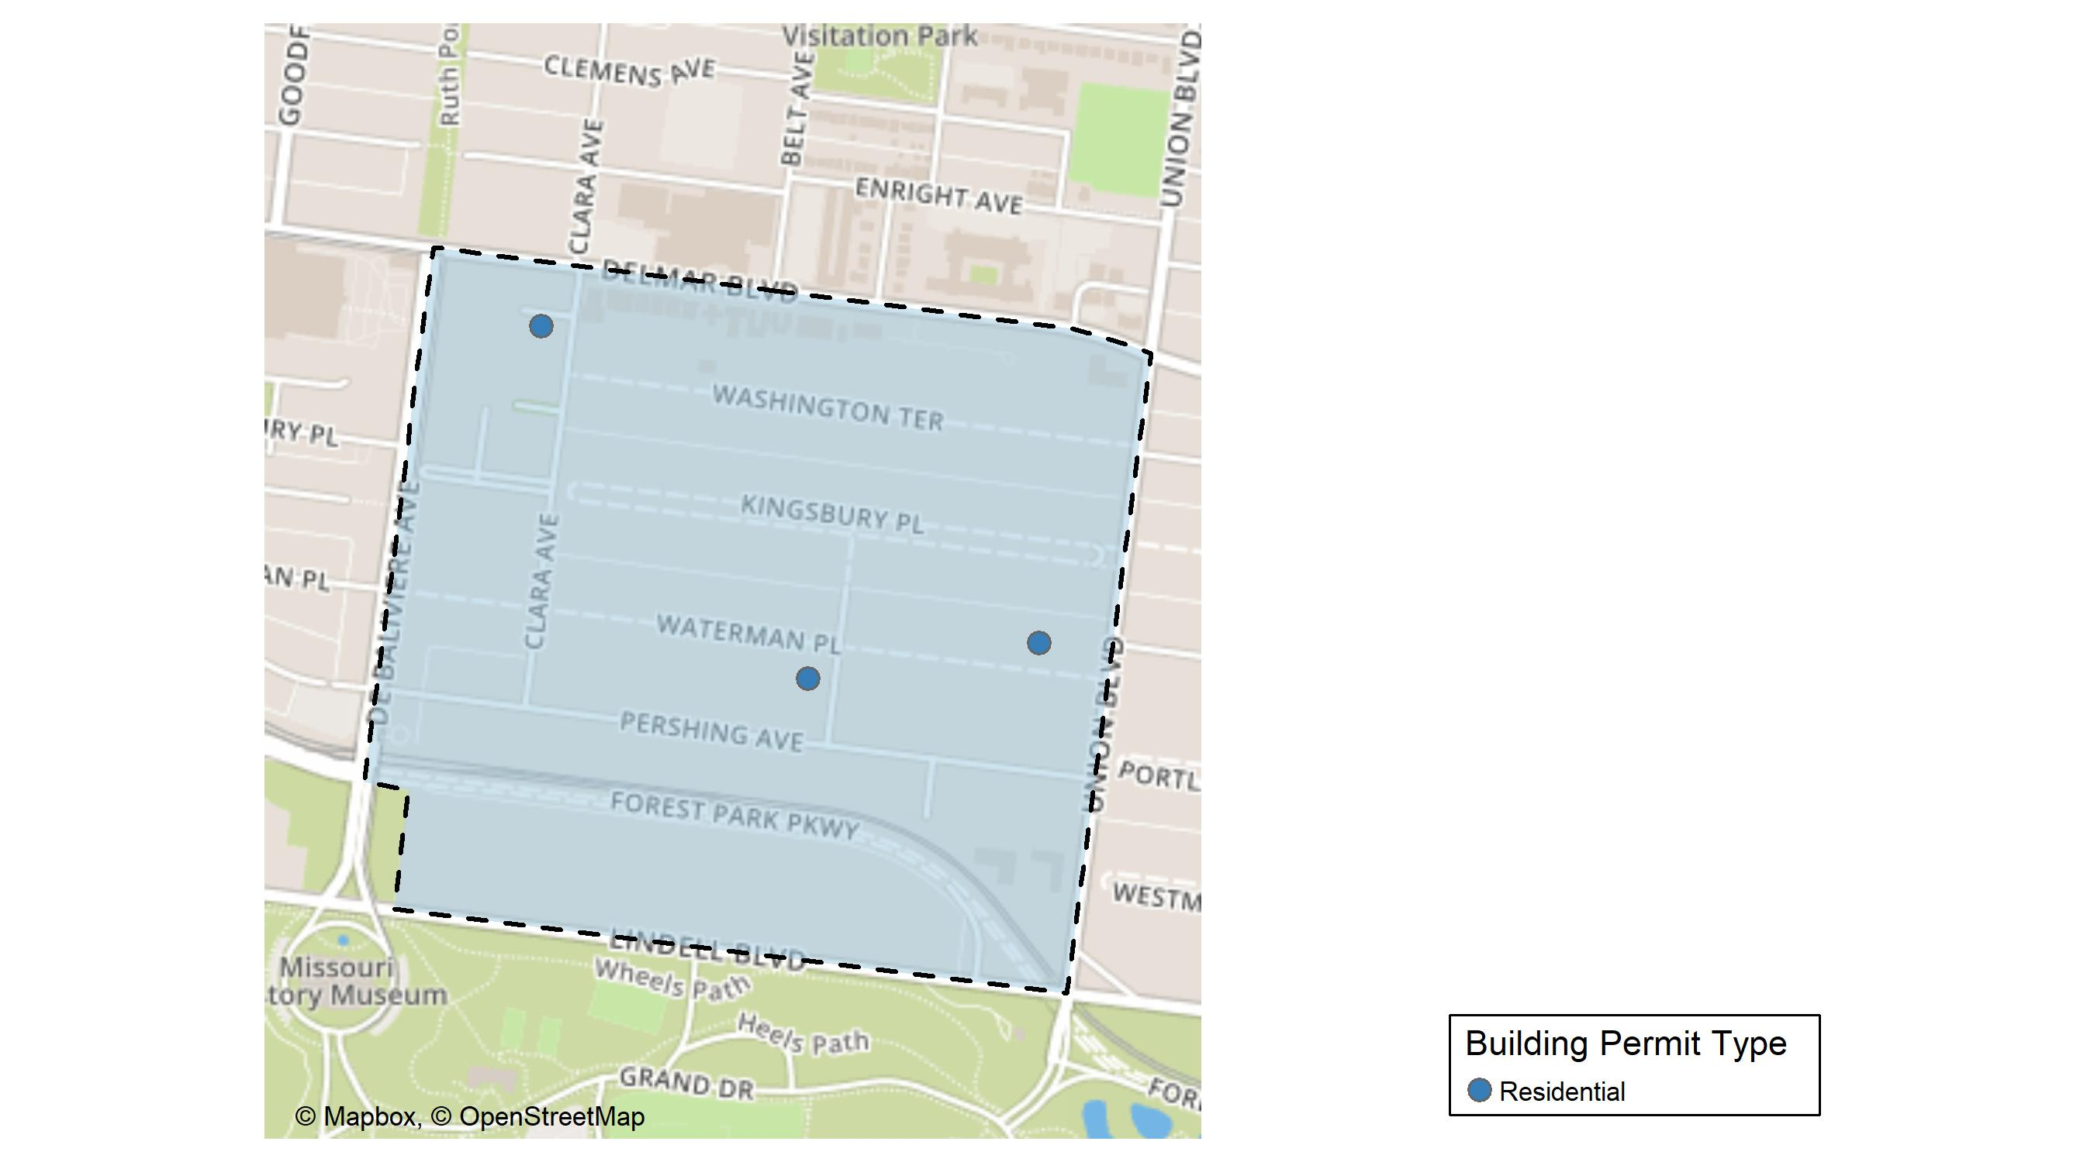
DeBaliviere Place

Slide 27
Neighborhood Summary
February 2024 | February 2024 | February 2024 | February 2024
Permit Use | Average Cost | # of Permits | Total Value of Permits
Commercial | $0 | 0 | $0
Industrial | $0 | 0 | $0
Residential | $17,875 | 3 | $53,625
Last 6 Months | Last 6 Months | Last 6 Months | Last 6 Months
Permit Use | Average Cost | # of Permits | Total Value of Permits
Commercial | $763,077.00 | 2 | $1,526,154
Industrial | $0.00 | 0 | $0
Residential | $62,277.52 | 25 | $1,556,938

Slide 28
DeBaliviere Place Individual Permit Breakdown
Neighborhood | Owner | New Use | Cost | address
DeBaliviere Place | JEWELL, DUANE K & GABRIELE K | Residential | $40,000 | 609 CLARA AV
DeBaliviere Place | BAKER, ERICA E TRS | Residential | $10,000 | 27 WATERMAN PL
DeBaliviere Place | HOWARD NATHANSON | Residential | $3,625 | 5510 WATERMAN BLVD

Slide 29
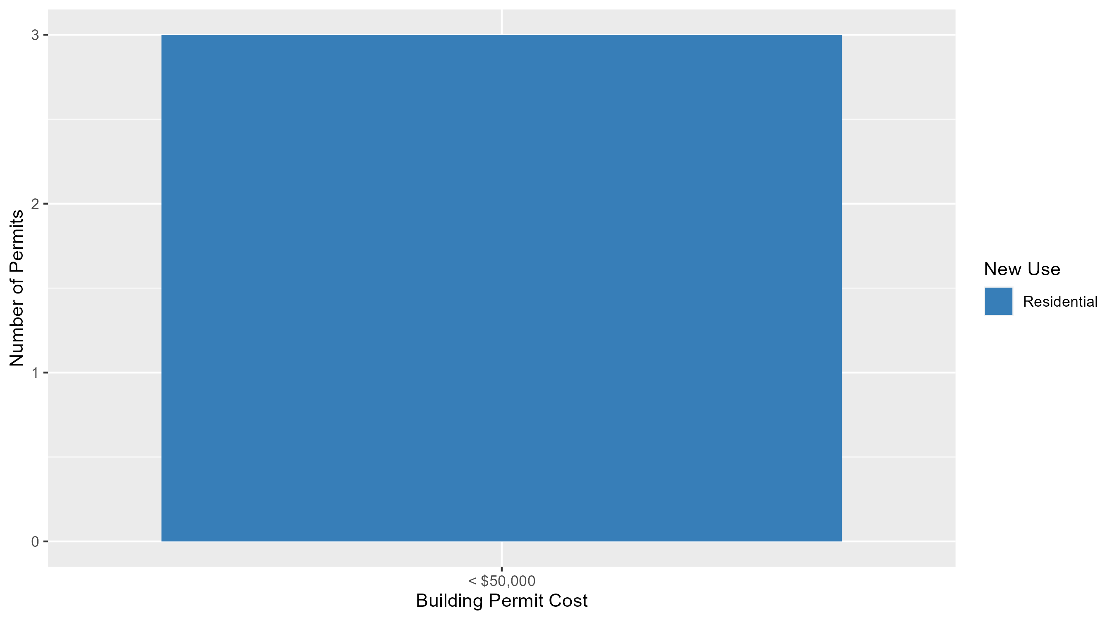
DeBaliviere Place Permit Cost Breakdown

Slide 30
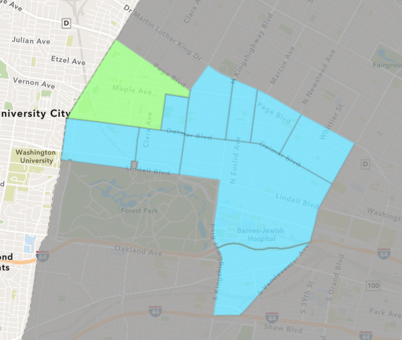
West End
February 2024 Neighborhood Cost Breakdown
  Mean: $252,143
  Median: $250,000
  Range: $5,000 - $850,000

Slide 31
West End: Summary Notes
7 building permits in February 2024
  250.00% change compared to February 2023 (2 total building permits)
  $252,143: Average building permit cost in February 2024
    74.49% change compared to February 2023 ($144,500)
16 total building permits in 2024
  33.33% change YTD compared to this time in 2023 (12 total building permits)
  $180,351: YTD average building permit cost in 2024
    210.37% change YTD compared to this time in 2023 ($58,109)

Slide 32
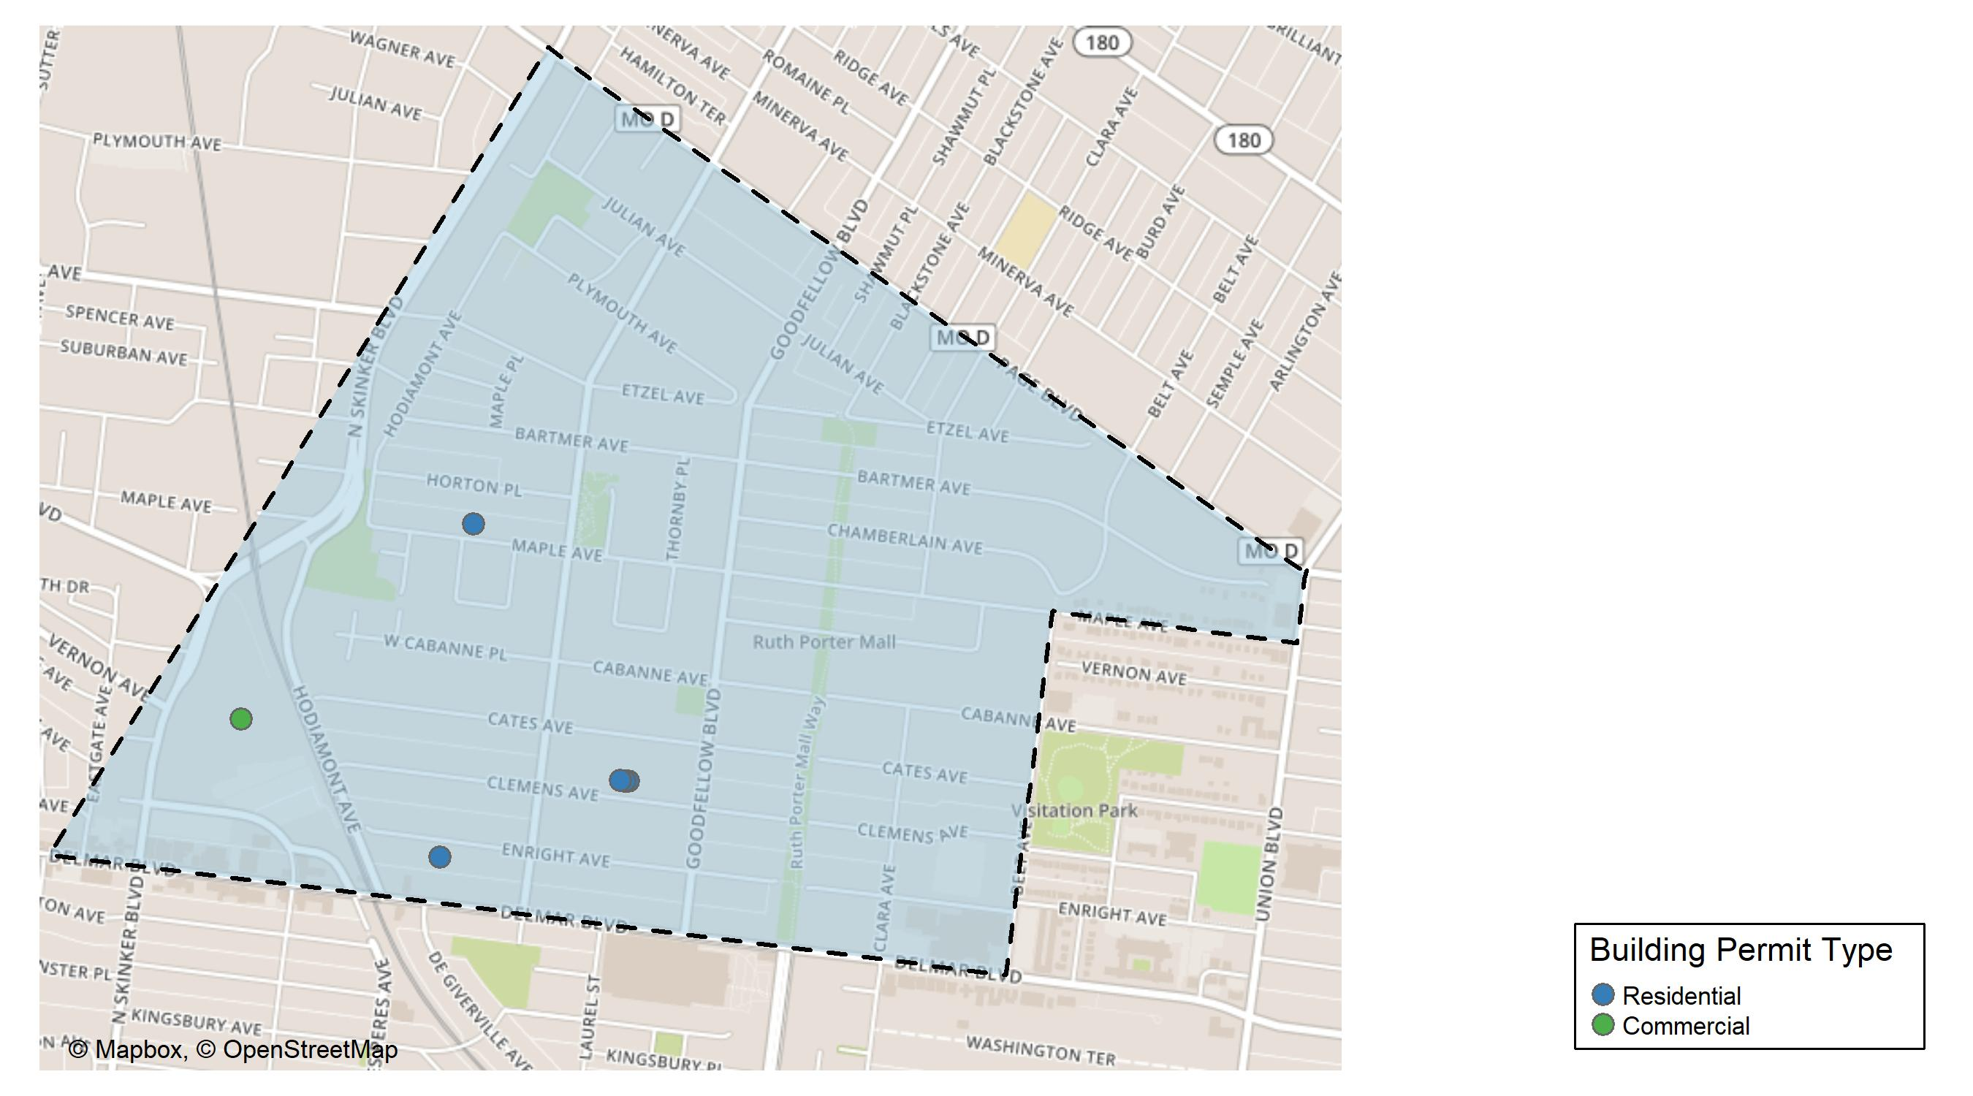
West End

Slide 33
Neighborhood Summary
February 2024 | February 2024 | February 2024 | February 2024
Permit Use | Average Cost | # of Permits | Total Value of Permits
Commercial | $500,000 | 2 | $1,000,000
Industrial | $0 | 0 | $0
Residential | $153,000 | 5 | $765,000
Last 6 Months | Last 6 Months | Last 6 Months | Last 6 Months
Permit Use | Average Cost | # of Permits | Total Value of Permits
Commercial | $266,439.1 | 9 | $2,397,952
Industrial | $0.0 | 0 | $0
Residential | $80,214.3 | 43 | $3,449,215

Slide 34
West End Individual Permit Breakdown
Neighborhood | Owner | New Use | Cost | address
West End | WEST END LLC | Residential | $250,000 | 5851 CLEMENS AV
West End | WEST END LLC | Residential | $250,000 | 5849 CLEMENS AV
West End | WEST END LLC | Residential | $250,000 | 5847 CLEMENS AV
West End | WASHINGTON UNIVERSITY | Commercial | $850,000 | 700 ROSEDALE AV
West End | WASHINGTON UNIVERSITY | Commercial | $150,000 | 700 ROSEDALE AV
West End | MCGEE, JONATHAN D & EBONY V | Residential | $5,000 | 5954 ENRIGHT AV
West End | SMITH, DANIEL E & SAN SAN SMITH | Residential | $10,000 | 5963 MAPLE AV

Slide 35
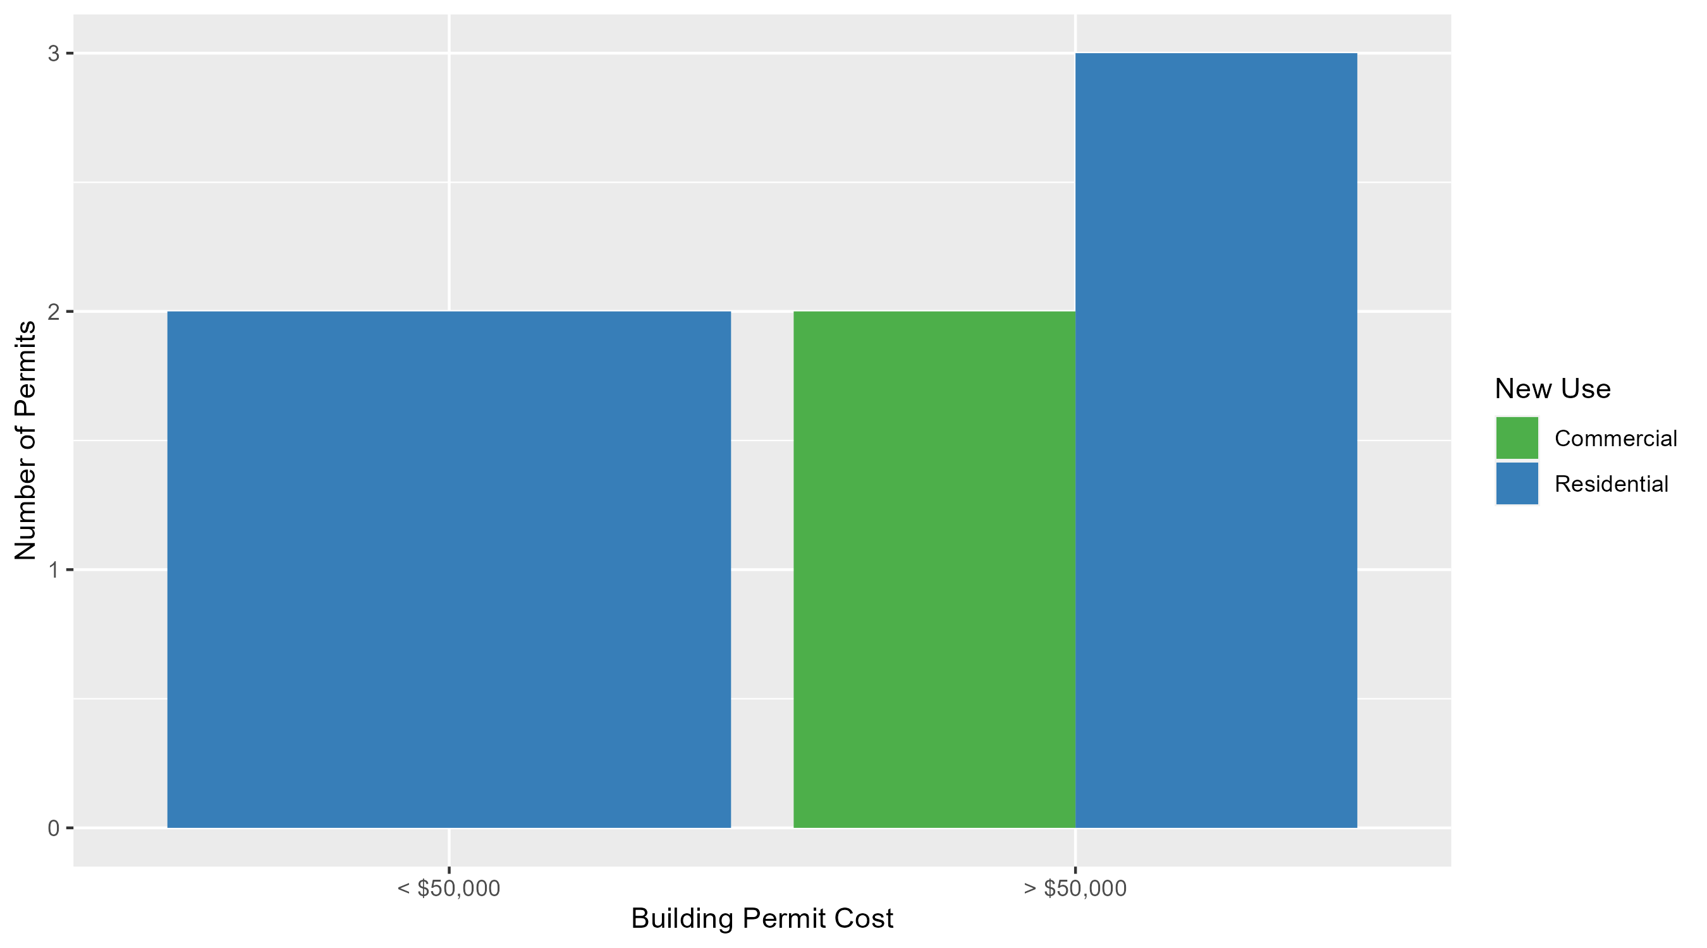
West End Permit Cost Breakdown

Slide 36
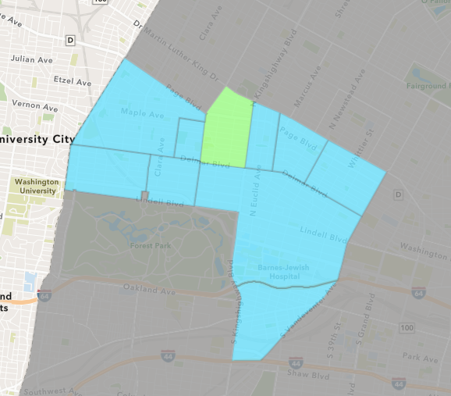
Academy
February 2024 Neighborhood Cost Breakdown
  Mean: $25,351
  Median: $25,351
  Range: $8,701 - $42,000

Slide 37
Academy: Summary Notes
2 building permits in February 2024
  0.00% change compared to February 2023 (2 total building permits)
  $25,351: Average building permit cost in February 2024
    -55.11% change compared to February 2023 ($56,468)
5 total building permits in 2024
  66.67% change YTD compared to this time in 2023 (3 total building permits)
  $11,240: YTD average building permit cost in 2024
    -70.53% change YTD compared to this time in 2023 ($38,145)

Slide 38
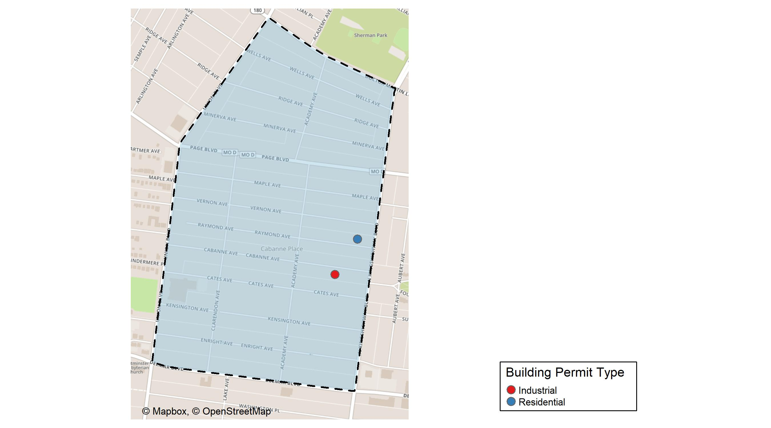
Academy

Slide 39
Neighborhood Summary
February 2024 | February 2024 | February 2024 | February 2024
Permit Use | Average Cost | # of Permits | Total Value of Permits
Commercial | $0 | 0 | $0
Industrial | $42,000 | 1 | $42,000
Residential | $8,701 | 1 | $8,701
Last 6 Months | Last 6 Months | Last 6 Months | Last 6 Months
Permit Use | Average Cost | # of Permits | Total Value of Permits
Commercial | $1,928.00 | 1 | $1,928
Industrial | $21,700.00 | 2 | $43,400
Residential | $33,695.07 | 15 | $505,426

Slide 40
Academy Individual Permit Breakdown
Neighborhood | Owner | New Use | Cost | address
Academy | JONES, DANIEL | Industrial | $42,000 | 5040-44 CABANNE AV
Academy | FACEN, WALTER C | Residential | $8,701 | 5019 RAYMOND AV

Slide 41
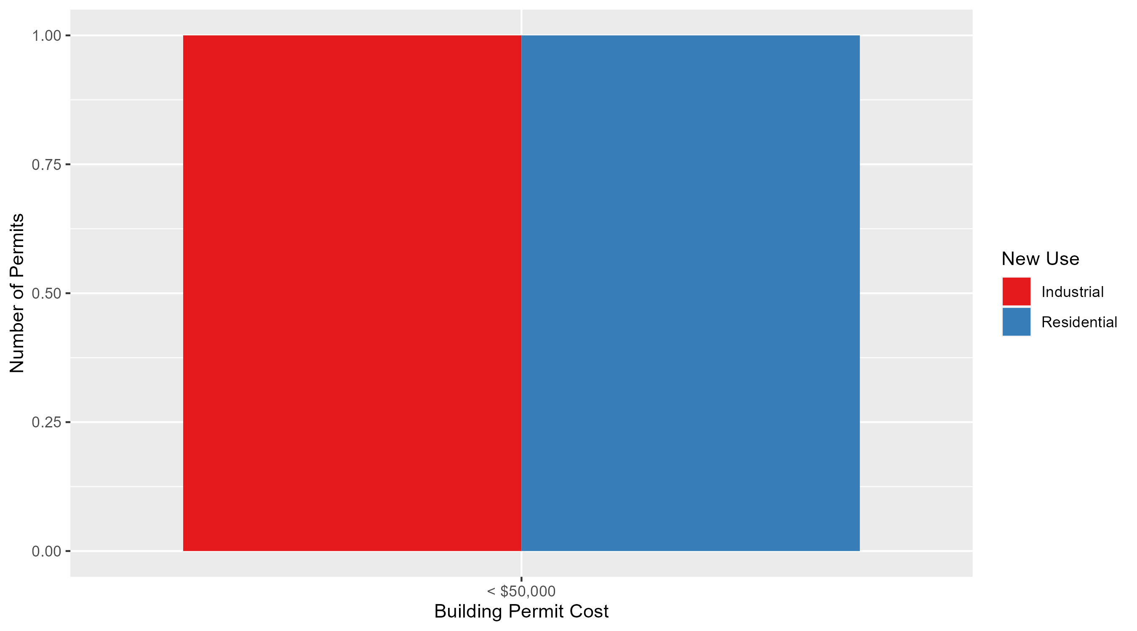
Academy Permit Cost Breakdown

Slide 42
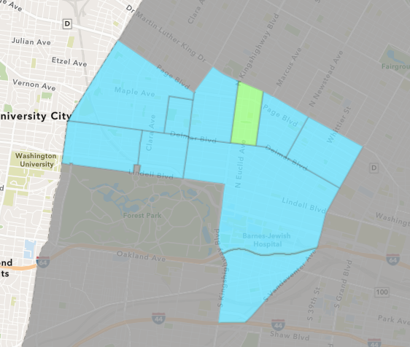
Fountain Park
February 2024 Neighborhood Cost Breakdown
  Mean: $19,500
  Median: $19,500
  Range: $4,000 - $35,000

Slide 43
Fountain Park: Summary Notes
2 building permits in February 2024
  Infinite change compared to February 2023 (0 total building permits)
  $19,500: Average building permit cost in February 2024
    Infinite change compared to February 2023 ($0)
3 total building permits in 2024
  50.00% change YTD compared to this time in 2023 (2 total building permits)
  $17,000: YTD average building permit cost in 2024
    -29.17% change YTD compared to this time in 2023 ($24,000)

Slide 44
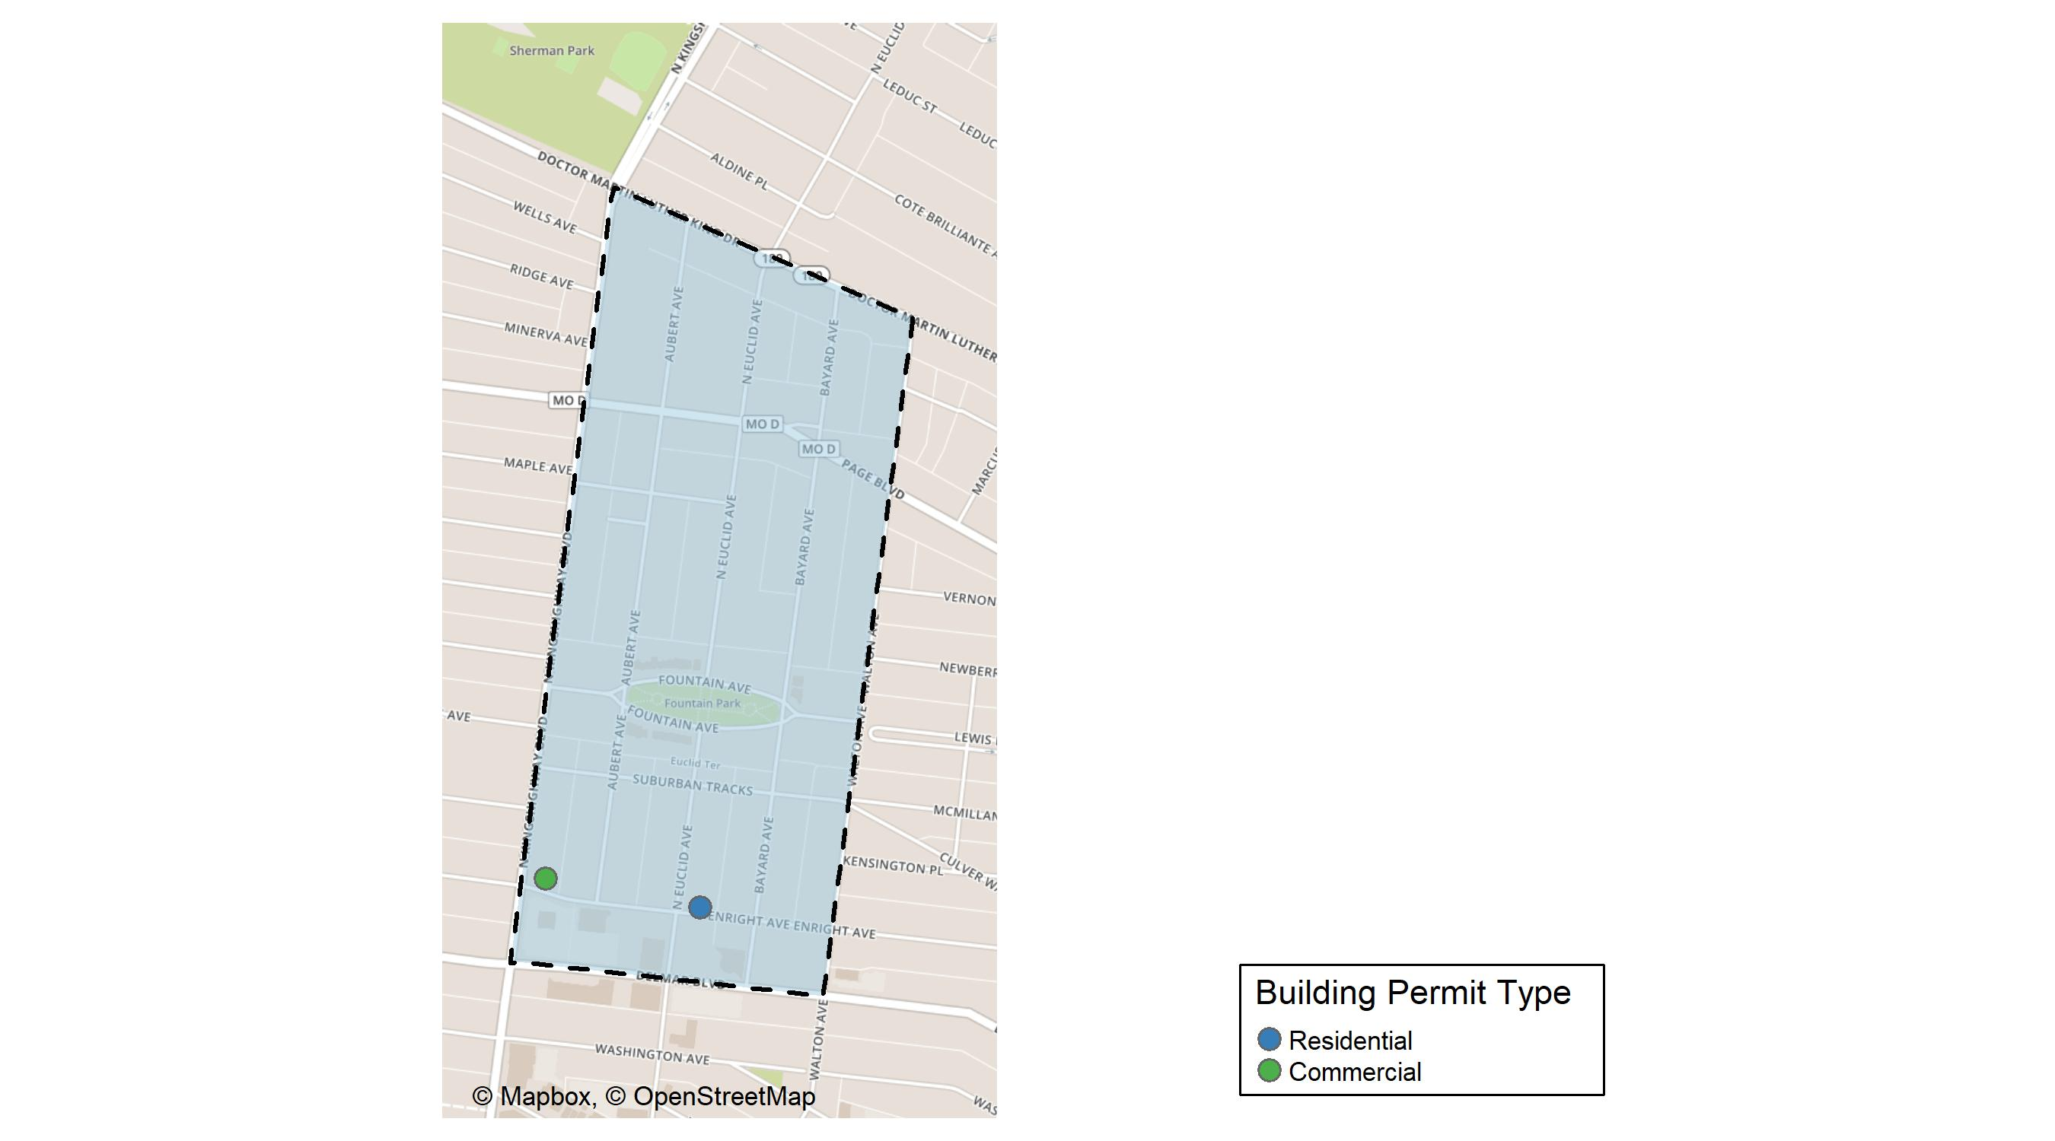
Fountain Park

Slide 45
Neighborhood Summary
February 2024 | February 2024 | February 2024 | February 2024
Permit Use | Average Cost | # of Permits | Total Value of Permits
Commercial | $4,000 | 1 | $4,000
Industrial | $0 | 0 | $0
Residential | $35,000 | 1 | $35,000
Last 6 Months | Last 6 Months | Last 6 Months | Last 6 Months
Permit Use | Average Cost | # of Permits | Total Value of Permits
Commercial | $29,183.33 | 6 | $175,100
Industrial | $0.00 | 0 | $0
Residential | $30,580.00 | 8 | $244,640

Slide 46
Fountain Park Individual Permit Breakdown
Neighborhood | Owner | New Use | Cost | address
Fountain Park | MBR KINGSHIGHWAY PROPERY LLC | Commercial | $4,000 | 802 N KINGSHIGHWAY BLVD
Fountain Park | KINGSWAY DEVELOPMENT LLC | Residential | $35,000 | 736 N EUCLID AV

Slide 47
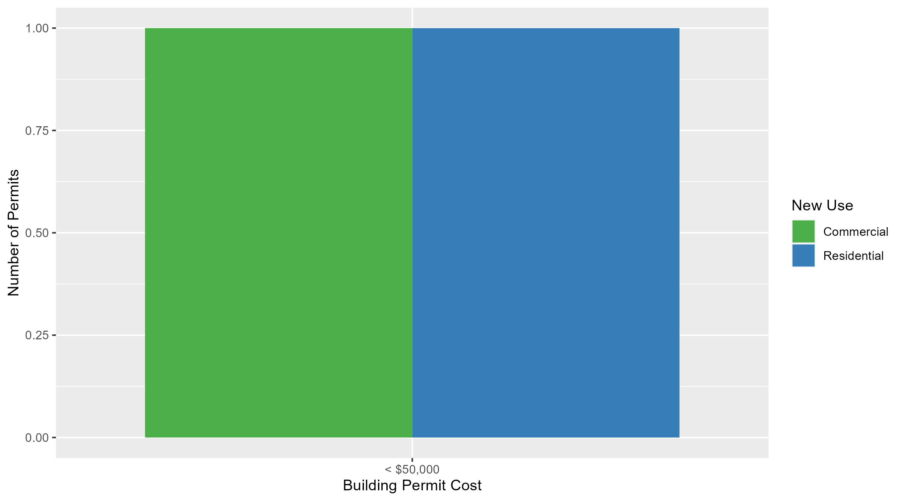
Fountain Park Permit Cost Breakdown

Slide 48
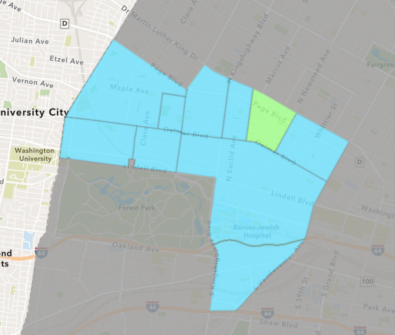
Lewis Place
February 2024 Neighborhood Cost Breakdown
  Mean: $1,000
  Median: $1,000
  Range: $1,000 - $1,000

Slide 49
Lewis Place: Summary Notes
1 building permits in February 2024
  -50.00% change compared to February 2023 (2 total building permits)
  $1,000: Average building permit cost in February 2024
    -97.78% change compared to February 2023 ($45,000)
2 total building permits in 2024
  0.00% change YTD compared to this time in 2023 (2 total building permits)
  $1,000: YTD average building permit cost in 2024
    -97.78% change YTD compared to this time in 2023 ($45,000)

Slide 50
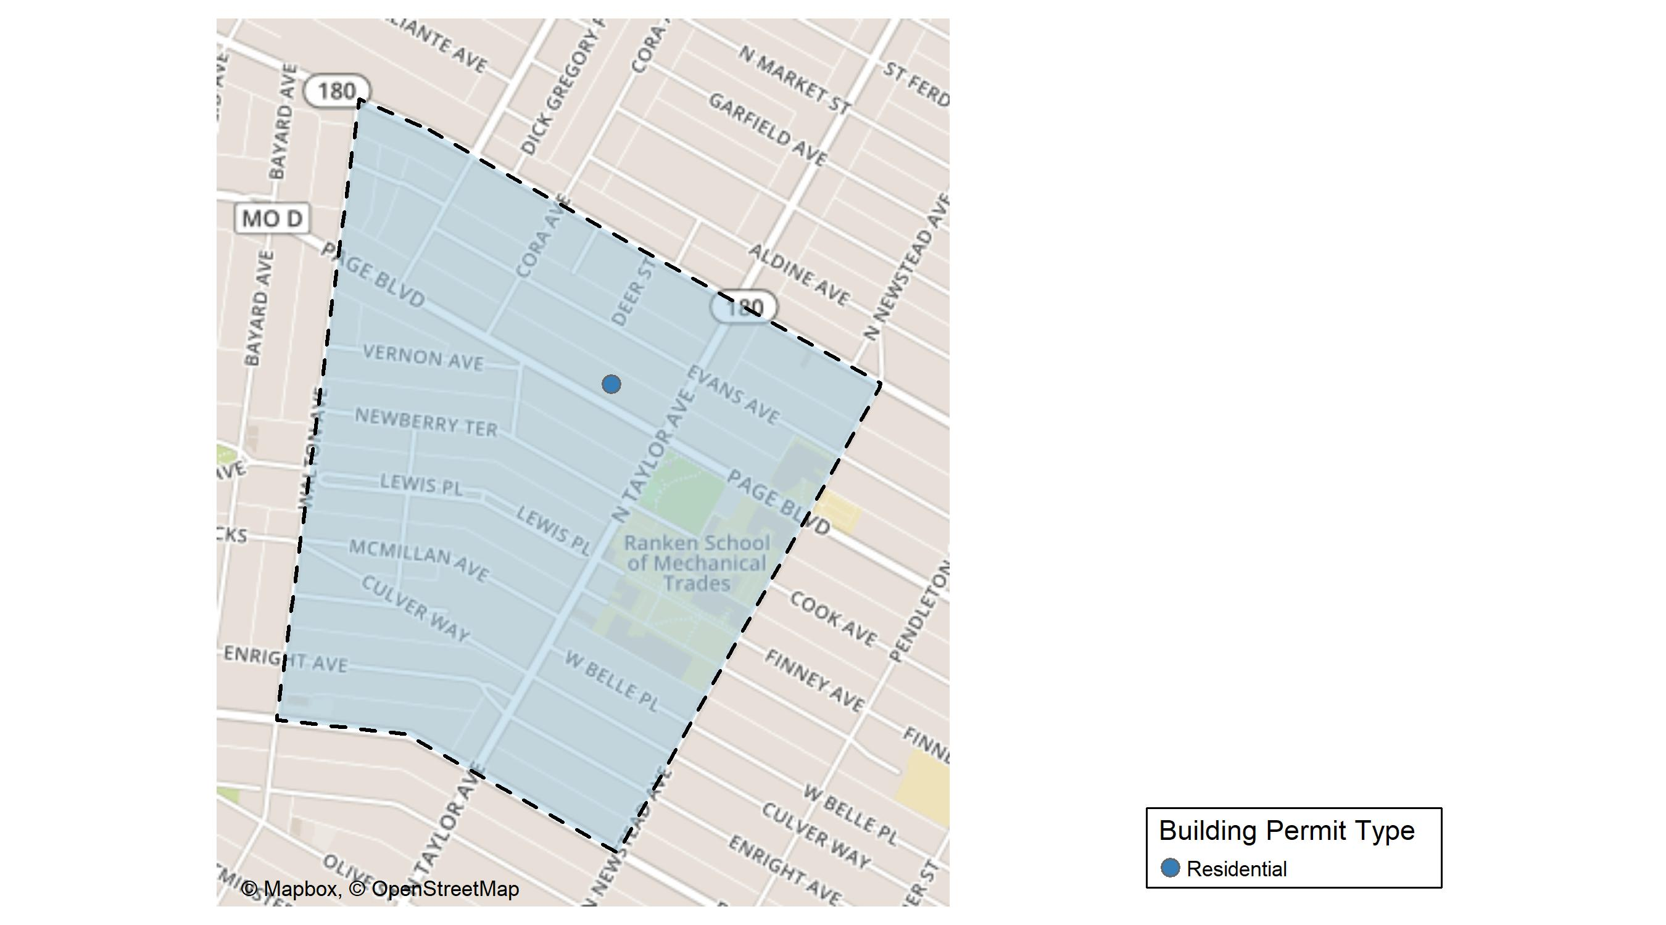
Lewis Place

Slide 51
Neighborhood Summary
February 2024 | February 2024 | February 2024 | February 2024
Permit Use | Average Cost | # of Permits | Total Value of Permits
Commercial | $0 | 0 | $0
Industrial | $0 | 0 | $0
Residential | $1,000 | 1 | $1,000
Last 6 Months | Last 6 Months | Last 6 Months | Last 6 Months
Permit Use | Average Cost | # of Permits | Total Value of Permits
Commercial | $225,535.00 | 1 | $225,535
Industrial | $0.00 | 0 | $0
Residential | $21,533.67 | 6 | $129,202

Slide 52
Lewis Place Individual Permit Breakdown
Neighborhood | Owner | New Use | Cost | address
Lewis Place | ETHRIDGE, LAUREN MICHELLE & | Residential | $1,000 | 4539 PAGE BLVD

Slide 53
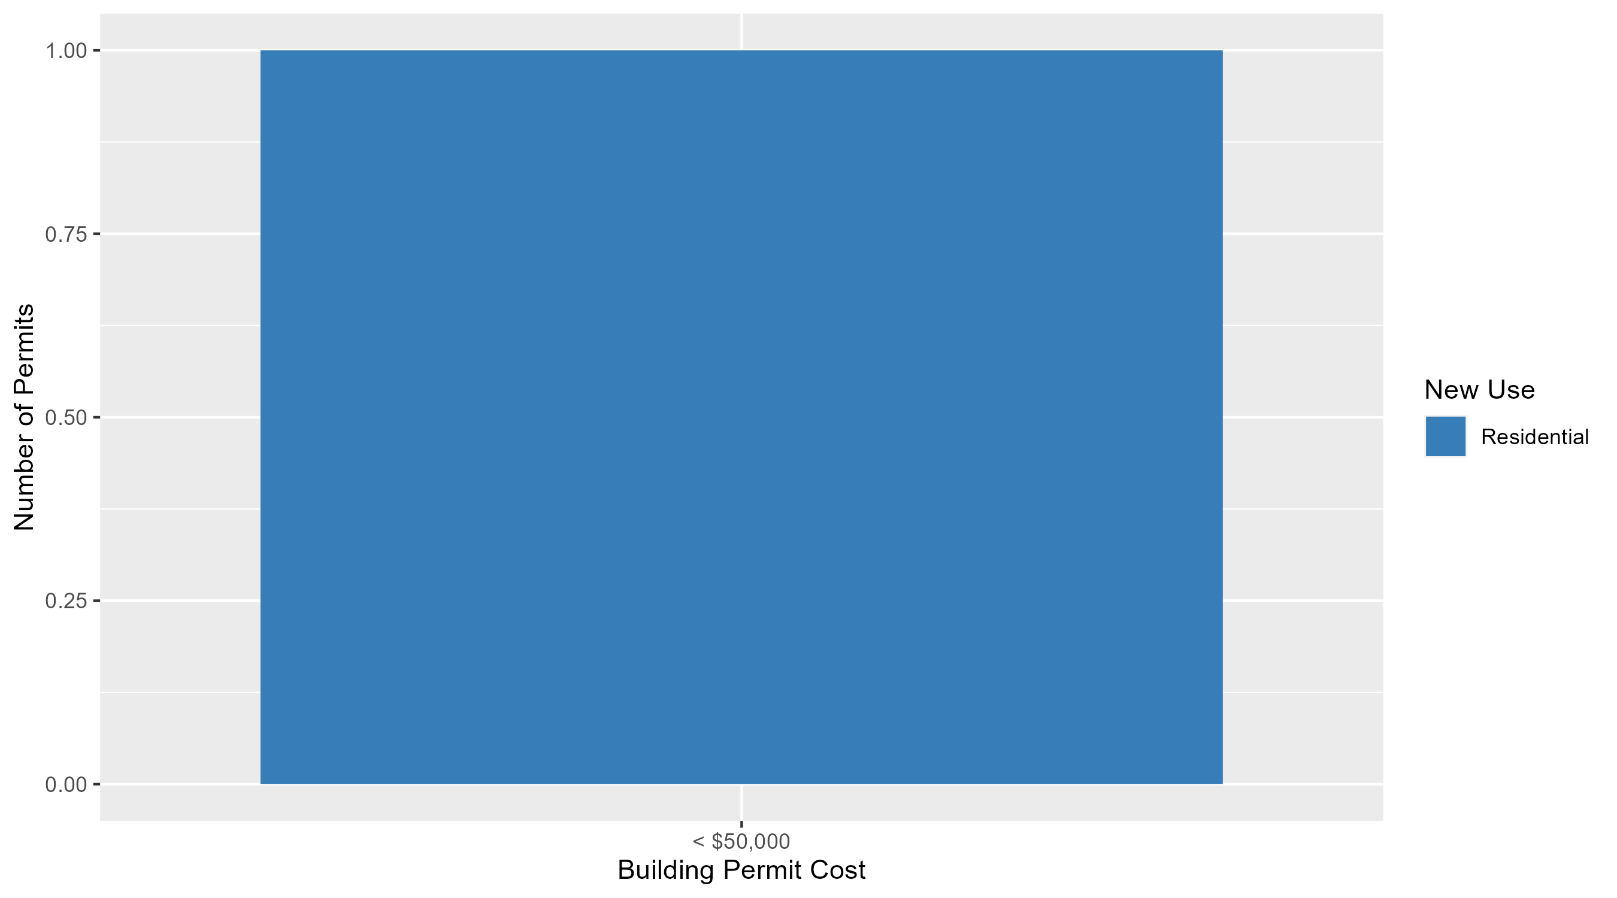
Lewis Place Permit Cost Breakdown

Slide 54
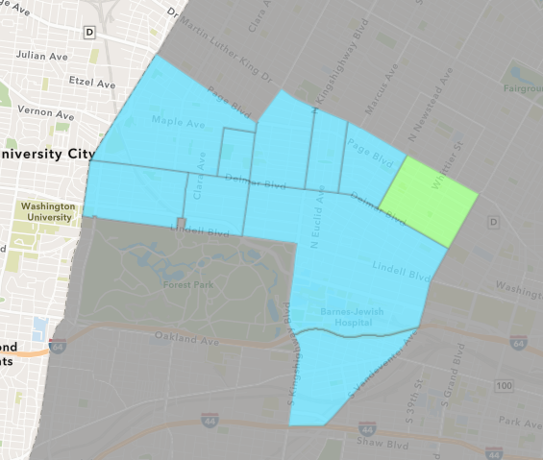
Vandeventer
February 2024 Neighborhood Cost Breakdown
  Mean: $31,650
  Median: $31,650
  Range: $28,500 - $34,800

Slide 55
Vandeventer: Summary Notes
2 building permits in February 2024
  0.00% change compared to February 2023 (2 total building permits)
  $31,650: Average building permit cost in February 2024
    669.60% change compared to February 2023 ($4,112)
3 total building permits in 2024
  0.00% change YTD compared to this time in 2023 (3 total building permits)
  $70,883: YTD average building permit cost in 2024
    777.81% change YTD compared to this time in 2023 ($8,075)

Slide 56
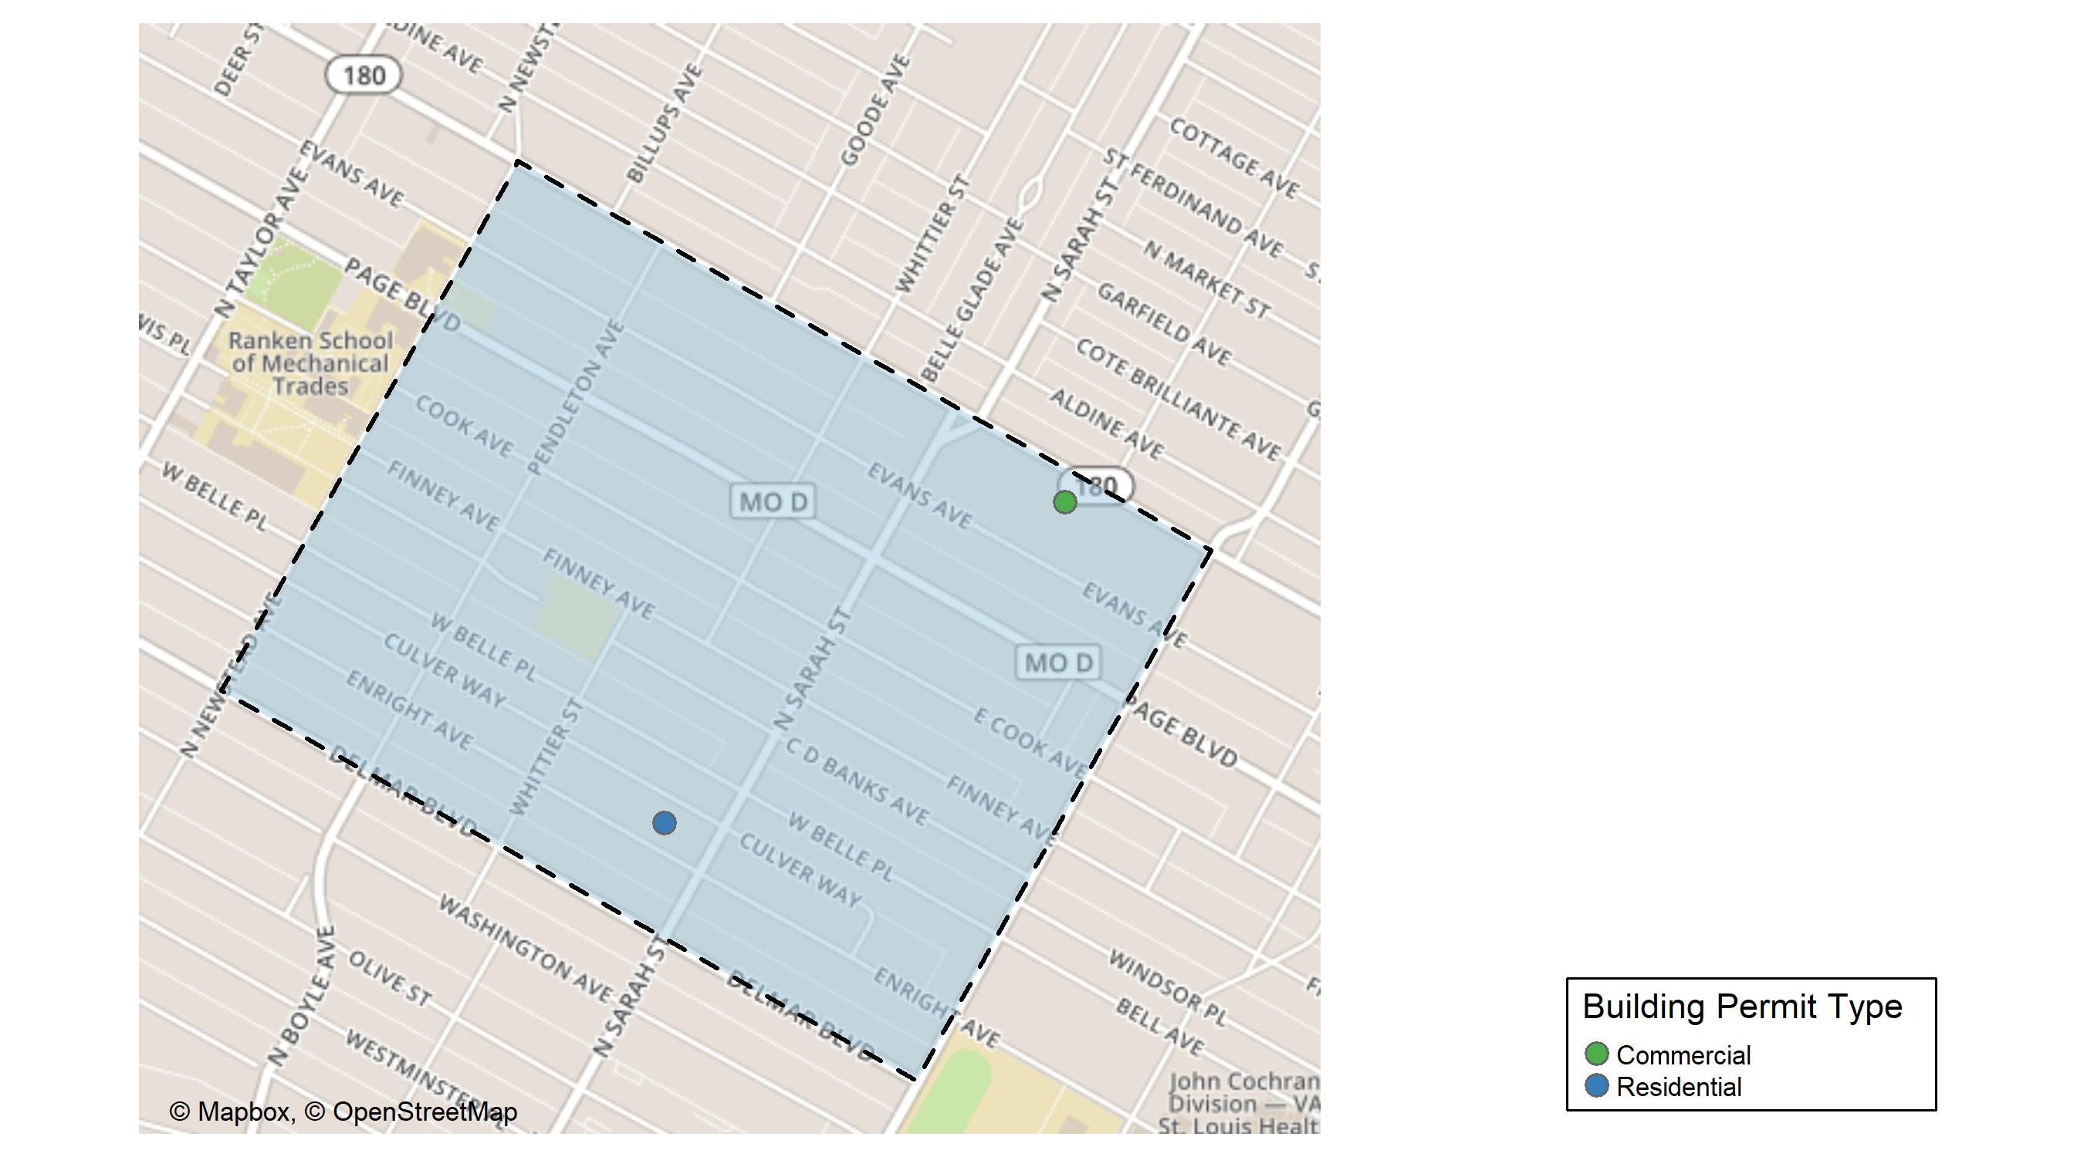
Vandeventer

Slide 57
Neighborhood Summary
February 2024 | February 2024 | February 2024 | February 2024
Permit Use | Average Cost | # of Permits | Total Value of Permits
Commercial | $28,500 | 1 | $28,500
Industrial | $0 | 0 | $0
Residential | $34,800 | 1 | $34,800
Last 6 Months | Last 6 Months | Last 6 Months | Last 6 Months
Permit Use | Average Cost | # of Permits | Total Value of Permits
Commercial | $1,014,250.00 | 2 | $2,028,500
Industrial | $10,900.00 | 1 | $10,900
Residential | $65,874.62 | 8 | $526,997

Slide 58
Vandeventer Individual Permit Breakdown
Neighborhood | Owner | New Use | Cost | address
Vandeventer | LCRA | Commercial | $28,500 | 4016 DR MARTIN LUTHER KING DR
Vandeventer | TDB PROPERTY ACQUISITIONS LLC | Residential | $34,800 | 4125 ENRIGHT AV

Slide 59
Vandeventer Permit Cost Breakdown

Slide 60
Additional Notes
Data retreived from https://www.stlouis-mo.gov/data/
Building permits with a cost of $0 were dropped
Building permits that were cancelled were dropped
Infinite change indicates 0 permits in the current or previous time period/comparison month so there was a overall increase or decrease

