Slide 1
St. Louis Central Corridor West Building Permits
Monthly Report: February 2025

Slide 2
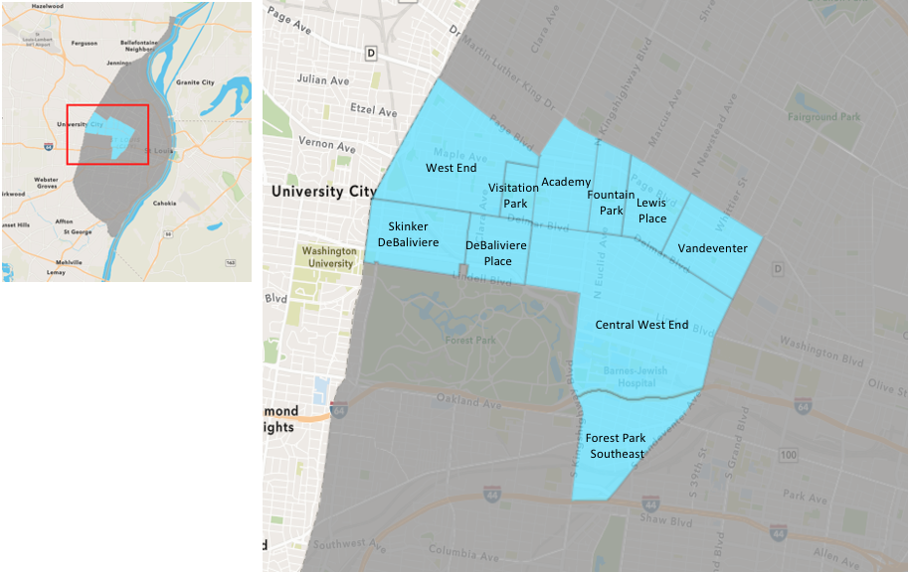
St. Louis Neighborhood Spatial Reference

Slide 3
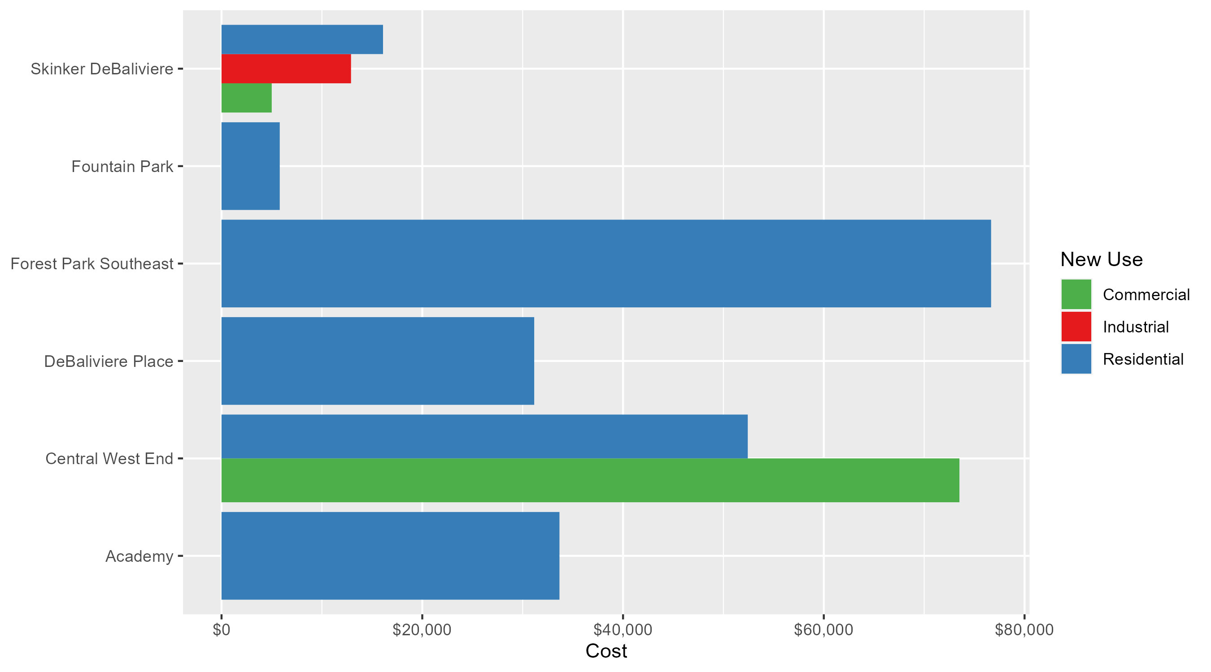
Neighborhood Summary: Average Building Permit Cost

Slide 4
Neighborhood Summary
February 2025 | February 2025 | February 2025 | February 2025
Neighborhood | Average Cost | # of Permits | Total Value of Permits
Academy | $33,666.67 | 3 | $101,000
Central West End | $60,860.15 | 20 | $1,217,203
DeBaliviere Place | $31,150.50 | 4 | $124,602
Forest Park Southeast | $76,666.67 | 3 | $230,000
Fountain Park | $5,800.00 | 1 | $5,800
Lewis Place | $0.00 | 0 | $0
Skinker DeBaliviere | $14,048.86 | 7 | $98,342
Vandeventer | $0.00 | 0 | $0
Visitation Park | $0.00 | 0 | $0
West End | $0.00 | 0 | $0
Last 6 Months | Last 6 Months | Last 6 Months | Last 6 Months
Neighborhood | Average Cost | # of Permits | Total Value of Permits
Academy | $25,486.44 | 16 | $407,783
Central West End | $213,042.37 | 203 | $43,247,602
DeBaliviere Place | $83,024.48 | 25 | $2,075,612
Forest Park Southeast | $157,866.11 | 35 | $5,525,314
Fountain Park | $43,475.00 | 8 | $347,800
Lewis Place | $35,333.33 | 6 | $212,000
Skinker DeBaliviere | $82,891.27 | 62 | $5,139,259
Vandeventer | $26,570.00 | 9 | $239,130
Visitation Park | $14,027.33 | 3 | $42,082
West End | $97,653.04 | 24 | $2,343,673

Slide 5
Core Neighborhoods

Slide 6
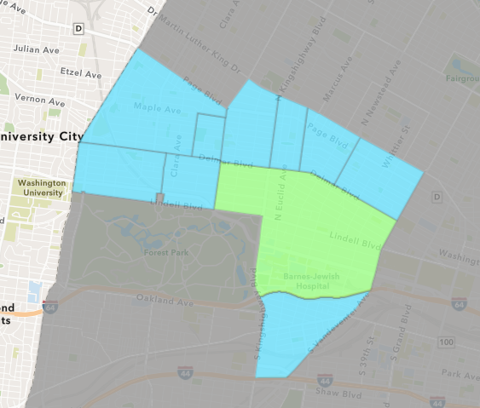
Central West End
February 2025 Neighborhood Cost Breakdown
  Mean: $60,860
  Median: $25,202
  Range: $2,000 - $250,000

Slide 7
Central West End: Summary Notes
20 building permits in February 2025
  -9.09% change compared to February 2024 (22 total building permits)
  $60,860: Average building permit cost in February 2025
    -45.13% change compared to February 2024 ($110,908)
39 total building permits in 2025
  -20.41% change YTD compared to this time in 2024 (49 total building permits)
  $114,443: YTD average building permit cost in 2025
    -81.47% change YTD compared to this time in 2024 ($617,587)

Slide 8
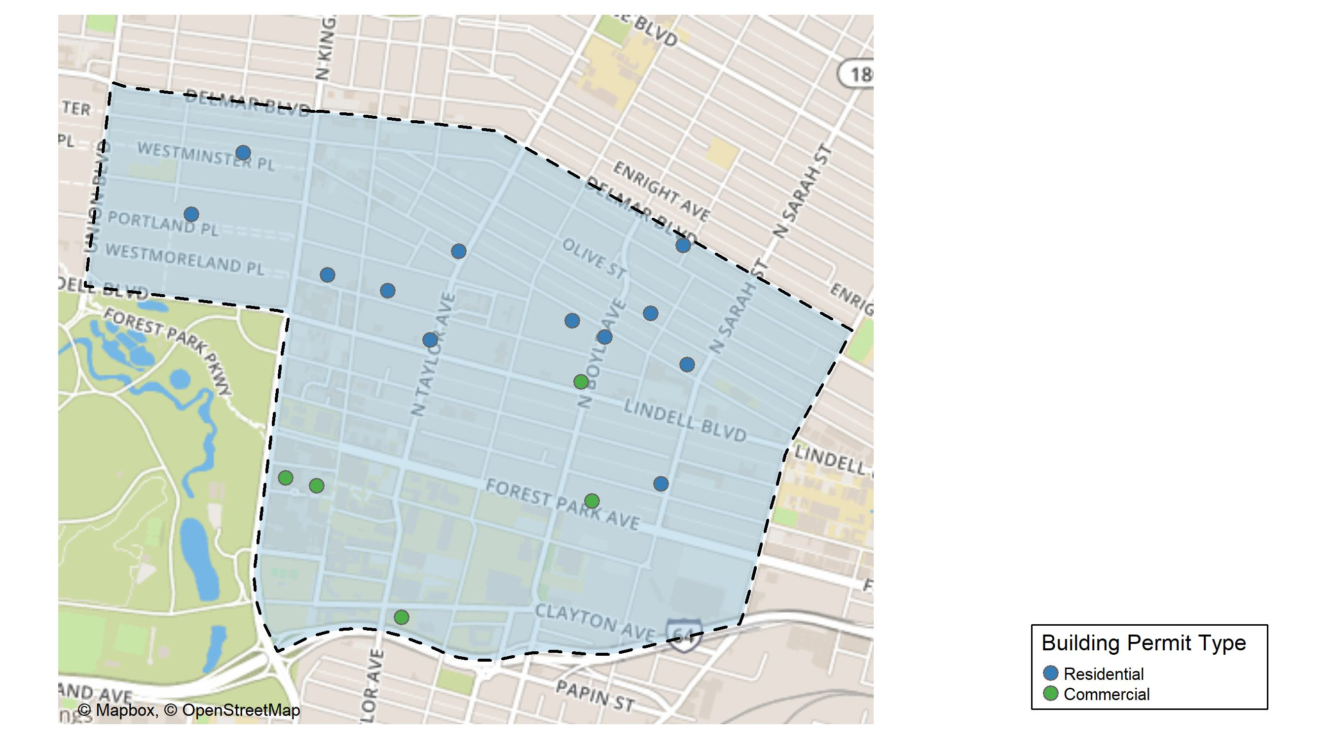
Central West End

Slide 9
Neighborhood Summary
February 2025 | February 2025 | February 2025 | February 2025
Permit Use | Average Cost | # of Permits | Total Value of Permits
Commercial | $73,512.38 | 8 | $588,099
Industrial | $0.00 | 0 | $0
Residential | $52,425.33 | 12 | $629,104
Last 6 Months | Last 6 Months | Last 6 Months | Last 6 Months
Permit Use | Average Cost | # of Permits | Total Value of Permits
Commercial | $324,352.2 | 85 | $27,569,935
Industrial | $61,107.0 | 2 | $122,214
Residential | $134,098.7 | 116 | $15,555,453

Slide 10
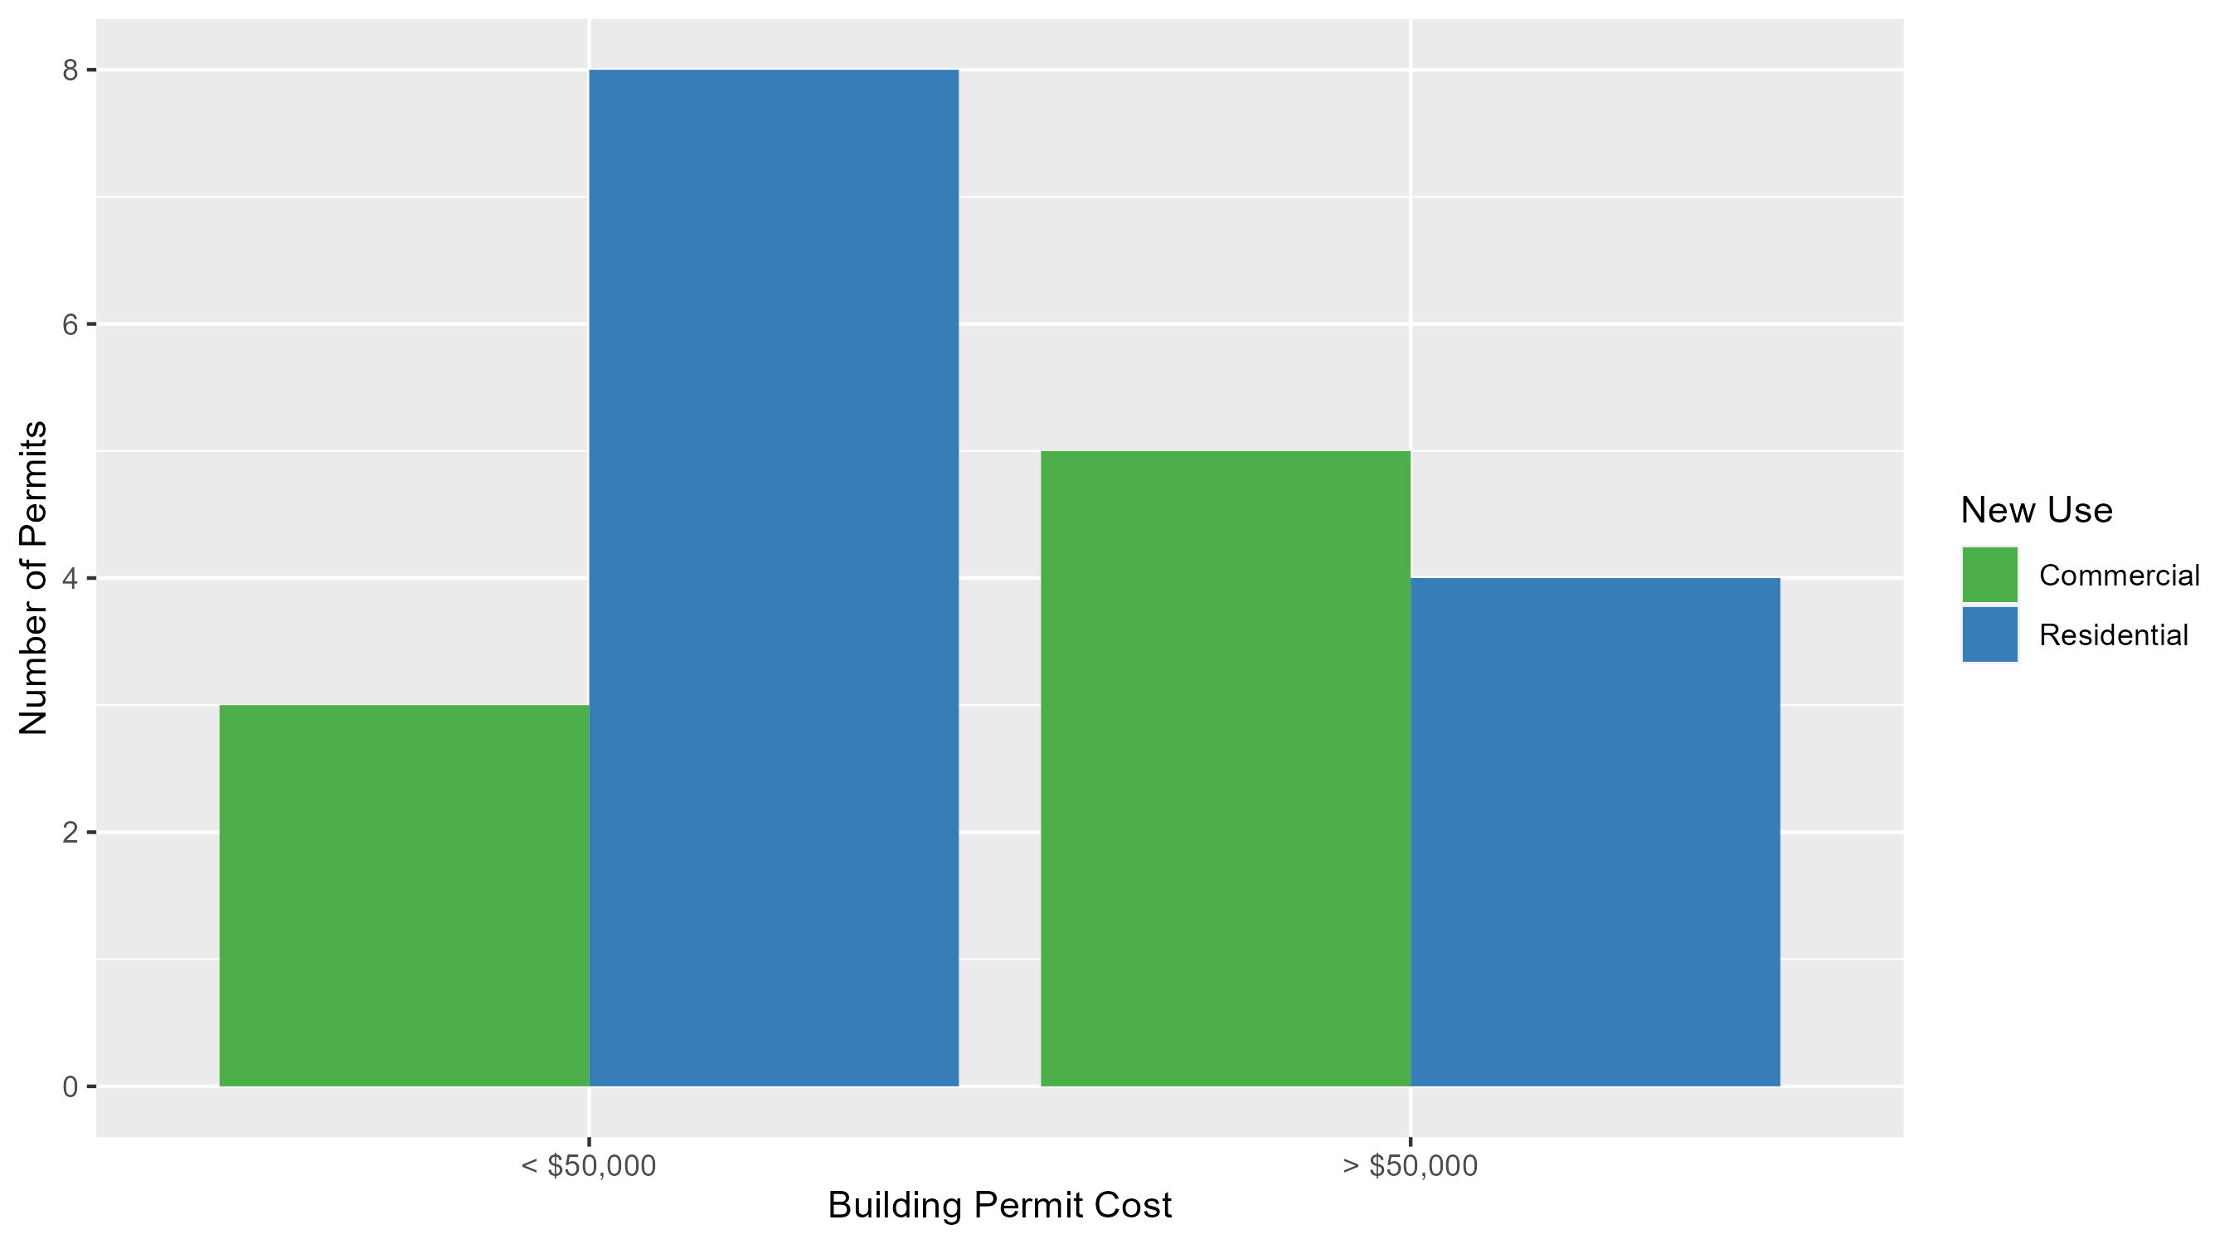
Central West End Permit Cost Breakdown

Slide 11
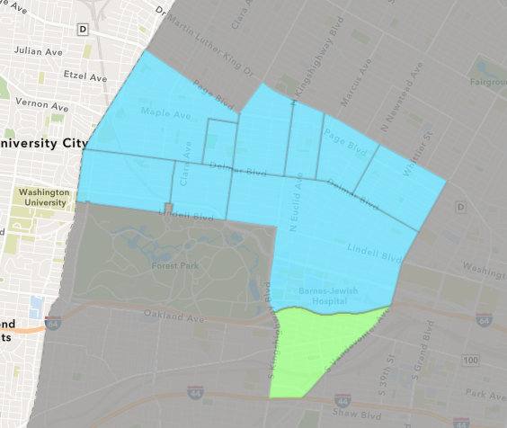
Forest Park Southeast
February 2025 Neighborhood Cost Breakdown
  Mean: $76,667
  Median: $60,000
  Range: $20,000 - $150,000

Slide 12
Forest Park Southeast: Summary Notes
3 building permits in February 2025
  -40.00% change compared to February 2024 (5 total building permits)
  $76,667: Average building permit cost in February 2025
    378.57% change compared to February 2024 ($16,020)
7 total building permits in 2025
  -41.67% change YTD compared to this time in 2024 (12 total building permits)
  $88,038: YTD average building permit cost in 2025
    262.61% change YTD compared to this time in 2024 ($24,279)

Slide 13
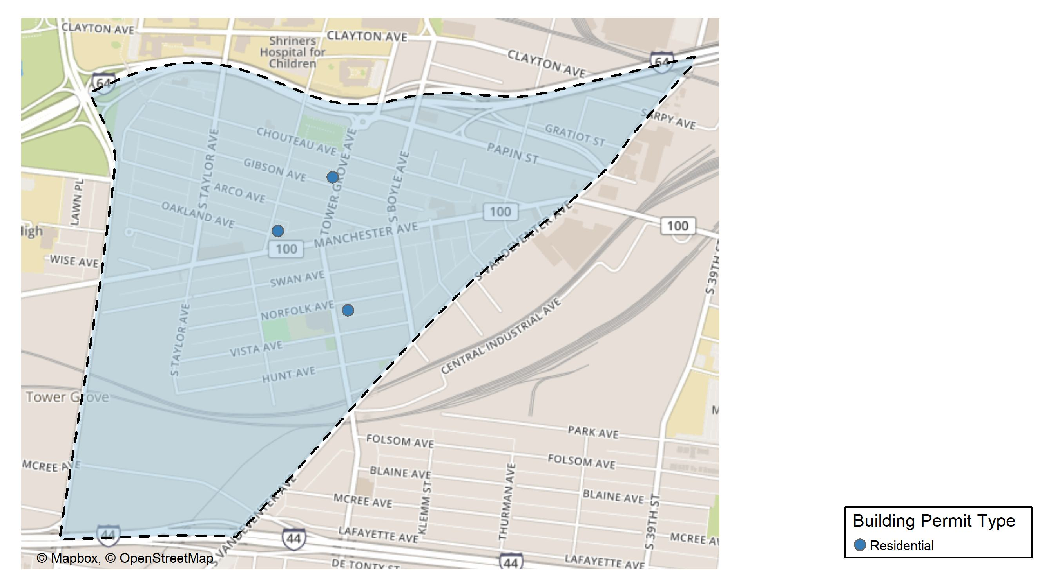
Forest Park Southeast

Slide 14
Neighborhood Summary
February 2025 | February 2025 | February 2025 | February 2025
Permit Use | Average Cost | # of Permits | Total Value of Permits
Commercial | $0.00 | 0 | $0
Industrial | $0.00 | 0 | $0
Residential | $76,666.67 | 3 | $230,000
Last 6 Months | Last 6 Months | Last 6 Months | Last 6 Months
Permit Use | Average Cost | # of Permits | Total Value of Permits
Commercial | $58,607.67 | 6 | $351,646
Industrial | $31,933.33 | 3 | $95,800
Residential | $195,302.62 | 26 | $5,077,868

Slide 15
Forest Park Southeast Individual Permit Breakdown
Neighborhood | Owner | New Use | Cost | address
Forest Park Southeast | NOYA HOLDINGS LLC | Residential | $20,000 | 4363 GIBSON AV
Forest Park Southeast | NASEER LLC | Residential | $150,000 | 1094 S NEWSTEAD AV
Forest Park Southeast | GRIFFIN DAVID PROPERTIES LLC | Residential | $60,000 | 4260 NORFOLK AV

Slide 16
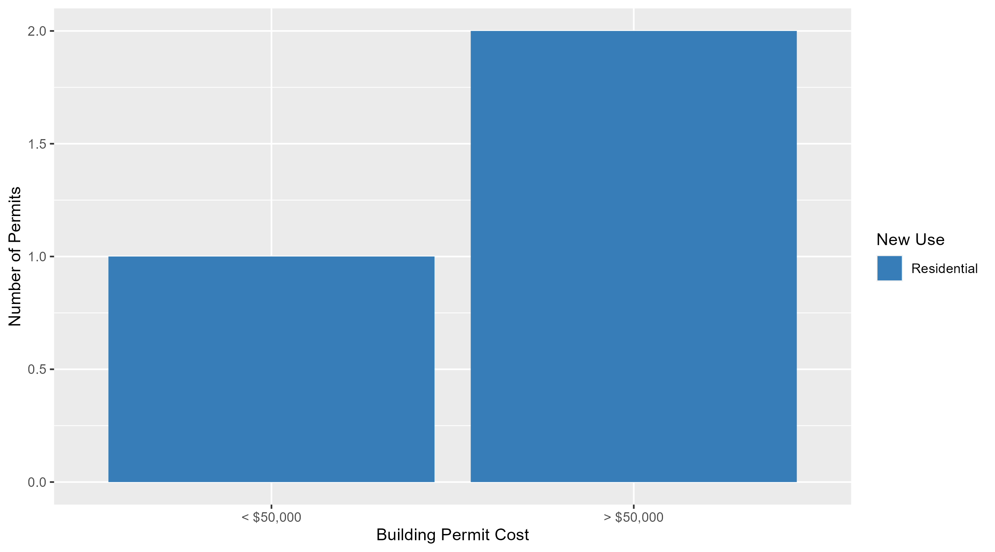
Forest Park Southeast Permit Cost Breakdown

Slide 17
Expanded Service Area

Slide 18
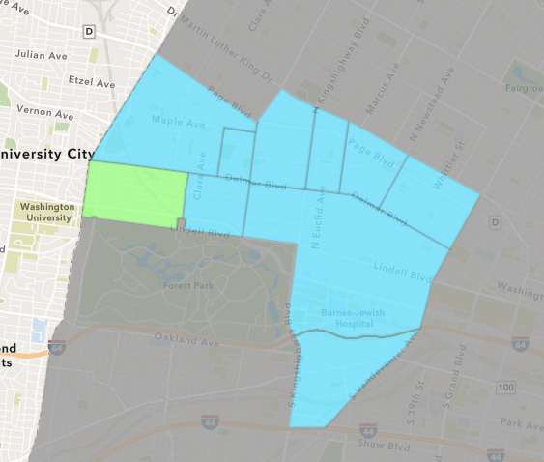
Skinker DeBaliviere
February 2025 Neighborhood Cost Breakdown
  Mean: $14,049
  Median: $12,900
  Range: $1,000 - $28,500

Slide 19
Skinker DeBaliviere: Summary Notes
7 building permits in February 2025
  250.00% change compared to February 2024 (2 total building permits)
  $14,049: Average building permit cost in February 2025
    -96.96% change compared to February 2024 ($461,455)
17 total building permits in 2025
  112.50% change YTD compared to this time in 2024 (8 total building permits)
  $57,078: YTD average building permit cost in 2025
    -58.11% change YTD compared to this time in 2024 ($136,270)

Slide 20
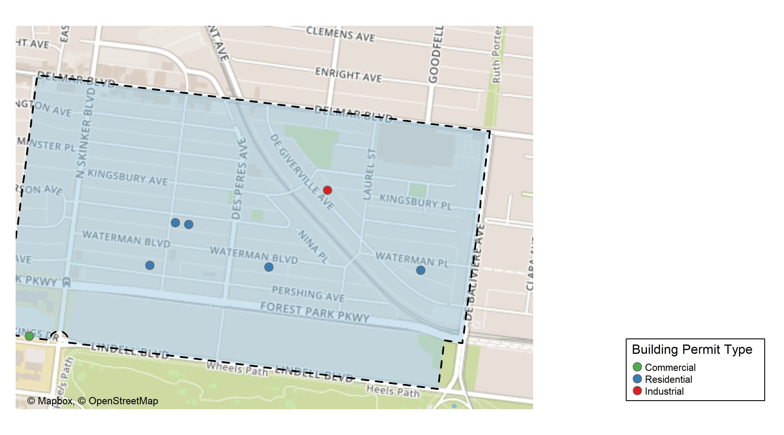
Skinker DeBaliviere

Slide 21
Neighborhood Summary
February 2025 | February 2025 | February 2025 | February 2025
Permit Use | Average Cost | # of Permits | Total Value of Permits
Commercial | $5,000.0 | 1 | $5,000
Industrial | $12,900.0 | 1 | $12,900
Residential | $16,088.4 | 5 | $80,442
Last 6 Months | Last 6 Months | Last 6 Months | Last 6 Months
Permit Use | Average Cost | # of Permits | Total Value of Permits
Commercial | $158,225.00 | 12 | $1,898,700
Industrial | $12,125.00 | 4 | $48,500
Residential | $69,392.59 | 46 | $3,192,059

Slide 22
Skinker DeBaliviere Individual Permit Breakdown
Neighborhood | Owner | New Use | Cost | address
Skinker DeBaliviere | HA, HANNAH & BRADLEY FREEMAN D | Industrial | $12,900 | 5855 DEGIVERVILLE AV
Skinker DeBaliviere | CROSS, ANDREW J & LINDA M | Residential | $28,500 | 6060 MCPHERSON AV
Skinker DeBaliviere | DOWGWILLO, ROBERT M & HEIDI K | Residential | $12,278 | 6113 PERSHING AV
Skinker DeBaliviere | WASHINGTON UNIVERSITY ART BUILDING | Commercial | $5,000 | 1 BROOKINGS DR
Skinker DeBaliviere | BANISAEID, NASSER & NEDA ADBIANNIA | Residential | $1,000 | 5750 WATERMAN BLVD
Skinker DeBaliviere | MATTOX, JOHN & MARY | Residential | $15,446 | 6046-48 MCPHERSON AV
Skinker DeBaliviere | QUINN, ROBERT T & JENNIFER | Residential | $23,218 | 5922 WATERMAN BLVD

Slide 23
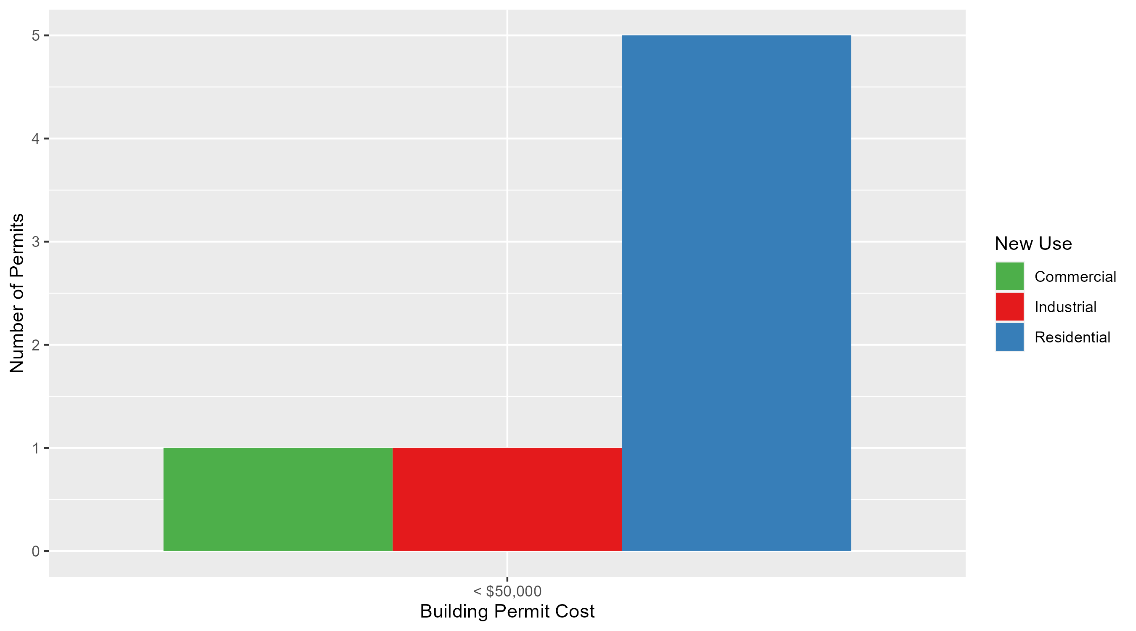
Skinker DeBaliviere Permit Cost Breakdown

Slide 24
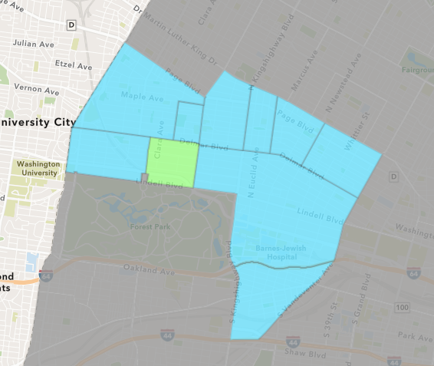
DeBaliviere Place
February 2025 Neighborhood Cost Breakdown
  Mean: $31,151
  Median: $21,301
  Range: $8,000 - $74,000

Slide 25
DeBaliviere Place: Summary Notes
4 building permits in February 2025
  33.33% change compared to February 2024 (3 total building permits)
  $31,151: Average building permit cost in February 2025
    74.27% change compared to February 2024 ($17,875)
7 total building permits in 2025
  0.00% change YTD compared to this time in 2024 (7 total building permits)
  $20,787: YTD average building permit cost in 2025
    -62.56% change YTD compared to this time in 2024 ($55,518)

Slide 26
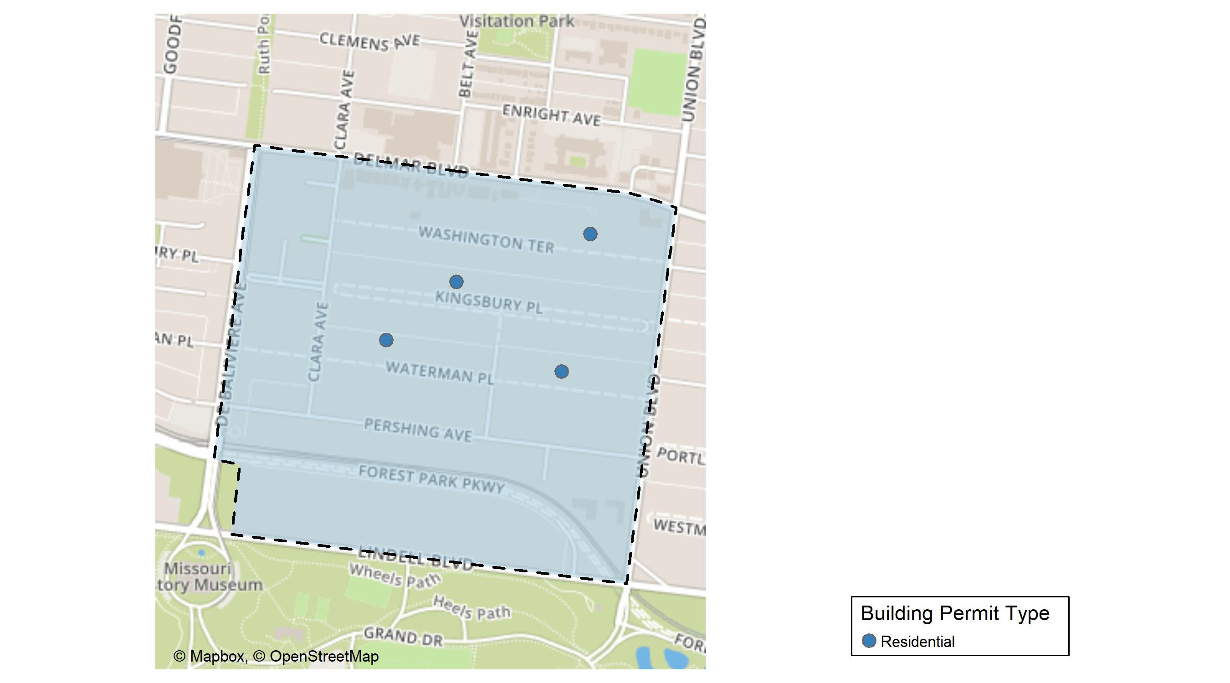
DeBaliviere Place

Slide 27
Neighborhood Summary
February 2025 | February 2025 | February 2025 | February 2025
Permit Use | Average Cost | # of Permits | Total Value of Permits
Commercial | $0.0 | 0 | $0
Industrial | $0.0 | 0 | $0
Residential | $31,150.5 | 4 | $124,602
Last 6 Months | Last 6 Months | Last 6 Months | Last 6 Months
Permit Use | Average Cost | # of Permits | Total Value of Permits
Commercial | $2,100.00 | 2 | $4,200
Industrial | $0.00 | 0 | $0
Residential | $90,061.39 | 23 | $2,071,412

Slide 28
DeBaliviere Place Individual Permit Breakdown
Neighborhood | Owner | New Use | Cost | address
DeBaliviere Place | BERNER, BEVERLY | Residential | $12,602 | 5575 WATERMAN BLVD
DeBaliviere Place | CAGLE, ZANE T & LEE M CAGLE | Residential | $30,000 | 33 KINGSBURY PL
DeBaliviere Place | BIGHAM, MATTHEW H & ELIZABETH BELLE | Residential | $74,000 | 63 WATERMAN PL
DeBaliviere Place | FOX, KEVIN & SOMYING | Residential | $8,000 | 11 WASHINGTON TER

Slide 29
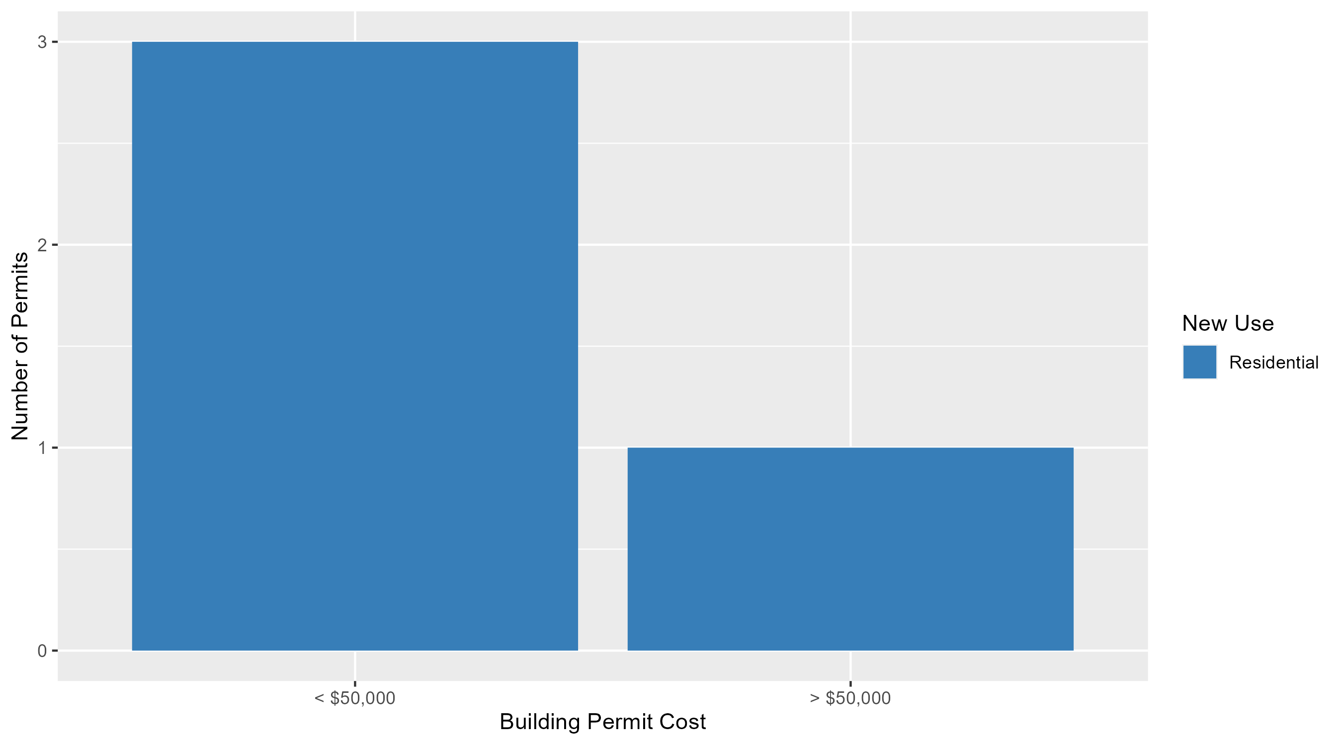
DeBaliviere Place Permit Cost Breakdown

Slide 30
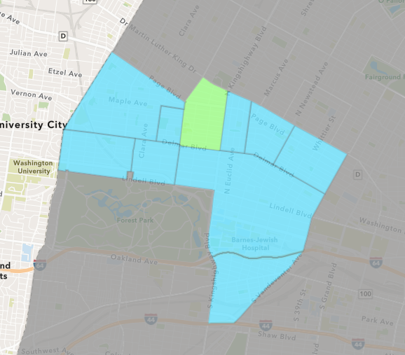
Academy
February 2025 Neighborhood Cost Breakdown
  Mean: $33,667
  Median: $30,000
  Range: $15,000 - $56,000

Slide 31
Academy: Summary Notes
3 building permits in February 2025
  50.00% change compared to February 2024 (2 total building permits)
  $33,667: Average building permit cost in February 2025
    32.80% change compared to February 2024 ($25,351)
6 total building permits in 2025
  20.00% change YTD compared to this time in 2024 (5 total building permits)
  $40,833: YTD average building permit cost in 2025
    263.28% change YTD compared to this time in 2024 ($11,240)

Slide 32
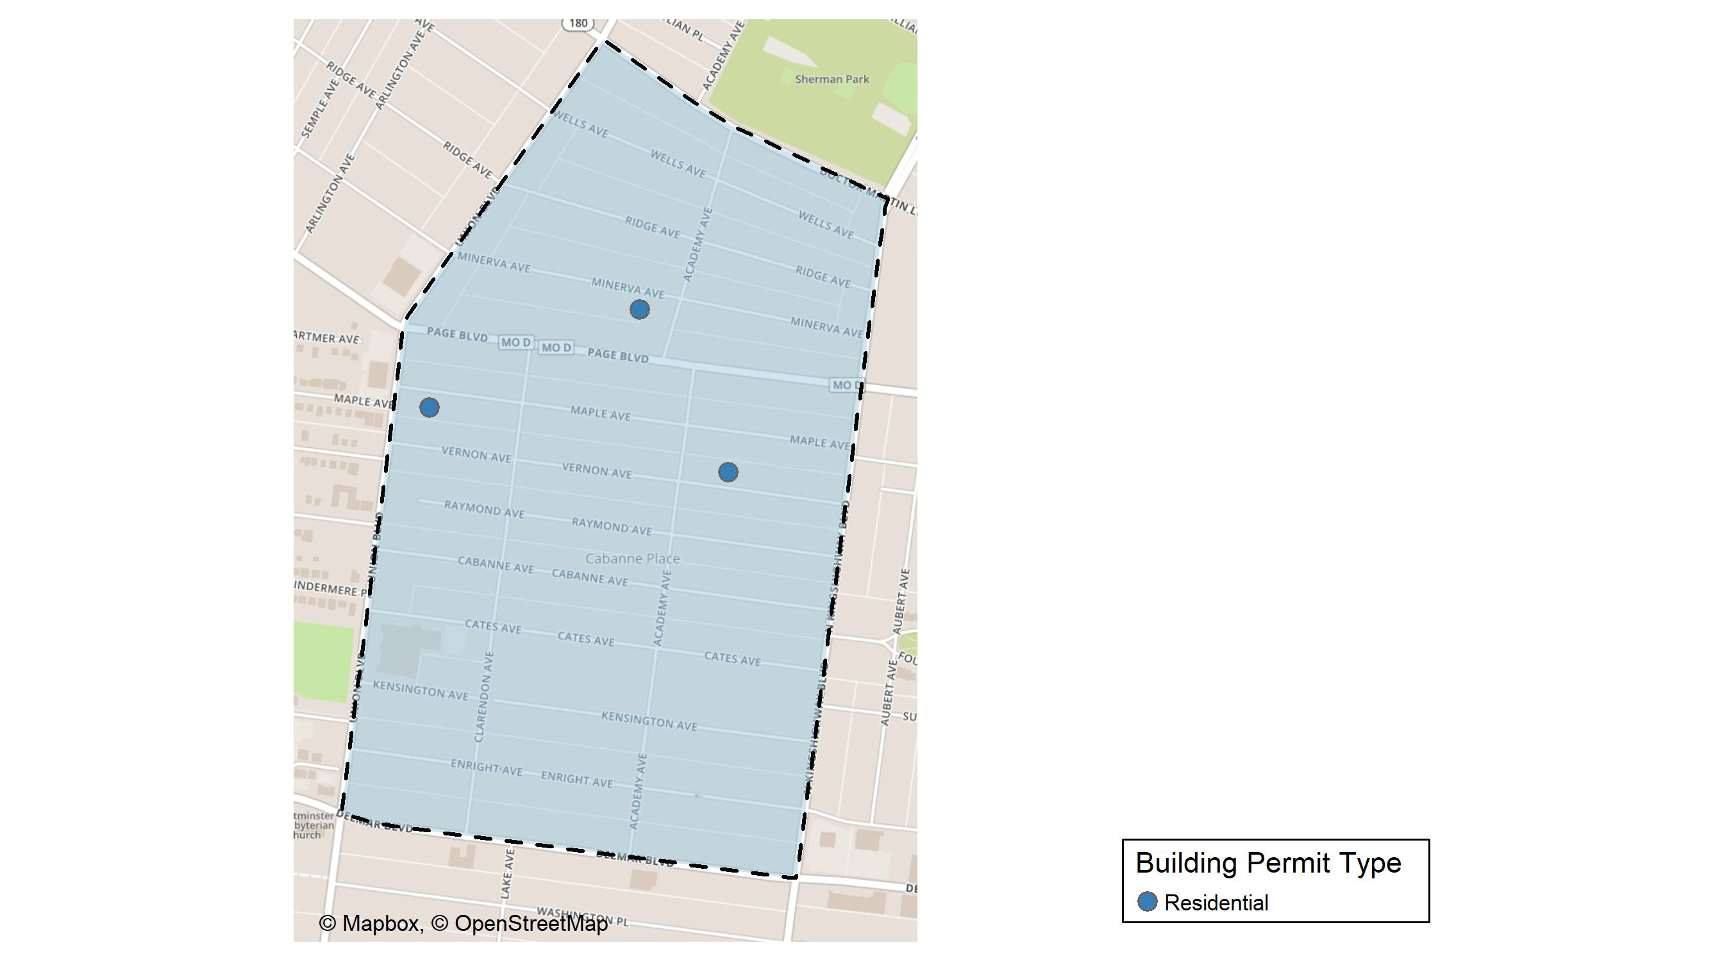
Academy

Slide 33
Neighborhood Summary
February 2025 | February 2025 | February 2025 | February 2025
Permit Use | Average Cost | # of Permits | Total Value of Permits
Commercial | $0.00 | 0 | $0
Industrial | $0.00 | 0 | $0
Residential | $33,666.67 | 3 | $101,000
Last 6 Months | Last 6 Months | Last 6 Months | Last 6 Months
Permit Use | Average Cost | # of Permits | Total Value of Permits
Commercial | $20,500.00 | 2 | $41,000
Industrial | $0.00 | 0 | $0
Residential | $26,198.79 | 14 | $366,783

Slide 34
Academy Individual Permit Breakdown
Neighborhood | Owner | New Use | Cost | address
Academy | FRAZIER, TAYLOUR | Residential | $15,000 | 5254 MAPLE AV
Academy | BL REAL ESTATE GROUP | Residential | $56,000 | 5069-71 VERNON AV
Academy | ABDULLATIF CONSULTING LLC | Residential | $30,000 | 5120 MINERVA AV

Slide 35
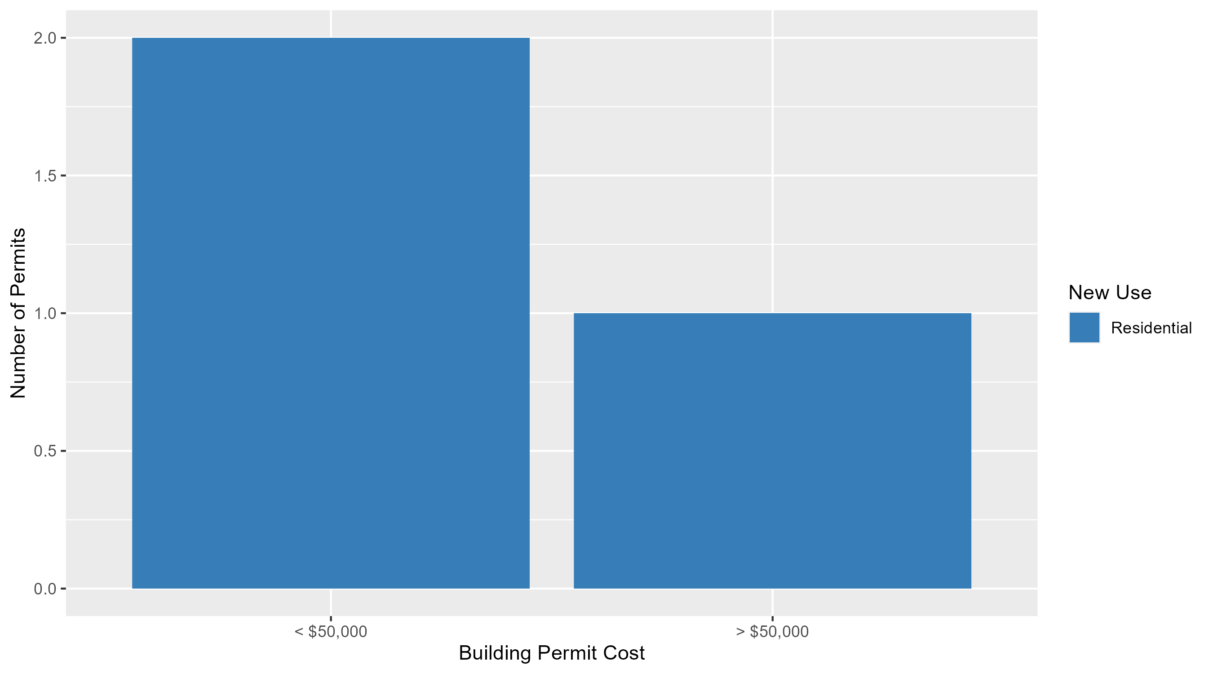
Academy Permit Cost Breakdown

Slide 36
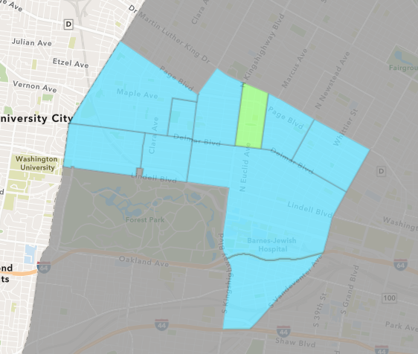
Fountain Park
February 2025 Neighborhood Cost Breakdown
  Mean: $5,800
  Median: $5,800
  Range: $5,800 - $5,800

Slide 37
Fountain Park: Summary Notes
1 building permits in February 2025
  -50.00% change compared to February 2024 (2 total building permits)
  $5,800: Average building permit cost in February 2025
    -70.26% change compared to February 2024 ($19,500)
1 total building permits in 2025
  -66.67% change YTD compared to this time in 2024 (3 total building permits)
  $5,800: YTD average building permit cost in 2025
    -65.88% change YTD compared to this time in 2024 ($17,000)

Slide 38
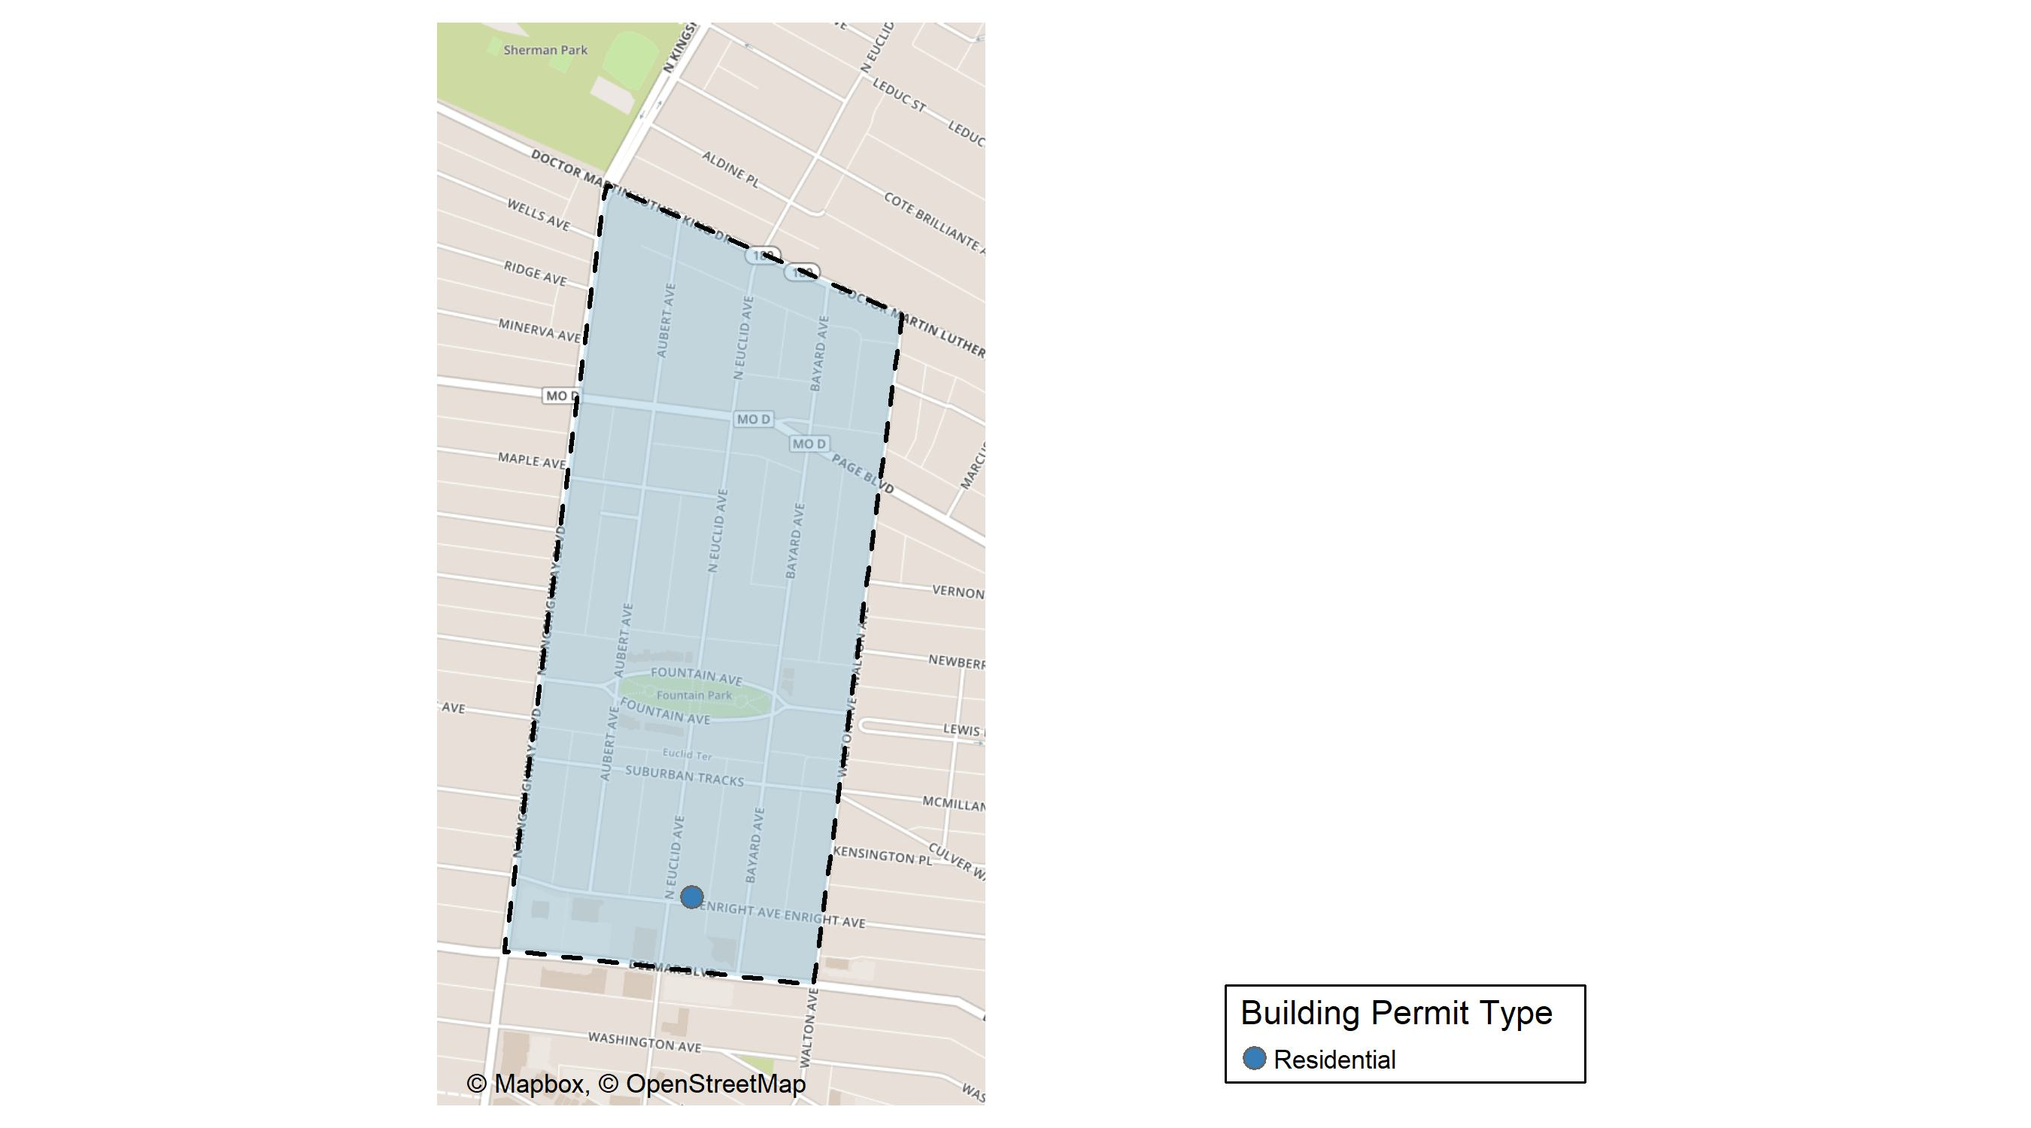
Fountain Park

Slide 39
Neighborhood Summary
February 2025 | February 2025 | February 2025 | February 2025
Permit Use | Average Cost | # of Permits | Total Value of Permits
Commercial | $0 | 0 | $0
Industrial | $0 | 0 | $0
Residential | $5,800 | 1 | $5,800
Last 6 Months | Last 6 Months | Last 6 Months | Last 6 Months
Permit Use | Average Cost | # of Permits | Total Value of Permits
Commercial | $50,000 | 3 | $150,000
Industrial | $0 | 0 | $0
Residential | $39,560 | 5 | $197,800

Slide 40
Fountain Park Individual Permit Breakdown
Neighborhood | Owner | New Use | Cost | address
Fountain Park | OODA GROUP LLC | Residential | $5,800 | 736 N EUCLID AV

Slide 41
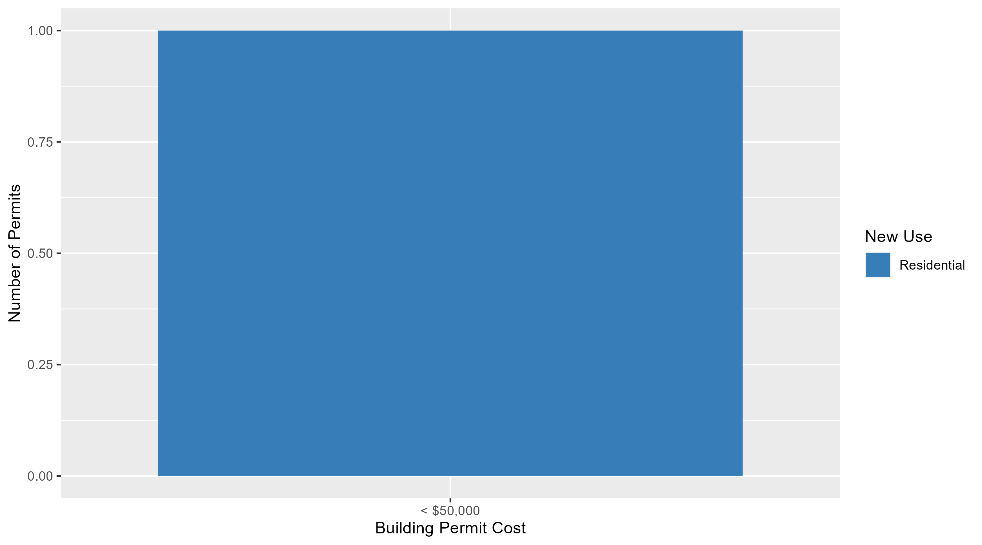
Fountain Park Permit Cost Breakdown

Slide 42
Additional Notes
Data retreived from https://www.stlouis-mo.gov/data/
Building permits with a cost of $0 were dropped
Building permits that were cancelled were dropped
Infinite change indicates 0 permits in the current or previous time period/comparison month so there was a overall increase or decrease

