Slide 1
St. Louis Central Corridor West Building Permits
Monthly Report: January 2024

Slide 2
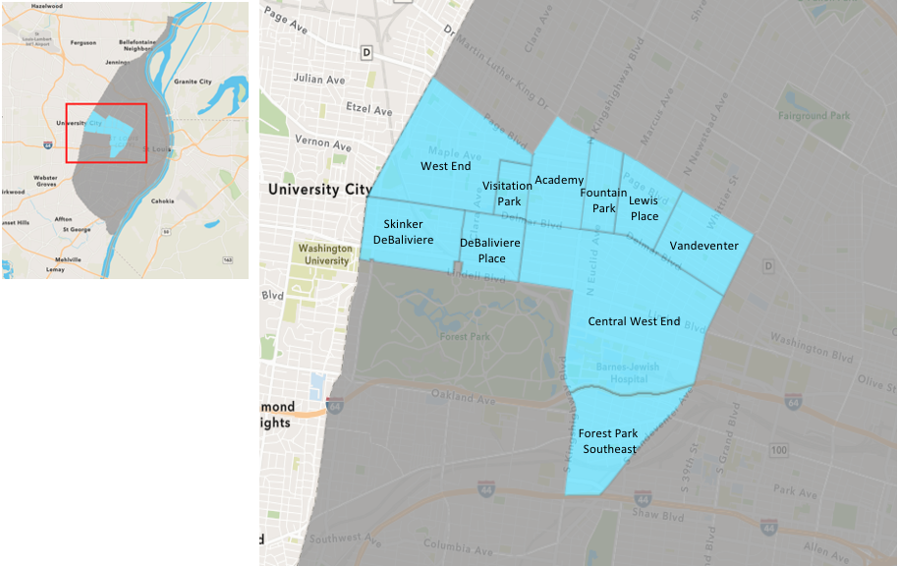
St. Louis Neighborhood Spatial Reference

Slide 3
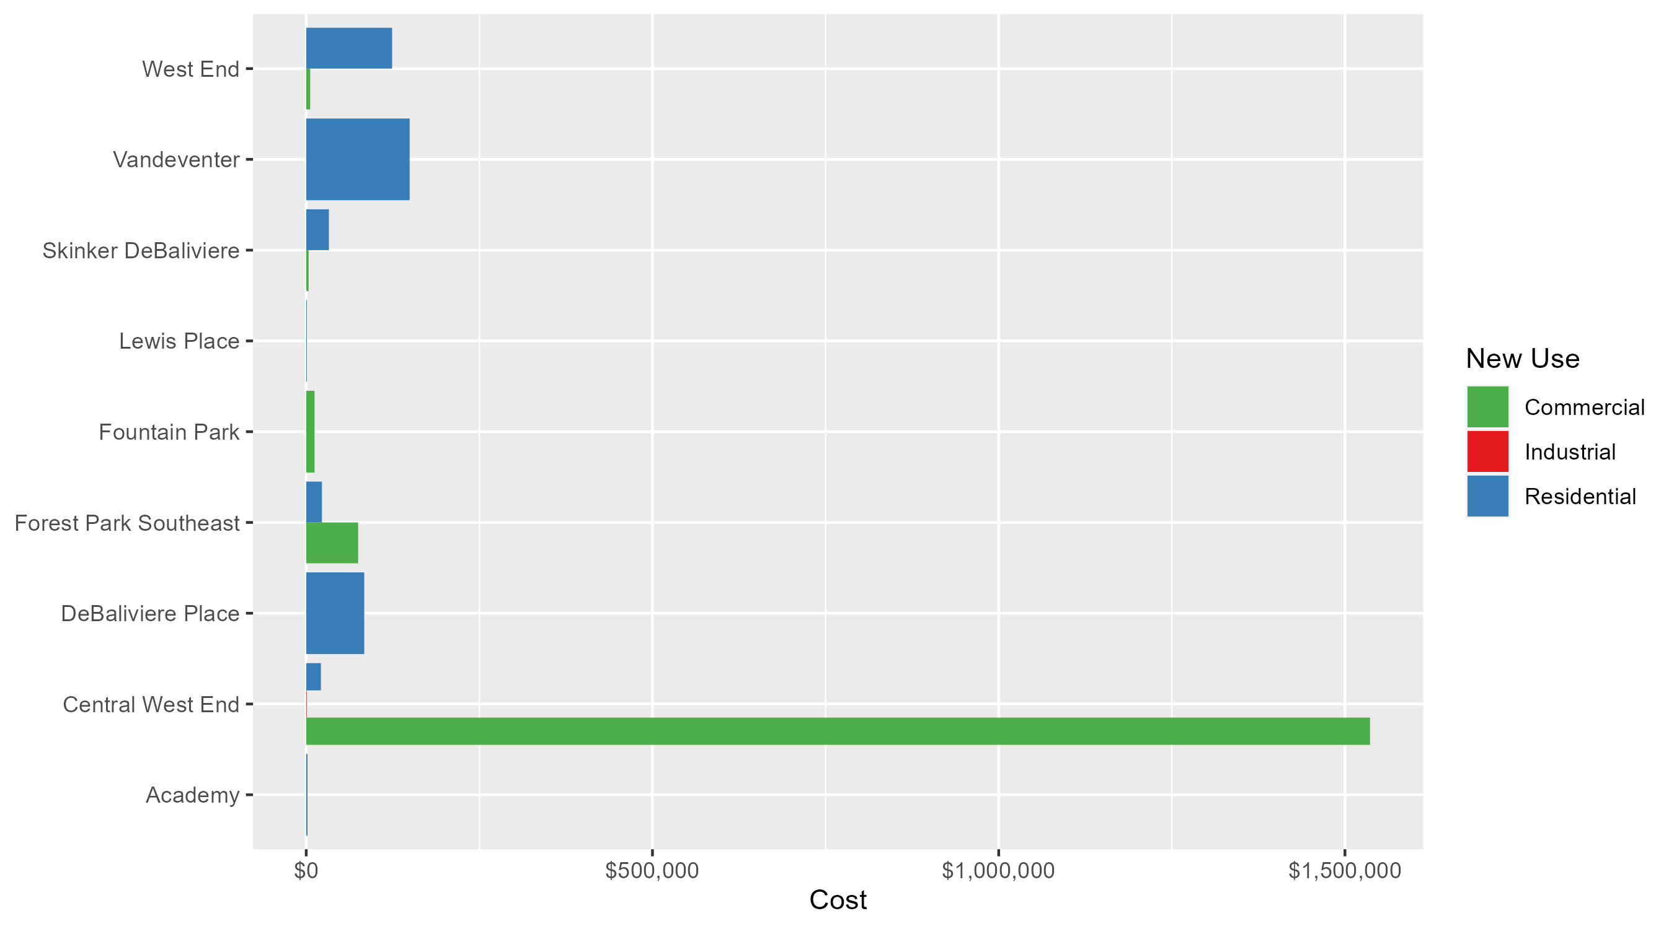
Neighborhood Summary: Average Building Permit Cost

Slide 4
Neighborhood Summary
January 2024 | January 2024 | January 2024 | January 2024
Neighborhood | Average Cost | # of Permits | Total Value of Permits
Academy | $1,833.333 | 3 | $5,500
Central West End | $1,030,436.676 | 27 | $27,821,790
DeBaliviere Place | $83,750.000 | 4 | $335,000
Forest Park Southeast | $30,178.571 | 7 | $211,250
Fountain Park | $12,000.000 | 1 | $12,000
Lewis Place | $1,000.000 | 1 | $1,000
Skinker DeBaliviere | $27,875.000 | 6 | $167,250
Vandeventer | $149,350.000 | 1 | $149,350
Visitation Park | $0.000 | 0 | $0
West End | $112,160.900 | 10 | $1,121,609
Last 6 Months | Last 6 Months | Last 6 Months | Last 6 Months
Neighborhood | Average Cost | # of Permits | Total Value of Permits
Academy | $26,143.40 | 20 | $522,868
Central West End | $284,727.82 | 212 | $60,362,298
DeBaliviere Place | $105,625.57 | 30 | $3,168,767
Forest Park Southeast | $60,686.60 | 43 | $2,609,524
Fountain Park | $177,311.67 | 12 | $2,127,740
Lewis Place | $58,956.17 | 6 | $353,737
Skinker DeBaliviere | $86,411.15 | 58 | $5,011,847
Vandeventer | $250,409.70 | 10 | $2,504,097
Visitation Park | $72,433.33 | 3 | $217,300
West End | $102,924.19 | 52 | $5,352,058

Slide 5
Core Neighborhoods

Slide 6
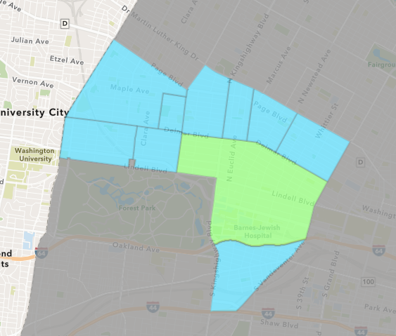
Central West End
January 2024 Neighborhood Cost Breakdown
  Mean: $1,030,437
  Median: $16,285
  Range: $800 - $13,000,000

Slide 7
Central West End: Summary Notes
27 building permits in January 2024
  -12.90% change compared to January 2023 (31 total building permits)
  $1,030,437: Average building permit cost in January 2024
    872.28% change compared to January 2023 ($105,981)
27 total building permits in 2024
  -12.90% change YTD compared to this time in 2023 (31 total building permits)
  $1,030,437: YTD average building permit cost in 2024
    872.28% change YTD compared to this time in 2023 ($105,981)

Slide 8
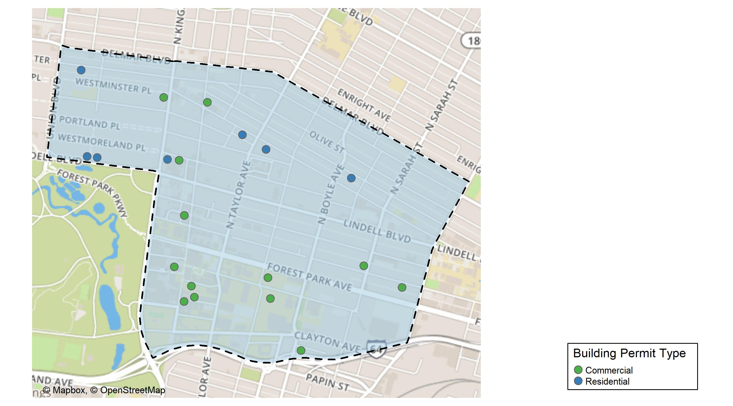
Central West End

Slide 9
Neighborhood Summary
January 2024 | January 2024 | January 2024 | January 2024
Permit Use | Average Cost | # of Permits | Total Value of Permits
Commercial | $1,536,191.56 | 18 | $27,651,448.0
Industrial | $800.00 | 1 | $800.0
Residential | $21,192.78 | 8 | $169,542.2
Last 6 Months | Last 6 Months | Last 6 Months | Last 6 Months
Permit Use | Average Cost | # of Permits | Total Value of Permits
Commercial | $607,183.82 | 91 | $55,253,728
Industrial | $15,150.00 | 4 | $60,600
Residential | $43,145.05 | 117 | $5,047,970

Slide 10
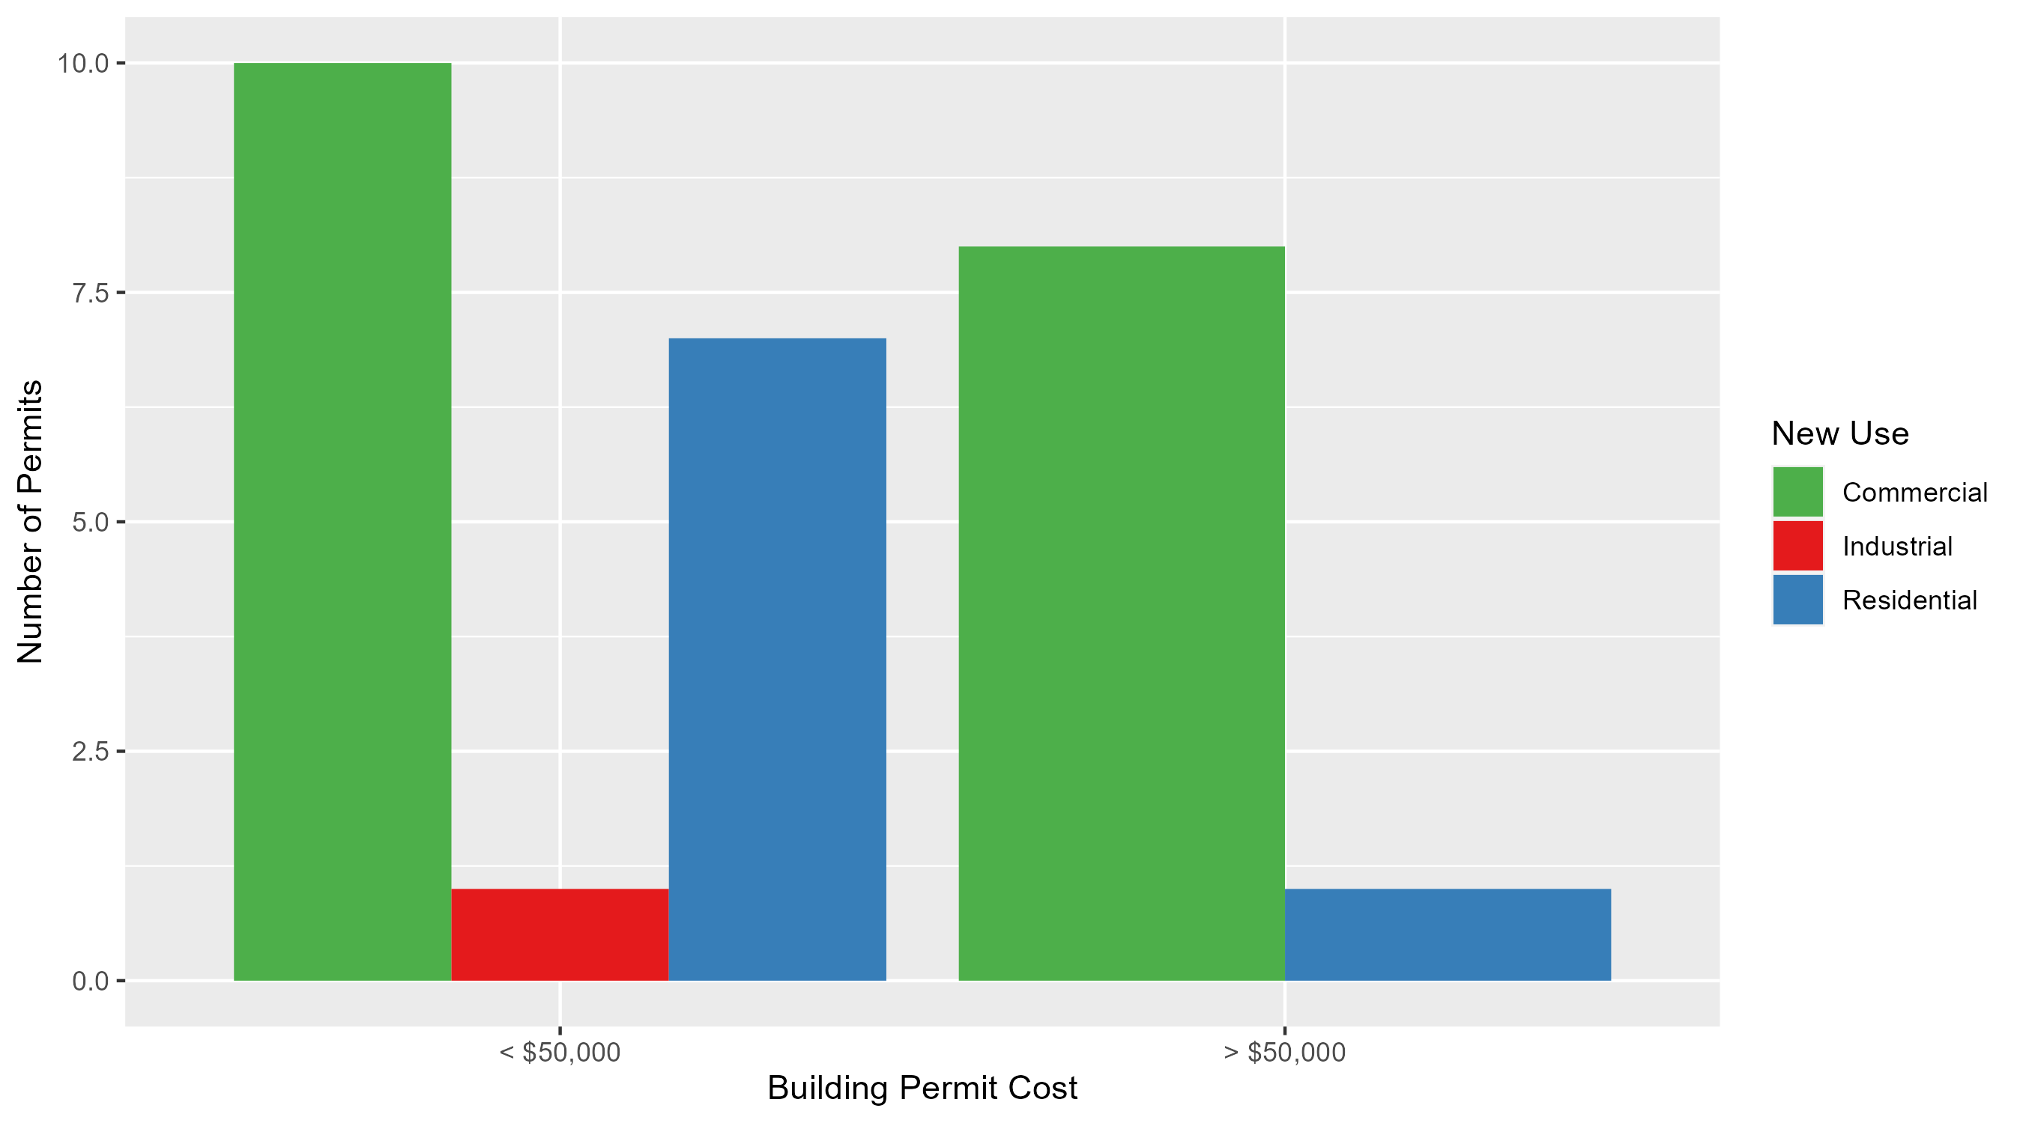
Central West End Permit Cost Breakdown

Slide 11
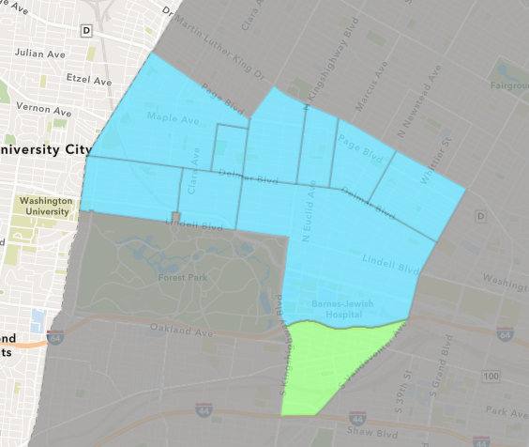
Forest Park Southeast
January 2024 Neighborhood Cost Breakdown
  Mean: $30,179
  Median: $16,000
  Range: $250 - $100,000

Slide 12
Forest Park Southeast: Summary Notes
7 building permits in January 2024
  0.00% change compared to January 2023 (7 total building permits)
  $30,179: Average building permit cost in January 2024
    3.10% change compared to January 2023 ($29,273)
7 total building permits in 2024
  0.00% change YTD compared to this time in 2023 (7 total building permits)
  $30,179: YTD average building permit cost in 2024
    3.10% change YTD compared to this time in 2023 ($29,273)

Slide 13
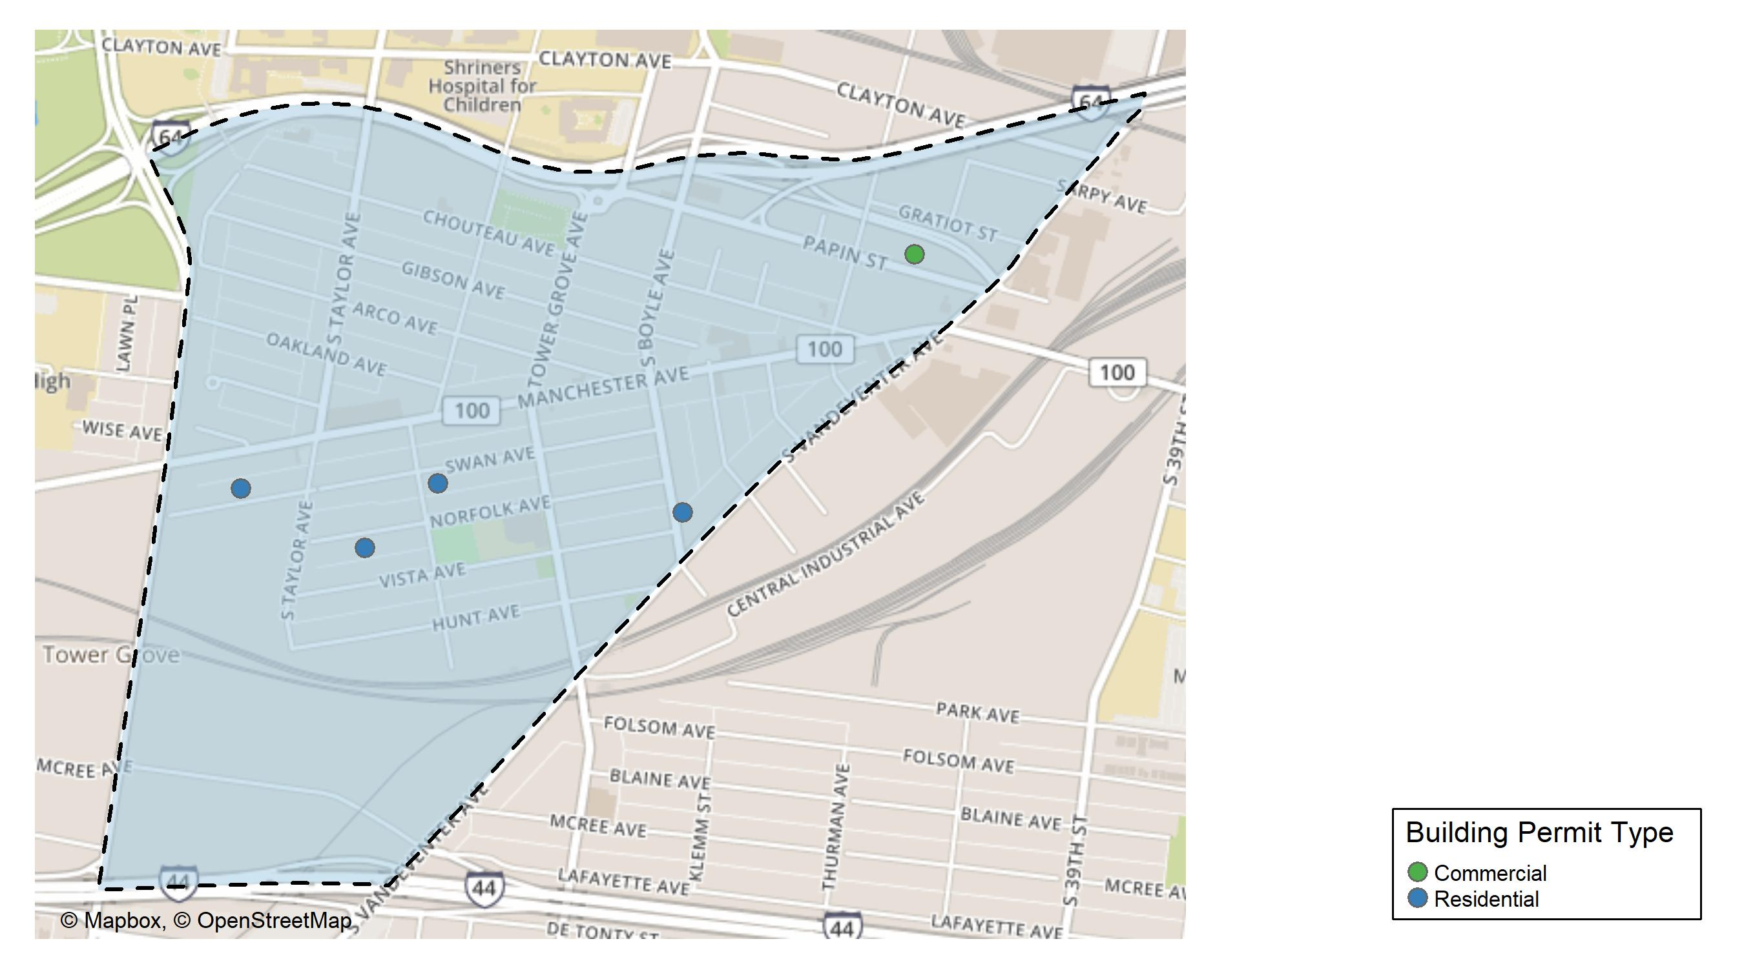
Forest Park Southeast

Slide 14
Neighborhood Summary
January 2024 | January 2024 | January 2024 | January 2024
Permit Use | Average Cost | # of Permits | Total Value of Permits
Commercial | $75,000.00 | 1 | $75,000
Industrial | $0.00 | 0 | $0
Residential | $22,708.33 | 6 | $136,250
Last 6 Months | Last 6 Months | Last 6 Months | Last 6 Months
Permit Use | Average Cost | # of Permits | Total Value of Permits
Commercial | $25,880.00 | 5 | $129,400
Industrial | $6,675.00 | 4 | $26,700
Residential | $72,159.53 | 34 | $2,453,424

Slide 15
Forest Park Southeast Individual Permit Breakdown
Neighborhood | Owner | New Use | Cost | address
Forest Park Southeast | NMR PARTNERS LLC | Residential | $100,000 | 1034 S KINGSHIGHWAY BLVD
Forest Park Southeast | HOLTZMAN PROPERTIES LLC | Commercial | $75,000 | 4015 PAPIN ST
Forest Park Southeast | LACLEDE AVENUE LLC | Residential | $1,000 | 1322-24 S BOYLE AV
Forest Park Southeast | EYERWORKS GREENS LLC | Residential | $16,000 | 4176 MANCHESTER AV
Forest Park Southeast | HARRIS, JUDY D | Residential | $250 | 4541-43 SWAN AV
Forest Park Southeast | QZ FUNDING LLC | Residential | $18,000 | 4438 NORFOLK AV
Forest Park Southeast | KING, BETTIE | Residential | $1,000 | 4362-64 SWAN AV

Slide 16
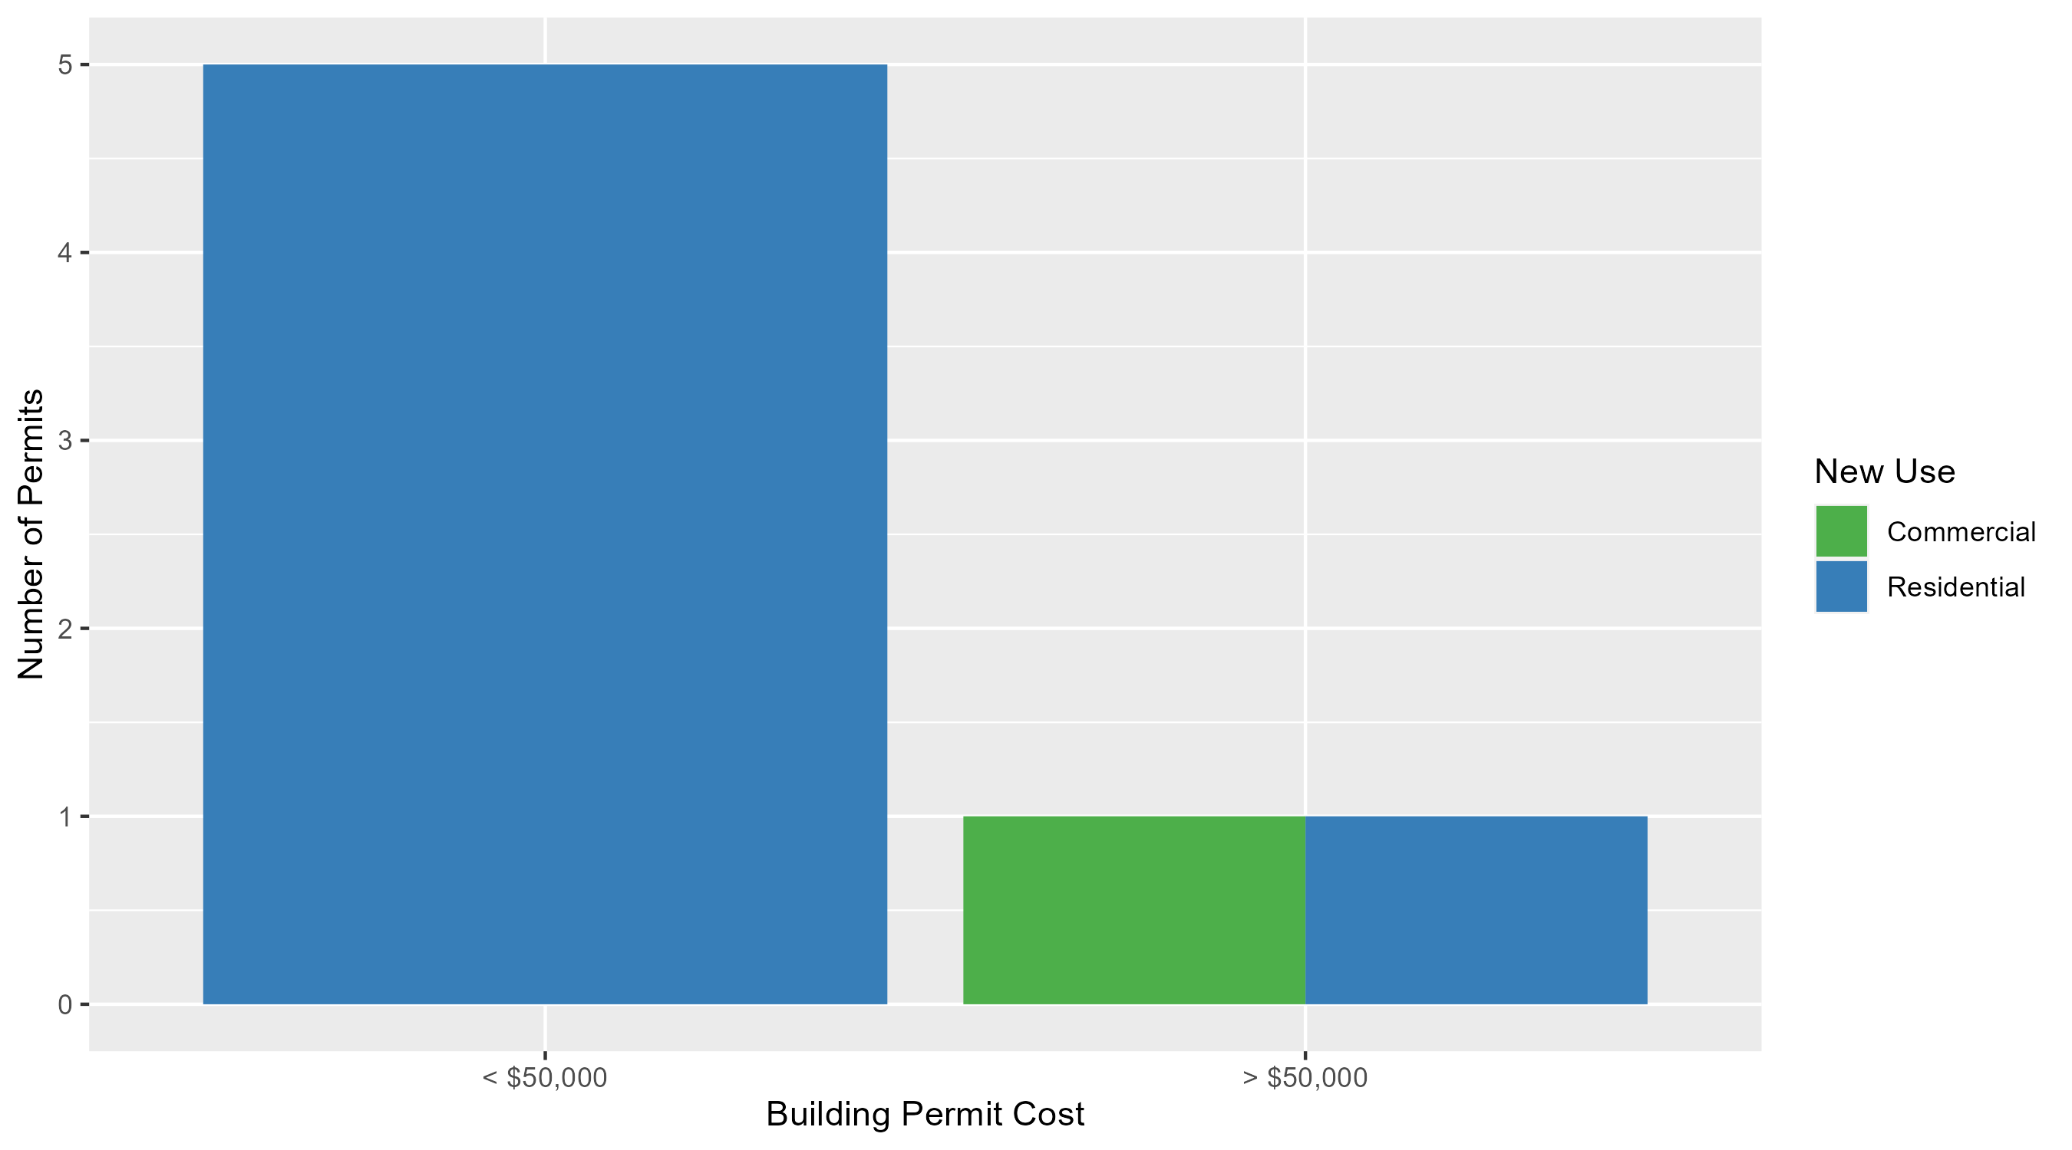
Forest Park Southeast Permit Cost Breakdown

Slide 17
Expanded Service Area

Slide 18
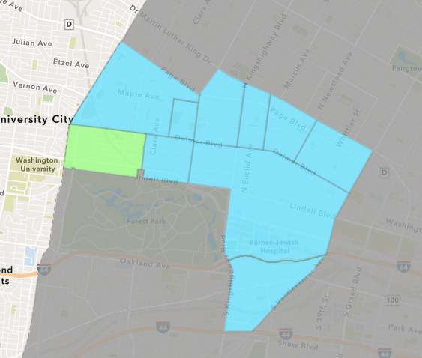
Skinker DeBaliviere
January 2024 Neighborhood Cost Breakdown
  Mean: $27,875
  Median: $18,925
  Range: $2,500 - $76,000

Slide 19
Skinker DeBaliviere: Summary Notes
6 building permits in January 2024
  -40.00% change compared to January 2023 (10 total building permits)
  $27,875: Average building permit cost in January 2024
    -68.61% change compared to January 2023 ($88,798)
6 total building permits in 2024
  -40.00% change YTD compared to this time in 2023 (10 total building permits)
  $27,875: YTD average building permit cost in 2024
    -68.61% change YTD compared to this time in 2023 ($88,798)

Slide 20
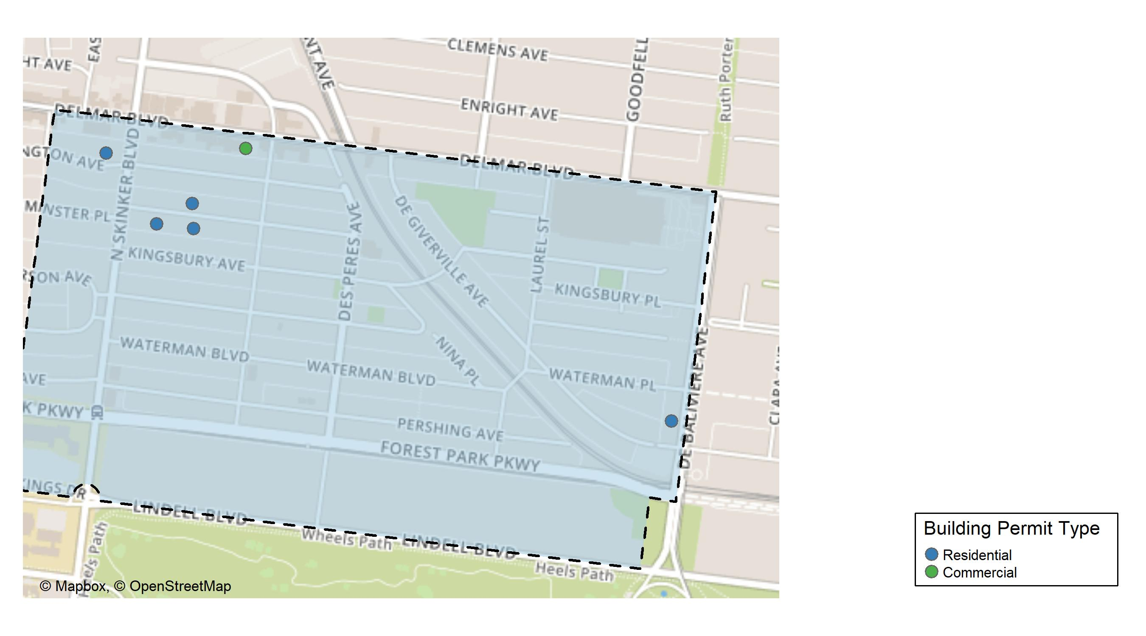
Skinker DeBaliviere

Slide 21
Neighborhood Summary
January 2024 | January 2024 | January 2024 | January 2024
Permit Use | Average Cost | # of Permits | Total Value of Permits
Commercial | $3,500 | 1 | $3,500
Industrial | $0 | 0 | $0
Residential | $32,750 | 5 | $163,750
Last 6 Months | Last 6 Months | Last 6 Months | Last 6 Months
Permit Use | Average Cost | # of Permits | Total Value of Permits
Commercial | $92,350.00 | 6 | $554,100
Industrial | $16,450.00 | 2 | $32,900
Residential | $88,496.93 | 50 | $4,424,847

Slide 22
Skinker DeBaliviere Individual Permit Breakdown
Neighborhood | Owner | New Use | Cost | address
Skinker DeBaliviere | LOOP CENTER SOUTH LLC | Commercial | $3,500 | 6118 DELMAR BLVD
Skinker DeBaliviere | DEBALIVIERE COMMUNITY CTR LP | Residential | $10,000 | 311 DEBALIVIERE AV
Skinker DeBaliviere | HUGHES, BRIAN & LISA | Residential | $76,000 | 6215 WASHINGTON AV
Skinker DeBaliviere | LEONARD, SARAH & MAXWELL ZIMMERMAN | Residential | $27,850 | 6174 WESTMINSTER PL
Skinker DeBaliviere | HORNER, WILLIAM F & LISA R | Residential | $47,400 | 6146 WESTMINSTER PL
Skinker DeBaliviere | SPACES DEVELOPMENT LLC | Residential | $2,500 | 6151 WESTMINSTER PL

Slide 23
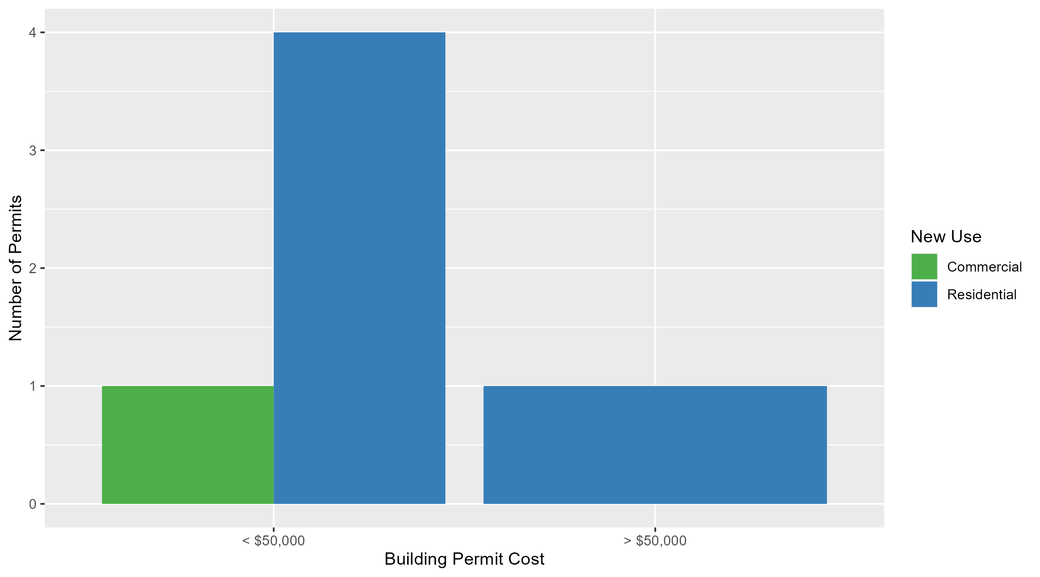
Skinker DeBaliviere Permit Cost Breakdown

Slide 24
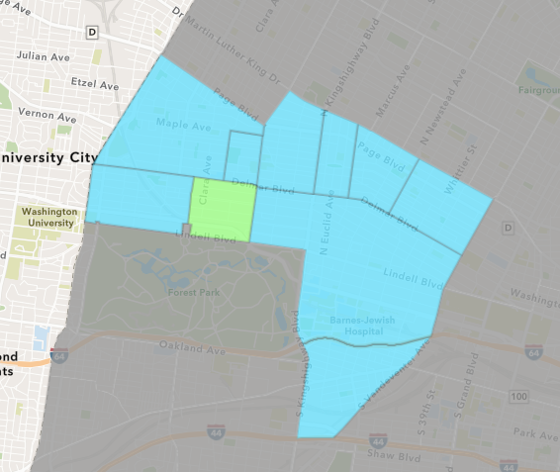
DeBaliviere Place
January 2024 Neighborhood Cost Breakdown
  Mean: $83,750
  Median: $70,000
  Range: $45,000 - $150,000

Slide 25
DeBaliviere Place: Summary Notes
4 building permits in January 2024
  -20.00% change compared to January 2023 (5 total building permits)
  $83,750: Average building permit cost in January 2024
    -30.74% change compared to January 2023 ($120,930)
4 total building permits in 2024
  -20.00% change YTD compared to this time in 2023 (5 total building permits)
  $83,750: YTD average building permit cost in 2024
    -30.74% change YTD compared to this time in 2023 ($120,930)

Slide 26
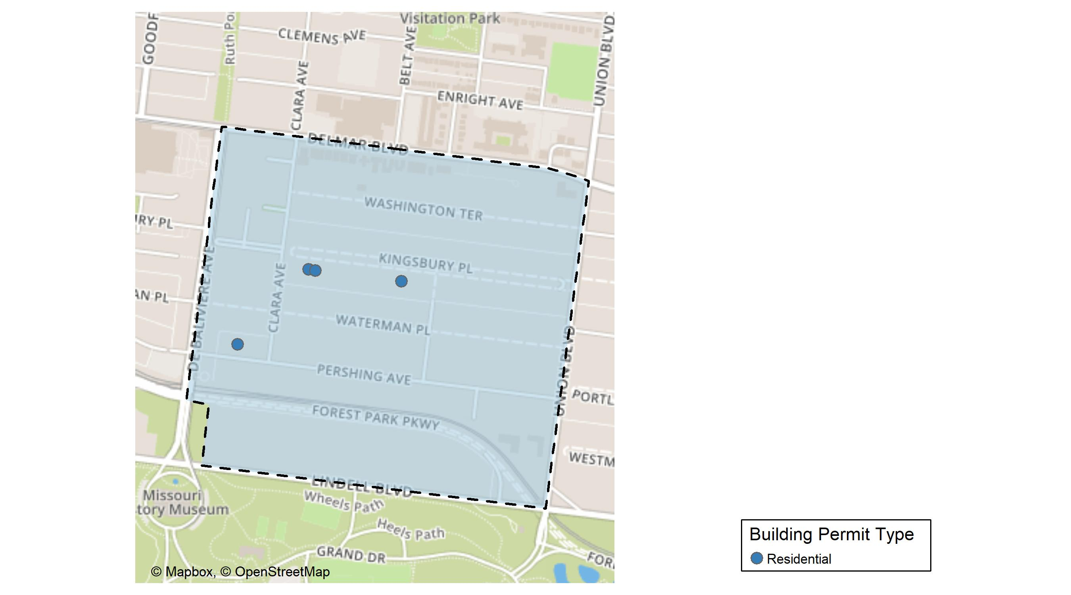
DeBaliviere Place

Slide 27
Neighborhood Summary
January 2024 | January 2024 | January 2024 | January 2024
Permit Use | Average Cost | # of Permits | Total Value of Permits
Commercial | $0 | 0 | $0
Industrial | $0 | 0 | $0
Residential | $83,750 | 4 | $335,000
Last 6 Months | Last 6 Months | Last 6 Months | Last 6 Months
Permit Use | Average Cost | # of Permits | Total Value of Permits
Commercial | $763,077.00 | 2 | $1,526,154
Industrial | $0.00 | 0 | $0
Residential | $58,664.75 | 28 | $1,642,613

Slide 28
DeBaliviere Place Individual Permit Breakdown
Neighborhood | Owner | New Use | Cost | address
DeBaliviere Place | MAGUIRE, CHRISTINA | Residential | $60,000 | 32 KINGSBURY PL
DeBaliviere Place | MINANA, KIMBERLY A & GREGORY J | Residential | $150,000 | 58 KINGSBURY PL
DeBaliviere Place | PERSHING AVE CONDO 2ND AMEND | Residential | $45,000 | 5631 PERSHING AV
DeBaliviere Place | THOMAS, SCOTT E | Residential | $80,000 | 56 KINGSBURY PL

Slide 29
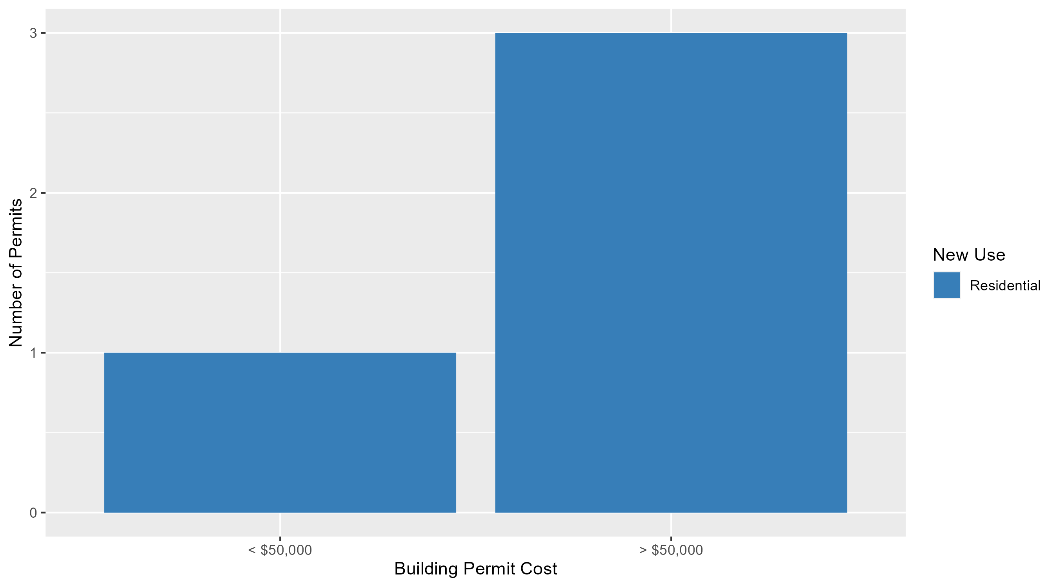
DeBaliviere Place Permit Cost Breakdown

Slide 30
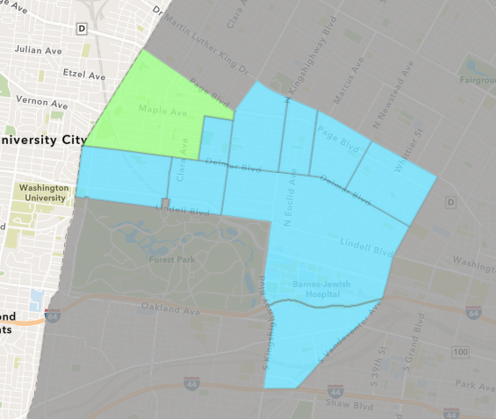
West End
January 2024 Neighborhood Cost Breakdown
  Mean: $112,161
  Median: $41,955
  Range: $1,000 - $250,000

Slide 31
West End: Summary Notes
10 building permits in January 2024
  0.00% change compared to January 2023 (10 total building permits)
  $112,161: Average building permit cost in January 2024
    174.70% change compared to January 2023 ($40,831)
10 total building permits in 2024
  0.00% change YTD compared to this time in 2023 (10 total building permits)
  $112,161: YTD average building permit cost in 2024
    174.70% change YTD compared to this time in 2023 ($40,831)

Slide 32
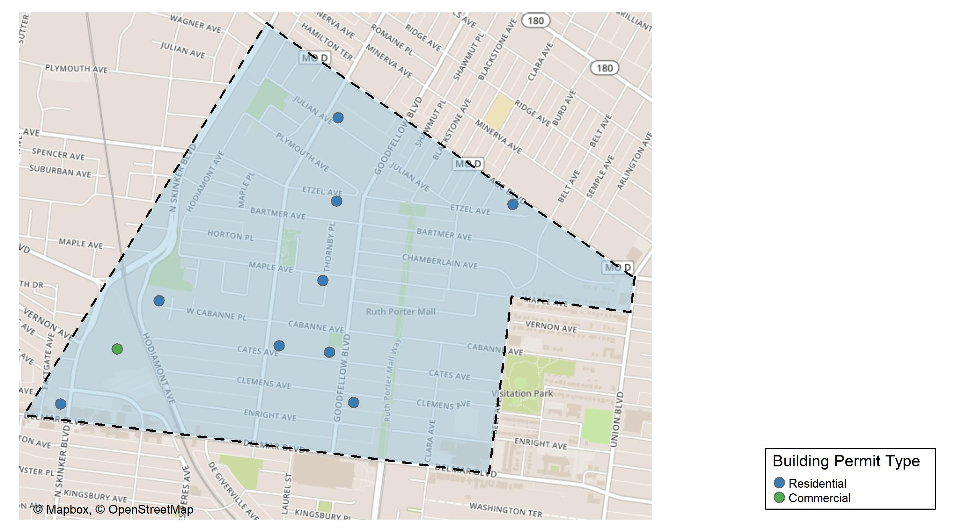
West End

Slide 33
Neighborhood Summary
January 2024 | January 2024 | January 2024 | January 2024
Permit Use | Average Cost | # of Permits | Total Value of Permits
Commercial | $5,700.0 | 1 | $5,700
Industrial | $0.0 | 0 | $0
Residential | $123,989.9 | 9 | $1,115,909
Last 6 Months | Last 6 Months | Last 6 Months | Last 6 Months
Permit Use | Average Cost | # of Permits | Total Value of Permits
Commercial | $199,707.43 | 7 | $1,397,952
Industrial | $0.00 | 0 | $0
Residential | $87,869.02 | 45 | $3,954,106

Slide 34
West End Individual Permit Breakdown
Neighborhood | Owner | New Use | Cost | address
West End | WEST END LLC | Residential | $250,000 | 5838 MAPLE AV
West End | WEST END LLC | Residential | $250,000 | 5887 CATES AV
West End | WEST END LLC | Residential | $250,000 | 5730 CLEMENS AV
West End | WEST END LLC | Residential | $250,000 | 5819 CATES AV
West End | WASHINGTON UNIVERSITY | Commercial | $5,700 | 700 ROSEDALE AV
West End | PACE-DELMAR ASSOCIATES LLC | Residential | $53,909 | 621 N SKINKER BLVD
West End | MAGNOLIA REALTY LLC | Residential | $30,000 | 5832-34 ETZEL AV
West End | JAL HOLDINGS STL LLC | Residential | $30,000 | 5536 PAGE BLVD
West End | KELLEY, CANATH E & BARBARA J KELLEY | Residential | $1,000 | 5883 JULIAN AV
West End | MCKINNIS, BERTHA | Residential | $1,000 | 6085 WEST CABANNE PL

Slide 35
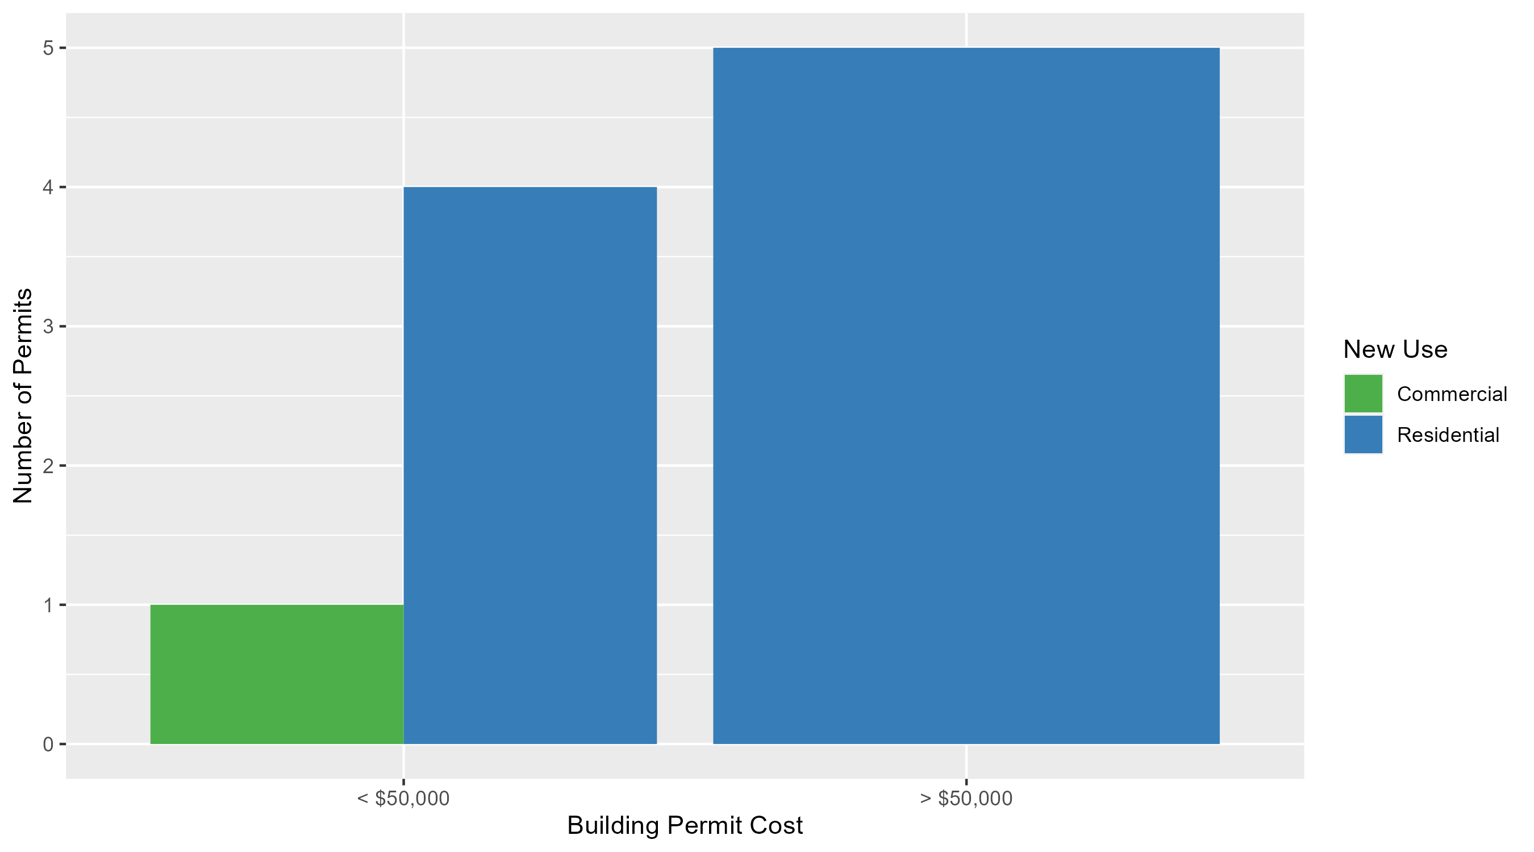
West End Permit Cost Breakdown

Slide 36
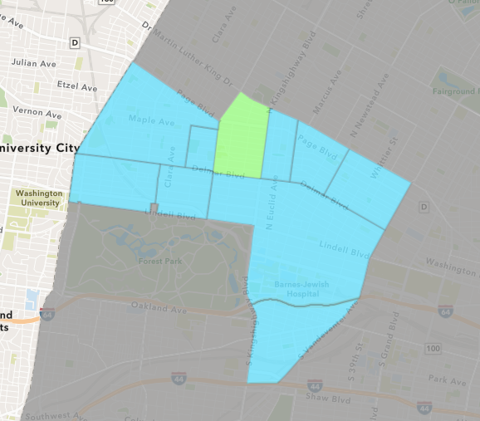
Academy
January 2024 Neighborhood Cost Breakdown
  Mean: $1,833
  Median: $1,000
  Range: $1,000 - $3,500

Slide 37
Academy: Summary Notes
3 building permits in January 2024
  200.00% change compared to January 2023 (1 total building permits)
  $1,833: Average building permit cost in January 2024
    22.22% change compared to January 2023 ($1,500)
3 total building permits in 2024
  200.00% change YTD compared to this time in 2023 (1 total building permits)
  $1,833: YTD average building permit cost in 2024
    22.22% change YTD compared to this time in 2023 ($1,500)

Slide 38
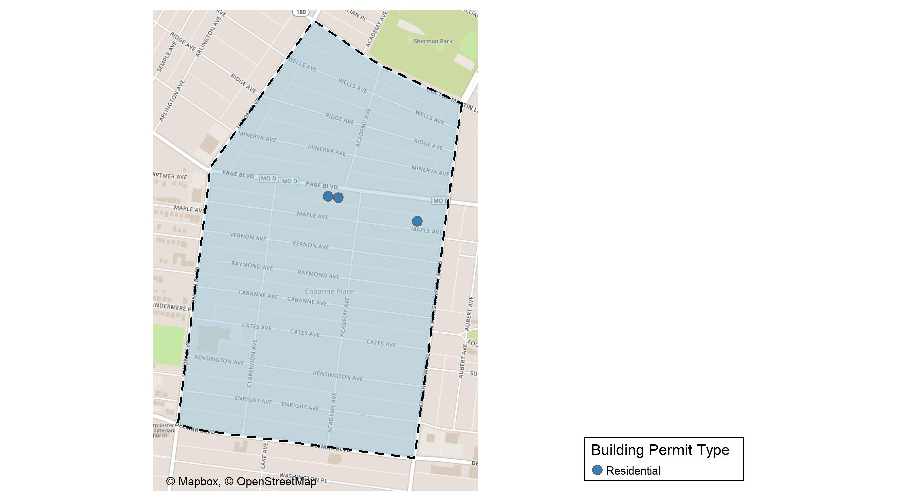
Academy

Slide 39
Neighborhood Summary
January 2024 | January 2024 | January 2024 | January 2024
Permit Use | Average Cost | # of Permits | Total Value of Permits
Commercial | $0.000 | 0 | $0
Industrial | $0.000 | 0 | $0
Residential | $1,833.333 | 3 | $5,500
Last 6 Months | Last 6 Months | Last 6 Months | Last 6 Months
Permit Use | Average Cost | # of Permits | Total Value of Permits
Commercial | $1,928.00 | 1 | $1,928
Industrial | $1,400.00 | 1 | $1,400
Residential | $28,863.33 | 18 | $519,540

Slide 40
Academy Individual Permit Breakdown
Neighborhood | Owner | New Use | Cost | address
Academy | SMITH, SHONTA MICHELLE | Residential | $3,500 | 5029 MAPLE AV
Academy | ELLIS, ETHEL MAE | Residential | $1,000 | 5122 PAGE BLVD
Academy | THOMPSON, TAUSHA | Residential | $1,000 | 5136 PAGE BLVD

Slide 41
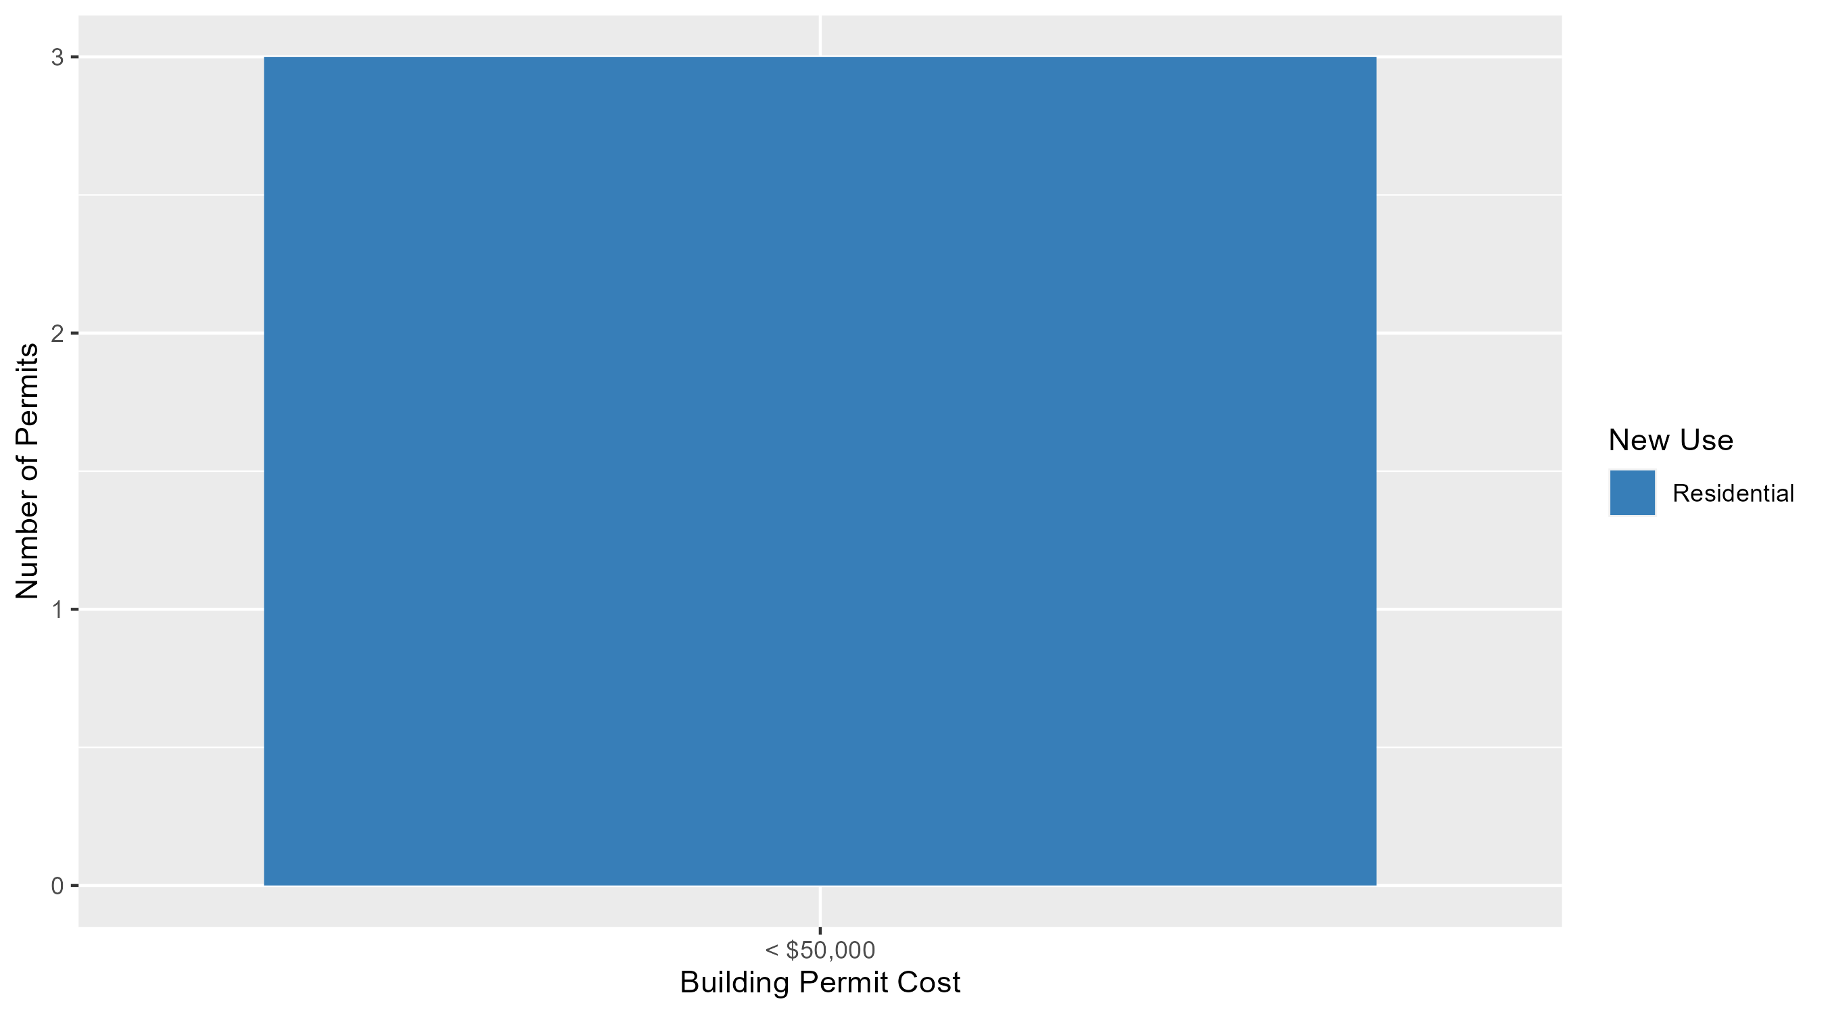
Academy Permit Cost Breakdown

Slide 42
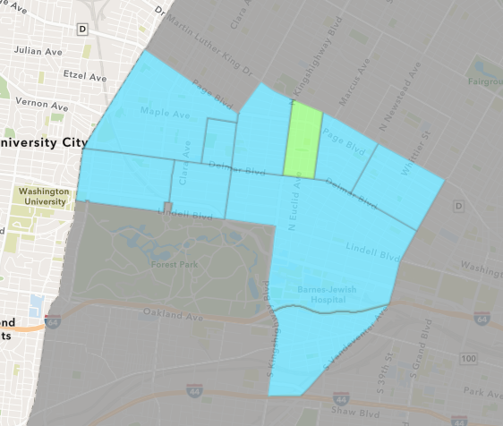
Fountain Park
January 2024 Neighborhood Cost Breakdown
  Mean: $12,000
  Median: $12,000
  Range: $12,000 - $12,000

Slide 43
Fountain Park: Summary Notes
1 building permits in January 2024
  -50.00% change compared to January 2023 (2 total building permits)
  $12,000: Average building permit cost in January 2024
    -50.00% change compared to January 2023 ($24,000)
1 total building permits in 2024
  -50.00% change YTD compared to this time in 2023 (2 total building permits)
  $12,000: YTD average building permit cost in 2024
    -50.00% change YTD compared to this time in 2023 ($24,000)

Slide 44
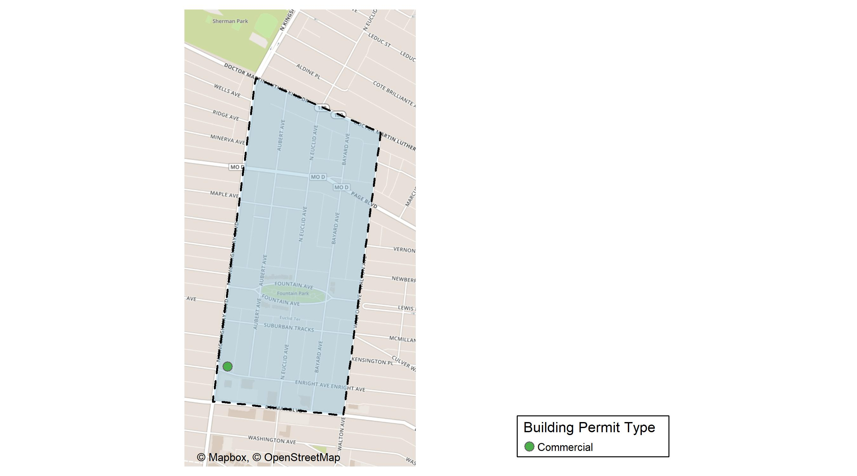
Fountain Park

Slide 45
Neighborhood Summary
January 2024 | January 2024 | January 2024 | January 2024
Permit Use | Average Cost | # of Permits | Total Value of Permits
Commercial | $12,000 | 1 | $12,000
Industrial | $0 | 0 | $0
Residential | $0 | 0 | $0
Last 6 Months | Last 6 Months | Last 6 Months | Last 6 Months
Permit Use | Average Cost | # of Permits | Total Value of Permits
Commercial | $34,220 | 5 | $171,100
Industrial | $1,750,000 | 1 | $1,750,000
Residential | $34,440 | 6 | $206,640

Slide 46
Fountain Park Individual Permit Breakdown
Neighborhood | Owner | New Use | Cost | address
Fountain Park | MBR KINGSHIGHWAY PROPERY LLC | Commercial | $12,000 | 802 N KINGSHIGHWAY BLVD

Slide 47
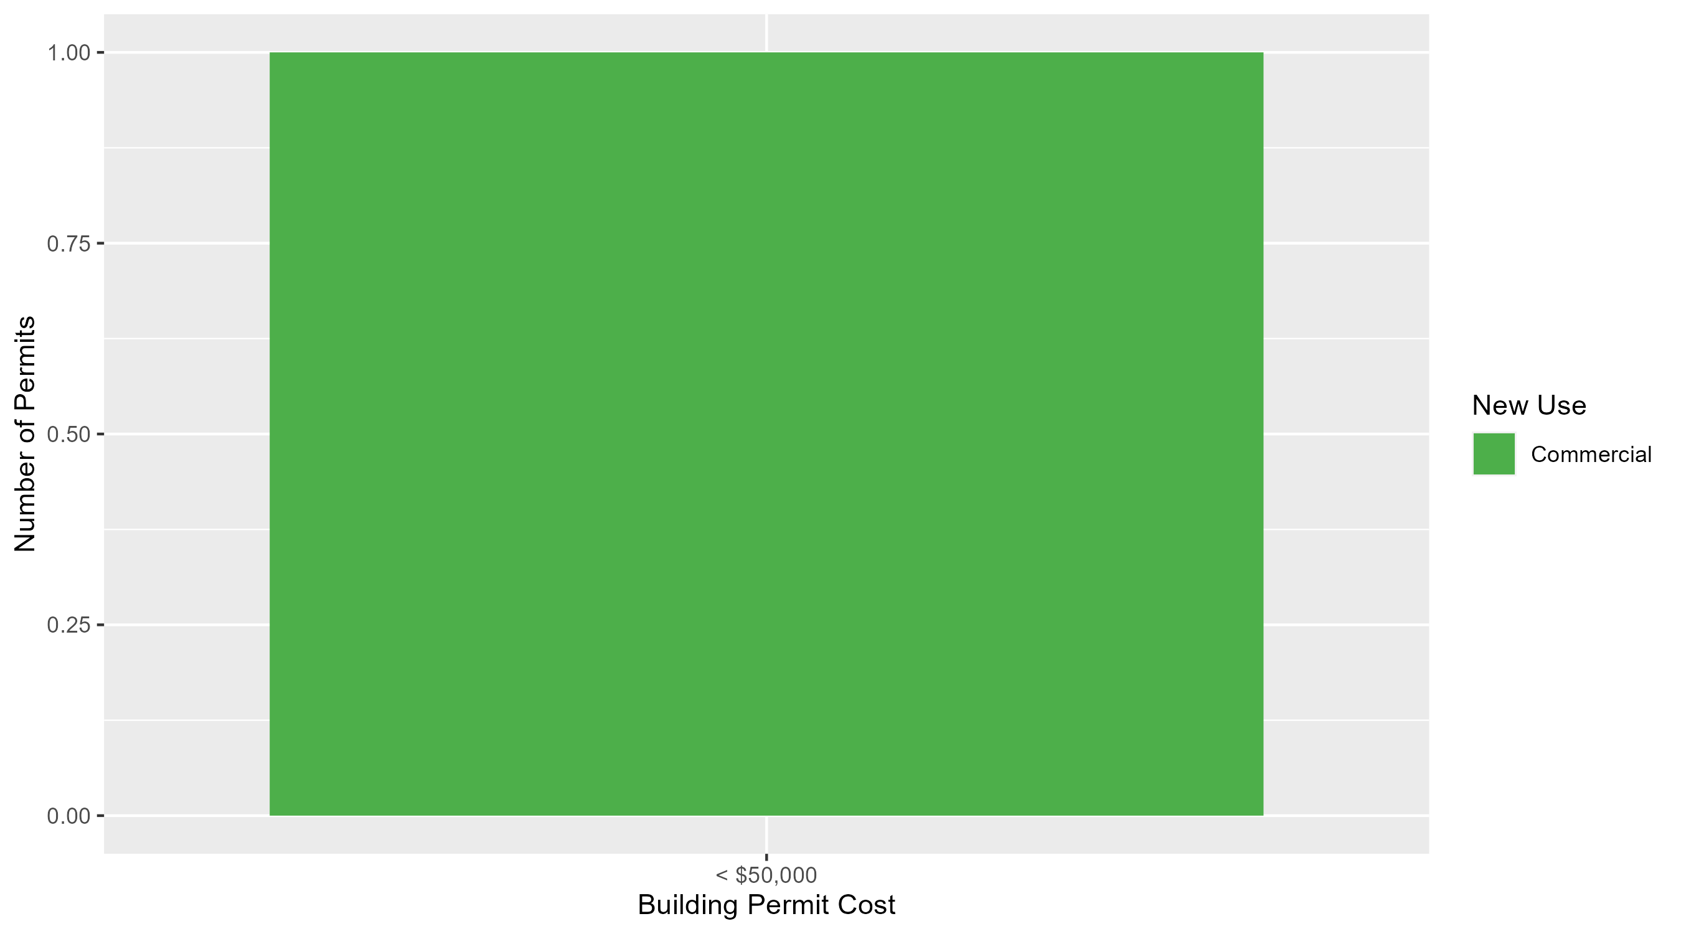
Fountain Park Permit Cost Breakdown

Slide 48
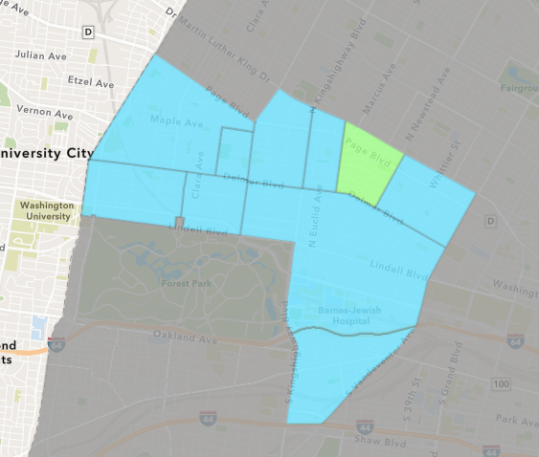
Lewis Place
January 2024 Neighborhood Cost Breakdown
  Mean: $1,000
  Median: $1,000
  Range: $1,000 - $1,000

Slide 49
Lewis Place: Summary Notes
1 building permits in January 2024
  Infinite change compared to January 2023 (0 total building permits)
  $1,000: Average building permit cost in January 2024
    Infinite change compared to January 2023 ($0)
1 total building permits in 2024
  Infinite change YTD compared to this time in 2023 (0 total building permits)
  $1,000: YTD average building permit cost in 2024
    Infinite change YTD compared to this time in 2023 ($0)

Slide 50
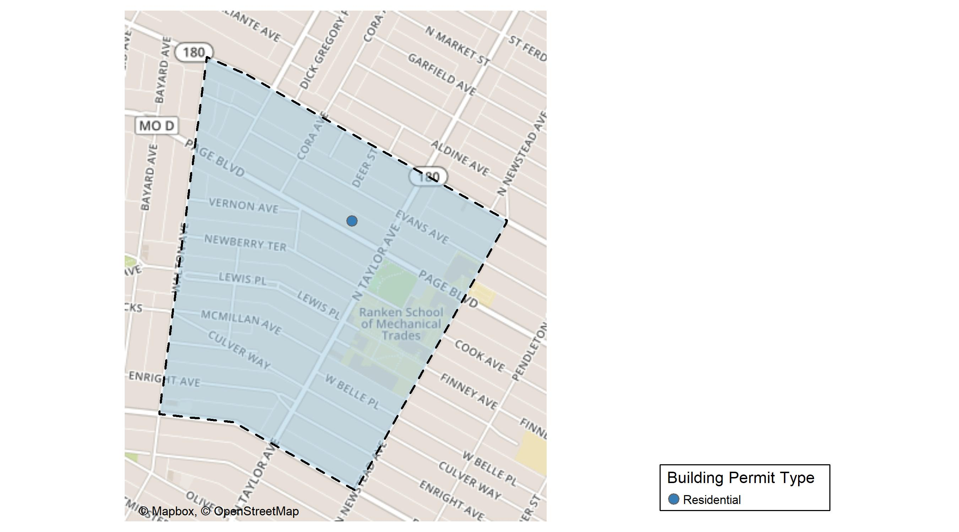
Lewis Place

Slide 51
Neighborhood Summary
January 2024 | January 2024 | January 2024 | January 2024
Permit Use | Average Cost | # of Permits | Total Value of Permits
Commercial | $0 | 0 | $0
Industrial | $0 | 0 | $0
Residential | $1,000 | 1 | $1,000
Last 6 Months | Last 6 Months | Last 6 Months | Last 6 Months
Permit Use | Average Cost | # of Permits | Total Value of Permits
Commercial | $225,535.0 | 1 | $225,535
Industrial | $0.0 | 0 | $0
Residential | $25,640.4 | 5 | $128,202

Slide 52
Lewis Place Individual Permit Breakdown
Neighborhood | Owner | New Use | Cost | address
Lewis Place | ETHRIDGE, LAUREN MICHELLE & | Residential | $1,000 | 4539 PAGE BLVD

Slide 53
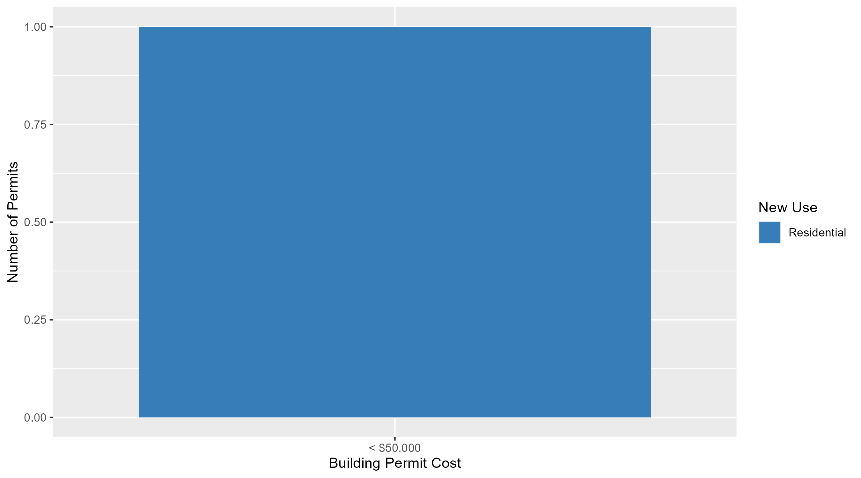
Lewis Place Permit Cost Breakdown

Slide 54
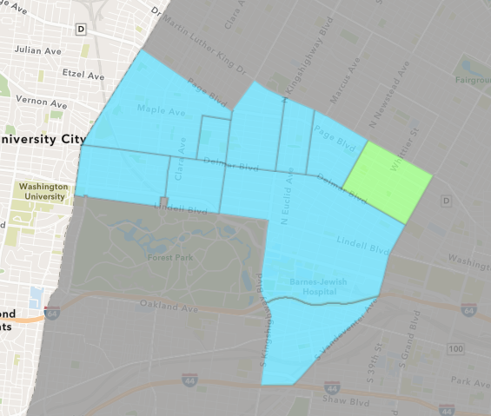
Vandeventer
January 2024 Neighborhood Cost Breakdown
  Mean: $149,350
  Median: $149,350
  Range: $149,350 - $149,350

Slide 55
Vandeventer: Summary Notes
1 building permits in January 2024
  0.00% change compared to January 2023 (1 total building permits)
  $149,350: Average building permit cost in January 2024
    833.44% change compared to January 2023 ($16,000)
1 total building permits in 2024
  0.00% change YTD compared to this time in 2023 (1 total building permits)
  $149,350: YTD average building permit cost in 2024
    833.44% change YTD compared to this time in 2023 ($16,000)

Slide 56
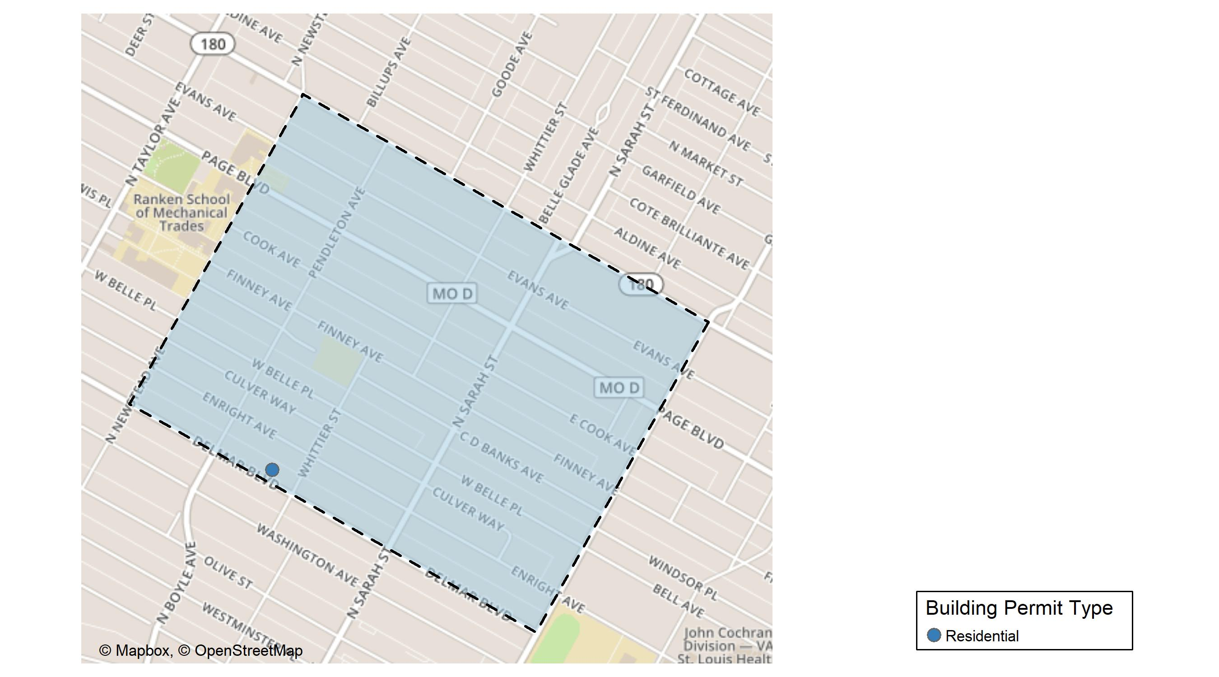
Vandeventer

Slide 57
Neighborhood Summary
January 2024 | January 2024 | January 2024 | January 2024
Permit Use | Average Cost | # of Permits | Total Value of Permits
Commercial | $0 | 0 | $0
Industrial | $0 | 0 | $0
Residential | $149,350 | 1 | $149,350
Last 6 Months | Last 6 Months | Last 6 Months | Last 6 Months
Permit Use | Average Cost | # of Permits | Total Value of Permits
Commercial | $2,000,000.00 | 1 | $2,000,000
Industrial | $10,900.00 | 1 | $10,900
Residential | $61,649.62 | 8 | $493,197

Slide 58
Vandeventer Individual Permit Breakdown
Neighborhood | Owner | New Use | Cost | address
Vandeventer | SMITH, BRIAN & HEATHER HENSLER | Residential | $149,350 | 4221 DELMAR BLVD

Slide 59

Vandeventer Permit Cost Breakdown

Slide 60
Additional Notes
Data retreived from https://www.stlouis-mo.gov/data/
Building permits with a cost of $0 were dropped
Building permits that were cancelled were dropped
Infinite change indicates 0 permits in the current or previous time period/comparison month so there was a overall increase or decrease

