Slide 1
St. Louis Central Corridor West Building Permits
Monthly Report: January 2025

Slide 2
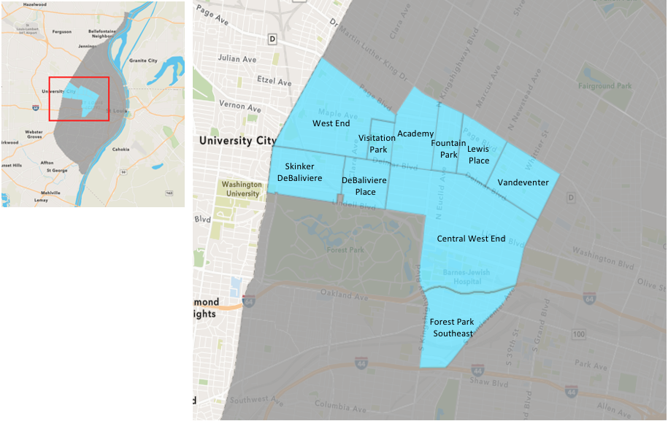
St. Louis Neighborhood Spatial Reference

Slide 3
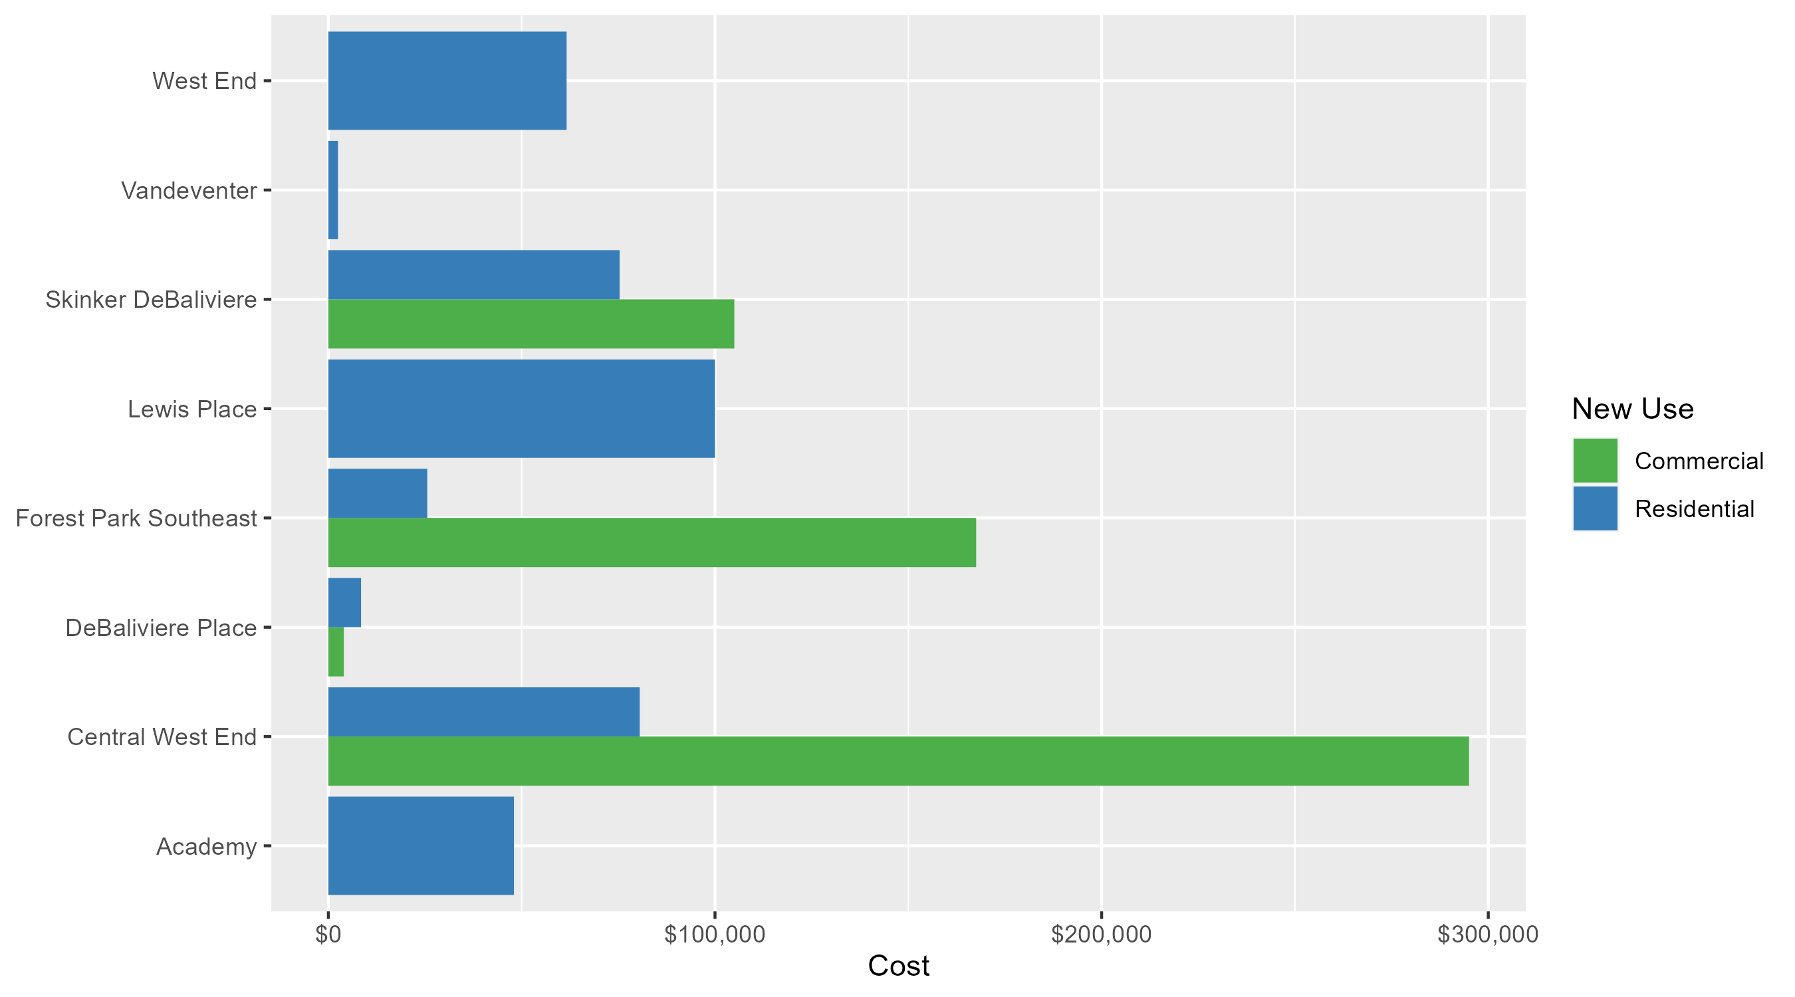
Neighborhood Summary: Average Building Permit Cost

Slide 4
Neighborhood Summary
January 2025 | January 2025 | January 2025 | January 2025
Neighborhood | Average Cost | # of Permits | Total Value of Permits
Academy | $48,000.00 | 3 | $144,000
Central West End | $170,845.53 | 19 | $3,246,065
DeBaliviere Place | $6,969.00 | 3 | $20,907
Forest Park Southeast | $96,566.00 | 4 | $386,264
Fountain Park | $0.00 | 0 | $0
Lewis Place | $100,000.00 | 1 | $100,000
Skinker DeBaliviere | $87,198.60 | 10 | $871,986
Vandeventer | $2,500.00 | 1 | $2,500
Visitation Park | $0.00 | 0 | $0
West End | $61,622.67 | 6 | $369,736
Last 6 Months | Last 6 Months | Last 6 Months | Last 6 Months
Neighborhood | Average Cost | # of Permits | Total Value of Permits
Academy | $23,611.44 | 16 | $377,783
Central West End | $203,061.72 | 215 | $43,658,270
DeBaliviere Place | $82,122.19 | 26 | $2,135,177
Forest Park Southeast | $138,392.73 | 40 | $5,535,709
Fountain Park | $42,875.00 | 8 | $343,000
Lewis Place | $27,952.56 | 9 | $251,573
Skinker DeBaliviere | $94,426.95 | 62 | $5,854,471
Vandeventer | $26,570.00 | 9 | $239,130
Visitation Park | $20,520.50 | 4 | $82,082
West End | $83,995.10 | 30 | $2,519,853

Slide 5
Core Neighborhoods

Slide 6
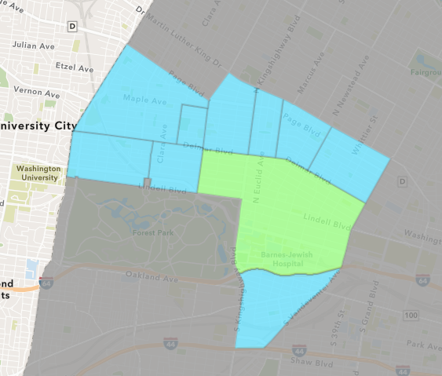
Central West End
January 2025 Neighborhood Cost Breakdown
  Mean: $170,846
  Median: $16,525
  Range: $600 - $2,112,000

Slide 7
Central West End: Summary Notes
19 building permits in January 2025
  -29.63% change compared to January 2024 (27 total building permits)
  $170,846: Average building permit cost in January 2025
    -83.42% change compared to January 2024 ($1,030,437)
19 total building permits in 2025
  -29.63% change YTD compared to this time in 2024 (27 total building permits)
  $170,846: YTD average building permit cost in 2025
    -83.42% change YTD compared to this time in 2024 ($1,030,437)

Slide 8
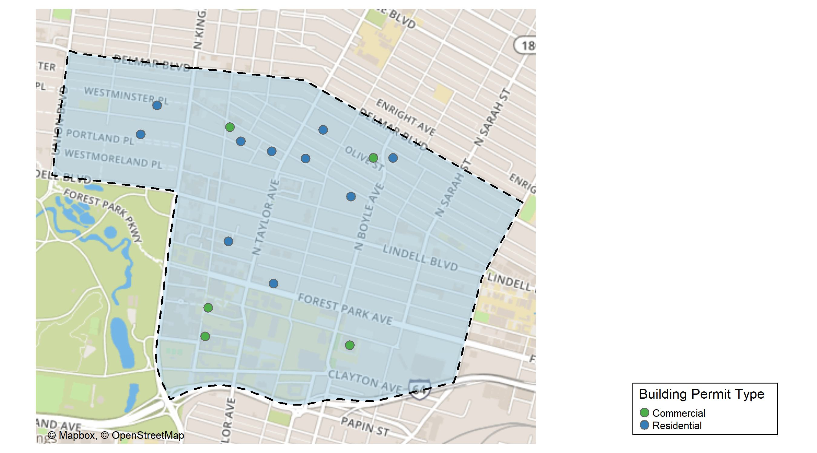
Central West End

Slide 9
Neighborhood Summary
January 2025 | January 2025 | January 2025 | January 2025
Permit Use | Average Cost | # of Permits | Total Value of Permits
Commercial | $295,028.38 | 8 | $2,360,227
Industrial | $0.00 | 0 | $0
Residential | $80,530.73 | 11 | $885,838
Last 6 Months | Last 6 Months | Last 6 Months | Last 6 Months
Permit Use | Average Cost | # of Permits | Total Value of Permits
Commercial | $313,593.2 | 89 | $27,909,799
Industrial | $61,107.0 | 2 | $122,214
Residential | $126,018.2 | 124 | $15,626,257

Slide 10
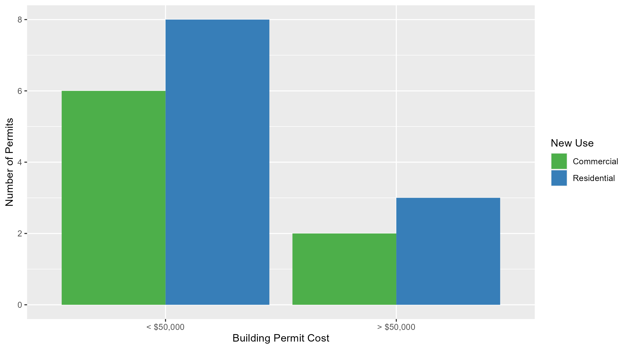
Central West End Permit Cost Breakdown

Slide 11
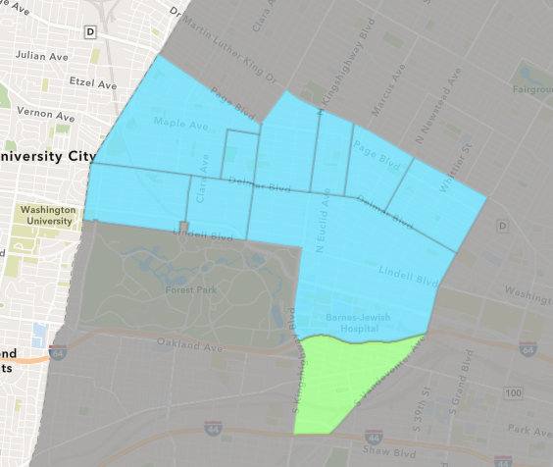
Forest Park Southeast
January 2025 Neighborhood Cost Breakdown
  Mean: $96,566
  Median: $33,132
  Range: $20,000 - $300,000

Slide 12
Forest Park Southeast: Summary Notes
4 building permits in January 2025
  -42.86% change compared to January 2024 (7 total building permits)
  $96,566: Average building permit cost in January 2025
    219.98% change compared to January 2024 ($30,179)
4 total building permits in 2025
  -42.86% change YTD compared to this time in 2024 (7 total building permits)
  $96,566: YTD average building permit cost in 2025
    219.98% change YTD compared to this time in 2024 ($30,179)

Slide 13
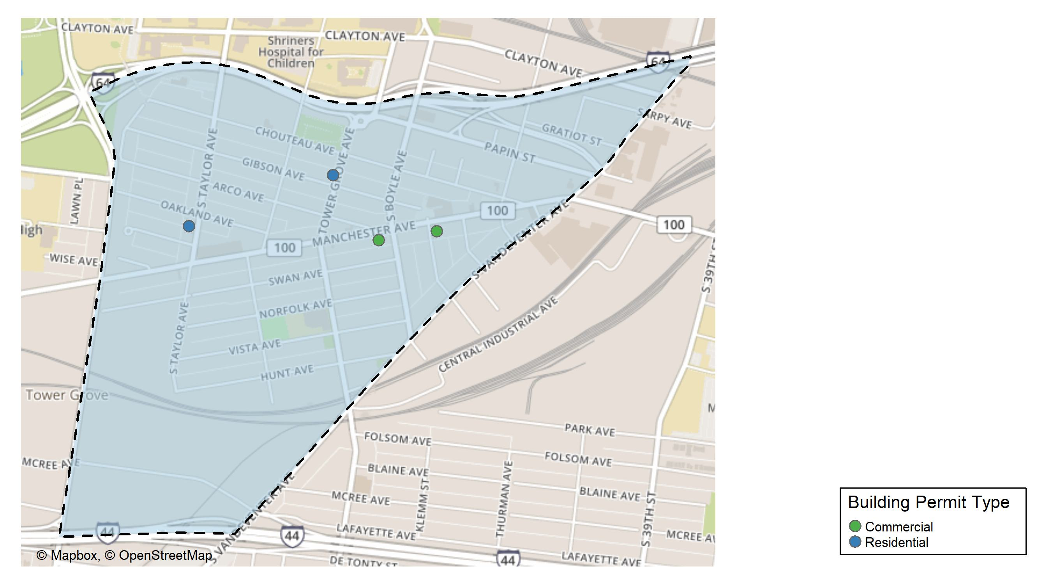
Forest Park Southeast

Slide 14
Neighborhood Summary
January 2025 | January 2025 | January 2025 | January 2025
Permit Use | Average Cost | # of Permits | Total Value of Permits
Commercial | $167,550 | 2 | $335,100
Industrial | $0 | 0 | $0
Residential | $25,582 | 2 | $51,164
Last 6 Months | Last 6 Months | Last 6 Months | Last 6 Months
Permit Use | Average Cost | # of Permits | Total Value of Permits
Commercial | $43,115.67 | 9 | $388,041
Industrial | $31,933.33 | 3 | $95,800
Residential | $180,423.86 | 28 | $5,051,868

Slide 15
Forest Park Southeast Individual Permit Breakdown
Neighborhood | Owner | New Use | Cost | address
Forest Park Southeast | CORMAN, DARIN & COURTNEY | Residential | $31,164 | 1111 S TAYLOR AV
Forest Park Southeast | SPACEGROVE LLC | Commercial | $300,000 | 4168 MANCHESTER AV
Forest Park Southeast | NOYA HOLDINGS LLC | Residential | $20,000 | 1015 TOWER GROVE AV
Forest Park Southeast | AC REALTY 5 LLC | Commercial | $35,100 | 4210 MANCHESTER AV

Slide 16
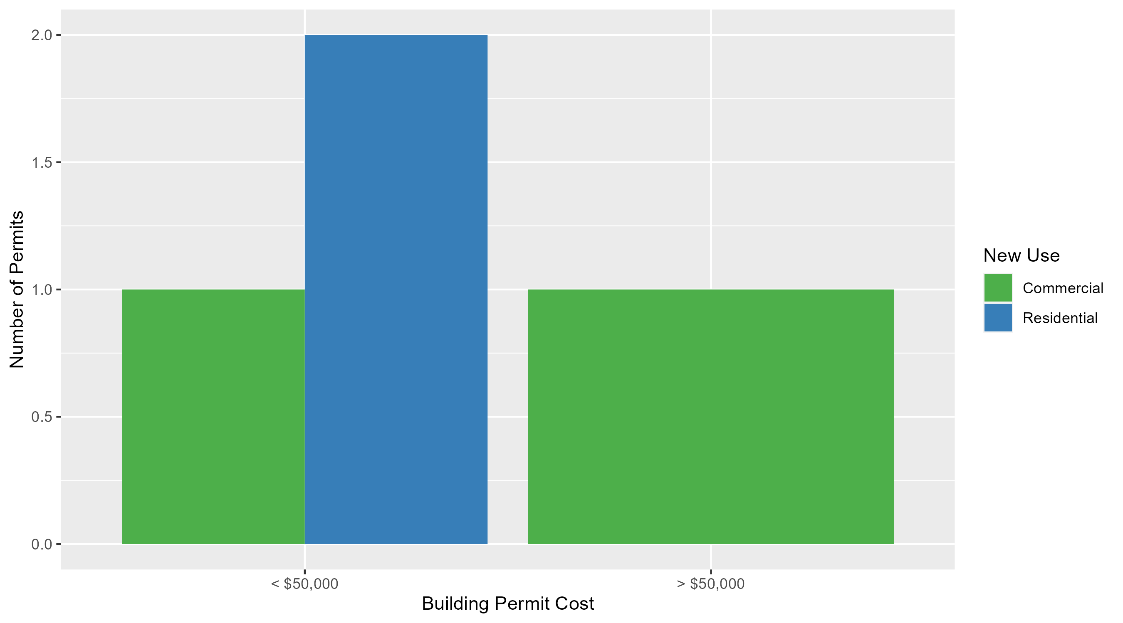
Forest Park Southeast Permit Cost Breakdown

Slide 17
Expanded Service Area

Slide 18
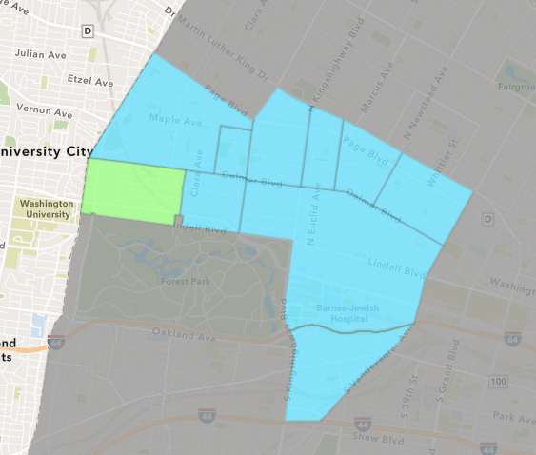
Skinker DeBaliviere
January 2025 Neighborhood Cost Breakdown
  Mean: $87,199
  Median: $32,000
  Range: $7,986 - $350,000

Slide 19
Skinker DeBaliviere: Summary Notes
10 building permits in January 2025
  66.67% change compared to January 2024 (6 total building permits)
  $87,199: Average building permit cost in January 2025
    212.82% change compared to January 2024 ($27,875)
10 total building permits in 2025
  66.67% change YTD compared to this time in 2024 (6 total building permits)
  $87,199: YTD average building permit cost in 2025
    212.82% change YTD compared to this time in 2024 ($27,875)

Slide 20
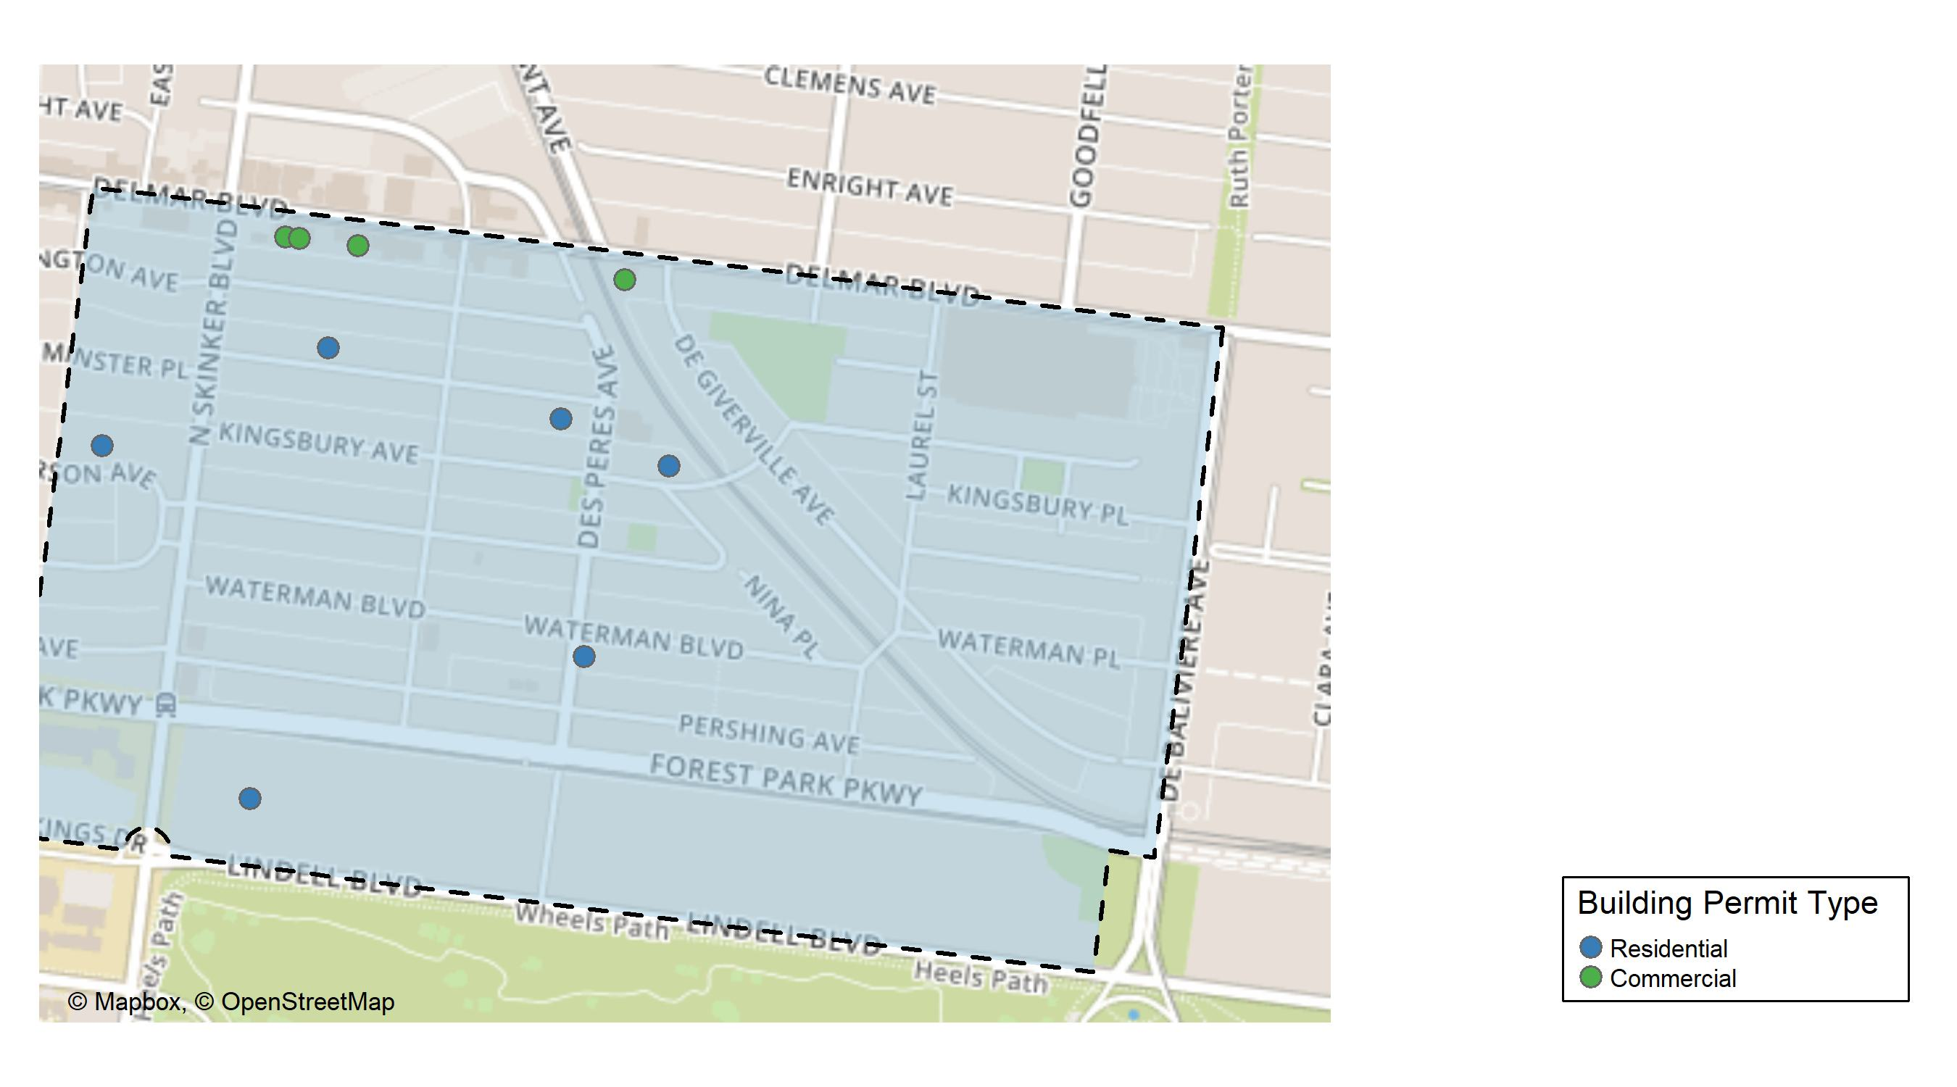
Skinker DeBaliviere

Slide 21
Neighborhood Summary
January 2025 | January 2025 | January 2025 | January 2025
Permit Use | Average Cost | # of Permits | Total Value of Permits
Commercial | $105,000 | 4 | $420,000
Industrial | $0 | 0 | $0
Residential | $75,331 | 6 | $451,986
Last 6 Months | Last 6 Months | Last 6 Months | Last 6 Months
Permit Use | Average Cost | # of Permits | Total Value of Permits
Commercial | $158,806.58 | 12 | $1,905,679
Industrial | $117,700.00 | 5 | $588,500
Residential | $74,673.16 | 45 | $3,360,292

Slide 22
Skinker DeBaliviere Individual Permit Breakdown
Neighborhood | Owner | New Use | Cost | address
Skinker DeBaliviere | QUADRANGLE MANAGEMENT CO | Commercial | $200,000 | 6138-46 DELMAR BLVD
Skinker DeBaliviere | QUADRANGLE MANAGEMENT CO | Commercial | $100,000 | 6172-78 DELMAR BLVD
Skinker DeBaliviere | QUADRANGLE MANAGEMENT CO | Commercial | $100,000 | 6170 DELMAR BLVD
Skinker DeBaliviere | BONAN, F WILLIAM | Residential | $350,000 | 6159 LINDELL BLVD
Skinker DeBaliviere | SPACES DEVELOPMENT LLC | Residential | $10,000 | 6151 WESTMINSTER PL
Skinker DeBaliviere | WASHINGTON UNIVERSITY | Commercial | $20,000 | 5980 DELMAR BLVD
Skinker DeBaliviere | WITHERS, ELEANOR L | Residential | $7,986 | 6237 MCPHERSON AV
Skinker DeBaliviere | LYNNE CHRISTMAN | Residential | $32,000 | 5921 KINGSBURY AV
Skinker DeBaliviere | THREE DOORS PROPERTIES | Residential | $20,000 | 6014 WESTMINSTER PL
Skinker DeBaliviere | POINT BREAK CAPITAL LLC | Residential | $32,000 | 5962 WATERMAN BLVD

Slide 23
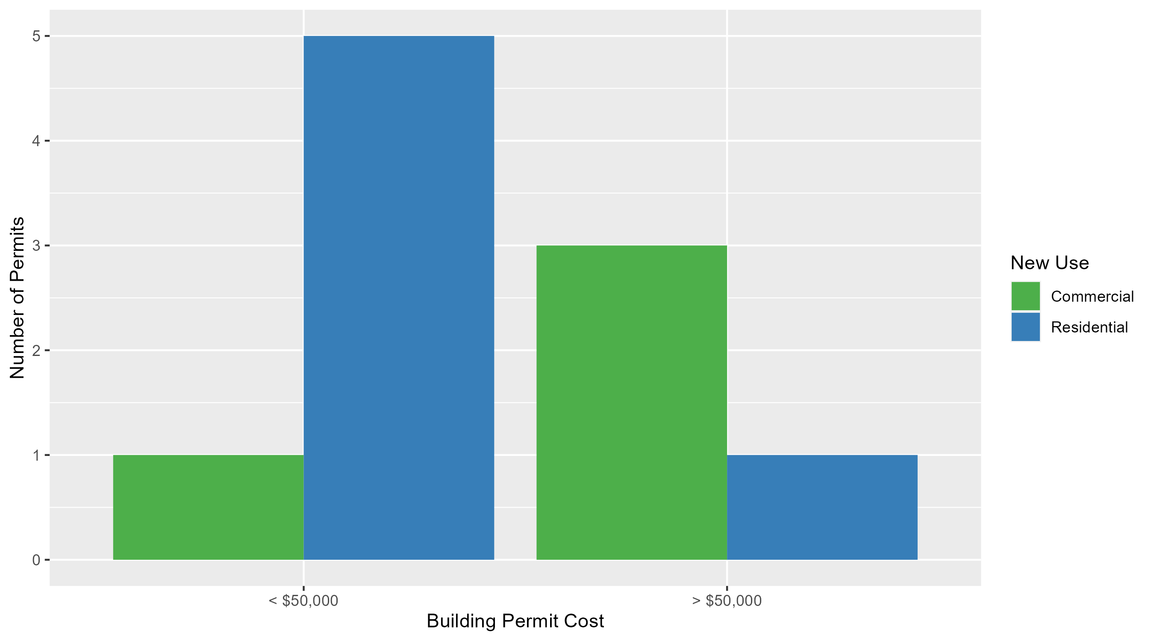
Skinker DeBaliviere Permit Cost Breakdown

Slide 24
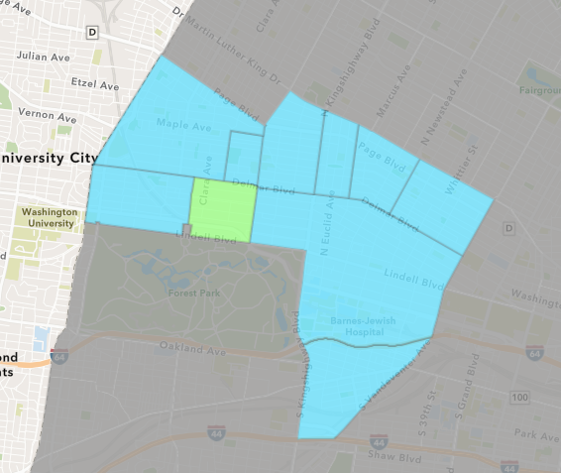
DeBaliviere Place
January 2025 Neighborhood Cost Breakdown
  Mean: $6,969
  Median: $7,491
  Range: $4,000 - $9,416

Slide 25
DeBaliviere Place: Summary Notes
3 building permits in January 2025
  -25.00% change compared to January 2024 (4 total building permits)
  $6,969: Average building permit cost in January 2025
    -91.68% change compared to January 2024 ($83,750)
3 total building permits in 2025
  -25.00% change YTD compared to this time in 2024 (4 total building permits)
  $6,969: YTD average building permit cost in 2025
    -91.68% change YTD compared to this time in 2024 ($83,750)

Slide 26
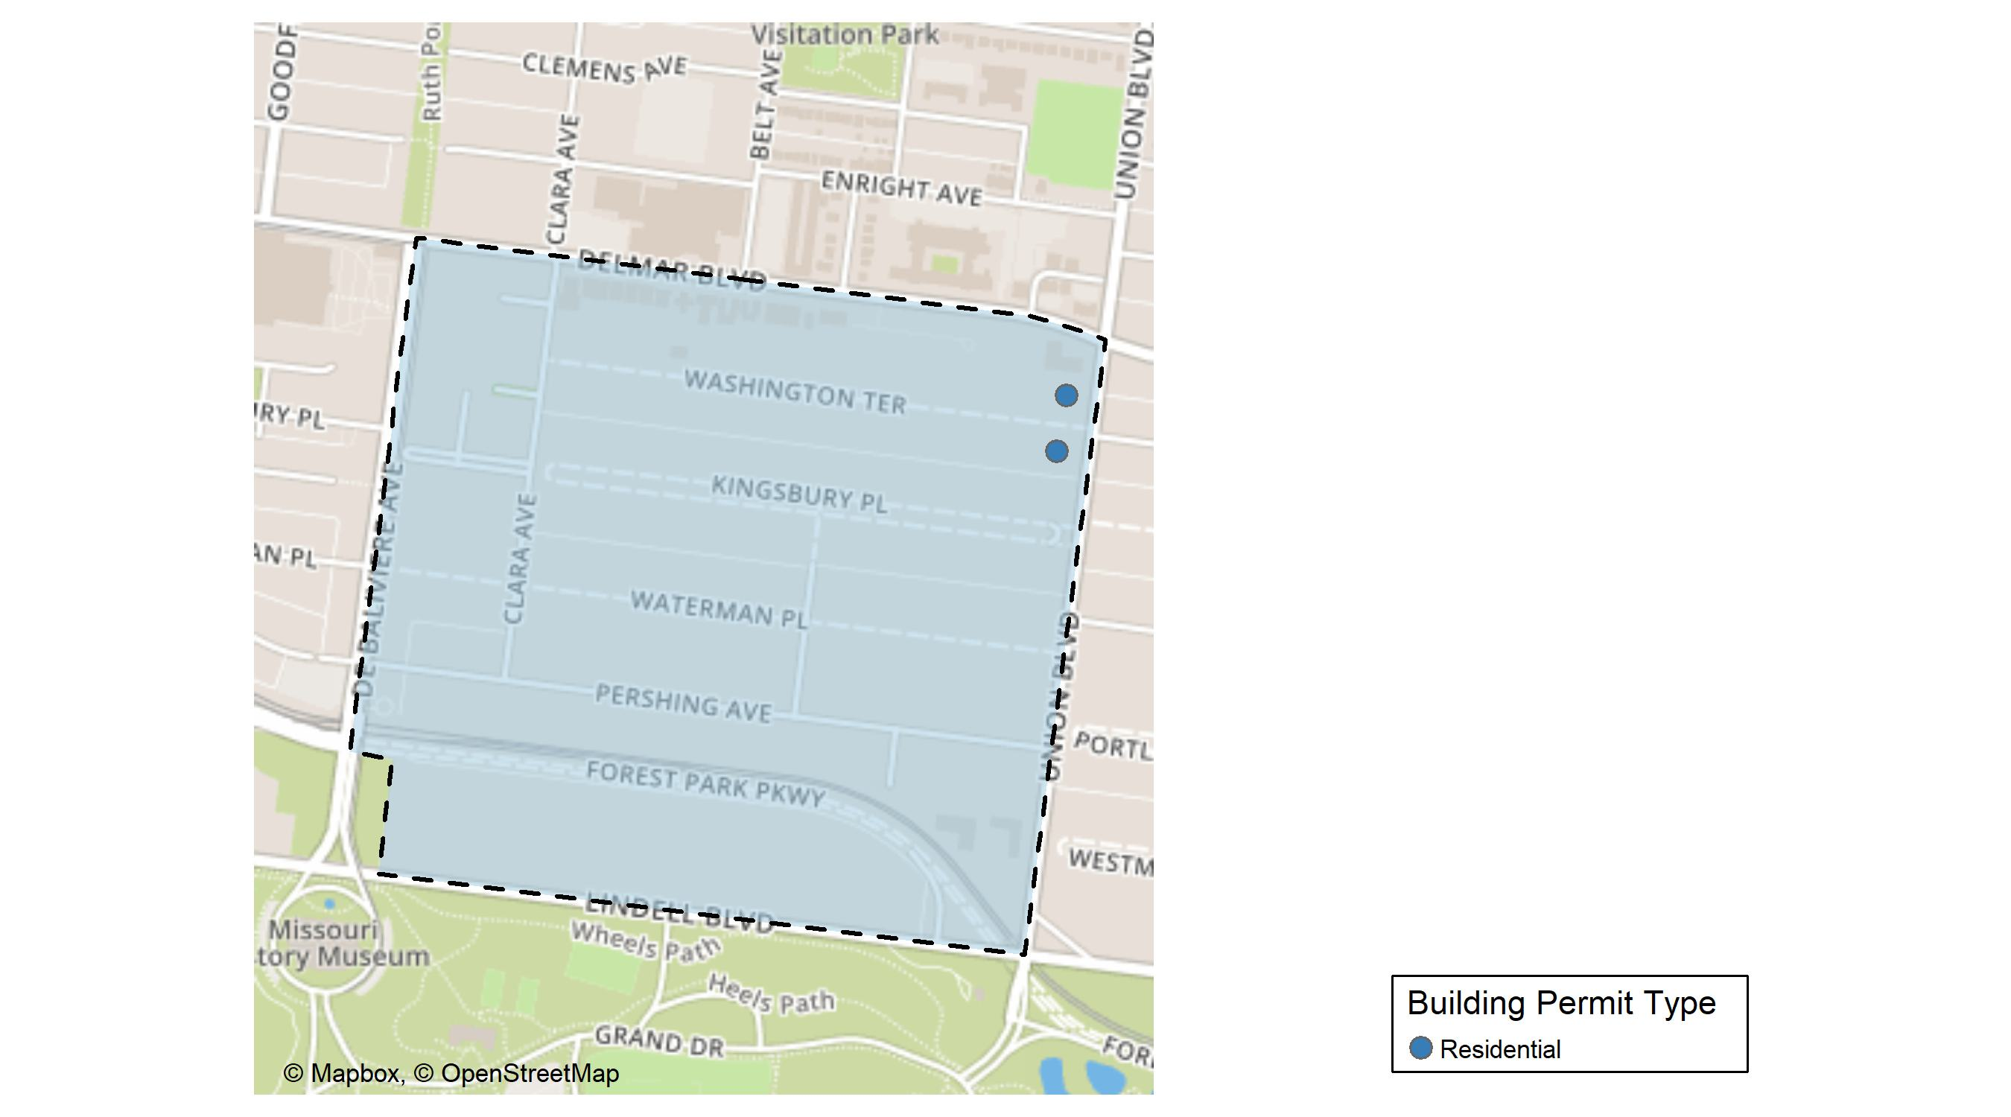
DeBaliviere Place

Slide 27
Neighborhood Summary
January 2025 | January 2025 | January 2025 | January 2025
Permit Use | Average Cost | # of Permits | Total Value of Permits
Commercial | $4,000.0 | 1 | $4,000
Industrial | $0.0 | 0 | $0
Residential | $8,453.5 | 2 | $16,907
Last 6 Months | Last 6 Months | Last 6 Months | Last 6 Months
Permit Use | Average Cost | # of Permits | Total Value of Permits
Commercial | $27,796.67 | 3 | $83,390
Industrial | $0.00 | 0 | $0
Residential | $89,208.13 | 23 | $2,051,787

Slide 28
DeBaliviere Place Individual Permit Breakdown
Neighborhood | Owner | New Use | Cost | address
DeBaliviere Place | BEATTY, VIRGINIA H TRS | Commercial | $4,000 | 305 UNION BLVD
DeBaliviere Place | KESEL, GREGORY A & | Residential | $7,491 | 2H WASHINGTON TER
DeBaliviere Place | BURKE, TIMOTHY ROBERT & | Residential | $9,416 | 1 WASHINGTON TER

Slide 29
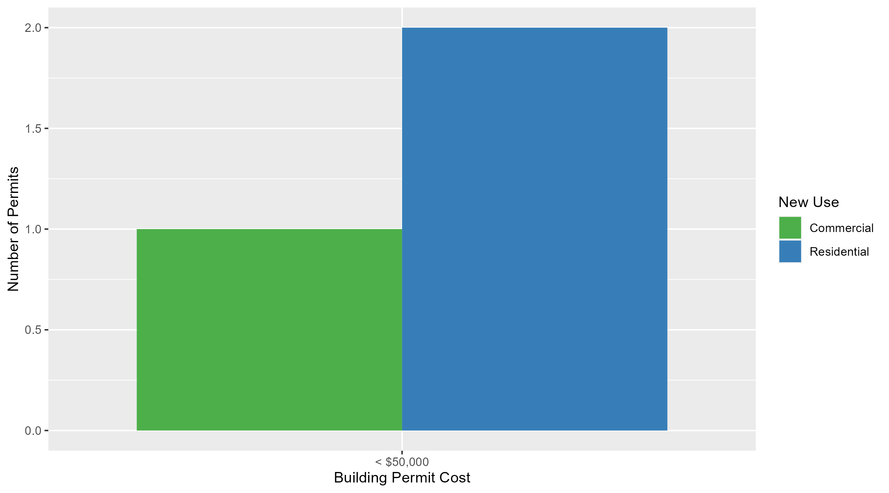
DeBaliviere Place Permit Cost Breakdown

Slide 30
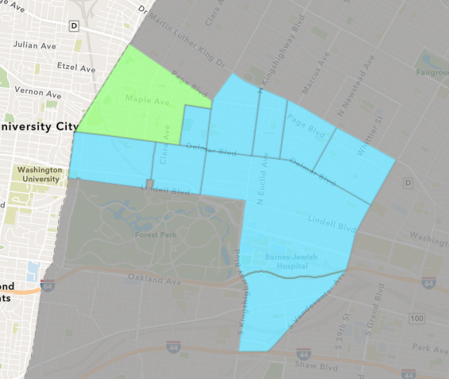
West End
January 2025 Neighborhood Cost Breakdown
  Mean: $61,623
  Median: $17,868
  Range: $3,000 - $225,000

Slide 31
West End: Summary Notes
6 building permits in January 2025
  -33.33% change compared to January 2024 (9 total building permits)
  $61,623: Average building permit cost in January 2025
    -50.51% change compared to January 2024 ($124,512)
6 total building permits in 2025
  -33.33% change YTD compared to this time in 2024 (9 total building permits)
  $61,623: YTD average building permit cost in 2025
    -50.51% change YTD compared to this time in 2024 ($124,512)

Slide 32
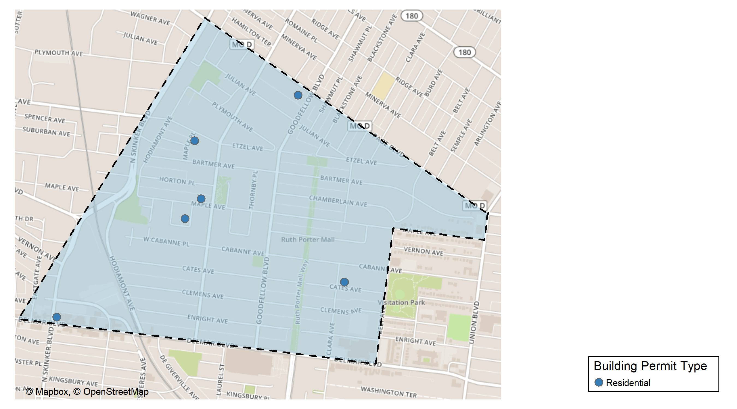
West End

Slide 33
Neighborhood Summary
January 2025 | January 2025 | January 2025 | January 2025
Permit Use | Average Cost | # of Permits | Total Value of Permits
Commercial | $0.00 | 0 | $0
Industrial | $0.00 | 0 | $0
Residential | $61,622.67 | 6 | $369,736
Last 6 Months | Last 6 Months | Last 6 Months | Last 6 Months
Permit Use | Average Cost | # of Permits | Total Value of Permits
Commercial | $25,875.00 | 4 | $103,500
Industrial | $439,045.50 | 4 | $1,756,182
Residential | $30,007.77 | 22 | $660,171

Slide 34
West End Individual Permit Breakdown
Neighborhood | Owner | New Use | Cost | address
West End | WASHINGTON UNIVERSITY | Residential | $100,000 | 610 N SKINKER BLVD
West End | BREWER, BEATRICE | Residential | $225,000 | 943 BEACH AV
West End | ELLIS, BRENDA JOYCE | Residential | $6,000 | 5940-42 ETZEL AV
West End | VIBRANT BLUE REALTY LLC | Residential | $3,000 | 5814 PAGE BLVD
West End | NICHOLS, SEAN & MAKINI | Residential | $21,736 | 5921 MAPLE AV
West End | FLOWERS, MILTON C JR | Residential | $14,000 | 5573 CATES AV

Slide 35
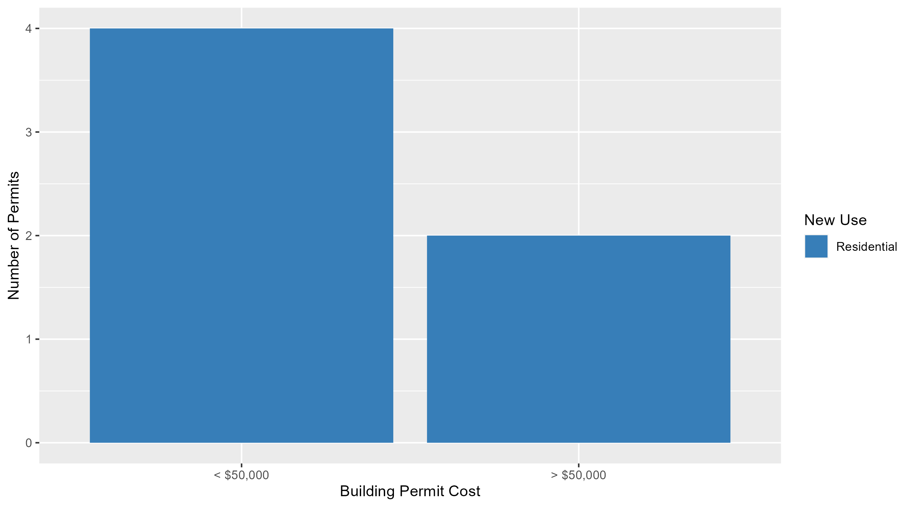
West End Permit Cost Breakdown

Slide 36
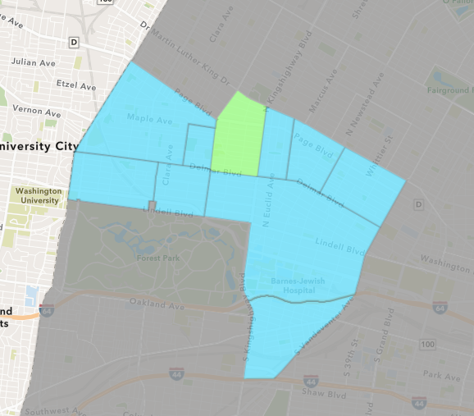
Academy
January 2025 Neighborhood Cost Breakdown
  Mean: $48,000
  Median: $3,000
  Range: $1,000 - $140,000

Slide 37
Academy: Summary Notes
3 building permits in January 2025
  0.00% change compared to January 2024 (3 total building permits)
  $48,000: Average building permit cost in January 2025
    2518.18% change compared to January 2024 ($1,833)
3 total building permits in 2025
  0.00% change YTD compared to this time in 2024 (3 total building permits)
  $48,000: YTD average building permit cost in 2025
    2518.18% change YTD compared to this time in 2024 ($1,833)

Slide 38
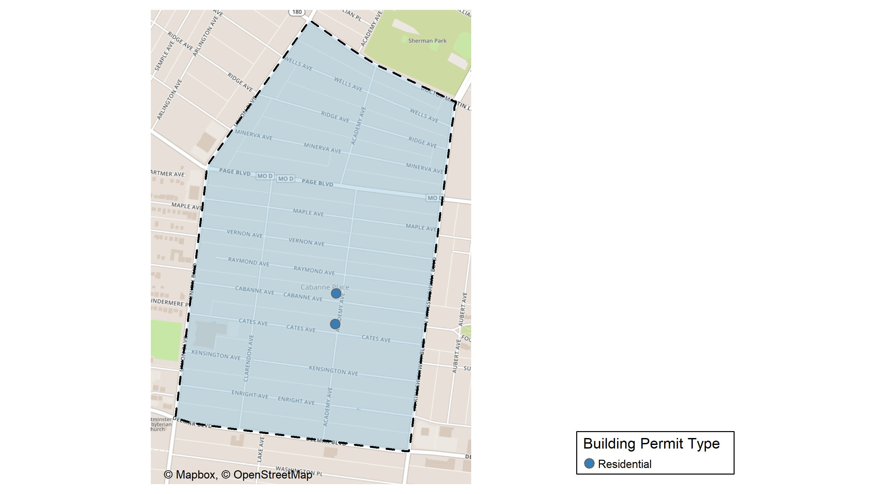
Academy

Slide 39
Neighborhood Summary
January 2025 | January 2025 | January 2025 | January 2025
Permit Use | Average Cost | # of Permits | Total Value of Permits
Commercial | $0 | 0 | $0
Industrial | $0 | 0 | $0
Residential | $48,000 | 3 | $144,000
Last 6 Months | Last 6 Months | Last 6 Months | Last 6 Months
Permit Use | Average Cost | # of Permits | Total Value of Permits
Commercial | $20,500.00 | 2 | $41,000
Industrial | $0.00 | 0 | $0
Residential | $24,055.93 | 14 | $336,783

Slide 40
Academy Individual Permit Breakdown
Neighborhood | Owner | New Use | Cost | address
Academy | CONFLUX PROPERTIES LLC | Residential | $140,000 | 5105 CABANNE AV
Academy | WAYNE, SHERRY ANN | Residential | $3,000 | 5101 CATES AV
Academy | ALEXANDER, ALVIN E | Residential | $1,000 | 5054 MAPLE AV

Slide 41
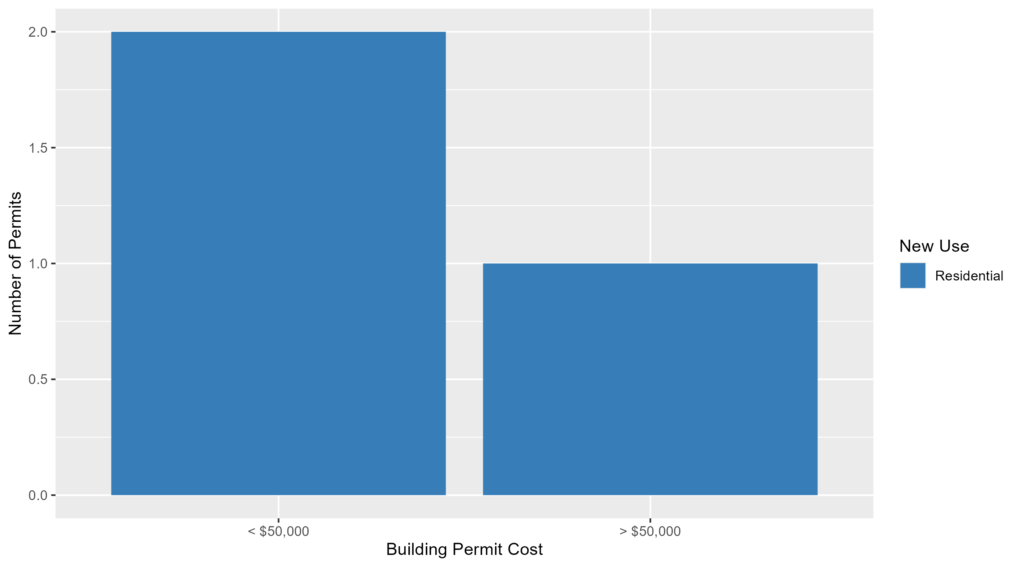
Academy Permit Cost Breakdown

Slide 42
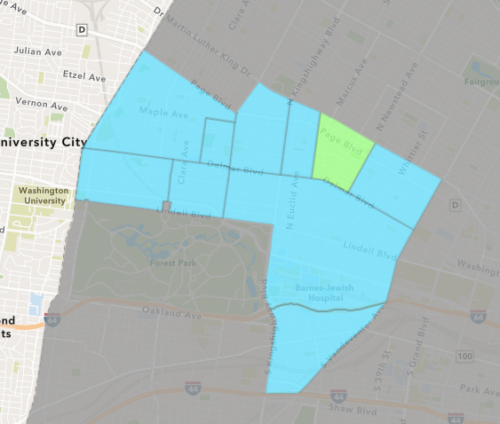
Lewis Place
January 2025 Neighborhood Cost Breakdown
  Mean: $100,000
  Median: $100,000
  Range: $100,000 - $100,000

Slide 43
Lewis Place: Summary Notes
1 building permits in January 2025
  0.00% change compared to January 2024 (1 total building permits)
  $100,000: Average building permit cost in January 2025
    9900.00% change compared to January 2024 ($1,000)
1 total building permits in 2025
  0.00% change YTD compared to this time in 2024 (1 total building permits)
  $100,000: YTD average building permit cost in 2025
    9900.00% change YTD compared to this time in 2024 ($1,000)

Slide 44
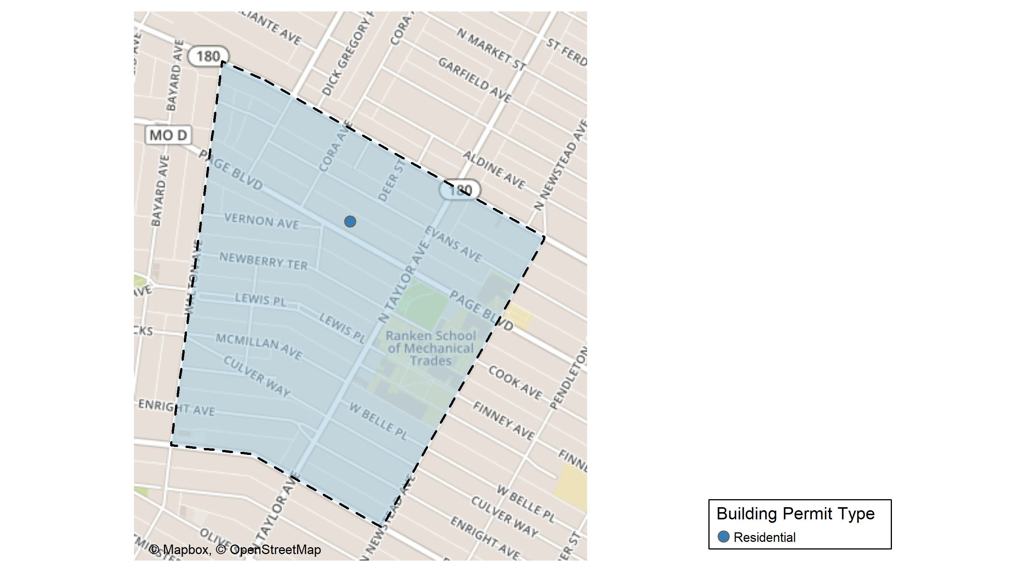
Lewis Place

Slide 45
Neighborhood Summary
January 2025 | January 2025 | January 2025 | January 2025
Permit Use | Average Cost | # of Permits | Total Value of Permits
Commercial | $0 | 0 | $0
Industrial | $0 | 0 | $0
Residential | $100,000 | 1 | $100,000
Last 6 Months | Last 6 Months | Last 6 Months | Last 6 Months
Permit Use | Average Cost | # of Permits | Total Value of Permits
Commercial | $13,357.67 | 3 | $40,073
Industrial | $2,750.00 | 2 | $5,500
Residential | $51,500.00 | 4 | $206,000

Slide 46
Lewis Place Individual Permit Breakdown
Neighborhood | Owner | New Use | Cost | address
Lewis Place | MARQUIS DEVELOPMENT LLC | Residential | $100,000 | 4571 PAGE BLVD

Slide 47
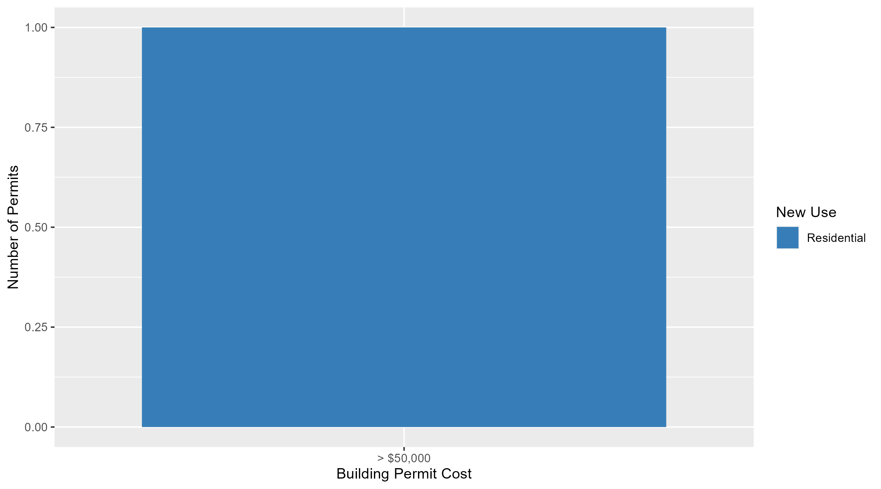
Lewis Place Permit Cost Breakdown

Slide 48
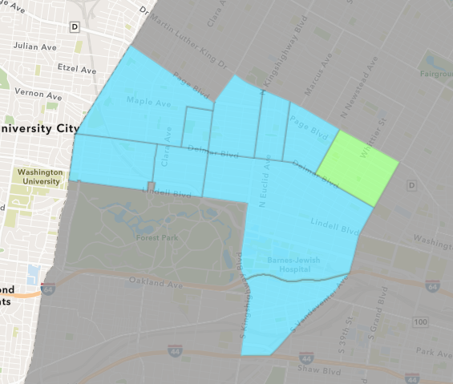
Vandeventer
January 2025 Neighborhood Cost Breakdown
  Mean: $2,500
  Median: $2,500
  Range: $2,500 - $2,500

Slide 49
Vandeventer: Summary Notes
1 building permits in January 2025
  0.00% change compared to January 2024 (1 total building permits)
  $2,500: Average building permit cost in January 2025
    -98.33% change compared to January 2024 ($149,350)
1 total building permits in 2025
  0.00% change YTD compared to this time in 2024 (1 total building permits)
  $2,500: YTD average building permit cost in 2025
    -98.33% change YTD compared to this time in 2024 ($149,350)

Slide 50
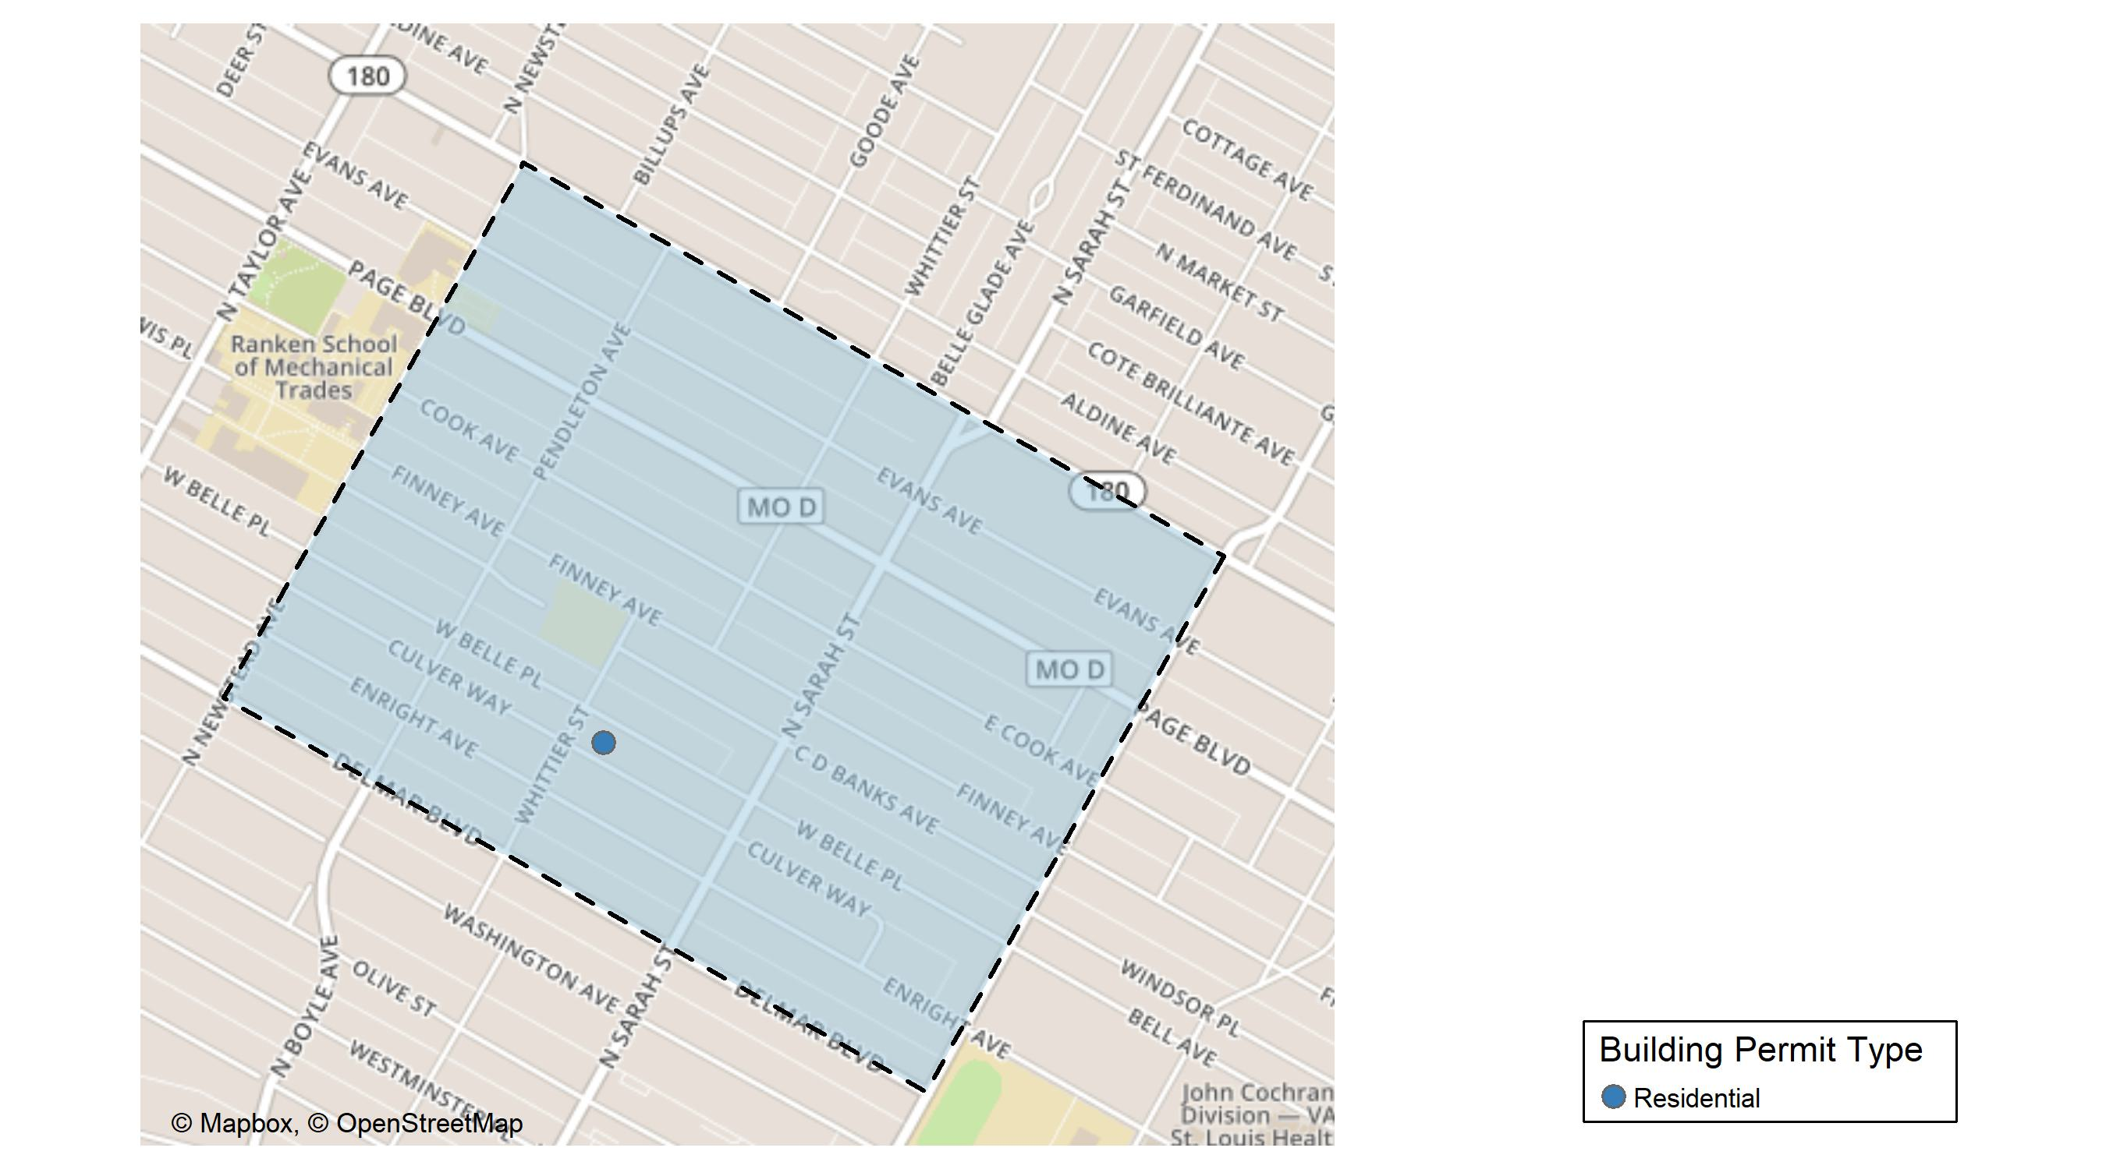
Vandeventer

Slide 51
Neighborhood Summary
January 2025 | January 2025 | January 2025 | January 2025
Permit Use | Average Cost | # of Permits | Total Value of Permits
Commercial | $0 | 0 | $0
Industrial | $0 | 0 | $0
Residential | $2,500 | 1 | $2,500
Last 6 Months | Last 6 Months | Last 6 Months | Last 6 Months
Permit Use | Average Cost | # of Permits | Total Value of Permits
Commercial | $6,815.00 | 2 | $13,630
Industrial | $3,000.00 | 1 | $3,000
Residential | $37,083.33 | 6 | $222,500

Slide 52
Vandeventer Individual Permit Breakdown
Neighborhood | Owner | New Use | Cost | address
Vandeventer | RD & D PROPERTIESLLC | Residential | $2,500 | 4180 WEST BELLE PL

Slide 53

Vandeventer Permit Cost Breakdown

Slide 54
Additional Notes
Data retreived from https://www.stlouis-mo.gov/data/
Building permits with a cost of $0 were dropped
Building permits that were cancelled were dropped
Infinite change indicates 0 permits in the current or previous time period/comparison month so there was a overall increase or decrease

