Slide 1
St. Louis Central Corridor West Building Permits
Monthly Report: June 2024

Slide 2
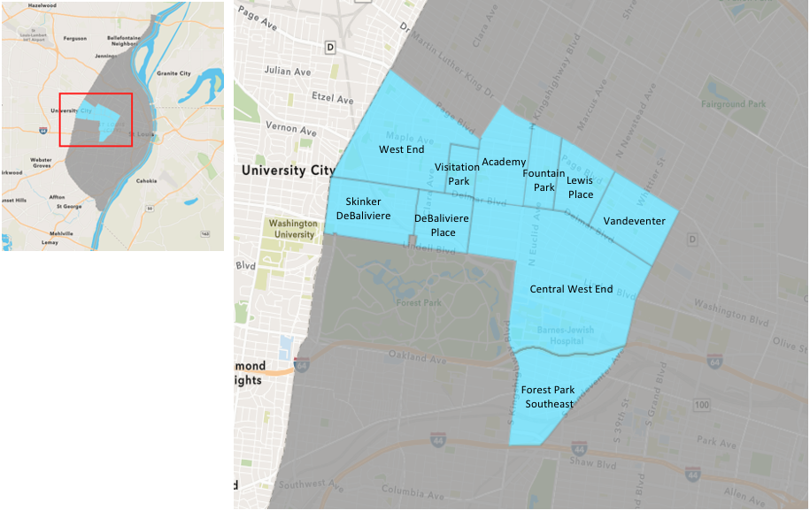
St. Louis Neighborhood Spatial Reference

Slide 3
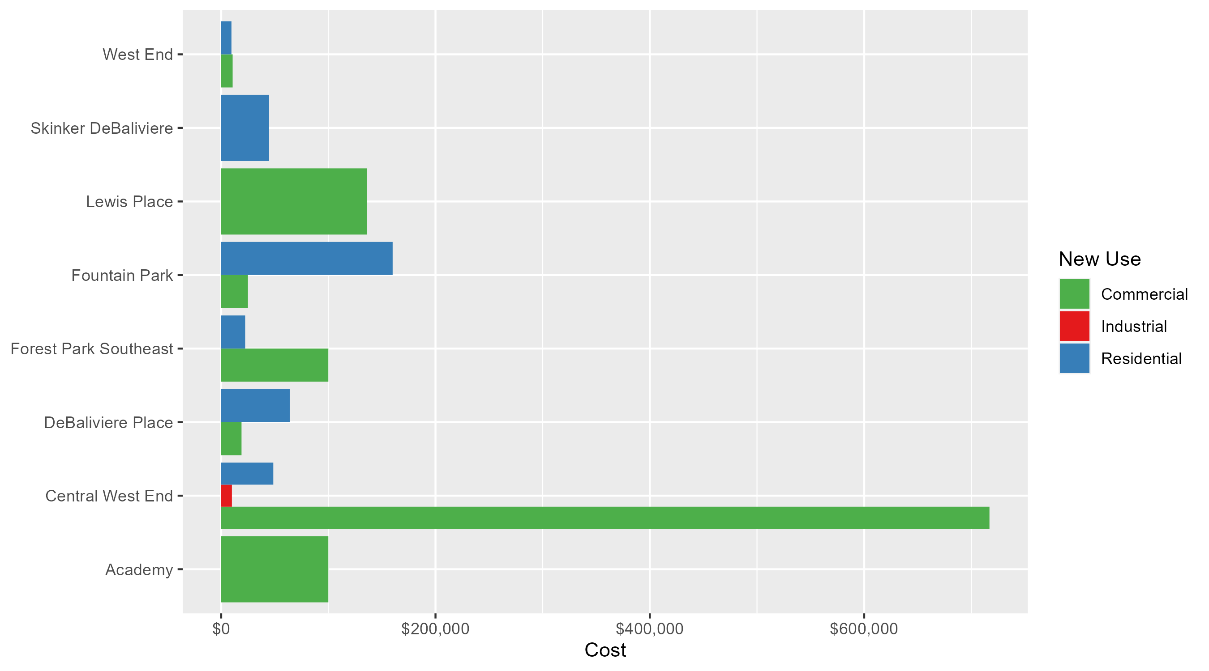
Neighborhood Summary: Average Building Permit Cost

Slide 4
Neighborhood Summary
June 2024 | June 2024 | June 2024 | June 2024
Neighborhood | Average Cost | # of Permits | Total Value of Permits
Academy | $100,000.000 | 1 | $100,000
Central West End | $355,577.423 | 26 | $9,245,013
DeBaliviere Place | $55,049.600 | 5 | $275,248
Forest Park Southeast | $35,354.167 | 6 | $212,125
Fountain Park | $92,500.000 | 2 | $185,000
Lewis Place | $136,131.000 | 1 | $136,131
Skinker DeBaliviere | $44,740.800 | 5 | $223,704
Vandeventer | $0.000 | 0 | $0
Visitation Park | $0.000 | 0 | $0
West End | $9,785.667 | 6 | $58,714
Last 6 Months | Last 6 Months | Last 6 Months | Last 6 Months
Neighborhood | Average Cost | # of Permits | Total Value of Permits
Academy | $50,477.00 | 13 | $656,201
Central West End | $514,555.82 | 194 | $99,823,829
DeBaliviere Place | $128,616.17 | 23 | $2,958,172
Forest Park Southeast | $69,698.11 | 47 | $3,275,811
Fountain Park | $52,375.00 | 8 | $419,000
Lewis Place | $25,536.11 | 9 | $229,825
Skinker DeBaliviere | $69,091.52 | 31 | $2,141,837
Vandeventer | $59,666.17 | 6 | $357,997
Visitation Park | $0.00 | 0 | $0
West End | $89,809.19 | 48 | $4,310,841

Slide 5
Core Neighborhoods

Slide 6
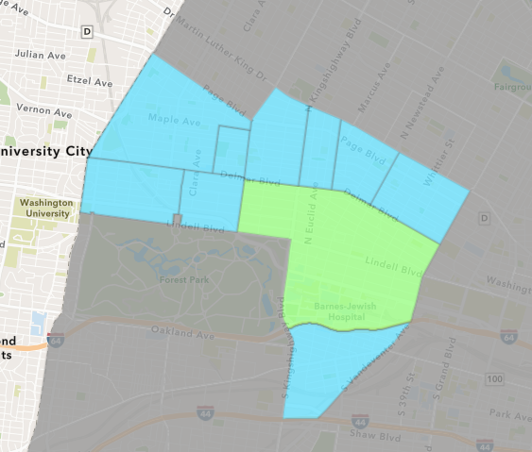
Central West End
June 2024 Neighborhood Cost Breakdown
  Mean: $355,577
  Median: $39,875
  Range: $4,000 - $5,200,000

Slide 7
Central West End: Summary Notes
26 building permits in June 2024
  -13.33% change compared to June 2023 (30 total building permits)
  $355,577: Average building permit cost in June 2024
    784.13% change compared to June 2023 ($40,218)
166 total building permits in 2024
  -12.63% change YTD compared to this time in 2023 (190 total building permits)
  $498,909: YTD average building permit cost in 2024
    53.01% change YTD compared to this time in 2023 ($326,064)

Slide 8
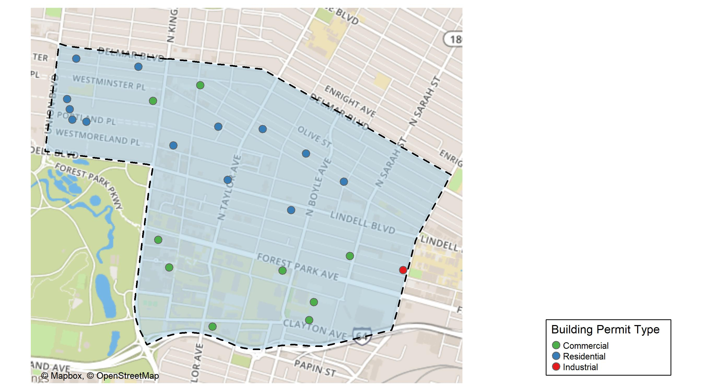
Central West End

Slide 9
Neighborhood Summary
June 2024 | June 2024 | June 2024 | June 2024
Permit Use | Average Cost | # of Permits | Total Value of Permits
Commercial | $716,905.2 | 12 | $8,602,862
Industrial | $10,000.0 | 1 | $10,000
Residential | $48,627.0 | 13 | $632,151
Last 6 Months | Last 6 Months | Last 6 Months | Last 6 Months
Permit Use | Average Cost | # of Permits | Total Value of Permits
Commercial | $1,011,550.96 | 94 | $95,085,790
Industrial | $16,179.67 | 6 | $97,078
Residential | $49,371.93 | 94 | $4,640,961

Slide 10
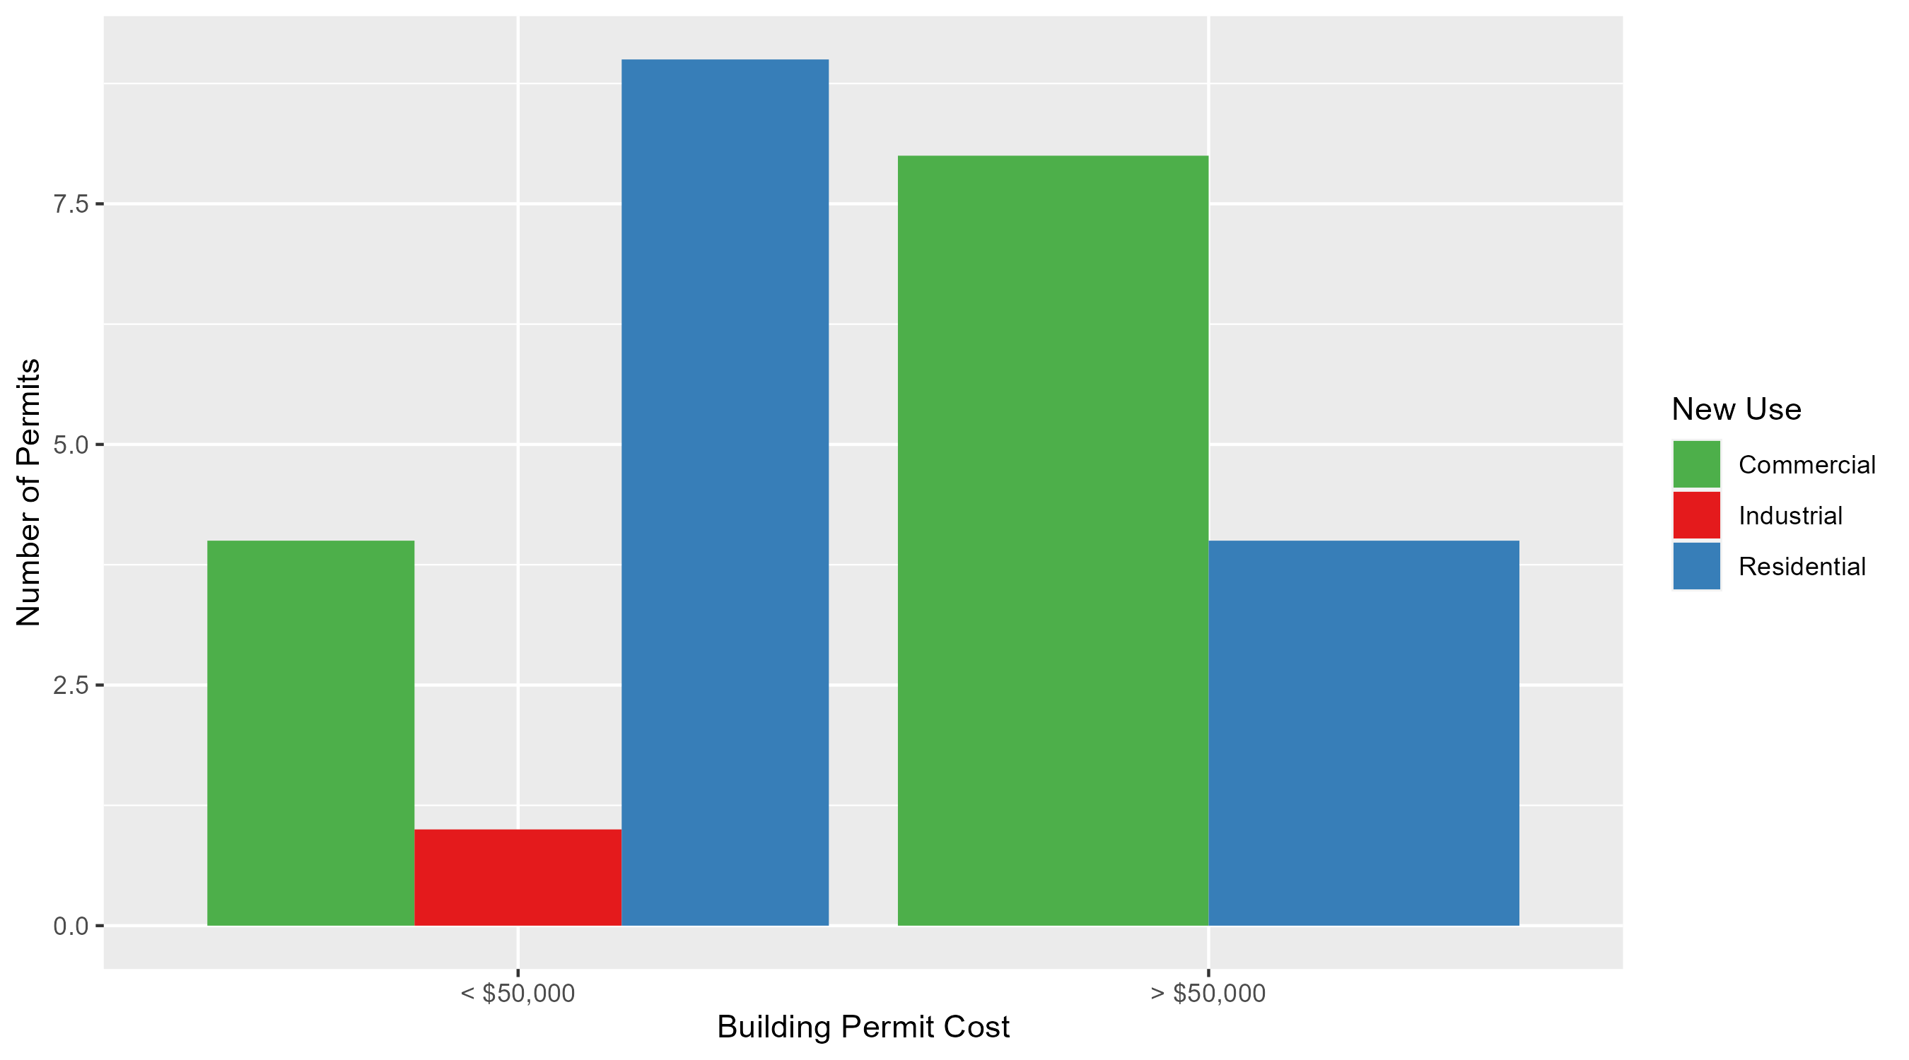
Central West End Permit Cost Breakdown

Slide 11
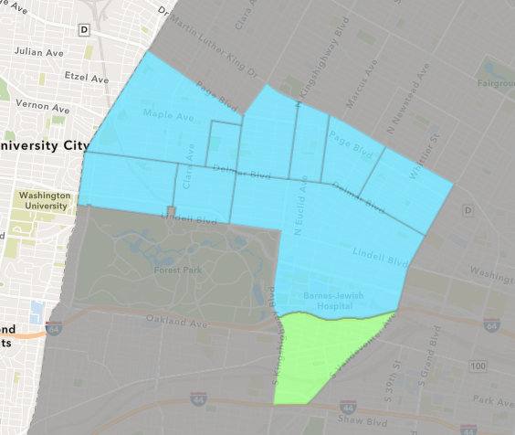
Forest Park Southeast
June 2024 Neighborhood Cost Breakdown
  Mean: $35,354
  Median: $3,750
  Range: $2,000 - $100,000

Slide 12
Forest Park Southeast: Summary Notes
6 building permits in June 2024
  -45.45% change compared to June 2023 (11 total building permits)
  $35,354: Average building permit cost in June 2024
    -73.23% change compared to June 2023 ($132,045)
38 total building permits in 2024
  2.70% change YTD compared to this time in 2023 (37 total building permits)
  $72,800: YTD average building permit cost in 2024
    -19.66% change YTD compared to this time in 2023 ($90,618)

Slide 13
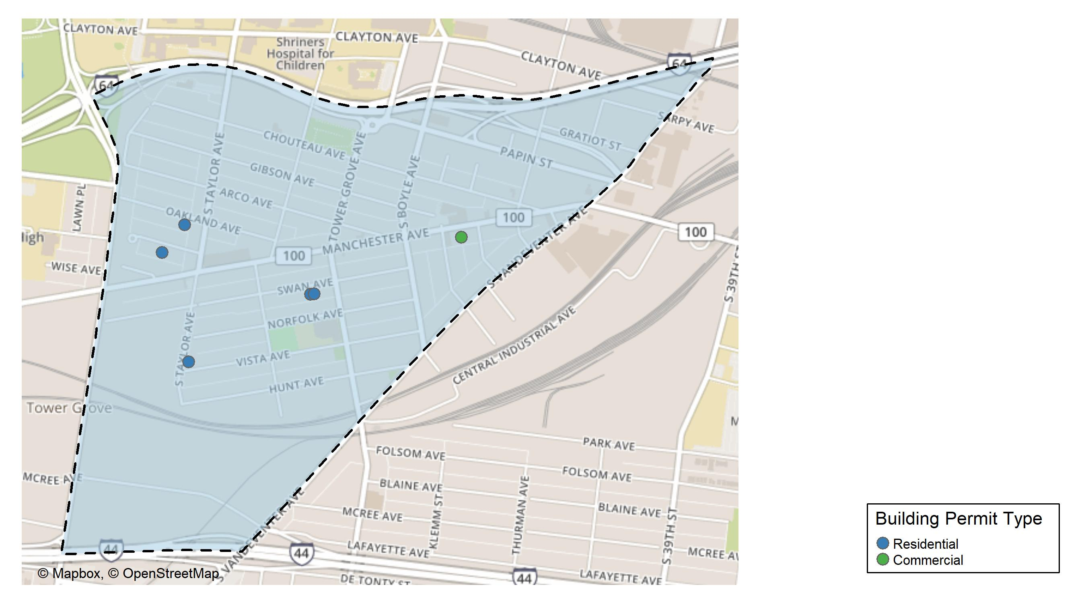
Forest Park Southeast

Slide 14
Neighborhood Summary
June 2024 | June 2024 | June 2024 | June 2024
Permit Use | Average Cost | # of Permits | Total Value of Permits
Commercial | $100,000 | 1 | $100,000
Industrial | $0 | 0 | $0
Residential | $22,425 | 5 | $112,125
Last 6 Months | Last 6 Months | Last 6 Months | Last 6 Months
Permit Use | Average Cost | # of Permits | Total Value of Permits
Commercial | $45,295.56 | 9 | $407,660
Industrial | $15,200.00 | 4 | $60,800
Residential | $82,569.15 | 34 | $2,807,351

Slide 15
Forest Park Southeast Individual Permit Breakdown
Neighborhood | Owner | New Use | Cost | address
Forest Park Southeast | PARK SOUTH PROPERTIES LLC | Residential | $100,000 | 4322-24 SWAN AV
Forest Park Southeast | 4156 MANCHESTER INVESTORS LLC | Commercial | $100,000 | 4156 MANCHESTER AV
Forest Park Southeast | SULLINS, CATHERYN S & JAMES DALE JR | Residential | $2,625 | 4518 OAKLAND AV
Forest Park Southeast | BRETON, PHILIPPE | Residential | $2,000 | 4536 WICHITA AV
Forest Park Southeast | CARDOZA, HAYDEN T & REBECCA D | Residential | $4,000 | 4481 VISTA AV
Forest Park Southeast | SCHOCH, MICHAEL | Residential | $3,500 | 4320 SWAN AV

Slide 16
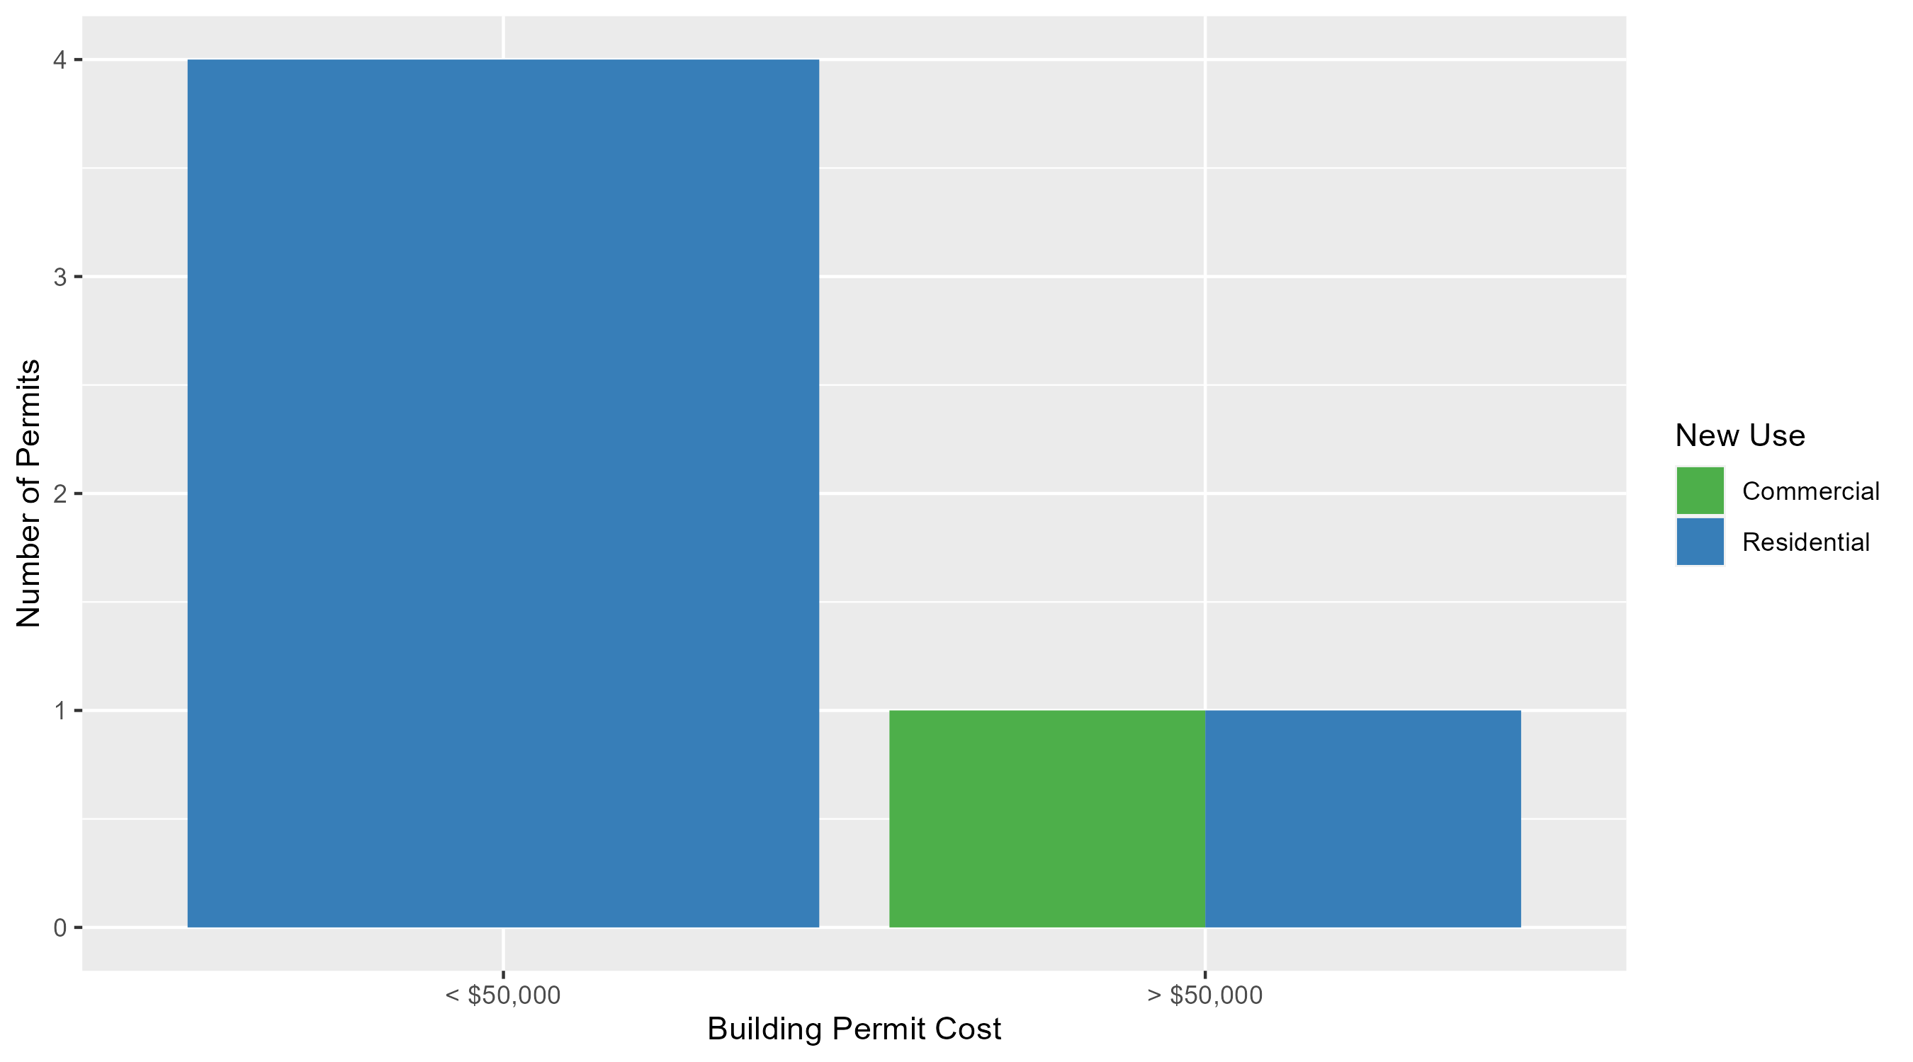
Forest Park Southeast Permit Cost Breakdown

Slide 17
Expanded Service Area

Slide 18
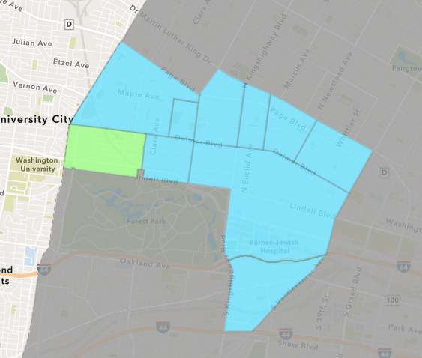
Skinker DeBaliviere
June 2024 Neighborhood Cost Breakdown
  Mean: $44,741
  Median: $60,000
  Range: $12,454 - $70,000

Slide 19
Skinker DeBaliviere: Summary Notes
5 building permits in June 2024
  -37.50% change compared to June 2023 (8 total building permits)
  $44,741: Average building permit cost in June 2024
    -42.84% change compared to June 2023 ($78,268)
27 total building permits in 2024
  -48.08% change YTD compared to this time in 2023 (52 total building permits)
  $75,247: YTD average building permit cost in 2024
    7.06% change YTD compared to this time in 2023 ($70,282)

Slide 20
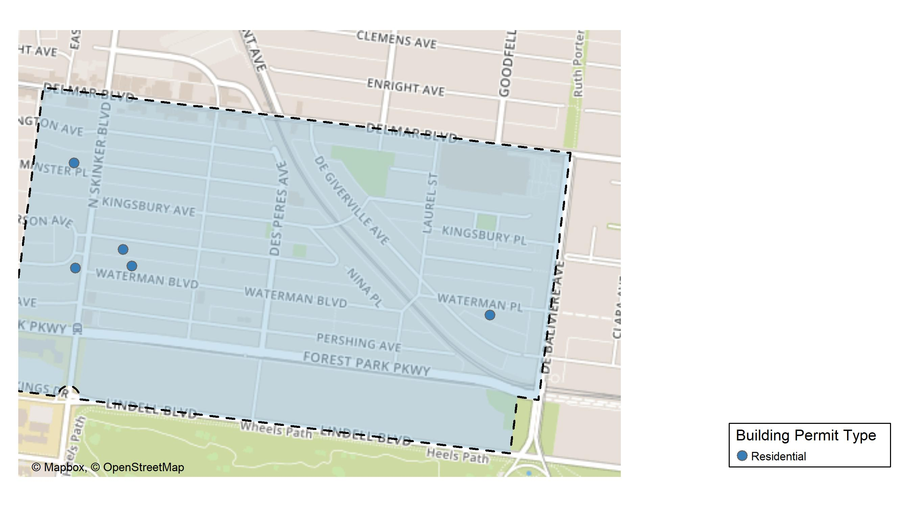
Skinker DeBaliviere

Slide 21
Neighborhood Summary
June 2024 | June 2024 | June 2024 | June 2024
Permit Use | Average Cost | # of Permits | Total Value of Permits
Commercial | $0.0 | 0 | $0
Industrial | $0.0 | 0 | $0
Residential | $44,740.8 | 5 | $223,704
Last 6 Months | Last 6 Months | Last 6 Months | Last 6 Months
Permit Use | Average Cost | # of Permits | Total Value of Permits
Commercial | $167,803.67 | 3 | $503,411
Industrial | $0.00 | 0 | $0
Residential | $58,515.21 | 28 | $1,638,426

Slide 22
Skinker DeBaliviere Individual Permit Breakdown
Neighborhood | Owner | New Use | Cost | address
Skinker DeBaliviere | GRITZ, LIGAYA | Residential | $12,454 | 6168 MCPHERSON AV
Skinker DeBaliviere | LONDON PROPERTIES LLC | Residential | $60,000 | 6157 WATERMAN BLVD
Skinker DeBaliviere | LEWIS, DONNA & SYLVESTER HEBRON JR & | Residential | $70,000 | 5750 WATERMAN BLVD
Skinker DeBaliviere | KEAVENY, JOSEPH P & KAREN ANNE | Residential | $66,250 | 6219 WESTMINSTER PL
Skinker DeBaliviere | MACHAFFIE, SAMUEL & ALIX WEITMAN & T | Residential | $15,000 | 6204 WATERMAN BLVD

Slide 23
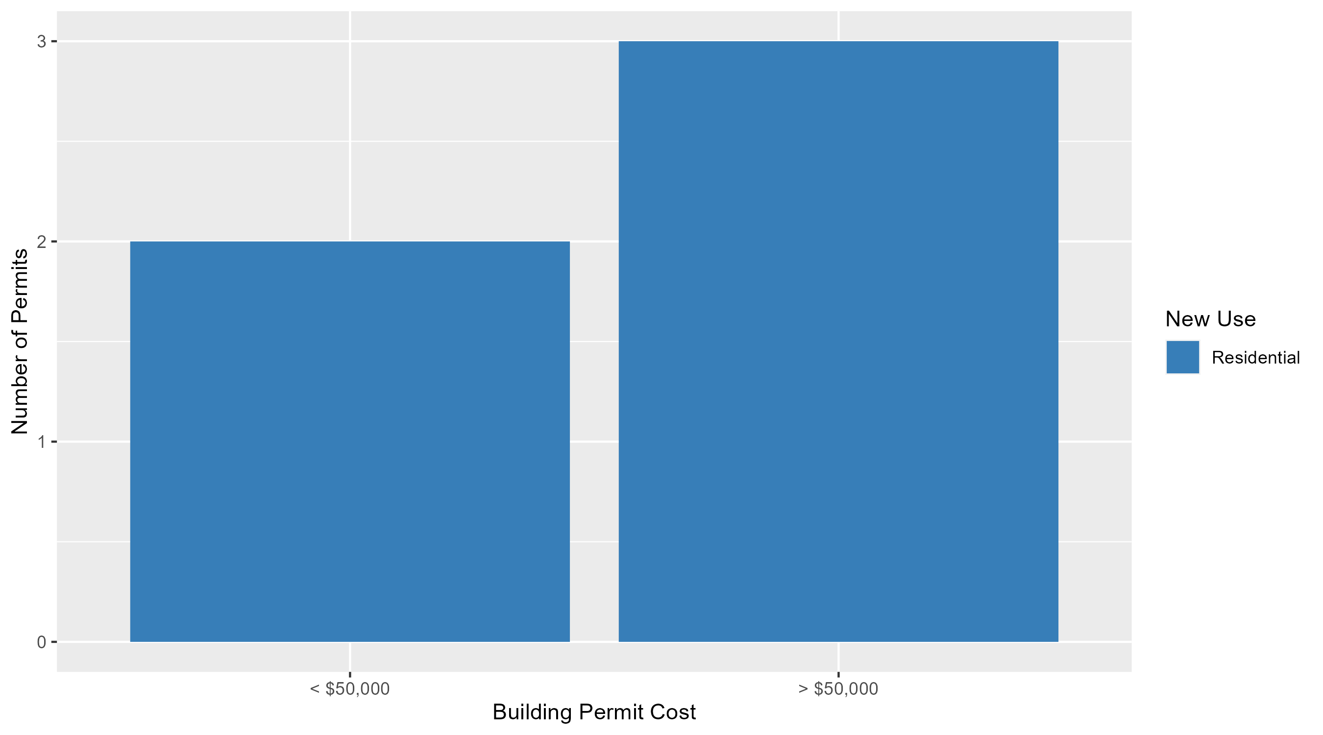
Skinker DeBaliviere Permit Cost Breakdown

Slide 24
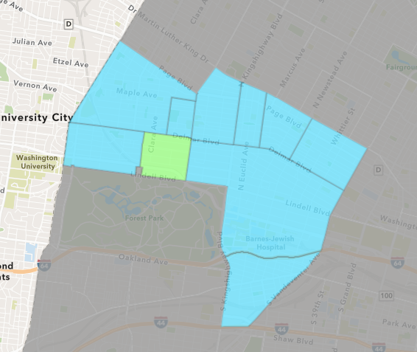
DeBaliviere Place
June 2024 Neighborhood Cost Breakdown
  Mean: $55,050
  Median: $79,916
  Range: $16,500 - $79,916

Slide 25
DeBaliviere Place: Summary Notes
5 building permits in June 2024
  150.00% change compared to June 2023 (2 total building permits)
  $55,050: Average building permit cost in June 2024
    -57.52% change compared to June 2023 ($129,604)
23 total building permits in 2024
  35.29% change YTD compared to this time in 2023 (17 total building permits)
  $128,616: YTD average building permit cost in 2024
    -47.07% change YTD compared to this time in 2023 ($242,973)

Slide 26
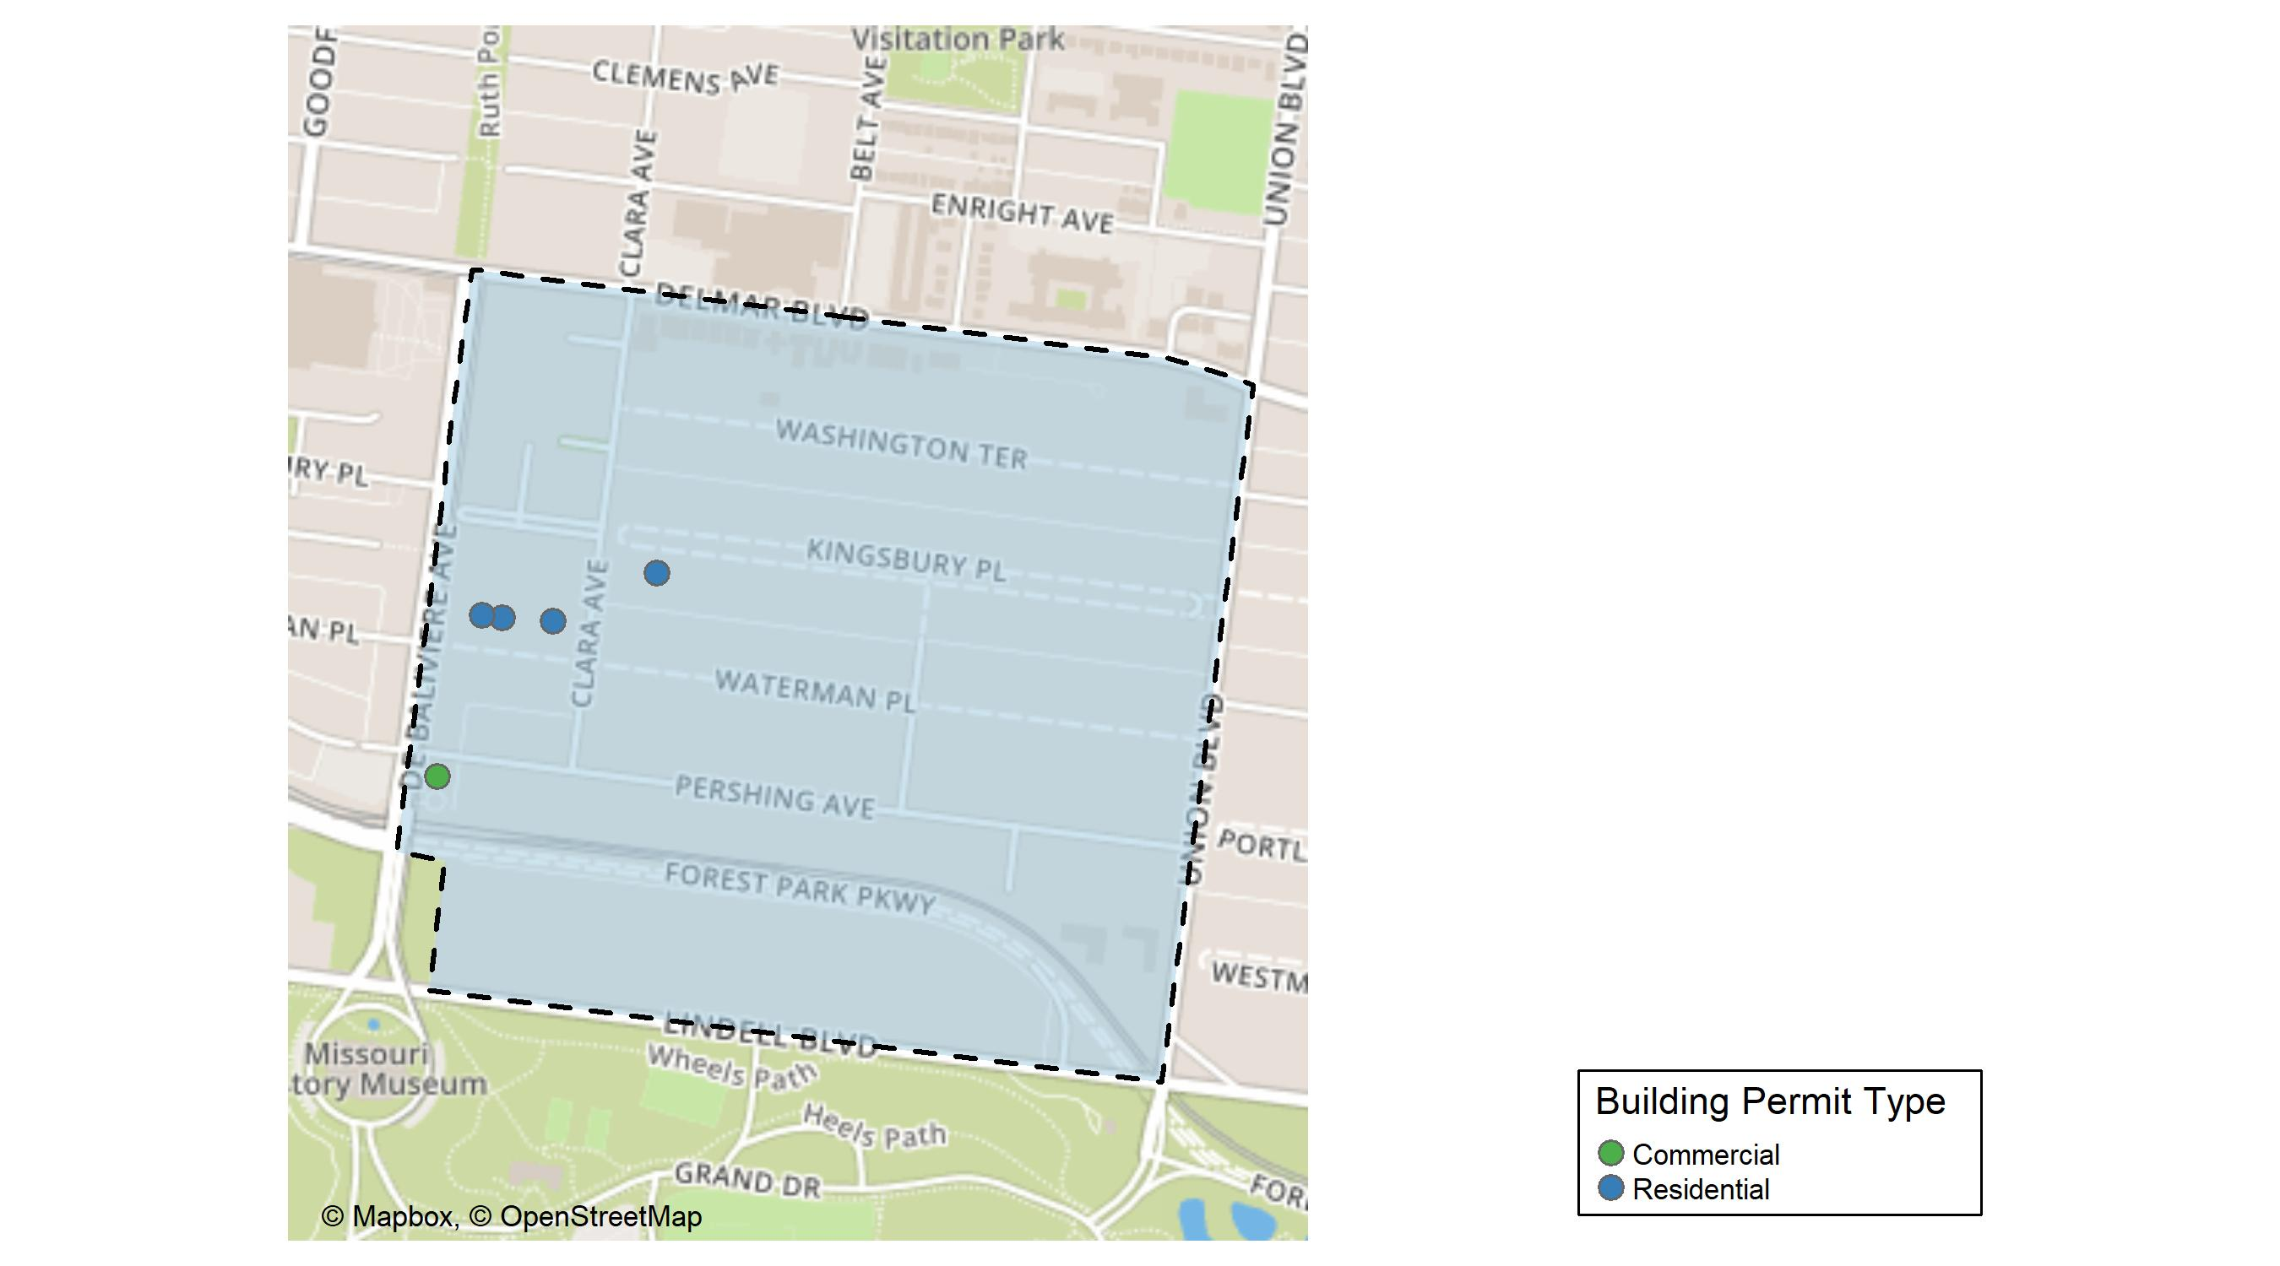
DeBaliviere Place

Slide 27
Neighborhood Summary
June 2024 | June 2024 | June 2024 | June 2024
Permit Use | Average Cost | # of Permits | Total Value of Permits
Commercial | $19,000 | 1 | $19,000
Industrial | $0 | 0 | $0
Residential | $64,062 | 4 | $256,248
Last 6 Months | Last 6 Months | Last 6 Months | Last 6 Months
Permit Use | Average Cost | # of Permits | Total Value of Permits
Commercial | $14,500.0 | 2 | $29,000
Industrial | $0.0 | 0 | $0
Residential | $139,484.4 | 21 | $2,929,172

Slide 28
DeBaliviere Place Individual Permit Breakdown
Neighborhood | Owner | New Use | Cost | address
DeBaliviere Place | PERSHING REDEVELOPMENT CORP | Commercial | $19,000 | 284 DEBALIVIERE AV
DeBaliviere Place | WATERMAN 4 HOMEOWNERS ASSOCIATION | Residential | $79,916 | 5653 WATERMAN BLVD
DeBaliviere Place | WATERMAN 4 HOMEOWNERS ASSOCIATION | Residential | $79,916 | 5661 WATERMAN BLVD
DeBaliviere Place | WATERMAN 4 HOMEOWNERS ASSOCIATION | Residential | $79,916 | 5671 WATERMAN BLVD
DeBaliviere Place | MINANA, KIMBERLY A & GREGORY J | Residential | $16,500 | 58 KINGSBURY PL

Slide 29
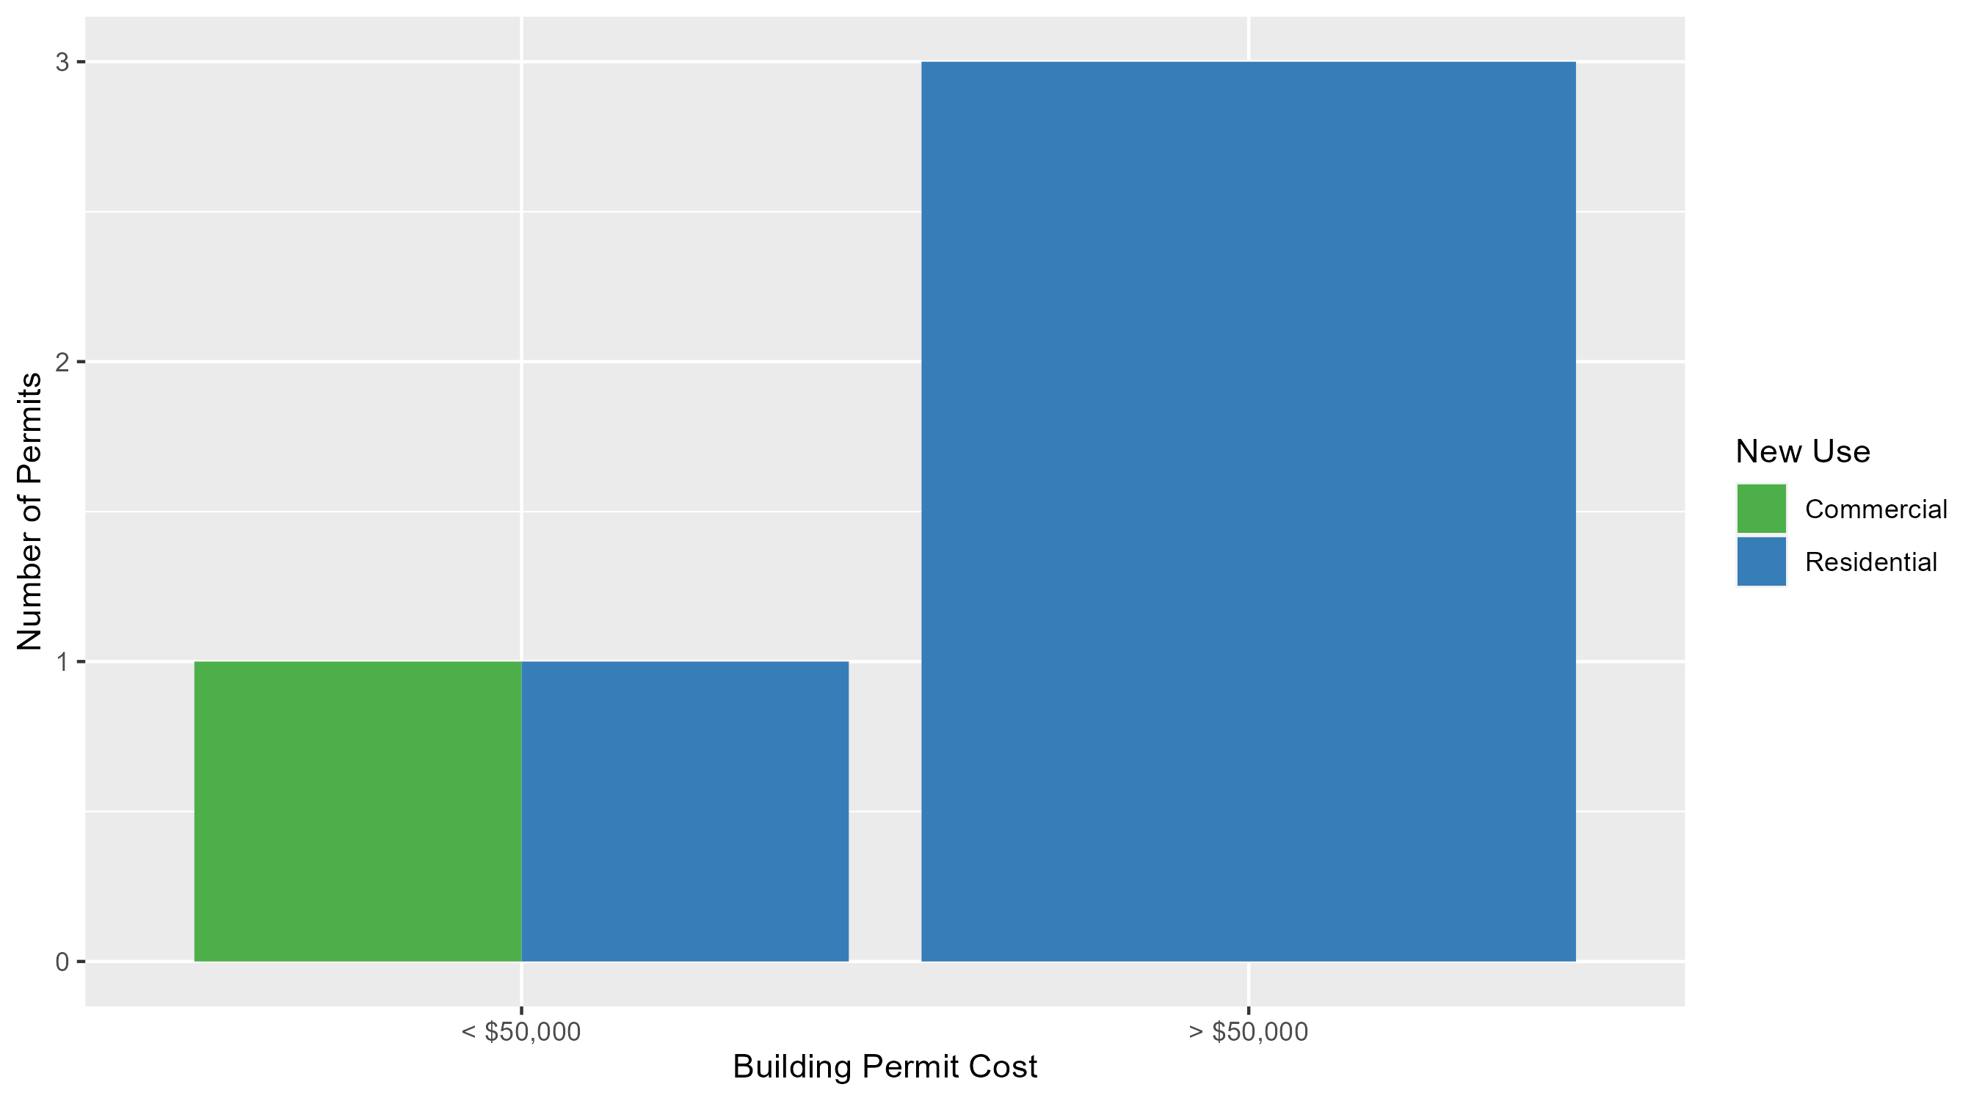
DeBaliviere Place Permit Cost Breakdown

Slide 30
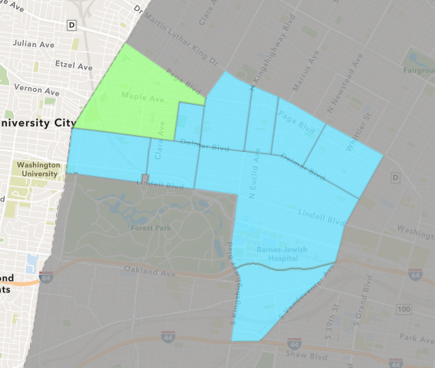
West End
June 2024 Neighborhood Cost Breakdown
  Mean: $9,786
  Median: $10,355
  Range: $1,000 - $25,004

Slide 31
West End: Summary Notes
6 building permits in June 2024
  0.00% change compared to June 2023 (6 total building permits)
  $9,786: Average building permit cost in June 2024
    -88.52% change compared to June 2023 ($85,223)
45 total building permits in 2024
  0.00% change YTD compared to this time in 2023 (45 total building permits)
  $94,863: YTD average building permit cost in 2024
    132.43% change YTD compared to this time in 2023 ($40,814)

Slide 32
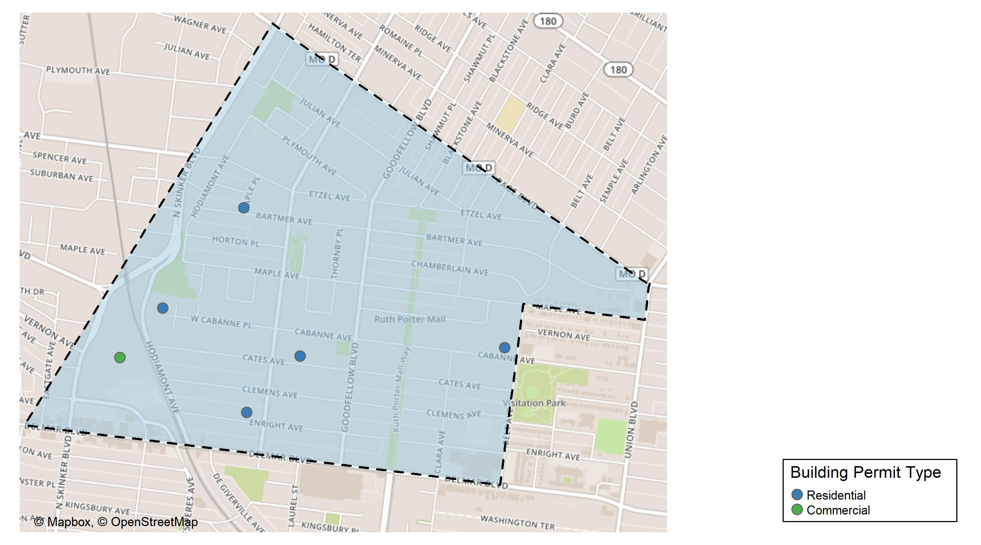
West End

Slide 33
Neighborhood Summary
June 2024 | June 2024 | June 2024 | June 2024
Permit Use | Average Cost | # of Permits | Total Value of Permits
Commercial | $10,710.0 | 1 | $10,710
Industrial | $0.0 | 0 | $0
Residential | $9,600.8 | 5 | $48,004
Last 6 Months | Last 6 Months | Last 6 Months | Last 6 Months
Permit Use | Average Cost | # of Permits | Total Value of Permits
Commercial | $239,014.22 | 9 | $2,151,128
Industrial | $14,400.00 | 2 | $28,800
Residential | $57,592.24 | 37 | $2,130,913

Slide 34
West End Individual Permit Breakdown
Neighborhood | Owner | New Use | Cost | address
West End | WASHINGTON UNIVERSITY | Commercial | $10,710 | 700 ROSEDALE AV
West End | KING HYKES HOLDING INC | Residential | $10,000 | 5515 CABANNE AV
West End | GATHINGS, MARY F | Residential | $25,004 | 5923 ENRIGHT AV
West End | AUGUSTUS, ERICKA | Residential | $11,000 | 5869 CATES AV
West End | BARBER, ALESHA | Residential | $1,000 | 6001 BARTMER AV
West End | MCKINNIS, BERTHA | Residential | $1,000 | 6085 WEST CABANNE PL

Slide 35
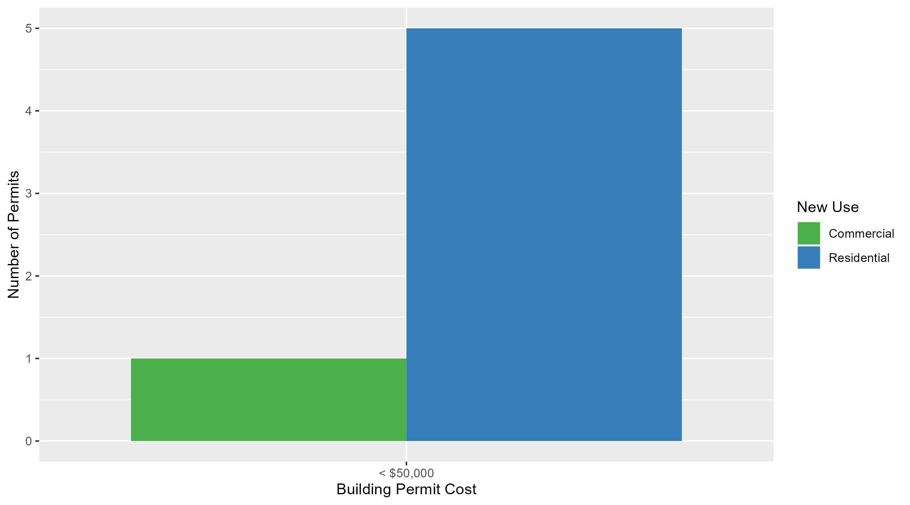
West End Permit Cost Breakdown

Slide 36
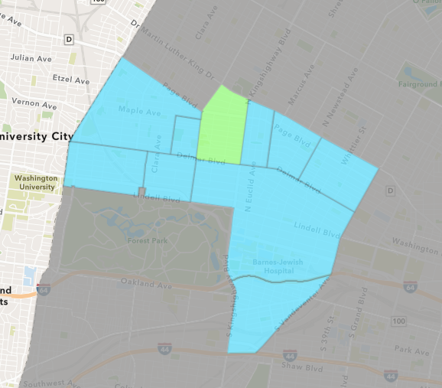
Academy
June 2024 Neighborhood Cost Breakdown
  Mean: $100,000
  Median: $100,000
  Range: $100,000 - $100,000

Slide 37
Academy: Summary Notes
1 building permits in June 2024
  -50.00% change compared to June 2023 (2 total building permits)
  $100,000: Average building permit cost in June 2024
    1283.70% change compared to June 2023 ($7,227)
10 total building permits in 2024
  -28.57% change YTD compared to this time in 2023 (14 total building permits)
  $59,020: YTD average building permit cost in 2024
    258.58% change YTD compared to this time in 2023 ($16,459)

Slide 38
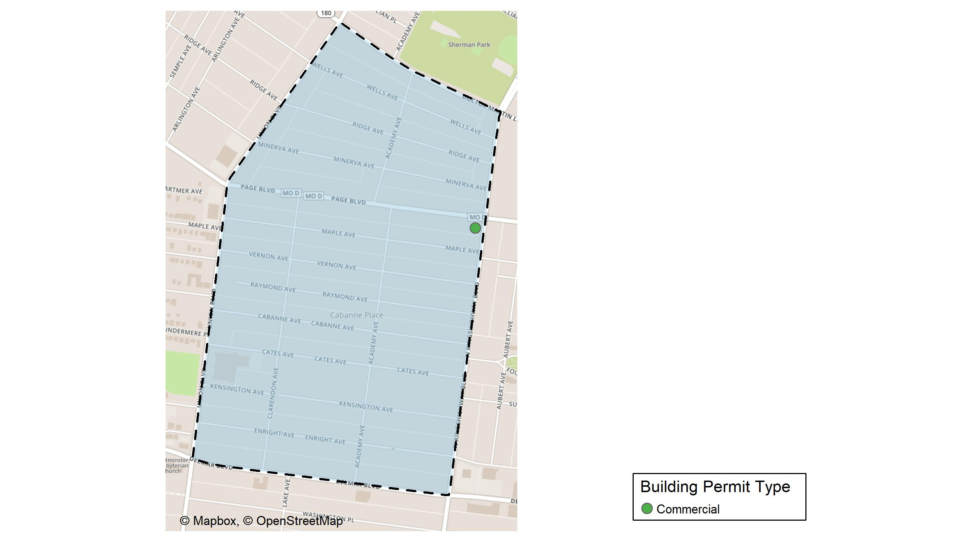
Academy

Slide 39
Neighborhood Summary
June 2024 | June 2024 | June 2024 | June 2024
Permit Use | Average Cost | # of Permits | Total Value of Permits
Commercial | $100,000 | 1 | $100,000
Industrial | $0 | 0 | $0
Residential | $0 | 0 | $0
Last 6 Months | Last 6 Months | Last 6 Months | Last 6 Months
Permit Use | Average Cost | # of Permits | Total Value of Permits
Commercial | $90,000.0 | 2 | $180,000
Industrial | $42,000.0 | 1 | $42,000
Residential | $43,420.1 | 10 | $434,201

Slide 40
Academy Individual Permit Breakdown
Neighborhood | Owner | New Use | Cost | address
Academy | PROLINE PROPERTY LLC | Commercial | $100,000 | 1259 N KINGSHIGHWAY BLVD

Slide 41
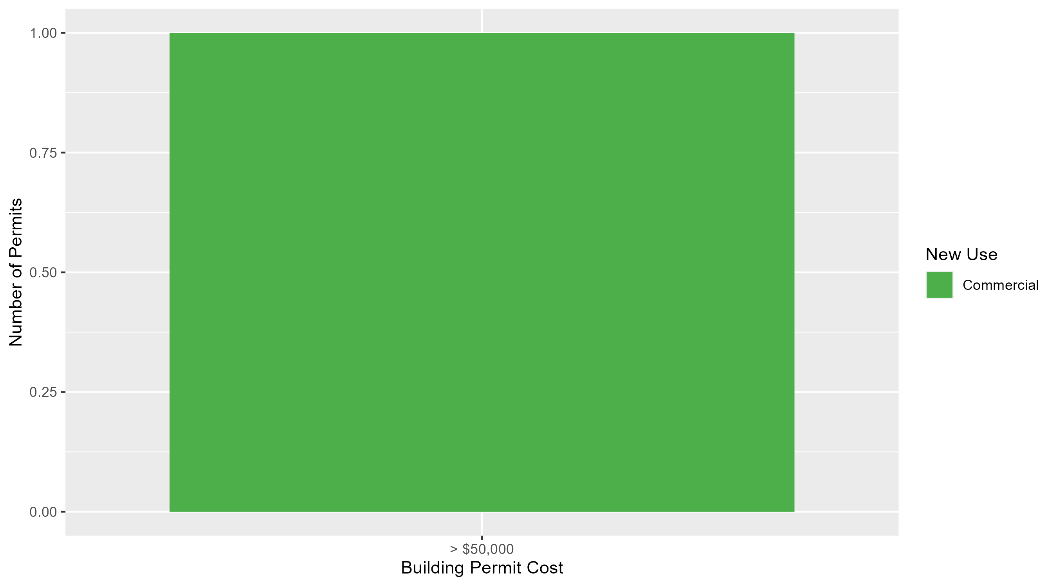
Academy Permit Cost Breakdown

Slide 42
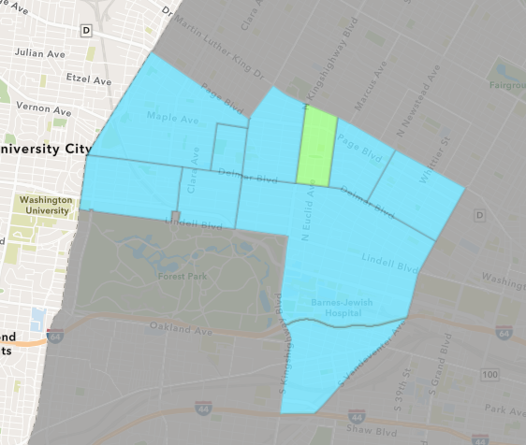
Fountain Park
June 2024 Neighborhood Cost Breakdown
  Mean: $92,500
  Median: $92,500
  Range: $25,000 - $160,000

Slide 43
Fountain Park: Summary Notes
2 building permits in June 2024
  Infinite change compared to June 2023 (0 total building permits)
  $92,500: Average building permit cost in June 2024
    Infinite change compared to June 2023 ($0)
6 total building permits in 2024
  20.00% change YTD compared to this time in 2023 (5 total building permits)
  $39,833: YTD average building permit cost in 2024
    237.57% change YTD compared to this time in 2023 ($11,800)

Slide 44
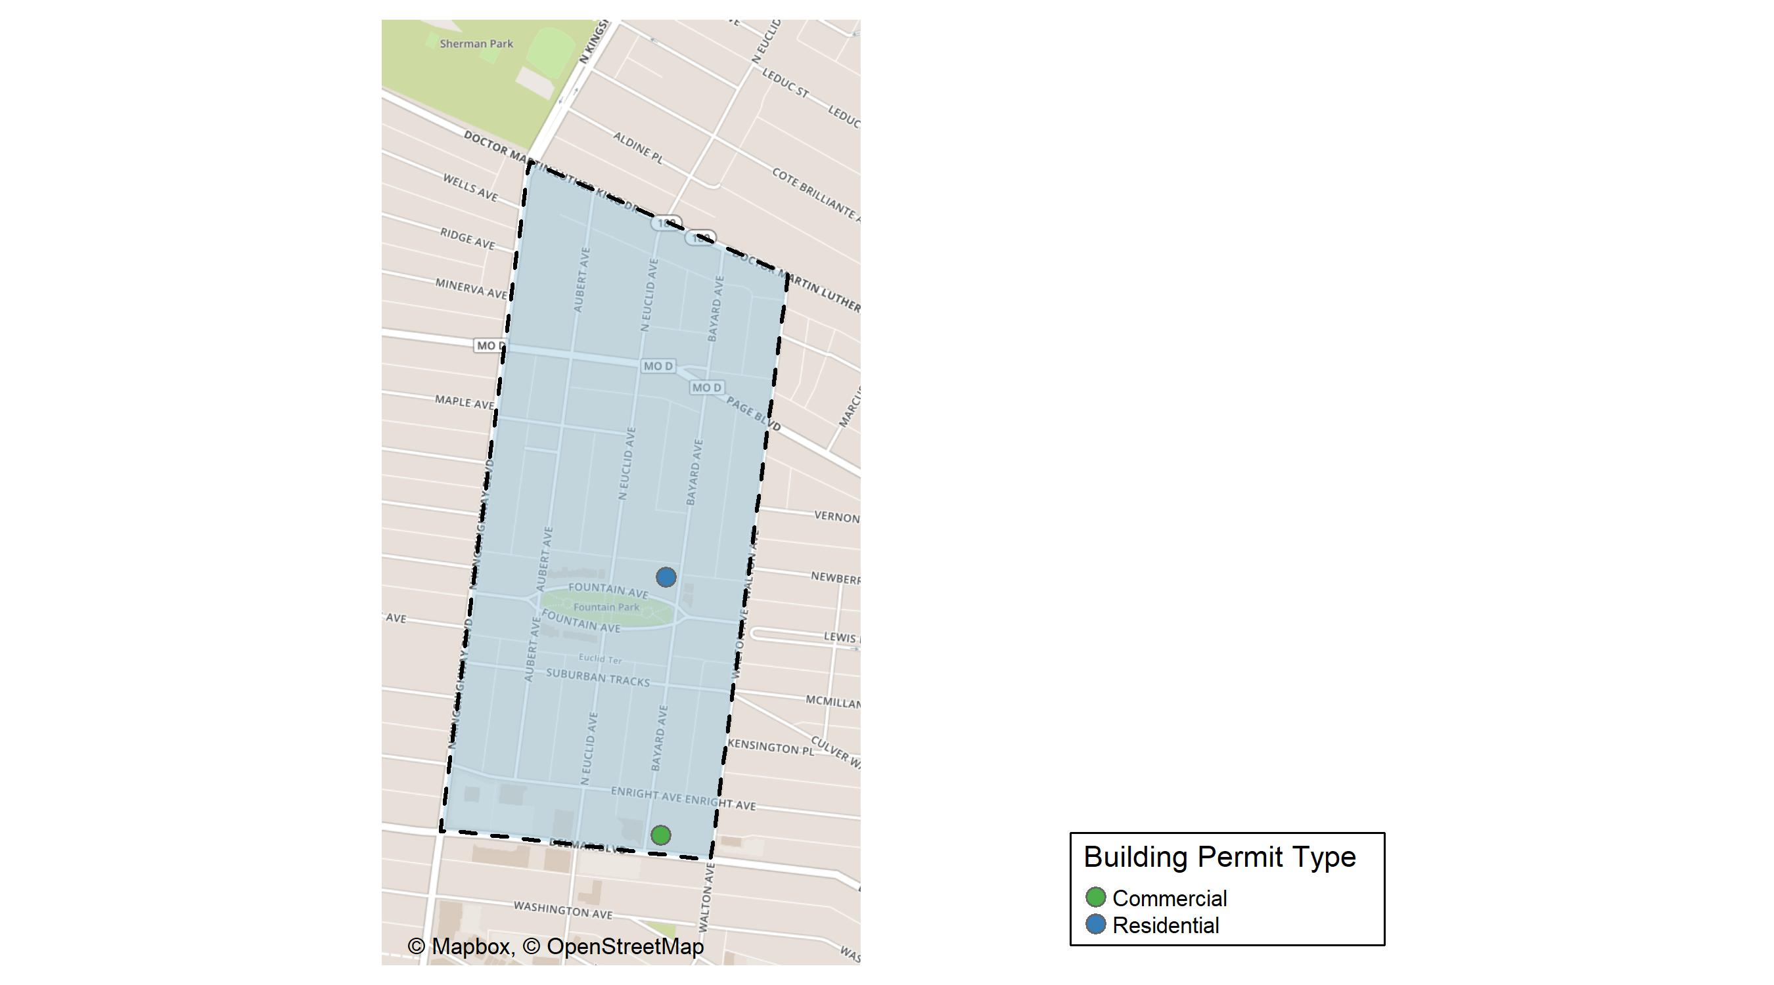
Fountain Park

Slide 45
Neighborhood Summary
June 2024 | June 2024 | June 2024 | June 2024
Permit Use | Average Cost | # of Permits | Total Value of Permits
Commercial | $25,000 | 1 | $25,000
Industrial | $0 | 0 | $0
Residential | $160,000 | 1 | $160,000
Last 6 Months | Last 6 Months | Last 6 Months | Last 6 Months
Permit Use | Average Cost | # of Permits | Total Value of Permits
Commercial | $32,750 | 4 | $131,000
Industrial | $0 | 0 | $0
Residential | $72,000 | 4 | $288,000

Slide 46
Fountain Park Individual Permit Breakdown
Neighborhood | Owner | New Use | Cost | address
Fountain Park | ELEVATION QALICB LLC | Commercial | $25,000 | 4731 DELMAR BLVD
Fountain Park | SHACKLEFORD, KEITH | Residential | $160,000 | 1113 BAYARD AV

Slide 47
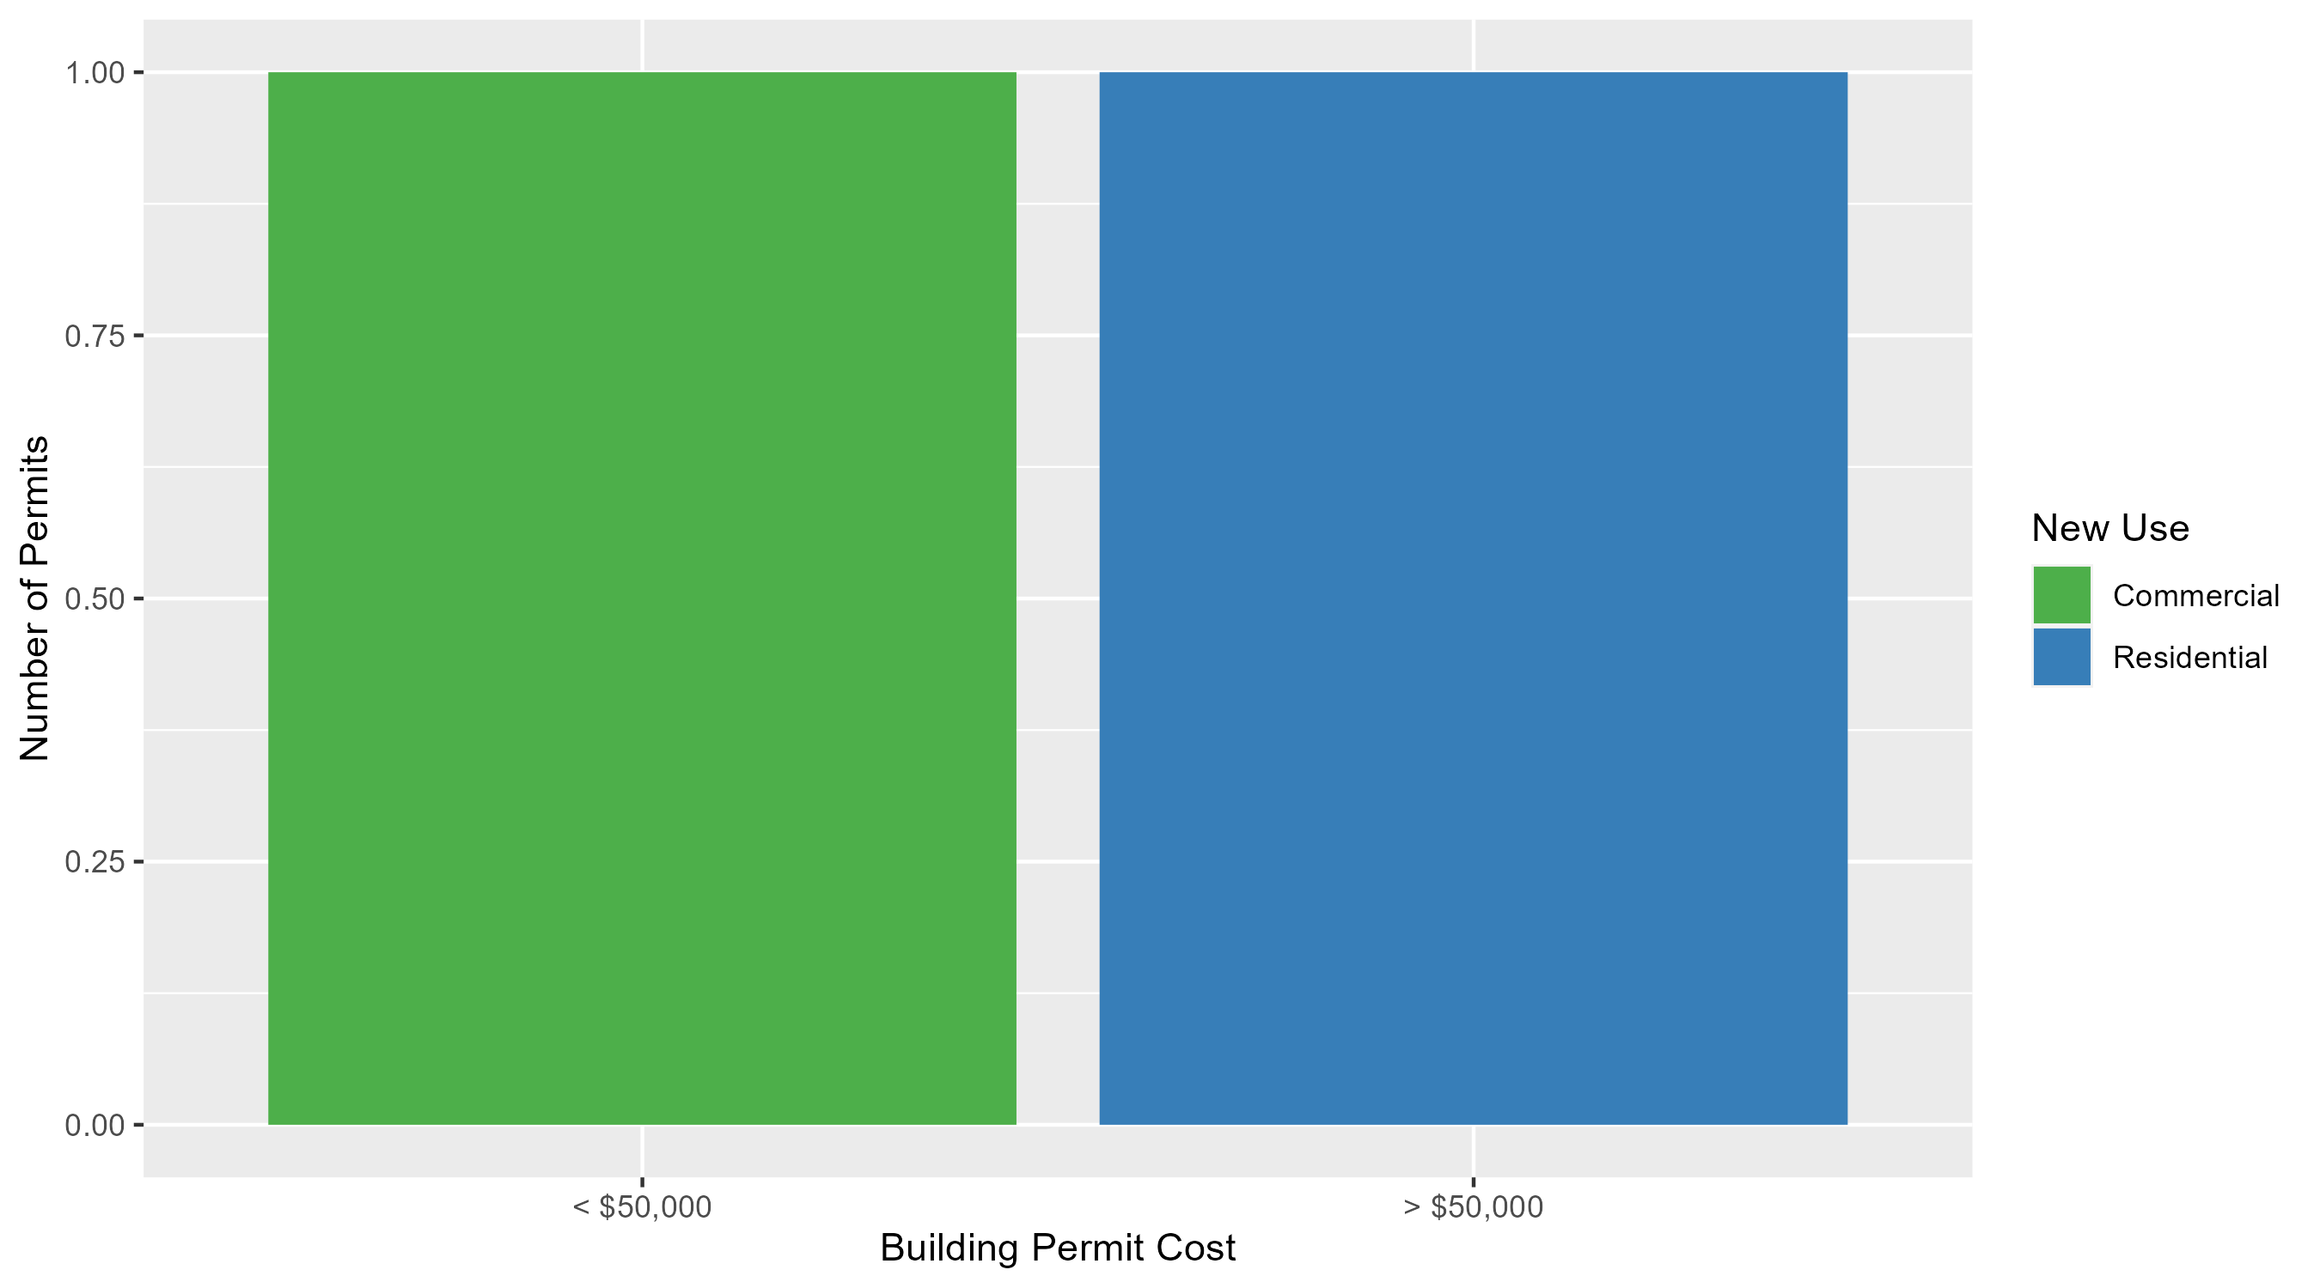
Fountain Park Permit Cost Breakdown

Slide 48
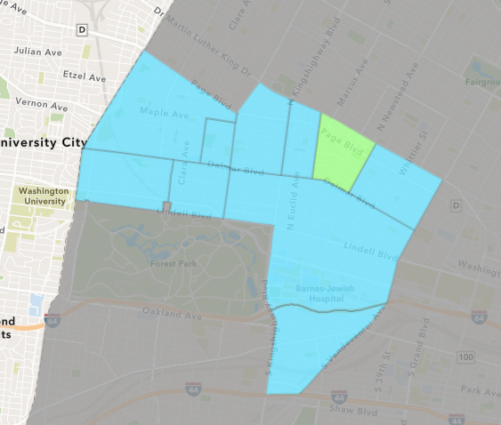
Lewis Place
June 2024 Neighborhood Cost Breakdown
  Mean: $136,131
  Median: $136,131
  Range: $136,131 - $136,131

Slide 49
Lewis Place: Summary Notes
1 building permits in June 2024
  0.00% change compared to June 2023 (1 total building permits)
  $136,131: Average building permit cost in June 2024
    444.52% change compared to June 2023 ($25,000)
7 total building permits in 2024
  -22.22% change YTD compared to this time in 2023 (9 total building permits)
  $24,518: YTD average building permit cost in 2024
    -52.88% change YTD compared to this time in 2023 ($52,034)

Slide 50
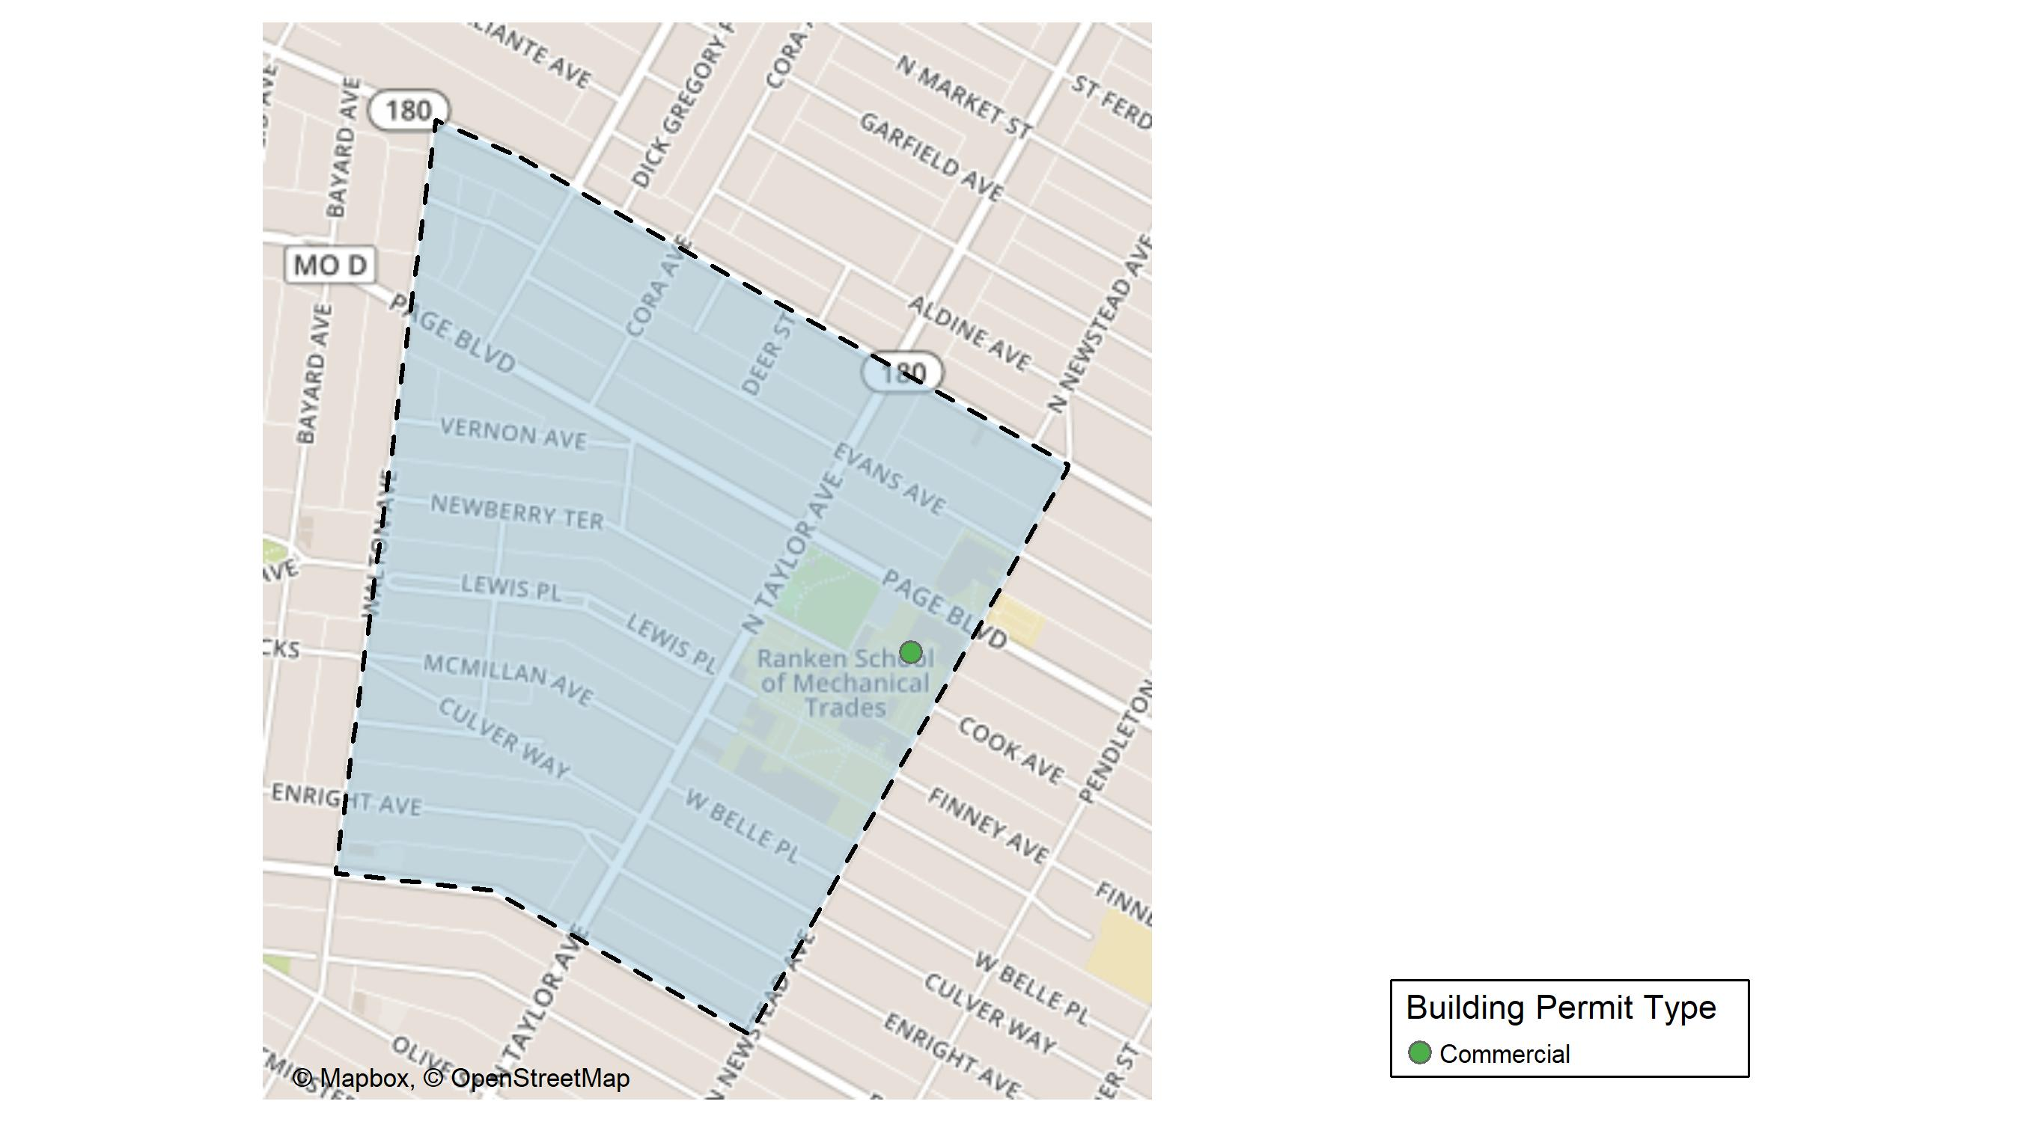
Lewis Place

Slide 51
Neighborhood Summary
June 2024 | June 2024 | June 2024 | June 2024
Permit Use | Average Cost | # of Permits | Total Value of Permits
Commercial | $136,131 | 1 | $136,131
Industrial | $0 | 0 | $0
Residential | $0 | 0 | $0
Last 6 Months | Last 6 Months | Last 6 Months | Last 6 Months
Permit Use | Average Cost | # of Permits | Total Value of Permits
Commercial | $69,061.5 | 2 | $138,123
Industrial | $7,000.0 | 1 | $7,000
Residential | $14,117.0 | 6 | $84,702

Slide 52
Lewis Place Individual Permit Breakdown
Neighborhood | Owner | New Use | Cost | address
Lewis Place | RANKEN TECHNICAL COLLEGE | Commercial | $136,131 | 4443 COOK AV

Slide 53
Lewis Place Permit Cost Breakdown

Slide 54
Additional Notes
Data retreived from https://www.stlouis-mo.gov/data/
Building permits with a cost of $0 were dropped
Building permits that were cancelled were dropped
Infinite change indicates 0 permits in the current or previous time period/comparison month so there was a overall increase or decrease

