Slide 1
St. Louis Central Corridor West Building Permits
Monthly Report: March 2024

Slide 2
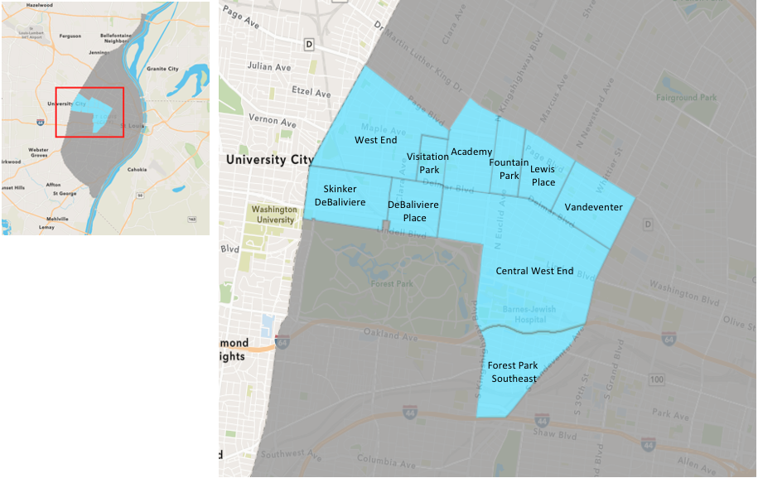
St. Louis Neighborhood Spatial Reference

Slide 3
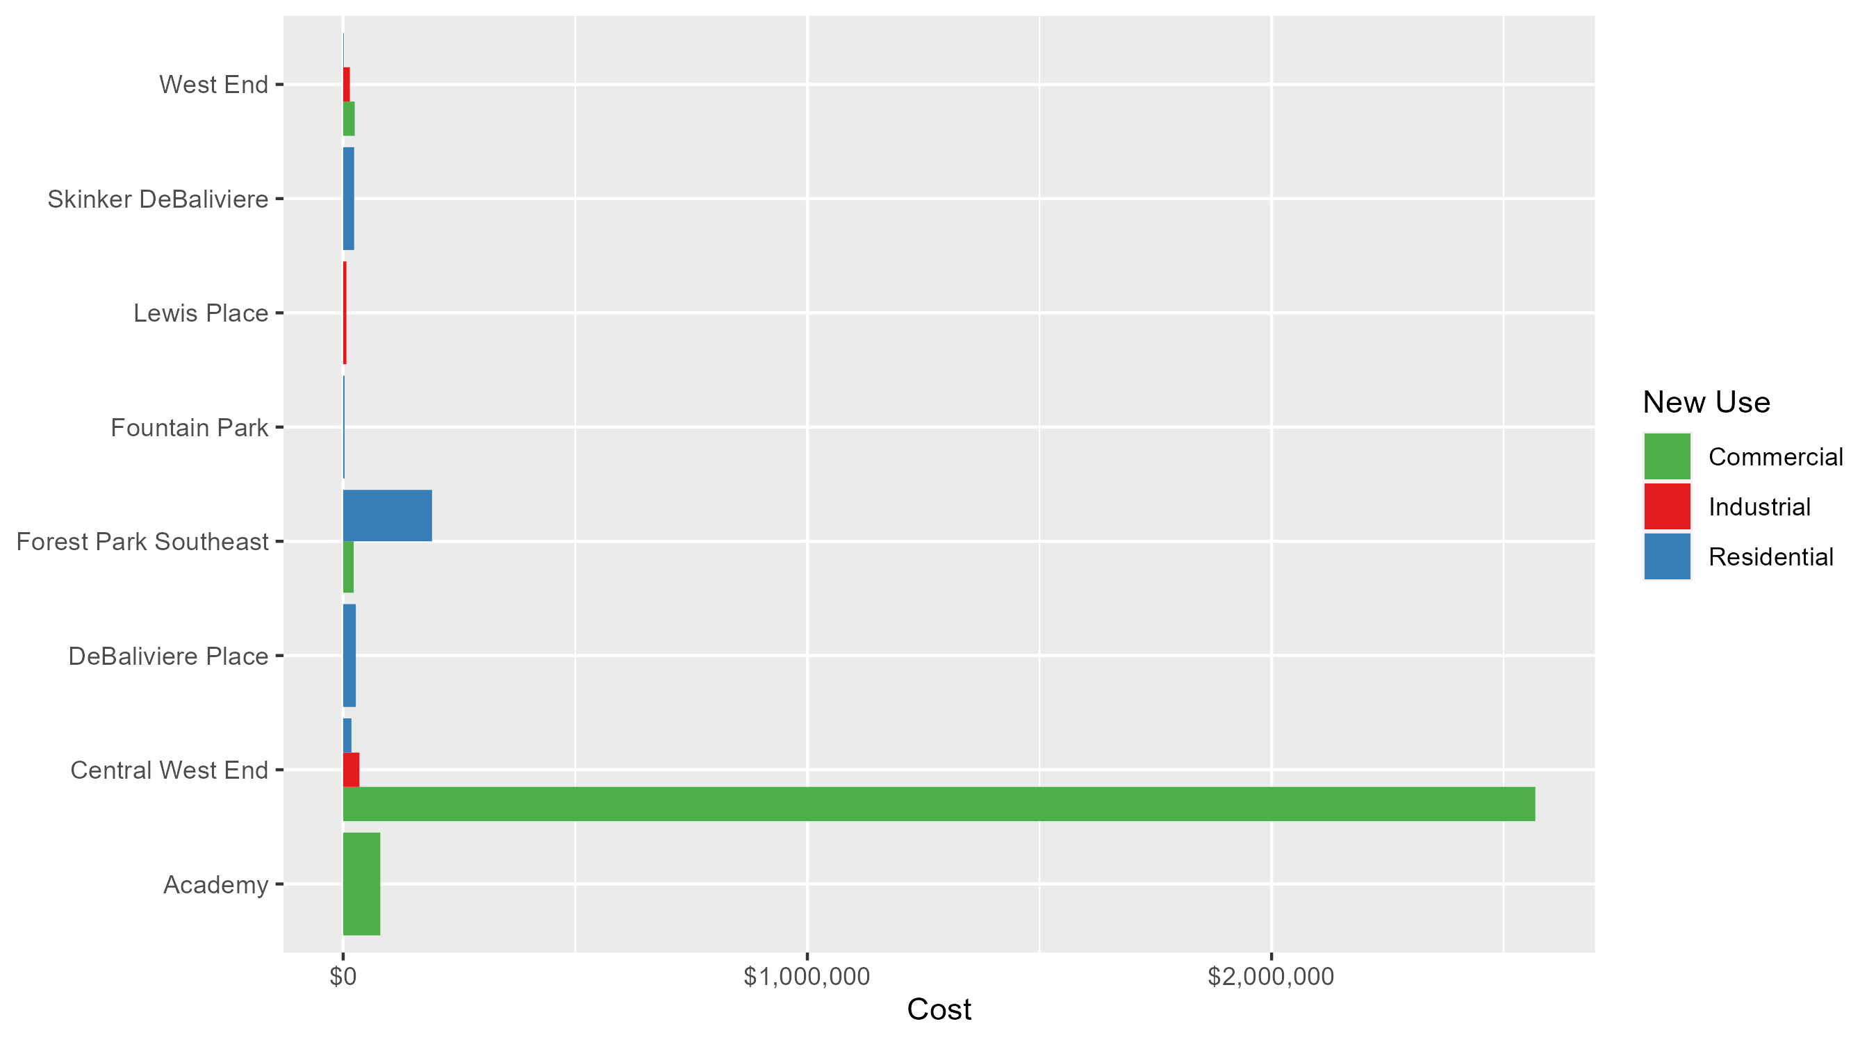
Neighborhood Summary: Average Building Permit Cost

Slide 4
Neighborhood Summary
March 2024 | March 2024 | March 2024 | March 2024
Neighborhood | Average Cost | # of Permits | Total Value of Permits
Academy | $80,000.00 | 1 | $80,000
Central West End | $1,399,961.08 | 24 | $33,599,066
DeBaliviere Place | $27,227.00 | 2 | $54,454
Forest Park Southeast | $149,278.00 | 12 | $1,791,336
Fountain Park | $3,000.00 | 1 | $3,000
Lewis Place | $7,000.00 | 1 | $7,000
Skinker DeBaliviere | $23,637.33 | 3 | $70,912
Vandeventer | $0.00 | 0 | $0
Visitation Park | $0.00 | 0 | $0
West End | $15,216.86 | 7 | $106,518
Last 6 Months | Last 6 Months | Last 6 Months | Last 6 Months
Neighborhood | Average Cost | # of Permits | Total Value of Permits
Academy | $33,302.84 | 19 | $632,754
Central West End | $473,597.75 | 197 | $93,298,757
DeBaliviere Place | $110,250.48 | 25 | $2,756,262
Forest Park Southeast | $93,334.41 | 49 | $4,573,386
Fountain Park | $36,649.09 | 11 | $403,140
Lewis Place | $45,217.12 | 8 | $361,737
Skinker DeBaliviere | $124,109.00 | 40 | $4,964,360
Vandeventer | $253,159.70 | 10 | $2,531,597
Visitation Park | $108,150.00 | 2 | $216,300
West End | $111,681.79 | 47 | $5,249,044

Slide 5
Core Neighborhoods

Slide 6
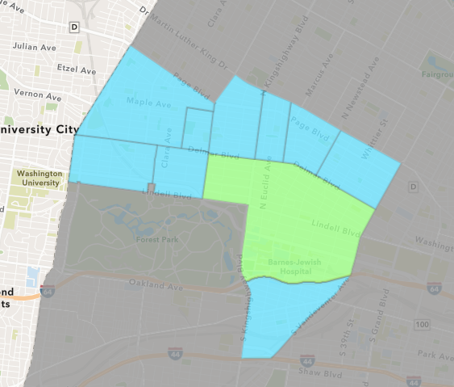
Central West End
March 2024 Neighborhood Cost Breakdown
  Mean: $1,399,961
  Median: $30,490
  Range: $1,550 - $26,663,529

Slide 7
Central West End: Summary Notes
24 building permits in March 2024
  -36.84% change compared to March 2023 (38 total building permits)
  $1,399,961: Average building permit cost in March 2024
    154.83% change compared to March 2023 ($549,362)
73 total building permits in 2024
  -29.81% change YTD compared to this time in 2023 (104 total building permits)
  $874,806: YTD average building permit cost in 2024
    106.98% change YTD compared to this time in 2023 ($422,658)

Slide 8
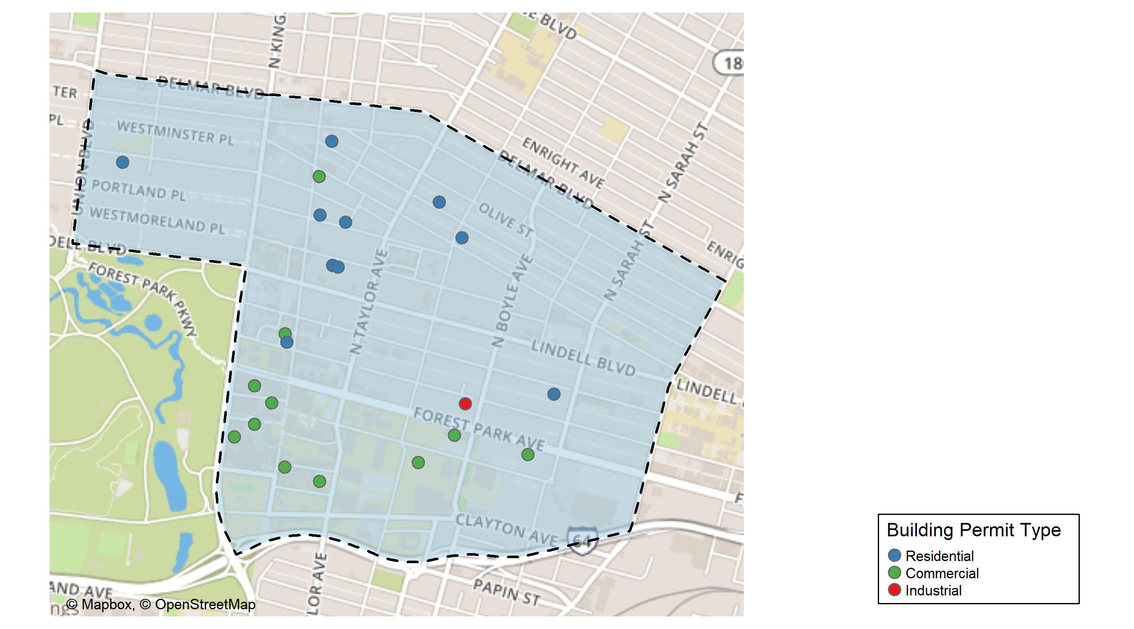
Central West End

Slide 9
Neighborhood Summary
March 2024 | March 2024 | March 2024 | March 2024
Permit Use | Average Cost | # of Permits | Total Value of Permits
Commercial | $2,568,157.6 | 13 | $33,386,049
Industrial | $35,000.0 | 1 | $35,000
Residential | $17,801.7 | 10 | $178,017
Last 6 Months | Last 6 Months | Last 6 Months | Last 6 Months
Permit Use | Average Cost | # of Permits | Total Value of Permits
Commercial | $935,688.77 | 95 | $88,890,433
Industrial | $18,750.00 | 5 | $93,750
Residential | $44,480.15 | 97 | $4,314,574

Slide 10
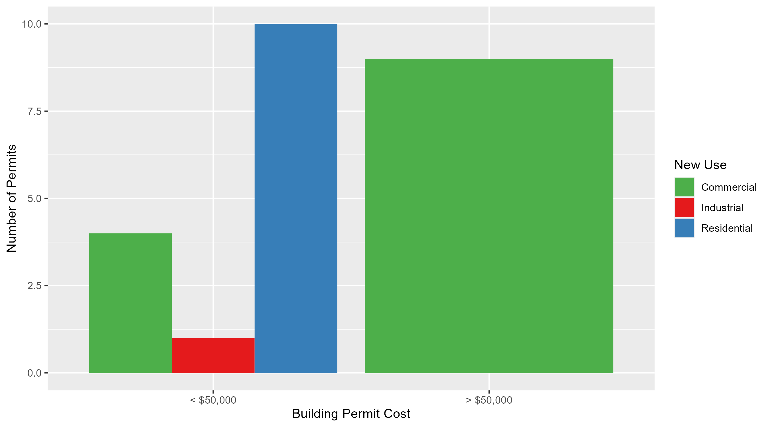
Central West End Permit Cost Breakdown

Slide 11
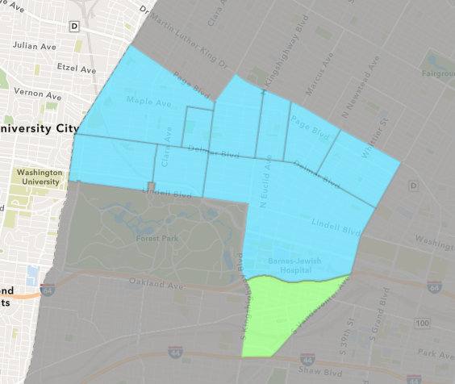
Forest Park Southeast
March 2024 Neighborhood Cost Breakdown
  Mean: $149,278
  Median: $157,784
  Range: $1,774 - $300,000

Slide 12
Forest Park Southeast: Summary Notes
12 building permits in March 2024
  1100.00% change compared to March 2023 (1 total building permits)
  $149,278: Average building permit cost in March 2024
    2032.54% change compared to March 2023 ($7,000)
24 total building permits in 2024
  84.62% change YTD compared to this time in 2023 (13 total building permits)
  $86,779: YTD average building permit cost in 2024
    59.16% change YTD compared to this time in 2023 ($54,523)

Slide 13
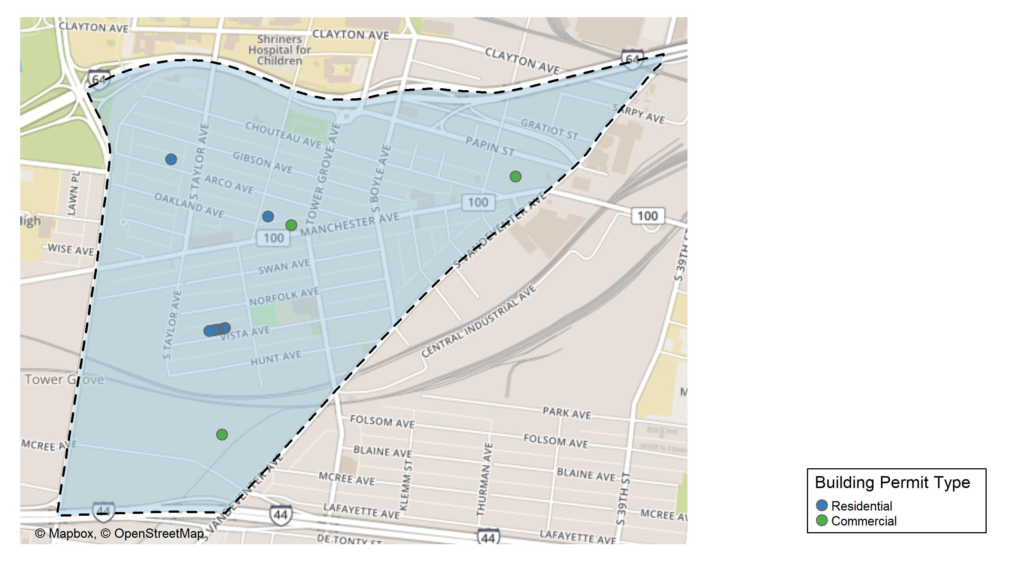
Forest Park Southeast

Slide 14
Neighborhood Summary
March 2024 | March 2024 | March 2024 | March 2024
Permit Use | Average Cost | # of Permits | Total Value of Permits
Commercial | $22,703.33 | 3 | $68,110
Industrial | $0.00 | 0 | $0
Residential | $191,469.56 | 9 | $1,723,226
Last 6 Months | Last 6 Months | Last 6 Months | Last 6 Months
Permit Use | Average Cost | # of Permits | Total Value of Permits
Commercial | $25,194.29 | 7 | $176,360
Industrial | $12,600.00 | 4 | $50,400
Residential | $114,384.89 | 38 | $4,346,626

Slide 15
Forest Park Southeast Individual Permit Breakdown
Neighborhood | Owner | New Use | Cost | address
Forest Park Southeast | ANAND SHARING LLC | Residential | $300,000 | 4443 VISTA AV
Forest Park Southeast | LC2022 LLC | Commercial | $1,774 | 4317 MANCHESTER AV
Forest Park Southeast | UNIFY GROVE DEVELOPMENT LLC | Residential | $275,000 | 4437 VISTA AV
Forest Park Southeast | UNIFY GROVE DEVELOPMENT LLC | Residential | $275,000 | 4433 VISTA AV
Forest Park Southeast | UNIFY GROVE DEVELOPMENT LLC | Residential | $275,000 | 4427 VISTA AV
Forest Park Southeast | UNIFY GROVE DEVELOPMENT LLC | Residential | $275,000 | 4435 VISTA AV
Forest Park Southeast | UNIFY GROVE DEVELOPMENT LLC | Residential | $275,000 | 4429 VISTA AV
Forest Park Southeast | SPENCER DEVELOPMENT LLC | Residential | $35,245 | 4041 CHOUTEAU AV
Forest Park Southeast | GREEN ST 4565 MCREE INVESTORS LLC | Commercial | $40,568 | 4565 MCREE AV
Forest Park Southeast | GS CHROMA PH I LLC | Commercial | $25,768 | 4041 CHOUTEAU AV
Forest Park Southeast | STOLL, ALEXANDER & | Residential | $9,981 | 1086 S NEWSTEAD AV
Forest Park Southeast | FRAILEY, SCOTT M & GANNA SHEYKO | Residential | $3,000 | 4529 ARCO AV

Slide 16
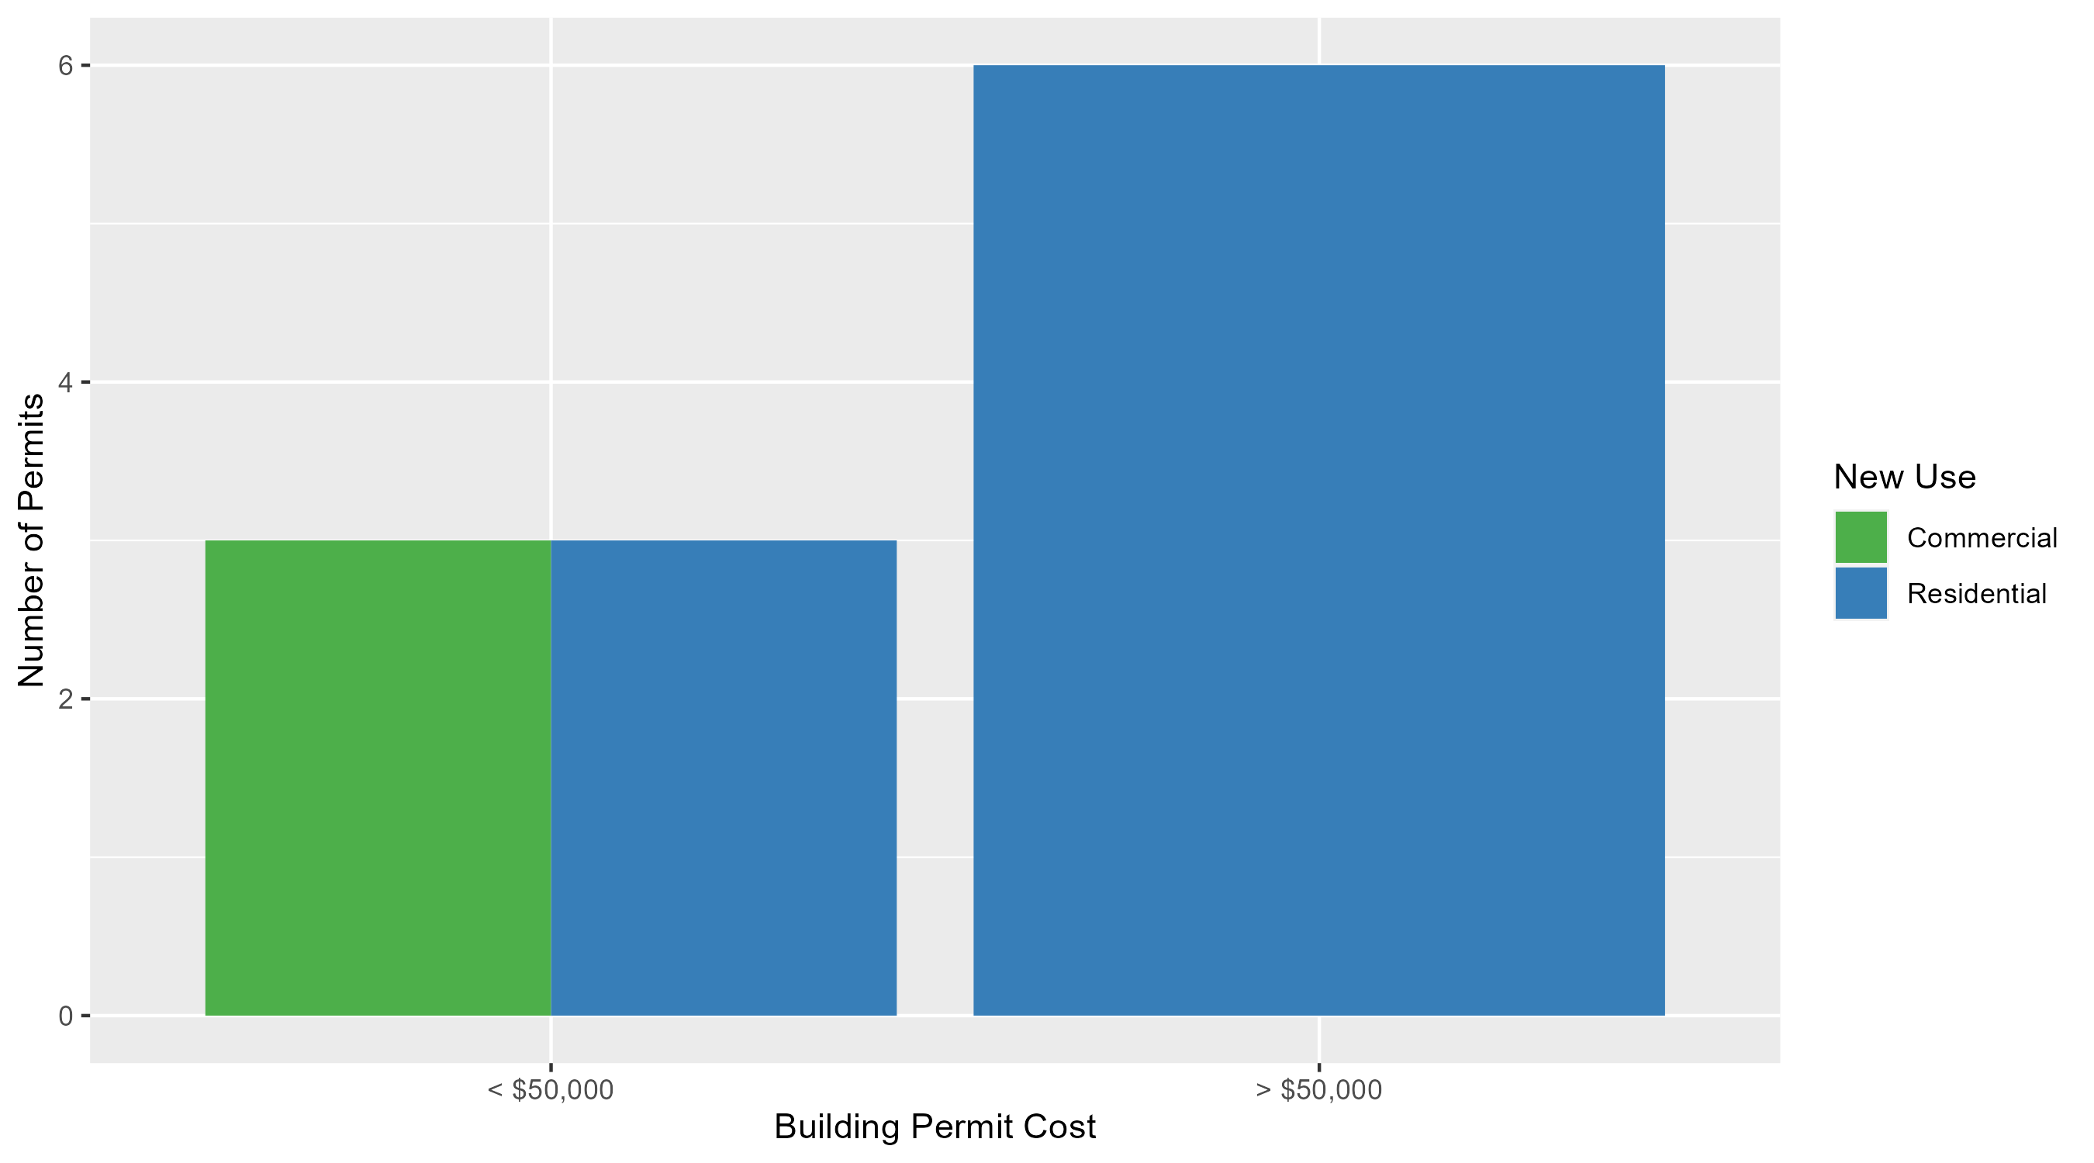
Forest Park Southeast Permit Cost Breakdown

Slide 17
Expanded Service Area

Slide 18
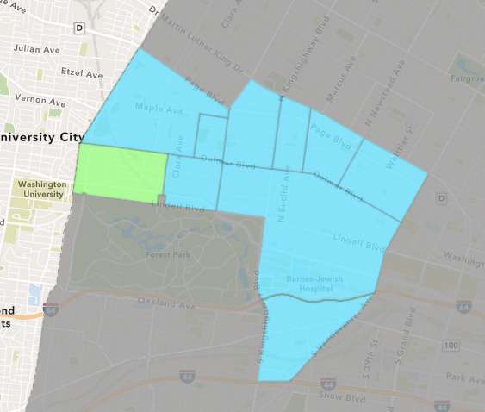
Skinker DeBaliviere
March 2024 Neighborhood Cost Breakdown
  Mean: $23,637
  Median: $9,912
  Range: $1,000 - $60,000

Slide 19
Skinker DeBaliviere: Summary Notes
3 building permits in March 2024
  -66.67% change compared to March 2023 (9 total building permits)
  $23,637: Average building permit cost in March 2024
    -72.42% change compared to March 2023 ($85,691)
11 total building permits in 2024
  -47.62% change YTD compared to this time in 2023 (21 total building permits)
  $105,552: YTD average building permit cost in 2024
    25.64% change YTD compared to this time in 2023 ($84,009)

Slide 20
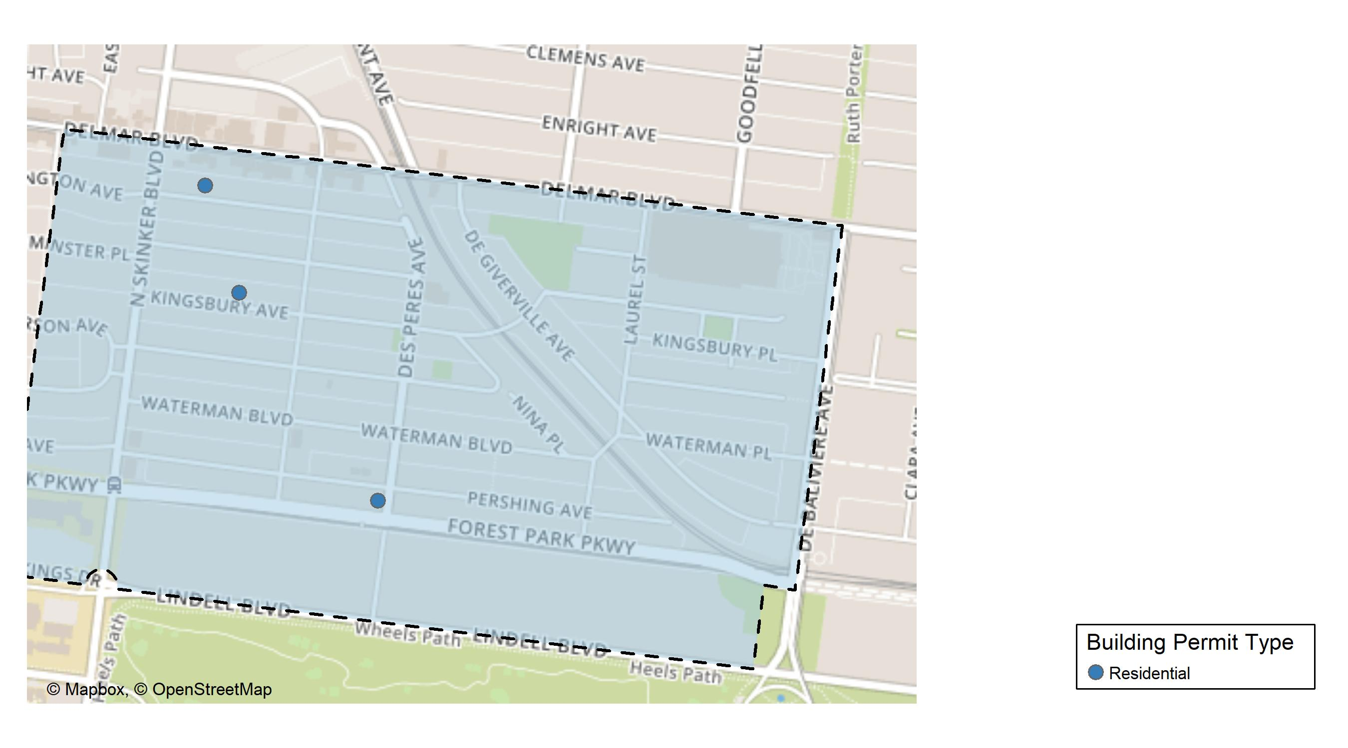
Skinker DeBaliviere

Slide 21
Neighborhood Summary
March 2024 | March 2024 | March 2024 | March 2024
Permit Use | Average Cost | # of Permits | Total Value of Permits
Commercial | $0.00 | 0 | $0
Industrial | $0.00 | 0 | $0
Residential | $23,637.33 | 3 | $70,912
Last 6 Months | Last 6 Months | Last 6 Months | Last 6 Months
Permit Use | Average Cost | # of Permits | Total Value of Permits
Commercial | $5,500 | 3 | $16,500
Industrial | $20,000 | 1 | $20,000
Residential | $136,885 | 36 | $4,927,860

Slide 22
Skinker DeBaliviere Individual Permit Breakdown
Neighborhood | Owner | New Use | Cost | address
Skinker DeBaliviere | RESIDENTIAL LLC | Residential | $60,000 | 6006 PERSHING AV
Skinker DeBaliviere | BOLLOZOS, GEORGE M & LAUREN ALFARO | Residential | $9,912 | 6139 KINGSBURY AV
Skinker DeBaliviere | KIMBRELL, MATTHEW H & | Residential | $1,000 | 6169 WASHINGTON AV

Slide 23
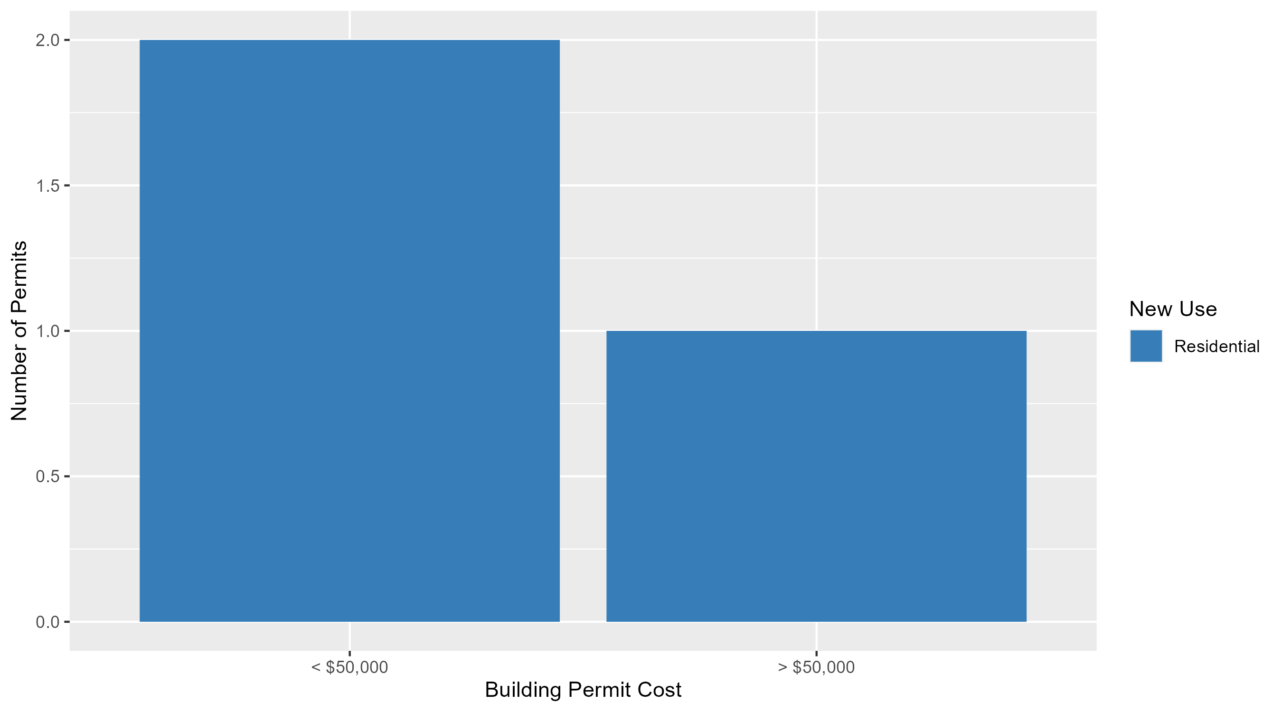
Skinker DeBaliviere Permit Cost Breakdown

Slide 24
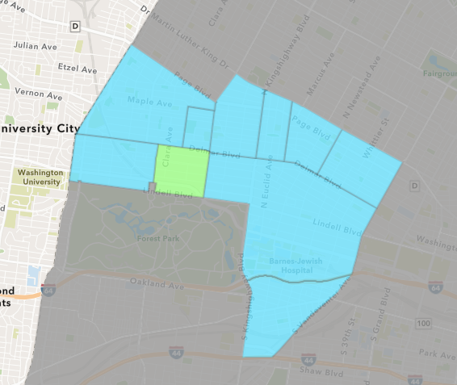
DeBaliviere Place
March 2024 Neighborhood Cost Breakdown
  Mean: $27,227
  Median: $27,227
  Range: $9,900 - $44,554

Slide 25
DeBaliviere Place: Summary Notes
2 building permits in March 2024
  100.00% change compared to March 2023 (1 total building permits)
  $27,227: Average building permit cost in March 2024
    -54.62% change compared to March 2023 ($60,000)
9 total building permits in 2024
  28.57% change YTD compared to this time in 2023 (7 total building permits)
  $49,231: YTD average building permit cost in 2024
    -50.03% change YTD compared to this time in 2023 ($98,519)

Slide 26
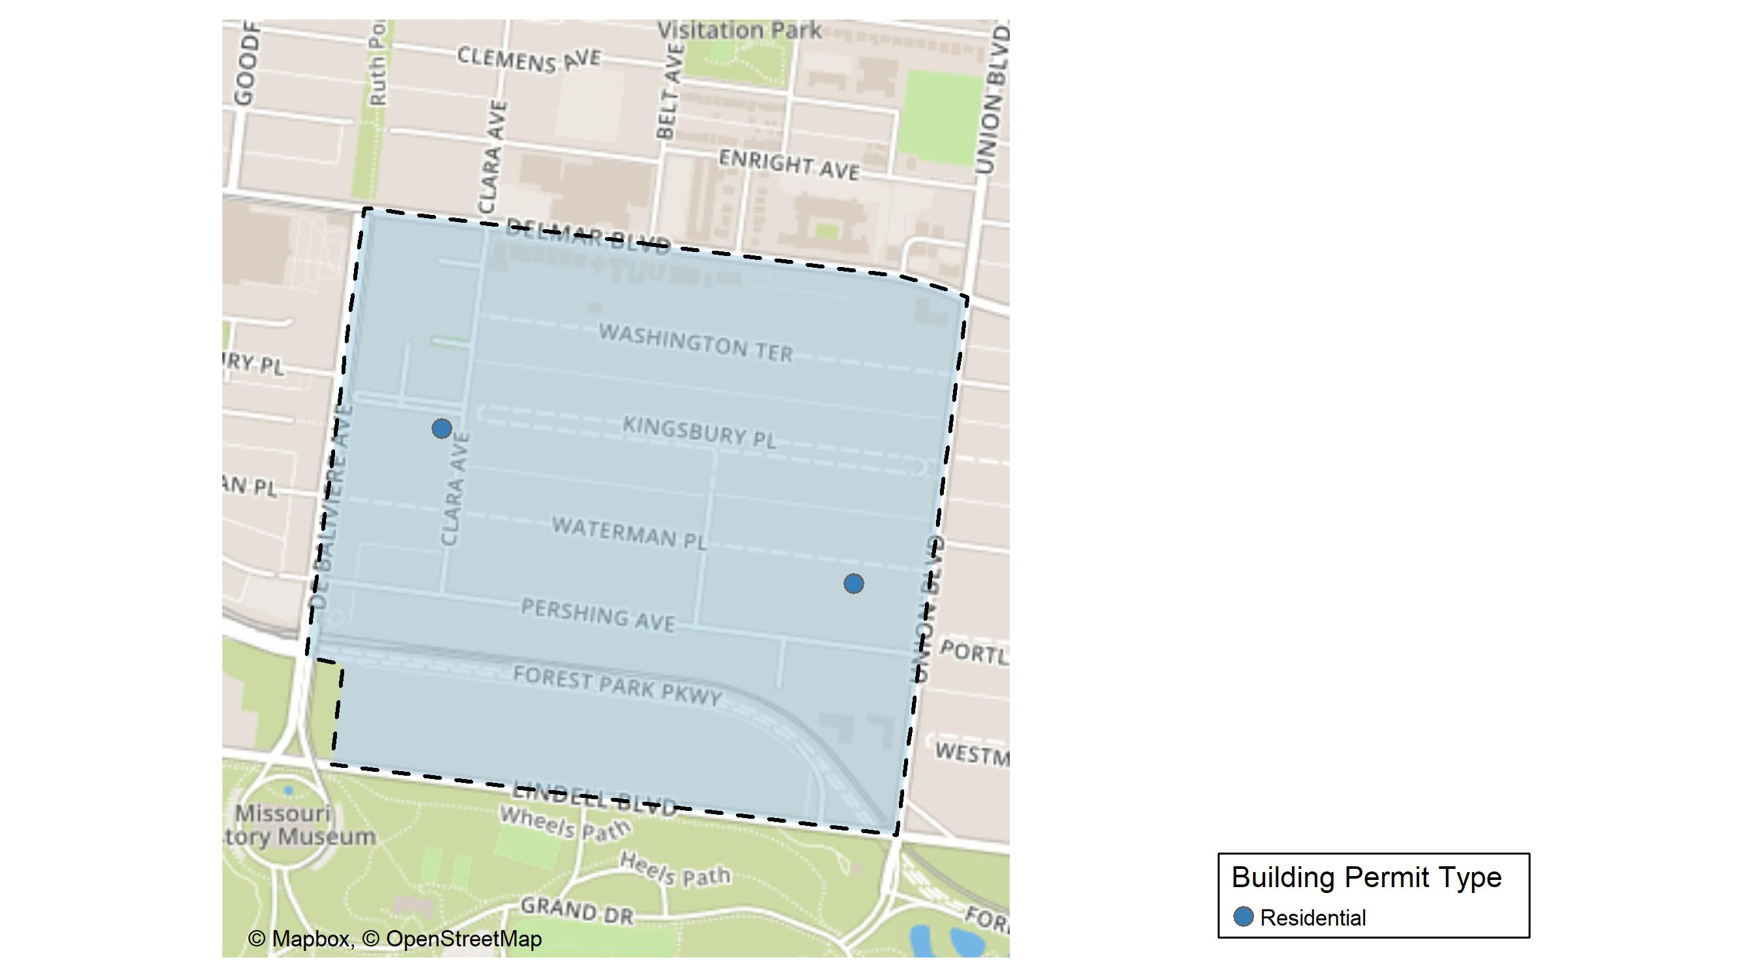
DeBaliviere Place

Slide 27
Neighborhood Summary
March 2024 | March 2024 | March 2024 | March 2024
Permit Use | Average Cost | # of Permits | Total Value of Permits
Commercial | $0 | 0 | $0
Industrial | $0 | 0 | $0
Residential | $27,227 | 2 | $54,454
Last 6 Months | Last 6 Months | Last 6 Months | Last 6 Months
Permit Use | Average Cost | # of Permits | Total Value of Permits
Commercial | $763,077.00 | 2 | $1,526,154
Industrial | $0.00 | 0 | $0
Residential | $53,482.96 | 23 | $1,230,108

Slide 28
DeBaliviere Place Individual Permit Breakdown
Neighborhood | Owner | New Use | Cost | address
DeBaliviere Place | MICHAEL COWAN | Residential | $44,554 | 445 CLARA AV
DeBaliviere Place | ABEKASIS, HAIM & | Residential | $9,900 | 34 WATERMAN PL

Slide 29
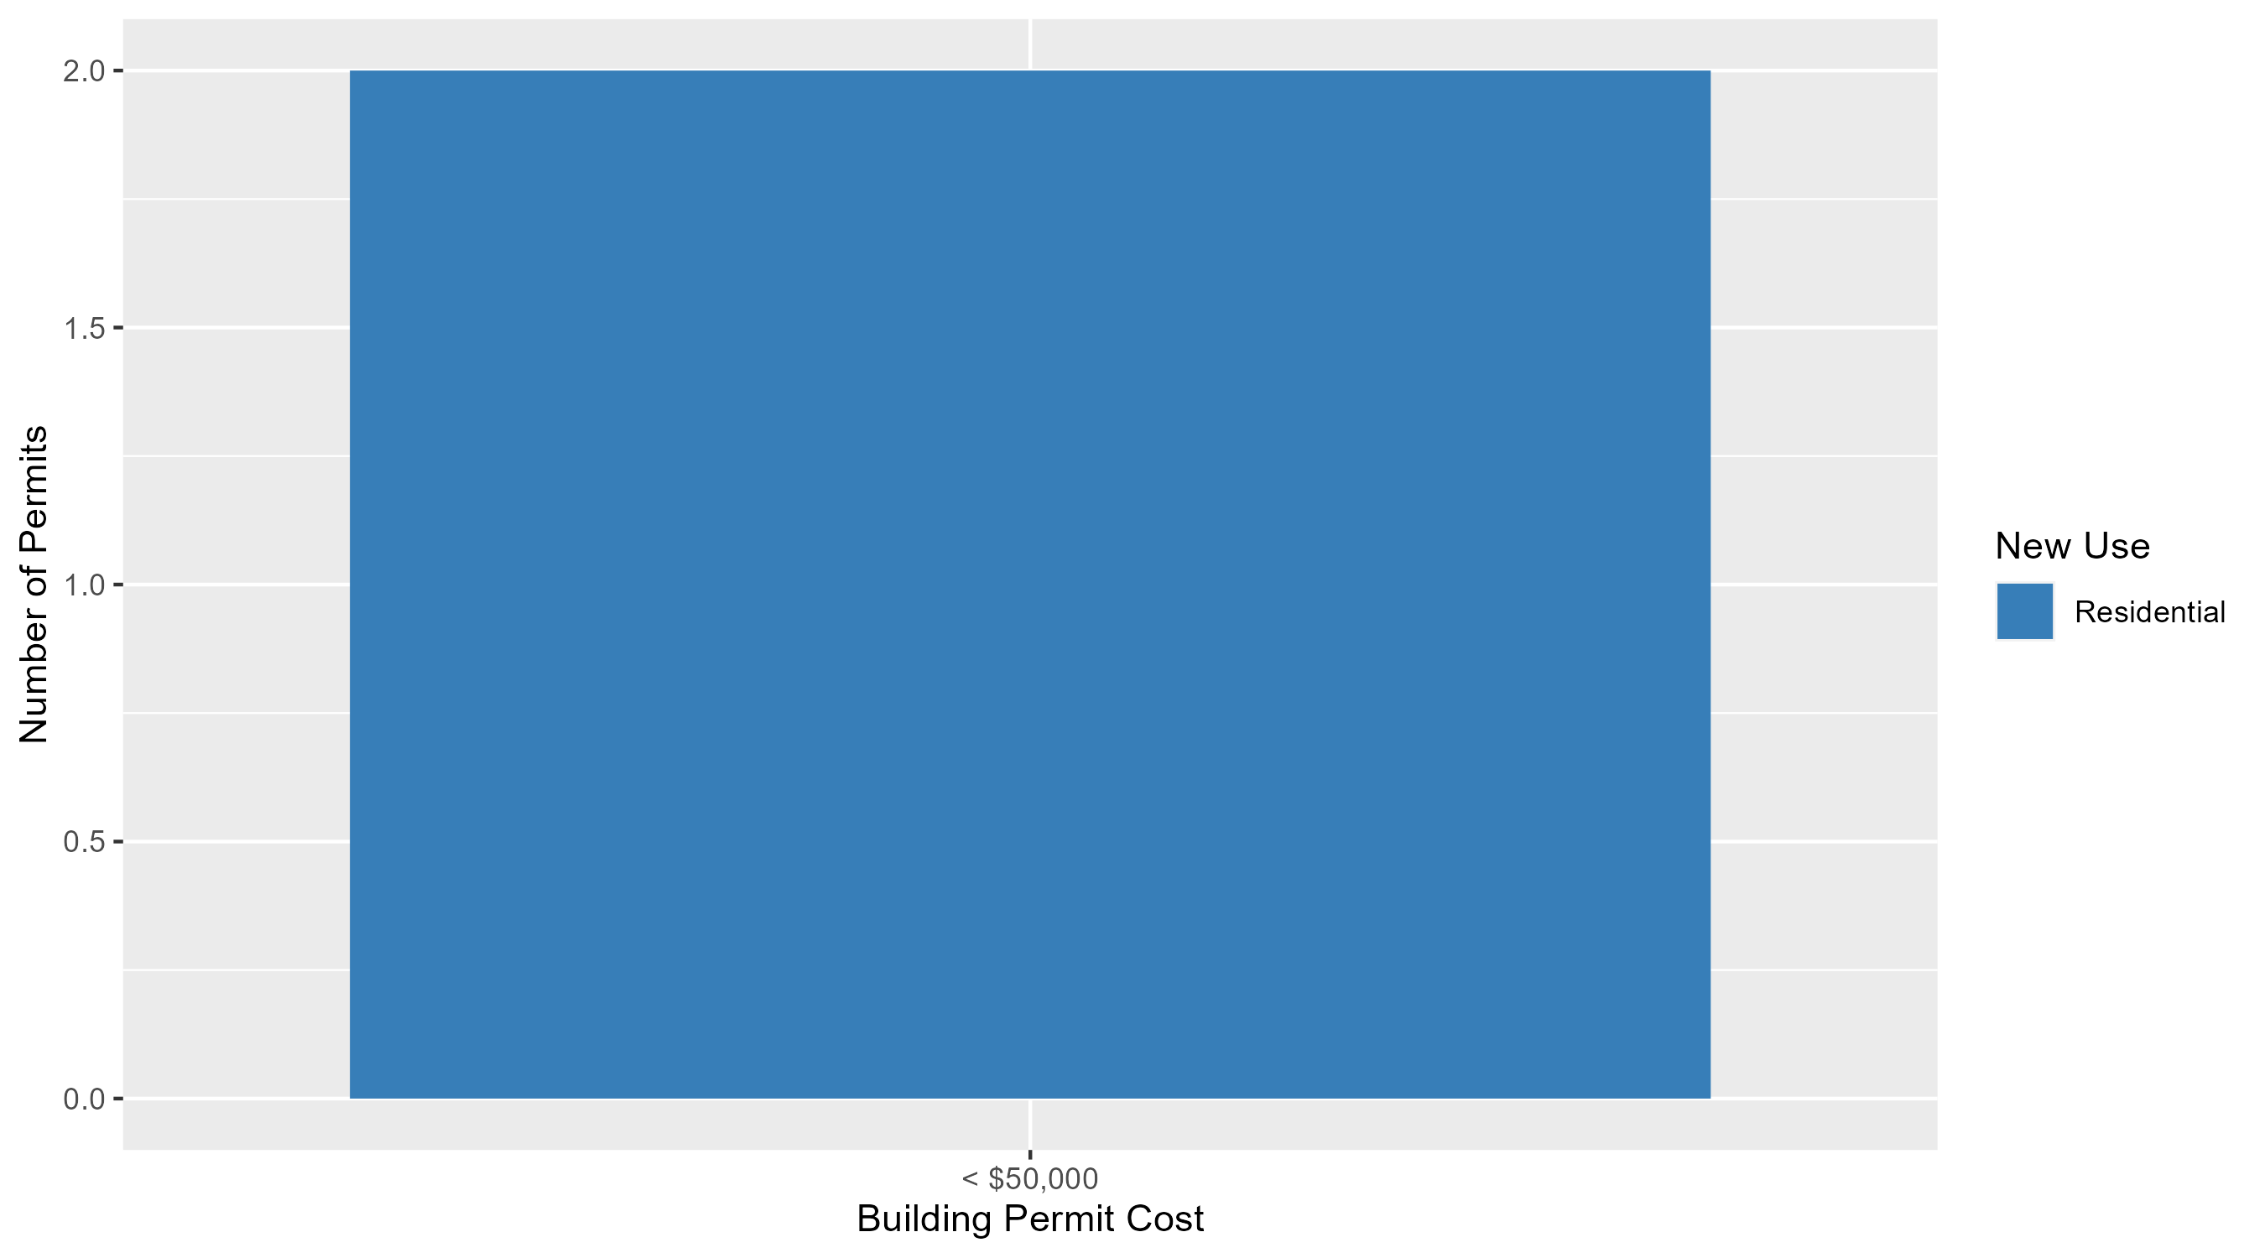
DeBaliviere Place Permit Cost Breakdown

Slide 30
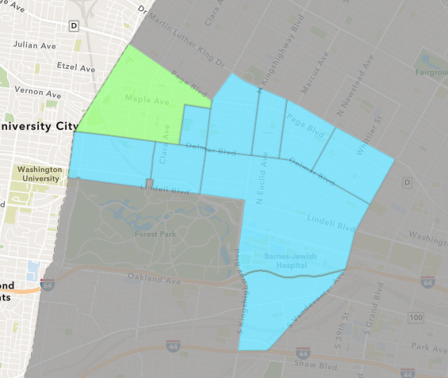
West End
March 2024 Neighborhood Cost Breakdown
  Mean: $15,217
  Median: $11,730
  Range: $1,000 - $54,188

Slide 31
West End: Summary Notes
7 building permits in March 2024
  -12.50% change compared to March 2023 (8 total building permits)
  $15,217: Average building permit cost in March 2024
    -12.65% change compared to March 2023 ($17,420)
23 total building permits in 2024
  15.00% change YTD compared to this time in 2023 (20 total building permits)
  $130,092: YTD average building permit cost in 2024
    210.98% change YTD compared to this time in 2023 ($41,833)

Slide 32
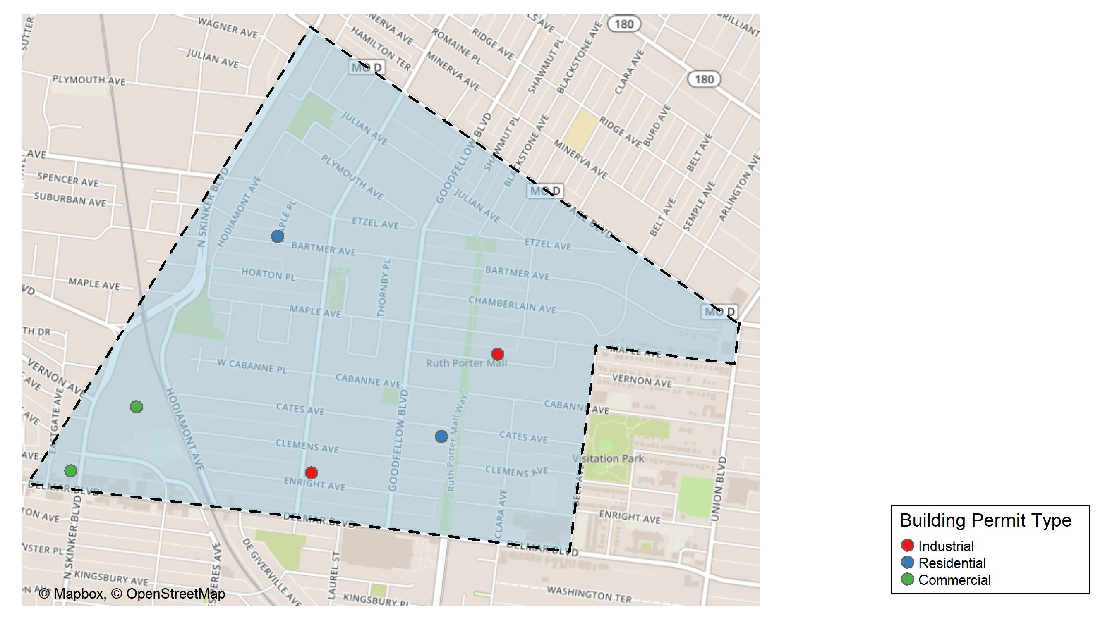
West End

Slide 33
Neighborhood Summary
March 2024 | March 2024 | March 2024 | March 2024
Permit Use | Average Cost | # of Permits | Total Value of Permits
Commercial | $24,906 | 3 | $74,718
Industrial | $14,400 | 2 | $28,800
Residential | $1,500 | 2 | $3,000
Last 6 Months | Last 6 Months | Last 6 Months | Last 6 Months
Permit Use | Average Cost | # of Permits | Total Value of Permits
Commercial | $234,006.80 | 10 | $2,340,068
Industrial | $14,400.00 | 2 | $28,800
Residential | $82,290.74 | 35 | $2,880,176

Slide 34
West End Individual Permit Breakdown
Neighborhood | Owner | New Use | Cost | address
West End | PHILLIPS, CHRISTOPHER & DANIELLE M | Industrial | $13,800 | 5621-23 VERNON AV
West End | WASHINGTON UNIVERSITY | Commercial | $54,188 | 700 ROSEDALE AV
West End | WASHINGTON UNIVERSITY | Commercial | $11,730 | 700 ROSEDALE AV
West End | PACE-DELMAR ASSOCIATES LLC | Commercial | $8,800 | 621 N SKINKER BLVD
West End | CARTER, JESSICA | Residential | $2,000 | 5700 CATES AV
West End | BURNETT, DUANE & ARSENIA JONES | Industrial | $15,000 | 5895 ENRIGHT AV
West End | BARBER, ALESHA | Residential | $1,000 | 6001 BARTMER AV

Slide 35
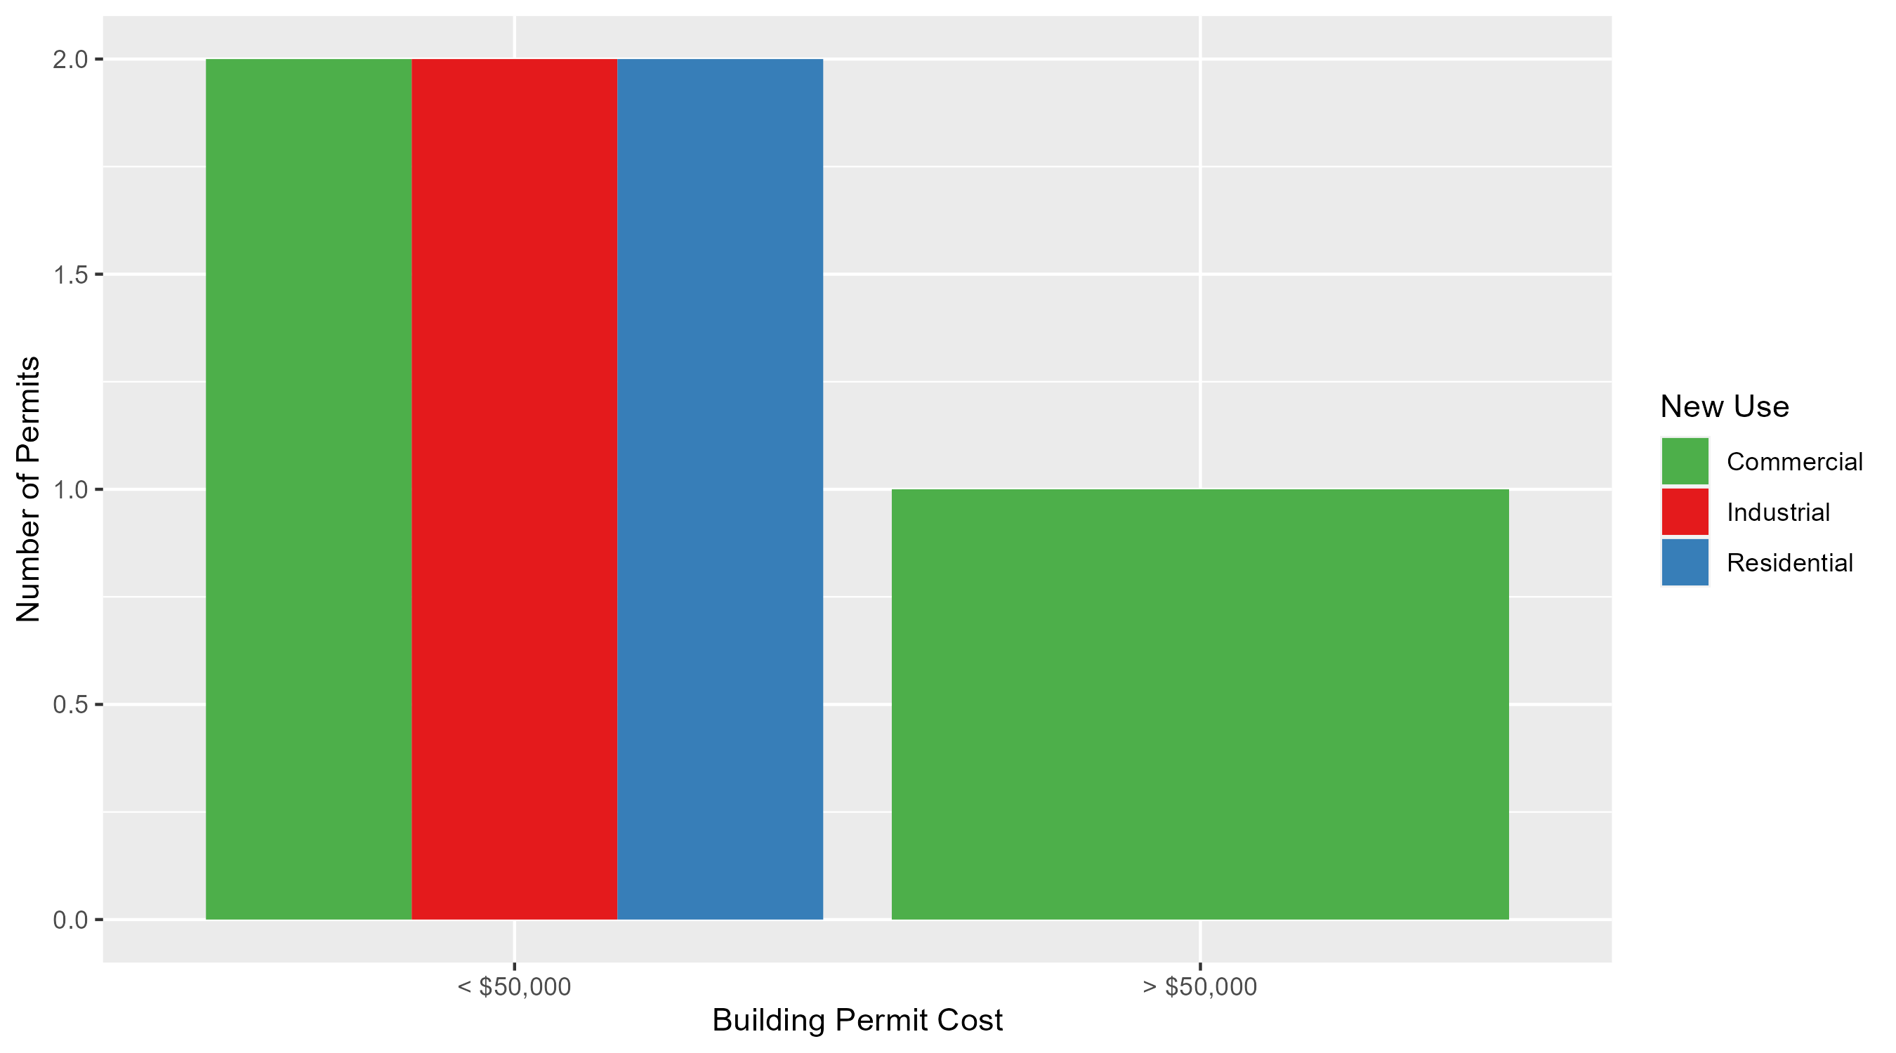
West End Permit Cost Breakdown

Slide 36
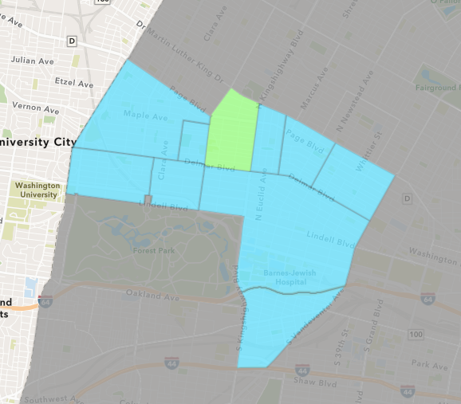
Academy
March 2024 Neighborhood Cost Breakdown
  Mean: $80,000
  Median: $80,000
  Range: $80,000 - $80,000

Slide 37
Academy: Summary Notes
1 building permits in March 2024
  -75.00% change compared to March 2023 (4 total building permits)
  $80,000: Average building permit cost in March 2024
    333.52% change compared to March 2023 ($18,454)
6 total building permits in 2024
  -14.29% change YTD compared to this time in 2023 (7 total building permits)
  $22,700: YTD average building permit cost in 2024
    -15.59% change YTD compared to this time in 2023 ($26,893)

Slide 38
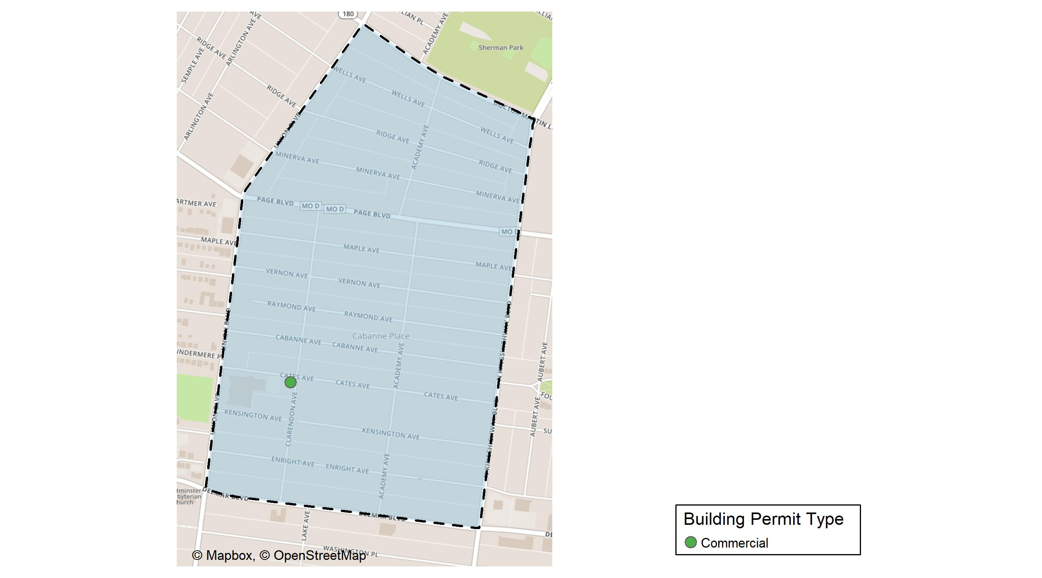
Academy

Slide 39
Neighborhood Summary
March 2024 | March 2024 | March 2024 | March 2024
Permit Use | Average Cost | # of Permits | Total Value of Permits
Commercial | $80,000 | 1 | $80,000
Industrial | $0 | 0 | $0
Residential | $0 | 0 | $0
Last 6 Months | Last 6 Months | Last 6 Months | Last 6 Months
Permit Use | Average Cost | # of Permits | Total Value of Permits
Commercial | $40,964.0 | 2 | $81,928
Industrial | $21,700.0 | 2 | $43,400
Residential | $33,828.4 | 15 | $507,426

Slide 40
Academy Individual Permit Breakdown
Neighborhood | Owner | New Use | Cost | address
Academy | GRAHAM, LIKEESHA | Commercial | $80,000 | 5200 CATES AV

Slide 41
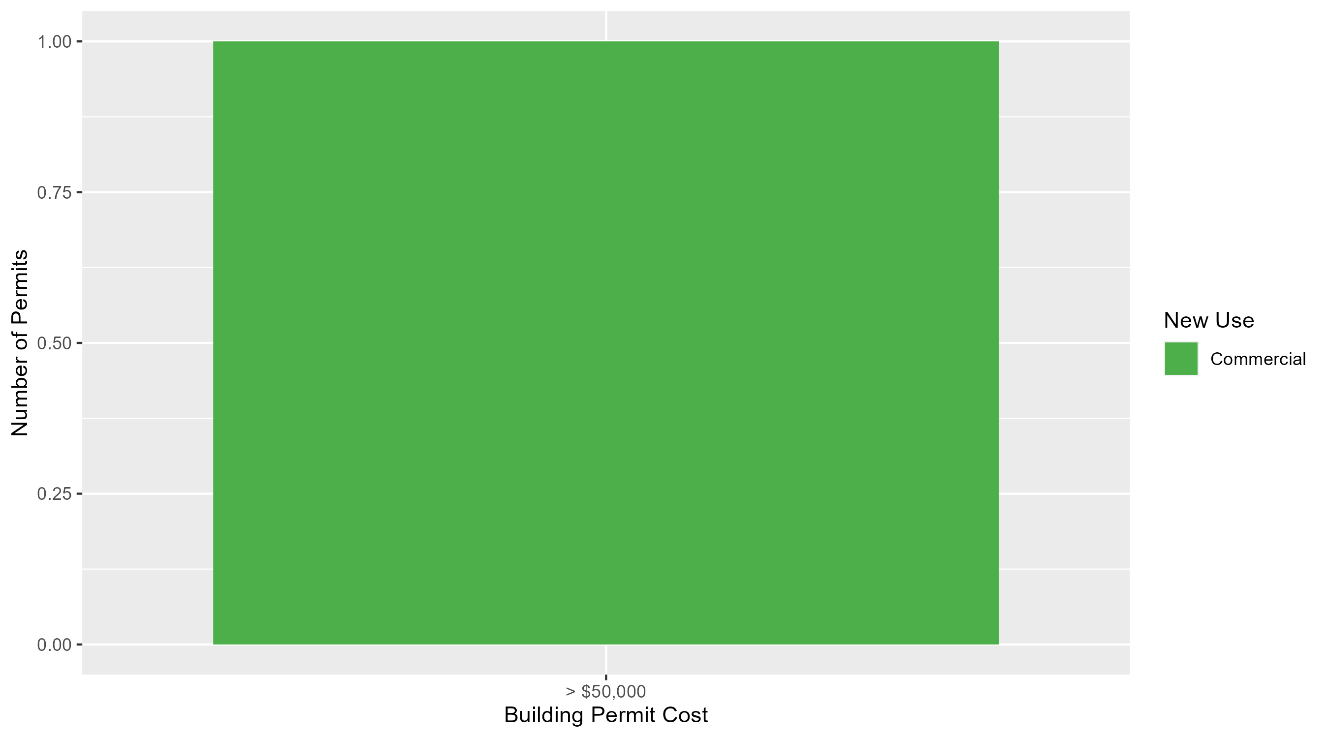
Academy Permit Cost Breakdown

Slide 42
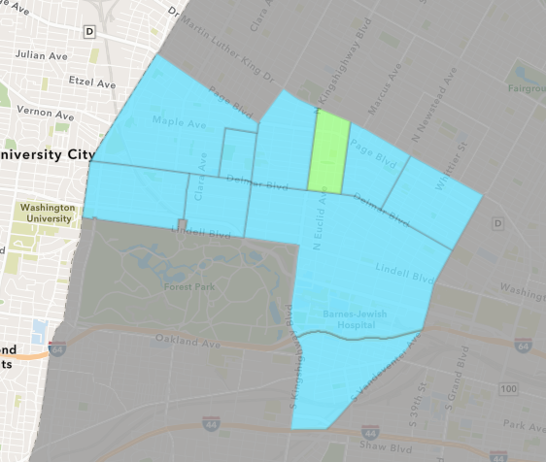
Fountain Park
March 2024 Neighborhood Cost Breakdown
  Mean: $3,000
  Median: $3,000
  Range: $3,000 - $3,000

Slide 43
Fountain Park: Summary Notes
1 building permits in March 2024
  Infinite change compared to March 2023 (0 total building permits)
  $3,000: Average building permit cost in March 2024
    Infinite change compared to March 2023 ($0)
4 total building permits in 2024
  100.00% change YTD compared to this time in 2023 (2 total building permits)
  $13,500: YTD average building permit cost in 2024
    -43.75% change YTD compared to this time in 2023 ($24,000)

Slide 44
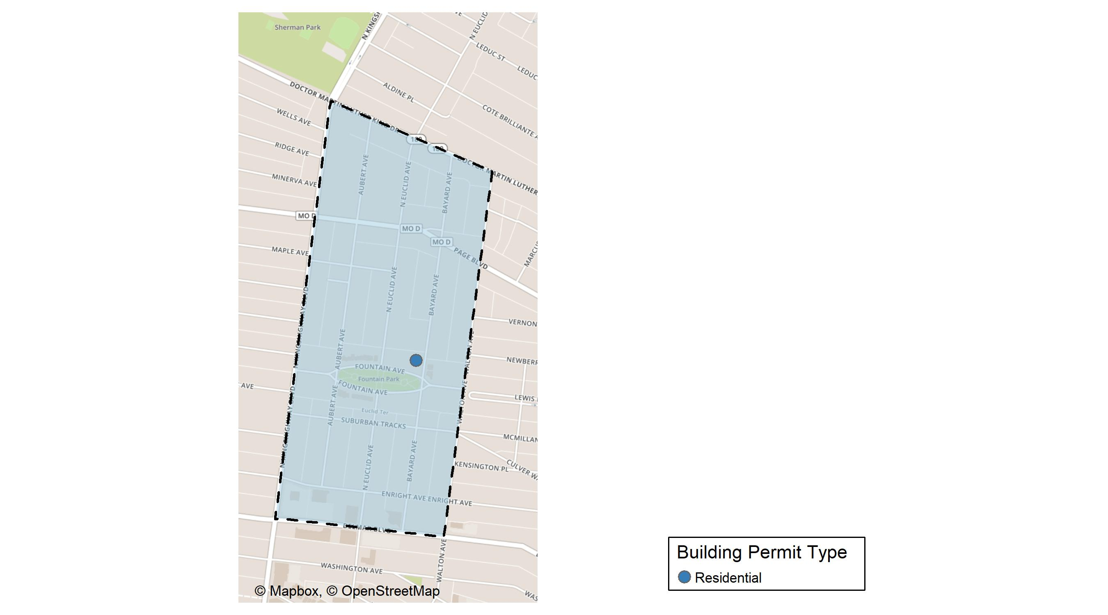
Fountain Park

Slide 45
Neighborhood Summary
March 2024 | March 2024 | March 2024 | March 2024
Permit Use | Average Cost | # of Permits | Total Value of Permits
Commercial | $0 | 0 | $0
Industrial | $0 | 0 | $0
Residential | $3,000 | 1 | $3,000
Last 6 Months | Last 6 Months | Last 6 Months | Last 6 Months
Permit Use | Average Cost | # of Permits | Total Value of Permits
Commercial | $40,250.00 | 4 | $161,000
Industrial | $0.00 | 0 | $0
Residential | $34,591.43 | 7 | $242,140

Slide 46
Fountain Park Individual Permit Breakdown
Neighborhood | Owner | New Use | Cost | address
Fountain Park | SHACKLEFORD, KEITH | Residential | $3,000 | 1113 BAYARD AV

Slide 47

Fountain Park Permit Cost Breakdown

Slide 48
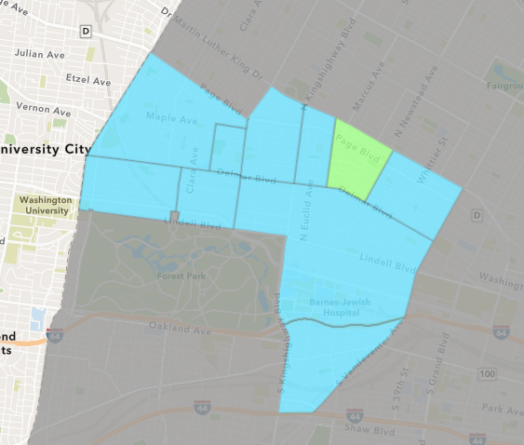
Lewis Place
March 2024 Neighborhood Cost Breakdown
  Mean: $7,000
  Median: $7,000
  Range: $7,000 - $7,000

Slide 49
Lewis Place: Summary Notes
1 building permits in March 2024
  0.00% change compared to March 2023 (1 total building permits)
  $7,000: Average building permit cost in March 2024
    600.00% change compared to March 2023 ($1,000)
3 total building permits in 2024
  0.00% change YTD compared to this time in 2023 (3 total building permits)
  $3,000: YTD average building permit cost in 2024
    -90.11% change YTD compared to this time in 2023 ($30,333)

Slide 50
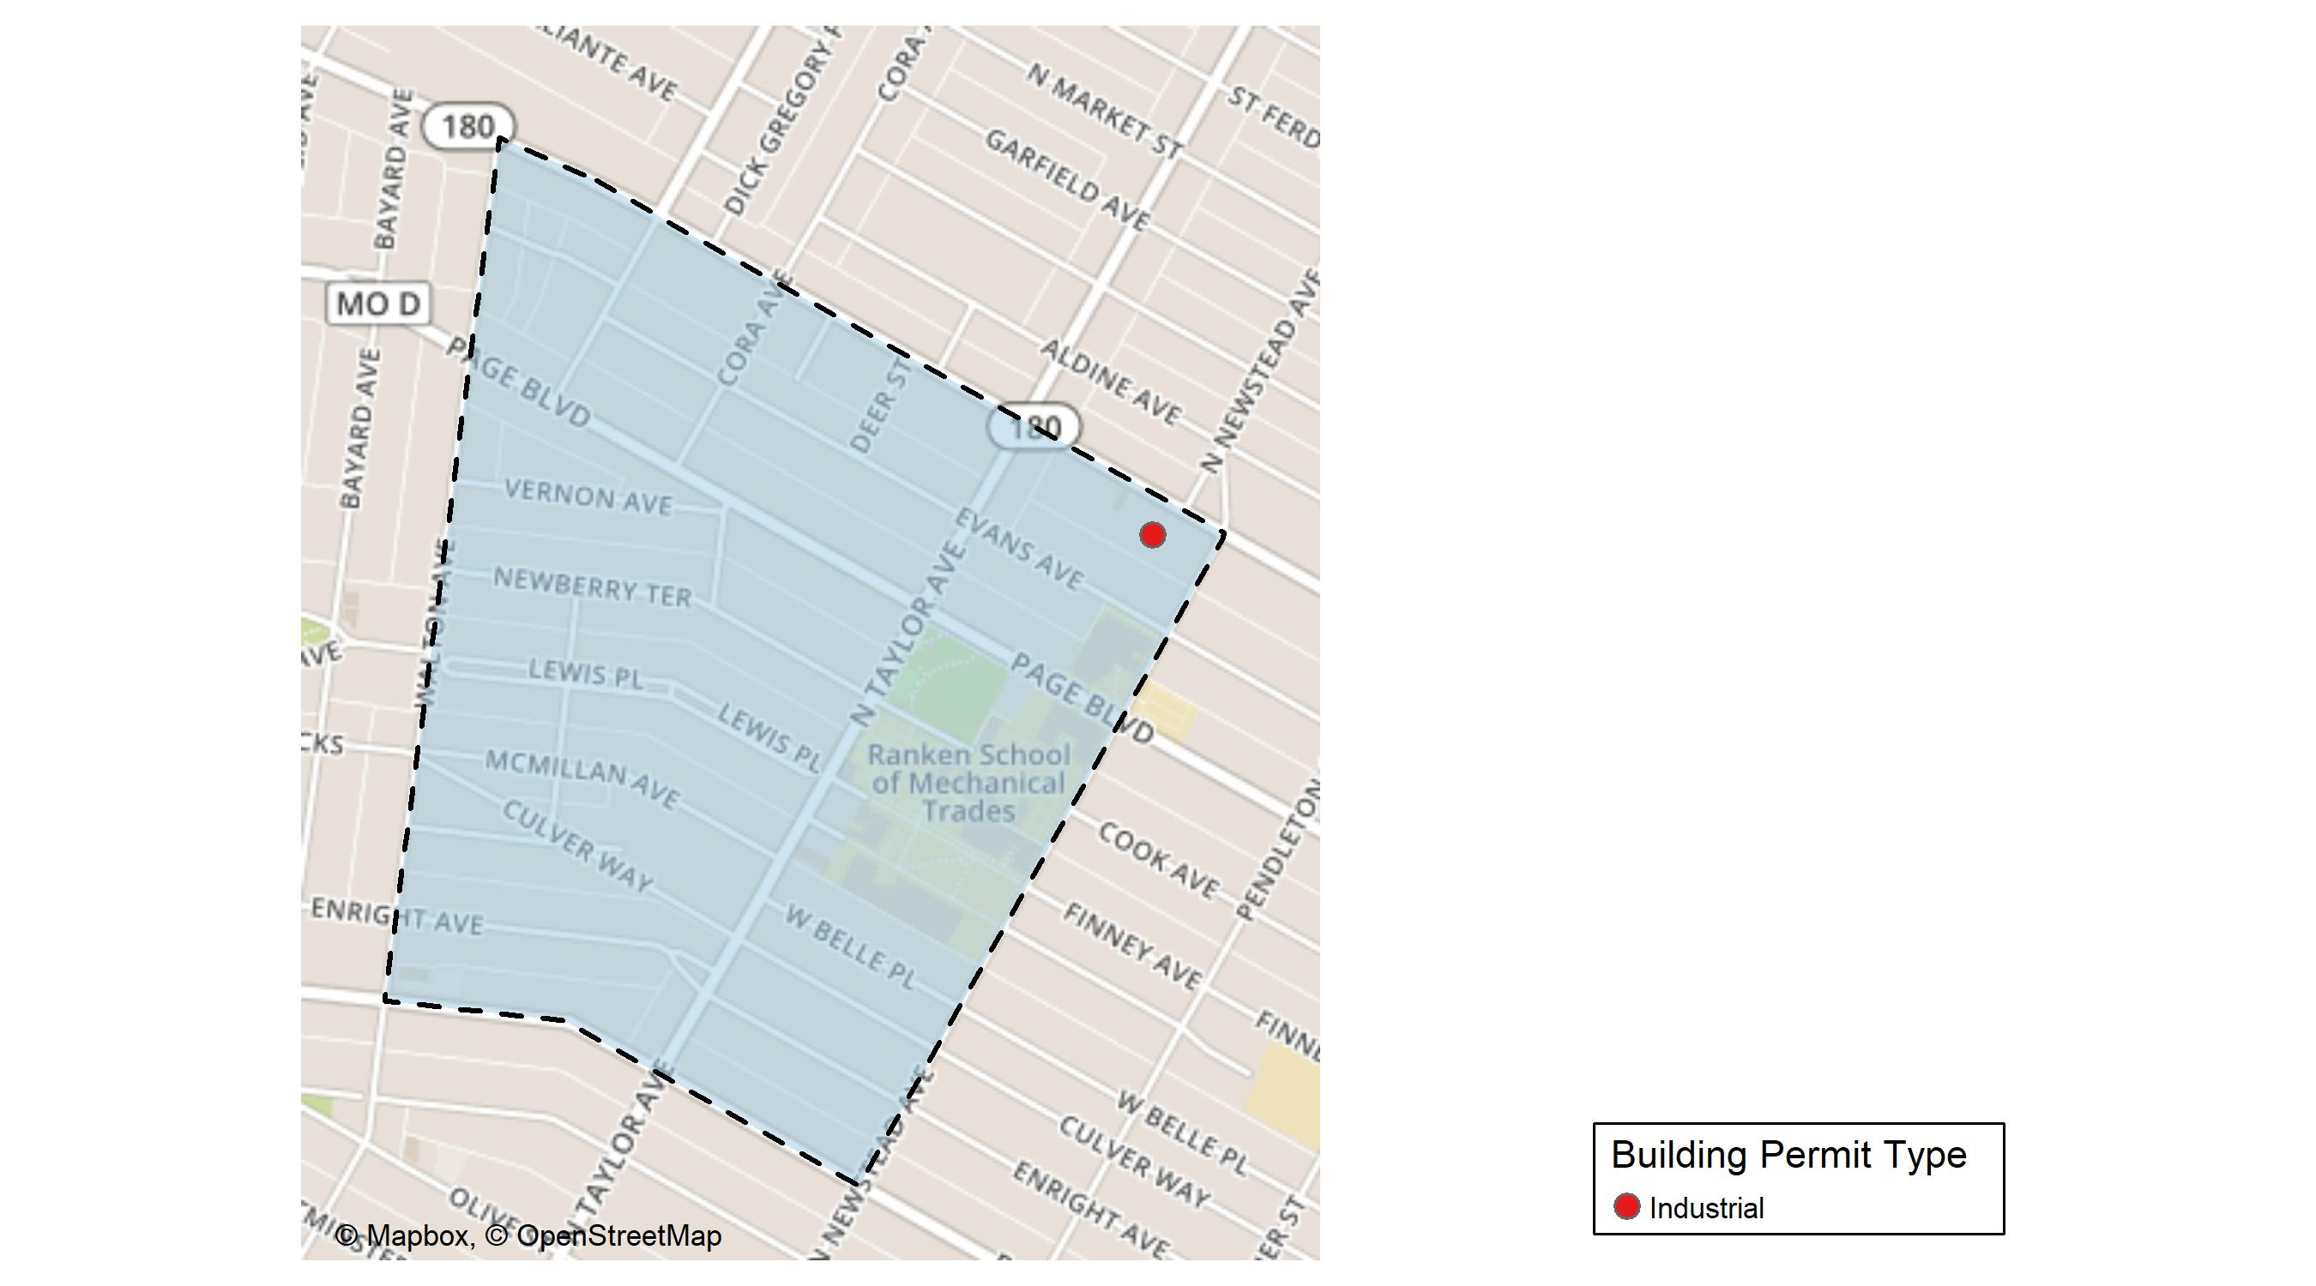
Lewis Place

Slide 51
Neighborhood Summary
March 2024 | March 2024 | March 2024 | March 2024
Permit Use | Average Cost | # of Permits | Total Value of Permits
Commercial | $0 | 0 | $0
Industrial | $7,000 | 1 | $7,000
Residential | $0 | 0 | $0
Last 6 Months | Last 6 Months | Last 6 Months | Last 6 Months
Permit Use | Average Cost | # of Permits | Total Value of Permits
Commercial | $225,535.00 | 1 | $225,535
Industrial | $7,000.00 | 1 | $7,000
Residential | $21,533.67 | 6 | $129,202

Slide 52
Lewis Place Individual Permit Breakdown
Neighborhood | Owner | New Use | Cost | address
Lewis Place | HAUL PROS LLC | Industrial | $7,000 | 4422-4430 DR MARTIN LUTHER KING DR

Slide 53
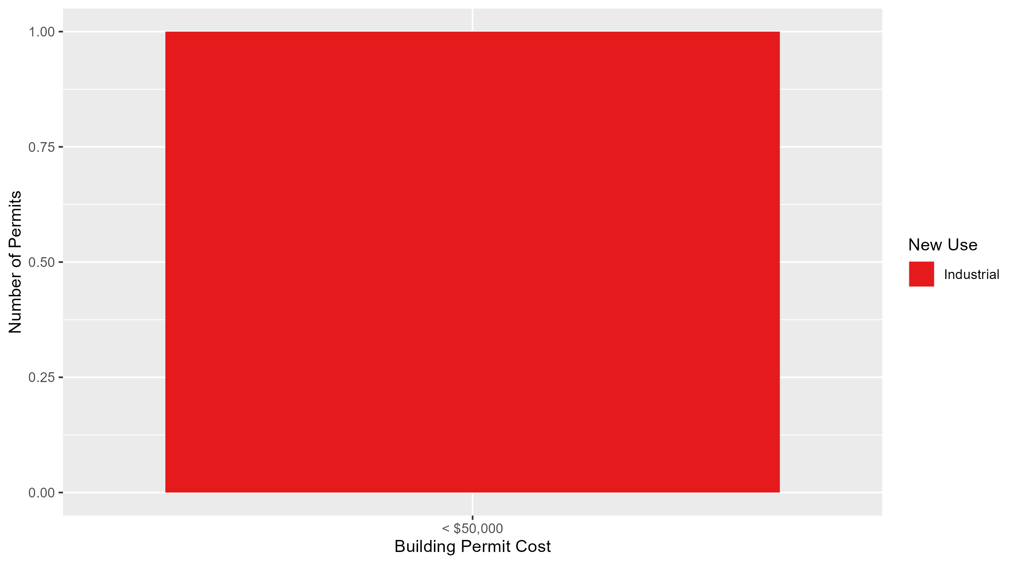
Lewis Place Permit Cost Breakdown

Slide 54
Additional Notes
Data retreived from https://www.stlouis-mo.gov/data/
Building permits with a cost of $0 were dropped
Building permits that were cancelled were dropped
Infinite change indicates 0 permits in the current or previous time period/comparison month so there was a overall increase or decrease

