Slide 1
St. Louis Central Corridor West Building Permits
Monthly Report: March 2025

Slide 2
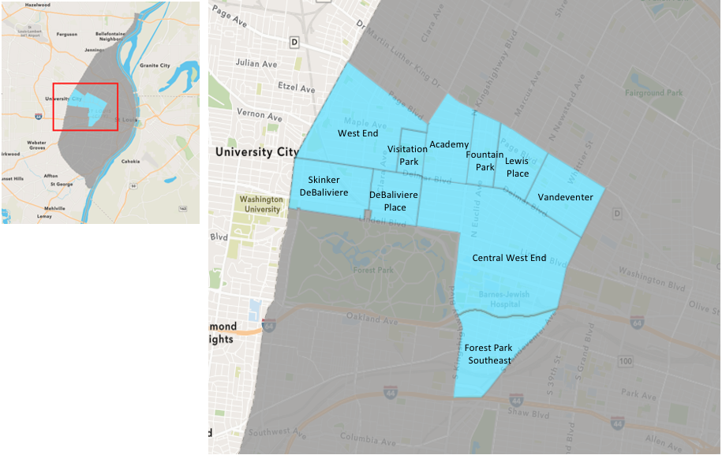
St. Louis Neighborhood Spatial Reference

Slide 3
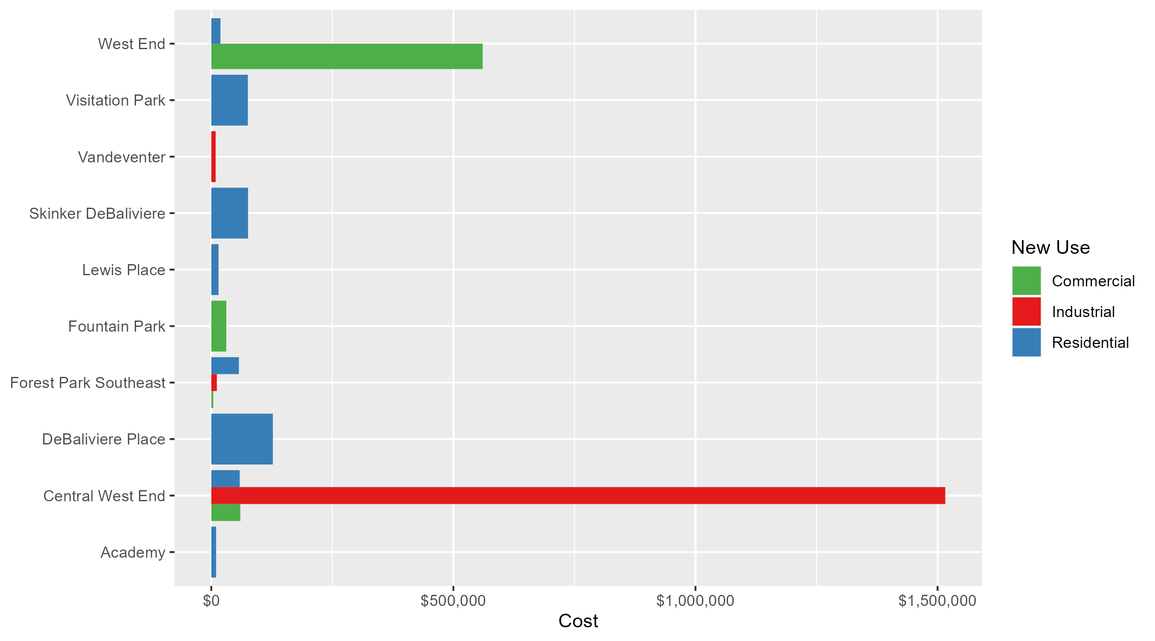
Neighborhood Summary: Average Building Permit Cost

Slide 4
Neighborhood Summary
March 2025 | March 2025 | March 2025 | March 2025
Neighborhood | Average Cost | # of Permits | Total Value of Permits
Academy | $10,000.0 | 3 | $30,000
Central West End | $170,882.1 | 26 | $4,442,934
DeBaliviere Place | $127,184.8 | 5 | $635,924
Forest Park Southeast | $28,180.0 | 5 | $140,900
Fountain Park | $31,000.0 | 1 | $31,000
Lewis Place | $15,000.0 | 1 | $15,000
Skinker DeBaliviere | $75,923.0 | 5 | $379,615
Vandeventer | $9,000.0 | 1 | $9,000
Visitation Park | $75,500.0 | 2 | $151,000
West End | $235,550.2 | 5 | $1,177,751
Last 6 Months | Last 6 Months | Last 6 Months | Last 6 Months
Neighborhood | Average Cost | # of Permits | Total Value of Permits
Academy | $23,517.69 | 16 | $376,283
Central West End | $173,921.83 | 187 | $32,523,383
DeBaliviere Place | $92,025.41 | 27 | $2,484,686
Forest Park Southeast | $158,023.14 | 35 | $5,530,810
Fountain Park | $42,725.00 | 8 | $341,800
Lewis Place | $29,500.00 | 6 | $177,000
Skinker DeBaliviere | $88,879.02 | 57 | $5,066,104
Vandeventer | $29,062.50 | 8 | $232,500
Visitation Park | $48,070.50 | 4 | $192,282
West End | $142,722.46 | 24 | $3,425,339

Slide 5
Core Neighborhoods

Slide 6
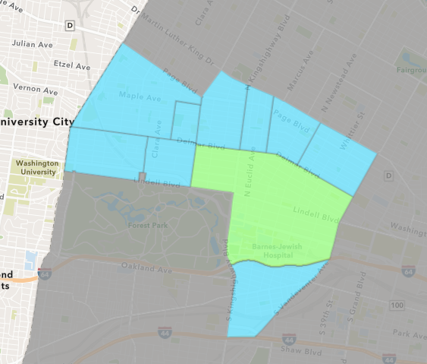
Central West End
March 2025 Neighborhood Cost Breakdown
  Mean: $170,882
  Median: $19,000
  Range: $2,000 - $2,744,516

Slide 7
Central West End: Summary Notes
26 building permits in March 2025
  8.33% change compared to March 2024 (24 total building permits)
  $170,882: Average building permit cost in March 2025
    -87.79% change compared to March 2024 ($1,399,961)
65 total building permits in 2025
  -10.96% change YTD compared to this time in 2024 (73 total building permits)
  $137,018: YTD average building permit cost in 2025
    -84.34% change YTD compared to this time in 2024 ($874,806)

Slide 8
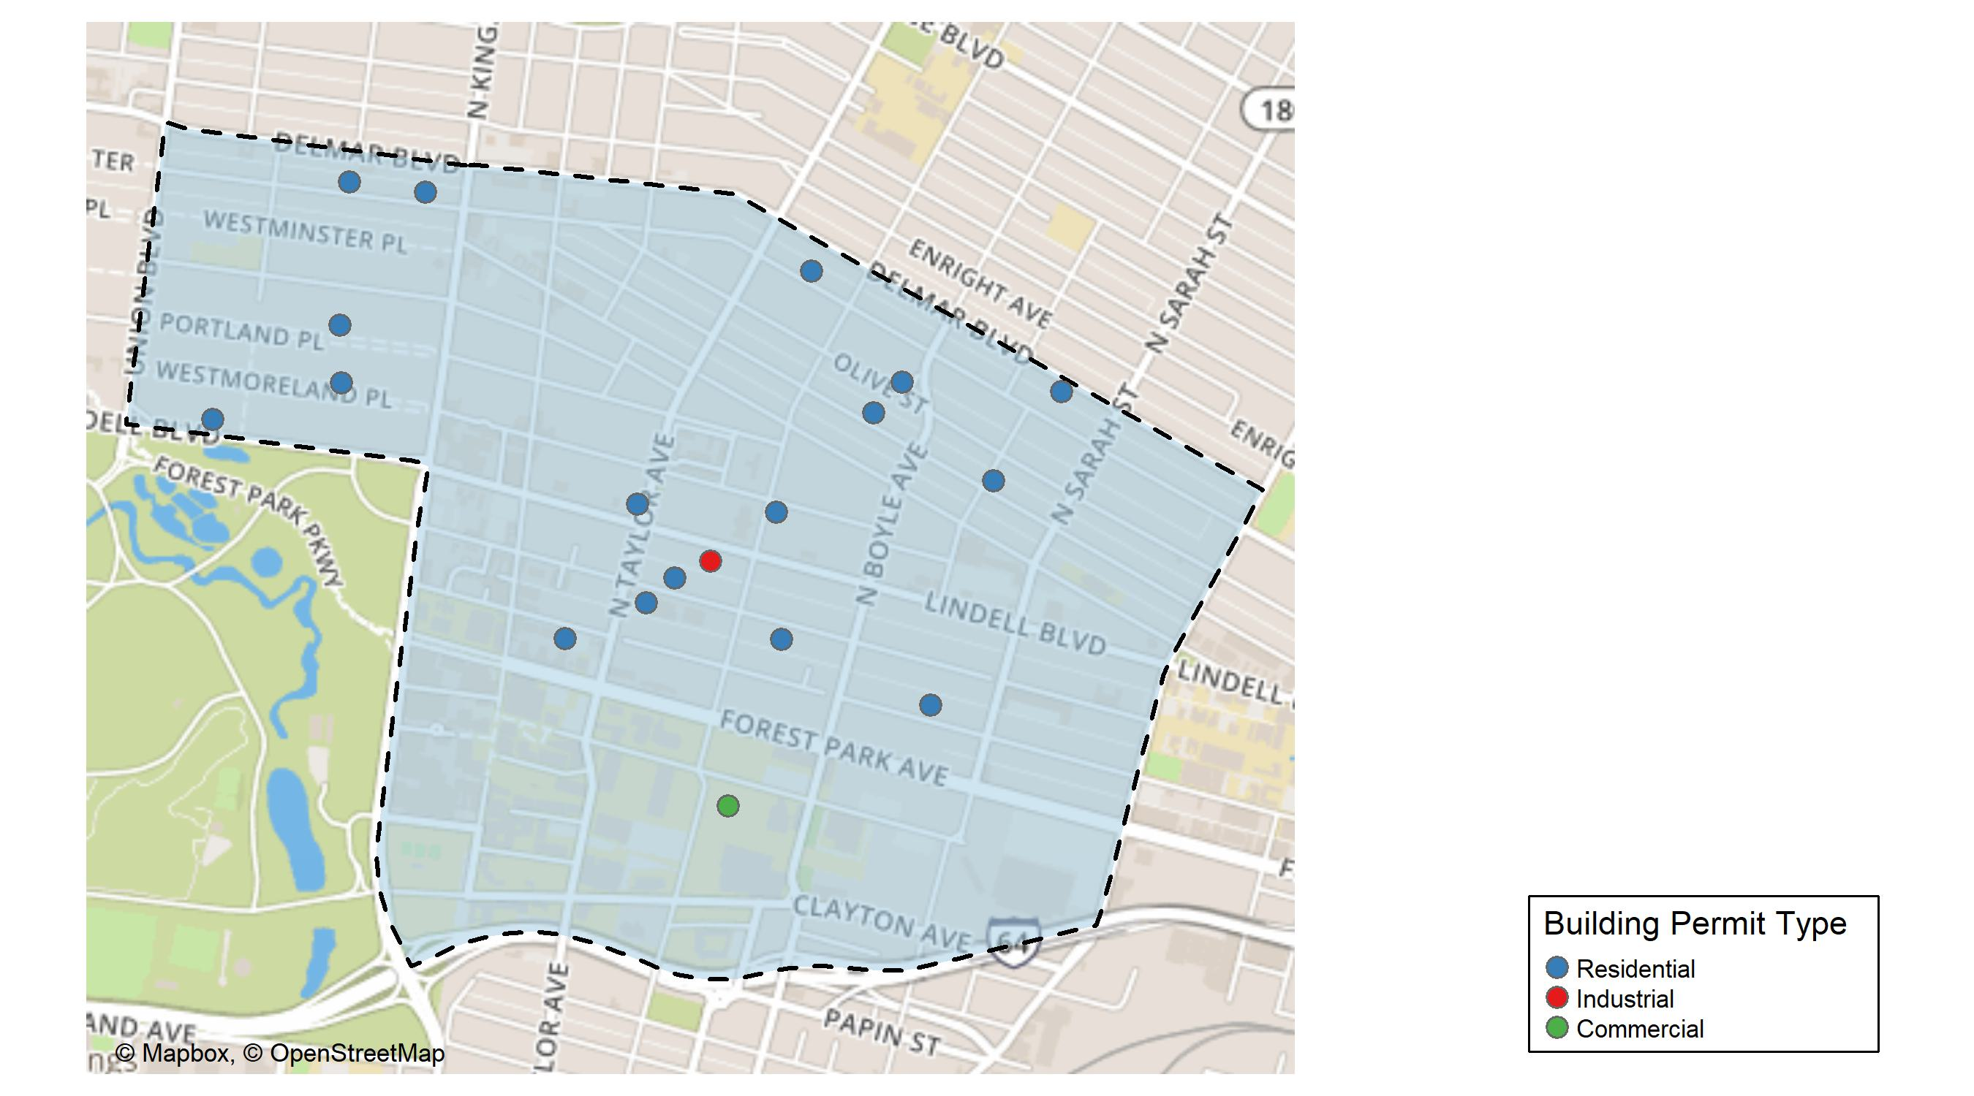
Central West End

Slide 9
Neighborhood Summary
March 2025 | March 2025 | March 2025 | March 2025
Permit Use | Average Cost | # of Permits | Total Value of Permits
Commercial | $60,000.00 | 1 | $60,000
Industrial | $1,515,860.50 | 2 | $3,031,721
Residential | $58,748.39 | 23 | $1,351,213
Last 6 Months | Last 6 Months | Last 6 Months | Last 6 Months
Permit Use | Average Cost | # of Permits | Total Value of Permits
Commercial | $356,269.55 | 66 | $23,513,790
Industrial | $788,483.75 | 4 | $3,153,935
Residential | $50,048.36 | 117 | $5,855,658

Slide 10
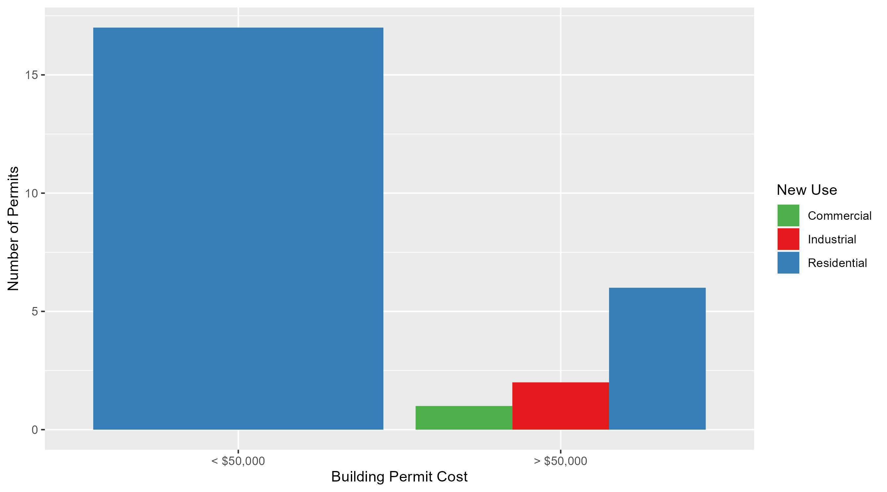
Central West End Permit Cost Breakdown

Slide 11
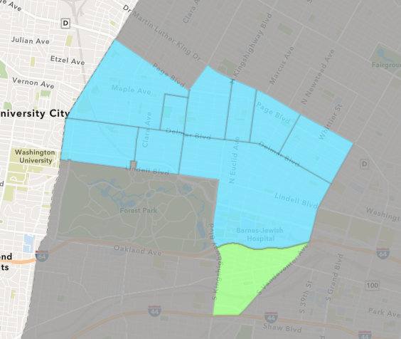
Forest Park Southeast
March 2025 Neighborhood Cost Breakdown
  Mean: $28,180
  Median: $12,900
  Range: $4,000 - $100,000

Slide 12
Forest Park Southeast: Summary Notes
5 building permits in March 2025
  -58.33% change compared to March 2024 (12 total building permits)
  $28,180: Average building permit cost in March 2025
    -81.12% change compared to March 2024 ($149,278)
12 total building permits in 2025
  -50.00% change YTD compared to this time in 2024 (24 total building permits)
  $63,097: YTD average building permit cost in 2025
    -27.29% change YTD compared to this time in 2024 ($86,779)

Slide 13
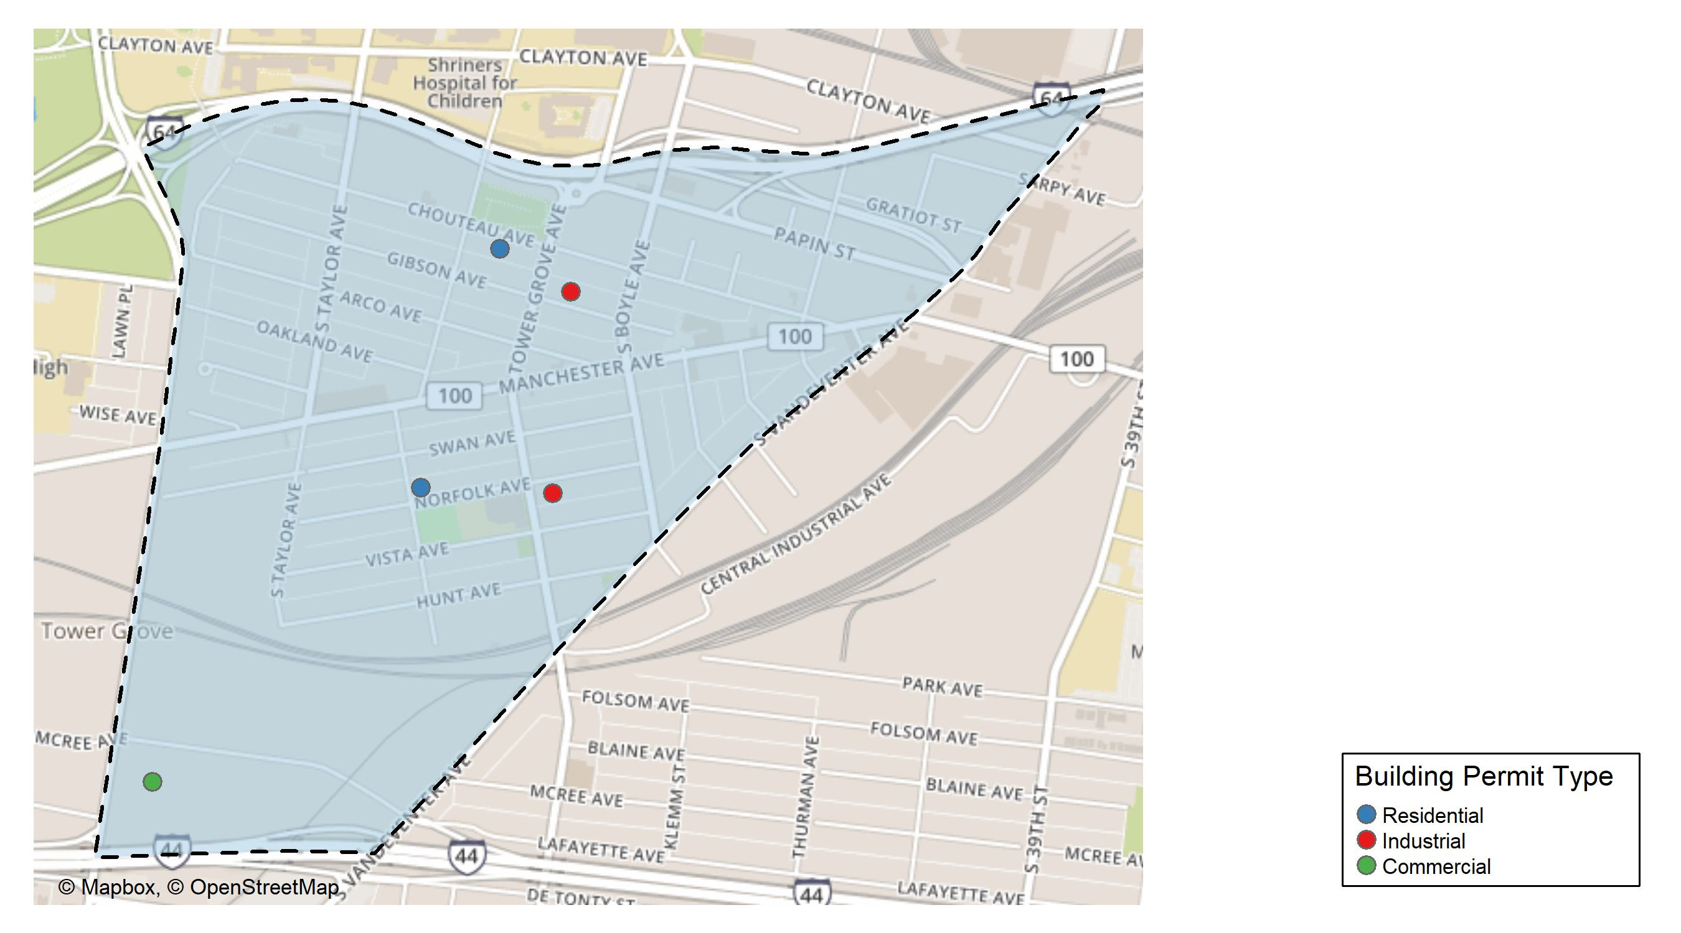
Forest Park Southeast

Slide 14
Neighborhood Summary
March 2025 | March 2025 | March 2025 | March 2025
Permit Use | Average Cost | # of Permits | Total Value of Permits
Commercial | $4,000 | 1 | $4,000
Industrial | $11,450 | 2 | $22,900
Residential | $57,000 | 2 | $114,000
Last 6 Months | Last 6 Months | Last 6 Months | Last 6 Months
Permit Use | Average Cost | # of Permits | Total Value of Permits
Commercial | $58,274.33 | 6 | $349,646
Industrial | $26,450.00 | 4 | $105,800
Residential | $203,014.56 | 25 | $5,075,364

Slide 15
Forest Park Southeast Individual Permit Breakdown
Neighborhood | Owner | New Use | Cost | address
Forest Park Southeast | MONTGOMERY, WILLIAM R | Industrial | $10,000 | 4335 GIBSON AV
Forest Park Southeast | DUBUQUE VENTURES LP | Commercial | $4,000 | 1616 S KINGSHIGHWAY BLVD
Forest Park Southeast | GRIFFIN DAVID PROPERTIES LLC | Industrial | $12,900 | 4260 NORFOLK AV
Forest Park Southeast | GYOROG, JASON & SOPHIA L | Residential | $14,000 | 4384 CHOUTEAU AV
Forest Park Southeast | ST LOUIS HOUSING AUTHORITY | Residential | $100,000 | 4377 NORFOLK AV

Slide 16
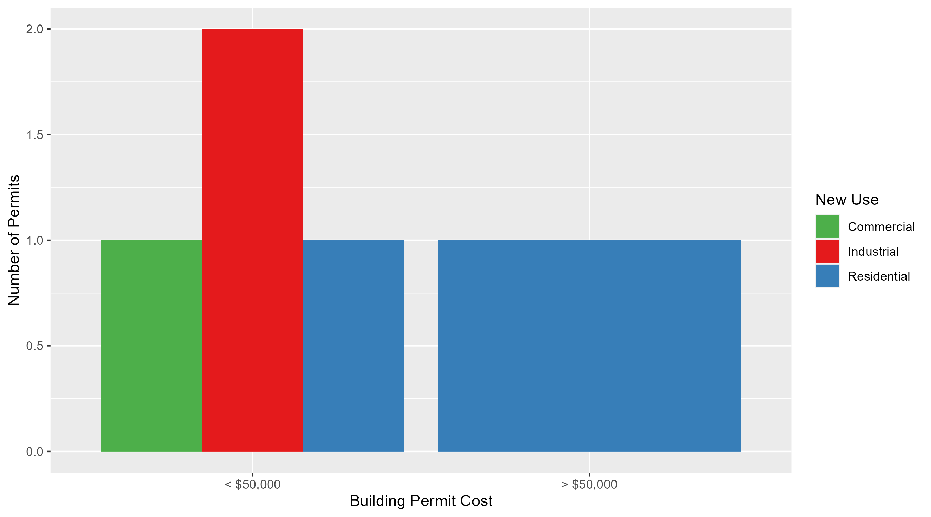
Forest Park Southeast Permit Cost Breakdown

Slide 17
Expanded Service Area

Slide 18
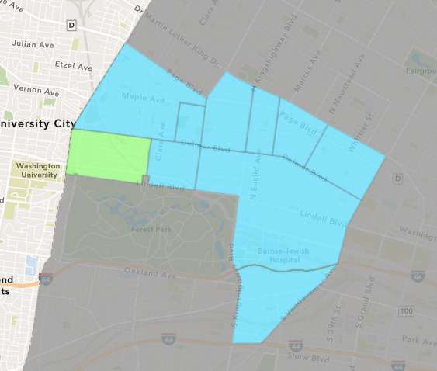
Skinker DeBaliviere
March 2025 Neighborhood Cost Breakdown
  Mean: $75,923
  Median: $25,000
  Range: $6,749 - $300,000

Slide 19
Skinker DeBaliviere: Summary Notes
5 building permits in March 2025
  66.67% change compared to March 2024 (3 total building permits)
  $75,923: Average building permit cost in March 2025
    221.20% change compared to March 2024 ($23,637)
22 total building permits in 2025
  100.00% change YTD compared to this time in 2024 (11 total building permits)
  $61,361: YTD average building permit cost in 2025
    -41.87% change YTD compared to this time in 2024 ($105,552)

Slide 20
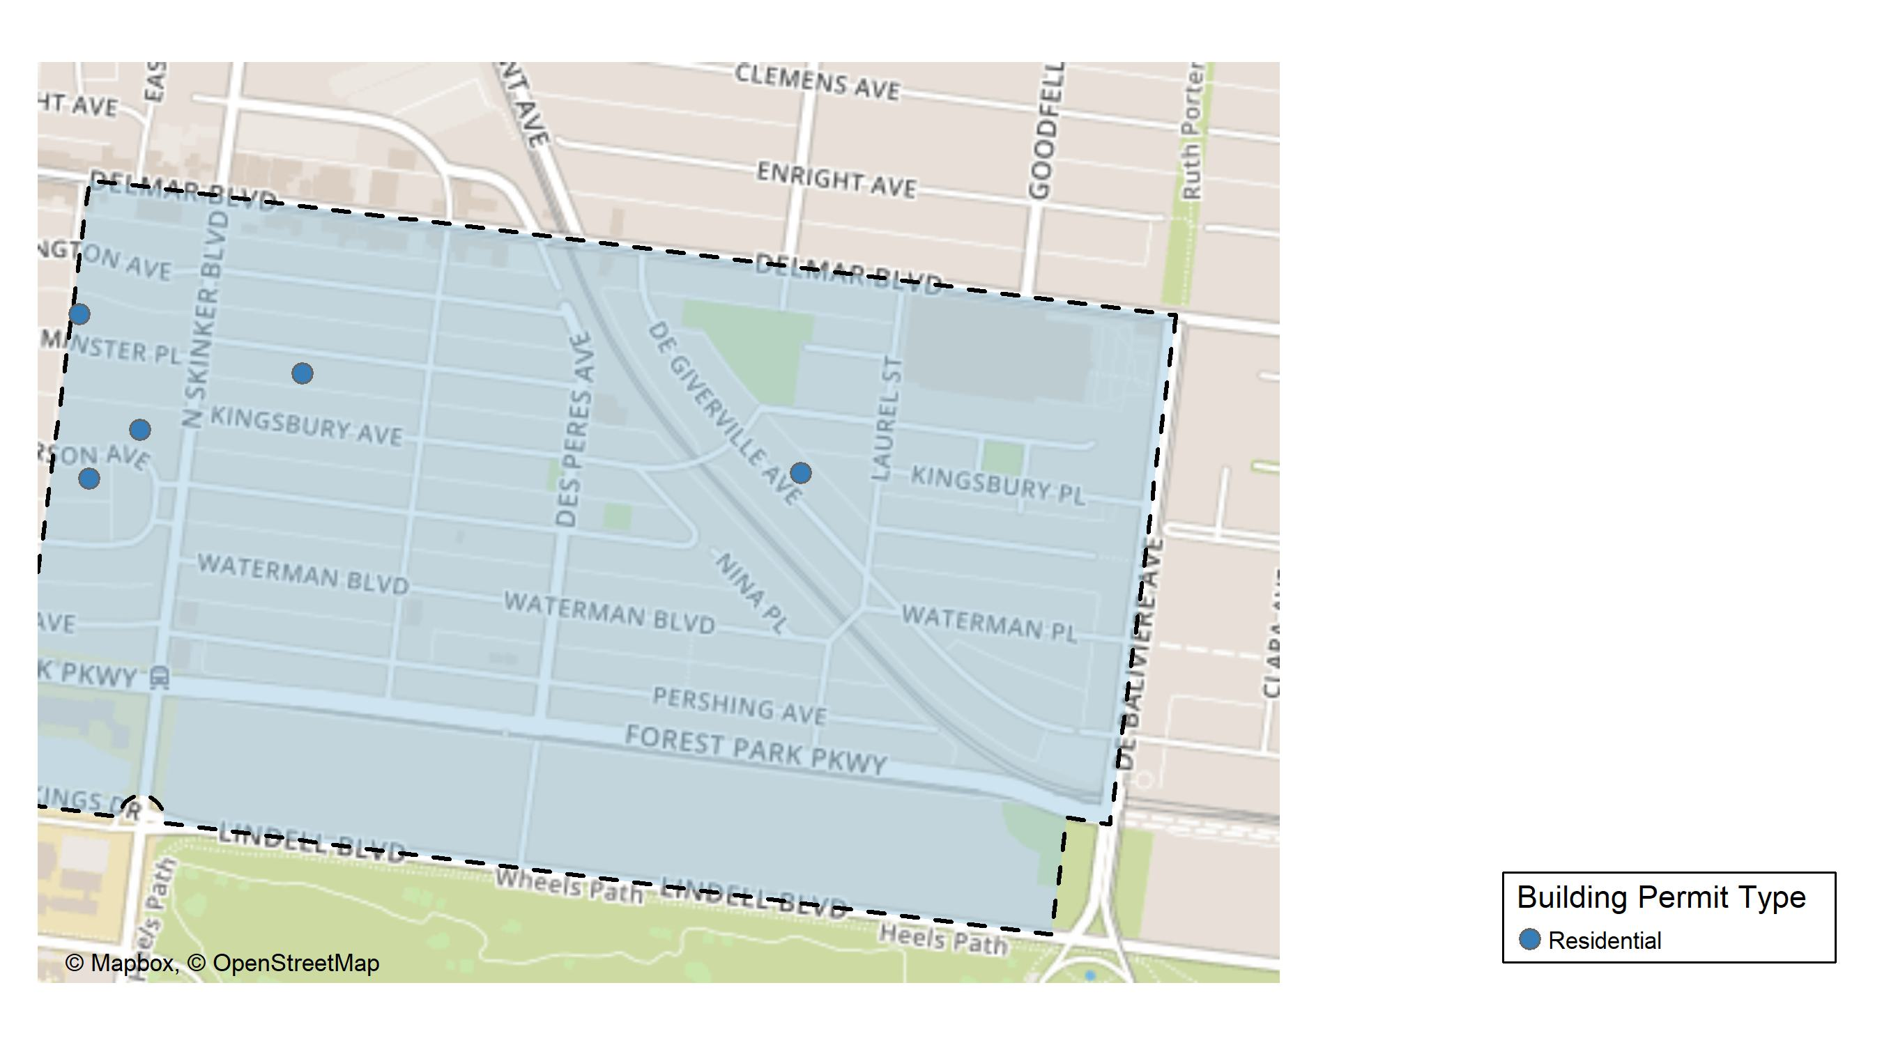
Skinker DeBaliviere

Slide 21
Neighborhood Summary
March 2025 | March 2025 | March 2025 | March 2025
Permit Use | Average Cost | # of Permits | Total Value of Permits
Commercial | $0 | 0 | $0
Industrial | $0 | 0 | $0
Residential | $75,923 | 5 | $379,615
Last 6 Months | Last 6 Months | Last 6 Months | Last 6 Months
Permit Use | Average Cost | # of Permits | Total Value of Permits
Commercial | $192,555.56 | 9 | $1,733,000
Industrial | $12,125.00 | 4 | $48,500
Residential | $74,650.09 | 44 | $3,284,604

Slide 22
Skinker DeBaliviere Individual Permit Breakdown
Neighborhood | Owner | New Use | Cost | address
Skinker DeBaliviere | FITZPATRICK, GALE A & JAMES N FITZPA | Residential | $15,673 | 6154 WESTMINSTER PL
Skinker DeBaliviere | SCHUH, MOLLY & | Residential | $300,000 | 6253 WESTMINSTER PL
Skinker DeBaliviere | LAZAROFF, DAVID & GAYLE | Residential | $25,000 | 6240 MCPHERSON AV
Skinker DeBaliviere | ORLOWSKY, DANIEL J & AMY E | Residential | $32,193 | 6219 MCPHERSON AV
Skinker DeBaliviere | BUTLER, MICHAEL A & RONDA | Residential | $6,749 | 5845 DEGIVERVILLE AV

Slide 23
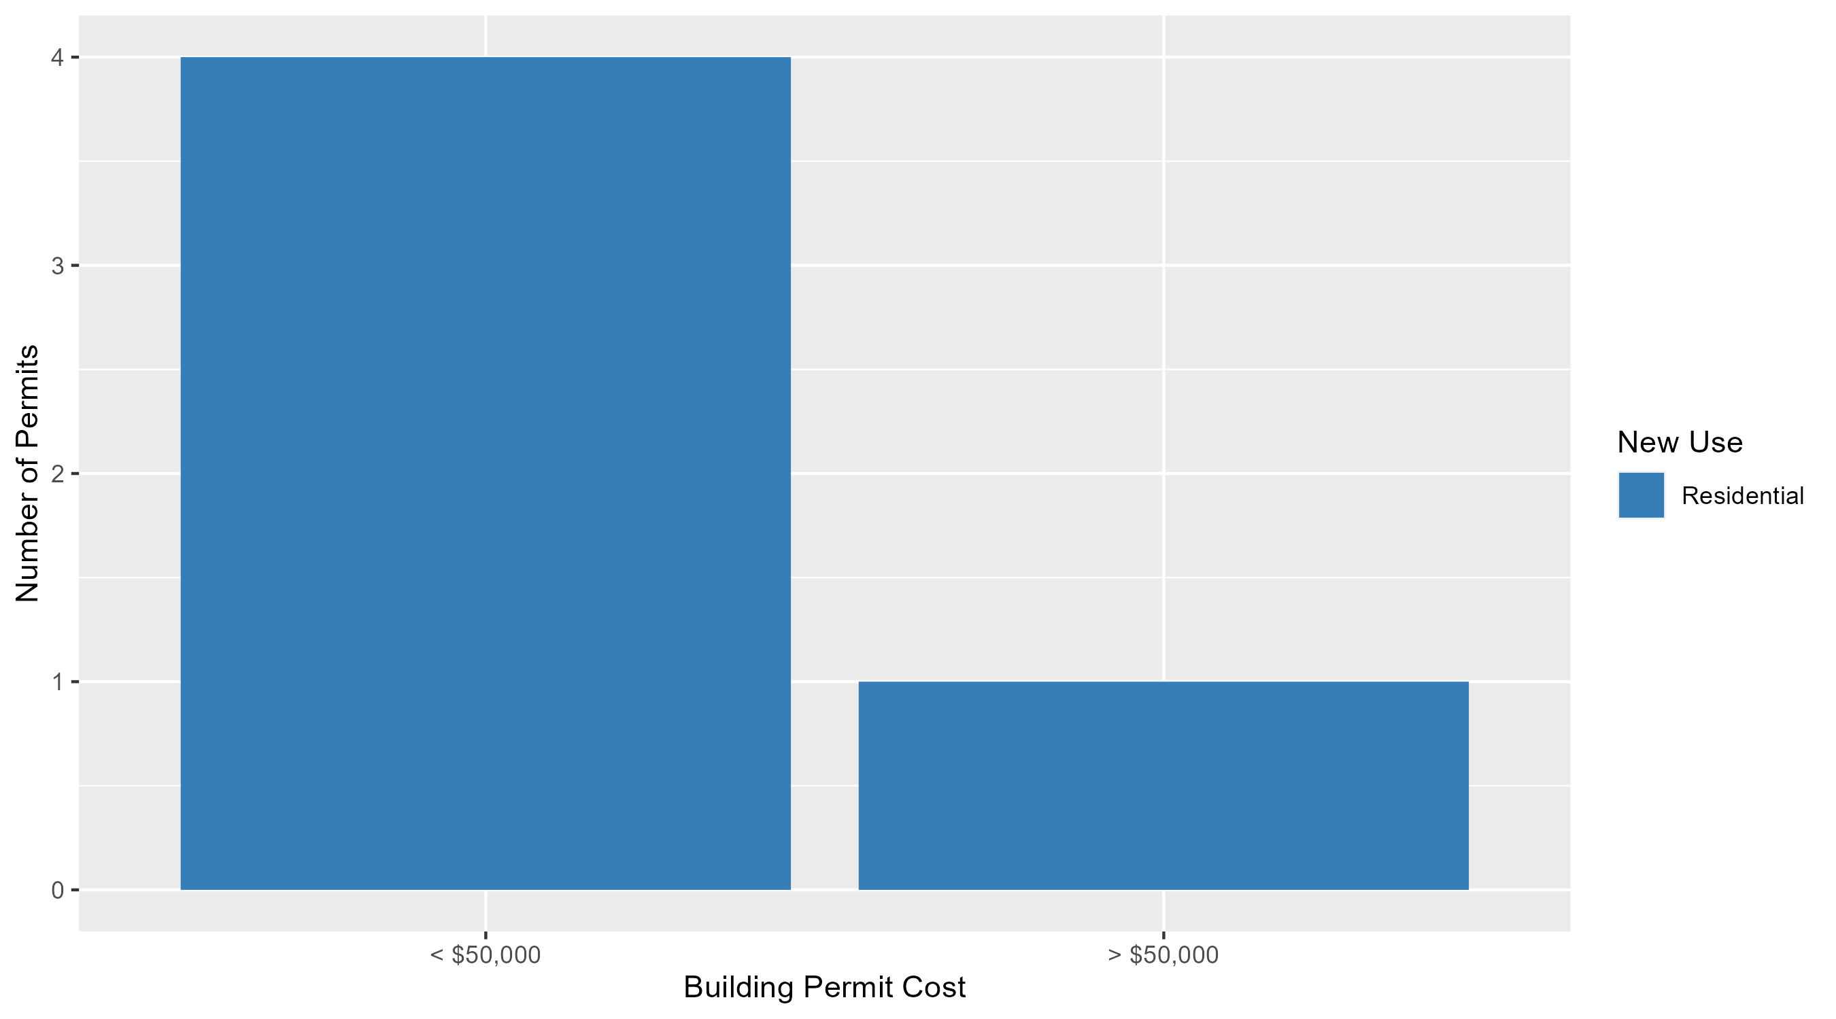
Skinker DeBaliviere Permit Cost Breakdown

Slide 24
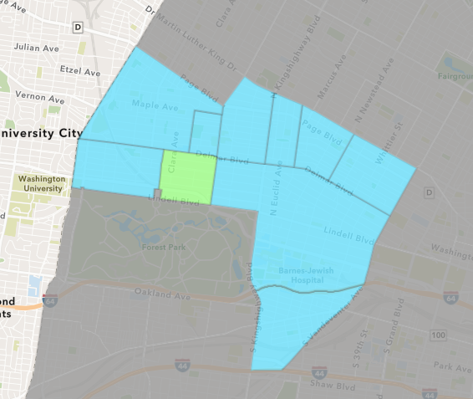
DeBaliviere Place
March 2025 Neighborhood Cost Breakdown
  Mean: $127,185
  Median: $9,000
  Range: $3,162 - $500,000

Slide 25
DeBaliviere Place: Summary Notes
5 building permits in March 2025
  150.00% change compared to March 2024 (2 total building permits)
  $127,185: Average building permit cost in March 2025
    367.13% change compared to March 2024 ($27,227)
12 total building permits in 2025
  33.33% change YTD compared to this time in 2024 (9 total building permits)
  $65,119: YTD average building permit cost in 2025
    32.27% change YTD compared to this time in 2024 ($49,231)

Slide 26
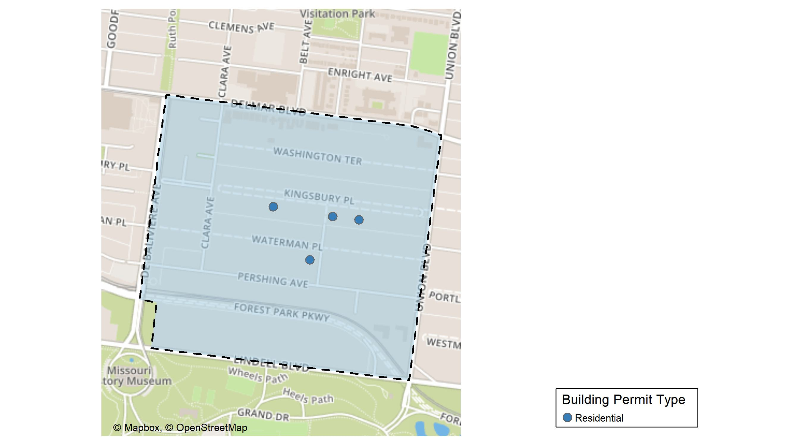
DeBaliviere Place

Slide 27
Neighborhood Summary
March 2025 | March 2025 | March 2025 | March 2025
Permit Use | Average Cost | # of Permits | Total Value of Permits
Commercial | $0.0 | 0 | $0
Industrial | $0.0 | 0 | $0
Residential | $127,184.8 | 5 | $635,924
Last 6 Months | Last 6 Months | Last 6 Months | Last 6 Months
Permit Use | Average Cost | # of Permits | Total Value of Permits
Commercial | $2,100.00 | 2 | $4,200
Industrial | $0.00 | 0 | $0
Residential | $99,219.44 | 25 | $2,480,486

Slide 28
DeBaliviere Place Individual Permit Breakdown
Neighborhood | Owner | New Use | Cost | address
DeBaliviere Place | ULRICH, DAVID & | Residential | $500,000 | 16 KINGSBURY PL
DeBaliviere Place | MCAFOOS, HANNAH C & JASON P | Residential | $115,000 | 42 KINGSBURY PL
DeBaliviere Place | GREGORY, PETER | Residential | $9,000 | 22 KINGSBURY PL
DeBaliviere Place | CHAUNCEY BATCHELON | Residential | $3,162 | 329 BELT AV
DeBaliviere Place | RANDOLPH CONDOMINIUMS | Residential | $8,762 | 5510 WATERMAN BLVD

Slide 29
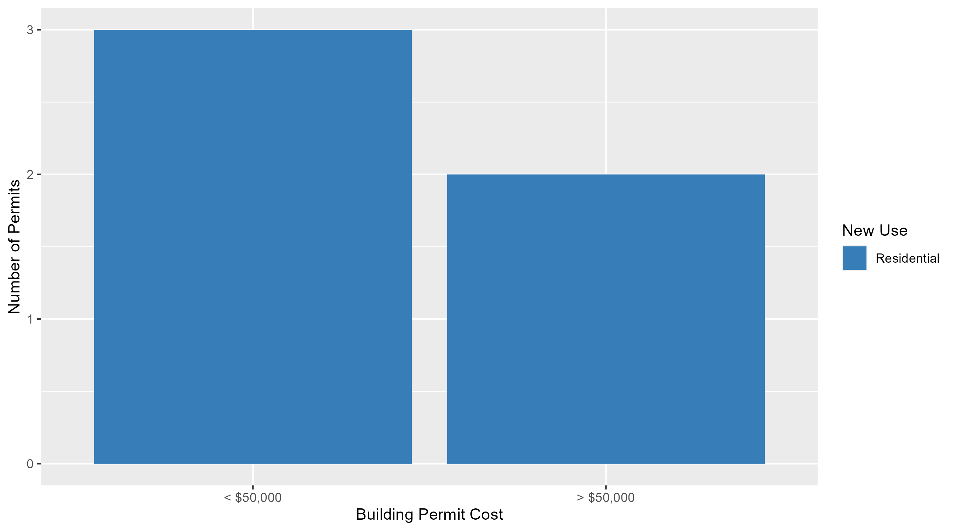
DeBaliviere Place Permit Cost Breakdown

Slide 30
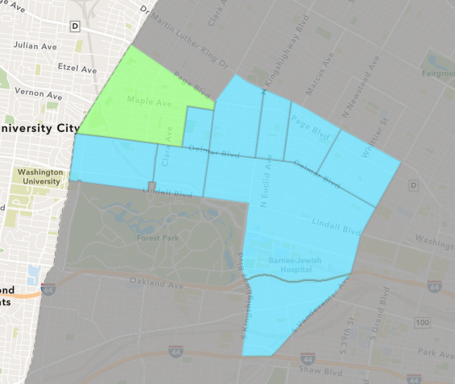
West End
March 2025 Neighborhood Cost Breakdown
  Mean: $235,550
  Median: $21,038
  Range: $2,000 - $1,100,000

Slide 31
West End: Summary Notes
5 building permits in March 2025
  -28.57% change compared to March 2024 (7 total building permits)
  $235,550: Average building permit cost in March 2025
    1447.96% change compared to March 2024 ($15,217)
11 total building permits in 2025
  -52.17% change YTD compared to this time in 2024 (23 total building permits)
  $140,681: YTD average building permit cost in 2025
    8.14% change YTD compared to this time in 2024 ($130,092)

Slide 32
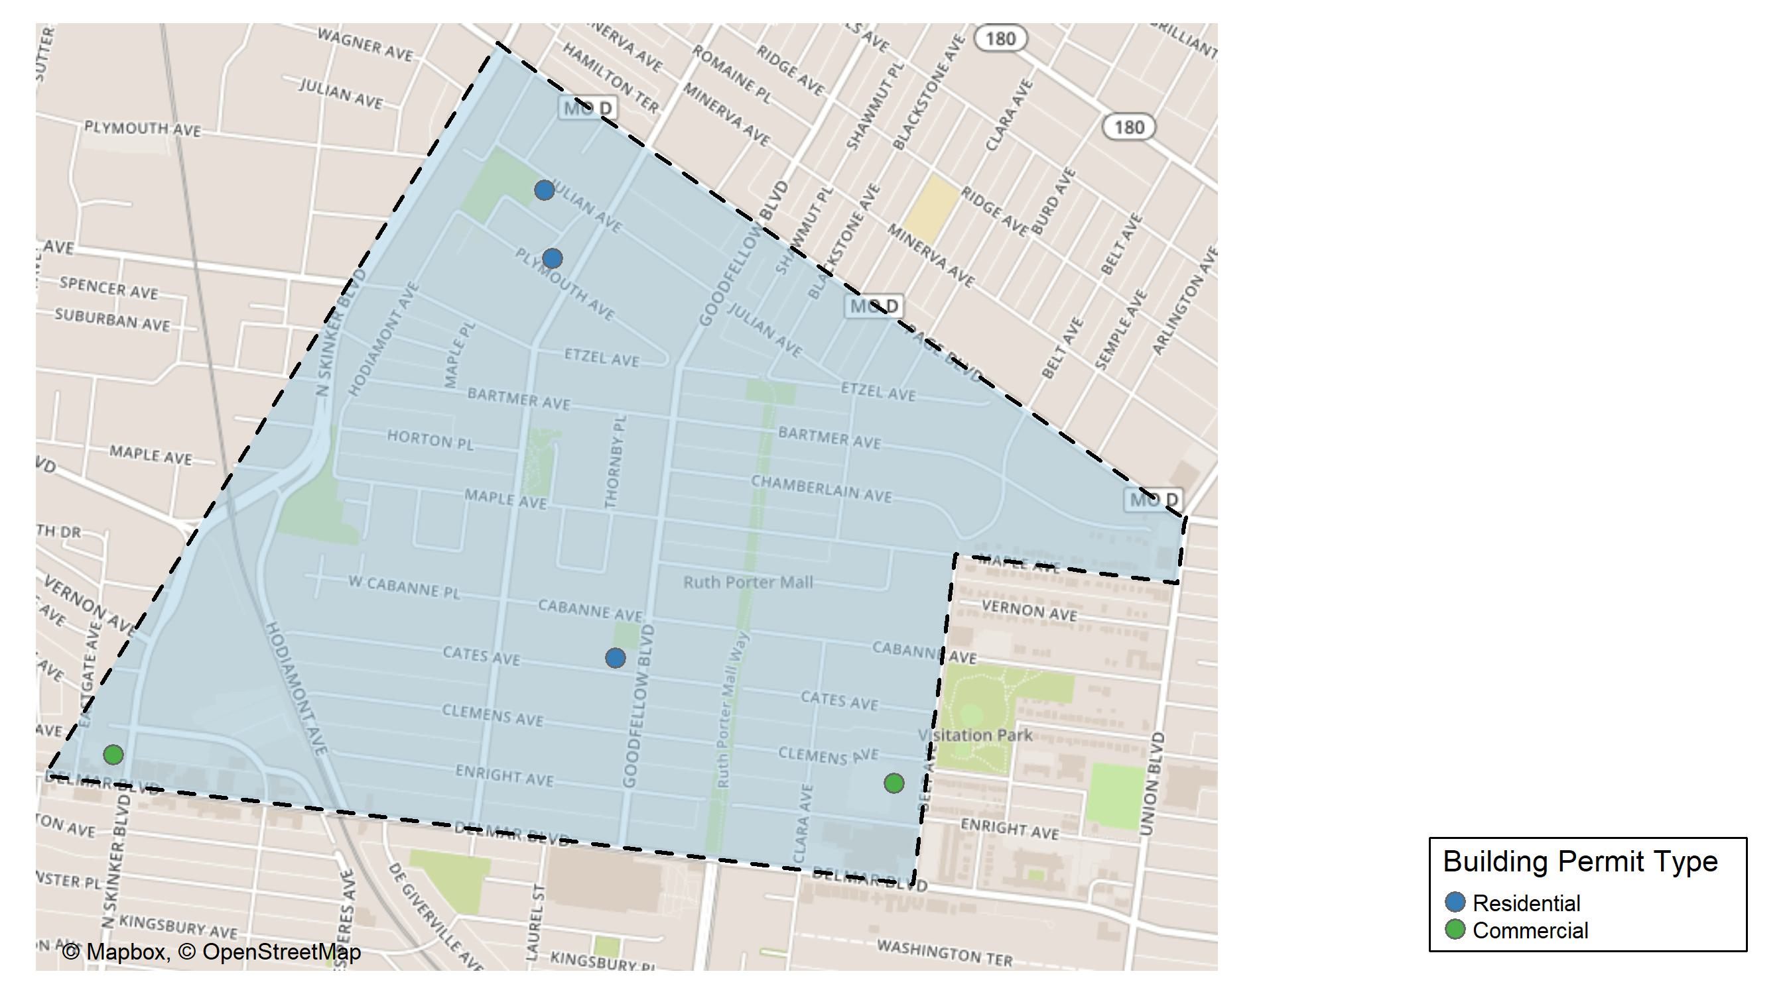
West End

Slide 33
Neighborhood Summary
March 2025 | March 2025 | March 2025 | March 2025
Permit Use | Average Cost | # of Permits | Total Value of Permits
Commercial | $560,519.00 | 2 | $1,121,038
Industrial | $0.00 | 0 | $0
Residential | $18,904.33 | 3 | $56,713
Last 6 Months | Last 6 Months | Last 6 Months | Last 6 Months
Permit Use | Average Cost | # of Permits | Total Value of Permits
Commercial | $373,846.00 | 3 | $1,121,538
Industrial | $439,045.50 | 4 | $1,756,182
Residential | $32,212.88 | 17 | $547,619

Slide 34
West End Individual Permit Breakdown
Neighborhood | Owner | New Use | Cost | address
West End | PACE-DELMAR ASSOCIATES LLC | Commercial | $21,038 | 621 N SKINKER BLVD
West End | DELMAR DIVINE MASTER LANDLORD | Commercial | $1,100,000 | 5507 ENRIGHT AV
West End | ROSS, HENRI LAVERNE | Residential | $2,000 | 1206 OAKLEY PL
West End | ROBINSON, DORISE | Residential | $3,000 | 5819 CATES AV
West End | BIRCHROCK CAPITAL MO LLC | Residential | $51,713 | 5946 JULIAN AV

Slide 35
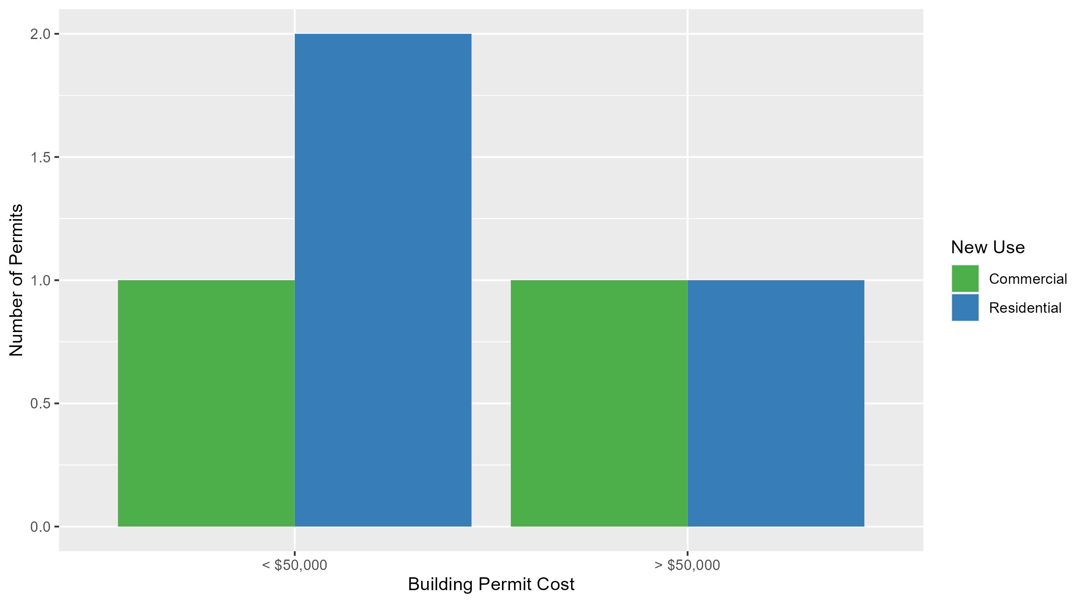
West End Permit Cost Breakdown

Slide 36
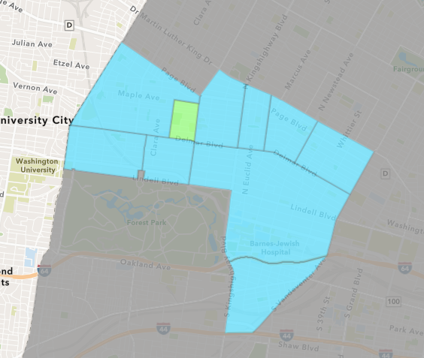
Visitation Park
March 2025 Neighborhood Cost Breakdown
  Mean: $75,500
  Median: $75,500
  Range: $1,000 - $150,000

Slide 37
Visitation Park: Summary Notes
2 building permits in March 2025
  Infinite change compared to March 2024 (0 total building permits)
  $75,500: Average building permit cost in March 2025
    Infinite change compared to March 2024 ($0)
2 total building permits in 2025
  Infinite change YTD compared to this time in 2024 (0 total building permits)
  $75,500: YTD average building permit cost in 2025
    Infinite change YTD compared to this time in 2024 ($0)

Slide 38
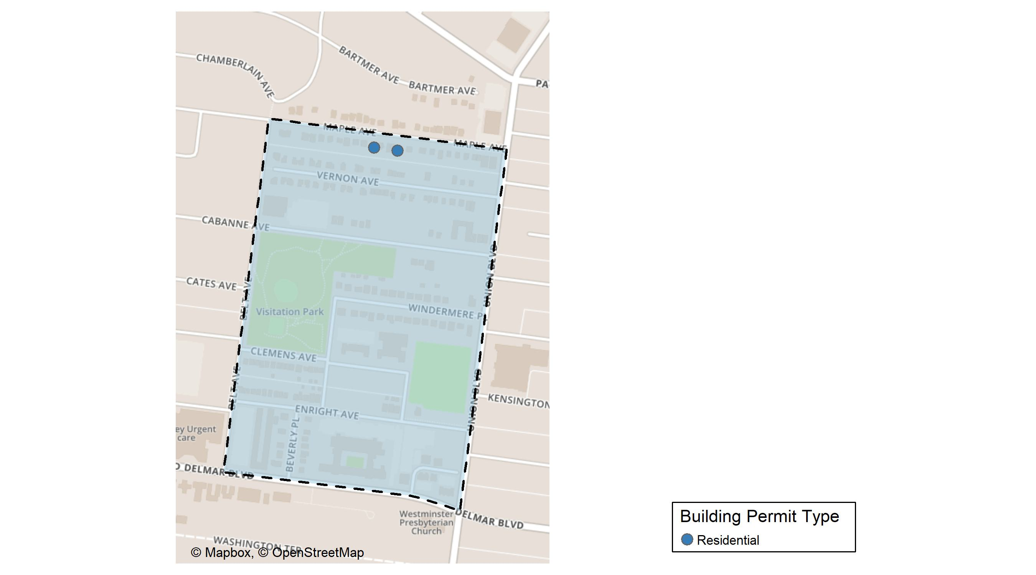
Visitation Park

Slide 39
Neighborhood Summary
March 2025 | March 2025 | March 2025 | March 2025
Permit Use | Average Cost | # of Permits | Total Value of Permits
Commercial | $0 | 0 | $0
Industrial | $0 | 0 | $0
Residential | $75,500 | 2 | $151,000
Last 6 Months | Last 6 Months | Last 6 Months | Last 6 Months
Permit Use | Average Cost | # of Permits | Total Value of Permits
Commercial | $0.0 | 0 | $0
Industrial | $0.0 | 0 | $0
Residential | $48,070.5 | 4 | $192,282

Slide 40
Visitation Park Individual Permit Breakdown
Neighborhood | Owner | New Use | Cost | address
Visitation Park | AMP EQUITY PARTNERS LLC & URBNCORE | Residential | $150,000 | 5408 MAPLE AV
Visitation Park | KEATON, PAMELA DUNHAM | Residential | $1,000 | 5370-5372 MAPLE AV

Slide 41
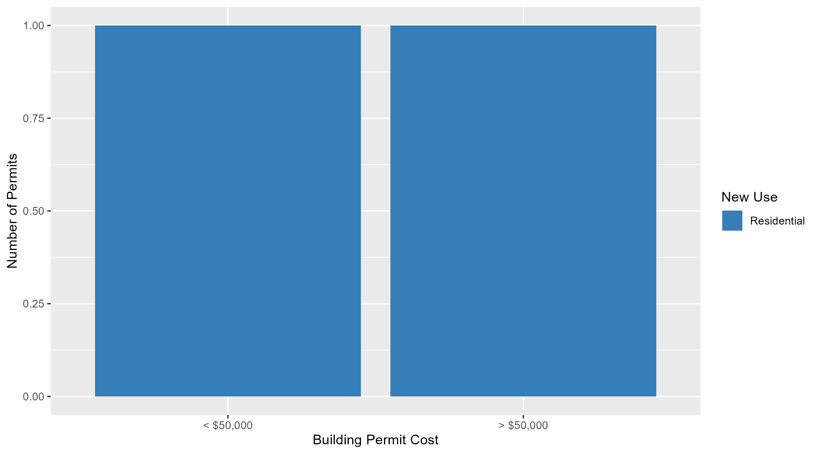
Visitation Park Permit Cost Breakdown

Slide 42
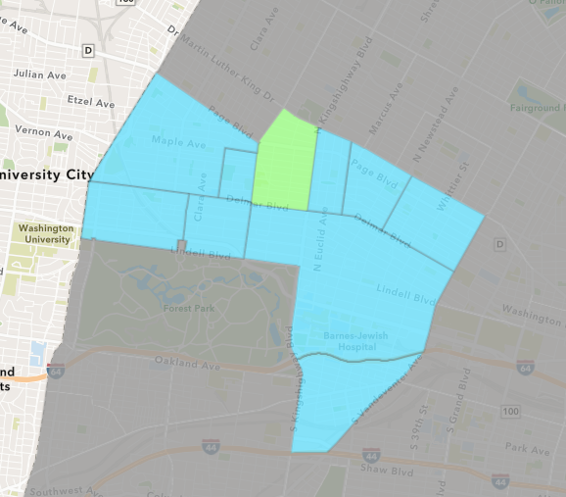
Academy
March 2025 Neighborhood Cost Breakdown
  Mean: $10,000
  Median: $4,000
  Range: $1,000 - $25,000

Slide 43
Academy: Summary Notes
3 building permits in March 2025
  200.00% change compared to March 2024 (1 total building permits)
  $10,000: Average building permit cost in March 2025
    -87.50% change compared to March 2024 ($80,000)
9 total building permits in 2025
  50.00% change YTD compared to this time in 2024 (6 total building permits)
  $30,556: YTD average building permit cost in 2025
    34.60% change YTD compared to this time in 2024 ($22,700)

Slide 44
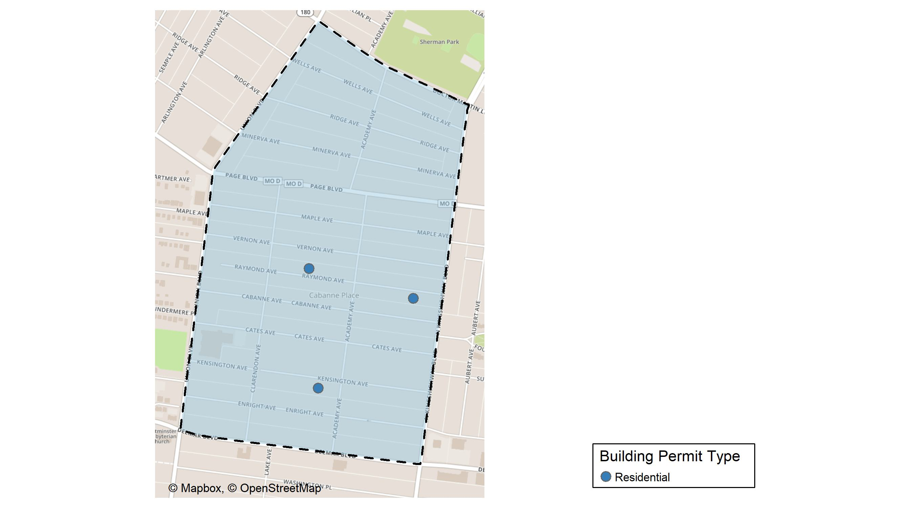
Academy

Slide 45
Neighborhood Summary
March 2025 | March 2025 | March 2025 | March 2025
Permit Use | Average Cost | # of Permits | Total Value of Permits
Commercial | $0 | 0 | $0
Industrial | $0 | 0 | $0
Residential | $10,000 | 3 | $30,000
Last 6 Months | Last 6 Months | Last 6 Months | Last 6 Months
Permit Use | Average Cost | # of Permits | Total Value of Permits
Commercial | $20,500.00 | 2 | $41,000
Industrial | $0.00 | 0 | $0
Residential | $23,948.79 | 14 | $335,283

Slide 46
Academy Individual Permit Breakdown
Neighborhood | Owner | New Use | Cost | address
Academy | INGRAM, TIFANEE | Residential | $25,000 | 5028 RAYMOND AV
Academy | BLUE WHALE PROPERTIES LLC | Residential | $4,000 | 5122-5124 KENSINGTON AV
Academy | MOODY, RISHONDA | Residential | $1,000 | 5153 RAYMOND AV

Slide 47
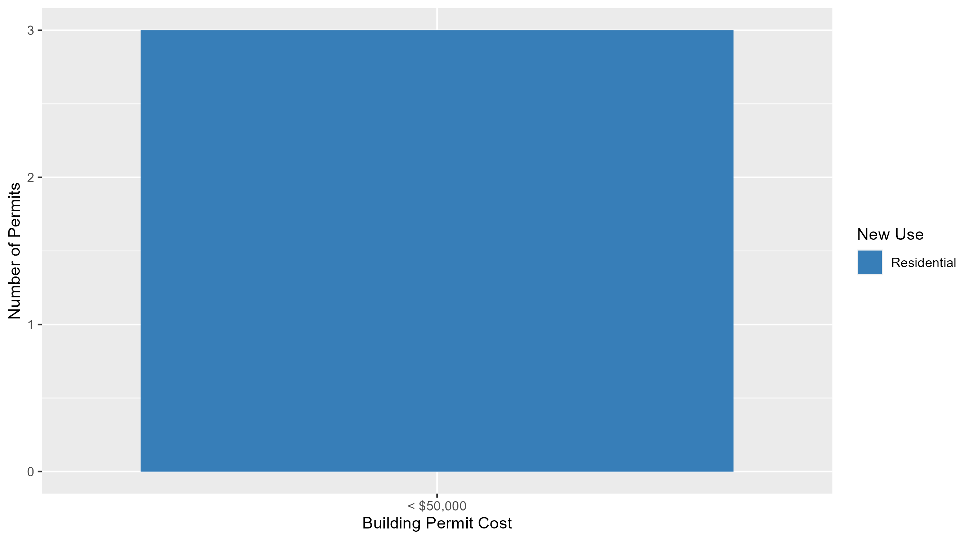
Academy Permit Cost Breakdown

Slide 48
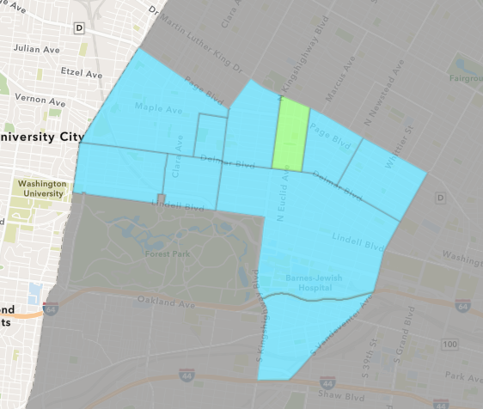
Fountain Park
March 2025 Neighborhood Cost Breakdown
  Mean: $31,000
  Median: $31,000
  Range: $31,000 - $31,000

Slide 49
Fountain Park: Summary Notes
1 building permits in March 2025
  0.00% change compared to March 2024 (1 total building permits)
  $31,000: Average building permit cost in March 2025
    933.33% change compared to March 2024 ($3,000)
2 total building permits in 2025
  -50.00% change YTD compared to this time in 2024 (4 total building permits)
  $18,400: YTD average building permit cost in 2025
    36.30% change YTD compared to this time in 2024 ($13,500)

Slide 50
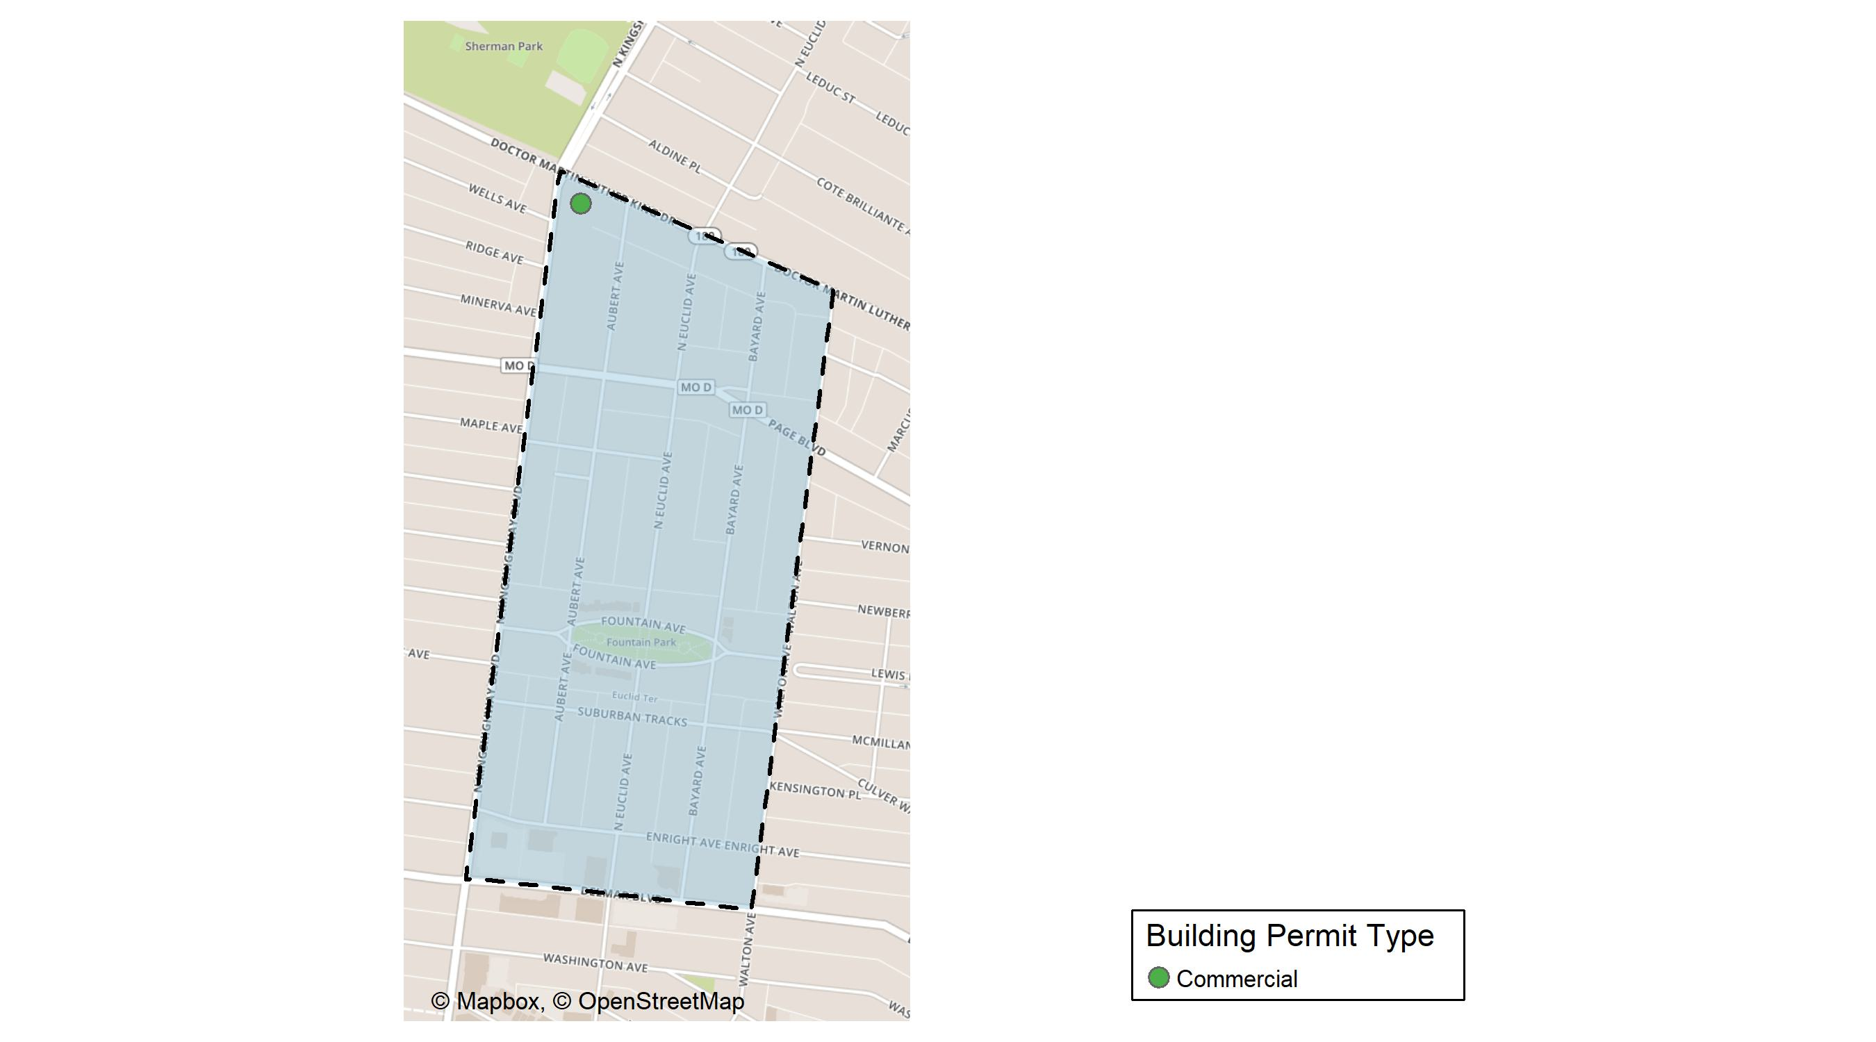
Fountain Park

Slide 51
Neighborhood Summary
March 2025 | March 2025 | March 2025 | March 2025
Permit Use | Average Cost | # of Permits | Total Value of Permits
Commercial | $31,000 | 1 | $31,000
Industrial | $0 | 0 | $0
Residential | $0 | 0 | $0
Last 6 Months | Last 6 Months | Last 6 Months | Last 6 Months
Permit Use | Average Cost | # of Permits | Total Value of Permits
Commercial | $45,250 | 4 | $181,000
Industrial | $0 | 0 | $0
Residential | $40,200 | 4 | $160,800

Slide 52
Fountain Park Individual Permit Breakdown
Neighborhood | Owner | New Use | Cost | address
Fountain Park | HOLLYWOOD BEAUTY SUPPLIES LLC | Commercial | $31,000 | 1448 N KINGSHIGHWAY BLVD

Slide 53
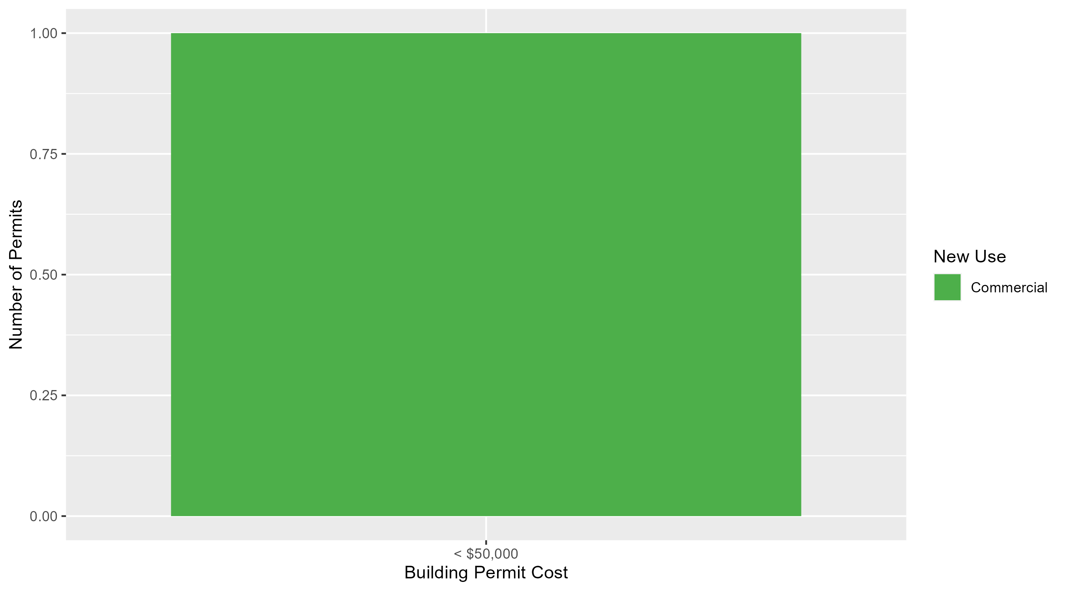
Fountain Park Permit Cost Breakdown

Slide 54
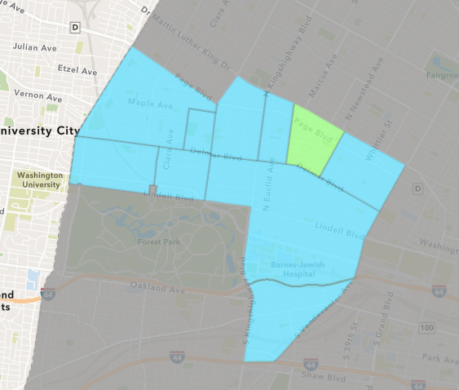
Lewis Place
March 2025 Neighborhood Cost Breakdown
  Mean: $15,000
  Median: $15,000
  Range: $15,000 - $15,000

Slide 55
Lewis Place: Summary Notes
1 building permits in March 2025
  0.00% change compared to March 2024 (1 total building permits)
  $15,000: Average building permit cost in March 2025
    114.29% change compared to March 2024 ($7,000)
2 total building permits in 2025
  -33.33% change YTD compared to this time in 2024 (3 total building permits)
  $57,500: YTD average building permit cost in 2025
    1816.67% change YTD compared to this time in 2024 ($3,000)

Slide 56
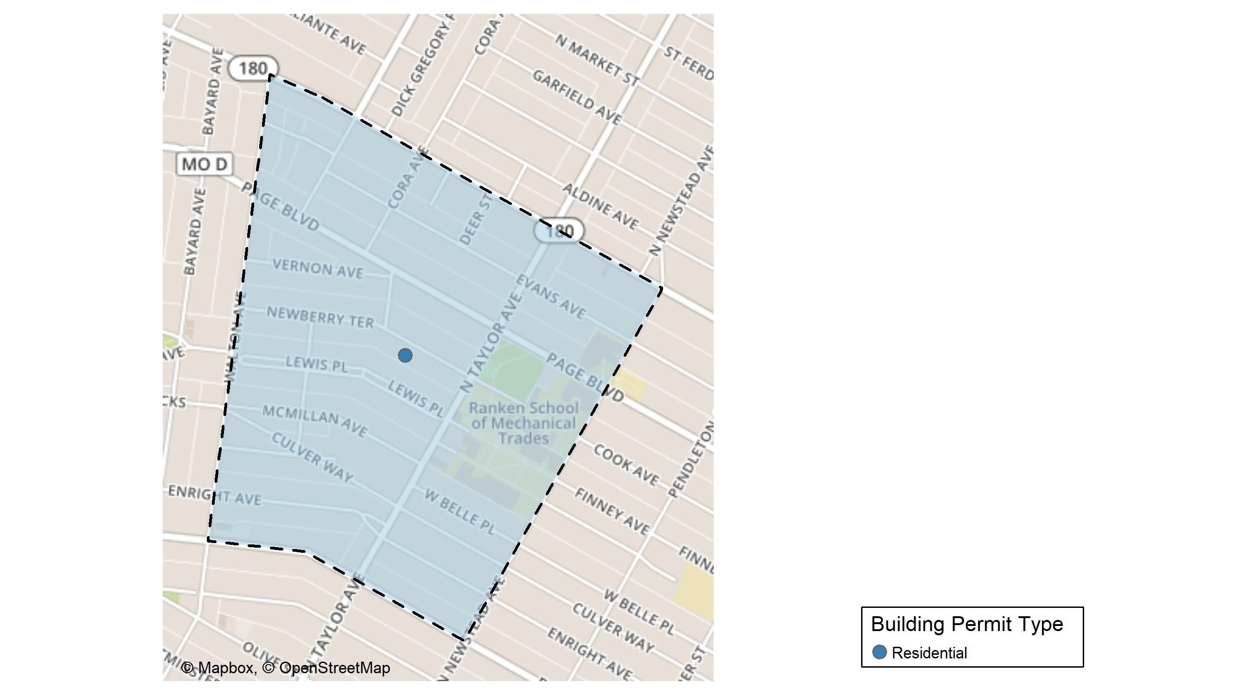
Lewis Place

Slide 57
Neighborhood Summary
March 2025 | March 2025 | March 2025 | March 2025
Permit Use | Average Cost | # of Permits | Total Value of Permits
Commercial | $0 | 0 | $0
Industrial | $0 | 0 | $0
Residential | $15,000 | 1 | $15,000
Last 6 Months | Last 6 Months | Last 6 Months | Last 6 Months
Permit Use | Average Cost | # of Permits | Total Value of Permits
Commercial | $4,500 | 1 | $4,500
Industrial | $1,500 | 1 | $1,500
Residential | $42,750 | 4 | $171,000

Slide 58
Lewis Place Individual Permit Breakdown
Neighborhood | Owner | New Use | Cost | address
Lewis Place | ISRAEL, URIYAH & AKIVA | Residential | $15,000 | 4550 NEWBERRY TER

Slide 59
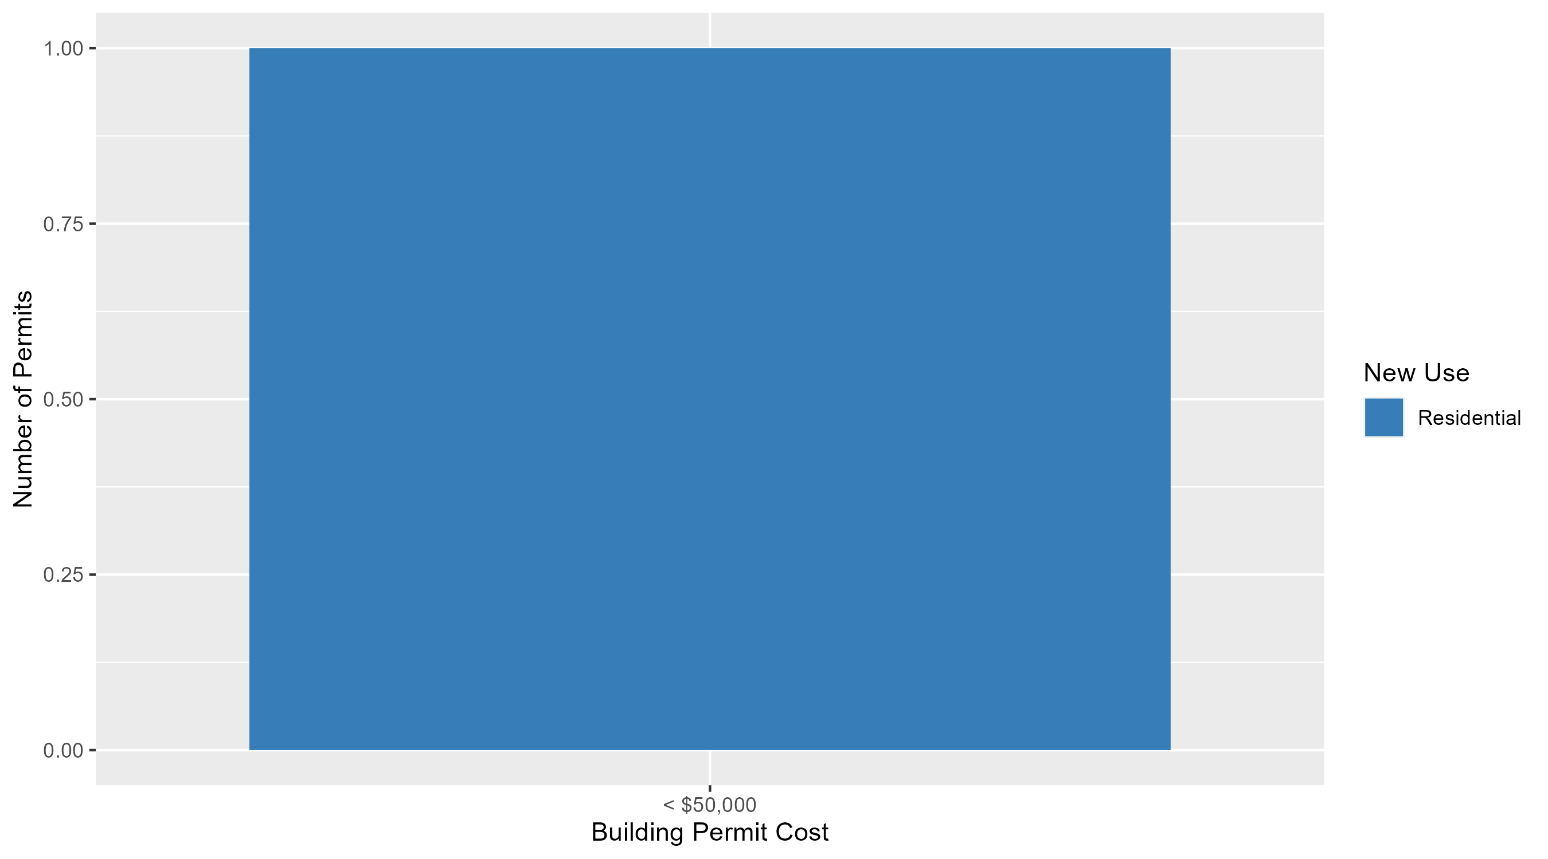
Lewis Place Permit Cost Breakdown

Slide 60
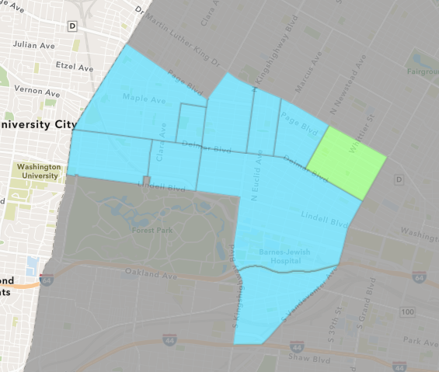
Vandeventer
March 2025 Neighborhood Cost Breakdown
  Mean: $9,000
  Median: $9,000
  Range: $9,000 - $9,000

Slide 61
Vandeventer: Summary Notes
1 building permits in March 2025
  Infinite change compared to March 2024 (0 total building permits)
  $9,000: Average building permit cost in March 2025
    Infinite change compared to March 2024 ($0)
2 total building permits in 2025
  -33.33% change YTD compared to this time in 2024 (3 total building permits)
  $5,750: YTD average building permit cost in 2025
    -91.89% change YTD compared to this time in 2024 ($70,883)

