Slide 1
St. Louis Central Corridor West Building Permits
Monthly Report: May 2024

Slide 2
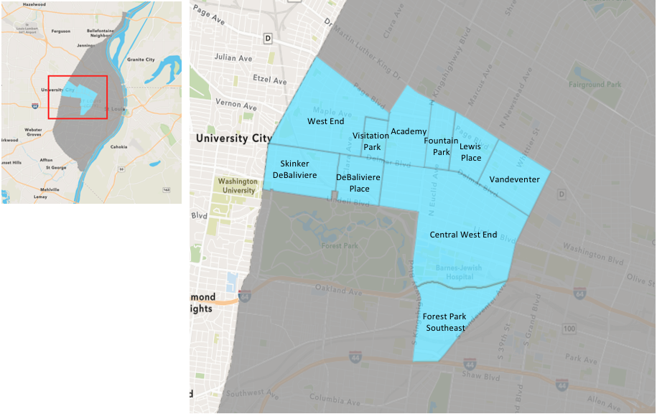
St. Louis Neighborhood Spatial Reference

Slide 3
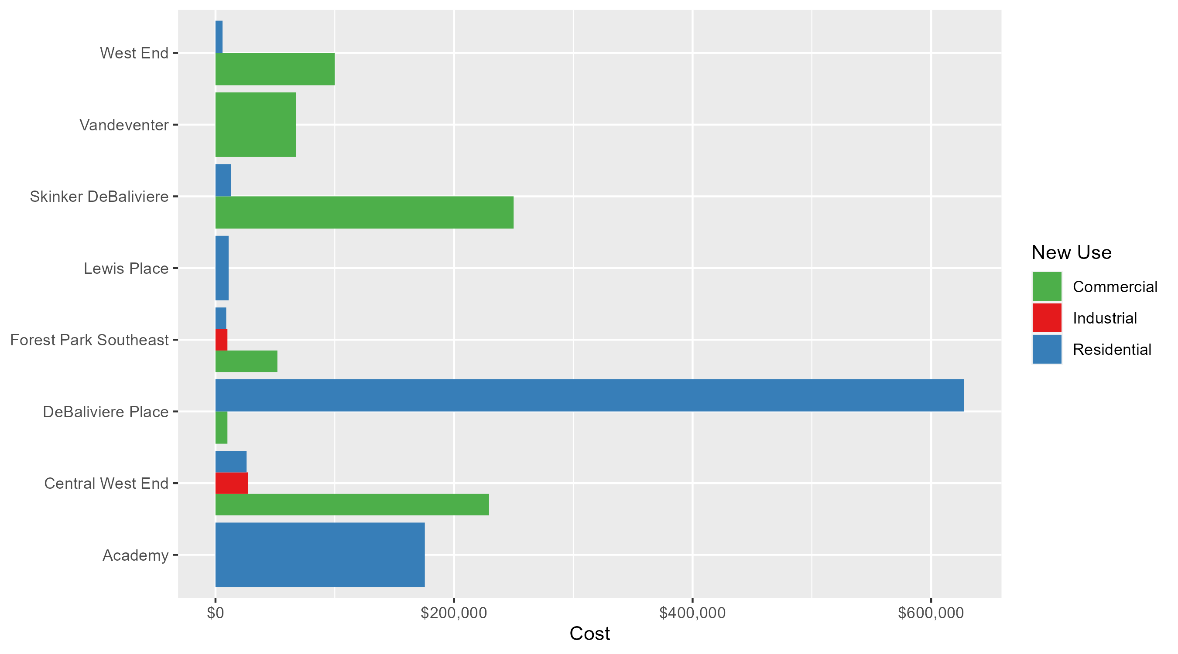
Neighborhood Summary: Average Building Permit Cost

Slide 4
Neighborhood Summary
May 2024 | May 2024 | May 2024 | May 2024
Neighborhood | Average Cost | # of Permits | Total Value of Permits
Academy | $175,500.00 | 2 | $351,000
Central West End | $123,996.22 | 27 | $3,347,898
DeBaliviere Place | $473,211.25 | 4 | $1,892,845
Forest Park Southeast | $30,616.67 | 6 | $183,700
Fountain Park | $0.00 | 0 | $0
Lewis Place | $11,000.00 | 1 | $11,000
Skinker DeBaliviere | $107,850.40 | 5 | $539,252
Vandeventer | $67,500.00 | 2 | $135,000
Visitation Park | $0.00 | 0 | $0
West End | $15,321.70 | 10 | $153,217
Last 6 Months | Last 6 Months | Last 6 Months | Last 6 Months
Neighborhood | Average Cost | # of Permits | Total Value of Permits
Academy | $41,510.75 | 12 | $498,129
Central West End | $488,880.18 | 193 | $94,353,874
DeBaliviere Place | $192,148.87 | 23 | $4,419,424
Forest Park Southeast | $94,878.43 | 47 | $4,459,286
Fountain Park | $34,155.56 | 9 | $307,400
Lewis Place | $16,269.40 | 10 | $162,694
Skinker DeBaliviere | $141,538.35 | 34 | $4,812,304
Vandeventer | $53,285.29 | 7 | $372,997
Visitation Park | $0.00 | 0 | $0
West End | $118,635.98 | 48 | $5,694,527

Slide 5
Core Neighborhoods

Slide 6
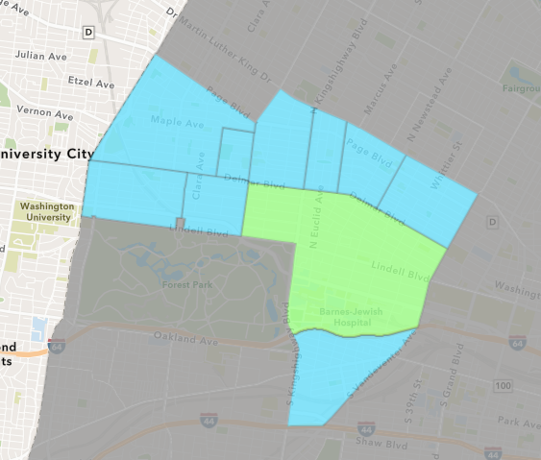
Central West End
May 2024 Neighborhood Cost Breakdown
  Mean: $123,996
  Median: $20,000
  Range: $3,500 - $1,255,000

Slide 7
Central West End: Summary Notes
27 building permits in May 2024
  -12.90% change compared to May 2023 (31 total building permits)
  $123,996: Average building permit cost in May 2024
    -63.63% change compared to May 2023 ($340,976)
140 total building permits in 2024
  -12.50% change YTD compared to this time in 2023 (160 total building permits)
  $525,527: YTD average building permit cost in 2024
    38.42% change YTD compared to this time in 2023 ($379,661)

Slide 8
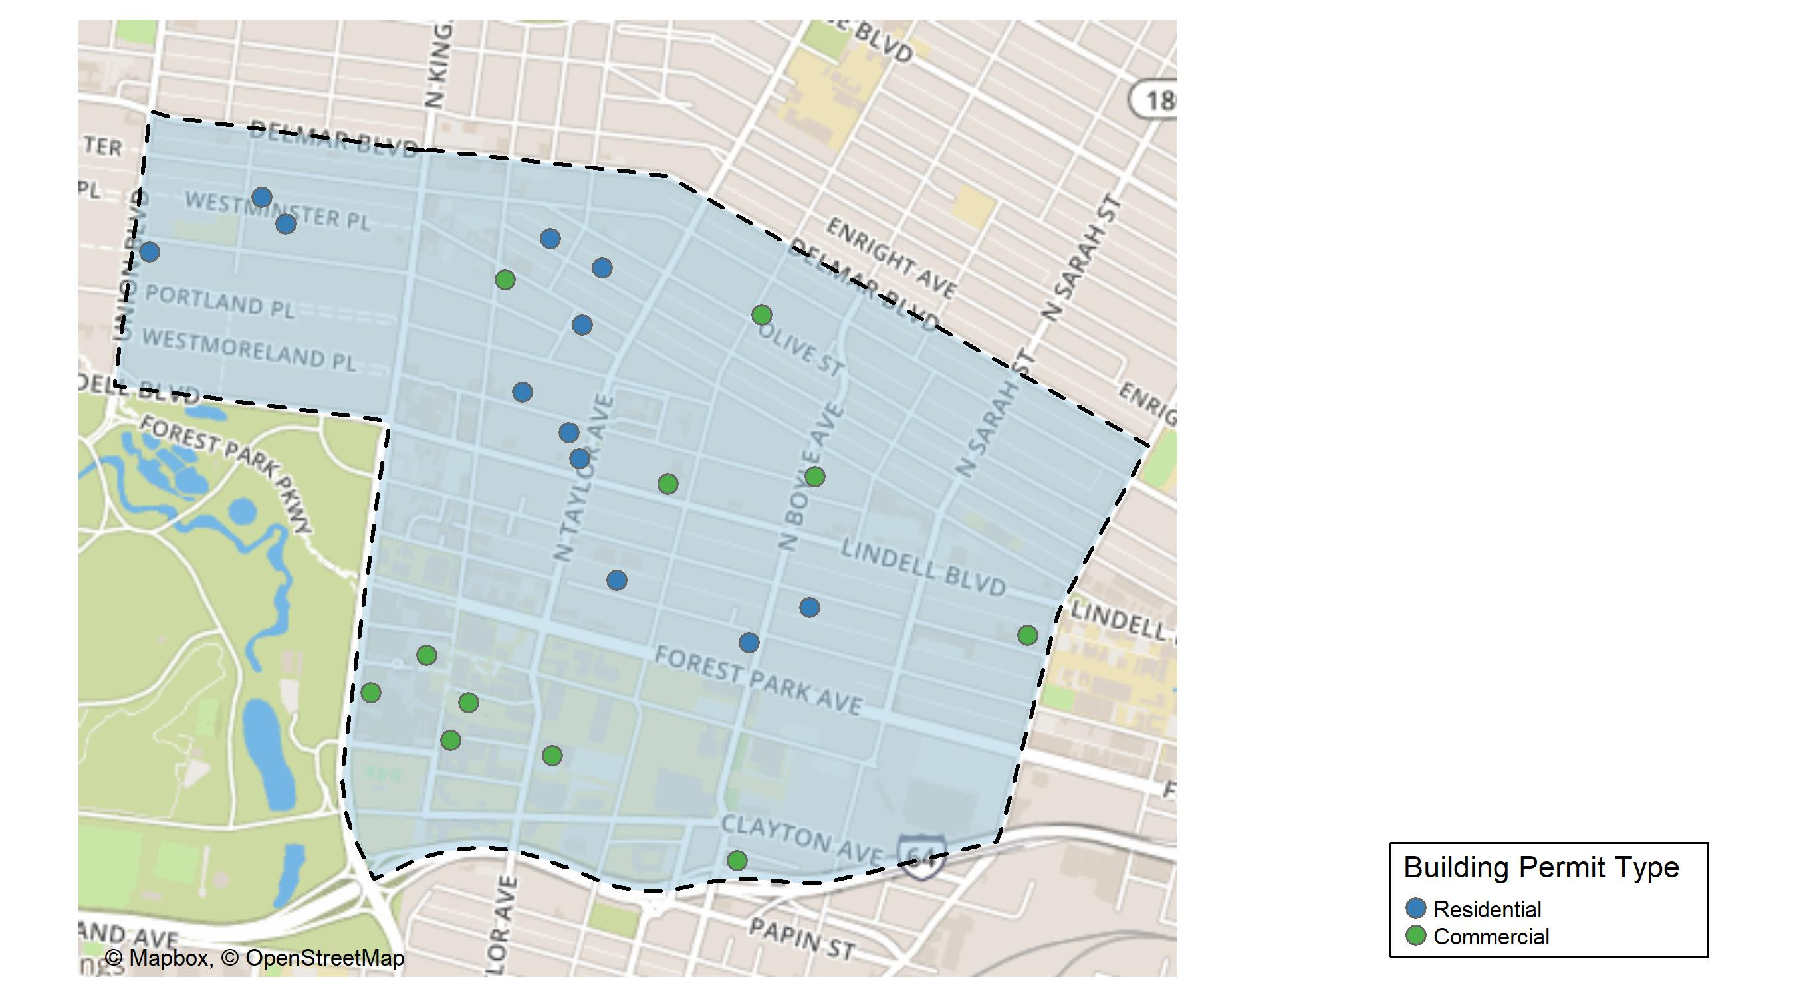
Central West End

Slide 9
Neighborhood Summary
May 2024 | May 2024 | May 2024 | May 2024
Permit Use | Average Cost | # of Permits | Total Value of Permits
Commercial | $229,353.08 | 13 | $2,981,590
Industrial | $27,328.00 | 1 | $27,328
Residential | $26,075.38 | 13 | $338,980
Last 6 Months | Last 6 Months | Last 6 Months | Last 6 Months
Permit Use | Average Cost | # of Permits | Total Value of Permits
Commercial | $934,275.22 | 96 | $89,690,421
Industrial | $17,415.60 | 5 | $87,078
Residential | $49,743.21 | 92 | $4,576,375

Slide 10
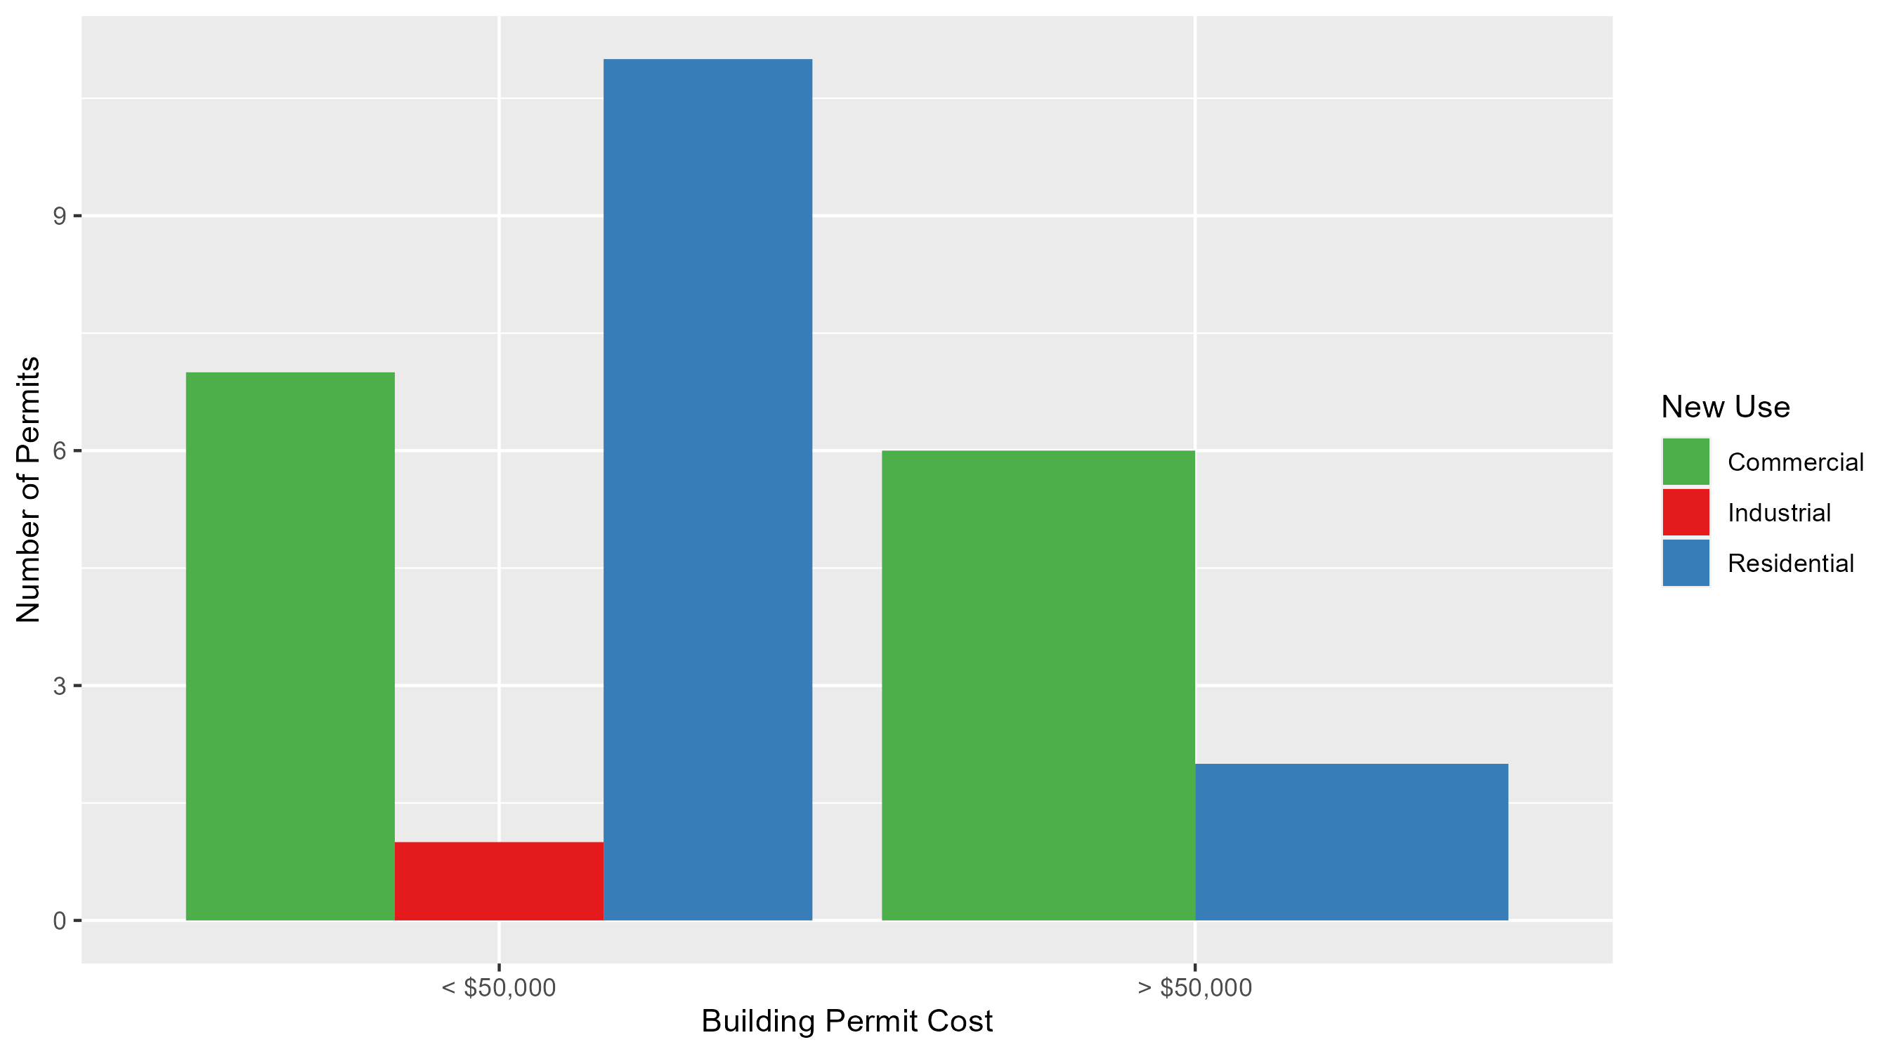
Central West End Permit Cost Breakdown

Slide 11
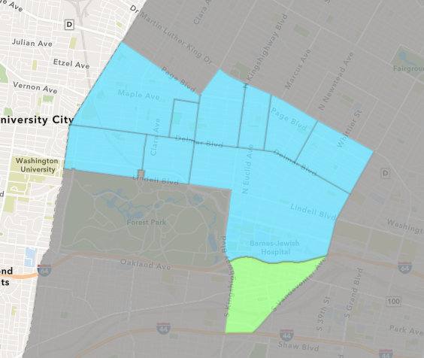
Forest Park Southeast
May 2024 Neighborhood Cost Breakdown
  Mean: $30,617
  Median: $10,000
  Range: $700 - $120,000

Slide 12
Forest Park Southeast: Summary Notes
6 building permits in May 2024
  0.00% change compared to May 2023 (6 total building permits)
  $30,617: Average building permit cost in May 2024
    -36.84% change compared to May 2023 ($48,478)
32 total building permits in 2024
  23.08% change YTD compared to this time in 2023 (26 total building permits)
  $79,821: YTD average building permit cost in 2024
    9.21% change YTD compared to this time in 2023 ($73,091)

Slide 13
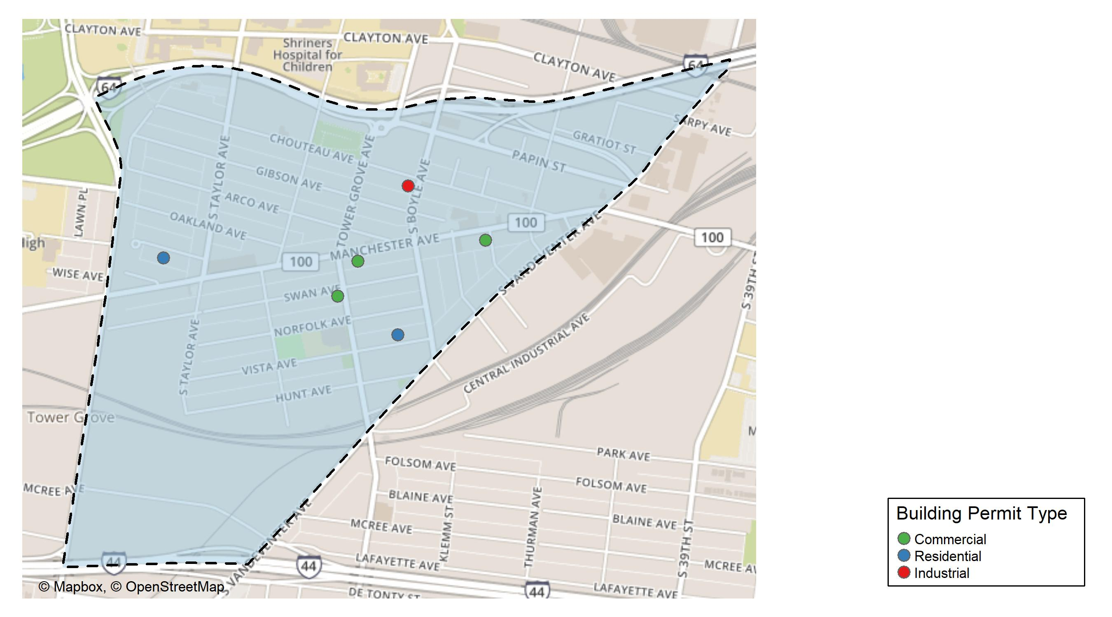
Forest Park Southeast

Slide 14
Neighborhood Summary
May 2024 | May 2024 | May 2024 | May 2024
Permit Use | Average Cost | # of Permits | Total Value of Permits
Commercial | $51,900 | 3 | $155,700
Industrial | $10,000 | 1 | $10,000
Residential | $9,000 | 2 | $18,000
Last 6 Months | Last 6 Months | Last 6 Months | Last 6 Months
Permit Use | Average Cost | # of Permits | Total Value of Permits
Commercial | $38,457.5 | 8 | $307,660
Industrial | $15,200.0 | 4 | $60,800
Residential | $116,880.7 | 35 | $4,090,826

Slide 15
Forest Park Southeast Individual Permit Breakdown
Neighborhood | Owner | New Use | Cost | address
Forest Park Southeast | RULE BREAKER LLC | Commercial | $700 | 1201 TOWER GROVE AV
Forest Park Southeast | COFFIN, SARAH | Industrial | $10,000 | 4306 CHOUTEAU AV
Forest Park Southeast | VAN, RICHARD ANTHONY | Residential | $10,000 | 4227 VISTA AV
Forest Park Southeast | 4256 MANCHESTER LLC | Commercial | $120,000 | 4256 MANCHESTER AV
Forest Park Southeast | ELYSIAN GROVE LLC | Commercial | $35,000 | 4138 MANCHESTER AV
Forest Park Southeast | FRANZ, CAITLIN ELIZABETH | Residential | $8,000 | 4538 WICHITA AV

Slide 16
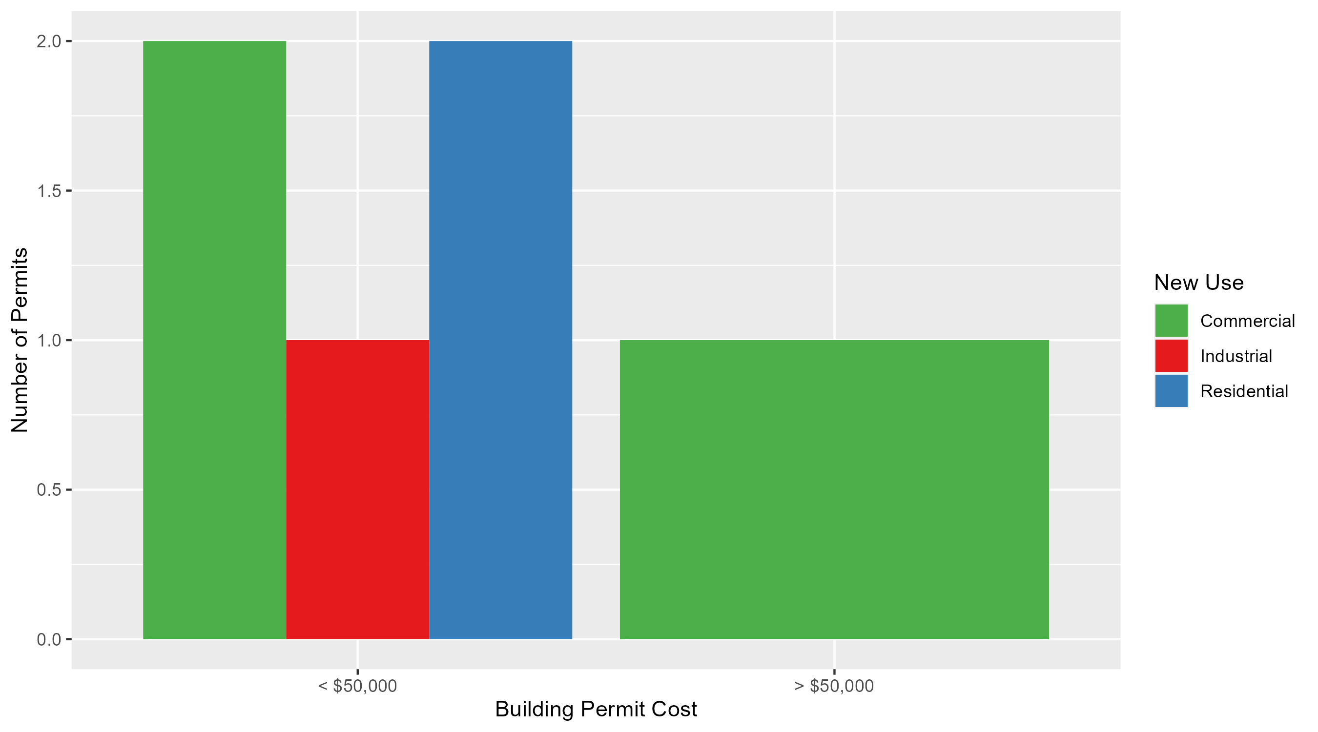
Forest Park Southeast Permit Cost Breakdown

Slide 17
Expanded Service Area

Slide 18
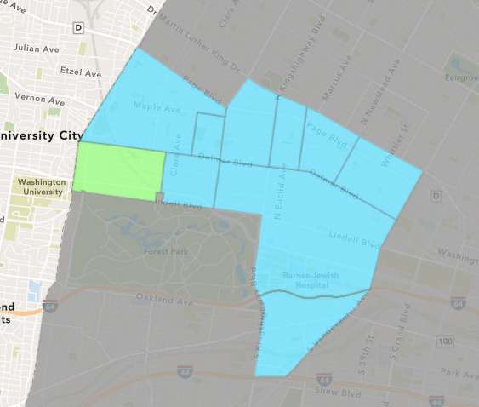
Skinker DeBaliviere
May 2024 Neighborhood Cost Breakdown
  Mean: $107,850
  Median: $14,000
  Range: $1,900 - $498,011

Slide 19
Skinker DeBaliviere: Summary Notes
5 building permits in May 2024
  -28.57% change compared to May 2023 (7 total building permits)
  $107,850: Average building permit cost in May 2024
    1276.45% change compared to May 2023 ($7,835)
22 total building permits in 2024
  -50.00% change YTD compared to this time in 2023 (44 total building permits)
  $82,180: YTD average building permit cost in 2024
    19.39% change YTD compared to this time in 2023 ($68,830)

Slide 20
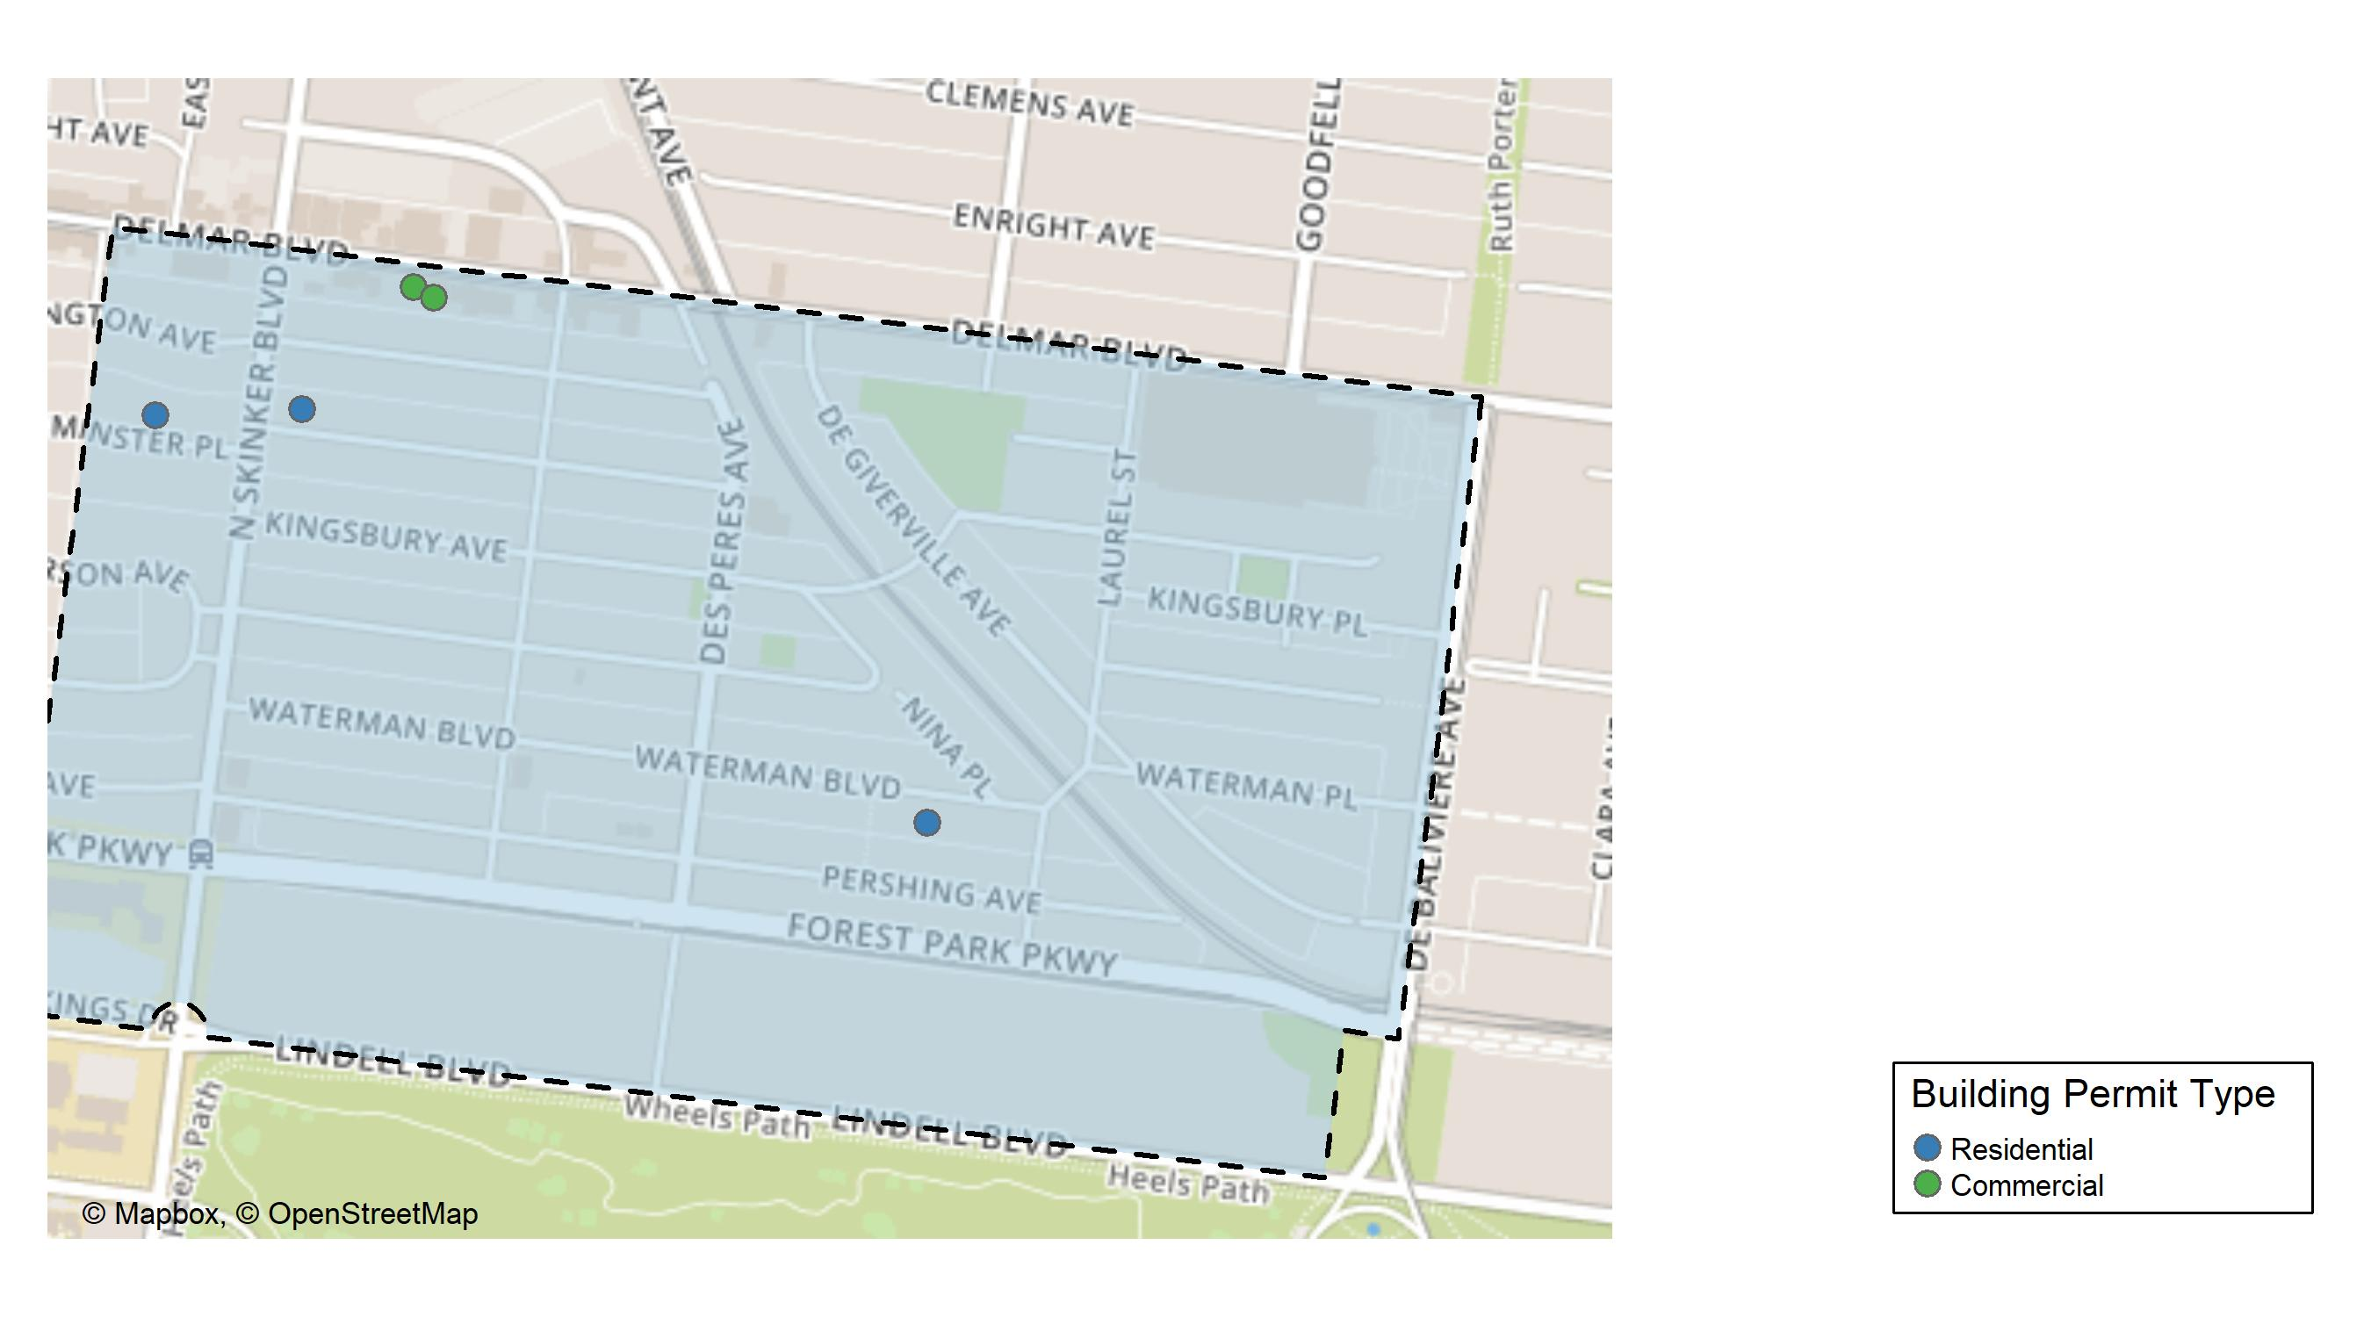
Skinker DeBaliviere

Slide 21
Neighborhood Summary
May 2024 | May 2024 | May 2024 | May 2024
Permit Use | Average Cost | # of Permits | Total Value of Permits
Commercial | $249,955.50 | 2 | $499,911
Industrial | $0.00 | 0 | $0
Residential | $13,113.67 | 3 | $39,341
Last 6 Months | Last 6 Months | Last 6 Months | Last 6 Months
Permit Use | Average Cost | # of Permits | Total Value of Permits
Commercial | $126,602.8 | 4 | $506,411
Industrial | $0.0 | 0 | $0
Residential | $143,529.8 | 30 | $4,305,893

Slide 22
Skinker DeBaliviere Individual Permit Breakdown
Neighborhood | Owner | New Use | Cost | address
Skinker DeBaliviere | QUADRANGLE MANAGEMENT CO | Commercial | $498,011 | 6148-50 DELMAR BLVD
Skinker DeBaliviere | GONZALEZ, FAUSTO J & ALISA R MUNOZ | Residential | $16,341 | 6185 WESTMINSTER PL
Skinker DeBaliviere | QUADRANGLE MANAGEMENT CO | Commercial | $1,900 | 6138 DELMAR BLVD
Skinker DeBaliviere | POWELL, DOUGLAS L & ANDREA R | Residential | $9,000 | 5838 WATERMAN BLVD
Skinker DeBaliviere | SCHULTZ, ROSALYN TRS | Residential | $14,000 | 6233 WESTMINSTER PL

Slide 23
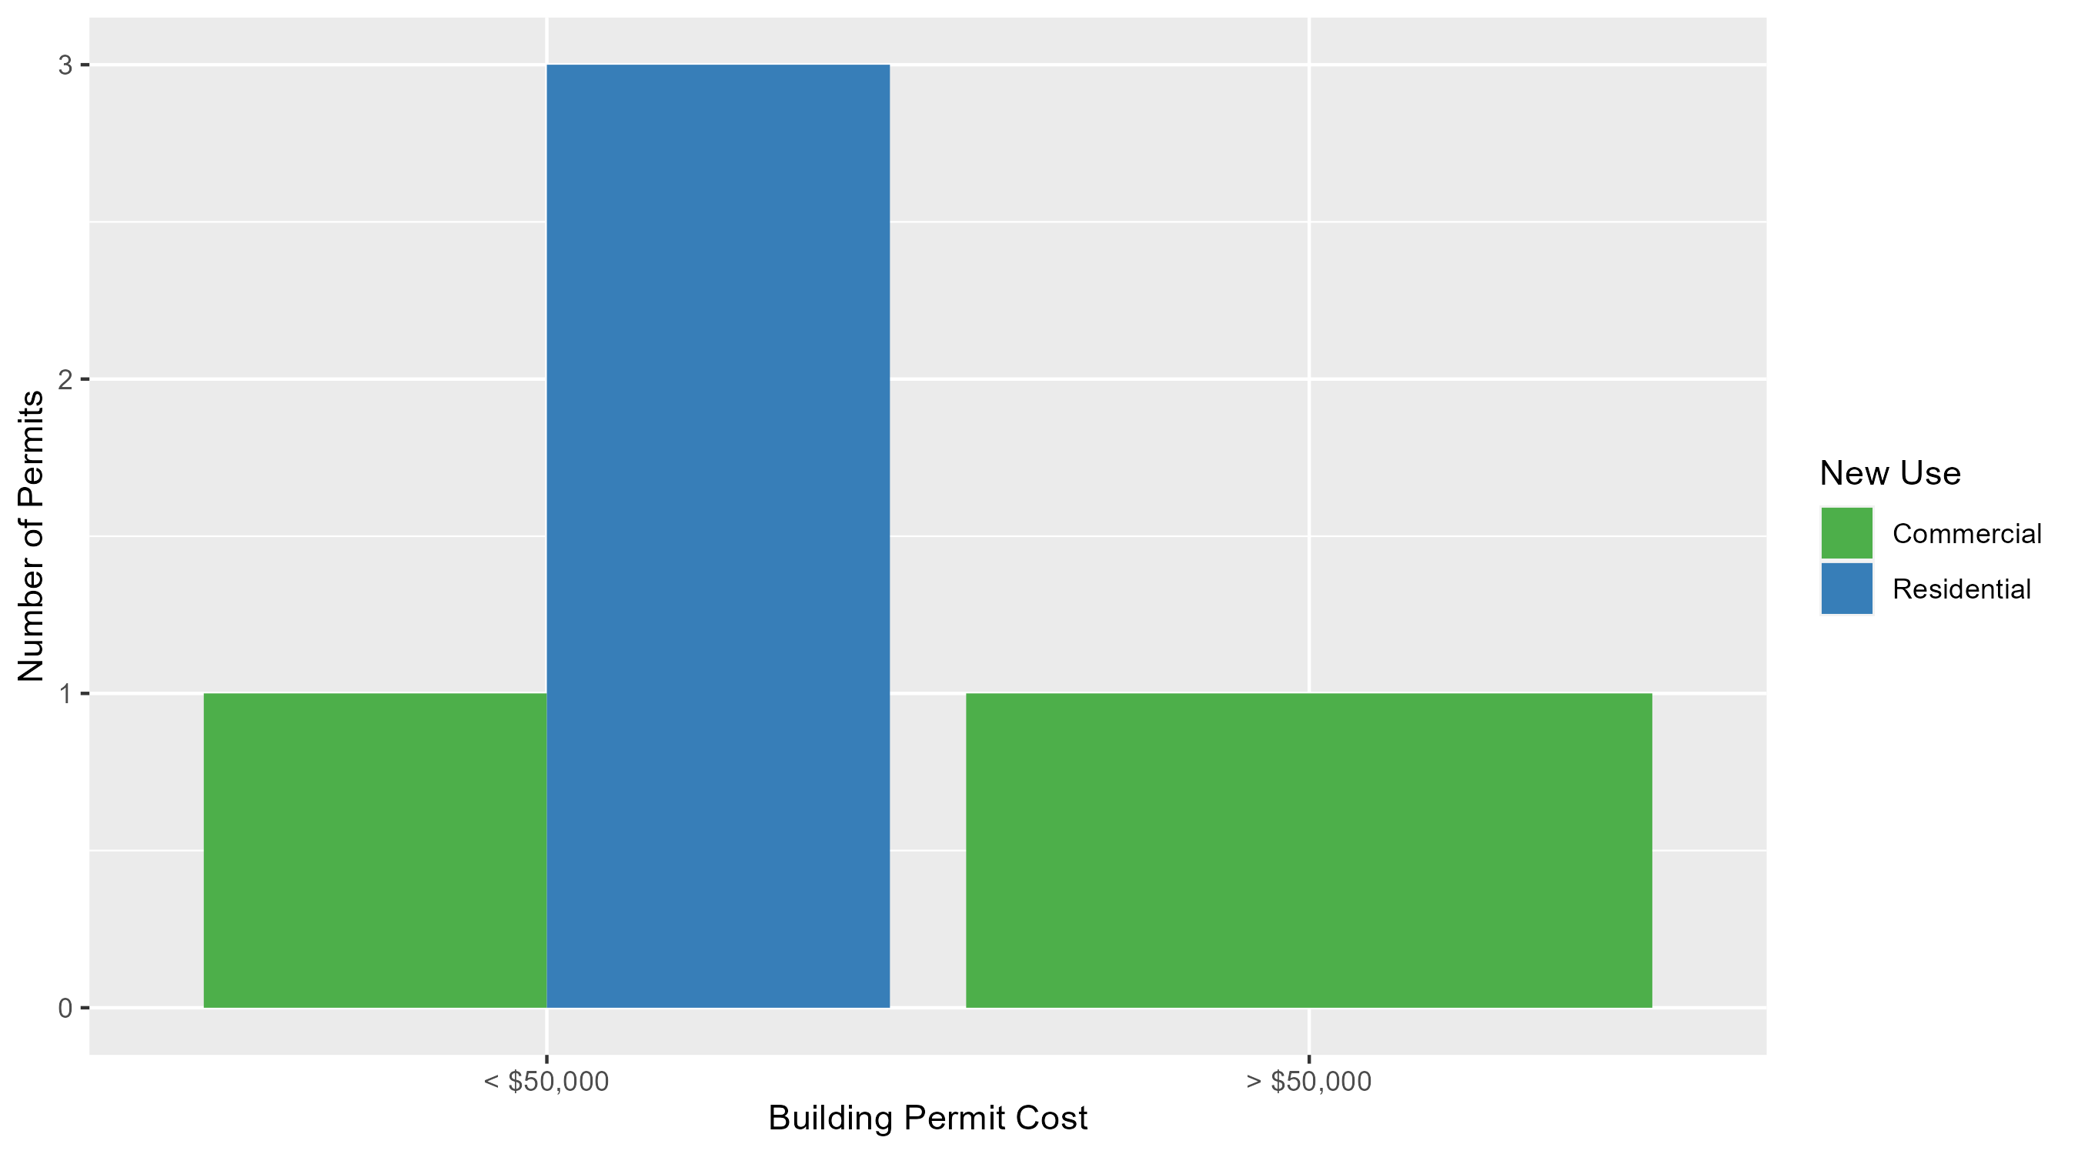
Skinker DeBaliviere Permit Cost Breakdown

Slide 24
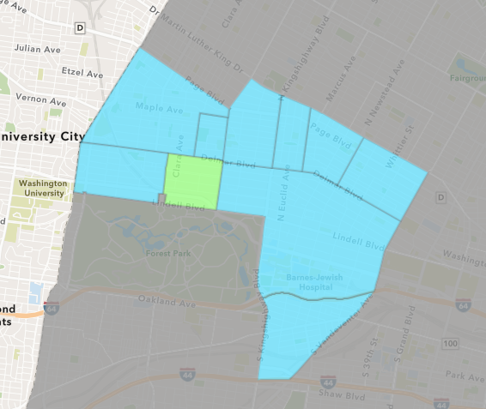
DeBaliviere Place
May 2024 Neighborhood Cost Breakdown
  Mean: $473,211
  Median: $91,423
  Range: $10,000 - $1,700,000

Slide 25
DeBaliviere Place: Summary Notes
4 building permits in May 2024
  0.00% change compared to May 2023 (4 total building permits)
  $473,211: Average building permit cost in May 2024
    -21.47% change compared to May 2023 ($602,571)
18 total building permits in 2024
  20.00% change YTD compared to this time in 2023 (15 total building permits)
  $149,051: YTD average building permit cost in 2024
    -42.25% change YTD compared to this time in 2023 ($258,089)

Slide 26
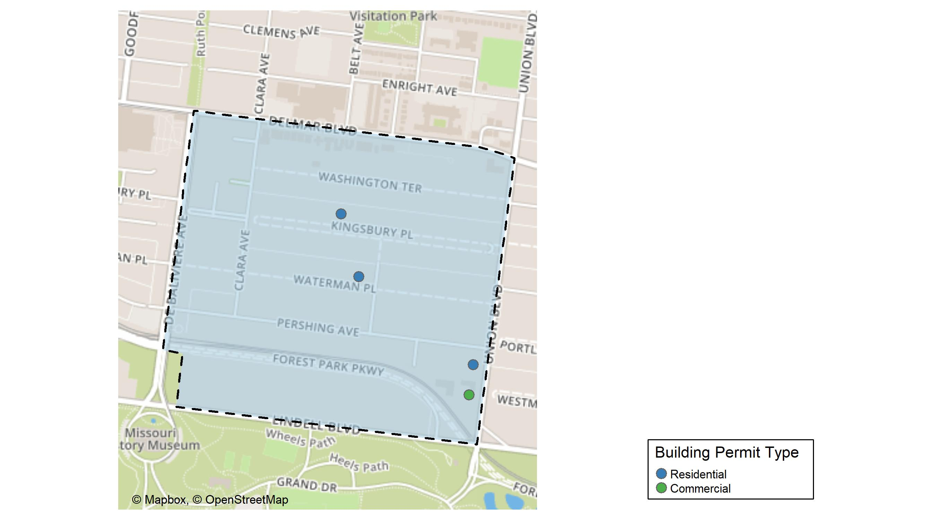
DeBaliviere Place

Slide 27
Neighborhood Summary
May 2024 | May 2024 | May 2024 | May 2024
Permit Use | Average Cost | # of Permits | Total Value of Permits
Commercial | $10,000 | 1 | $10,000
Industrial | $0 | 0 | $0
Residential | $627,615 | 3 | $1,882,845
Last 6 Months | Last 6 Months | Last 6 Months | Last 6 Months
Permit Use | Average Cost | # of Permits | Total Value of Permits
Commercial | $755,000 | 2 | $1,510,000
Industrial | $0 | 0 | $0
Residential | $138,544 | 21 | $2,909,424

Slide 28
DeBaliviere Place Individual Permit Breakdown
Neighborhood | Owner | New Use | Cost | address
DeBaliviere Place | ORO 275 PARKSIDE LLC & | Residential | $1,700,000 | 275 UNION BLVD
DeBaliviere Place | ORO 275 PARKSIDE LLC & | Commercial | $10,000 | 245 UNION BLVD
DeBaliviere Place | OTT, DAVID B & MARGARET MCDONALD | Residential | $127,925 | 35 KINGSBURY PL
DeBaliviere Place | HAN, LU & LIUZHAN YANGLAT 7 | Residential | $54,920 | 5515 WATERMAN BLVD

Slide 29
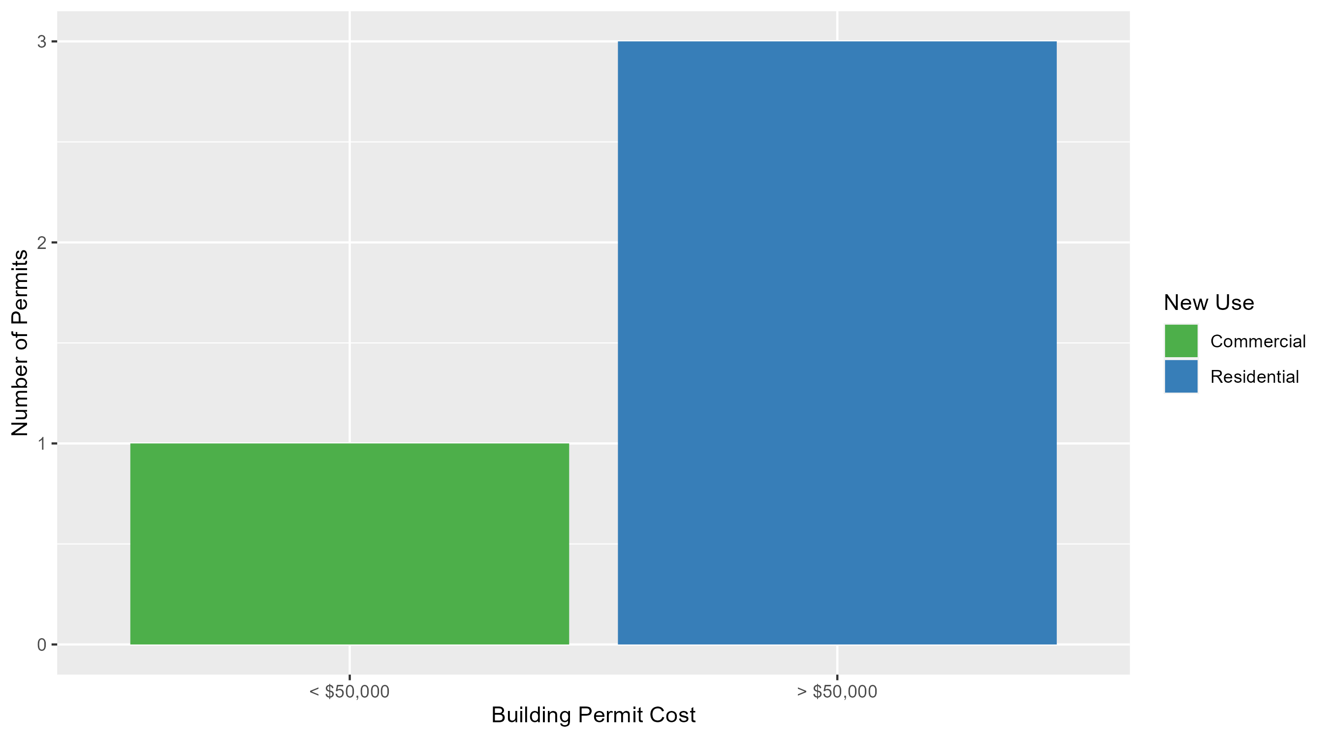
DeBaliviere Place Permit Cost Breakdown

Slide 30
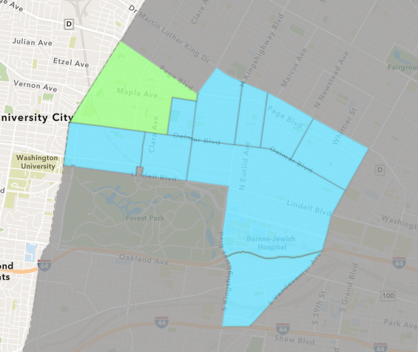
West End
May 2024 Neighborhood Cost Breakdown
  Mean: $15,322
  Median: $2,650
  Range: $1,000 - $100,000

Slide 31
West End: Summary Notes
10 building permits in May 2024
  25.00% change compared to May 2023 (8 total building permits)
  $15,322: Average building permit cost in May 2024
    -52.01% change compared to May 2023 ($31,924)
39 total building permits in 2024
  0.00% change YTD compared to this time in 2023 (39 total building permits)
  $107,952: YTD average building permit cost in 2024
    217.68% change YTD compared to this time in 2023 ($33,982)

Slide 32
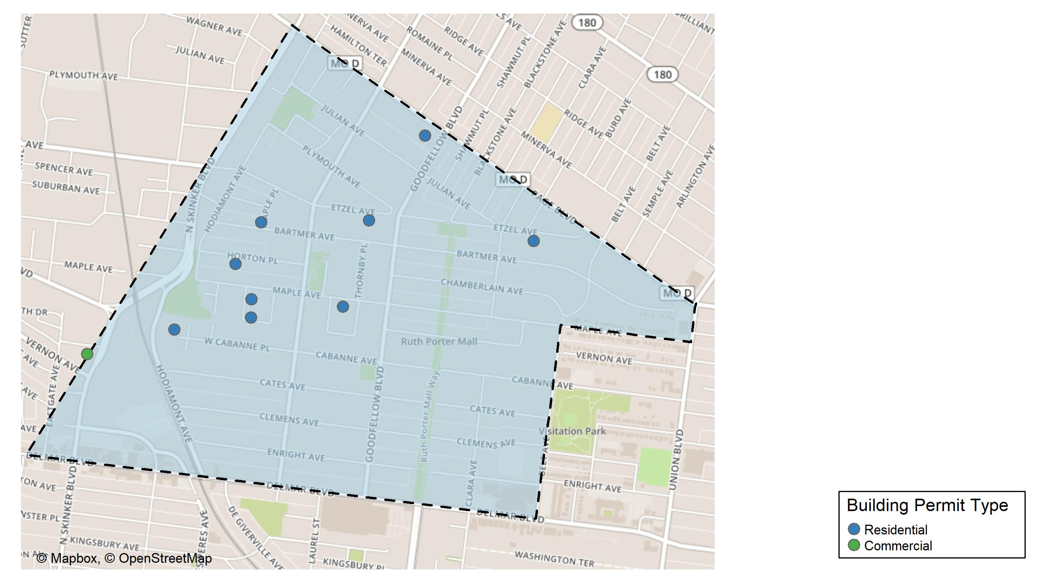
West End

Slide 33
Neighborhood Summary
May 2024 | May 2024 | May 2024 | May 2024
Permit Use | Average Cost | # of Permits | Total Value of Permits
Commercial | $100,000 | 1 | $100,000
Industrial | $0 | 0 | $0
Residential | $5,913 | 9 | $53,217
Last 6 Months | Last 6 Months | Last 6 Months | Last 6 Months
Permit Use | Average Cost | # of Permits | Total Value of Permits
Commercial | $371,157.56 | 9 | $3,340,418
Industrial | $14,400.00 | 2 | $28,800
Residential | $62,846.19 | 37 | $2,325,309

Slide 34
West End Individual Permit Breakdown
Neighborhood | Owner | New Use | Cost | address
West End | GENXMEX REAL ESTATE HOLDING CO LLC | Commercial | $100,000 | 851 N SKINKER BLVD
West End | SNEED, DOROTHY | Residential | $5,117 | 5578 ETZEL AV
West End | BONNER, WALTER A JR | Residential | $2,000 | 934 MAPLE PL
West End | HAMILTON, JEFFREY L | Residential | $2,500 | 5850 MAPLE AV
West End | JOHNSON, MARQUITA E | Residential | $11,800 | 6014 HORTON PL
West End | MAGNOLIA REALTY LLC | Residential | $2,000 | 5832-34 ETZEL AV
West End | TURNER, AARON | Residential | $25,000 | 956 MAPLE PL
West End | VIBRANT BLUE REALTY LLC | Residential | $2,800 | 5814 PAGE BLVD
West End | BARBER, ALESHA | Residential | $1,000 | 6001 BARTMER AV
West End | MCKINNIS, BERTHA | Residential | $1,000 | 6085 WEST CABANNE PL

Slide 35
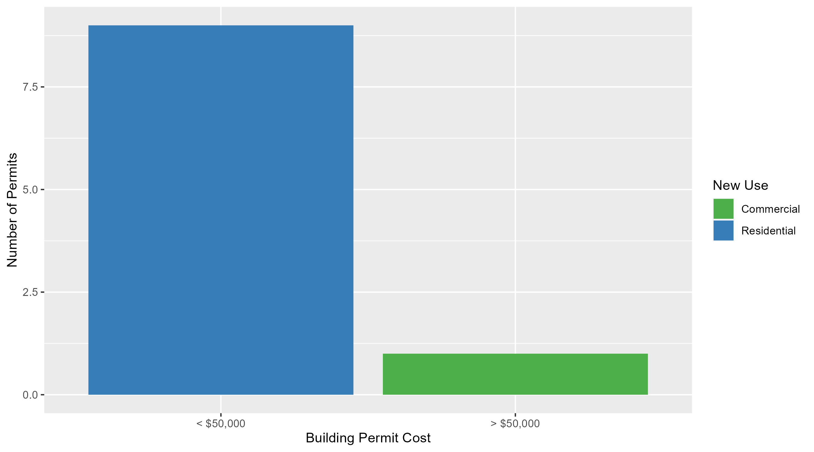
West End Permit Cost Breakdown

Slide 36
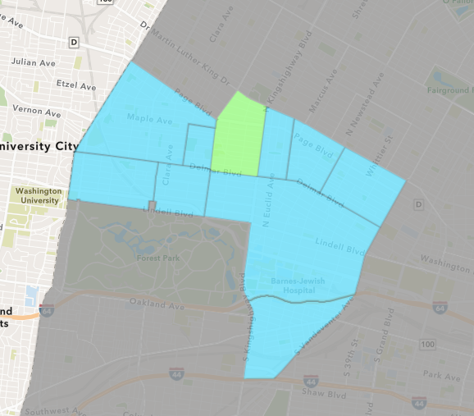
Academy
May 2024 Neighborhood Cost Breakdown
  Mean: $175,500
  Median: $175,500
  Range: $1,000 - $350,000

Slide 37
Academy: Summary Notes
2 building permits in May 2024
  -50.00% change compared to May 2023 (4 total building permits)
  $175,500: Average building permit cost in May 2024
    2526.46% change compared to May 2023 ($6,682)
9 total building permits in 2024
  -25.00% change YTD compared to this time in 2023 (12 total building permits)
  $54,467: YTD average building permit cost in 2024
    202.62% change YTD compared to this time in 2023 ($17,998)

Slide 38
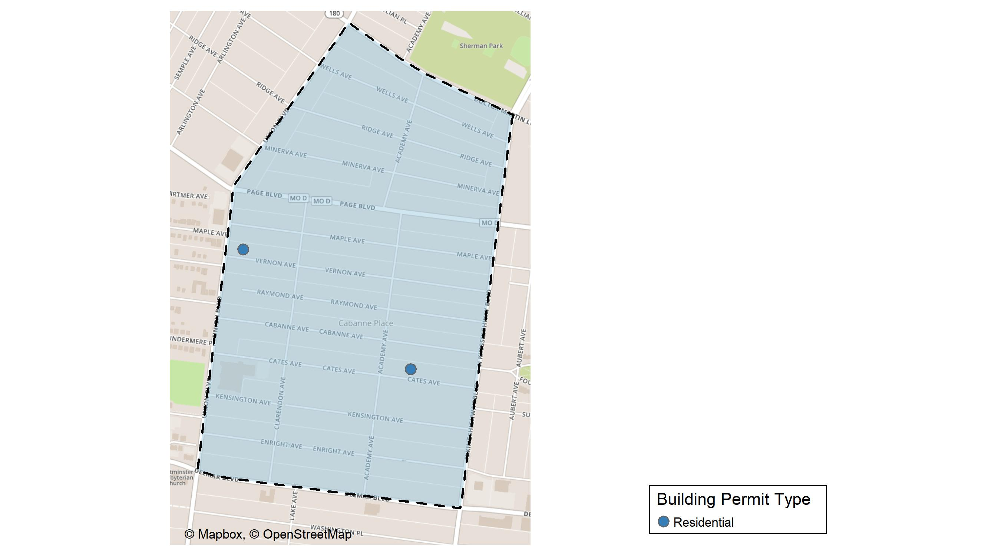
Academy

Slide 39
Neighborhood Summary
May 2024 | May 2024 | May 2024 | May 2024
Permit Use | Average Cost | # of Permits | Total Value of Permits
Commercial | $0 | 0 | $0
Industrial | $0 | 0 | $0
Residential | $175,500 | 2 | $351,000
Last 6 Months | Last 6 Months | Last 6 Months | Last 6 Months
Permit Use | Average Cost | # of Permits | Total Value of Permits
Commercial | $40,964.00 | 2 | $81,928
Industrial | $42,000.00 | 1 | $42,000
Residential | $41,577.89 | 9 | $374,201

Slide 40
Academy Individual Permit Breakdown
Neighborhood | Owner | New Use | Cost | address
Academy | 5259 VERNON LLC | Residential | $350,000 | 5259 VERNON AV
Academy | INVIGOR PROPERTIES LLC | Residential | $1,000 | 5067 CATES AV

Slide 41
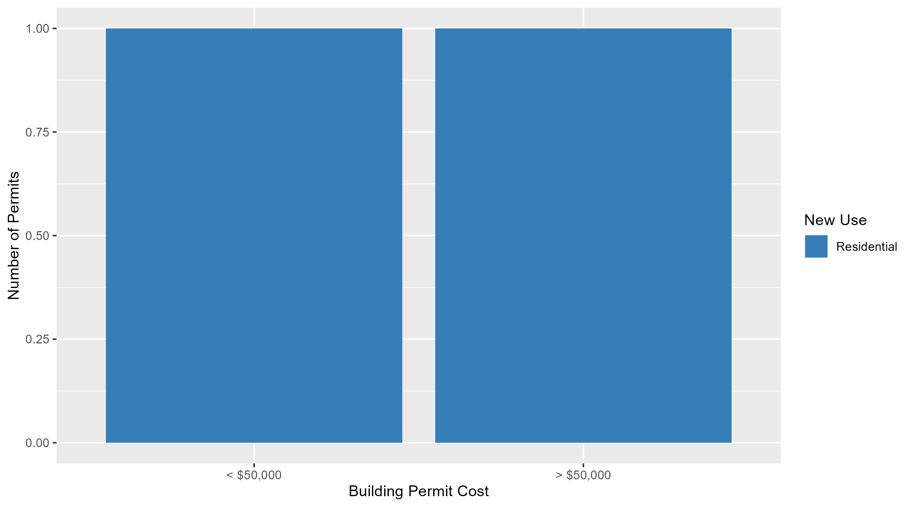
Academy Permit Cost Breakdown

Slide 42
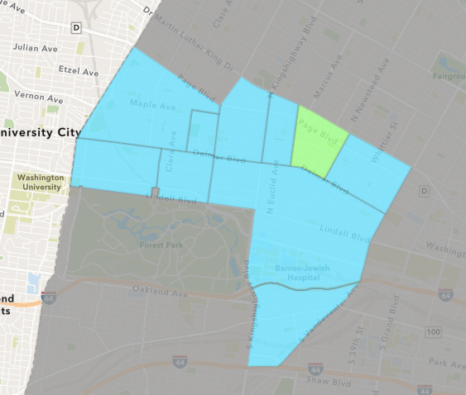
Lewis Place
May 2024 Neighborhood Cost Breakdown
  Mean: $11,000
  Median: $11,000
  Range: $11,000 - $11,000

Slide 43
Lewis Place: Summary Notes
1 building permits in May 2024
  -50.00% change compared to May 2023 (2 total building permits)
  $11,000: Average building permit cost in May 2024
    -93.46% change compared to May 2023 ($168,103)
6 total building permits in 2024
  -25.00% change YTD compared to this time in 2023 (8 total building permits)
  $5,915: YTD average building permit cost in 2024
    -89.33% change YTD compared to this time in 2023 ($55,413)

Slide 44
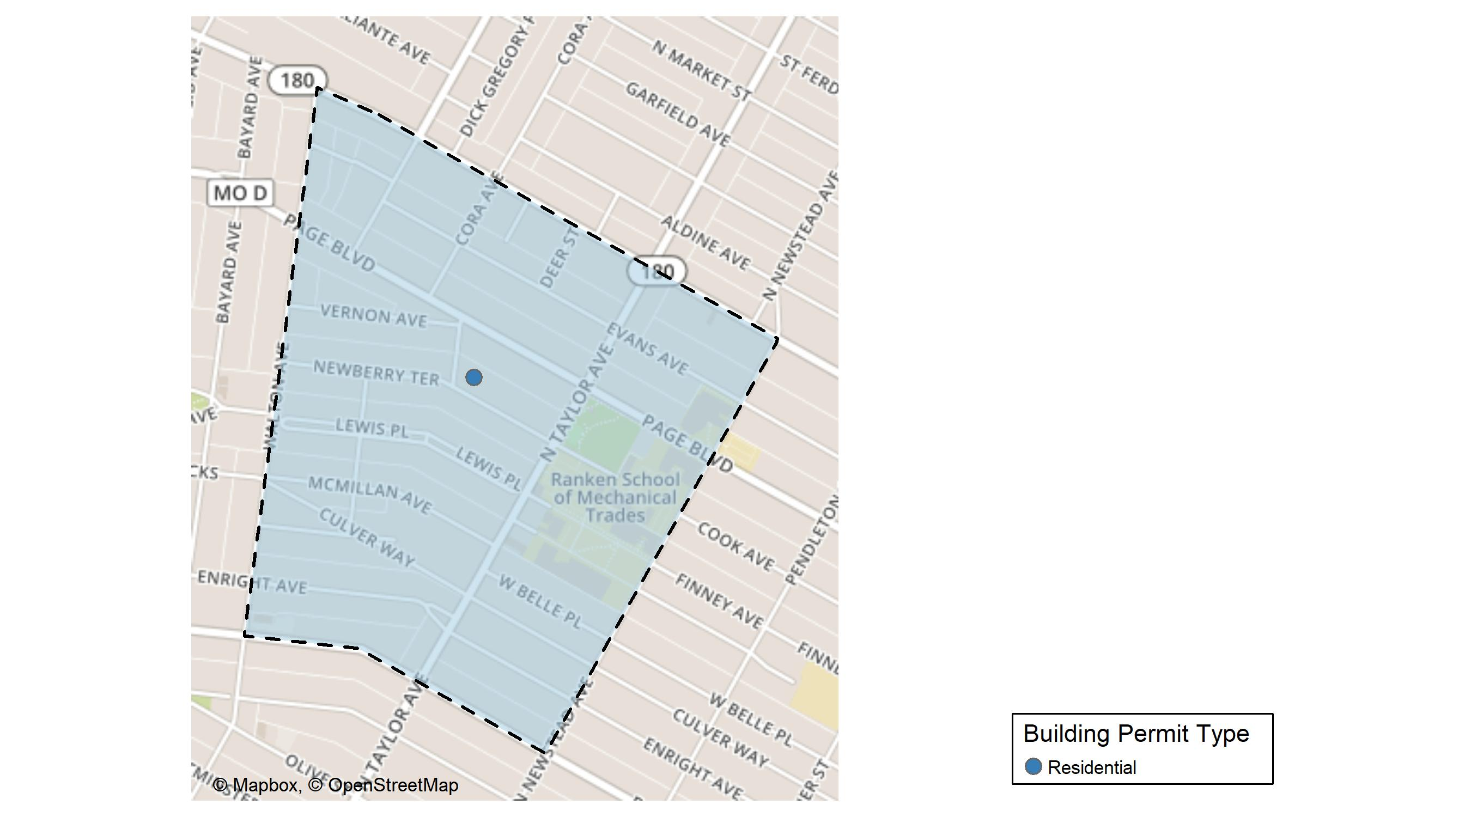
Lewis Place

Slide 45
Neighborhood Summary
May 2024 | May 2024 | May 2024 | May 2024
Permit Use | Average Cost | # of Permits | Total Value of Permits
Commercial | $0 | 0 | $0
Industrial | $0 | 0 | $0
Residential | $11,000 | 1 | $11,000
Last 6 Months | Last 6 Months | Last 6 Months | Last 6 Months
Permit Use | Average Cost | # of Permits | Total Value of Permits
Commercial | $1,992.00 | 1 | $1,992
Industrial | $7,000.00 | 1 | $7,000
Residential | $19,212.75 | 8 | $153,702

Slide 46
Lewis Place Individual Permit Breakdown
Neighborhood | Owner | New Use | Cost | address
Lewis Place | MCDOWELL, VONTRICE L & NICHOLAS | Residential | $11,000 | 4565-69 NEWBERRY TER

Slide 47
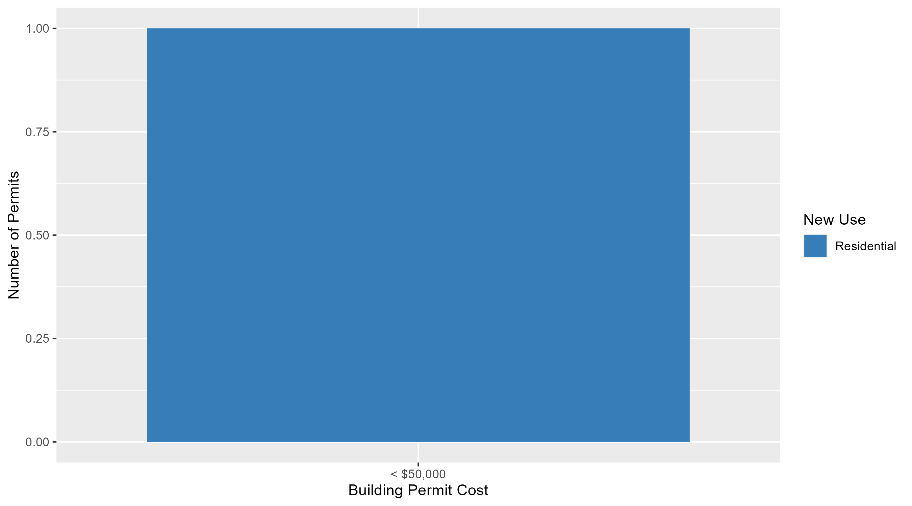
Lewis Place Permit Cost Breakdown

Slide 48
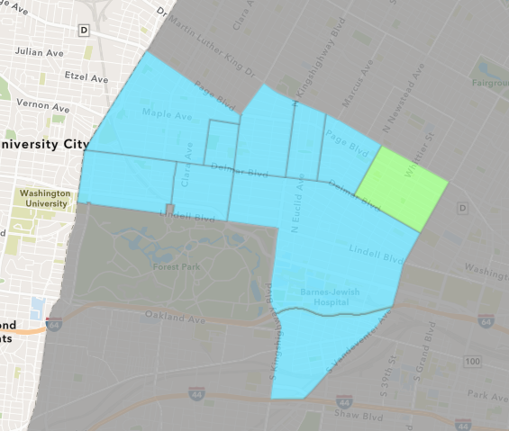
Vandeventer
May 2024 Neighborhood Cost Breakdown
  Mean: $67,500
  Median: $67,500
  Range: $35,000 - $100,000

Slide 49
Vandeventer: Summary Notes
2 building permits in May 2024
  -33.33% change compared to May 2023 (3 total building permits)
  $67,500: Average building permit cost in May 2024
    726.53% change compared to May 2023 ($8,167)
5 total building permits in 2024
  -28.57% change YTD compared to this time in 2023 (7 total building permits)
  $69,530: YTD average building permit cost in 2024
    878.80% change YTD compared to this time in 2023 ($7,104)

Slide 50
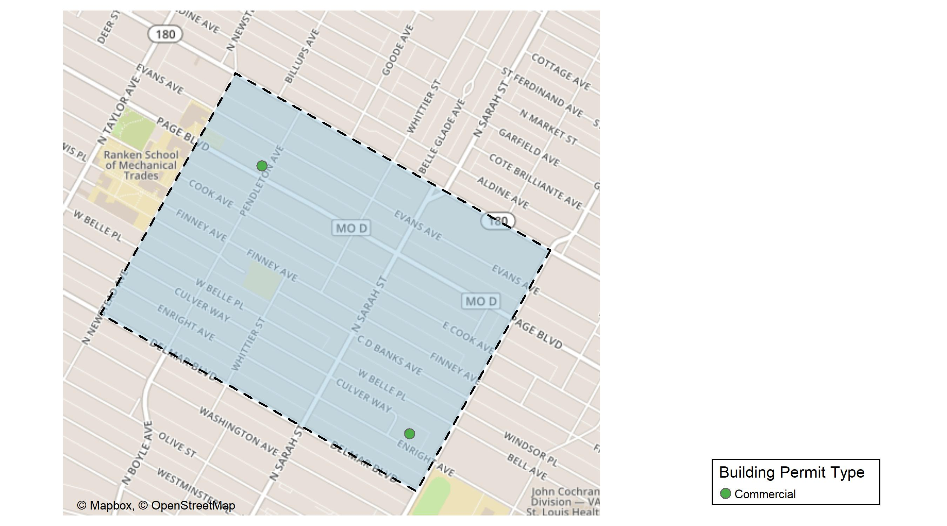
Vandeventer

Slide 51
Neighborhood Summary
May 2024 | May 2024 | May 2024 | May 2024
Permit Use | Average Cost | # of Permits | Total Value of Permits
Commercial | $67,500 | 2 | $135,000
Industrial | $0 | 0 | $0
Residential | $0 | 0 | $0
Last 6 Months | Last 6 Months | Last 6 Months | Last 6 Months
Permit Use | Average Cost | # of Permits | Total Value of Permits
Commercial | $54,500.00 | 3 | $163,500
Industrial | $0.00 | 0 | $0
Residential | $52,374.25 | 4 | $209,497

Slide 52
Vandeventer Individual Permit Breakdown
Neighborhood | Owner | New Use | Cost | address
Vandeventer | B O E OF THE CITY OF ST LOUIS | Commercial | $100,000 | 3935 ENRIGHT AV
Vandeventer | PAGE AVE REALTY LLC | Commercial | $35,000 | 4301 PAGE BLVD

Slide 53
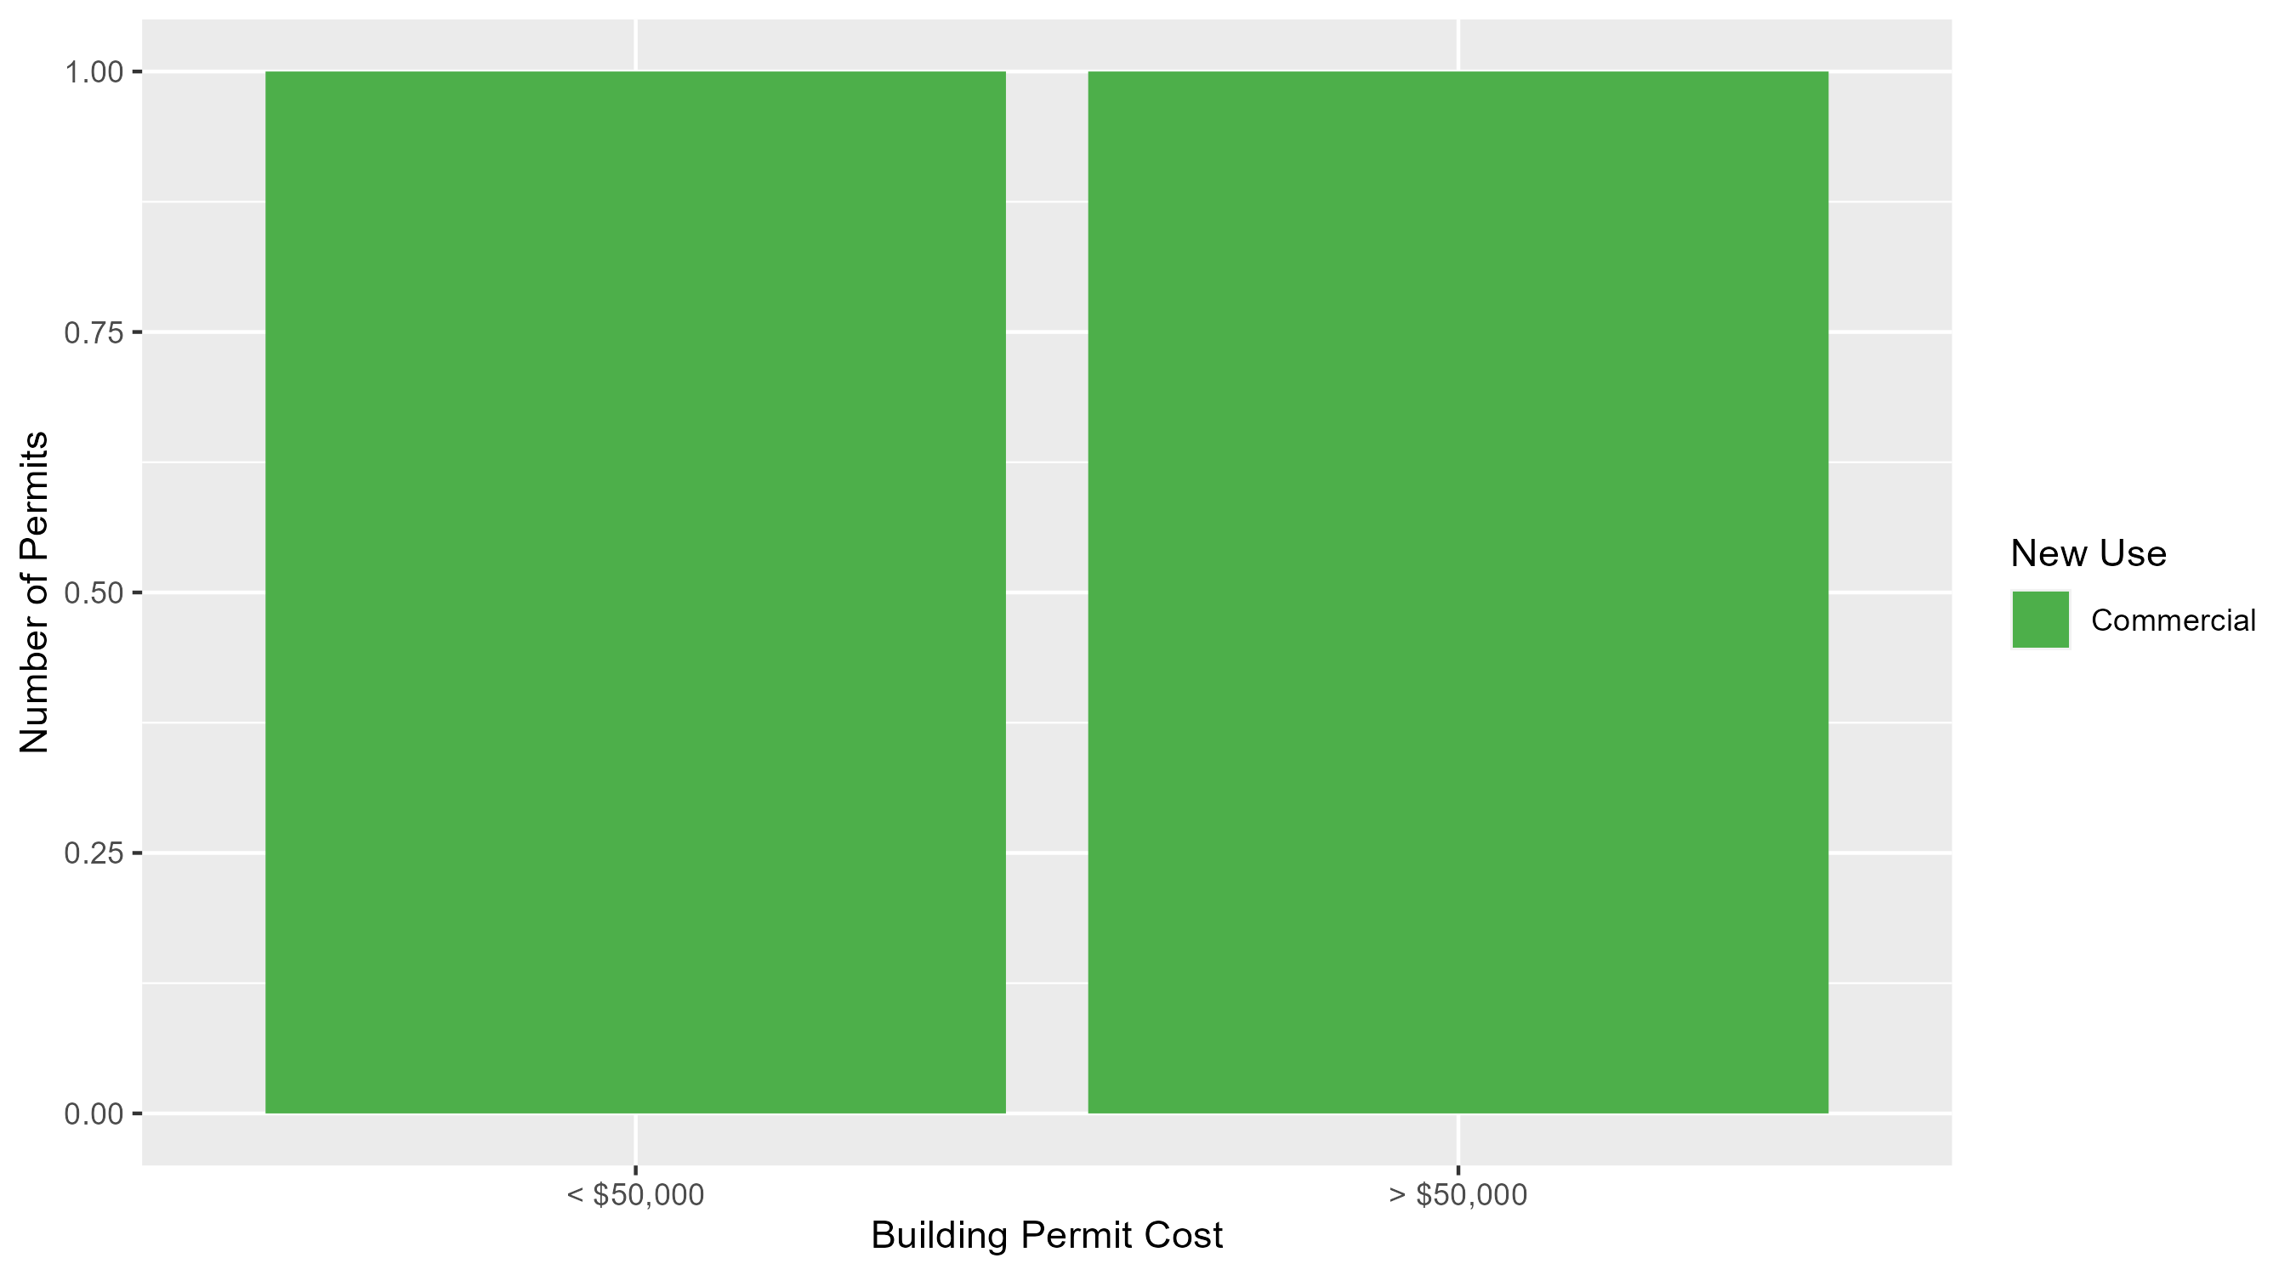
Vandeventer Permit Cost Breakdown

Slide 54
Additional Notes
Data retreived from https://www.stlouis-mo.gov/data/
Building permits with a cost of $0 were dropped
Building permits that were cancelled were dropped
Infinite change indicates 0 permits in the current or previous time period/comparison month so there was a overall increase or decrease

