Slide 1
St. Louis Central Corridor West Building Permits
Monthly Report: November 2023

Slide 2
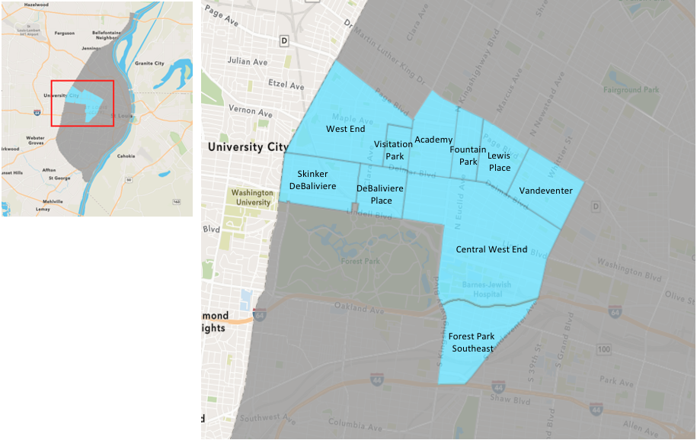
St. Louis Neighborhood Spatial Reference

Slide 3
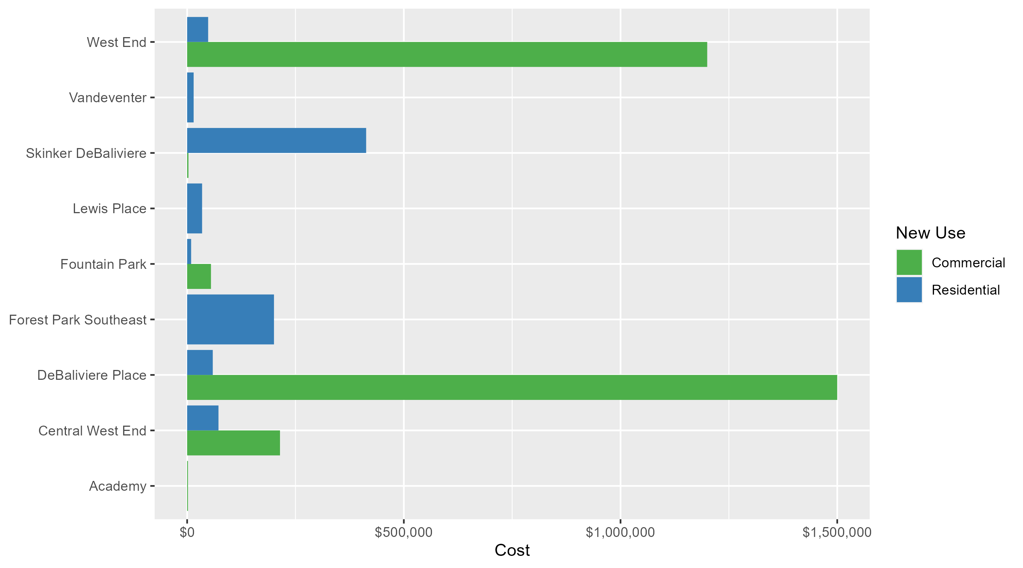
Neighborhood Summary: Average Building Permit Cost

Slide 4
Neighborhood Summary
November 2023 | November 2023 | November 2023 | November 2023
Neighborhood | Average Cost | # of Permits | Total Value of Permits
Academy | $1,928.00 | 1 | $1,928
Central West End | $151,157.70 | 27 | $4,081,258
DeBaliviere Place | $347,300.00 | 5 | $1,736,500
Forest Park Southeast | $200,371.43 | 7 | $1,402,600
Fountain Park | $24,466.67 | 3 | $73,400
Lewis Place | $34,500.00 | 2 | $69,000
Skinker DeBaliviere | $361,771.38 | 8 | $2,894,171
Vandeventer | $15,000.00 | 1 | $15,000
Visitation Park | $0.00 | 0 | $0
West End | $240,400.00 | 6 | $1,442,400
Last 6 Months | Last 6 Months | Last 6 Months | Last 6 Months
Neighborhood | Average Cost | # of Permits | Total Value of Permits
Academy | $26,311.90 | 21 | $552,550
Central West End | $127,205.49 | 225 | $28,621,236
DeBaliviere Place | $171,976.84 | 32 | $5,503,259
Forest Park Southeast | $80,871.98 | 45 | $3,639,239
Fountain Park | $193,674.00 | 10 | $1,936,740
Lewis Place | $94,849.00 | 7 | $663,943
Skinker DeBaliviere | $85,958.88 | 63 | $5,415,410
Vandeventer | $215,354.55 | 11 | $2,368,900
Visitation Park | $56,075.00 | 4 | $224,300
West End | $91,781.15 | 54 | $4,956,182

Slide 5
Core Neighborhoods

Slide 6
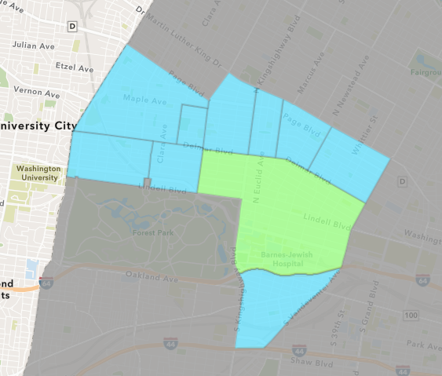
Central West End
November 2023 Neighborhood Cost Breakdown
  Mean: $151,158
  Median: $20,000
  Range: $4,000 - $1,000,000

Slide 7
Central West End: Summary Notes
27 building permits in November 2023
  -10.00% change compared to November 2022 (30 total building permits)
  $151,158: Average building permit cost in November 2023
    60.23% change compared to November 2022 ($94,337)
348 total building permits in 2023
  0.29% change YTD compared to this time in 2022 (347 total building permits)
  $223,408: YTD average building permit cost in 2023
    -84.83% change YTD compared to this time in 2022 ($1,472,339)

Slide 8
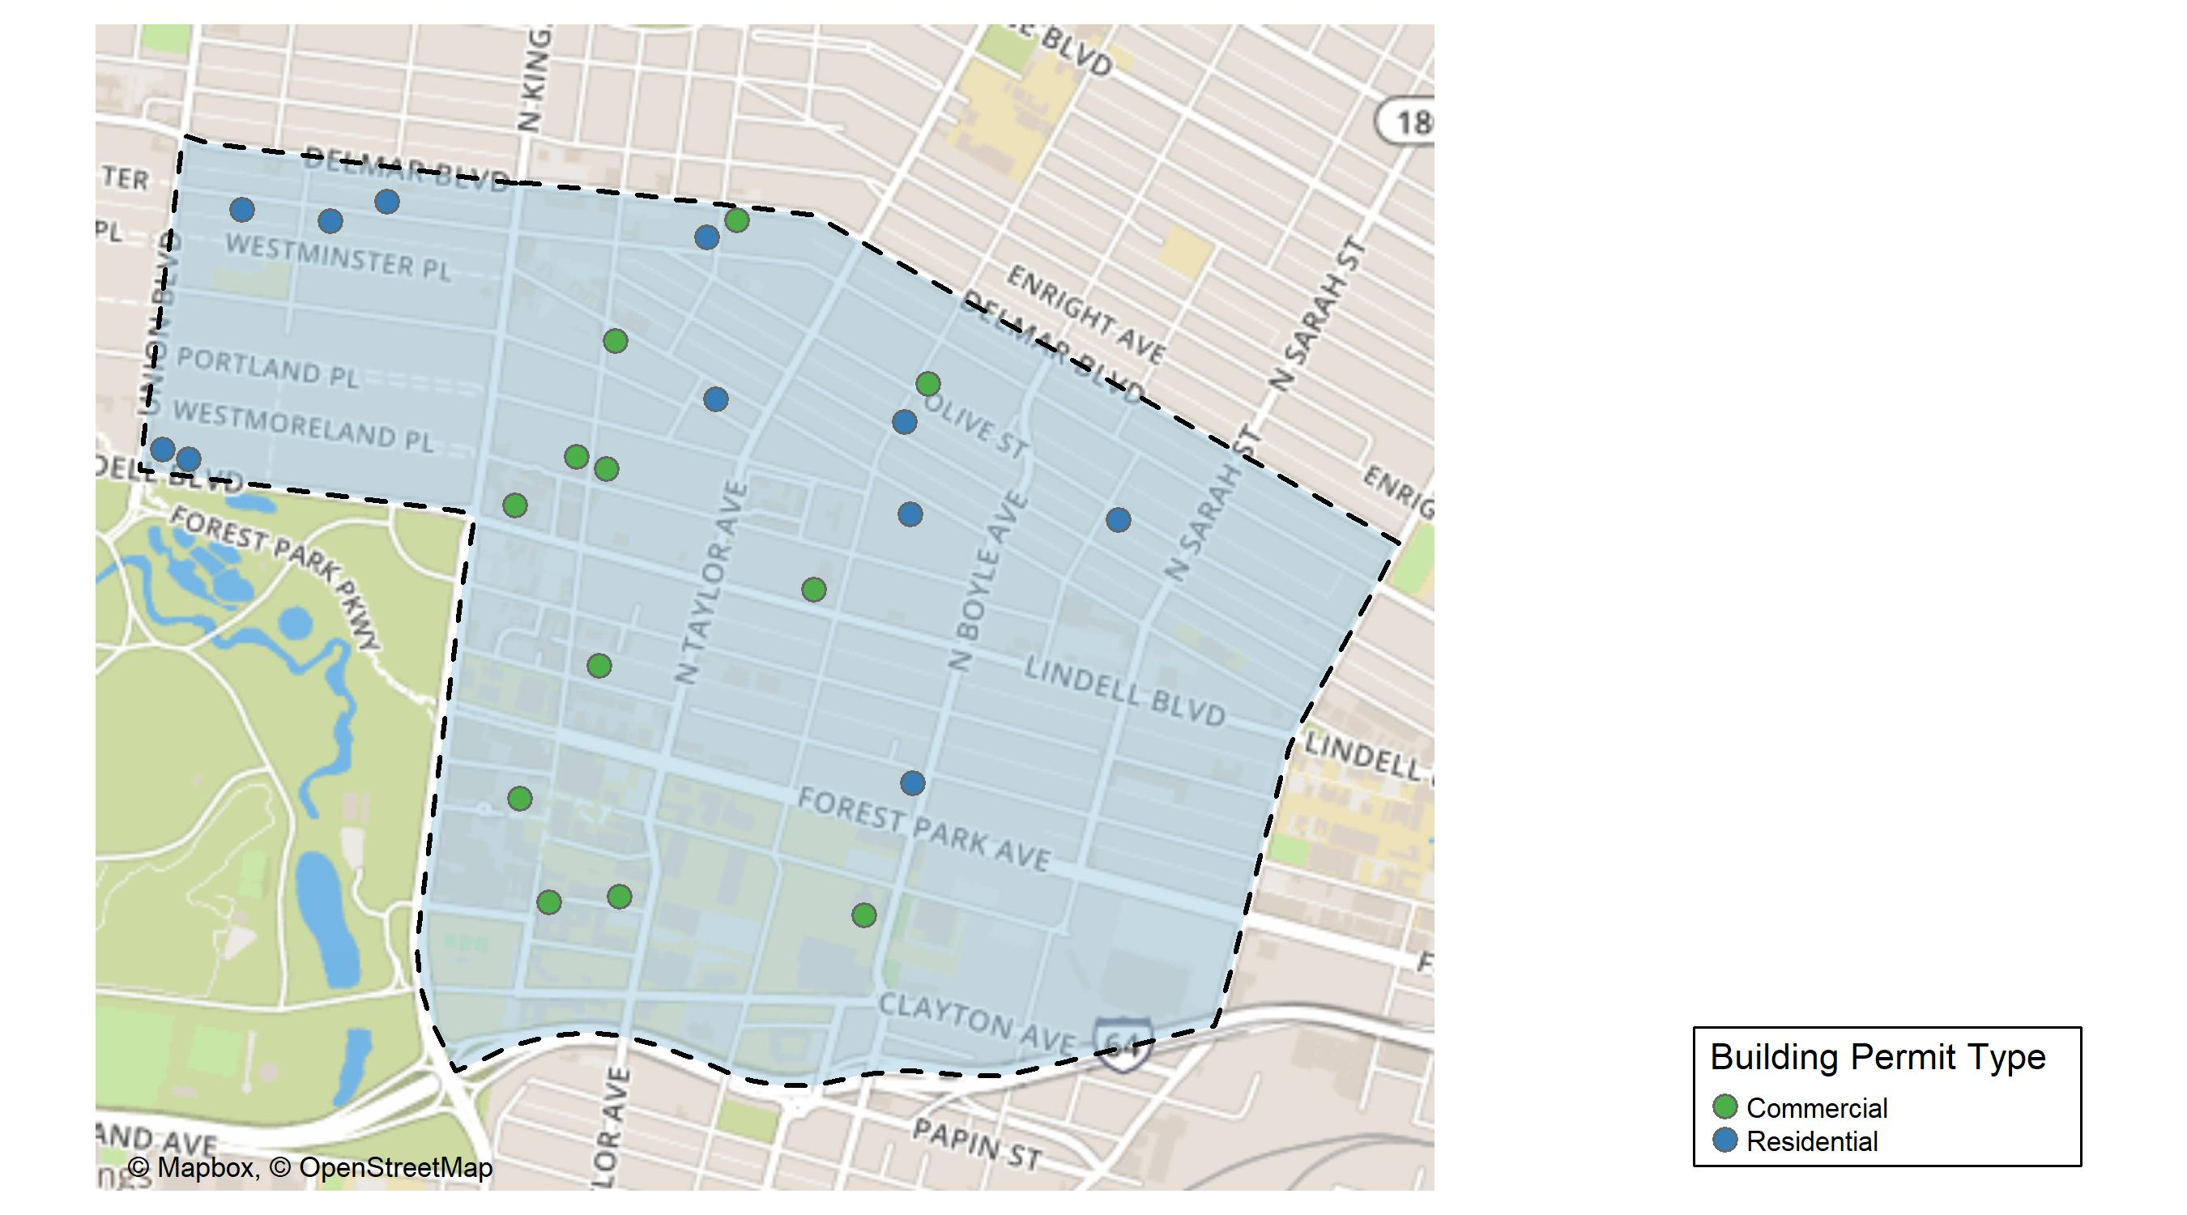
Central West End

Slide 9
Neighborhood Summary
November 2023 | November 2023 | November 2023 | November 2023
Permit Use | Average Cost | # of Permits | Total Value of Permits
Commercial | $214,246.20 | 15 | $3,213,693
Industrial | $0.00 | 0 | $0
Residential | $72,297.08 | 12 | $867,565
Last 6 Months | Last 6 Months | Last 6 Months | Last 6 Months
Permit Use | Average Cost | # of Permits | Total Value of Permits
Commercial | $200,836.06 | 86 | $17,271,901
Industrial | $18,560.00 | 5 | $92,800
Residential | $84,003.99 | 134 | $11,256,535

Slide 10
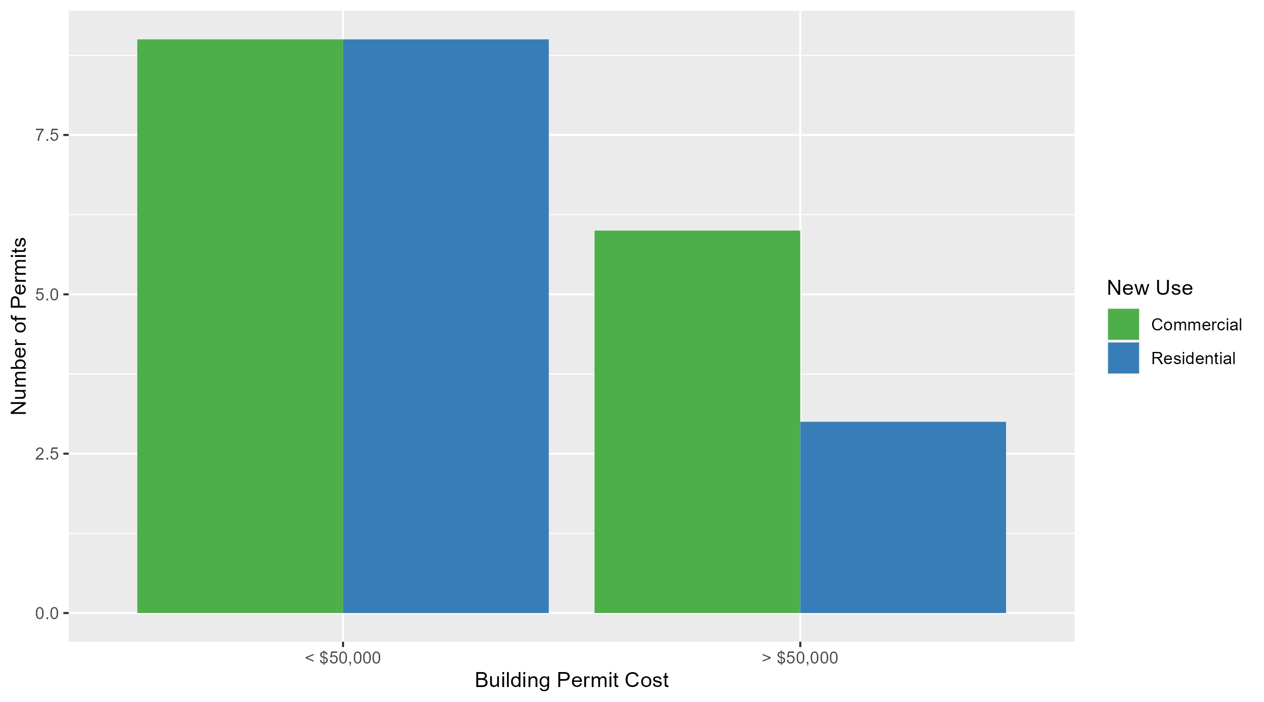
Central West End Permit Cost Breakdown

Slide 11
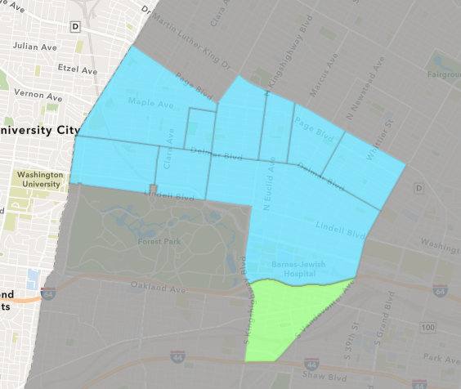
Forest Park Southeast
November 2023 Neighborhood Cost Breakdown
  Mean: $200,371
  Median: $37,000
  Range: $800 - $1,250,000

Slide 12
Forest Park Southeast: Summary Notes
7 building permits in November 2023
  -22.22% change compared to November 2022 (9 total building permits)
  $200,371: Average building permit cost in November 2023
    -92.70% change compared to November 2022 ($2,743,667)
65 total building permits in 2023
  -53.24% change YTD compared to this time in 2022 (139 total building permits)
  $80,750: YTD average building permit cost in 2023
    -86.78% change YTD compared to this time in 2022 ($610,894)

Slide 13
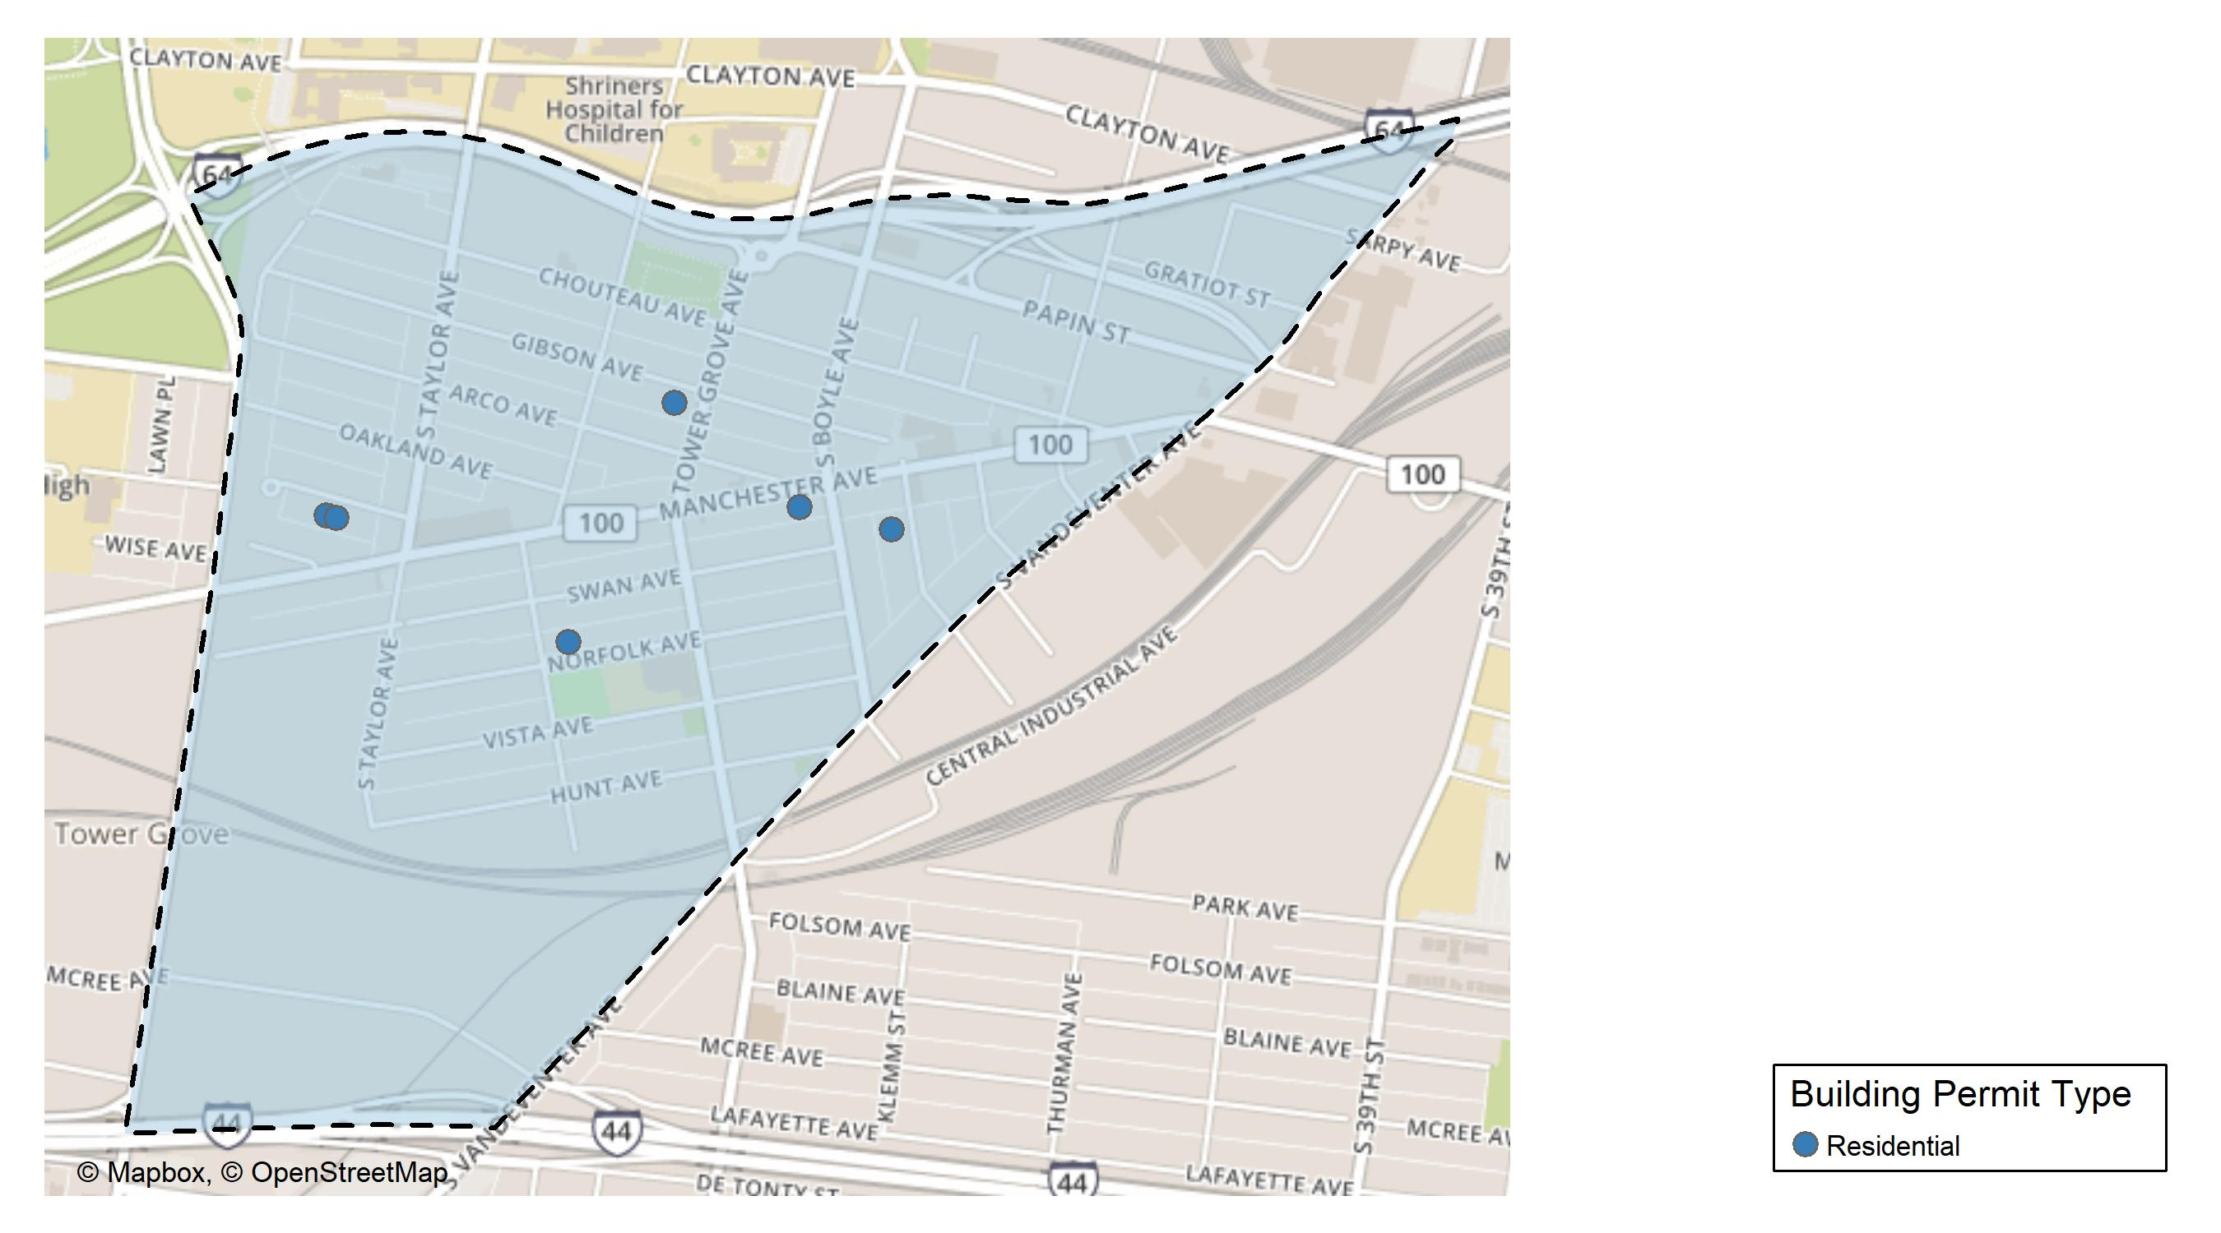
Forest Park Southeast

Slide 14
Neighborhood Summary
November 2023 | November 2023 | November 2023 | November 2023
Permit Use | Average Cost | # of Permits | Total Value of Permits
Commercial | $0.0 | 0 | $0
Industrial | $0.0 | 0 | $0
Residential | $200,371.4 | 7 | $1,402,600
Last 6 Months | Last 6 Months | Last 6 Months | Last 6 Months
Permit Use | Average Cost | # of Permits | Total Value of Permits
Commercial | $144,789.88 | 8 | $1,158,319
Industrial | $12,200.00 | 4 | $48,800
Residential | $73,700.61 | 33 | $2,432,120

Slide 15
Forest Park Southeast Individual Permit Breakdown
Neighborhood | Owner | New Use | Cost | address
Forest Park Southeast | CHEUNG, ALAN | Residential | $1,250,000 | 4210-14 MANCHESTER AV
Forest Park Southeast | ONICA, ADAM & | Residential | $14,100 | 4363 NORFOLK AV
Forest Park Southeast | FREEDOM HOUSE PARTNERS LLC | Residential | $60,000 | 4370 GIBSON AV
Forest Park Southeast | FRANZ, CAITLIN ELIZABETH | Residential | $37,000 | 4538 WICHITA AV
Forest Park Southeast | GATES, CAMRON & | Residential | $39,000 | 4534 WICHITA AV
Forest Park Southeast | ROWELL, JASON | Residential | $1,700 | 1125 KENTUCKY AV
Forest Park Southeast | JEMZ INVESTMENTS & PROPERTIES LLC C | Residential | $800 | 4352-54 VISTA AV

Slide 16
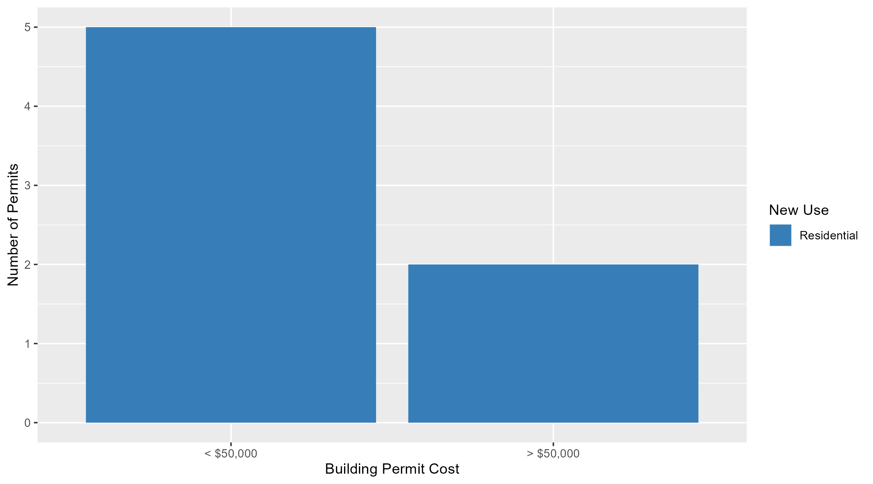
Forest Park Southeast Permit Cost Breakdown

Slide 17
Expanded Service Area

Slide 18
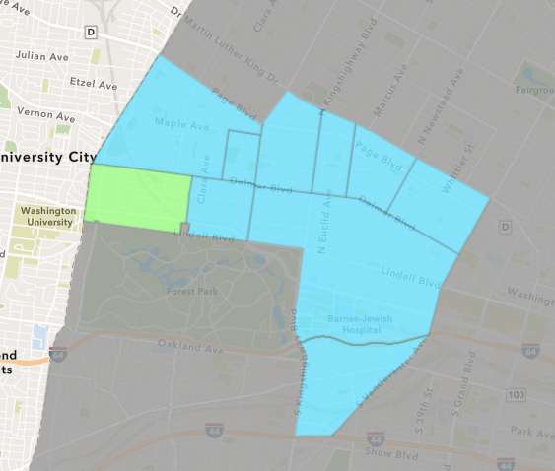
Skinker DeBaliviere
November 2023 Neighborhood Cost Breakdown
  Mean: $361,771
  Median: $10,425
  Range: $1,500 - $2,800,000

Slide 19
Skinker DeBaliviere: Summary Notes
8 building permits in November 2023
  14.29% change compared to November 2022 (7 total building permits)
  $361,771: Average building permit cost in November 2023
    1074.98% change compared to November 2022 ($30,790)
100 total building permits in 2023
  29.87% change YTD compared to this time in 2022 (77 total building permits)
  $83,891: YTD average building permit cost in 2023
    -28.17% change YTD compared to this time in 2022 ($116,795)

Slide 20
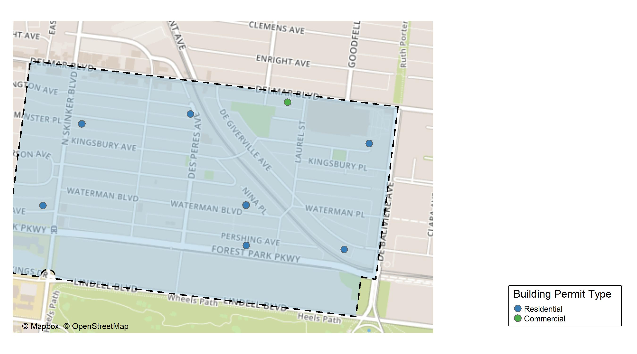
Skinker DeBaliviere

Slide 21
Neighborhood Summary
November 2023 | November 2023 | November 2023 | November 2023
Permit Use | Average Cost | # of Permits | Total Value of Permits
Commercial | $3,000.0 | 1 | $3,000
Industrial | $0.0 | 0 | $0
Residential | $413,024.4 | 7 | $2,891,171
Last 6 Months | Last 6 Months | Last 6 Months | Last 6 Months
Permit Use | Average Cost | # of Permits | Total Value of Permits
Commercial | $82,075.00 | 8 | $656,600
Industrial | $57,633.33 | 3 | $172,900
Residential | $88,190.57 | 52 | $4,585,910

Slide 22
Skinker DeBaliviere Individual Permit Breakdown
Neighborhood | Owner | New Use | Cost | address
Skinker DeBaliviere | ONE WORLD - USA LLC | Residential | $2,000 | 5838 PERSHING AV
Skinker DeBaliviere | LLOYD, KENNETH J & CAROL A | Residential | $5,850 | 6182 WESTMINSTER PL
Skinker DeBaliviere | STL SENIOR HOUSING LLC | Residential | $2,800,000 | 6000 WASHINGTON AV
Skinker DeBaliviere | JDJ DEVELOPMENT LLC | Commercial | $3,000 | 5874 DELMAR BLVD
Skinker DeBaliviere | BASCOM, TERI D | Residential | $15,000 | 5721 WESTMINSTER PL
Skinker DeBaliviere | CHRISTINE JAMES REAL ESTATE MO LLC | Residential | $35,000 | 5847 WATERMAN BLVD
Skinker DeBaliviere | NEWELL-STANLEY, HEATHER | Residential | $31,821 | 6215 PERSHING AV
Skinker DeBaliviere | FOSTER, LUCILLE | Residential | $1,500 | 5740 DEGIVERVILLE AV

Slide 23
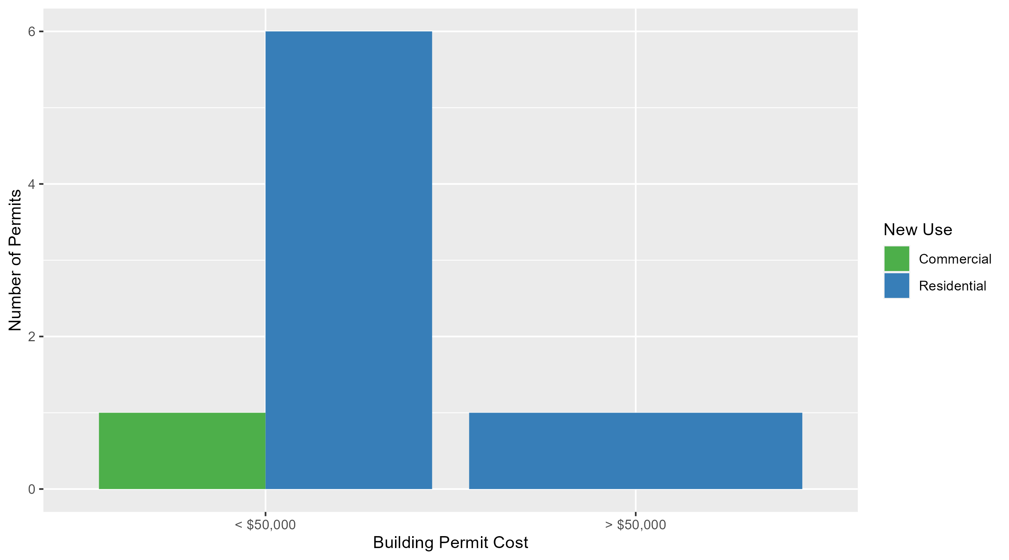
Skinker DeBaliviere Permit Cost Breakdown

Slide 24
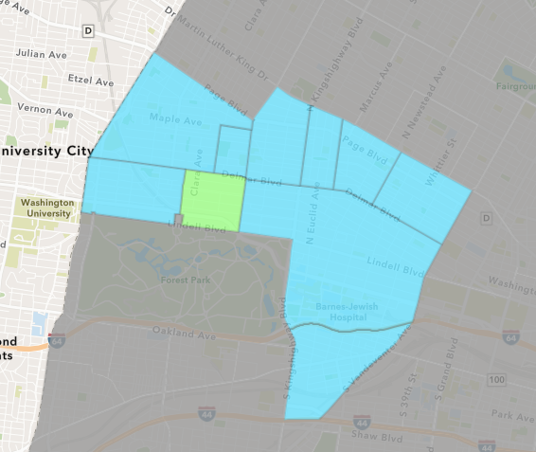
DeBaliviere Place
November 2023 Neighborhood Cost Breakdown
  Mean: $347,300
  Median: $90,000
  Range: $11,500 - $1,500,000

Slide 25
DeBaliviere Place: Summary Notes
5 building permits in November 2023
  150.00% change compared to November 2022 (2 total building permits)
  $347,300: Average building permit cost in November 2023
    248.27% change compared to November 2022 ($99,721)
43 total building permits in 2023
  -34.85% change YTD compared to this time in 2022 (66 total building permits)
  $161,961: YTD average building permit cost in 2023
    90.46% change YTD compared to this time in 2022 ($85,035)

Slide 26
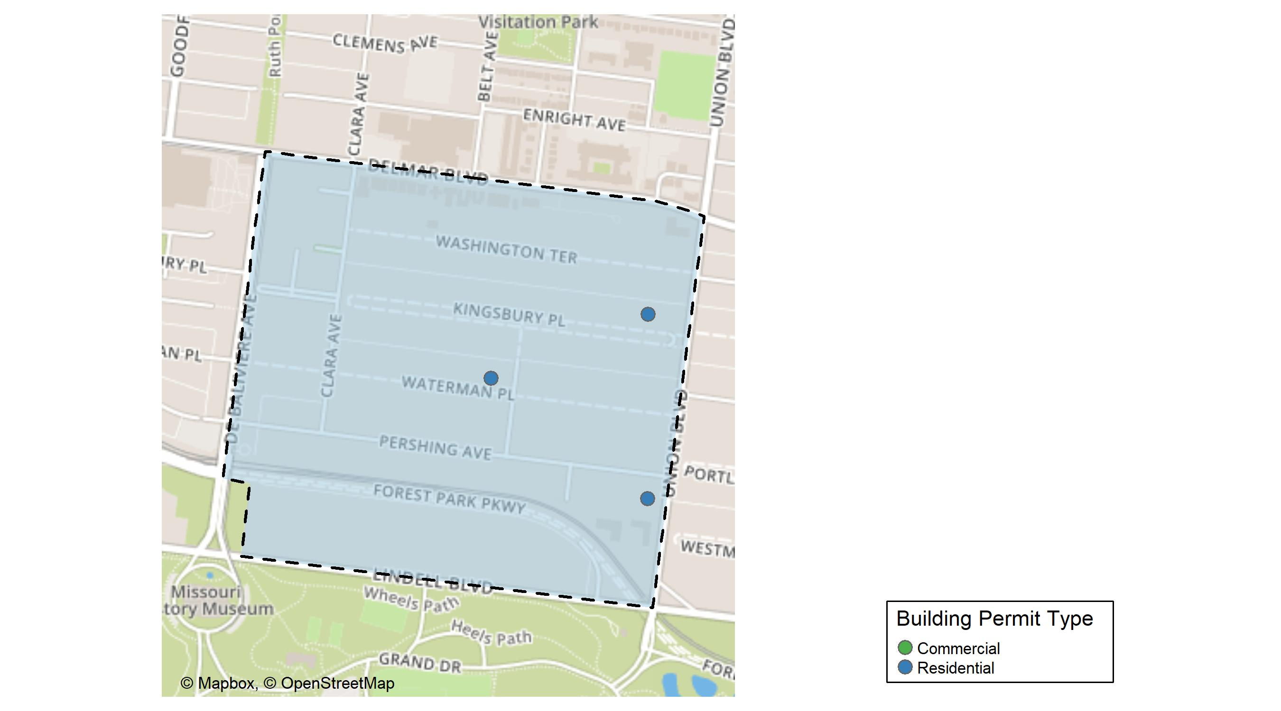
DeBaliviere Place

Slide 27
Neighborhood Summary
November 2023 | November 2023 | November 2023 | November 2023
Permit Use | Average Cost | # of Permits | Total Value of Permits
Commercial | $1,500,000 | 1 | $1,500,000
Industrial | $0 | 0 | $0
Residential | $59,125 | 4 | $236,500
Last 6 Months | Last 6 Months | Last 6 Months | Last 6 Months
Permit Use | Average Cost | # of Permits | Total Value of Permits
Commercial | $763,077.00 | 2 | $1,526,154
Industrial | $2,300,000.00 | 1 | $2,300,000
Residential | $57,831.21 | 29 | $1,677,105

Slide 28
DeBaliviere Place Individual Permit Breakdown
Neighborhood | Owner | New Use | Cost | address
DeBaliviere Place | ORO 275 PARKSIDE LLC & | Residential | $90,000 | 275 UNION BLVD
DeBaliviere Place | ORO 275 PARKSIDE LLC & | Commercial | $1,500,000 | 275 UNION BLVD
DeBaliviere Place | ORO 275 PARKSIDE LLC & | Residential | $90,000 | 275 UNION BLVD
DeBaliviere Place | LU HAN & LIUZHAN YANG | Residential | $11,500 | 5515 WATERMAN BLVD
DeBaliviere Place | MONROE, THOMAS E & SUSAN R | Residential | $45,000 | 5 KINGSBURY PL

Slide 29
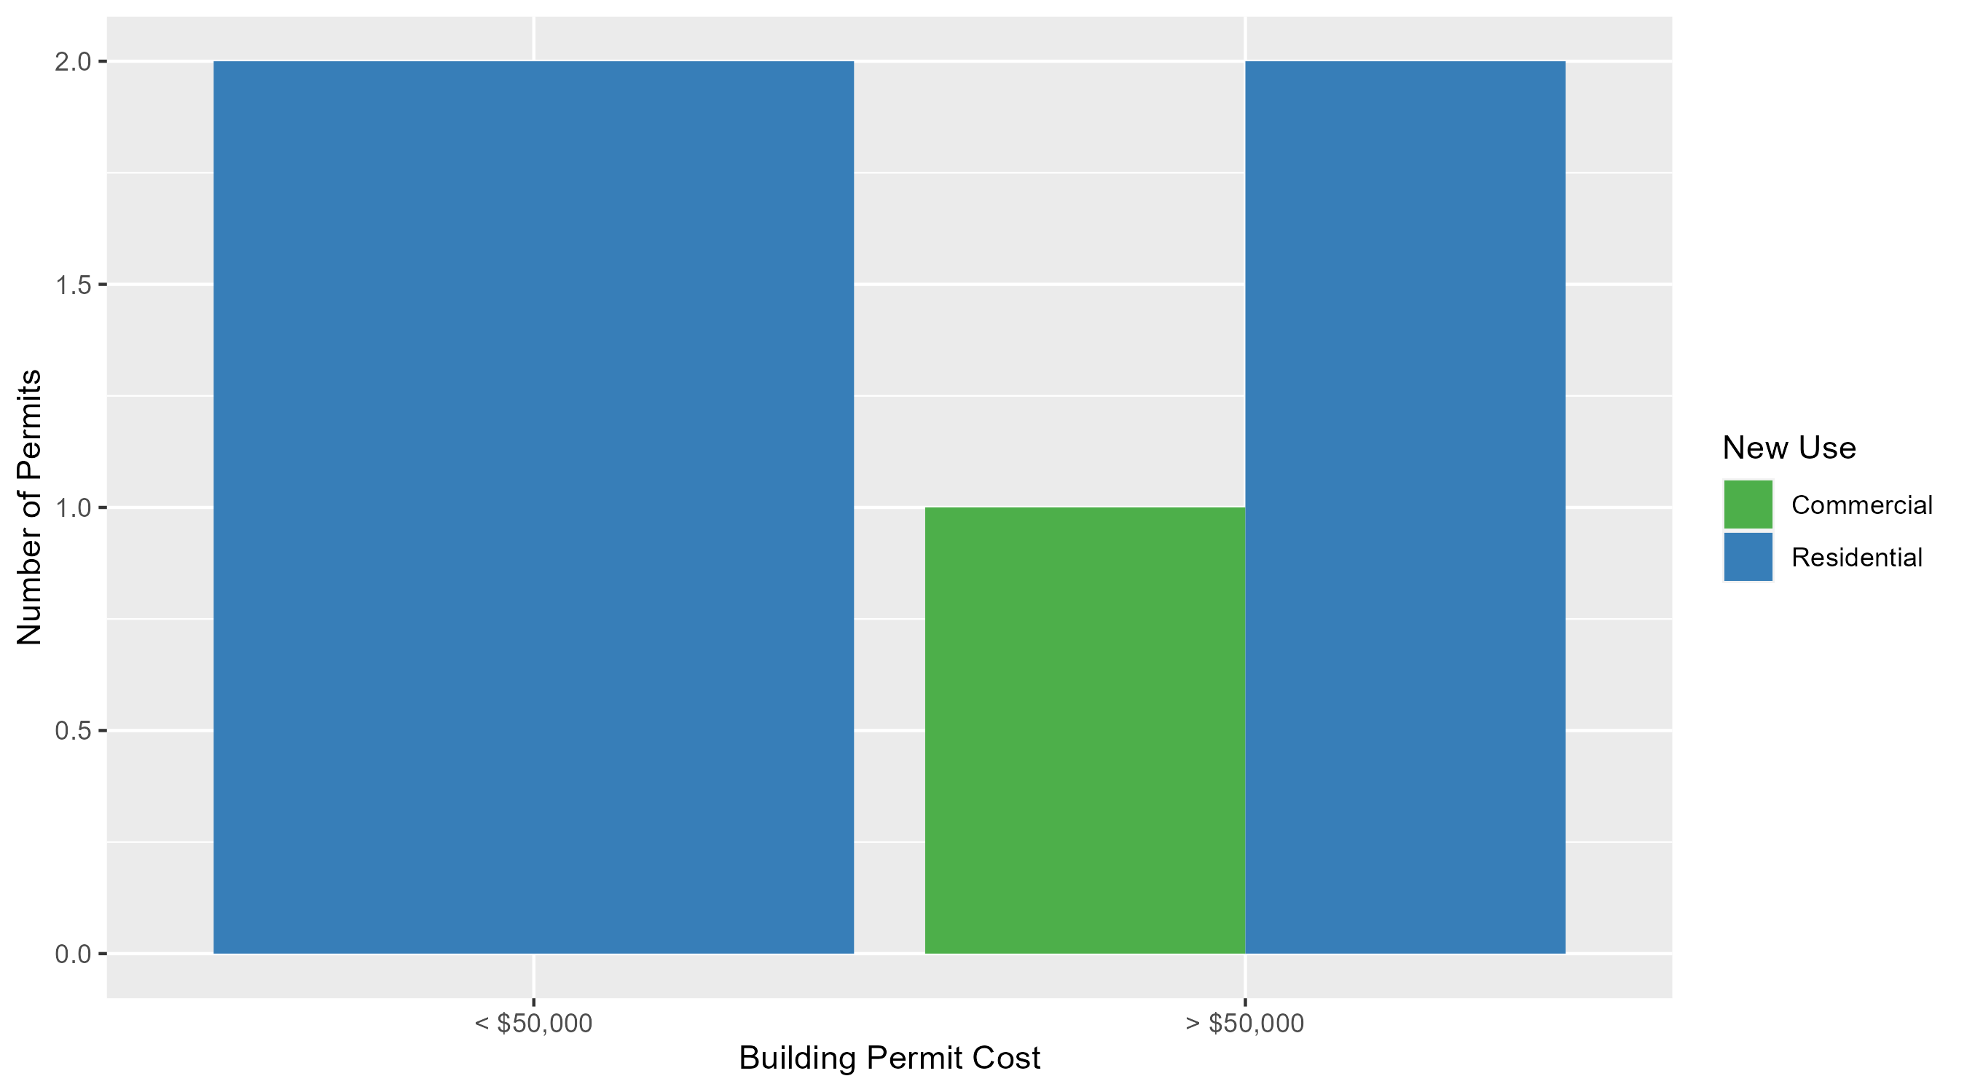
DeBaliviere Place Permit Cost Breakdown

Slide 30
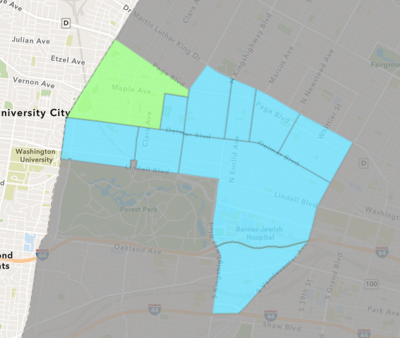
West End
November 2023 Neighborhood Cost Breakdown
  Mean: $240,400
  Median: $43,900
  Range: $1,000 - $1,200,000

Slide 31
West End: Summary Notes
6 building permits in November 2023
  20.00% change compared to November 2022 (5 total building permits)
  $240,400: Average building permit cost in November 2023
    58.45% change compared to November 2022 ($151,720)
84 total building permits in 2023
  -18.45% change YTD compared to this time in 2022 (103 total building permits)
  $71,727: YTD average building permit cost in 2023
    -39.88% change YTD compared to this time in 2022 ($119,308)

Slide 32
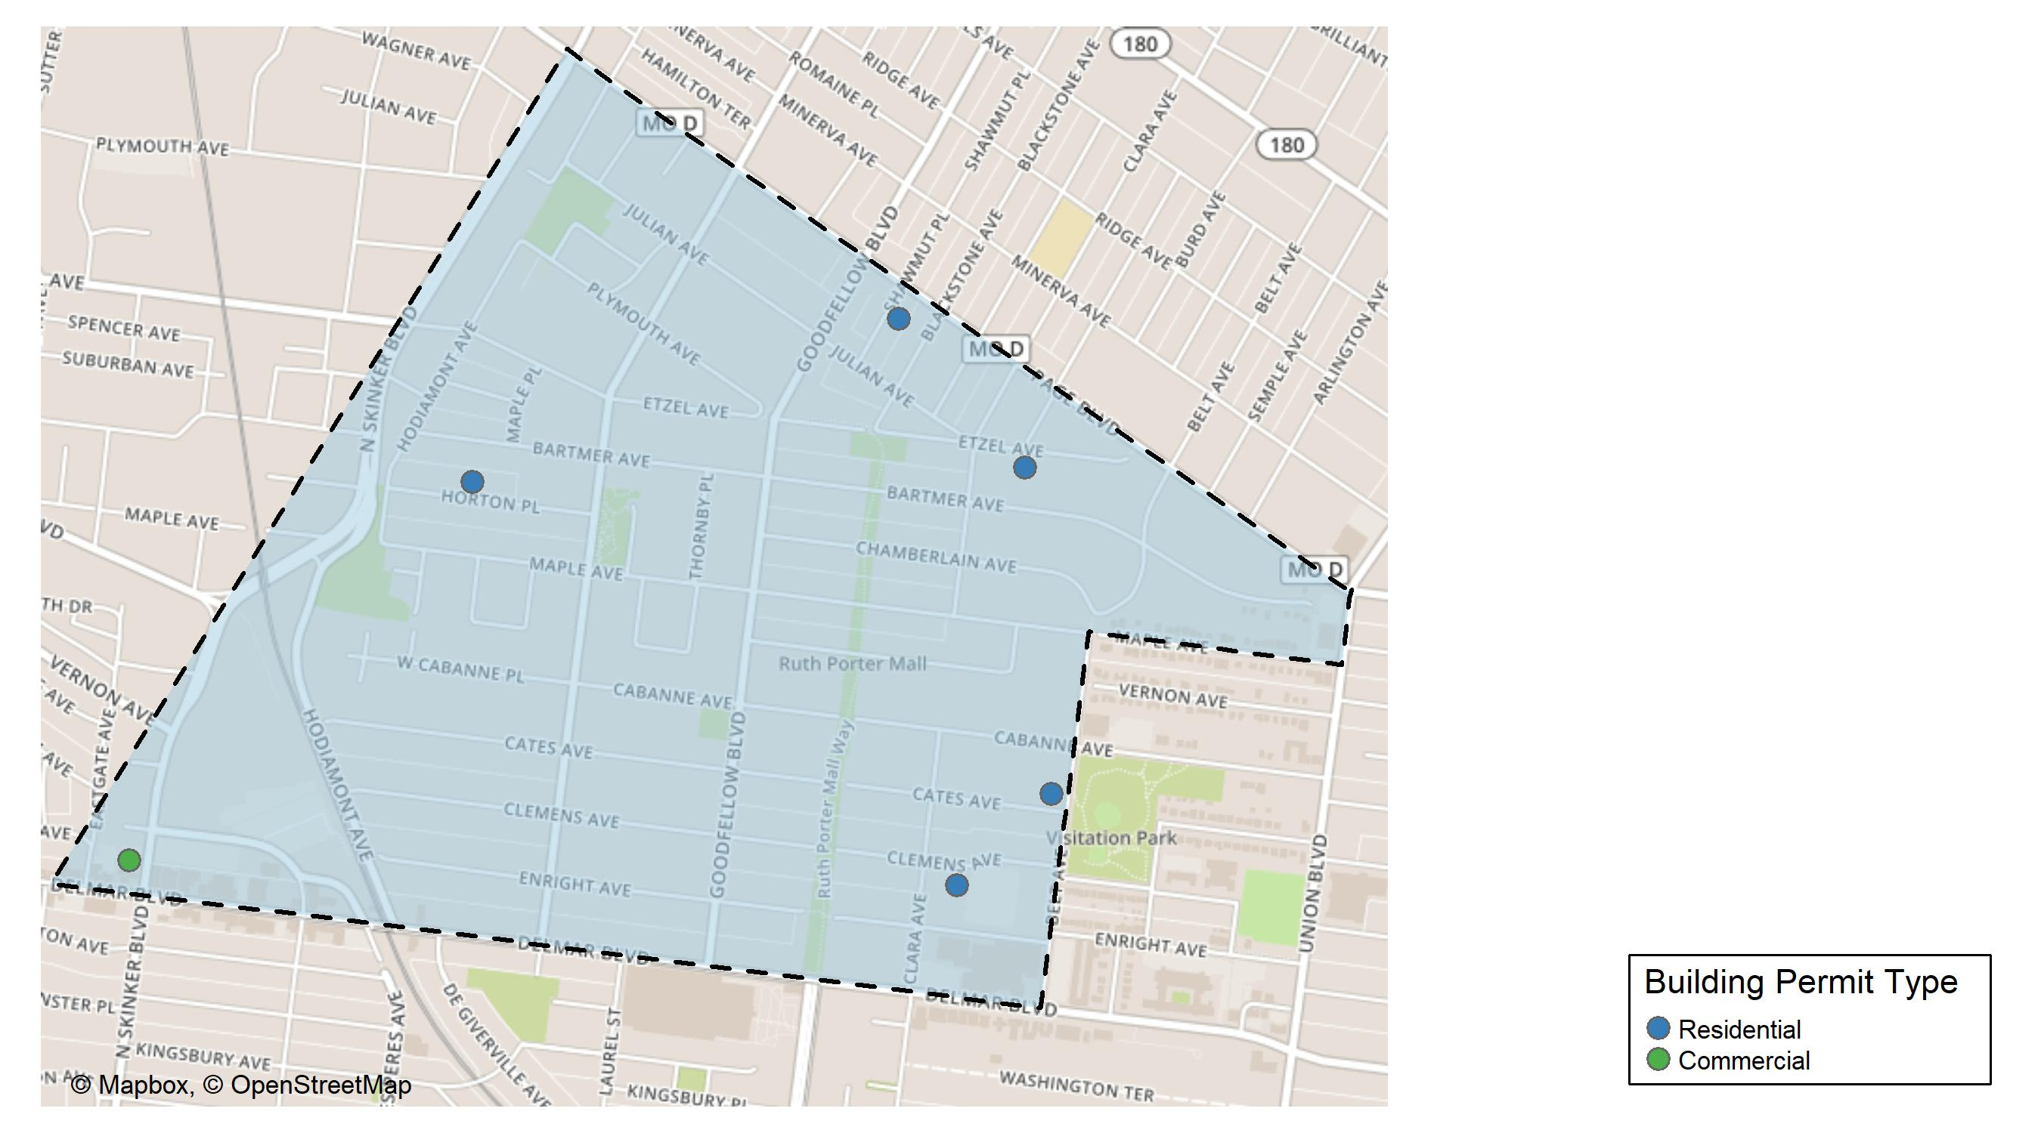
West End

Slide 33
Neighborhood Summary
November 2023 | November 2023 | November 2023 | November 2023
Permit Use | Average Cost | # of Permits | Total Value of Permits
Commercial | $1,200,000 | 1 | $1,200,000
Industrial | $0 | 0 | $0
Residential | $48,480 | 5 | $242,400
Last 6 Months | Last 6 Months | Last 6 Months | Last 6 Months
Permit Use | Average Cost | # of Permits | Total Value of Permits
Commercial | $175,156.50 | 8 | $1,401,252
Industrial | $0.00 | 0 | $0
Residential | $77,281.09 | 46 | $3,554,930

Slide 34
West End Individual Permit Breakdown
Neighborhood | Owner | New Use | Cost | address
West End | PACE-DELMAR ASSOCIATES LLC | Commercial | $1,200,000 | 621 N SKINKER BLVD
West End | JACKSON, ALMANZO & EVELYN JACKSON | Residential | $80,000 | 5505 CATES AV
West End | HARDWRICT, WILBER & JUANITA | Residential | $6,100 | 6011 HORTON PL
West End | FITZPATRICK, RENATO | Residential | $7,800 | 5582 ETZEL AV
West End | SHENGOU LLC | Residential | $147,500 | 5556-62 CLEMENS AV
West End | WALLACE, JAMES R & | Residential | $1,000 | 1234 SHAWMUT PL

Slide 35
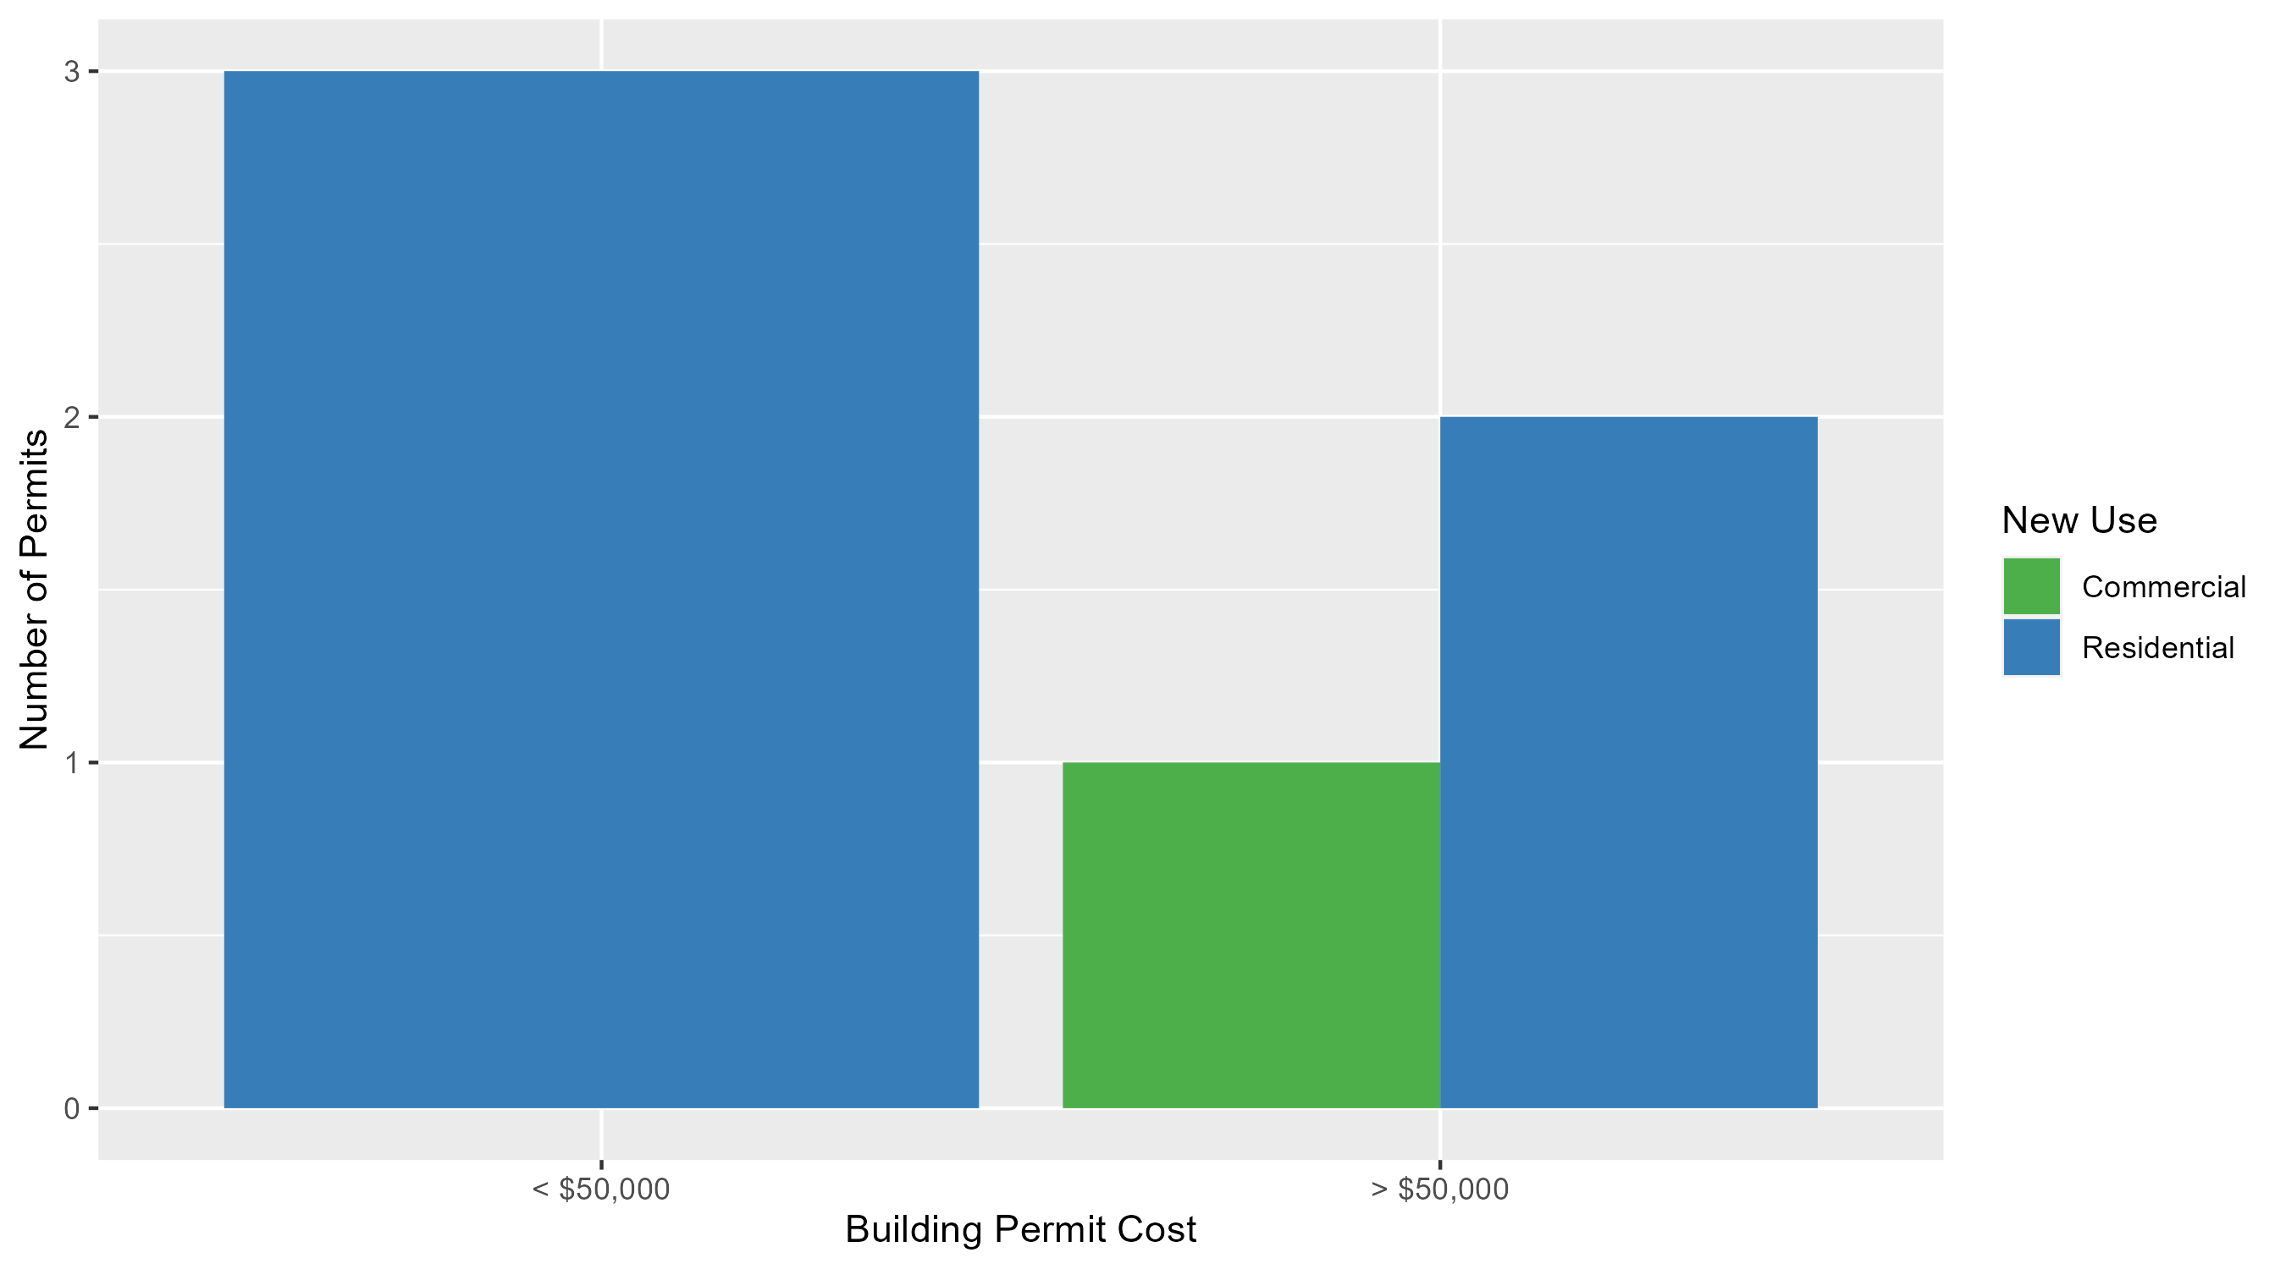
West End Permit Cost Breakdown

Slide 36
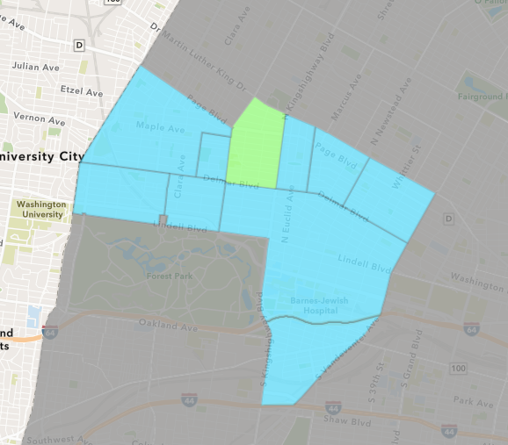
Academy
November 2023 Neighborhood Cost Breakdown
  Mean: $1,928
  Median: $1,928
  Range: $1,928 - $1,928

Slide 37
Academy: Summary Notes
1 building permits in November 2023
  -80.00% change compared to November 2022 (5 total building permits)
  $1,928: Average building permit cost in November 2023
    -96.21% change compared to November 2022 ($50,840)
29 total building permits in 2023
  -3.33% change YTD compared to this time in 2022 (30 total building permits)
  $25,579: YTD average building permit cost in 2023
    -59.49% change YTD compared to this time in 2022 ($63,140)

Slide 38
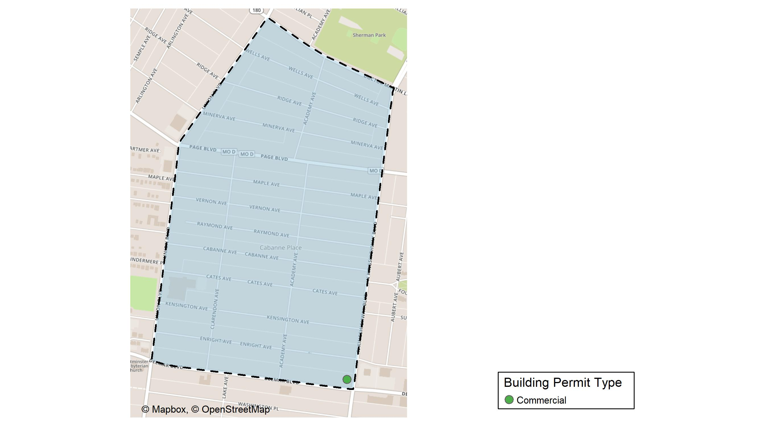
Academy

Slide 39
Neighborhood Summary
November 2023 | November 2023 | November 2023 | November 2023
Permit Use | Average Cost | # of Permits | Total Value of Permits
Commercial | $1,928 | 1 | $1,928
Industrial | $0 | 0 | $0
Residential | $0 | 0 | $0
Last 6 Months | Last 6 Months | Last 6 Months | Last 6 Months
Permit Use | Average Cost | # of Permits | Total Value of Permits
Commercial | $1,928.00 | 1 | $1,928
Industrial | $1,400.00 | 1 | $1,400
Residential | $28,906.42 | 19 | $549,222

Slide 40
Academy Individual Permit Breakdown
Neighborhood | Owner | New Use | Cost | address
Academy | JMK INC | Commercial | $1,928 | 707 N KINGSHIGHWAY BLVD

Slide 41
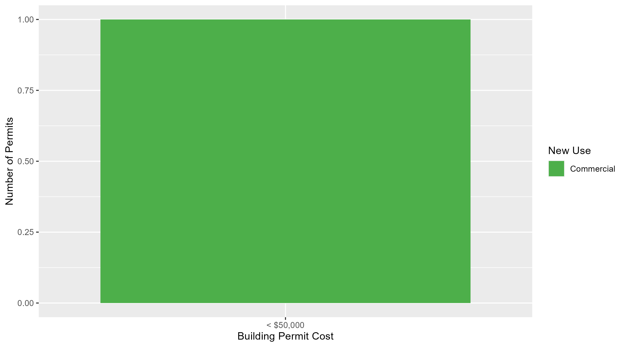
Academy Permit Cost Breakdown

Slide 42
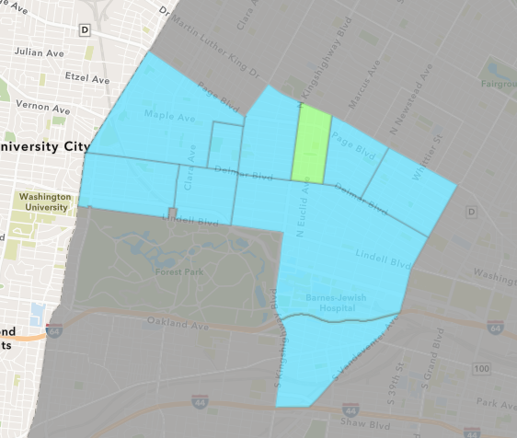
Fountain Park
November 2023 Neighborhood Cost Breakdown
  Mean: $24,467
  Median: $15,000
  Range: $3,400 - $55,000

Slide 43
Fountain Park: Summary Notes
3 building permits in November 2023
  200.00% change compared to November 2022 (1 total building permits)
  $24,467: Average building permit cost in November 2023
    -38.83% change compared to November 2022 ($40,000)
14 total building permits in 2023
  -22.22% change YTD compared to this time in 2022 (18 total building permits)
  $142,481: YTD average building permit cost in 2023
    -38.97% change YTD compared to this time in 2022 ($233,475)

Slide 44
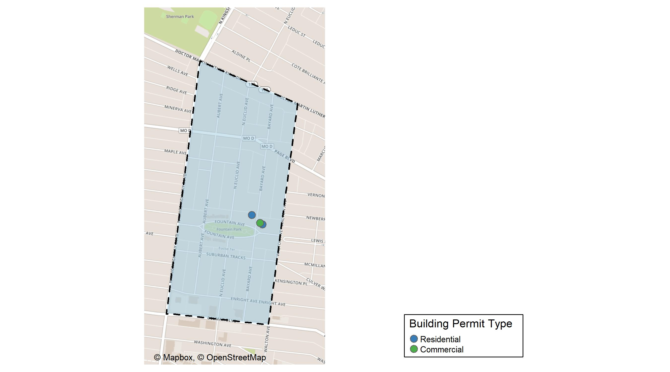
Fountain Park

Slide 45
Neighborhood Summary
November 2023 | November 2023 | November 2023 | November 2023
Permit Use | Average Cost | # of Permits | Total Value of Permits
Commercial | $55,000 | 1 | $55,000
Industrial | $0 | 0 | $0
Residential | $9,200 | 2 | $18,400
Last 6 Months | Last 6 Months | Last 6 Months | Last 6 Months
Permit Use | Average Cost | # of Permits | Total Value of Permits
Commercial | $23,033.33 | 3 | $69,100
Industrial | $1,750,000.00 | 1 | $1,750,000
Residential | $19,606.67 | 6 | $117,640

Slide 46
Fountain Park Individual Permit Breakdown
Neighborhood | Owner | New Use | Cost | address
Fountain Park | TITSWORTH PROPERTIES LLC | Commercial | $55,000 | 4831 FOUNTAIN AV
Fountain Park | FLIP USA LLC | Residential | $15,000 | 4829 FOUNTAIN AV
Fountain Park | MILLER, PATRICIA A | Residential | $3,400 | 1117 BAYARD AV

Slide 47
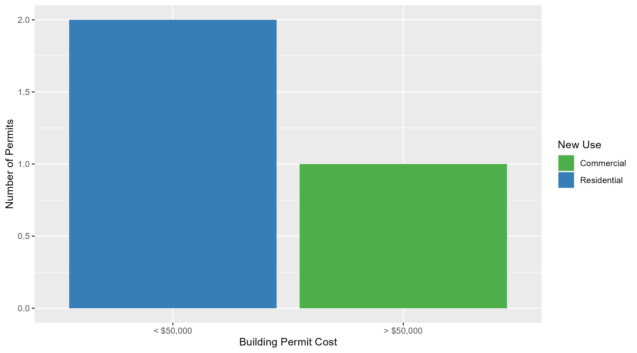
Fountain Park Permit Cost Breakdown

Slide 48
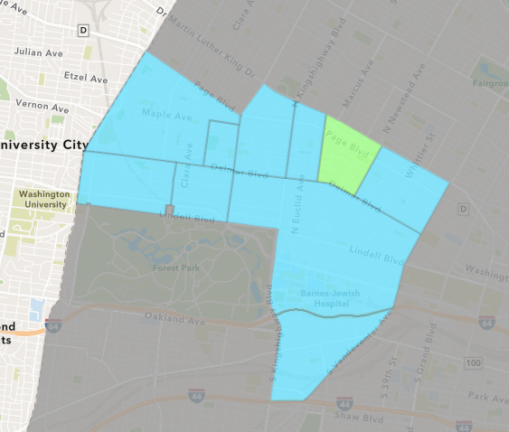
Lewis Place
November 2023 Neighborhood Cost Breakdown
  Mean: $34,500
  Median: $34,500
  Range: $6,000 - $63,000

Slide 49
Lewis Place: Summary Notes
2 building permits in November 2023
  100.00% change compared to November 2022 (1 total building permits)
  $34,500: Average building permit cost in November 2023
    100.58% change compared to November 2022 ($17,200)
12 total building permits in 2023
  -25.00% change YTD compared to this time in 2022 (16 total building permits)
  $63,570: YTD average building permit cost in 2023
    103.75% change YTD compared to this time in 2022 ($31,200)

Slide 50
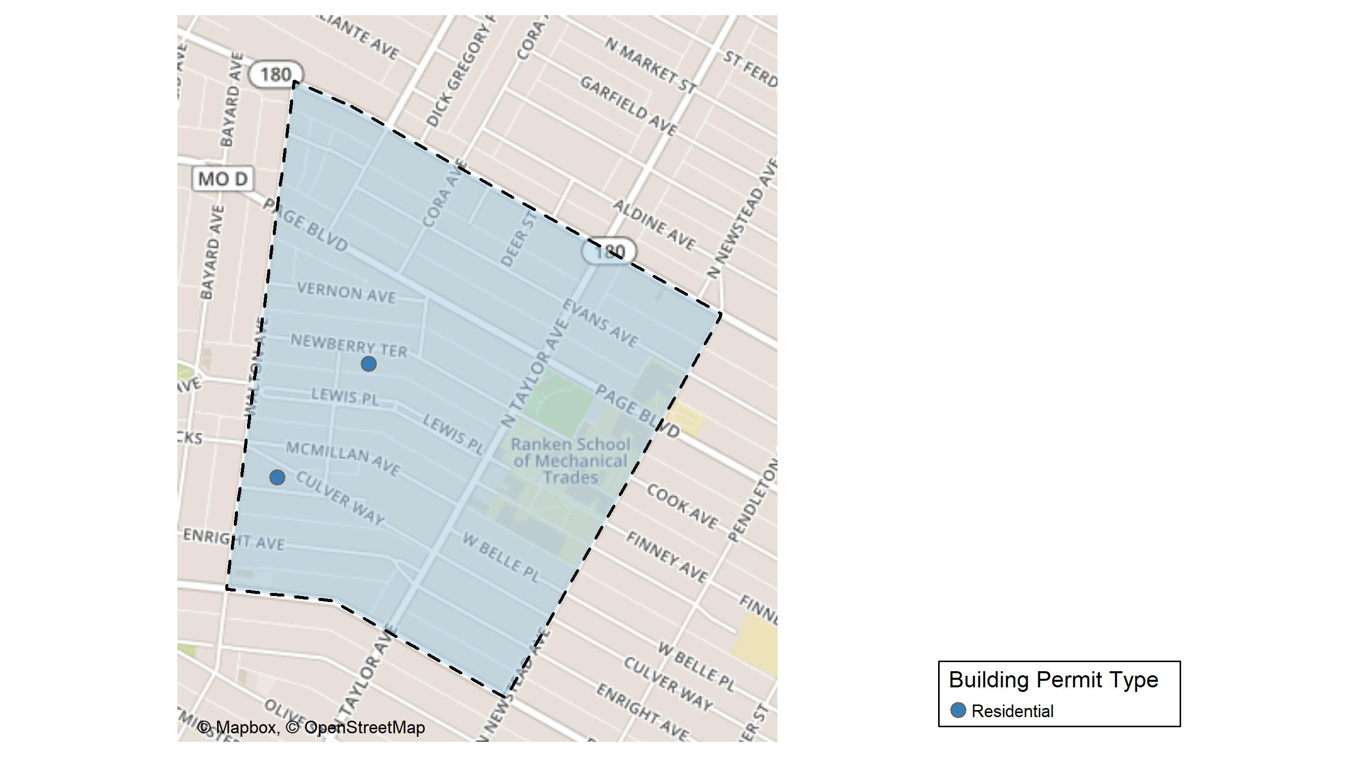
Lewis Place

Slide 51
Neighborhood Summary
November 2023 | November 2023 | November 2023 | November 2023
Permit Use | Average Cost | # of Permits | Total Value of Permits
Commercial | $0 | 0 | $0
Industrial | $0 | 0 | $0
Residential | $34,500 | 2 | $69,000
Last 6 Months | Last 6 Months | Last 6 Months | Last 6 Months
Permit Use | Average Cost | # of Permits | Total Value of Permits
Commercial | $230,870.5 | 2 | $461,741
Industrial | $62,500.0 | 2 | $125,000
Residential | $25,734.0 | 3 | $77,202

Slide 52
Lewis Place Individual Permit Breakdown
Neighborhood | Owner | New Use | Cost | address
Lewis Place | WALLS, YVES L JR | Residential | $63,000 | 4735 KENSINGTON AV
Lewis Place | BURT, KAREN | Residential | $6,000 | 4626 NEWBERRY TER

Slide 53
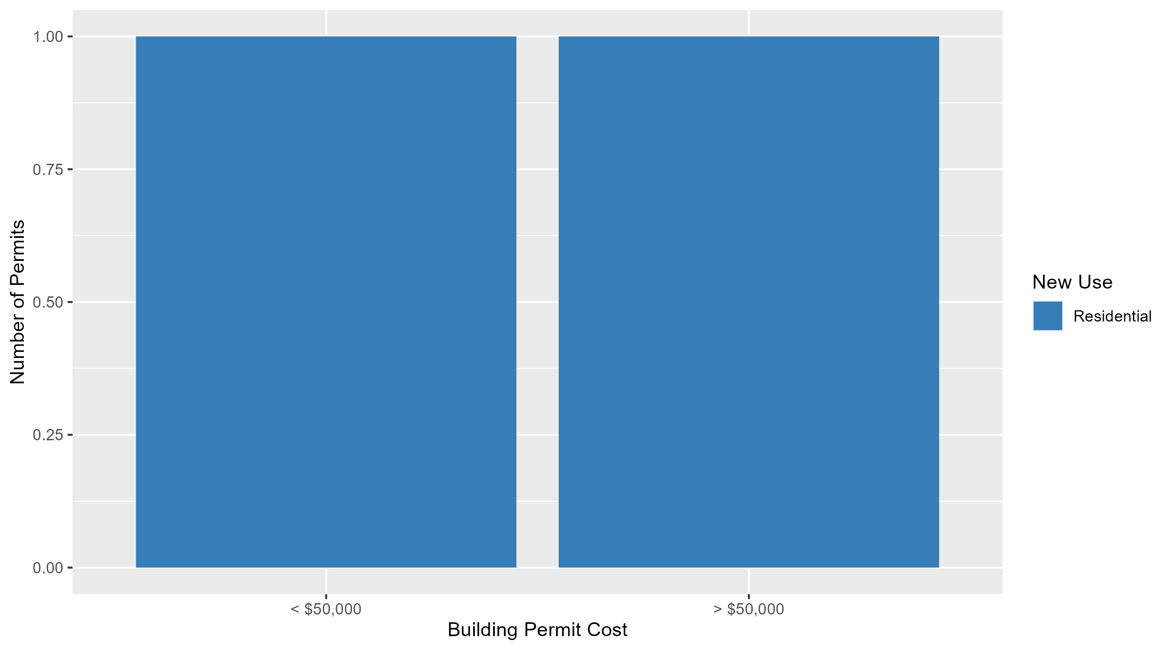
Lewis Place Permit Cost Breakdown

Slide 54
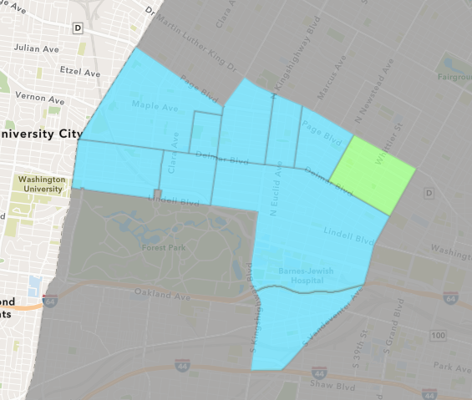
Vandeventer
November 2023 Neighborhood Cost Breakdown
  Mean: $15,000
  Median: $15,000
  Range: $15,000 - $15,000

Slide 55
Vandeventer: Summary Notes
1 building permits in November 2023
  -50.00% change compared to November 2022 (2 total building permits)
  $15,000: Average building permit cost in November 2023
    -70.00% change compared to November 2022 ($50,000)
16 total building permits in 2023
  -40.74% change YTD compared to this time in 2022 (27 total building permits)
  $149,945: YTD average building permit cost in 2023
    -53.51% change YTD compared to this time in 2022 ($322,566)

Slide 56
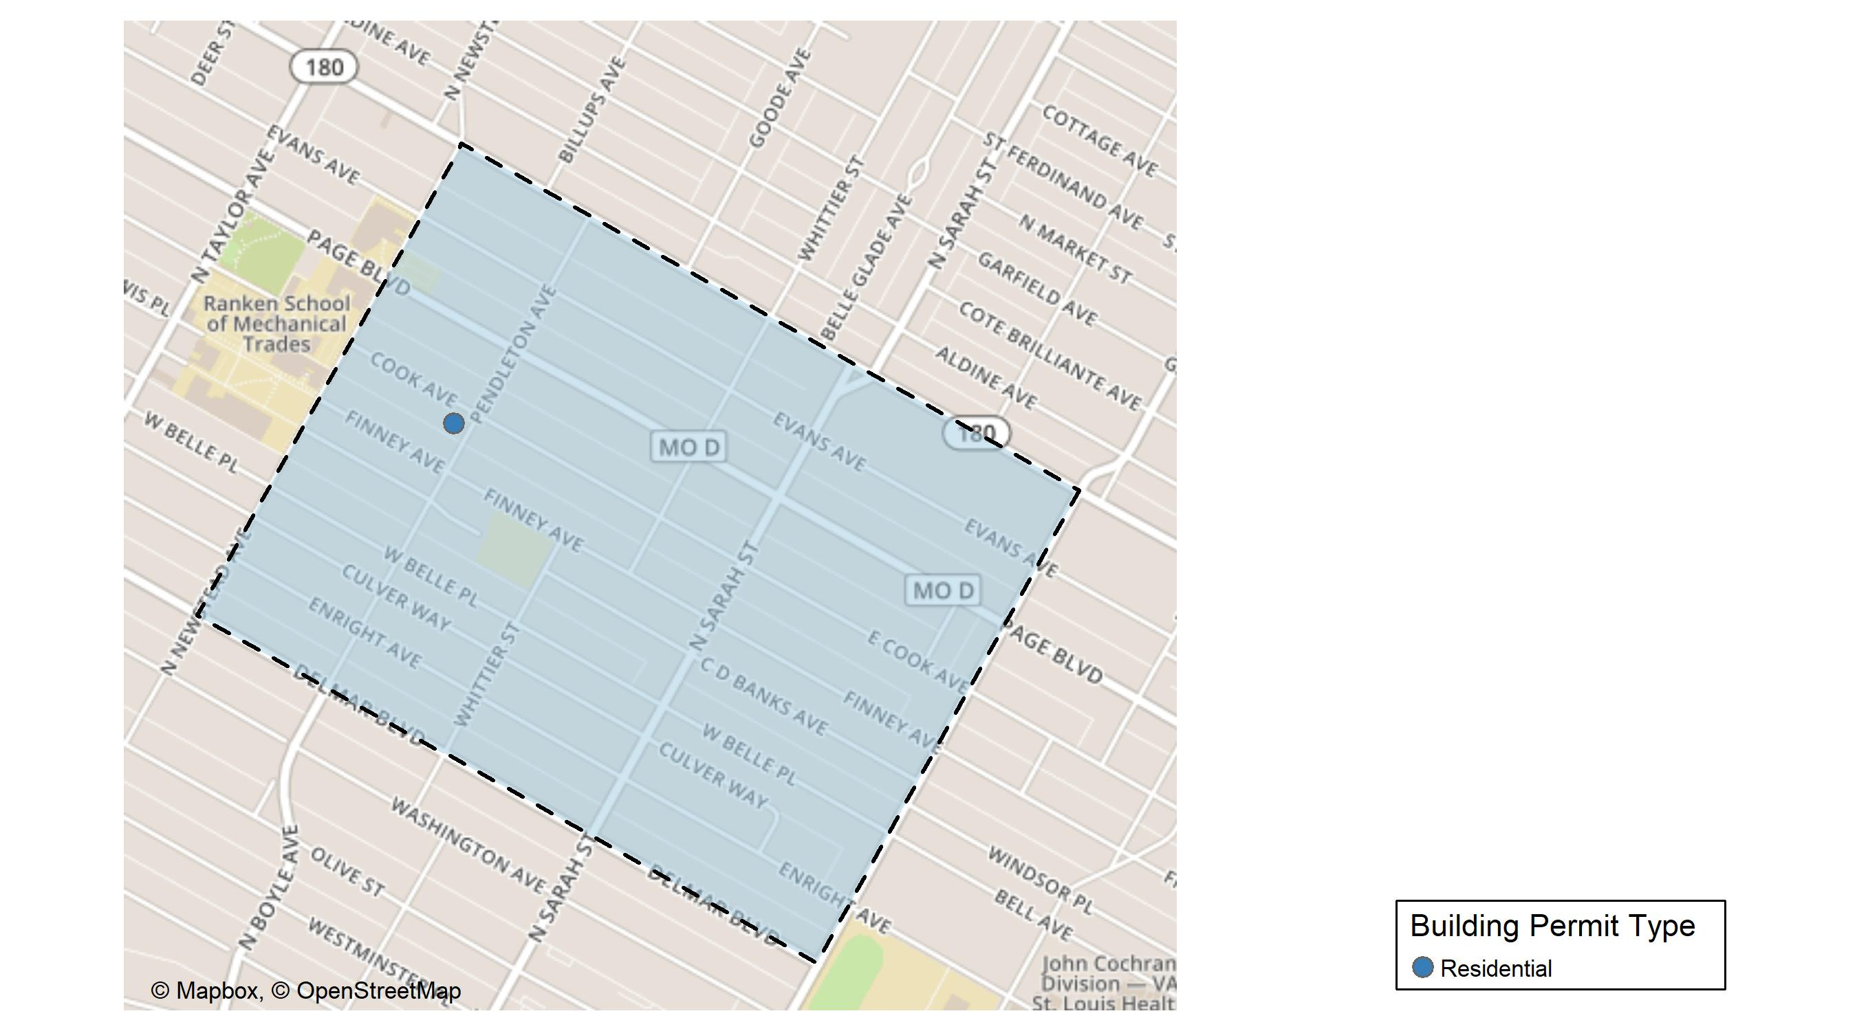
Vandeventer

Slide 57
Neighborhood Summary
November 2023 | November 2023 | November 2023 | November 2023
Permit Use | Average Cost | # of Permits | Total Value of Permits
Commercial | $0 | 0 | $0
Industrial | $0 | 0 | $0
Residential | $15,000 | 1 | $15,000
Last 6 Months | Last 6 Months | Last 6 Months | Last 6 Months
Permit Use | Average Cost | # of Permits | Total Value of Permits
Commercial | $2,000,000.00 | 1 | $2,000,000
Industrial | $10,900.00 | 1 | $10,900
Residential | $39,777.78 | 9 | $358,000

Slide 58
Vandeventer Individual Permit Breakdown
Neighborhood | Owner | New Use | Cost | address
Vandeventer | MCCREA, DELORES CARLITA TRS | Residential | $15,000 | 4306 COOK AV

Slide 59
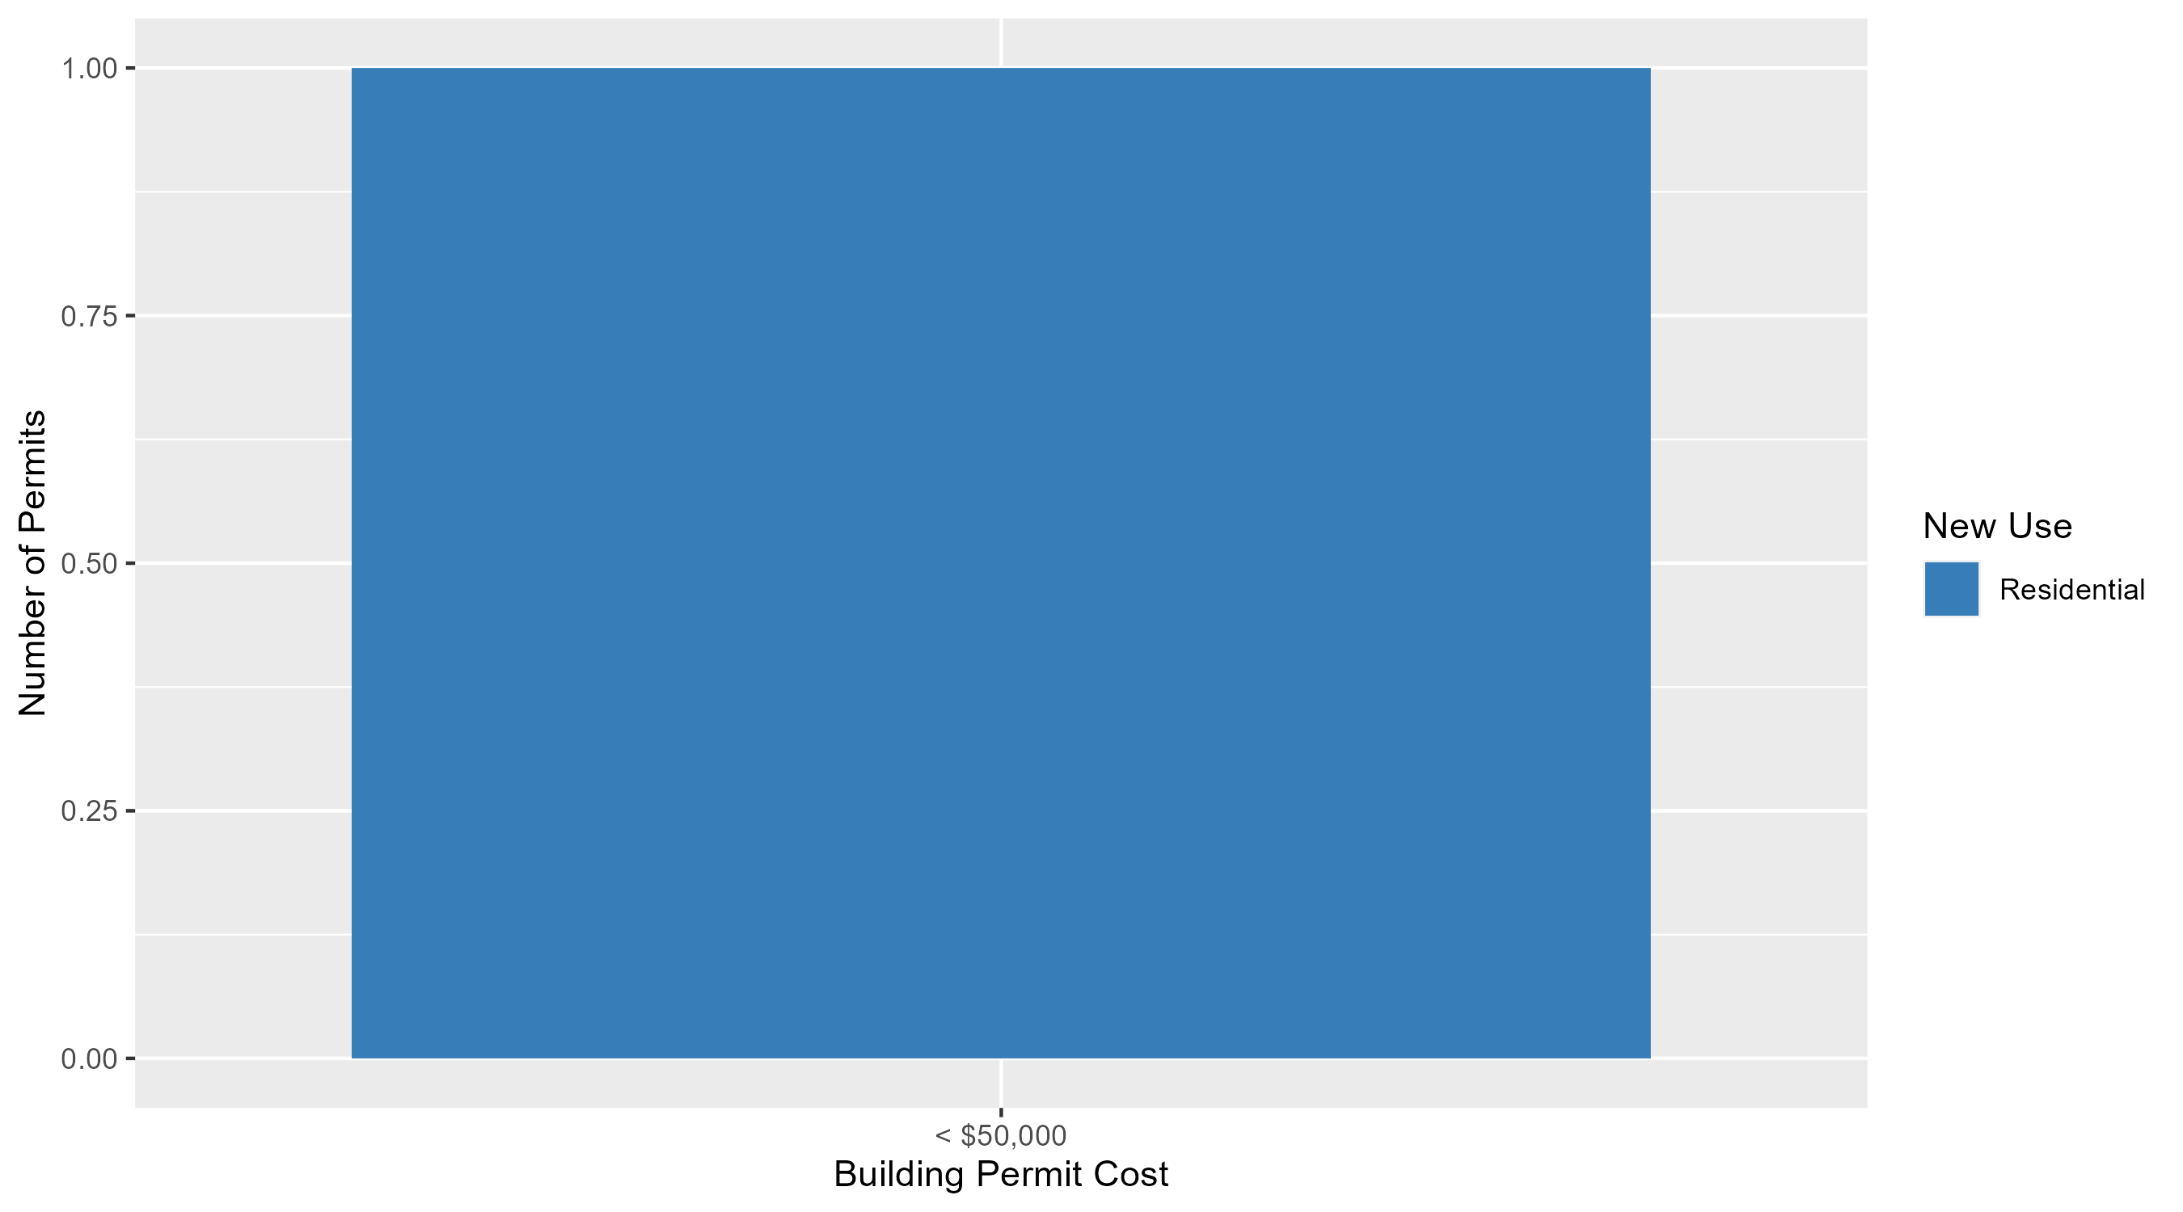
Vandeventer Permit Cost Breakdown

Slide 60
Additional Notes
Data retreived from https://www.stlouis-mo.gov/data/
Building permits with a cost of $0 were dropped
Building permits that were cancelled were dropped
Infinite change indicates 0 permits in the current or previous time period/comparison month so there was a overall increase or decrease

