Slide 1
St. Louis Central Corridor West Building Permits
Monthly Report: November 2024

Slide 2
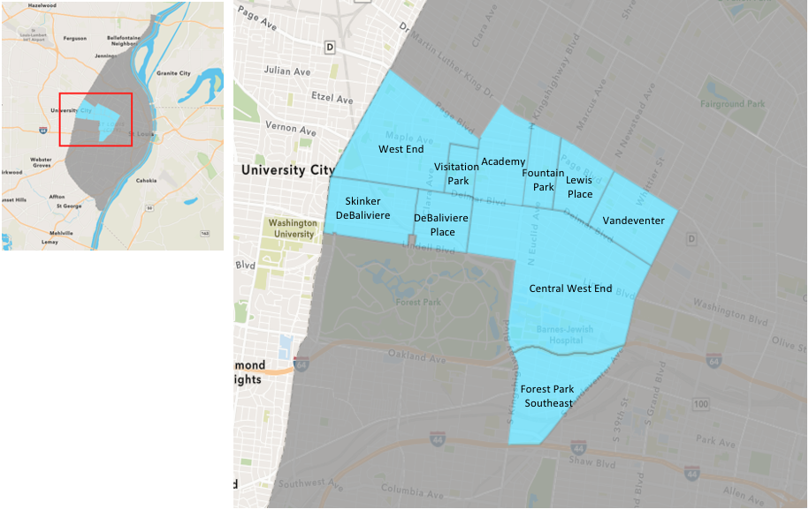
St. Louis Neighborhood Spatial Reference

Slide 3
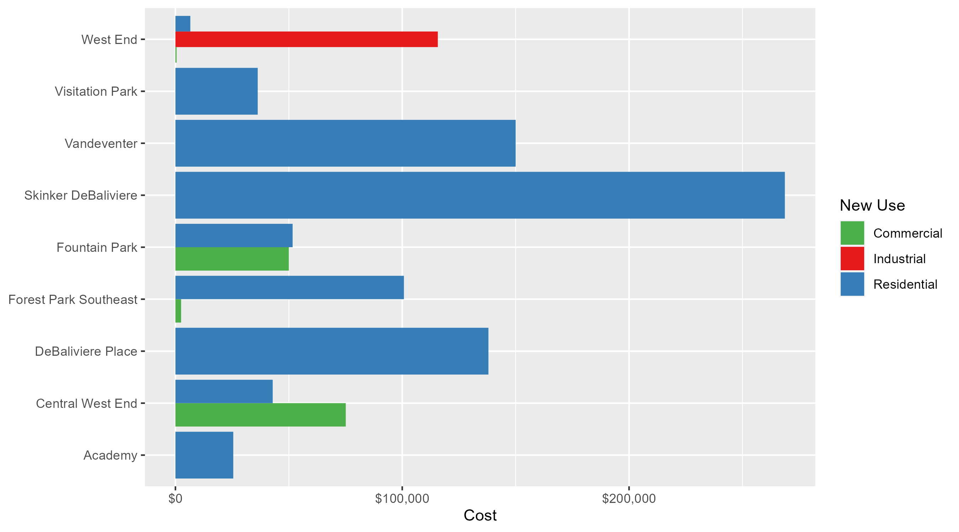
Neighborhood Summary: Average Building Permit Cost

Slide 4
Neighborhood Summary
November 2024 | November 2024 | November 2024 | November 2024
Neighborhood | Average Cost | # of Permits | Total Value of Permits
Academy | $25,500.00 | 2 | $51,000
Central West End | $50,696.52 | 33 | $1,672,985
DeBaliviere Place | $138,000.00 | 3 | $414,000
Forest Park Southeast | $84,366.67 | 6 | $506,200
Fountain Park | $50,833.33 | 6 | $305,000
Lewis Place | $0.00 | 0 | $0
Skinker DeBaliviere | $268,691.40 | 5 | $1,343,457
Vandeventer | $150,000.00 | 1 | $150,000
Visitation Park | $36,282.00 | 1 | $36,282
West End | $27,176.40 | 5 | $135,882
Last 6 Months | Last 6 Months | Last 6 Months | Last 6 Months
Neighborhood | Average Cost | # of Permits | Total Value of Permits
Academy | $42,798.94 | 16 | $684,783
Central West End | $237,903.39 | 212 | $50,435,519
DeBaliviere Place | $142,299.97 | 30 | $4,268,999
Forest Park Southeast | $37,292.20 | 40 | $1,491,688
Fountain Park | $52,800.00 | 10 | $528,000
Lewis Place | $29,870.40 | 10 | $298,704
Skinker DeBaliviere | $99,110.54 | 52 | $5,153,748
Vandeventer | $41,181.11 | 9 | $370,630
Visitation Park | $20,520.50 | 4 | $82,082
West End | $62,704.81 | 37 | $2,320,078

Slide 5
Core Neighborhoods

Slide 6
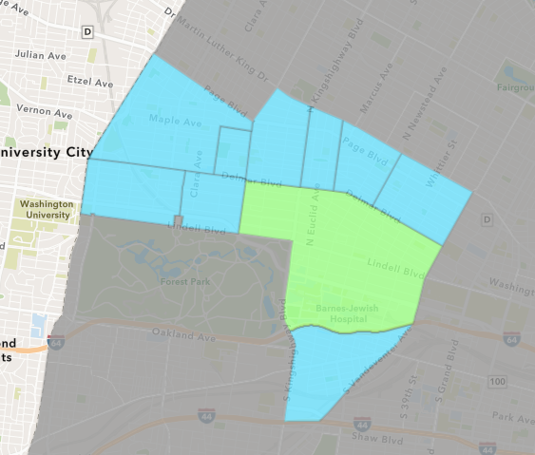
Central West End
November 2024 Neighborhood Cost Breakdown
  Mean: $50,697
  Median: $23,664
  Range: $500 - $221,582

Slide 7
Central West End: Summary Notes
33 building permits in November 2024
  22.22% change compared to November 2023 (27 total building permits)
  $50,697: Average building permit cost in November 2024
    -66.46% change compared to November 2023 ($151,158)
325 total building permits in 2024
  -6.34% change YTD compared to this time in 2023 (347 total building permits)
  $371,266: YTD average building permit cost in 2024
    65.78% change YTD compared to this time in 2023 ($223,946)

Slide 8
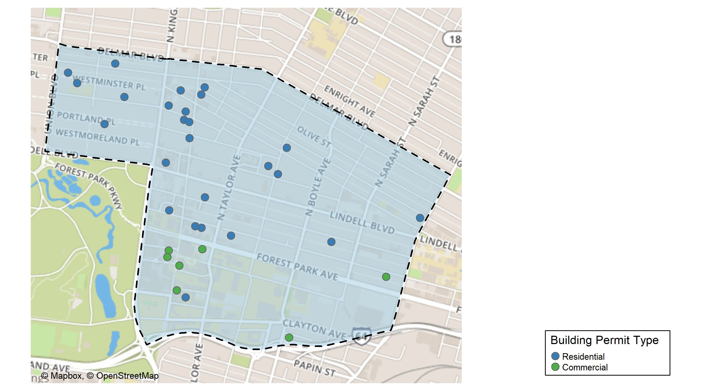
Central West End

Slide 9
Neighborhood Summary
November 2024 | November 2024 | November 2024 | November 2024
Permit Use | Average Cost | # of Permits | Total Value of Permits
Commercial | $75,103.75 | 8 | $600,830
Industrial | $0.00 | 0 | $0
Residential | $42,886.20 | 25 | $1,072,155
Last 6 Months | Last 6 Months | Last 6 Months | Last 6 Months
Permit Use | Average Cost | # of Permits | Total Value of Permits
Commercial | $390,174.8 | 92 | $35,896,080
Industrial | $39,885.5 | 4 | $159,542
Residential | $123,964.6 | 116 | $14,379,897

Slide 10
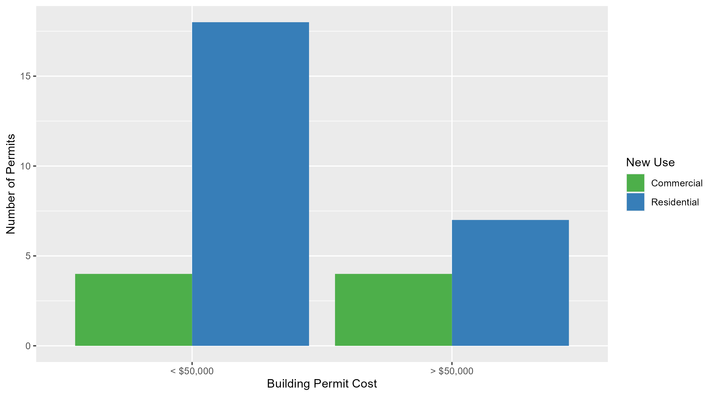
Central West End Permit Cost Breakdown

Slide 11
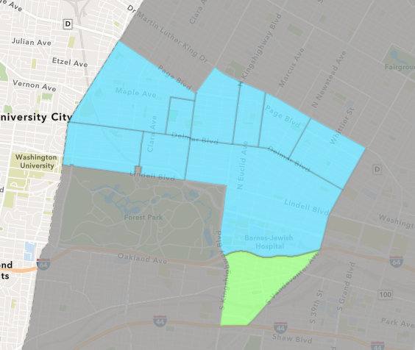
Forest Park Southeast
November 2024 Neighborhood Cost Breakdown
  Mean: $84,367
  Median: $76,350
  Range: $2,500 - $185,000

Slide 12
Forest Park Southeast: Summary Notes
6 building permits in November 2024
  -14.29% change compared to November 2023 (7 total building permits)
  $84,367: Average building permit cost in November 2024
    -57.89% change compared to November 2023 ($200,371)
66 total building permits in 2024
  3.12% change YTD compared to this time in 2023 (64 total building permits)
  $58,519: YTD average building permit cost in 2024
    -28.47% change YTD compared to this time in 2023 ($81,816)

Slide 13
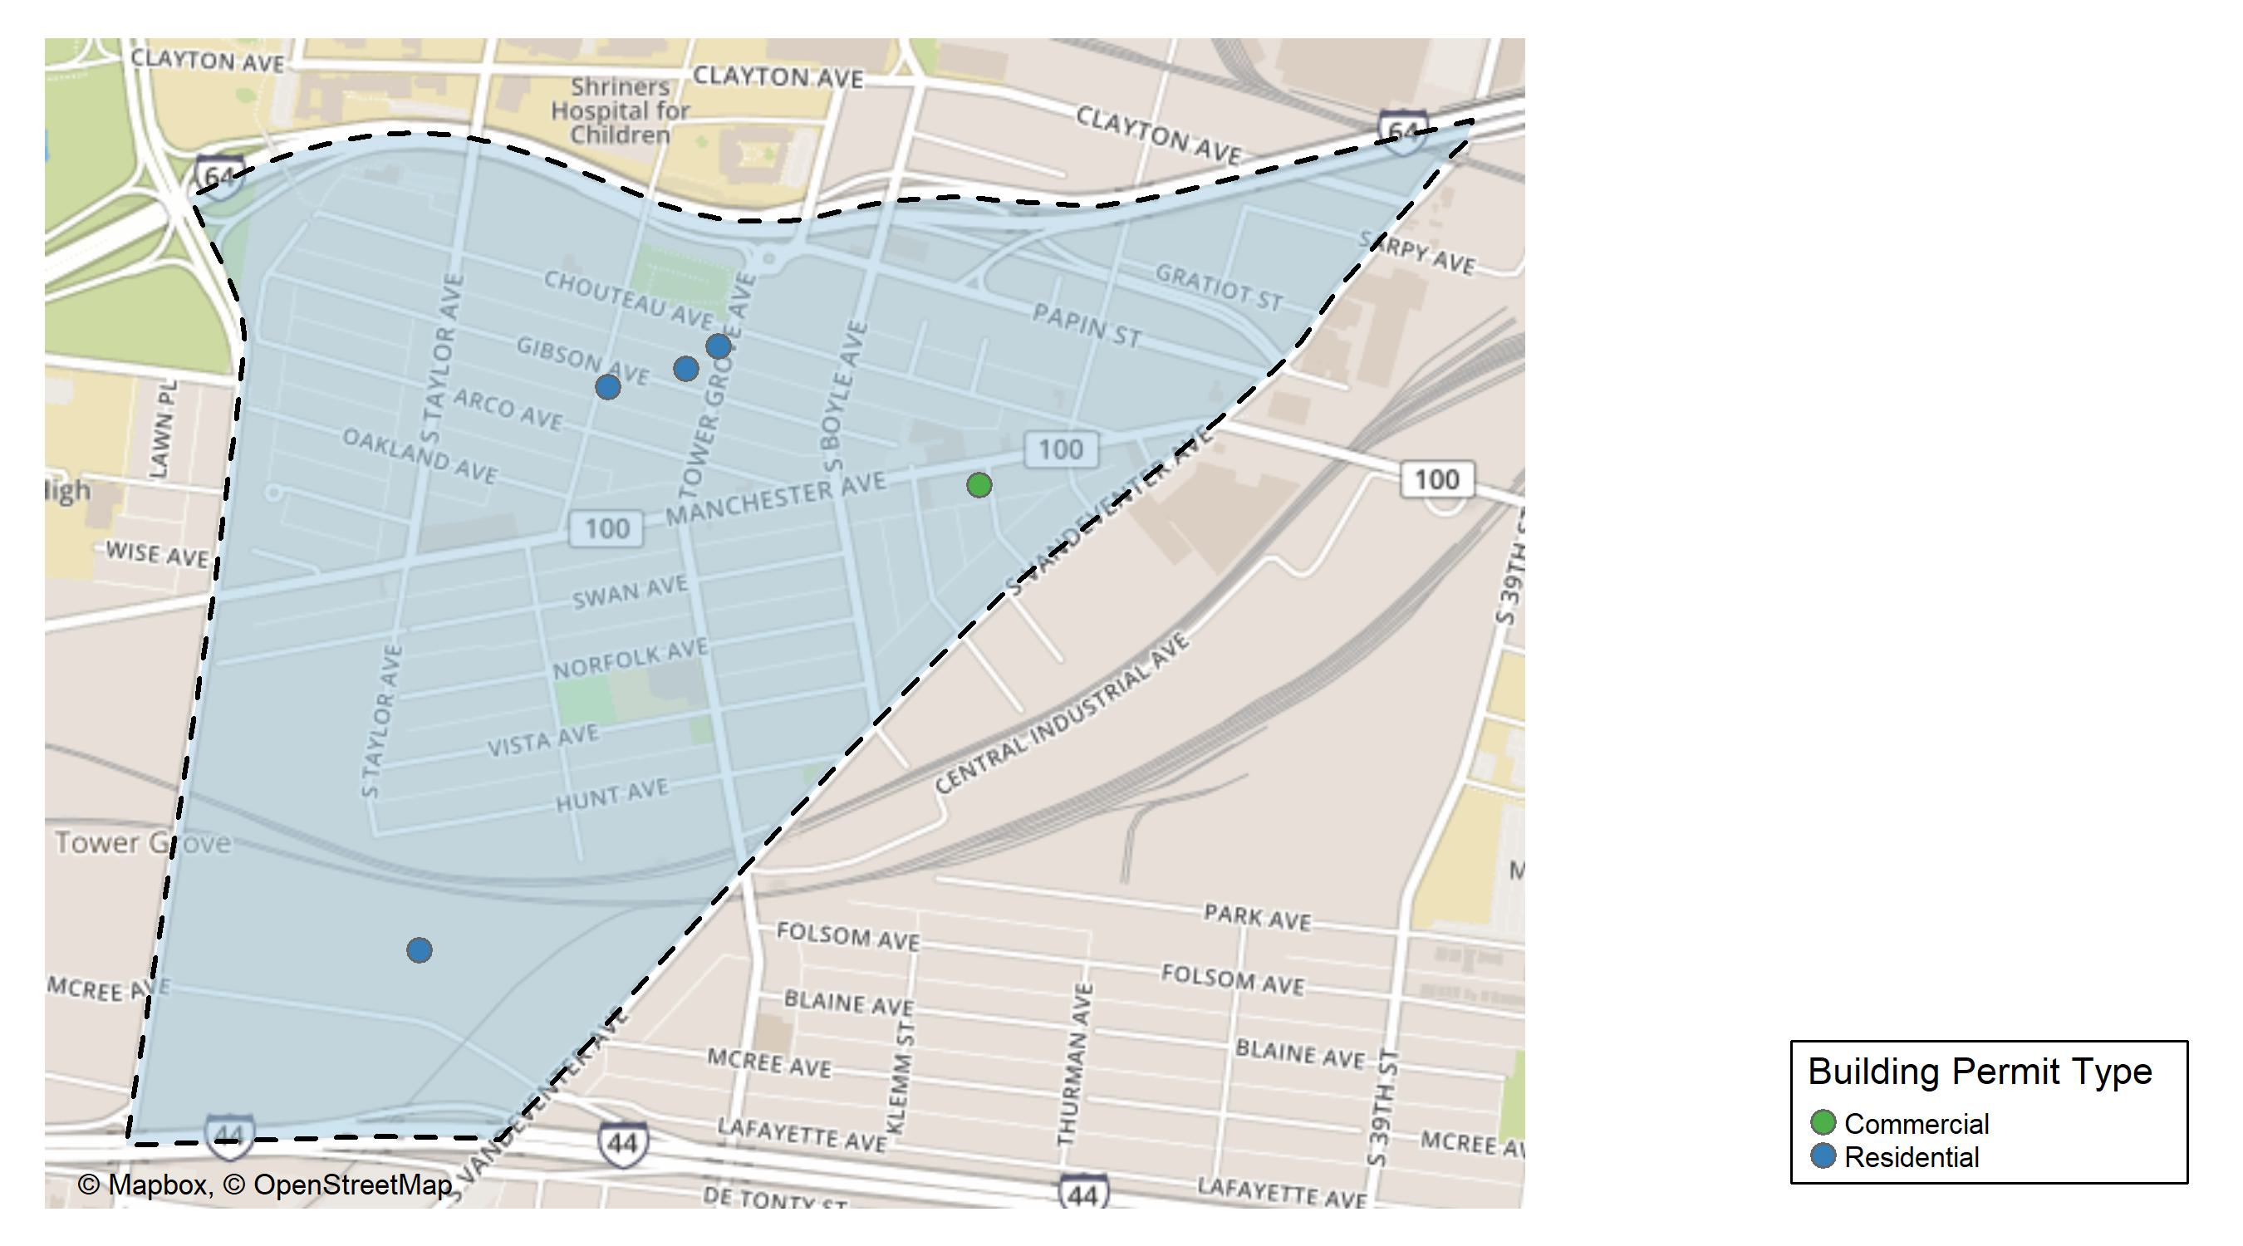
Forest Park Southeast

Slide 14
Neighborhood Summary
November 2024 | November 2024 | November 2024 | November 2024
Permit Use | Average Cost | # of Permits | Total Value of Permits
Commercial | $2,500 | 1 | $2,500
Industrial | $0 | 0 | $0
Residential | $100,740 | 5 | $503,700
Last 6 Months | Last 6 Months | Last 6 Months | Last 6 Months
Permit Use | Average Cost | # of Permits | Total Value of Permits
Commercial | $30,155.90 | 10 | $301,559
Industrial | $26,450.00 | 4 | $105,800
Residential | $41,704.96 | 26 | $1,084,329

Slide 15
Forest Park Southeast Individual Permit Breakdown
Neighborhood | Owner | New Use | Cost | address
Forest Park Southeast | GREEN STREET 4951 MCREE INVESTORS | Residential | $12,700 | 4591 MCREE AV
Forest Park Southeast | C O N E C T ST LOUIS LP | Residential | $160,000 | 4360 CHOUTEAU AV
Forest Park Southeast | C.O.N.E.C.T. ST LOUIS L P | Residential | $140,000 | 4373 GIBSON AV
Forest Park Southeast | C O N E C T ST LOUIS LP | Residential | $185,000 | 4398-H GIBSON AV
Forest Park Southeast | GREEN STREET 4951 MCREE INVESTORS | Residential | $6,000 | 4591 MCREE AV
Forest Park Southeast | ELYSIAN GROVE LLC | Commercial | $2,500 | 4140 MANCHESTER AV

Slide 16
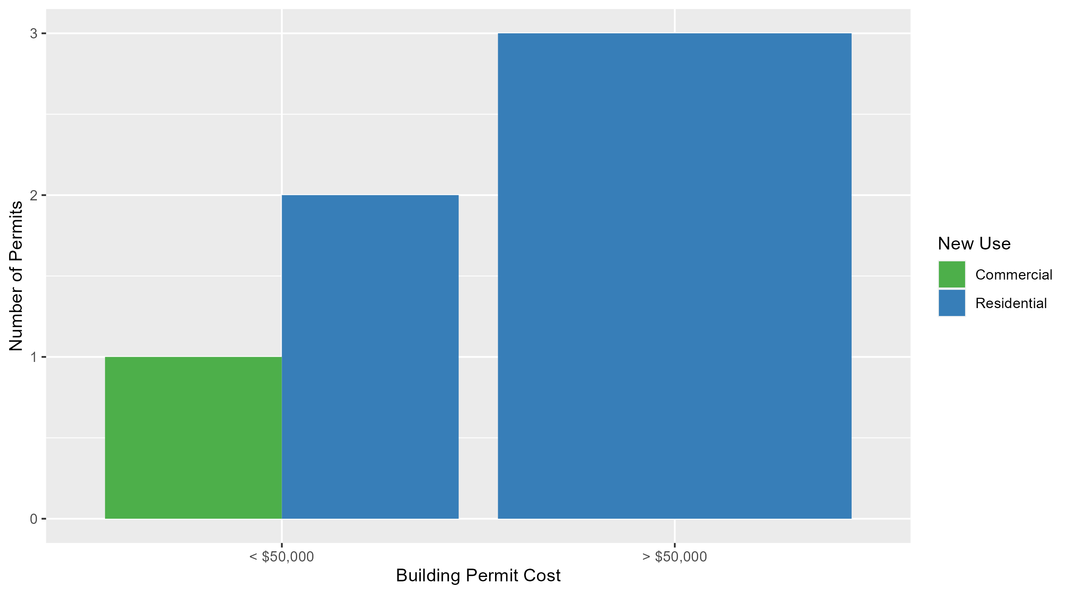
Forest Park Southeast Permit Cost Breakdown

Slide 17
Expanded Service Area

Slide 18
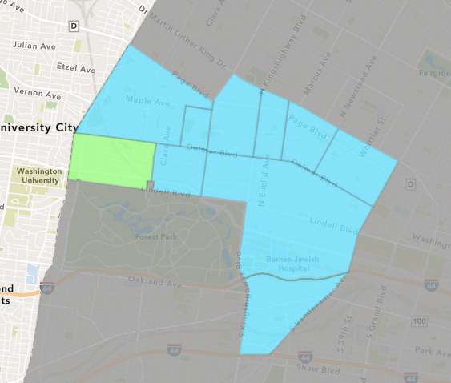
Skinker DeBaliviere
November 2024 Neighborhood Cost Breakdown
  Mean: $268,691
  Median: $30,000
  Range: $4,700 - $1,000,000

Slide 19
Skinker DeBaliviere: Summary Notes
5 building permits in November 2024
  -37.50% change compared to November 2023 (8 total building permits)
  $268,691: Average building permit cost in November 2024
    -25.73% change compared to November 2023 ($361,771)
69 total building permits in 2024
  -31.00% change YTD compared to this time in 2023 (100 total building permits)
  $93,079: YTD average building permit cost in 2024
    10.95% change YTD compared to this time in 2023 ($83,891)

Slide 20
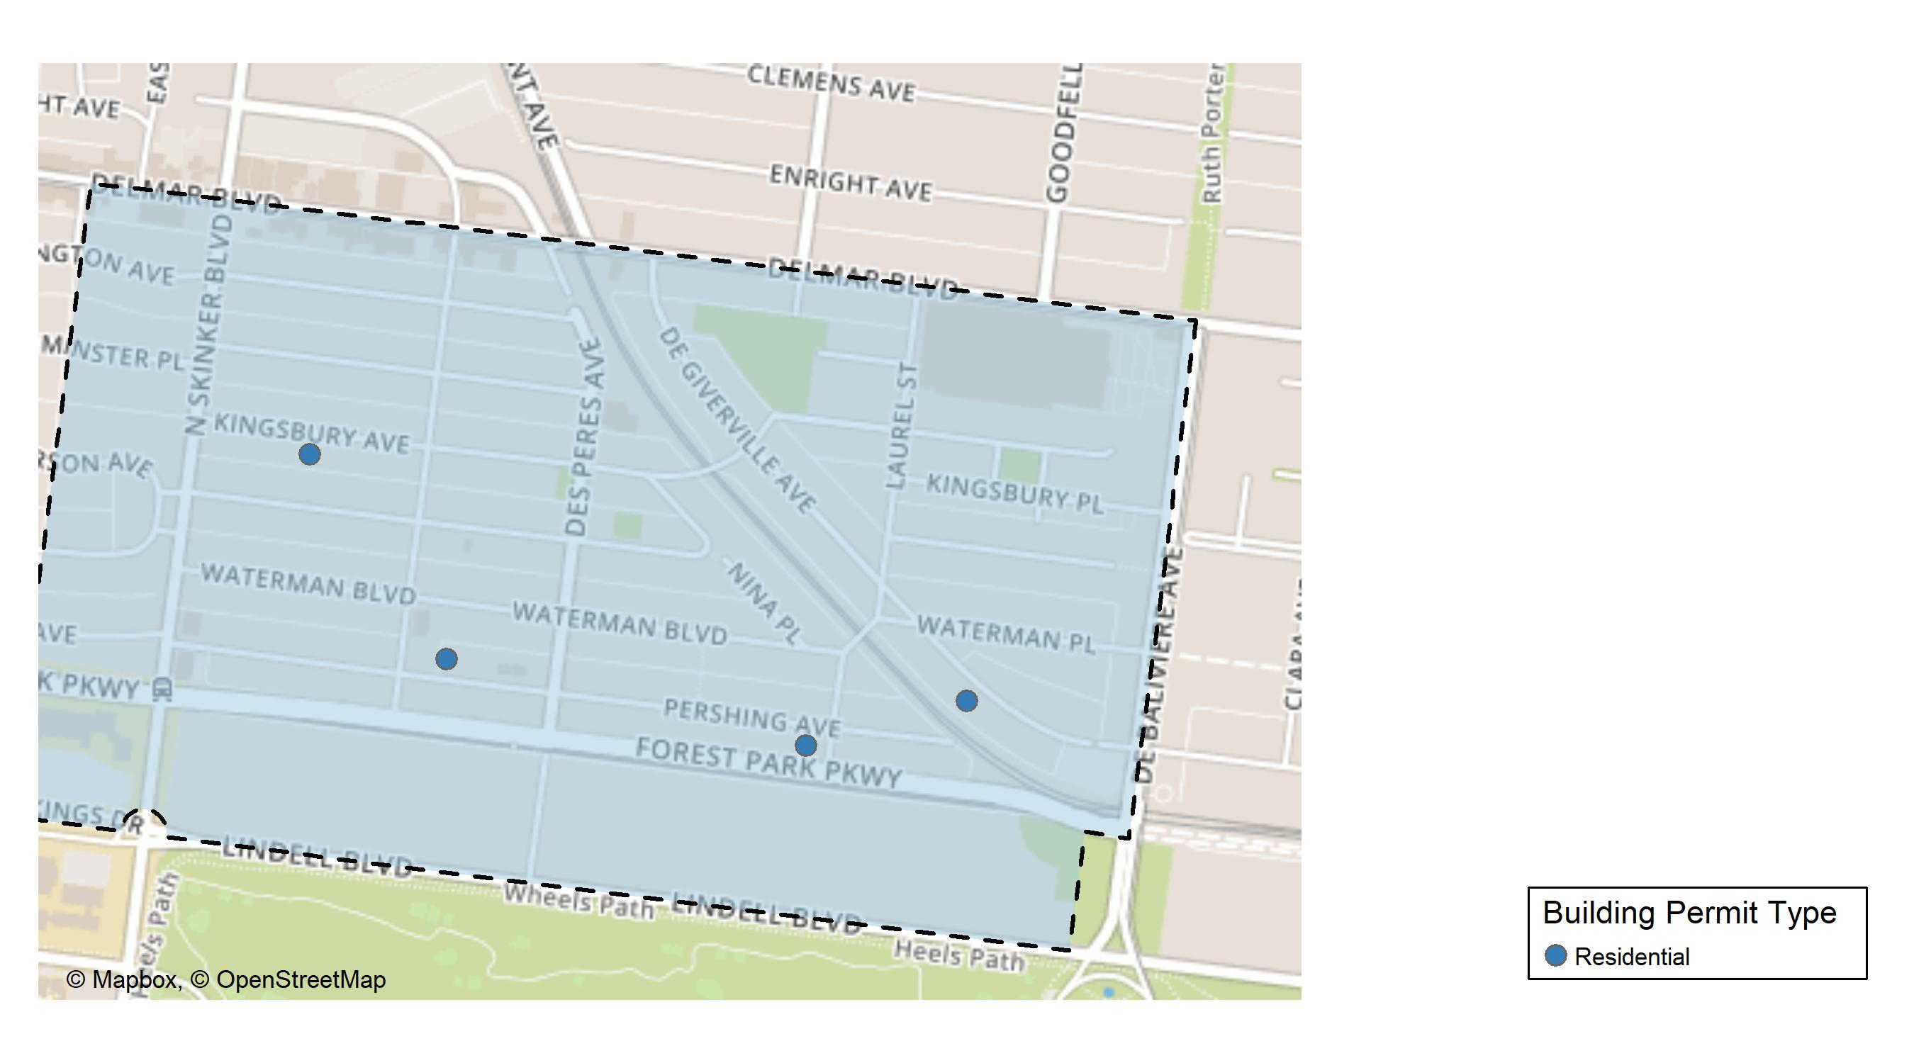
Skinker DeBaliviere

Slide 21
Neighborhood Summary
November 2024 | November 2024 | November 2024 | November 2024
Permit Use | Average Cost | # of Permits | Total Value of Permits
Commercial | $0.0 | 0 | $0
Industrial | $0.0 | 0 | $0
Residential | $268,691.4 | 5 | $1,343,457
Last 6 Months | Last 6 Months | Last 6 Months | Last 6 Months
Permit Use | Average Cost | # of Permits | Total Value of Permits
Commercial | $259,984.29 | 7 | $1,819,890
Industrial | $192,300.00 | 3 | $576,900
Residential | $65,641.86 | 42 | $2,756,958

Slide 22
Skinker DeBaliviere Individual Permit Breakdown
Neighborhood | Owner | New Use | Cost | address
Skinker DeBaliviere | BOXDORFER, MATT & RACHEL | Residential | $300,000 | 6150 KINGSBURY AV
Skinker DeBaliviere | PARKER, JONATHAN H & ELIZABETH M | Residential | $1,000,000 | 6047 PERSHING AV
Skinker DeBaliviere | CHRISTMAN, WILLIAM D & MARY B | Residential | $4,700 | 6014 KINGSBURY AV
Skinker DeBaliviere | DAVISON, GLORIA DEAN | Residential | $8,757 | 5764 DEGIVERVILLE AV
Skinker DeBaliviere | GREEN, BRENDA L & LINNIE THIGPEN JR | Residential | $30,000 | 5808 PERSHING AV

Slide 23
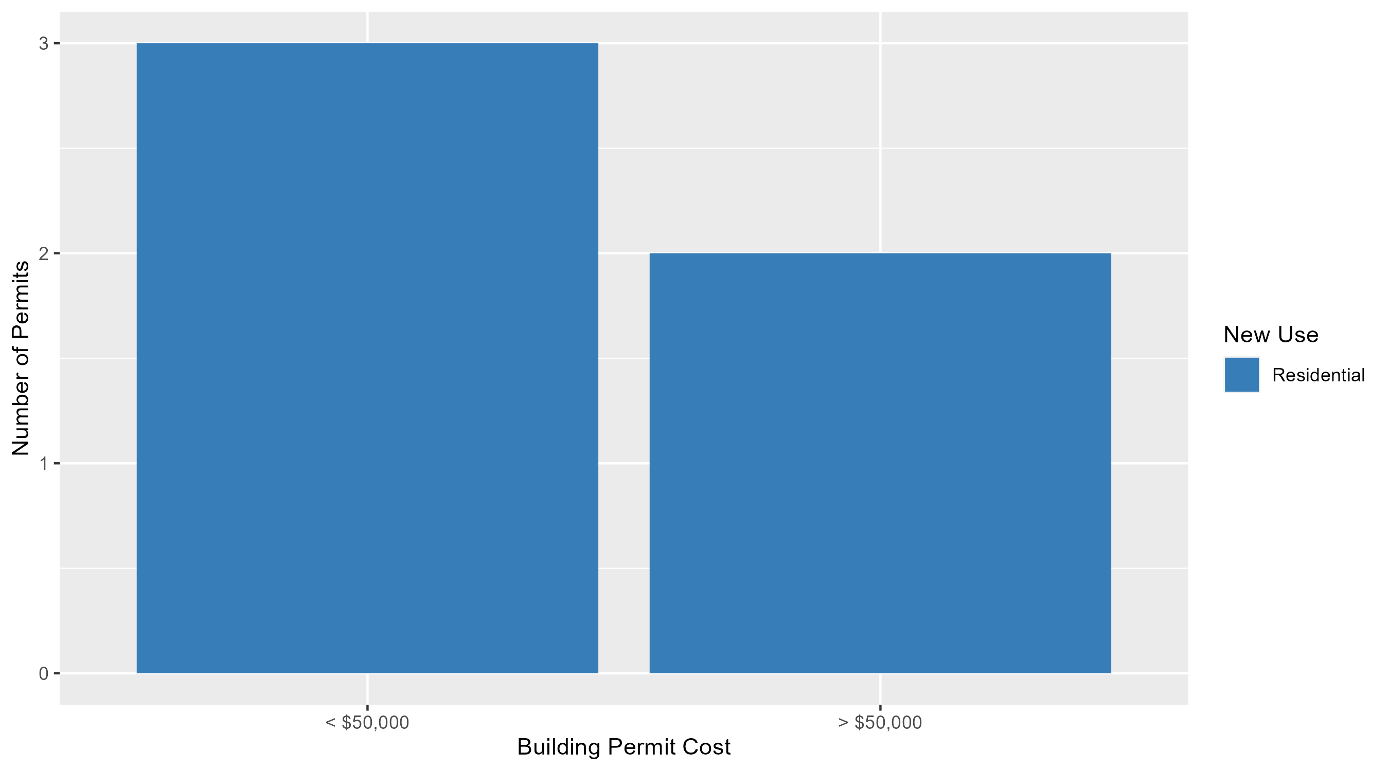
Skinker DeBaliviere Permit Cost Breakdown

Slide 24
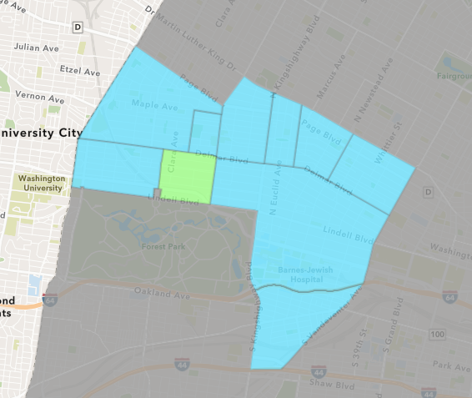
DeBaliviere Place
November 2024 Neighborhood Cost Breakdown
  Mean: $138,000
  Median: $10,000
  Range: $4,000 - $400,000

Slide 25
DeBaliviere Place: Summary Notes
3 building permits in November 2024
  -40.00% change compared to November 2023 (5 total building permits)
  $138,000: Average building permit cost in November 2024
    -60.26% change compared to November 2023 ($347,300)
44 total building permits in 2024
  2.33% change YTD compared to this time in 2023 (43 total building permits)
  $114,979: YTD average building permit cost in 2024
    -29.01% change YTD compared to this time in 2023 ($161,961)

Slide 26
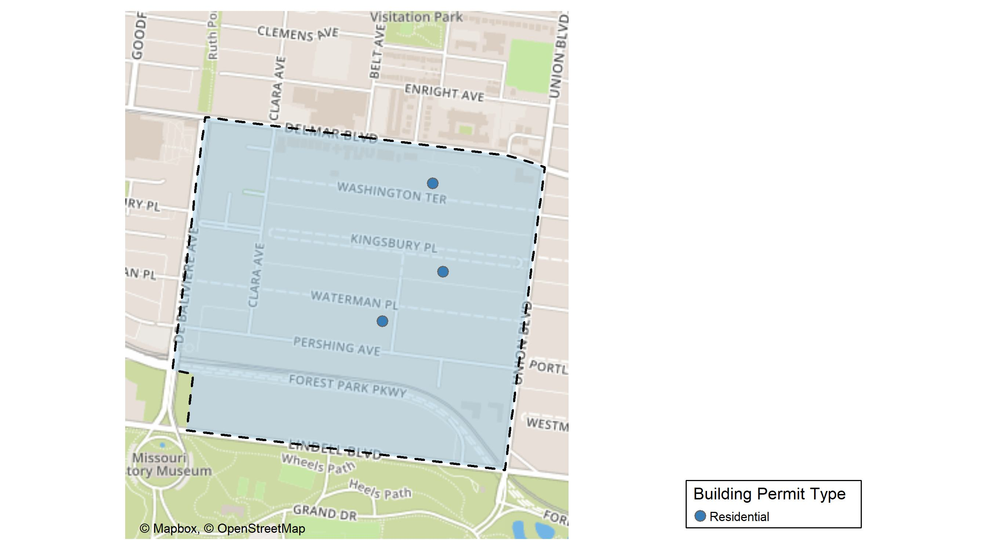
DeBaliviere Place

Slide 27
Neighborhood Summary
November 2024 | November 2024 | November 2024 | November 2024
Permit Use | Average Cost | # of Permits | Total Value of Permits
Commercial | $0 | 0 | $0
Industrial | $0 | 0 | $0
Residential | $138,000 | 3 | $414,000
Last 6 Months | Last 6 Months | Last 6 Months | Last 6 Months
Permit Use | Average Cost | # of Permits | Total Value of Permits
Commercial | $27,097.5 | 4 | $108,390
Industrial | $0.0 | 0 | $0
Residential | $160,023.4 | 26 | $4,160,609

Slide 28
DeBaliviere Place Individual Permit Breakdown
Neighborhood | Owner | New Use | Cost | address
DeBaliviere Place | ULRICH, DAVID & | Residential | $400,000 | 16 KINGSBURY PL
DeBaliviere Place | HOWE, MICHAEL P & DEBORAH A | Residential | $10,000 | 19 WASHINGTON TER
DeBaliviere Place | ROBERT CHAPMAN | Residential | $4,000 | 321 BELT AV

Slide 29
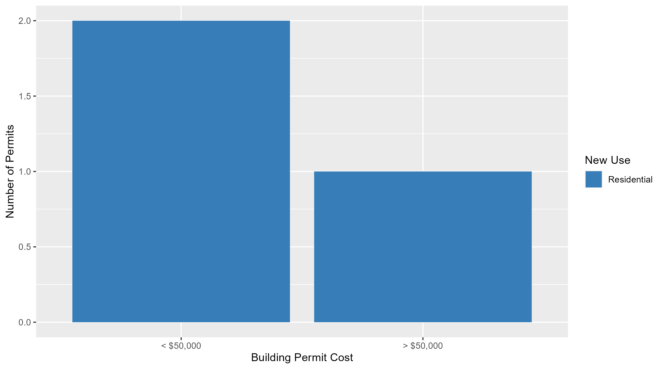
DeBaliviere Place Permit Cost Breakdown

Slide 30
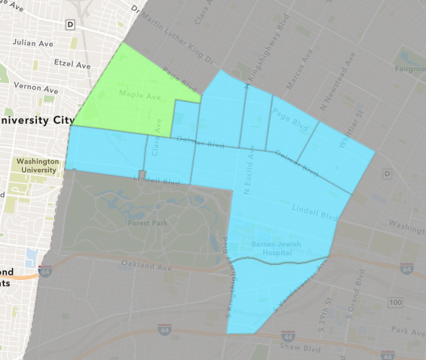
West End
November 2024 Neighborhood Cost Breakdown
  Mean: $27,176
  Median: $5,500
  Range: $500 - $115,682

Slide 31
West End: Summary Notes
5 building permits in November 2024
  -16.67% change compared to November 2023 (6 total building permits)
  $27,176: Average building permit cost in November 2024
    -88.70% change compared to November 2023 ($240,400)
66 total building permits in 2024
  -21.43% change YTD compared to this time in 2023 (84 total building permits)
  $96,621: YTD average building permit cost in 2024
    34.71% change YTD compared to this time in 2023 ($71,727)

Slide 32
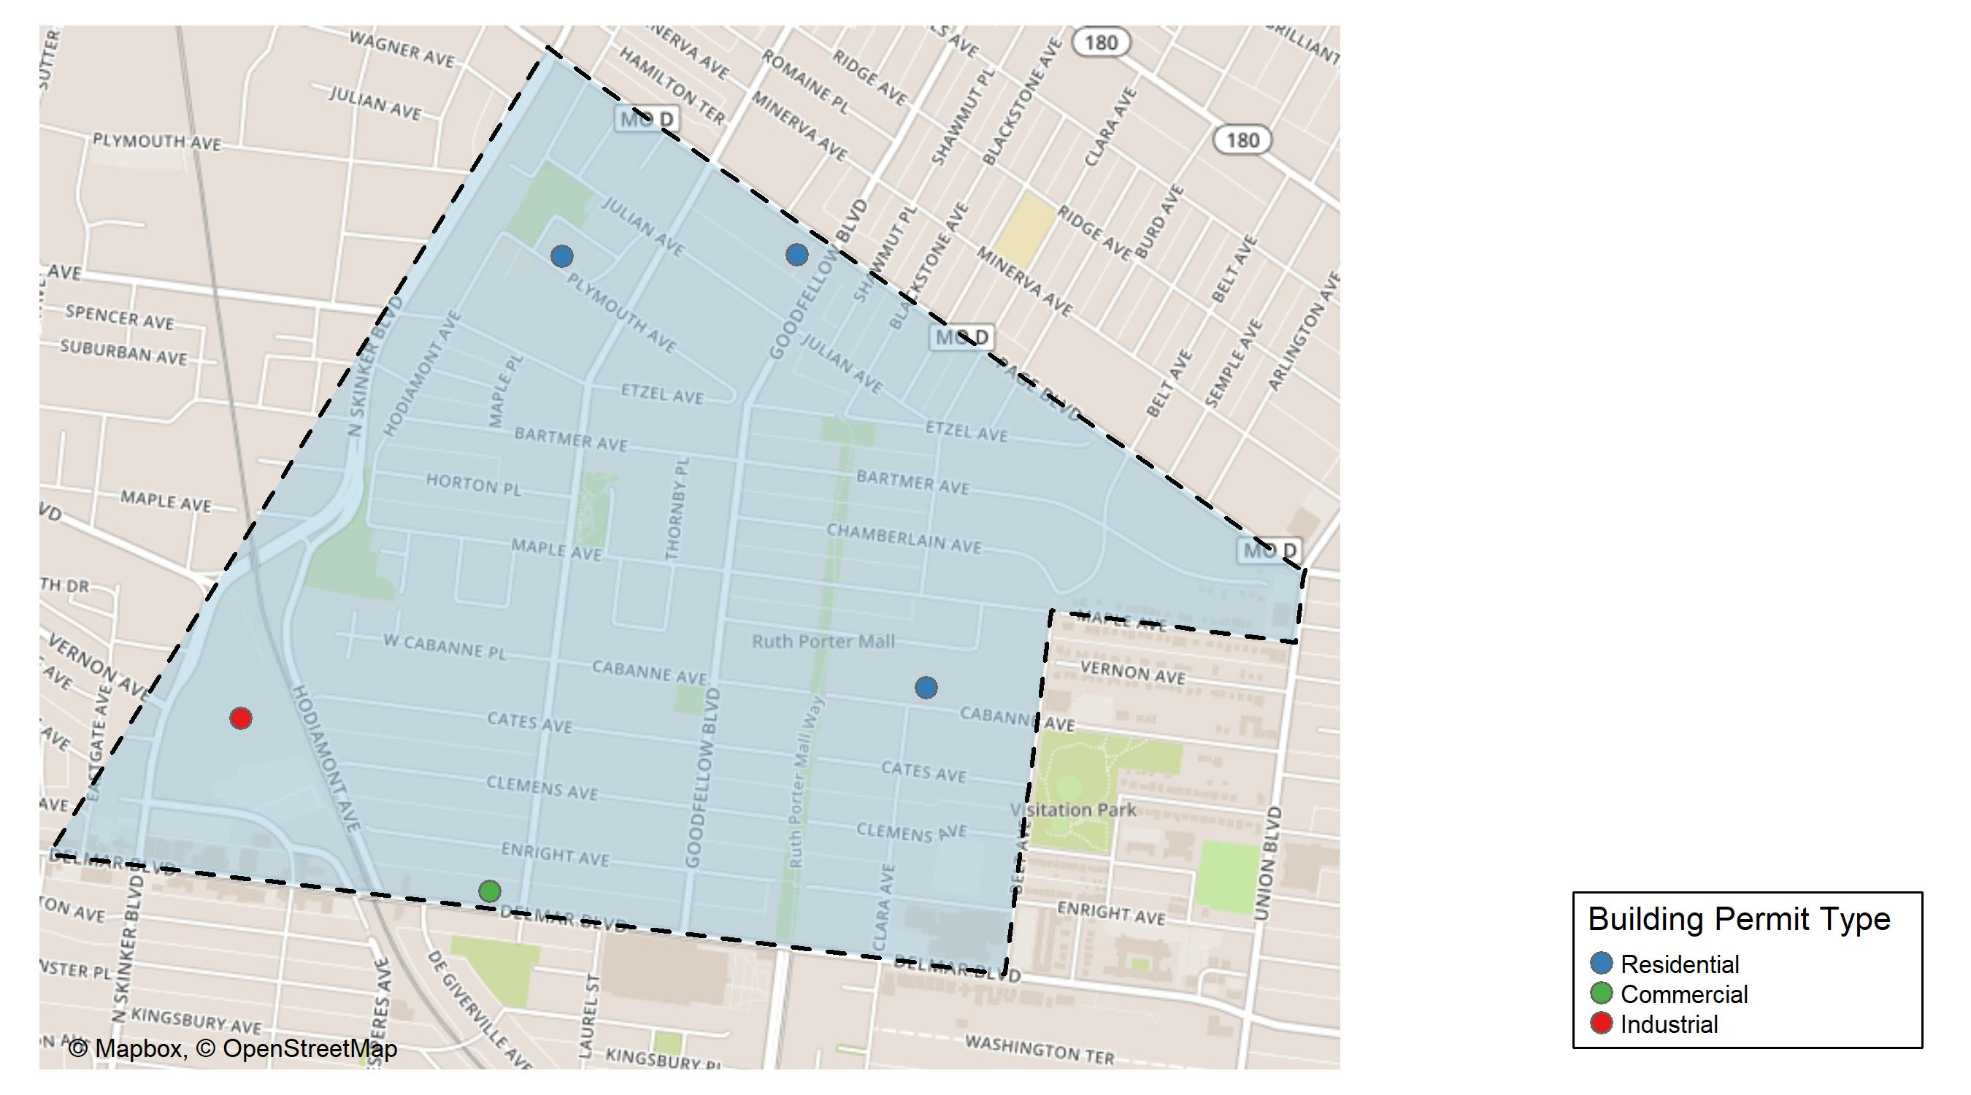
West End

Slide 33
Neighborhood Summary
November 2024 | November 2024 | November 2024 | November 2024
Permit Use | Average Cost | # of Permits | Total Value of Permits
Commercial | $500.000 | 1 | $500
Industrial | $115,682.000 | 1 | $115,682
Residential | $6,566.667 | 3 | $19,700
Last 6 Months | Last 6 Months | Last 6 Months | Last 6 Months
Permit Use | Average Cost | # of Permits | Total Value of Permits
Commercial | $35,701.67 | 6 | $214,210
Industrial | $862,841.00 | 2 | $1,725,682
Residential | $13,109.86 | 29 | $380,186

Slide 34
West End Individual Permit Breakdown
Neighborhood | Owner | New Use | Cost | address
West End | MONTANO, GLORIA M | Commercial | $500 | 5917 DELMAR BLVD
West End | WASHINGTON UNIVERSITY | Industrial | $115,682 | 700 ROSEDALE AV
West End | TAYLOR, STEPHEN J & JACQUELINE R | Residential | $4,200 | 5575 CABANNE AV
West End | VAILS, JANICE & CARLA HERMAN | Residential | $10,000 | 5955 PLYMOUTH AV
West End | VIBRANT BLUE REALTY LLC | Residential | $5,500 | 5814 PAGE BLVD

Slide 35
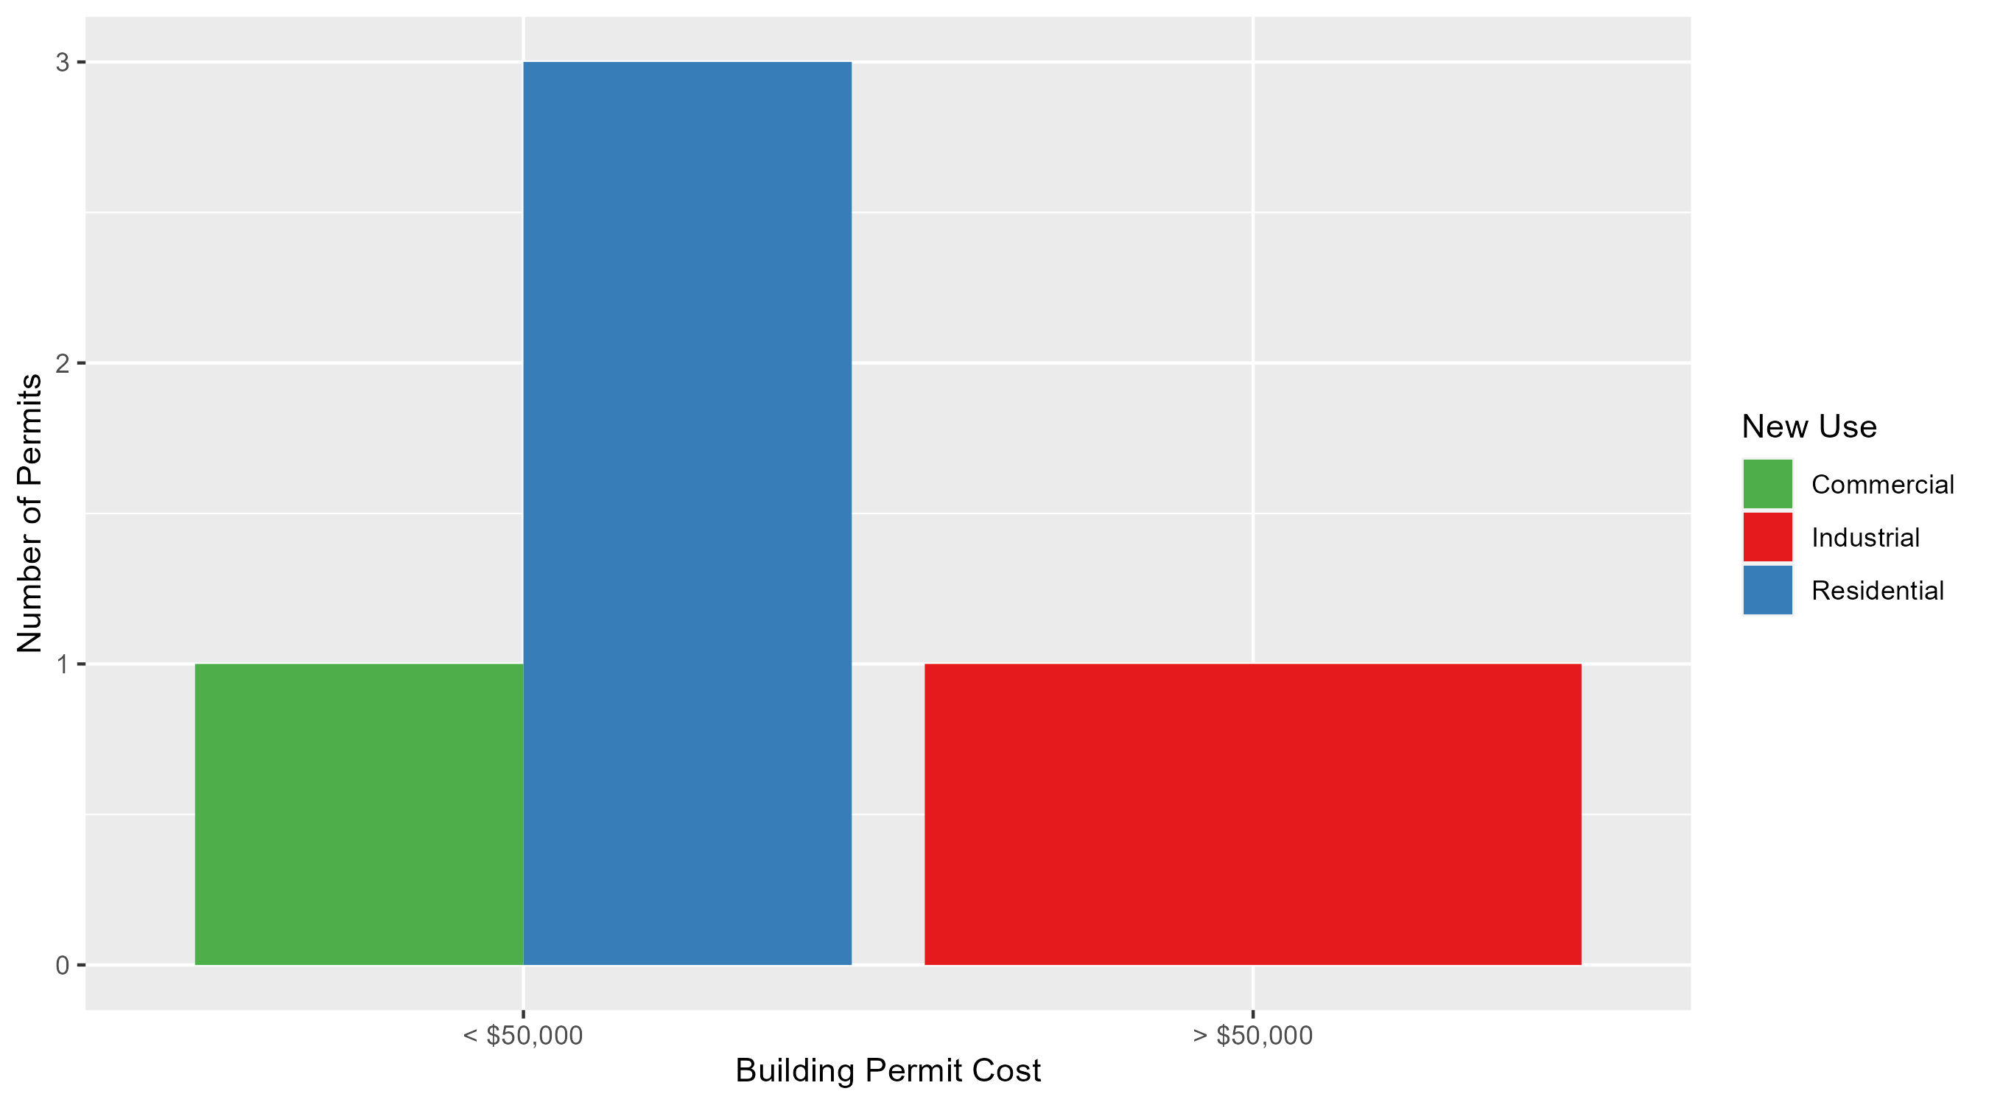
West End Permit Cost Breakdown

Slide 36
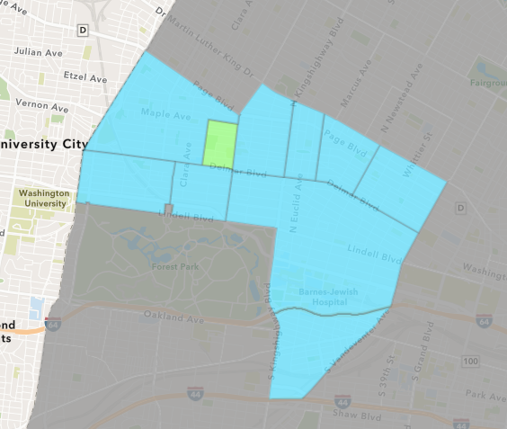
Visitation Park
November 2024 Neighborhood Cost Breakdown
  Mean: $36,282
  Median: $36,282
  Range: $36,282 - $36,282

Slide 37
Visitation Park: Summary Notes
1 building permits in November 2024
  Infinite change compared to November 2023 (0 total building permits)
  $36,282: Average building permit cost in November 2024
    Infinite change compared to November 2023 ($0)
4 total building permits in 2024
  -33.33% change YTD compared to this time in 2023 (6 total building permits)
  $20,521: YTD average building permit cost in 2024
    -89.63% change YTD compared to this time in 2023 ($197,967)

Slide 38
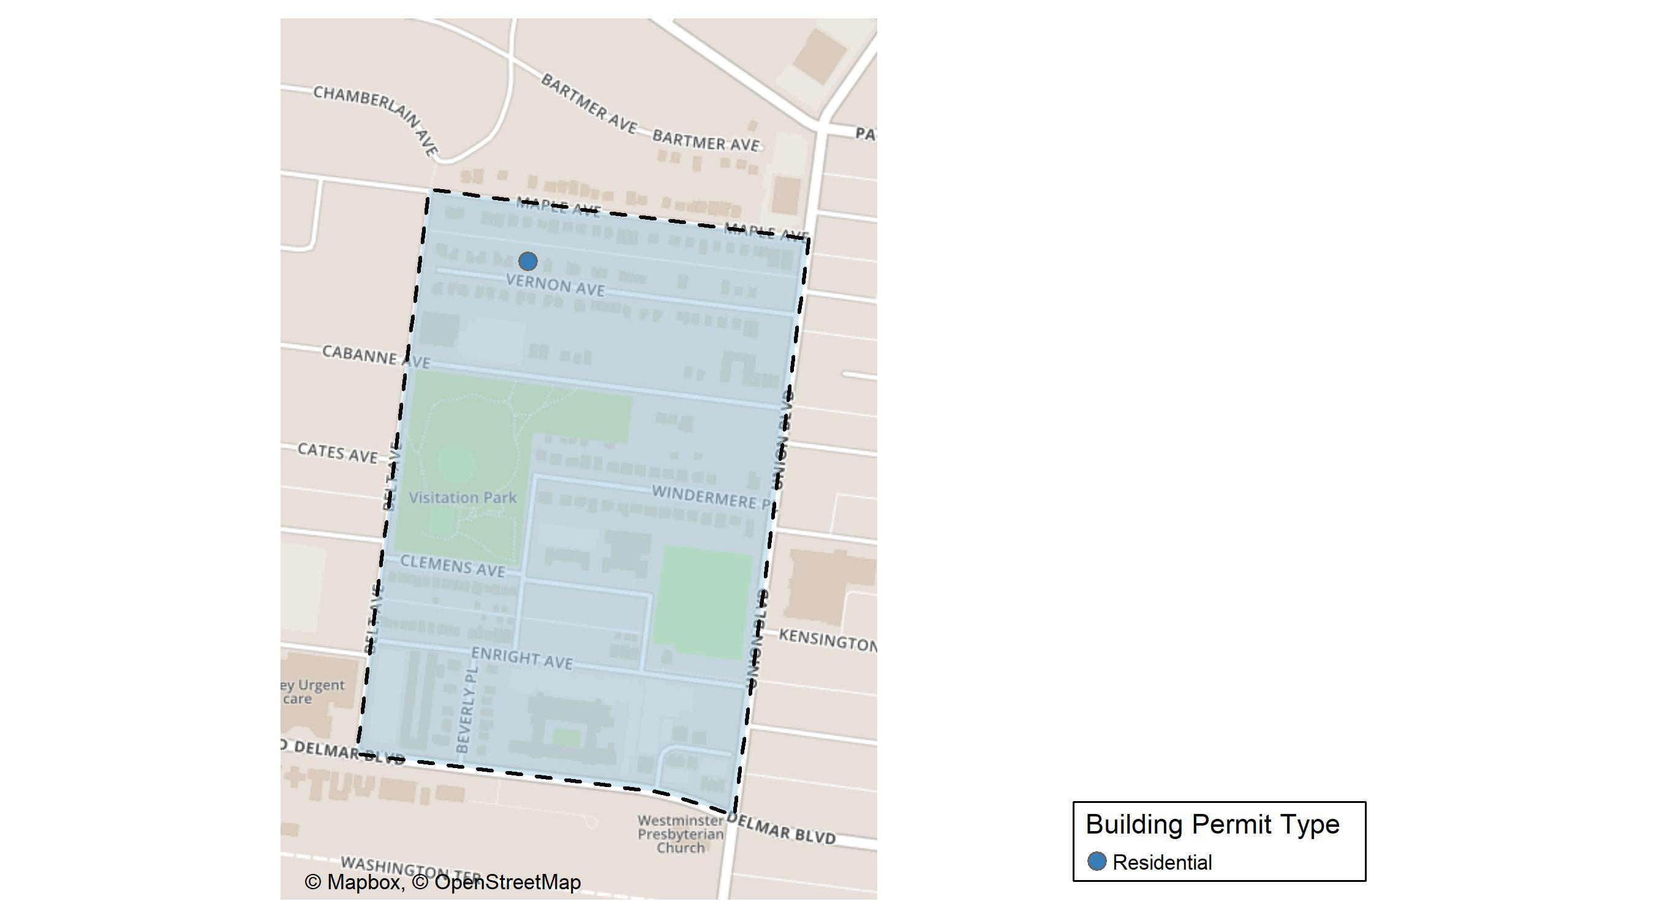
Visitation Park

Slide 39
Neighborhood Summary
November 2024 | November 2024 | November 2024 | November 2024
Permit Use | Average Cost | # of Permits | Total Value of Permits
Commercial | $0 | 0 | $0
Industrial | $0 | 0 | $0
Residential | $36,282 | 1 | $36,282
Last 6 Months | Last 6 Months | Last 6 Months | Last 6 Months
Permit Use | Average Cost | # of Permits | Total Value of Permits
Commercial | $0.0 | 0 | $0
Industrial | $0.0 | 0 | $0
Residential | $20,520.5 | 4 | $82,082

Slide 40
Visitation Park Individual Permit Breakdown
Neighborhood | Owner | New Use | Cost | address
Visitation Park | HALL, LORI & HENRY | Residential | $36,282 | 5433 VERNON AV

Slide 41
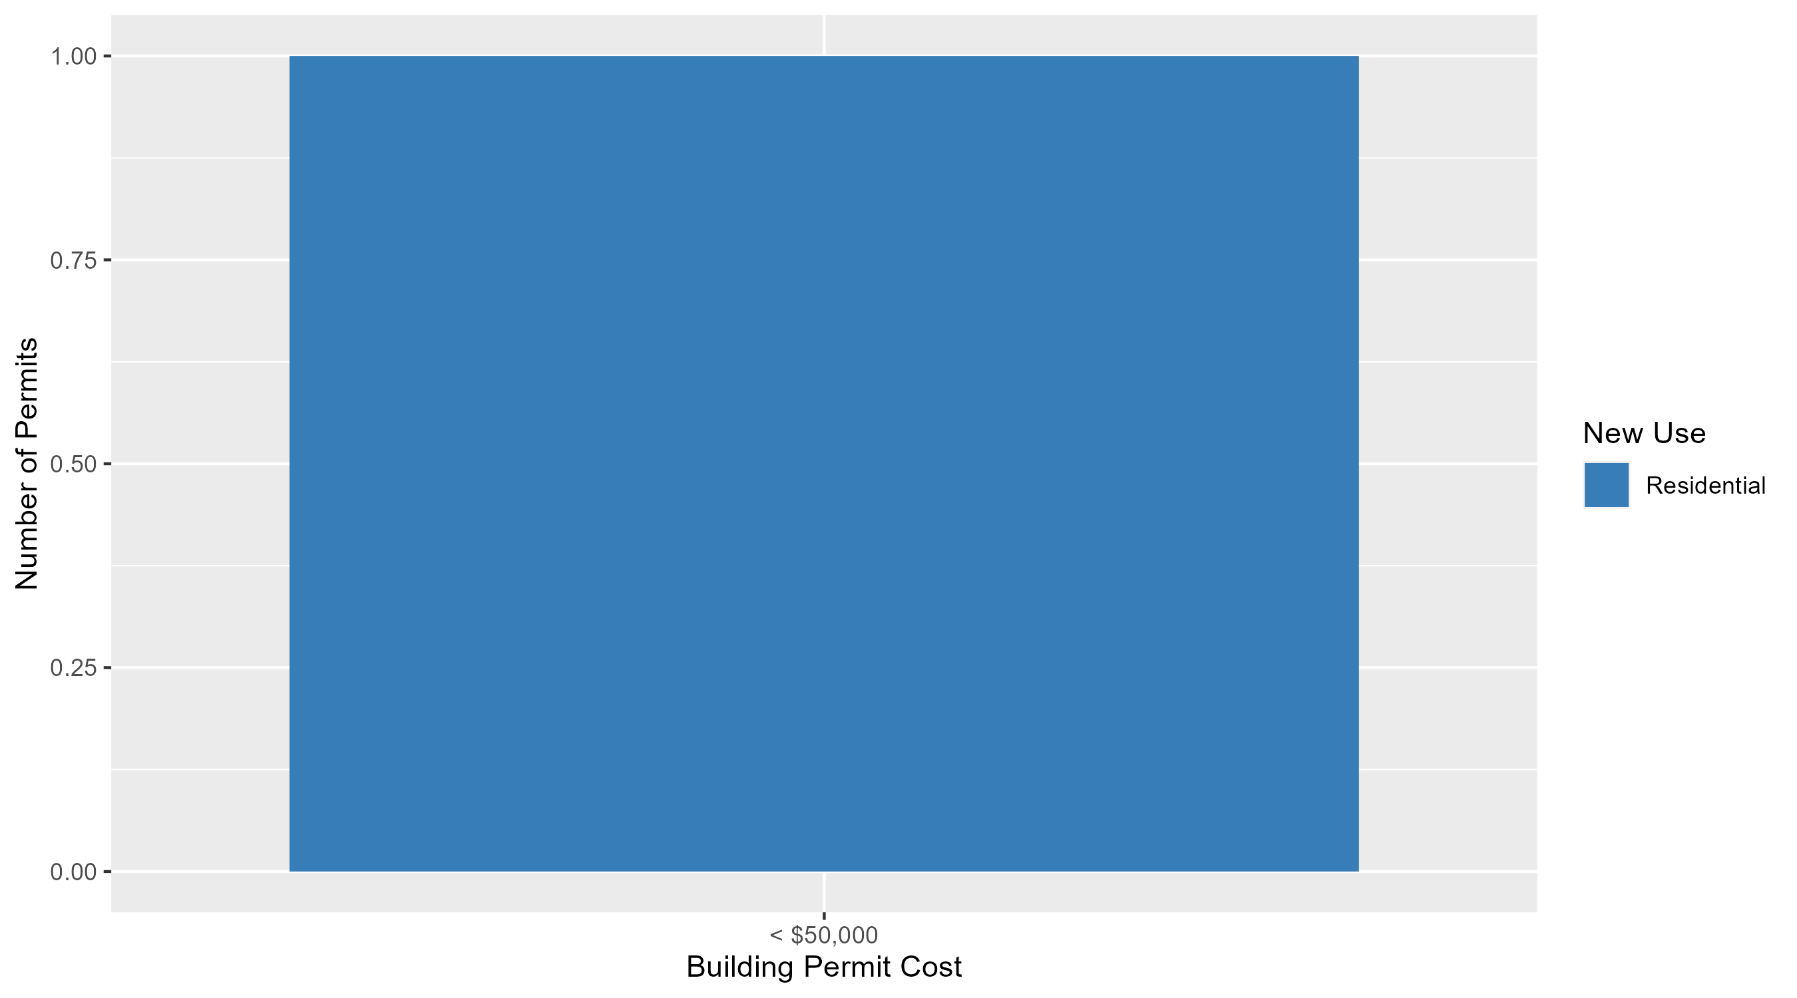
Visitation Park Permit Cost Breakdown

Slide 42
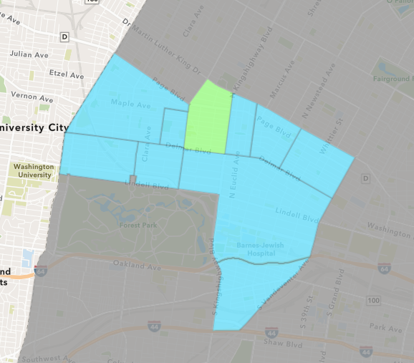
Academy
November 2024 Neighborhood Cost Breakdown
  Mean: $25,500
  Median: $25,500
  Range: $1,000 - $50,000

Slide 43
Academy: Summary Notes
2 building permits in November 2024
  100.00% change compared to November 2023 (1 total building permits)
  $25,500: Average building permit cost in November 2024
    1222.61% change compared to November 2023 ($1,928)
23 total building permits in 2024
  -20.69% change YTD compared to this time in 2023 (29 total building permits)
  $35,825: YTD average building permit cost in 2024
    40.06% change YTD compared to this time in 2023 ($25,579)

Slide 44
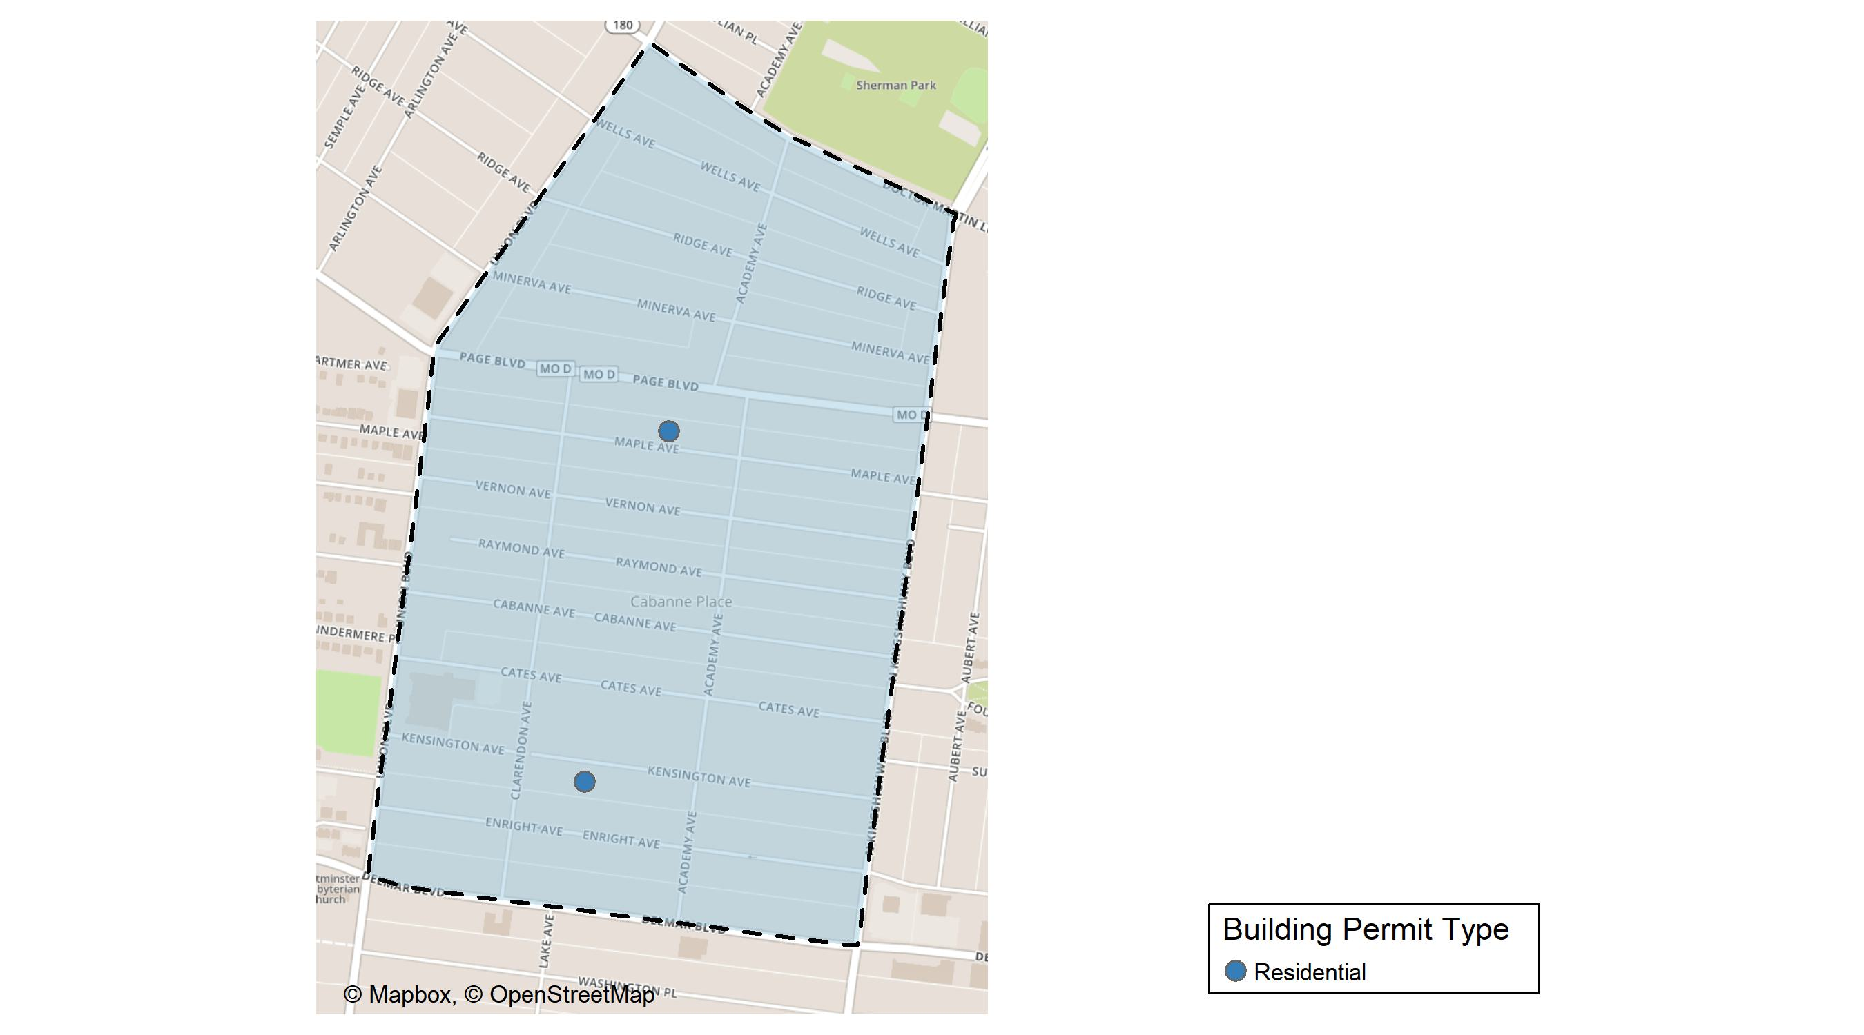
Academy

Slide 45
Neighborhood Summary
November 2024 | November 2024 | November 2024 | November 2024
Permit Use | Average Cost | # of Permits | Total Value of Permits
Commercial | $0 | 0 | $0
Industrial | $0 | 0 | $0
Residential | $25,500 | 2 | $51,000
Last 6 Months | Last 6 Months | Last 6 Months | Last 6 Months
Permit Use | Average Cost | # of Permits | Total Value of Permits
Commercial | $47,000.00 | 3 | $141,000
Industrial | $0.00 | 0 | $0
Residential | $41,829.46 | 13 | $543,783

Slide 46
Academy Individual Permit Breakdown
Neighborhood | Owner | New Use | Cost | address
Academy | BRICK BY BRICK CONSULTING LLC | Residential | $50,000 | 5139 MAPLE AV
Academy | PHILLIPS, KARL E | Residential | $1,000 | 5158-50 KENSINGTON AV

Slide 47
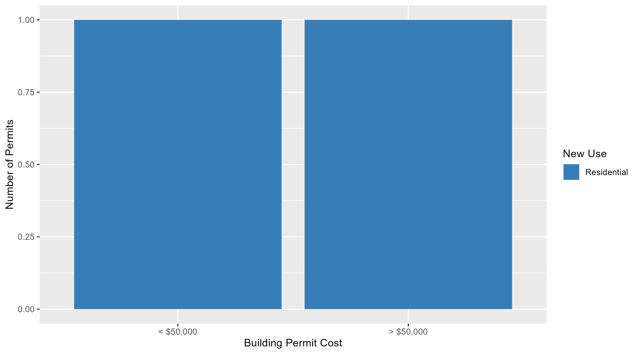
Academy Permit Cost Breakdown

Slide 48
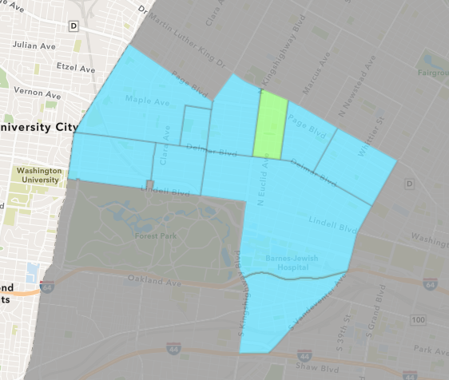
Fountain Park
November 2024 Neighborhood Cost Breakdown
  Mean: $50,833
  Median: $47,500
  Range: $5,000 - $120,000

Slide 49
Fountain Park: Summary Notes
6 building permits in November 2024
  100.00% change compared to November 2023 (3 total building permits)
  $50,833: Average building permit cost in November 2024
    107.77% change compared to November 2023 ($24,467)
14 total building permits in 2024
  -6.67% change YTD compared to this time in 2023 (15 total building permits)
  $41,571: YTD average building permit cost in 2024
    -68.75% change YTD compared to this time in 2023 ($133,049)

Slide 50
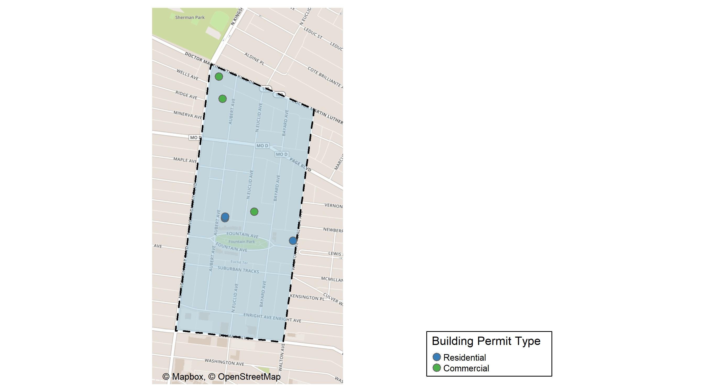
Fountain Park

Slide 51
Neighborhood Summary
November 2024 | November 2024 | November 2024 | November 2024
Permit Use | Average Cost | # of Permits | Total Value of Permits
Commercial | $50,000.00 | 3 | $150,000
Industrial | $0.00 | 0 | $0
Residential | $51,666.67 | 3 | $155,000
Last 6 Months | Last 6 Months | Last 6 Months | Last 6 Months
Permit Use | Average Cost | # of Permits | Total Value of Permits
Commercial | $43,750.00 | 4 | $175,000
Industrial | $0.00 | 0 | $0
Residential | $58,833.33 | 6 | $353,000

Slide 52
Fountain Park Individual Permit Breakdown
Neighborhood | Owner | New Use | Cost | address
Fountain Park | URBAN LEAGUE OF METROPOLITAN ST LOUIS | Commercial | $20,000 | 1408 N KINGSHIGHWAY BLVD
Fountain Park | KINGSWAY DEVELOPMENT LLC | Residential | $75,000 | 1124 AUBERT AV
Fountain Park | KINGSWAY DEVELOPMENT LLC | Residential | $75,000 | 1122 AUBERT AV
Fountain Park | B O E OF THE CITY OF ST LOUIS | Commercial | $120,000 | 1130 N EUCLID AV
Fountain Park | HOLLYWOOD BEAUTY SUPPLIES LLC | Commercial | $10,000 | 1448 N KINGSHIGHWAY BLVD
Fountain Park | R2R INVESTMENTS LLC | Residential | $5,000 | 4803 FOUNTAIN AV

Slide 53
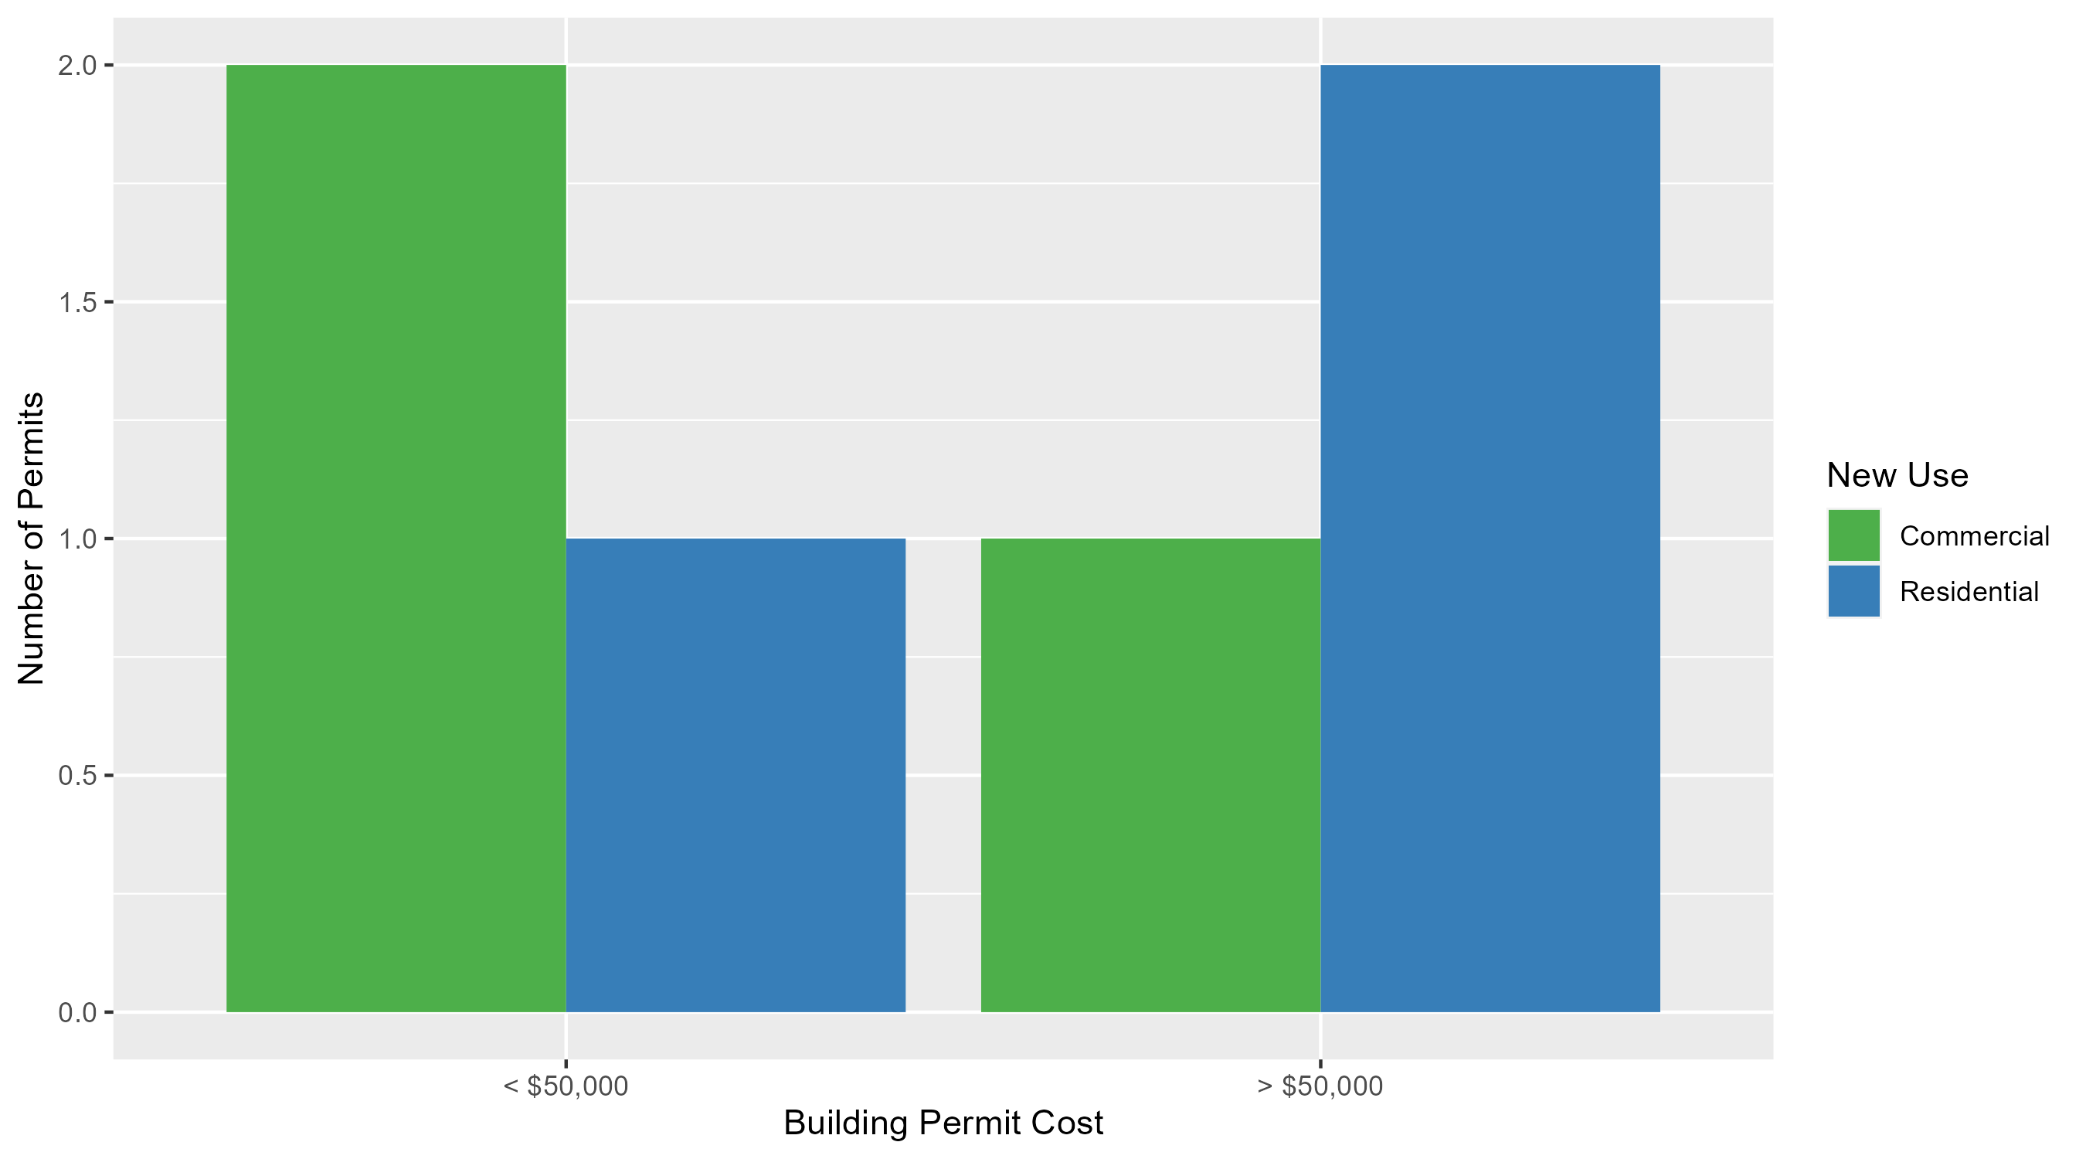
Fountain Park Permit Cost Breakdown

Slide 54
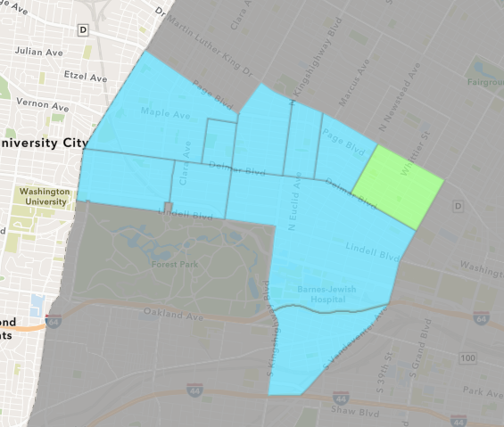
Vandeventer
November 2024 Neighborhood Cost Breakdown
  Mean: $150,000
  Median: $150,000
  Range: $150,000 - $150,000

Slide 55
Vandeventer: Summary Notes
1 building permits in November 2024
  0.00% change compared to November 2023 (1 total building permits)
  $150,000: Average building permit cost in November 2024
    900.00% change compared to November 2023 ($15,000)
12 total building permits in 2024
  -14.29% change YTD compared to this time in 2023 (14 total building permits)
  $48,607: YTD average building permit cost in 2024
    -71.56% change YTD compared to this time in 2023 ($170,938)

Slide 56
Additional Notes
Data retreived from https://www.stlouis-mo.gov/data/
Building permits with a cost of $0 were dropped
Building permits that were cancelled were dropped
Infinite change indicates 0 permits in the current or previous time period/comparison month so there was a overall increase or decrease

