Slide 1
St. Louis Central Corridor West Building Permits
Monthly Report: October 2024

Slide 2
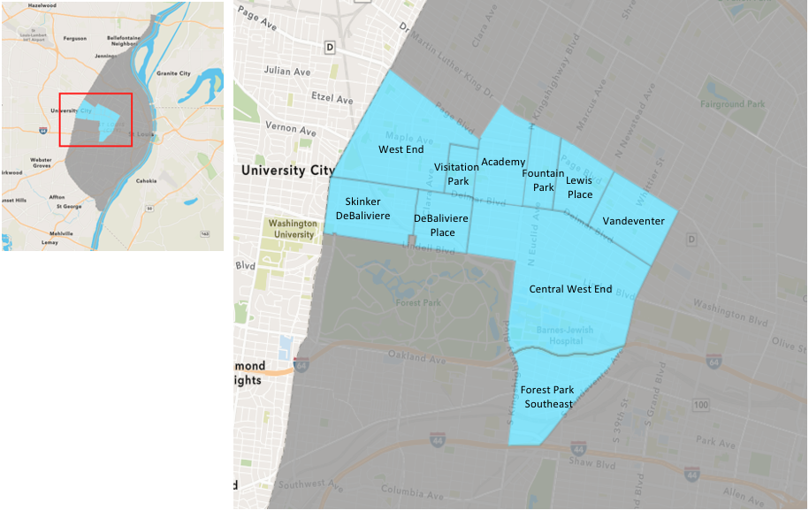
St. Louis Neighborhood Spatial Reference

Slide 3
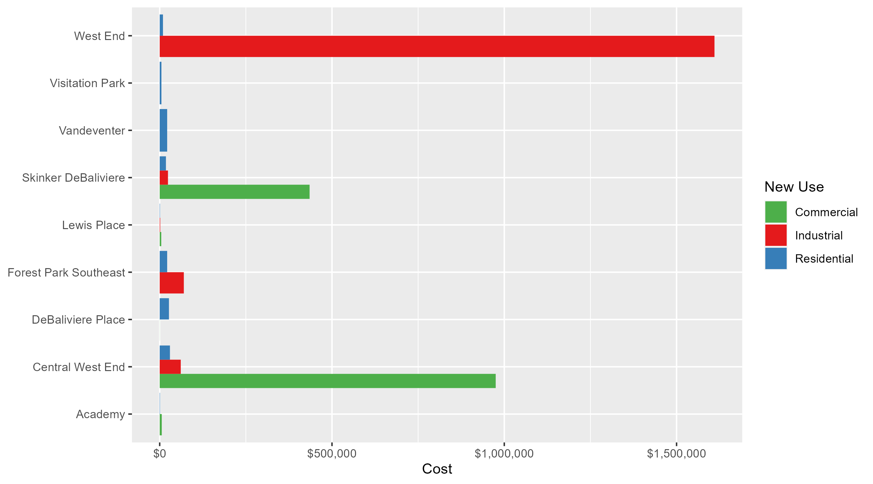
Neighborhood Summary: Average Building Permit Cost

Slide 4
Neighborhood Summary
October 2024 | October 2024 | October 2024 | October 2024
Neighborhood | Average Cost | # of Permits | Total Value of Permits
Academy | $2,666.667 | 3 | $8,000
Central West End | $532,073.529 | 34 | $18,090,500
DeBaliviere Place | $22,398.167 | 6 | $134,389
Forest Park Southeast | $28,571.429 | 7 | $200,000
Fountain Park | $0.000 | 0 | $0
Lewis Place | $2,333.333 | 3 | $7,000
Skinker DeBaliviere | $114,754.692 | 13 | $1,491,811
Vandeventer | $21,666.667 | 3 | $65,000
Visitation Park | $5,000.000 | 1 | $5,000
West End | $543,000.000 | 3 | $1,629,000
Last 6 Months | Last 6 Months | Last 6 Months | Last 6 Months
Neighborhood | Average Cost | # of Permits | Total Value of Permits
Academy | $42,452.20 | 15 | $636,783
Central West End | $250,739.31 | 220 | $55,162,648
DeBaliviere Place | $131,312.47 | 32 | $4,201,999
Forest Park Southeast | $35,371.89 | 36 | $1,273,388
Fountain Park | $55,750.00 | 4 | $223,000
Lewis Place | $26,183.00 | 12 | $314,196
Skinker DeBaliviere | $73,923.11 | 53 | $3,917,925
Vandeventer | $27,578.75 | 8 | $220,630
Visitation Park | $15,266.67 | 3 | $45,800
West End | $85,499.45 | 38 | $3,248,979

Slide 5
Core Neighborhoods

Slide 6
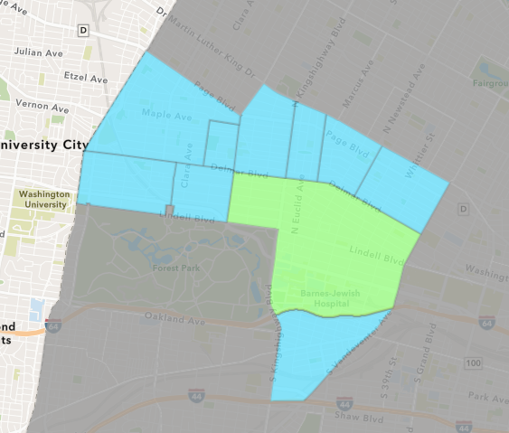
Central West End
October 2024 Neighborhood Cost Breakdown
  Mean: $532,074
  Median: $34,375
  Range: $1,200 - $10,252,000

Slide 7
Central West End: Summary Notes
34 building permits in October 2024
  17.24% change compared to October 2023 (29 total building permits)
  $532,074: Average building permit cost in October 2024
    395.90% change compared to October 2023 ($107,294)
292 total building permits in 2024
  -8.75% change YTD compared to this time in 2023 (320 total building permits)
  $407,495: YTD average building permit cost in 2024
    77.10% change YTD compared to this time in 2023 ($230,088)

Slide 8
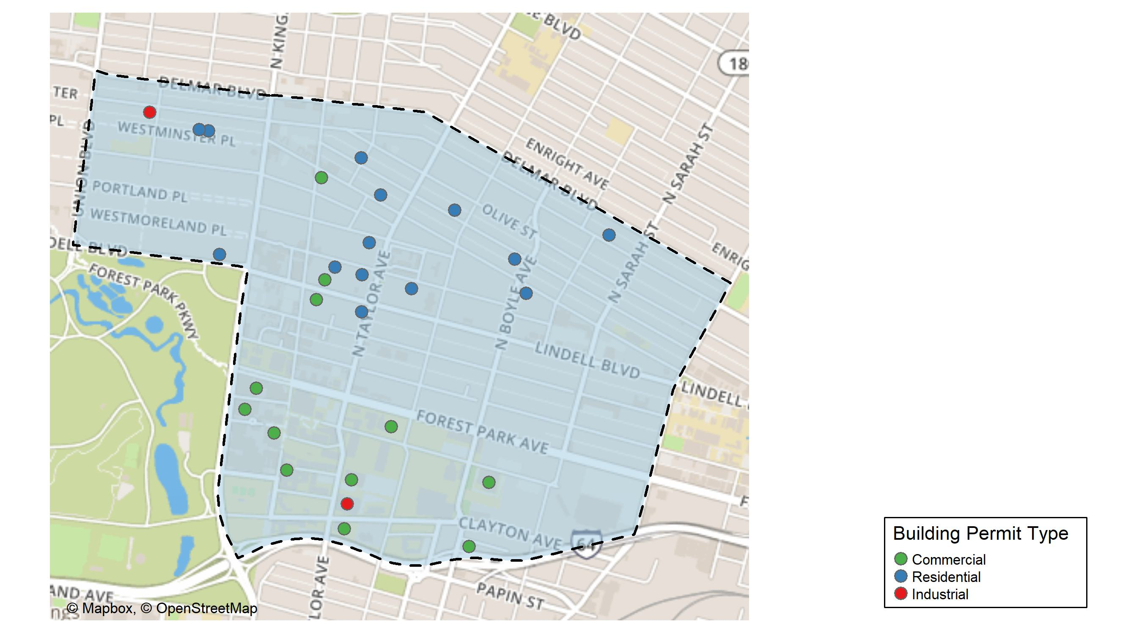
Central West End

Slide 9
Neighborhood Summary
October 2024 | October 2024 | October 2024 | October 2024
Permit Use | Average Cost | # of Permits | Total Value of Permits
Commercial | $975,117.83 | 18 | $17,552,121
Industrial | $61,107.00 | 2 | $122,214
Residential | $29,726.07 | 14 | $416,165
Last 6 Months | Last 6 Months | Last 6 Months | Last 6 Months
Permit Use | Average Cost | # of Permits | Total Value of Permits
Commercial | $405,427.4 | 100 | $40,542,743
Industrial | $34,488.4 | 5 | $172,442
Residential | $125,630.1 | 115 | $14,447,463

Slide 10
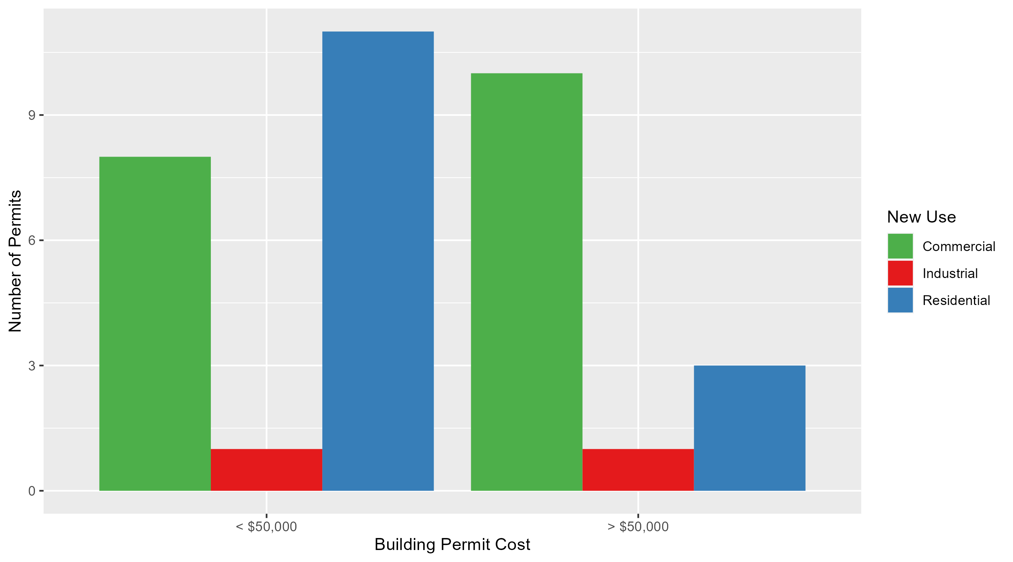
Central West End Permit Cost Breakdown

Slide 11
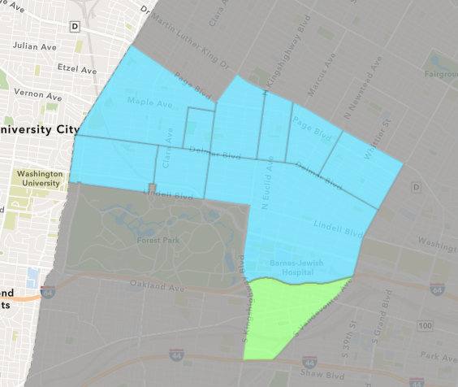
Forest Park Southeast
October 2024 Neighborhood Cost Breakdown
  Mean: $28,571
  Median: $15,000
  Range: $3,000 - $80,000

Slide 12
Forest Park Southeast: Summary Notes
7 building permits in October 2024
  40.00% change compared to October 2023 (5 total building permits)
  $28,571: Average building permit cost in October 2024
    -25.79% change compared to October 2023 ($38,500)
60 total building permits in 2024
  5.26% change YTD compared to this time in 2023 (57 total building permits)
  $55,935: YTD average building permit cost in 2024
    -16.83% change YTD compared to this time in 2023 ($67,257)

Slide 13
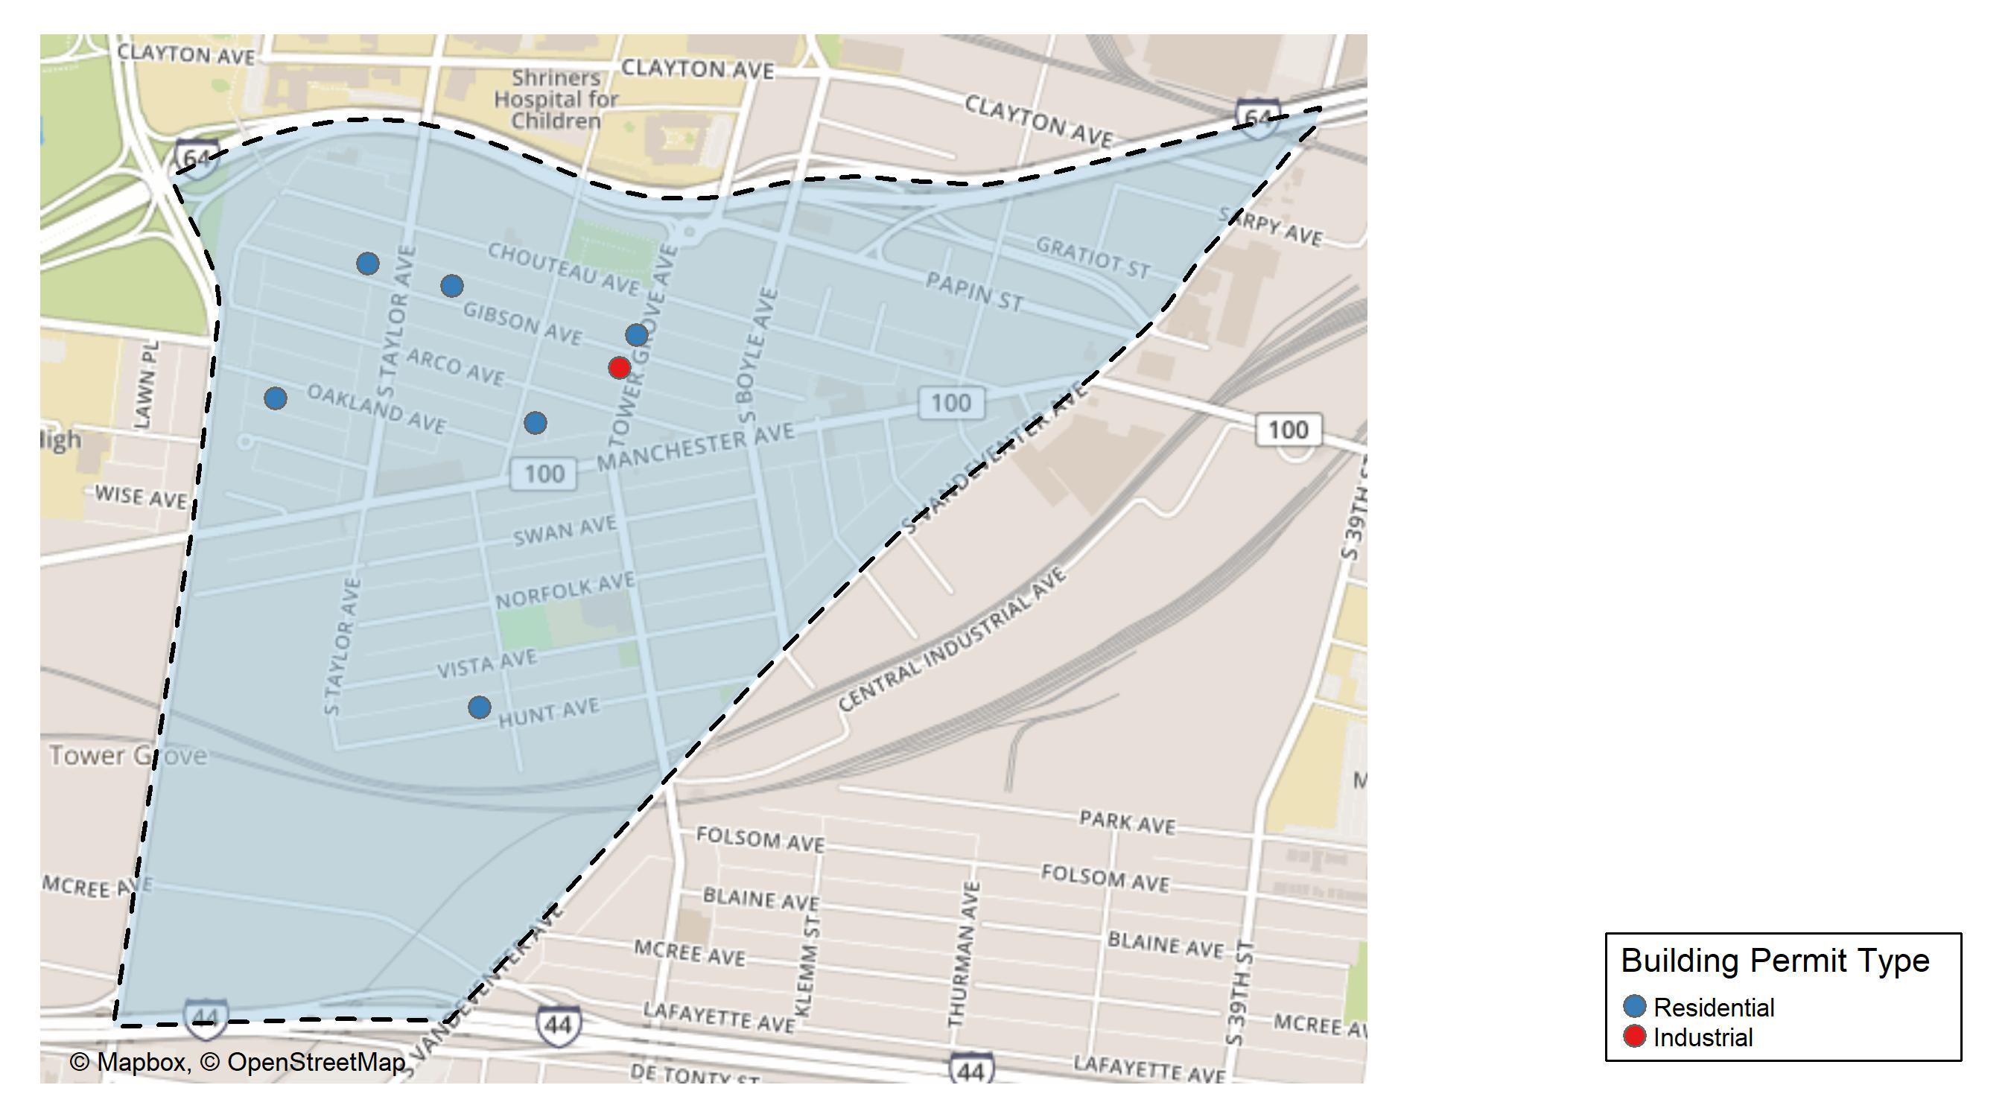
Forest Park Southeast

Slide 14
Neighborhood Summary
October 2024 | October 2024 | October 2024 | October 2024
Permit Use | Average Cost | # of Permits | Total Value of Permits
Commercial | $0.00 | 0 | $0
Industrial | $70,000.00 | 1 | $70,000
Residential | $21,666.67 | 6 | $130,000
Last 6 Months | Last 6 Months | Last 6 Months | Last 6 Months
Permit Use | Average Cost | # of Permits | Total Value of Permits
Commercial | $33,228.78 | 9 | $299,059
Industrial | $23,740.00 | 5 | $118,700
Residential | $38,892.23 | 22 | $855,629

Slide 15
Forest Park Southeast Individual Permit Breakdown
Neighborhood | Owner | New Use | Cost | address
Forest Park Southeast | TCF INVESTMENTS LLC | Industrial | $70,000 | 4366-68 GIBSON AV
Forest Park Southeast | ADLER, KEVIN & ERICA | Residential | $15,000 | 4519 GIBSON AV
Forest Park Southeast | JAGGIE INVESTMENTS LLC | Residential | $80,000 | 4413 HUNT AV
Forest Park Southeast | REILLY, MARY | Residential | $10,000 | 4451 GIBSON AV
Forest Park Southeast | CAMACHO, ELYZABETH | Residential | $7,000 | 4556 OAKLAND AV
Forest Park Southeast | GOODWIN, CHARLES R | Residential | $3,000 | 1082 S NEWSTEAD AV
Forest Park Southeast | NOYA HOLDINGS LLC | Residential | $15,000 | 4361 GIBSON AV

Slide 16
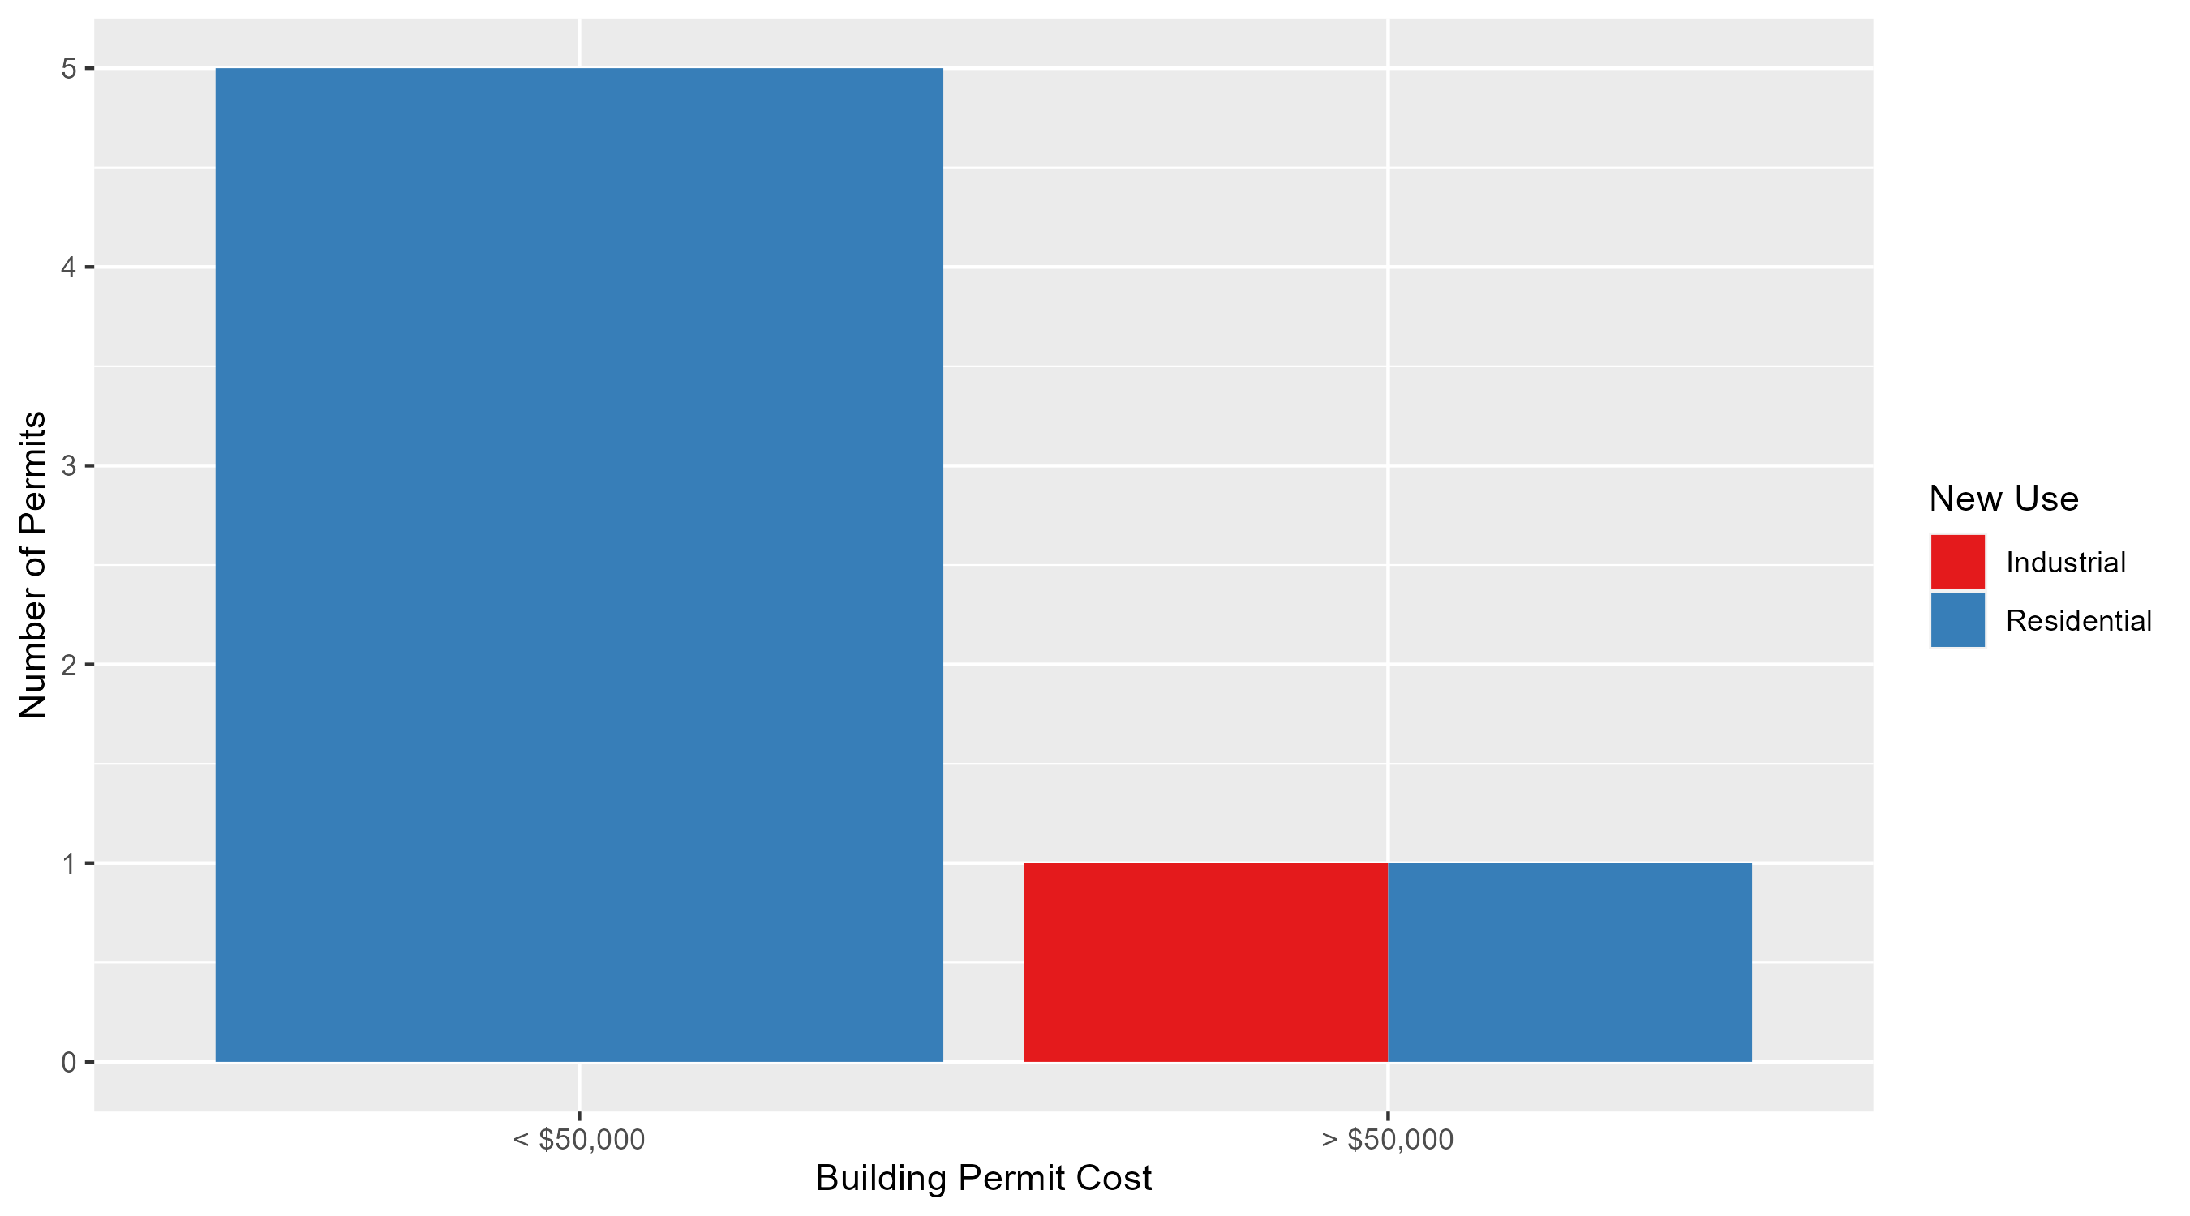
Forest Park Southeast Permit Cost Breakdown

Slide 17
Expanded Service Area

Slide 18
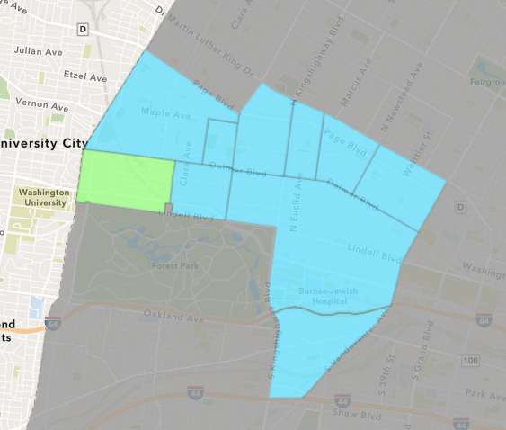
Skinker DeBaliviere
October 2024 Neighborhood Cost Breakdown
  Mean: $114,755
  Median: $15,660
  Range: $1,100 - $1,285,000

Slide 19
Skinker DeBaliviere: Summary Notes
13 building permits in October 2024
  116.67% change compared to October 2023 (6 total building permits)
  $114,755: Average building permit cost in October 2024
    617.07% change compared to October 2023 ($16,003)
64 total building permits in 2024
  -30.43% change YTD compared to this time in 2023 (92 total building permits)
  $79,359: YTD average building permit cost in 2024
    32.87% change YTD compared to this time in 2023 ($59,728)

Slide 20
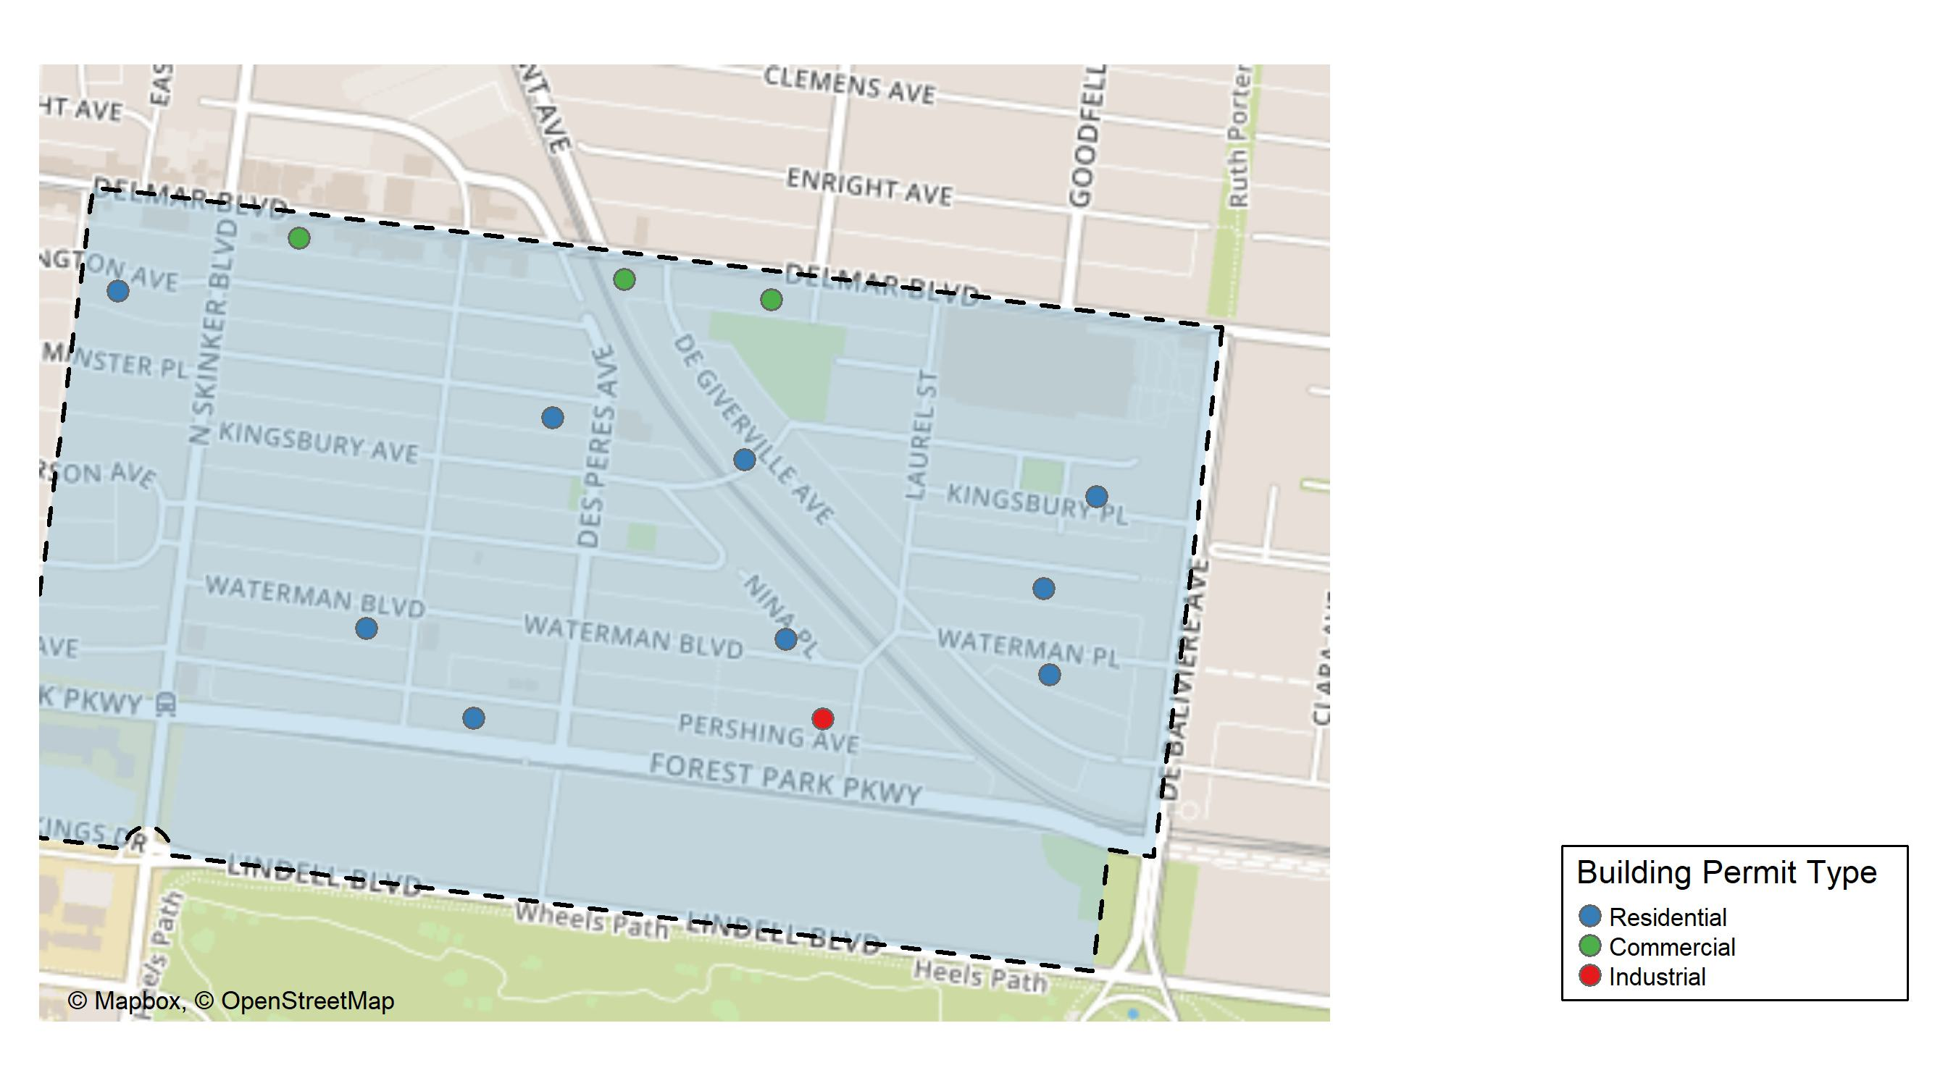
Skinker DeBaliviere

Slide 21
Neighborhood Summary
October 2024 | October 2024 | October 2024 | October 2024
Permit Use | Average Cost | # of Permits | Total Value of Permits
Commercial | $435,000.00 | 3 | $1,305,000
Industrial | $24,000.00 | 1 | $24,000
Residential | $18,090.11 | 9 | $162,811
Last 6 Months | Last 6 Months | Last 6 Months | Last 6 Months
Permit Use | Average Cost | # of Permits | Total Value of Permits
Commercial | $259,984.29 | 7 | $1,819,890
Industrial | $192,300.00 | 3 | $576,900
Residential | $35,375.23 | 43 | $1,521,135

Slide 22
Skinker DeBaliviere Individual Permit Breakdown
Neighborhood | Owner | New Use | Cost | address
Skinker DeBaliviere | CRUZ, ARACELI | Residential | $25,000 | 5835 WATERMAN BLVD
Skinker DeBaliviere | WASHINGTON UNIVERSITY | Commercial | $1,285,000 | 5980-84 DELMAR BLVD
Skinker DeBaliviere | MESTRES, MARLENE M TRS | Residential | $22,049 | 5725 KINGSBURY PL
Skinker DeBaliviere | MR LANDLORD LLC | Residential | $60,000 | 6018 WESTMINSTER PL
Skinker DeBaliviere | RUIZ, ELOY A & | Residential | $2,094 | 6238 WASHINGTON AV
Skinker DeBaliviere | MONTANO, GLORIA M | Commercial | $15,000 | 5916 DELMAR BLVD
Skinker DeBaliviere | QUADRANGLE MANAGEMENT CO | Commercial | $5,000 | 6170 DELMAR BLVD
Skinker DeBaliviere | BAUER, JEROME H | Residential | $6,000 | 6036 PERSHING AV
Skinker DeBaliviere | BANISAEID, NASSER & NEDA ADBIANNIA | Residential | $1,100 | 5750 WATERMAN BLVD
Skinker DeBaliviere | ATWT PERSHING LLC | Industrial | $24,000 | 5811 PERSHING AV
Skinker DeBaliviere | WHEELER, CHARLES E & CAROLYN T | Residential | $5,839 | 5902 DEGIVERVILLE AV
Skinker DeBaliviere | HUMPHREY, WILLIAM & ELISE | Residential | $25,069 | 6118 WATERMAN BLVD
Skinker DeBaliviere | OCG ACQUISITIONS GP | Residential | $15,660 | 5758 MCPHERSON AV

Slide 23
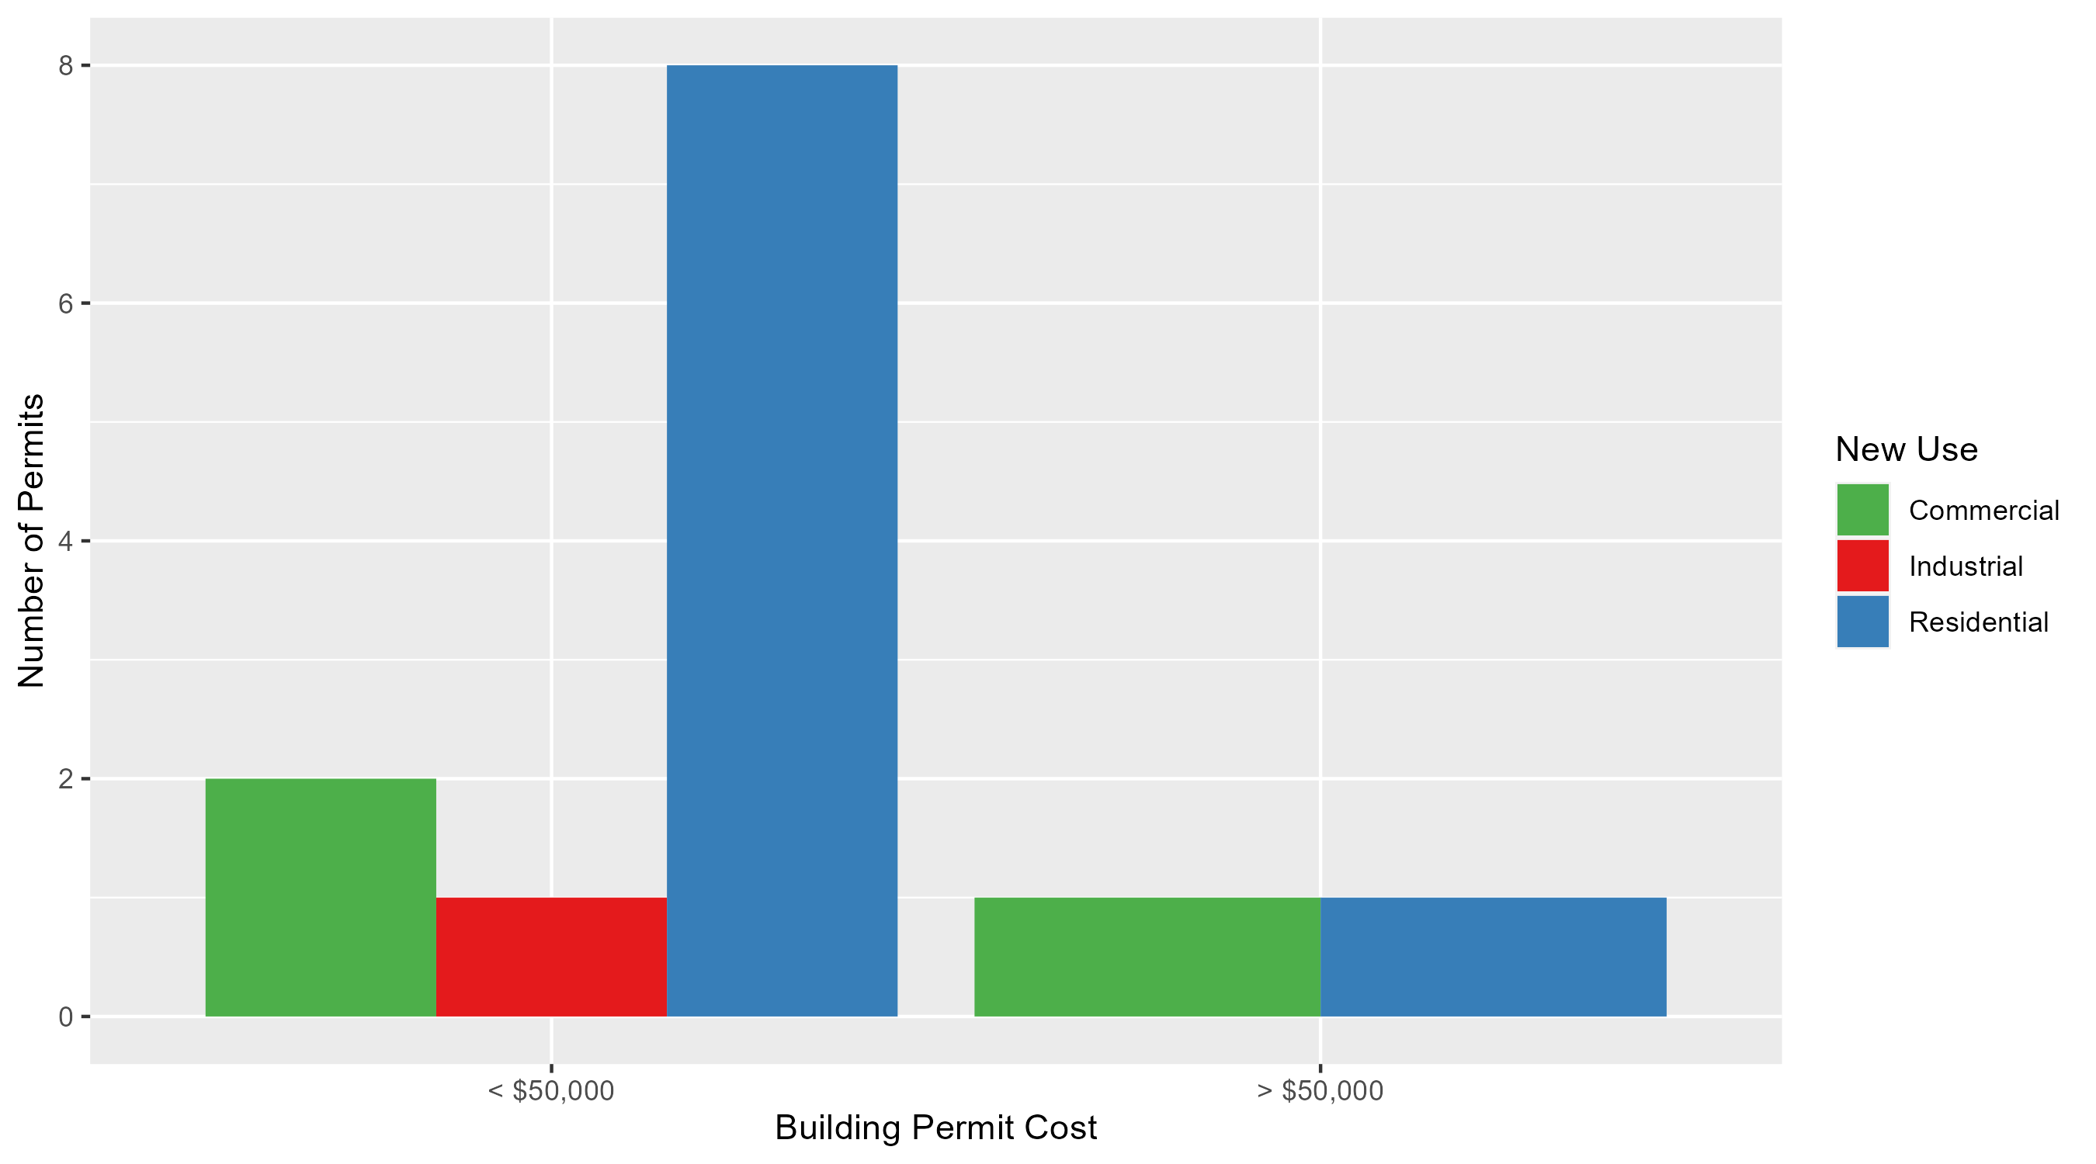
Skinker DeBaliviere Permit Cost Breakdown

Slide 24
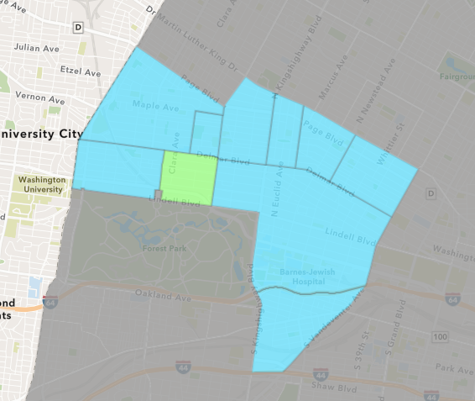
DeBaliviere Place
October 2024 Neighborhood Cost Breakdown
  Mean: $22,398
  Median: $16,839
  Range: $200 - $61,230

Slide 25
DeBaliviere Place: Summary Notes
6 building permits in October 2024
  50.00% change compared to October 2023 (4 total building permits)
  $22,398: Average building permit cost in October 2024
    -52.93% change compared to October 2023 ($47,586)
41 total building permits in 2024
  7.89% change YTD compared to this time in 2023 (38 total building permits)
  $113,295: YTD average building permit cost in 2024
    -17.65% change YTD compared to this time in 2023 ($137,574)

Slide 26
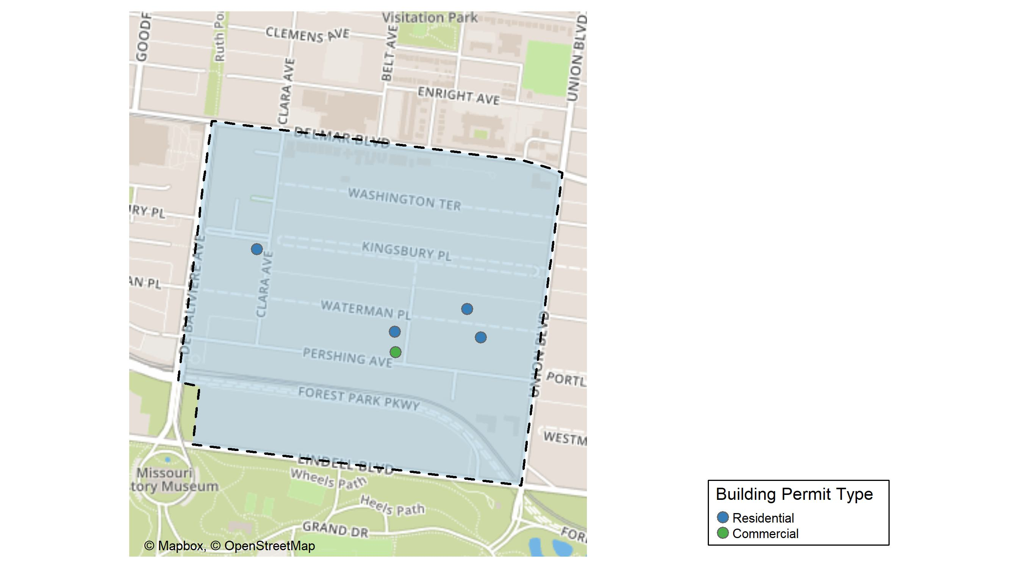
DeBaliviere Place

Slide 27
Neighborhood Summary
October 2024 | October 2024 | October 2024 | October 2024
Permit Use | Average Cost | # of Permits | Total Value of Permits
Commercial | $200.0 | 1 | $200
Industrial | $0.0 | 0 | $0
Residential | $26,837.8 | 5 | $134,189
Last 6 Months | Last 6 Months | Last 6 Months | Last 6 Months
Permit Use | Average Cost | # of Permits | Total Value of Permits
Commercial | $27,097.5 | 4 | $108,390
Industrial | $0.0 | 0 | $0
Residential | $146,200.3 | 28 | $4,093,609

Slide 28
DeBaliviere Place Individual Permit Breakdown
Neighborhood | Owner | New Use | Cost | address
DeBaliviere Place | MINHAAT BOTNIM LLC | Residential | $6,000 | 307 BELT AV
DeBaliviere Place | MINHAAT BOTNIM LLC | Commercial | $200 | 307 BELT AV
DeBaliviere Place | BLAYLOCK, JOSEPH & ANDREA | Residential | $27,678 | 50 WATERMAN PL
DeBaliviere Place | BIGHAM, MATTHEW H & ELIZABETH BELLE | Residential | $61,230 | 63 WATERMAN PL
DeBaliviere Place | RANDOLPH CONDOMINIUMS | Residential | $5,000 | 5510 WATERMAN BLVD
DeBaliviere Place | MAURENN FORD | Residential | $34,281 | 437 CLARA AV

Slide 29
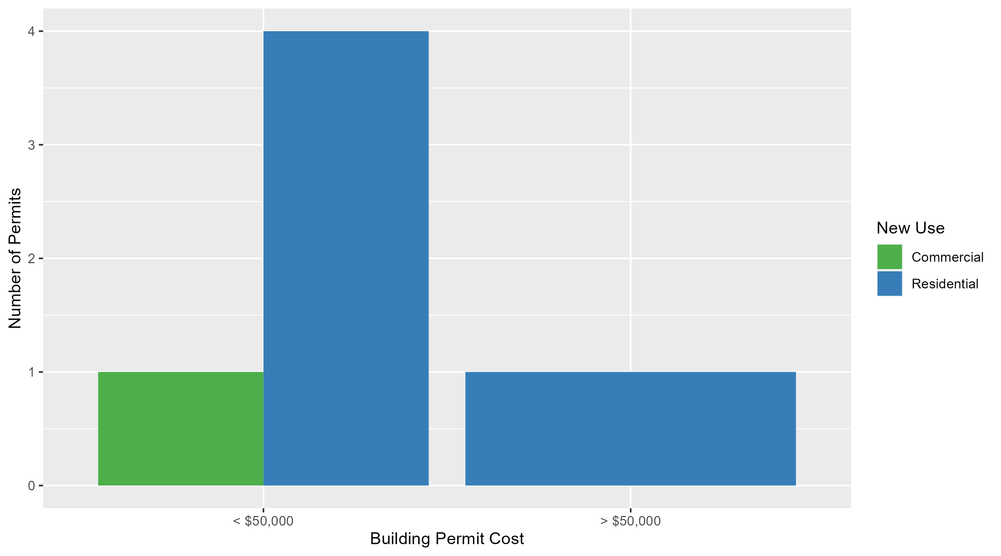
DeBaliviere Place Permit Cost Breakdown

Slide 30
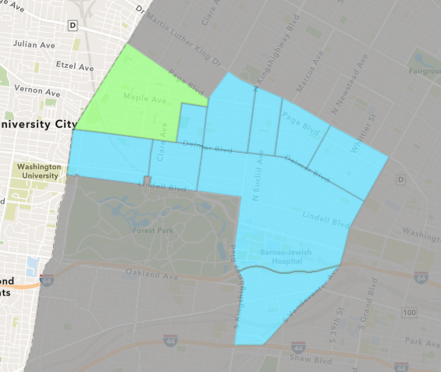
West End
October 2024 Neighborhood Cost Breakdown
  Mean: $543,000
  Median: $14,000
  Range: $5,000 - $1,610,000

Slide 31
West End: Summary Notes
3 building permits in October 2024
  -57.14% change compared to October 2023 (7 total building permits)
  $543,000: Average building permit cost in October 2024
    470.99% change compared to October 2023 ($95,098)
61 total building permits in 2024
  -21.79% change YTD compared to this time in 2023 (78 total building permits)
  $102,313: YTD average building permit cost in 2024
    74.14% change YTD compared to this time in 2023 ($58,752)

Slide 32
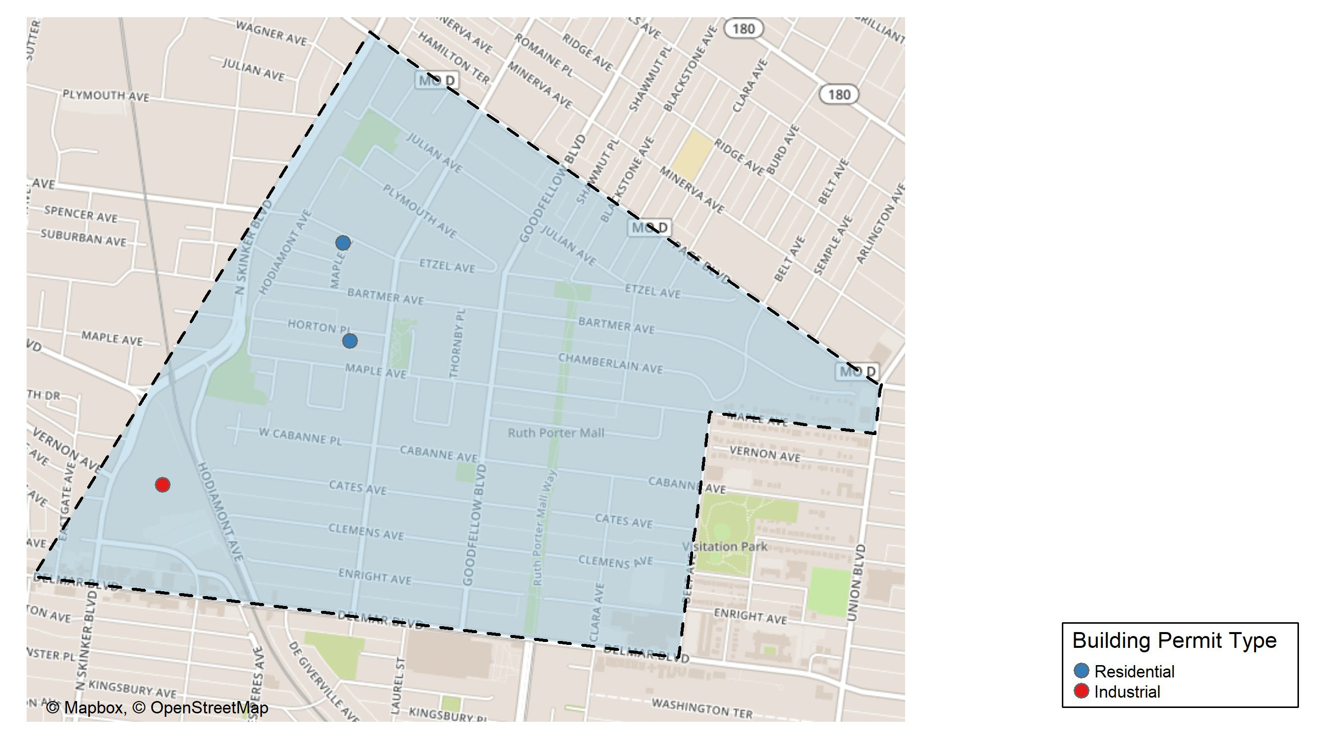
West End

Slide 33
Neighborhood Summary
October 2024 | October 2024 | October 2024 | October 2024
Permit Use | Average Cost | # of Permits | Total Value of Permits
Commercial | $0 | 0 | $0
Industrial | $1,610,000 | 1 | $1,610,000
Residential | $9,500 | 2 | $19,000
Last 6 Months | Last 6 Months | Last 6 Months | Last 6 Months
Permit Use | Average Cost | # of Permits | Total Value of Permits
Commercial | $195,618.33 | 6 | $1,173,710
Industrial | $1,610,000.00 | 1 | $1,610,000
Residential | $15,008.68 | 31 | $465,269

Slide 34
West End Individual Permit Breakdown
Neighborhood | Owner | New Use | Cost | address
West End | ARMSTRONG, BRENDA | Residential | $5,000 | 5934 HORTON PL
West End | WASHINGTON UNIVERSITY | Industrial | $1,610,000 | 700 ROSEDALE AV
West End | CARDINAL PROPERTIES OF ST LOUIS II L | Residential | $14,000 | 6000-02 ETZEL AV

Slide 35
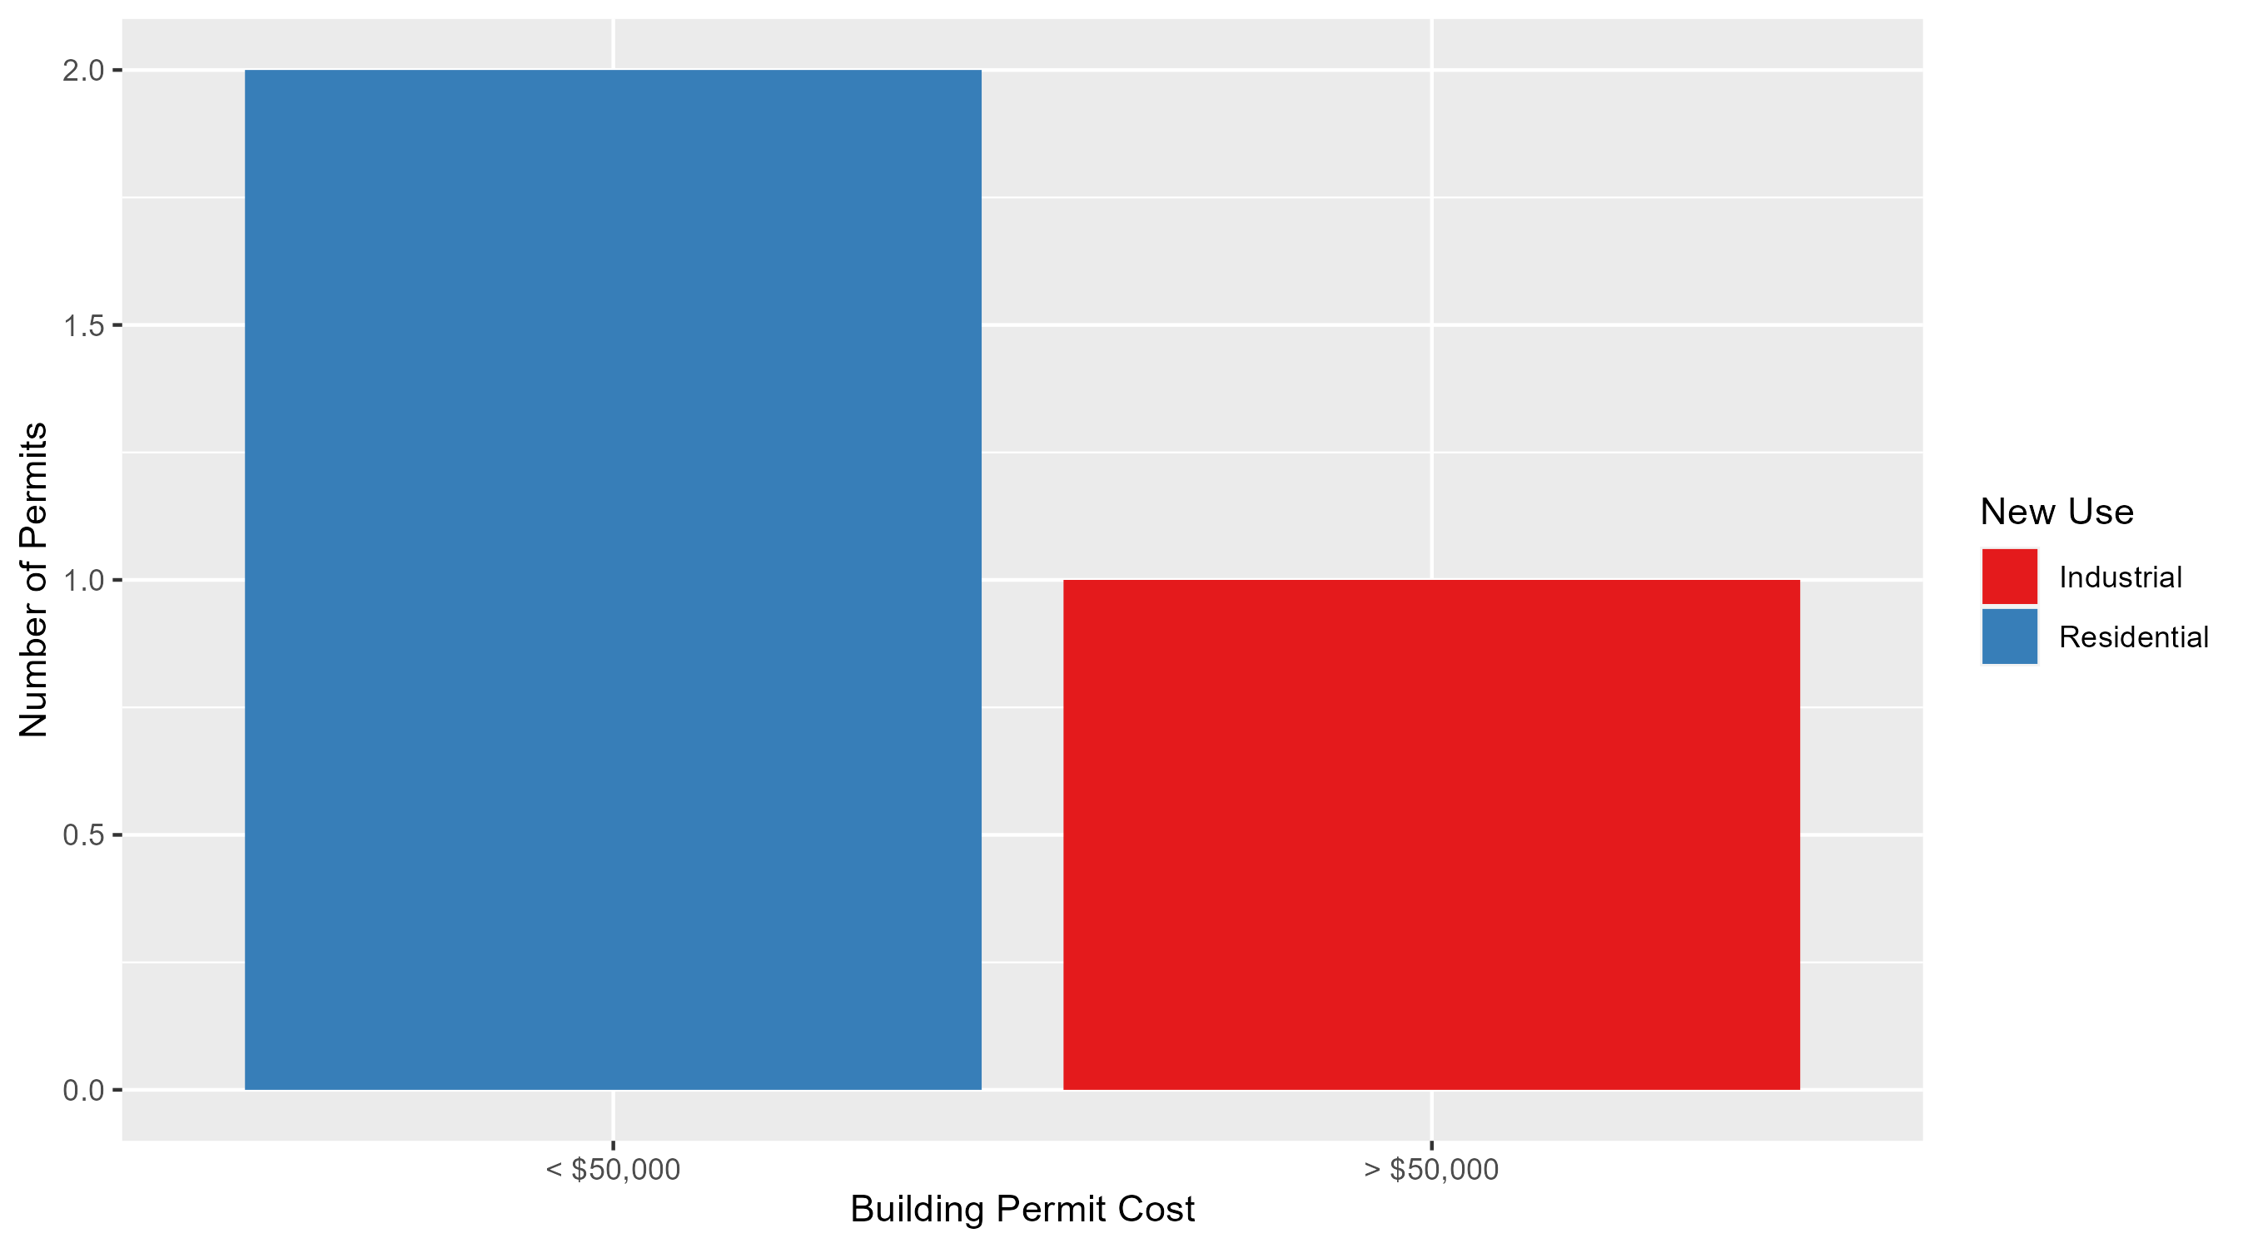
West End Permit Cost Breakdown

Slide 36
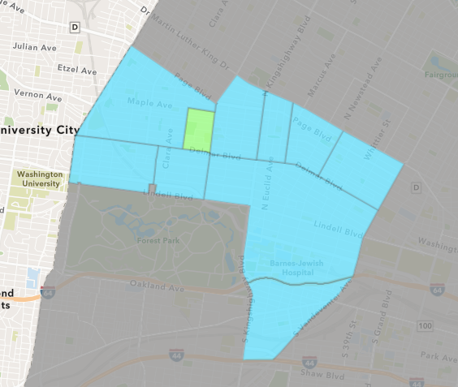
Visitation Park
October 2024 Neighborhood Cost Breakdown
  Mean: $5,000
  Median: $5,000
  Range: $5,000 - $5,000

Slide 37
Visitation Park: Summary Notes
1 building permits in October 2024
  0.00% change compared to October 2023 (1 total building permits)
  $5,000: Average building permit cost in October 2024
    -86.30% change compared to October 2023 ($36,500)
3 total building permits in 2024
  -50.00% change YTD compared to this time in 2023 (6 total building permits)
  $15,267: YTD average building permit cost in 2024
    -92.29% change YTD compared to this time in 2023 ($197,967)

Slide 38
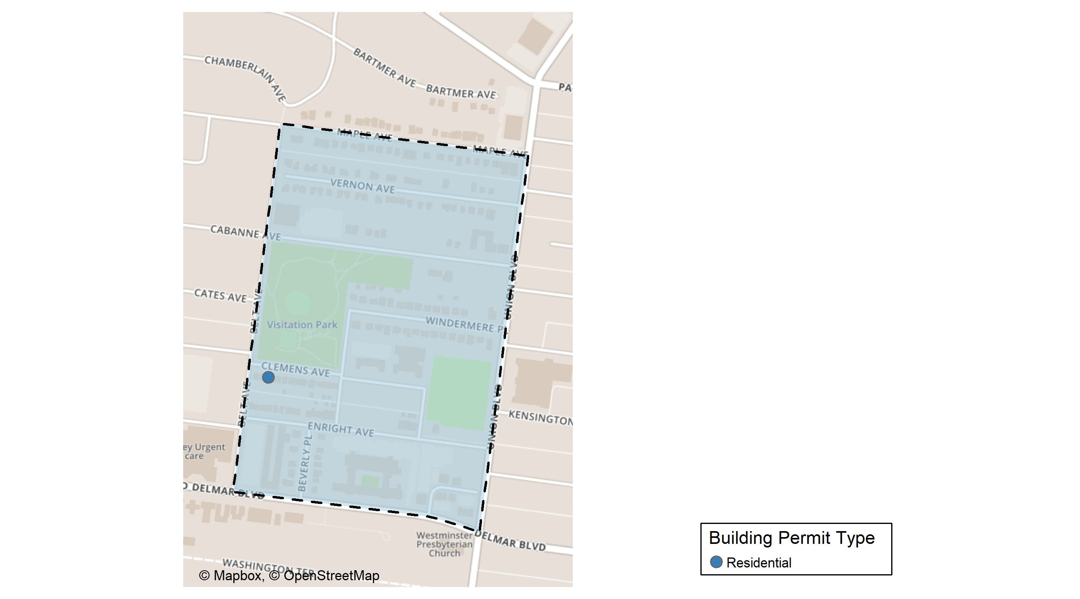
Visitation Park

Slide 39
Neighborhood Summary
October 2024 | October 2024 | October 2024 | October 2024
Permit Use | Average Cost | # of Permits | Total Value of Permits
Commercial | $0 | 0 | $0
Industrial | $0 | 0 | $0
Residential | $5,000 | 1 | $5,000
Last 6 Months | Last 6 Months | Last 6 Months | Last 6 Months
Permit Use | Average Cost | # of Permits | Total Value of Permits
Commercial | $0.00 | 0 | $0
Industrial | $0.00 | 0 | $0
Residential | $15,266.67 | 3 | $45,800

Slide 40
Visitation Park Individual Permit Breakdown
Neighborhood | Owner | New Use | Cost | address
Visitation Park | DU MAINE, JESSICA J | Residential | $5,000 | 5470 CLEMENS PL

Slide 41
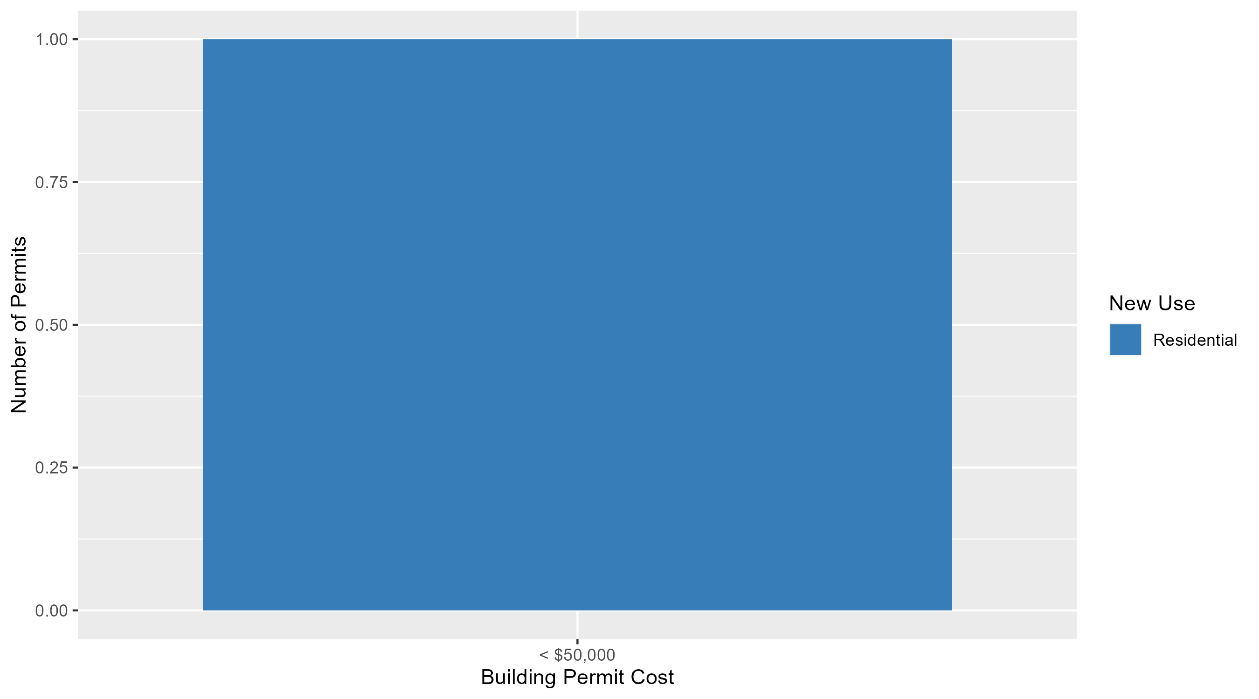
Visitation Park Permit Cost Breakdown

Slide 42
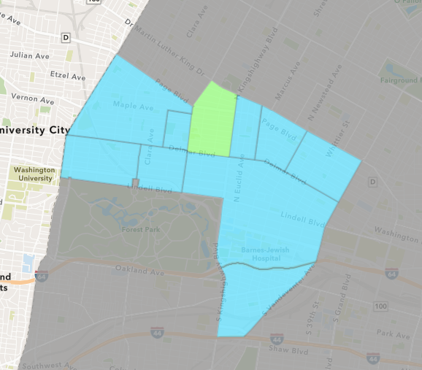
Academy
October 2024 Neighborhood Cost Breakdown
  Mean: $2,667
  Median: $1,000
  Range: $1,000 - $6,000

Slide 43
Academy: Summary Notes
3 building permits in October 2024
  -57.14% change compared to October 2023 (7 total building permits)
  $2,667: Average building permit cost in October 2024
    -96.14% change compared to October 2023 ($69,032)
21 total building permits in 2024
  -25.00% change YTD compared to this time in 2023 (28 total building permits)
  $36,809: YTD average building permit cost in 2024
    39.30% change YTD compared to this time in 2023 ($26,424)

Slide 44
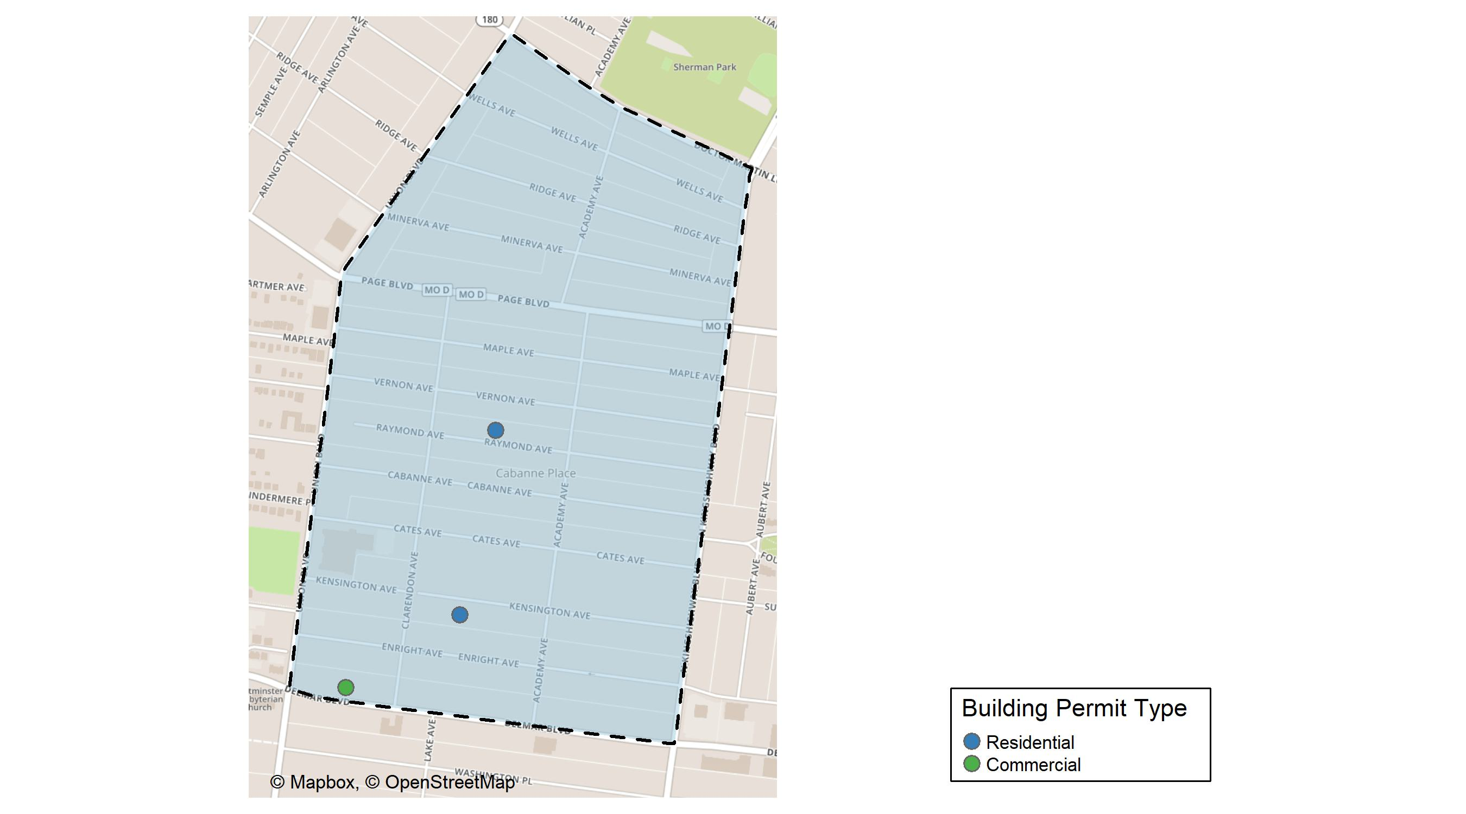
Academy

Slide 45
Neighborhood Summary
October 2024 | October 2024 | October 2024 | October 2024
Permit Use | Average Cost | # of Permits | Total Value of Permits
Commercial | $6,000 | 1 | $6,000
Industrial | $0 | 0 | $0
Residential | $1,000 | 2 | $2,000
Last 6 Months | Last 6 Months | Last 6 Months | Last 6 Months
Permit Use | Average Cost | # of Permits | Total Value of Permits
Commercial | $47,000.00 | 3 | $141,000
Industrial | $0.00 | 0 | $0
Residential | $41,315.25 | 12 | $495,783

Slide 46
Academy Individual Permit Breakdown
Neighborhood | Owner | New Use | Cost | address
Academy | TWIN BIRDS A LLC | Commercial | $6,000 | 5237 DELMAR BLVD
Academy | MOODY, RISHONDA | Residential | $1,000 | 5153 RAYMOND AV
Academy | PHILLIPS, KARL E | Residential | $1,000 | 5158-60 KENSINGTON AV

Slide 47
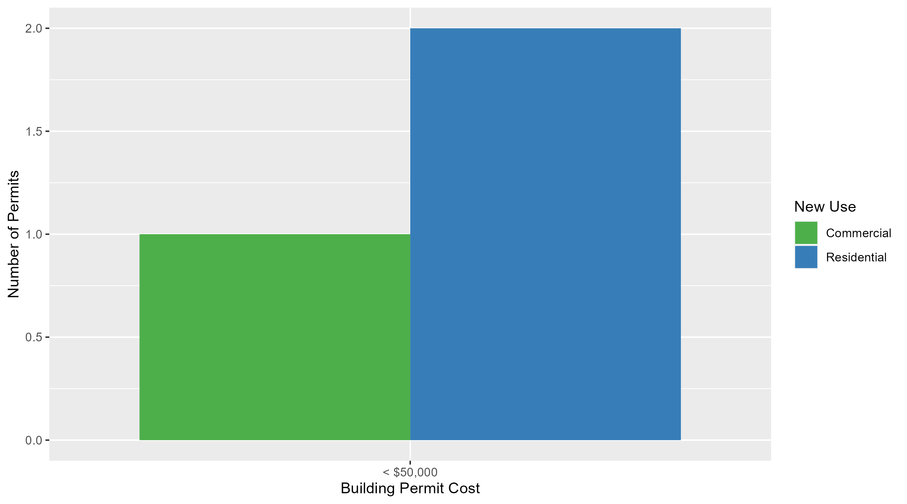
Academy Permit Cost Breakdown

Slide 48
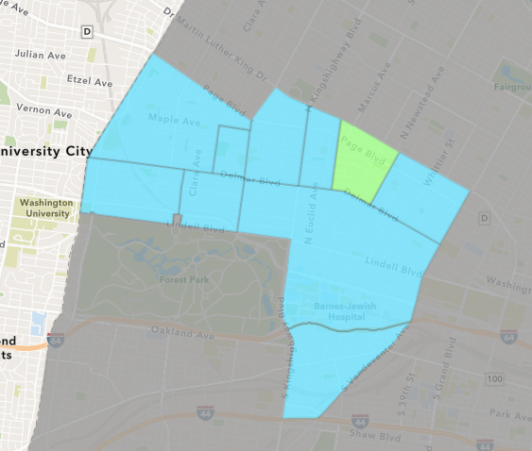
Lewis Place
October 2024 Neighborhood Cost Breakdown
  Mean: $2,333
  Median: $1,500
  Range: $1,000 - $4,500

Slide 49
Lewis Place: Summary Notes
3 building permits in October 2024
  200.00% change compared to October 2023 (1 total building permits)
  $2,333: Average building permit cost in October 2024
    -98.97% change compared to October 2023 ($225,535)
15 total building permits in 2024
  50.00% change YTD compared to this time in 2023 (10 total building permits)
  $21,546: YTD average building permit cost in 2024
    -68.95% change YTD compared to this time in 2023 ($69,384)

Slide 50
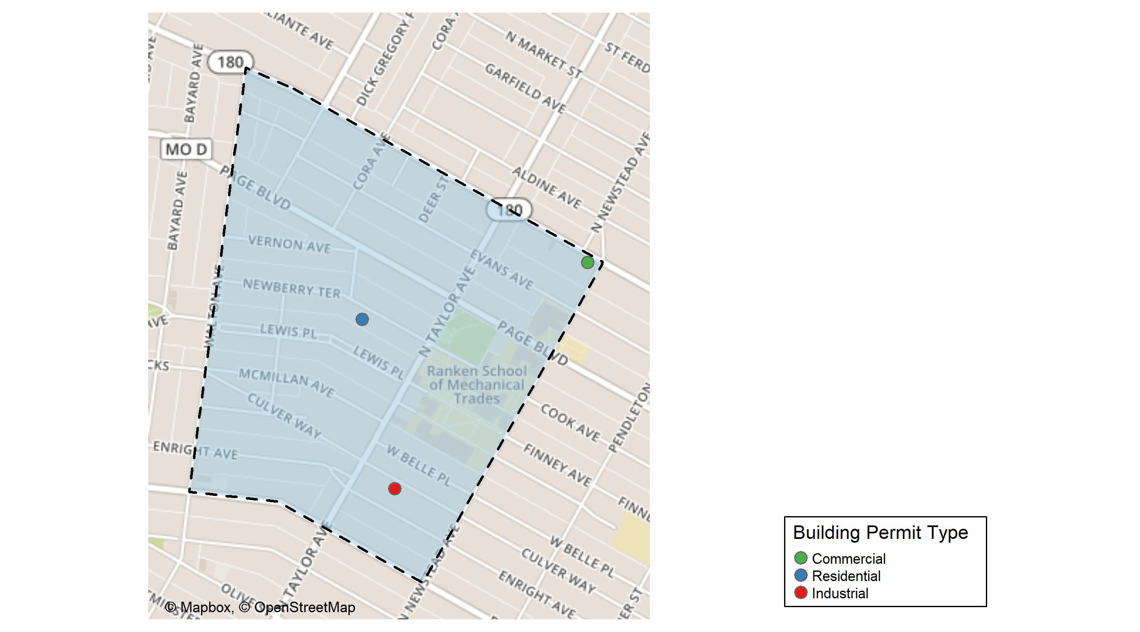
Lewis Place

Slide 51
Neighborhood Summary
October 2024 | October 2024 | October 2024 | October 2024
Permit Use | Average Cost | # of Permits | Total Value of Permits
Commercial | $4,500 | 1 | $4,500
Industrial | $1,500 | 1 | $1,500
Residential | $1,000 | 1 | $1,000
Last 6 Months | Last 6 Months | Last 6 Months | Last 6 Months
Permit Use | Average Cost | # of Permits | Total Value of Permits
Commercial | $35,639.2 | 5 | $178,196
Industrial | $2,750.0 | 2 | $5,500
Residential | $26,100.0 | 5 | $130,500

Slide 52
Lewis Place Individual Permit Breakdown
Neighborhood | Owner | New Use | Cost | address
Lewis Place | MALONE, ANGELA | Commercial | $4,500 | 4408 DR MARTIN LUTHER KING DR
Lewis Place | CHEEKS, BRITTANY | Industrial | $1,500 | 4459-R ENRIGHT AV
Lewis Place | WHITE, SYLVIA A & TERMON T WHITE & | Residential | $1,000 | 4558 NEWBERRY TER

Slide 53
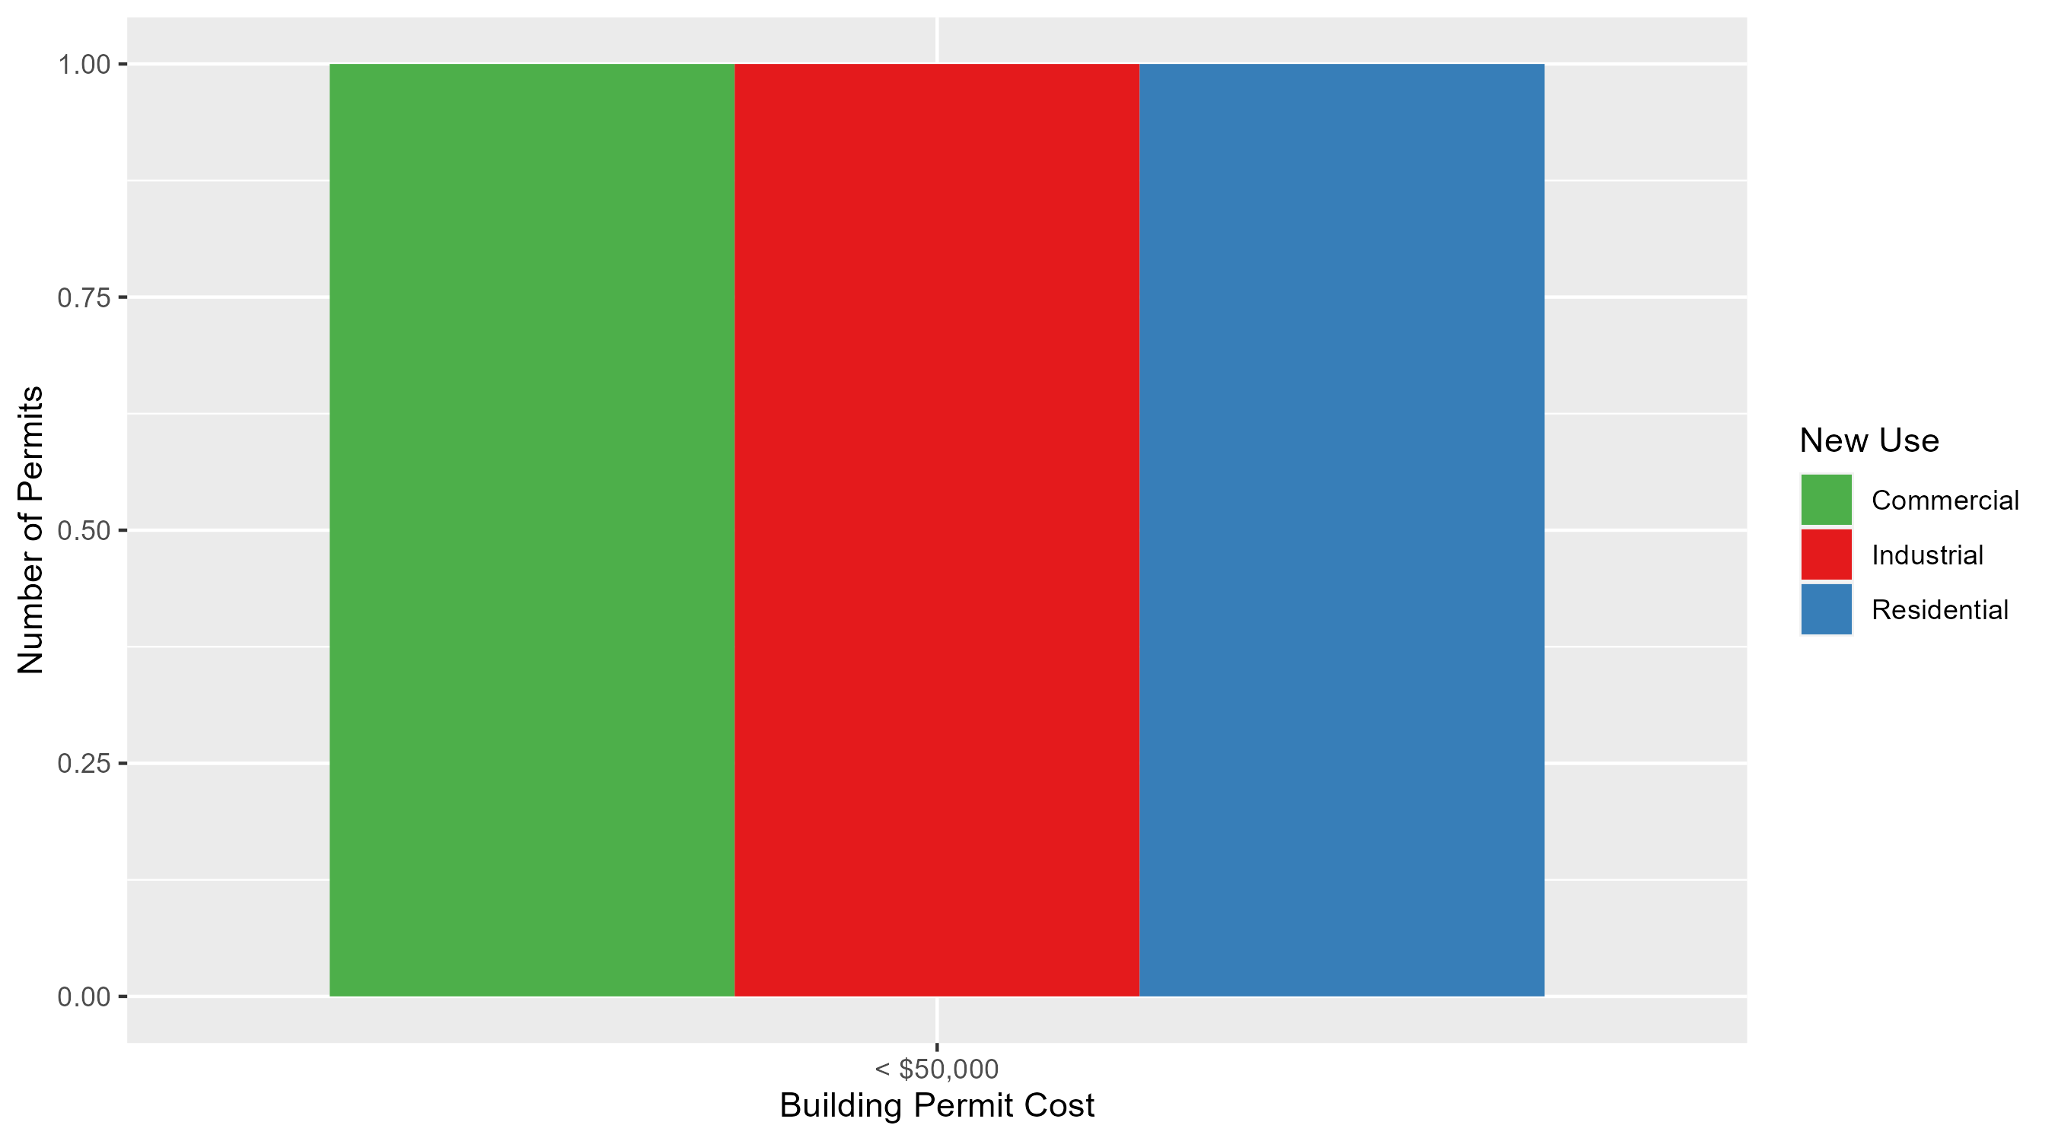
Lewis Place Permit Cost Breakdown

Slide 54
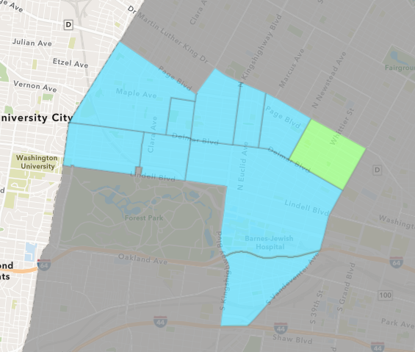
Vandeventer
October 2024 Neighborhood Cost Breakdown
  Mean: $21,667
  Median: $4,000
  Range: $1,000 - $60,000

Slide 55
Vandeventer: Summary Notes
3 building permits in October 2024
  Infinite change compared to October 2023 (0 total building permits)
  $21,667: Average building permit cost in October 2024
    Infinite change compared to October 2023 ($0)
11 total building permits in 2024
  -15.38% change YTD compared to this time in 2023 (13 total building permits)
  $39,389: YTD average building permit cost in 2024
    -78.47% change YTD compared to this time in 2023 ($182,933)

Slide 56
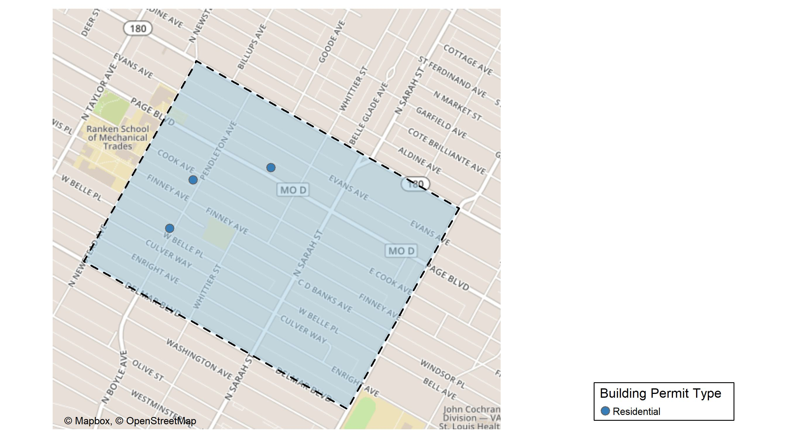
Vandeventer

Slide 57
Neighborhood Summary
October 2024 | October 2024 | October 2024 | October 2024
Permit Use | Average Cost | # of Permits | Total Value of Permits
Commercial | $0.00 | 0 | $0
Industrial | $0.00 | 0 | $0
Residential | $21,666.67 | 3 | $65,000
Last 6 Months | Last 6 Months | Last 6 Months | Last 6 Months
Permit Use | Average Cost | # of Permits | Total Value of Permits
Commercial | $49,210 | 3 | $147,630
Industrial | $3,000 | 1 | $3,000
Residential | $17,500 | 4 | $70,000

Slide 58
Vandeventer Individual Permit Breakdown
Neighborhood | Owner | New Use | Cost | address
Vandeventer | BROWN, SHAUN M | Residential | $60,000 | 4243 PAGE BLVD
Vandeventer | SPIGHT, LANCE J | Residential | $4,000 | 4301 WEST BELLE PL
Vandeventer | MCCREA, DELORES CARLITA TRS | Residential | $1,000 | 4306 COOK AV

Slide 59
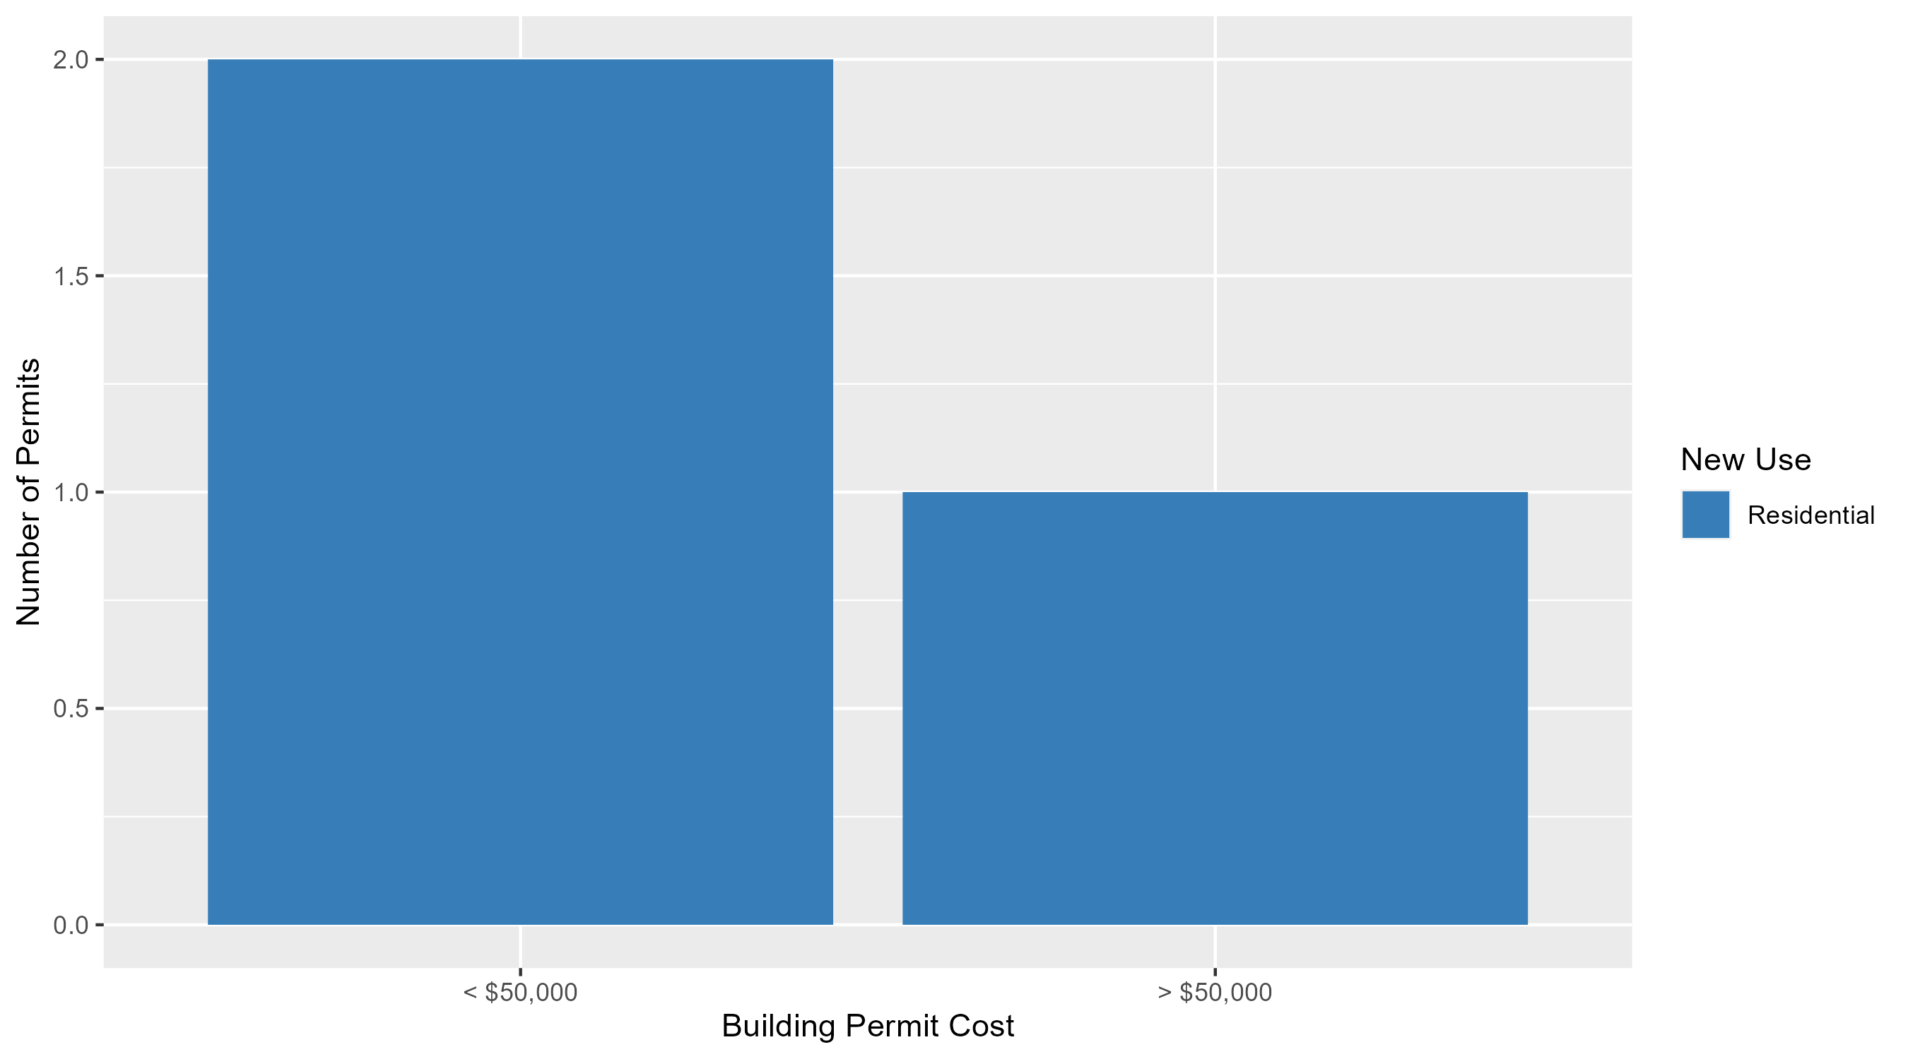
Vandeventer Permit Cost Breakdown

Slide 60
Additional Notes
Data retreived from https://www.stlouis-mo.gov/data/
Building permits with a cost of $0 were dropped
Building permits that were cancelled were dropped
Infinite change indicates 0 permits in the current or previous time period/comparison month so there was a overall increase or decrease

