Slide 1
St. Louis Central Corridor West Building Permits
Monthly Report: September 2024

Slide 2
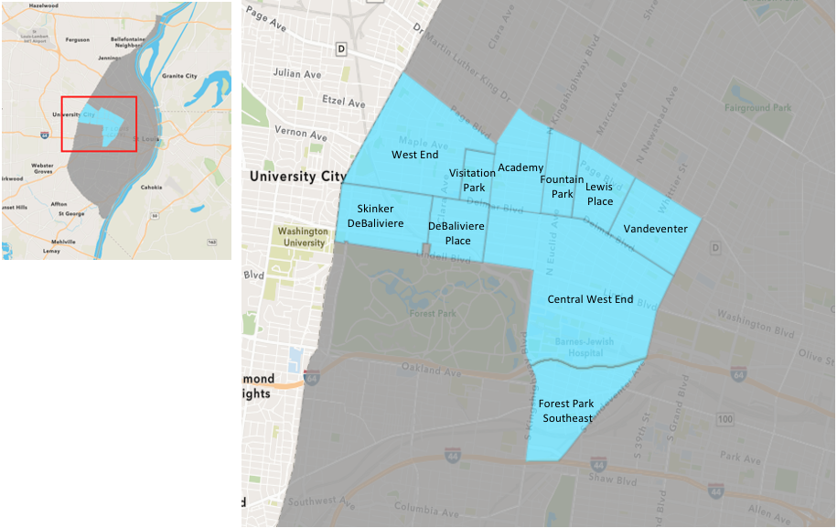
St. Louis Neighborhood Spatial Reference

Slide 3
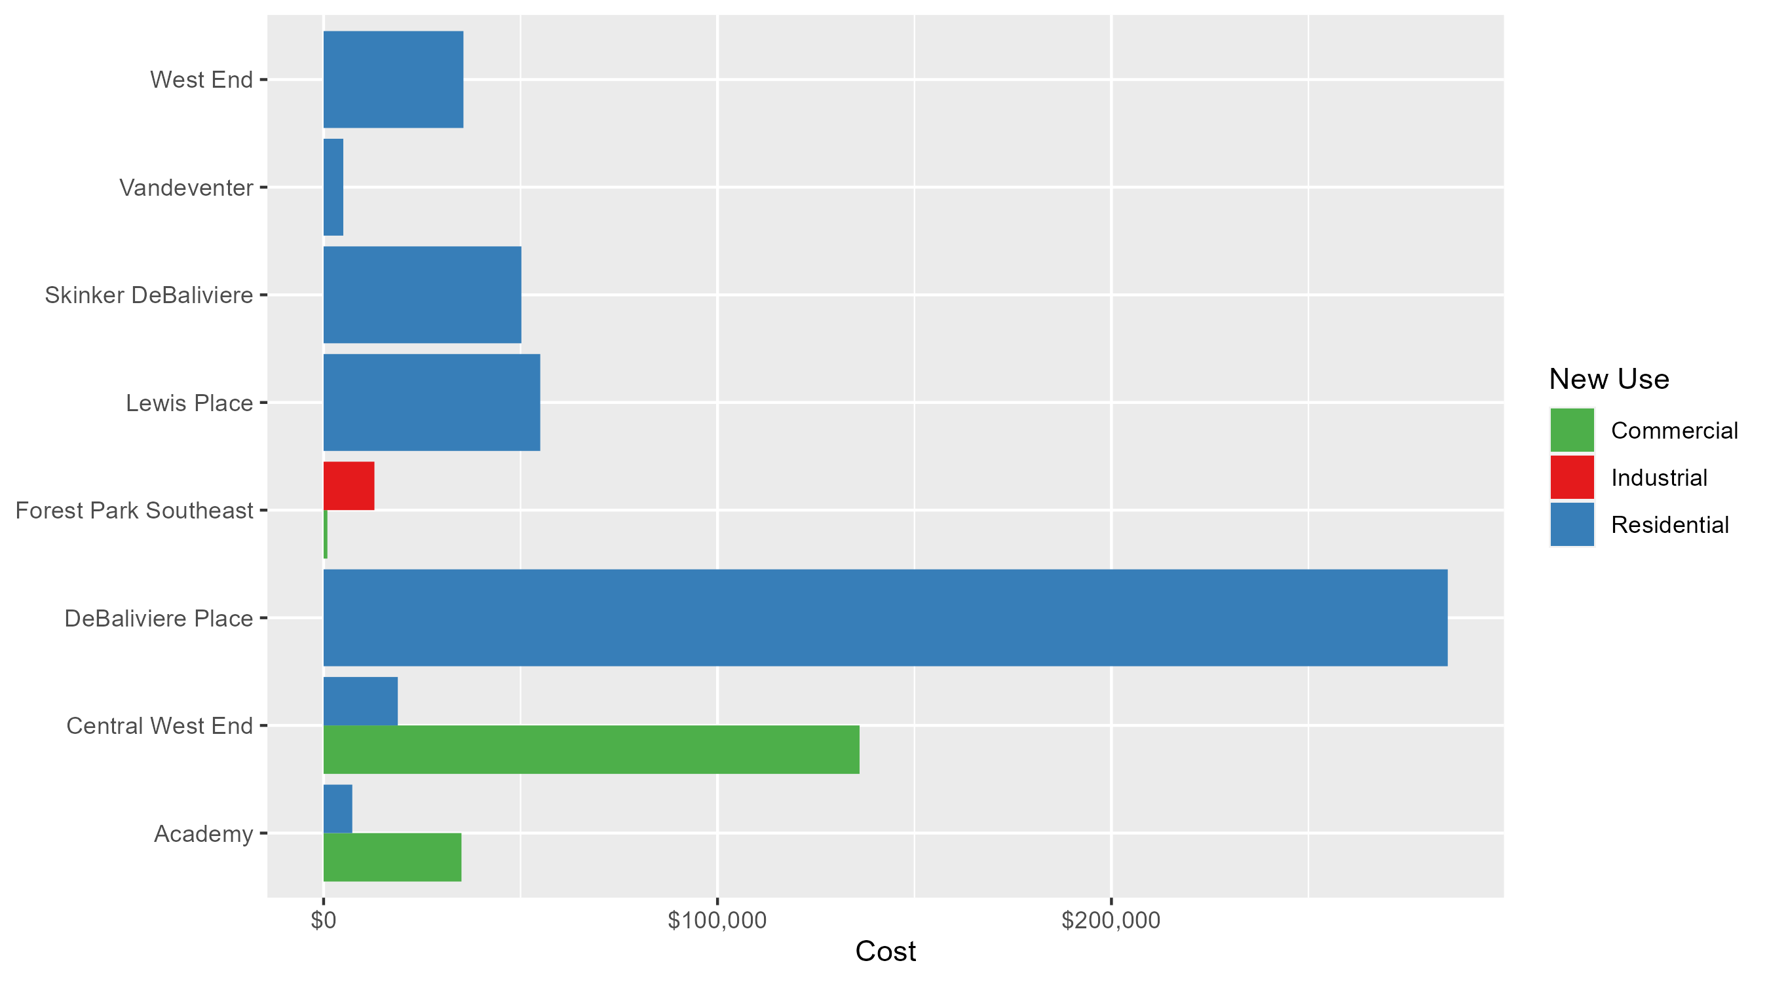
Neighborhood Summary: Average Building Permit Cost

Slide 4
Neighborhood Summary
September 2024 | September 2024 | September 2024 | September 2024
Neighborhood | Average Cost | # of Permits | Total Value of Permits
Academy | $21,141.50 | 2 | $42,283
Central West End | $73,999.94 | 17 | $1,257,999
DeBaliviere Place | $285,375.00 | 4 | $1,141,500
Forest Park Southeast | $6,932.00 | 2 | $13,864
Fountain Park | $0.00 | 0 | $0
Lewis Place | $55,000.00 | 1 | $55,000
Skinker DeBaliviere | $50,211.11 | 9 | $451,900
Vandeventer | $5,000.00 | 1 | $5,000
Visitation Park | $0.00 | 0 | $0
West End | $35,500.00 | 2 | $71,000
Last 6 Months | Last 6 Months | Last 6 Months | Last 6 Months
Neighborhood | Average Cost | # of Permits | Total Value of Permits
Academy | $54,521.77 | 13 | $708,783
Central West End | $336,434.35 | 210 | $70,651,214
DeBaliviere Place | $147,216.57 | 28 | $4,122,064
Forest Park Southeast | $70,112.48 | 42 | $2,944,724
Fountain Park | $45,200.00 | 5 | $226,000
Lewis Place | $31,419.60 | 10 | $314,196
Skinker DeBaliviere | $57,251.70 | 44 | $2,519,075
Vandeventer | $31,126.00 | 5 | $155,630
Visitation Park | $20,400.00 | 2 | $40,800
West End | $41,107.07 | 42 | $1,726,497

Slide 5
Core Neighborhoods

Slide 6
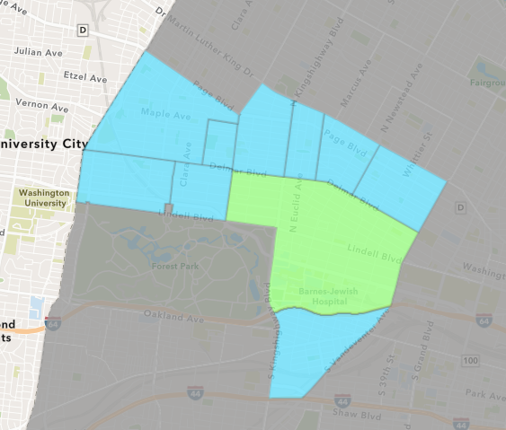
Central West End
September 2024 Neighborhood Cost Breakdown
  Mean: $74,000
  Median: $21,000
  Range: $1,000 - $604,569

Slide 7
Central West End: Summary Notes
17 building permits in September 2024
  -57.50% change compared to September 2023 (40 total building permits)
  $74,000: Average building permit cost in September 2024
    -46.05% change compared to September 2023 ($137,169)
258 total building permits in 2024
  -11.34% change YTD compared to this time in 2023 (291 total building permits)
  $391,077: YTD average building permit cost in 2024
    61.39% change YTD compared to this time in 2023 ($242,325)

Slide 8
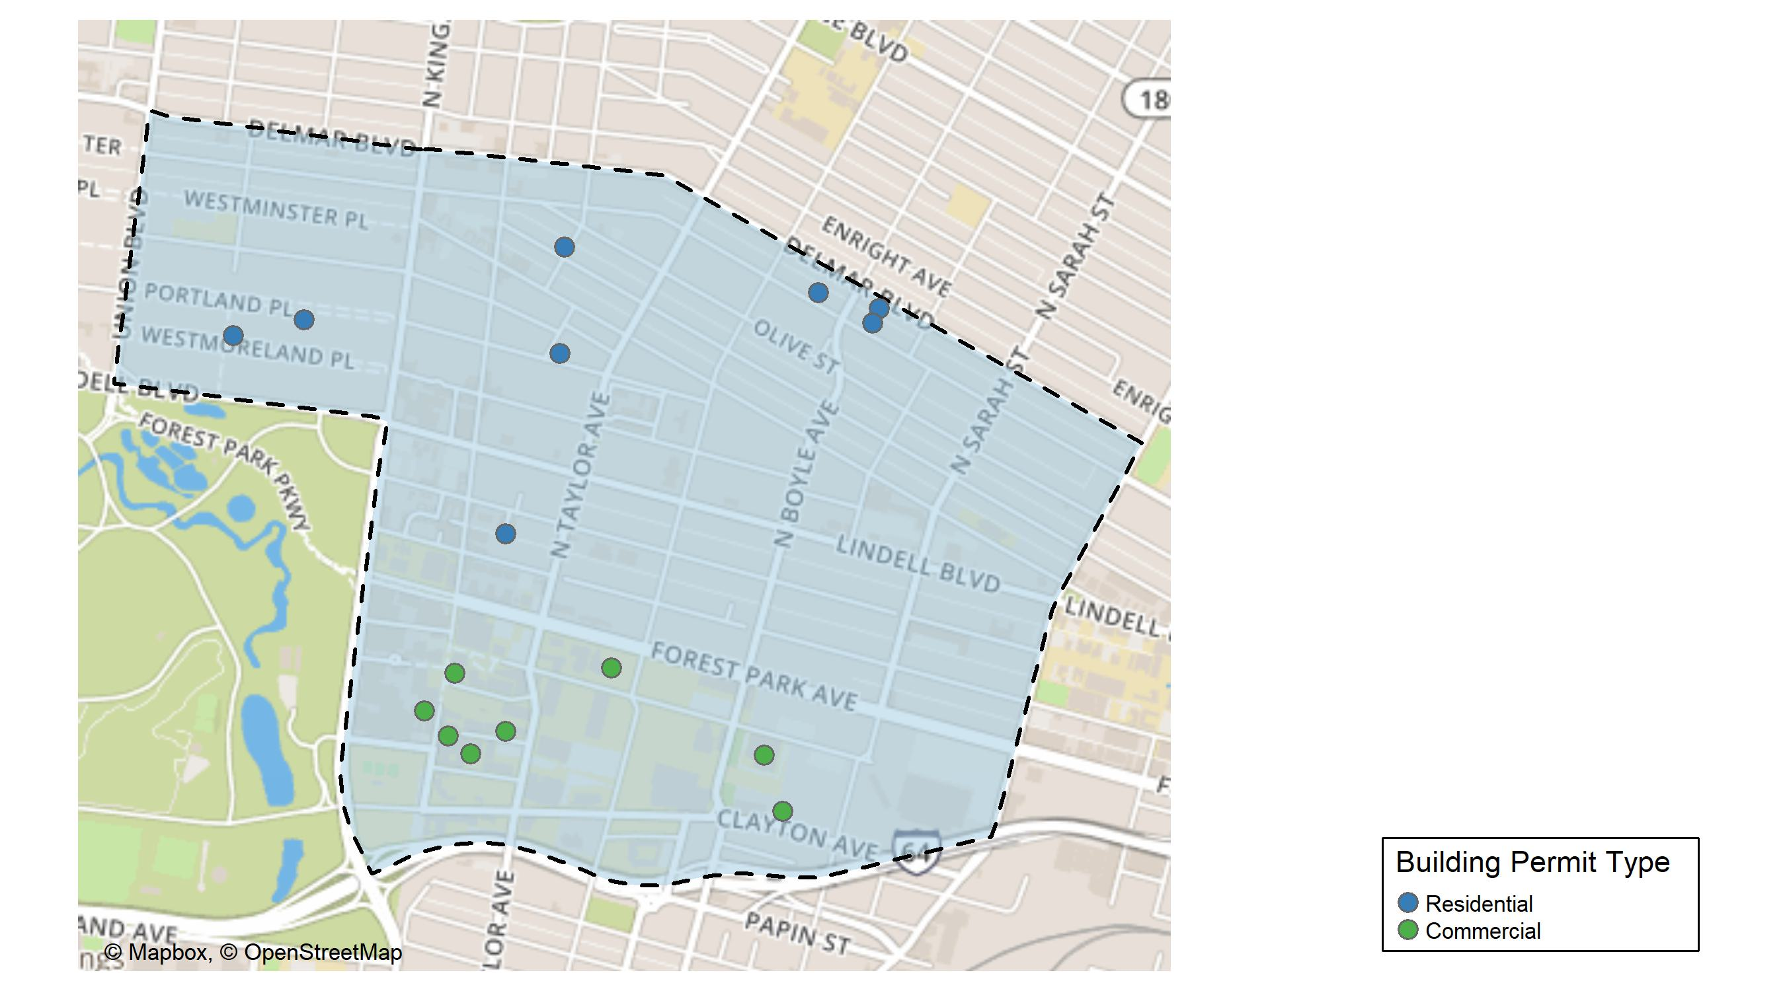
Central West End

Slide 9
Neighborhood Summary
September 2024 | September 2024 | September 2024 | September 2024
Permit Use | Average Cost | # of Permits | Total Value of Permits
Commercial | $136,058.62 | 8 | $1,088,469
Industrial | $0.00 | 0 | $0
Residential | $18,836.67 | 9 | $169,530
Last 6 Months | Last 6 Months | Last 6 Months | Last 6 Months
Permit Use | Average Cost | # of Permits | Total Value of Permits
Commercial | $593,438.6 | 95 | $56,376,671
Industrial | $21,307.0 | 4 | $85,228
Residential | $127,831.7 | 111 | $14,189,315

Slide 10
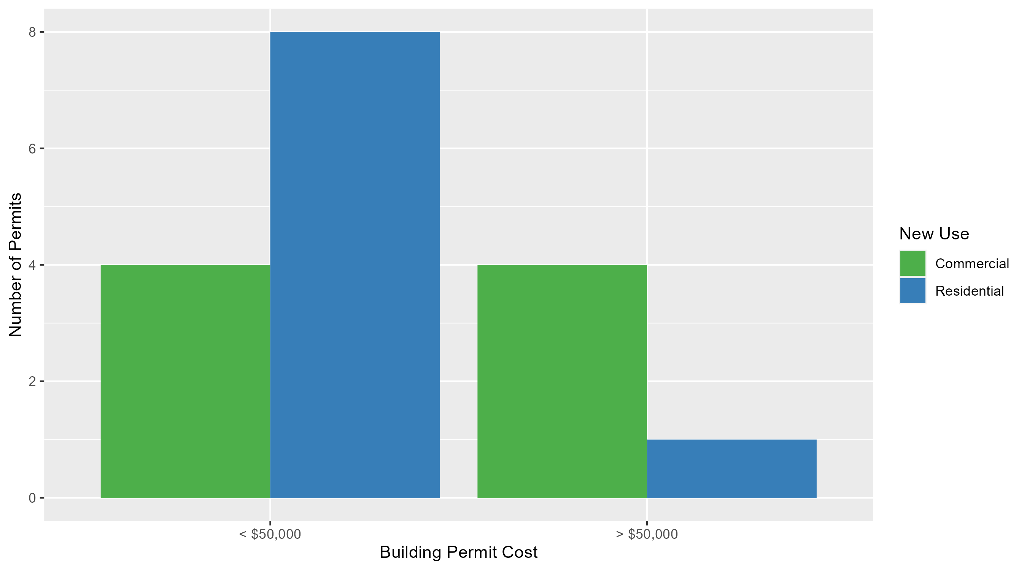
Central West End Permit Cost Breakdown

Slide 11
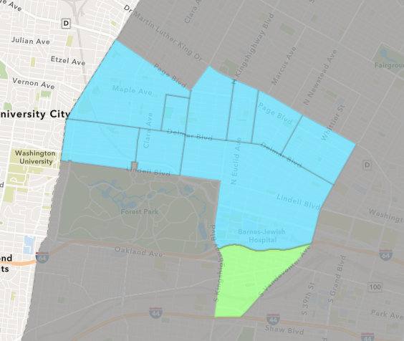
Forest Park Southeast
September 2024 Neighborhood Cost Breakdown
  Mean: $6,932
  Median: $6,932
  Range: $964 - $12,900

Slide 12
Forest Park Southeast: Summary Notes
2 building permits in September 2024
  -50.00% change compared to September 2023 (4 total building permits)
  $6,932: Average building permit cost in September 2024
    -76.54% change compared to September 2023 ($29,550)
53 total building permits in 2024
  1.92% change YTD compared to this time in 2023 (52 total building permits)
  $59,549: YTD average building permit cost in 2024
    -14.96% change YTD compared to this time in 2023 ($70,022)

Slide 13
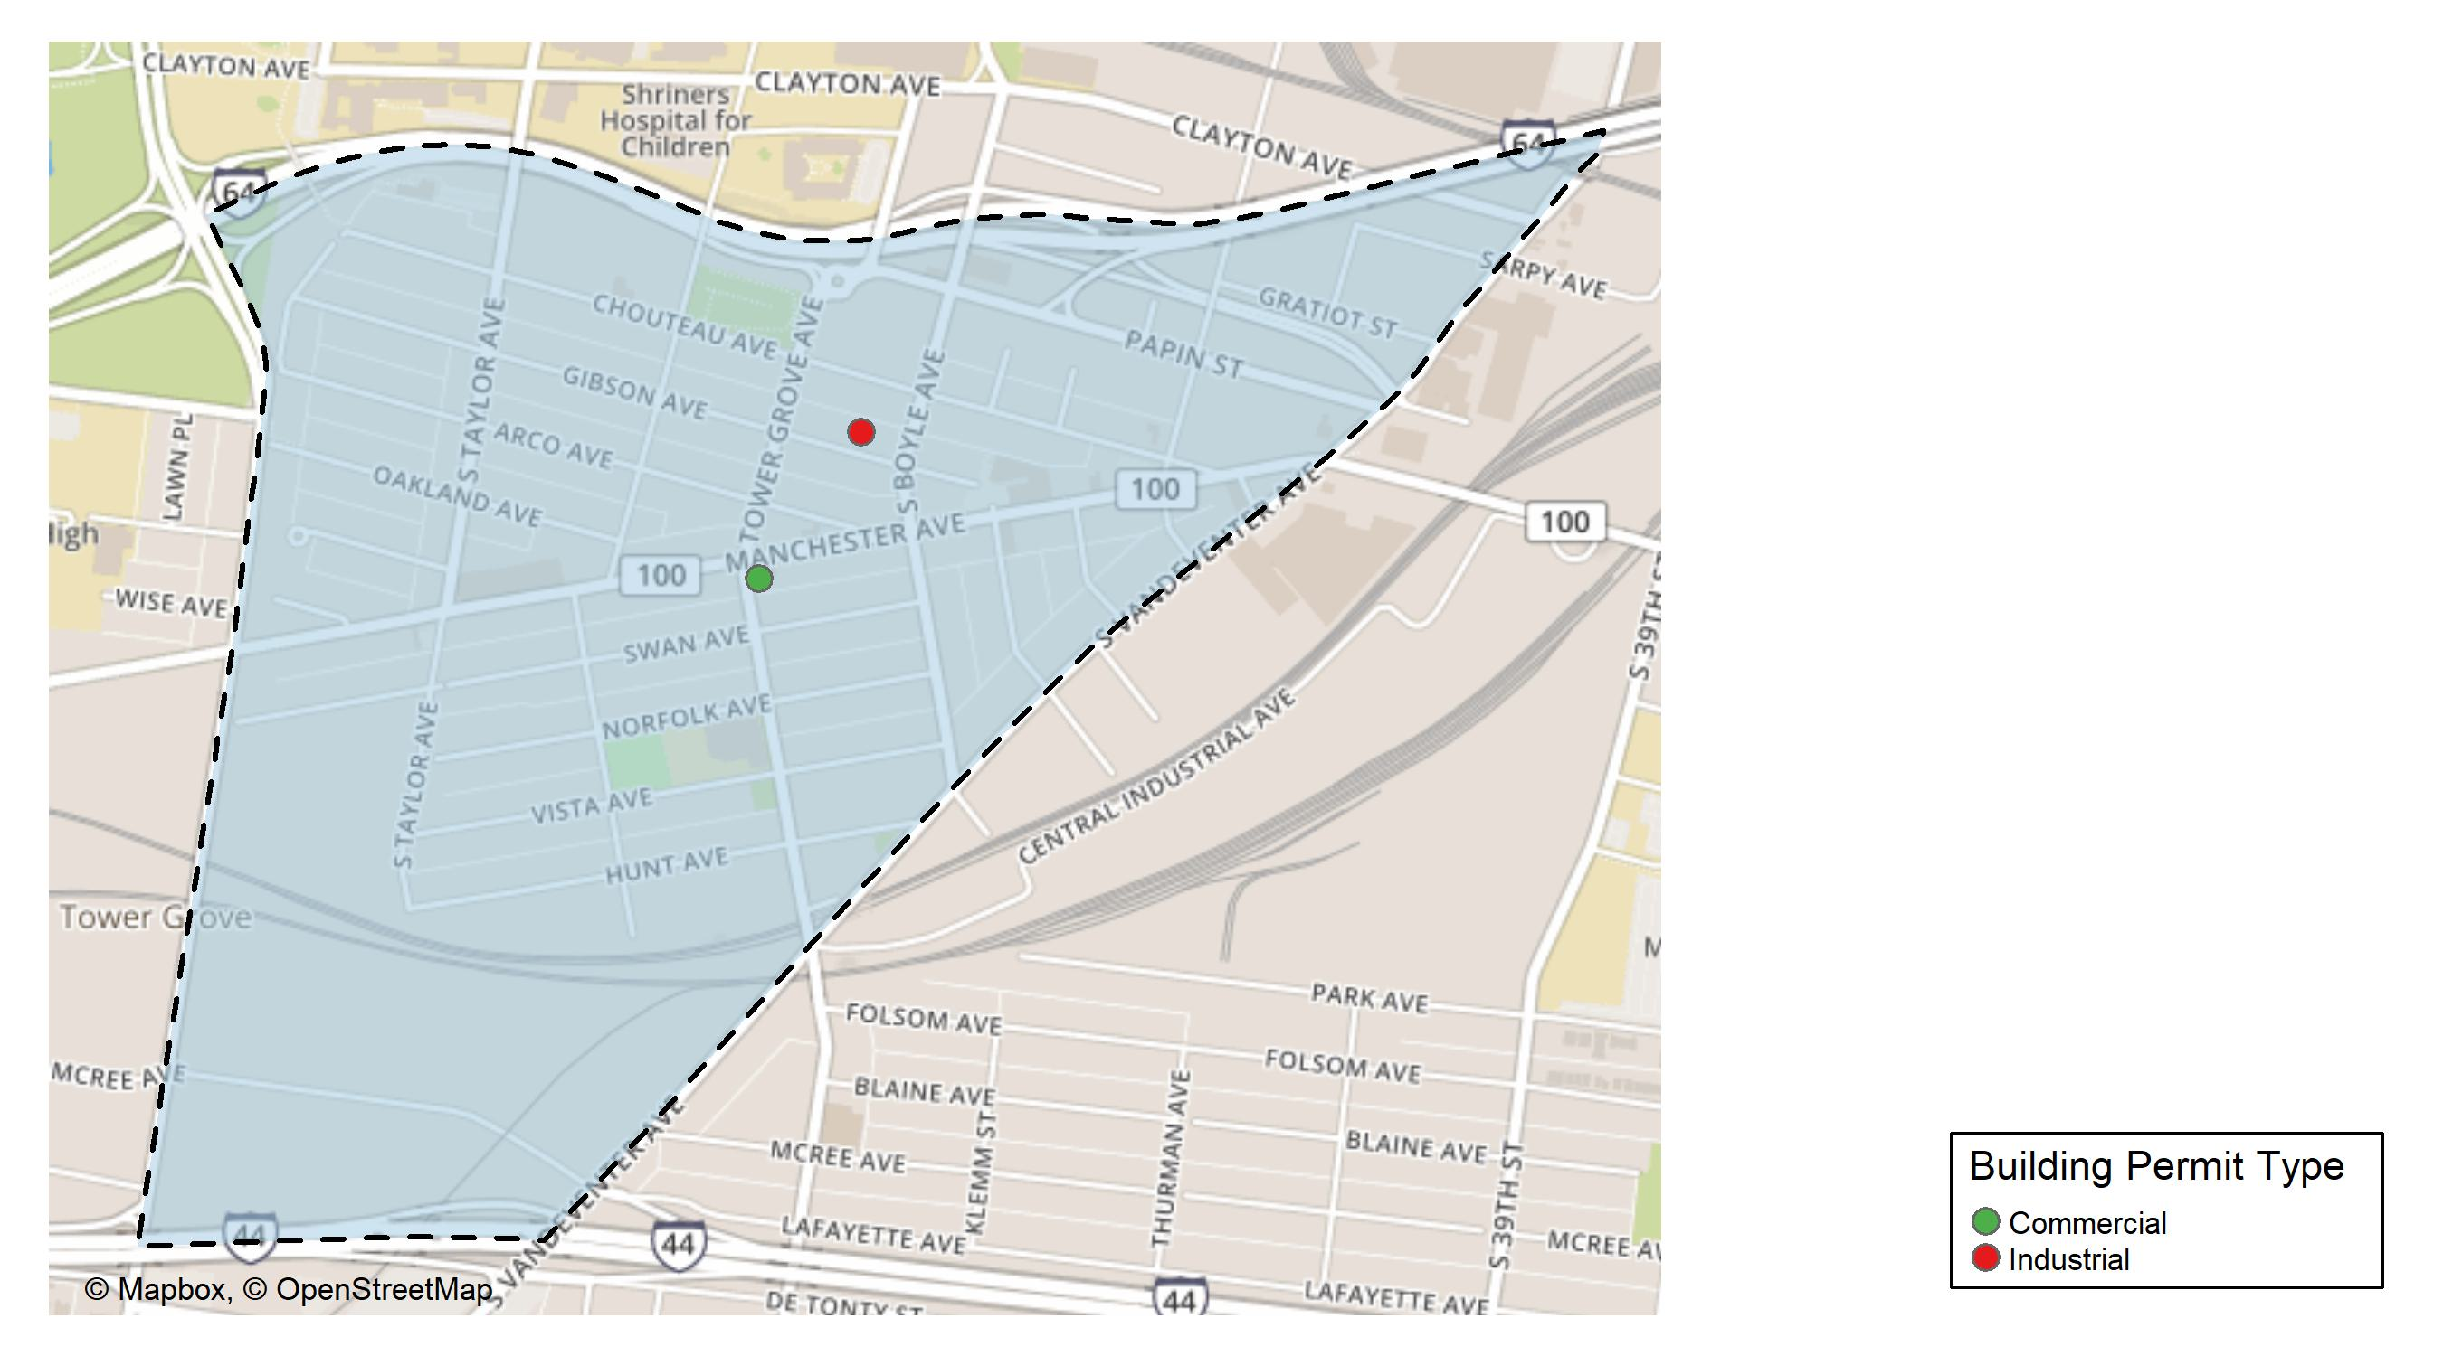
Forest Park Southeast

Slide 14
Neighborhood Summary
September 2024 | September 2024 | September 2024 | September 2024
Permit Use | Average Cost | # of Permits | Total Value of Permits
Commercial | $964 | 1 | $964
Industrial | $12,900 | 1 | $12,900
Residential | $0 | 0 | $0
Last 6 Months | Last 6 Months | Last 6 Months | Last 6 Months
Permit Use | Average Cost | # of Permits | Total Value of Permits
Commercial | $30,597.42 | 12 | $367,169
Industrial | $12,175.00 | 4 | $48,700
Residential | $97,263.65 | 26 | $2,528,855

Slide 15
Forest Park Southeast Individual Permit Breakdown
Neighborhood | Owner | New Use | Cost | address
Forest Park Southeast | JUSTIN BANDINO | Industrial | $12,900 | 4319 GIBSON AV
Forest Park Southeast | 4270 MANCHESTER LLC | Commercial | $964 | 4268 MANCHESTER AV

Slide 16
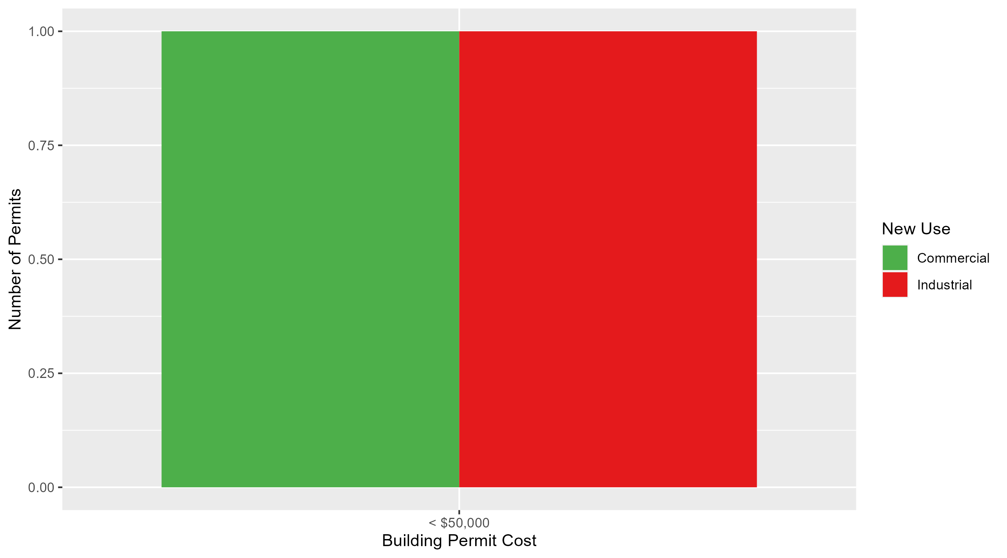
Forest Park Southeast Permit Cost Breakdown

Slide 17
Expanded Service Area

Slide 18
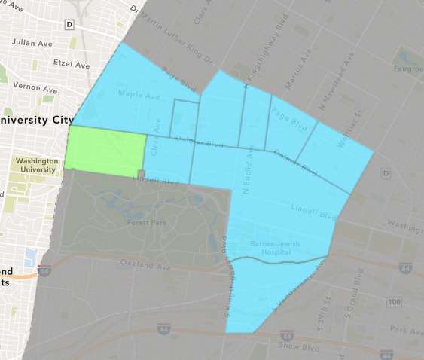
Skinker DeBaliviere
September 2024 Neighborhood Cost Breakdown
  Mean: $50,211
  Median: $14,700
  Range: $1,000 - $190,000

Slide 19
Skinker DeBaliviere: Summary Notes
9 building permits in September 2024
  -18.18% change compared to September 2023 (11 total building permits)
  $50,211: Average building permit cost in September 2024
    -21.42% change compared to September 2023 ($63,902)
51 total building permits in 2024
  -40.70% change YTD compared to this time in 2023 (86 total building permits)
  $70,337: YTD average building permit cost in 2024
    12.04% change YTD compared to this time in 2023 ($62,778)

Slide 20
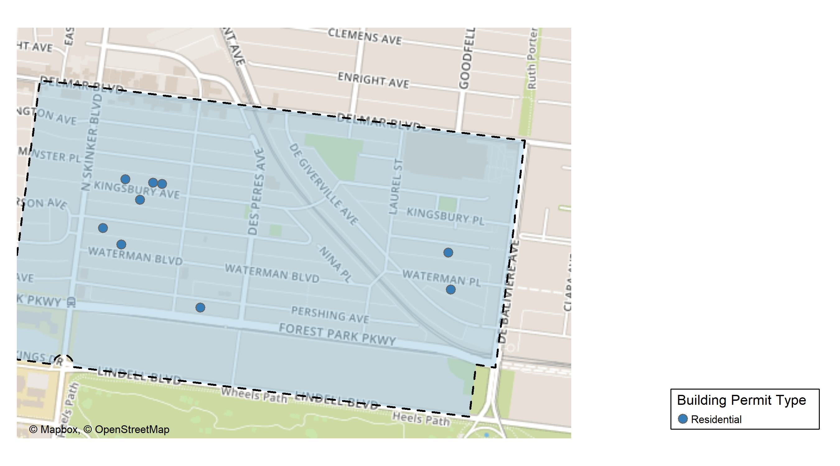
Skinker DeBaliviere

Slide 21
Neighborhood Summary
September 2024 | September 2024 | September 2024 | September 2024
Permit Use | Average Cost | # of Permits | Total Value of Permits
Commercial | $0.00 | 0 | $0
Industrial | $0.00 | 0 | $0
Residential | $50,211.11 | 9 | $451,900
Last 6 Months | Last 6 Months | Last 6 Months | Last 6 Months
Permit Use | Average Cost | # of Permits | Total Value of Permits
Commercial | $128,722.50 | 4 | $514,890
Industrial | $276,450.00 | 2 | $552,900
Residential | $38,191.71 | 38 | $1,451,285

Slide 22
Skinker DeBaliviere Individual Permit Breakdown
Neighborhood | Owner | New Use | Cost | address
Skinker DeBaliviere | THE LYNDE FAMILY TRUST | Residential | $190,000 | 6127 KINGSBURY AV
Skinker DeBaliviere | DUCKER, ROBERT G & JEAN E | Residential | $14,700 | 6135 KINGSBURY AV
Skinker DeBaliviere | LONDON PROPERTIES LLC | Residential | $30,000 | 6157 WATERMAN BLVD
Skinker DeBaliviere | SMC HOLDINGS LLC | Residential | $13,000 | 6038 PERSHING AV
Skinker DeBaliviere | BANISAEID, NASSER & NEDA ADBIANNIA | Residential | $1,000 | 5750 WATERMAN BLVD
Skinker DeBaliviere | MCGROARTY, SEAN M & CRISTINA F | Residential | $125,000 | 6146 KINGSBURY AV
Skinker DeBaliviere | PANAGOS, PETER D & WENDY L | Residential | $65,000 | 6165 KINGSBURY AV
Skinker DeBaliviere | MOLINA, LAWRENCE S JR | Residential | $4,200 | 6178 MCPHERSON AV
Skinker DeBaliviere | OCG ACQUISITIONS GP | Residential | $9,000 | 5758 MCPHERSON AV

Slide 23
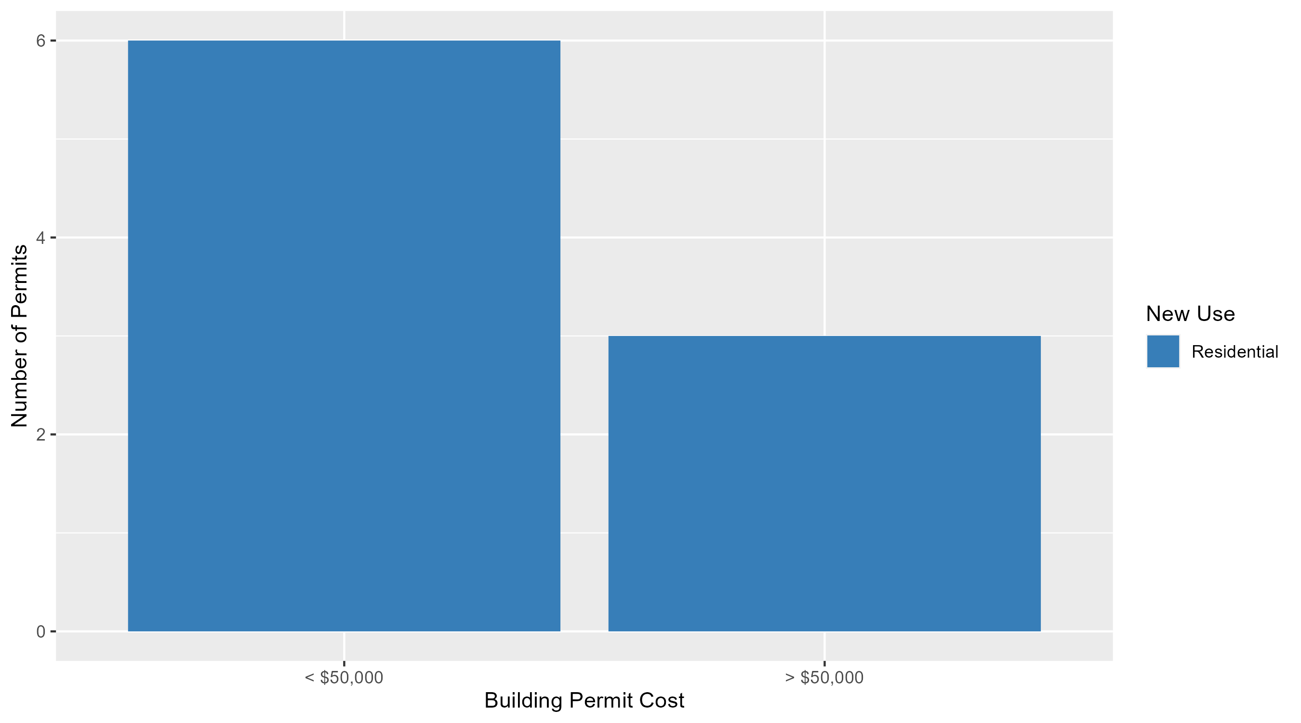
Skinker DeBaliviere Permit Cost Breakdown

Slide 24
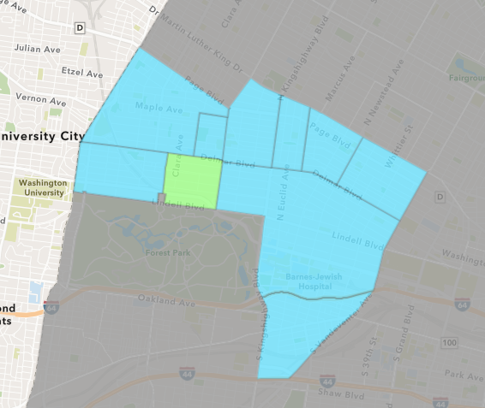
DeBaliviere Place
September 2024 Neighborhood Cost Breakdown
  Mean: $285,375
  Median: $94,500
  Range: $2,500 - $950,000

Slide 25
DeBaliviere Place: Summary Notes
4 building permits in September 2024
  -42.86% change compared to September 2023 (7 total building permits)
  $285,375: Average building permit cost in September 2024
    417.07% change compared to September 2023 ($55,191)
35 total building permits in 2024
  2.94% change YTD compared to this time in 2023 (34 total building permits)
  $128,877: YTD average building permit cost in 2024
    -13.02% change YTD compared to this time in 2023 ($148,161)

Slide 26
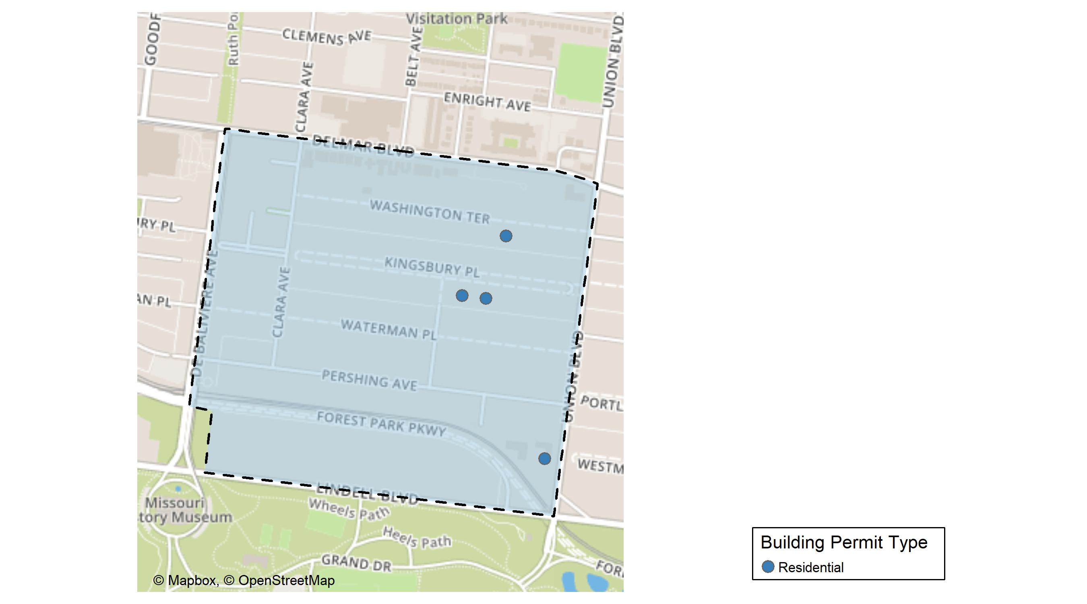
DeBaliviere Place

Slide 27
Neighborhood Summary
September 2024 | September 2024 | September 2024 | September 2024
Permit Use | Average Cost | # of Permits | Total Value of Permits
Commercial | $0 | 0 | $0
Industrial | $0 | 0 | $0
Residential | $285,375 | 4 | $1,141,500
Last 6 Months | Last 6 Months | Last 6 Months | Last 6 Months
Permit Use | Average Cost | # of Permits | Total Value of Permits
Commercial | $36,063.33 | 3 | $108,190
Industrial | $0.00 | 0 | $0
Residential | $160,554.96 | 25 | $4,013,874

Slide 28
DeBaliviere Place Individual Permit Breakdown
Neighborhood | Owner | New Use | Cost | address
DeBaliviere Place | ORO 275 PARKSIDE LLC & | Residential | $950,000 | 245 UNION BLVD
DeBaliviere Place | HSIEH, FRANCES | Residential | $2,500 | 14 WASHINGTON TER
DeBaliviere Place | NEUMANN, HAROLD & MAREN L FJORD | Residential | $39,000 | 20 KINGSBURY PL
DeBaliviere Place | ULRICH, DAVID & | Residential | $150,000 | 16 KINGSBURY PL

Slide 29
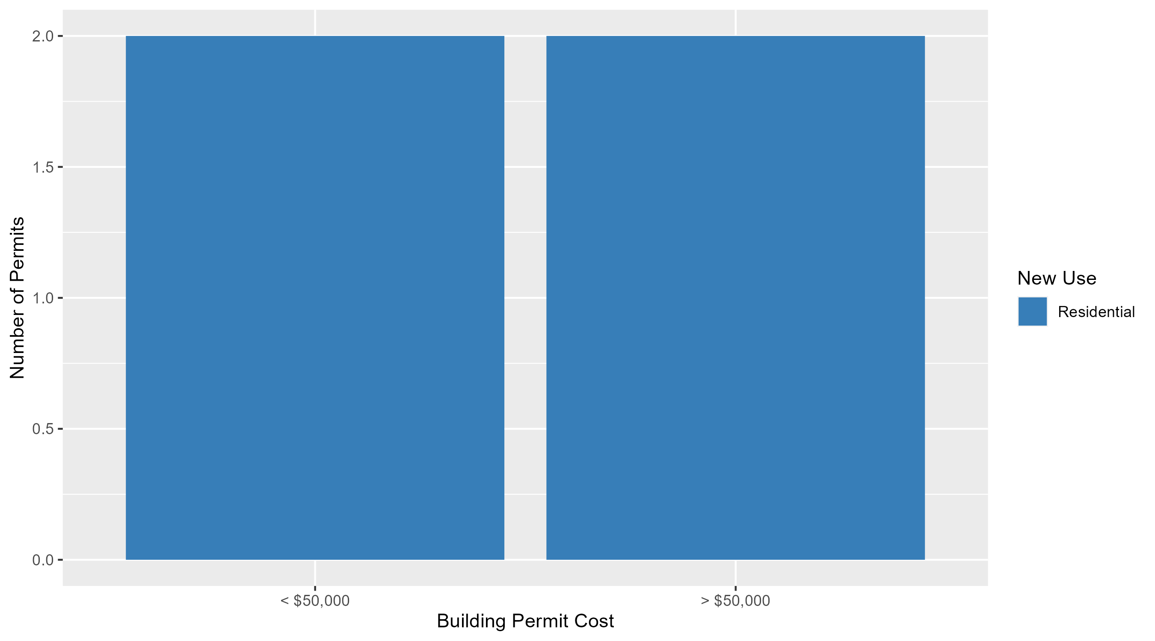
DeBaliviere Place Permit Cost Breakdown

Slide 30
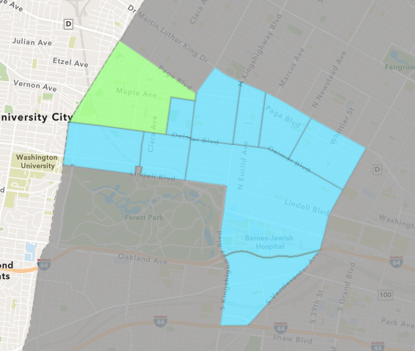
West End
September 2024 Neighborhood Cost Breakdown
  Mean: $35,500
  Median: $35,500
  Range: $6,000 - $65,000

Slide 31
West End: Summary Notes
2 building permits in September 2024
  -71.43% change compared to September 2023 (7 total building permits)
  $35,500: Average building permit cost in September 2024
    150.18% change compared to September 2023 ($14,190)
58 total building permits in 2024
  -18.31% change YTD compared to this time in 2023 (71 total building permits)
  $79,519: YTD average building permit cost in 2024
    44.14% change YTD compared to this time in 2023 ($55,169)

Slide 32
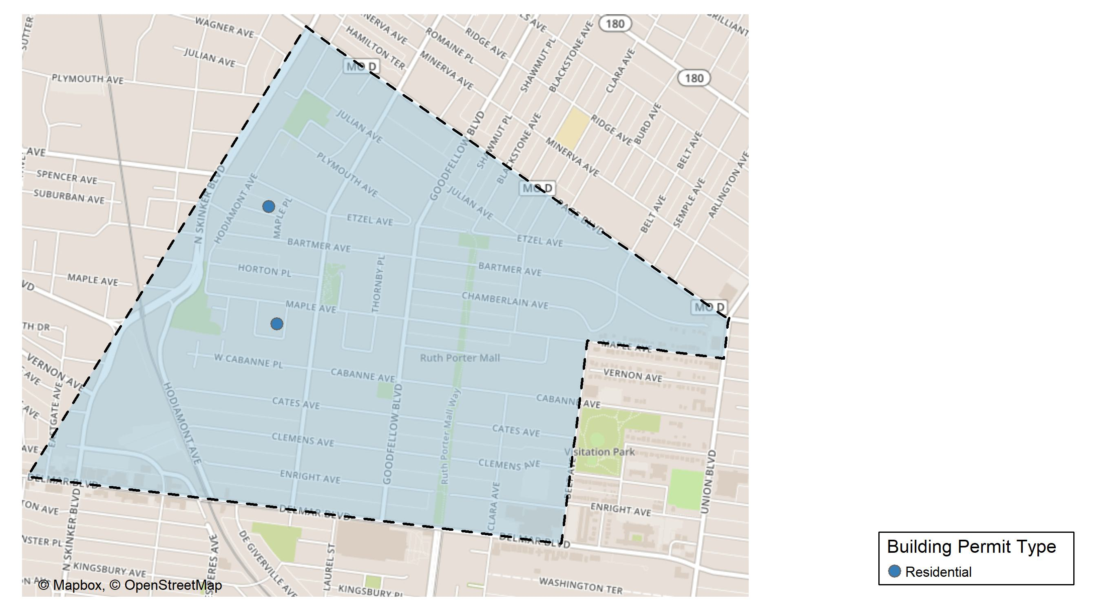
West End

Slide 33
Neighborhood Summary
September 2024 | September 2024 | September 2024 | September 2024
Permit Use | Average Cost | # of Permits | Total Value of Permits
Commercial | $0 | 0 | $0
Industrial | $0 | 0 | $0
Residential | $35,500 | 2 | $71,000
Last 6 Months | Last 6 Months | Last 6 Months | Last 6 Months
Permit Use | Average Cost | # of Permits | Total Value of Permits
Commercial | $138,714.22 | 9 | $1,248,428
Industrial | $14,400.00 | 2 | $28,800
Residential | $14,492.55 | 31 | $449,269

Slide 34
West End Individual Permit Breakdown
Neighborhood | Owner | New Use | Cost | address
West End | HINDMON, MARCUS & | Residential | $6,000 | 945-947 BEACH AV
West End | THOMAS, LADONNA C | Residential | $65,000 | 6015 SUBURBAN AV

Slide 35
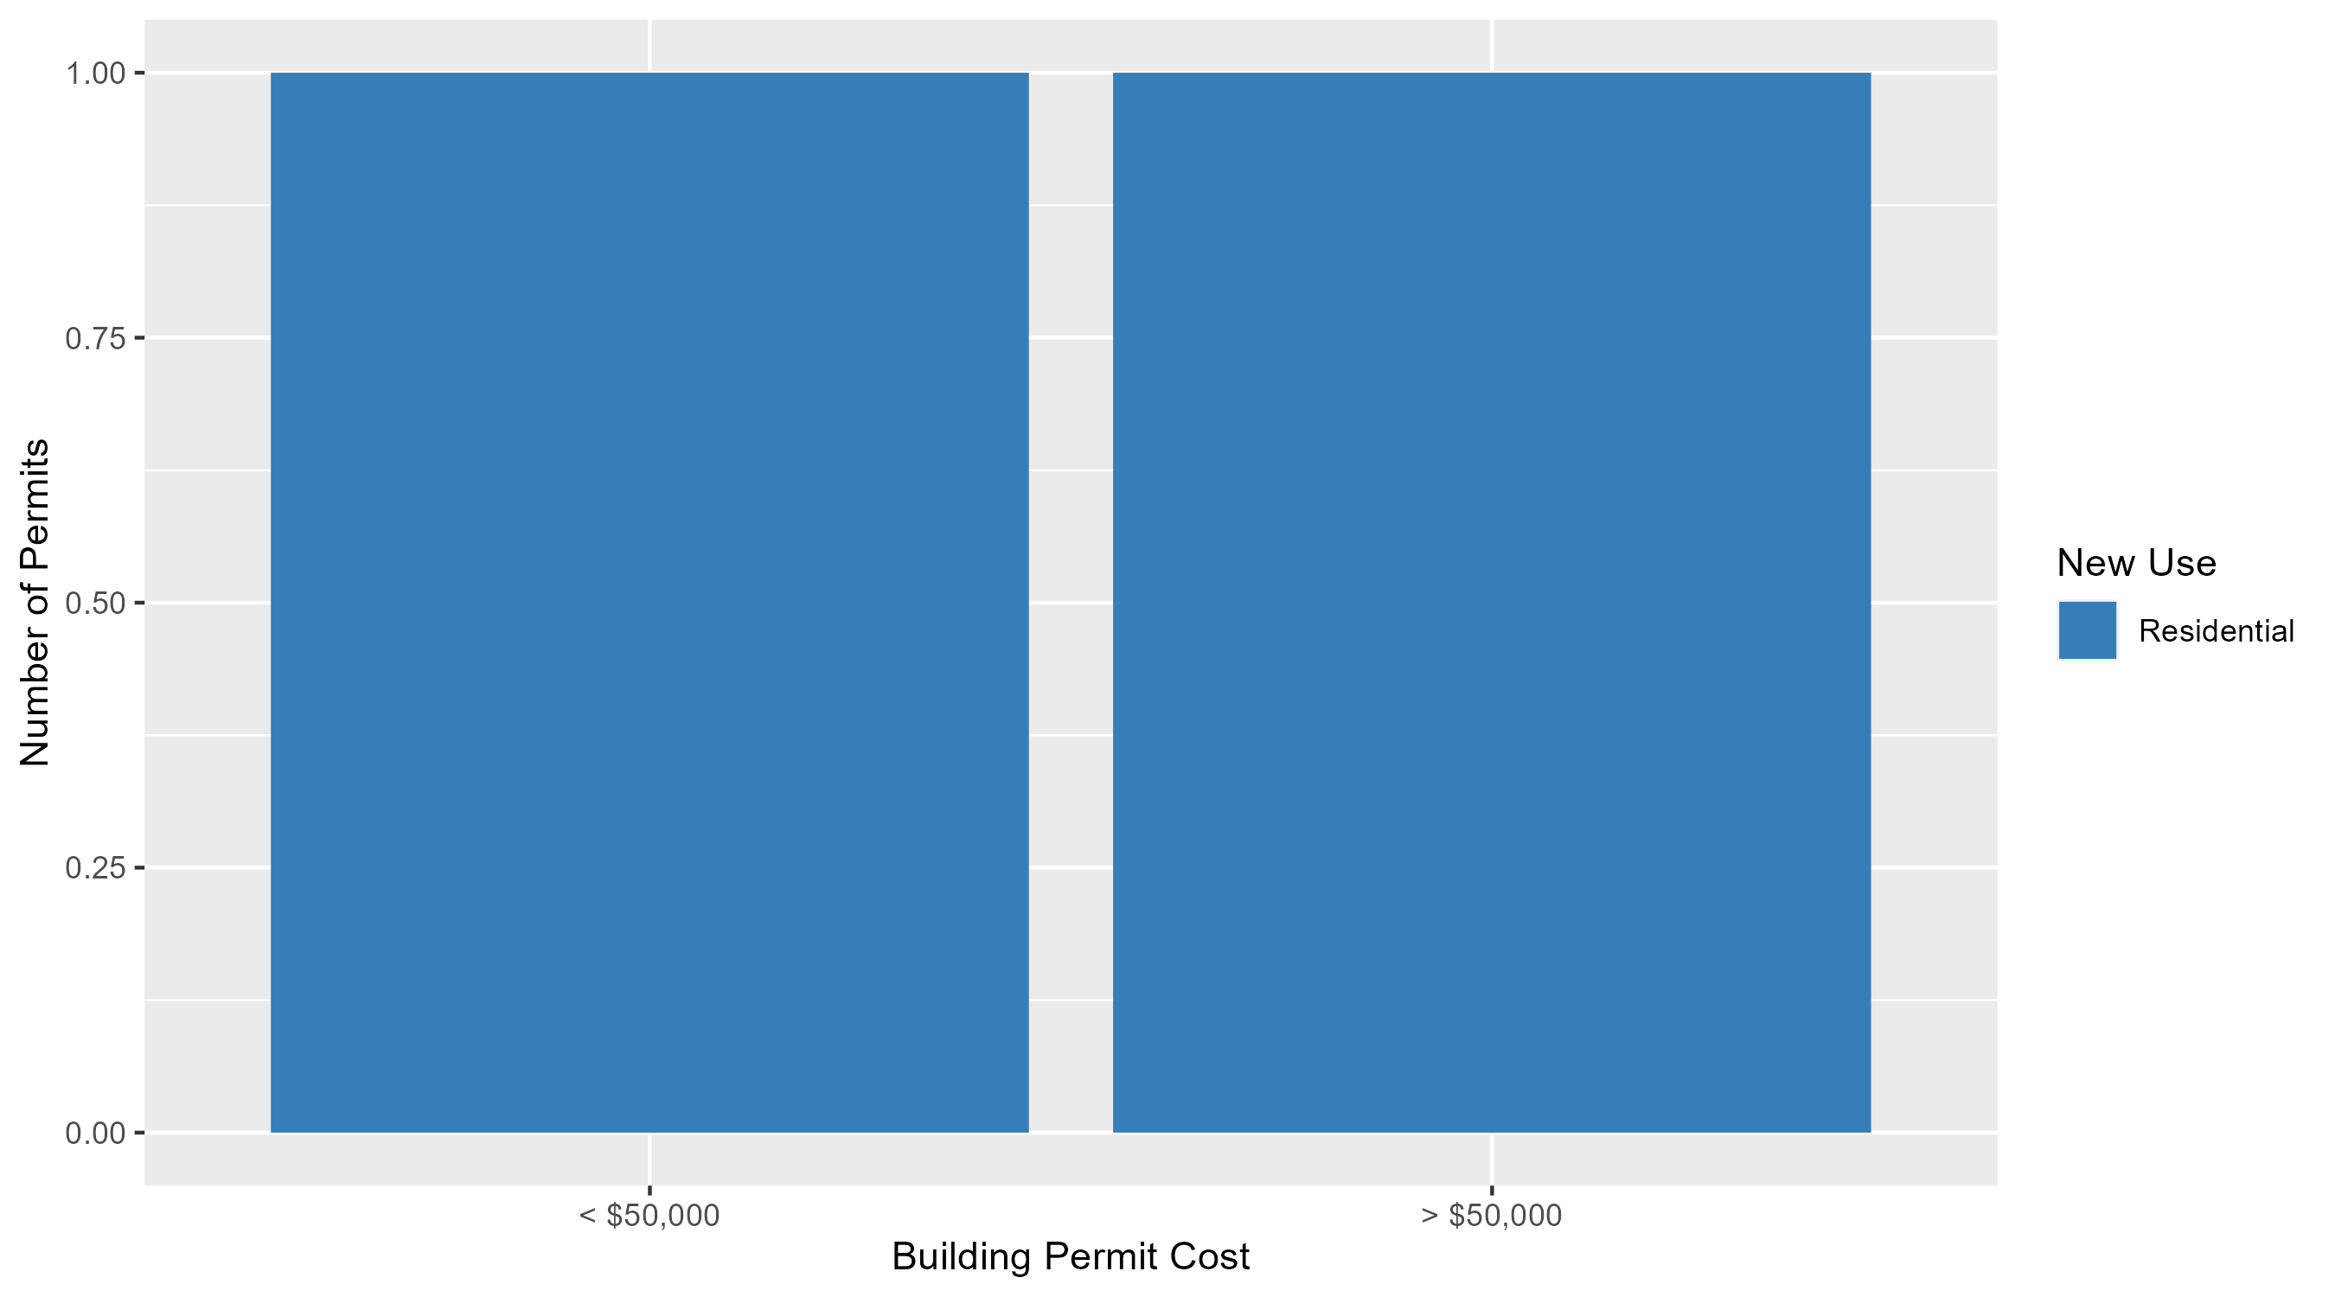
West End Permit Cost Breakdown

Slide 36
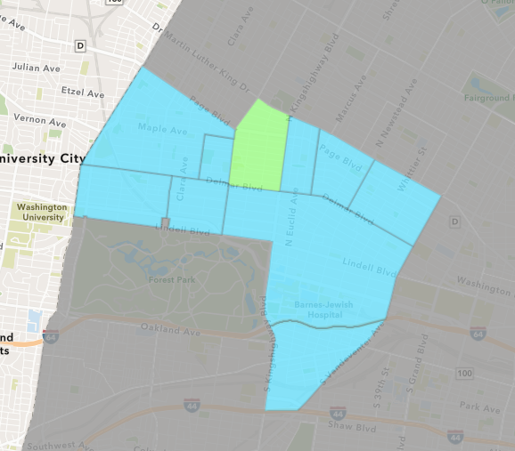
Academy
September 2024 Neighborhood Cost Breakdown
  Mean: $21,142
  Median: $21,142
  Range: $7,283 - $35,000

Slide 37
Academy: Summary Notes
2 building permits in September 2024
  0.00% change compared to September 2023 (2 total building permits)
  $21,142: Average building permit cost in September 2024
    1661.79% change compared to September 2023 ($1,200)
18 total building permits in 2024
  -14.29% change YTD compared to this time in 2023 (21 total building permits)
  $42,499: YTD average building permit cost in 2024
    247.75% change YTD compared to this time in 2023 ($12,221)

Slide 38
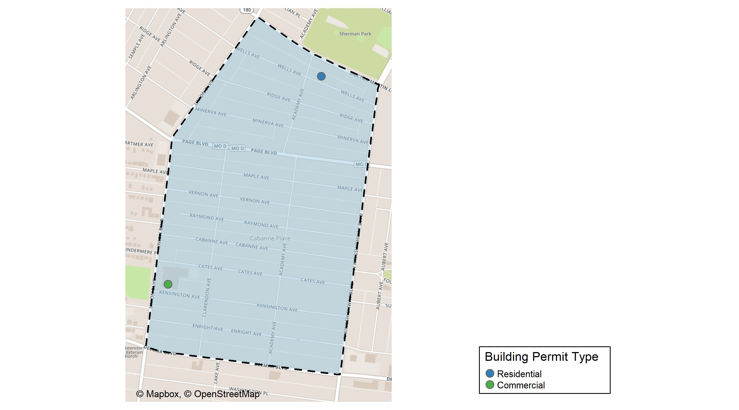
Academy

Slide 39
Neighborhood Summary
September 2024 | September 2024 | September 2024 | September 2024
Permit Use | Average Cost | # of Permits | Total Value of Permits
Commercial | $35,000 | 1 | $35,000
Industrial | $0 | 0 | $0
Residential | $7,283 | 1 | $7,283
Last 6 Months | Last 6 Months | Last 6 Months | Last 6 Months
Permit Use | Average Cost | # of Permits | Total Value of Permits
Commercial | $71,666.67 | 3 | $215,000
Industrial | $0.00 | 0 | $0
Residential | $49,378.30 | 10 | $493,783

Slide 40
Academy Individual Permit Breakdown
Neighborhood | Owner | New Use | Cost | address
Academy | ST LOUIS PUBLIC SCHOOL DST BLDG CORP | Commercial | $35,000 | 918 UNION BLVD
Academy | SMITH-MASON, JASMINE & MARILYN SMITH | Residential | $7,283 | 5085 WELLS AV

Slide 41
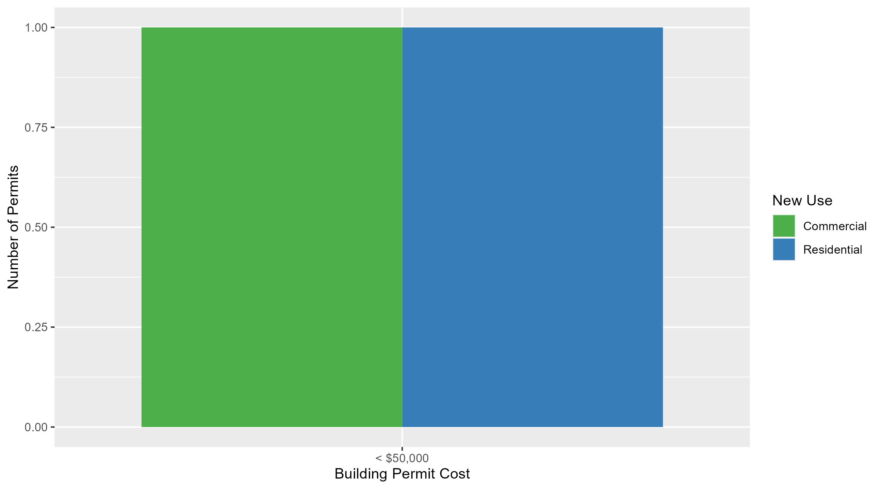
Academy Permit Cost Breakdown

Slide 42
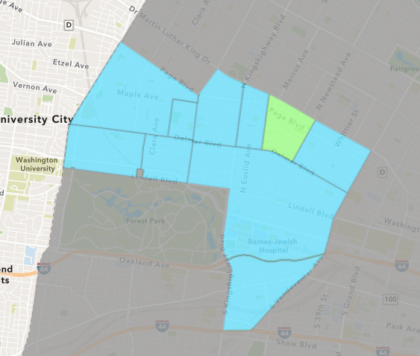
Lewis Place
September 2024 Neighborhood Cost Breakdown
  Mean: $55,000
  Median: $55,000
  Range: $55,000 - $55,000

Slide 43
Lewis Place: Summary Notes
1 building permits in September 2024
  Infinite change compared to September 2023 (0 total building permits)
  $55,000: Average building permit cost in September 2024
    Infinite change compared to September 2023 ($0)
12 total building permits in 2024
  33.33% change YTD compared to this time in 2023 (9 total building permits)
  $26,350: YTD average building permit cost in 2024
    -49.36% change YTD compared to this time in 2023 ($52,034)

Slide 44
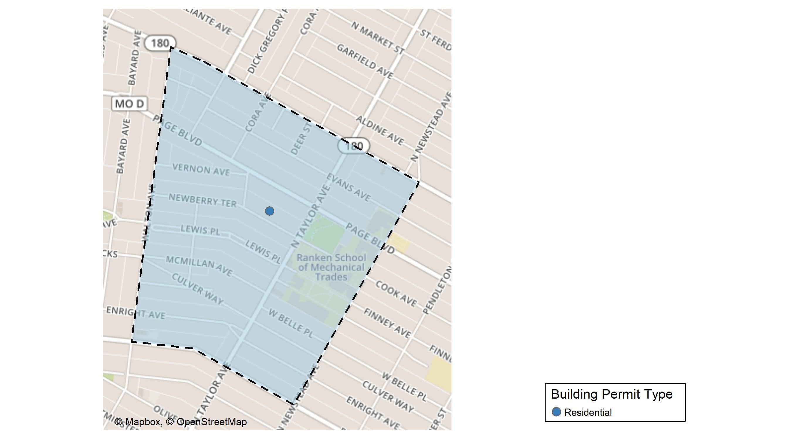
Lewis Place

Slide 45
Neighborhood Summary
September 2024 | September 2024 | September 2024 | September 2024
Permit Use | Average Cost | # of Permits | Total Value of Permits
Commercial | $0 | 0 | $0
Industrial | $0 | 0 | $0
Residential | $55,000 | 1 | $55,000
Last 6 Months | Last 6 Months | Last 6 Months | Last 6 Months
Permit Use | Average Cost | # of Permits | Total Value of Permits
Commercial | $43,424 | 4 | $173,696
Industrial | $5,500 | 2 | $11,000
Residential | $32,375 | 4 | $129,500

Slide 46
Lewis Place Individual Permit Breakdown
Neighborhood | Owner | New Use | Cost | address
Lewis Place | MUHAMMAD, RODNEY L | Residential | $55,000 | 4545 NEWBERRY TER

Slide 47
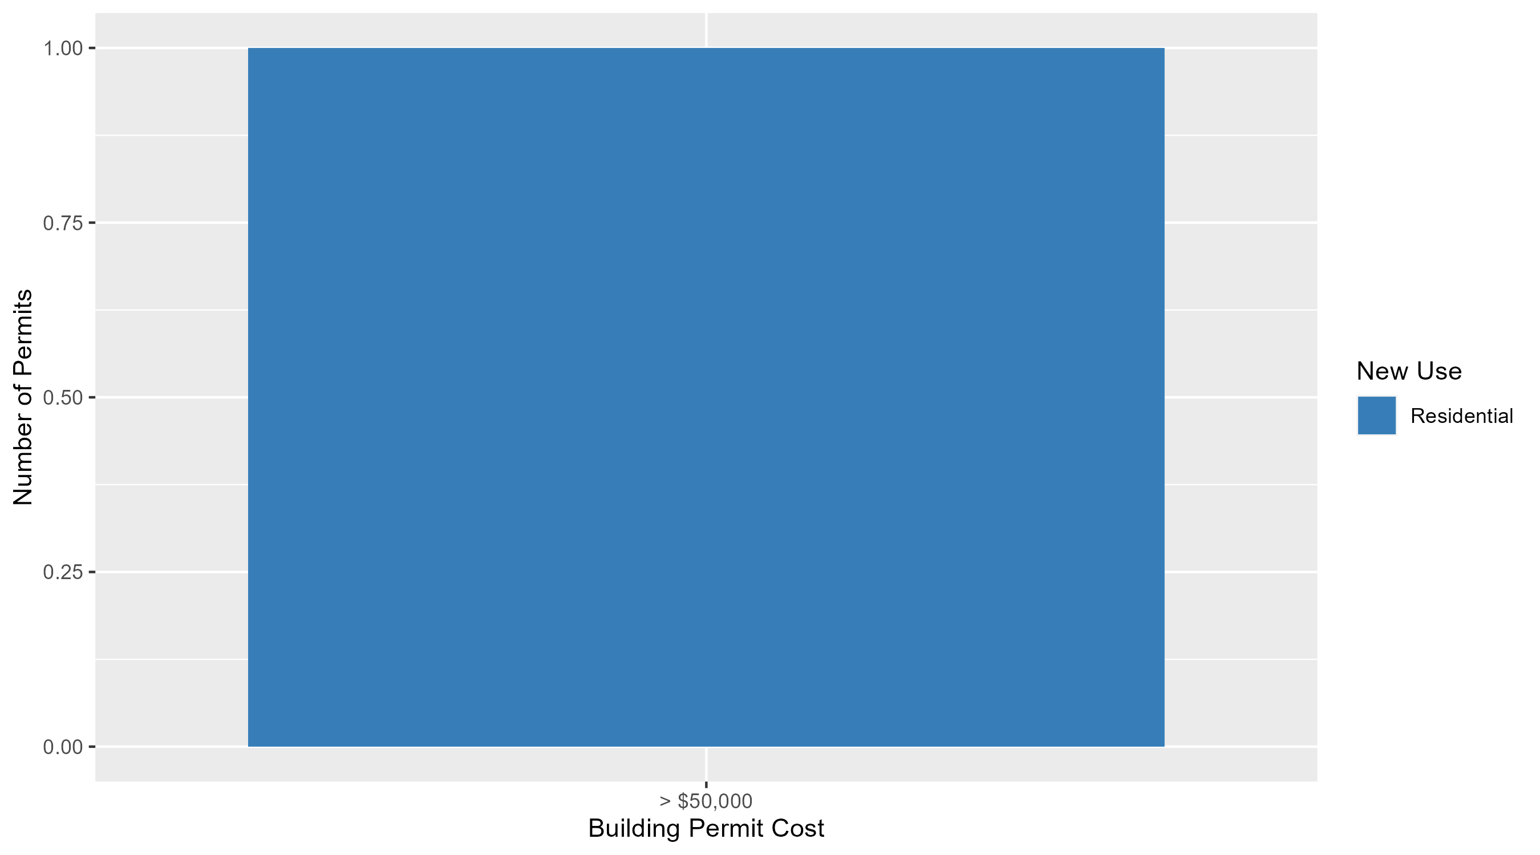
Lewis Place Permit Cost Breakdown

Slide 48
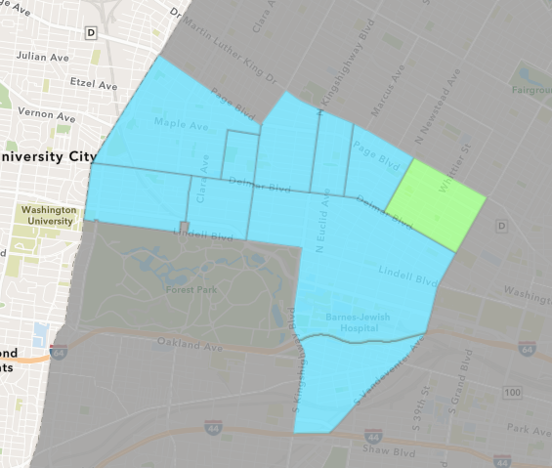
Vandeventer
September 2024 Neighborhood Cost Breakdown
  Mean: $5,000
  Median: $5,000
  Range: $5,000 - $5,000

Slide 49
Vandeventer: Summary Notes
1 building permits in September 2024
  -83.33% change compared to September 2023 (6 total building permits)
  $5,000: Average building permit cost in September 2024
    -98.71% change compared to September 2023 ($388,067)
8 total building permits in 2024
  -38.46% change YTD compared to this time in 2023 (13 total building permits)
  $46,035: YTD average building permit cost in 2024
    -74.84% change YTD compared to this time in 2023 ($182,933)

Slide 50
Additional Notes
Data retreived from https://www.stlouis-mo.gov/data/
Building permits with a cost of $0 were dropped
Building permits that were cancelled were dropped
Infinite change indicates 0 permits in the current or previous time period/comparison month so there was a overall increase or decrease

