Slide 1
Forest Park Southeast Central West End
May 2025
Monthly Crime Report
Washington University Medical Center

Slide 2
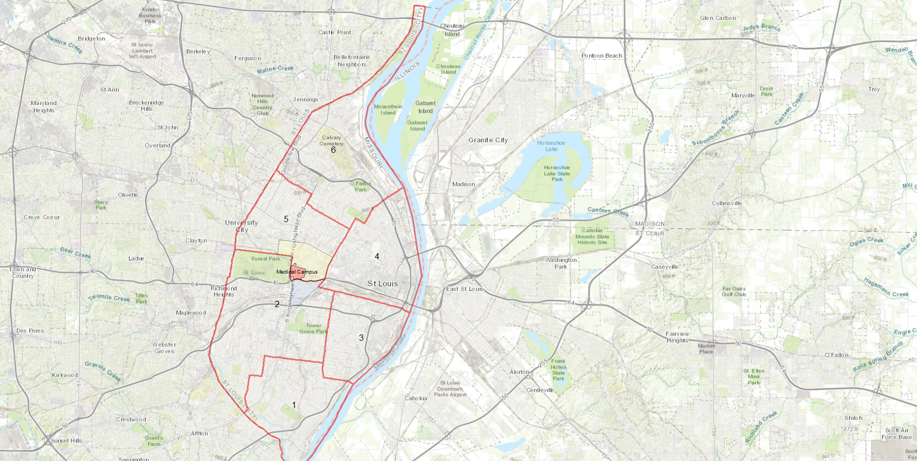
City of St Louis Police Districts
6
Central West End Neighborhood
5
WUMC
4
Forest Park Southeast Neighborhood
2
3
1

Slide 3
District 5 Summary Notes
There are 15 neighborhoods in District 5.
Academy
Central West End
DeBaliviere Place
Fountain Park
Hamilton Heights
Kingsway East
Kingsway West
Lewis Place
Skinker-DeBaliviere
The Greater Ville
The Ville
Vandeventer
Visitation Park
Wells-Goodfellow
West End
The lowest number of crimes in one neighborhood was 7 in Lewis Place
The highest number of crimes in one neighborhood was 178 in the Central West End
The average number of crimes per neighborhood was 49.73
The lowest crime rate per 100,000 in one neighborhood was 487.3 in Skinker/DeBaliviere
The highest crime rate per 100,000 in one neighborhood was 3069.77 in Fountain Park
The overall crime rate in District 5 was 1318.99
Source: SLMPD

Slide 4
District 2 Summary Notes
There are 19 neighborhoods in District 2.
Botanical Heights
Cheltenham
Clayton-Tamm
Clifton Heights
Ellendale
Forest Park Southeast
Franz Park
Hi-Pointe
Kings Oak
Lindenwood Park
Northampton
Shaw
Southampton
Southwest Garden
St. Louis Hills
The Hill
Tiffany
Tower Grove South
Wydown-Skinker
*Southampton is split between District 2 and District 1.
The lowest number of crimes in one neighborhood was 4 in Kings Oak
The highest number of crimes in one neighborhood was 105 in Tower Grove South
The average number of crimes per neighborhood was 27.89
The lowest crime rate per 100,000 in one neighborhood was 330.24 in Lindenwood Park
The highest crime rate per 100,000 in one neighborhood was 2395.21 in Kings Oak
The overall crime rate in District 2 was 683.82
Source: SLMPD

Slide 5
Neighborhoods vs City Crime rate Over the past year

Slide 6
Forest Park Southeast Neighborhood Detail

Slide 7
Forest Park Southeast Summary Notes
46 total crimes in May 2025
Up 43% compared to May 2024 (99 crimes)
2 crimes against persons in May 2025
Up 20% compared to May 2024 (5 crimes)
225 total crimes so far in 2025
Down 7% compared to this time in 2024 (291 crimes)
28 total crimes against persons so far in 2025
Down 24% when compared to this time in 2024 (39 crimes)
Source: SLMPD

Slide 8
Forest Park Southeast Year to Year Comparison
2024 | 2020 | 2020 | 2020 | 2020 |  |  |  |  |  |  |  |  | 2020
Crimes | Jan | Feb | Mar | Apr | May | Jun | Jul | Aug | Sep | Oct | Nov | Dec | Total
Aggravated Assault | 4 | 3 | 3 | 1 | 3 | 0 | 2 | 3 | 1 | 0 | 6 | 2 | 28
Arson | 0 | 0 | 0 | 0 | 0 | 0 | 0 | 0 | 0 | 0 | 0 | 0 | 0
Burglary | 1 | 1 | 1 | 1 | 2 | 6 | 3 | 1 | 0 | 4 | 3 | 0 | 23
Homicide | 0 | 0 | 2 | 0 | 0 | 0 | 0 | 0 | 0 | 0 | 0 | 0 | 2
Larceny | 10 | 16 | 12 | 10 | 29 | 26 | 36 | 17 | 10 | 14 | 16 | 4 | 200
Motor Vehicle Theft | 4 | 2 | 6 | 4 | 6 | 5 | 8 | 5 | 5 | 2 | 1 | 3 | 51
Robbery | 1 | 0 | 0 | 0 | 1 | 0 | 0 | 2 | 0 | 1 | 1 | 1 | 7
Total | 20 | 22 | 24 | 16 | 41 | 37 | 49 | 28 | 16 | 21 | 27 | 10 | 311
2025 | 2020 |  |  |  |  |  |  |  |  |  |  |  | 2020
Crimes | Jan | Feb | Mar | Apr | May | Jun | Jul | Aug | Sep | Oct | Nov | Dec | Total
Aggravated Assault | 0 | 0 | 4 | 1 | 0 |  |  |  |  |  |  |  | 5
Arson | 0 | 0 | 0 | 0 | 0 |  |  |  |  |  |  |  | 0
Burglary | 0 | 1 | 0 | 1 | 0 |  |  |  |  |  |  |  | 2
Homicide | 0 | 0 | 0 | 0 | 0 |  |  |  |  |  |  |  | 0
Larceny | 3 | 14 | 13 | 11 | 15 |  |  |  |  |  |  |  | 56
Motor Vehicle Theft | 5 | 9 | 3 | 2 | 1 |  |  |  |  |  |  |  | 20
Robbery | 1 | 0 | 0 | 2 | 1 |  |  |  |  |  |  |  | 4
Total | 9 | 24 | 20 | 17 | 17 |  |  |  |  |  |  |  | 87
Source: SLMPD

Slide 9
Forest Park southeast 2024 vs 2025
Source: SLMPD

Slide 10
Forest Park southeast Crimes by day of the week
Source: SLMPD

Slide 11
Forest park southeast Crimes by time of day
40.82% - Daytime (8AM-8PM)
59.18% - Nighttime (8PM-8AM)
Source: SLMPD

Slide 12
Forest park southeast Crimes by day of the Month
Source: SLMPD

Slide 13
Central West End Neighborhood Detail

Slide 14
Central West End Summary Notes
178 total crimes in May 2025
Down 22% compared to May 2024 (149 crimes)
19 crimes against persons in May 2025
Up 69% compared to May 2024 (18 crimes)
729 total crimes so far in 2025
Down 19% compared to this time in 2024 (829 crimes)
107 crimes against persons so far in 2025
Up 4% compared to this time in 2024 (102 crimes)
Source: SLMPD

Slide 15
Central West End Year to Year Comparison
2024 | 2020 | 2020 | 2020 | 2020 |  |  |  |  |  |  |  |  | 2020
Crimes | Jan | Feb | Mar | Apr | May | Jun | Jul | Aug | Sep | Oct | Nov | Dec | Total
Aggravated Assault | 0 | 7 | 0 | 5 | 6 | 8 | 0 | 4 | 2 | 10 | 6 | 3 | 51
Arson | 1 | 0 | 0 | 0 | 0 | 0 | 0 | 0 | 0 | 0 | 0 | 0 | 1
Burglary | 9 | 10 | 9 | 8 | 6 | 10 | 6 | 5 | 5 | 6 | 6 | 1 | 81
Homicide | 0 | 1 | 0 | 0 | 0 | 0 | 0 | 0 | 0 | 0 | 0 | 0 | 1
Larceny | 52 | 37 | 35 | 53 | 47 | 63 | 68 | 37 | 62 | 39 | 85 | 59 | 637
Motor Vehicle Theft | 16 | 27 | 9 | 26 | 16 | 22 | 17 | 16 | 17 | 11 | 6 | 22 | 205
Robbery | 2 | 5 | 0 | 2 | 3 | 4 | 0 | 2 | 3 | 2 | 1 | 1 | 25
Total | 80 | 87 | 53 | 94 | 78 | 107 | 91 | 64 | 89 | 68 | 104 | 86 | 1001
2025 | 2020 |  |  |  |  |  |  |  |  |  |  |  | 2020
Crimes | Jan | Feb | Mar | Apr | May | Jun | Jul | Aug | Sep | Oct | Nov | Dec | Total
Aggravated Assault | 7 | 5 | 9 | 3 | 2 |  |  |  |  |  |  |  | 26
Arson | 0 | 0 | 0 | 0 | 0 |  |  |  |  |  |  |  | 0
Burglary | 5 | 7 | 6 | 5 | 4 |  |  |  |  |  |  |  | 27
Homicide | 0 | 0 | 0 | 0 | 1 |  |  |  |  |  |  |  | 1
Larceny | 40 | 35 | 34 | 46 | 48 |  |  |  |  |  |  |  | 203
Motor Vehicle Theft | 4 | 5 | 7 | 6 | 11 |  |  |  |  |  |  |  | 33
Robbery | 3 | 2 | 1 | 0 | 1 |  |  |  |  |  |  |  | 7
Total | 59 | 54 | 57 | 60 | 67 |  |  |  |  |  |  |  | 297
Source: SLMPD

Slide 16
Central West End 2024 vs 2025
Source: SLMPD

Slide 17
Central West End Crimes by day of the week
Source: SLMPD

Slide 18
Central West End Crimes by time of day
51.35% - Daytime (8AM-8PM)
48.65% - Nighttime (8PM-8AM)
Source: SLMPD

Slide 19
Central West End Crimes by day of the Month
Source: SLMPD

