Slide 1
St. Louis Central Corridor West Building Permits
Monthly Report: May 2025

Slide 2
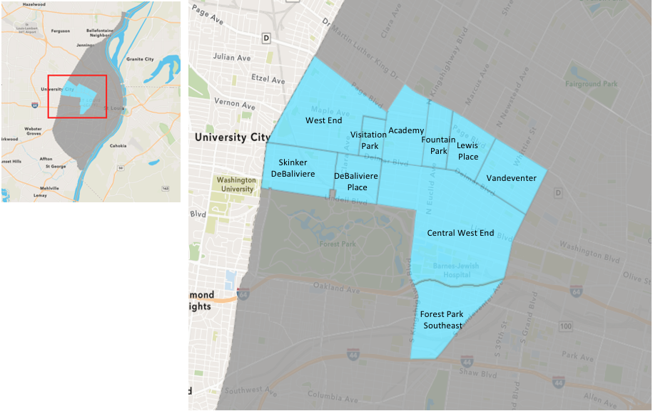
St. Louis Neighborhood Spatial Reference

Slide 3
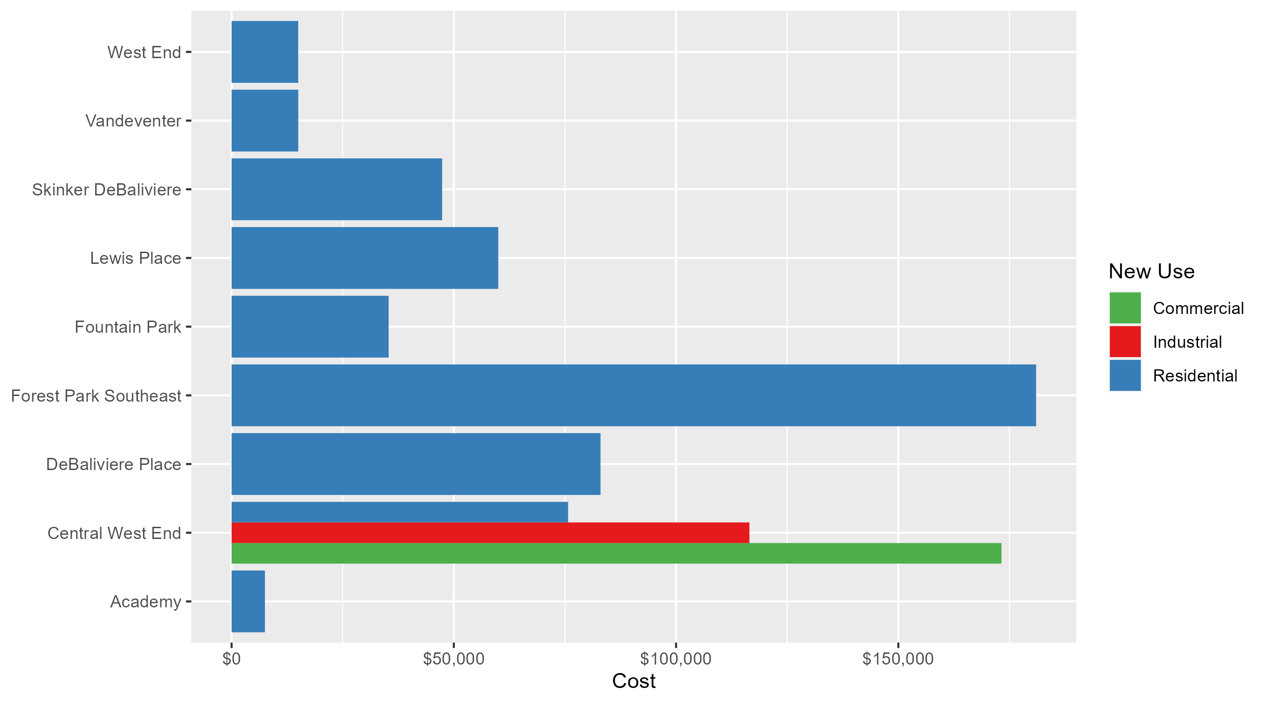
Neighborhood Summary: Average Building Permit Cost

Slide 4
Neighborhood Summary
May 2025 | May 2025 | May 2025 | May 2025
Neighborhood | Average Cost | # of Permits | Total Value of Permits
Academy | $7,500.00 | 2 | $15,000
Central West End | $132,594.86 | 22 | $2,917,087
DeBaliviere Place | $83,000.00 | 5 | $415,000
Forest Park Southeast | $181,000.00 | 5 | $905,000
Fountain Park | $35,333.33 | 3 | $106,000
Lewis Place | $60,000.00 | 2 | $120,000
Skinker DeBaliviere | $47,366.67 | 6 | $284,200
Vandeventer | $15,000.00 | 1 | $15,000
Visitation Park | $0.00 | 0 | $0
West End | $14,993.67 | 3 | $44,981
Last 6 Months | Last 6 Months | Last 6 Months | Last 6 Months
Neighborhood | Average Cost | # of Permits | Total Value of Permits
Academy | $28,875.00 | 16 | $462,000
Central West End | $151,924.32 | 183 | $27,802,150
DeBaliviere Place | $70,643.35 | 23 | $1,624,797
Forest Park Southeast | $184,828.67 | 33 | $6,099,346
Fountain Park | $53,436.36 | 11 | $587,800
Lewis Place | $39,500.00 | 6 | $237,000
Skinker DeBaliviere | $72,087.50 | 50 | $3,604,375
Vandeventer | $35,500.00 | 5 | $177,500
Visitation Park | $62,427.33 | 3 | $187,282
West End | $356,878.86 | 32 | $11,420,124

Slide 5
Core Neighborhoods

Slide 6
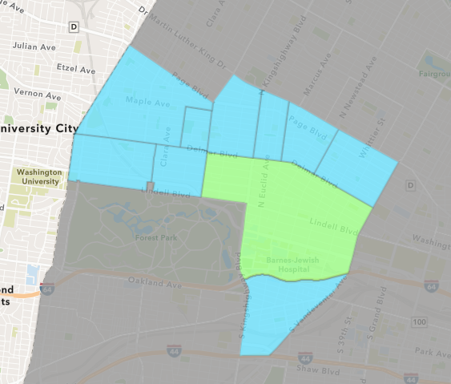
Central West End
May 2025 Neighborhood Cost Breakdown
  Mean: $132,595
  Median: $30,500
  Range: $1,000 - $850,000

Slide 7
Central West End: Summary Notes
22 building permits in May 2025
  -18.52% change compared to May 2024 (27 total building permits)
  $132,595: Average building permit cost in May 2025
    6.93% change compared to May 2024 ($123,996)
113 total building permits in 2025
  -19.29% change YTD compared to this time in 2024 (140 total building permits)
  $208,492: YTD average building permit cost in 2025
    -60.33% change YTD compared to this time in 2024 ($525,527)

Slide 8
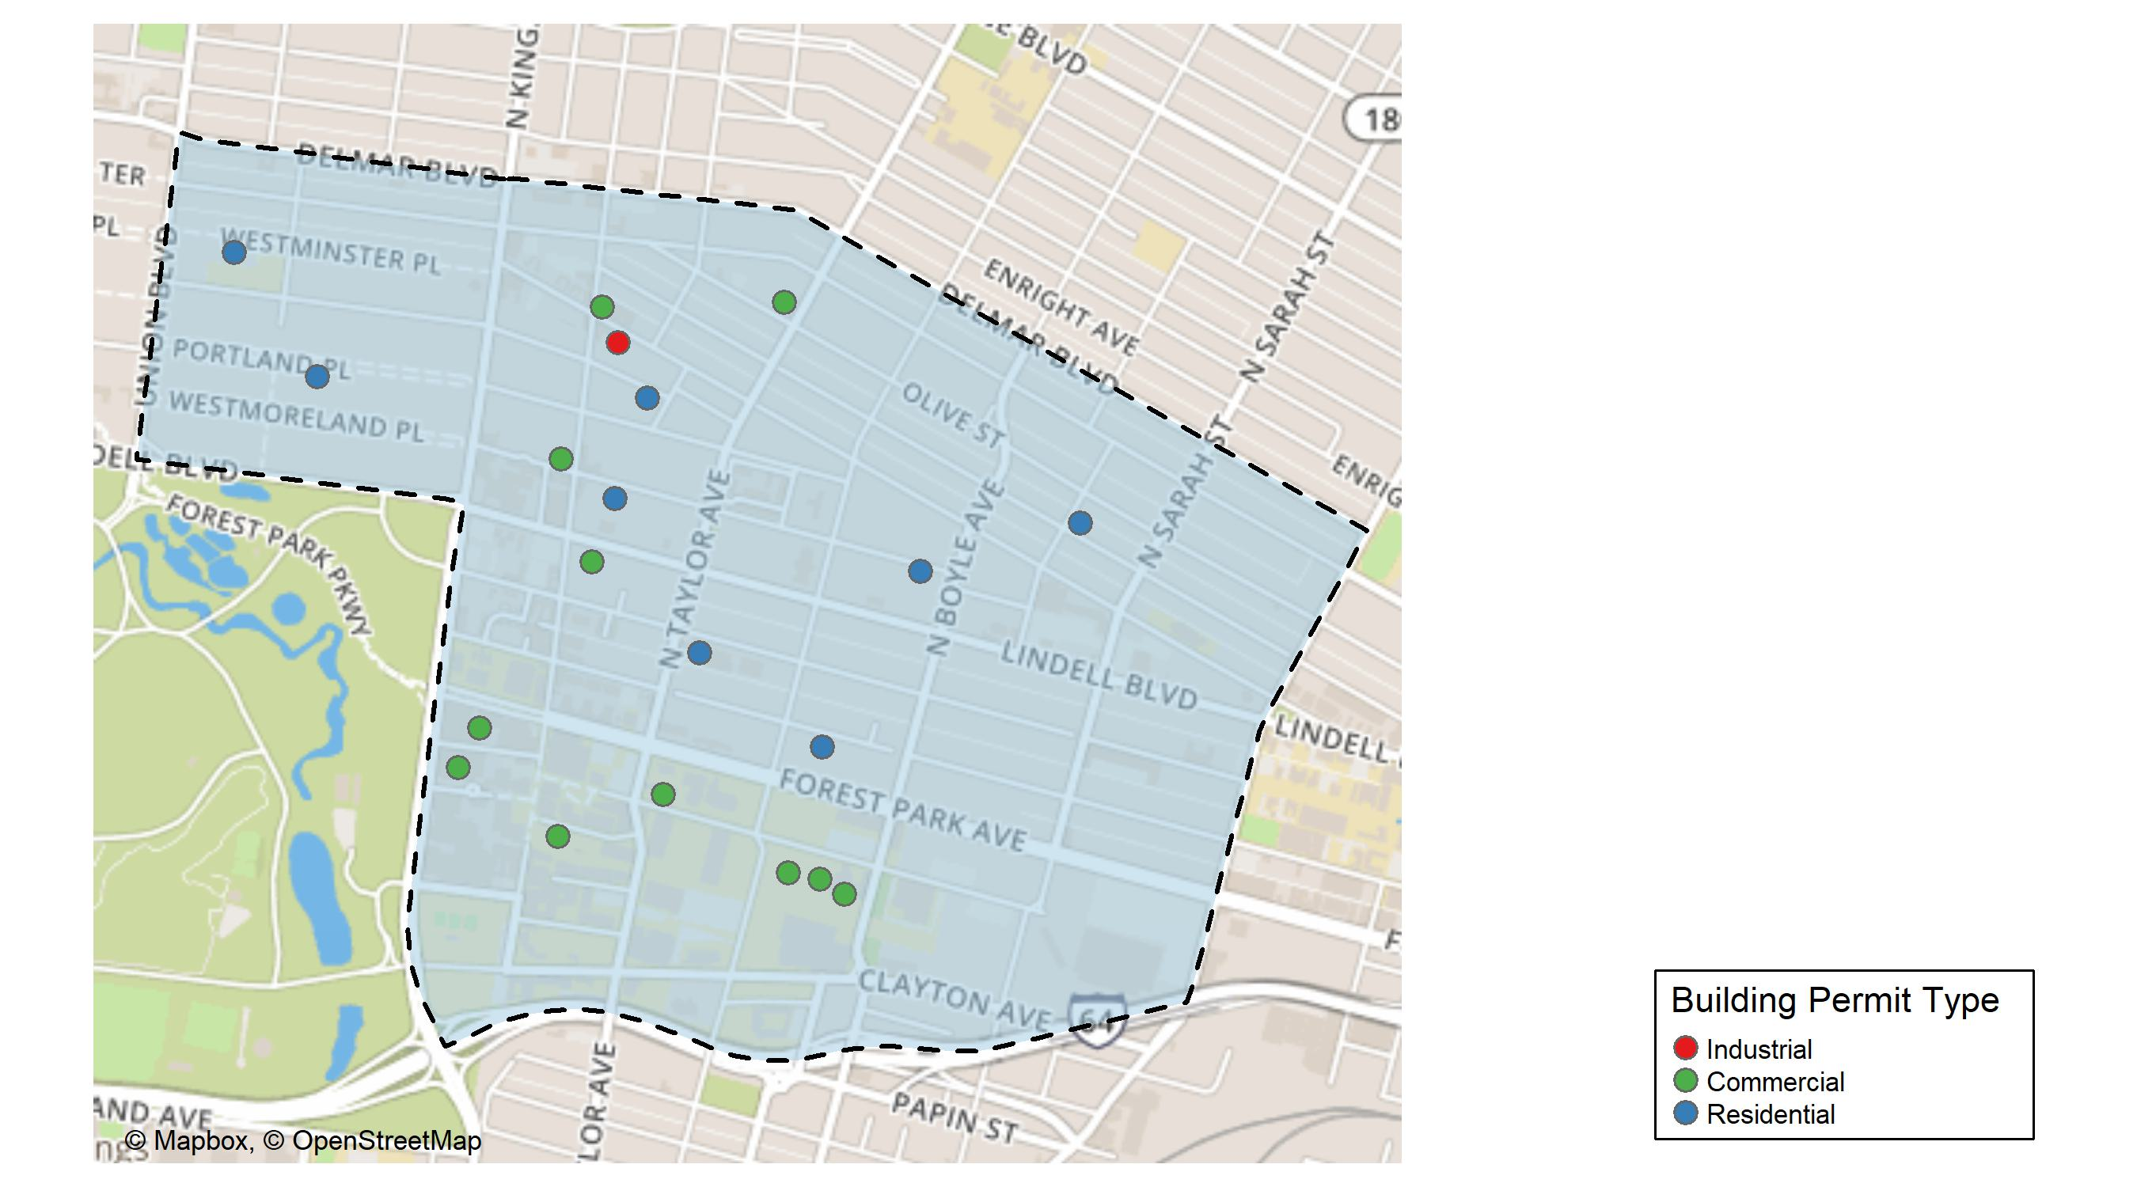
Central West End

Slide 9
Neighborhood Summary
May 2025 | May 2025 | May 2025 | May 2025
Permit Use | Average Cost | # of Permits | Total Value of Permits
Commercial | $173,204.9 | 12 | $2,078,459
Industrial | $116,500.0 | 2 | $233,000
Residential | $75,703.5 | 8 | $605,628
Last 6 Months | Last 6 Months | Last 6 Months | Last 6 Months
Permit Use | Average Cost | # of Permits | Total Value of Permits
Commercial | $168,638.4 | 61 | $10,286,941
Industrial | $654,344.2 | 5 | $3,271,721
Residential | $121,739.2 | 117 | $14,243,488

Slide 10
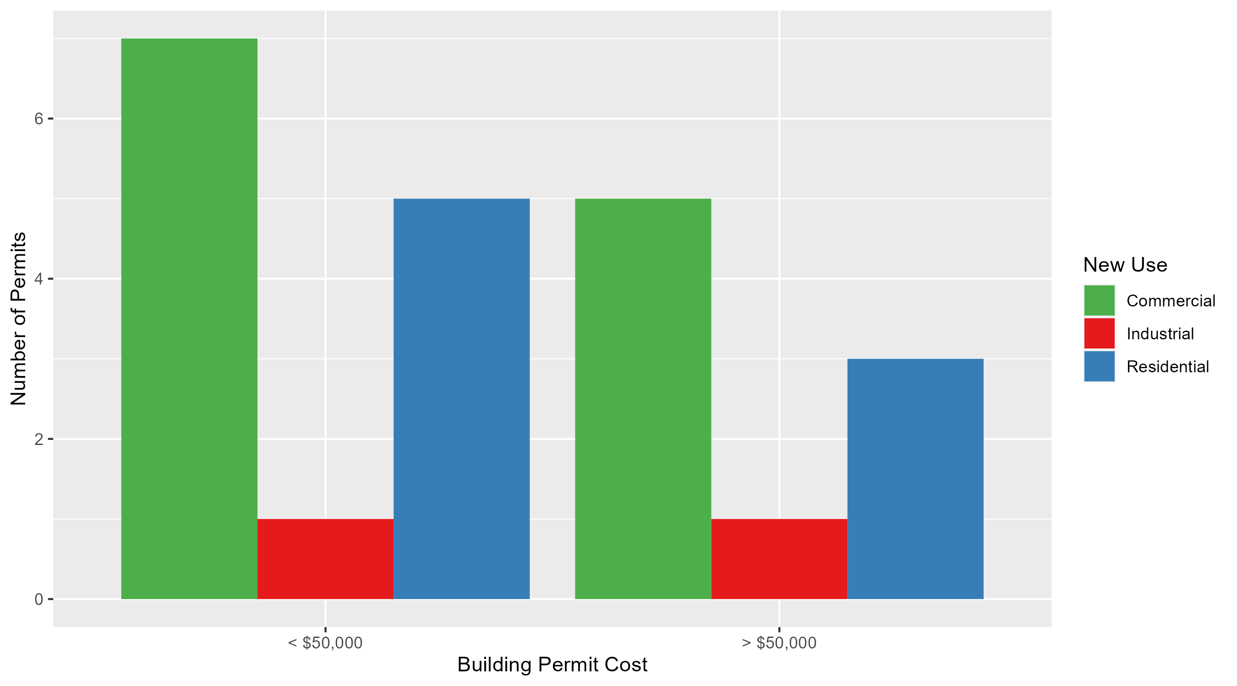
Central West End Permit Cost Breakdown

Slide 11
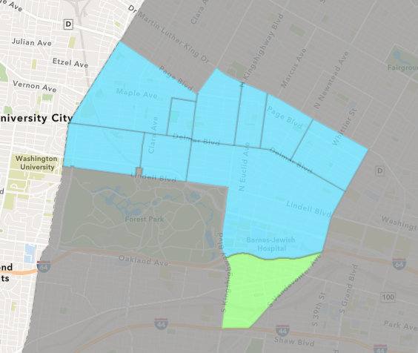
Forest Park Southeast
May 2025 Neighborhood Cost Breakdown
  Mean: $181,000
  Median: $200,000
  Range: $5,000 - $250,000

Slide 12
Forest Park Southeast: Summary Notes
5 building permits in May 2025
  -16.67% change compared to May 2024 (6 total building permits)
  $181,000: Average building permit cost in May 2025
    491.18% change compared to May 2024 ($30,617)
20 total building permits in 2025
  -37.50% change YTD compared to this time in 2024 (32 total building permits)
  $84,353: YTD average building permit cost in 2025
    5.68% change YTD compared to this time in 2024 ($79,821)

Slide 13
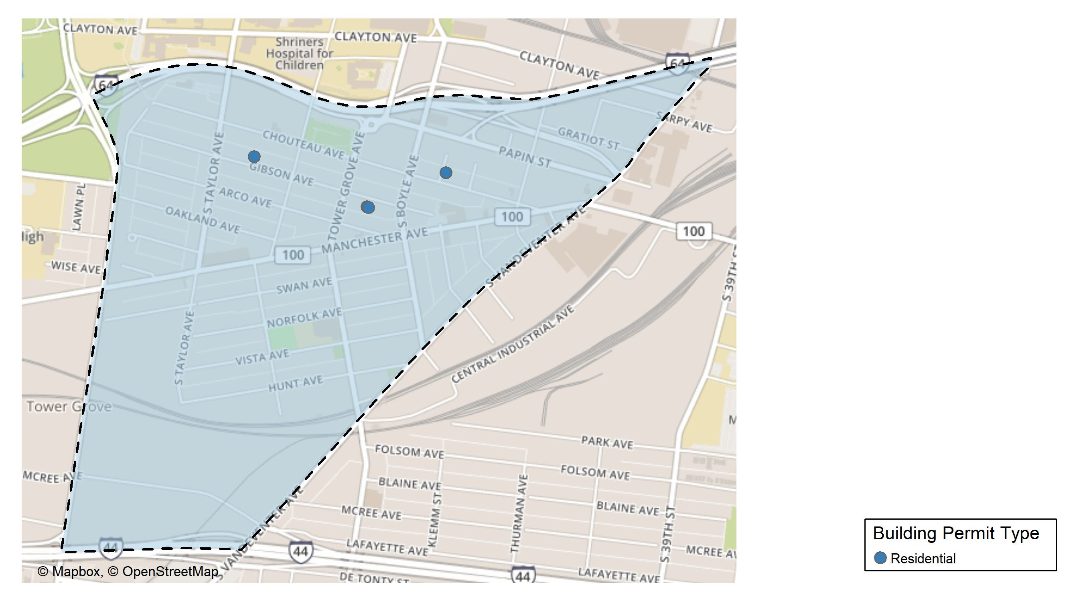
Forest Park Southeast

Slide 14
Neighborhood Summary
May 2025 | May 2025 | May 2025 | May 2025
Permit Use | Average Cost | # of Permits | Total Value of Permits
Commercial | $0 | 0 | $0
Industrial | $0 | 0 | $0
Residential | $181,000 | 5 | $905,000
Last 6 Months | Last 6 Months | Last 6 Months | Last 6 Months
Permit Use | Average Cost | # of Permits | Total Value of Permits
Commercial | $69,736.4 | 5 | $348,682
Industrial | $11,450.0 | 4 | $45,800
Residential | $237,702.7 | 24 | $5,704,864

Slide 15
Forest Park Southeast Individual Permit Breakdown
Neighborhood | Owner | New Use | Cost | address
Forest Park Southeast | STARKE INC | Residential | $250,000 | 4439 GIBSON AV
Forest Park Southeast | STARKE INC | Residential | $250,000 | 4441 GIBSON AV
Forest Park Southeast | PRESERVATION GROUP LLC | Residential | $200,000 | 4330 GIBSON AV
Forest Park Southeast | PERSERVATION GROUP LLC | Residential | $200,000 | 4328 GIBSON AV
Forest Park Southeast | BELLON, DONALD J | Residential | $5,000 | 4225 CHOUTEAU AV

Slide 16
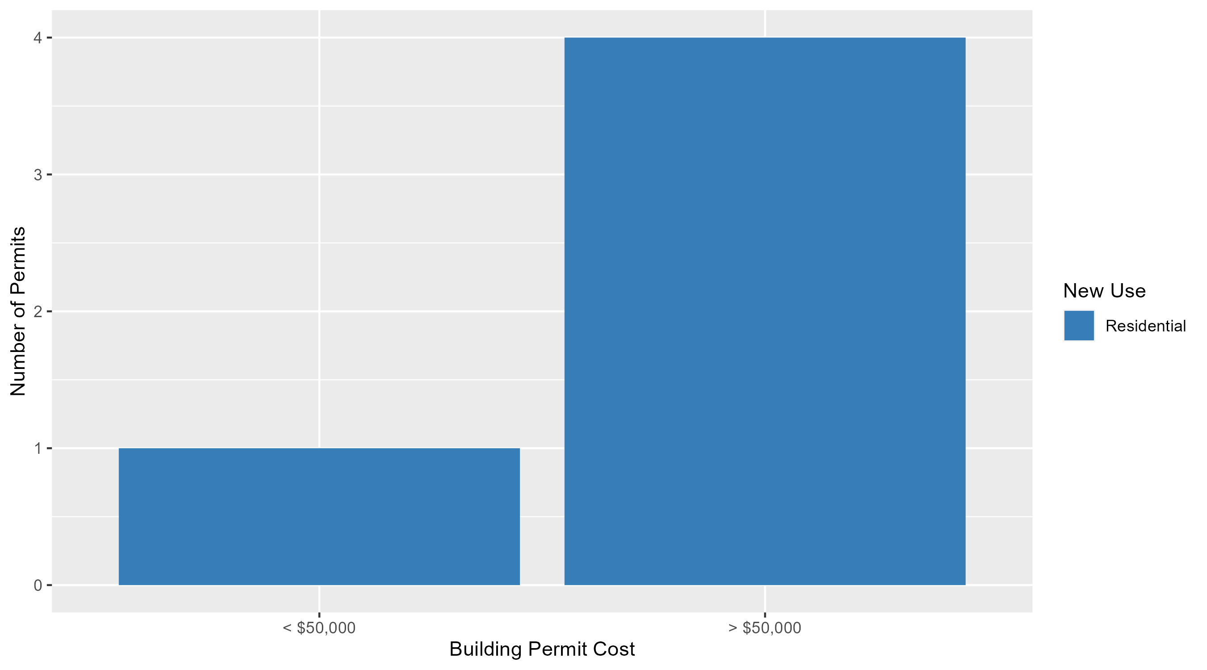
Forest Park Southeast Permit Cost Breakdown

Slide 17
Expanded Service Area

Slide 18
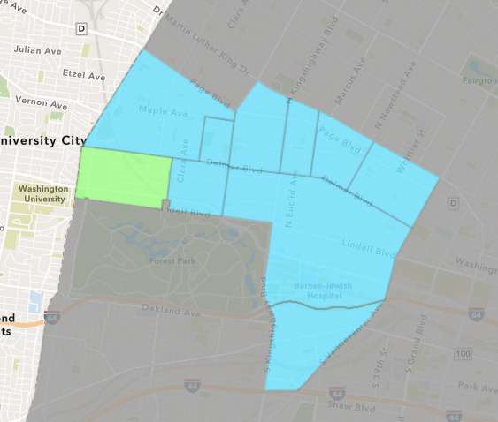
Skinker DeBaliviere
May 2025 Neighborhood Cost Breakdown
  Mean: $47,367
  Median: $45,000
  Range: $1,200 - $100,000

Slide 19
Skinker DeBaliviere: Summary Notes
6 building permits in May 2025
  0.00% change compared to May 2024 (6 total building permits)
  $47,367: Average building permit cost in May 2025
    -47.64% change compared to May 2024 ($90,459)
38 total building permits in 2025
  46.15% change YTD compared to this time in 2024 (26 total building permits)
  $48,288: YTD average building permit cost in 2025
    -63.00% change YTD compared to this time in 2024 ($130,503)

Slide 20
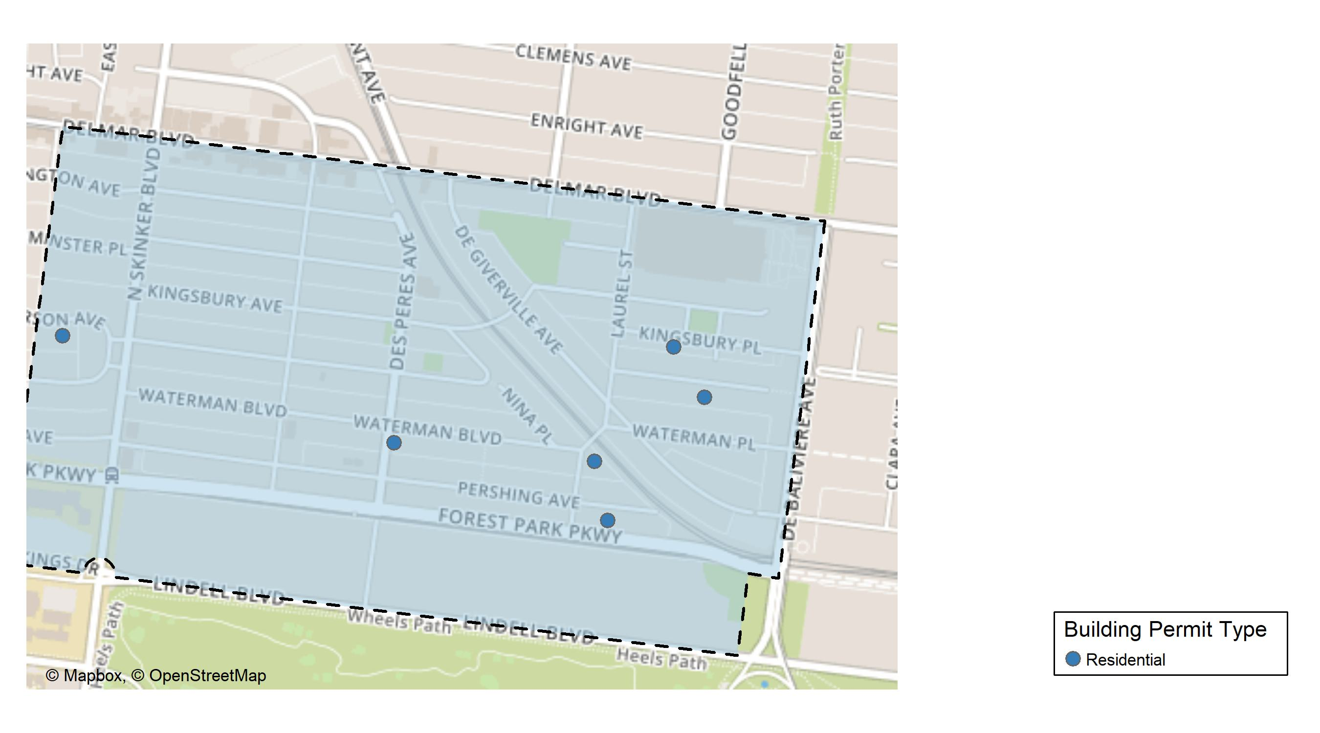
Skinker DeBaliviere

Slide 21
Neighborhood Summary
May 2025 | May 2025 | May 2025 | May 2025
Permit Use | Average Cost | # of Permits | Total Value of Permits
Commercial | $0.00 | 0 | $0
Industrial | $0.00 | 0 | $0
Residential | $47,366.67 | 6 | $284,200
Last 6 Months | Last 6 Months | Last 6 Months | Last 6 Months
Permit Use | Average Cost | # of Permits | Total Value of Permits
Commercial | $66,762.714 | 7 | $467,339
Industrial | $8,166.667 | 3 | $24,500
Residential | $77,813.400 | 40 | $3,112,536

Slide 22
Skinker DeBaliviere Individual Permit Breakdown
Neighborhood | Owner | New Use | Cost | address
Skinker DeBaliviere | POINT BREAK CAPITAL LLC | Residential | $1,200 | 5962 WATERMAN BLVD
Skinker DeBaliviere | LAZAROFF, DAVID & GAYLE | Residential | $75,000 | 6240 MCPHERSON AV
Skinker DeBaliviere | PACHECO, ERNESTO | Residential | $18,000 | 5760 KINGSBURY PL
Skinker DeBaliviere | GORMAN, MARK B & MARY | Residential | $100,000 | 324 LAUREL ST
Skinker DeBaliviere | GORMAN, MARK | Residential | $70,000 | 5778 PERSHING AV
Skinker DeBaliviere | OCG ACQUISITIONS GP | Residential | $20,000 | 5758 MCPHERSON AV

Slide 23
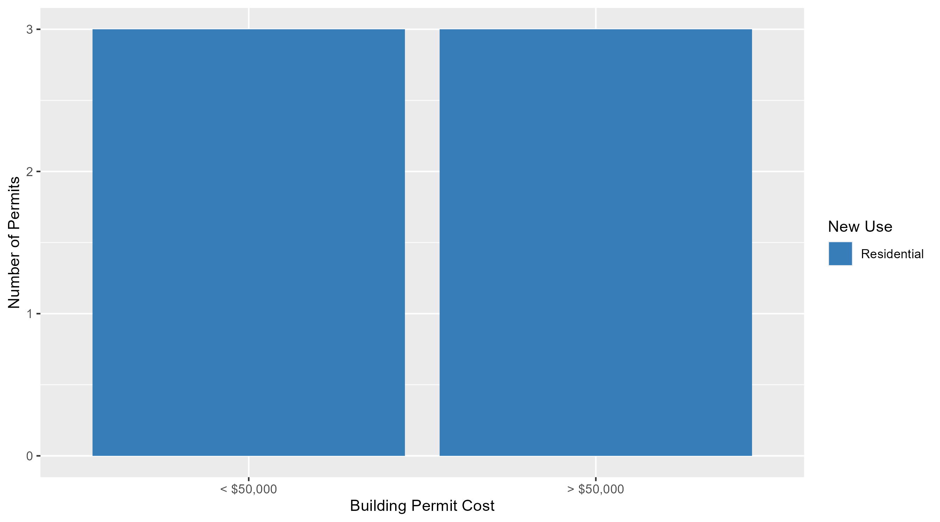
Skinker DeBaliviere Permit Cost Breakdown

Slide 24
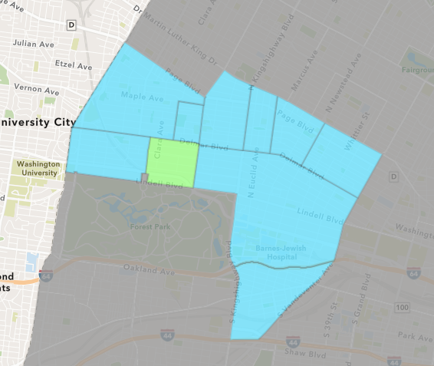
DeBaliviere Place
May 2025 Neighborhood Cost Breakdown
  Mean: $83,000
  Median: $20,000
  Range: $5,000 - $250,000

Slide 25
DeBaliviere Place: Summary Notes
5 building permits in May 2025
  25.00% change compared to May 2024 (4 total building permits)
  $83,000: Average building permit cost in May 2025
    -82.46% change compared to May 2024 ($473,211)
18 total building permits in 2025
  0.00% change YTD compared to this time in 2024 (18 total building permits)
  $66,524: YTD average building permit cost in 2025
    -55.37% change YTD compared to this time in 2024 ($149,051)

Slide 26
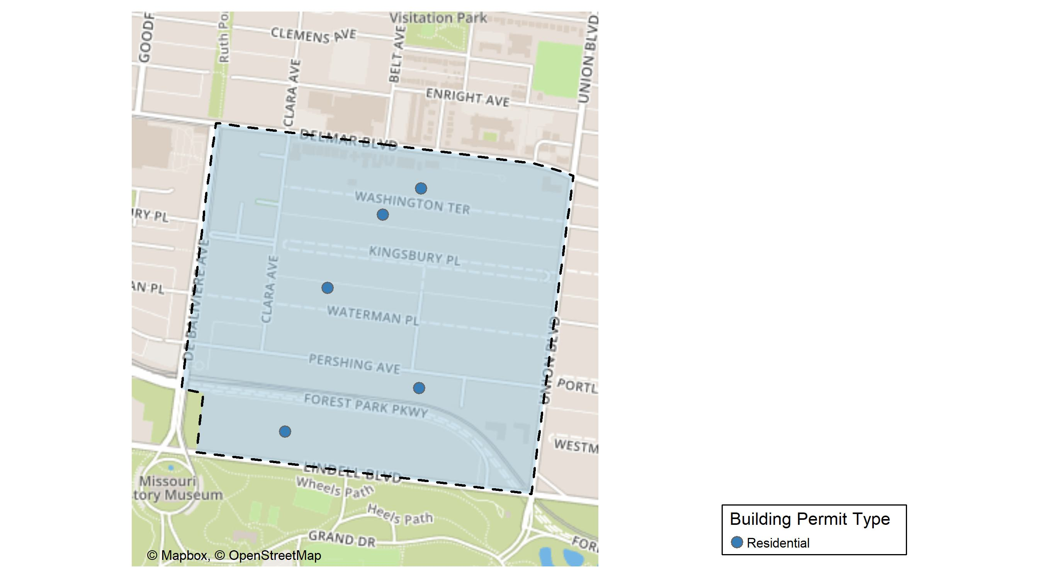
DeBaliviere Place

Slide 27
Neighborhood Summary
May 2025 | May 2025 | May 2025 | May 2025
Permit Use | Average Cost | # of Permits | Total Value of Permits
Commercial | $0 | 0 | $0
Industrial | $0 | 0 | $0
Residential | $83,000 | 5 | $415,000
Last 6 Months | Last 6 Months | Last 6 Months | Last 6 Months
Permit Use | Average Cost | # of Permits | Total Value of Permits
Commercial | $4,000.00 | 1 | $4,000
Industrial | $0.00 | 0 | $0
Residential | $73,672.59 | 22 | $1,620,797

Slide 28
DeBaliviere Place Individual Permit Breakdown
Neighborhood | Owner | New Use | Cost | address
DeBaliviere Place | O'CONNOR, MARY PATRICIA | Residential | $15,000 | 32 WASHINGTON TER
DeBaliviere Place | BERTZ, SONDRA R | Residential | $5,000 | 5583 WATERMAN BLVD
DeBaliviere Place | BRENTWOOD PARTNERS LLC | Residential | $125,000 | 5394 PERSHING AV
DeBaliviere Place | KESEL, GREGORY A & | Residential | $250,000 | 25 WASHINGTON TER
DeBaliviere Place | JOHNSON, JEANNE ROBERTS | Residential | $20,000 | 5583 LINDELL BLVD

Slide 29
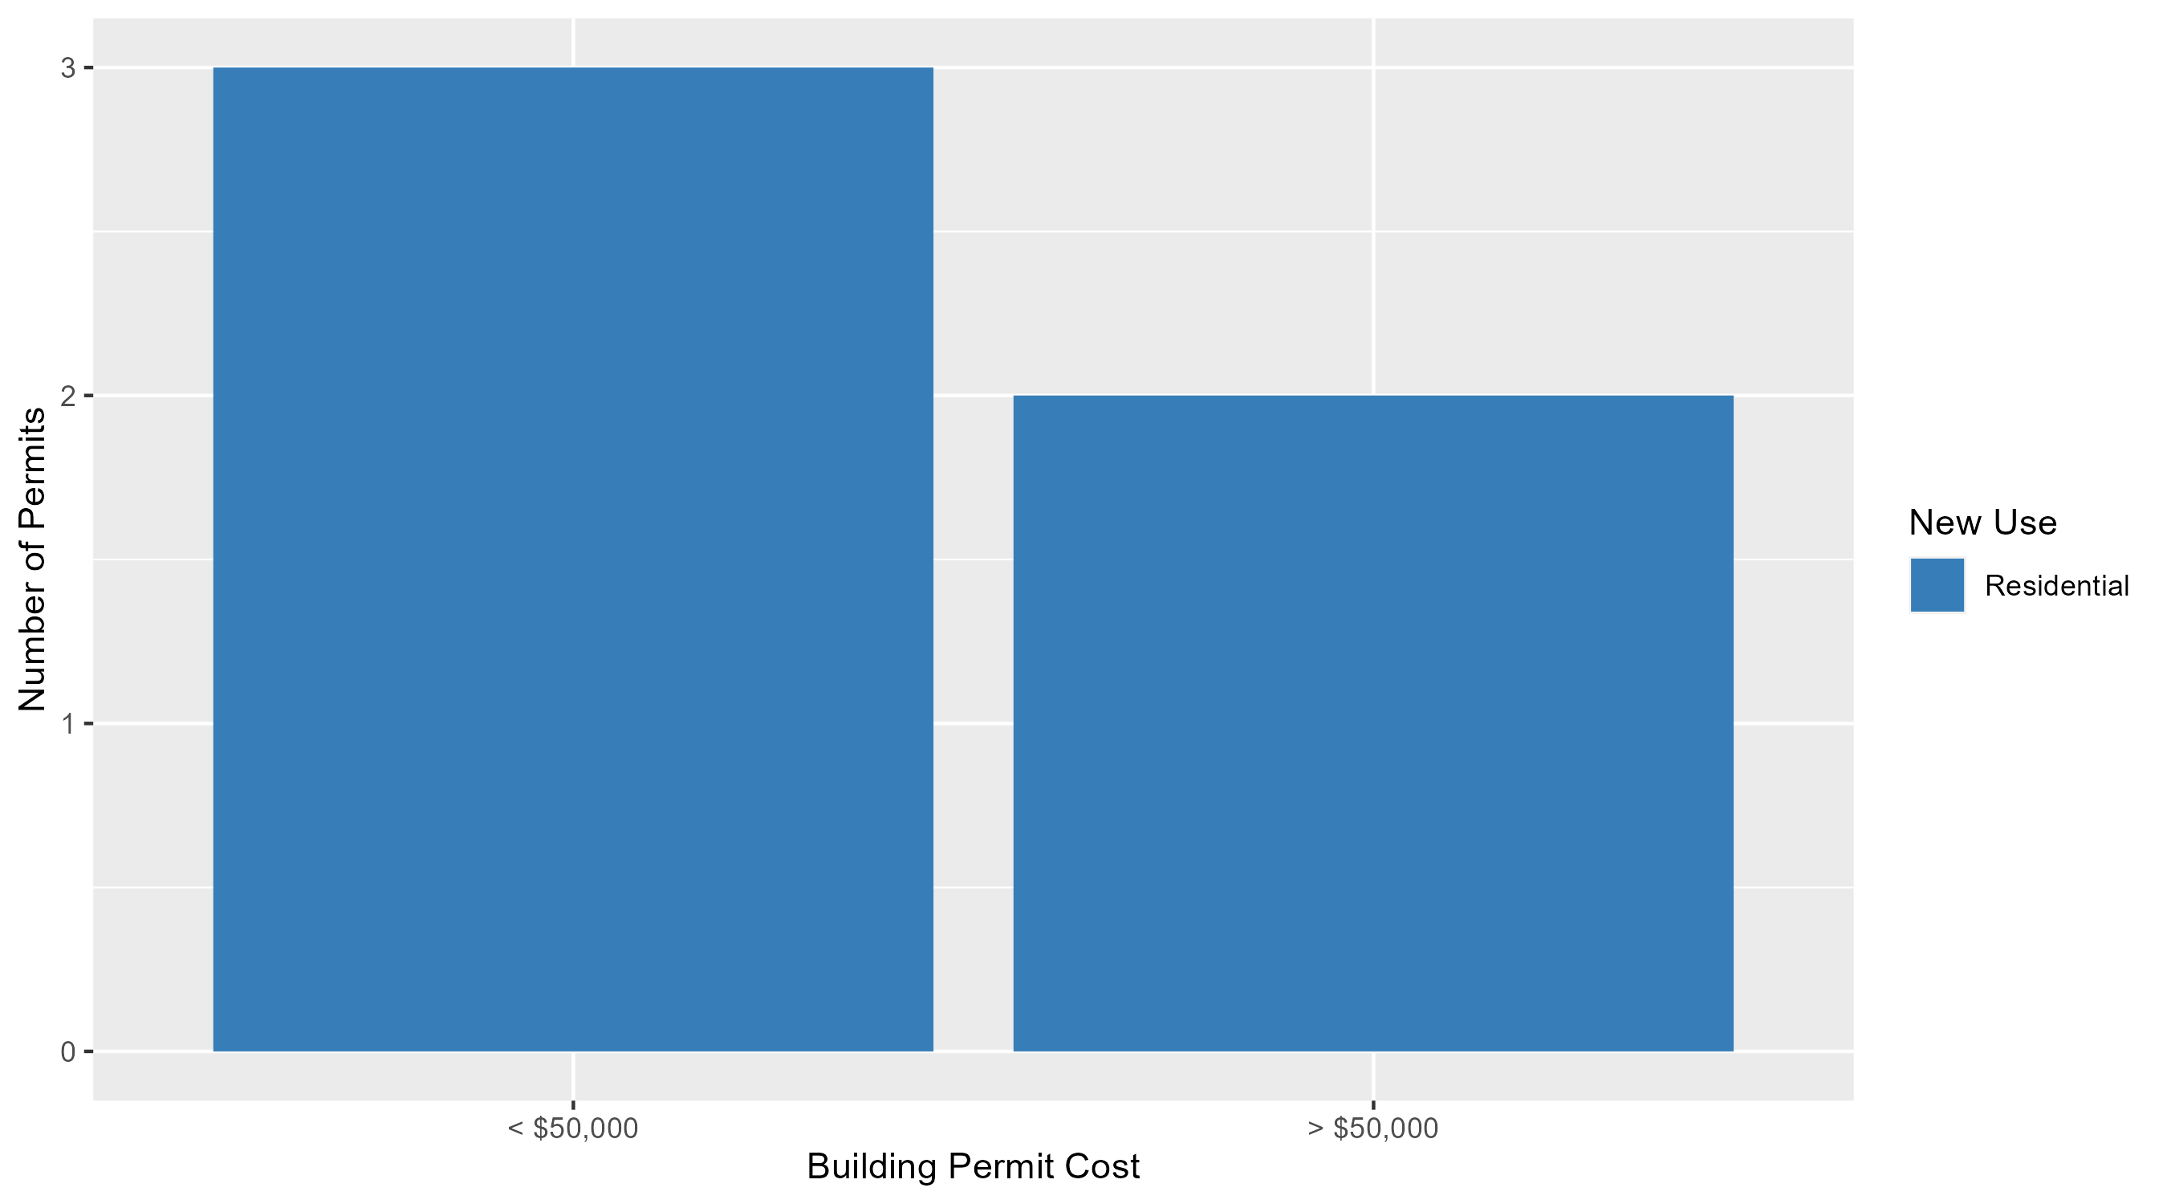
DeBaliviere Place Permit Cost Breakdown

Slide 30
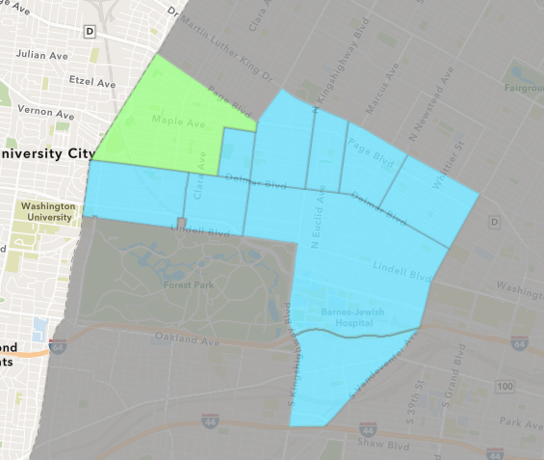
West End
May 2025 Neighborhood Cost Breakdown
  Mean: $14,994
  Median: $14,000
  Range: $12,981 - $18,000

Slide 31
West End: Summary Notes
3 building permits in May 2025
  -70.00% change compared to May 2024 (10 total building permits)
  $14,994: Average building permit cost in May 2025
    -2.14% change compared to May 2024 ($15,322)
24 total building permits in 2025
  -38.46% change YTD compared to this time in 2024 (39 total building permits)
  $468,428: YTD average building permit cost in 2025
    333.92% change YTD compared to this time in 2024 ($107,952)

Slide 32
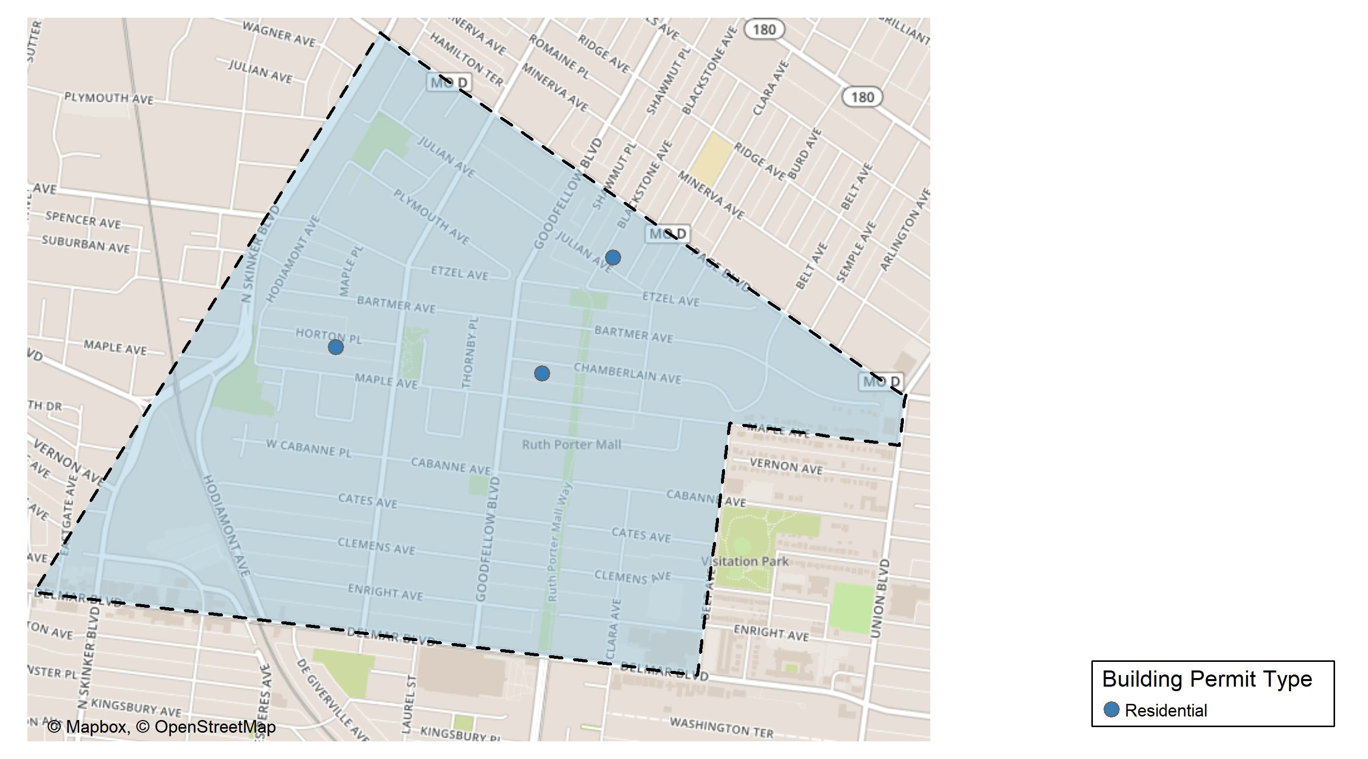
West End

Slide 33
Neighborhood Summary
May 2025 | May 2025 | May 2025 | May 2025
Permit Use | Average Cost | # of Permits | Total Value of Permits
Commercial | $0.00 | 0 | $0
Industrial | $0.00 | 0 | $0
Residential | $14,993.67 | 3 | $44,981
Last 6 Months | Last 6 Months | Last 6 Months | Last 6 Months
Permit Use | Average Cost | # of Permits | Total Value of Permits
Commercial | $1,512,362.57 | 7 | $10,586,538.0
Industrial | $78,080.75 | 4 | $312,323.0
Residential | $24,822.03 | 21 | $521,262.7

Slide 34
West End Individual Permit Breakdown
Neighborhood | Owner | New Use | Cost | address
West End | WHITFIELD, FREDDIE | Residential | $12,981 | 5958 HORTON PL
West End | WID INC & IVY WILLIAMS | Residential | $18,000 | 5730 CHAMBERLAIN AV
West End | HUDSON, BYRON & CATHY YVONNE | Residential | $14,000 | 1206 BLACKSTONE AV

Slide 35
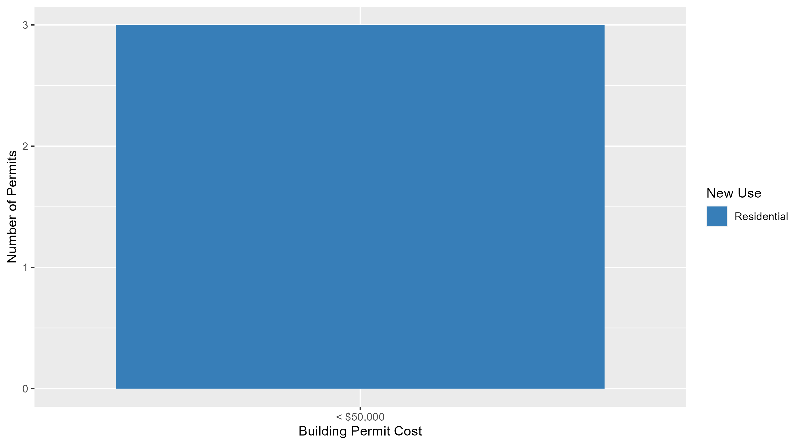
West End Permit Cost Breakdown

Slide 36
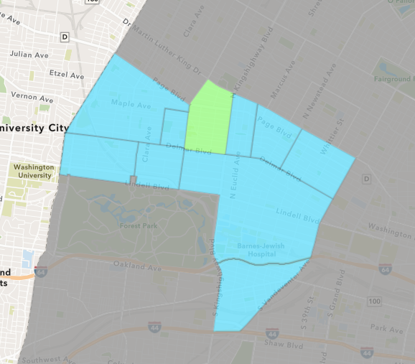
Academy
May 2025 Neighborhood Cost Breakdown
  Mean: $7,500
  Median: $7,500
  Range: $1,000 - $14,000

Slide 37
Academy: Summary Notes
2 building permits in May 2025
  0.00% change compared to May 2024 (2 total building permits)
  $7,500: Average building permit cost in May 2025
    -95.73% change compared to May 2024 ($175,500)
14 total building permits in 2025
  55.56% change YTD compared to this time in 2024 (9 total building permits)
  $29,357: YTD average building permit cost in 2025
    -46.10% change YTD compared to this time in 2024 ($54,467)

Slide 38
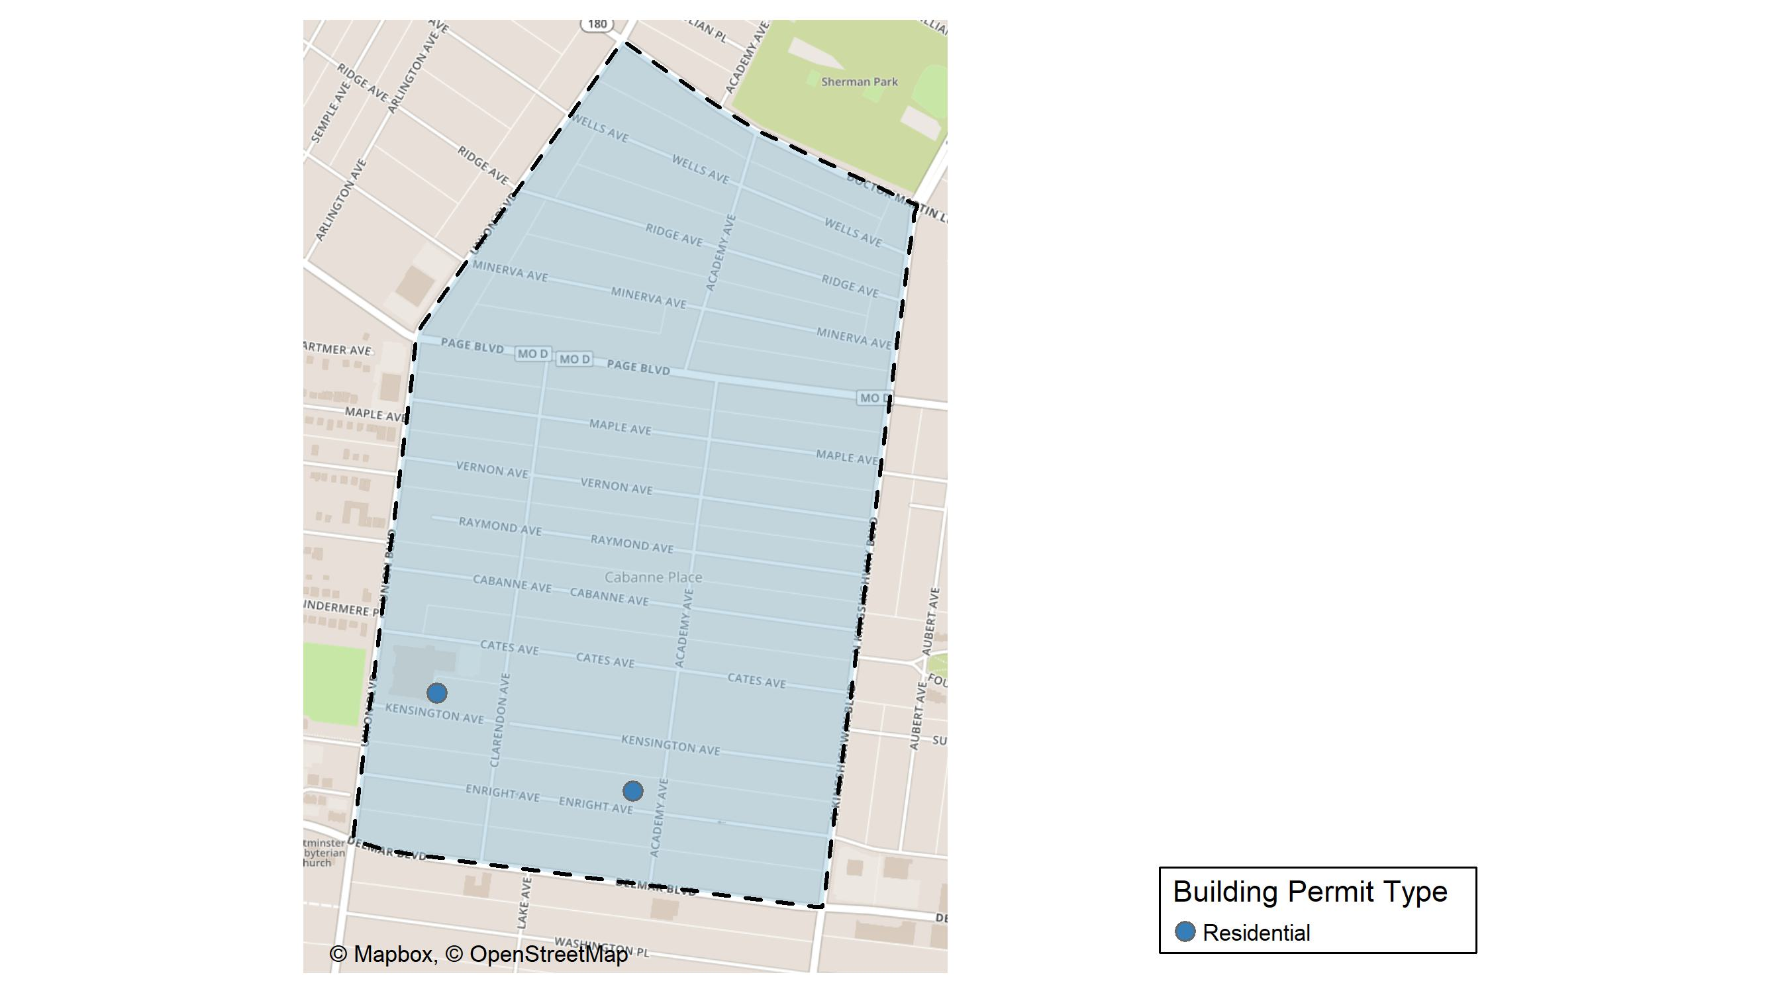
Academy

Slide 39
Neighborhood Summary
May 2025 | May 2025 | May 2025 | May 2025
Permit Use | Average Cost | # of Permits | Total Value of Permits
Commercial | $0 | 0 | $0
Industrial | $0 | 0 | $0
Residential | $7,500 | 2 | $15,000
Last 6 Months | Last 6 Months | Last 6 Months | Last 6 Months
Permit Use | Average Cost | # of Permits | Total Value of Permits
Commercial | $39,400.00 | 1 | $39,400
Industrial | $0.00 | 0 | $0
Residential | $28,173.33 | 15 | $422,600

Slide 40
Academy Individual Permit Breakdown
Neighborhood | Owner | New Use | Cost | address
Academy | JAMES, ELIZABETH S | Residential | $14,000 | 5235 KENSINGTON AV
Academy | HARRIS, SANDRA D | Residential | $1,000 | 5115 ENRIGHT AV

Slide 41
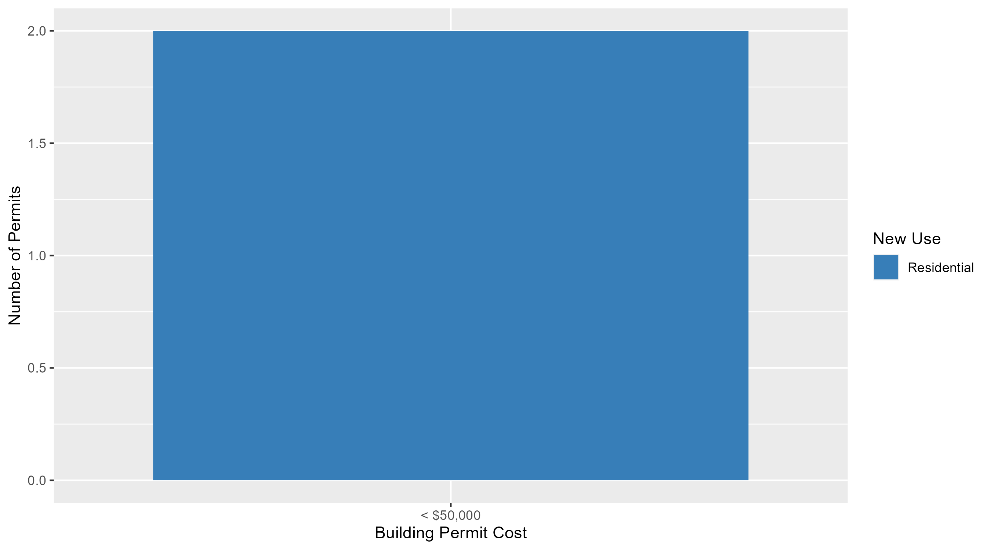
Academy Permit Cost Breakdown

Slide 42
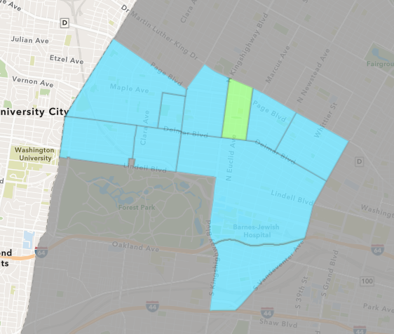
Fountain Park
May 2025 Neighborhood Cost Breakdown
  Mean: $35,333
  Median: $5,000
  Range: $1,000 - $100,000

Slide 43
Fountain Park: Summary Notes
3 building permits in May 2025
  Infinite change compared to May 2024 (0 total building permits)
  $35,333: Average building permit cost in May 2025
    Infinite change compared to May 2024 ($0)
6 total building permits in 2025
  50.00% change YTD compared to this time in 2024 (4 total building permits)
  $48,800: YTD average building permit cost in 2025
    261.48% change YTD compared to this time in 2024 ($13,500)

Slide 44
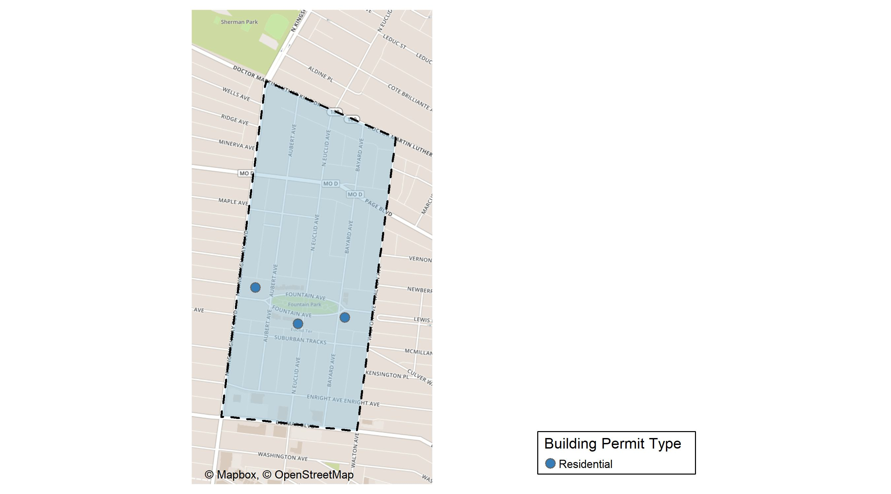
Fountain Park

Slide 45
Neighborhood Summary
May 2025 | May 2025 | May 2025 | May 2025
Permit Use | Average Cost | # of Permits | Total Value of Permits
Commercial | $0.00 | 0 | $0
Industrial | $0.00 | 0 | $0
Residential | $35,333.33 | 3 | $106,000
Last 6 Months | Last 6 Months | Last 6 Months | Last 6 Months
Permit Use | Average Cost | # of Permits | Total Value of Permits
Commercial | $57,000 | 3 | $171,000
Industrial | $0 | 0 | $0
Residential | $52,100 | 8 | $416,800

Slide 46
Fountain Park Individual Permit Breakdown
Neighborhood | Owner | New Use | Cost | address
Fountain Park | KINGSWAY DEVELOPMENT LLC | Residential | $100,000 | 4830 FOUNTAIN AV
Fountain Park | GREEN DOT PROPERTIES LLC | Residential | $5,000 | 4961-65 FOUNTAIN AV
Fountain Park | LAMMERT, HOLLY R | Residential | $1,000 | 4900 FOUNTAIN AV

Slide 47
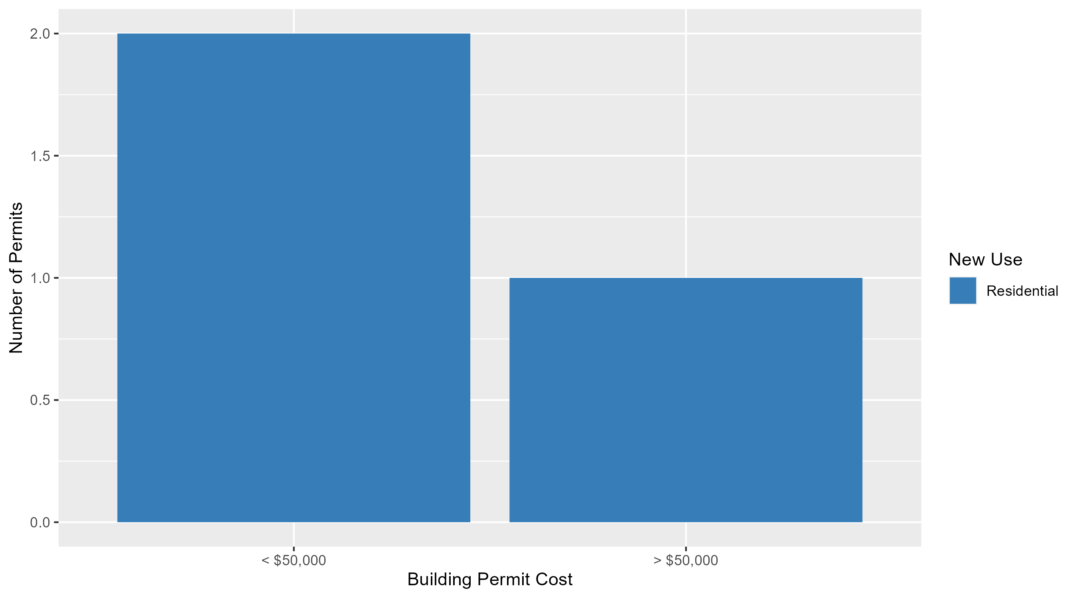
Fountain Park Permit Cost Breakdown

Slide 48
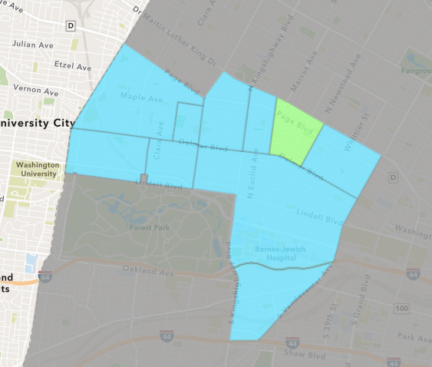
Lewis Place
May 2025 Neighborhood Cost Breakdown
  Mean: $60,000
  Median: $60,000
  Range: $60,000 - $60,000

Slide 49
Lewis Place: Summary Notes
2 building permits in May 2025
  100.00% change compared to May 2024 (1 total building permits)
  $60,000: Average building permit cost in May 2025
    445.45% change compared to May 2024 ($11,000)
6 total building permits in 2025
  0.00% change YTD compared to this time in 2024 (6 total building permits)
  $39,500: YTD average building permit cost in 2025
    567.76% change YTD compared to this time in 2024 ($5,915)

Slide 50
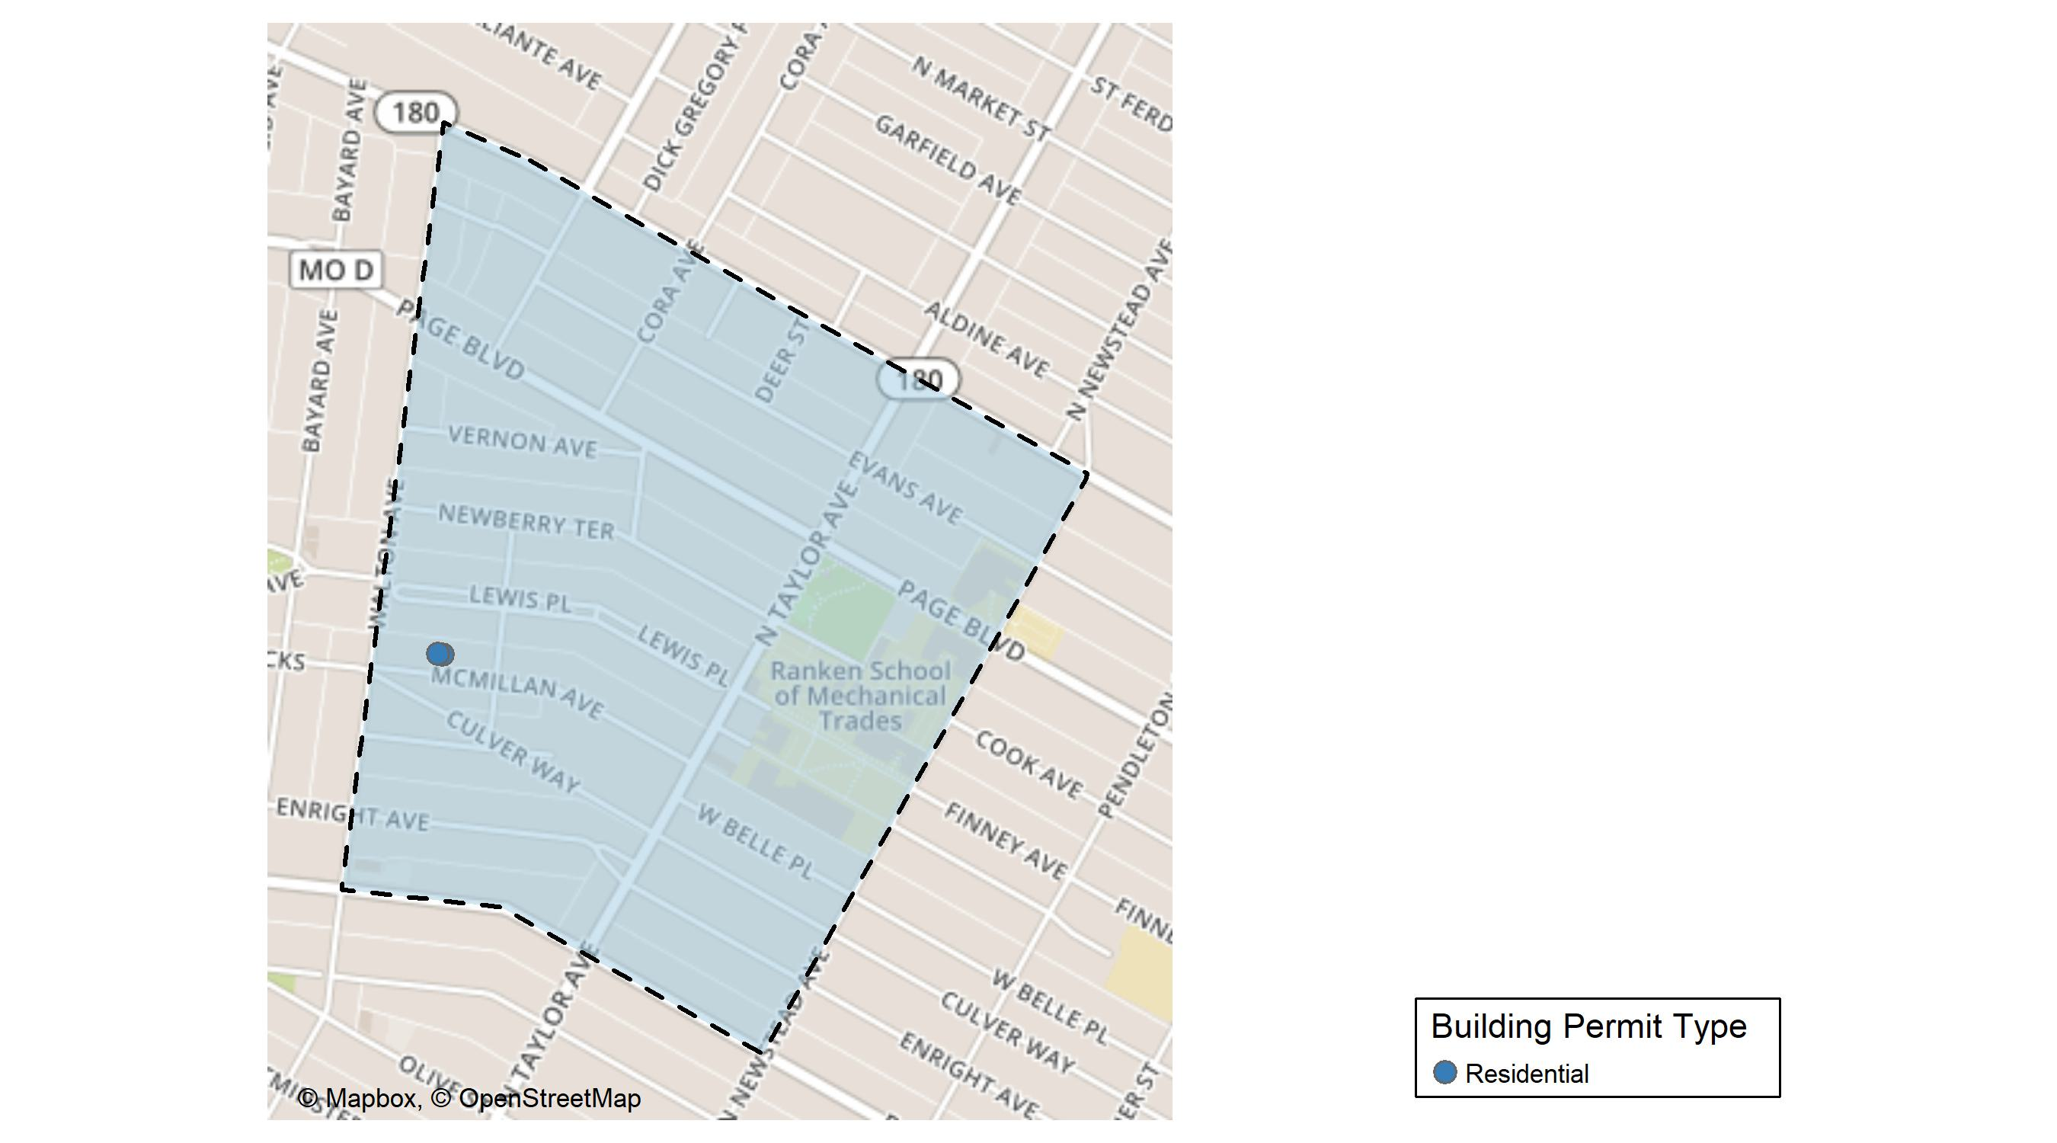
Lewis Place

Slide 51
Neighborhood Summary
May 2025 | May 2025 | May 2025 | May 2025
Permit Use | Average Cost | # of Permits | Total Value of Permits
Commercial | $0 | 0 | $0
Industrial | $0 | 0 | $0
Residential | $60,000 | 2 | $120,000
Last 6 Months | Last 6 Months | Last 6 Months | Last 6 Months
Permit Use | Average Cost | # of Permits | Total Value of Permits
Commercial | $0 | 0 | $0
Industrial | $0 | 0 | $0
Residential | $39,500 | 6 | $237,000

Slide 52
Lewis Place Individual Permit Breakdown
Neighborhood | Owner | New Use | Cost | address
Lewis Place | LRA C/O BELM HOLDINGS LLC | Residential | $60,000 | 4725 MCMILLAN AV
Lewis Place | BELM HOLDINGS LLC | Residential | $60,000 | 4727 MCMILLAN AV

Slide 53

Lewis Place Permit Cost Breakdown

Slide 54
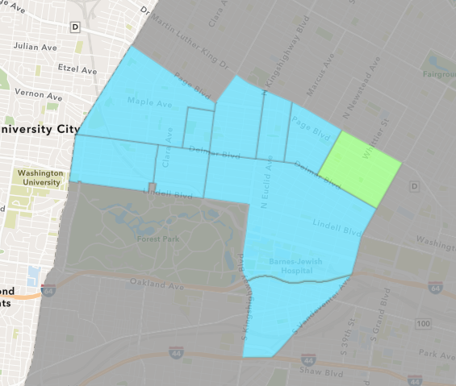
Vandeventer
May 2025 Neighborhood Cost Breakdown
  Mean: $15,000
  Median: $15,000
  Range: $15,000 - $15,000

Slide 55
Vandeventer: Summary Notes
1 building permits in May 2025
  -50.00% change compared to May 2024 (2 total building permits)
  $15,000: Average building permit cost in May 2025
    -77.78% change compared to May 2024 ($67,500)
3 total building permits in 2025
  -40.00% change YTD compared to this time in 2024 (5 total building permits)
  $8,833: YTD average building permit cost in 2025
    -87.30% change YTD compared to this time in 2024 ($69,530)

Slide 56
Additional Notes
Data retreived from https://www.stlouis-mo.gov/data/
Building permits with a cost of $0 were dropped
Building permits that were cancelled were dropped
Infinite change indicates 0 permits in the current or previous time period/comparison month so there was a overall increase or decrease

