Slide 1
St. Louis Central Corridor West Building Permits
Monthly Report: August 2025

Slide 2
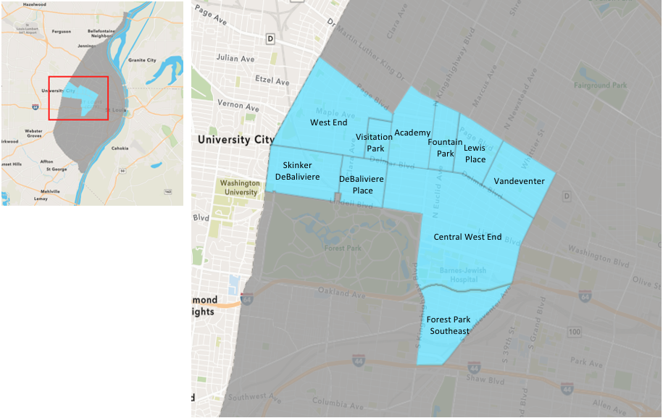
St. Louis Neighborhood Spatial Reference

Slide 3
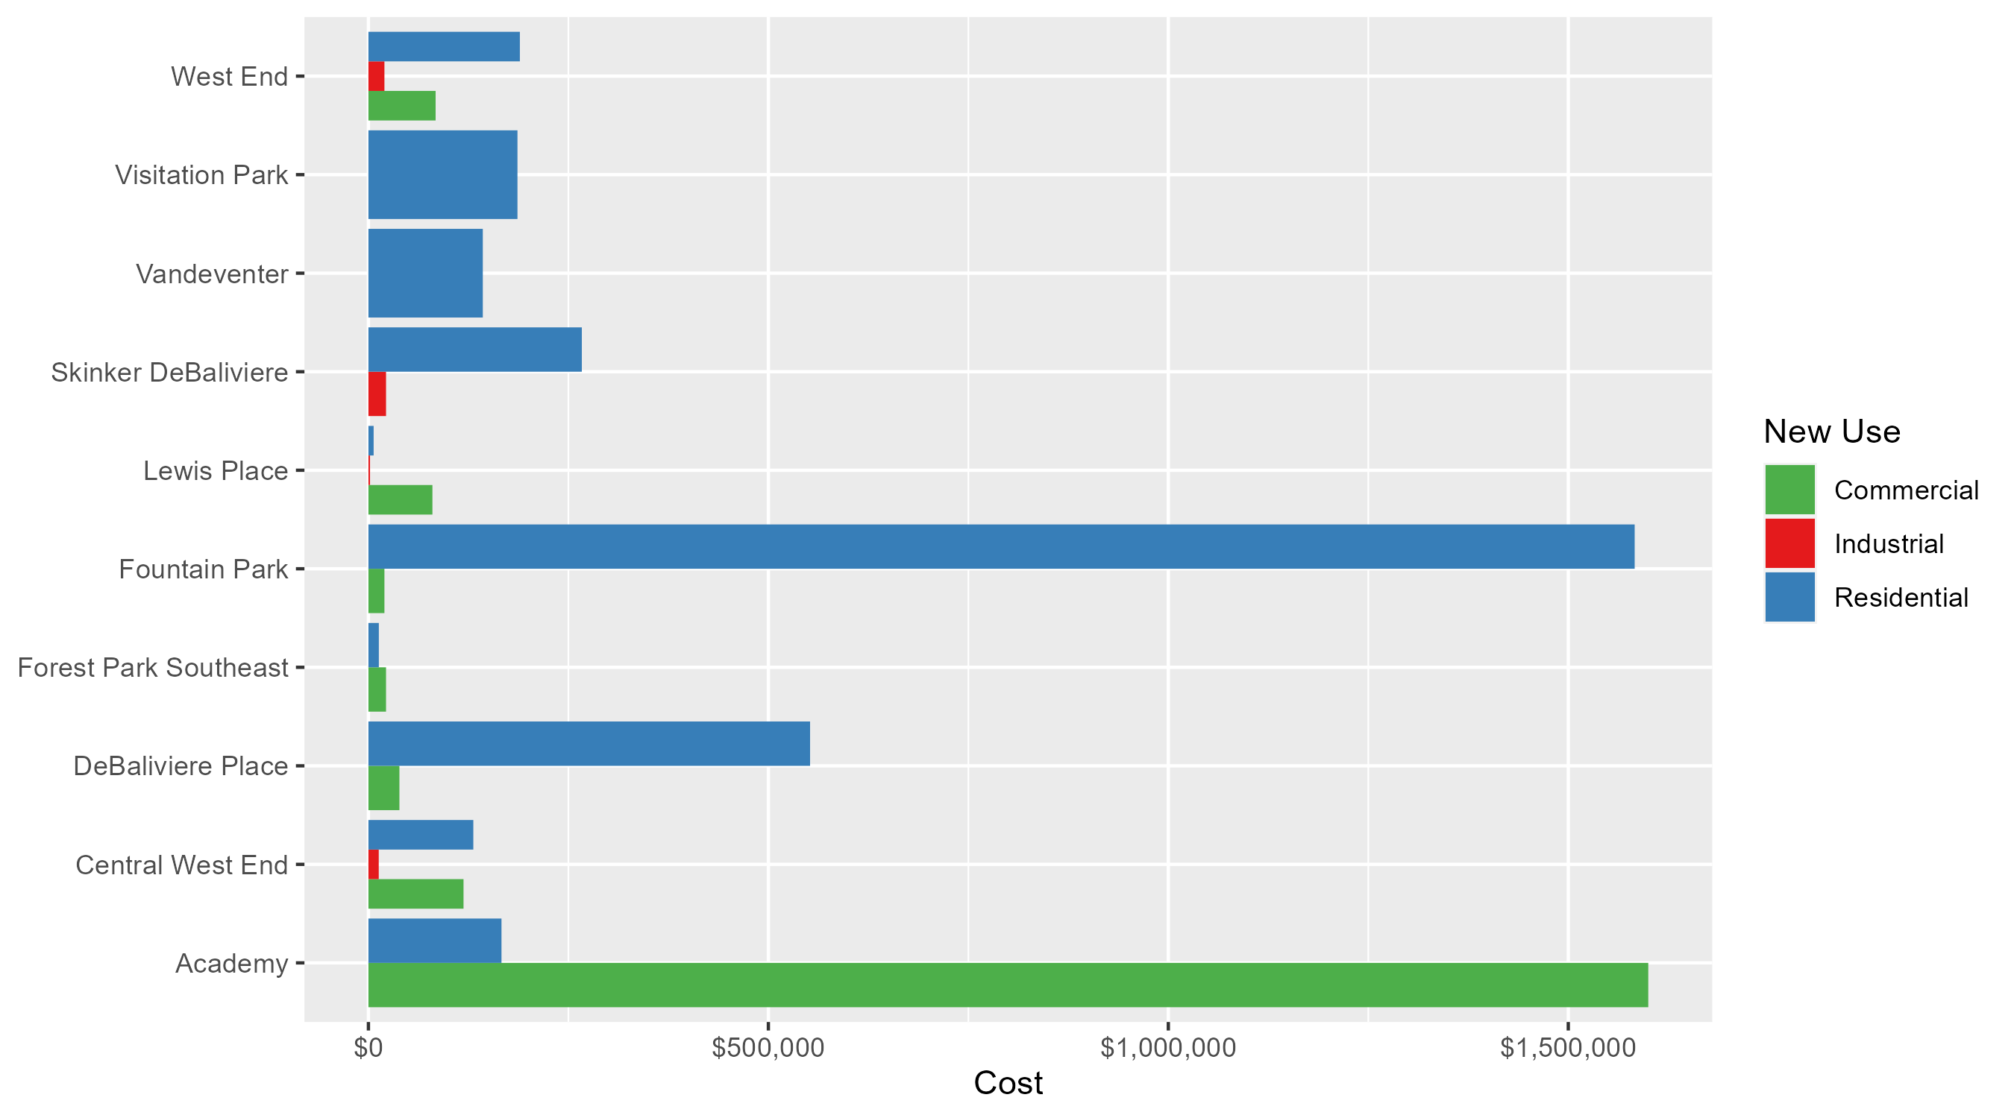
Neighborhood Summary: Average Building Permit Cost

Slide 4
Neighborhood Summary
August 2025 | August 2025 | August 2025 | August 2025
Neighborhood | Average Cost | # of Permits | Total Value of Permits
Academy | $345,553.25 | 8 | $2,764,426
Central West End | $125,209.37 | 51 | $6,385,678
DeBaliviere Place | $524,370.35 | 37 | $19,401,703
Forest Park Southeast | $16,870.14 | 7 | $118,091
Fountain Park | $1,192,250.00 | 4 | $4,769,000
Lewis Place | $29,500.00 | 3 | $88,500
Skinker DeBaliviere | $239,587.22 | 9 | $2,156,285
Vandeventer | $143,000.00 | 1 | $143,000
Visitation Park | $186,320.00 | 2 | $372,640
West End | $134,400.00 | 5 | $672,000
Last 6 Months | Last 6 Months | Last 6 Months | Last 6 Months
Neighborhood | Average Cost | # of Permits | Total Value of Permits
Academy | $143,684.42 | 24 | $3,448,426
Central West End | $174,470.35 | 221 | $38,557,947
DeBaliviere Place | $318,521.28 | 88 | $28,029,873
Forest Park Southeast | $69,174.21 | 43 | $2,974,491
Fountain Park | $360,000.00 | 15 | $5,400,000
Lewis Place | $119,708.69 | 16 | $1,915,339
Skinker DeBaliviere | $74,854.30 | 70 | $5,239,801
Vandeventer | $55,666.67 | 3 | $167,000
Visitation Park | $104,828.00 | 5 | $524,140
West End | $371,294.11 | 33 | $12,252,706

Slide 5
Core Neighborhoods

Slide 6
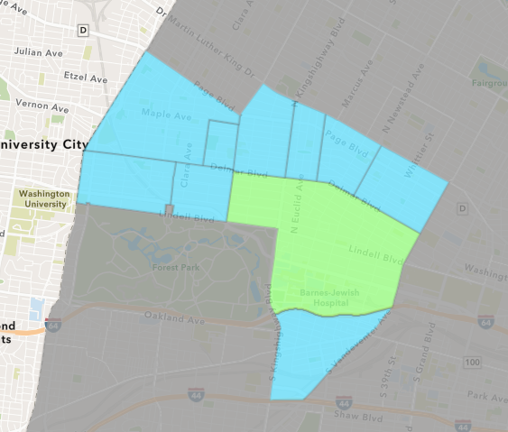
Central West End
August 2025 Neighborhood Cost Breakdown
Mean: $125,209
Median: $22,148
Range: $2,233 - $1,200,000

Slide 7
Central West End: Summary Notes
51 building permits in August 2025
18.60% change compared to August 2024 (43 total building permits)
$125,209: Average building permit cost in August 2025
-64.56% change compared to August 2024 ($353,331)
240 total building permits in 2025
0.00% change YTD compared to this time in 2024 (240 total building permits)
$174,183: YTD average building permit cost in 2025
-58.03% change YTD compared to this time in 2024 ($415,000)

Slide 8
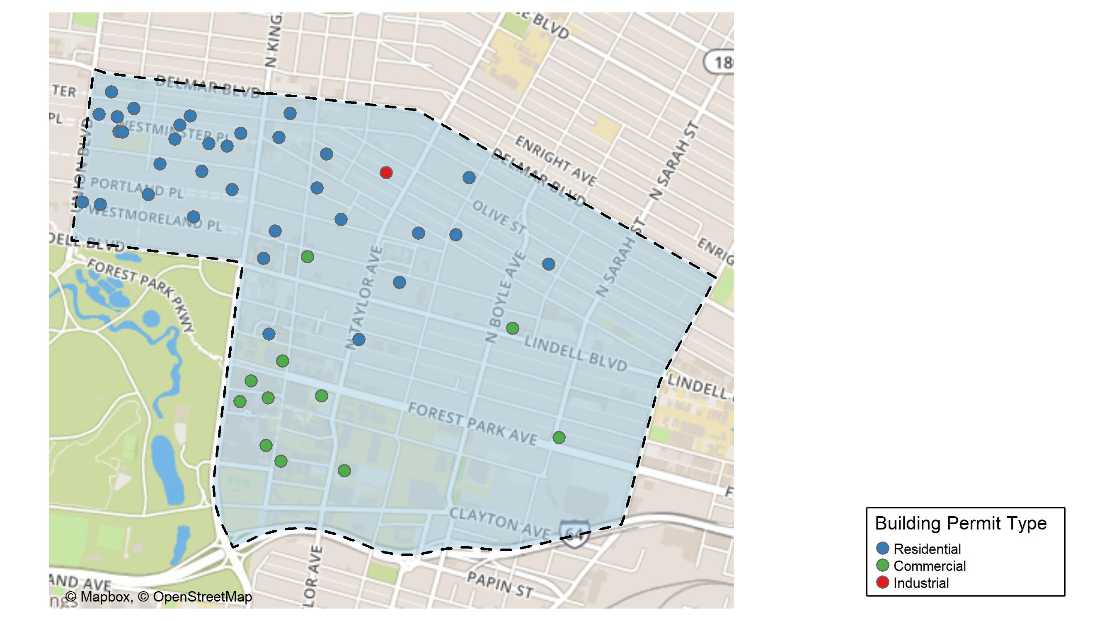
Central West End

Slide 9
Neighborhood Summary
August 2025 | August 2025 | August 2025 | August 2025
Permit Use | Average Cost | # of Permits | Total Value of Permits
Commercial | $118,882.7 | 15 | $1,783,240
Industrial | $12,900.0 | 1 | $12,900
Residential | $131,129.7 | 35 | $4,589,538
Last 6 Months | Last 6 Months | Last 6 Months | Last 6 Months
Permit Use | Average Cost | # of Permits | Total Value of Permits
Commercial | $233,141.8 | 72 | $16,786,207
Industrial | $363,221.2 | 11 | $3,995,433
Residential | $128,813.8 | 138 | $17,776,307

Slide 10
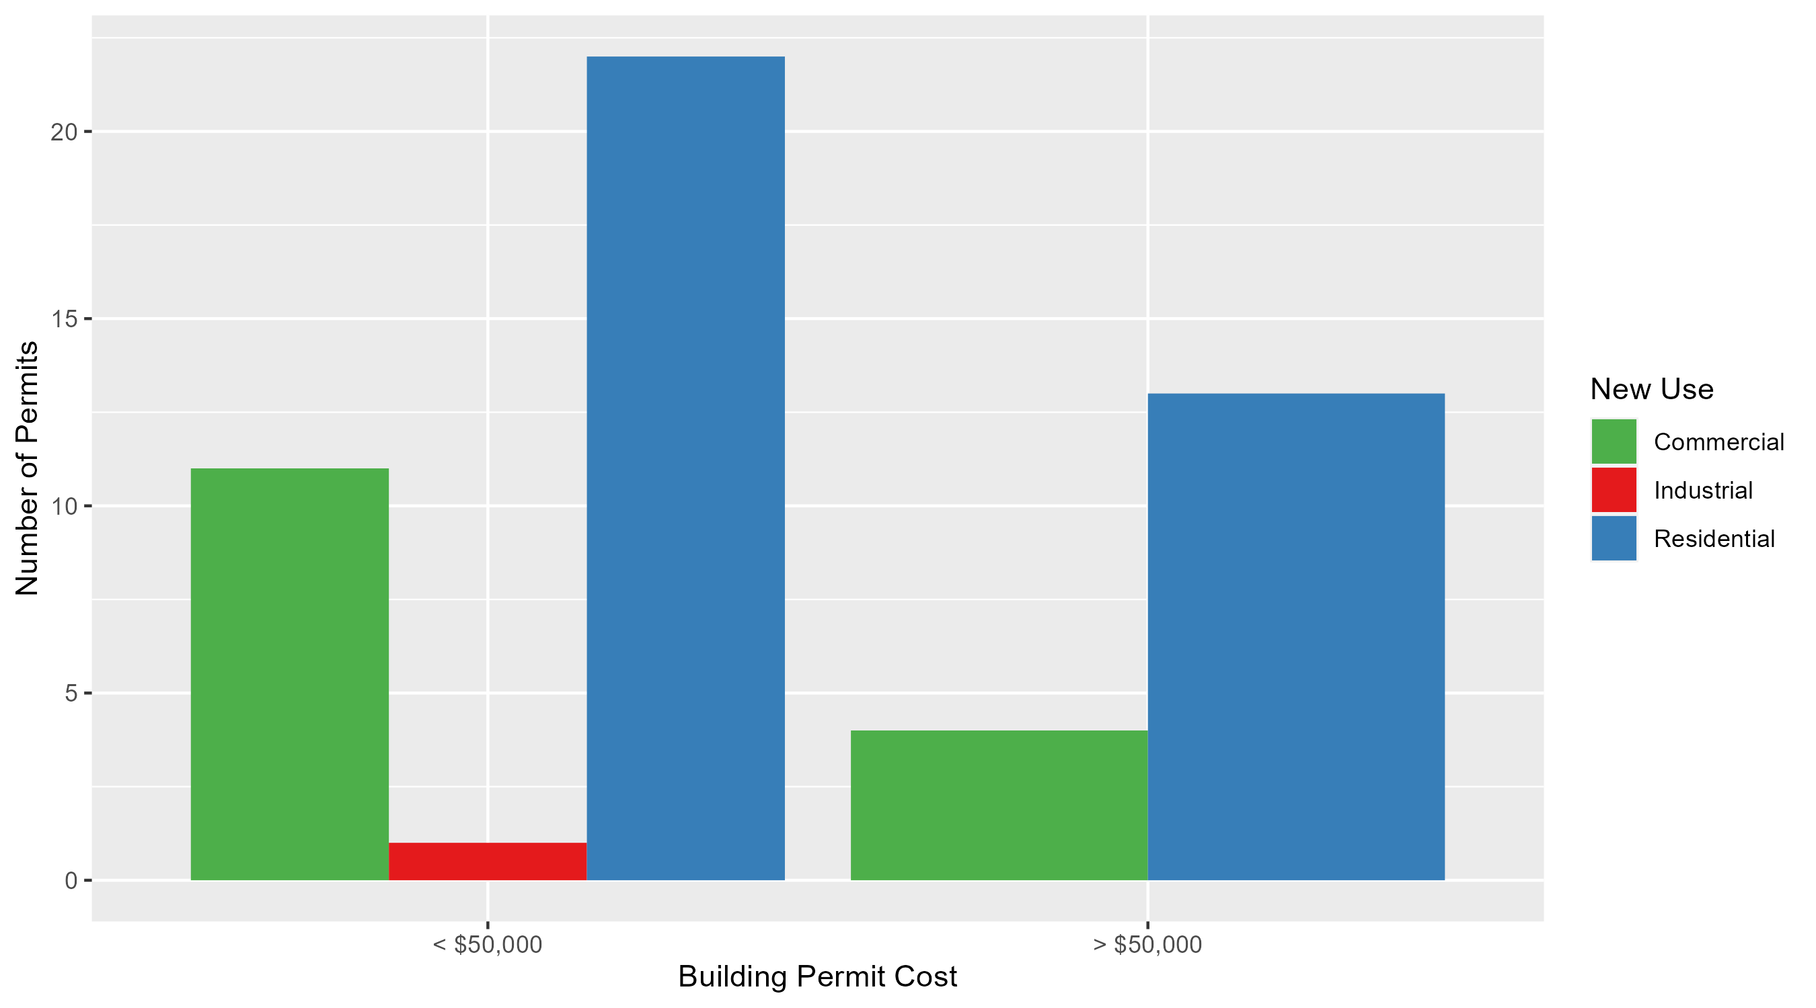
Central West End Permit Cost Breakdown

Slide 11
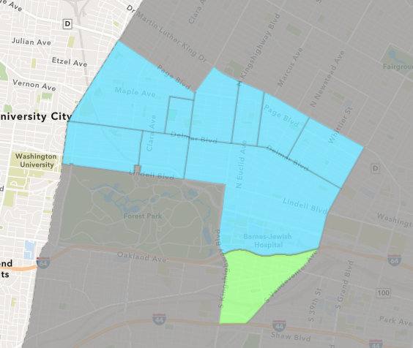
Forest Park Southeast
August 2025 Neighborhood Cost Breakdown
Mean: $16,870
Median: $6,000
Range: $4,000 - $35,100

Slide 12
Forest Park Southeast: Summary Notes
7 building permits in August 2025
40.00% change compared to August 2024 (5 total building permits)
$16,870: Average building permit cost in August 2025
-37.70% change compared to August 2024 ($27,081)
47 total building permits in 2025
-7.84% change YTD compared to this time in 2024 (51 total building permits)
$71,505: YTD average building permit cost in 2025
16.06% change YTD compared to this time in 2024 ($61,612)

Slide 13
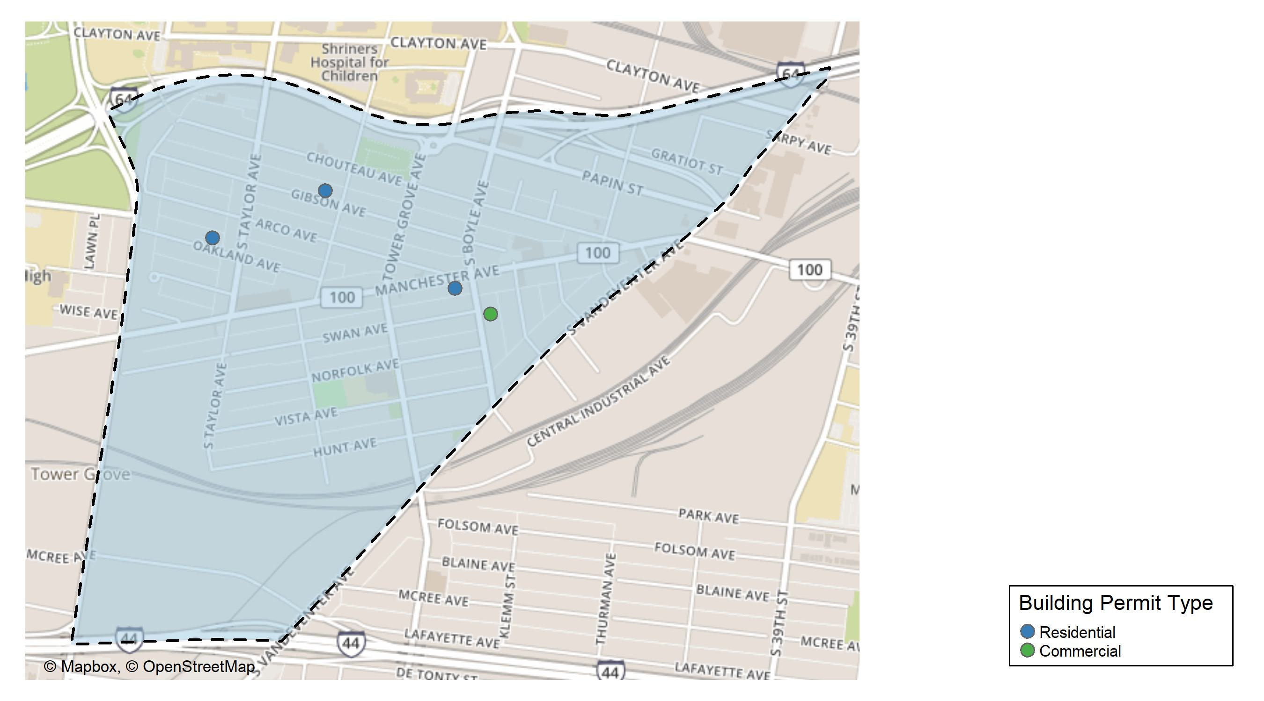
Forest Park Southeast

Slide 14
Neighborhood Summary
August 2025 | August 2025 | August 2025 | August 2025
Permit Use | Average Cost | # of Permits | Total Value of Permits
Commercial | $22,000.00 | 3 | $66,000
Industrial | $0.00 | 0 | $0
Residential | $13,022.75 | 4 | $52,091
Last 6 Months | Last 6 Months | Last 6 Months | Last 6 Months
Permit Use | Average Cost | # of Permits | Total Value of Permits
Commercial | $20,071.43 | 7 | $140,500
Industrial | $11,450.00 | 4 | $45,800
Residential | $87,130.97 | 32 | $2,788,191

Slide 15
Forest Park Southeast Individual Permit Breakdown
Neighborhood | Owner | New Use | Cost | address
Forest Park Southeast | TOBIN, MAURA F & CHRISTOPHER S FARRA | Residential | $5,891 | 4413 GIBSON AV
Forest Park Southeast | AC REALTY 5 LLC | Residential | $35,100 | 4210 MANCHESTER AV
Forest Park Southeast | ST LOUIS CITY CATHOLIC CHURCH REAL | Commercial | $32,000 | 1202 S BOYLE AV
Forest Park Southeast | ST LOUIS CITY CATHOLIC CHURCH REAL | Commercial | $30,000 | 1202 S BOYLE AV
Forest Park Southeast | SUDDARTH, MATTHEW T | Residential | $5,100 | 4525 OAKLAND AV
Forest Park Southeast | SUDDARTH, MATTHEW T | Residential | $6,000 | 4525 OAKLAND AV
Forest Park Southeast | ST LOUIS CITY CATHOLIC CHURCH REAL | Commercial | $4,000 | 1202 S BOYLE AV

Slide 16
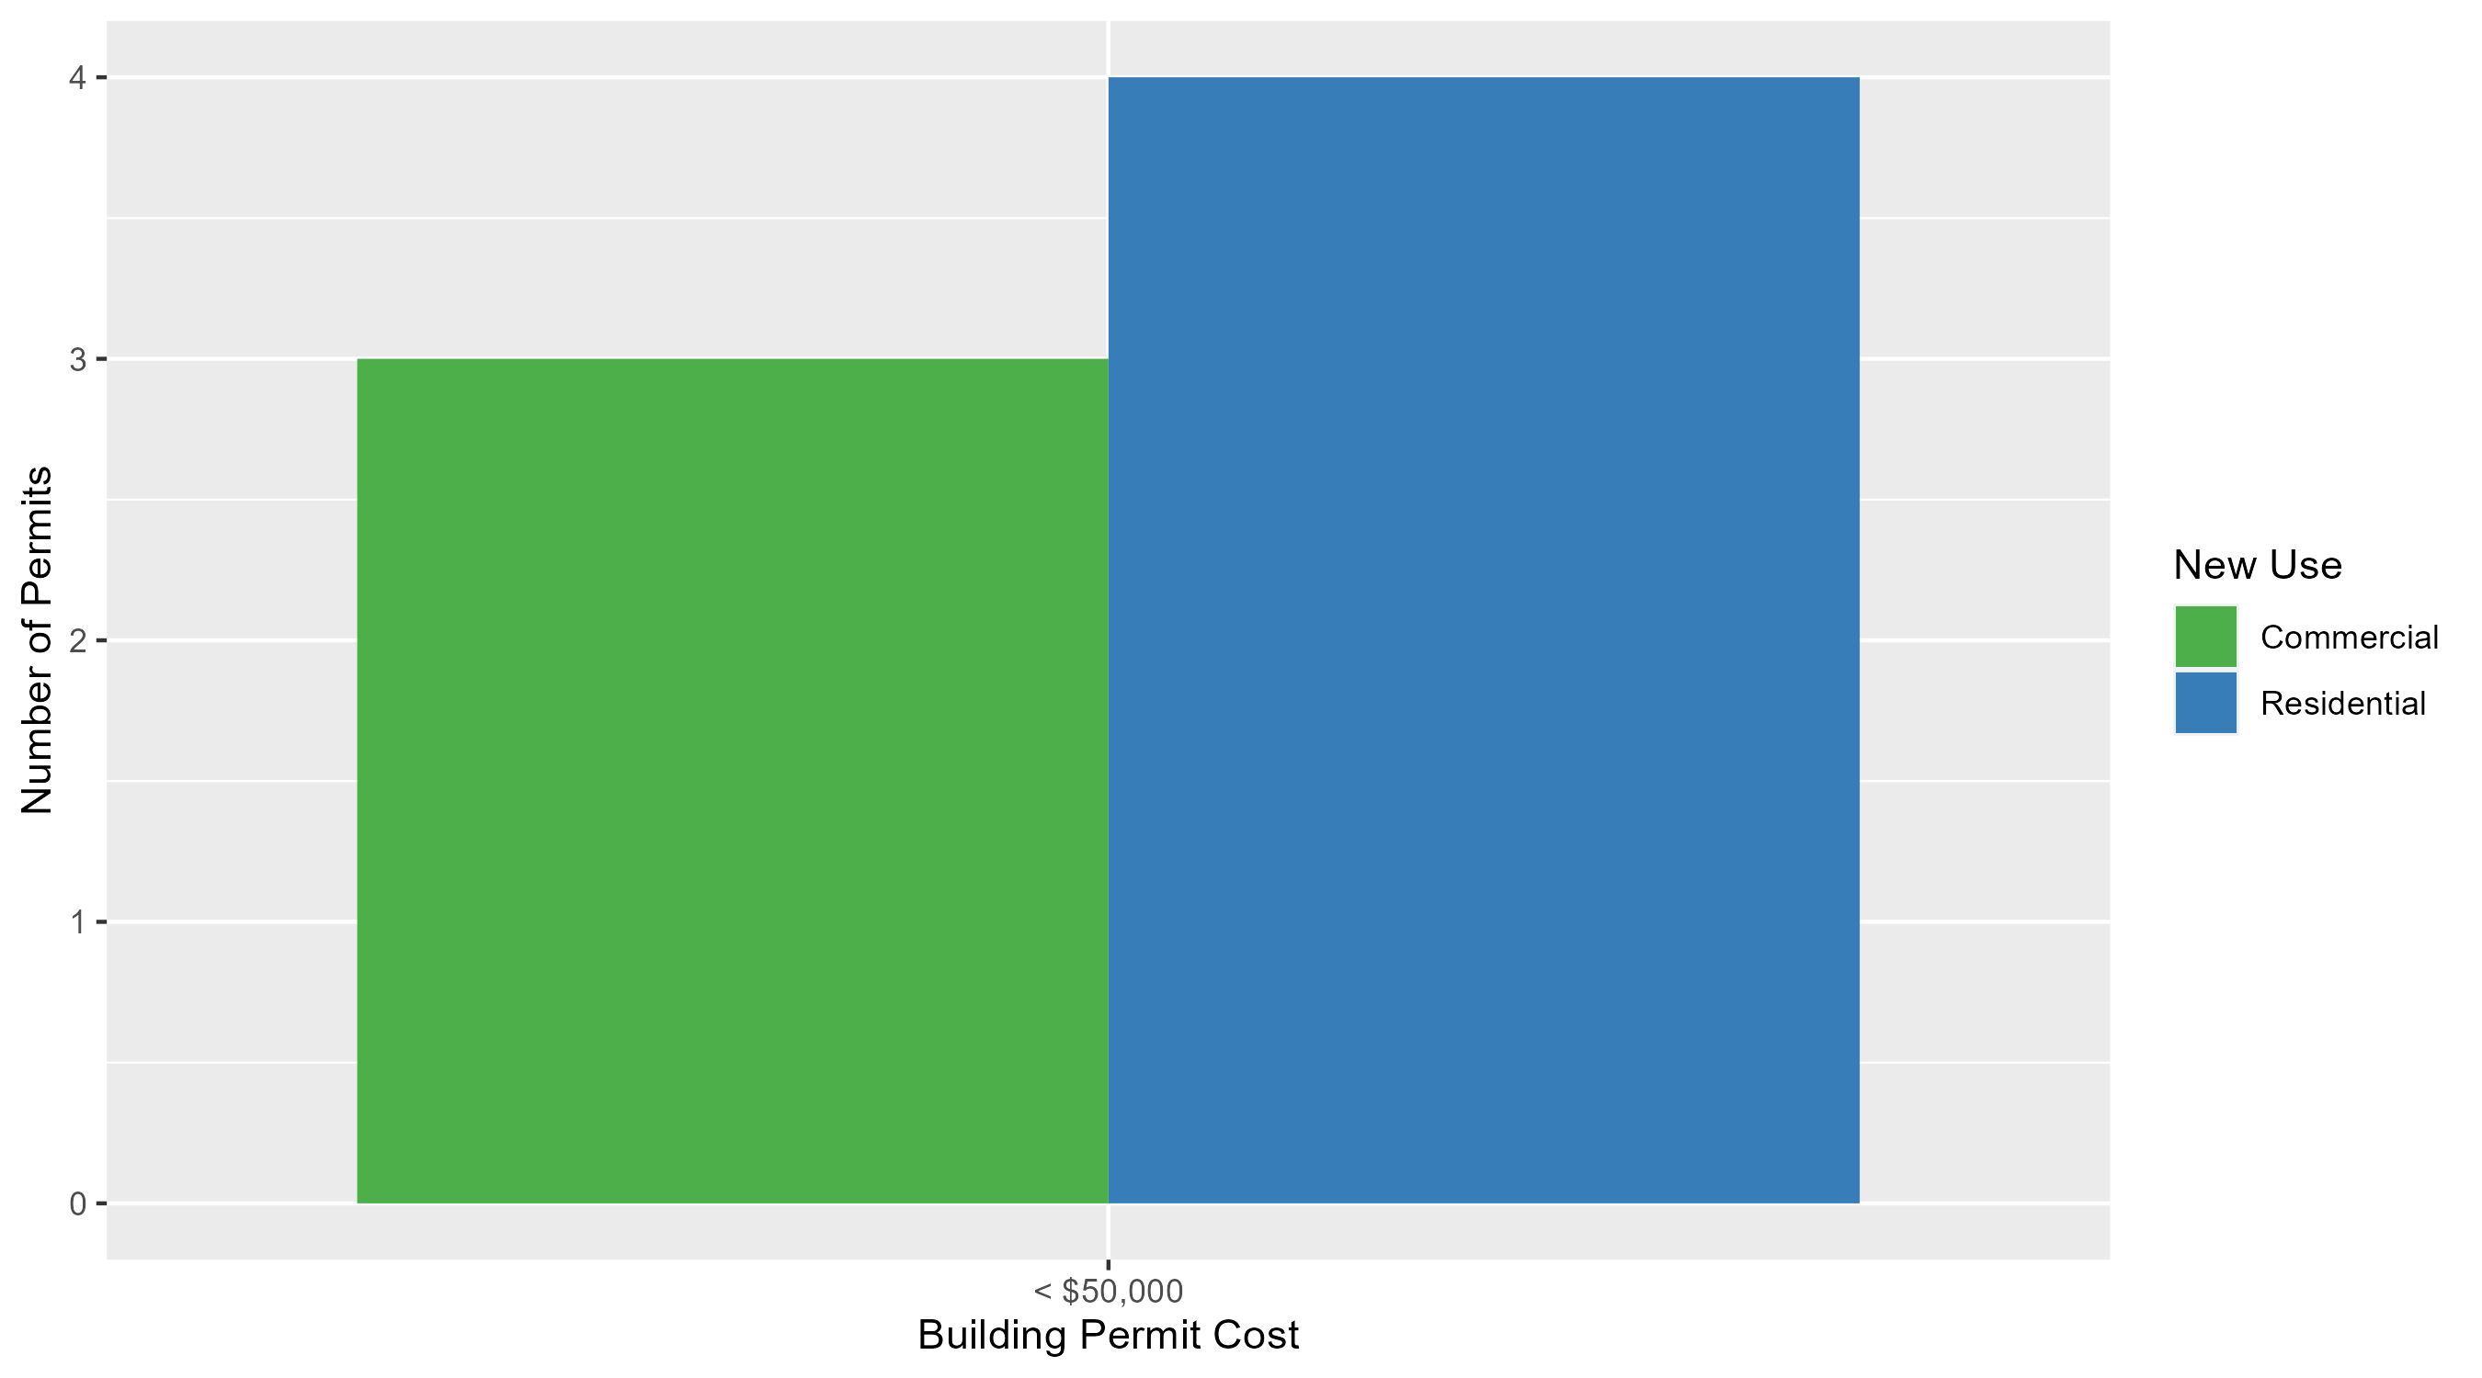
Forest Park Southeast Permit Cost Breakdown

Slide 17
Expanded Service Area

Slide 18
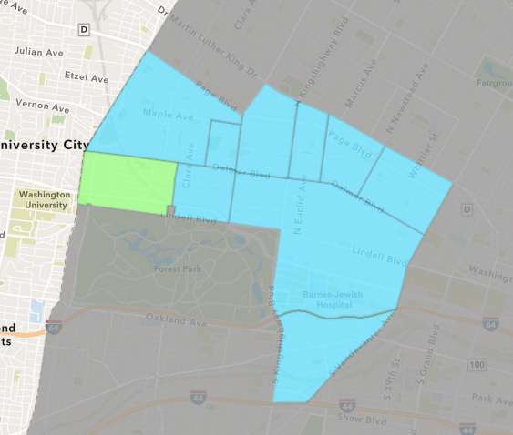
Skinker DeBaliviere
August 2025 Neighborhood Cost Breakdown
Mean: $239,587
Median: $22,000
Range: $7,244 - $1,640,000

Slide 19
Skinker DeBaliviere: Summary Notes
9 building permits in August 2025
-10.00% change compared to August 2024 (10 total building permits)
$239,587: Average building permit cost in August 2025
429.16% change compared to August 2024 ($45,277)
80 total building permits in 2025
66.67% change YTD compared to this time in 2024 (48 total building permits)
$76,397: YTD average building permit cost in 2025
-24.90% change YTD compared to this time in 2024 ($101,731)

Slide 20
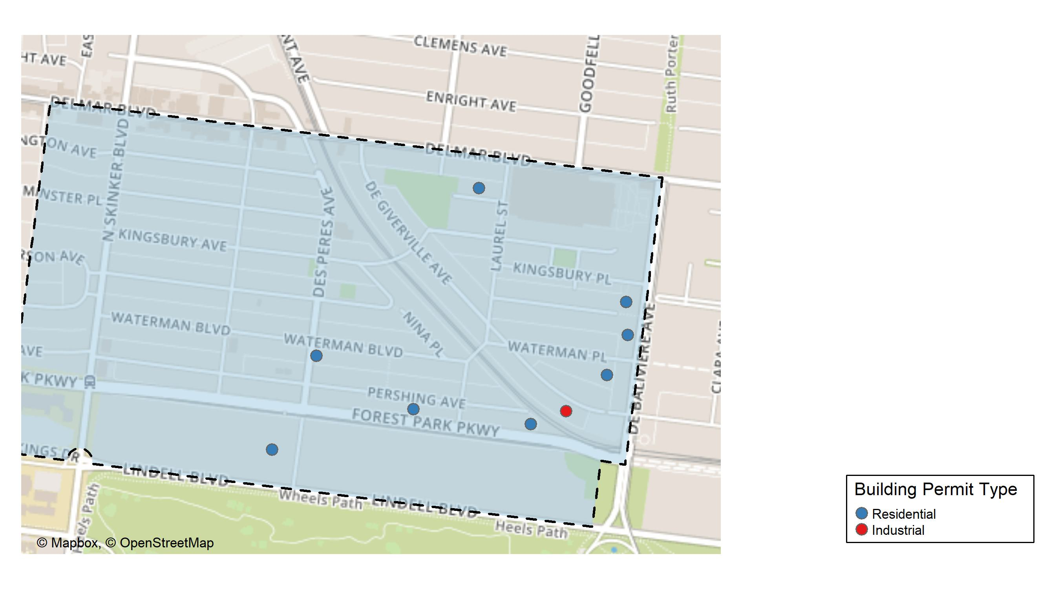
Skinker DeBaliviere

Slide 21
Neighborhood Summary
August 2025 | August 2025 | August 2025 | August 2025
Permit Use | Average Cost | # of Permits | Total Value of Permits
Commercial | $0.0 | 0 | $0
Industrial | $22,000.0 | 1 | $22,000
Residential | $266,785.6 | 8 | $2,134,285
Last 6 Months | Last 6 Months | Last 6 Months | Last 6 Months
Permit Use | Average Cost | # of Permits | Total Value of Permits
Commercial | $15,779.67 | 3 | $47,339
Industrial | $17,450.00 | 2 | $34,900
Residential | $79,347.11 | 65 | $5,157,562

Slide 22
Skinker DeBaliviere Individual Permit Breakdown
Neighborhood | Owner | New Use | Cost | address
Skinker DeBaliviere | POINT BREAK CAPITAL LLC | Residential | $15,000 | 5962 WATERMAN BLVD
Skinker DeBaliviere | JOHNSON, DAVID & YOUPIER | Residential | $7,244 | 5718 WATERMAN BLVD
Skinker DeBaliviere | FLASPOHLER, JASON & | Industrial | $22,000 | 5744 DEGIVERVILLE AV
Skinker DeBaliviere | WINTER GARDEN SENIOR HOUSING LP | Residential | $343,000 | 5708 KINGSBURY PL
Skinker DeBaliviere | 5744-50 PERSHING LLC | Residential | $75,000 | 5744 PERSHING AV
Skinker DeBaliviere | WILSON, JAMES & ESTELLAR MOORE | Residential | $8,000 | 5871 WASHINGTON AV
Skinker DeBaliviere | EUREKA DESOTO ENTERPRISES LLC | Residential | $1,640,000 | 415 DEBALIVIERE AV
Skinker DeBaliviere | CABRAL, SAMUEL & CASSANDRA | Residential | $37,000 | 6025 LINDELL BLVD
Skinker DeBaliviere | G'SELL, EILEEN P | Residential | $9,041 | 5834 PERSHING AV

Slide 23
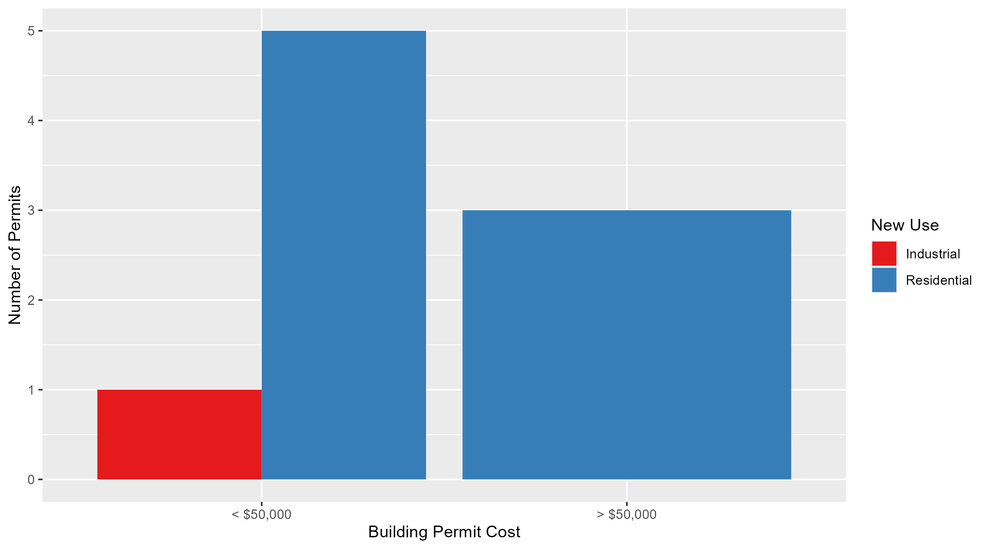
Skinker DeBaliviere Permit Cost Breakdown

Slide 24
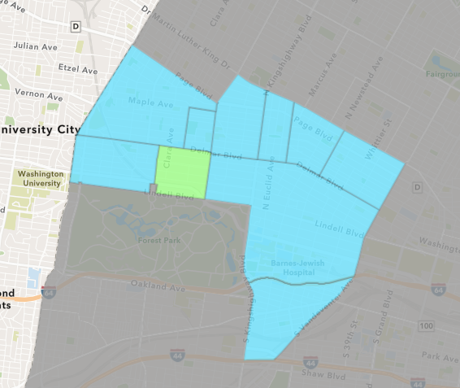
DeBaliviere Place
August 2025 Neighborhood Cost Breakdown
Mean: $524,370
Median: $200,000
Range: $6,950 - $6,500,000

Slide 25
DeBaliviere Place: Summary Notes
37 building permits in August 2025
1133.33% change compared to August 2024 (3 total building permits)
$524,370: Average building permit cost in August 2025
593.46% change compared to August 2024 ($75,617)
91 total building permits in 2025
193.55% change YTD compared to this time in 2024 (31 total building permits)
$308,250: YTD average building permit cost in 2025
183.62% change YTD compared to this time in 2024 ($108,684)

Slide 26
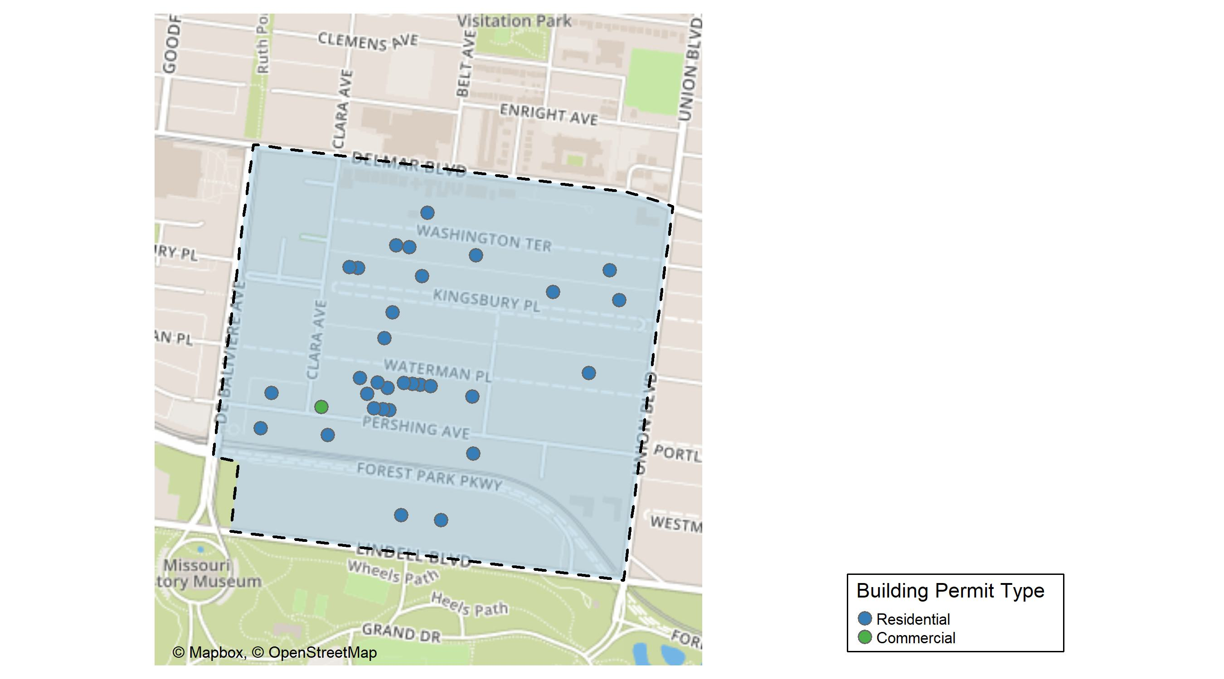
DeBaliviere Place

Slide 27
Neighborhood Summary
August 2025 | August 2025 | August 2025 | August 2025
Permit Use | Average Cost | # of Permits | Total Value of Permits
Commercial | $38,740.0 | 2 | $77,480
Industrial | $0.0 | 0 | $0
Residential | $552,120.7 | 35 | $19,324,223
Last 6 Months | Last 6 Months | Last 6 Months | Last 6 Months
Permit Use | Average Cost | # of Permits | Total Value of Permits
Commercial | $74,240.8 | 5 | $371,204
Industrial | $0.0 | 0 | $0
Residential | $333,237.0 | 83 | $27,658,669

Slide 28
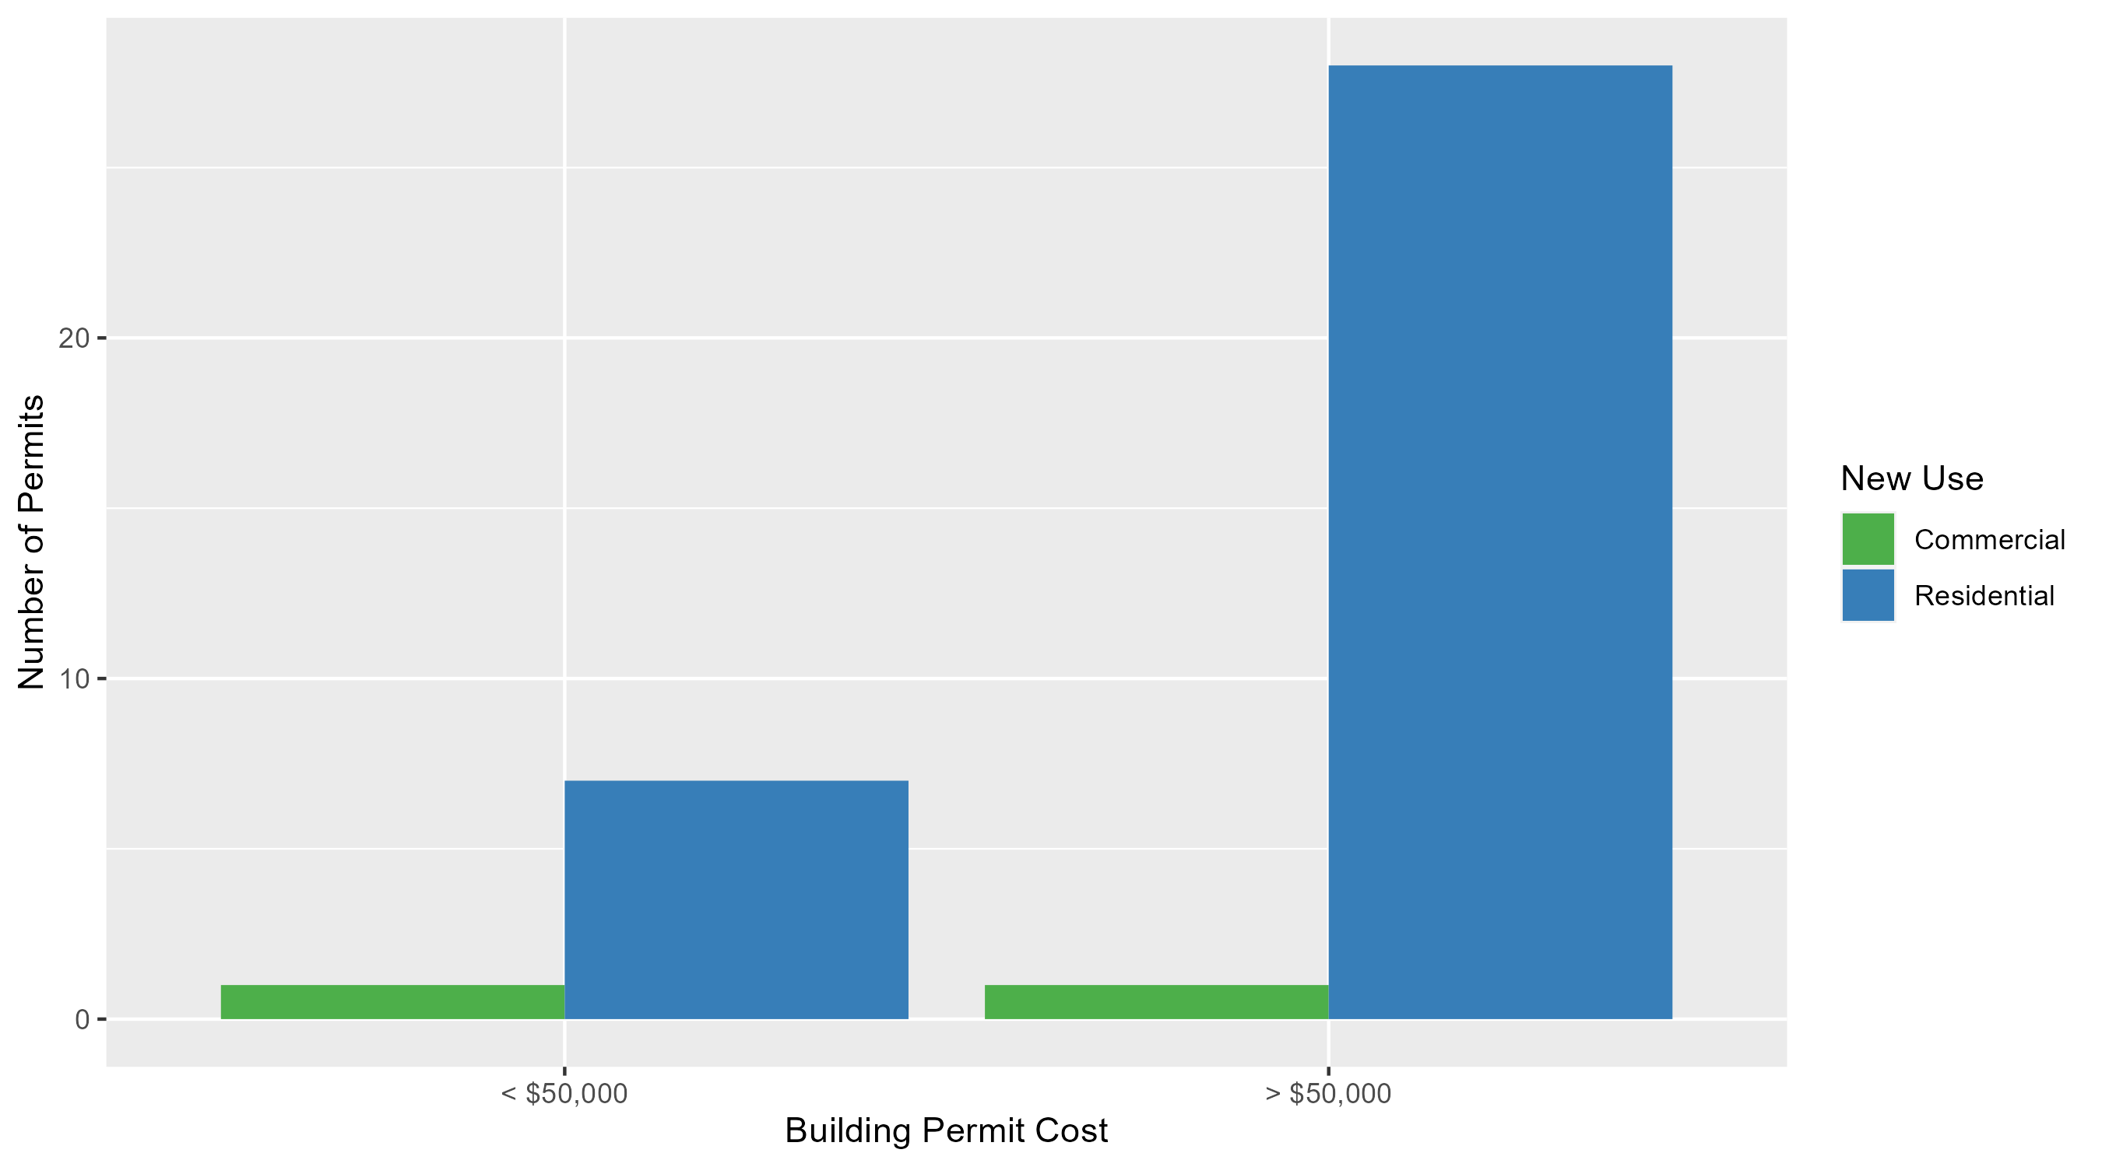
DeBaliviere Place Permit Cost Breakdown

Slide 29
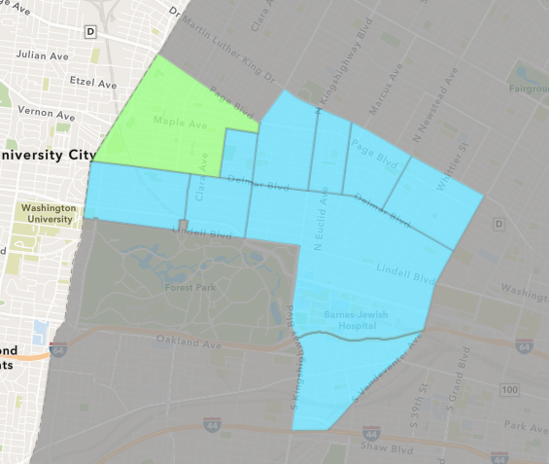
West End
August 2025 Neighborhood Cost Breakdown
Mean: $134,400
Median: $74,000
Range: $12,000 - $482,000

Slide 30
West End: Summary Notes
5 building permits in August 2025
0.00% change compared to August 2024 (5 total building permits)
$134,400: Average building permit cost in August 2025
599.38% change compared to August 2024 ($19,217)
39 total building permits in 2025
-30.36% change YTD compared to this time in 2024 (56 total building permits)
$323,652: YTD average building permit cost in 2025
299.12% change YTD compared to this time in 2024 ($81,091)

Slide 31
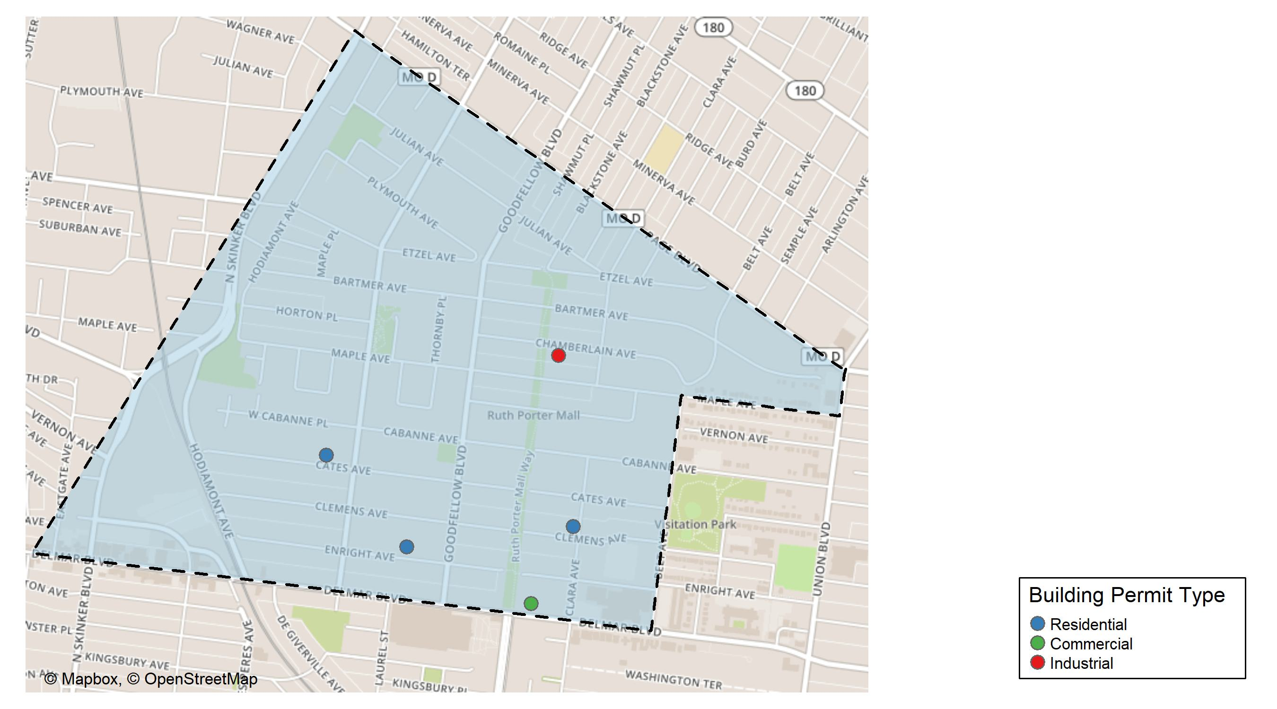
West End

Slide 32
Neighborhood Summary
August 2025 | August 2025 | August 2025 | August 2025
Permit Use | Average Cost | # of Permits | Total Value of Permits
Commercial | $84,000.0 | 1 | $84,000
Industrial | $20,000.0 | 1 | $20,000
Residential | $189,333.3 | 3 | $568,000
Last 6 Months | Last 6 Months | Last 6 Months | Last 6 Months
Permit Use | Average Cost | # of Permits | Total Value of Permits
Commercial | $1,354,379.75 | 8 | $10,835,038
Industrial | $93,070.50 | 2 | $186,141
Residential | $53,544.64 | 23 | $1,231,527

Slide 33
West End Individual Permit Breakdown
Neighborhood | Owner | New Use | Cost | address
West End | BETTY JEAN KERR PEOPLES HEALTH CNTRS | Commercial | $84,000 | 5635 DELMAR BLVD
West End | RHODEWALT, JASON & AMANDA | Residential | $482,000 | 807 CLARA AV
West End | JACKSON, DARRYL FREEMAN | Industrial | $20,000 | 5640 CHAMBERLAIN AV
West End | BULWORTH HOMES LLC | Residential | $12,000 | 5929 CATES AV
West End | UNPARALLELED LODGING LLC | Residential | $74,000 | 5843 ENRIGHT AV

Slide 34
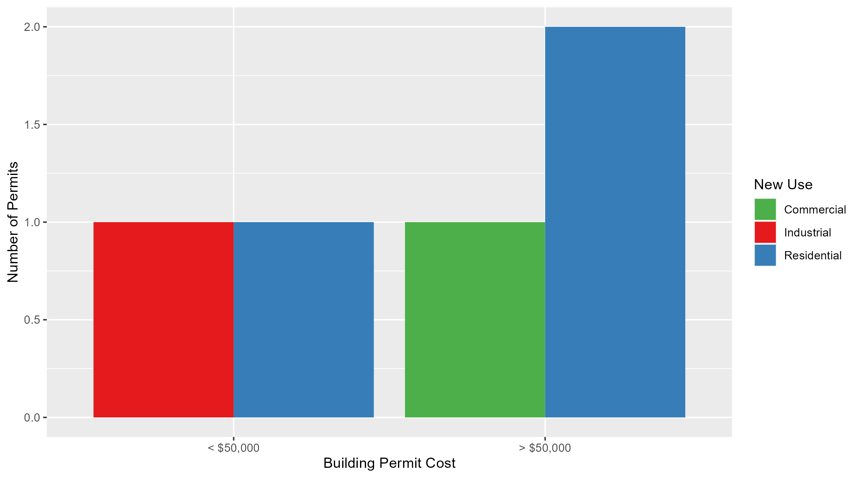
West End Permit Cost Breakdown

Slide 35
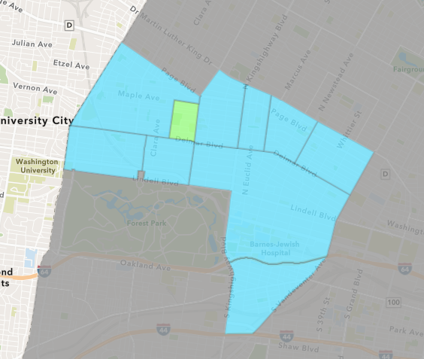
Visitation Park
August 2025 Neighborhood Cost Breakdown
Mean: $186,320
Median: $186,320
Range: $9,300 - $363,340

Slide 36
Visitation Park: Summary Notes
2 building permits in August 2025
100.00% change compared to August 2024 (1 total building permits)
$186,320: Average building permit cost in August 2025
23190.00% change compared to August 2024 ($800)
5 total building permits in 2025
150.00% change YTD compared to this time in 2024 (2 total building permits)
$104,828: YTD average building permit cost in 2025
413.86% change YTD compared to this time in 2024 ($20,400)

Slide 37
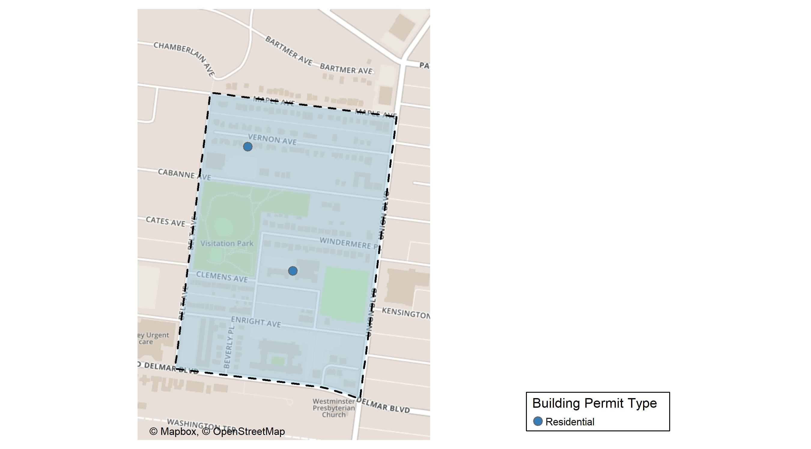
Visitation Park

Slide 38
Neighborhood Summary
August 2025 | August 2025 | August 2025 | August 2025
Permit Use | Average Cost | # of Permits | Total Value of Permits
Commercial | $0 | 0 | $0
Industrial | $0 | 0 | $0
Residential | $186,320 | 2 | $372,640
Last 6 Months | Last 6 Months | Last 6 Months | Last 6 Months
Permit Use | Average Cost | # of Permits | Total Value of Permits
Commercial | $0 | 0 | $0
Industrial | $0 | 0 | $0
Residential | $104,828 | 5 | $524,140

Slide 39
Visitation Park Individual Permit Breakdown
Neighborhood | Owner | New Use | Cost | address
Visitation Park | JOHNSON, DONALD R & P | Residential | $9,300 | 5446 VERNON AV
Visitation Park | SOLOFTS LLC | Residential | $363,340 | 800 ARLINGTON AV

Slide 40
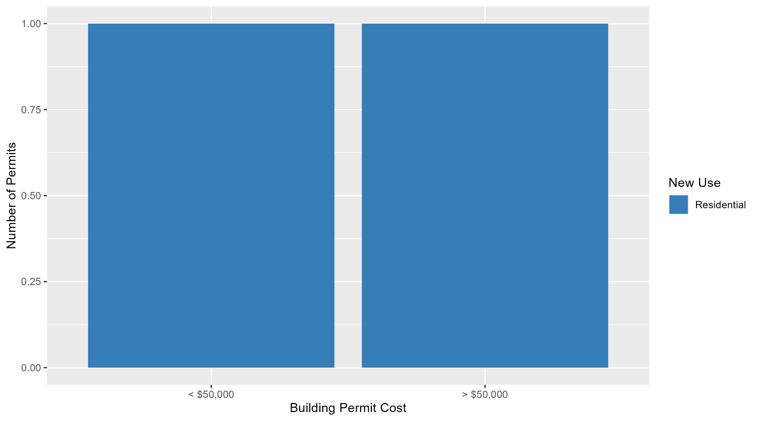
Visitation Park Permit Cost Breakdown

Slide 41
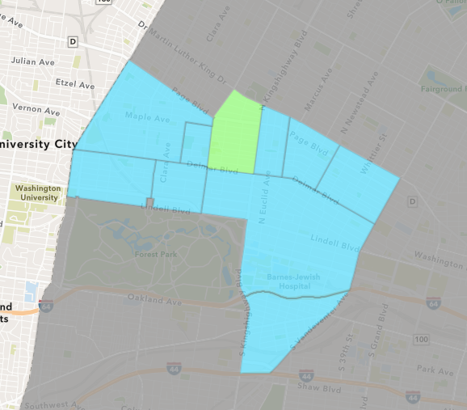
Academy
August 2025 Neighborhood Cost Breakdown
Mean: $345,553
Median: $150,000
Range: $22,000 - $1,600,000

Slide 42
Academy: Summary Notes
8 building permits in August 2025
166.67% change compared to August 2024 (3 total building permits)
$345,553: Average building permit cost in August 2025
1585.63% change compared to August 2024 ($20,500)
27 total building permits in 2025
68.75% change YTD compared to this time in 2024 (16 total building permits)
$133,053: YTD average building permit cost in 2025
194.57% change YTD compared to this time in 2024 ($45,169)

Slide 43
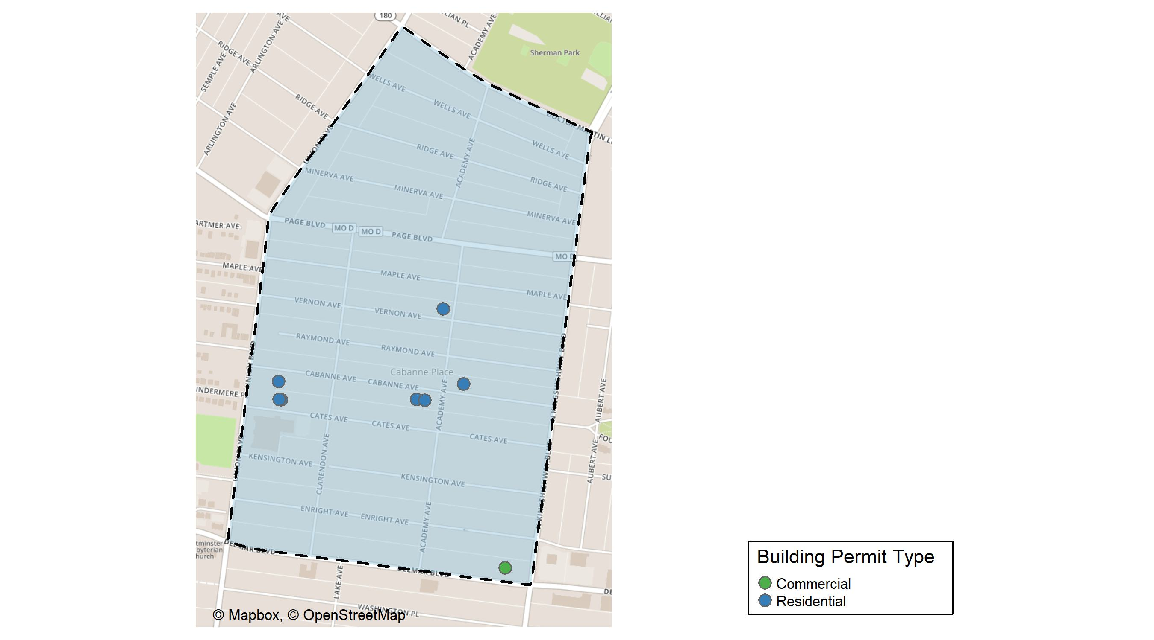
Academy

Slide 44
Neighborhood Summary
August 2025 | August 2025 | August 2025 | August 2025
Permit Use | Average Cost | # of Permits | Total Value of Permits
Commercial | $1,600,000.0 | 1 | $1,600,000
Industrial | $0.0 | 0 | $0
Residential | $166,346.6 | 7 | $1,164,426
Last 6 Months | Last 6 Months | Last 6 Months | Last 6 Months
Permit Use | Average Cost | # of Permits | Total Value of Permits
Commercial | $598,133.33 | 3 | $1,794,400
Industrial | $0.00 | 0 | $0
Residential | $78,763.14 | 21 | $1,654,026

Slide 45
Academy Individual Permit Breakdown
Neighborhood | Owner | New Use | Cost | address
Academy | BRG DELMAR PROP LLC | Commercial | $1,600,000 | 5025 DELMAR BLVD
Academy | RICHARDSON, MICHAEL & ZELDA Y | Residential | $47,551 | 5120 CABANNE AV
Academy | RICHARDSON, BETTY J | Residential | $22,000 | 5105 VERNON AV
Academy | COLE, GABRIELLE & THEOLIN | Residential | $300,000 | 5112 CABANNE AV
Academy | FRANKLIN, MICHAEL E | Residential | $120,000 | 5083 CABANNE AV
Academy | 5243 CATES AVE LLC | Residential | $150,000 | 5243 CATES AV
Academy | 5245 CATES AVE LLC | Residential | $150,000 | 5245 CATES AV
Academy | CLARKUNION LLC | Residential | $374,875 | 1020 UNION BLVD

Slide 46
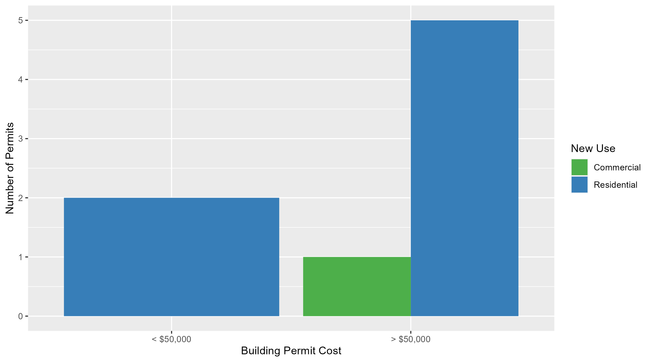
Academy Permit Cost Breakdown

Slide 47
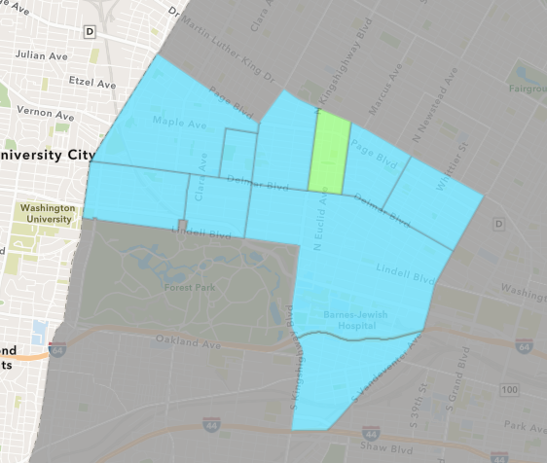
Fountain Park
August 2025 Neighborhood Cost Breakdown
Mean: $1,192,250
Median: $1,124,500
Range: $20,000 - $2,500,000

Slide 48
Fountain Park: Summary Notes
4 building permits in August 2025
300.00% change compared to August 2024 (1 total building permits)
$1,192,250: Average building permit cost in August 2025
3122.30% change compared to August 2024 ($37,000)
15 total building permits in 2025
87.50% change YTD compared to this time in 2024 (8 total building permits)
$360,000: YTD average building permit cost in 2025
939.71% change YTD compared to this time in 2024 ($34,625)

Slide 49
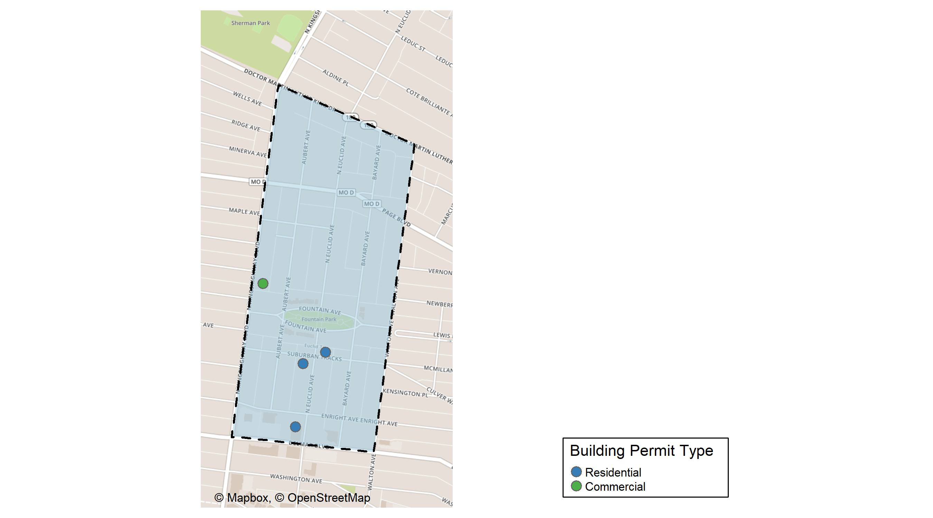
Fountain Park

Slide 50
Neighborhood Summary
August 2025 | August 2025 | August 2025 | August 2025
Permit Use | Average Cost | # of Permits | Total Value of Permits
Commercial | $20,000 | 1 | $20,000
Industrial | $0 | 0 | $0
Residential | $1,583,000 | 3 | $4,749,000
Last 6 Months | Last 6 Months | Last 6 Months | Last 6 Months
Permit Use | Average Cost | # of Permits | Total Value of Permits
Commercial | $64,450.0 | 4 | $257,800
Industrial | $0.0 | 0 | $0
Residential | $467,472.7 | 11 | $5,142,200

Slide 51
Fountain Park Individual Permit Breakdown
Neighborhood | Owner | New Use | Cost | address
Fountain Park | SRK 848 LLC | Residential | $2,139,000 | 785 N EUCLID AV
Fountain Park | SRK 848 LLC | Residential | $110,000 | 904-8 N EUCLID AV
Fountain Park | BOWEN, JAMES H | Commercial | $20,000 | 1124 N KINGSHIGHWAY BLVD
Fountain Park | ROOSEVELT TOWN APARTMENTS LP | Residential | $2,500,000 | 711 N EUCLID AV

Slide 52
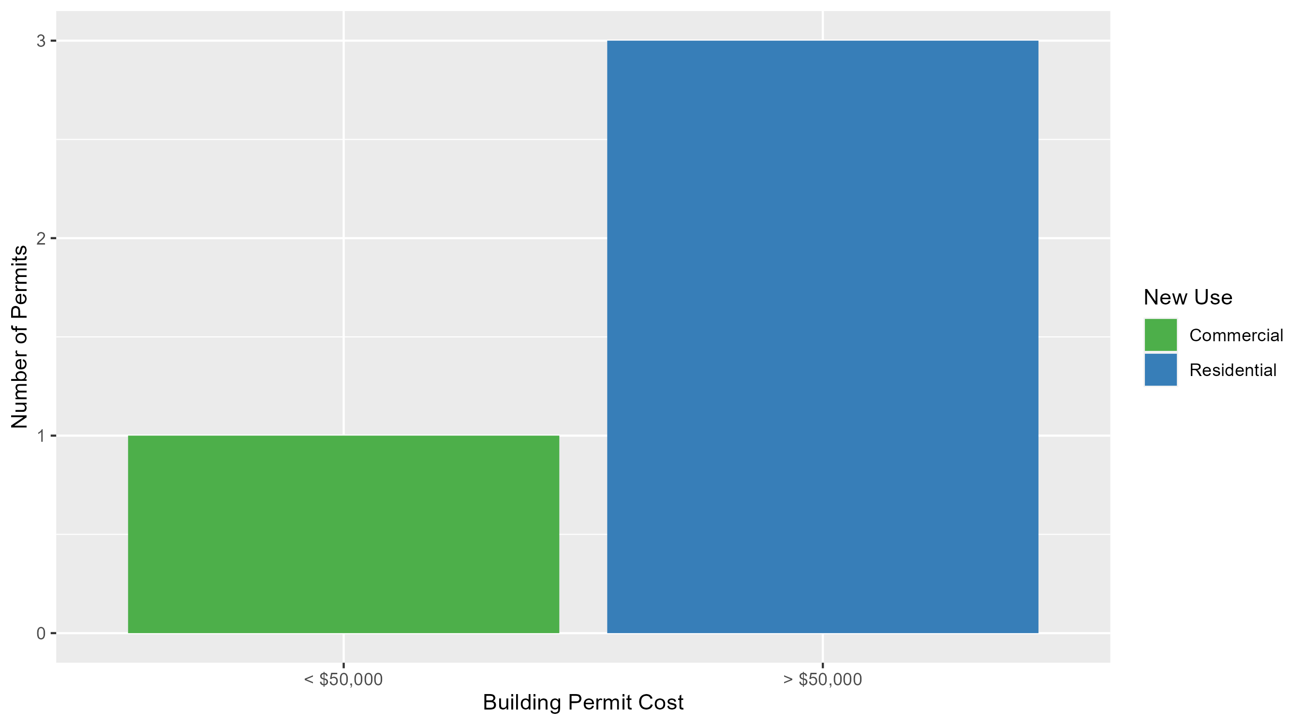
Fountain Park Permit Cost Breakdown

Slide 53
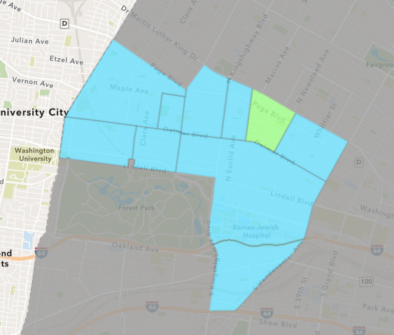
Lewis Place
August 2025 Neighborhood Cost Breakdown
Mean: $29,500
Median: $6,500
Range: $2,000 - $80,000

Slide 54
Lewis Place: Summary Notes
3 building permits in August 2025
200.00% change compared to August 2024 (1 total building permits)
$29,500: Average building permit cost in August 2025
-41.00% change compared to August 2024 ($50,000)
17 total building permits in 2025
54.55% change YTD compared to this time in 2024 (11 total building permits)
$118,549: YTD average building permit cost in 2025
399.26% change YTD compared to this time in 2024 ($23,745)

Slide 55
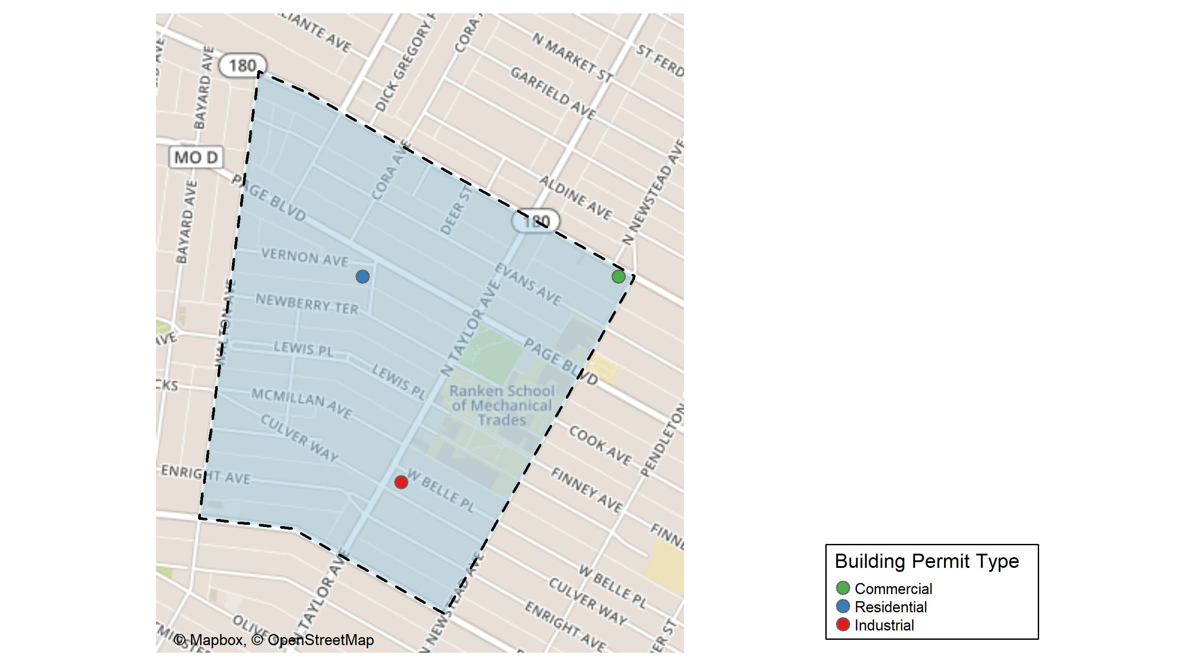
Lewis Place

Slide 56
Neighborhood Summary
August 2025 | August 2025 | August 2025 | August 2025
Permit Use | Average Cost | # of Permits | Total Value of Permits
Commercial | $80,000 | 1 | $80,000
Industrial | $2,000 | 1 | $2,000
Residential | $6,500 | 1 | $6,500
Last 6 Months | Last 6 Months | Last 6 Months | Last 6 Months
Permit Use | Average Cost | # of Permits | Total Value of Permits
Commercial | $225,367.8 | 5 | $1,126,839
Industrial | $2,000.0 | 1 | $2,000
Residential | $78,650.0 | 10 | $786,500

Slide 57
Lewis Place Individual Permit Breakdown
Neighborhood | Owner | New Use | Cost | address
Lewis Place | MALONE, ANGELA | Commercial | $80,000 | 4408-10 DR MARTIN LUTHER KING DR
Lewis Place | ESCALONA, MAURICIO | Industrial | $2,000 | 4482 WEST BELLE PL
Lewis Place | STEWART, ADDINGTON C | Residential | $6,500 | 4606 VERNON AV

Slide 58
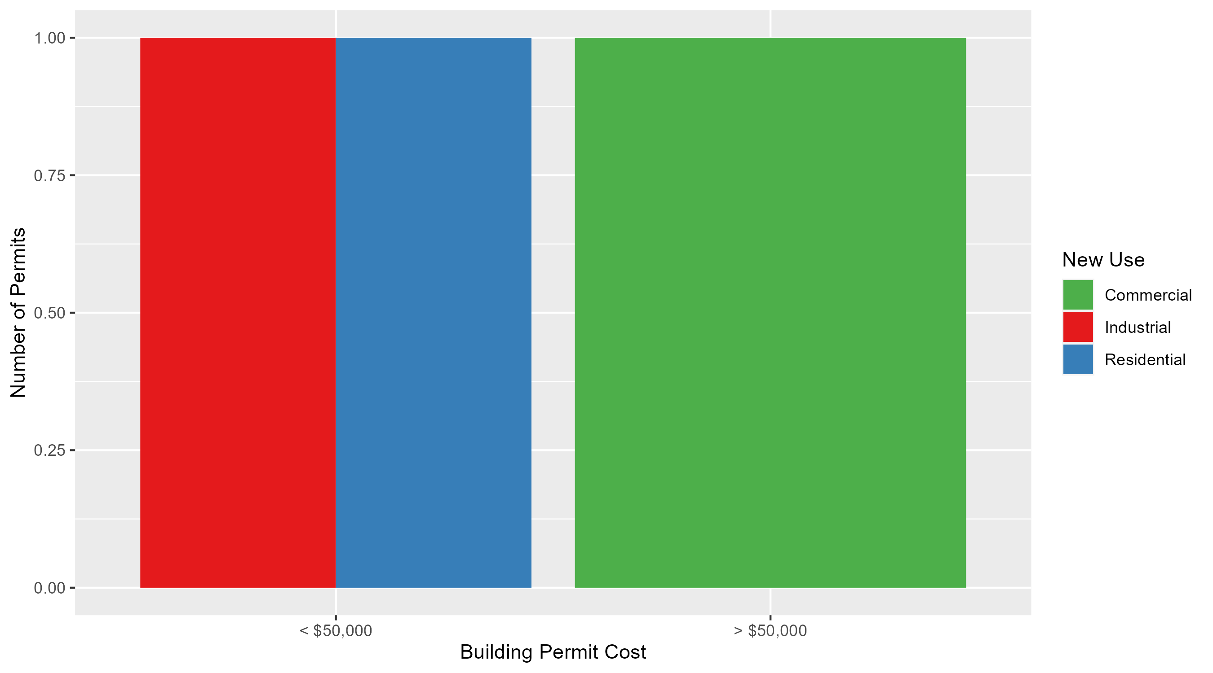
Lewis Place Permit Cost Breakdown

Slide 59
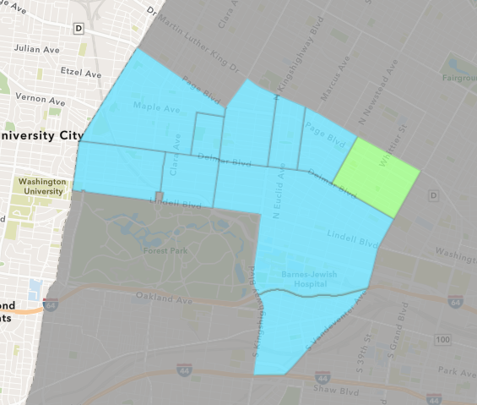
Vandeventer
August 2025 Neighborhood Cost Breakdown
Mean: $143,000
Median: $143,000
Range: $143,000 - $143,000

Slide 60
Vandeventer: Summary Notes
1 building permits in August 2025
-50.00% change compared to August 2024 (2 total building permits)
$143,000: Average building permit cost in August 2025
1729.81% change compared to August 2024 ($7,815)
4 total building permits in 2025
-42.86% change YTD compared to this time in 2024 (7 total building permits)
$42,375: YTD average building permit cost in 2025
-18.35% change YTD compared to this time in 2024 ($51,897)

Slide 61
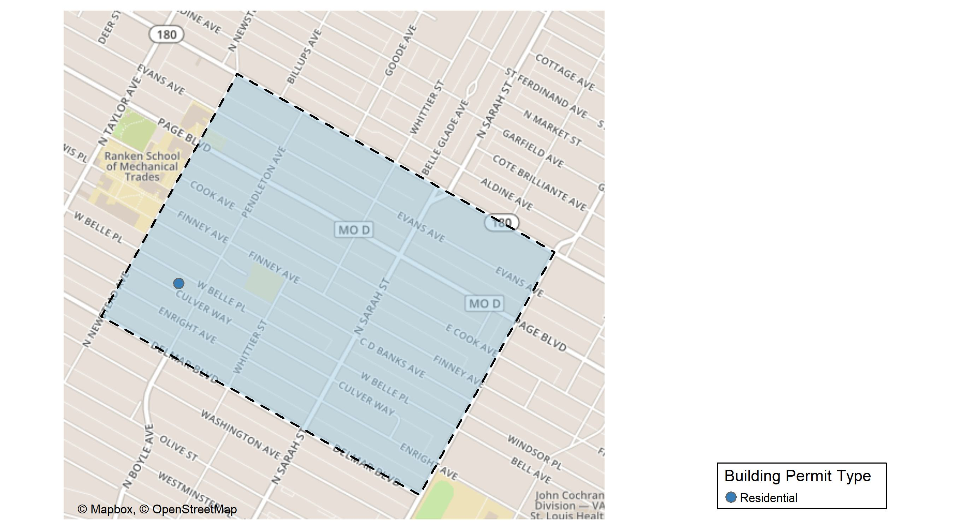
Vandeventer

Slide 62
Neighborhood Summary
August 2025 | August 2025 | August 2025 | August 2025
Permit Use | Average Cost | # of Permits | Total Value of Permits
Commercial | $0 | 0 | $0
Industrial | $0 | 0 | $0
Residential | $143,000 | 1 | $143,000
Last 6 Months | Last 6 Months | Last 6 Months | Last 6 Months
Permit Use | Average Cost | # of Permits | Total Value of Permits
Commercial | $0 | 0 | $0
Industrial | $9,000 | 1 | $9,000
Residential | $79,000 | 2 | $158,000

Slide 63
Vandeventer Individual Permit Breakdown
Neighborhood | Owner | New Use | Cost | address
Vandeventer | BARNES, LOUISE & ANITA L & LEVI | Residential | $143,000 | 4322 WEST BELLE PL

Slide 64
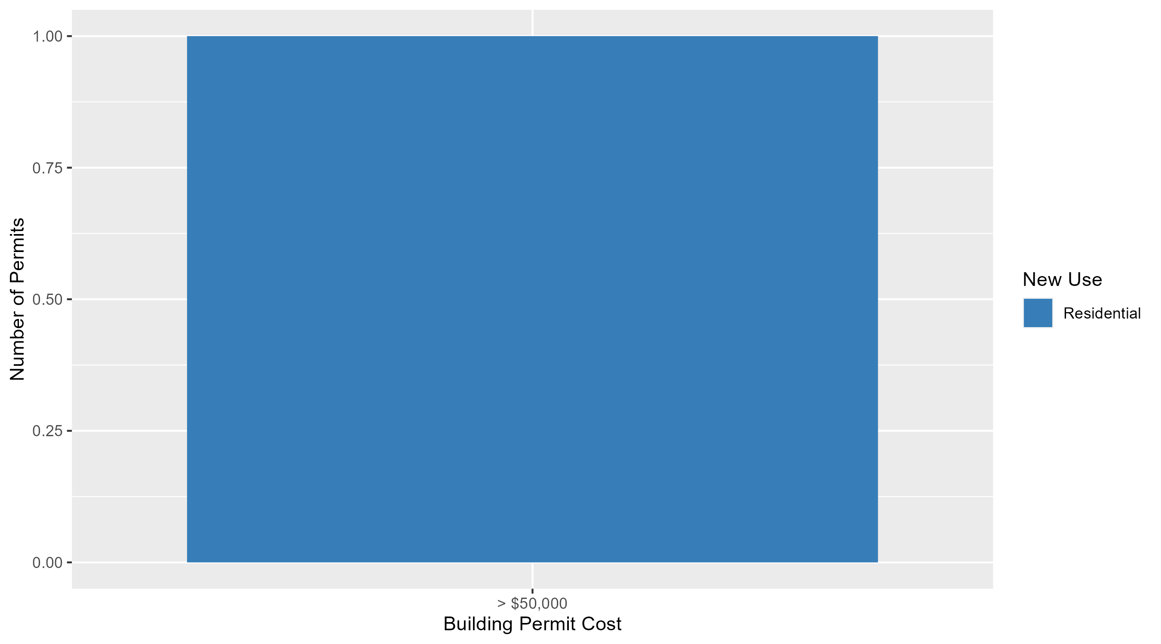
Vandeventer Permit Cost Breakdown

Slide 65
Additional Notes
Data retreived from https://www.stlouis-mo.gov/data/
Building permits with a cost of $0 were dropped
Building permits that were cancelled were dropped
Infinite change indicates 0 permits in the current or previous time period/comparison month so there was a overall increase or decrease

