Slide 1
St. Louis Central Corridor West Building Permits
Monthly Report: September 2025

Slide 2
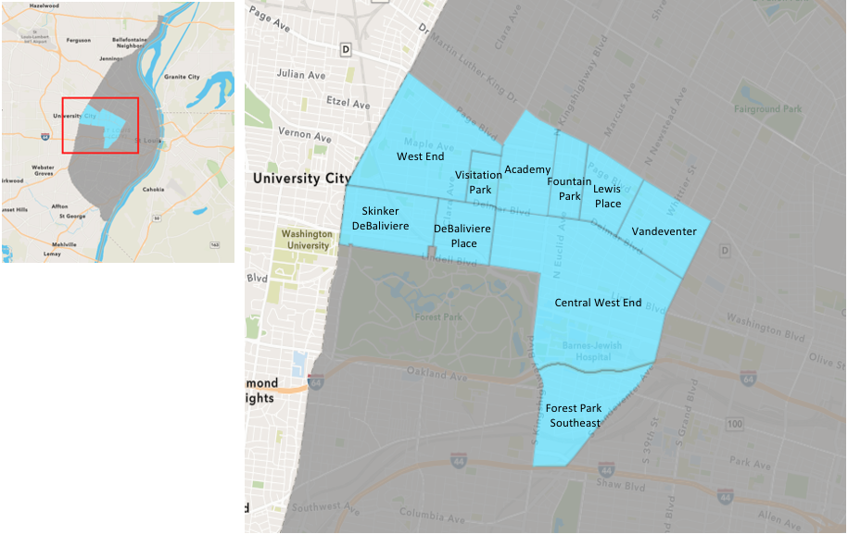
St. Louis Neighborhood Spatial Reference

Slide 3
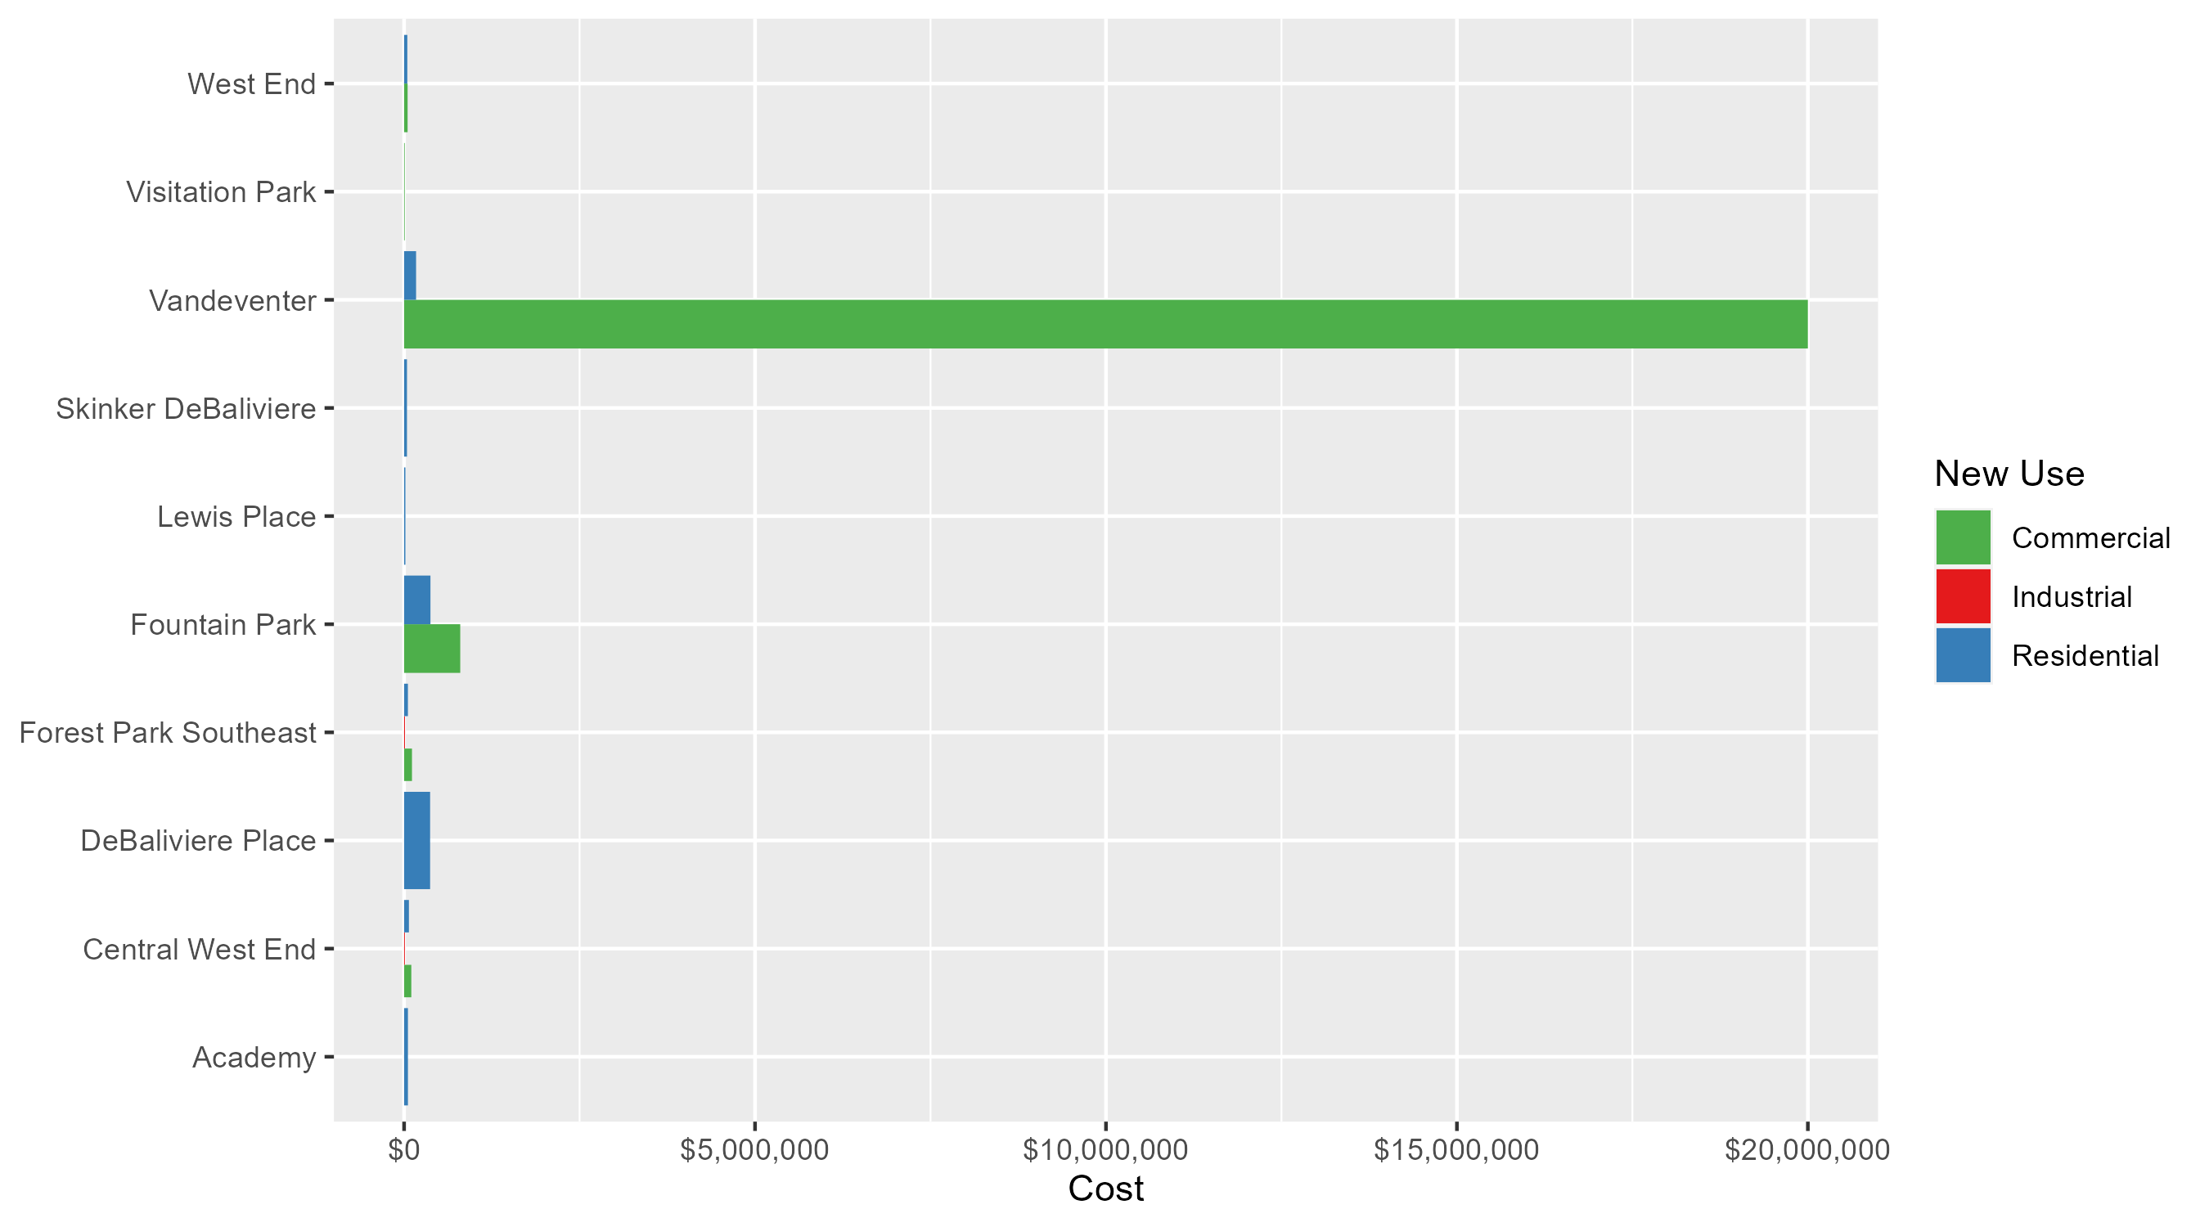
Neighborhood Summary: Average Building Permit Cost

Slide 4
Neighborhood Summary
September 2025 | September 2025 | September 2025 | September 2025
Neighborhood | Average Cost | # of Permits | Total Value of Permits
Academy | $54,740.00 | 5 | $273,700
Central West End | $71,844.67 | 48 | $3,448,544
DeBaliviere Place | $370,599.94 | 18 | $6,670,799
Forest Park Southeast | $73,492.31 | 13 | $955,400
Fountain Park | $460,400.00 | 5 | $2,302,000
Lewis Place | $19,000.00 | 4 | $76,000
Skinker DeBaliviere | $40,968.08 | 13 | $532,585
Vandeventer | $8,102,400.00 | 5 | $40,512,000
Visitation Park | $9,000.00 | 1 | $9,000
West End | $46,957.75 | 4 | $187,831
Last 6 Months | Last 6 Months | Last 6 Months | Last 6 Months
Neighborhood | Average Cost | # of Permits | Total Value of Permits
Academy | $134,152.81 | 27 | $3,622,126
Central West End | $161,357.99 | 255 | $41,146,288
DeBaliviere Place | $338,981.08 | 102 | $34,576,070
Forest Park Southeast | $69,164.65 | 54 | $3,734,891
Fountain Park | $405,063.16 | 19 | $7,696,200
Lewis Place | $99,566.95 | 20 | $1,991,339
Skinker DeBaliviere | $73,759.43 | 77 | $5,679,476
Vandeventer | $5,084,875.00 | 8 | $40,679,000
Visitation Park | $88,856.67 | 6 | $533,140
West End | $329,487.81 | 38 | $12,520,537

Slide 5
Core Neighborhoods

Slide 6
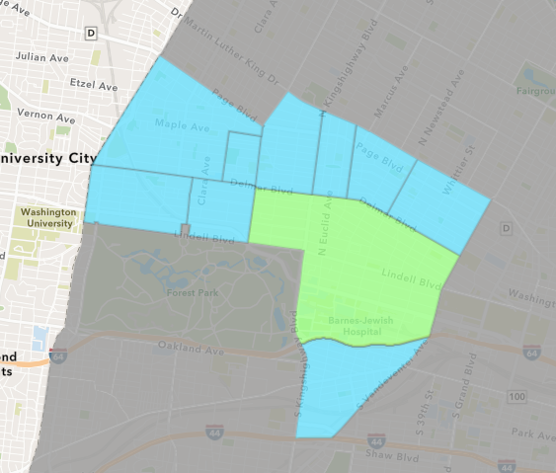
Central West End
September 2025 Neighborhood Cost Breakdown
  Mean: $71,845
  Median: $30,000
  Range: $775 - $425,000

Slide 7
Central West End: Summary Notes
48 building permits in September 2025
  182.35% change compared to September 2024 (17 total building permits)
  $71,845: Average building permit cost in September 2025
    -2.91% change compared to September 2024 ($74,000)
288 total building permits in 2025
  12.06% change YTD compared to this time in 2024 (257 total building permits)
  $157,127: YTD average building permit cost in 2025
    -59.96% change YTD compared to this time in 2024 ($392,443)

Slide 8
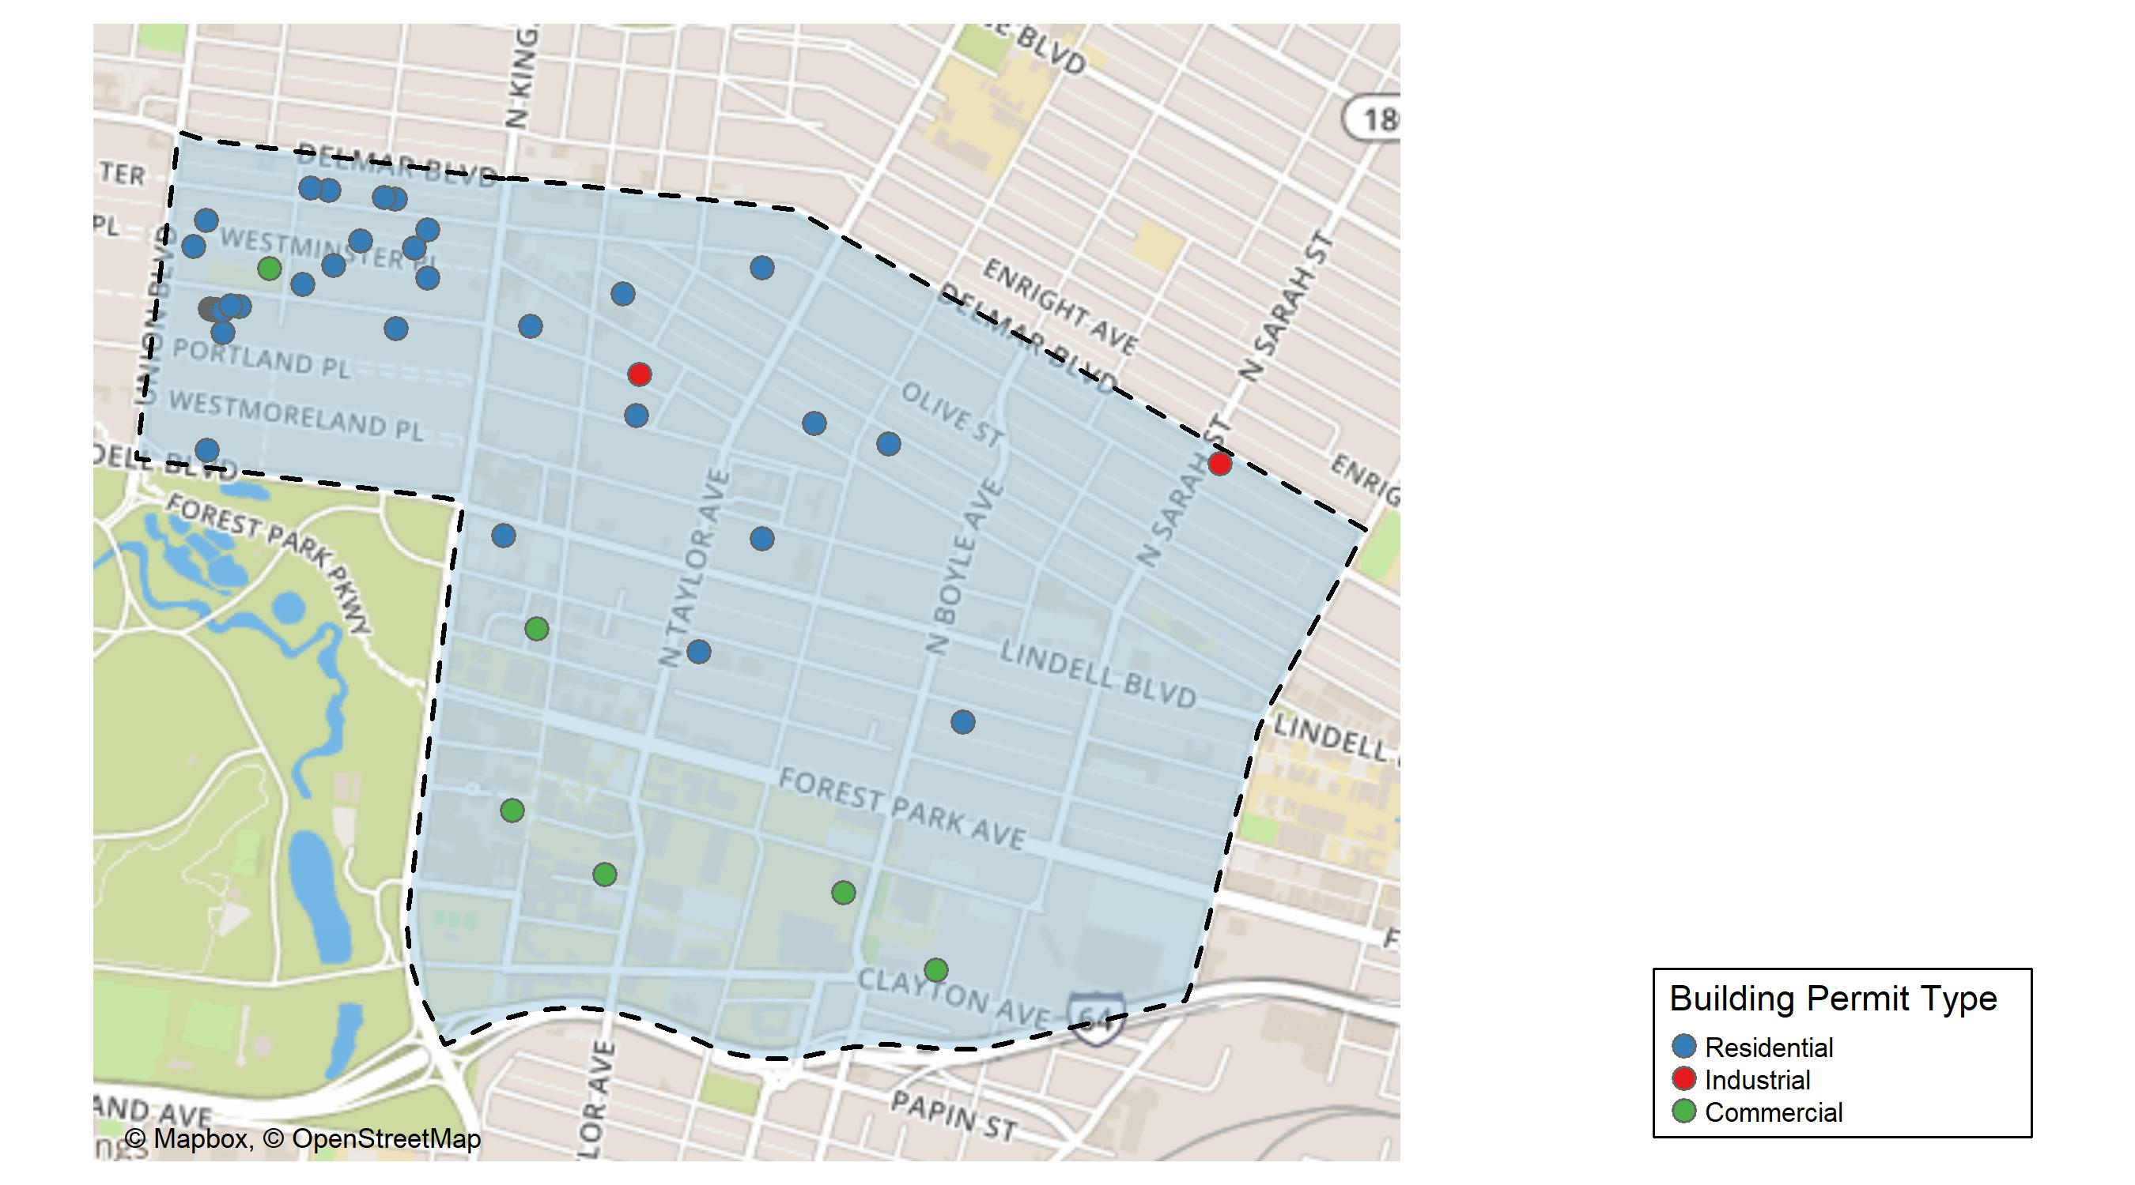
Central West End

Slide 9
Neighborhood Summary
September 2025 | September 2025 | September 2025 | September 2025
Permit Use | Average Cost | # of Permits | Total Value of Permits
Commercial | $102,816.25 | 8 | $822,530
Industrial | $11,340.00 | 2 | $22,680
Residential | $68,508.79 | 38 | $2,603,334
Last 6 Months | Last 6 Months | Last 6 Months | Last 6 Months
Permit Use | Average Cost | # of Permits | Total Value of Permits
Commercial | $230,887.0 | 74 | $17,085,638
Industrial | $309,085.6 | 13 | $4,018,113
Residential | $119,300.8 | 168 | $20,042,537

Slide 10
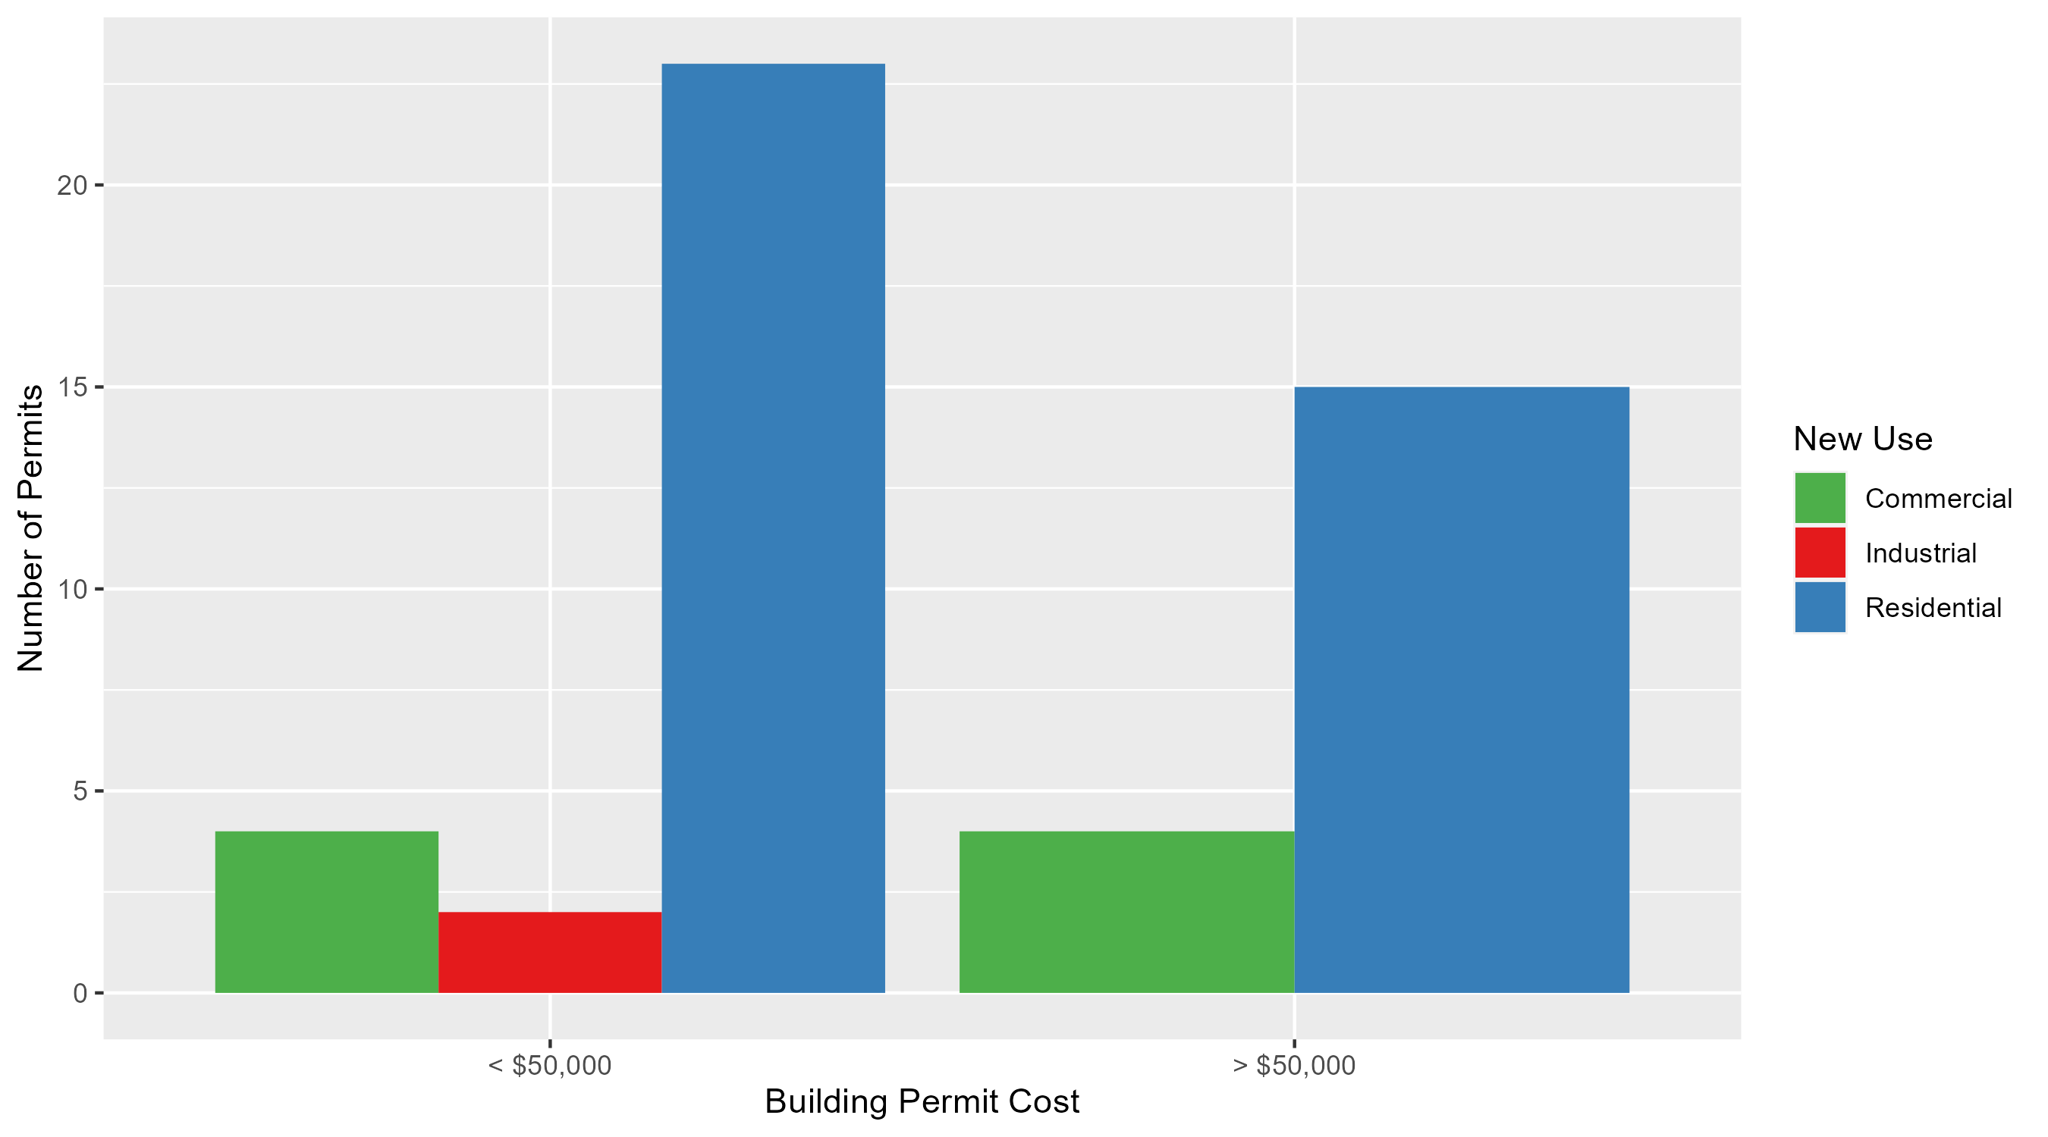
Central West End Permit Cost Breakdown

Slide 11
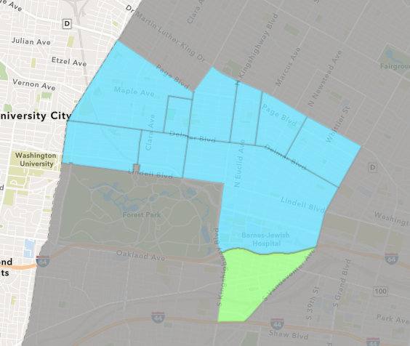
Forest Park Southeast
September 2025 Neighborhood Cost Breakdown
  Mean: $73,492
  Median: $28,000
  Range: $1,500 - $250,000

Slide 12
Forest Park Southeast: Summary Notes
13 building permits in September 2025
  550.00% change compared to September 2024 (2 total building permits)
  $73,492: Average building permit cost in September 2025
    960.19% change compared to September 2024 ($6,932)
60 total building permits in 2025
  13.21% change YTD compared to this time in 2024 (53 total building permits)
  $71,936: YTD average building permit cost in 2025
    20.80% change YTD compared to this time in 2024 ($59,549)

Slide 13
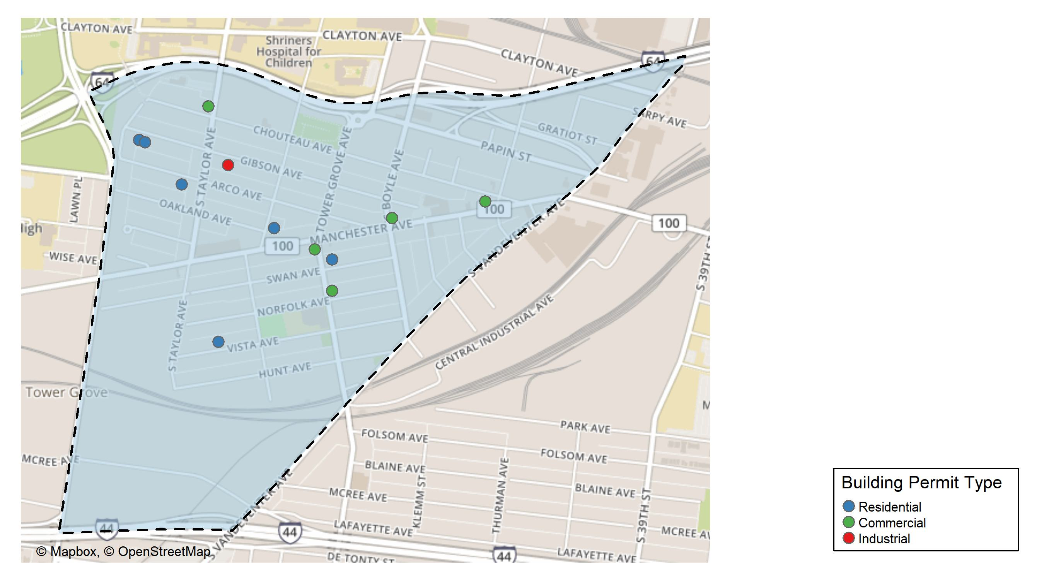
Forest Park Southeast

Slide 14
Neighborhood Summary
September 2025 | September 2025 | September 2025 | September 2025
Permit Use | Average Cost | # of Permits | Total Value of Permits
Commercial | $112,300.00 | 5 | $561,500
Industrial | $12,900.00 | 1 | $12,900
Residential | $54,428.57 | 7 | $381,000
Last 6 Months | Last 6 Months | Last 6 Months | Last 6 Months
Permit Use | Average Cost | # of Permits | Total Value of Permits
Commercial | $58,500.00 | 12 | $702,000
Industrial | $11,740.00 | 5 | $58,700
Residential | $80,383.54 | 37 | $2,974,191

Slide 15
Forest Park Southeast Individual Permit Breakdown
Neighborhood | Owner | New Use | Cost | address
Forest Park Southeast | SPENCER DEVELOPMENT LLC | Commercial | $155,000 | 4101 MANCHESTER AV
Forest Park Southeast | JABBAR, ABBAS | Residential | $250,000 | 4570 GIBSON AV
Forest Park Southeast | 4269 NORFOLK LLC | Commercial | $55,000 | 4269 NORFOLK AV
Forest Park Southeast | TROUTS LANDING LLC | Commercial | $200,000 | 4199 MANCHESTER AV
Forest Park Southeast | TOWER GROVE LLC | Commercial | $1,500 | 4300 MANCHESTER AV
Forest Park Southeast | BUCHHEIT, ELISE N | Residential | $28,000 | 4265 SWAN AV
Forest Park Southeast | TRAIN HARD PROPERTIES LLC | Commercial | $150,000 | 4503 CHOUTEAU AV
Forest Park Southeast | SLAG LLC | Industrial | $12,900 | 4452 GIBSON AV
Forest Park Southeast | 4441 VISTA AVENUE LLC | Residential | $4,000 | 4441 VISTA AV
Forest Park Southeast | MC ALINDEN, AUDREY TRS | Residential | $22,000 | 4518 ARCO AV
Forest Park Southeast | SLAG LLC | Residential | $45,000 | 4452 GIBSON AV
Forest Park Southeast | NASEER LLC | Residential | $15,000 | 1092-94 S NEWSTEAD AV
Forest Park Southeast | HUGUENARD, ANNA & MATTHEW J | Residential | $17,000 | 4564 GIBSON AV

Slide 16
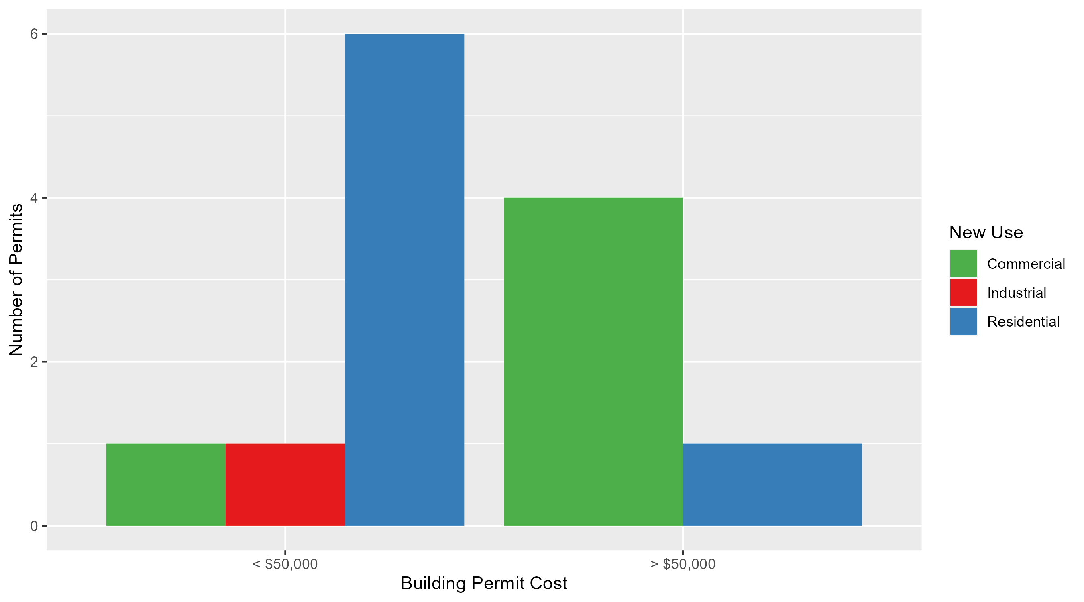
Forest Park Southeast Permit Cost Breakdown

Slide 17
Expanded Service Area

Slide 18
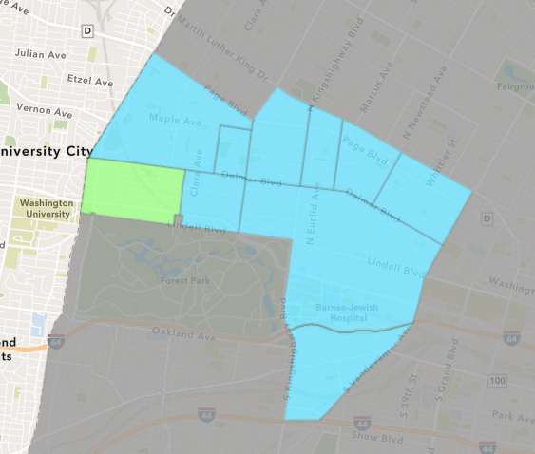
Skinker DeBaliviere
September 2025 Neighborhood Cost Breakdown
  Mean: $40,968
  Median: $13,972
  Range: $5,550 - $300,000

Slide 19
Skinker DeBaliviere: Summary Notes
13 building permits in September 2025
  44.44% change compared to September 2024 (9 total building permits)
  $40,968: Average building permit cost in September 2025
    -18.41% change compared to September 2024 ($50,211)
93 total building permits in 2025
  63.16% change YTD compared to this time in 2024 (57 total building permits)
  $71,445: YTD average building permit cost in 2025
    -23.67% change YTD compared to this time in 2024 ($93,596)

Slide 20
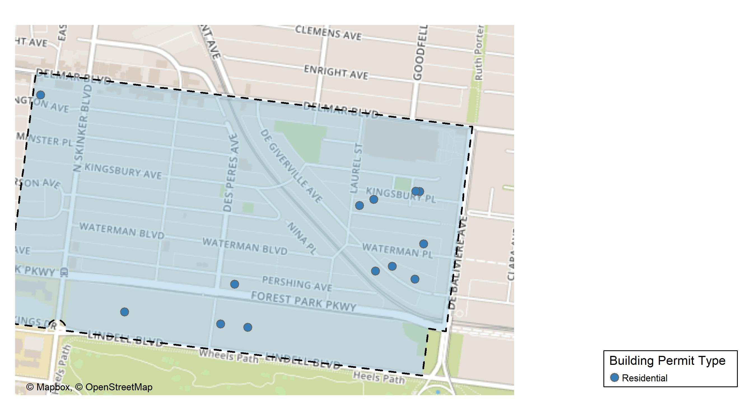
Skinker DeBaliviere

Slide 21
Neighborhood Summary
September 2025 | September 2025 | September 2025 | September 2025
Permit Use | Average Cost | # of Permits | Total Value of Permits
Commercial | $0.00 | 0 | $0
Industrial | $0.00 | 0 | $0
Residential | $40,968.08 | 13 | $532,585
Last 6 Months | Last 6 Months | Last 6 Months | Last 6 Months
Permit Use | Average Cost | # of Permits | Total Value of Permits
Commercial | $21,169.50 | 2 | $42,339
Industrial | $22,000.00 | 1 | $22,000
Residential | $75,880.23 | 74 | $5,615,137

Slide 22
Skinker DeBaliviere Individual Permit Breakdown
Neighborhood | Owner | New Use | Cost | address
Skinker DeBaliviere | HANNAH HA MD LLC | Residential | $5,550 | 5944 PERSHING AV
Skinker DeBaliviere | SAHM, BRITTANY & TAYLOR DUNNINGTON | Residential | $9,870 | 5733 WATERMAN BLVD
Skinker DeBaliviere | HIGBEE, PAUL | Residential | $300,000 | 5925 LINDELL BLVD
Skinker DeBaliviere | RD2 FLIP INTERNATIONAL LLC | Residential | $12,000 | 6251 WASHINGTON AV
Skinker DeBaliviere | SHARP, THEONNIS | Residential | $18,675 | 5727 KINGSBURY PL
Skinker DeBaliviere | BONNER, CARMEN P | Residential | $18,198 | 500 KINGSBURY SQUARE
Skinker DeBaliviere | MOORE, GERALD L & DEBRA A | Residential | $9,000 | 5773 DEGIVERVILLE AV
Skinker DeBaliviere | BARNETT, GEORGIA A | Residential | $12,000 | 5741 DEGIVERVILLE AV
Skinker DeBaliviere | SOCK, SHANNON P & WENDI K | Residential | $80,000 | 6127 LINDELL BLVD
Skinker DeBaliviere | HAYNES, LAJUANA | Residential | $28,620 | 5770 DEGIVERVILLE AV
Skinker DeBaliviere | ROBERTS, ANGELA A | Residential | $13,972 | 5797 MCPHERSON AV
Skinker DeBaliviere | LORBERT, STEPHEN J & GERMAINE L | Residential | $14,000 | 5949 LINDELL BLVD
Skinker DeBaliviere | BANNES, ANN R | Residential | $10,700 | 5774 KINGSBURY PL

Slide 23
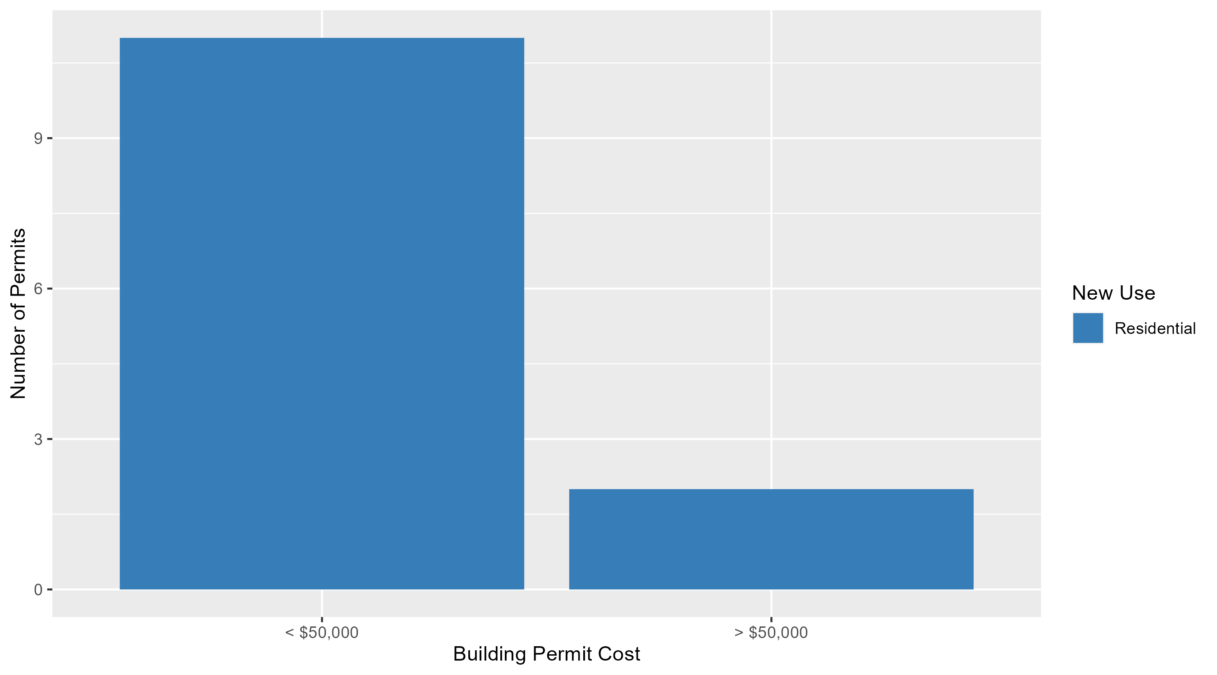
Skinker DeBaliviere Permit Cost Breakdown

Slide 24
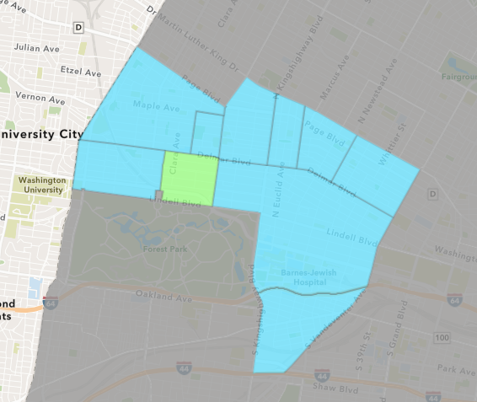
DeBaliviere Place
September 2025 Neighborhood Cost Breakdown
  Mean: $370,600
  Median: $172,500
  Range: $6,500 - $1,715,000

Slide 25
DeBaliviere Place: Summary Notes
18 building permits in September 2025
  350.00% change compared to September 2024 (4 total building permits)
  $370,600: Average building permit cost in September 2025
    29.86% change compared to September 2024 ($285,375)
109 total building permits in 2025
  211.43% change YTD compared to this time in 2024 (35 total building permits)
  $318,547: YTD average building permit cost in 2025
    147.17% change YTD compared to this time in 2024 ($128,877)

Slide 26
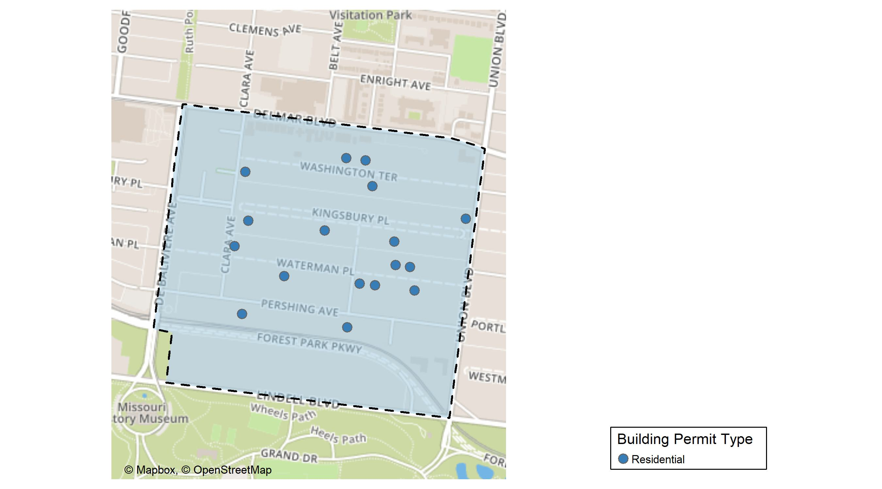
DeBaliviere Place

Slide 27
Neighborhood Summary
September 2025 | September 2025 | September 2025 | September 2025
Permit Use | Average Cost | # of Permits | Total Value of Permits
Commercial | $0.0 | 0 | $0
Industrial | $0.0 | 0 | $0
Residential | $370,599.9 | 18 | $6,670,799
Last 6 Months | Last 6 Months | Last 6 Months | Last 6 Months
Permit Use | Average Cost | # of Permits | Total Value of Permits
Commercial | $74,240.8 | 5 | $371,204
Industrial | $0.0 | 0 | $0
Residential | $352,627.5 | 97 | $34,204,866

Slide 28
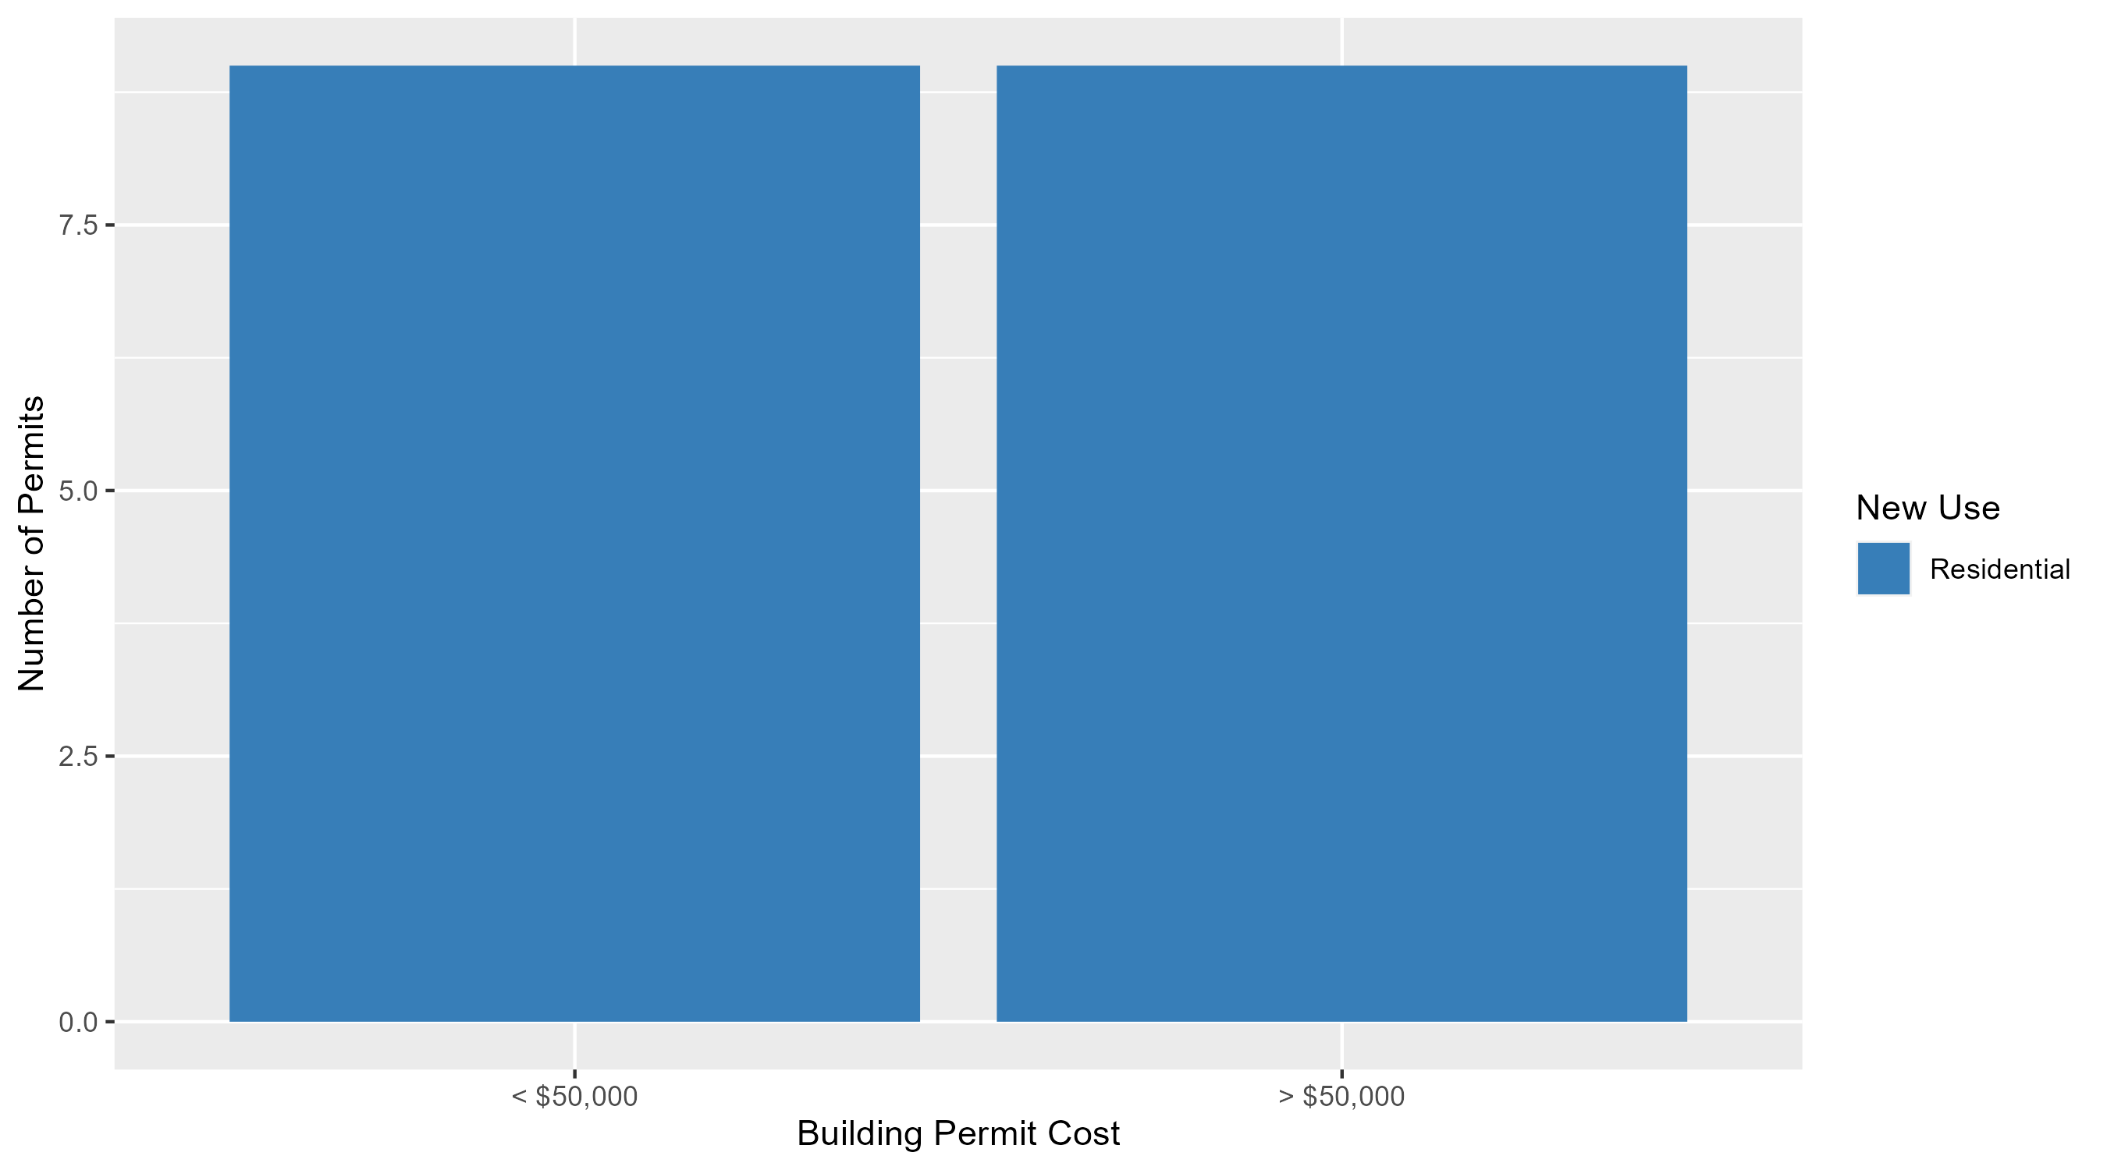
DeBaliviere Place Permit Cost Breakdown

Slide 29
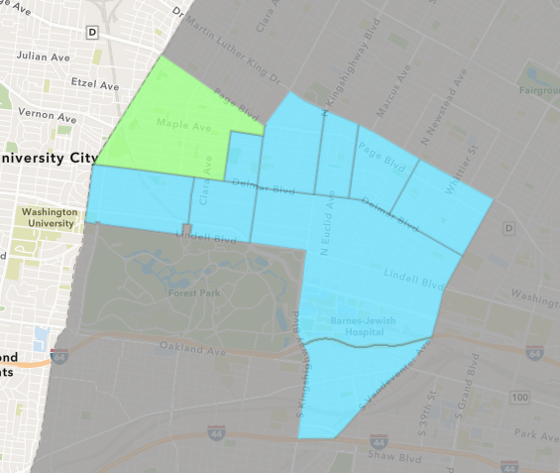
West End
September 2025 Neighborhood Cost Breakdown
  Mean: $46,958
  Median: $57,500
  Range: $7,831 - $65,000

Slide 30
West End: Summary Notes
4 building permits in September 2025
  100.00% change compared to September 2024 (2 total building permits)
  $46,958: Average building permit cost in September 2025
    32.28% change compared to September 2024 ($35,500)
43 total building permits in 2025
  -25.86% change YTD compared to this time in 2024 (58 total building permits)
  $297,913: YTD average building permit cost in 2025
    274.64% change YTD compared to this time in 2024 ($79,519)

Slide 31
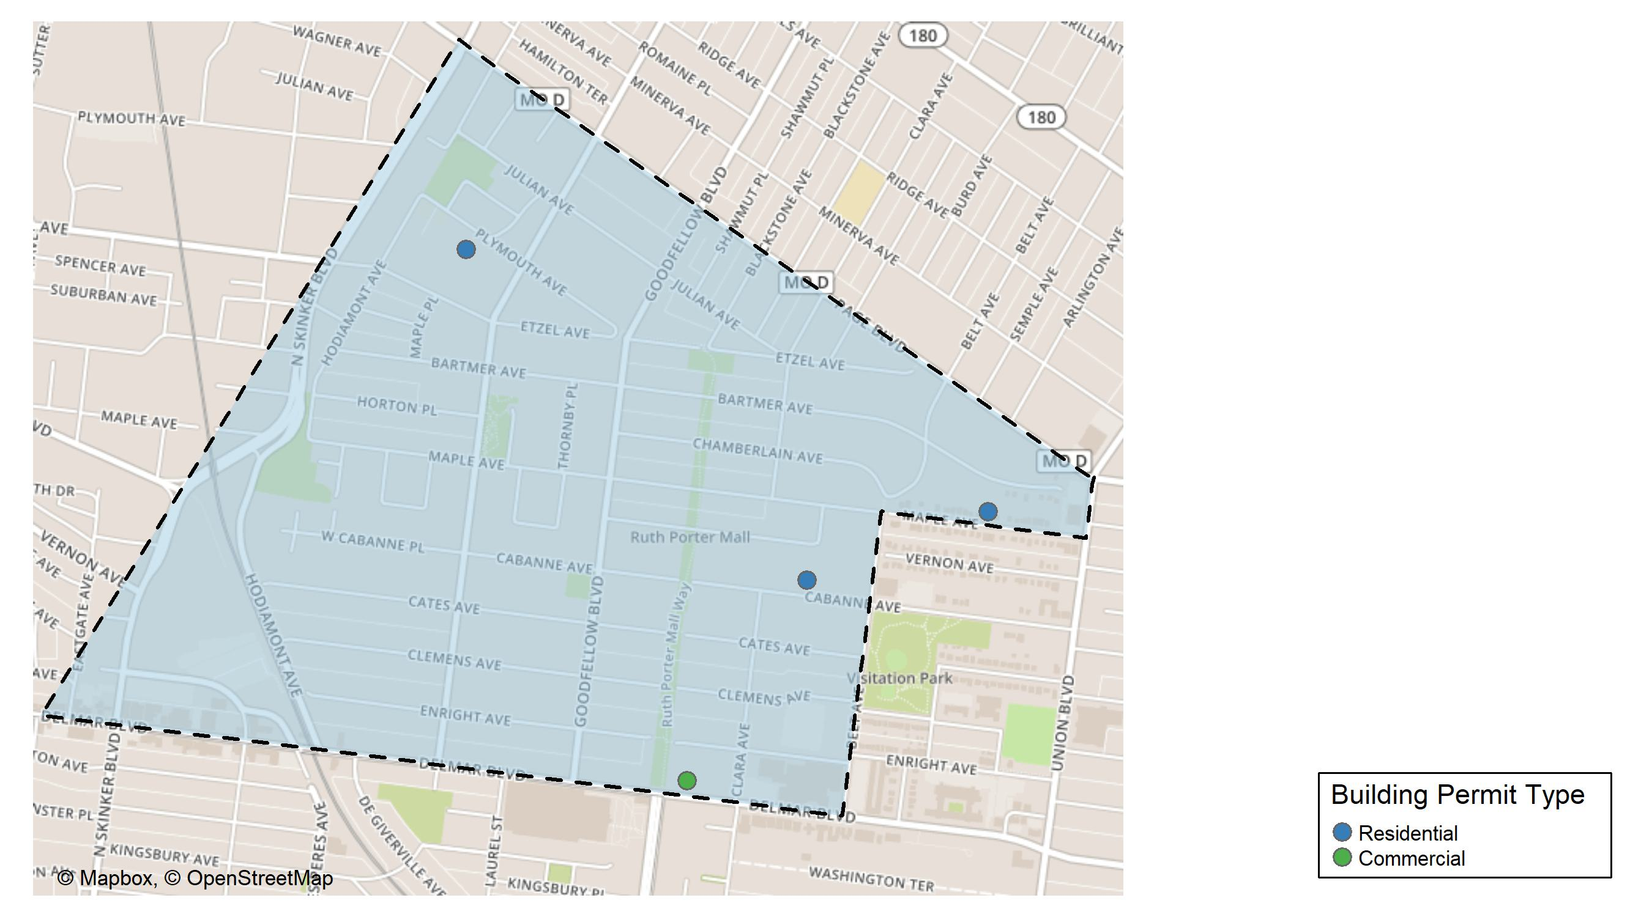
West End

Slide 32
Neighborhood Summary
September 2025 | September 2025 | September 2025 | September 2025
Permit Use | Average Cost | # of Permits | Total Value of Permits
Commercial | $50,000.00 | 1 | $50,000
Industrial | $0.00 | 0 | $0
Residential | $45,943.67 | 3 | $137,831
Last 6 Months | Last 6 Months | Last 6 Months | Last 6 Months
Permit Use | Average Cost | # of Permits | Total Value of Permits
Commercial | $1,209,448.67 | 9 | $10,885,038
Industrial | $93,070.50 | 2 | $186,141
Residential | $53,679.91 | 27 | $1,449,358

Slide 33
West End Individual Permit Breakdown
Neighborhood | Owner | New Use | Cost | address
West End | VALUE FIRST CONTRACTORS LLC | Residential | $65,000 | 5942 PLYMOUTH AV
West End | BETTY JEAN KERR PEOPLES HEALTH CNTRS | Commercial | $50,000 | 5635 DELMAR BLVD
West End | MADISON, ANTHONETTE D | Residential | $65,000 | 5375 MAPLE AV
West End | BARNES, JOHNNY E & VERNELL WILLIAMS | Residential | $7,831 | 5551 CABANNE AV

Slide 34
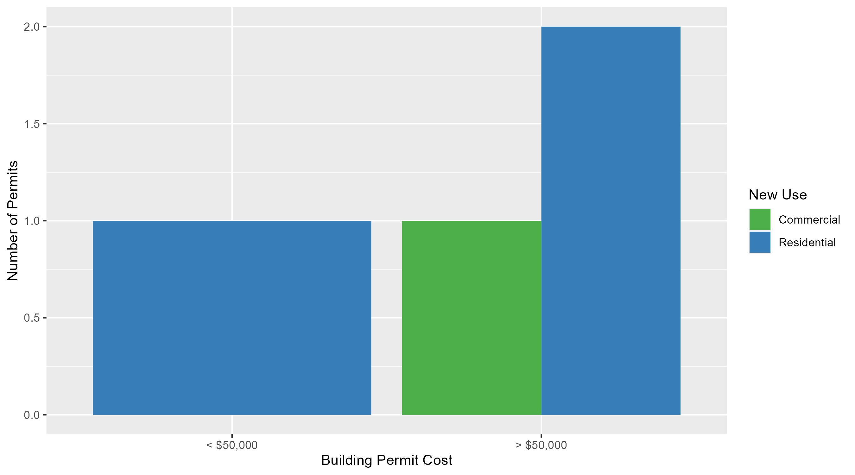
West End Permit Cost Breakdown

Slide 35
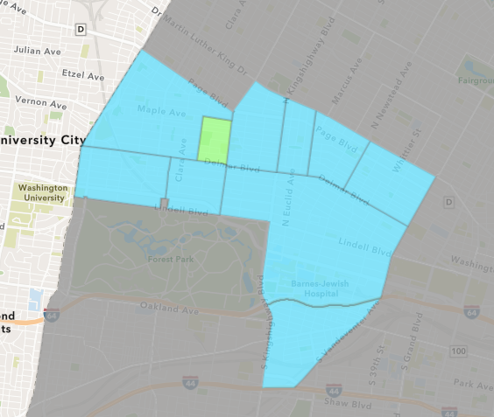
Visitation Park
September 2025 Neighborhood Cost Breakdown
  Mean: $9,000
  Median: $9,000
  Range: $9,000 - $9,000

Slide 36
Visitation Park: Summary Notes
1 building permits in September 2025
  Infinite change compared to September 2024 (0 total building permits)
  $9,000: Average building permit cost in September 2025
    Infinite change compared to September 2024 ($0)
6 total building permits in 2025
  200.00% change YTD compared to this time in 2024 (2 total building permits)
  $88,857: YTD average building permit cost in 2025
    335.57% change YTD compared to this time in 2024 ($20,400)

Slide 37
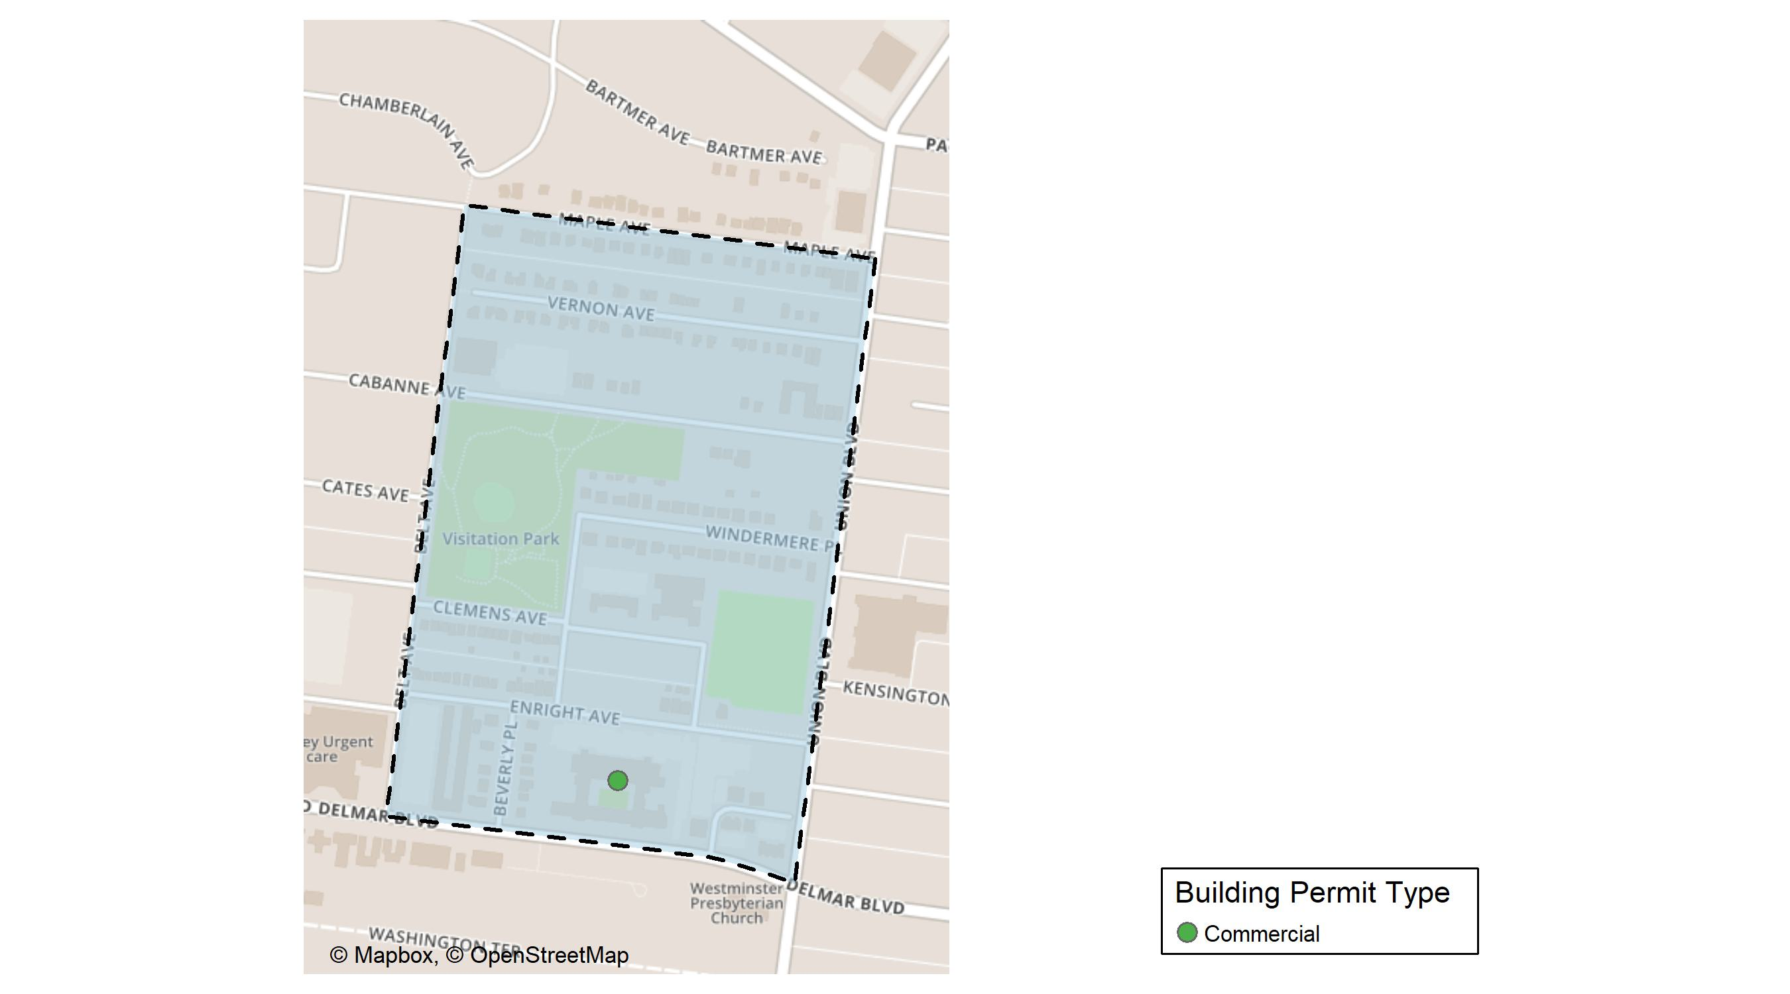
Visitation Park

Slide 38
Neighborhood Summary
September 2025 | September 2025 | September 2025 | September 2025
Permit Use | Average Cost | # of Permits | Total Value of Permits
Commercial | $9,000 | 1 | $9,000
Industrial | $0 | 0 | $0
Residential | $0 | 0 | $0
Last 6 Months | Last 6 Months | Last 6 Months | Last 6 Months
Permit Use | Average Cost | # of Permits | Total Value of Permits
Commercial | $9,000 | 1 | $9,000
Industrial | $0 | 0 | $0
Residential | $104,828 | 5 | $524,140

Slide 39
Visitation Park Individual Permit Breakdown
Neighborhood | Owner | New Use | Cost | address
Visitation Park | STATE OF MISSOURI | Commercial | $9,000 | 5351 DELMAR BLVD

Slide 40
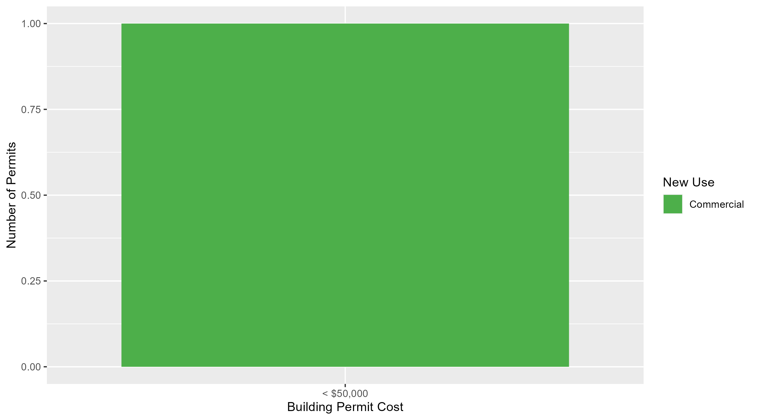
Visitation Park Permit Cost Breakdown

Slide 41
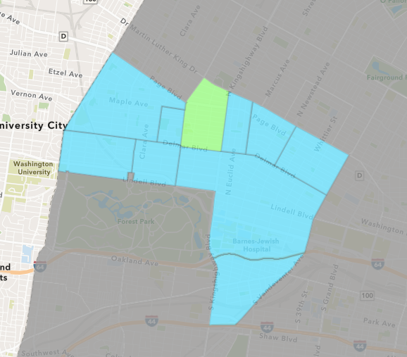
Academy
September 2025 Neighborhood Cost Breakdown
  Mean: $54,740
  Median: $18,000
  Range: $5,700 - $205,000

Slide 42
Academy: Summary Notes
5 building permits in September 2025
  150.00% change compared to September 2024 (2 total building permits)
  $54,740: Average building permit cost in September 2025
    158.92% change compared to September 2024 ($21,142)
32 total building permits in 2025
  77.78% change YTD compared to this time in 2024 (18 total building permits)
  $120,816: YTD average building permit cost in 2025
    184.28% change YTD compared to this time in 2024 ($42,499)

Slide 43
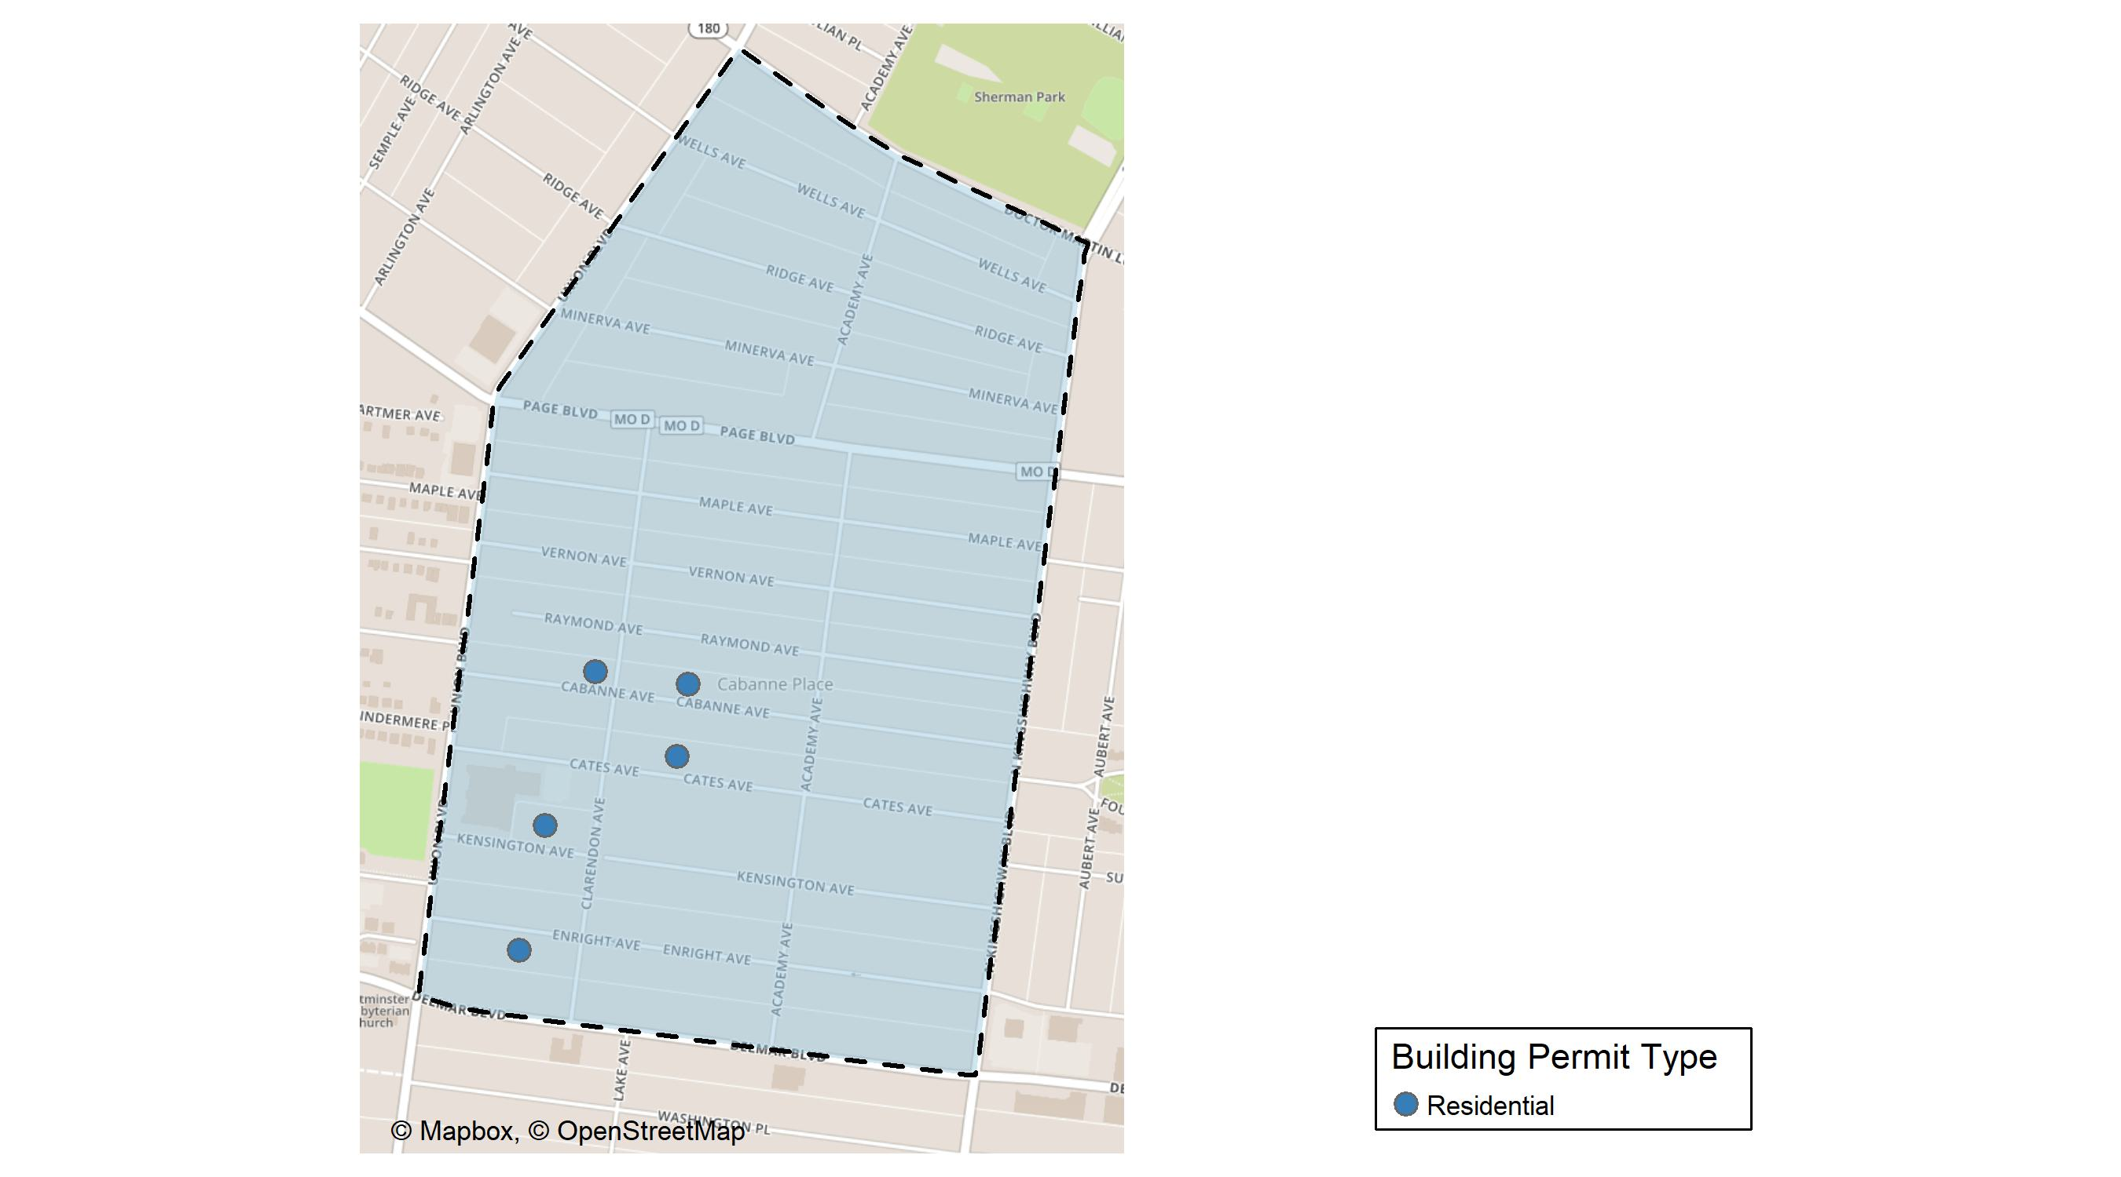
Academy

Slide 44
Neighborhood Summary
September 2025 | September 2025 | September 2025 | September 2025
Permit Use | Average Cost | # of Permits | Total Value of Permits
Commercial | $0 | 0 | $0
Industrial | $0 | 0 | $0
Residential | $54,740 | 5 | $273,700
Last 6 Months | Last 6 Months | Last 6 Months | Last 6 Months
Permit Use | Average Cost | # of Permits | Total Value of Permits
Commercial | $598,133.33 | 3 | $1,794,400
Industrial | $0.00 | 0 | $0
Residential | $76,155.25 | 24 | $1,827,726

Slide 45
Academy Individual Permit Breakdown
Neighborhood | Owner | New Use | Cost | address
Academy | GLOVER, LOUELLA | Residential | $30,000 | 5228 ENRIGHT AV
Academy | JOHNSON, KENA & JAMAL | Residential | $5,700 | 5165 CATES AV
Academy | MALONE, EARL | Residential | $205,000 | 5209 CABANNE AV
Academy | POWELL, LARRY | Residential | $18,000 | 5223 KENSINGTON AV
Academy | WINFIELD, MURL D | Residential | $15,000 | 5165 CABANNE AV

Slide 46
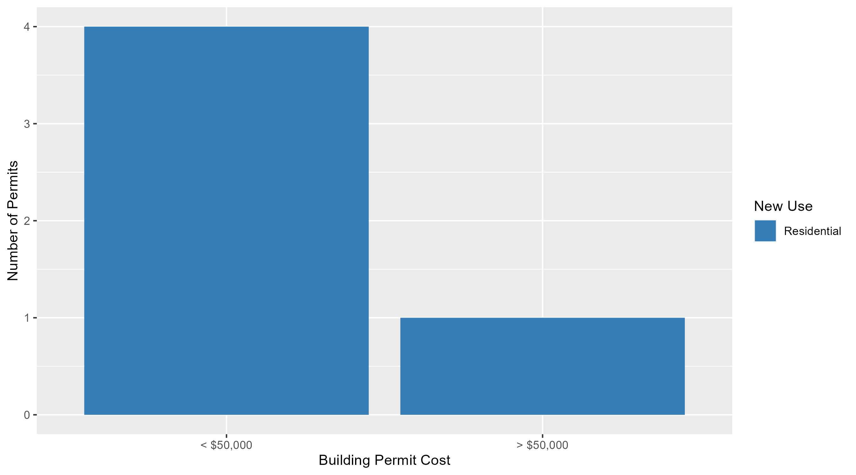
Academy Permit Cost Breakdown

Slide 47
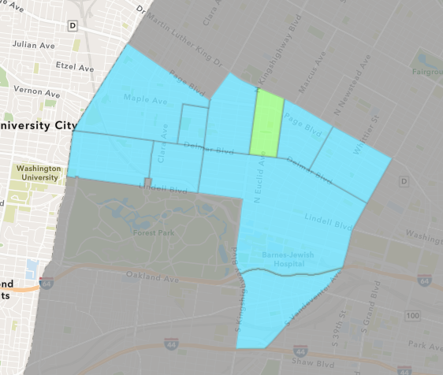
Fountain Park
September 2025 Neighborhood Cost Breakdown
  Mean: $460,400
  Median: $95,000
  Range: $7,000 - $1,350,000

Slide 48
Fountain Park: Summary Notes
5 building permits in September 2025
  Infinite change compared to September 2024 (0 total building permits)
  $460,400: Average building permit cost in September 2025
    Infinite change compared to September 2024 ($0)
20 total building permits in 2025
  150.00% change YTD compared to this time in 2024 (8 total building permits)
  $385,100: YTD average building permit cost in 2025
    1012.20% change YTD compared to this time in 2024 ($34,625)

Slide 49
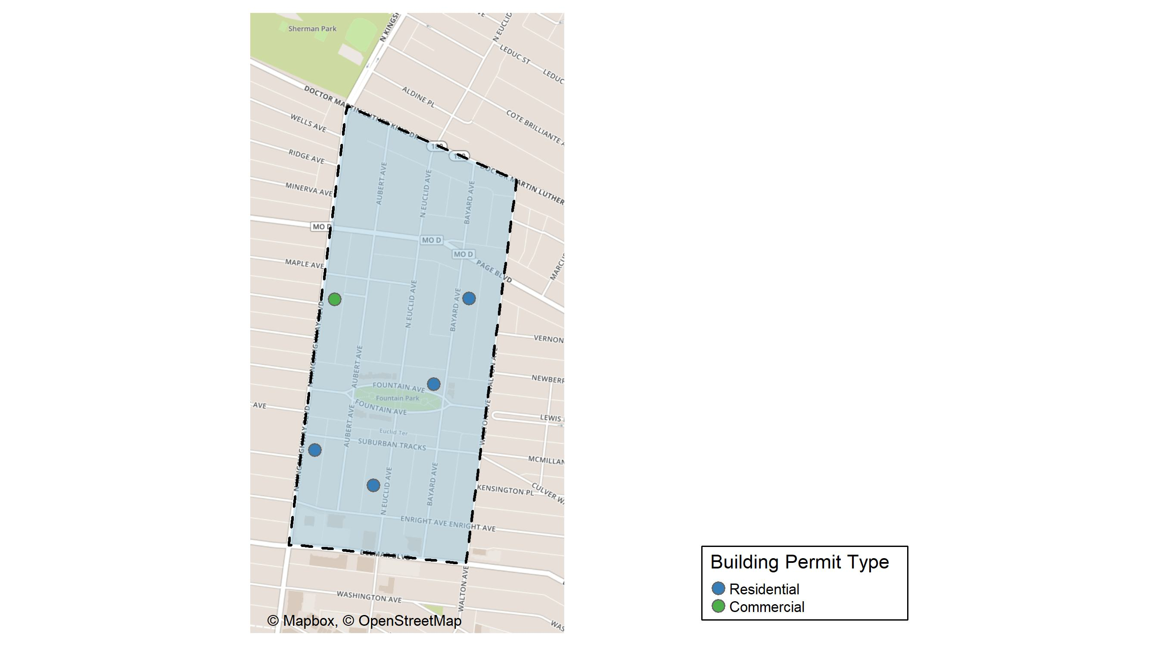
Fountain Park

Slide 50
Neighborhood Summary
September 2025 | September 2025 | September 2025 | September 2025
Permit Use | Average Cost | # of Permits | Total Value of Permits
Commercial | $800,000 | 1 | $800,000
Industrial | $0 | 0 | $0
Residential | $375,500 | 4 | $1,502,000
Last 6 Months | Last 6 Months | Last 6 Months | Last 6 Months
Permit Use | Average Cost | # of Permits | Total Value of Permits
Commercial | $211,560.0 | 5 | $1,057,800
Industrial | $0.0 | 0 | $0
Residential | $474,171.4 | 14 | $6,638,400

Slide 51
Fountain Park Individual Permit Breakdown
Neighborhood | Owner | New Use | Cost | address
Fountain Park | PAD LLC | Residential | $50,000 | 1228 BAYARD AV
Fountain Park | WHITE, JOHNNY III & ANNETTE F SMITH | Residential | $95,000 | 4851 FOUNTAIN AV
Fountain Park | ARAA LLC | Commercial | $800,000 | 1206 N KINGSHIGHWAY BLVD
Fountain Park | ANDERSON, BRIAN & BENJAMIN | Residential | $7,000 | 761 N EUCLID AV
Fountain Park | SRK 848 LLC | Residential | $1,350,000 | 848 N KINGSHIGHWAY BLVD

Slide 52
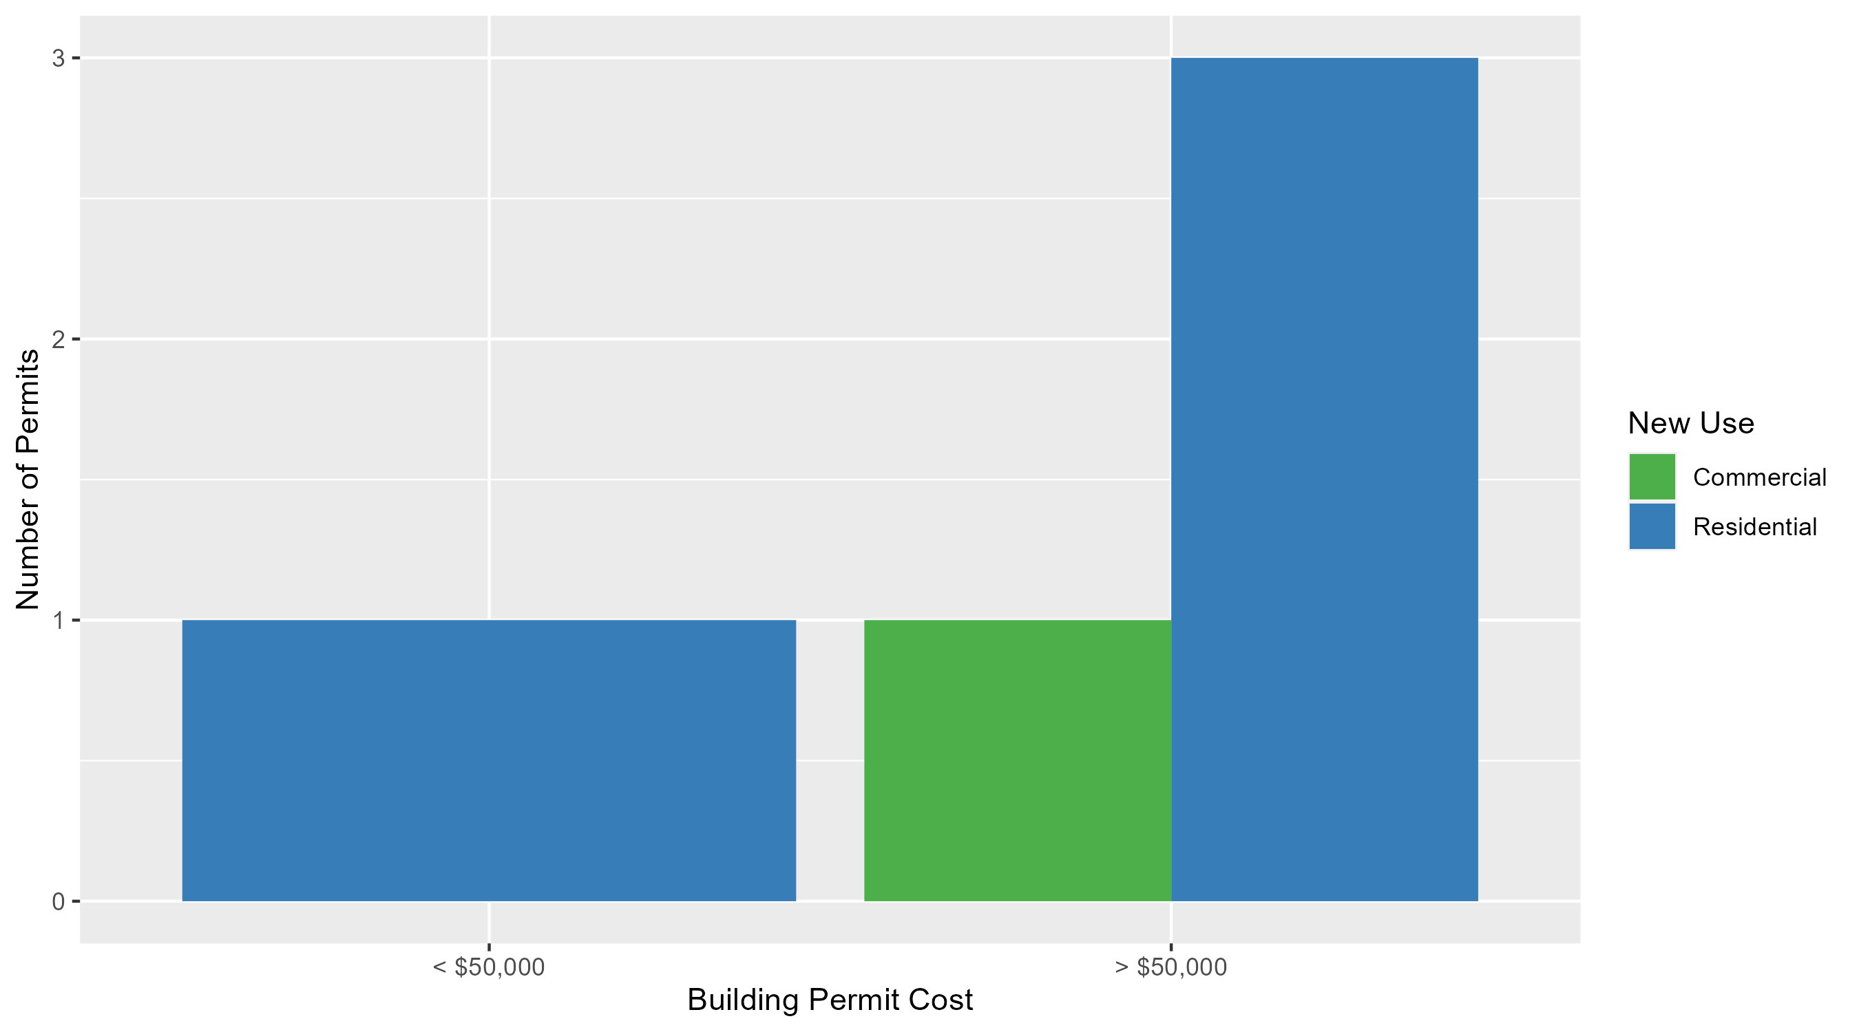
Fountain Park Permit Cost Breakdown

Slide 53
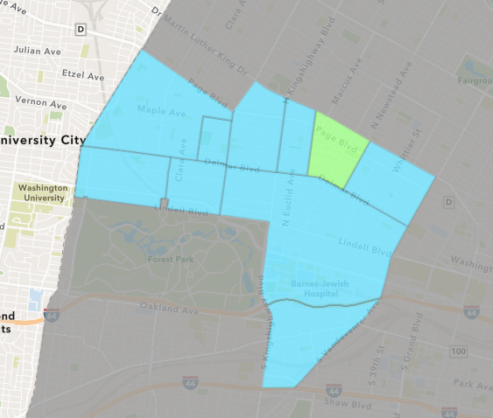
Lewis Place
September 2025 Neighborhood Cost Breakdown
  Mean: $19,000
  Median: $13,500
  Range: $1,000 - $48,000

Slide 54
Lewis Place: Summary Notes
4 building permits in September 2025
  300.00% change compared to September 2024 (1 total building permits)
  $19,000: Average building permit cost in September 2025
    -65.45% change compared to September 2024 ($55,000)
21 total building permits in 2025
  75.00% change YTD compared to this time in 2024 (12 total building permits)
  $99,588: YTD average building permit cost in 2025
    277.95% change YTD compared to this time in 2024 ($26,350)

Slide 55
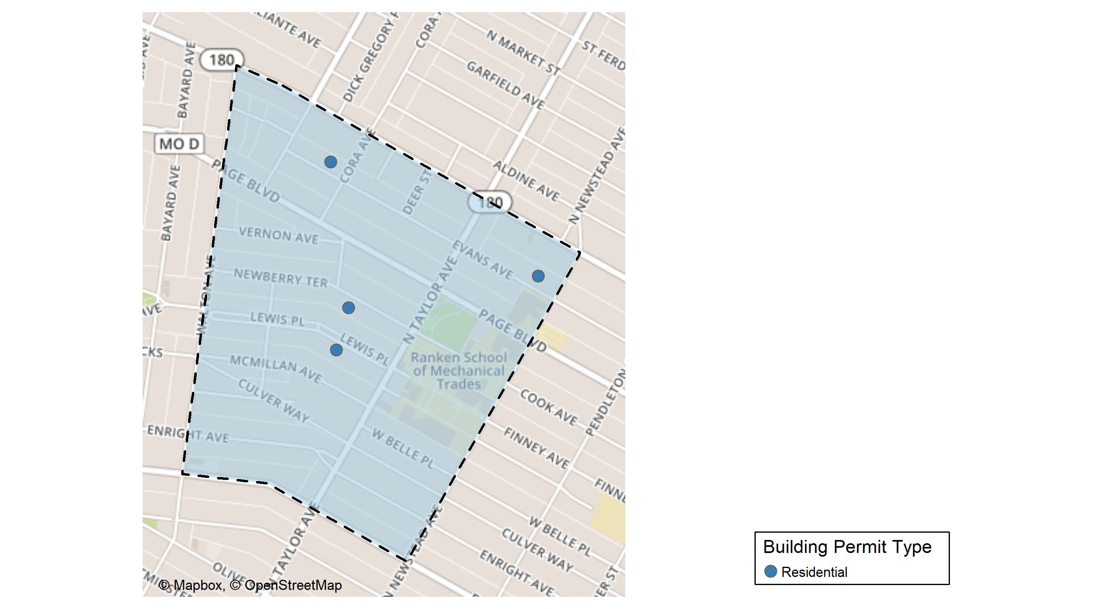
Lewis Place

Slide 56
Neighborhood Summary
September 2025 | September 2025 | September 2025 | September 2025
Permit Use | Average Cost | # of Permits | Total Value of Permits
Commercial | $0 | 0 | $0
Industrial | $0 | 0 | $0
Residential | $19,000 | 4 | $76,000
Last 6 Months | Last 6 Months | Last 6 Months | Last 6 Months
Permit Use | Average Cost | # of Permits | Total Value of Permits
Commercial | $225,367.80 | 5 | $1,126,839
Industrial | $2,000.00 | 1 | $2,000
Residential | $61,607.14 | 14 | $862,500

Slide 57
Lewis Place Individual Permit Breakdown
Neighborhood | Owner | New Use | Cost | address
Lewis Place | LATIMORE, ARETHA INEZ | Residential | $4,000 | 4417 EVANS AV
Lewis Place | BENSON, ANNETTA M & MARKEITH | Residential | $48,000 | 4637 EVANS AV
Lewis Place | BUFFORD-THOMAS, CHERYL | Residential | $23,000 | 20 LEWIS PL
Lewis Place | WHITE, SYLVIA A & TERMON T WHITE & | Residential | $1,000 | 4558 NEWBERRY TER

Slide 58
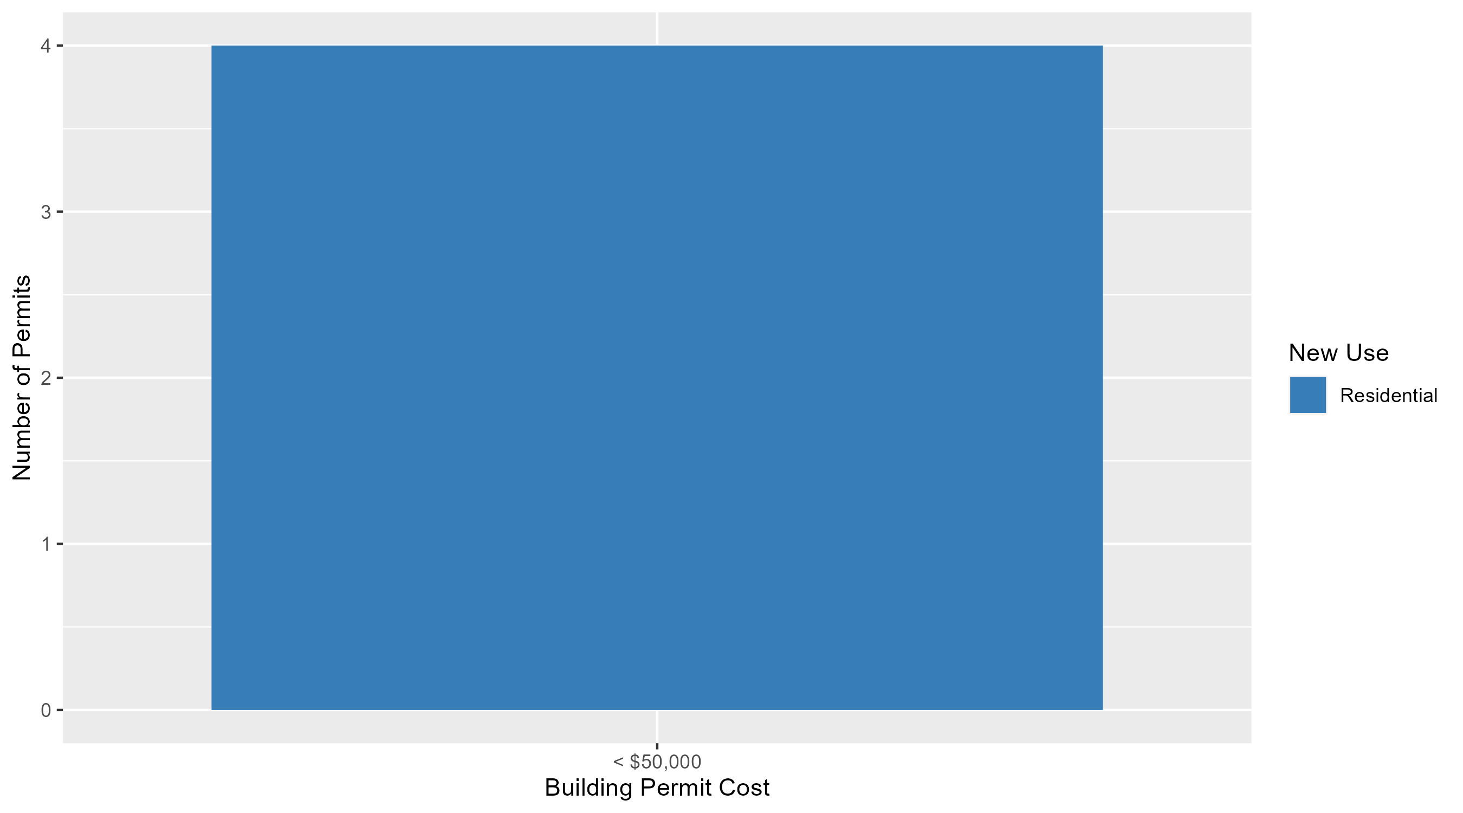
Lewis Place Permit Cost Breakdown

Slide 59
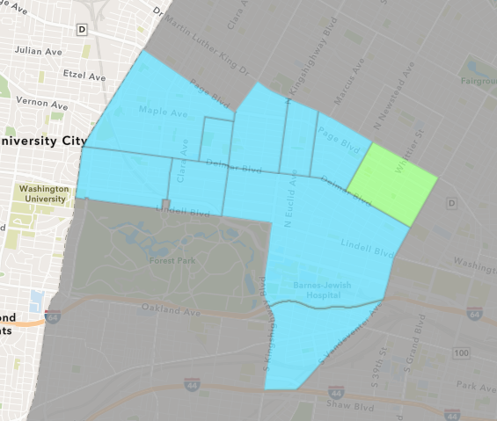
Vandeventer
September 2025 Neighborhood Cost Breakdown
  Mean: $8,102,400
  Median: $495,000
  Range: $1,000 - $20,000,000

Slide 60
Vandeventer: Summary Notes
5 building permits in September 2025
  400.00% change compared to September 2024 (1 total building permits)
  $8,102,400: Average building permit cost in September 2025
    161948.00% change compared to September 2024 ($5,000)
9 total building permits in 2025
  12.50% change YTD compared to this time in 2024 (8 total building permits)
  $4,520,167: YTD average building permit cost in 2025
    9718.98% change YTD compared to this time in 2024 ($46,035)

Slide 61
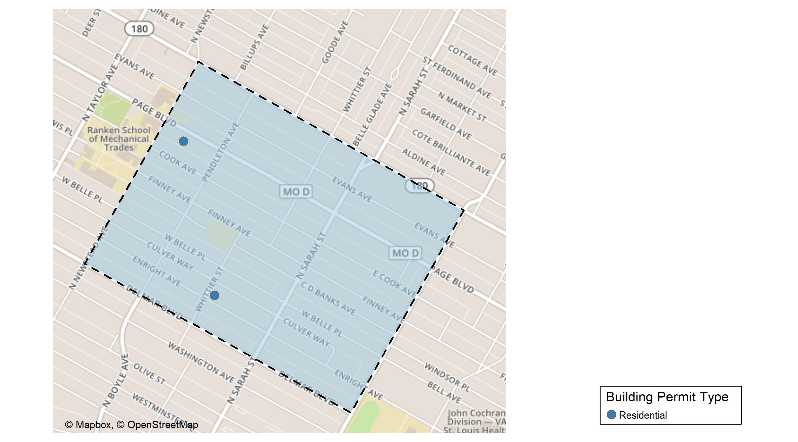
Vandeventer

Slide 62
Neighborhood Summary
September 2025 | September 2025 | September 2025 | September 2025
Permit Use | Average Cost | # of Permits | Total Value of Permits
Commercial | $20,000,000.0 | 2 | $40,000,000
Industrial | $0.0 | 0 | $0
Residential | $170,666.7 | 3 | $512,000
Last 6 Months | Last 6 Months | Last 6 Months | Last 6 Months
Permit Use | Average Cost | # of Permits | Total Value of Permits
Commercial | $20,000,000 | 2 | $40,000,000
Industrial | $9,000 | 1 | $9,000
Residential | $134,000 | 5 | $670,000

Slide 63
Vandeventer Individual Permit Breakdown
Neighborhood | Owner | New Use | Cost | address
Vandeventer | LRA | Residential | $495,000 | 4329 ENRIGHT AV
Vandeventer | RANKEN TECHNICAL COLLEGE | Commercial | $20,000,000 | 4300 FINNEY AV
Vandeventer | RANKEN TECHNICAL COLLEGE | Commercial | $20,000,000 | 4351 FINNEY AV
Vandeventer | HACHE, ENOW | Residential | $16,000 | 4185 ENRIGHT AV
Vandeventer | WASHINGTON, CORDELIA | Residential | $1,000 | 4348 PAGE BLVD

Slide 64
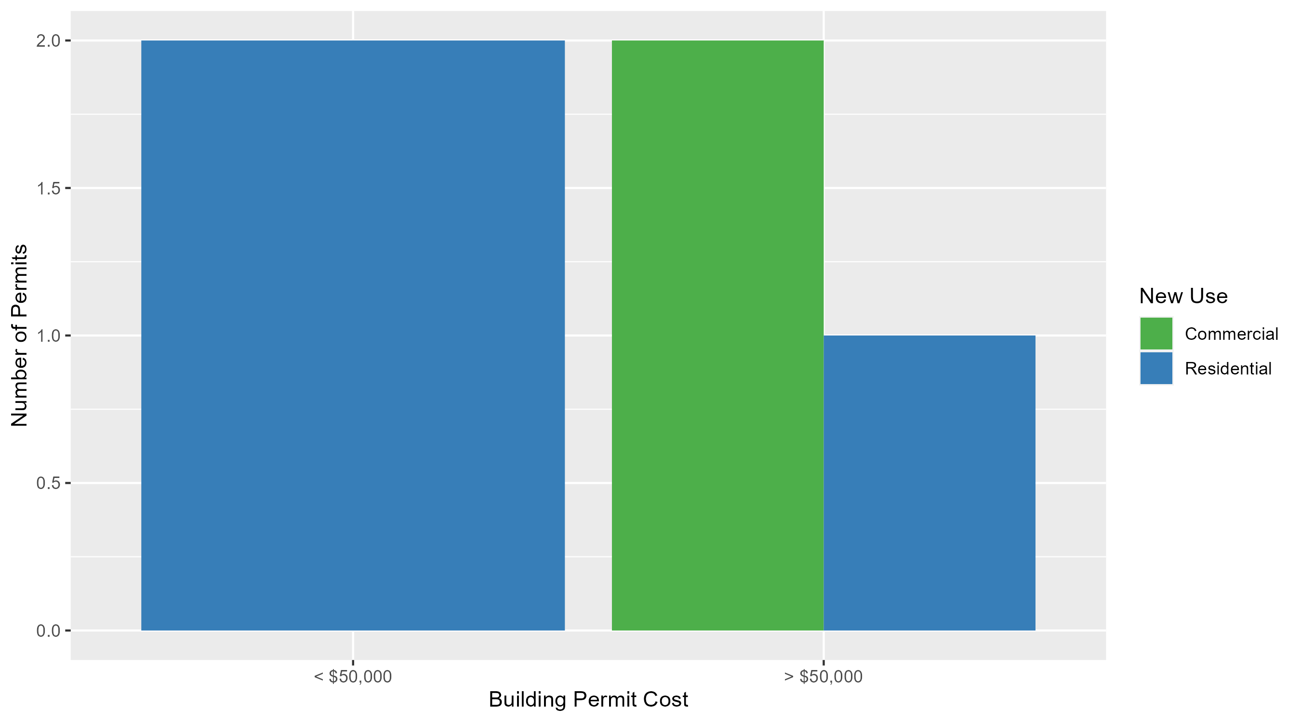
Vandeventer Permit Cost Breakdown

Slide 65
Additional Notes
Data retreived from https://www.stlouis-mo.gov/data/
Building permits with a cost of $0 were dropped
Building permits that were cancelled were dropped
Infinite change indicates 0 permits in the current or previous time period/comparison month so there was a overall increase or decrease

