Slide 1
St. Louis Central Corridor West Building Permits
Monthly Report: October 2025

Slide 2
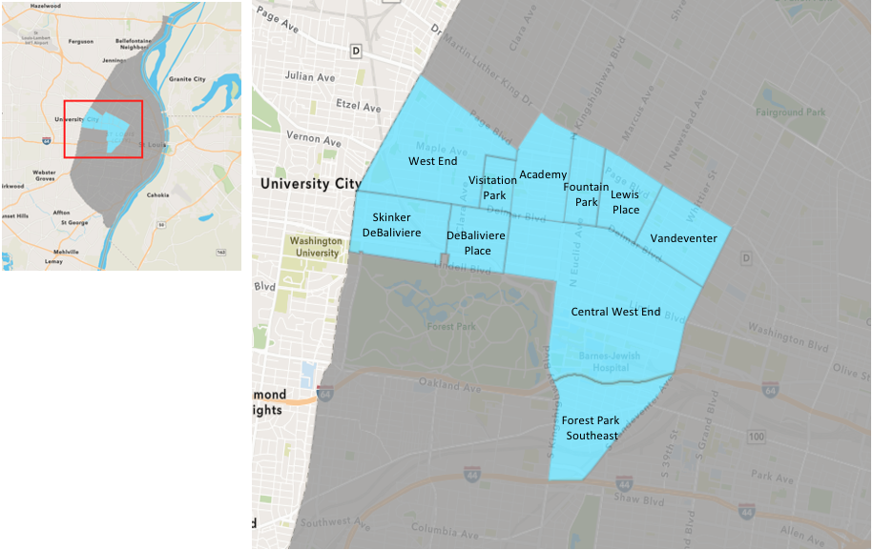
St. Louis Neighborhood Spatial Reference

Slide 3
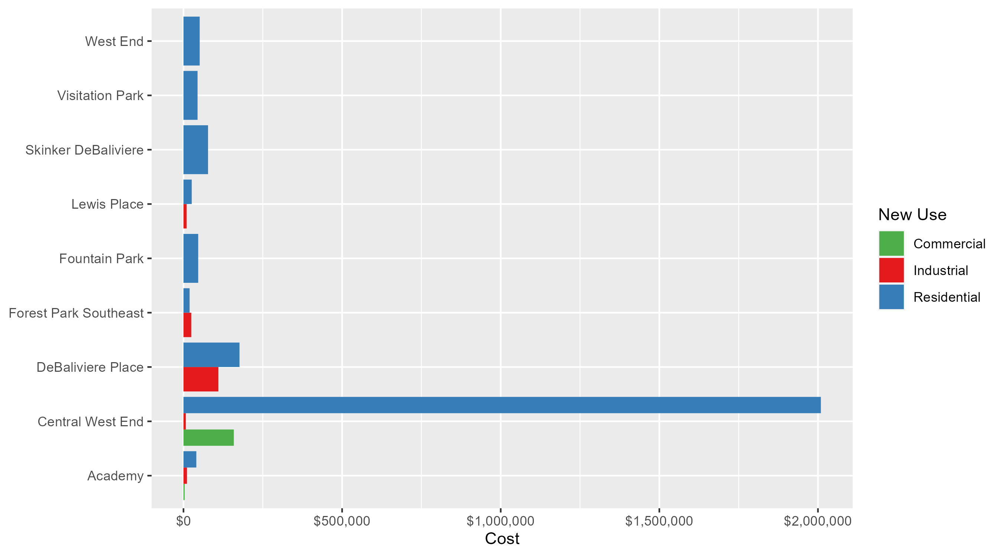
Neighborhood Summary: Average Building Permit Cost

Slide 4
Neighborhood Summary
October 2025 | October 2025 | October 2025 | October 2025
Neighborhood | Average Cost | # of Permits | Total Value of Permits
Academy | $31,750.00 | 11 | $349,250
Central West End | $1,692,091.95 | 53 | $89,680,873
DeBaliviere Place | $172,868.57 | 18 | $3,111,634
Forest Park Southeast | $20,338.00 | 5 | $101,690
Fountain Park | $46,400.00 | 5 | $232,000
Lewis Place | $20,666.67 | 3 | $62,000
Skinker DeBaliviere | $77,418.30 | 10 | $774,183
Vandeventer | $0.00 | 0 | $0
Visitation Park | $44,389.50 | 2 | $88,779
West End | $51,116.67 | 6 | $306,700
Last 6 Months | Last 6 Months | Last 6 Months | Last 6 Months
Neighborhood | Average Cost | # of Permits | Total Value of Permits
Academy | $115,893.41 | 34 | $3,940,376
Central West End | $456,620.39 | 276 | $126,027,227
DeBaliviere Place | $322,189.39 | 115 | $37,051,780
Forest Park Southeast | $69,069.45 | 53 | $3,660,681
Fountain Park | $343,356.52 | 23 | $7,897,200
Lewis Place | $92,651.77 | 22 | $2,038,339
Skinker DeBaliviere | $75,736.91 | 80 | $6,058,953
Vandeventer | $5,810,000.00 | 7 | $40,670,000
Visitation Park | $78,486.50 | 6 | $470,919
West End | $304,460.15 | 38 | $11,569,486

Slide 5
Core Neighborhoods

Slide 6
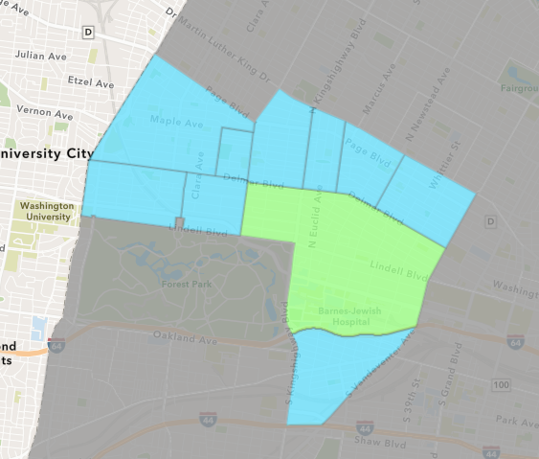
Central West End
October 2025 Neighborhood Cost Breakdown
  Mean: $1,692,092
  Median: $30,000
  Range: $1,000 - $83,156,953

Slide 7
Central West End: Summary Notes
53 building permits in October 2025
  55.88% change compared to October 2024 (34 total building permits)
  $1,692,092: Average building permit cost in October 2025
    218.02% change compared to October 2024 ($532,074)
341 total building permits in 2025
  17.18% change YTD compared to this time in 2024 (291 total building permits)
  $395,699: YTD average building permit cost in 2025
    -3.19% change YTD compared to this time in 2024 ($408,758)

Slide 8
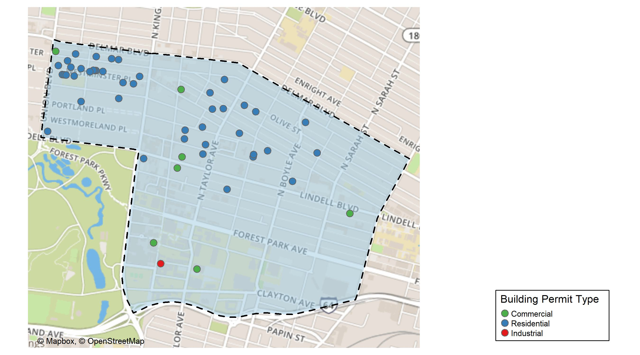
Central West End

Slide 9
Neighborhood Summary
October 2025 | October 2025 | October 2025 | October 2025
Permit Use | Average Cost | # of Permits | Total Value of Permits
Commercial | $158,697.5 | 8 | $1,269,580
Industrial | $7,400.0 | 1 | $7,400
Residential | $2,009,179.4 | 44 | $88,403,893
Last 6 Months | Last 6 Months | Last 6 Months | Last 6 Months
Permit Use | Average Cost | # of Permits | Total Value of Permits
Commercial | $230,762.3 | 79 | $18,230,218
Industrial | $82,816.0 | 12 | $993,792
Residential | $577,314.7 | 185 | $106,803,217

Slide 10
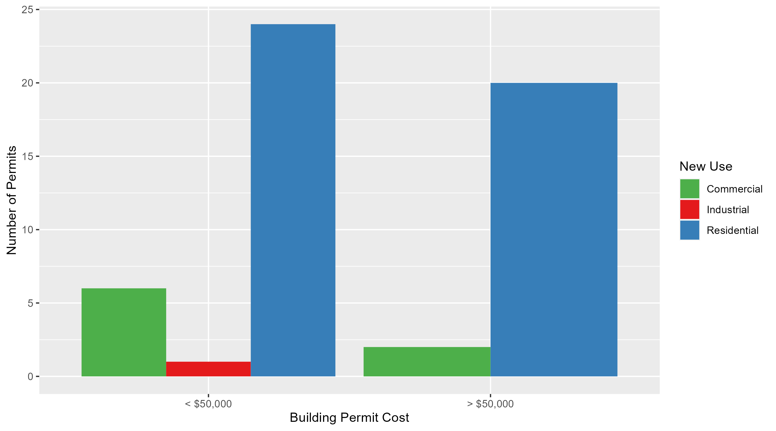
Central West End Permit Cost Breakdown

Slide 11
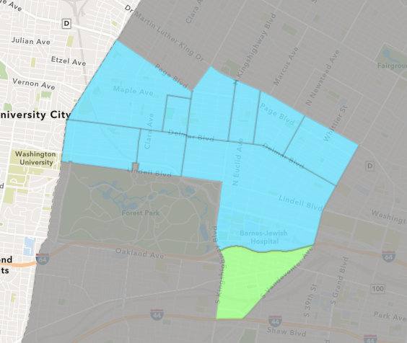
Forest Park Southeast
October 2025 Neighborhood Cost Breakdown
  Mean: $20,338
  Median: $15,000
  Range: $12,200 - $35,000

Slide 12
Forest Park Southeast: Summary Notes
5 building permits in October 2025
  -28.57% change compared to October 2024 (7 total building permits)
  $20,338: Average building permit cost in October 2025
    -28.82% change compared to October 2024 ($28,571)
65 total building permits in 2025
  8.33% change YTD compared to this time in 2024 (60 total building permits)
  $67,967: YTD average building permit cost in 2025
    21.51% change YTD compared to this time in 2024 ($55,935)

Slide 13
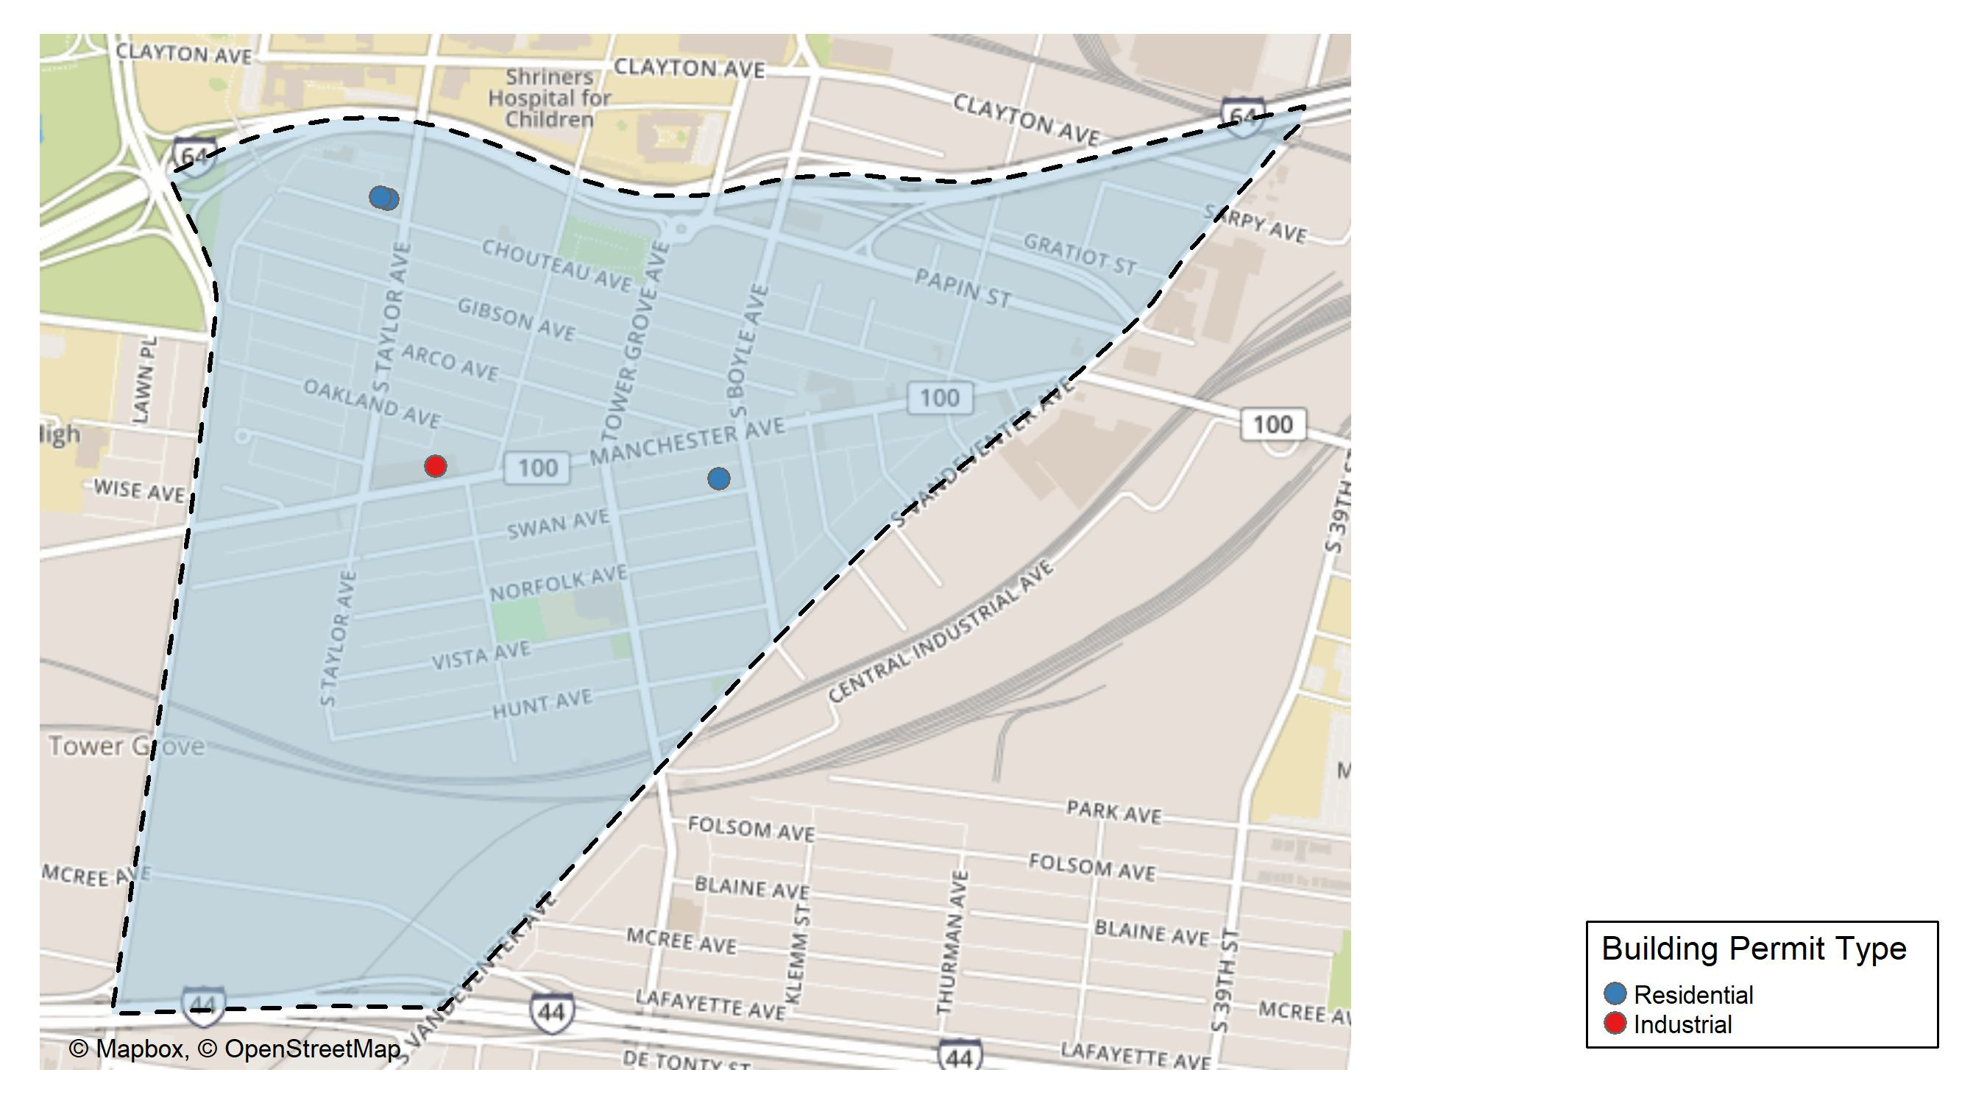
Forest Park Southeast

Slide 14
Neighborhood Summary
October 2025 | October 2025 | October 2025 | October 2025
Permit Use | Average Cost | # of Permits | Total Value of Permits
Commercial | $0 | 0 | $0
Industrial | $24,490 | 1 | $24,490
Residential | $19,300 | 4 | $77,200
Last 6 Months | Last 6 Months | Last 6 Months | Last 6 Months
Permit Use | Average Cost | # of Permits | Total Value of Permits
Commercial | $63,454.55 | 11 | $698,000
Industrial | $15,072.50 | 4 | $60,290
Residential | $76,378.71 | 38 | $2,902,391

Slide 15
Forest Park Southeast Individual Permit Breakdown
Neighborhood | Owner | New Use | Cost | address
Forest Park Southeast | 4465 MANCHESTER LLC | Industrial | $24,490 | 4465 MANCHESTER AV
Forest Park Southeast | JAM VENTURES LLC | Residential | $35,000 | 4431 NORFOLK AV
Forest Park Southeast | MCCLELLAND, CURTIS J | Residential | $12,200 | 4215 SWAN AV
Forest Park Southeast | 45S LLC | Residential | $15,000 | 4515 CHOUTEAU AV
Forest Park Southeast | 45S LLC | Residential | $15,000 | 4509 CHOUTEAU AV

Slide 16
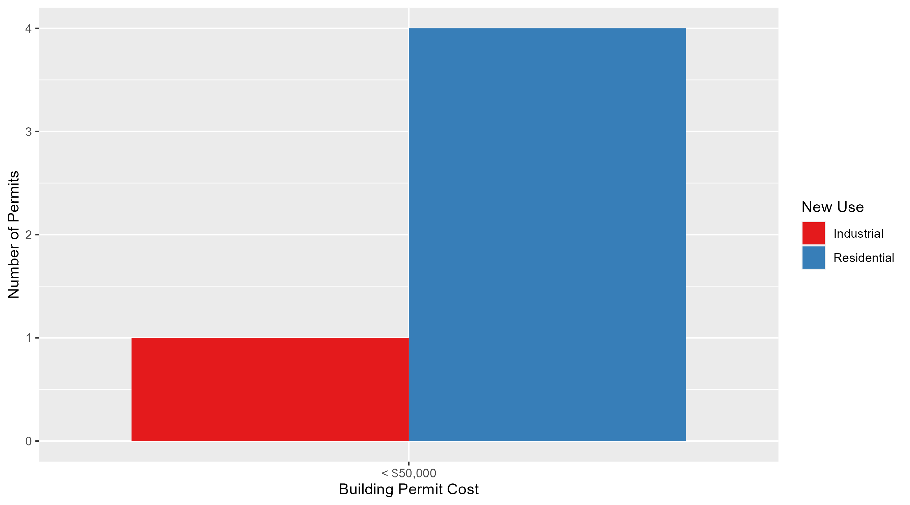
Forest Park Southeast Permit Cost Breakdown

Slide 17
Expanded Service Area

Slide 18
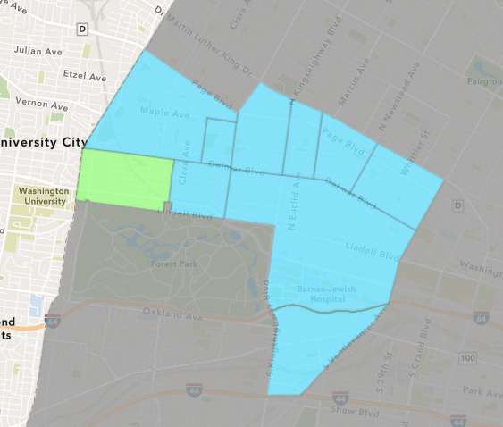
Skinker DeBaliviere
October 2025 Neighborhood Cost Breakdown
  Mean: $77,418
  Median: $25,671
  Range: $2,000 - $354,573

Slide 19
Skinker DeBaliviere: Summary Notes
10 building permits in October 2025
  -28.57% change compared to October 2024 (14 total building permits)
  $77,418: Average building permit cost in October 2025
    -27.49% change compared to October 2024 ($106,772)
102 total building permits in 2025
  43.66% change YTD compared to this time in 2024 (71 total building permits)
  $72,636: YTD average building permit cost in 2025
    -24.49% change YTD compared to this time in 2024 ($96,194)

Slide 20
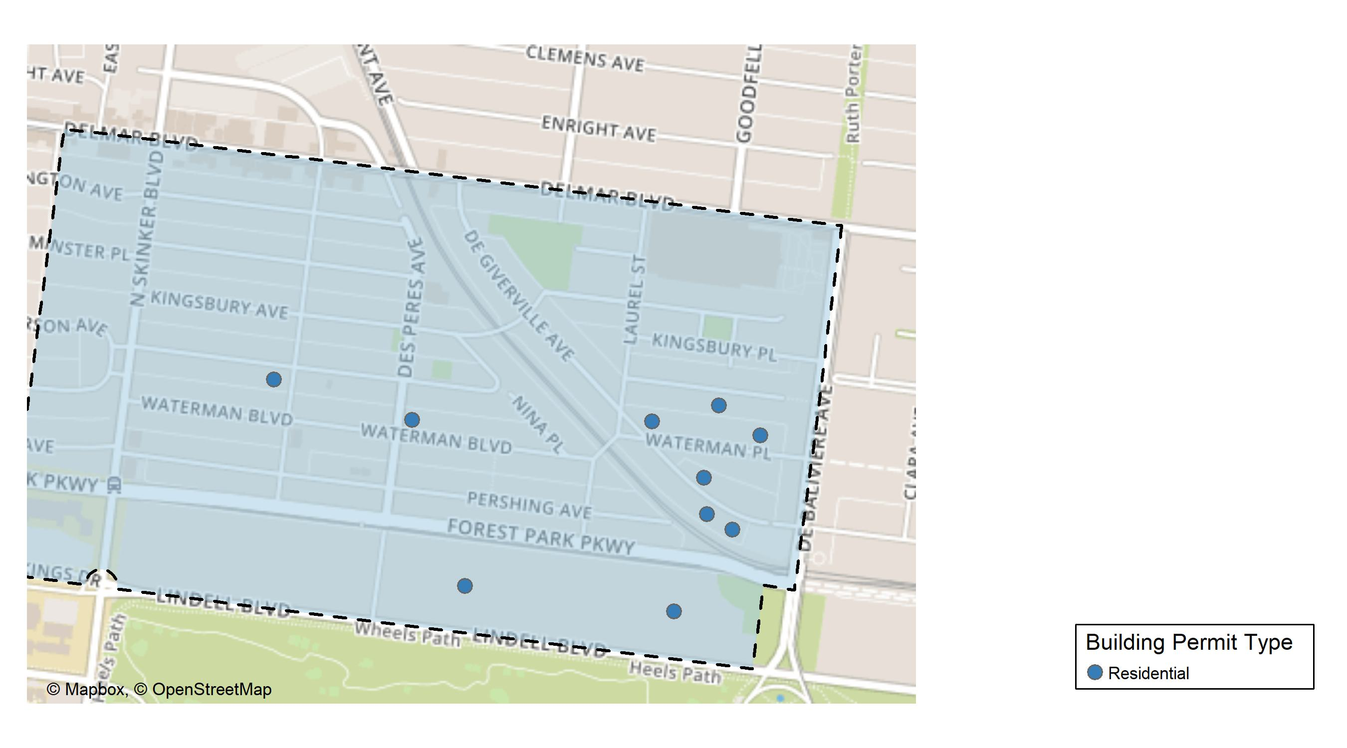
Skinker DeBaliviere

Slide 21
Neighborhood Summary
October 2025 | October 2025 | October 2025 | October 2025
Permit Use | Average Cost | # of Permits | Total Value of Permits
Commercial | $0.0 | 0 | $0
Industrial | $0.0 | 0 | $0
Residential | $77,418.3 | 10 | $774,183
Last 6 Months | Last 6 Months | Last 6 Months | Last 6 Months
Permit Use | Average Cost | # of Permits | Total Value of Permits
Commercial | $32,680.00 | 1 | $32,680
Industrial | $22,000.00 | 1 | $22,000
Residential | $76,977.86 | 78 | $6,004,273

Slide 22
Skinker DeBaliviere Individual Permit Breakdown
Neighborhood | Owner | New Use | Cost | address
Skinker DeBaliviere | DUNN, JENNIFER & SYTSE PIERSMA | Residential | $3,545 | 5793 WATERMAN BLVD
Skinker DeBaliviere | OCG ACQUISITIONS GP | Residential | $30,000 | 5758 MCPHERSON AV
Skinker DeBaliviere | STARKS, CODY F | Residential | $35,254 | 5769 DEGIVERVILLE AV
Skinker DeBaliviere | HIRSHBERG, GARY E & MARTHA J | Residential | $354,573 | 5751 LINDELL BLVD
Skinker DeBaliviere | EDSON, COLETTE E | Residential | $17,000 | 6108 MCPHERSON AV
Skinker DeBaliviere | FOSTER-COLVIN, CYNTHIA J | Residential | $5,432 | 5750 DEGIVERVILLE AV
Skinker DeBaliviere | EUROTRASH HOLDINGS LLC | Residential | $255,037 | 5915 LINDELL BLVD
Skinker DeBaliviere | MCLAREN, MARK P & KE KAY MASCHEK | Residential | $21,342 | 5731 WATERMAN BLVD
Skinker DeBaliviere | MR LANDLORD LLC | Residential | $2,000 | 5959 WATERMAN BLVD
Skinker DeBaliviere | NICHOLS, GENEVIEVE | Residential | $50,000 | 5738 DEGIVERVILLE AV

Slide 23
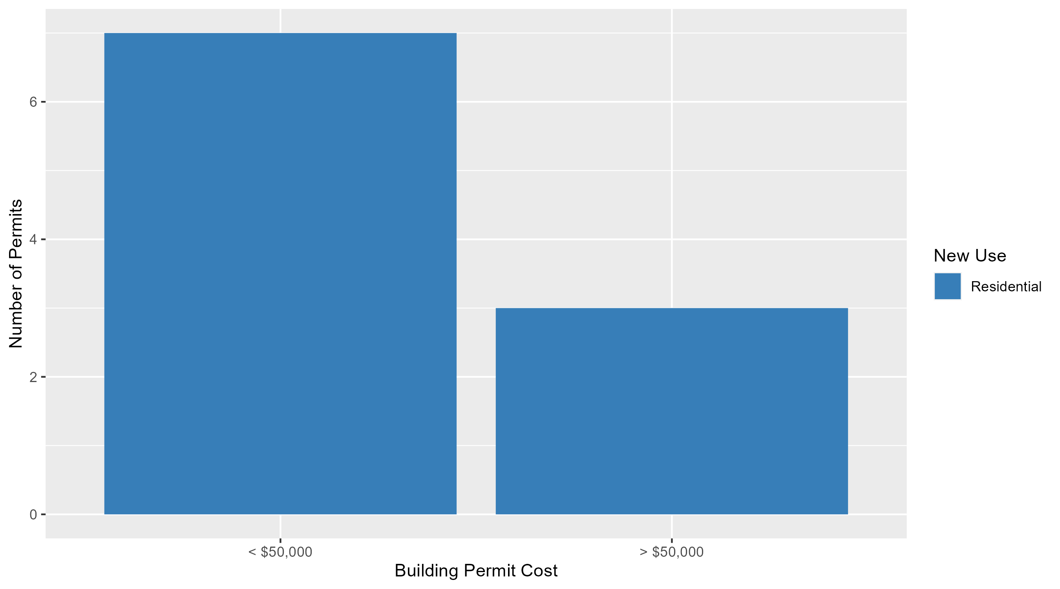
Skinker DeBaliviere Permit Cost Breakdown

Slide 24
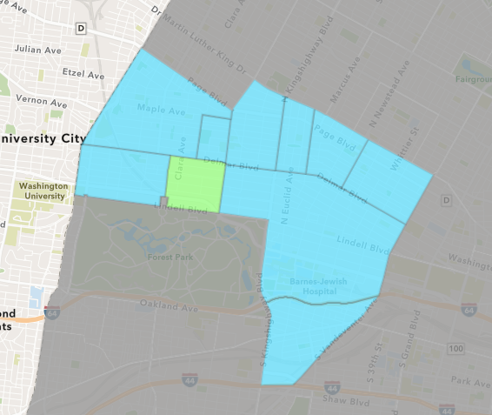
DeBaliviere Place
October 2025 Neighborhood Cost Breakdown
  Mean: $172,869
  Median: $122,500
  Range: $4,000 - $700,000

Slide 25
DeBaliviere Place: Summary Notes
18 building permits in October 2025
  200.00% change compared to October 2024 (6 total building permits)
  $172,869: Average building permit cost in October 2025
    671.80% change compared to October 2024 ($22,398)
127 total building permits in 2025
  209.76% change YTD compared to this time in 2024 (41 total building permits)
  $297,899: YTD average building permit cost in 2025
    162.94% change YTD compared to this time in 2024 ($113,295)

Slide 26
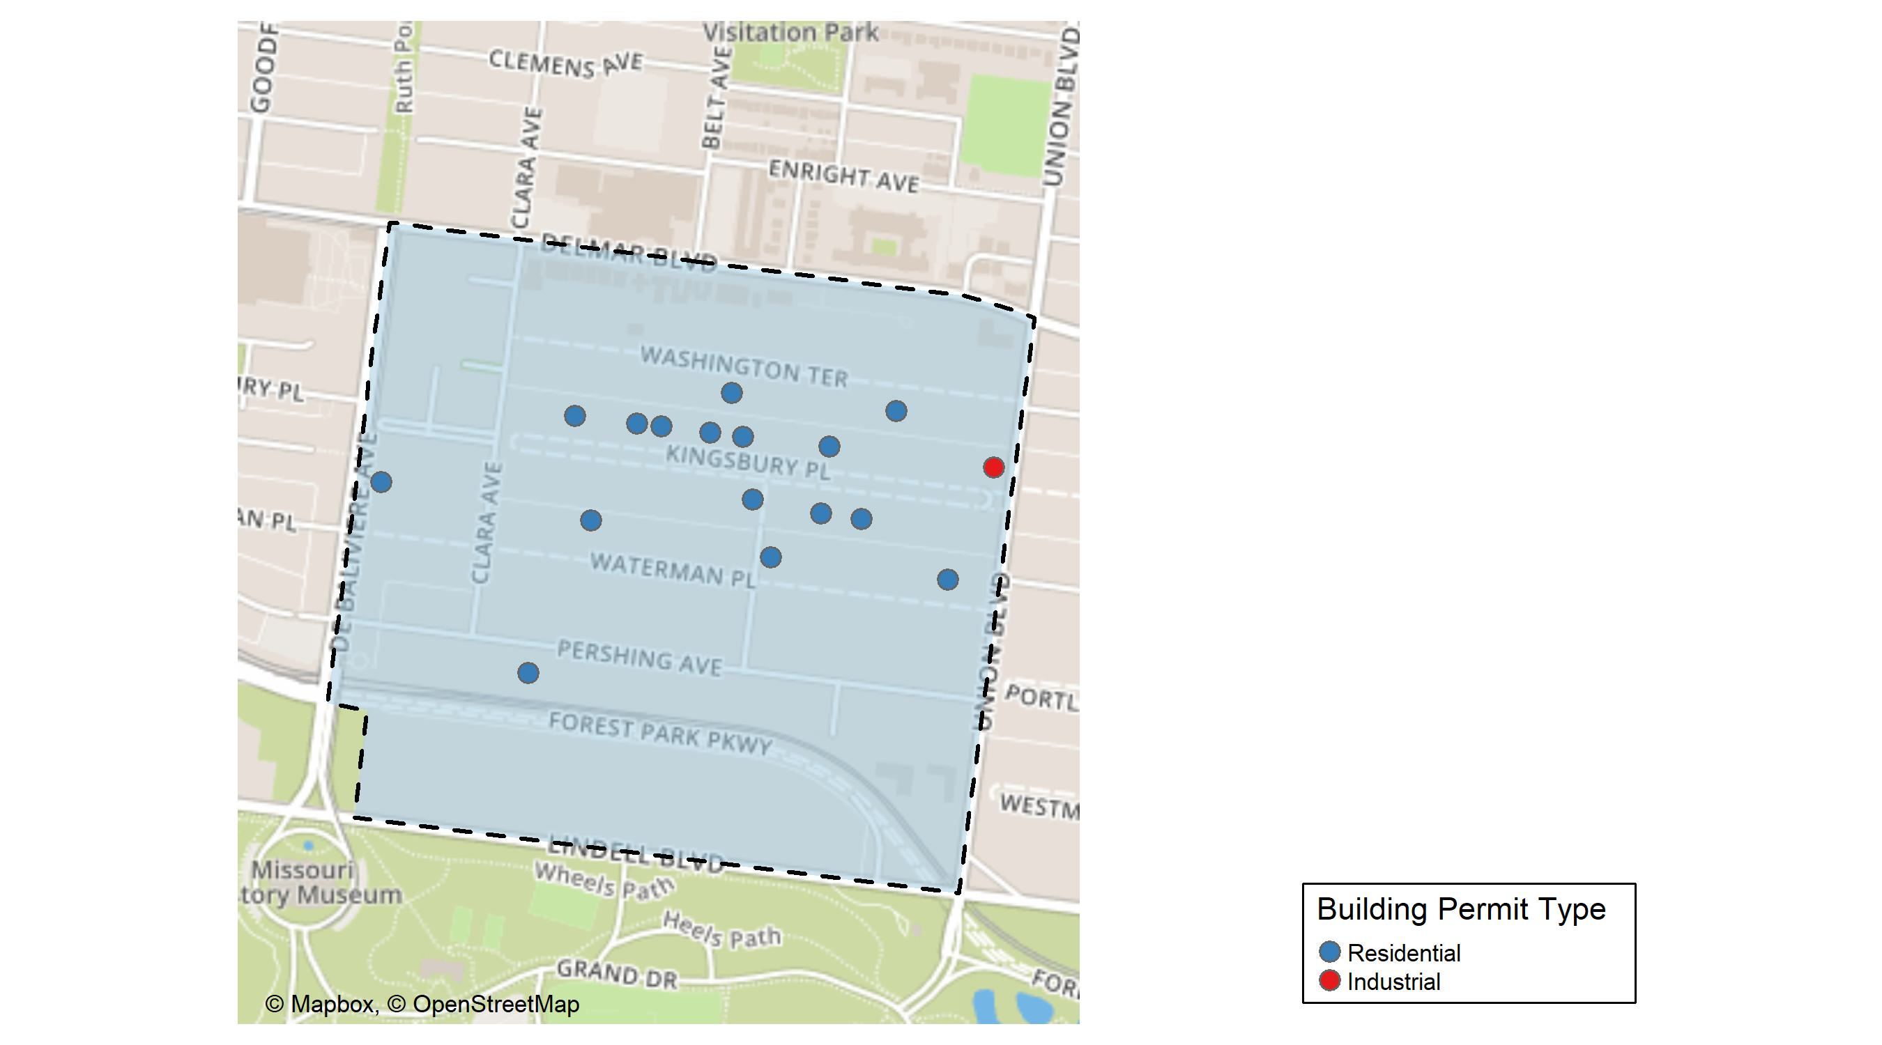
DeBaliviere Place

Slide 27
Neighborhood Summary
October 2025 | October 2025 | October 2025 | October 2025
Permit Use | Average Cost | # of Permits | Total Value of Permits
Commercial | $0.0 | 0 | $0
Industrial | $110,000.0 | 1 | $110,000
Residential | $176,566.7 | 17 | $3,001,634
Last 6 Months | Last 6 Months | Last 6 Months | Last 6 Months
Permit Use | Average Cost | # of Permits | Total Value of Permits
Commercial | $74,240.8 | 5 | $371,204
Industrial | $110,000.0 | 1 | $110,000
Residential | $335,509.9 | 109 | $36,570,576

Slide 28
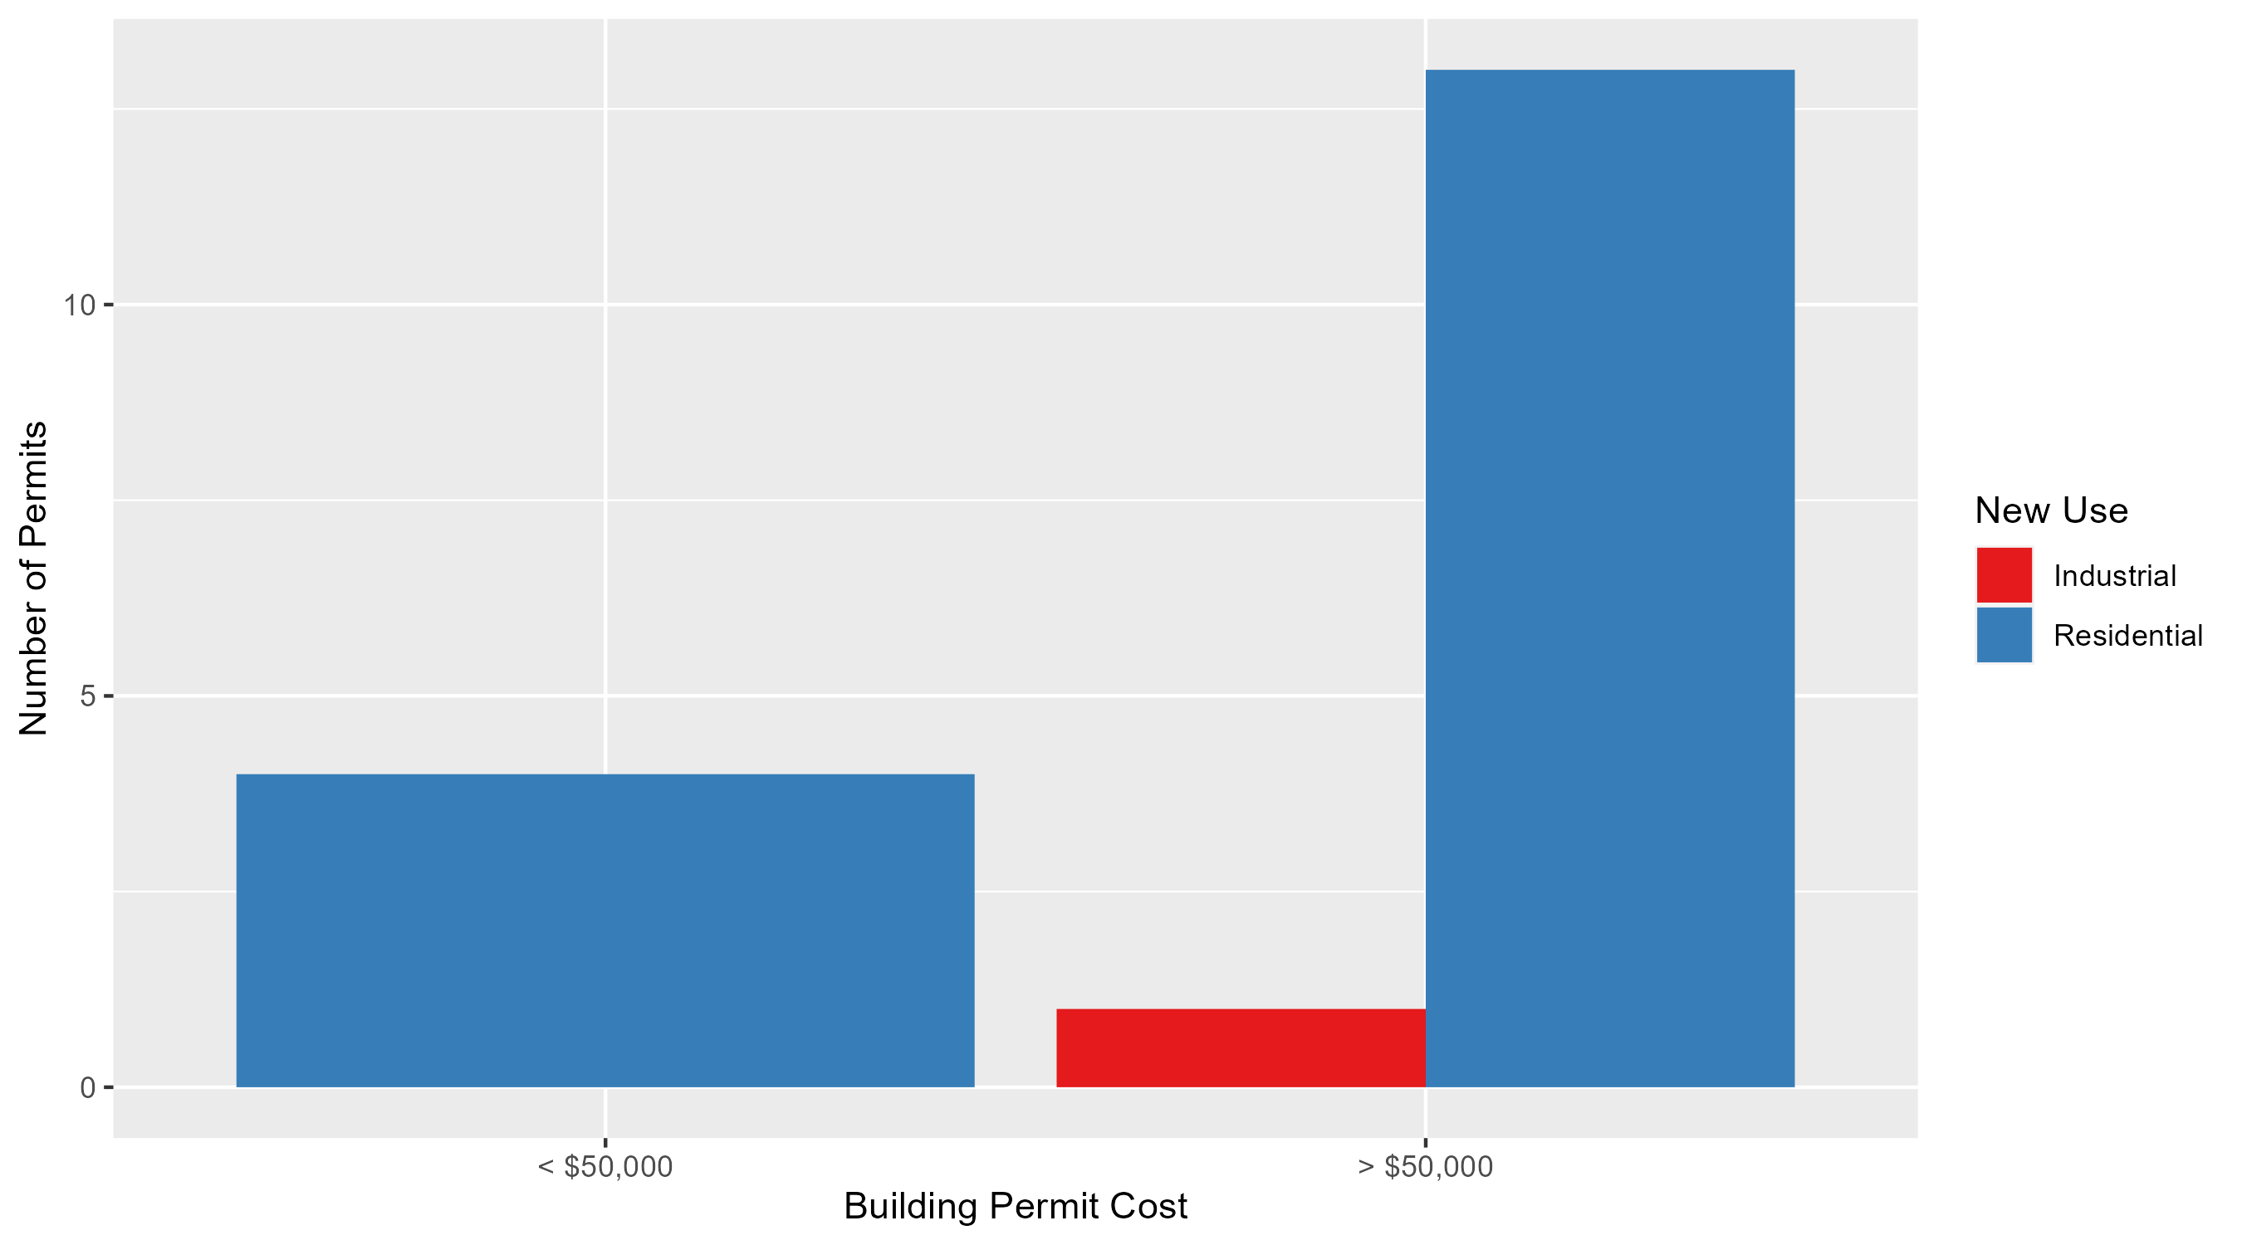
DeBaliviere Place Permit Cost Breakdown

Slide 29
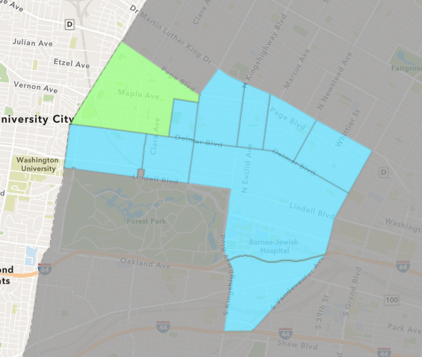
West End
October 2025 Neighborhood Cost Breakdown
  Mean: $51,117
  Median: $29,500
  Range: $2,700 - $150,000

Slide 30
West End: Summary Notes
6 building permits in October 2025
  100.00% change compared to October 2024 (3 total building permits)
  $51,117: Average building permit cost in October 2025
    -90.59% change compared to October 2024 ($543,000)
49 total building permits in 2025
  -19.67% change YTD compared to this time in 2024 (61 total building permits)
  $267,693: YTD average building permit cost in 2025
    161.64% change YTD compared to this time in 2024 ($102,313)

Slide 31
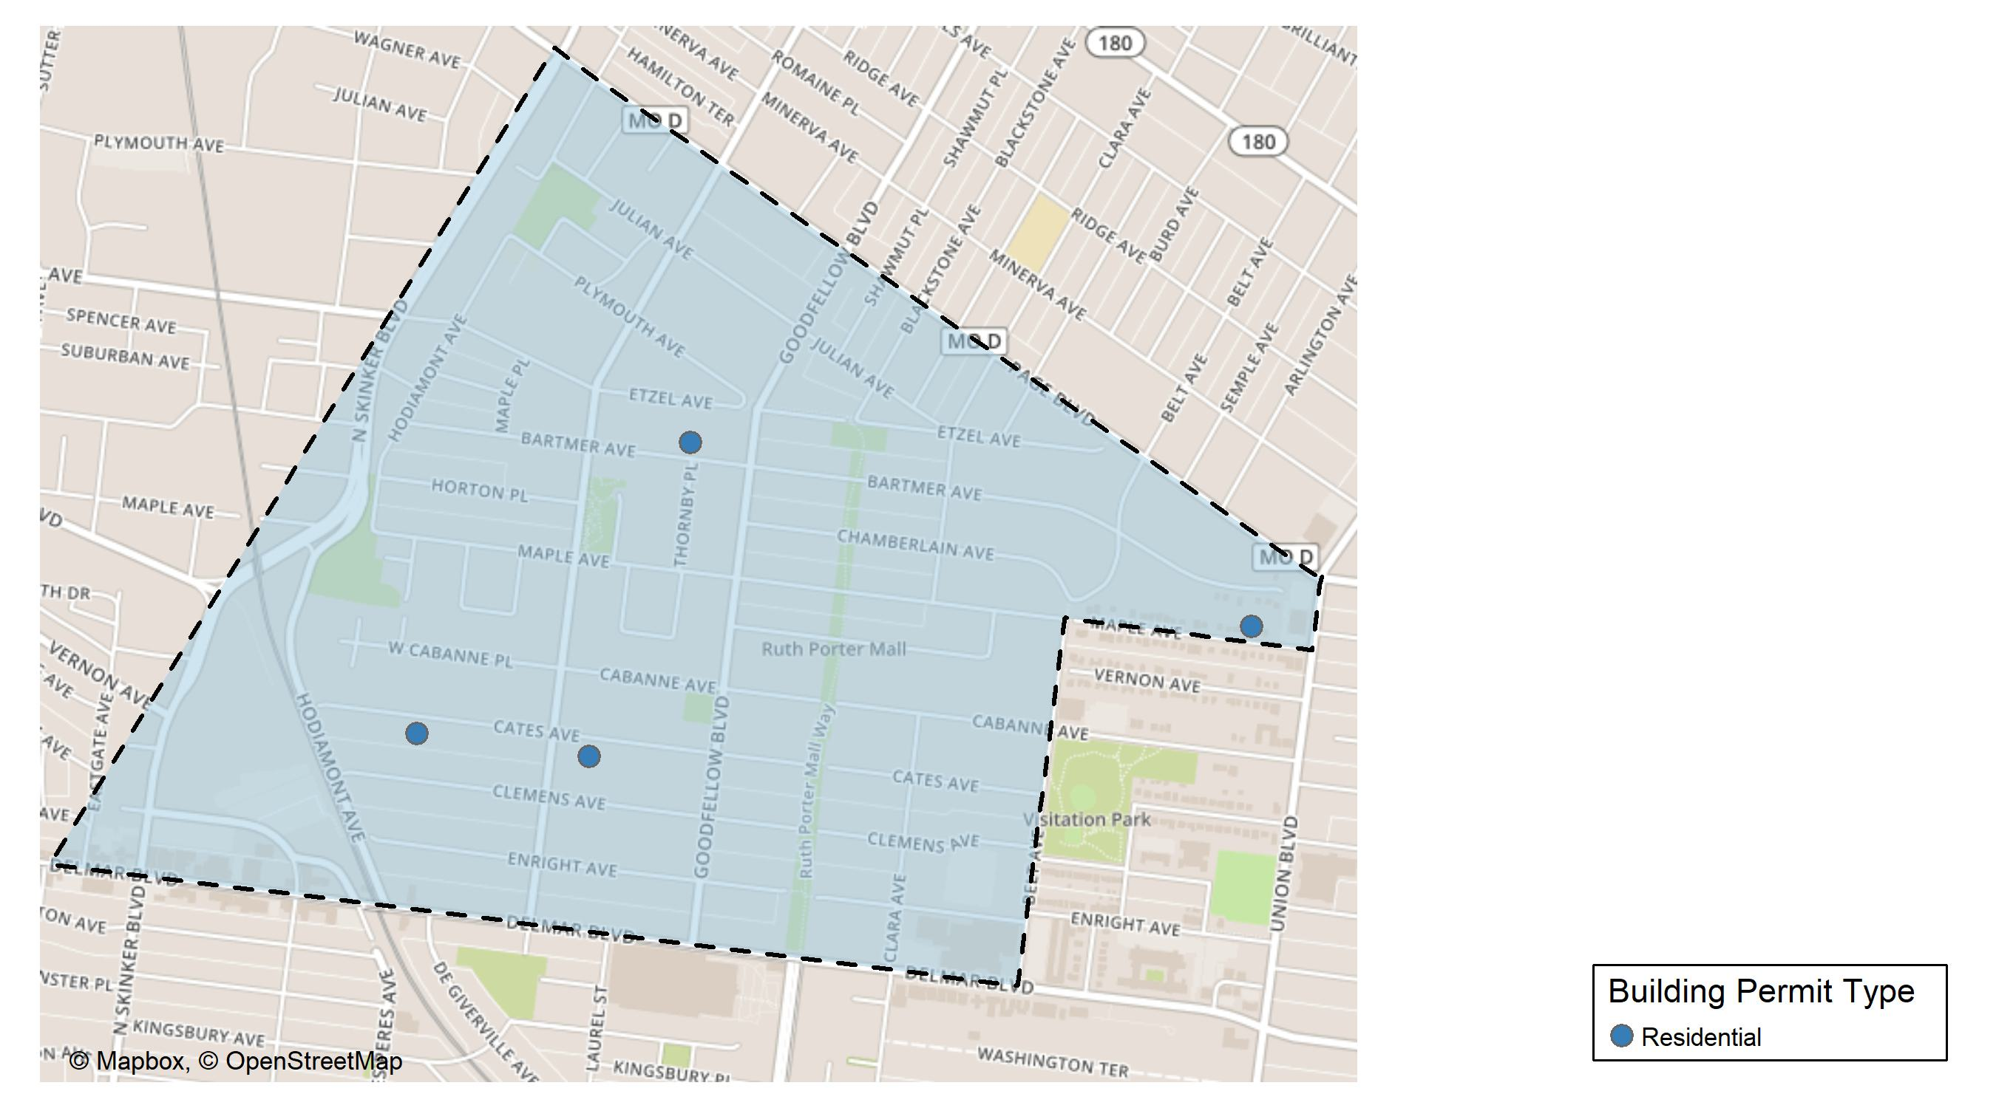
West End

Slide 32
Neighborhood Summary
October 2025 | October 2025 | October 2025 | October 2025
Permit Use | Average Cost | # of Permits | Total Value of Permits
Commercial | $0.00 | 0 | $0
Industrial | $0.00 | 0 | $0
Residential | $51,116.67 | 6 | $306,700
Last 6 Months | Last 6 Months | Last 6 Months | Last 6 Months
Permit Use | Average Cost | # of Permits | Total Value of Permits
Commercial | $1,394,857.14 | 7 | $9,764,000
Industrial | $93,070.50 | 2 | $186,141
Residential | $55,839.47 | 29 | $1,619,345

Slide 33
West End Individual Permit Breakdown
Neighborhood | Owner | New Use | Cost | address
West End | R549M431 | Residential | $30,000 | 5835 BARTMER AV
West End | BELL, DAVID & LENEISHA | Residential | $80,000 | 5339 MAPLE AV
West End | BELL, DAVID & LENEISHA | Residential | $150,000 | 5339 MAPLE AV
West End | WOODARD, L PAUL & KARHY WOODARD TRS | Residential | $2,700 | 6012 CATES AV
West End | NORMAN, RODNEY & JUANITA | Residential | $29,000 | 5640 MAPLE AV
West End | BRADFORD, SHELIA L TRS | Residential | $15,000 | 5876 CATES AV

Slide 34
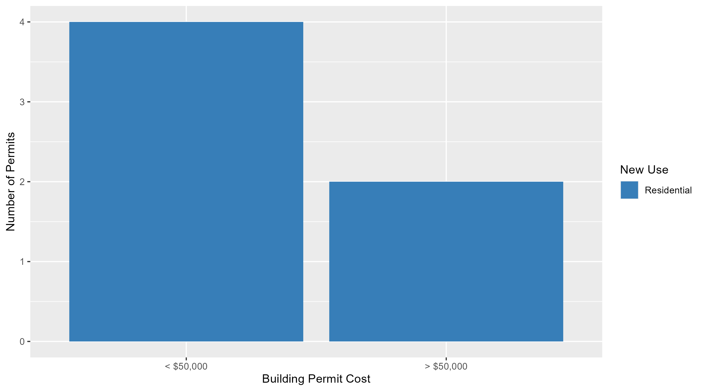
West End Permit Cost Breakdown

Slide 35
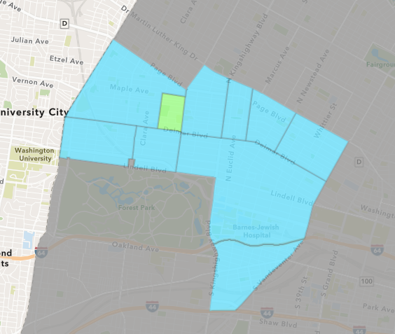
Visitation Park
October 2025 Neighborhood Cost Breakdown
  Mean: $44,390
  Median: $44,390
  Range: $18,371 - $70,408

Slide 36
Visitation Park: Summary Notes
2 building permits in October 2025
  100.00% change compared to October 2024 (1 total building permits)
  $44,390: Average building permit cost in October 2025
    787.79% change compared to October 2024 ($5,000)
8 total building permits in 2025
  166.67% change YTD compared to this time in 2024 (3 total building permits)
  $77,740: YTD average building permit cost in 2025
    409.21% change YTD compared to this time in 2024 ($15,267)

Slide 37
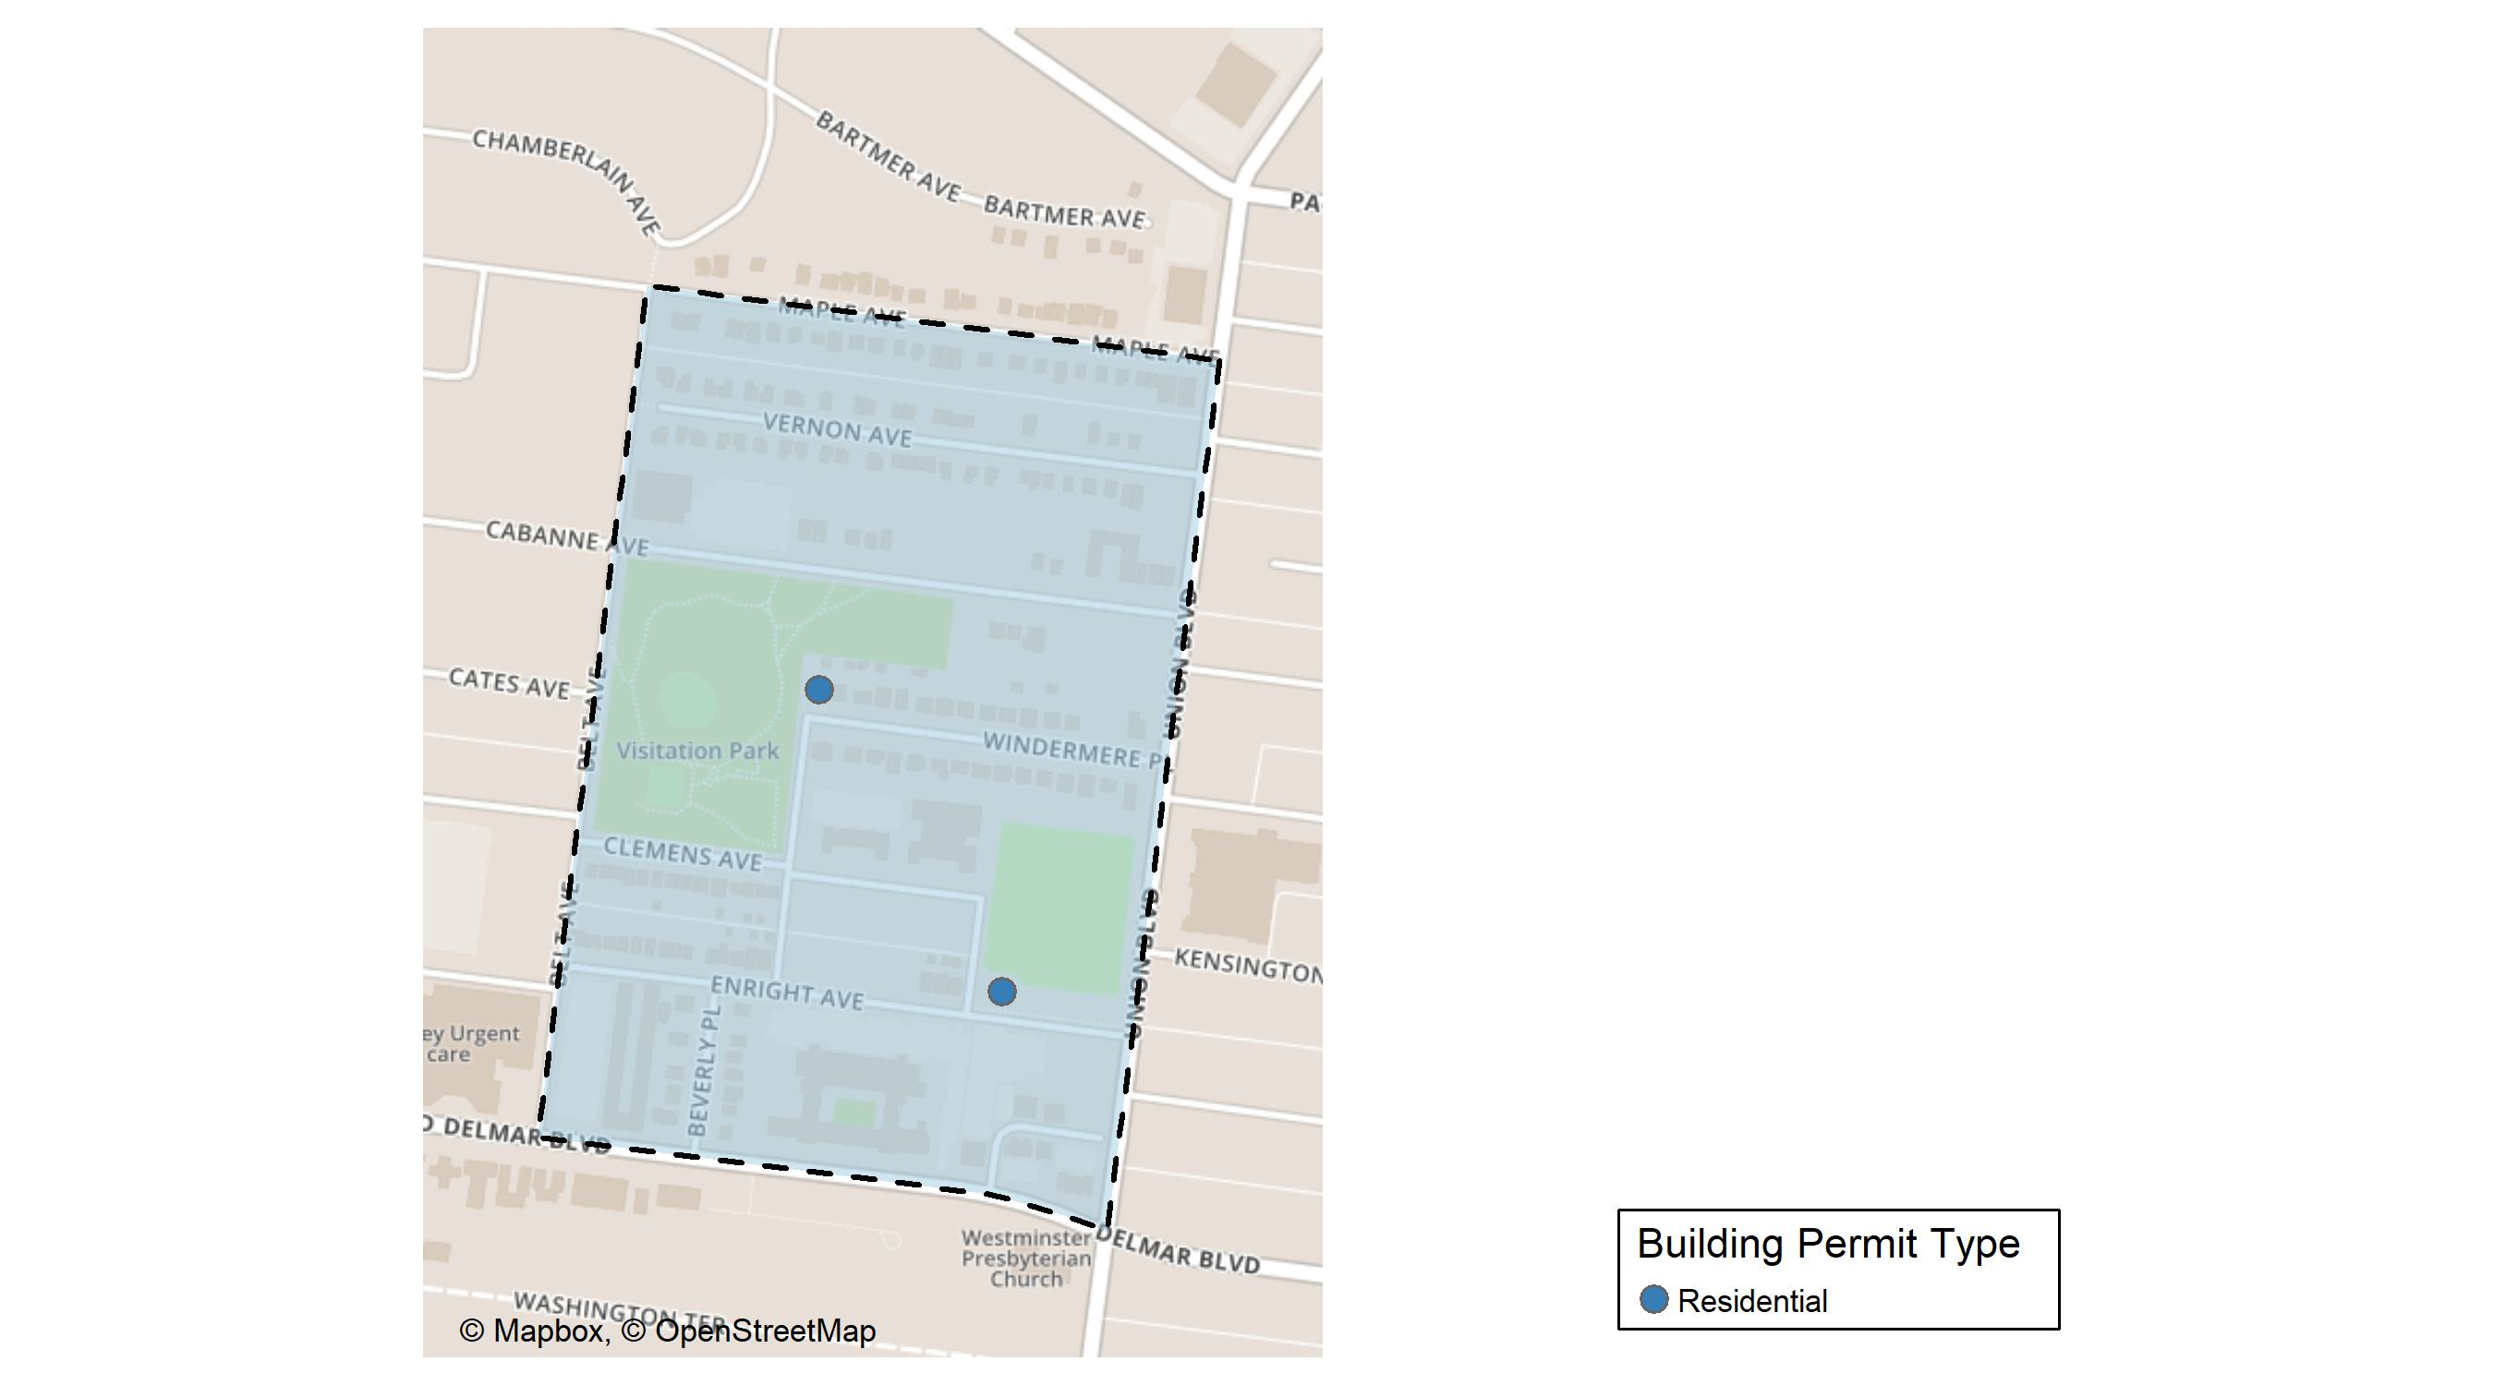
Visitation Park

Slide 38
Neighborhood Summary
October 2025 | October 2025 | October 2025 | October 2025
Permit Use | Average Cost | # of Permits | Total Value of Permits
Commercial | $0.0 | 0 | $0
Industrial | $0.0 | 0 | $0
Residential | $44,389.5 | 2 | $88,779
Last 6 Months | Last 6 Months | Last 6 Months | Last 6 Months
Permit Use | Average Cost | # of Permits | Total Value of Permits
Commercial | $9,000.0 | 1 | $9,000
Industrial | $0.0 | 0 | $0
Residential | $92,383.8 | 5 | $461,919

Slide 39
Visitation Park Individual Permit Breakdown
Neighborhood | Owner | New Use | Cost | address
Visitation Park | CARTER, BRIAN & DENISE | Residential | $18,371 | 31 WINDERMERE PL
Visitation Park | SLAY, GUY G TRS | Residential | $70,408 | 5331 ENRIGHT AV

Slide 40
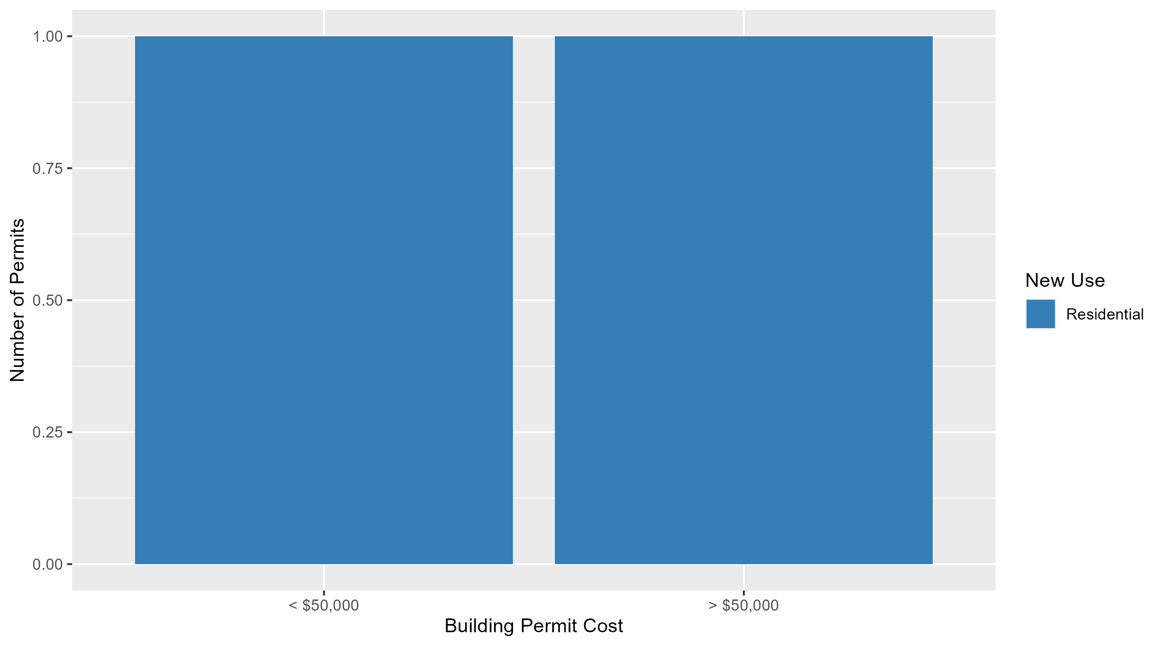
Visitation Park Permit Cost Breakdown

Slide 41
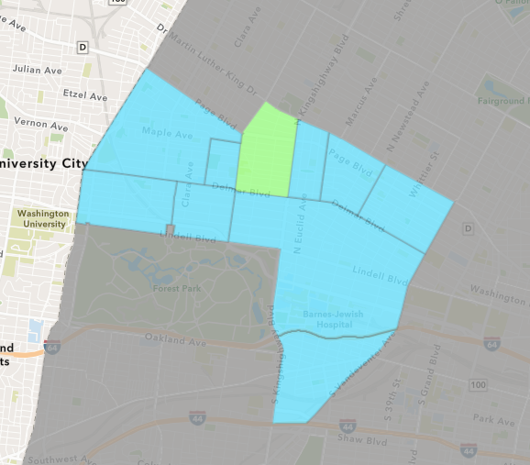
Academy
October 2025 Neighborhood Cost Breakdown
  Mean: $31,750
  Median: $12,000
  Range: $1,000 - $250,000

Slide 42
Academy: Summary Notes
11 building permits in October 2025
  266.67% change compared to October 2024 (3 total building permits)
  $31,750: Average building permit cost in October 2025
    1090.62% change compared to October 2024 ($2,667)
43 total building permits in 2025
  104.76% change YTD compared to this time in 2024 (21 total building permits)
  $98,032: YTD average building permit cost in 2025
    166.33% change YTD compared to this time in 2024 ($36,809)

Slide 43
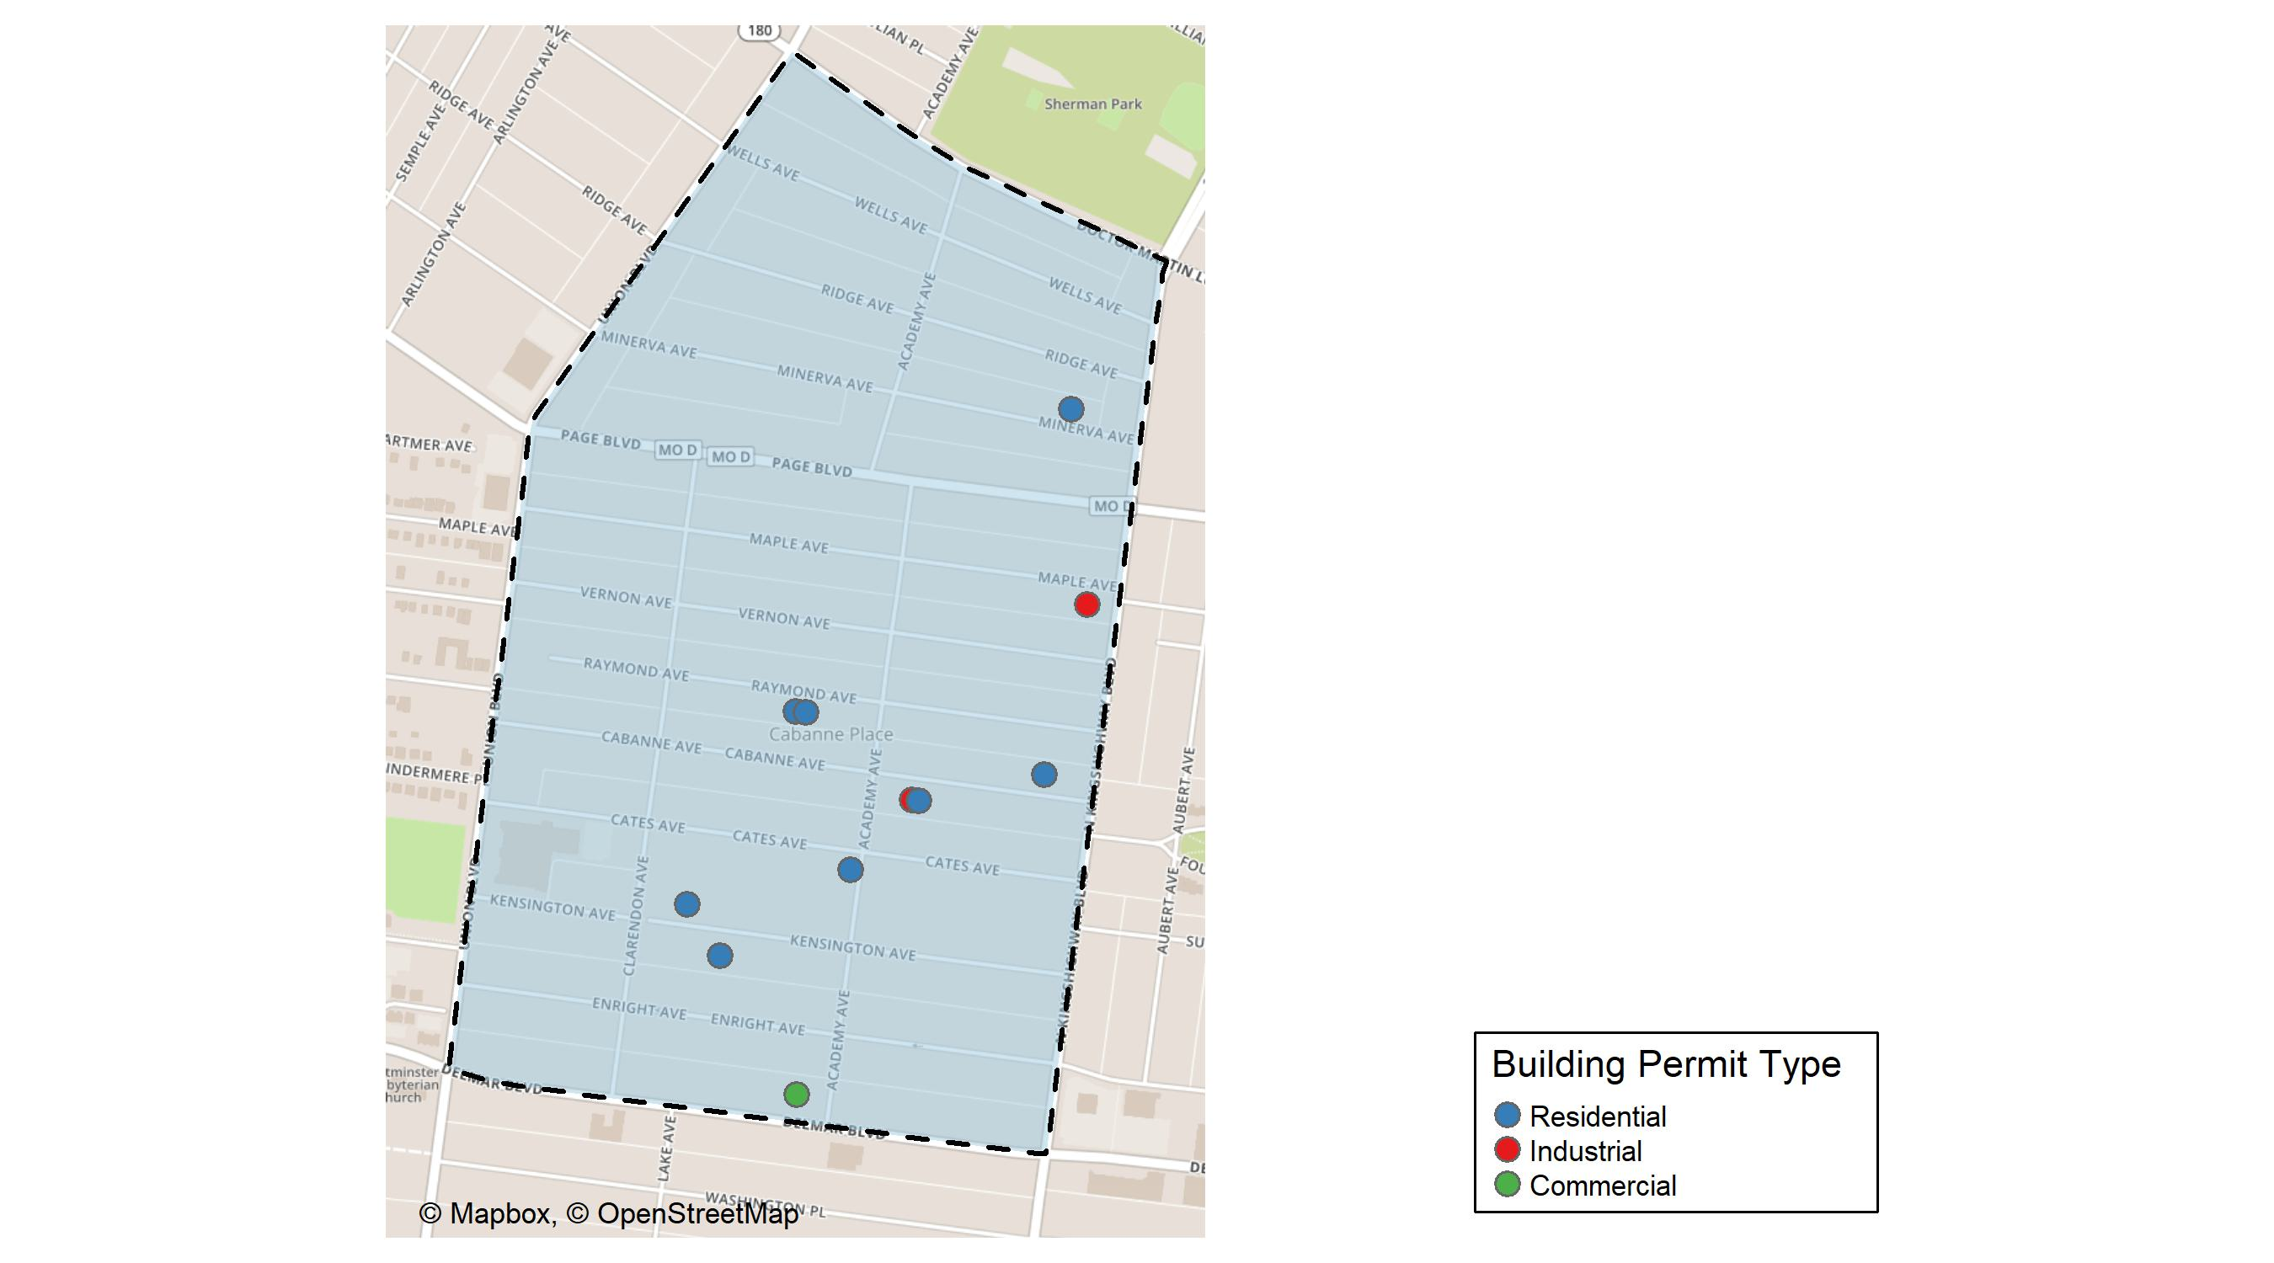
Academy

Slide 44
Neighborhood Summary
October 2025 | October 2025 | October 2025 | October 2025
Permit Use | Average Cost | # of Permits | Total Value of Permits
Commercial | $3,500 | 1 | $3,500
Industrial | $10,875 | 2 | $21,750
Residential | $40,500 | 8 | $324,000
Last 6 Months | Last 6 Months | Last 6 Months | Last 6 Months
Permit Use | Average Cost | # of Permits | Total Value of Permits
Commercial | $449,475.00 | 4 | $1,797,900
Industrial | $10,875.00 | 2 | $21,750
Residential | $75,740.21 | 28 | $2,120,726

Slide 45
Academy Individual Permit Breakdown
Neighborhood | Owner | New Use | Cost | address
Academy | BROOKS, ERIC M | Residential | $21,000 | 5021 CABANNE AV
Academy | BIOMAT USA INC | Commercial | $3,500 | 5121 DELMAR BLVD
Academy | RIDDLE, ANTHONY SR & BRIDGET RENEE | Residential | $14,000 | 5156 KENSINGTON AV
Academy | HERNANDEZ, JUAN CARLOS | Residential | $20,000 | 5175 KENSINGTON AV
Academy | NASH, STACIE P | Residential | $250,000 | 5100 CATES AV
Academy | AUTOZONE, INC | Industrial | $16,750 | 1211 N KINGSHIGHWAY BLVD
Academy | BROWN, FREIDA A TRS | Residential | $12,000 | 5134 RAYMOND AV
Academy | WALKER, KOVEL & ASHLEY | Residential | $5,000 | 5076 CABANNE AV
Academy | WALKER, KOVEL & ASHLEY | Industrial | $5,000 | 5078 CABANNE AV
Academy | FRANKLIN, FLORA D | Residential | $1,000 | 5029 MINERVA AV
Academy | GILLESPIE, MARCIA E | Residential | $1,000 | 5138 RAYMOND AV

Slide 46
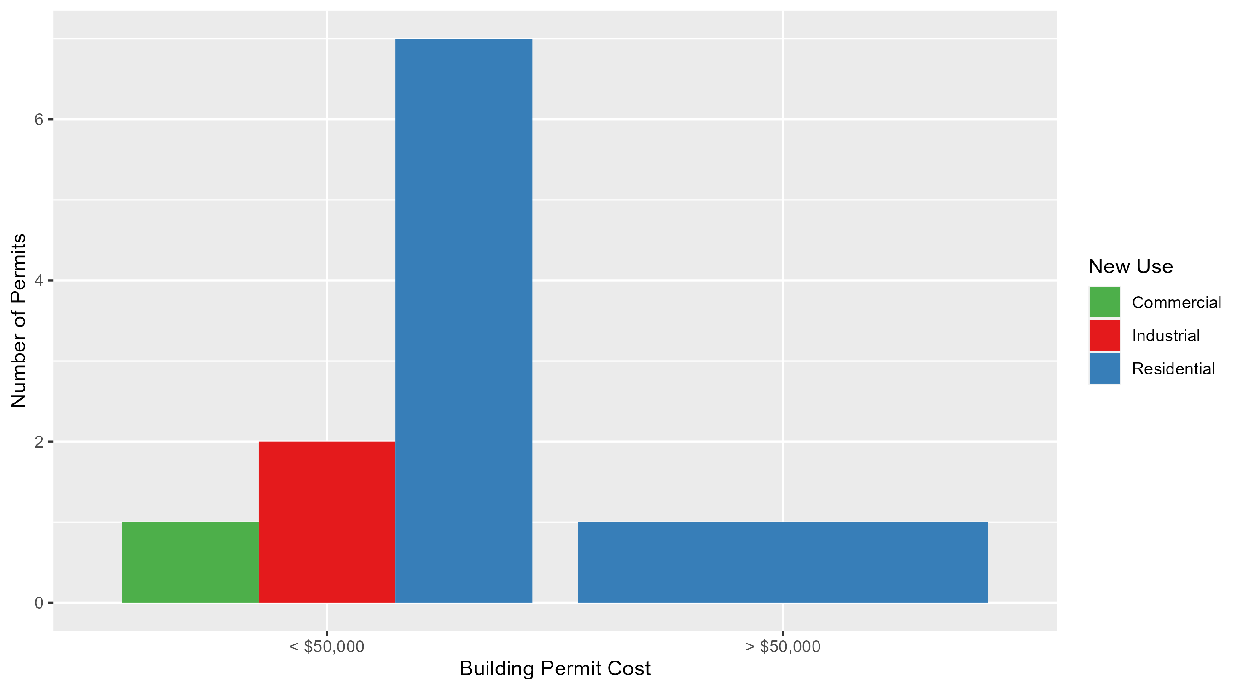
Academy Permit Cost Breakdown

Slide 47
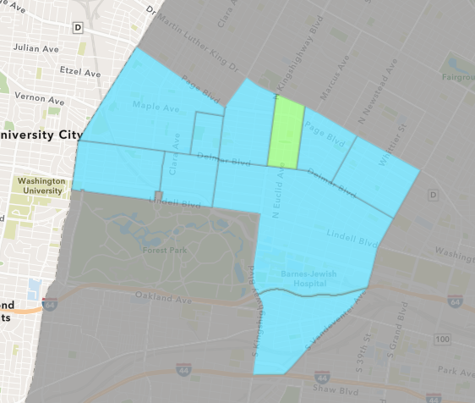
Fountain Park
October 2025 Neighborhood Cost Breakdown
  Mean: $46,400
  Median: $40,000
  Range: $4,000 - $96,000

Slide 48
Fountain Park: Summary Notes
5 building permits in October 2025
  Infinite change compared to October 2024 (0 total building permits)
  $46,400: Average building permit cost in October 2025
    Infinite change compared to October 2024 ($0)
25 total building permits in 2025
  212.50% change YTD compared to this time in 2024 (8 total building permits)
  $317,360: YTD average building permit cost in 2025
    816.56% change YTD compared to this time in 2024 ($34,625)

Slide 49
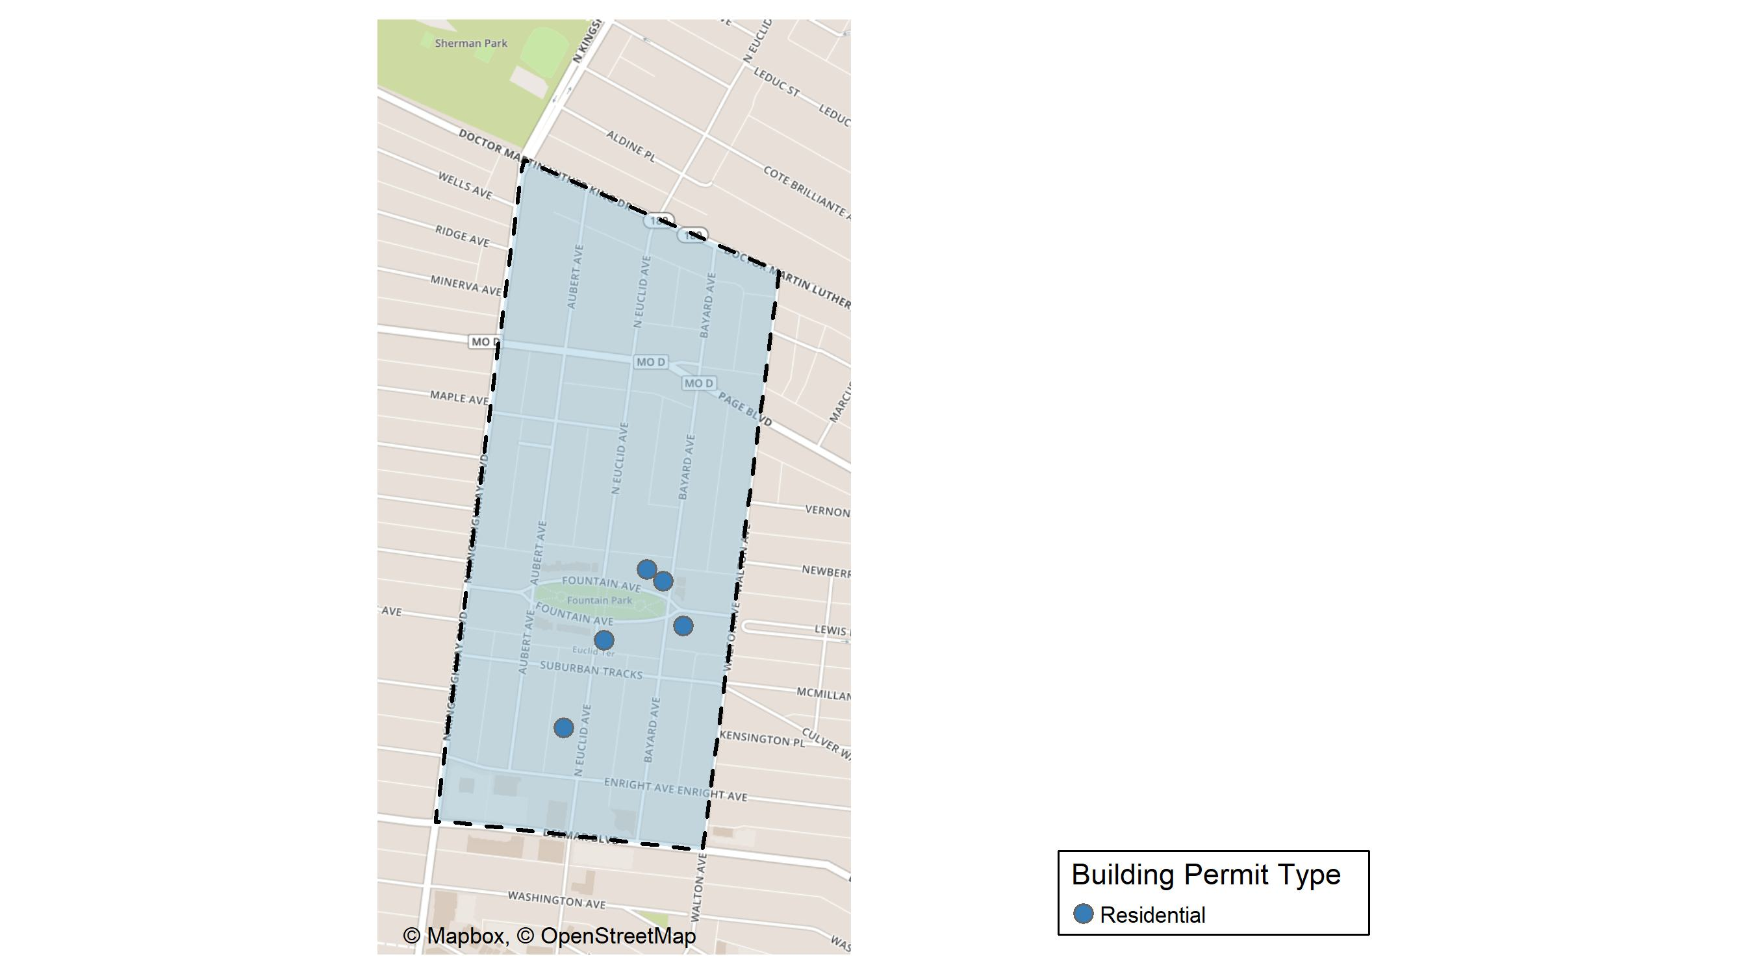
Fountain Park

Slide 50
Neighborhood Summary
October 2025 | October 2025 | October 2025 | October 2025
Permit Use | Average Cost | # of Permits | Total Value of Permits
Commercial | $0 | 0 | $0
Industrial | $0 | 0 | $0
Residential | $46,400 | 5 | $232,000
Last 6 Months | Last 6 Months | Last 6 Months | Last 6 Months
Permit Use | Average Cost | # of Permits | Total Value of Permits
Commercial | $256,700 | 4 | $1,026,800
Industrial | $0 | 0 | $0
Residential | $361,600 | 19 | $6,870,400

Slide 51
Fountain Park Individual Permit Breakdown
Neighborhood | Owner | New Use | Cost | address
Fountain Park | GATEWAY HOMES DEVELOPMENT LLC | Residential | $85,000 | 4826 FOUNTAIN AV
Fountain Park | KINGSWAY DEVELOPMENT LLC | Residential | $40,000 | 4876 FOUNTAIN AV
Fountain Park | FOXWELL, BILLIE GRACE | Residential | $7,000 | 4855 FOUNTAIN AV
Fountain Park | WOOTEN, VICTOR | Residential | $4,000 | 763 N EUCLID AV
Fountain Park | DAMPIER, TERRAN L | Residential | $96,000 | 4845 FOUNTAIN AV

Slide 52
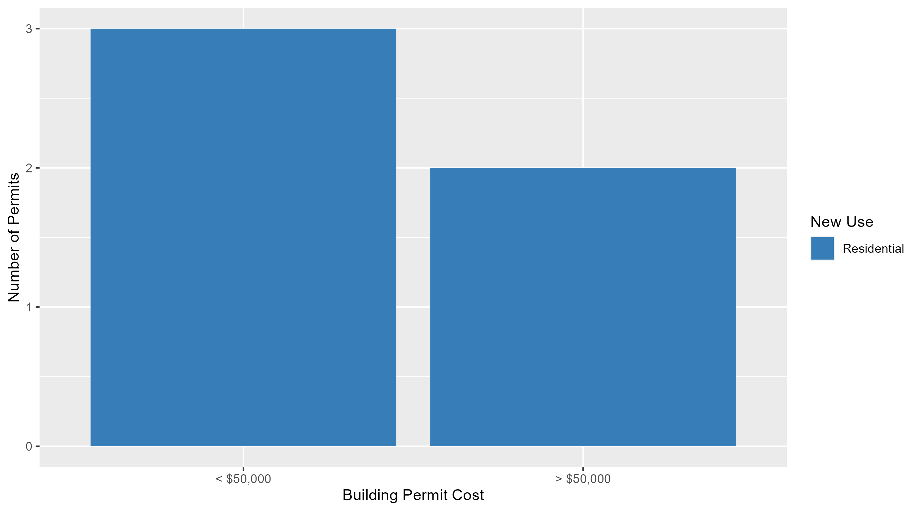
Fountain Park Permit Cost Breakdown

Slide 53
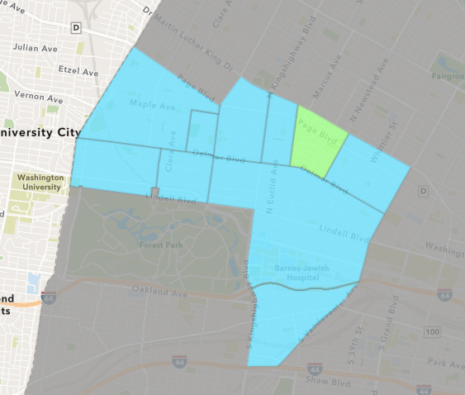
Lewis Place
October 2025 Neighborhood Cost Breakdown
  Mean: $20,667
  Median: $10,000
  Range: $5,000 - $47,000

Slide 54
Lewis Place: Summary Notes
3 building permits in October 2025
  0.00% change compared to October 2024 (3 total building permits)
  $20,667: Average building permit cost in October 2025
    785.71% change compared to October 2024 ($2,333)
24 total building permits in 2025
  60.00% change YTD compared to this time in 2024 (15 total building permits)
  $89,722: YTD average building permit cost in 2025
    316.42% change YTD compared to this time in 2024 ($21,546)

Slide 55
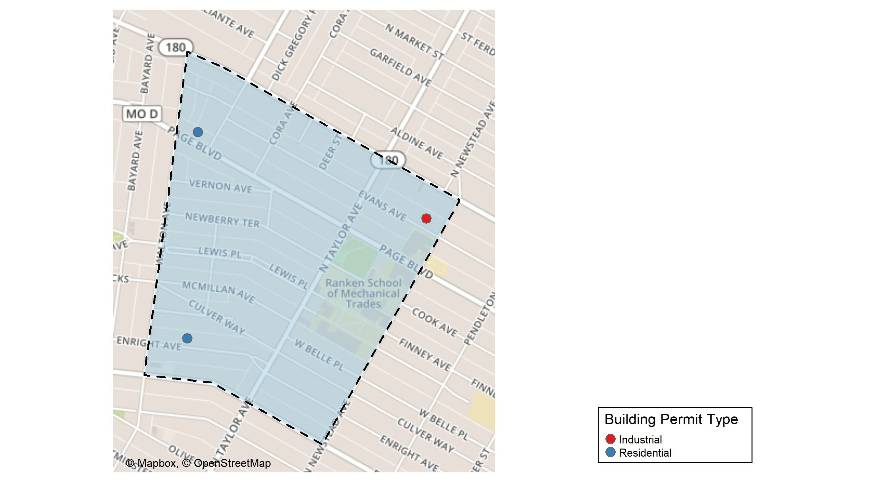
Lewis Place

Slide 56
Neighborhood Summary
October 2025 | October 2025 | October 2025 | October 2025
Permit Use | Average Cost | # of Permits | Total Value of Permits
Commercial | $0 | 0 | $0
Industrial | $10,000 | 1 | $10,000
Residential | $26,000 | 2 | $52,000
Last 6 Months | Last 6 Months | Last 6 Months | Last 6 Months
Permit Use | Average Cost | # of Permits | Total Value of Permits
Commercial | $225,367.80 | 5 | $1,126,839
Industrial | $6,000.00 | 2 | $12,000
Residential | $59,966.67 | 15 | $899,500

Slide 57
Lewis Place Individual Permit Breakdown
Neighborhood | Owner | New Use | Cost | address
Lewis Place | BAKER INVESTMENT GROUP LLC | Residential | $5,000 | 4615 ENRIGHT AV
Lewis Place | TAYLOR, GERRY & ROBIN | Residential | $47,000 | 4715 PAGE BLVD
Lewis Place | LATIMORE, ARETHA INEZ | Industrial | $10,000 | 4417 EVANS AV

Slide 58
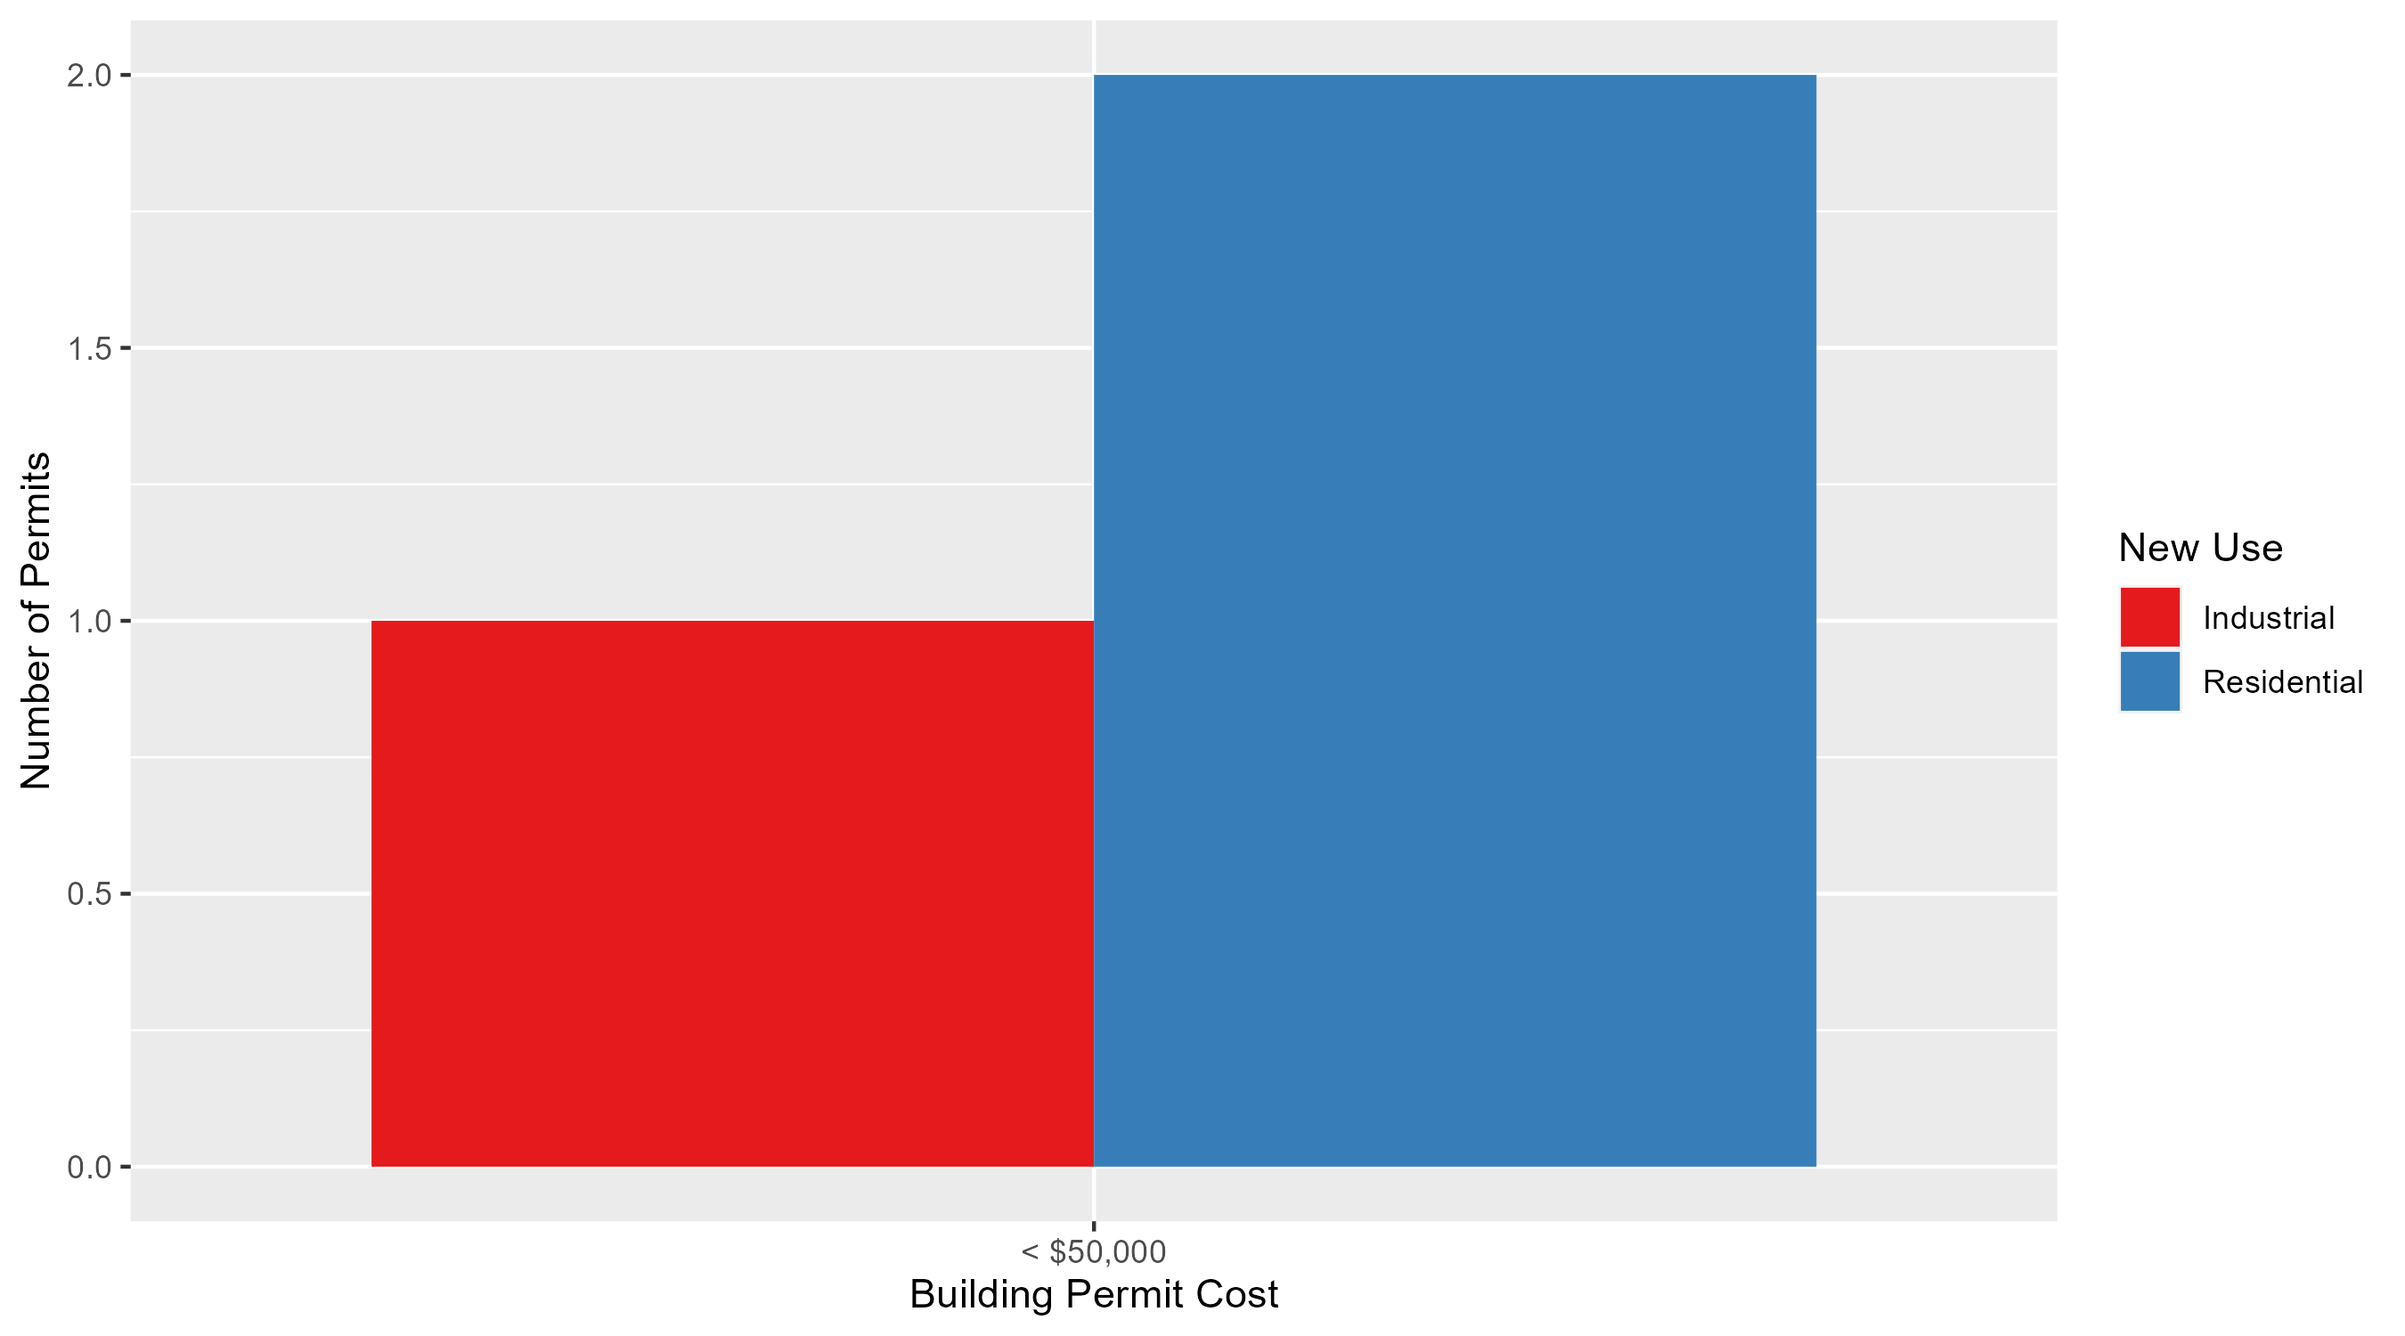
Lewis Place Permit Cost Breakdown

Slide 59
Additional Notes
Data retreived from https://www.stlouis-mo.gov/data/
Building permits with a cost of $0 were dropped
Building permits that were cancelled were dropped
Infinite change indicates 0 permits in the current or previous time period/comparison month so there was a overall increase or decrease

