Slide 1
St. Louis Central Corridor West Building Permits
Monthly Report: December 2025

Slide 2
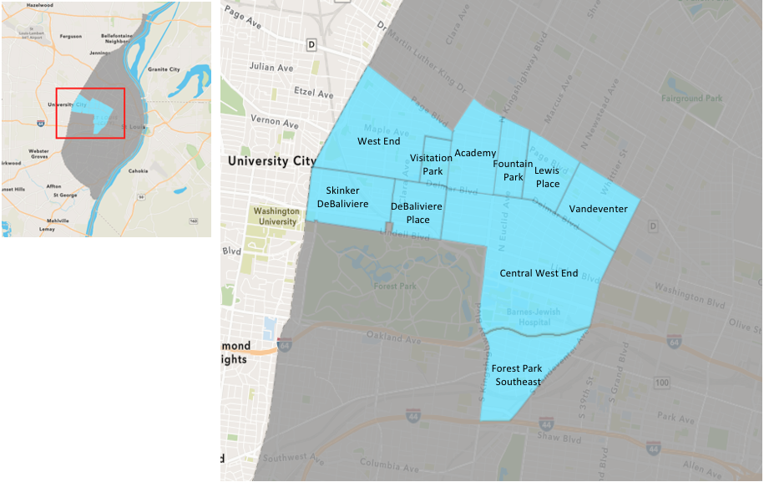
St. Louis Neighborhood Spatial Reference

Slide 3
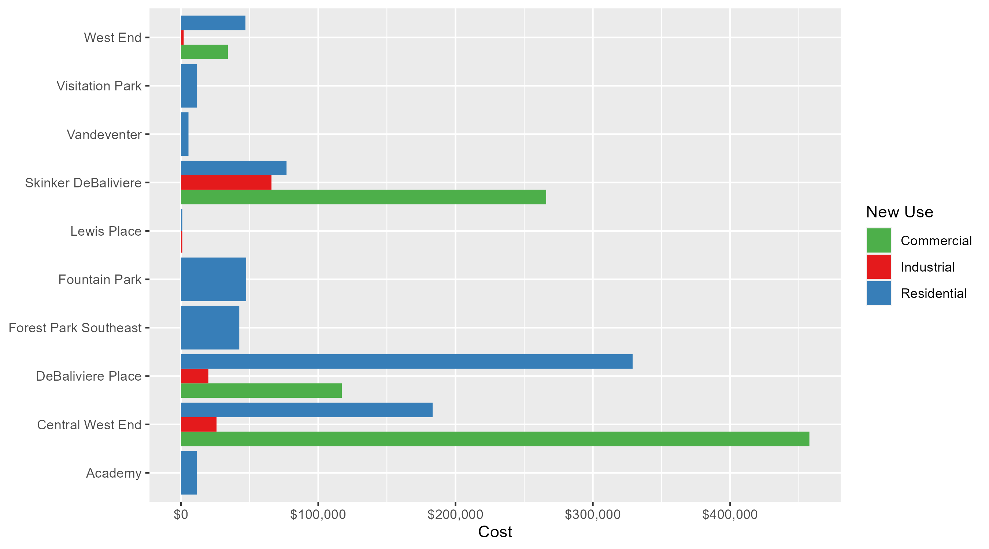
Neighborhood Summary: Average Building Permit Cost

Slide 4
Neighborhood Summary
December 2025 | December 2025 | December 2025 | December 2025
Neighborhood | Average Cost | # of Permits | Total Value of Permits
Academy | $11,590.62 | 8 | $92,725
Central West End | $302,811.20 | 41 | $12,415,259
DeBaliviere Place | $295,670.88 | 22 | $6,504,759
Forest Park Southeast | $42,500.00 | 2 | $85,000
Fountain Park | $47,500.00 | 2 | $95,000
Lewis Place | $1,000.00 | 7 | $7,000
Skinker DeBaliviere | $94,732.70 | 10 | $947,327
Vandeventer | $5,500.00 | 2 | $11,000
Visitation Park | $11,490.00 | 2 | $22,980
West End | $36,920.57 | 7 | $258,444
Last 6 Months | Last 6 Months | Last 6 Months | Last 6 Months
Neighborhood | Average Cost | # of Permits | Total Value of Permits
Academy | $100,095.37 | 43 | $4,304,101
Central West End | $443,289.71 | 295 | $130,770,464
DeBaliviere Place | $300,529.35 | 149 | $44,778,873
Forest Park Southeast | $55,920.39 | 51 | $2,851,940
Fountain Park | $528,918.18 | 22 | $11,636,200
Lewis Place | $71,938.48 | 27 | $1,942,339
Skinker DeBaliviere | $83,691.10 | 88 | $7,364,817
Vandeventer | $4,519,555.56 | 9 | $40,676,000
Visitation Park | $61,737.38 | 8 | $493,899
West End | $125,214.34 | 38 | $4,758,145

Slide 5
Core Neighborhoods

Slide 6
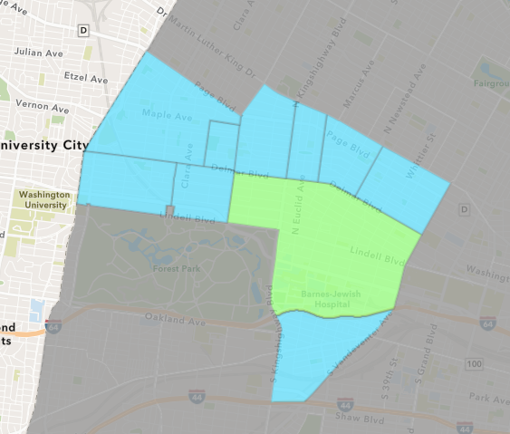
Central West End
December 2025 Neighborhood Cost Breakdown
Mean: $302,811
Median: $33,592
Range: $1,900 - $6,980,877

Slide 7
Central West End: Summary Notes
41 building permits in December 2025
10.81% change compared to December 2024 (37 total building permits)
$302,811: Average building permit cost in December 2025
336.02% change compared to December 2024 ($69,449)
408 total building permits in 2025
13.02% change YTD compared to this time in 2024 (361 total building permits)
$378,260: YTD average building permit cost in 2025
10.85% change YTD compared to this time in 2024 ($341,249)

Slide 8
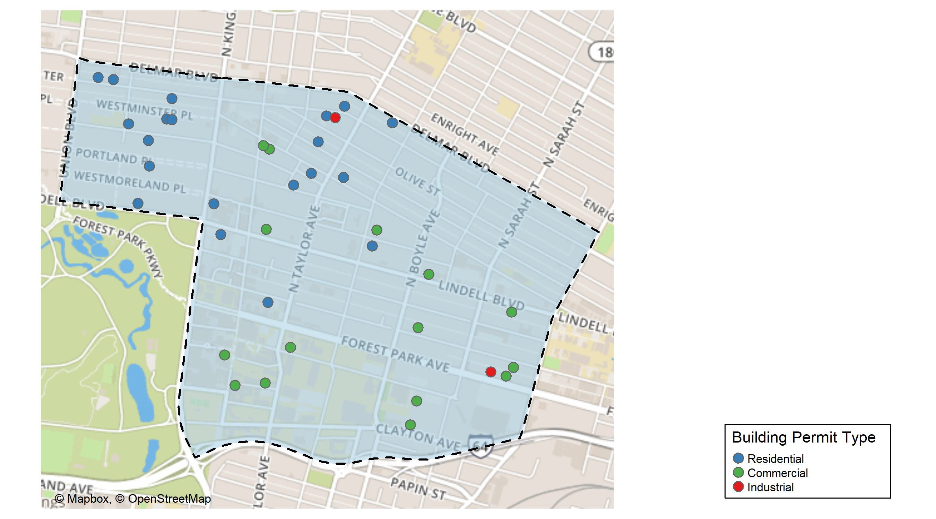
Central West End

Slide 9
Neighborhood Summary
December 2025 | December 2025 | December 2025 | December 2025
Permit Use | Average Cost | # of Permits | Total Value of Permits
Commercial | $457,718.8 | 19 | $8,696,658
Industrial | $25,950.0 | 2 | $51,900
Residential | $183,335.0 | 20 | $3,666,701
Last 6 Months | Last 6 Months | Last 6 Months | Last 6 Months
Permit Use | Average Cost | # of Permits | Total Value of Permits
Commercial | $293,714.73 | 82 | $24,084,608
Industrial | $71,307.67 | 12 | $855,692
Residential | $526,518.23 | 201 | $105,830,164

Slide 10
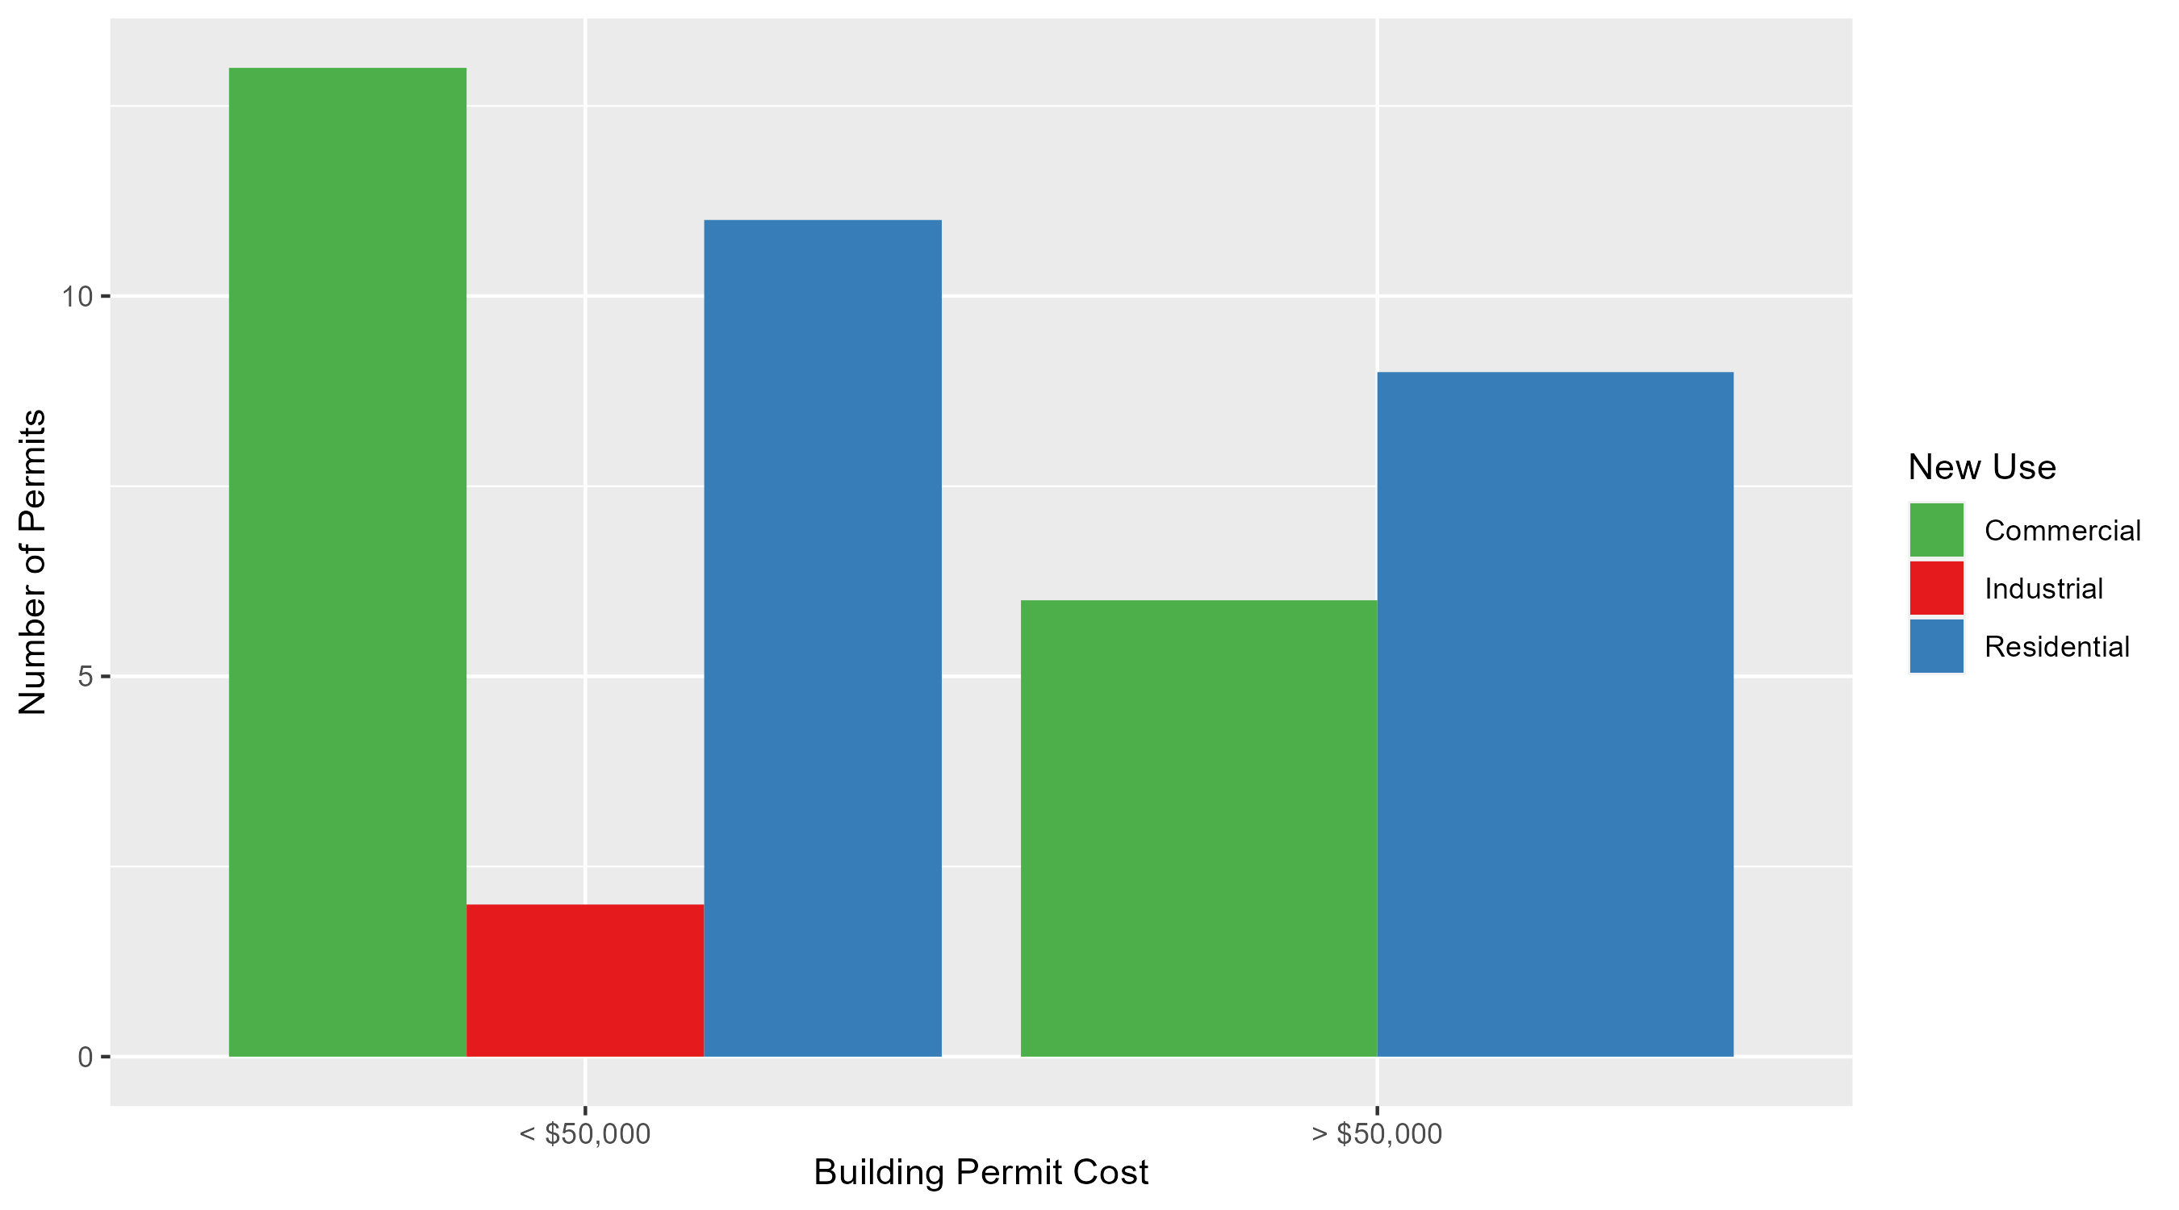
Central West End Permit Cost Breakdown

Slide 11
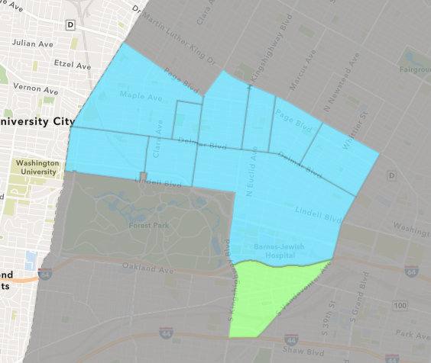
Forest Park Southeast
December 2025 Neighborhood Cost Breakdown
Mean: $42,500
Median: $42,500
Range: $10,000 - $75,000

Slide 12
Forest Park Southeast: Summary Notes
2 building permits in December 2025
-75.00% change compared to December 2024 (8 total building permits)
$42,500: Average building permit cost in December 2025
-91.61% change compared to December 2024 ($506,698)
71 total building permits in 2025
-4.05% change YTD compared to this time in 2024 (74 total building permits)
$63,930: YTD average building permit cost in 2025
-40.24% change YTD compared to this time in 2024 ($106,971)

Slide 13
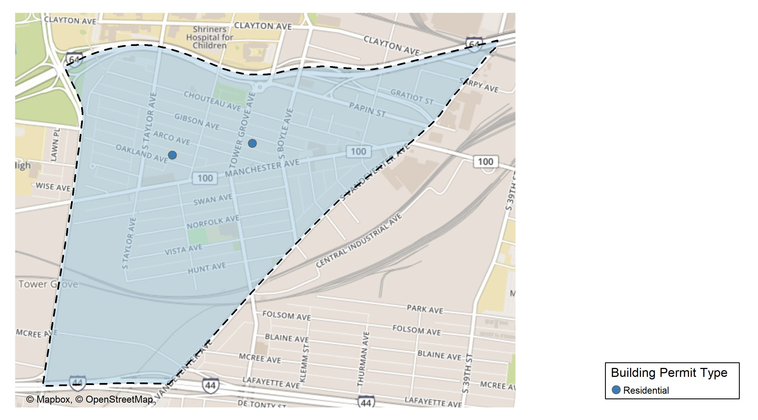
Forest Park Southeast

Slide 14
Neighborhood Summary
December 2025 | December 2025 | December 2025 | December 2025
Permit Use | Average Cost | # of Permits | Total Value of Permits
Commercial | $0 | 0 | $0
Industrial | $0 | 0 | $0
Residential | $42,500 | 2 | $85,000
Last 6 Months | Last 6 Months | Last 6 Months | Last 6 Months
Permit Use | Average Cost | # of Permits | Total Value of Permits
Commercial | $63,454.55 | 11 | $698,000
Industrial | $18,695.00 | 2 | $37,390
Residential | $55,698.68 | 38 | $2,116,550

Slide 15
Forest Park Southeast Individual Permit Breakdown
Neighborhood | Owner | New Use | Cost | address
Forest Park Southeast | HE PROPERTY GROUP LLC | Residential | $75,000 | 4336 GIBSON AV
Forest Park Southeast | BROWNING, MICHAEL & SARAH KOGAN | Residential | $10,000 | 4431 OAKLAND AV

Slide 16
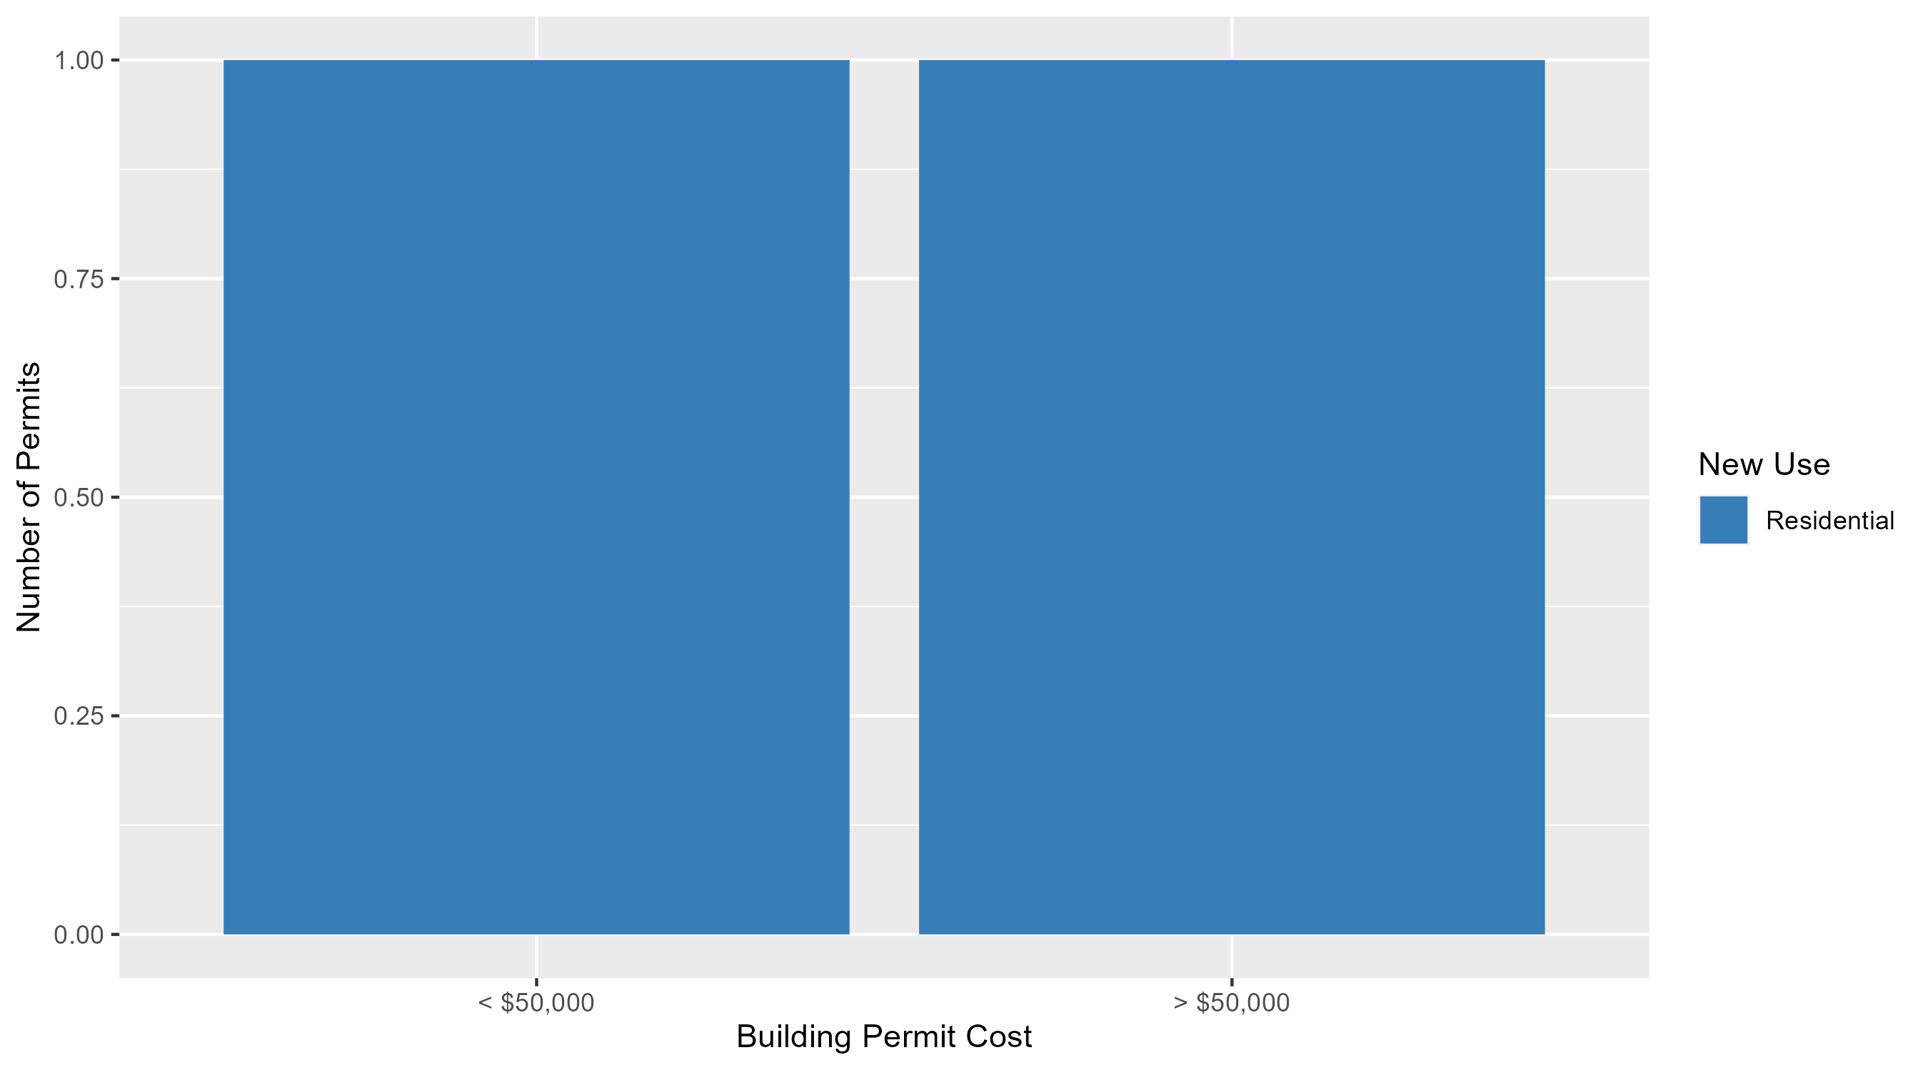
Forest Park Southeast Permit Cost Breakdown

Slide 17
Expanded Service Area

Slide 18
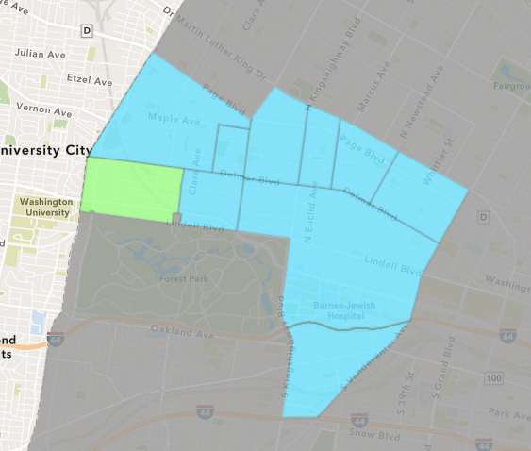
Skinker DeBaliviere
December 2025 Neighborhood Cost Breakdown
Mean: $94,733
Median: $70,481
Range: $6,345 - $284,000

Slide 19
Skinker DeBaliviere: Summary Notes
10 building permits in December 2025
42.86% change compared to December 2024 (7 total building permits)
$94,733: Average building permit cost in December 2025
55.67% change compared to December 2024 ($60,856)
125 total building permits in 2025
50.60% change YTD compared to this time in 2024 (83 total building permits)
$73,521: YTD average building permit cost in 2025
-29.04% change YTD compared to this time in 2024 ($103,605)

Slide 20
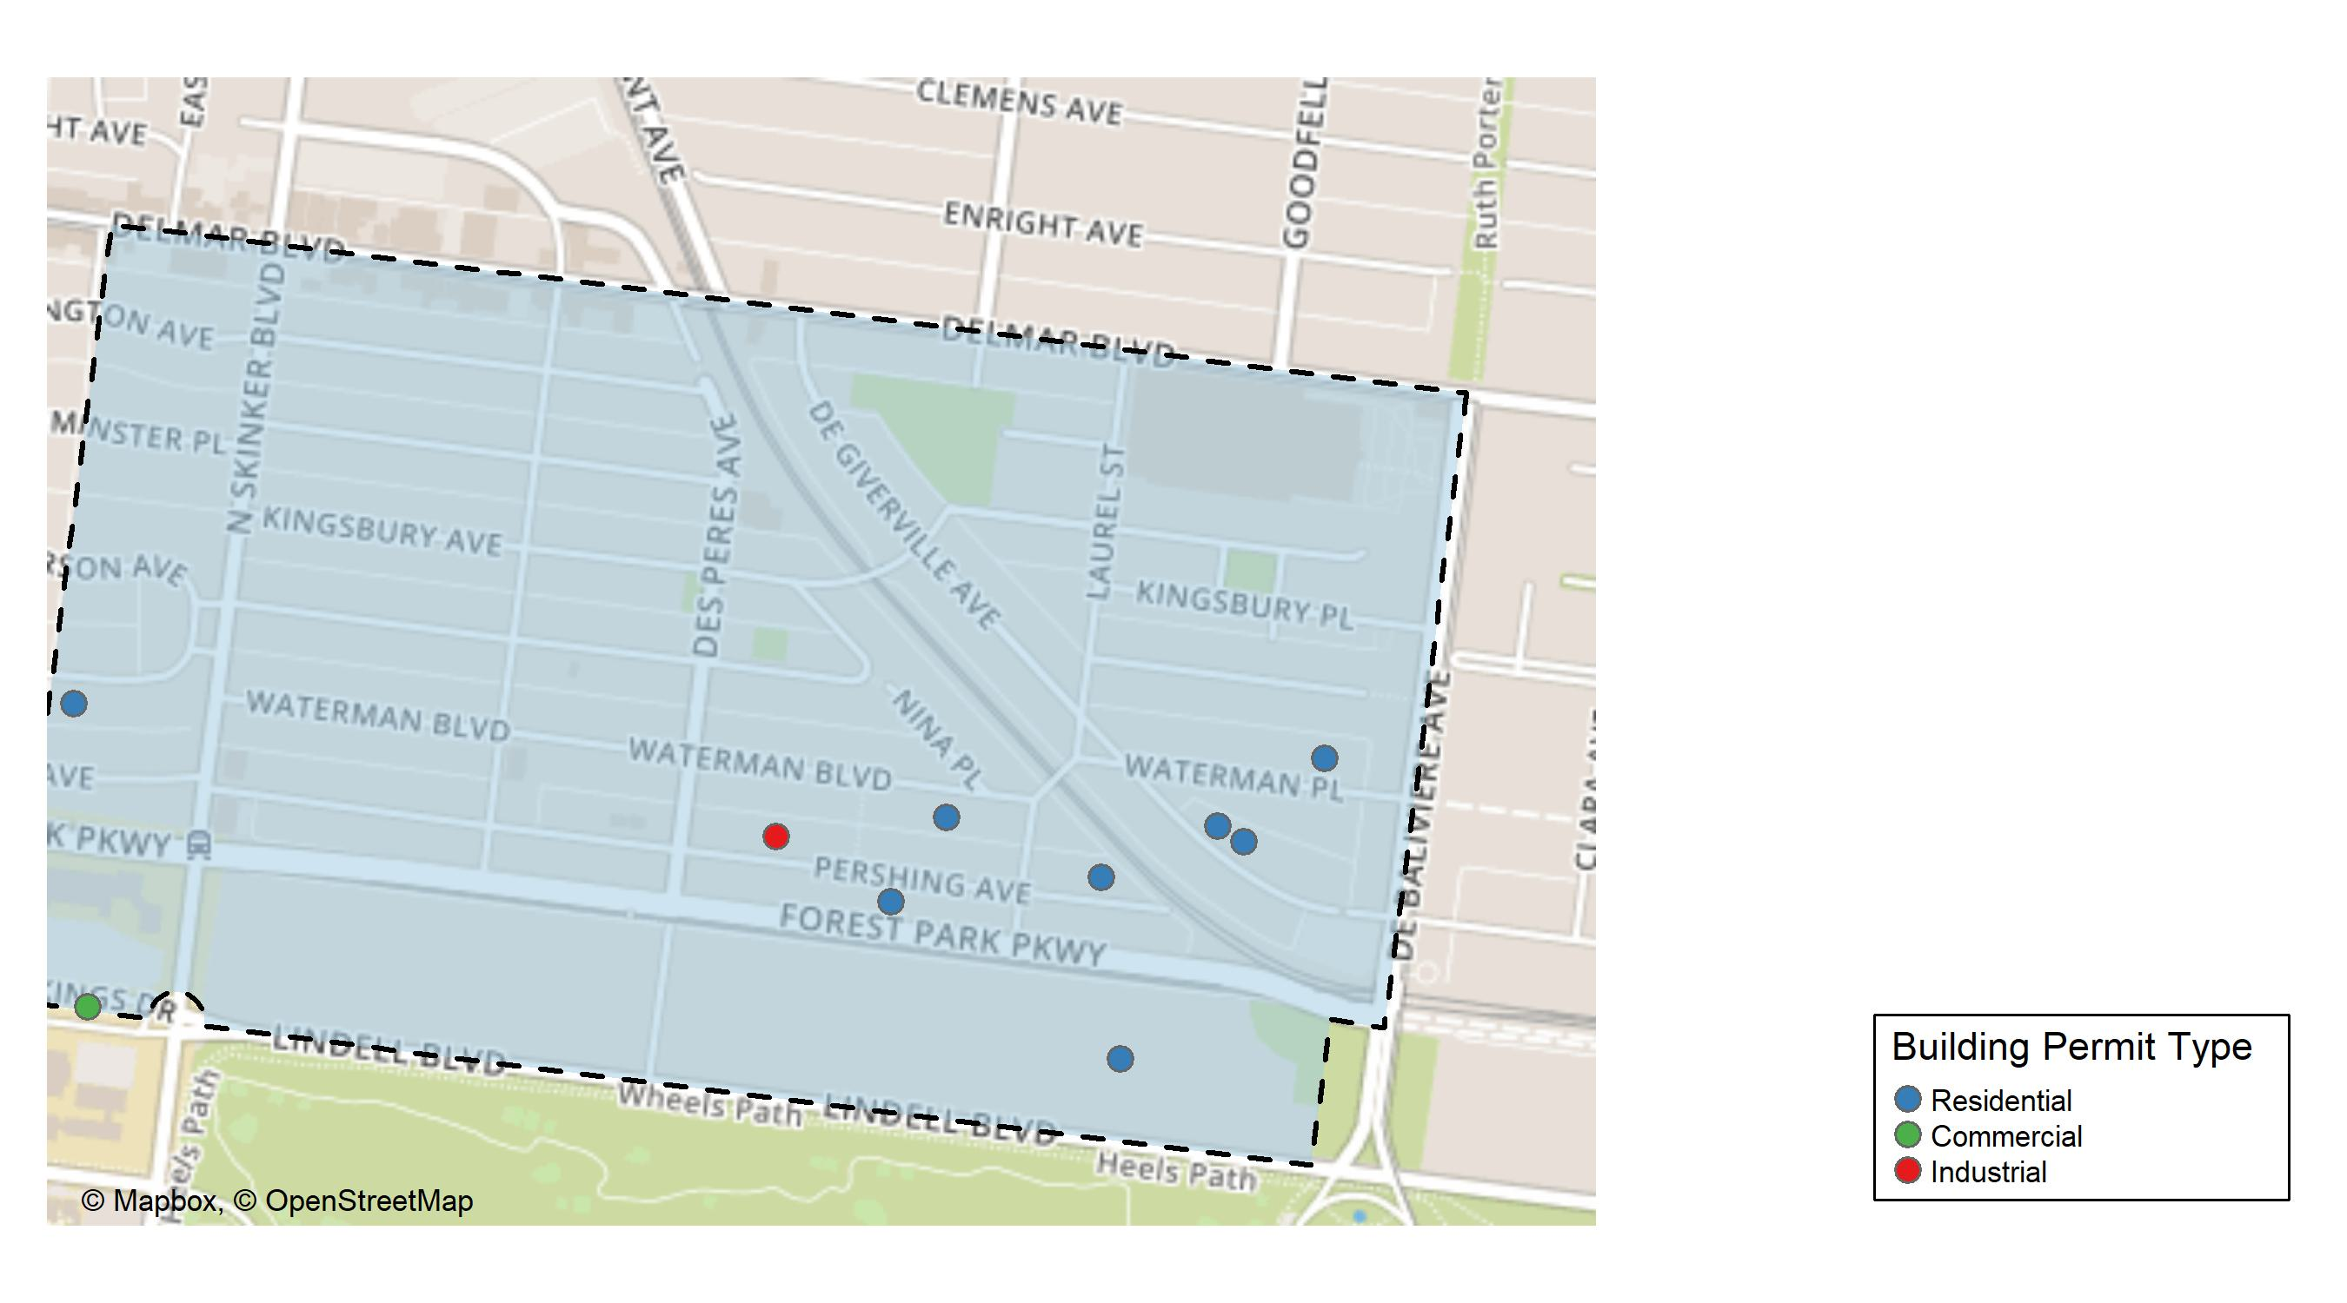
Skinker DeBaliviere

Slide 21
Neighborhood Summary
December 2025 | December 2025 | December 2025 | December 2025
Permit Use | Average Cost | # of Permits | Total Value of Permits
Commercial | $266,000.00 | 1 | $266,000
Industrial | $65,962.00 | 1 | $65,962
Residential | $76,920.62 | 8 | $615,365
Last 6 Months | Last 6 Months | Last 6 Months | Last 6 Months
Permit Use | Average Cost | # of Permits | Total Value of Permits
Commercial | $266,000.00 | 1 | $266,000
Industrial | $33,620.67 | 3 | $100,862
Residential | $83,308.99 | 84 | $6,997,955

Slide 22
Skinker DeBaliviere Individual Permit Breakdown
Neighborhood | Owner | New Use | Cost | address
Skinker DeBaliviere | WASHINGTON UNIVERSITY ART BUILDING | Commercial | $266,000 | 1 BROOKINGS DR
Skinker DeBaliviere | DODSON, WILLIAM EDWIN & KAREN L | Residential | $18,589 | 6248 WATERMAN BLVD
Skinker DeBaliviere | ORTON, JOSEPH CD & KADIE | Residential | $284,000 | 5761 DEGIVERVILLE AV
Skinker DeBaliviere | GANNON, MARILYN LAMONT TRS | Residential | $75,000 | 5763 LINDELL BLVD
Skinker DeBaliviere | MCLAREN, MARK P & KE KAY MASCHEK | Residential | $75,000 | 5731 WATERMAN BLVD
Skinker DeBaliviere | MCCLAIN, CALVIN | Residential | $6,345 | 5826 WATERMAN BLVD
Skinker DeBaliviere | MOORE, GERALD L & DEBRA A | Residential | $21,431 | 5773 DEGIVERVILLE AV
Skinker DeBaliviere | BRDT PROPERTIES LLC | Residential | $25,000 | 5842 PERSHING AV
Skinker DeBaliviere | EMCON PROPERTIES LLC | Residential | $110,000 | 5771 PERSHING AV
Skinker DeBaliviere | RODEN, DANIELLE & CARL GIVENS | Industrial | $65,962 | 5931 PERSHING AV

Slide 23
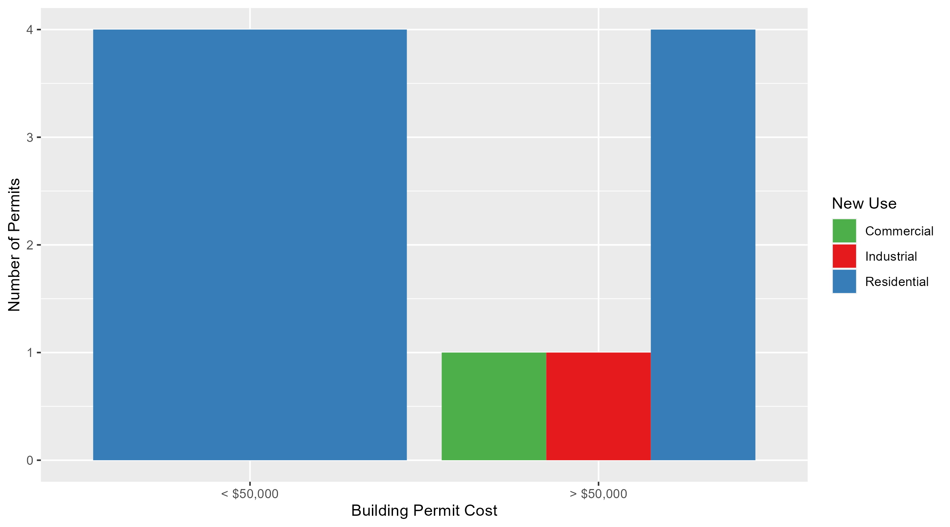
Skinker DeBaliviere Permit Cost Breakdown

Slide 24
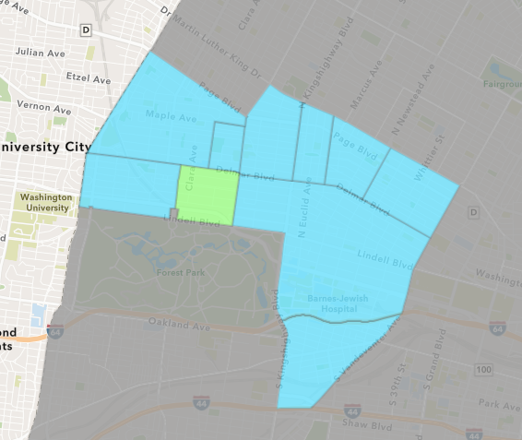
DeBaliviere Place
December 2025 Neighborhood Cost Breakdown
Mean: $295,671
Median: $206,829
Range: $6,264 - $1,200,000

Slide 25
DeBaliviere Place: Summary Notes
22 building permits in December 2025
1000.00% change compared to December 2024 (2 total building permits)
$295,671: Average building permit cost in December 2025
4324.89% change compared to December 2024 ($6,682)
167 total building permits in 2025
263.04% change YTD compared to this time in 2024 (46 total building permits)
$275,307: YTD average building permit cost in 2025
149.67% change YTD compared to this time in 2024 ($110,270)

Slide 26
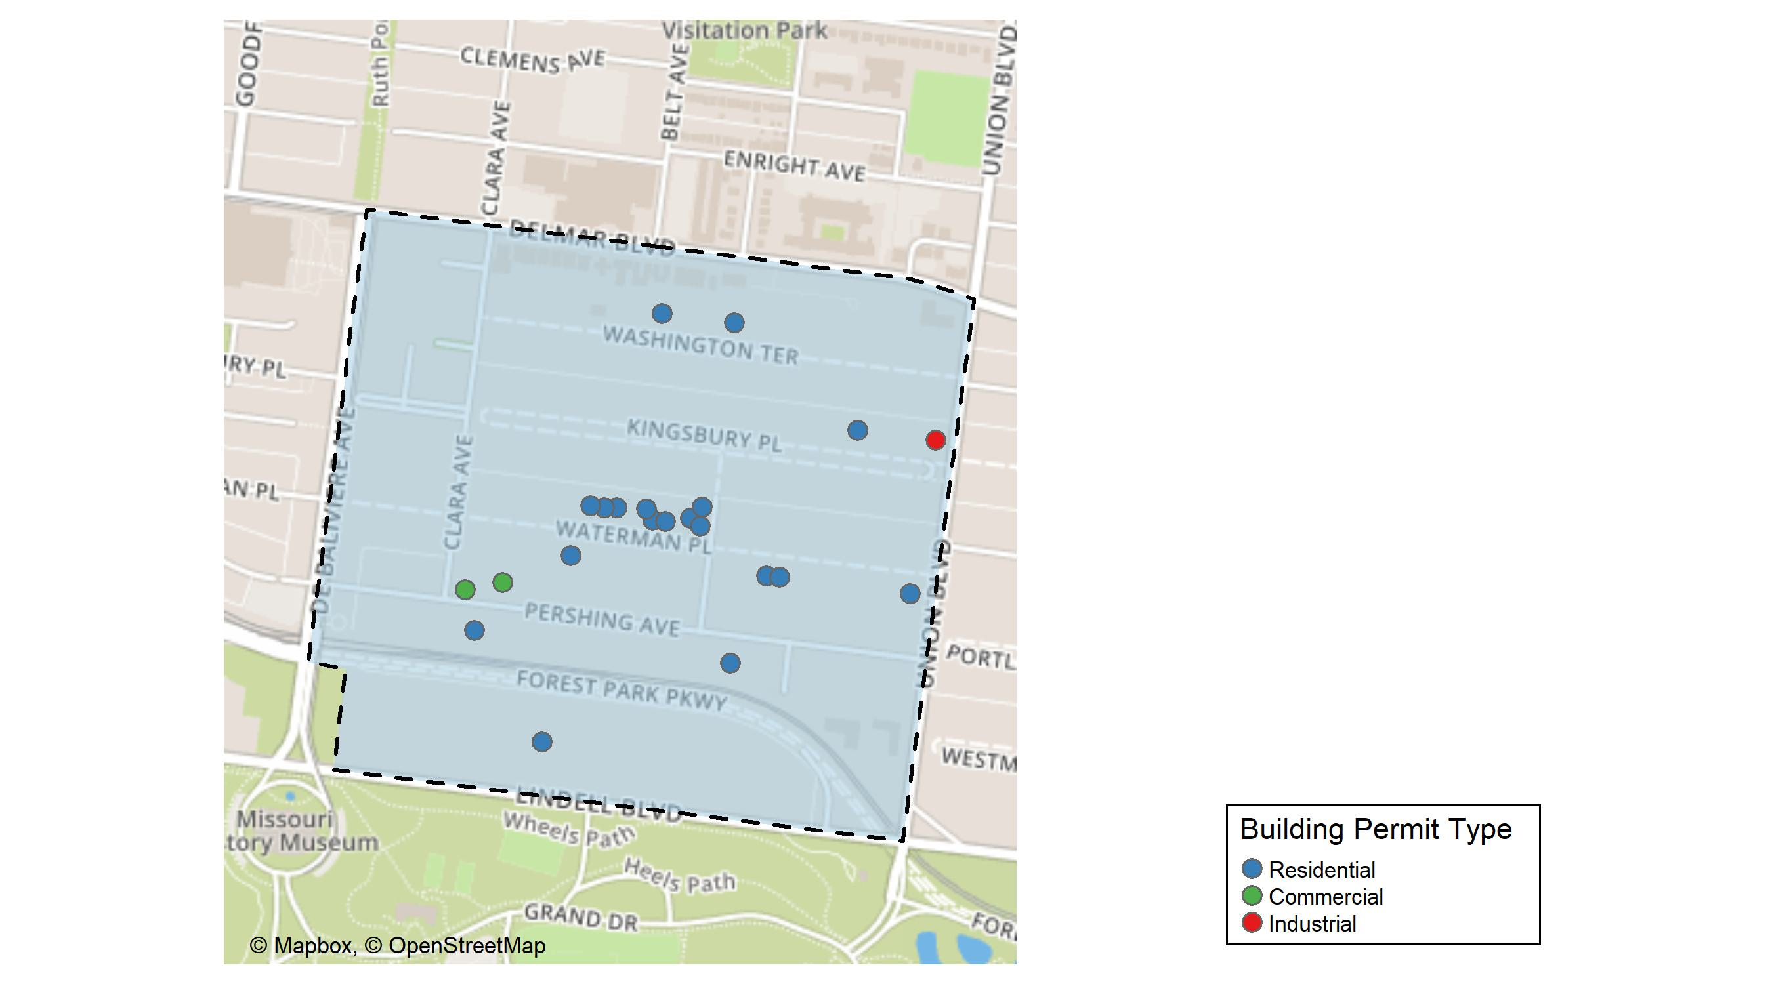
DeBaliviere Place

Slide 27
Neighborhood Summary
December 2025 | December 2025 | December 2025 | December 2025
Permit Use | Average Cost | # of Permits | Total Value of Permits
Commercial | $117,179.0 | 2 | $234,358
Industrial | $20,000.0 | 1 | $20,000
Residential | $328,968.5 | 19 | $6,250,401
Last 6 Months | Last 6 Months | Last 6 Months | Last 6 Months
Permit Use | Average Cost | # of Permits | Total Value of Permits
Commercial | $86,508.86 | 7 | $605,562
Industrial | $65,000.00 | 2 | $130,000
Residential | $314,595.08 | 140 | $44,043,311

Slide 28
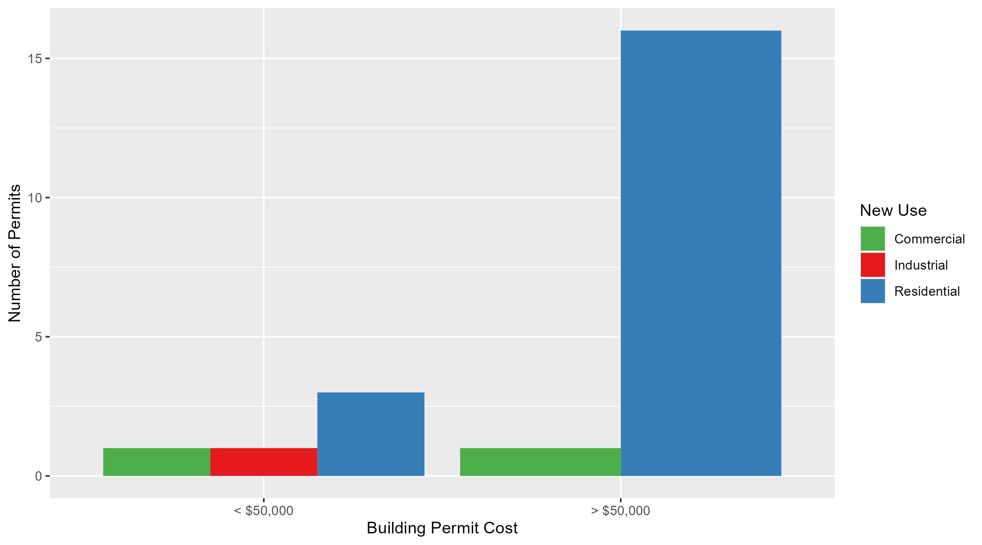
DeBaliviere Place Permit Cost Breakdown

Slide 29
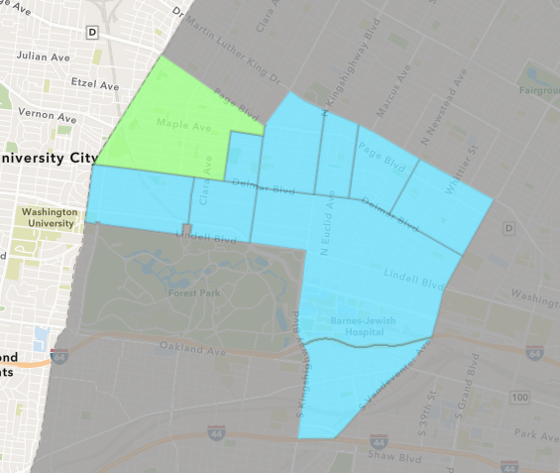
West End
December 2025 Neighborhood Cost Breakdown
Mean: $36,921
Median: $7,000
Range: $1,000 - $150,000

Slide 30
West End: Summary Notes
7 building permits in December 2025
133.33% change compared to December 2024 (3 total building permits)
$36,921: Average building permit cost in December 2025
163.91% change compared to December 2024 ($13,990)
61 total building permits in 2025
-10.29% change YTD compared to this time in 2024 (68 total building permits)
$259,578: YTD average building permit cost in 2025
175.42% change YTD compared to this time in 2024 ($94,249)

Slide 31
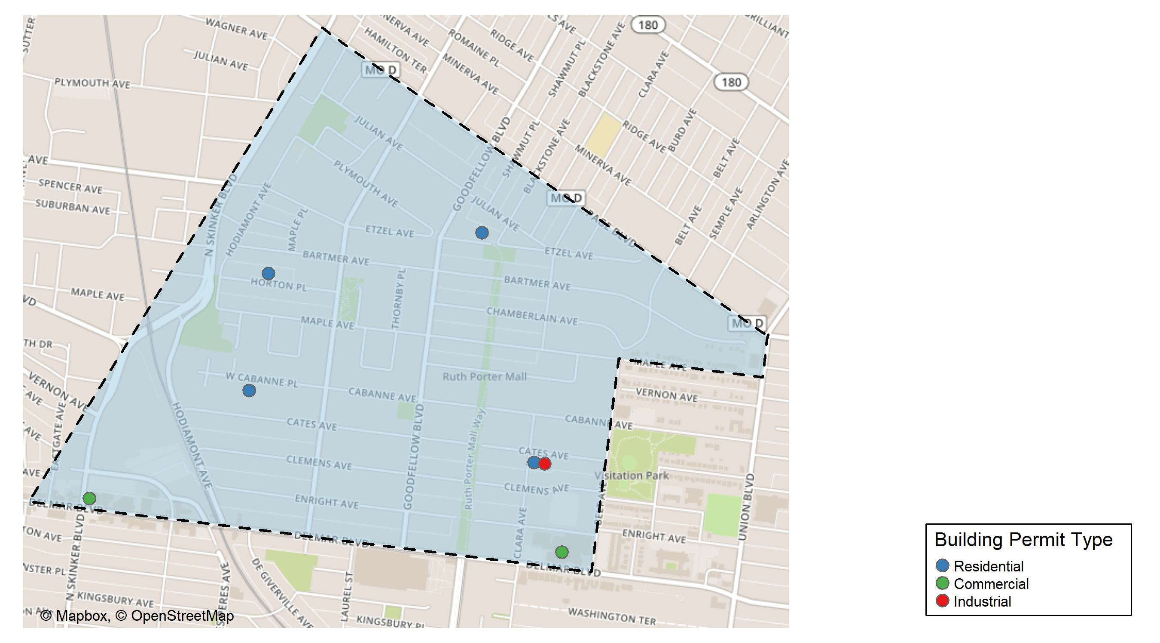
West End

Slide 32
Neighborhood Summary
December 2025 | December 2025 | December 2025 | December 2025
Permit Use | Average Cost | # of Permits | Total Value of Permits
Commercial | $34,222 | 2 | $68,444
Industrial | $2,000 | 1 | $2,000
Residential | $47,000 | 4 | $188,000
Last 6 Months | Last 6 Months | Last 6 Months | Last 6 Months
Permit Use | Average Cost | # of Permits | Total Value of Permits
Commercial | $62,240.67 | 6 | $373,444
Industrial | $11,000.00 | 2 | $22,000
Residential | $145,423.37 | 30 | $4,362,701

Slide 33
West End Individual Permit Breakdown
Neighborhood | Owner | New Use | Cost | address
West End | WASHINGTON UNIVERSITY | Commercial | $62,444 | 616 N SKINKER BLVD
West End | PEOPLES HEALTH CENTERS INC | Residential | $30,000 | 5576 CATES AV
West End | HARDWRICT, WILBER & JUANITA | Residential | $7,000 | 6011 HORTON PL
West End | GARDNER, DERYL & BRANDI | Residential | $150,000 | 6014 WEST CABANNE PL
West End | DELMAR DIVINE CONDO | Commercial | $6,000 | 5501 DELMAR BLVD
West End | PEOPLES HEALTH CENTERS INC | Industrial | $2,000 | 5566 CATES AV
West End | CARADINE, ERIKA D | Residential | $1,000 | 5717-19 ETZEL AV

Slide 34
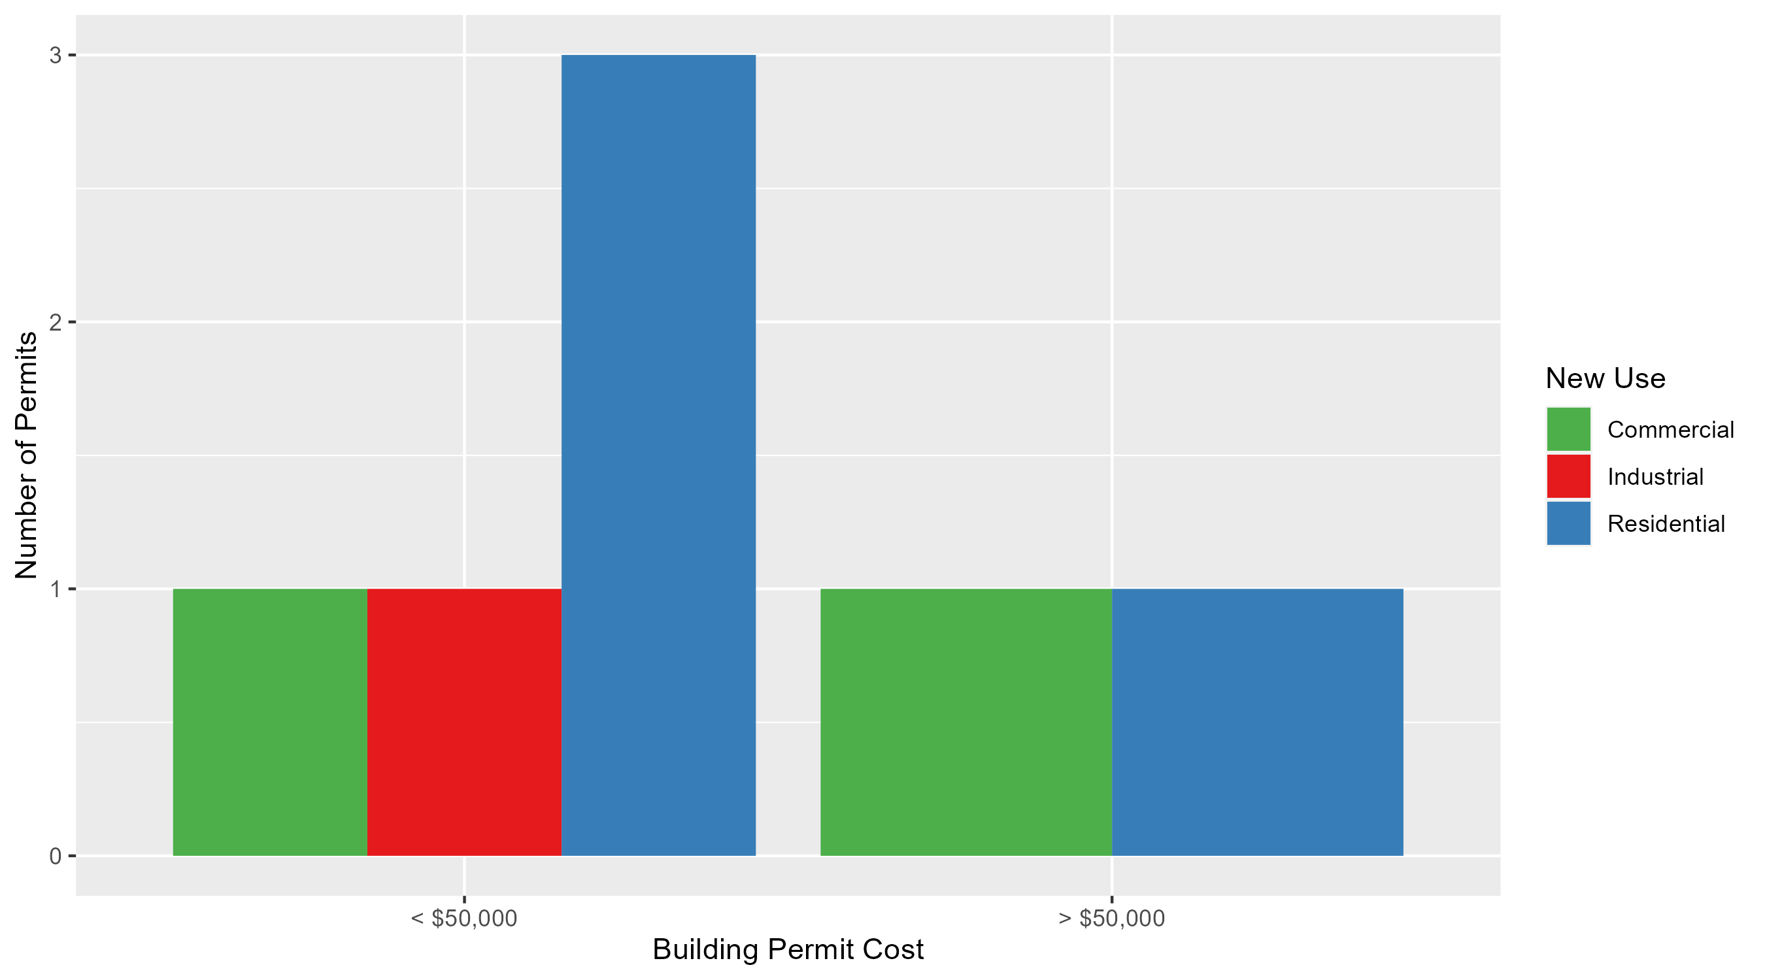
West End Permit Cost Breakdown

Slide 35
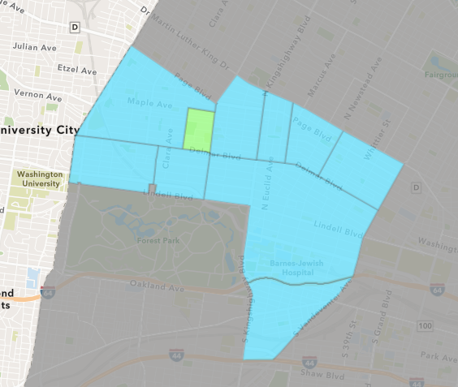
Visitation Park
December 2025 Neighborhood Cost Breakdown
Mean: $11,490
Median: $11,490
Range: $1,000 - $21,980

Slide 36
Visitation Park: Summary Notes
2 building permits in December 2025
Infinite change compared to December 2024 (0 total building permits)
$11,490: Average building permit cost in December 2025
Infinite change compared to December 2024 ($0)
10 total building permits in 2025
150.00% change YTD compared to this time in 2024 (4 total building permits)
$64,490: YTD average building permit cost in 2025
214.27% change YTD compared to this time in 2024 ($20,521)

Slide 37
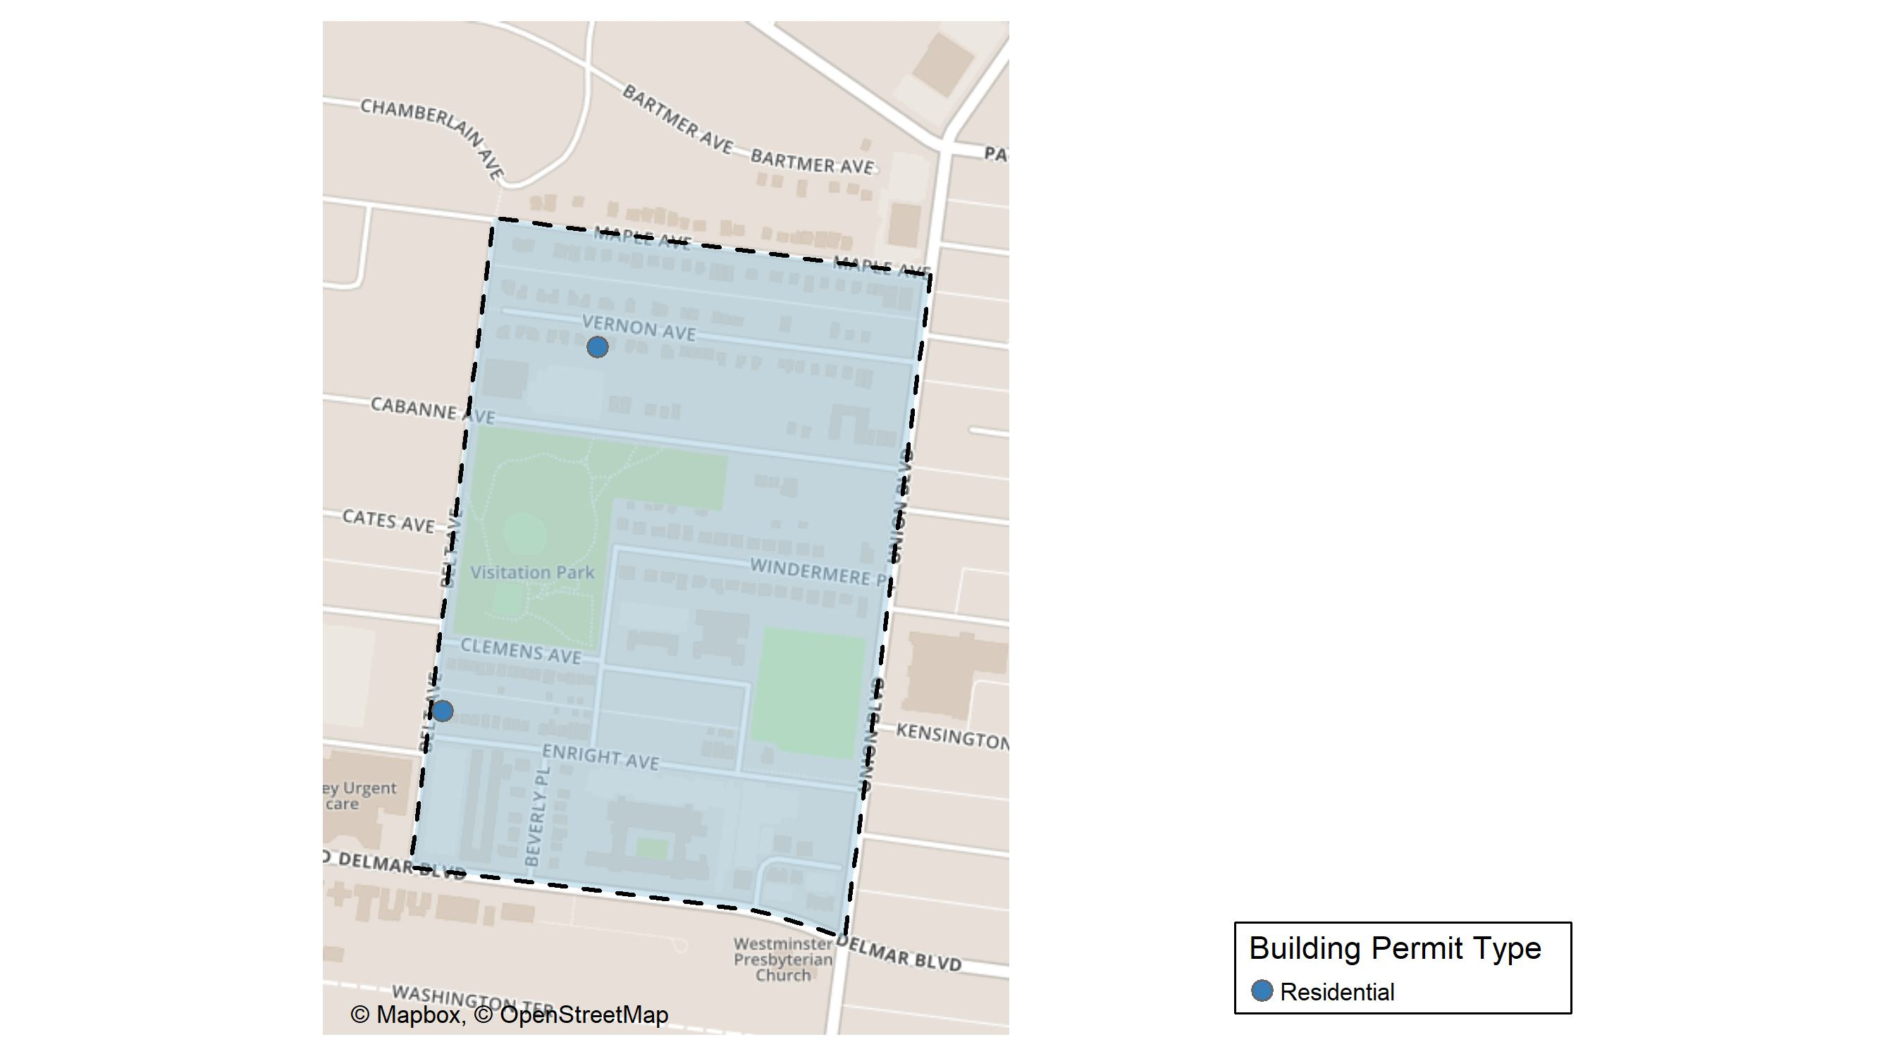
Visitation Park

Slide 38
Neighborhood Summary
December 2025 | December 2025 | December 2025 | December 2025
Permit Use | Average Cost | # of Permits | Total Value of Permits
Commercial | $0 | 0 | $0
Industrial | $0 | 0 | $0
Residential | $11,490 | 2 | $22,980
Last 6 Months | Last 6 Months | Last 6 Months | Last 6 Months
Permit Use | Average Cost | # of Permits | Total Value of Permits
Commercial | $9,000.00 | 1 | $9,000
Industrial | $0.00 | 0 | $0
Residential | $69,271.29 | 7 | $484,899

Slide 39
Visitation Park Individual Permit Breakdown
Neighborhood | Owner | New Use | Cost | address
Visitation Park | THOMAS, VINCENT E SR & BARBARA | Residential | $21,980 | 5440 VERNON AV
Visitation Park | FRANKLIN, KIM M | Residential | $1,000 | 5479 ENRIGHT AV

Slide 40
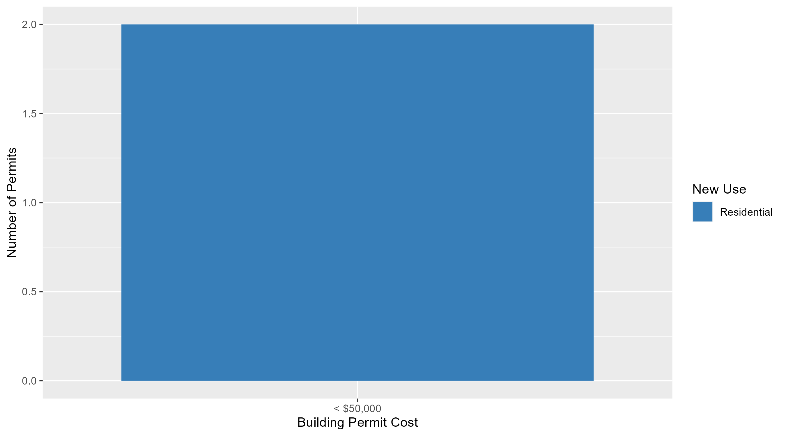
Visitation Park Permit Cost Breakdown

Slide 41
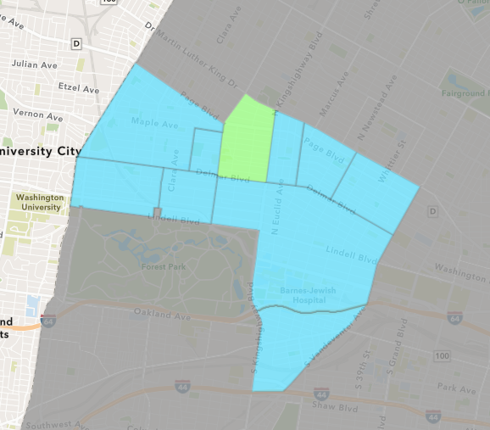
Academy
December 2025 Neighborhood Cost Breakdown
Mean: $11,591
Median: $7,350
Range: $4,025 - $32,000

Slide 42
Academy: Summary Notes
8 building permits in December 2025
Infinite change compared to December 2024 (0 total building permits)
$11,591: Average building permit cost in December 2025
Infinite change compared to December 2024 ($0)
56 total building permits in 2025
143.48% change YTD compared to this time in 2024 (23 total building permits)
$82,770: YTD average building permit cost in 2025
131.04% change YTD compared to this time in 2024 ($35,825)

Slide 43
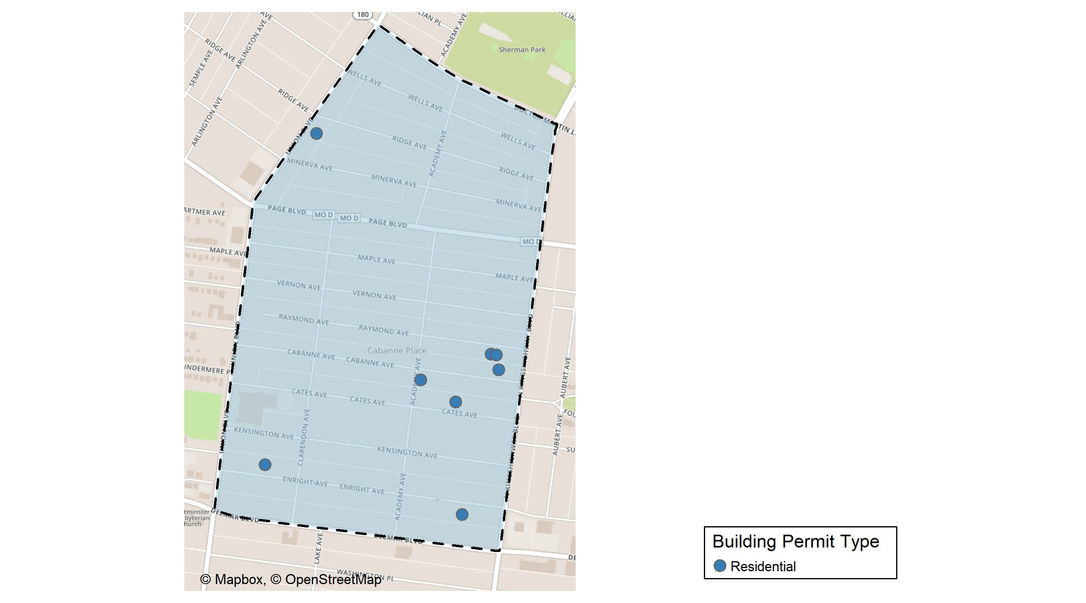
Academy

Slide 44
Neighborhood Summary
December 2025 | December 2025 | December 2025 | December 2025
Permit Use | Average Cost | # of Permits | Total Value of Permits
Commercial | $0.00 | 0 | $0
Industrial | $0.00 | 0 | $0
Residential | $11,590.62 | 8 | $92,725
Last 6 Months | Last 6 Months | Last 6 Months | Last 6 Months
Permit Use | Average Cost | # of Permits | Total Value of Permits
Commercial | $356,700.00 | 5 | $1,783,500
Industrial | $10,875.00 | 2 | $21,750
Residential | $69,412.53 | 36 | $2,498,851

Slide 45
Academy Individual Permit Breakdown
Neighborhood | Owner | New Use | Cost | address
Academy | BEATTY, MONET M | Residential | $4,025 | 5231 ENRIGHT AV
Academy | VIBRANT BLUE REALTY LLC | Residential | $5,000 | 5059 CATES AV
Academy | PICKETT, CHRISTOPHER | Residential | $5,000 | 5024 RAYMOND AV
Academy | MOORE, KETRINA & ANDRE | Residential | $12,000 | 5036 ENRIGHT AV
Academy | INGRAM, TIFANEE | Residential | $32,000 | 5028 RAYMOND AV
Academy | COLLINS, DEREK | Residential | $20,000 | 5094 CABANNE AV
Academy | BROOKS, ERIC M | Residential | $5,700 | 5021 CABANNE AV
Academy | FLENOID, TONI K | Residential | $9,000 | 1384 UNION BLVD

Slide 46
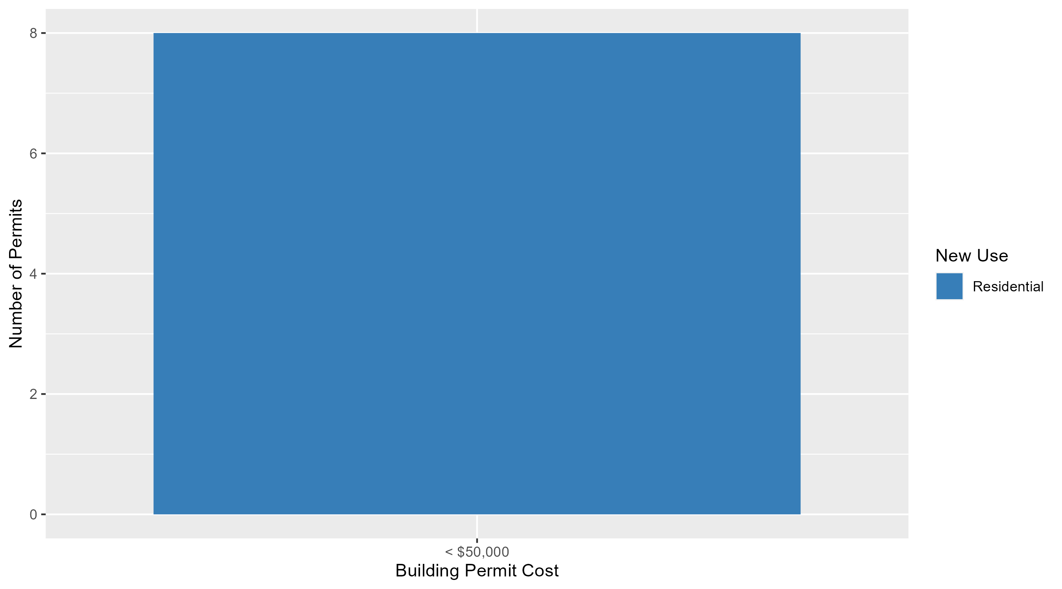
Academy Permit Cost Breakdown

Slide 47
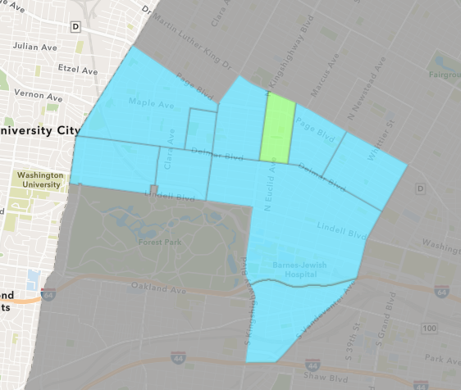
Fountain Park
December 2025 Neighborhood Cost Breakdown
Mean: $47,500
Median: $47,500
Range: $5,000 - $90,000

Slide 48
Fountain Park: Summary Notes
2 building permits in December 2025
Infinite change compared to December 2024 (0 total building permits)
$47,500: Average building permit cost in December 2025
Infinite change compared to December 2024 ($0)
28 total building permits in 2025
115.38% change YTD compared to this time in 2024 (13 total building permits)
$426,036: YTD average building permit cost in 2025
868.26% change YTD compared to this time in 2024 ($44,000)

Slide 49
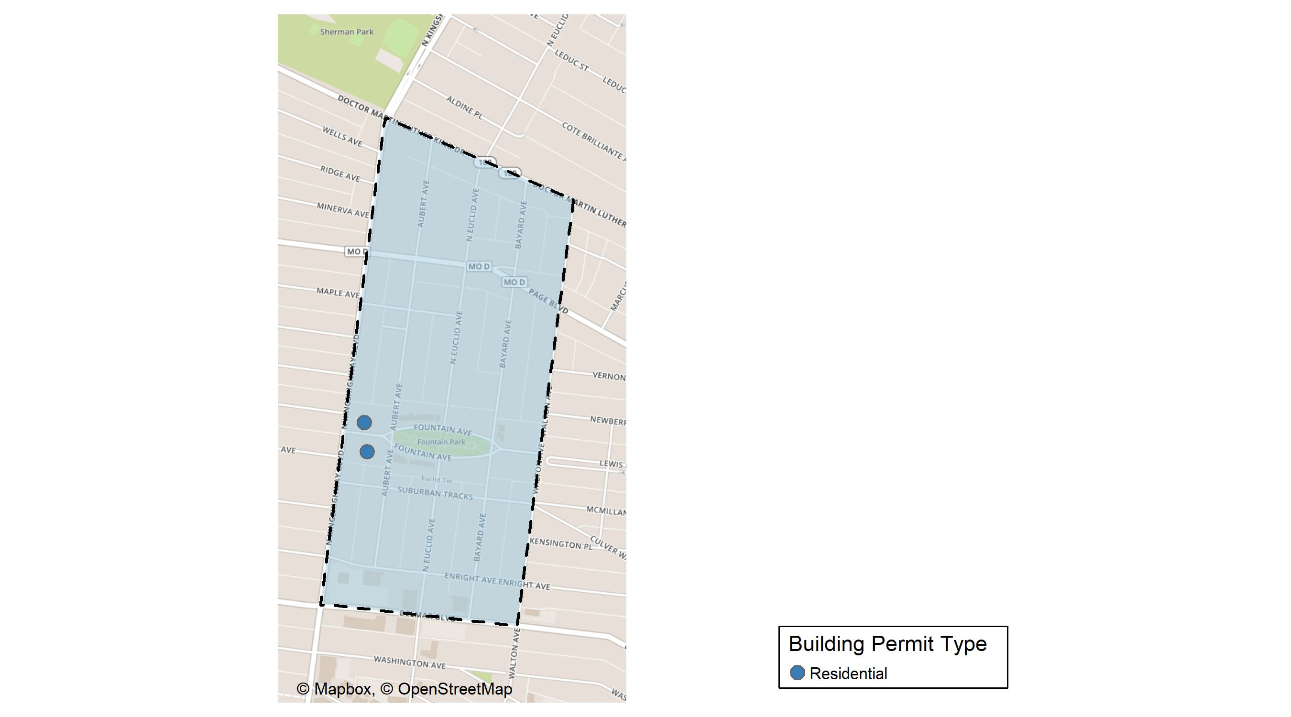
Fountain Park

Slide 50
Neighborhood Summary
December 2025 | December 2025 | December 2025 | December 2025
Permit Use | Average Cost | # of Permits | Total Value of Permits
Commercial | $0 | 0 | $0
Industrial | $0 | 0 | $0
Residential | $47,500 | 2 | $95,000
Last 6 Months | Last 6 Months | Last 6 Months | Last 6 Months
Permit Use | Average Cost | # of Permits | Total Value of Permits
Commercial | $985,360.0 | 5 | $4,926,800
Industrial | $0.0 | 0 | $0
Residential | $394,670.6 | 17 | $6,709,400

Slide 51
Fountain Park Individual Permit Breakdown
Neighborhood | Owner | New Use | Cost | address
Fountain Park | DEHART, PAUL & MELISSA | Residential | $5,000 | 4958 FOUNTAIN AV
Fountain Park | KURZ, FRANK JR & AZADEH DIVANBEIGI | Residential | $90,000 | 4969 FOUNTAIN AV

Slide 52
Fountain Park Permit Cost Breakdown

Slide 53
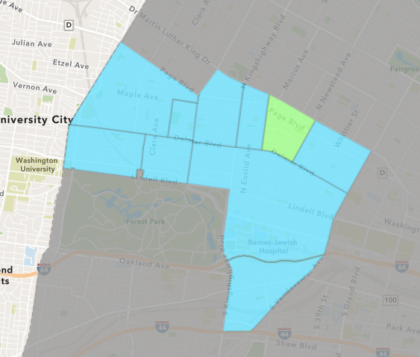
Lewis Place
December 2025 Neighborhood Cost Breakdown
Mean: $1,000
Median: $1,000
Range: $1,000 - $1,000

Slide 54
Lewis Place: Summary Notes
7 building permits in December 2025
Infinite change compared to December 2024 (0 total building permits)
$1,000: Average building permit cost in December 2025
Infinite change compared to December 2024 ($0)
33 total building permits in 2025
120.00% change YTD compared to this time in 2024 (15 total building permits)
$66,041: YTD average building permit cost in 2025
206.50% change YTD compared to this time in 2024 ($21,546)

Slide 55
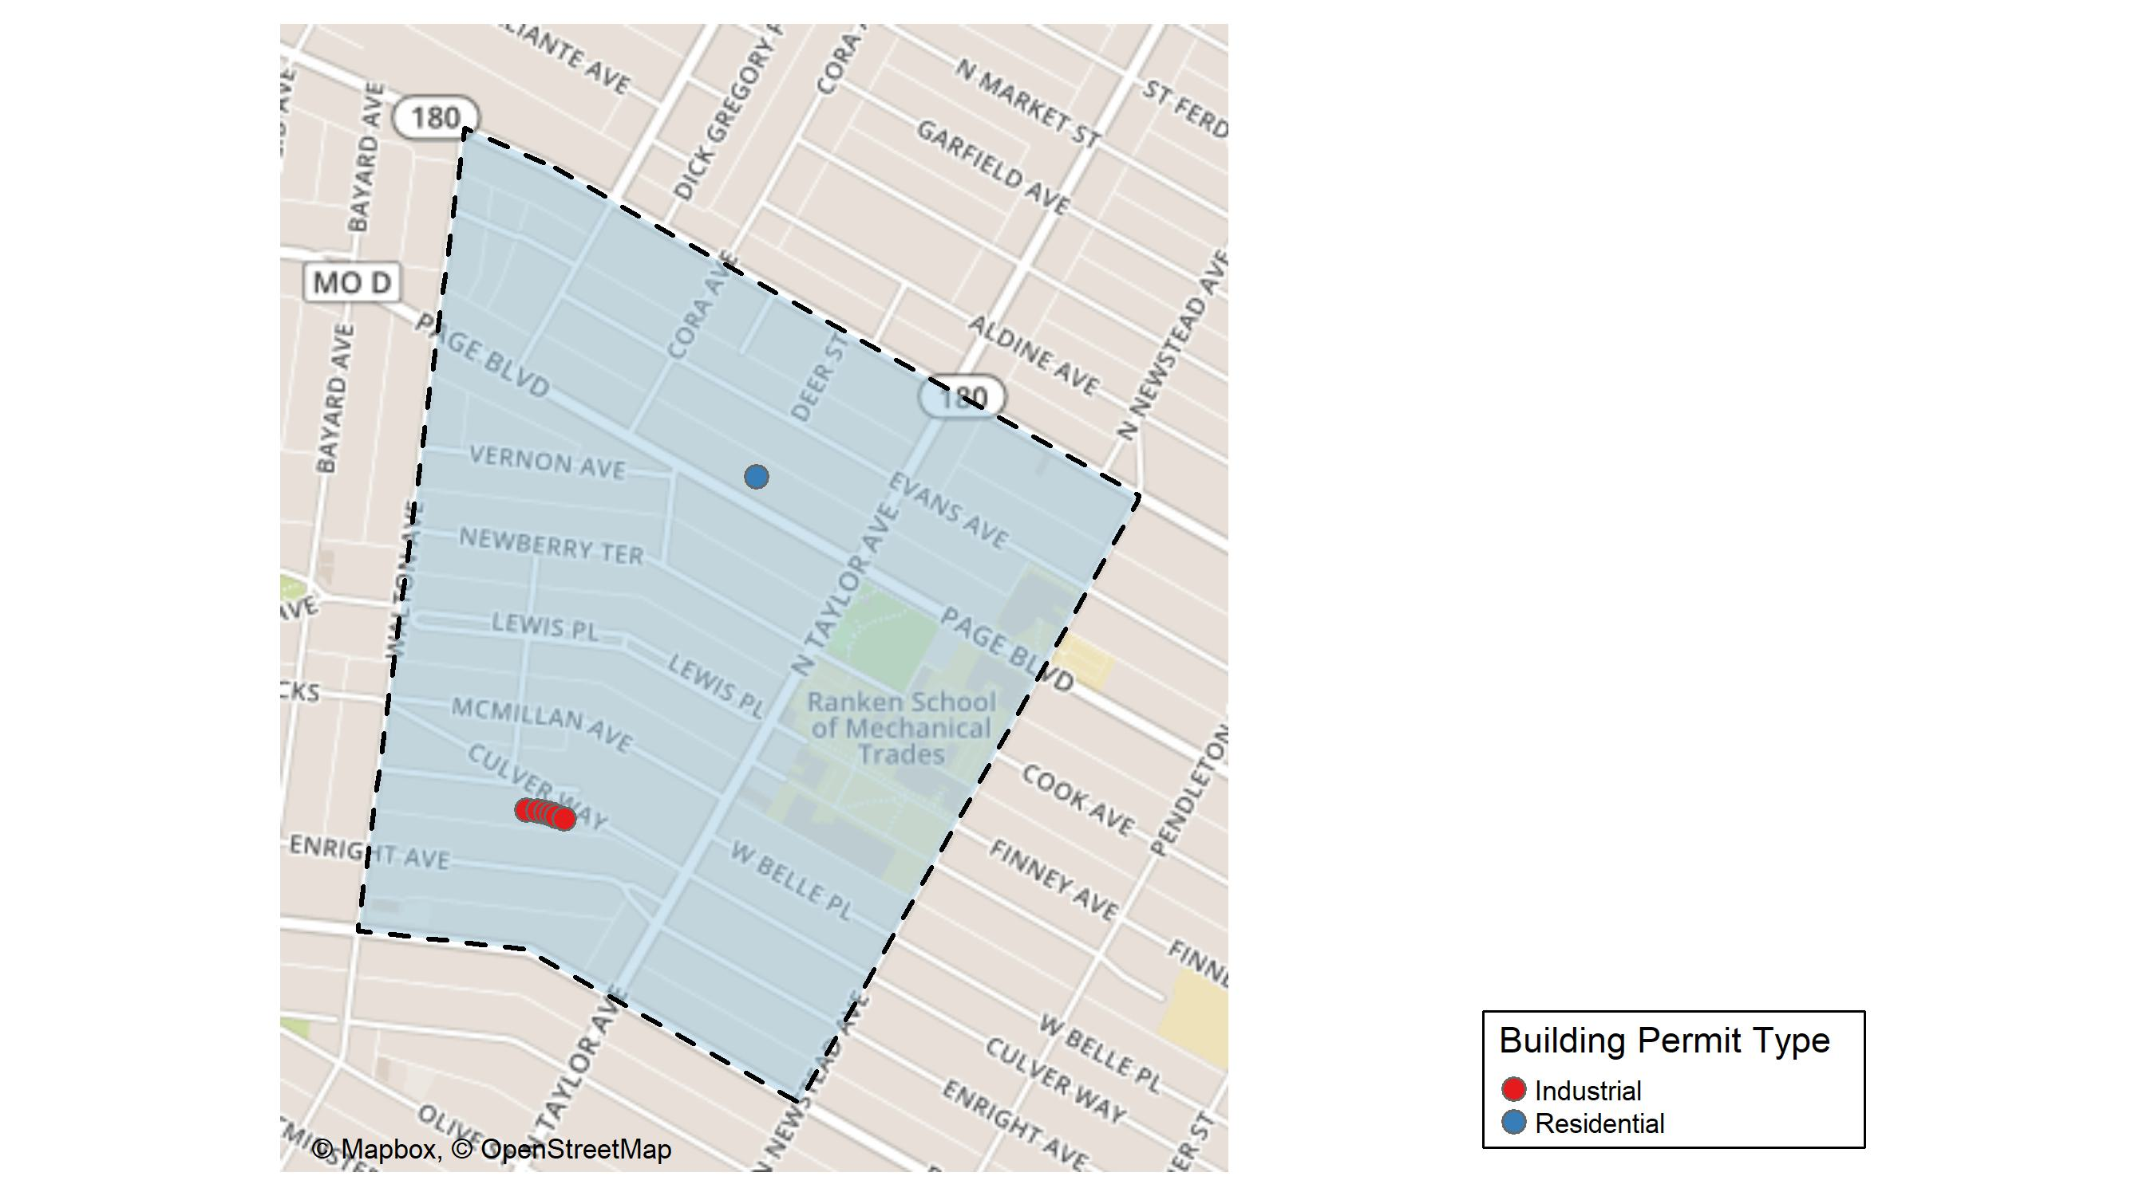
Lewis Place

Slide 56
Neighborhood Summary
December 2025 | December 2025 | December 2025 | December 2025
Permit Use | Average Cost | # of Permits | Total Value of Permits
Commercial | $0 | 0 | $0
Industrial | $1,000 | 6 | $6,000
Residential | $1,000 | 1 | $1,000
Last 6 Months | Last 6 Months | Last 6 Months | Last 6 Months
Permit Use | Average Cost | # of Permits | Total Value of Permits
Commercial | $225,367.8 | 5 | $1,126,839
Industrial | $3,700.0 | 10 | $37,000
Residential | $64,875.0 | 12 | $778,500

Slide 57
Lewis Place Individual Permit Breakdown
Neighborhood | Owner | New Use | Cost | address
Lewis Place | GRO HEALTH CENTER | Industrial | $1,000 | 4582 KENSINGTON AV
Lewis Place | GRO HEALTH CENTER | Industrial | $1,000 | 4576 KENSINGTON AV
Lewis Place | GRO HEALTH CENTER | Industrial | $1,000 | 4572 KENSINGTON AV
Lewis Place | GRO HEALTH CENTER | Industrial | $1,000 | 4570 KENSINGTON AV
Lewis Place | GRO HEALTH CENTER | Industrial | $1,000 | 4568 KENSINGTON AV
Lewis Place | GRO HEALTH CENTER | Industrial | $1,000 | 4564 KENSINGTON AV
Lewis Place | HOLMES, JANIE S | Residential | $1,000 | 4555 PAGE BLVD

Slide 58
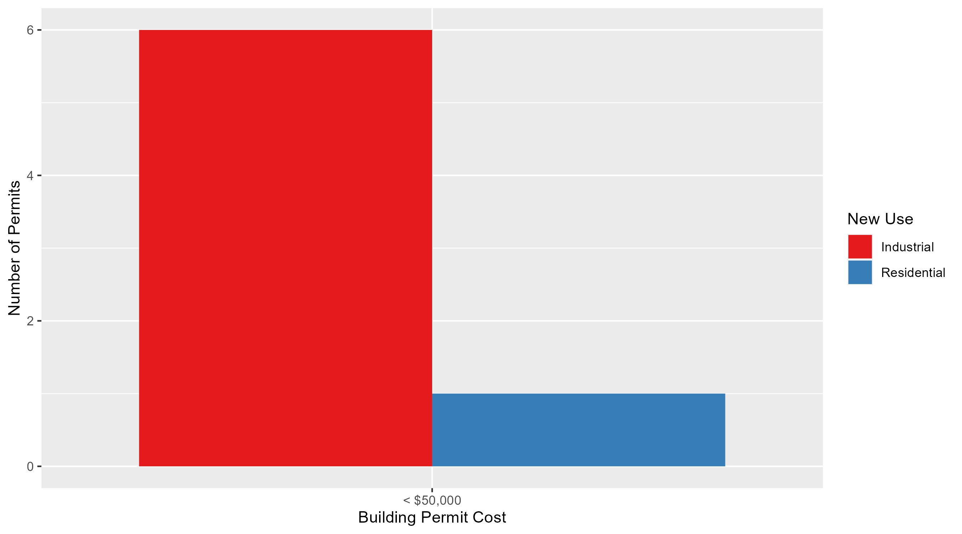
Lewis Place Permit Cost Breakdown

Slide 59
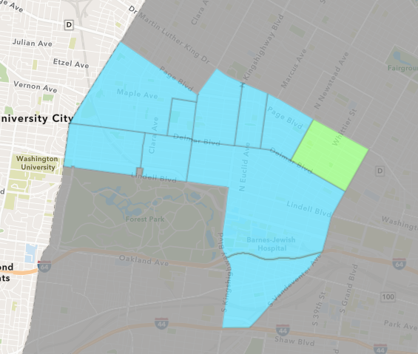
Vandeventer
December 2025 Neighborhood Cost Breakdown
Mean: $5,500
Median: $5,500
Range: $1,000 - $10,000

Slide 60
Vandeventer: Summary Notes
2 building permits in December 2025
100.00% change compared to December 2024 (1 total building permits)
$5,500: Average building permit cost in December 2025
450.00% change compared to December 2024 ($1,000)
12 total building permits in 2025
-7.69% change YTD compared to this time in 2024 (13 total building permits)
$3,391,875: YTD average building permit cost in 2025
7446.79% change YTD compared to this time in 2024 ($44,945)

Slide 61
Additional Notes
Data retreived from https://www.stlouis-mo.gov/data/
Building permits with a cost of $0 were dropped
Building permits that were cancelled were dropped
Infinite change indicates 0 permits in the current or previous time period/comparison month so there was a overall increase or decrease

