Slide 1
St. Louis Central Corridor West Building Permits
Monthly Report: November 2025

Slide 2
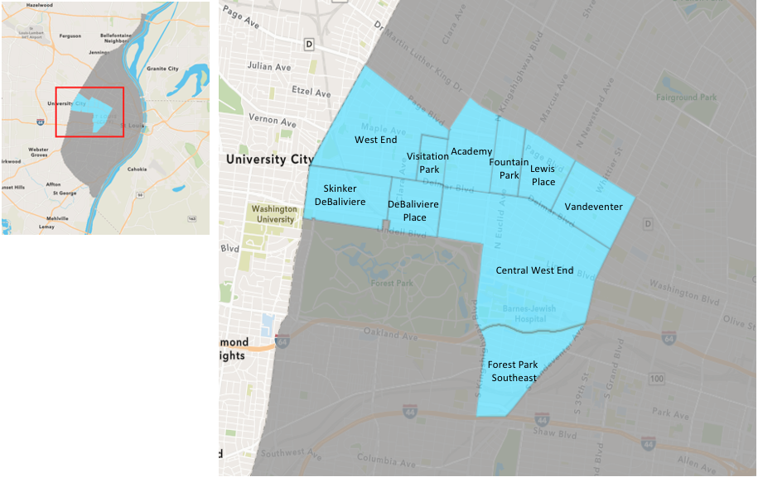
St. Louis Neighborhood Spatial Reference

Slide 3
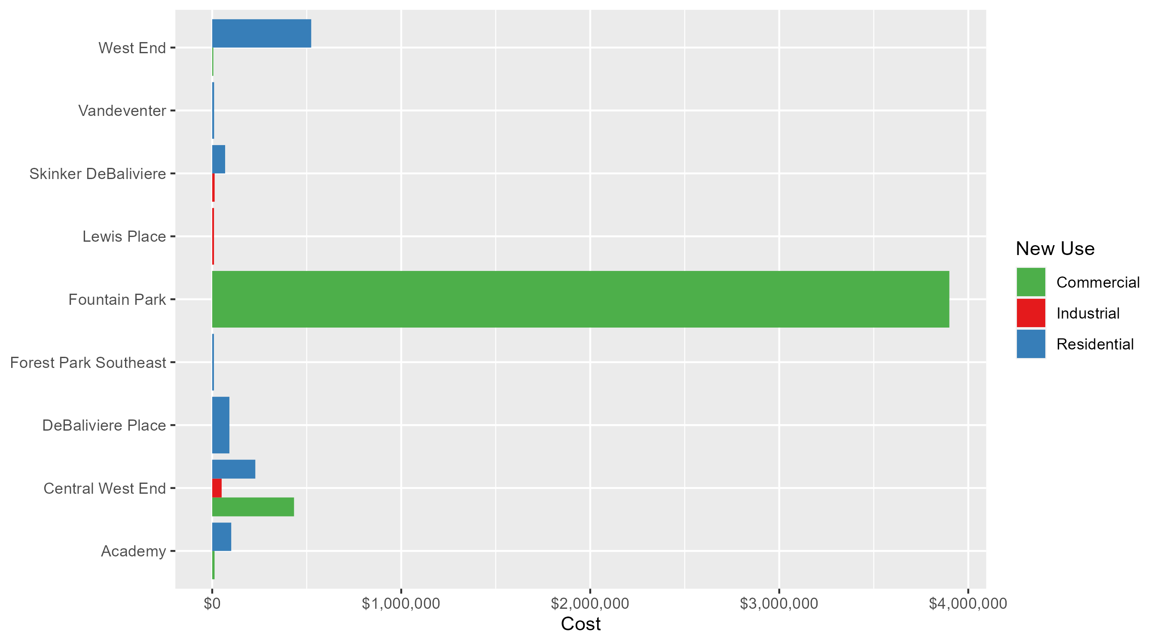
Neighborhood Summary: Average Building Permit Cost

Slide 4
Neighborhood Summary
November 2025 | November 2025 | November 2025 | November 2025
Neighborhood | Average Cost | # of Permits | Total Value of Permits
Academy | $65,400.00 | 5 | $327,000
Central West End | $268,513.23 | 26 | $6,981,344
DeBaliviere Place | $91,018.50 | 18 | $1,638,333
Forest Park Southeast | $9,039.75 | 4 | $36,159
Fountain Park | $3,900,000.00 | 1 | $3,900,000
Lewis Place | $9,500.00 | 2 | $19,000
Skinker DeBaliviere | $64,143.08 | 13 | $833,860
Vandeventer | $10,000.00 | 1 | $10,000
Visitation Park | $0.00 | 0 | $0
West End | $437,500.00 | 6 | $2,625,000
Last 6 Months | Last 6 Months | Last 6 Months | Last 6 Months
Neighborhood | Average Cost | # of Permits | Total Value of Permits
Academy | $114,226.38 | 37 | $4,226,376
Central West End | $439,392.36 | 276 | $121,272,292
DeBaliviere Place | $293,099.34 | 132 | $38,689,113
Forest Park Southeast | $68,126.18 | 55 | $3,746,940
Fountain Park | $506,400.00 | 23 | $11,647,200
Lewis Place | $93,424.50 | 22 | $2,055,339
Skinker DeBaliviere | $79,782.02 | 84 | $6,701,690
Vandeventer | $5,085,000.00 | 8 | $40,680,000
Visitation Park | $78,486.50 | 6 | $470,919
West End | $133,667.12 | 34 | $4,544,682

Slide 5
Core Neighborhoods

Slide 6
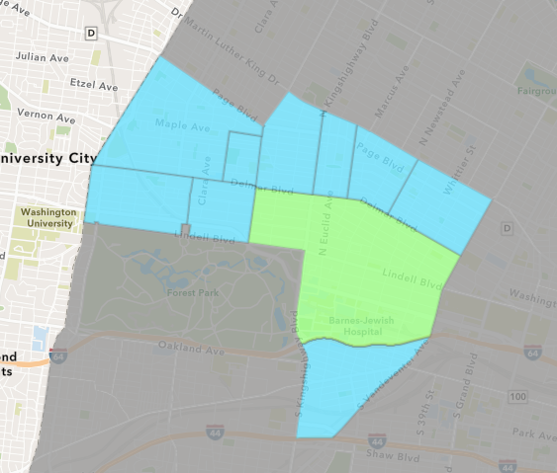
Central West End
November 2025 Neighborhood Cost Breakdown
  Mean: $268,513
  Median: $87,500
  Range: $1,000 - $1,966,305

Slide 7
Central West End: Summary Notes
26 building permits in November 2025
  -21.21% change compared to November 2024 (33 total building permits)
  $268,513: Average building permit cost in November 2025
    429.65% change compared to November 2024 ($50,697)
367 total building permits in 2025
  13.27% change YTD compared to this time in 2024 (324 total building permits)
  $386,689: YTD average building permit cost in 2025
    3.87% change YTD compared to this time in 2024 ($372,288)

Slide 8
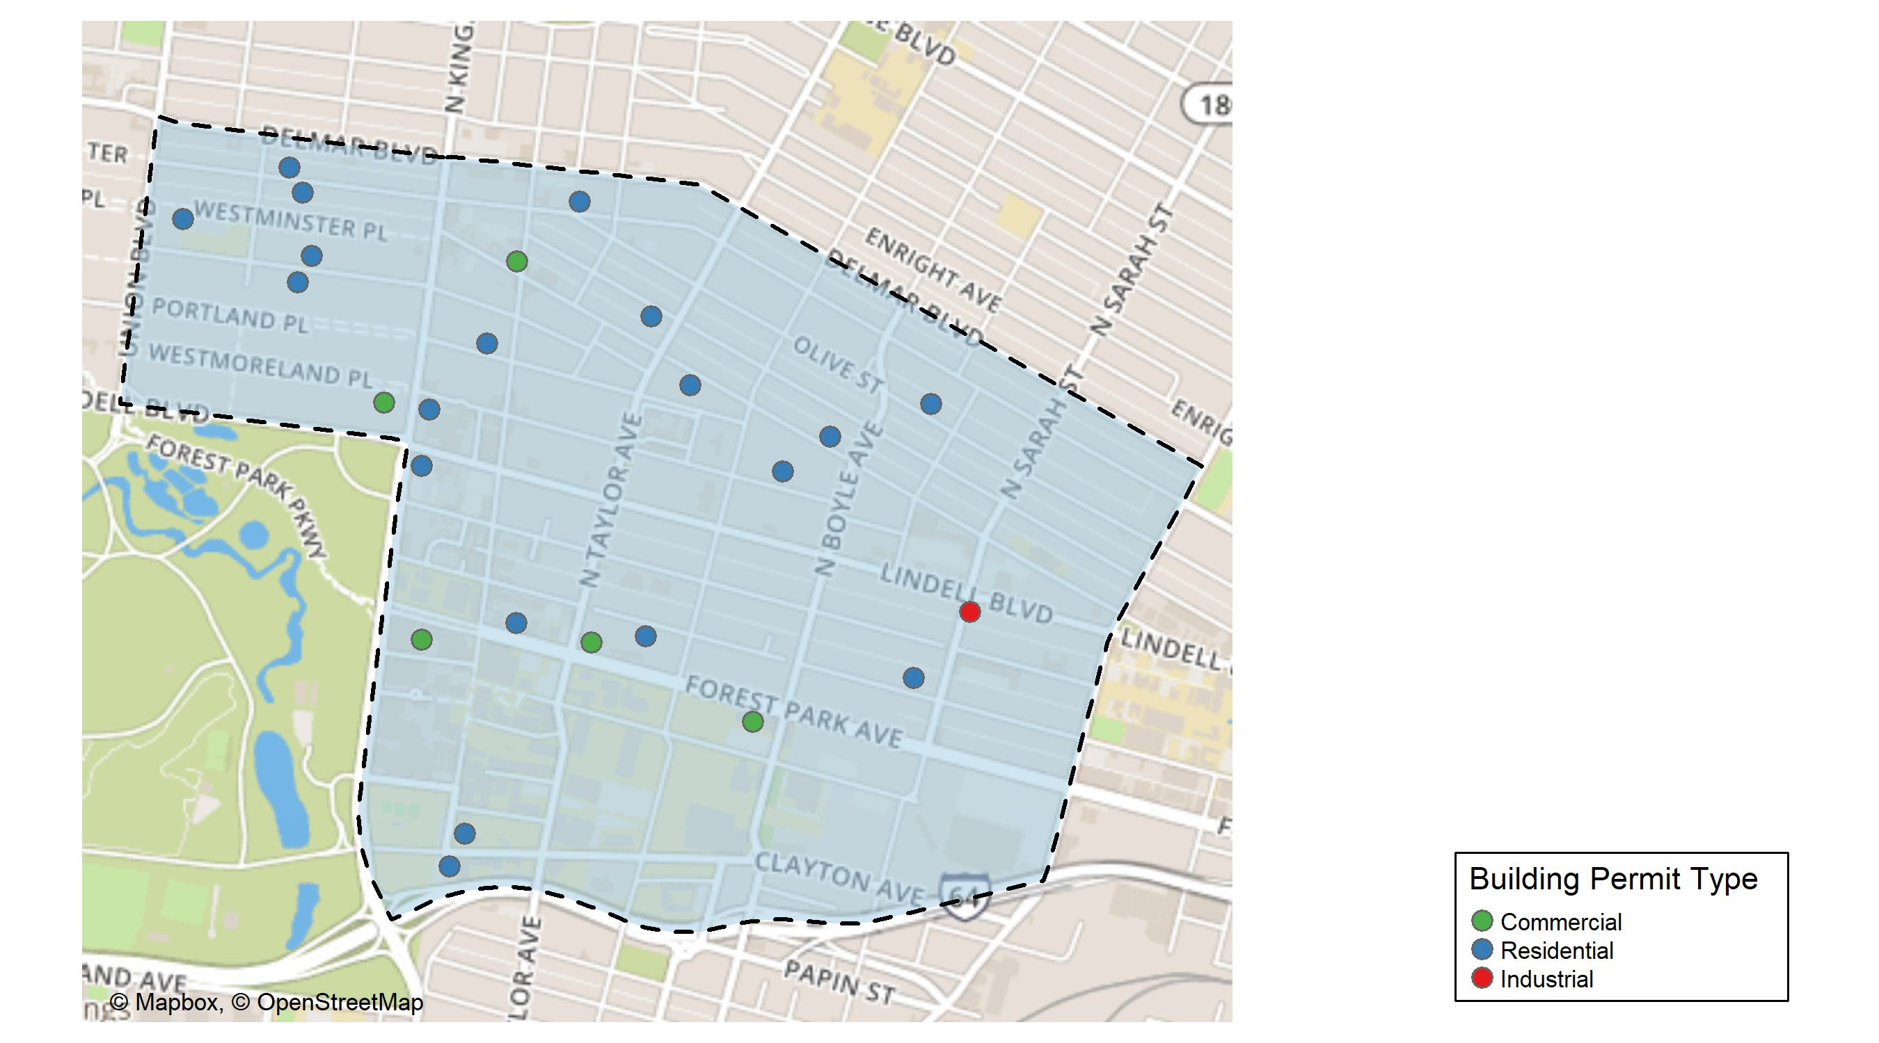
Central West End

Slide 9
Neighborhood Summary
November 2025 | November 2025 | November 2025 | November 2025
Permit Use | Average Cost | # of Permits | Total Value of Permits
Commercial | $432,928.8 | 6 | $2,597,573
Industrial | $50,000.0 | 1 | $50,000
Residential | $228,093.2 | 19 | $4,333,771
Last 6 Months | Last 6 Months | Last 6 Months | Last 6 Months
Permit Use | Average Cost | # of Permits | Total Value of Permits
Commercial | $232,885.45 | 75 | $17,466,409
Industrial | $86,399.33 | 12 | $1,036,792
Residential | $543,751.81 | 189 | $102,769,091

Slide 10
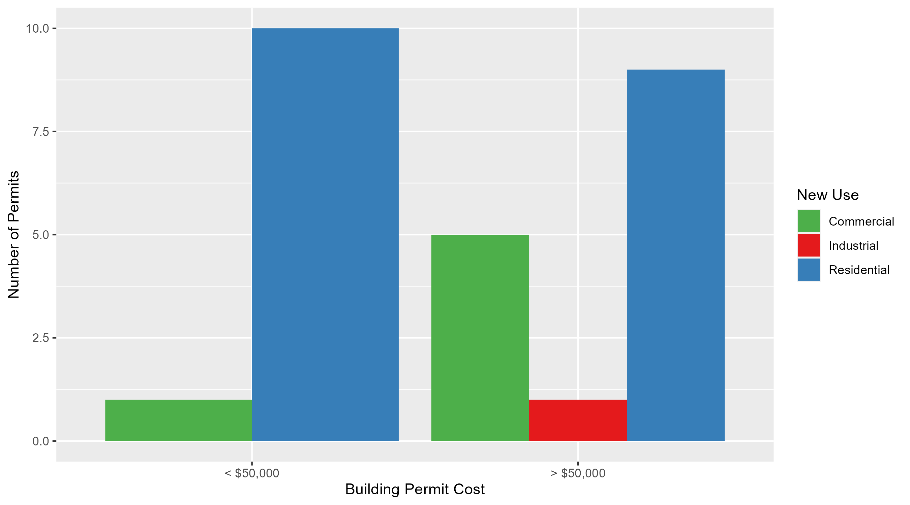
Central West End Permit Cost Breakdown

Slide 11
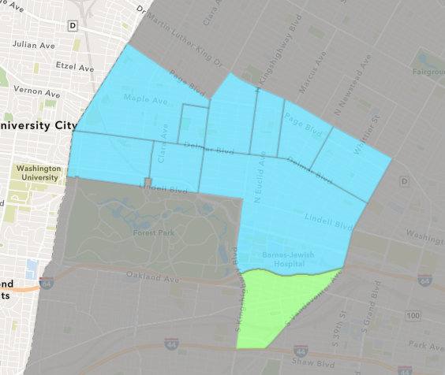
Forest Park Southeast
November 2025 Neighborhood Cost Breakdown
  Mean: $9,040
  Median: $4,580
  Range: $2,000 - $25,000

Slide 12
Forest Park Southeast: Summary Notes
4 building permits in November 2025
  -33.33% change compared to November 2024 (6 total building permits)
  $9,040: Average building permit cost in November 2025
    -89.29% change compared to November 2024 ($84,367)
69 total building permits in 2025
  4.55% change YTD compared to this time in 2024 (66 total building permits)
  $64,551: YTD average building permit cost in 2025
    10.31% change YTD compared to this time in 2024 ($58,519)

Slide 13
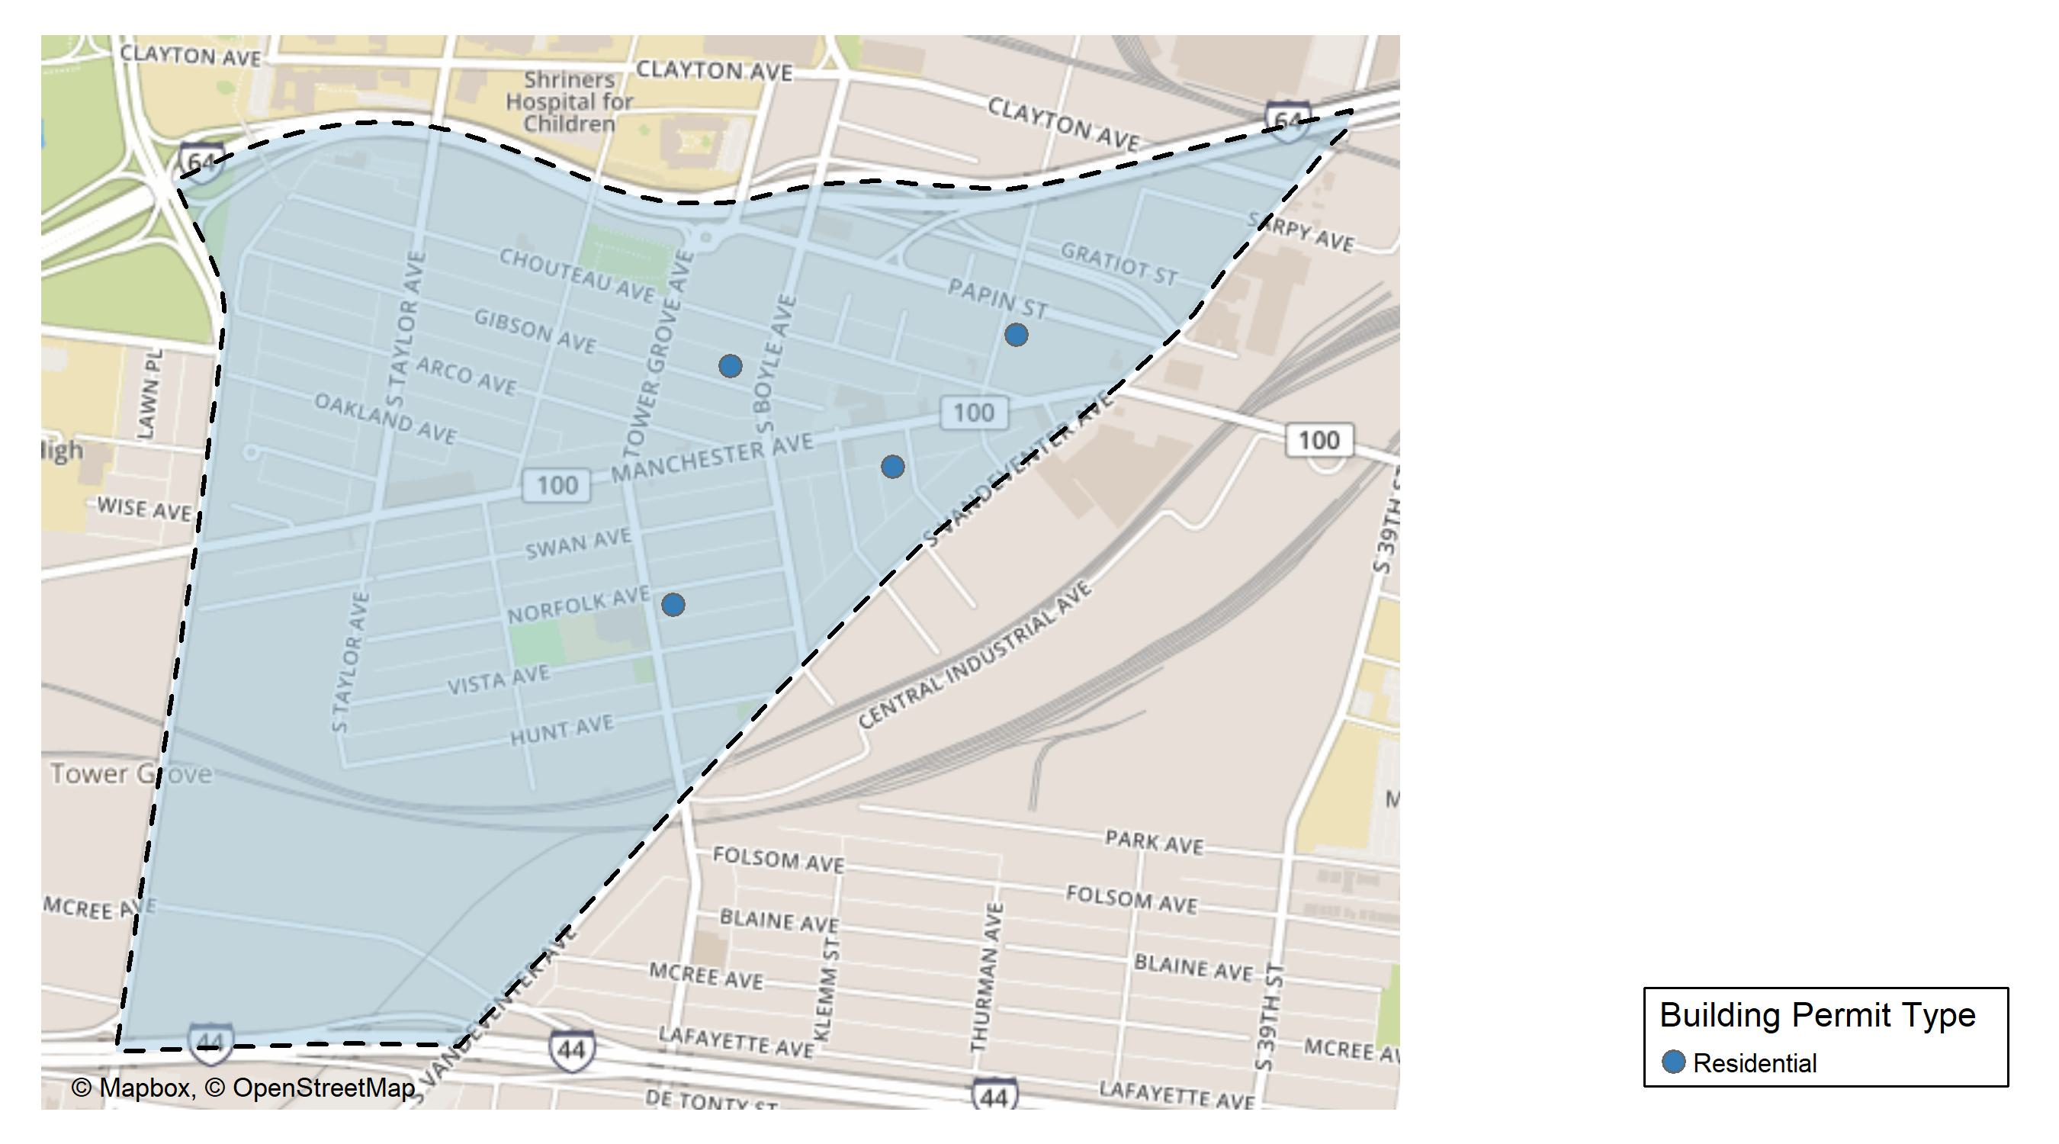
Forest Park Southeast

Slide 14
Neighborhood Summary
November 2025 | November 2025 | November 2025 | November 2025
Permit Use | Average Cost | # of Permits | Total Value of Permits
Commercial | $0.00 | 0 | $0
Industrial | $0.00 | 0 | $0
Residential | $9,039.75 | 4 | $36,159
Last 6 Months | Last 6 Months | Last 6 Months | Last 6 Months
Permit Use | Average Cost | # of Permits | Total Value of Permits
Commercial | $63,454.55 | 11 | $698,000
Industrial | $18,695.00 | 2 | $37,390
Residential | $71,703.57 | 42 | $3,011,550

Slide 15
Forest Park Southeast Individual Permit Breakdown
Neighborhood | Owner | New Use | Cost | address
Forest Park Southeast | CHAITAN, VERONICA LINDA & | Residential | $5,159 | 4317 GIBSON AV
Forest Park Southeast | CORNELL, LAWRENCE | Residential | $2,000 | 1117-19 TALMAGE AV
Forest Park Southeast | BROSCH, ALAN R & SHARON G | Residential | $4,000 | 4262 NORFOLK AV
Forest Park Southeast | 900 S SARAH LLC | Residential | $25,000 | 900 S SARAH ST

Slide 16
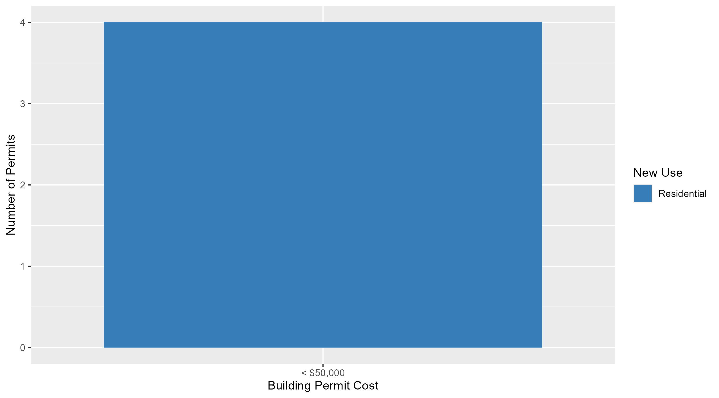
Forest Park Southeast Permit Cost Breakdown

Slide 17
Expanded Service Area

Slide 18
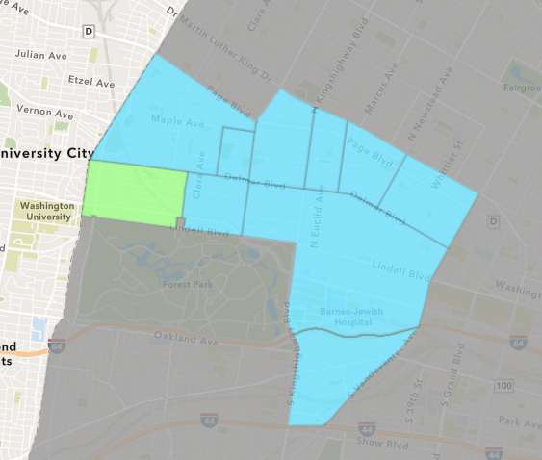
Skinker DeBaliviere
November 2025 Neighborhood Cost Breakdown
  Mean: $64,143
  Median: $24,750
  Range: $1,000 - $320,000

Slide 19
Skinker DeBaliviere: Summary Notes
13 building permits in November 2025
  160.00% change compared to November 2024 (5 total building permits)
  $64,143: Average building permit cost in November 2025
    -76.13% change compared to November 2024 ($268,691)
115 total building permits in 2025
  51.32% change YTD compared to this time in 2024 (76 total building permits)
  $71,676: YTD average building permit cost in 2025
    -33.35% change YTD compared to this time in 2024 ($107,543)

Slide 20
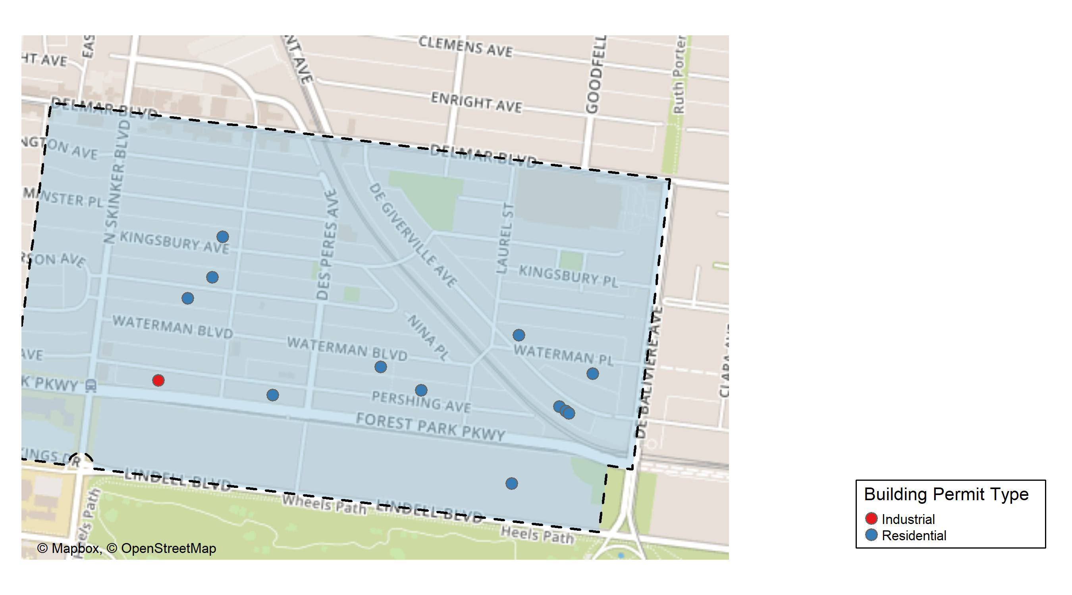
Skinker DeBaliviere

Slide 21
Neighborhood Summary
November 2025 | November 2025 | November 2025 | November 2025
Permit Use | Average Cost | # of Permits | Total Value of Permits
Commercial | $0.00 | 0 | $0
Industrial | $12,900.00 | 1 | $12,900
Residential | $68,413.33 | 12 | $820,960
Last 6 Months | Last 6 Months | Last 6 Months | Last 6 Months
Permit Use | Average Cost | # of Permits | Total Value of Permits
Commercial | $0.00 | 0 | $0
Industrial | $17,450.00 | 2 | $34,900
Residential | $81,302.32 | 82 | $6,666,790

Slide 22
Skinker DeBaliviere Individual Permit Breakdown
Neighborhood | Owner | New Use | Cost | address
Skinker DeBaliviere | SYMEONOGLOU, RHEBA TRS | Residential | $24,750 | 6117 MCPHERSON AV
Skinker DeBaliviere | PRUITT, OLIVIA D | Residential | $265,000 | 5736 WATERMAN BLVD
Skinker DeBaliviere | DUNN, JENNIFER & SYTSE PIERSMA | Residential | $18,260 | 5793 WATERMAN BLVD
Skinker DeBaliviere | WATERFORD PACIFIC LLC | Residential | $320,000 | 6026 PERSHING AV
Skinker DeBaliviere | JACQUES, JAMES & JOANNA L | Residential | $55,000 | 5752 DEGIVERVILLE AV
Skinker DeBaliviere | GANNON, MARILYN LAMONT TRS | Residential | $10,000 | 5763 LINDELL BLVD
Skinker DeBaliviere | BARNETT, GEORGIA A | Residential | $28,000 | 5748 DEGIVERVILLE AV
Skinker DeBaliviere | TAYLOR, GLORIA JONES | Residential | $38,000 | 5910 WATERMAN BLVD
Skinker DeBaliviere | ZITTEL DEVELOPMENT & REHAB LLC | Industrial | $12,900 | 6146 PERSHING AV
Skinker DeBaliviere | RUDLOFF, MARY ANNE TRSTE | Residential | $19,950 | 6115 KINGSBURY AV
Skinker DeBaliviere | FLAGG, FREDERIC & ALAN & ALLEDA ETAL | Residential | $4,000 | 5746 DEGIVERVILLE AV
Skinker DeBaliviere | DAVIDSON, JACK & MICHELLE | Residential | $37,000 | 5835 PERSHING AV
Skinker DeBaliviere | PATTON, WILLIAM J & RUBINA | Residential | $1,000 | 6134 MCPHERSON AV

Slide 23
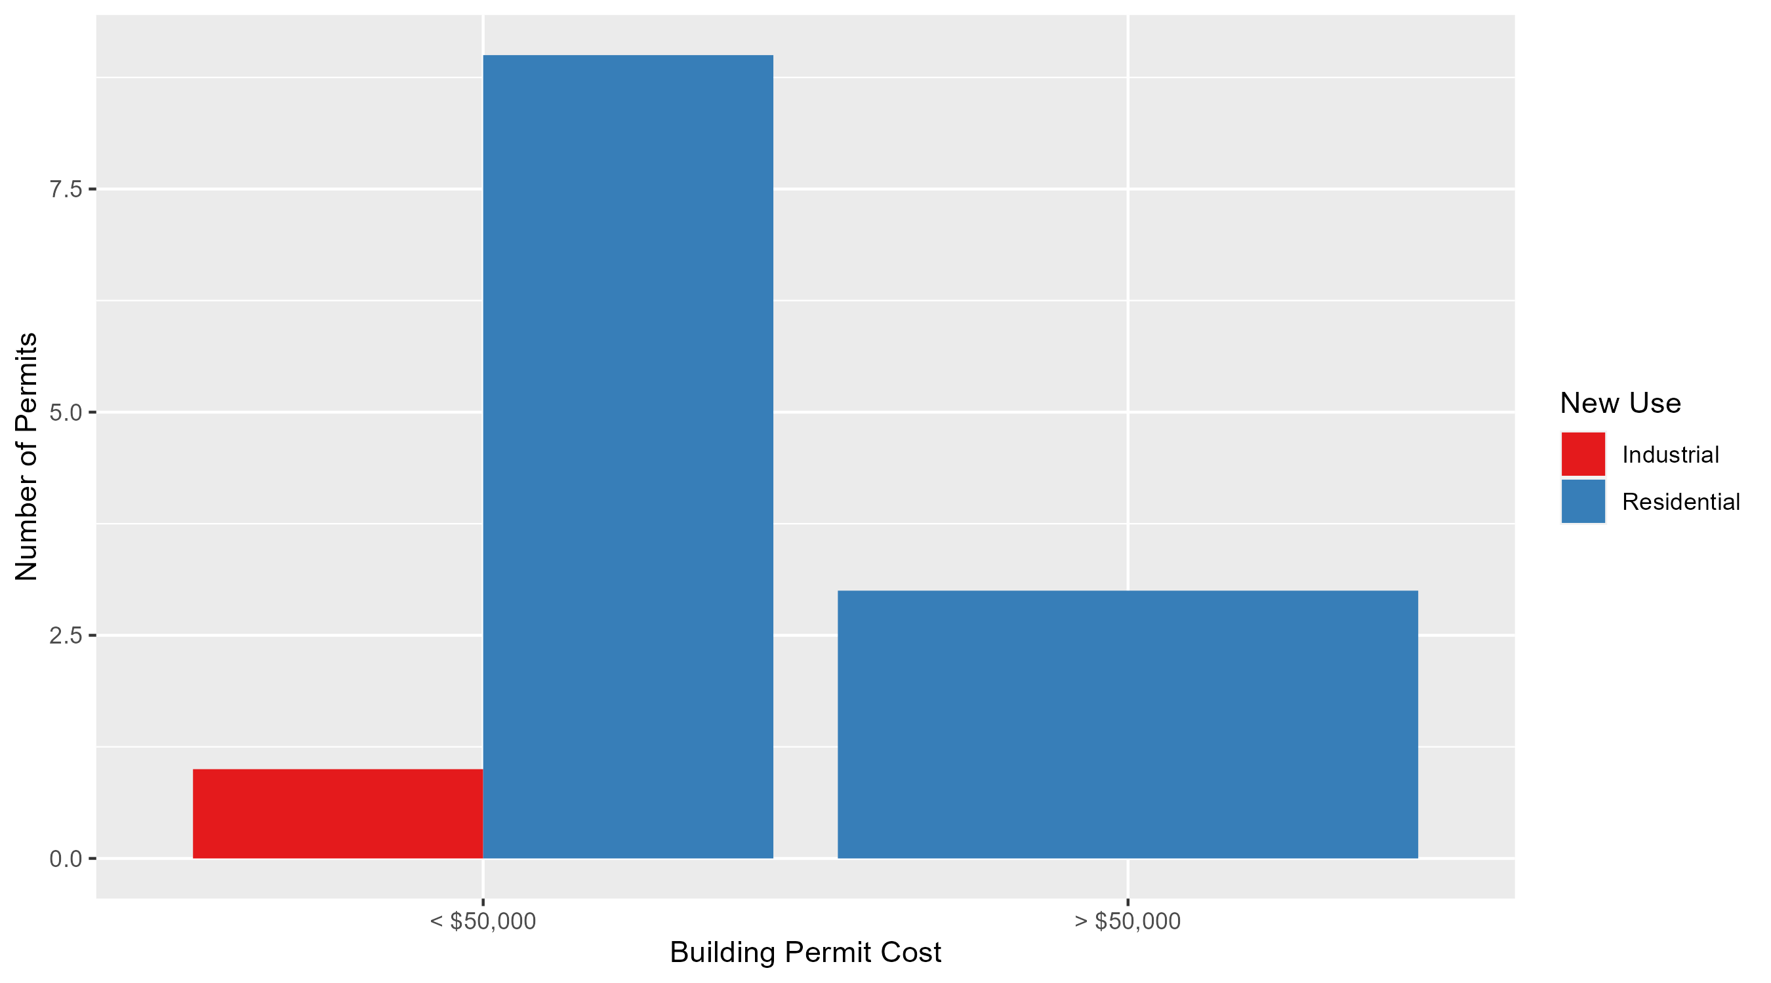
Skinker DeBaliviere Permit Cost Breakdown

Slide 24
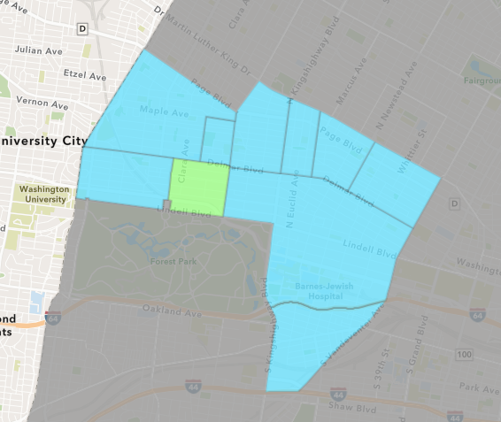
DeBaliviere Place
November 2025 Neighborhood Cost Breakdown
  Mean: $91,019
  Median: $27,835
  Range: $1,000 - $280,000

Slide 25
DeBaliviere Place: Summary Notes
18 building permits in November 2025
  500.00% change compared to November 2024 (3 total building permits)
  $91,019: Average building permit cost in November 2025
    -34.04% change compared to November 2024 ($138,000)
145 total building permits in 2025
  229.55% change YTD compared to this time in 2024 (44 total building permits)
  $272,218: YTD average building permit cost in 2025
    136.75% change YTD compared to this time in 2024 ($114,979)

Slide 26
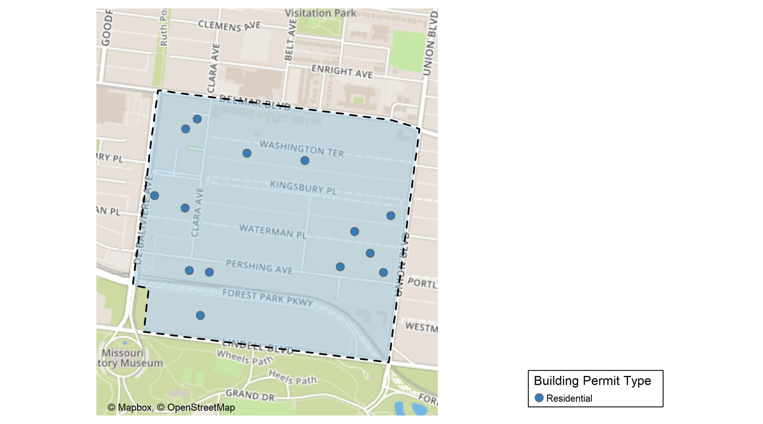
DeBaliviere Place

Slide 27
Neighborhood Summary
November 2025 | November 2025 | November 2025 | November 2025
Permit Use | Average Cost | # of Permits | Total Value of Permits
Commercial | $0.0 | 0 | $0
Industrial | $0.0 | 0 | $0
Residential | $91,018.5 | 18 | $1,638,333
Last 6 Months | Last 6 Months | Last 6 Months | Last 6 Months
Permit Use | Average Cost | # of Permits | Total Value of Permits
Commercial | $74,240.8 | 5 | $371,204
Industrial | $110,000.0 | 1 | $110,000
Residential | $303,237.4 | 126 | $38,207,909

Slide 28
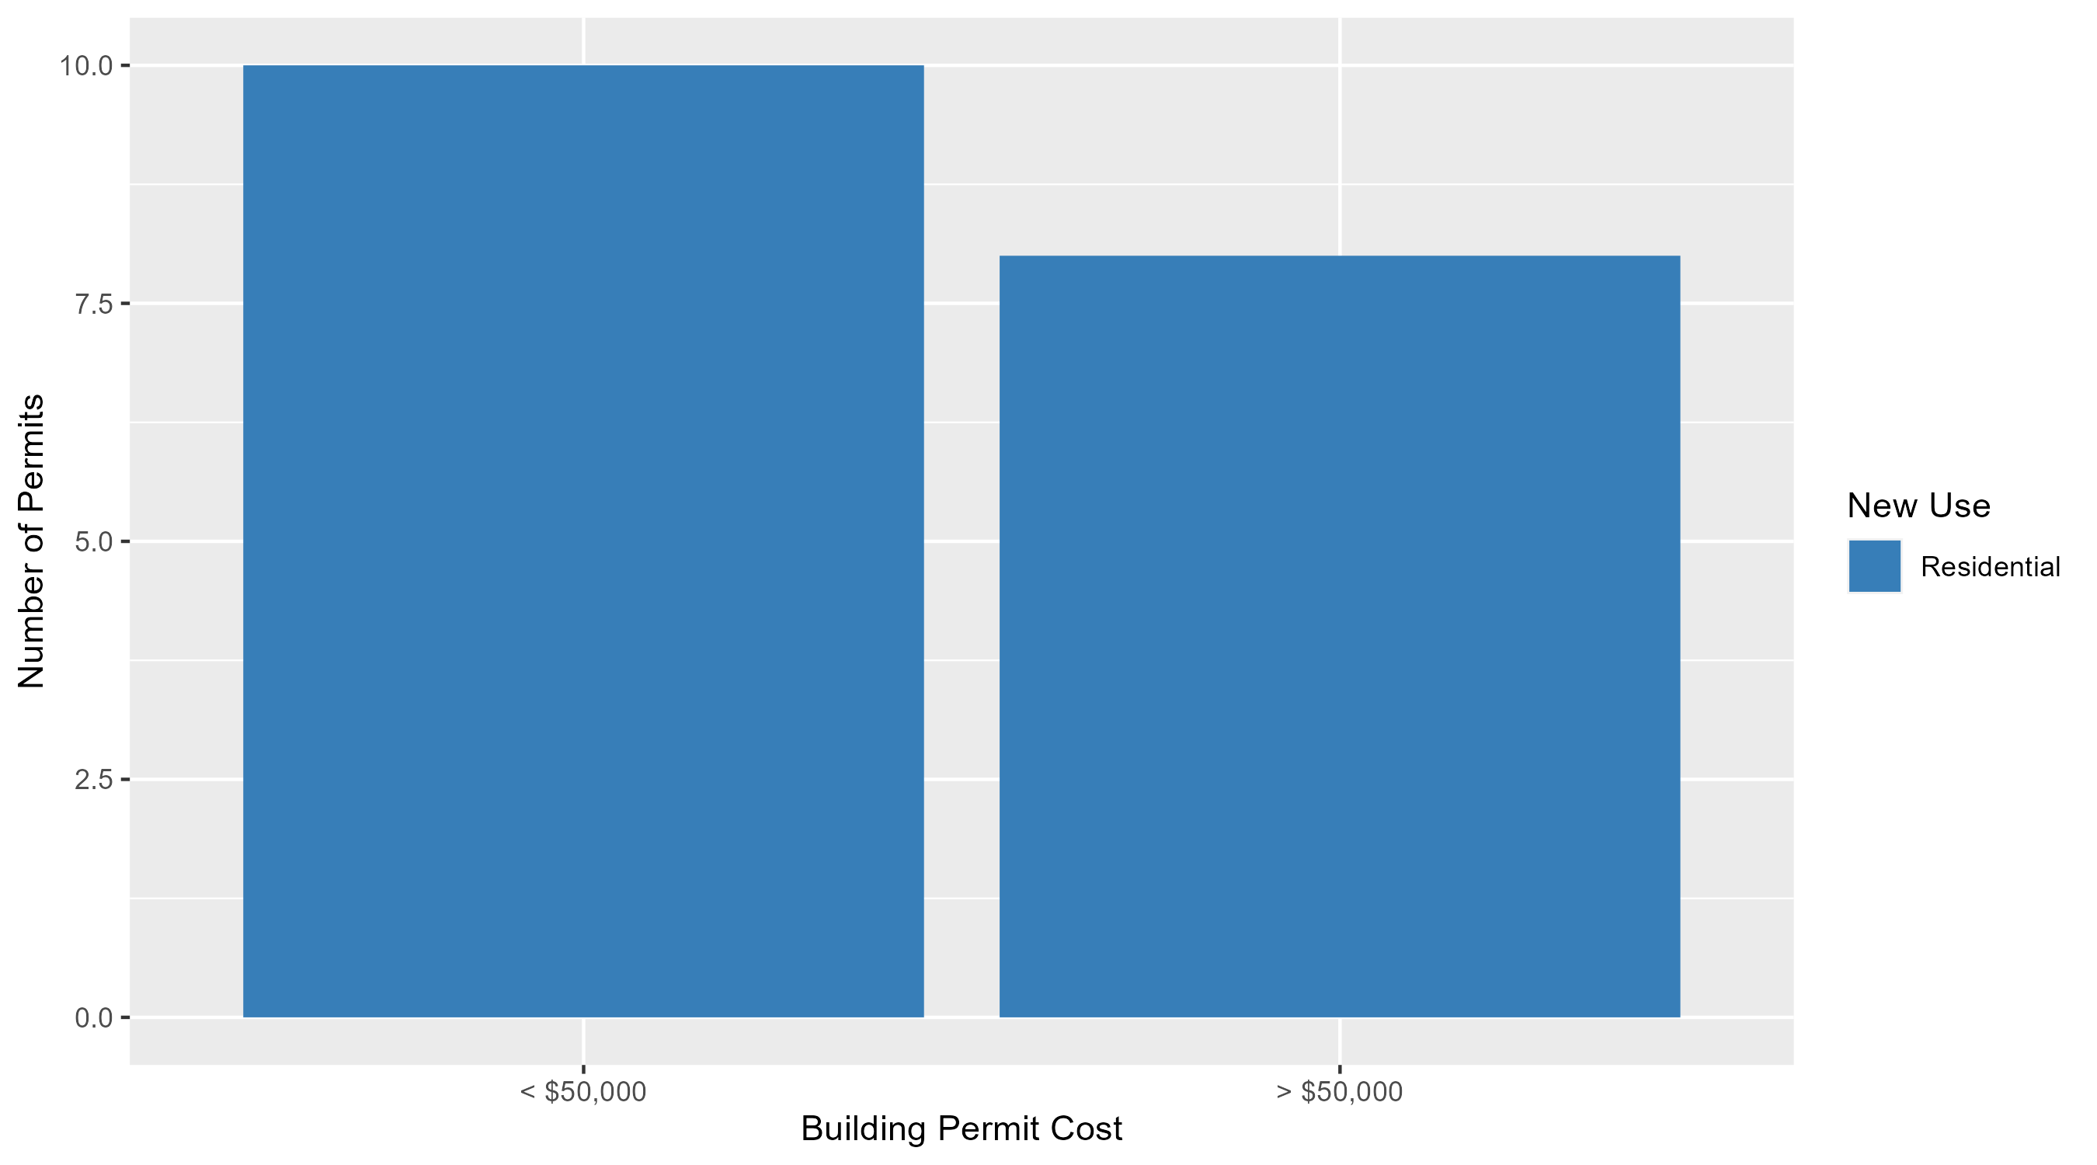
DeBaliviere Place Permit Cost Breakdown

Slide 29
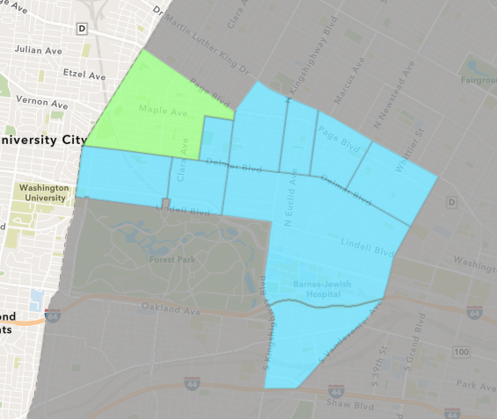
West End
November 2025 Neighborhood Cost Breakdown
  Mean: $437,500
  Median: $17,500
  Range: $6,000 - $2,520,000

Slide 30
West End: Summary Notes
6 building permits in November 2025
  50.00% change compared to November 2024 (4 total building permits)
  $437,500: Average building permit cost in November 2025
    1290.19% change compared to November 2024 ($31,471)
54 total building permits in 2025
  -16.92% change YTD compared to this time in 2024 (65 total building permits)
  $288,441: YTD average building permit cost in 2025
    194.47% change YTD compared to this time in 2024 ($97,954)

Slide 31
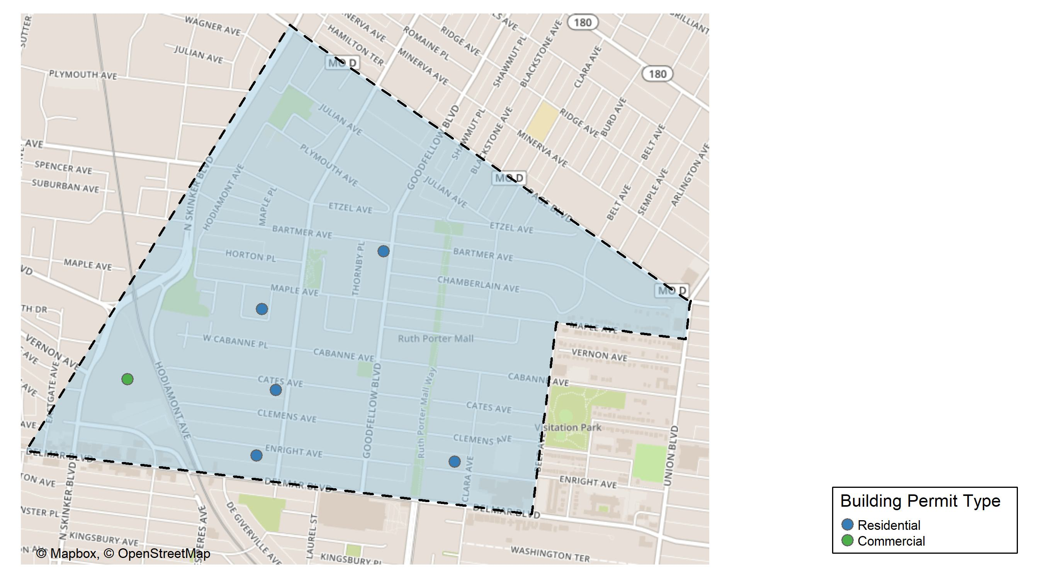
West End

Slide 32
Neighborhood Summary
November 2025 | November 2025 | November 2025 | November 2025
Permit Use | Average Cost | # of Permits | Total Value of Permits
Commercial | $6,000 | 1 | $6,000
Industrial | $0 | 0 | $0
Residential | $523,800 | 5 | $2,619,000
Last 6 Months | Last 6 Months | Last 6 Months | Last 6 Months
Permit Use | Average Cost | # of Permits | Total Value of Permits
Commercial | $76,250.0 | 4 | $305,000
Industrial | $20,000.0 | 1 | $20,000
Residential | $145,506.3 | 29 | $4,219,682

Slide 33
West End Individual Permit Breakdown
Neighborhood | Owner | New Use | Cost | address
West End | WASHINGTON UNIVERSITY | Commercial | $6,000 | 700 ROSEDALE AV
West End | RANSOM, DONNA CHRISTINE | Residential | $12,000 | 5806 BARTMER AV
West End | BREWER, BEATRICE | Residential | $52,000 | 943 BEACH AV
West End | FRANKLIN, BRANDIE | Residential | $23,000 | 5926 ENRIGHT AV
West End | ROSEN, LEWIS WARREN & MERCEDENE JACK | Residential | $12,000 | 5912 CATES AV
West End | ST LUKES PRESERVATION PARTNERS LP | Residential | $2,520,000 | 5605 ENRIGHT AV

Slide 34
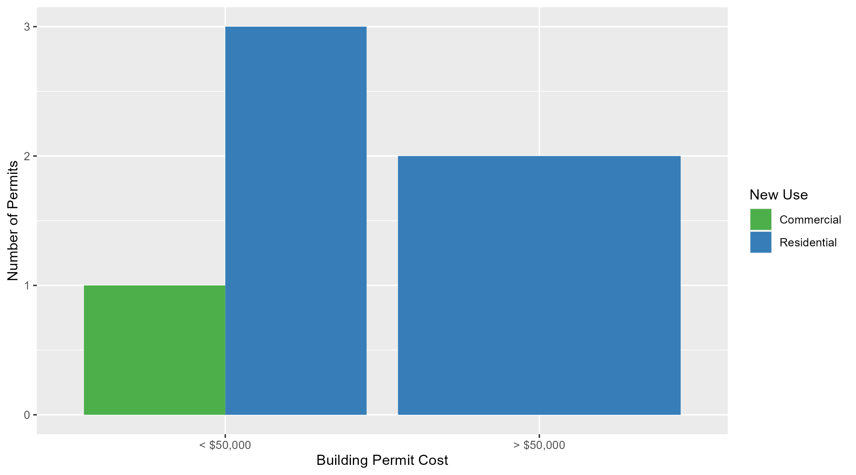
West End Permit Cost Breakdown

Slide 35
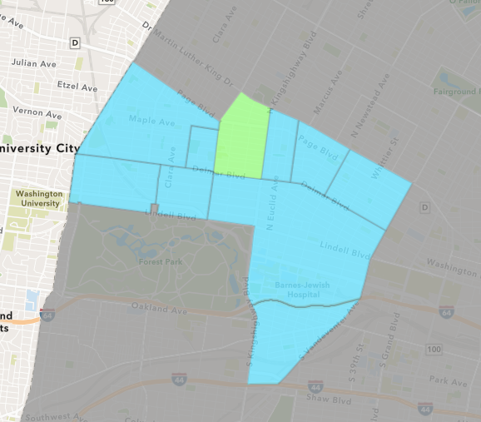
Academy
November 2025 Neighborhood Cost Breakdown
  Mean: $65,400
  Median: $11,000
  Range: $1,000 - $300,000

Slide 36
Academy: Summary Notes
5 building permits in November 2025
  150.00% change compared to November 2024 (2 total building permits)
  $65,400: Average building permit cost in November 2025
    156.47% change compared to November 2024 ($25,500)
48 total building permits in 2025
  108.70% change YTD compared to this time in 2024 (23 total building permits)
  $94,633: YTD average building permit cost in 2025
    164.15% change YTD compared to this time in 2024 ($35,825)

Slide 37
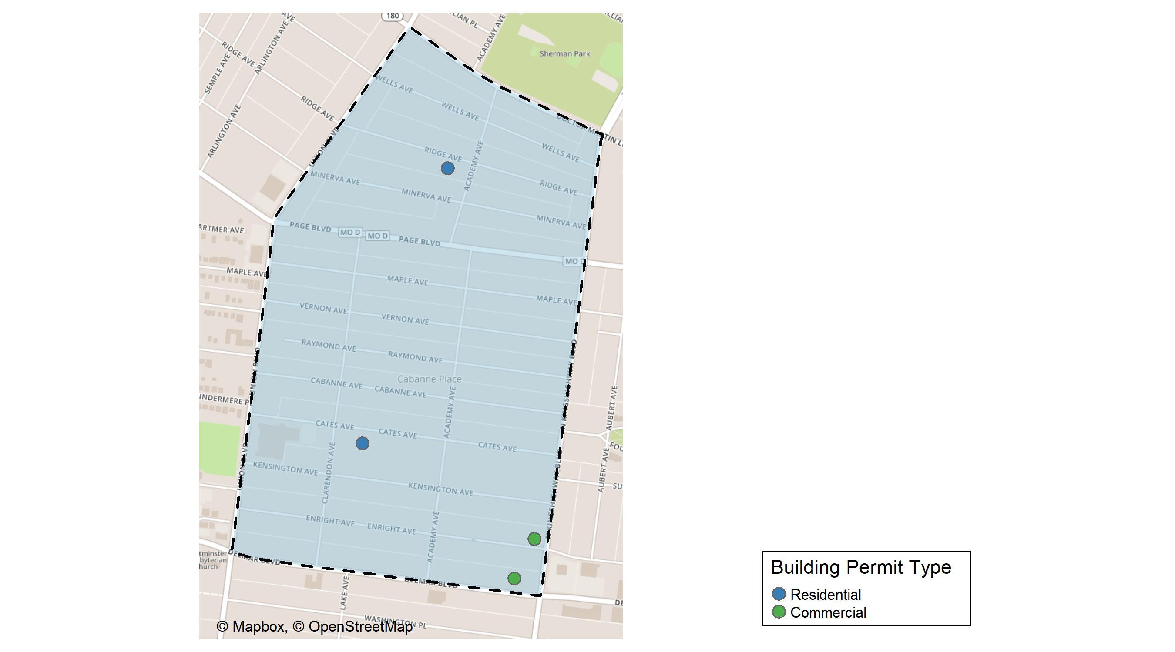
Academy

Slide 38
Neighborhood Summary
November 2025 | November 2025 | November 2025 | November 2025
Permit Use | Average Cost | # of Permits | Total Value of Permits
Commercial | $12,500.0 | 2 | $25,000
Industrial | $0.0 | 0 | $0
Residential | $100,666.7 | 3 | $302,000
Last 6 Months | Last 6 Months | Last 6 Months | Last 6 Months
Permit Use | Average Cost | # of Permits | Total Value of Permits
Commercial | $356,700.0 | 5 | $1,783,500
Industrial | $10,875.0 | 2 | $21,750
Residential | $80,704.2 | 30 | $2,421,126

Slide 39
Academy Individual Permit Breakdown
Neighborhood | Owner | New Use | Cost | address
Academy | BRG DELMAR PROP LLC | Commercial | $14,000 | 5025 DELMAR BLVD
Academy | SPIRIT SPE PORTFOLIO 2004 6 LLC | Commercial | $11,000 | 805 N KINGSHIGHWAY BLVD
Academy | TURNER, MONICA L & ANGELA M BYRD | Residential | $300,000 | 5170 CATES AV
Academy | STONE, FELICIA | Residential | $1,000 | 5120 RIDGE AV
Academy | STONE, FELICIA | Residential | $1,000 | 5120 RIDGE AV

Slide 40
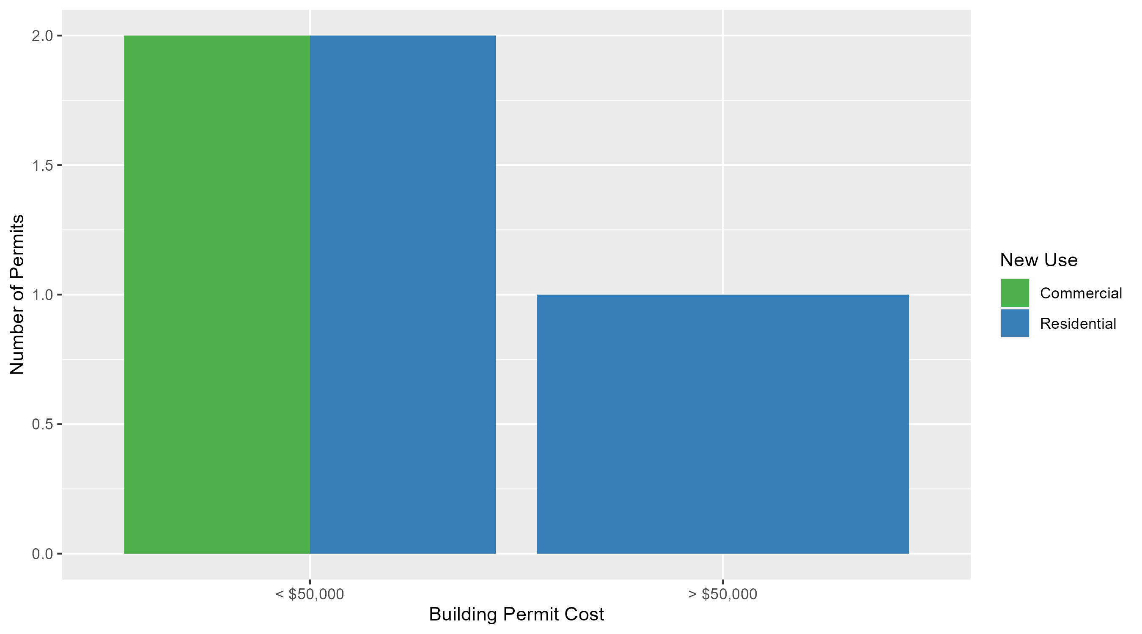
Academy Permit Cost Breakdown

Slide 41
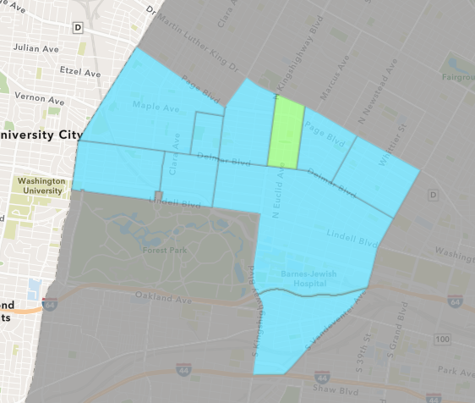
Fountain Park
November 2025 Neighborhood Cost Breakdown
  Mean: $3,900,000
  Median: $3,900,000
  Range: $3,900,000 - $3,900,000

Slide 42
Fountain Park: Summary Notes
1 building permits in November 2025
  -80.00% change compared to November 2024 (5 total building permits)
  $3,900,000: Average building permit cost in November 2025
    6510.17% change compared to November 2024 ($59,000)
26 total building permits in 2025
  100.00% change YTD compared to this time in 2024 (13 total building permits)
  $455,154: YTD average building permit cost in 2025
    934.44% change YTD compared to this time in 2024 ($44,000)

Slide 43
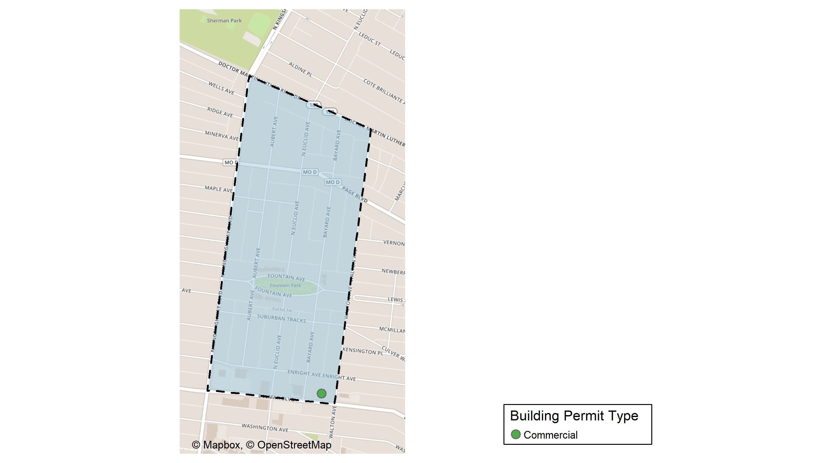
Fountain Park

Slide 44
Neighborhood Summary
November 2025 | November 2025 | November 2025 | November 2025
Permit Use | Average Cost | # of Permits | Total Value of Permits
Commercial | $3,900,000 | 1 | $3,900,000
Industrial | $0 | 0 | $0
Residential | $0 | 0 | $0
Last 6 Months | Last 6 Months | Last 6 Months | Last 6 Months
Permit Use | Average Cost | # of Permits | Total Value of Permits
Commercial | $985,360.0 | 5 | $4,926,800
Industrial | $0.0 | 0 | $0
Residential | $373,355.6 | 18 | $6,720,400

Slide 45
Fountain Park Individual Permit Breakdown
Neighborhood | Owner | New Use | Cost | address
Fountain Park | 4709 DELMAR LLC | Commercial | $3,900,000 | 4709 DELMAR BLVD

Slide 46
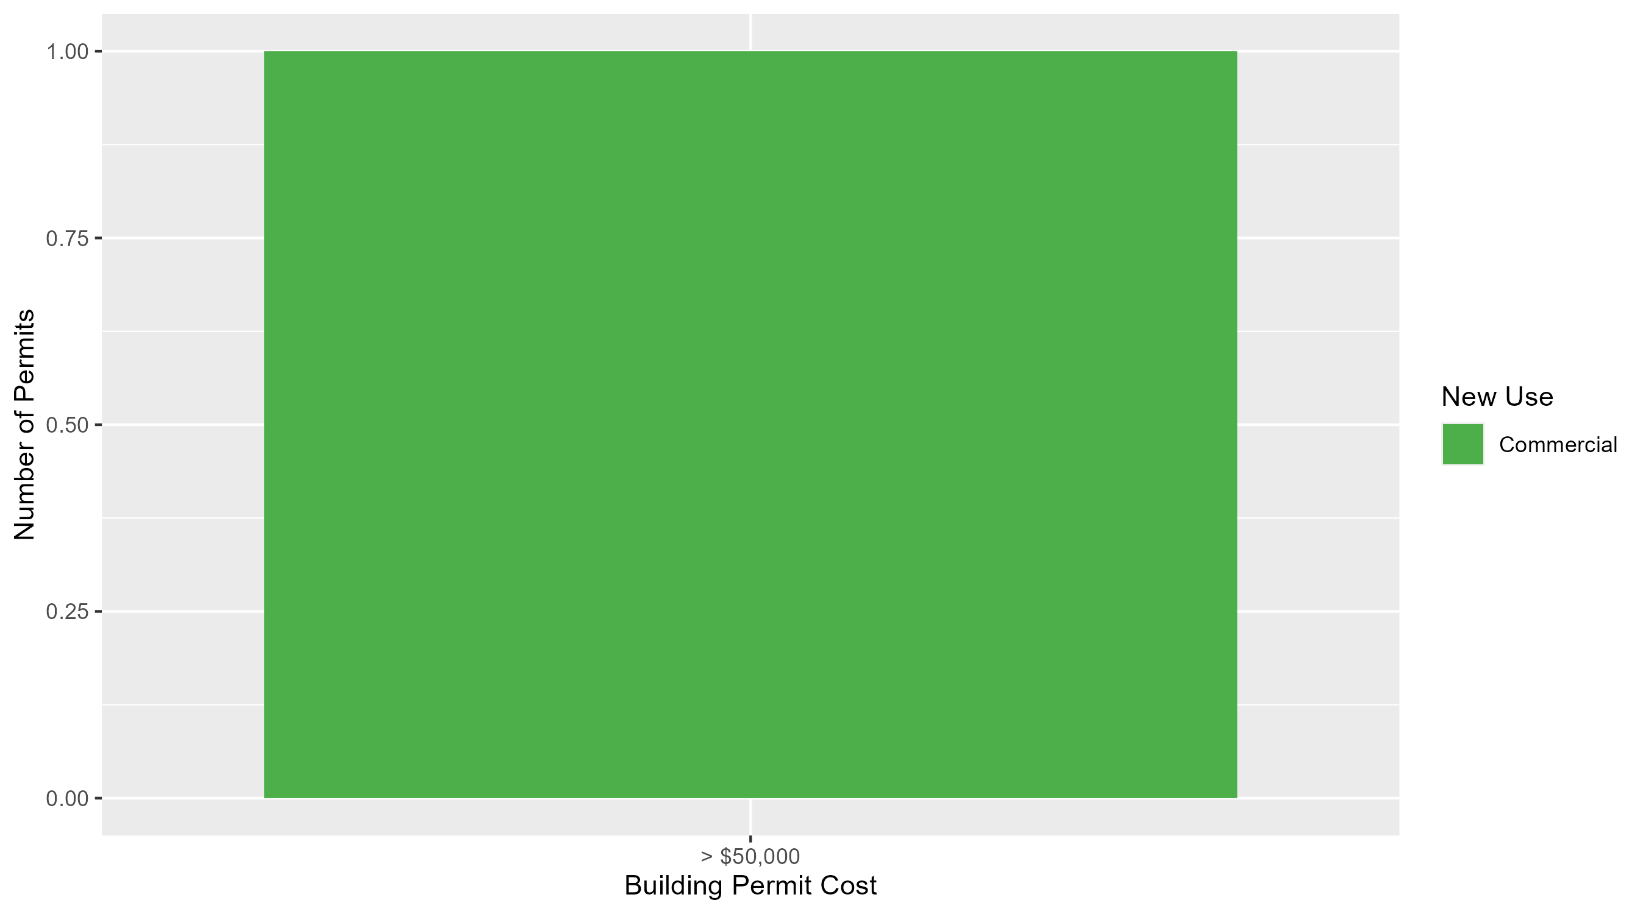
Fountain Park Permit Cost Breakdown

Slide 47
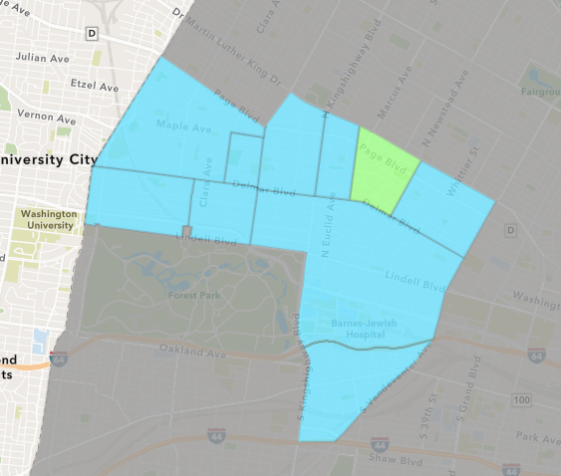
Lewis Place
November 2025 Neighborhood Cost Breakdown
  Mean: $9,500
  Median: $9,500
  Range: $4,000 - $15,000

Slide 48
Lewis Place: Summary Notes
2 building permits in November 2025
  Infinite change compared to November 2024 (0 total building permits)
  $9,500: Average building permit cost in November 2025
    Infinite change compared to November 2024 ($0)
26 total building permits in 2025
  73.33% change YTD compared to this time in 2024 (15 total building permits)
  $83,552: YTD average building permit cost in 2025
    287.77% change YTD compared to this time in 2024 ($21,546)

Slide 49
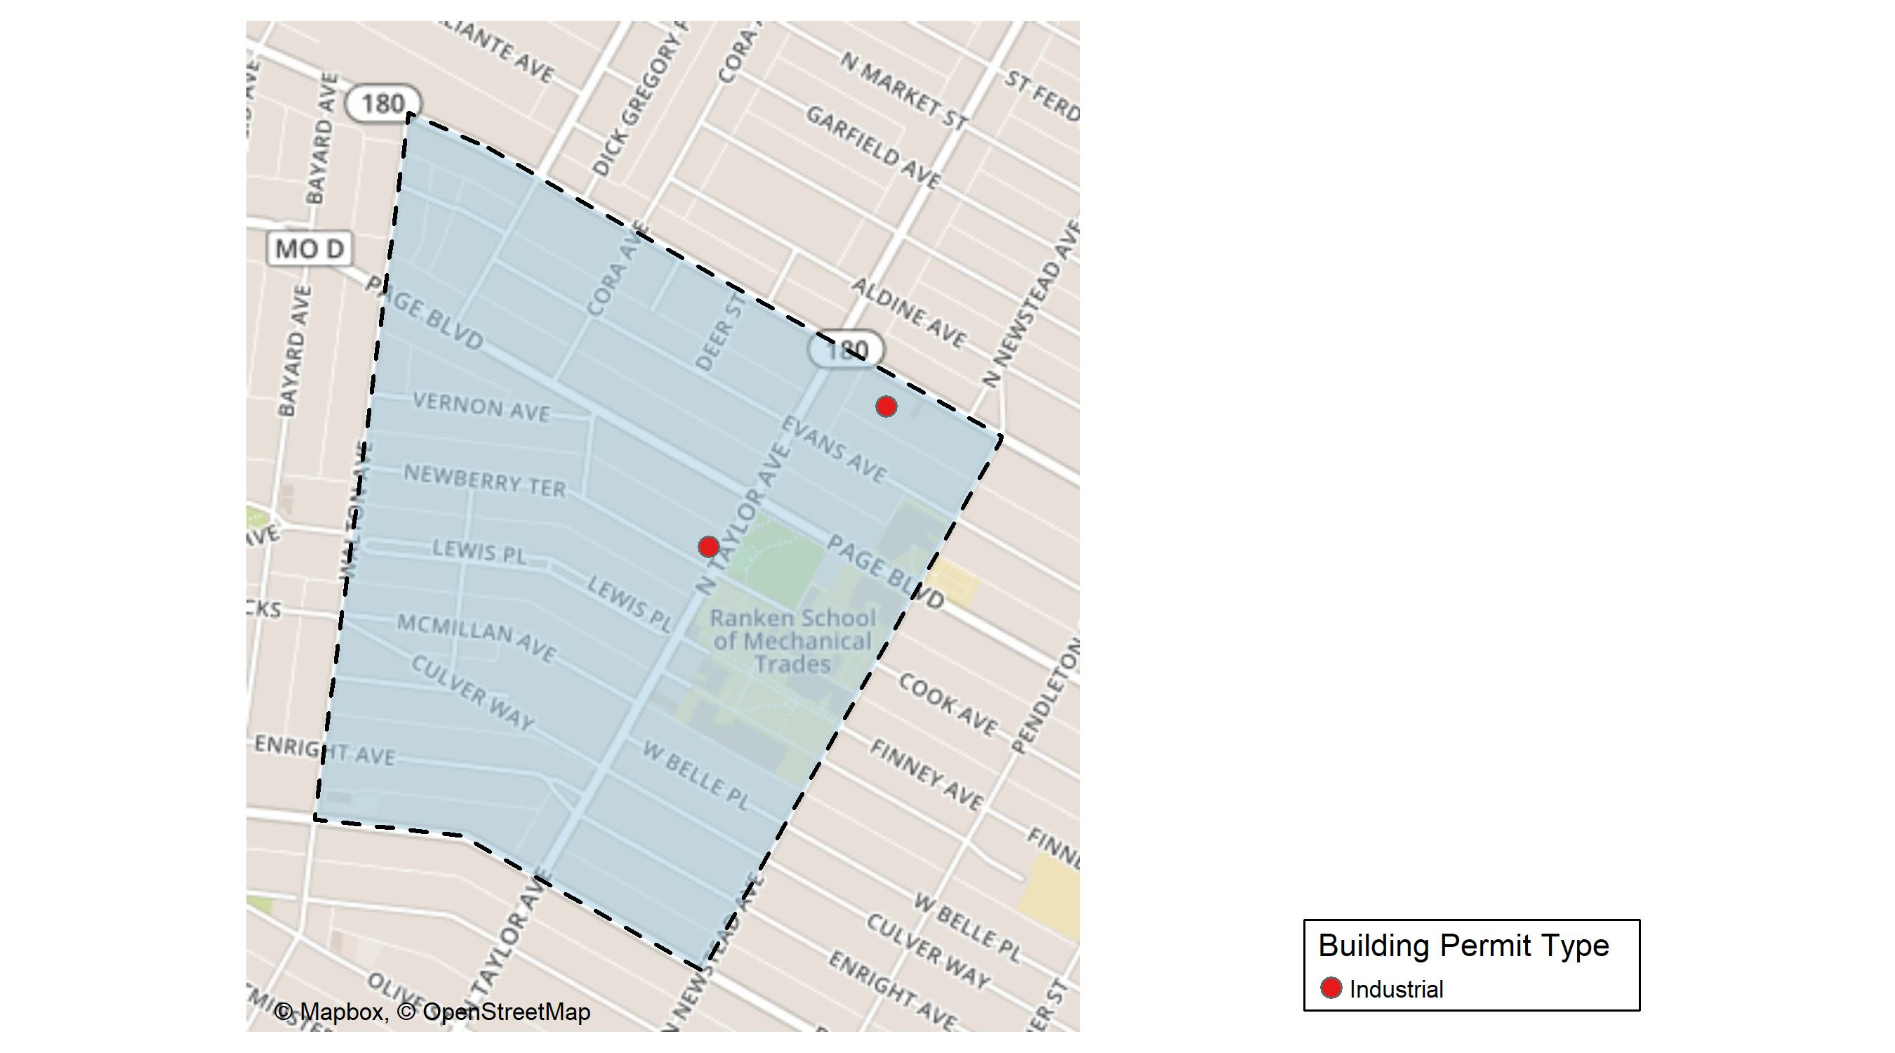
Lewis Place

Slide 50
Neighborhood Summary
November 2025 | November 2025 | November 2025 | November 2025
Permit Use | Average Cost | # of Permits | Total Value of Permits
Commercial | $0 | 0 | $0
Industrial | $9,500 | 2 | $19,000
Residential | $0 | 0 | $0
Last 6 Months | Last 6 Months | Last 6 Months | Last 6 Months
Permit Use | Average Cost | # of Permits | Total Value of Permits
Commercial | $225,367.80 | 5 | $1,126,839
Industrial | $7,750.00 | 4 | $31,000
Residential | $69,038.46 | 13 | $897,500

Slide 51
Lewis Place Individual Permit Breakdown
Neighborhood | Owner | New Use | Cost | address
Lewis Place | ZIBAH, ZACK | Industrial | $15,000 | 1205-07 N TAYLOR AV
Lewis Place | TILSON ENTERPRISE LLC | Industrial | $4,000 | 4456 DR MARTIN LUTHER KING DR

Slide 52
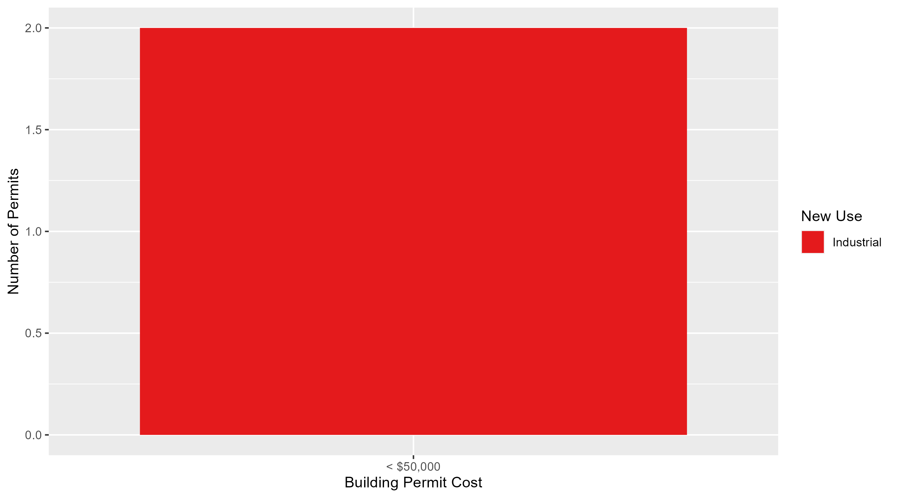
Lewis Place Permit Cost Breakdown

Slide 53
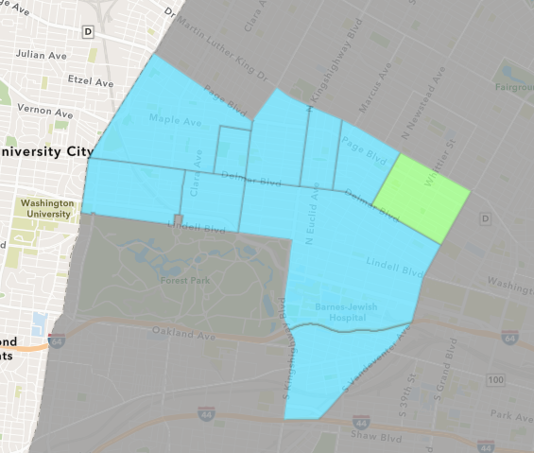
Vandeventer
November 2025 Neighborhood Cost Breakdown
  Mean: $10,000
  Median: $10,000
  Range: $10,000 - $10,000

Slide 54
Vandeventer: Summary Notes
1 building permits in November 2025
  0.00% change compared to November 2024 (1 total building permits)
  $10,000: Average building permit cost in November 2025
    -93.33% change compared to November 2024 ($150,000)
10 total building permits in 2025
  -16.67% change YTD compared to this time in 2024 (12 total building permits)
  $4,069,150: YTD average building permit cost in 2025
    8271.59% change YTD compared to this time in 2024 ($48,607)

Slide 55
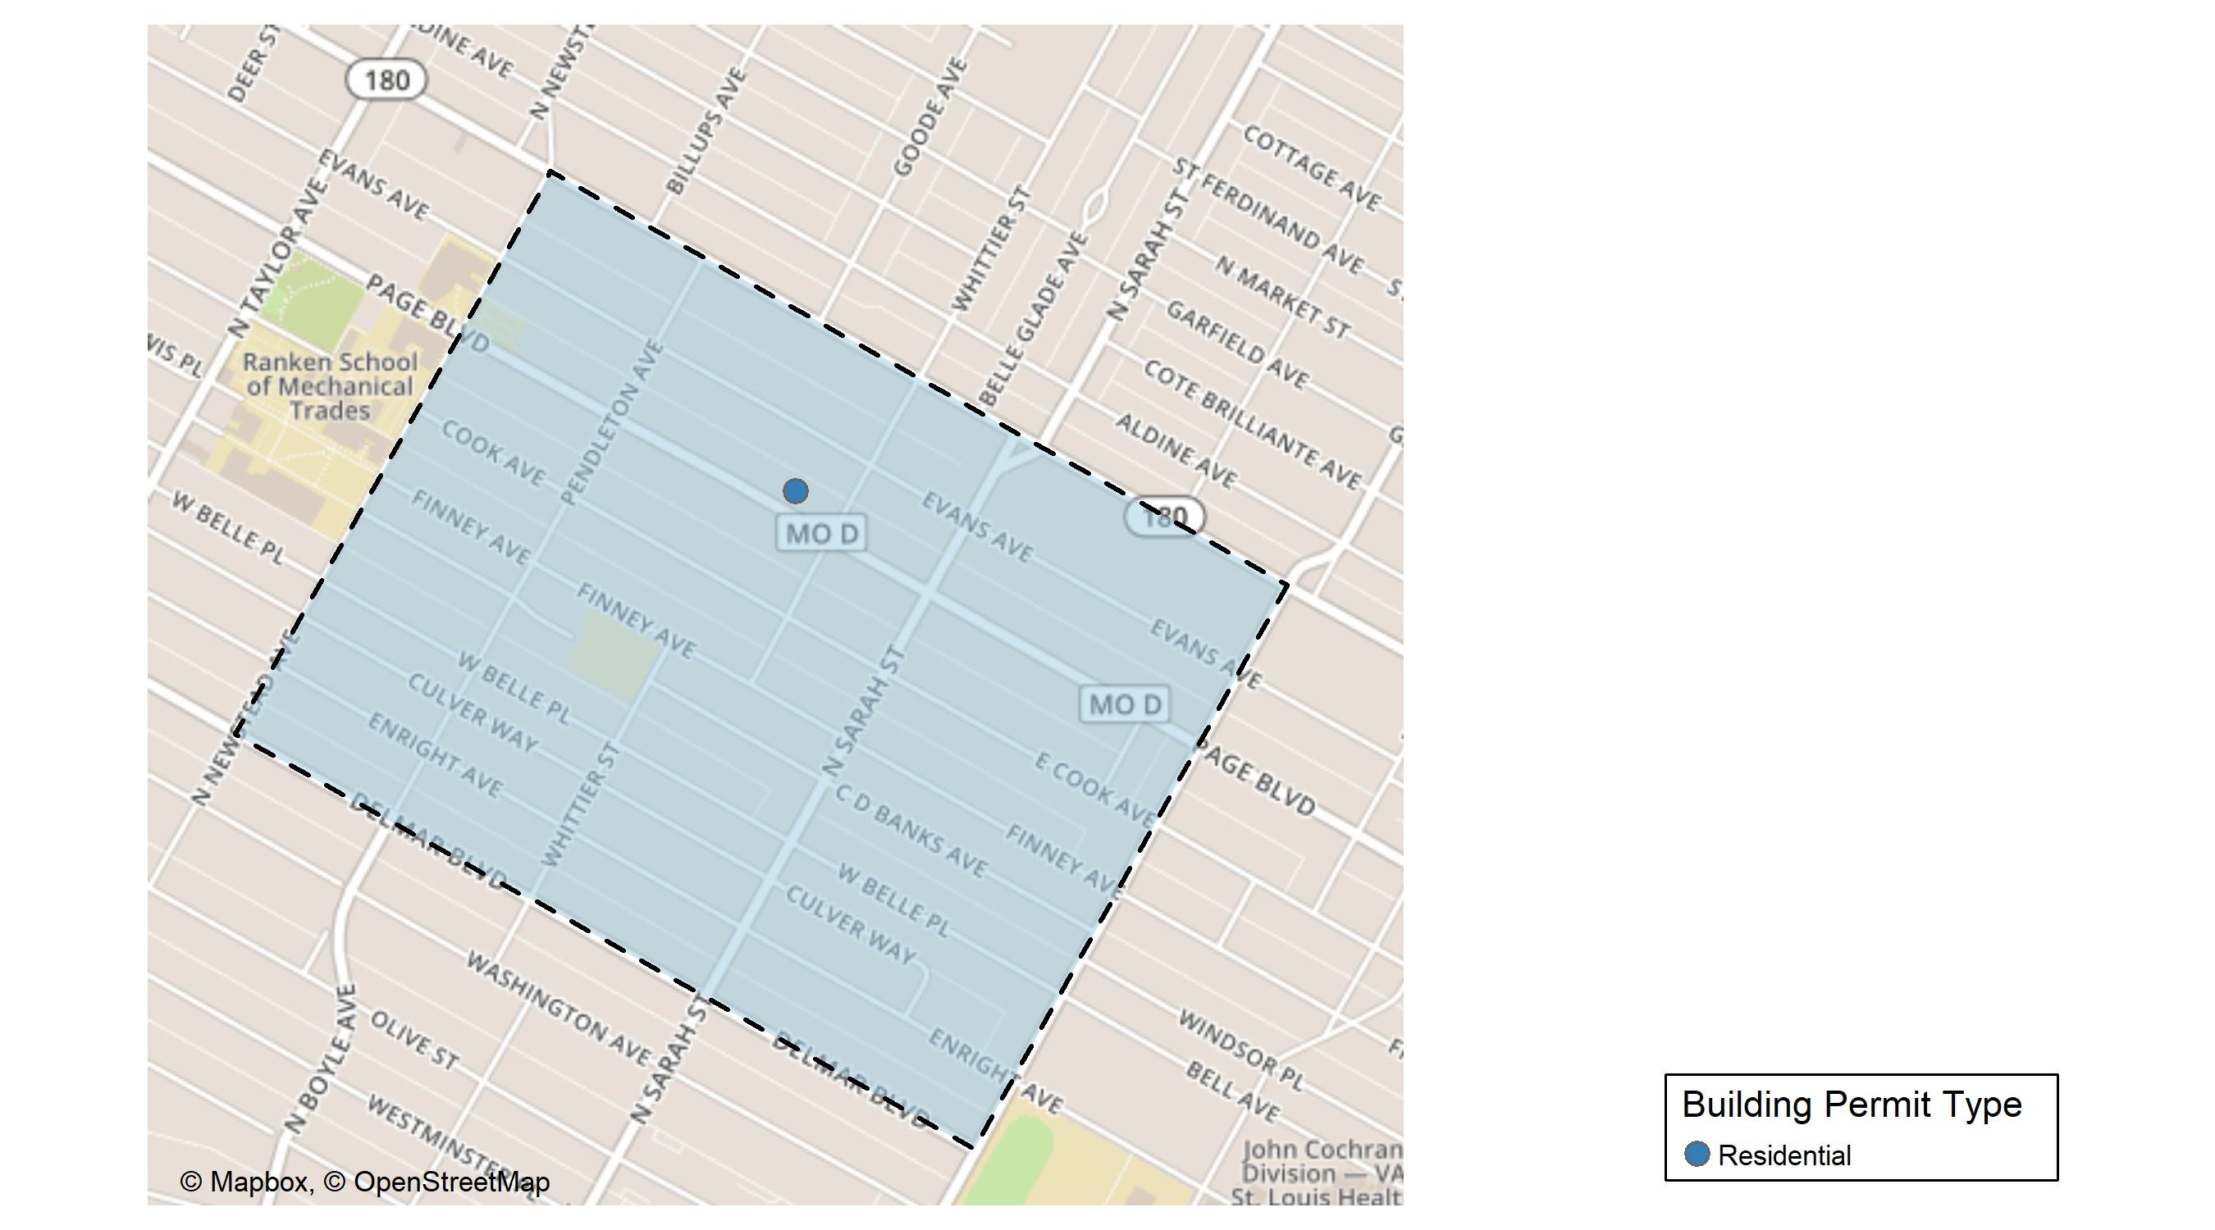
Vandeventer

Slide 56
Neighborhood Summary
November 2025 | November 2025 | November 2025 | November 2025
Permit Use | Average Cost | # of Permits | Total Value of Permits
Commercial | $0 | 0 | $0
Industrial | $0 | 0 | $0
Residential | $10,000 | 1 | $10,000
Last 6 Months | Last 6 Months | Last 6 Months | Last 6 Months
Permit Use | Average Cost | # of Permits | Total Value of Permits
Commercial | $20,000,000.0 | 2 | $40,000,000
Industrial | $0.0 | 0 | $0
Residential | $113,333.3 | 6 | $680,000

Slide 57
Vandeventer Individual Permit Breakdown
Neighborhood | Owner | New Use | Cost | address
Vandeventer | ROMIOUS, LEONARD K | Residential | $10,000 | 4223 PAGE BLVD

Slide 58
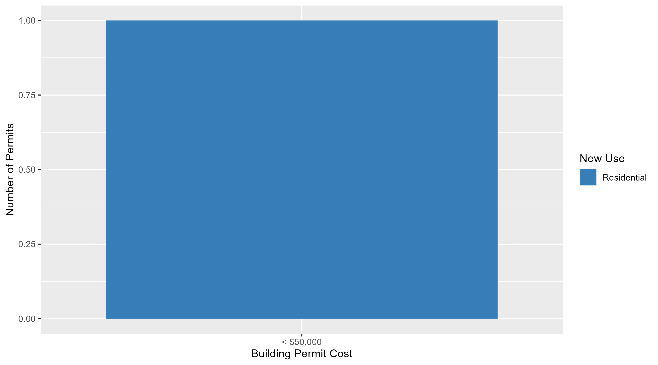
Vandeventer Permit Cost Breakdown

Slide 59
Additional Notes
Data retreived from https://www.stlouis-mo.gov/data/
Building permits with a cost of $0 were dropped
Building permits that were cancelled were dropped
Infinite change indicates 0 permits in the current or previous time period/comparison month so there was a overall increase or decrease

