Slide 1
July 2026 Monthly Crime Report
ACADEMY FOUNTAIN PARK
LEWIS PLACE VANDEVENTER
Washington University Medical Center

Slide 2
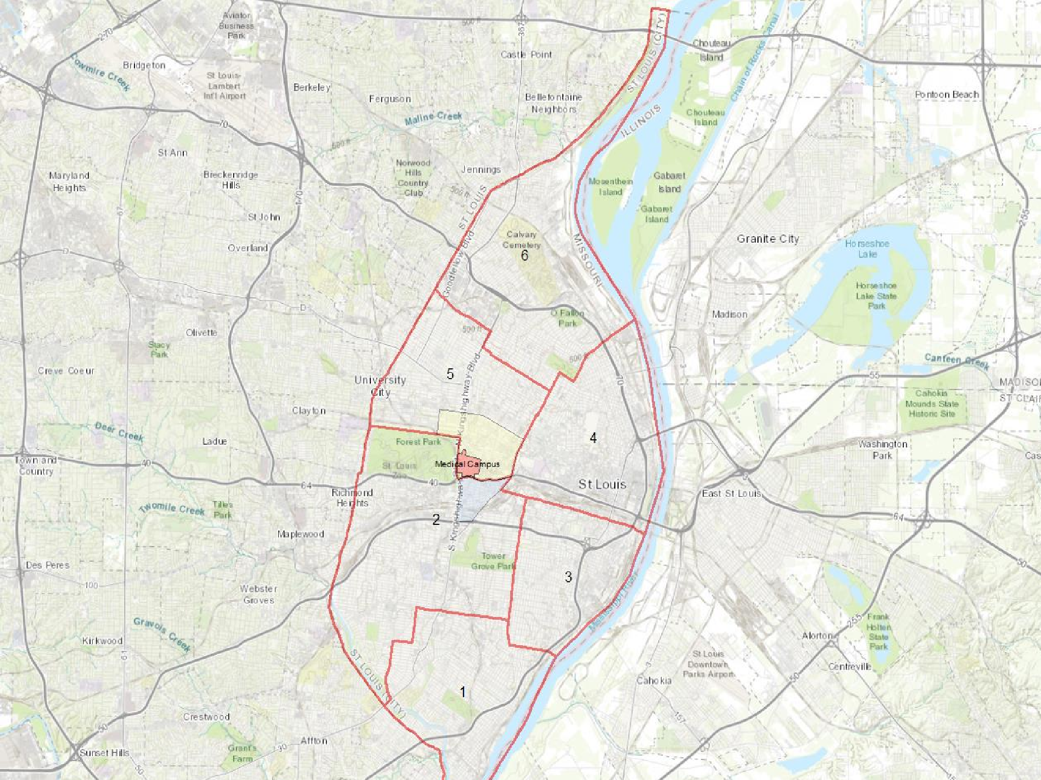
CI T Y OF ST LOUIS POLICE DISTRICTS
6
Academy, Fountain Park, Lewis Place, and Vandeventer are all located within District 5.
5
WUMC
4
2
3
1

Slide 3
DISTRICT 5 SUMMARY NOTES
There are 15 neighborhoods in District 5.
The lowest number of crimes in one
neighborhood was 12 in Fountain Park
The highest number of crimes in one neighborhood was 126 in Central West End
The average number of crimes per
neighborhood was 48.9
The lowest crime rate per 100,000 in one neighborhood was 564.2 in Skinker-Debaliviere
The highest crime rate per 100,000 in one neighborhood was 2749.8 in Wells-Goodfellow
The overall crime rate in District 5 was 1296.0
Academy
DeBaliviere Place
Fountain Park
Hamilton Heights
Kingsway East
Kingsway West
Lewis Place
Skinker-DeBaliviere
The Greater Ville
The Ville
Vandeventer
Visitation Park
Wells-Goodfellow
West End
Source: SLMPD

Slide 4
NEIGHBORHOODS VS CI T Y
CRIME RATE OVER THE PAST YEAR
2500
2000
Crime Rate per 100,000 Residents
1500
1000
500
0
City Crime Rate
Lewis Place Crime Rate
Academy Crime Rate Vandeventer Crime Rate
Fountain Park Crime Rate
Source: SLMPD

Slide 5
ACADEMY
NEIGHBORHOOD DETAIL

Slide 6
ACADEMY SUMMARY NOTES
28 total crimes in July 2026
  Up 27.3% compared to July 2025 (22 crimes)
  5 crimes against persons in July 2026
    No change compared to July 2025 (5 crimes)
200 total crimes so far in 2026
  Down 4.3% compared to this time in 2025 (209 crimes)
  41 total crimes against persons so far in 2026
    Down 16.3% compared to this time in 2025 (49 crimes)
  88 total crimes against property so far in 2026
    Up 2.3% compared to this time in 2025 (86 crimes)
Source: SLMPD

Slide 7
2025 | Academy Year to Year Comparison
Crimes | Jan | Feb | Mar | Apr | May | Jun | Jul | Aug | Sep | Oct | Nov | Dec | Total
Aggravated Assault | 2 | 0 | 3 | 1 | 3 | 4 | 2 | 1 | 1 | 1 | 2 | 1 | 21
Arson | 0 | 0 | 0 | 0 | 0 | 0 | 0 | 0 | 0 | 0 | 0 | 1 | 1
Burglary | 0 | 2 | 1 | 0 | 3 | 1 | 1 | 1 | 5 | 2 | 2 | 2 | 20
Homicide | 1 | 1 | 1 | 1 | 3 | 0 | 0 | 0 | 0 | 0 | 0 | 0 | 7
Larceny | 6 | 5 | 3 | 6 | 5 | 2 | 4 | 3 | 4 | 6 | 2 | 2 | 48
Motor Vehicle Theft | 3 | 0 | 1 | 3 | 3 | 2 | 1 | 6 | 4 | 2 | 1 | 1 | 27
Robbery | 1 | 0 | 0 | 1 | 0 | 0 | 0 | 1 | 2 | 0 | 0 | 1 | 6
Total | 13 | 8 | 9 | 12 | 17 | 9 | 8 | 12 | 16 | 11 | 7 | 8 | 130
2026
Crimes | Jan | Feb | Mar | Apr | May | Jun | Jul | Aug | Sep | Oct | Nov | Dec | Total
Aggravated Assault | 1 | 4 | 5 | 3 | 4 | 2 | 3 |  |  |  |  |  | 17
Arson | 0 | 0 | 0 | 0 | 0 | 0 | 0 |  |  |  |  |  | 0
Burglary | 1 | 1 | 1 | 2 | 0 | 2 | 3 |  |  |  |  |  | 5
Homicide | 0 | 0 | 0 | 0 | 0 | 0 | 0 |  |  |  |  |  | 0
Larceny | 0 | 3 | 6 | 5 | 3 | 5 | 3 |  |  |  |  |  | 17
Motor Vehicle Theft | 1 | 4 | 2 | 3 | 2 | 0 | 2 |  |  |  |  |  | 12
Robbery | 0 | 1 | 0 | 1 | 0 | 0 | 1 |  |  |  |  |  | 2
Total | 3 | 13 | 14 | 14 | 9 | 10 | 12 |  |  |  |  |  | 53
Source: SLMPD

Slide 8



ACADEMY 2025 VS 2026
2500.0
2000.0
Crime Rate per 100,000
1500.0
1000.0
500.0
0.0
2025 City Crime Rate
Academy 2025 Crime Rate
Academy 2026 Crime Rate
Source: SLMPD

Slide 9
ACADEMY
CRIMES BY DAY OF THE WEEK
20
18
16
14
12
10
8
6
4
2
0
Number of Crimes
Sun
Mon
Tue
Wed
Thu
Fri
Sat
Crimes Against Persons
Property Crimes
Societal Crimes
Unspecified
Source: SLMPD

Slide 10






ACADEMY
CRIMES BY TIME OF DAY
4AM-8AM
4%
8AM-12PM
8%
12AM-4AM
21%
12PM-4PM
31%
8PM-12AM
11%
4PM-8PM
25%
64% - Daytime (8AM-8PM)
36% - Nighttime (8PM-8AM)
Source: SLMPD

Slide 11
ACADEMY
CRIMES BY DAY OF THE MON TH
8
7
6
5
4
3
2
1
0
1 2 3 4 5 6 7 8 9 10 11 12 13 14 15 16 17 18 19 20 21 22 23 24 25 26 27 28 29 30 31
Day of the Month
Number of Crimes
Source: SLMPD

Slide 12
FOUNTAIN PARK
NEIGHBORHOOD DETAIL

Slide 13
FOUNTAIN PARK SUMMARY NOTES
12 total crimes in July 2026
  Down 52.0% compared to July 2025 (25 crimes)
  3 crimes against persons in July 2026
    Down 62.5% compared to this time in 2025 (8 crimes)
99 total crimes so far in 2026
  Down 34.4% compared to this time in 2025 (151 crimes)
  15 total crimes against persons so far in 2026
    Down 51.6% compared to this time in 2025 (31 crimes)
  38 total crimes against property so far in 2026
    Down 42.4% compared to this time in 2025 (66 crimes)
Source: SLMPD

Slide 14

2025
Crimes |  | Jan | Feb | Mar | Apr | May | Jun | Jul | Aug | Sep | Oct | Nov | Dec |  | Total
Aggravated Assault |  | 0 | 0 | 1 | 1 | 0 | 0 | 1 | 0 | 0 | 4 | 3 | 0 |  | 10
Arson |  | 0 | 0 | 0 | 0 | 1 | 0 | 0 | 0 | 0 | 0 | 1 | 0 |  | 2
Burglary |  | 3 | 1 | 0 | 0 | 1 | 0 | 2 | 4 | 0 | 4 | 3 | 0 |  | 18
Homicide |  | 0 | 0 | 0 | 0 | 0 | 0 | 0 | 0 | 0 | 0 | 0 | 0 |  | 0
Larceny |  | 3 | 5 | 1 | 5 | 5 | 1 | 3 | 2 | 1 | 3 | 1 | 1 |  | 31
Motor Vehicle Theft |  | 1 | 4 | 0 | 0 | 1 | 0 | 2 | 0 | 2 | 0 | 1 | 0 |  | 12
Robbery |  | 0 | 0 | 1 | 0 | 0 | 1 | 0 | 0 | 0 | 1 | 0 | 0 |  | 3
Total |  | 7 | 10 | 3 | 6 | 8 | 2 | 8 | 6 | 3 | 12 | 9 | 1 |  | 76
2026
Crimes |  | Jan | Feb | Mar | Apr | May | Jun | Jul | Aug | Sep | Oct | Nov | Dec |  | Total
Aggravated Assault |  | 2 | 0 | 0 | 1 | 1 | 1 | 1 |  |  |  |  |  |  | 4
Arson |  | 0 | 0 | 0 | 0 | 0 | 0 | 0 |  |  |  |  |  |  | 0
Burglary |  | 1 | 2 | 0 | 1 | 1 | 2 | 0 |  |  |  |  |  |  | 5
Homicide |  | 0 | 0 | 0 | 0 | 0 | 0 | 0 |  |  |  |  |  |  | 0
Larceny |  | 1 | 1 | 0 | 2 | 2 | 2 | 1 |  |  |  |  |  |  | 6
Motor Vehicle Theft |  | 0 | 1 | 1 | 1 | 0 | 0 | 0 |  |  |  |  |  |  | 3
Robbery |  | 0 | 0 | 0 | 1 | 0 | 0 | 0 |  |  |  |  |  |  | 1
Total |  | 4 | 4 | 1 | 6 | 4 | 5 | 2 |  |  |  |  |  |  | 19
Source: SLMPD

Slide 15



FOUN TAIN PARK
2025 VS 2026
3500.0
3000.0
2500.0
2000.0
1500.0
1000.0
500.0
0.0
Crime Rate per 100,000
2025 City Crime Rate
Fountain Park 2025 Crime Rate
Fountain Park 2026 Crime Rate
Source: SLMPD

Slide 16
FOUNTAIN PARK
CRIMES BY DAY OF THE WEEK
10
9
8
7
6
5
4
3
2
1
0
Number of Crimes
Sun
Mon
Tue
Wed
Thu
Fri
Sat
Crimes Against Persons
Property Crimes
Societal Crimes
Unspecified
Source: SLMPD

Slide 17






FOUN TAIN PARK
CRIMES BY TIME OF DAY
4AM-8AM
27%
8AM-12PM
38%
12AM-4AM
8%
8PM-12AM
8%
12PM-4PM
4%
4PM-8PM
15%
57% - Daytime (8AM-8PM)
43% - Nighttime (8PM-8AM)
Source: SLMPD

Slide 18
FOUN TAIN PARK
CRIMES BY DAY OF THE MON TH
8
7
6
5
4
3
2
1
0
1 2 3 4 5 6 7 8 9 10 11 12 13 14 15 16 17 18 19 20 21 22 23 24 25 26 27 28 29 30
Day of the Month
Number of Crimes
Source: SLMPD

Slide 19
LEWIS PLACE
NEIGHBORHOOD DETAIL

Slide 20
LEWIS PLACE SUMMARY NOTES
26 total crimes in July 2026
  Up 160.0% compared to July 2025 (10 crimes)
  7 crimes against persons in July 2026
    compared to July 2025 (0 crimes)
133 total crimes so far in 2026
  Up 64.2% compared to this time in 2025 (81 crimes)
  21 total crimes against persons so far in 2026
    Up 61.5% compared to this time in 2025 (13 crimes)
  51 total crimes against property so far in 2026
    Up 24.4% compared to this time in 2025 (41 crimes)
Source: SLMPD

Slide 21
LEWIS PLACE
YEAR TO YEAR COMPARISON
2025
Crimes | Jan | Feb | Mar | Apr | May | Jun | Jul | Aug | Sep | Oct | Nov | Dec | Total
Aggravated Assault | 1 | 0 | 0 | 0 | 0 | 2 | 0 | 0 | 0 | 0 | 2 | 0 | 5
Arson | 0 | 0 | 0 | 0 | 0 | 0 | 0 | 0 | 0 | 0 | 0 | 0 | 0
Burglary | 3 | 0 | 1 | 0 | 0 | 0 | 0 | 3 | 0 | 1 | 1 | 0 | 9
Homicide | 0 | 0 | 0 | 0 | 0 | 0 | 0 | 0 | 0 | 0 | 0 | 0 | 0
Larceny | 2 | 1 | 4 | 0 | 3 | 3 | 1 | 0 | 1 | 2 | 2 | 2 | 21
Motor Vehicle Theft | 0 | 0 | 1 | 4 | 1 | 1 | 0 | 0 | 0 | 0 | 1 | 0 | 8
Robbery | 1 | 0 | 1 | 0 | 0 | 0 | 0 | 0 | 1 | 0 | 0 | 0 | 3
Total | 7 | 1 | 7 | 4 | 4 | 6 | 1 | 3 | 2 | 3 | 6 | 2 | 46
2026
Crimes | Jan | Feb | Mar | Apr | May | Jun | Jul | Aug | Sep | Oct | Nov | Dec | Total
Aggravated Assault | 0 | 0 | 1 | 4 | 1 | 1 | 5 |  |  |  |  |  | 6
Arson | 0 | 0 | 0 | 0 | 0 | 0 | 0 |  |  |  |  |  | 0
Burglary | 0 | 0 | 0 | 0 | 1 | 0 | 1 |  |  |  |  |  | 1
Homicide | 0 | 0 | 0 | 0 | 1 | 0 | 0 |  |  |  |  |  | 1
Larceny | 2 | 1 | 2 | 5 | 1 | 2 | 1 |  |  |  |  |  | 10
Motor Vehicle Theft | 0 | 0 | 2 | 4 | 0 | 1 | 2 |  |  |  |  |  | 6
Robbery | 0 | 0 | 0 | 1 | 0 | 0 | 0 |  |  |  |  |  | 1
Total | 2 | 1 | 5 | 14 | 4 | 4 | 9 |  |  |  |  |  | 26
Source: SLMPD

Slide 22




LEWIS PLACE
2025 VS 2026
2500.0
2000.0
Crime Rate per 100,000
1500.0
1000.0
500.0
0.0
2025 City Crime Rate
Lewis Place 2025 Crime Rate
Lewis Place 2026 Crime Rate
Source: SLMPD

Slide 23
LEWIS PLACE
CRIMES BY DAY OF THE WEEK
18
16
14
12
10
8
6
4
2
0
Number of Crimes
Sun
Mon
Tue
Wed
Thu
Fri
Sat
Crimes Against Persons
Property Crimes
Societal Crimes
Unspecified
Source: SLMPD

Slide 24





LEWIS PLACE
CRIMES BY TIME OF DAY
4AM-8AM8AM-12PM
0% 7%
12PM-4PM
7%
12AM-4AM
26%
4PM-8PM
32%
8PM-12AM
28%
46% - Daytime (8AM-8PM)
54% - Nighttime (8PM-8AM)
Source: SLMPD

Slide 25
LEWIS PLACE
CRIMES BY DAY OF THE MON TH
12
10
8
Number of Crimes
6
4
2
0
1 2 3 4 5 6 7 8 9 10 11 12 13 14 15 16 17 18 19 20 21 22 23 24 25 26 27 28 29 30 31
Day of the Month
Source: SLMPD

Slide 26
VANDEVENTER
NEIGHBORHOOD DETAIL

Slide 27
VANDEVENTER SUMMARY NOTES
39 total crimes in July 2026
  Up 8.3% compared to July 2025 (36 crimes)
  7 crimes against persons in July 2026
    Down 12.5% compared to July 2025 (8 crimes)
178 total crimes so far in 2026
  Down 21.9% compared to this time in 2025 (228 crimes)
  32 total crimes against persons so far in 2026
    Down 50.0% compared to this time in 2025 (64 crimes)
  84 total crimes against property so far in 2026
    Down 3.4% compared to this time in 2025 (87 crimes)
Source: SLMPD

Slide 28
VANDEVENTER
YEAR TO YEAR COMPARISON
2025
Crimes | Jan | Feb | Mar | Apr | May | Jun | Jul | Aug | Sep | Oct | Nov | Dec | Total
Aggravated Assault | 1 | 5 | 1 | 3 | 2 | 8 | 1 | 3 | 0 | 6 | 1 | 0 | 30
Arson | 0 | 2 | 0 | 0 | 0 | 0 | 0 | 0 | 0 | 0 | 0 | 0 | 2
Burglary | 1 | 0 | 1 | 2 | 0 | 2 | 2 | 2 | 4 | 3 | 1 | 3 | 21
Homicide | 0 | 0 | 0 | 0 | 1 | 0 | 0 | 0 | 0 | 0 | 0 | 0 | 1
Larceny | 4 | 2 | 0 | 3 | 4 | 2 | 5 | 5 | 4 | 2 | 2 | 1 | 34
Motor Vehicle Theft | 0 | 0 | 0 | 2 | 1 | 4 | 2 | 2 | 1 | 1 | 1 | 1 | 15
Robbery | 0 | 2 | 1 | 0 | 1 | 1 | 1 | 0 | 0 | 1 | 0 | 0 | 7
Total | 6 | 11 | 3 | 10 | 9 | 17 | 11 | 12 | 9 | 13 | 5 | 5 | 110
2026
Crimes | Jan | Feb | Mar | Apr | May | Jun | Jul | Aug | Sep | Oct | Nov | Dec | Total
Aggravated Assault | 0 | 0 | 2 | 3 | 3 | 2 | 3 |  |  |  |  |  | 8
Arson | 0 | 0 | 0 | 0 | 0 | 0 | 0 |  |  |  |  |  | 0
Burglary | 0 | 1 | 0 | 0 | 2 | 1 | 3 |  |  |  |  |  | 3
Homicide | 0 | 0 | 0 | 0 | 0 | 1 | 0 |  |  |  |  |  | 0
Larceny | 2 | 1 | 3 | 4 | 7 | 3 | 4 |  |  |  |  |  | 17
Motor Vehicle Theft | 0 | 0 | 1 | 1 | 2 | 3 | 1 |  |  |  |  |  | 4
Robbery | 1 | 0 | 1 | 1 | 0 | 0 | 0 |  |  |  |  |  | 3
Total | 3 | 2 | 7 | 9 | 14 | 10 | 11 |  |  |  |  |  | 35
Source: SLMPD

Slide 29
VANDEVENTER
CRIMES BY DAY OF THE MON TH
9
8
7
6
5
4
3
2
1
0
1 2 3 4 5 6 7 8 9 10 11 12 13 14 15 16 17 18 19 20 21 22 23 24 25 26 27 28 29 30
Day of the Month
Number of Crimes
Source: SLMPD

Slide 30
VANDEVENTER PLACE
CRIMES BY DAY OF THE WEEK
14
12
10
8
6
4
2
0
Number of Crimes
Sun
Mon
Tue
Wed
Thu
Fri
Sat
Crimes Against Persons
Property Crimes
Societal Crimes
Unspecified
Source: SLMPD

Slide 31





VANDEVENTER
CRIMES BY TIME OF DAY
12AM-4AM
15%
4AM-8AM
2%
8AM-12PM
11%
12PM-4PM
10%
8PM-12AM
33%
4PM-8PM
29%
50% - Daytime (8AM-8PM)
50% - Nighttime (8PM-8AM)
Source: SLMPD

