Slide 1
Forest Park Southeast
Central West End
July 2026
Monthly Crime Report
Washington University Medical Center

Slide 2
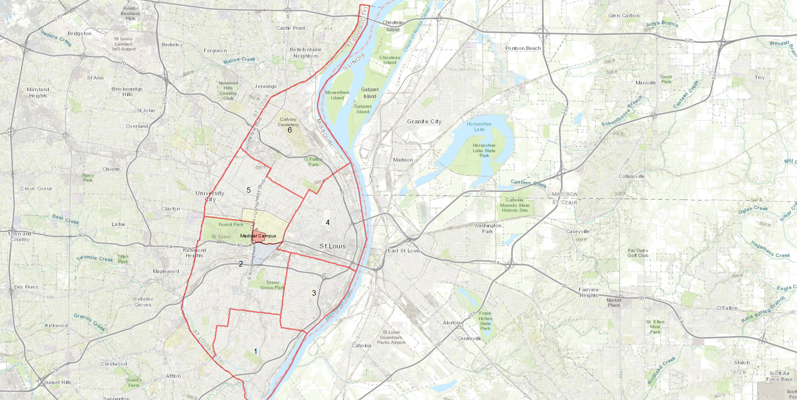
City of St Louis
Police Districts
6
Central West End Neighborhood
5
WUMC
4
Forest Park Southeast Neighborhood
2
3
1

Slide 3
District 5 Summary Notes
There are 15 neighborhoods in District 5.
Academy
Central West End
DeBaliviere Place
Fountain Park
Hamilton Heights
Kingsway East
Kingsway West
Lewis Place
Skinker-DeBaliviere
The Greater Ville
The Ville
Vandeventer
Visitation Park
Wells-Goodfellow
West End
The lowest number of crimes in one neighborhood was 12 in Fountain Park
The highest number of crimes in one neighborhood was 126 in Central West End
The average number of crimes per neighborhood was 48.9
The lowest crime rate per 100,000 in one neighborhood was 564.2 in Skinker- Debaliviere
The highest crime rate per 100,000 in one neighborhood was 2749.8 in Wells-Goodfellow
The overall crime rate in District 5 was 1296.0
Source: SLMPD

Slide 4
District 2 Summary Notes
There are 19 neighborhoods in District 2.
Botanical Heights
Cheltenham
Clayton-Tamm
Clifton Heights
Ellendale
Forest Park Southeast
Franz Park
Hi-Pointe
Kings Oak
Lindenwood Park
Northampton
Shaw
Southampton
Southwest Garden
St. Louis Hills
The Hill
Tiffany
Tower Grove South
Wydown-Skinker
*Southampton is split between District 2 and District 1.
The lowest number of crimes in one neighborhood was 1 in Kings Oak
The highest number of crimes in one neighborhood was 106 in Tower Grove South
The average number of crimes per neighborhood was 21.9
The lowest crime rate per 100,000 in one neighborhood was 89.2 in Wydown-Skinker
The highest crime rate per 100,000 in one neighborhood was 1857.9 in Tiffany
The overall crime rate in District 2 was 536.7
Source: SLMPD

Slide 5
Neighborhoods vs City
Crime rate Over the past year
Source: SLMPD

Slide 6
Forest Park Southeast Neighborhood Detail

Slide 7
Forest Park Southeast
Summary Notes
34 total crimes in July 2026
  Down 51.4% compared to July 2025 (70 crimes)
  6 crimes against persons in July 2026
    Down 25.0% compared to July 2025 (8 crimes)
227 total crimes so far in 2026
  Down 34.0% compared to this time in 2025 (344 crimes)
  33 total crimes against persons so far in 2026
    Down 37.7% when compared to this time in 2025 (53 crimes)
  115 total crimes against property so far in 2026
    Down 43.9% when compared to this time in 2025 (205 crimes)
Source: SLMPD

Slide 8

Forest Park Southeast
Year to Year Comparison
Crimes | Jan | Feb | Mar | Apr | May | Jun | Jul | Aug | Sep | Oct | Nov | Dec | Total
Aggravated Assault | 0 | 0 | 4 | 1 | 0 | 4 | 2 | 0 | 1 | 0 | 1 | 1 | 14
Arson | 0 | 0 | 0 | 0 | 0 | 0 | 0 | 0 | 0 | 0 | 0 | 0 | 0
Burglary | 0 | 1 | 0 | 1 | 0 | 0 | 1 | 0 | 0 | 2 | 1 | 1 | 7
Homicide | 0 | 0 | 0 | 0 | 0 | 0 | 0 | 0 | 0 | 0 | 0 | 0 | 0
Larceny | 3 | 14 | 13 | 11 | 15 | 7 | 14 | 13 | 7 | 9 | 12 | 32 | 150
Motor Vehicle Theft | 5 | 9 | 3 | 2 | 1 | 2 | 10 | 6 | 2 | 0 | 7 | 1 | 48
Robbery | 1 | 0 | 0 | 2 | 1 | 0 | 1 | 0 | 0 | 1 | 0 | 1 | 7
Total | 9 | 24 | 20 | 17 | 17 | 13 | 28 | 19 | 10 | 12 | 21 | 36 | 226
2026
Crimes | Jan | Feb | Mar | Apr | May | Jun | Jul | Aug | Sep | Oct | Nov | Dec | Total
Aggravated Assault | 1 | 1 | 2 | 1 | 4 | 2 | 1 |  |  |  |  |  | 12
Arson | 0 | 0 | 0 | 0 | 0 | 0 | 0 |  |  |  |  |  | 0
Burglary | 0 | 0 | 0 | 3 | 0 | 1 | 1 |  |  |  |  |  | 5
Homicide | 0 | 0 | 0 | 0 | 0 | 1 | 0 |  |  |  |  |  | 1
Larceny | 8 | 5 | 5 | 4 | 13 | 3 | 6 |  |  |  |  |  | 44
Motor Vehicle Theft | 0 | 1 | 3 | 2 | 4 | 3 | 3 |  |  |  |  |  | 16
Robbery | 0 | 0 | 1 | 0 | 1 | 0 | 23 |  |  |  |  |  | 25
Total | 9 | 7 | 11 | 10 | 22 | 10 | 34 |  |  |  |  |  | 103
Source: SLMPD

Slide 9
Forest Park southeast
2025 vs 2026
Source: SLMPD

Slide 10
Forest Park southeast
Crimes by day of the week
Source: SLMPD

Slide 11
Forest park southeast
Crimes by time of day
41% - Daytime (8AM-8PM)
59% - Nighttime (8PM-8AM)
Source: SLMPD

Slide 12
Forest park southeast
Crimes by day of the Month
Source: SLMPD

Slide 13
Central West End
Neighborhood Detail

Slide 14
Central West End
Summary Notes
126 total crimes in July 2026
  Down 26.3% compared to July 2025 (171 crimes)
  30 crimes against persons in July 2026
    Down 3.2% compared to July 2025 (31 crimes)
1051 total crimes so far in 2026
  Down 5.2% compared to this time in 2025 (1109 crimes)
  191 crimes against persons so far in 2026
    Up 11.7% compared to this time in 2025 (171 crimes)
  587 crimes against property so far in 2026
    Down 8.4% compared to this time in 2025 (641 crimes)
Source: SLMPD

Slide 15
Central West End
Year to Year Comparison
2025
Crimes | Jan | Feb | Mar | Apr | May | Jun | Jul | Aug | Sep | Oct | Nov | Dec | Total
Aggravated Assault | 7 | 5 | 9 | 3 | 2 | 6 | 10 | 10 | 5 | 3 | 3 | 3 | 66
Arson | 0 | 0 | 0 | 0 | 0 | 0 | 0 | 0 | 0 | 0 | 0 | 0 | 0
Burglary | 5 | 7 | 6 | 5 | 4 | 6 | 6 | 5 | 12 | 4 | 8 | 3 | 71
Homicide | 0 | 0 | 0 | 0 | 1 | 0 | 0 | 0 | 0 | 0 | 0 | 0 | 1
Larceny | 40 | 35 | 34 | 46 | 48 | 77 | 35 | 46 | 37 | 38 | 44 | 38 | 518
Motor Vehicle Theft | 4 | 5 | 7 | 6 | 11 | 13 | 18 | 22 | 13 | 15 | 21 | 3 | 138
Robbery | 3 | 2 | 1 | 0 | 1 | 1 | 7 | 3 | 2 | 3 | 4 | 2 | 29
Total | 59 | 54 | 57 | 60 | 67 | 103 | 76 | 86 | 69 | 63 | 80 | 49 | 823
2026
Crimes | Jan | Feb | Mar | Apr | May | Jun | Jul | Aug | Sep | Oct | Nov | Dec | Total
Aggravated Assault | 7 | 3 | 5 | 2 | 2 | 1 | 10 |  |  |  |  |  | 30
Arson | 0 | 0 | 0 | 0 | 0 | 0 | 0 |  |  |  |  |  | 0
Burglary | 3 | 6 | 4 | 3 | 3 | 3 | 2 |  |  |  |  |  | 24
Homicide | 1 | 0 | 1 | 2 | 0 | 1 | 0 |  |  |  |  |  | 5
Larceny | 41 | 57 | 38 | 46 | 56 | 44 | 48 |  |  |  |  |  | 330
Motor Vehicle Theft | 7 | 4 | 8 | 9 | 8 | 17 | 6 |  |  |  |  |  | 59
Robbery | 0 | 3 | 3 | 1 | 0 | 1 | 0 |  |  |  |  |  | 8
Total | 59 | 73 | 59 | 63 | 69 | 67 | 66 |  |  |  |  |  | 456
Source: SLMPD

Slide 16
Central West End
2025 vs 2026
Source: SLMPD

Slide 17
Central West End
Crimes by day of the week
Source: SLMPD

Slide 18
Central West End
Crimes by time of day
41% - Daytime (8AM-8PM)
59% - Nighttime (8PM-8AM)
Source: SLMPD

Slide 19
Central West End
Crimes by day of the Month
Source: SLMPD

